Slide 1
Better Together!
August 2022
Keys to Creating Collaborative, Efficient, and Effective Intensive Intervention Team Meetings
Sarah Benz | Amy Peterson | Nicole Bucka

Slide 2
About NCII
The mission of the NCII is to build knowledge and capacity of state and local leaders, faculty and professional development providers, educators, and other stakeholders to support implementation of intensive intervention for students with severe and persistent learning and/or social, emotional, or behavioral needs using data-based individualization (DBI).

Slide 3
Presenters
Sarah Benz
Targeted and Intensive Technical Assistance Coordinator for NCII
Amy Peterson
Universal
Technical Assistance Coordinator for NCII
Nicole Bucka
Senior MTSS Implementation Specialist and Instructional Designer at Westbay Collaborative in Rhode Island

Slide 4
Objectives
Understand how teaming structures support DBI implementation.
Determine steps to complete before, during, and after an intensive intervention team meeting.
Identify resources that school teams can use to facilitate intensive intervention meetings.
Be familiar with ways to improve teaming efficiency.

Slide 5
What Is DBI and Why Is Teaming Important?

Slide 6
Teaming Structures Across the Tiers
Notes:
https://intensiveintervention.org/resource/IEP-Teams

Slide 7
What Is Intensive Intervention?
Intensive intervention addresses severe and persistent learning and behavioral difficulties.
Driven by data
Characterized by increased intensity and individualization

Slide 8
Why Do We Need Intensive Intervention?
Validated programs are not universally effective programs; 3% to 5% of students need more help (NCII, 2013).
Students with intensive needs often require 10–30 times as much practice as their peers to learn new information (Gersten et al., 2009).
For students with intensive needs, co-occurring academic and behavioral needs are the rule, not the exception (Kuchle & Riley-Tillman, 2019).

Slide 9
What Is NCII’s Approach to Intensive Intervention?
DBI is a research-based process for individualizing and intensifying interventions for students with severe and persistent learning and behavioral needs.
The process integrates evidence-based intervention, assessment, and strategies.

Slide 10
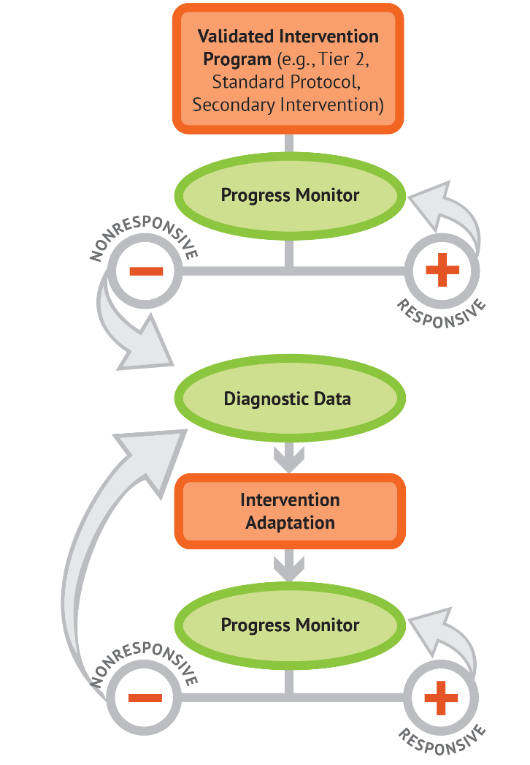
Remember: Individualizing instruction is an ongoing process.

Slide 11
Do I Need a DBI Team to Implement DBI?
No; individual teachers can independently implement DBI.
But three (or more) heads are always better than one when engaging in problem solving!

Slide 12
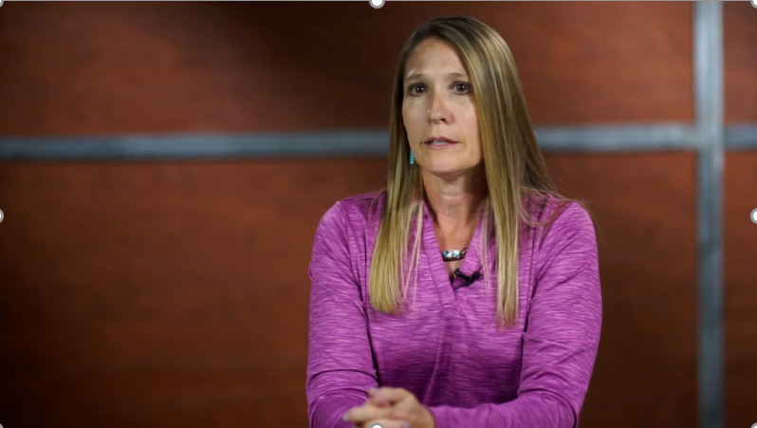
The Impact of Teaming Processes
Notes:
This slide featured a video clip. The clip is not embedded in the presentation, but can be found in the webinar archive.

Slide 13
All Teams Are Not Created Equal

Slide 14
What Does the Teaming Process Look Like?
Before for the Meeting
During the Meeting
After the Meeting

Slide 15
Before the Meeting

Slide 16
Keys to Preparing for the Meeting
Schedule Regular Team Meetings and Prepare Meeting Space
Identify Relevant Team Members and Roles
Identify and Prepare Required Information
Draft Initial Hypothesis

Slide 17
Establishing the Team
Identify team members.
Establish team member responsibilities.
Determine team norms and decision rules.
Schedule regular times to meet during the school day.

Slide 18
Team Roles
Facilitator: Explains the purpose of the meeting and keeps the participants on task.
Referring Teacher: Completes premeeting process, describes the student, and shares student data during the meeting.
Scribe: Takes informal notes and tracks brainstorming ideas in a visible space.
Timekeeper: Times each section of the meeting and helps the team adhere to the allotted time.
Note Taker: Takes formal notes for documentation using a template.

Slide 19
Potential Team Members
Referring teacher/intervention provider
Content specialist
Administrator
Coach
School psychologist
Social worker
Special educator
English as a second language/English language development instructor
General educator/classroom teacher
Parent (as available and appropriate)

Slide 20
Establish Team Norms
Be Present
1
Be Prepared
2
Share the Air
3
Assume Good Will
4
Respect What Is Shared
5
Allow Space for Different Perspectives
6
What other norms does your team have? Share some examples in the chat.

Slide 21
Schedule and Prepare for Meetings
Use a regular teaming schedule.
Leverage existing meeting times.
Use standardized meeting tools.
Agenda
Participant Guide
Student Information Summary

Slide 22
Student Summary Information
The success of teaming depends on the knowledge of the student based on accurate data.
The referring teacher summarizes data prior to meeting.
The referring teacher comes prepared to share major concerns and hypothesize about why the student is not responding.

Slide 23
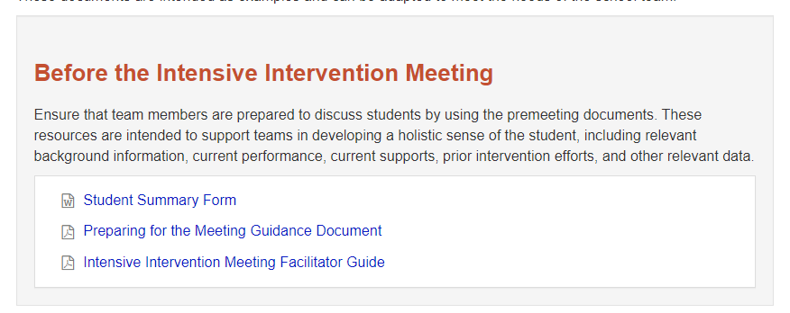
Tools to Support Preparing for the Meeting
Notes:
https://intensiveintervention.org/implementation-intervention/data-teaming

Slide 24
During the Meeting

Slide 25
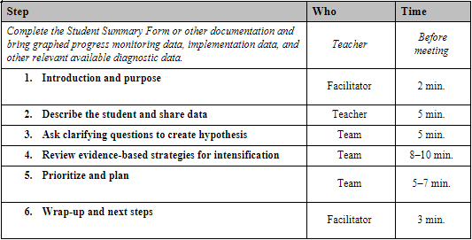
Team Meeting Agenda

Slide 26
Meeting Opening: Introduction and Purpose
The role of the meeting facilitator:
Reviews the meeting purpose
Reviews the meeting process
Overview of agenda
Confirms roles and responsibilities

Slide 27
Referring Teacher Briefly Describes the Student and Shares Data
Identifies Strengths and Primary Area of Concern
Summarizes Intervention(s) Attempted
Review Student Data Objectively
Presents Initial Hypothesis

Slide 28
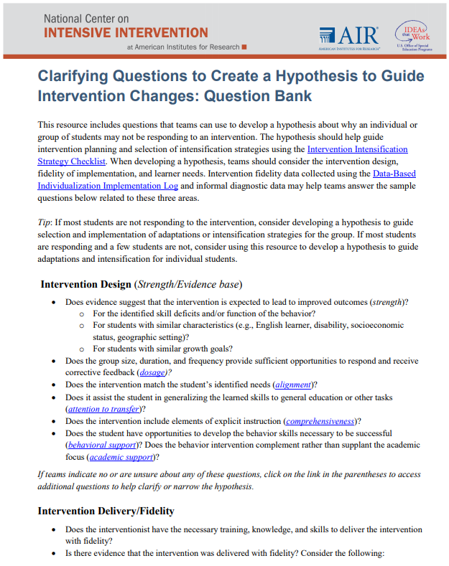
The Team Asks Clarifying Questions to Create the Hypothesis
Consider questions related to
intervention design,
intervention delivery/fidelity, and
learner needs and background.
Notes:
https://intensiveintervention.org/sites/default/files/Clarifying_Questions_Hypothesis_508.pdf

Slide 29
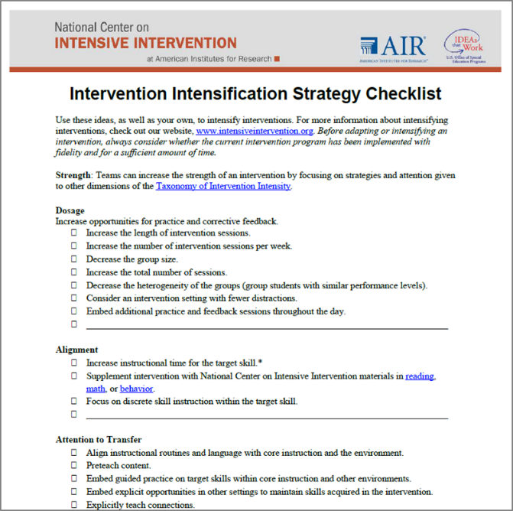
Review Evidence-Based Strategies for Intensification
Use hypothesis to drive strategy selection.
Leverage the expertise of team members.
Review the intervention intensification strategy checklist.
Focus on strategies that have an evidence base.

Slide 30
Prioritize and Plan
Example Rating Scale
1 = Will try right away
2 = Will consider trying in the future
3 = Have already attempted
4 = Need to research further
Rating Process
Confirm which adaptation(s) to implement.
Identify supports needed for implementation.
Consider points of contact.

Slide 31
Document Your Plan
The plan should include the following:
The person responsible for each step/aspect of the plan
A timeline for each part of the plan
A clearly defined goal and method for progress monitoring
Any other next steps needed

Slide 32
Wrap-Up and Next Steps
Establish a date and time for the follow-up meeting. Generally, teams should plan to check in two (behavior) to six weeks (academic) after the initial meeting.
Ensure that a plan is in place for how and where the student’s plan will be documented and disseminated to teachers and team members.
Confirm that a plan is in place to communicate the changes or the new plan with the parent(s).
Check that all team members are clear on their next steps for implementing the plan.

Slide 33
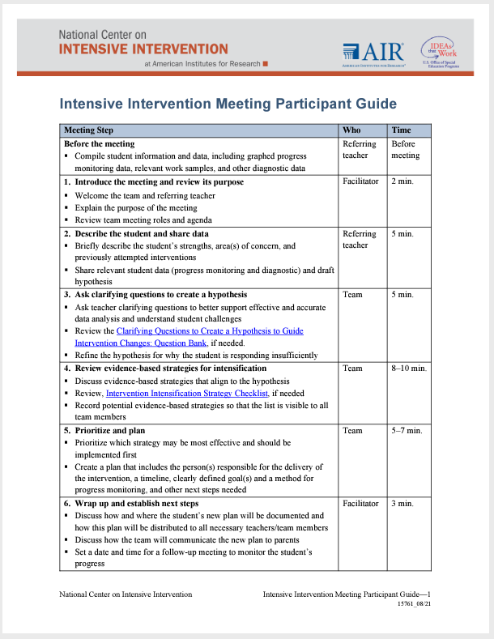
Tools to Use During Meeting
Notes:
https://intensiveintervention.org/implementation-intervention/data-teaming

Slide 34
After the Meeting

Slide 35
Referring Teacher Briefly Describes the Student and Shares Data
Schedule Next Meeting
Communicate the Plan
Implement the Plan and Collect Data
Review and Refine Teaming Process (as needed)

Slide 36
Tips for Enhancing the Efficiency of Intensive Intervention Meetings

Slide 37
Establish Clear and Consistent Processes
Enhances familiarity with the meeting structure.
Confirms that participants understand their roles and responsibilities.
Ensures participants are available for meetings.
Creates clear documentation to support implementation.

Slide 38
Enforce Data-Driven Meetings
Collect and summarize data prior to the meeting.
Gather data sources for reference as needed.
Summarize information in a concise, thorough, objective, and accessible manner.
Gather information from others.
Share data summary with the team before the meeting.
If additional data or information are needed to move the plan forward, skip to planning for the collection of that information and reconvene once the information is available.

Slide 39
Focus Intensive Intervention Meetings
Provide time to celebrate student success.
Protect meeting times to focus on students who are nonresponsive to intervention.
Stick to suggested times and steps of the meeting.

Slide 40
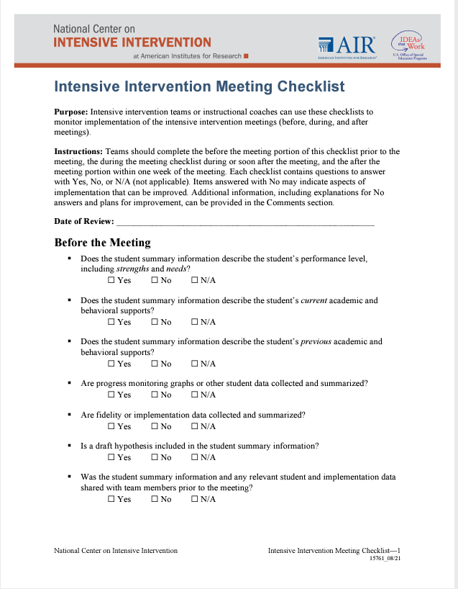
Ensuring Ongoing Meetings Are Effective and Efficient
Ask team members for feedback.
Consider asking an outside observer to review the meeting structure.
Consider conducting a self-assessment.
Notes:
https://intensiveintervention.org/sites/default/files/Intensive_Intervention_Meeting_Checklist.pdf

Slide 41
Experience From the Field
Rhode Island Spotlight

Slide 42
BRIDGE RI Website

Slide 43
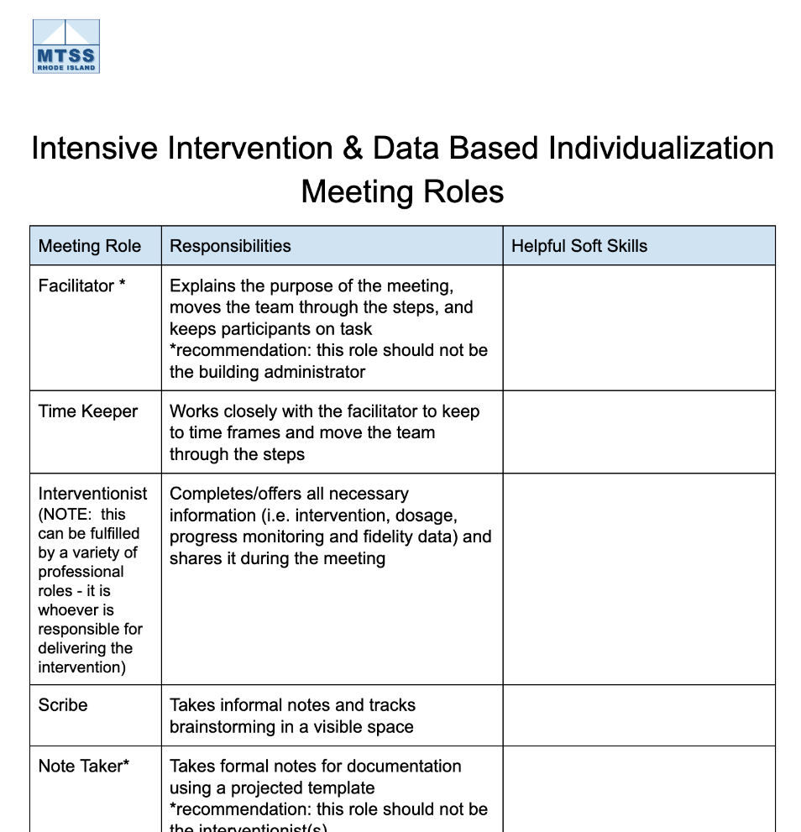
DBI Meeting Roles
Rhode Island Systems of Support. (2022, August 18). Tier 3 systems teaming for intensive intervention. BRIDGE-RI. https://www.mtssri.org/

Slide 44
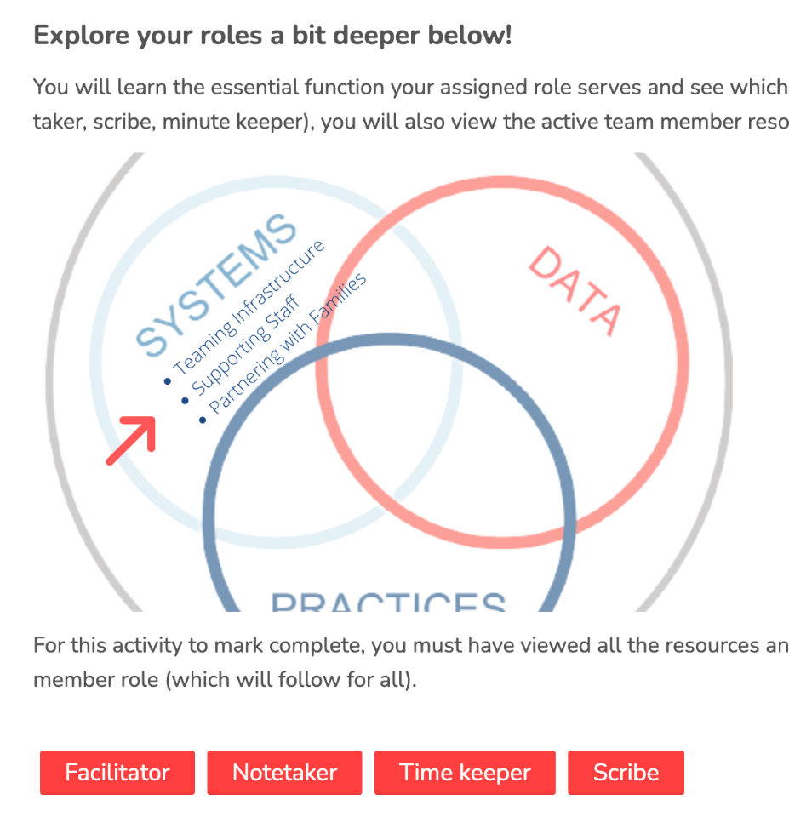
Meeting Tools
Rhode Island Systems of Support. (2022, August 18). Tier 3 Systems Teaming for Intensive Intervention. BRIDGE-RI. https://www.mtssri.org/

Slide 45
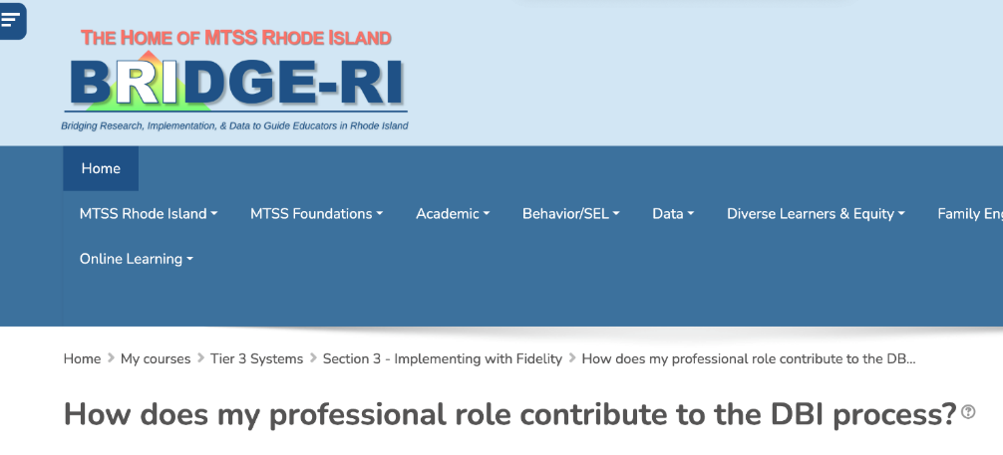
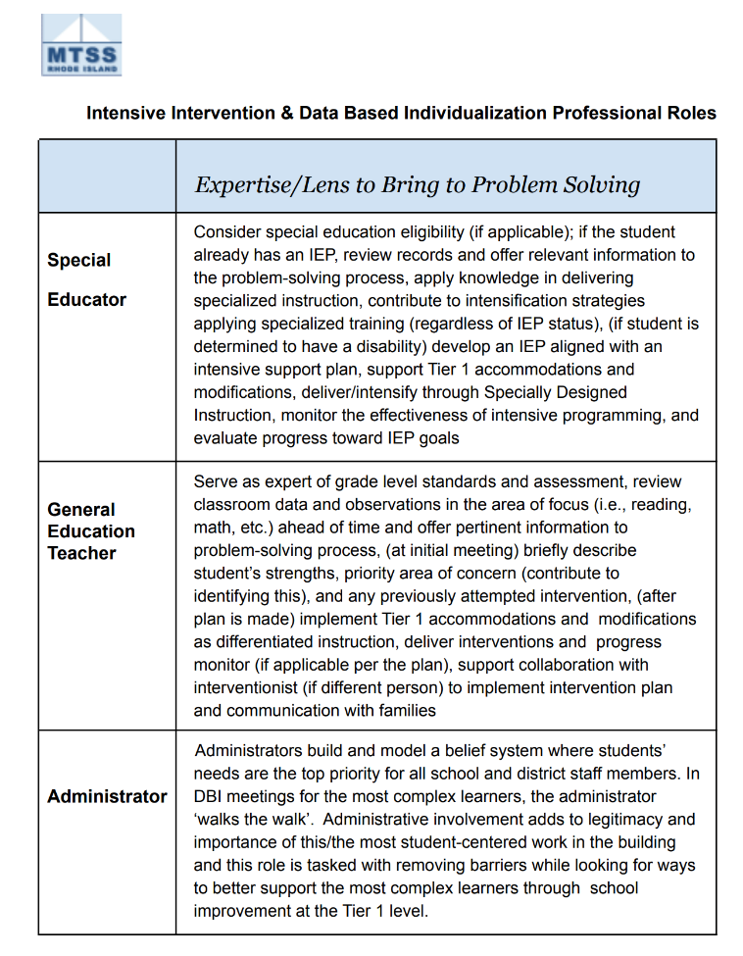
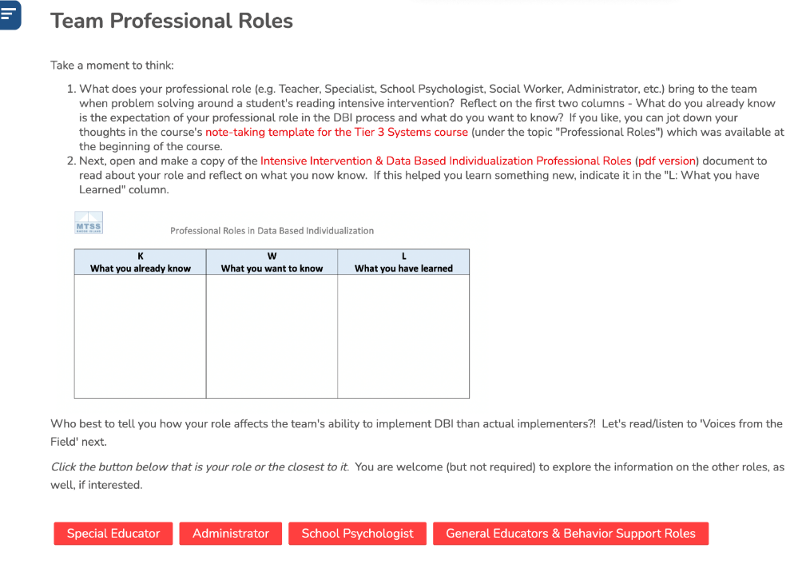
Professional and Meeting Roles
Rhode Island Systems of Support. (2022, August 18). Tier 3 systems teaming for intensive intervention. BRIDGE-RI. https://www.mtssri.org/

Slide 46
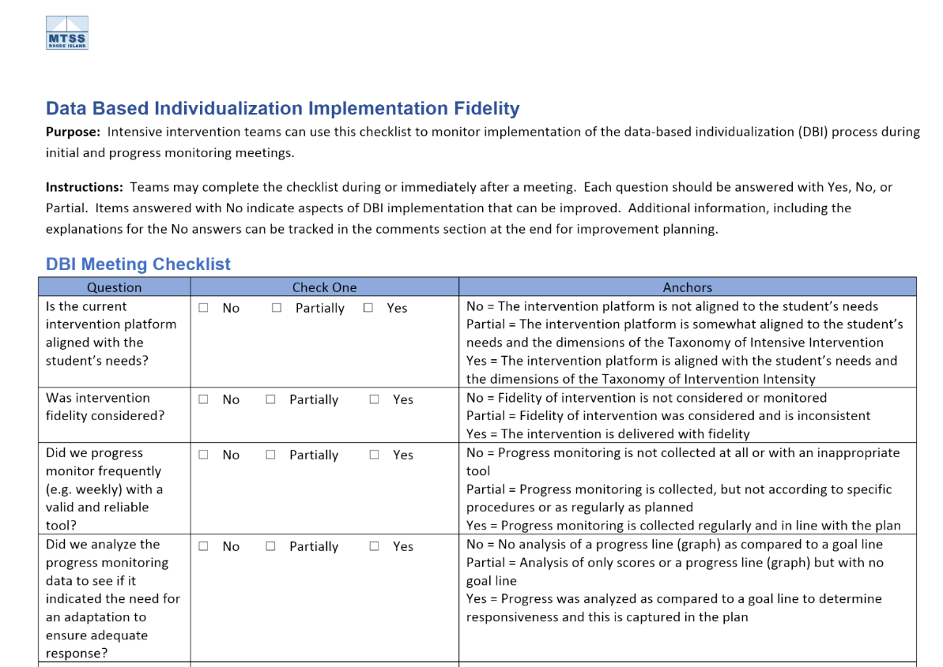
Improving Efficiency

Slide 47
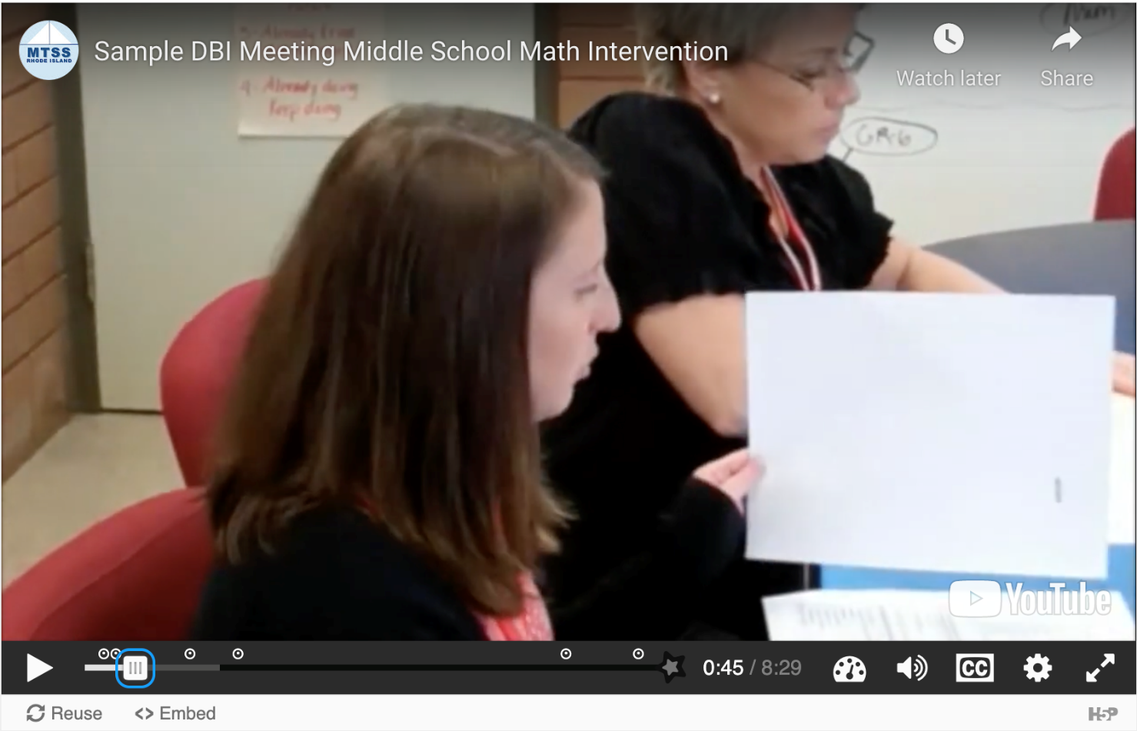
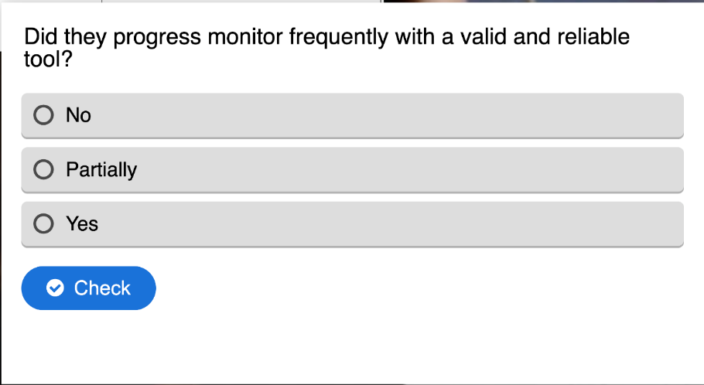
BRIDGE RI Course
Rhode Island Systems of Support. (2022, August 18). Tier 3 systems teaming for intensive intervention. BRIDGE-RI. https://www.mtssri.org/

Slide 48
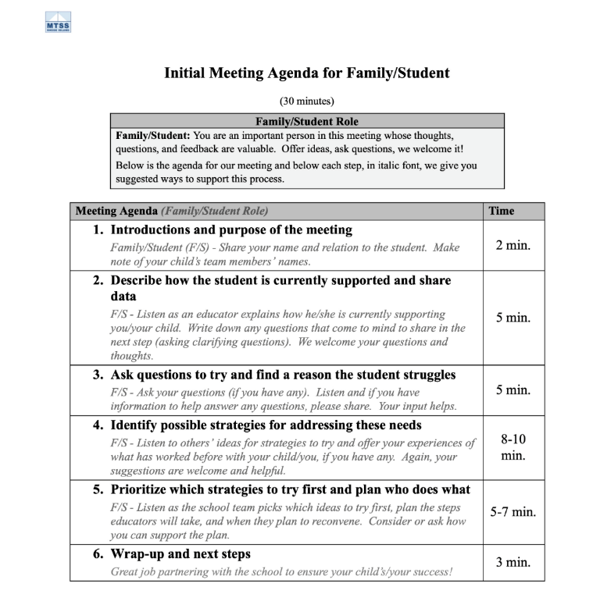
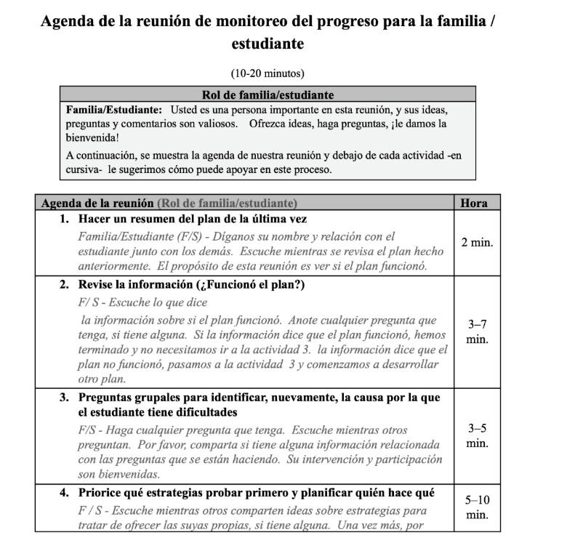
Family/Student as a Team Member
Rhode Island Systems of Support. (2022, August 18). Tier 3 systems teaming for intensive intervention. BRIDGE-RI. https://www.mtssri.org/

Slide 49
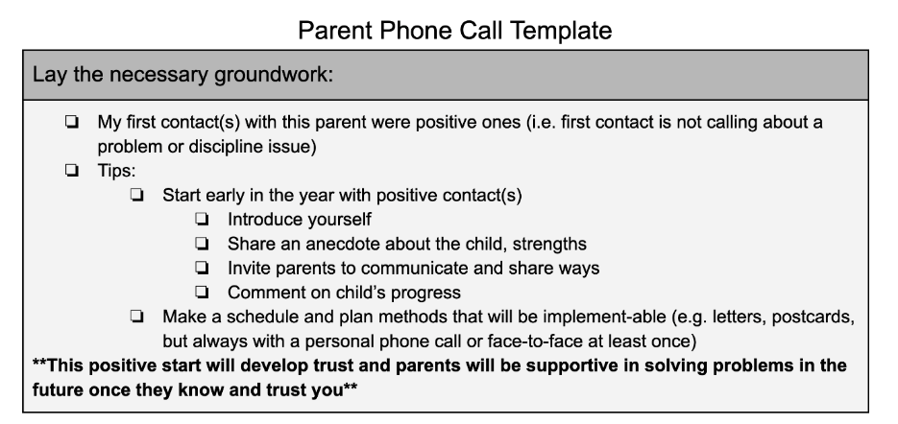
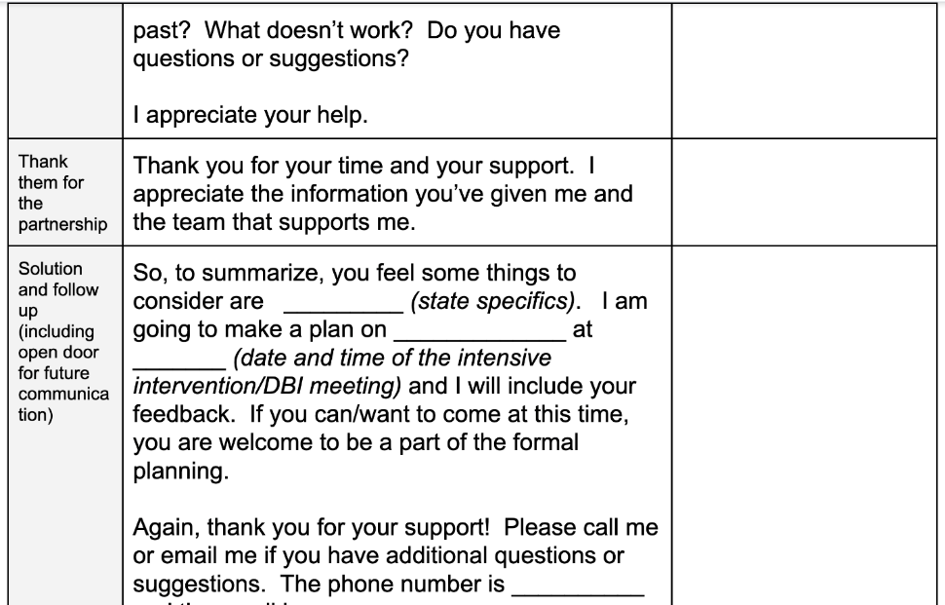
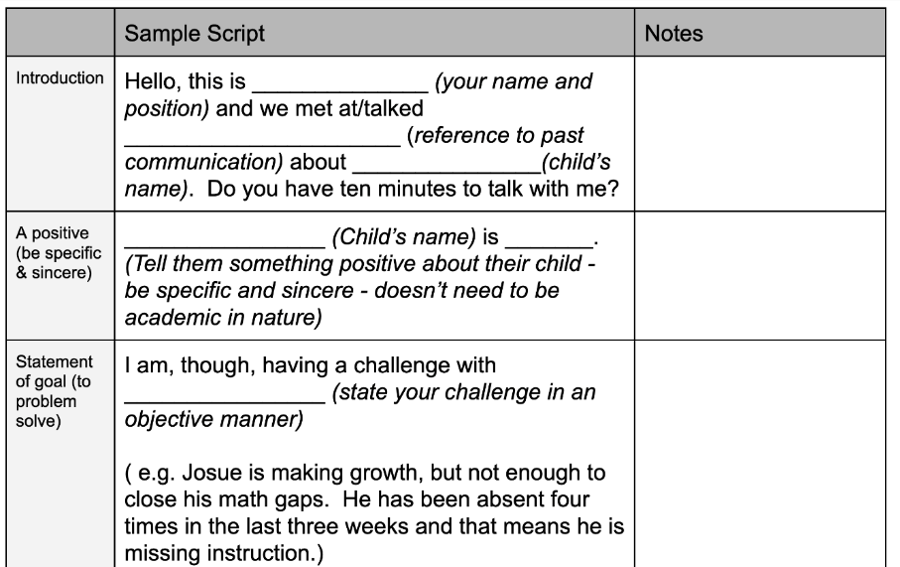
Parent Phone Call Template
Rhode Island Systems of Support. (2022, August 18). Tier 3 systems teaming for intensive intervention. BRIDGE-RI. https://www.mtssri.org/

Slide 50
Questions and Answers

Slide 51
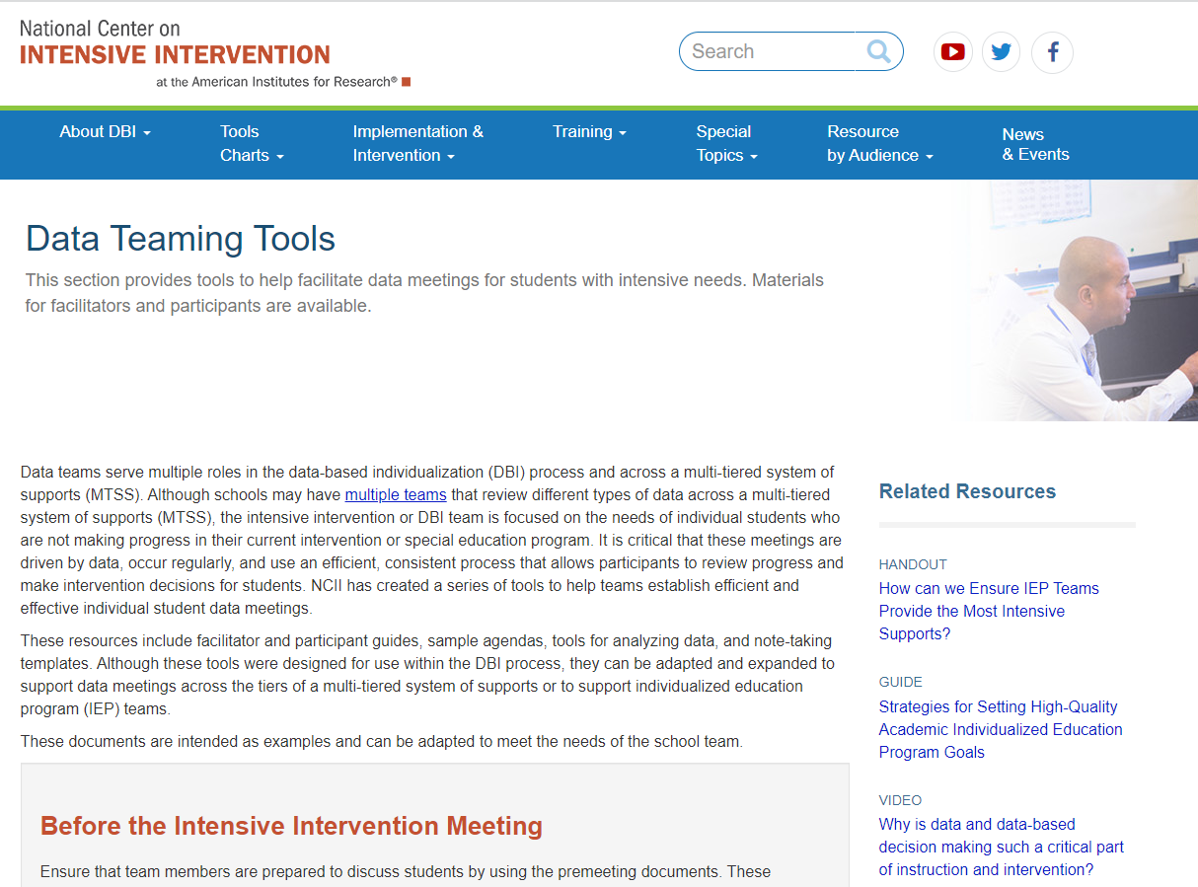
Tools to Support Data Meetings
Notes:
https://intensiveintervention.org/implementation-intervention/data-teaming
https://www.mtssri.org/

Slide 52
Teaming Module
Notes:
https://intensiveintervention.org/using-teaming-implement-dbi

Slide 53
NCII Disclaimer
This presentation was produced under the U.S. Department of Education, Office of Special Education Programs, Award No. H326Q260001. Celia Rosenquist serves as the project officer. The views expressed herein do not necessarily represent the positions or policies of the U.S. Department of Education. No official endorsement by the U.S. Department of Education of any product, commodity, service, or enterprise mentioned in this resource is intended or should be inferred.

Slide 54
References
Gersten, R., Compton, D., Connor, C. M., Dimino, J., Santoro, L., Linan-Thompson, S., & Tilly, W. D. (2009). Assisting students struggling with reading: Response to Intervention and multi-tier intervention for reading in the primary grades. A practice guide (NCEE 2009-4045). National Center for Education Evaluation and Regional Assistance, Institute of Education Sciences, U.S. Department of Education. https://ies.ed.gov/ncee/wwc/PracticeGuide/3
Kuchle, L. B., & Riley-Tillman, T. C. (2019). Integrating behavior and academics in intervention planning. In R. Z. Edmonds, A. G. Gandhi, & L. C. Danielson (Eds.), Essentials of intensive intervention (pp. 51–70). The Guilford Press. ​
National Center on Intensive Intervention. (2013). Data-based individualization: A framework for intensive intervention. American Institutes for Research. https://intensiveintervention.org/resource/data-based-individualization-framework-intensive-intervention

Slide 55
Thank you

