Slide 1
Don’t Socially Distance, Physically Distance!
August 2020
How to Support Social-Behavioral Needs in Virtual, In-Person, and Hybrid Learning
Teri Marx, Ph.D. | Leanne Hawken, Ph.D. | Stacy Hirt, Ed.S.

Slide 2
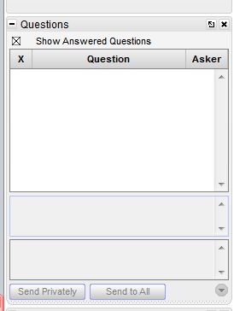
Webinar Format & Questions
Throughout the presentation, submit your questions into the question pod.
For technical issues/questions, a webinar team member will try to assist you as soon as possible.
For content related questions, there will be a time for Q&A at the end of the presentation. Submit your questions and we will share them with the presenters.

Slide 3
Session Outcomes
Participants will understand critical features of social-behavioral instruction across the tiers to support students’ needs, whether through virtual, in-person, or hybrid learning.
Participants will identify strategies, tools, and resources to support their implementation.

Slide 4
Introductions
Teri Marx, Ph.D., Senior Researcher, National Center on Intensive Intervention at American Institutes for Research
Leanne Hawken, Ph.D., Professor Emeritus, University of Utah
Stacy Hirt, Ed.S., Doctoral Student, University of Missouri

Slide 5
Setting the Stage
Multi-Tiered System of Supports

Slide 6
Multi-Tiered System of Supports (MTSS)
Intensive Intervention
Students with disabilities
Receive services at all levels, according to need, including intensive intervention.
Targeted
Intervention
Core, Universal Instruction and Supports

Slide 7
What’s Different about MTSS Now?
How do we know if our data are valid and reliable?
How can we best engage parents and families?
We anticipate many students will have social-emotional needs.
How can we provide effective tiered instruction?
Some of our students don’t have access to technology.
Tip: Leverage existing strengths across data, systems, and practices.

Slide 8
Social-Emotional Competency
MTSS/PBIS + SEL = overall mental health​
(Cook, Frye, Slemrod, Lyon, Renshaw, & Zhang, 2015)​
Self-awareness
Self-Management
Relationship Skills
Responsible Decision-Making
Social Awareness
Tip: Identify a strength for every student, parent, and colleague.

Slide 9
Supporting All Learners
Core Instruction across Virtual, In-Person, and Hybrid

Slide 10
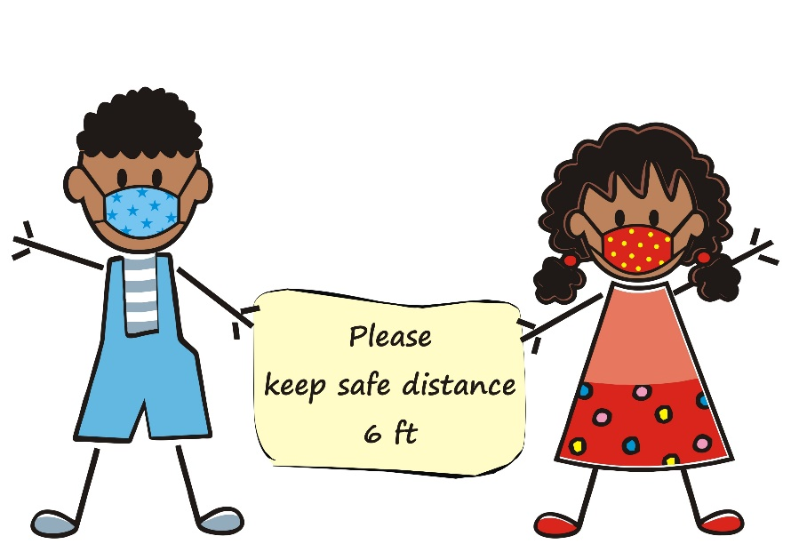
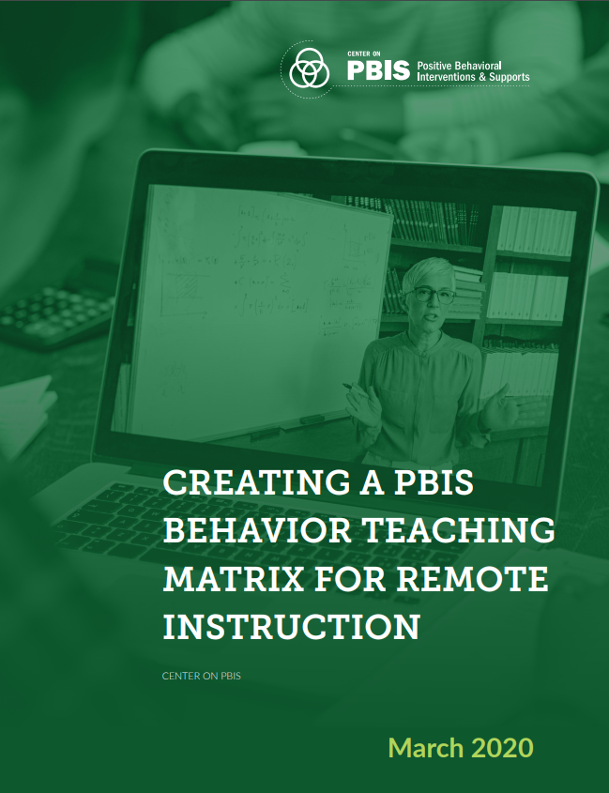
Plan for Success
Consider the skills students will need in the learning environment and:
Review/Develop Schoolwide or Classwide Expectations
Review/Develop Teaching Matrices
Develop Mini-Lessons for Pre-Teaching Skills

Slide 11
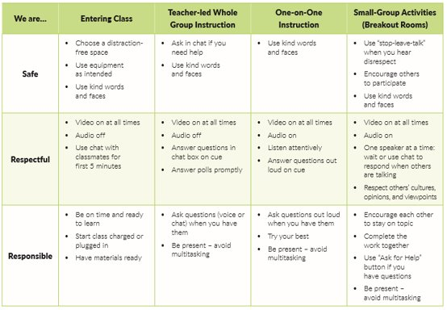
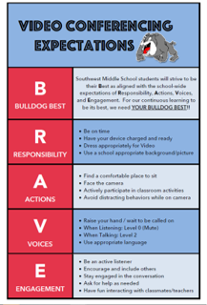
Example Matrices
Settings
Expectations

Slide 12
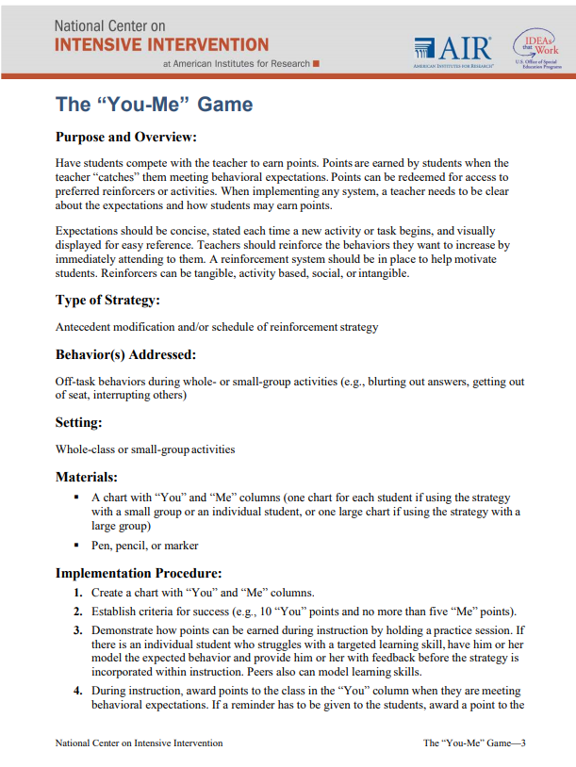
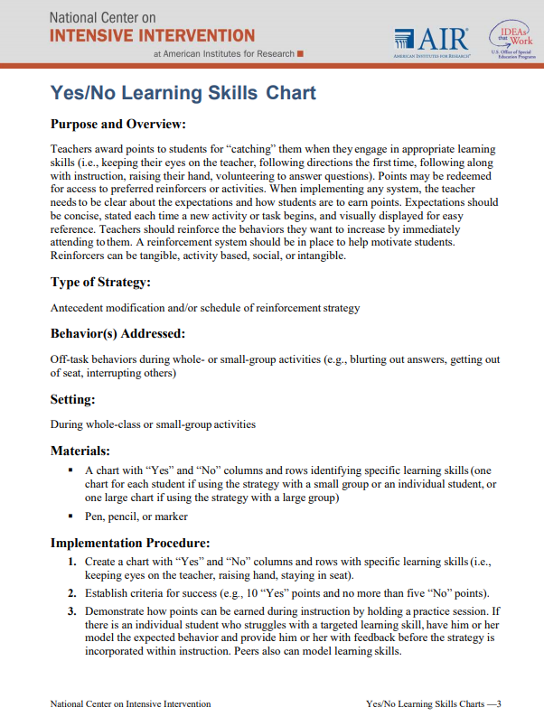
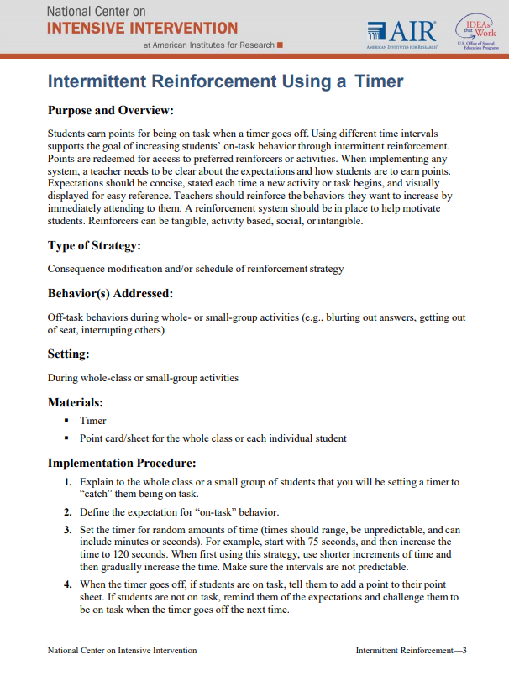
Group Contingencies
Use for skills such as:
Mask wearing
Maintaining physical distance
Using “chat” appropriately
Viewing asynchronous videos
Participating in discussions/discussion boards

Slide 13
Engagement Matters!
​ | Synchronous​ | Asynchronous​
Content Delivery​ ​ | Live instruction ​ Pre-record instruction followed by a live session​ | Pre-record instruction​ Sequence content in a learning management system ​
Responding to Questions​ | Chat box​ Hold up a solution or work sample to the camera​ Give a hand signal (e.g., thumbs up)​ | Use discussion forums that allow students to respond via: ​ Text response​ Video response​ Image/picture response​
Peer Interactions​ | Use breakout rooms​ Create a shared document for peer workgroups ​ | Create small group discussion boards​ Partner students to complete a “think, pair, share” post ​
Providing Feedback​ | Verbalize feedback ​ Provide feedback through private chat​ | Record a video with feedback ​ Provide written feedback​

Slide 14
The Critical Role of Families
Consider families’ needs
Don’t try and “replicate” a full, in-person school day
Consider how to reduce screen time exposure for students through learning “experiences”
Help families create a sense of normalcy in the “new normal”
Send frequent updates and create easy to access tools/resources related to school/student schedules, login information, assignment submission
Support families with identifying expectations/goals/objectives by day/week
Communicate with transparency
Shifts in schedules or learning modality
Instructional adjustments and student progress
Involve parents, families, and community members
Mental health/community health speakers
Record videos and share with school community
Send text reminders, video messages, newsletters
Provide them with sample lessons to try at home
Be understanding of factors outside of parents’ control.​

Slide 15
Addressing Targeted Needs
Check-in, Check-out (CICO) and Social Skills Training

Slide 16
Acknowledgements
Michigan’s MTSS Technical Assistance Center, Michigan Department of Education
Adapting Check-In Check-Out (CICO) for Distance Learning
Valerie Vandlen
Allison Olivo
Melissa Nantais
Steve Goodman
Center on Positive Behavior Interventions and Supports
Guidance for Adapting CICO for Distance Learning
Kathleen Lane, PhD, BCBA-D (http://www.ci3t.org/)

Slide 17
Check-In, Check-Out Implementation Process
Student Recommended for CICO
Teacher, Parent, Student Agree & Implementation Starts
Morning
Check-in/DPR
Pick-up
CICO Coordinator
Summarizes Data
For Decision Making
Parent/ Home
Feedback
Regular Teacher(s)
Feedback
Student Progress Assessed
1: responding,
2: needs more,
3: completed goals
Afternoon
Check-out
1: Continue
2: Add Support
3: Exit/ Graduate
Notes:
Adapted from: Crone, D., Horner, Robert H, & Hawken, Leanne S. (2010) Responding to problem behavior in schools : The behavior education program (Guilford practical intervention in the schools series).

Slide 18
Daily Progress Reports (DPRs)

Slide 19
Key Features to Consider for CICO in Virtual or Hybrid Environment
Connection of students with adults at school
Regular feedback/instruction on behavior and practice in self-monitoring
Home/School Communication
Caregiver feedback
Data are used for decision making

Slide 20
Step 1: Determine Need for CICO
Team-based decision
Risk variables may be different than traditional CICO
Factors to consider
Lack of work completion
Inappropriate language or other problem behavior during virtual meetings
Lack of attendance in online meetings/instructional periods
Withdrawn and lack of active participation online
from Michigan’s MTSS Technical Assistance Center

Slide 21
Step 2: Determine How a Student will Check-in/Check-out
Who
CICO Coordinator or facilitator
Sample Check-in with Middle School Student
Other school staff (e.g., librarian, bus drivers, cafeteria workers)
Frequency
Daily
2-3 times per week
Monday check-in, Friday check-out
Time(s) of Day
Method
Phone call/text/voice recordings
Zoom
Google Meets

Slide 22
Step 3: Align Intervention with Student, Family, and Instructional Needs
A few distance learning scenarios:
1. Live Virtual Instruction (Synchronous)
2. Live Virtual Instruction with Home Routines Included
3. Web-Based Recordings and/or Packet (Asynchronous) Learning
Students and families will need instruction on how to participate in these options of CICO
Training script for parent
Note: These are only a few of the possible distance learning scenarios
from Michigan’s MTSS Technical Assistance Center

Slide 23
Live Virtual Instruction (Synchronous)
Single Session Feedback
Feedback provided by
Teacher at end of session
Paraprofessional who has sat in on the session
from Michigan’s MTSS Technical Assistance Center & OSEP PBIS Technical Assistance Center

Slide 24
Live Virtual Instruction with Home Routines Included
Multiple Feedback Sessions
Feedback provided by
Teacher
Parent/Caregiver
Student Self-Monitoring
Sample Teacher Feedback – Elementary School
from Michigan’s MTSS Technical Assistance Center & OSEP PBIS Technical Assistance Center

Slide 25
Web-Based Recordings and/or Packet (Asynchronous) Learning
No feedback sessions based on live interactions
Feedback provided by
Parent/Caregiver
Student Self-Monitoring
If Parent/Caregiver cannot provide feedback nor child can self monitor – no DPR is needed
Coordinator/Facilitator check-in/out at agreed upon times with student
from Michigan’s MTSS Technical Assistance Center & OSEP PBIS Technical Assistance Center

Slide 26
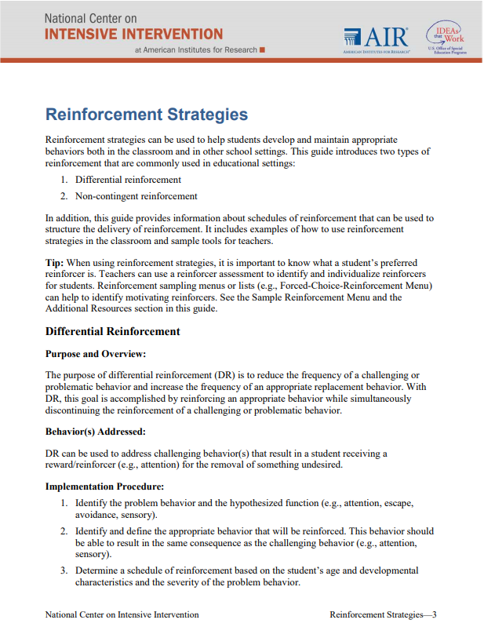
Step 4: Determine Reinforcement
Determine criteria for receiving reinforcement
If DPR is used = 70%-80% of points likely a good target goal
May need to start goals for reinforcement lower with some students (e.g., 50-60%) to ensure success
Sample reinforcers include:
Caregiver allows child additional time with activity of choice
Teacher has a one-on-one “virtual snack time” with student
Coordinator plays a virtual game with student or facilitates virtual social time with other students from the class (e.g., lunch bunch)
Earned “breaks” from online learning or extended lunch time
Additional student sharing time online
Telling Joke/Story
Developing and sharing a video (e.g., using Flipgrid), etc.
from Michigan’s MTSS Technical Assistance Center & OSEP PBIS Technical Assistance Center

Slide 27
Step 4: Determine Reinforcement
No DPR used = provide frequent check-in/check-out interactions
Set weekly goal (e.g., complete 20 minutes of reading daily)
Provide praise and reinforcement for meeting weekly individualized goal
Resource for rewards for distance learning PBISRewards

Slide 28
Step 5 – Use Data for Decision Making
Platforms for Data Collection/Organization
WWW.SWIS.org
PBISRewards.com
Google Forms
Teams may need to adjust data-based decision rules for:
Measuring response to intervention
Need for additional support
Criteria for fading
from Michigan’s MTSS Technical Assistance Center & OSEP PBIS Technical Assistance Center

Slide 29
Few More Considerations for Virtual CICO
Consider including families in the check-out process – even once a week
Get feedback on how school can be supportive re: distance learning.
If key components of virtual CICO are not going well:
What skills need to be retaught or what supports need to be put into place?
How to check-in?
How to earn points during synchronous online instruction?
How to remember to check-out?

Slide 30
Social Skills Instruction

Slide 31
Top 10 School-related Social Skills
Listens to Others
Follows Directions
Follows Classroom Rules
Ignores Peer Distractions
Asks for Help
Takes Turns in Conversations
Cooperates With Others
Controls Temper in Conflict Situations
Acts Responsibly With Others
Shows Kindness to Others
Use social skills instruction with students who need additional support demonstrating SEL competencies!
(Lane et al. 2004, 2007; Gresham & Elliott, 2008)

Slide 32
Examples: Screening and Curriculum for Social Skills Instruction
Sample Screening Tools:
Student Risk Screening Scale- Internalizing and Externalizing (SRSS-IE)
Systematic Screening for Behavior Disorders (SSBD)
Sample Curriculum:
Social Skills Improvement System
PREPARE

Slide 33
Social Skills Improvement System: Lesson Structure (Gresham & Elliott)
Tell
Coaching
1
Show
Modeling
2
Do
Using Role Play
3
Practice
Behavioral Rehearsal
4
Monitor Progress
Feedback
Self-Assess
5
Generalize
Applying Learning in Multiple Settings
6
Notice the Explicit Instruction Principles!
Notes:
Using self as a model in virtual environment
Flip grip video

Slide 34
Monitoring Progress of Social Skills Instruction
Curriculum Specific Pre/Post Measures
SSiS-Rating Scale (Pre/Post)
Daily behavior rating (DBR)
Attendance
Teacher and Parent Social Validity Ratings

Slide 35
Addressing Intensive Needs
Intensifying Virtual, In-Person, and Hybrid Learning

Slide 36
What Is Intensive Intervention?
Intensive intervention addresses severe and persistent learning and behavioral difficulties.
Characterized by increased intensity and individualization
Driven by data

Slide 37
Tier 3 Provides…
Tier 3 instruction differs from that provided in Tiers 1 or 2:
Increased explicitness
Increased intensity
Increased Explicitness and Intensity
Source: IRIS Center, 2020.

Slide 38
Explicitness Is…
A way of teaching where the teacher:
Selects an important objective
Specifies the learning outcome
Designs structured instructional experiences
Explains directly
Models the skill being taught
Provides scaffolded practice to achieve mastery
Instructional modalities change. Technologies change. The principles of explicit instruction remain the same.
Source: Kearns, 2018.
Notes:
SAY: Regardless of instructional platform, the principals of explicit instruction remain the same.
Explicitness is a way of teaching where the teacher:
Identifies an important objective and expectation for learning.
Explicitness, specifies the learning outcome. Here the teacher highlights important details for the concept or skill being learned.
Explicitness, designs the structured experience. Here the teacher provides systematic instruction which sequences its lessons to build one on another.
At times, the structured experience is achieved through scripted lessons.
Explicitness, explains directly. This means the teacher uses precise instructions with clear, direct language.
Explicitness models the skill being taught. The teacher demonstrates lessons through ‘I do’, ‘We do’, ‘You do’
Explicitness provides scaffolded practice. The teacher should provide students with opportunities to practice learned skills.
Scaffolded practice can include guided and independent practice to aid in the mastering of skills, tasks, and concepts.

Slide 39
Intensity Is…
A way of teaching where the teacher:
Offers more instructional time
Increased duration
More frequent check-ins
morning, lunch, afternoon
Offers smaller groups
Matched instructional level
1-3
Higher Dosage, More Frequent Check-Ins
Source: IRIS Center, 2020.

Slide 40
Taxonomy of Intervention Intensity
Taxonomy dimensions include:
Strength
Dosage
Alignment
Attention to transfer
Comprehensiveness
Academic Support
Individualization
Taxonomy Supports the Virtual, In-Person, and Hybrid Learner
Source: NCII, 2020.

Slide 41
Blended Supports for Intensive Intervention
Intensification Practice Categories | Synchronous | Asynchronous
1. Change intervention dosage or time | Virtual features to increase response opportunities (e.g., polling, annotation) Shorter and more frequent sessions | Access to recorded intervention sessions Supports for parents and families to practice with their student
2. Change learning environment to promote attention and engagement | Small group or individual breakout groups Visual cues to remain on-task | Virtual class resource space Multimedia resources and activities
3. Combine cognitive processing strategies with academic learning | Virtual note-taking templates and graphic organizers Self-regulation and self-monitoring supports | Support with offline organization skills Self-regulation and self-monitoring supports
4. Modify delivery of instruction | Explicit, systematic instruction with visual and auditory aids Virtual features to increase feedback opportunities (e.g., chat pod, breakouts) | Structured independent practice opportunities with feedback (e.g., submission of video, online quiz, etc.)

Slide 42
Collaboration With Home
Support use of assistive technologies
Increase communication
Increase levels of feedback to student
Partner with parent to target optimal session time
Make home visits when needed
Partner with outside agencies

Slide 43
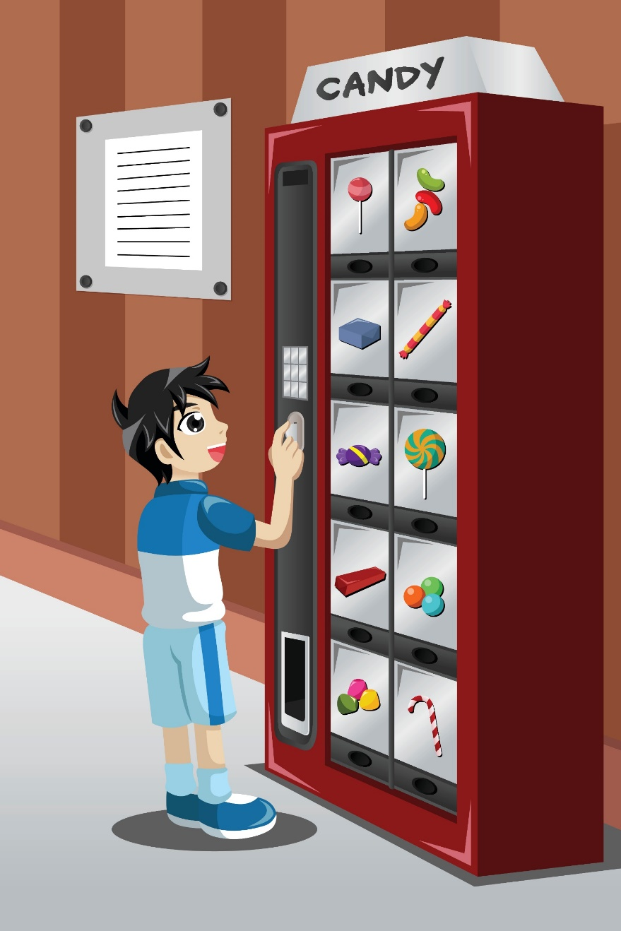
Plan for Success
Lessons from the Field:
Promote Attendance
Groupings (1-3)
Control/Choice
Engagement
Self-Monitoring

Slide 44
Plan for Success
Lessons from the Field:
6. Balance Academics and Social Activities
7. Record Sessions to Support Monitoring Progress
8. Reinforce Positive Behavior
9. Plan Extension Activities
10. Provide Wrap-Around Supports

Slide 45
Connection
My students just longed for connection. Last spring, I spoke with my students anywhere from a couple of minutes to an hour per student.
-District Behavior Virtual Interventionist, August 2020

Slide 46
Questions & Answers

Slide 47
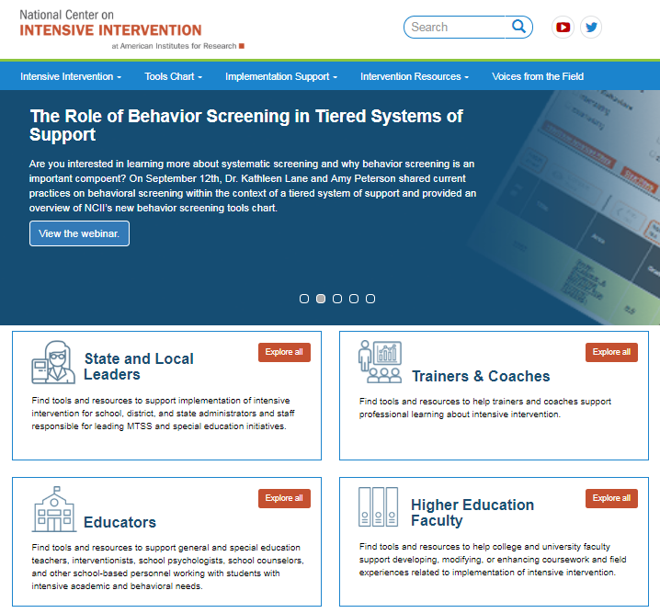
Resources to Learn More!
NCII’s website www.intensiveintervention.org has a wealth of resources to support this process!

Slide 48
NCII Disclaimer
This presentation was produced under the U.S. Department of Education, Office of Special Education Programs, Award No. H326Q160001. Celia Rosenquist serves as the project officer. The views expressed herein do not necessarily represent the positions or policies of the U.S. Department of Education. No official endorsement by the U.S. Department of Education of any product, commodity, service, or enterprise mentioned in this website is intended or should be inferred.

Slide 49
Thank you!

