Slide 1
Qualitative Adaptations for Teaching Word Reading
Module 6 – Introduction

Slide 2
Objectives
Objectives
You will learn…
Part 1:
What effective modeling looks like in intensive reading interventions.
How to adapt reading instruction to improve instructional modeling.
Part 2:
What effective practice looks like in intensive reading interventions.
How to adapt reading instruction to improve student practice.

Slide 3
Objectives
Objectives
You will learn…
Part 3:
How to elicit frequent responses and provide effective feedback during word reading instruction.
How to adapt reading instruction to improve these supporting practices.

Slide 4
Module Orientation
In this module, you will learn…
How to provide effective modeling in intensive word reading interventions.
How to provide effective practice opportunities in intensive word reading interventions.
How to elicit frequent responses and provide feedback in intensive word reading interventions.

Slide 5

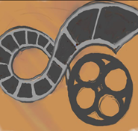

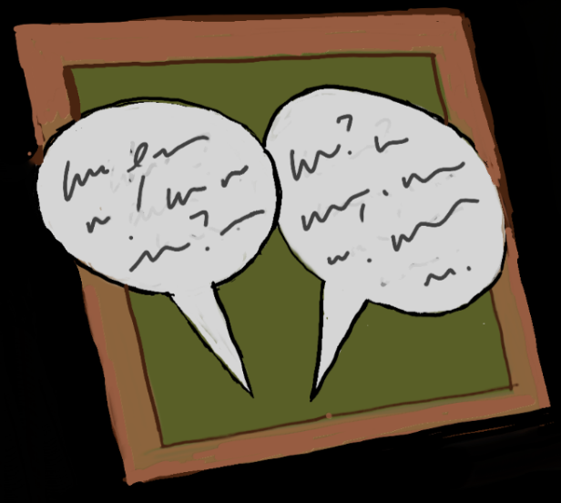

Module Orientation
Module Orientation
Workbook Activities:
Reflect on examples of effective and ineffective instructional delivery from curriculum samples and videos of classroom instruction
Analyze curriculum samples and case study videos of real classroom instruction
Online Activities:
Take a quick quiz
Participate in a discussion board on the article “Beginning reading instruction for students at risk for reading disabilities: What, how, and when”
Submit a journal entry discussing your thoughts

Slide 6


Module Orientation
Reading:
Coyne, M. D., Zipoli, R. P., & Ruby, M. F. (2006). Beginning reading instruction for students at risk for reading disabilities: What, how, and when. Intervention in School and Clinic, 41(3), 161-168.
Classroom Application:
Plan a lesson using the new knowledge about word reading instruction from this module.
Implement the lesson.

Slide 7
Big Ideas in Reading

Slide 8
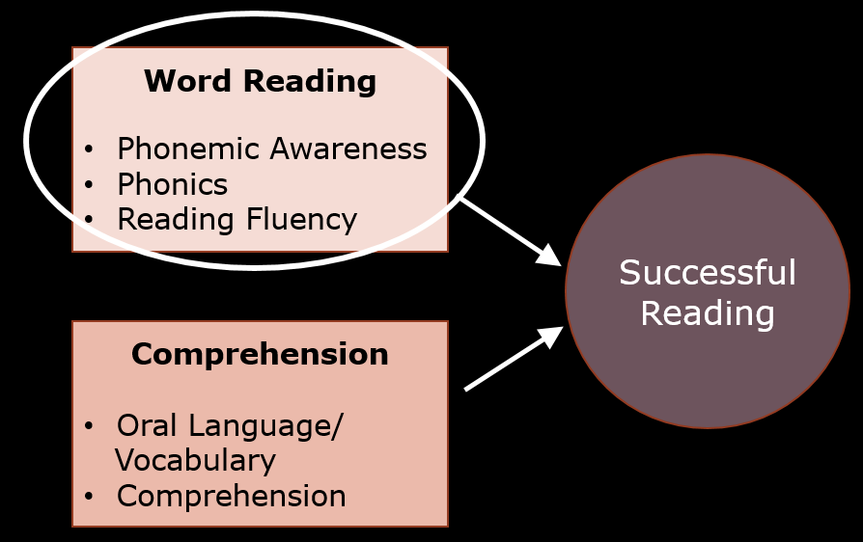
Big Ideas in Reading

Slide 9
Why We’re Learning This
Why We’re Learning This
WHAT we teach
HOW we teach

Slide 10
Explicit Instruction
I Do
Modeling
Practice
Clear Explanation
Guided
Practice
We Do
Planned
Examples
Independent Practice
You Do
Supporting Practices
Asking the right questions
Eliciting frequent responses
Providing immediate specific feedback
Maintaining a brisk pace

Slide 11
Explicit Instruction
I Do
Modeling
Clear Explanation
Planned
Examples

Slide 12
Explicit Instruction
I Do
Modeling
Practice
Clear Explanation
Guided
Practice
We Do
Planned
Examples
Independent Practice
You Do
Supporting Practices
Asking the right questions
Eliciting frequent responses
Providing immediate specific feedback
Maintaining a brisk pace

Slide 13
Explicit Instruction
Practice
Guided
Practice
We Do
Independent Practice
You Do

Slide 14
Explicit Instruction
I Do
Modeling
Practice
Clear Explanation
Guided
Practice
We Do
Planned
Examples
Independent Practice
You Do
Supporting Practices
Asking the right questions
Eliciting frequent responses
Providing immediate specific feedback
Maintaining a brisk pace

Slide 15
Explicit Instruction
Supporting Practices
Asking the right questions
Eliciting frequent responses
Providing immediate specific feedback
Maintaining a brisk pace

Slide 16
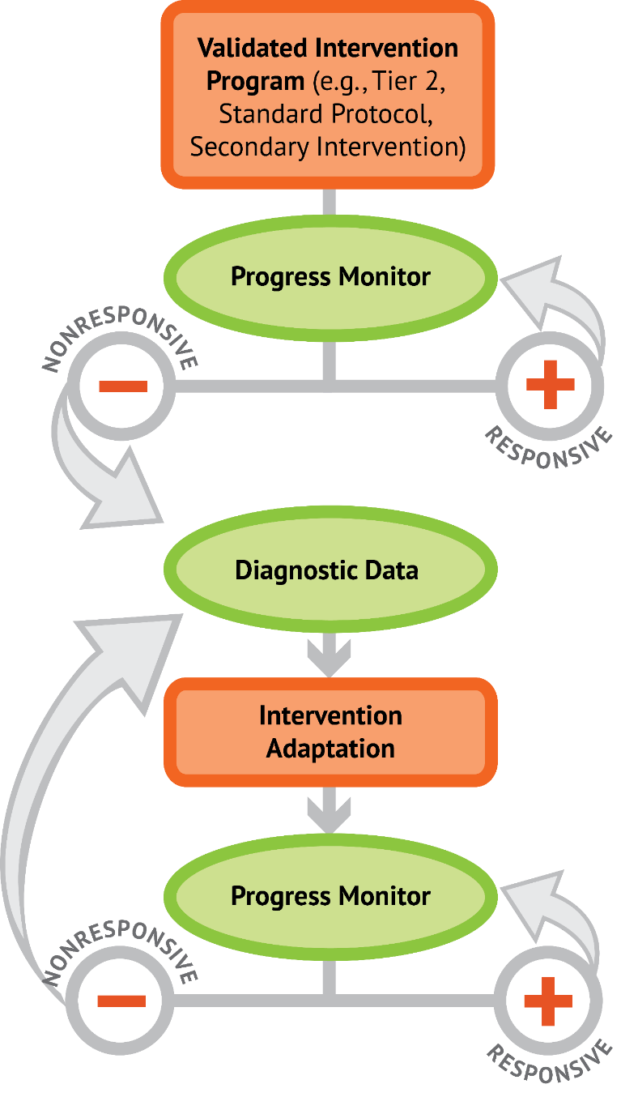
DBI
Qualitative Adaptations:
Explicit Instruction

Slide 17
Welcome
Welcome!
We are excited to start on the Module!

Slide 18
Qualitative Adaptations in Word Reading: Modeling
Module 6 – Part 1

Slide 19
Part 1 Objectives
You will learn…
What effective modeling looks like in intensive reading interventions.
How to adapt reading instruction to improve instructional modeling.

Slide 20
Explicit Instruction
I Do
Modeling
Practice
Clear Explanation
Guided
Practice
We Do
Planned
Examples
Independent Practice
You Do
Supporting Practices
Asking the right questions
Eliciting frequent responses
Providing immediate specific feedback
Maintaining a brisk pace

Slide 21
Explicit Instruction
I Do
Modeling
Clear Explanation
Planned
Examples

Slide 22
Modeling: Why We’re Learning This
Students experiencing reading difficulties will not discover effective or efficient reading skills and strategies.
The strategies that expert readers rely on are effectively hidden from students experiencing reading difficulties.
The role of modeling is to let students
“in on the secret” of reading success by making skills and strategies explicit.

Slide 23
Effective Models
Focus on a singular objective
Explain with clear, concise, consistent language
Model/demonstrate the skill/strategy
(show the thinking)
Select appropriate examples to model
Model additional examples
(use multiple models)

Slide 24
Effective Models
Focus on a singular objective
Explain with clear, concise, consistent language
Model/demonstrate the skill/strategy
(show the thinking)
Select appropriate examples to model
Model additional examples
(use multiple models)

Slide 25

Focus on a singular objective
Focus on a singular objective
“Today we are going to learn the sound for the letter b.”

Slide 26
Focus on a singular objective
X
Focus on a singular objective
“Today we are going to learn the sounds for the letters
a, b, c, d, and e.”

Slide 27
Focus on a singular objective
X
Focus on a singular objective
“Today we are going to learn…”
“…how to listen for first and last sounds.”
“…the letter combinations ai and oa.”
“…how to read words with consonant blends and digraphs”
“…open and closed syllables.”
“…how to do a repeated reading and graph your results.”

Slide 28
Focus on a singular objective
Focus on a singular objective
“Today we are going to learn…”
“…how to listen for first and last sounds.”
“…the letter combination ai and oa.”
“…how to read words with consonant blends and digraphs”
“…open and closed syllables.”
“…how to do a repeated reading and graph your results.”

Slide 29
Focus on a singular objective
Focus on a singular objective
Learning Goal: Students will demonstrate phoneme segmentation by isolating each sound in a three phoneme word presented orally.

Slide 30
Focus on a singular objective
X
Focus on a singular objective
Learning Goal: Students will demonstrate phonemic awareness by segmenting words.

Slide 31
Effective Models
Focus on a singular objective
Explain with clear, concise, consistent language
Model/demonstrate the skill/strategy
(show the thinking)
Select appropriate examples to model
Model additional examples
(use multiple models)

Slide 32
Effective Models
Focus on a singular objective
Explain with clear, concise, consistent language
Model/demonstrate the skill/strategy
(show the thinking)
Select appropriate examples to model
Model additional examples
(use multiple models)

Slide 33
Explain with clear, concise, consistent language
Explain with clear, concise, consistent language
“Let’s review our letters…”
s
The name of this letter is s. The sound it makes is /sss/.
The name of this letter is d. The sound it makes is /d/.
The name of this letter is m. The sound it makes is /mmm/.
d
m

Slide 34
Explain with clear, concise, consistent language
X
Explain with clear, concise, consistent language
“Let’s review our letters…”
s
The name of this letter is s. The sound it makes is /sss/.
This letter is d. It makes the sound /d/.
This one says m, /mmm/.
d
m

Slide 35
Effective Models
Focus on a singular objective
Explain with clear, concise, consistent language
Model/demonstrate the skill/strategy
(show the thinking)
Select appropriate examples to model
Model additional examples
(use multiple models)

Slide 36
Effective Models
Focus on a singular objective
Explain with clear, concise, consistent language
Model/demonstrate the skill/strategy
(show the thinking)
Select appropriate examples to model
Model additional examples
(use multiple models)

Slide 37

Model/demonstrate the skill/strategy
(show the thinking)
Model/demonstrate the skill/strategy
(show the thinking)
Watch me read this word. I’ll touch each letter and say its sound. I won’t stop between sounds. /mmm/-/uuu/-/d/. Now I’ll say it fast – mud The word is mud.

Slide 38
Model/demonstrate the skill/strategy
(show the thinking)
X
Model/demonstrate the skill/strategy
(show the thinking)
In an open syllable, the vowel makes the long sound. It says its name.
Who can read one of these syllables?
ti
ro
ma
le

Slide 39
Model/demonstrate the skill/strategy
(show the thinking)
Model/demonstrate the skill/strategy
(show the thinking)
In an open syllable, the vowel makes the long sound. It says its name.
(Model saying the sound then reading the syllable)
ti
ro
ma
le

Slide 40
Effective Models
Focus on a singular objective
Explain with clear, concise, consistent language
Model/demonstrate the skill/strategy
(show the thinking)
Select appropriate examples to model
Model additional examples
(use multiple models)

Slide 41
Effective Models
Focus on a singular objective
Explain with clear, concise, consistent language
Model/demonstrate the skill/strategy
(show the thinking)
Select appropriate examples to model
Model additional examples
(use multiple models)

Slide 42

Select appropriate examples to model
X
Select appropriate examples to model
Watch me read this word. I’ll touch each letter and say its sound. I won’t stop between sounds. /t/-/iii/-/p/. Now I’ll say it fast – tip. The word is tip.

Slide 43

Select appropriate examples to model
Select appropriate examples to model
Watch me read this word. I’ll touch each letter and say its sound. I won’t stop between sounds. /lll/-/iii/-/p/. Now I’ll say it fast – lip The word is lip.

Slide 44

Select appropriate examples to model
Select appropriate examples to model
I’ll circle the parts at the beginning and end of this word. I’ll read the parts, then I’ll read the word.

Slide 45

Select appropriate examples to model
X
Select appropriate examples to model
I’ll circle the parts at the beginning and end of this word. I’ll read the parts, then I’ll read the word.

Slide 46
Effective Models
Focus on a singular objective
Explain with clear, concise, consistent language
Model/demonstrate the skill/strategy
(show the thinking)
Select appropriate examples to model
Model additional examples
(use multiple models)

Slide 47
Effective Models
Focus on a singular objective
Explain with clear, concise, consistent language
Model/demonstrate the skill/strategy
(show the thinking)
Select appropriate examples to model
Model additional examples
(use multiple models)

Slide 48
Model additional examples
(use multiple models)
Model additional examples
(use multiple models)
We just learned that the sound-spelling a_e makes the long a sound. Now, I’ll show you how to read words with the sound-spelling a_e. First I’ll say the sound, then I’ll say the word.
cake

Slide 49
Model additional examples
(use multiple models)
X
Model additional examples
(use multiple models)
Now, its your turn to read some words with the sound-spelling a_e.
tape

Slide 50
Model additional examples
(use multiple models)
Model additional examples
(use multiple models)
We just learned that the sound-spelling a_e makes the long a sound. Now, I’ll show you how to read words with the sound-spelling a_e. First I’ll say the sound, then I’ll say the word.
cake

Slide 51
Model additional examples
(use multiple models)
Model additional examples
(use multiple models)
We just learned that the sound-spelling a_e makes the long a sound. Now, I’ll show you how to read words with the sound-spelling a_e. First I’ll say the sound, then I’ll say the word.
tape

Slide 52
Model additional examples
(use multiple models)
Model additional examples
(use multiple models)
We just learned that the sound-spelling a_e makes the long a sound. Now, I’ll show you how to read words with the sound-spelling a_e. First I’ll say the sound, then I’ll say the word.
save

Slide 53
Model additional examples
(use multiple models)
Model additional examples
(use multiple models)
We just learned that the sound-spelling a_e makes the long a sound. Now, I’ll show you how to read words with the sound-spelling a_e. First I’ll say the sound, then I’ll say the word.
flame

Slide 54
Effective Models
Focus on a singular objective
Explain with clear, concise, consistent language
Model/demonstrate the skill/strategy
(show the thinking)
Select appropriate examples to model
Model additional examples
(use multiple models)

Slide 55
Lead Teacher Demonstration
https://youtu.be/rbpEfBX5z-I

Slide 56
Script
Script
Today we are going to learn how to listen for the first sound in a word and change the sound to make a new word.
I’ll show you how to listen for the first sound in a word. For example, the word tree starts with the same sound as table, tightrope, and Ticonderoga. (emphasize the “t” sound) Everyone, what does table start with? Great job! Now I can change the sound in table, to make fable, or label.

Slide 57

Script
Script
Now its your turn, who can tell me the first sound in gentleman?

Slide 58
Effective Models
Focus on a singular objective
Explain with clear, concise, consistent language
Model/demonstrate the skill/strategy
(show the thinking)
Select appropriate examples to model
Model additional examples
(use multiple models)

Slide 59
Lead Teacher Demonstration
https://youtu.be/YAx0EvUClgI

Slide 60
Script
Script
We are going to learn how to say the first sound in a word.
This is man (point to the picture). Everyone, say man.
I’ll say the first sound in man. /mmm/
/mmm/ is the first sound in man.

Slide 61
Script
Script
I’ll show you again
This is sun (point to the picture). Everyone, say sun.
I’ll say the first sound in sun. /sss/
/sss/ is the first sound in sun

Slide 62
Activity 6.1
Evaluate a Lesson
Activity 6.1
Evaluate a Lesson
Effective Models
Focus on a singular objective
Explain with clear, concise, consistent language
Model/demonstrate the skill/strategy
(show the thinking)
Select appropriate examples to model
Model additional examples
(use multiple models)

Slide 63
LESSON 14: Reading Words with ea
LESSON 14: Reading Words with ea
TEACH/MODEL
Display the vowel digraph ea card.
Explain that ea can make two sounds, the long e sound like in read and the short e sound like in bread.
Lead students in pronouncing both sounds of ea while pointing to the ea card.
Say “ea can say /eee/ like in read. Everyone say /eee/ - read. ea can also say /e/ like in bread. Everyone say /e/ - bread.”
PRACTICE
Have students read the following words with ea.
  read, bread, real, wealth, steam, lead
Effective Models
Focus on a singular objective
Explain with clear, concise, consistent language
Model/demonstrate the skill/strategy
(show the thinking)
Select appropriate examples to model
Model additional examples
(use multiple models)

Slide 64
LESSON 14: Introducing ea
LESSON 14: Introducing ea
TEACH/MODEL
Display the vowel digraph ea card.
Say “These letters usually say /eee/. Everyone, what do these letters usually say? That’s right, ea usually says /eee/.”
“I’ll show you how to read words with ea. First I’ll say the sound, then I’ll read the word.”
(Model saying the sound and reading the following words: eat, real, meat, bead)
eat
real
meat
bead
ea

Slide 65
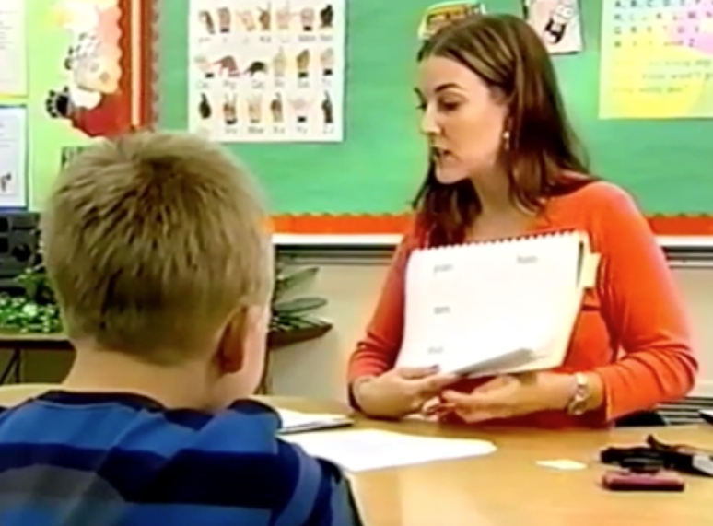
Activity 6.2
Evaluate a Video
Activity 6.2
Evaluate a Video
Effective Models
Focus on a singular objective
Explain with clear, concise, consistent language
Model/demonstrate the skill/strategy
(show the thinking)
Select appropriate examples to model
Model additional examples
(use multiple models)

Slide 66
Activity 6.2
Evaluate a Video
Activity 6.2
Evaluate a Video
Effective Models
Focus on a singular objective
Explain with clear, concise, consistent language
Model/demonstrate the skill/strategy
(show the thinking)
Select appropriate examples to model
Model additional examples
(use multiple models)

Slide 67
Activity 6.2
https://youtu.be/ipgF83Miv5c

Slide 68
Qualitative Adaptations in Word Reading: Practice
Module 6 – Part 2

Slide 69
Part 2 Objectives
You will learn…
What effective practice looks like in intensive reading interventions.
How to adapt reading instruction to improve student practice.

Slide 70
Explicit Instruction
I Do
Modeling
Practice
Clear Explanation
Guided
Practice
We Do
Planned
Examples
Independent Practice
You Do
Supporting Practices
Asking the right questions
Eliciting frequent responses
Providing immediate specific feedback
Maintaining a brisk pace

Slide 71
Explicit Instruction
Practice
Guided
Practice
We Do
Independent Practice
You Do

Slide 72
Practice:
Why We’re Learning This

Slide 73
Explicit Instruction
Lesson timeframe (30 minutes)
Modeling
Practice
Guided Practice
Independent Practice
Modeling
Practice
Guided Practice
Independent Practice

Slide 74
Explicit Instruction: Word Reading
Lesson timeframe (15 minutes)
Modeling
Practice
M
P
M
P
M
P
M
P
M
P
M
P
Instructional Sequence
(30 seconds)

Slide 75

Explicit Instruction: Word Reading
My turn: Watch me read this word. I’ll touch each letter and say its sound. I won’t stop between sounds. /mmm/ -/uuu/-/d/. Now I’ll say it fast – mud The word is mud.
Your turn: Now its your turn to read this word. I’ll touch each letter and you say its sound. Don’t stop between sounds. Now say it fast. You read the word mud!

Slide 76

Explicit Instruction: Word Reading
My turn: Watch me read this word. I’ll touch each letter and say its sound. I won’t stop between sounds. /mmm/ -/uuu/-/d/. Now I’ll say it fast – mud The word is mud.
Your turn: Now its your turn to read this word. I’ll touch each letter and you say its sound. Don’t stop between sounds. Now say it fast. You read the word mud!
Your turn: Now its your turn to read a new word. I’ll touch each letter and you say its sound. Don’t stop between sounds. Now say it fast. You read the word fin!

Slide 77
Explicit Instruction: Word Reading
Lesson timeframe (15 minutes)
PA
Letter sounds
Word reading
Dictation
Letter combinations
Word reading
Sentence reading
Word parts
Polysyllabic word reading
Paragraph reading
M
P
M
P
M
P
M
P
M
P
M
P
M
P
M
P
M
P
M
P

Slide 78
Effective Guided Practice
Focus on same singular objective
(using similar examples)
Guide students through the skill/strategy
Provide ”just right” amount of guidance
(based on students’ skills)
Provide clear prompts and supports

Slide 79
Effective Guided Practice
Focus on same singular objective
(using similar examples)
Guide students through the skill/strategy
Provide ”just right” amount of guidance
(based on students’ skills)
Provide clear prompts and supports

Slide 80
Focus on same singular objective
Focus on same singular objective
“Today we are going to listen for first sounds in words.”
My turn: The first sound in sit is /sss/.What’s the first sound in sit? (Model additional examples)
Your turn: What’s the first sound in mud?

Slide 81
Focus on same singular objective
X
Focus on same singular objective
“Today we are going to listen for first sounds in words.”
My turn: The first sound in sit is /sss/.What’s the first sound in sit?
Your turn:
What’s the first sound in popcorn?
What word starts with the same sound as man?
What does nap begin with?
Chose the picture that starts with /sss/.
What’s the first sound in mud?

Slide 82
Focus on same singular objective
Focus on same singular objective
Learning Goal: Students will demonstrate phoneme isolation by saying the first sound in a one-syllable word (beginning with a continuous sound) presented orally.

Slide 83
Effective Guided Practice
Focus on same singular objective
(using similar examples)
Guide students through the skill/strategy
Provide ”just right” amount of guidance
(based on students’ skills)
Provide clear prompts and supports

Slide 84
Guide students through the skill/strategy
X
Guide students through the skill/strategy
My turn: I’ll show you how to read words with our new sound ea. Remember, ea usually says /eee/. I’ll read the first two. I’ll say each sound, then I’ll read the word.
eat
real
meat
lead
Your turn: Now its your turn to read the next two words. Ready – what word?

Slide 85
Guide students through the skill/strategy
Guide students through the skill/strategy
My turn: I’ll show you how to read words with our new sound ea. Remember, ea usually says /eee/. I’ll read the first two. I’ll say each sound, then I’ll read the word.
eat
real
meat
lead
Your turn: Now its your turn to read the next two words. You’ll say each sound, then you’ll read the word.

Slide 86
Guide students through the skill/strategy
Guide students through the skill/strategy
My turn: I’ll circle the parts at the beginning and end of this word. I’ll read the parts, then I’ll read the word.

Slide 87
Guide students through the skill/strategy
X
Guide students through the skill/strategy
Your turn: Circle the parts at the beginning and end of this word. Read the parts, then read the word.
returning

Slide 88

Guide students through the skill/strategy
Guide students through the skill/strategy
Your turn:
Circle parts at the beginning of the word
Circle parts at the end of the word
Read each part
Read the word.

Slide 89
Effective Guided Practice
Focus on same singular objective
(using similar examples)
Guide students through the skill/strategy
Provide ”just right” amount of guidance
(based on students’ skills)
Provide clear prompts and supports

Slide 90
Provide “just right” amount of guidance
Provide “just right” amount of guidance
Modeling
Practice

Slide 91
Provide “just right” amount of guidance
Provide “just right” amount of guidance
Modeling
Practice
My turn: “My turn to read a word. When I touch a letter, I’ll say its sound. I’ll keep saying the sound until I touch the next letter.”
Your turn: “Your turn to read the same word. When I touch a letter, you’ll say its sound. Keep saying the sound until I touch the next letter.”

Slide 92
Provide “just right” amount of guidance
Provide “just right” amount of guidance
Modeling
Practice
My turn: “My turn to read a word. When I touch a letter, I’ll say its sound. I’ll keep saying the sound until I touch the next letter.”
Your turn: “Your turn to read the same word. When I touch a letter, you’ll say its sound. Keep saying the sound until I touch the next letter.”

Slide 93
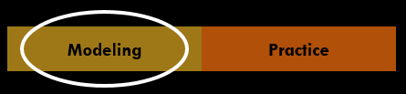
Provide “just right” amount of guidance
Provide “just right” amount of guidance
My turn: “My turn to read a word. When I touch a letter, I’ll say its sound. I’ll keep saying the sound until I touch the next letter.”
Your turn: “Your turn to read the same word. When I touch a letter, you’ll say its sound. Keep saying the sound until I touch the next letter.”

Slide 94
Provide “just right” amount of guidance
Provide “just right” amount of guidance
My turn: “My turn to read a word. When I touch a letter, I’ll say its sound. I’ll keep saying the sound until I touch the next letter.”
Your turn: “Your turn to read the same word. When I touch a letter, you’ll say its sound. Keep saying the sound until I touch the next letter.”

Slide 95


Provide “just right” amount of guidance
Provide “just right” amount of guidance
Your turn: “Your turn to read some new words. When I touch a letter, you’ll say its sound. Keep saying the sound until I touch the next letter.”

Slide 96
Provide “just right” amount of guidance
Provide “just right” amount of guidance
My turn: “My turn to read a word. When I touch a letter, I’ll say its sound. I’ll keep saying the sound until I touch the next letter.”

Slide 97
Provide “just right” amount of guidance
Provide “just right” amount of guidance
Your turn: “Your turn to read some new words. When I touch a letter, you’ll say its sound. Keep saying the sound until I touch the next letter.”

Slide 98
Provide “just right” amount of guidance
Provide “just right” amount of guidance
X
M
Practice
Your turn: “You already know how to read words that begin with a long sound. When I touch a letter, you’ll say its sound. Keep saying the sound until I touch the next letter.”

Slide 99
Provide “just right” amount of guidance
Provide “just right” amount of guidance
Practice
flash
Your turn: “You are going to read this word. When I touch a letter, you’ll say its sound. Keep saying the sound until I touch the next letter.”
Your turn: “You are going to read this word without saying the sounds out loud. When I touch a letter, sound out this word to yourself.”
Your turn: “You are going to read this word the fast way. When I point to a word, sound it out to yourself. When I signal, say the word the fast way.”

Slide 100
Provide “just right” amount of guidance
Provide “just right” amount of guidance
Practice
Your turn:
Circle parts at the beginning of the word
Circle parts at the end of the word
Read each part
Read the word.

Slide 101
Provide “just right” amount of guidance
Provide “just right” amount of guidance
Practice
Your turn:
Circle the parts at the beginning and end of this word. Read the parts, then read the word.
returning

Slide 102
Effective Guided Practice
Focus on same singular objective
(using similar examples)
Guide students through the skill/strategy
Provide ”just right” amount of guidance
(based on students’ skills)
Provide clear prompts and supports

Slide 103
Provide clear prompts and supports
Provide clear prompts and supports
ea
ur
ch
oy
Visual/Physical
Your turn: When I touch, you say the sound.
Auditory
Your turn: When I signal, you say the sound

Slide 104
Provide clear prompts and supports
Provide clear prompts and supports
Material supports
Your turn: “Say the sounds in the word sun and touch a square for each sound.”

Slide 105

Provide clear prompts and supports
Provide clear prompts and supports
Material supports
Your turn: “Touch under each letter and say its sound. Then read the word.”

Slide 106
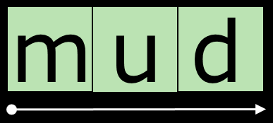
Provide clear prompts and supports
Provide clear prompts and supports
Material supports
Your turn: “Put your finger on the dot. When I signal, read the whole word.”

Slide 107

Provide clear prompts and supports
X
Provide clear prompts and supports
Your turn: “You’re going to sound out this word. Ready – Letter. (pause) Letter (pause), Letter. (pause) Letter (pause), What word did you read?”

Slide 108

Provide clear prompts and supports
Provide clear prompts and supports
Your turn: “You’re going to sound out this word. Ready – Sound. (pause) Sound. (pause) Sound. (pause) Word. (pause)”

Slide 109
Activity 6.3
Evaluate a Video
Activity 6.3
Evaluate a Video
Effective Models
Focus on a singular objective
Explain with clear, concise, consistent language
Model/demonstrate the skill/strategy
(show the thinking)
Select appropriate examples to model
Model additional examples
(use multiple models)
Effective Guided Practice
Focus on same singular objective
(using similar examples)
Guide students through the skill/strategy
Provide ”just right” amount of guidance
(based on students’ skills)
Provide clear prompts and supports
Irregular Word Reading

Slide 110
Activity 6.3
https://youtu.be/G45QcU81IyI

Slide 111
Activity 6.4
Evaluate a Lesson
Activity 6.4
Evaluate a Lesson
Directions for teaching open syllables:
Write the following words on the board – me, hi, no, she. Ask students: Look at these words. How many vowels do you see in each word? (1)
2. Then ask: What does each word end with? (One vowel). Can these be closed syllables? (No, closed syllables end in a consonant.)
3. Have the students read the words, paying attention to the way each is pronounced. Ask: How are the words pronounced at the end? (The mouth is open.)
4. Say: What would be a good name for this syllable? Open syllable because our mouth is open.
5. Define open syllables for students. (An open syllable ends in a vowel and the sound is long).
6. Write the following sentences on the board for students to complete: An open syllables ends in a ______ (vowel). The vowel sound is _____ (long).
7. Extend the lesson by writing two-syllable words with an open first syllable: tiger, lady, secret. Help students blend each syllable to read the words. Talk about what they are hearing.
Effective Models
Focus on a singular objective
Explain with clear, concise, consistent language
Model/demonstrate the skill/strategy
(show the thinking)
Select appropriate examples to model
Model additional examples
(use multiple models)
Effective Guided Practice
Focus on same singular objective
(using similar examples)
Guide students through the skill/strategy
Provide ”just right” amount of guidance
(based on students’ skills)
Provide clear prompts and supports

Slide 112
Directions for teaching open syllables
Directions for teaching open syllables:
Write the following words on the board – me, hi, no, she. Ask students: Look at these words. How many vowels do you see in each word? (1)
2. Then ask: What does each word end with? (One vowel). Can these be closed syllables? (No, closed syllables end in a consonant.)
3. Have the students read the words, paying attention to the way each is pronounced. Ask: How are the words pronounced at the end? (The mouth is open.)
4. Say: What would be a good name for this syllable? Open syllable because our mouth is open.
5. Define open syllables for students. (An open syllable ends in a vowel and the sound is long).
6. Write the following sentences on the board for students to complete: An open syllables ends in a ______ (vowel). The vowel sound is _____ (long).
7. Extend the lesson by writing two-syllable words with an open first syllable: tiger, lady, secret. Help students blend each syllable to read the words. Talk about what they are hearing.
Effective Models
Focus on a singular objective
Explain with clear, concise, consistent language
Model/demonstrate the skill/strategy
(show the thinking)
Select appropriate examples to model
Model additional examples
(use multiple models)
Effective Guided Practice
Focus on same singular objective
(using similar examples)
Guide students through the skill/strategy
Provide ”just right” amount of guidance
(based on students’ skills)
Provide clear prompts and supports

Slide 113
Directions for teaching open syllables
Directions for teaching open syllables:
Write the following words on the board – me, hi, no, she. Ask students: Look at these words. How many vowels do you see in each word? (1)
2. Then ask: What does each word end with? (One vowel). Can these be closed syllables? (No, closed syllables end in a consonant.)
3. Have the students read the words, paying attention to the way each is pronounced. Ask: How are the words pronounced at the end? (The mouth is open.)
4. Say: What would be a good name for this syllable? Open syllable because our mouth is open.
5. Define open syllables for students. (An open syllable ends in a vowel and the sound is long).
6. Write the following sentences on the board for students to complete: An open syllables ends in a ______ (vowel). The vowel sound is _____ (long).
7. Extend the lesson by writing two-syllable words with an open first syllable: tiger, lady, secret. Help students blend each syllable to read the words. Talk about what they are hearing.
Effective Models
Focus on a singular objective
Explain with clear, concise, consistent language
Model/demonstrate the skill/strategy
(show the thinking)
Select appropriate examples to model
Model additional examples
(use multiple models)
Effective Guided Practice
Focus on same singular objective
(using similar examples)
Guide students through the skill/strategy
Provide ”just right” amount of guidance
(based on students’ skills)
Provide clear prompts and supports

Slide 114
Directions for teaching open syllables
Directions for teaching open syllables:
Write the following words on the board – me, hi, no, she. Ask students: Look at these words. How many vowels do you see in each word? (1)
2. Then ask: What does each word end with? (One vowel). Can these be closed syllables? (No, closed syllables end in a consonant.)
3. Have the students read the words, paying attention to the way each is pronounced. Ask: How are the words pronounced at the end? (The mouth is open.)
4. Say: What would be a good name for this syllable? Open syllable because our mouth is open.
5. Define open syllables for students. (An open syllable ends in a vowel and the sound is long).
6. Write the following sentences on the board for students to complete: An open syllables ends in a ______ (vowel). The vowel sound is _____ (long).
7. Extend the lesson by writing two-syllable words with an open first syllable: tiger, lady, secret. Help students blend each syllable to read the words. Talk about what they are hearing.
Effective Models
Focus on a singular objective
Explain with clear, concise, consistent language
Model/demonstrate the skill/strategy
(show the thinking)
Select appropriate examples to model
Model additional examples
(use multiple models)
Effective Guided Practice
Focus on same singular objective
(using similar examples)
Guide students through the skill/strategy
Provide ”just right” amount of guidance
(based on students’ skills)
Provide clear prompts and supports

Slide 115
Directions for teaching open syllables
Directions for teaching open syllables:
Write the following words on the board – me, hi, no, she. Ask students: Look at these words. How many vowels do you see in each word? (1)
2. Then ask: What does each word end with? (One vowel). Can these be closed syllables? (No, closed syllables end in a consonant.)
3. Have the students read the words, paying attention to the way each is pronounced. Ask: How are the words pronounced at the end? (The mouth is open.)
4. Say: What would be a good name for this syllable? Open syllable because our mouth is open.
5. Define open syllables for students. (An open syllable ends in a vowel and the sound is long).
6. Write the following sentences on the board for students to complete: An open syllables ends in a ______ (vowel). The vowel sound is _____ (long).
7. Extend the lesson by writing two-syllable words with an open first syllable: tiger, lady, secret. Help students blend each syllable to read the words. Talk about what they are hearing.
?
Effective Models
Focus on a singular objective
Explain with clear, concise, consistent language
Model/demonstrate the skill/strategy
(show the thinking)
Select appropriate examples to model
Model additional examples
(use multiple models)
Effective Guided Practice
Focus on same singular objective
(using similar examples)
Guide students through the skill/strategy
Provide ”just right” amount of guidance
(based on students’ skills)
Provide clear prompts and supports

Slide 116
Directions for teaching open syllables
Directions for teaching open syllables:
Write the following words on the board – me, hi, no, she. Ask students: Look at these words. How many vowels do you see in each word? (1)
2. Then ask: What does each word end with? (One vowel). Can these be closed syllables? (No, closed syllables end in a consonant.)
3. Have the students read the words, paying attention to the way each is pronounced. Ask: How are the words pronounced at the end? (The mouth is open.)
4. Say: What would be a good name for this syllable? Open syllable because our mouth is open.
5. Define open syllables for students. (An open syllable ends in a vowel and the sound is long).
6. Write the following sentences on the board for students to complete: An open syllables ends in a ______ (vowel). The vowel sound is _____ (long).
7. Extend the lesson by writing two-syllable words with an open first syllable: tiger, lady, secret. Help students blend each syllable to read the words. Talk about what they are hearing.
?
Effective Models
Focus on a singular objective
Explain with clear, concise, consistent language
Model/demonstrate the skill/strategy
(show the thinking)
Select appropriate examples to model
Model additional examples
(use multiple models)
Effective Guided Practice
Focus on same singular objective
(using similar examples)
Guide students through the skill/strategy
Provide ”just right” amount of guidance
(based on students’ skills)
Provide clear prompts and supports

Slide 117
Directions for teaching open syllables
Directions for teaching open syllables:
Write the following words on the board – me, hi, no, she. Ask students: Look at these words. How many vowels do you see in each word? (1)
2. Then ask: What does each word end with? (One vowel). Can these be closed syllables? (No, closed syllables end in a consonant.)
3. Have the students read the words, paying attention to the way each is pronounced. Ask: How are the words pronounced at the end? (The mouth is open.)
4. Say: What would be a good name for this syllable? Open syllable because our mouth is open.
5. Define open syllables for students. (An open syllable ends in a vowel and the sound is long).
6. Write the following sentences on the board for students to complete: An open syllables ends in a ______ (vowel). The vowel sound is _____ (long).
7. Extend the lesson by writing two-syllable words with an open first syllable: tiger, lady, secret. Help students blend each syllable to read the words. Talk about what they are hearing.
Effective Models
Focus on a singular objective
Explain with clear, concise, consistent language
Model/demonstrate the skill/strategy
(show the thinking)
Select appropriate examples to model
Model additional examples
(use multiple models)
Effective Guided Practice
Focus on same singular objective
(using similar examples)
Guide students through the skill/strategy
Provide ”just right” amount of guidance
(based on students’ skills)
Provide clear prompts and supports

Slide 118
Directions for teaching open syllables
Directions for teaching open syllables:
Write the following words on the board – me, hi, no, she. Ask students: Look at these words. How many vowels do you see in each word? (1)
2. Then ask: What does each word end with? (One vowel). Can these be closed syllables? (No, closed syllables end in a consonant.)
3. Have the students read the words, paying attention to the way each is pronounced. Ask: How are the words pronounced at the end? (The mouth is open.)
4. Say: What would be a good name for this syllable? Open syllable because our mouth is open.
5. Define open syllables for students. (An open syllable ends in a vowel and the sound is long).
6. Write the following sentences on the board for students to complete: An open syllables ends in a ______ (vowel). The vowel sound is _____ (long).
7. Extend the lesson by writing two-syllable words with an open first syllable: tiger, lady, secret. Help students blend each syllable to read the words. Talk about what they are hearing.
Effective Models
Focus on a singular objective
Explain with clear, concise, consistent language
Model/demonstrate the skill/strategy
(show the thinking)
Select appropriate examples to model
Model additional examples
(use multiple models)
Effective Guided Practice
Focus on same singular objective
(using similar examples)
Guide students through the skill/strategy
Provide ”just right” amount of guidance
(based on students’ skills)
Provide clear prompts and supports

Slide 119
Directions for teaching open syllables
Directions for teaching open syllables:
Write the following words on the board – me, hi, no, she. Ask students: Look at these words. How many vowels do you see in each word? (1)
2. Then ask: What does each word end with? (One vowel). Can these be closed syllables? (No, closed syllables end in a consonant.)
3. Have the students read the words, paying attention to the way each is pronounced. Ask: How are the words pronounced at the end? (The mouth is open.)
4. Say: What would be a good name for this syllable? Open syllable because our mouth is open.
5. Define open syllables for students. (An open syllable ends in a vowel and the sound is long).
6. Write the following sentences on the board for students to complete: An open syllables ends in a ______ (vowel). The vowel sound is _____ (long).
7. Extend the lesson by writing two-syllable words with an open first syllable: tiger, lady, secret. Help students blend each syllable to read the words. Talk about what they are hearing.
Effective Models
Focus on a singular objective
Explain with clear, concise, consistent language
Model/demonstrate the skill/strategy
(show the thinking)
Select appropriate examples to model
Model additional examples
(use multiple models)
Effective Guided Practice
Focus on same singular objective
(using similar examples)
Guide students through the skill/strategy
Provide ”just right” amount of guidance
(based on students’ skills)
Provide clear prompts and supports

Slide 120
Directions for teaching open syllables
Directions for teaching open syllables:
Write the following words on the board – me, hi, no, she. Ask students: Look at these words. How many vowels do you see in each word? (1)
2. Then ask: What does each word end with? (One vowel). Can these be closed syllables? (No, closed syllables end in a consonant.)
3. Have the students read the words, paying attention to the way each is pronounced. Ask: How are the words pronounced at the end? (The mouth is open.)
4. Say: What would be a good name for this syllable? Open syllable because our mouth is open.
5. Define open syllables for students. (An open syllable ends in a vowel and the sound is long).
6. Write the following sentences on the board for students to complete: An open syllables ends in a ______ (vowel). The vowel sound is _____ (long).
7. Extend the lesson by writing two-syllable words with an open first syllable: tiger, lady, secret. Help students blend each syllable to read the words. Talk about what they are hearing.
Effective Models
Focus on a singular objective
Explain with clear, concise, consistent language
Model/demonstrate the skill/strategy
(show the thinking)
Select appropriate examples to model
Model additional examples
(use multiple models)
Effective Guided Practice
Focus on same singular objective
(using similar examples)
Guide students through the skill/strategy
Provide ”just right” amount of guidance
(based on students’ skills)
Provide clear prompts and supports

Slide 121
Directions for teaching open syllables
ti mel
Directions for teaching open syllables:
(preskills: long and short vowels, closed syllables)
Define open syllables for students. An open syllable ends in a vowel and the sound is long.
Write the following syllables on the board—me, ti, mel, lo. Model reading the syllables.
  This syllable ends with a vowel, so it is an open syllable. The vowel says ___. The syllable is ____.
  This syllable doesn't end in a vowel, so it isn't an open syllable. This closed syllable is ____.
Have student practice reading the syllables.
  Does this syllable end with a vowel? (yes) Vowel? (signal) Syllable? (signal)
  Does this syllable end with a vowel? (no) Syllable? (signal)
Practice reading the following syllables with same procedure. (lo, fi, tag, be, re, ta, reb, bi, ro, lib, ma, pon)
Effective Models
Focus on a singular objective
Explain with clear, concise, consistent language
Model/demonstrate the skill/strategy
(show the thinking)
Select appropriate examples to model
Model additional examples
(use multiple models)
Effective Guided Practice
Focus on same singular objective
(using similar examples)
Guide students through the skill/strategy
Provide ”just right” amount of guidance
(based on students’ skills)
Provide clear prompts and supports

Slide 122
Qualitative Adaptations in Word Reading: Eliciting Responses & Providing Feedback
Module 6 – Part 3

Slide 123
Part 3 Objectives
You will learn…
How to elicit frequent responses and provide effective feedback during word reading instruction.
How to adapt reading instruction to improve these supporting practices.

Slide 124
Explicit Instruction
I Do
Modeling
Practice
Clear Explanation
Guided
Practice
We Do
Planned
Examples
Independent Practice
You Do
Supporting Practices
Asking the right questions
Eliciting frequent responses
Providing immediate specific feedback
Maintaining a brisk pace

Slide 125
Explicit Instruction
Supporting Practices
Asking the right questions
Eliciting frequent responses
Providing immediate specific feedback
Maintaining a brisk pace

Slide 126
Explicit Instruction
Supporting Practices
Asking the right questions
Eliciting frequent responses
Providing immediate specific feedback
Maintaining a brisk pace

Slide 127
Eliciting Responses and Feedback:
Why We’re Learning This
Student Learning
Eliciting Frequent = Maximizes opportunities to
Responses learn and student engagement
Providing Immediate = Ensures learning is happening
Specific Feedback

Slide 128
Eliciting Frequent Reponses
Opportunities to Learn and Practice

Slide 129
Eliciting Frequent Reponses
Select most appropriate response format
  (type of response, number of students, time)
Maximize engagement & opportunities to practice

Slide 130
Opportunities to Learn and Practice
Response Format
Select most appropriate response format
Maximize engagement and opportunities to practice
Opportunities to Learn and Practice
Response Format
Response
Verbal, Written, Gesture
Students
Individual, Pair, Group
Time
Short ------------- Long

Slide 131
Keep students’ heads in the game
Select most appropriate response format
Maximize engagement and opportunities to practice
Keep students’ heads in the game

Slide 132

Opportunities to Learn and Practice
Select most appropriate response format
Maximize engagement and opportunities to practice
Touch a finger for each sound in sun. /sss/ - /uuu/ - /nnn/
X

Slide 133
Opportunities to Learn and Practice
Select most appropriate response format
Maximize engagement and opportunities to practice
Who wants to come up and spell this word on the board?
X

Slide 134
Opportunities to Learn and Practice
Select most appropriate response format
Maximize engagement & opportunities to practice
Everyone read this word. I’ll touch each letter and you say its sound.
X

Slide 135
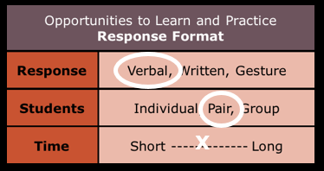
Opportunities to Learn and Practice
Select most appropriate response format
Maximize engagement and opportunities to practice
Turn to your partner and take turns reading the sentence.

Slide 136
Opportunities to Learn and Practice
Select most appropriate response format
Maximize engagement and opportunities to practice
Jimbo, your turn to read the first sentence.

Slide 137
Opportunities to Learn and Practice
Select most appropriate response format
Maximize engagement and opportunities to practice
Ann, your turn to read the next sentence.

Slide 138
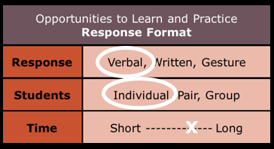
Opportunities to Learn and Practice
Select most appropriate response format
Maximize engagement and opportunities to practice
Marco, your turn to read the next sentence.

Slide 139
Opportunities to Learn and Practice
Select most appropriate response format
Maximize engagement and opportunities to practice
Everyone get ready to read the word. (pause) Ann, what word?

Slide 140
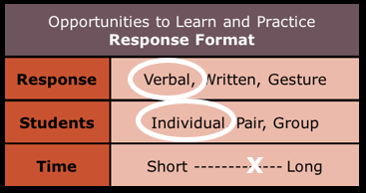
Opportunities to Learn and Practice
Select most appropriate response format
Maximize engagement and opportunities to practice
Everyone get ready to read the word. (pause) Sam, what word?

Slide 141
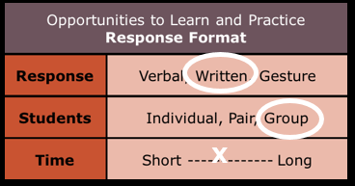
Opportunities to Learn and Practice
Select most appropriate response format
Maximize engagement and opportunities to practice
Everyone write the letters for these sounds. /fff/, /iii/, /ssshhh/

Slide 142
Count the # of opportunities to respond per student per minute
Select most appropriate response format
Maximize engagement and opportunities to practice
Count the # of opportunities to respond per student per minute

Slide 143
Eliciting Frequent Reponses
m
t
a
ee
oy
p
i
s
o
ar
n
sh
l

Slide 144
Activity 6.5
Evaluate a Lesson
Activity 6.5
Evaluate a Lesson
Reading Decodable Text
(Page 1) “My cat!” said Jan. “I can pat it!”
Say: We are going to read this story together. We’ve done this before, so you know what to do.
Group practice
Say: Touch under the first word. Students touch under My.
Say: Think (pause 3 seconds)
Say: Word? And immediately tap. Students say My.
After students respond, say: Next Word. Students touch under cat.
Say: Think (pause 3 seconds).
Say: Word? And immediately tap. Students say cat.
Repeat the same procedure for each word in the sentence.
When the students have read a sentence correctly, the teacher reads the sentence naturally to the students. Repeat the same procedure for each sentence.
Independent practice
When the group has read the story, call on individual students to read one sentence at a time, while other students read along silently. Call on select students to read in an unpredictable order.
Additional practice
Partner read – students reread story using the partner reading routine
Select most appropriate response format
  (type of response, number of students, time)
Maximize engagement & opportunities to practice
(# opportunities per minute)

Slide 145
Reading Decodable Text
Reading Decodable Text
(Page 1) “My cat!” said Jan. “I can pat it!”
Say: We are going to read this story together. We’ve done this before, so you know what to do.
Group practice
Say: Touch under the first word. Students touch under My.
Say: Think (pause 3 seconds)
Say: Word? And immediately tap. Students say My.
After students respond, say: Next Word. Students touch under cat.
Say: Think (pause 3 seconds).
Say: Word? And immediately tap. Students say cat.
Repeat the same procedure for each word in the sentence.
When the students have read a sentence correctly, the teacher reads the sentence naturally to the students. Repeat the same procedure for each sentence.
Independent practice
When the group has read the story, call on individual students to read one sentence at a time, while other students read along silently. Call on select students to read in an unpredictable order.
Additional practice
Partner read – students reread story using the partner reading routine

Slide 146
Reading Decodable Text
Reading Decodable Text
(Page 1) “My cat!” said Jan. “I can pat it!”
Say: We are going to read this story together. We’ve done this before, so you know what to do.
Group practice
Say: Touch under the first word. Students touch under My.
Say: Think (pause 3 seconds)
Say: Word? And immediately tap. Students say My.
After students respond, say: Next Word. Students touch under cat.
Say: Think (pause 3 seconds).
Say: Word? And immediately tap. Students say cat.
Repeat the same procedure for each word in the sentence.
When the students have read a sentence correctly, the teacher reads the sentence naturally to the students. Repeat the same procedure for each sentence.
Independent practice
When the group has read the story, call on individual students to read one sentence at a time, while other students read along silently. Call on select students to read in an unpredictable order.
Additional practice
Partner read – students reread story using the partner reading routine

Slide 147
Eliciting Frequent Reponses
Include more group responses
  Verbal, Written, Gesture
  Use prompts and signals
Structure pair responses
  Give clear directions and practice the rules
Provide targeted individual responses
  Students you want to “check on”
  Unpredictable and short

Slide 148
Activity 6.6
Evaluate a Video
Activity 6.6
Evaluate a Video
Select most appropriate response format
  (type of response, number of students, time)
Maximize engagement and opportunities to practice
(# opportunities per minute)
Word Decoding

Slide 149
Activity 6.6
https://youtu.be/kyUa8Nclfmw

Slide 150
Activity 6.7
Evaluate a Video
Activity 6.7
Evaluate a Video
Select most appropriate response format
  (type of response, number of students, time)
Maximize engagement and opportunities to practice
(# opportunities per minute)
Irregular Word Reading

Slide 151
Activity 6.7
https://youtu.be/0S6n8p0ZIms

Slide 152
Eliciting Responses and Feedback:
Why We’re Learning This
Student Learning
Eliciting Frequent = Maximizes opportunities to
Responses learn and student engagement
Providing Immediate = Ensures learning is happening
Specific Feedback

Slide 153
Immediate Specific Feedback
Ensuring Learning is Happening

Slide 154
Immediate Specific Feedback
Provide immediate feedback
Affirm correct responses
Correct incorrect responses
(and provide additional practice)

Slide 155
Immediate Specific Feedback
Provide immediate feedback
Affirm correct responses
Correct incorrect responses
(and provide additional practice)

Slide 156
Provide immediate feedback
Provide immediate feedback
X
eat
boat
tail
meat
aim
Your turn to read these words.
Eat, beat, teal, meat, aim.
Lets go back to the ones you missed.

Slide 157
Provide immediate feedback
Provide immediate feedback
eat
boat
tail
meat
aim
Your turn to read these words.
Eat, beat…
That word is boat. What word?

Slide 158
Immediate Specific Feedback
Provide immediate feedback
Affirm correct responses
Correct incorrect responses
(and provide additional practice)

Slide 159
Immediate Specific Feedback
Provide immediate feedback
Affirm correct responses
Correct incorrect responses
(and provide additional practice)

Slide 160
Affirm correct responses
Affirm correct responses
Feedback should be specific
X
Great job!
You’re so smart!
… (crickets)
Nice job reading the word boat.
Yes, the sounds in eat are /eee/-/t/.
Affirmative body language (and move on)
X
X

Slide 161
Immediate Specific Feedback
Provide immediate feedback
Affirm correct responses
Correct incorrect responses
(and provide additional practice)

Slide 162
Immediate Specific Feedback
Provide immediate feedback
Affirm correct responses
Correct incorrect responses
(and provide additional practice)

Slide 163
Correct incorrect responses
Correct incorrect responses
X
Your turn to read this word.
boat
bite
?

Slide 164
Correct incorrect responses
Correct incorrect responses
Your turn to read this word.
boat
bite
This word is boat. What word?
boat

Slide 165
Correct incorrect responses
Correct incorrect responses
When students make a mistake
Model the correct response.
Give the student another opportunity to respond.
Come back to the missed item later in the activity.

Slide 166
Correct incorrect responses
Correct incorrect responses
m
t
a
ee
oy
p
i
s
o
ar
n
sh
l

Slide 167
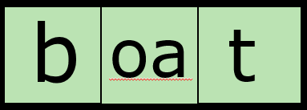
Correct incorrect responses
Correct incorrect responses

Slide 168
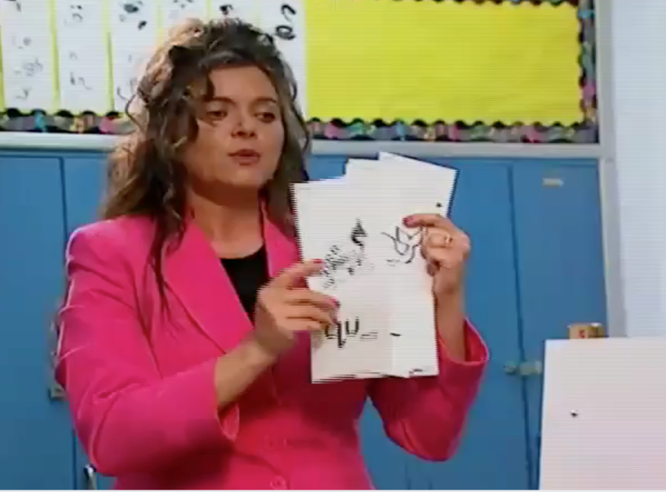
Activity 6.8
Evaluate a Video
Activity 6.8
Evaluate a Video
Effective Models
Focus on a singular objective
Explain with clear, concise, consistent language
Model/demonstrate the skill/strategy
(show the thinking)
Select appropriate examples to model
Model additional examples
(use multiple models)
Effective Guided Practice
Focus on same singular objective
(using similar examples)
Guide students through the skill/strategy
Provide ”just right” amount of guidance
(based on students’ skills)
Provide clear prompts and supports
Eliciting Responses & Providing Feedback
Select most appropriate response format
  (type of response, number of students, time)
Maximize engagement and opportunities to practice
(# opportunities per minute)
Phonemic Awareness

Slide 169
Activity 6.8
https://youtu.be/w7sMcpsh9Ao

Slide 170
Journal Entry
Journal Entry
Analyze Modeling, Practice, and Supporting Practices
(Evaluate a Video Lesson)
Select one of the following two videos from the http://explicitinstruction.org/ website.
  “Word and Sentence Dictation – Second grade”
  http://explicitinstruction.org/video-elementary/elementary-video-5/
  “Pronunciation of Multi-Syllabic Passage Words – Sixth Grade Language Arts” http://explicitinstruction.org/video-secondary-main/secondary-video-2/
Identify which of the two videos you selected. Describe how the teacher models and practices word recognition skills during instruction and what supporting practices are used during instruction. Which of the criteria from the Checklist are/are not included or fully implemented? How does the quality of the instructional model, practice, and supporting practices affect student reading performance? As you discuss the video, be as specific as you can about any details related to reading.
Based on this Module, discuss how you would improve the instruction used in the teacher’s lesson. If you were working with the teacher as an instructional coach, what are your recommendations, based on the Module 6 Checklist, to help the teacher improve his/her instruction?

Slide 171
Qualitative Adaptations for Teaching Word Reading
Module 6 – Closing

Slide 172
Looking Ahead
Looking Ahead
1.
Intro to Reading and DBI
2.
Big Ideas in Reading
3.
4.
Intervention Programs in Reading
5.
Progress Monitoring and Instructional Decision Making
6.
Mastery Assessment
7.
Adapting and Intensifying Word Reading Intervention
Adapting and Intensifying Comprehension Intervention

