Slide 1
Word Problem Solving in Mathematics for Students With Disabilities
Using the Understand-Plan-Solve-Evaluate Method
Tammy Moran, Special Education Teacher
Ferris Independent School District, Texas

Slide 2
Outline
Steps for problem solving
Review the Understand-Plan-Solve-Evaluate (UPSE) Method
Watch an example

Slide 3
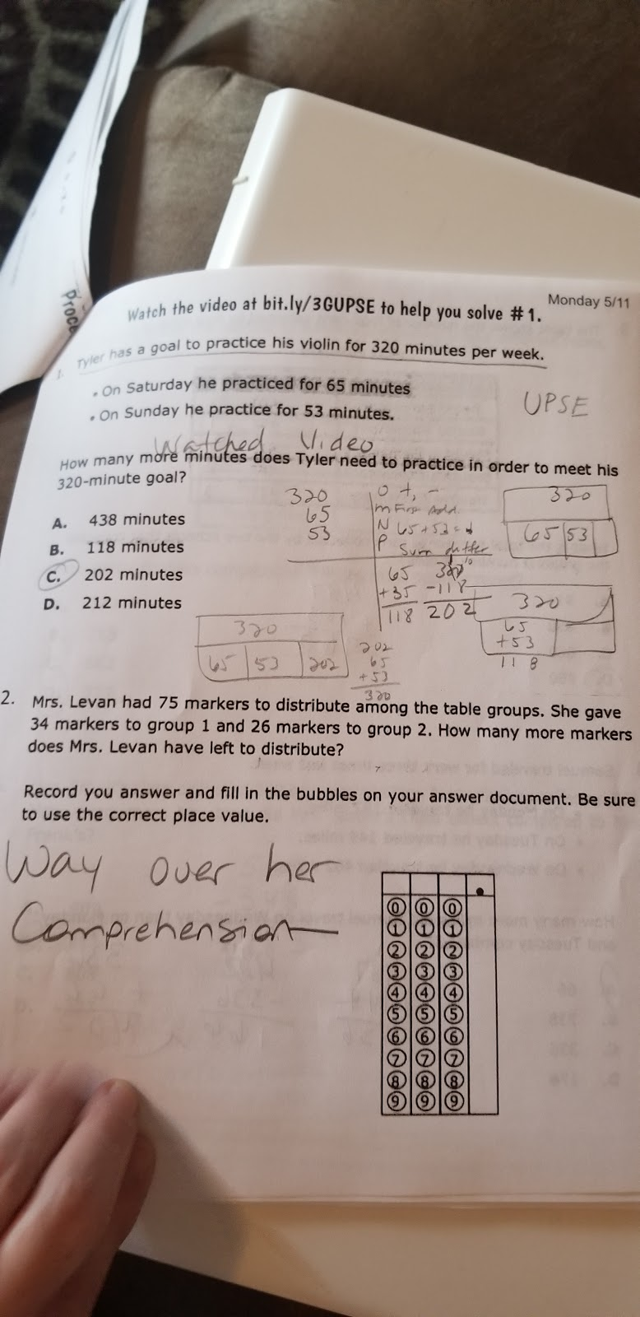
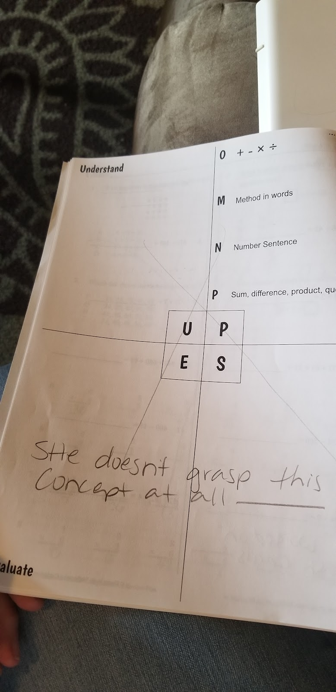
Have parents indicated that their children did not understand word problem-solving homework?
The UPSE Method can be taught in class and reinforced at home by sharing these materials with parents.

Slide 4
UPSE Method
Understand | Plan
Evaluate | Solve
Understand: Check your understanding of the problem.
Plan: Plan how you will solve the problem.
Solve: Solve the problem.
Evaluate: Check to be sure your answer is reasonable.

Slide 5
Steps for Word Problem Solving
Read the problem twice.
Think: Do you understand all the words used in the problem? Can you restate or retell the problem in your own words? Can you think of a picture or diagram that might help you understand the problem?
Underline the problem.
Circle the important information.
Solve the problem using the UPSE Method.

Slide 6
Let’s See the UPSE Method in Action

