Slide 1
Using the Taxonomy of Intervention Intensity to Select, Design, and Intensify Intervention
December 2019
Notes:
Welcome to the National Center on Intensive Intervention’s (NCII’s) module on using the Taxonomy of Intervention Intensity to Identify, Design, and Intensify Intervention. This module will fill a day-long training (approximately 6 hours to complete). It includes slides, speakers’ notes and a workbook of activities.
This module is intended for individuals and teams who are interested in learning more about how to design and implement intensive intervention as a part of the Data-Based Individualization (DBI) process. Specifically, this training is focused on learning dimensions to consider when selecting a strong validated platform and considering intensification. For more information about the DBI process, see https://intensiveintervention.org/resource/self-paced-introduction-intensive-intervention. This module is intended to introduce the taxonomy and provide an overview. Additional modules focused on applying the taxonomy for reading, mathematics, and behavior are also available. In addition, a module will go more in depth on considerations for intensification.
Preferred citation:
While permission to reprint this publication is not necessary, the citation should be: National Center on Intensive Intervention. (2019.). Using the Taxonomy of Intervention Intensity to Select, Design, and Intensify Intervention. Washington, DC: U.S. Department of Education, Office of Special Education Programs, National Center on Intensive Intervention.
Facilitators: Introduce yourself and provide a brief summary of your background before moving on.
Tips for using the speaker’s notes:
Text formatted in standard font provides a sample script for the facilitator.
Text formatted in italics is intended as directions, notes, or background information for the facilitator. This includes notes for animations within the slide deck.
Slides that reference handouts that can be found in the speaker notes are noted with a banner indicating handout.

Slide 2
Learner Outcomes
At the end of the session, participants will be able to:
Define the dimensions of the Taxonomy of Intervention Intensity and explain how they support the Data-Based Individualization (DBI) process.
Apply the dimensions of the Taxonomy of Intervention Intensity to evaluate or select a validated intervention program.
Use the Taxonomy of Intervention Intensity to intensify an intervention for a student who is not responding as expected.
Access existing resources to support evaluation and intensification.
Notes:
In this presentation, you will be introduced to the Taxonomy of Intervention Intensity and learn how it supports the DBI process by helping providing explicit guidance on how to select and evaluate validated intervention programs to best meet students’ needs and intensify or adapt those interventions when students or groups of students do not adequately respond.
At the end of the session you will be able to:
Define the dimensions of the Taxonomy of Intervention Intensity and explain how they support the DBI process.
Apply the dimensions of the Taxonomy to evaluate or select a validated intervention program.
Use the Taxonomy of Intervention Intensity to intensify an intervention for a student who is not responsive.
Access existing resources to support evaluation and intensification.
This presentation is intended to provide an overview and introduction to the Taxonomy. If you are interested in exploring in depth a specific content area including reading, mathematics, and behavior, we encourage you to explore the resources available on the NCII website.

Slide 3
Agenda
Overview of Data-Based Individualization (DBI)
Defining Elements of a Validated Intervention Program
Designed Based on Taxonomy of Intervention Intensity
Implemented With Fidelity
Using the Taxonomy to Individualize and Intensify an Intervention
Applying the Taxonomy of Intervention Intensity to a Case Example
Wrap-Up and Reflection
Notes:
Review slide. Based on available time and focus, adjust the agenda to meet your needs.
While timeframe may vary this is intended to be a full day (5 hr) training and estimated times are provided below. The actual time for the session will depend on time spent on activities.
Introductions (15-30 minutes)
Overview of Data-Based Individualization (DBI) (30-45 minutes)
Defining Elements of a Validated Intervention Program (60-90 minutes)
Designed Based on Taxonomy of Intervention Intensity
Lunch Break
Implemented with Fidelity (approximately 30 minutes)
Using the Taxonomy to Individualize and Intensify an Intervention (approximately 30-45 minutes)
Applying the Taxonomy of Intervention Intensity to a Case Example (approximately 60 minutes)
Wrap-Up and Reflection (approximately 30 minutes)

Slide 4
Activity: Taxonomy K-W-L
What Does It Help Me KNOW? | What More Do I WANT to Know? | How Will I LEARN More?
Handout
Notes:
Each of you will have two handouts in your workbook. The first looks like this and includes brief definitions for each of the seven dimensions of the Taxonomy. You will notice that the handout is two-sided. On one side, the dimensions are defined in the context of academics, and on the backside the same seven dimensions are defined in the context of behavior. The second handout looks like this (click for animations). Many of you are likely familiar with a K-W-L (for Know, Want to Know, Learn). This is a slightly modified version that includes space for you to document what you know from reviewing the resource, what questions you have or what you want to learn more about, and finally how you will learn more. For the next activity, you will focus on the first two columns (click for animation). Using the Taxonomy overview handout, individually document what you know from reviewing the handout and what you want to know more about. You will have about 5–7 minutes to do this. Once you have completed documenting what you know and want to know more about, turn to your neighbor or tablemates and share some of the things that you documented.
Provide about 5–7 minutes for individual review; provide about 3–5 minutes for table/partner talk; and then provide time for group share out. Note how you will address these questions throughout the training.

Slide 5
Data-Based Individualization
A systematic method for using data to determine when and how to provide more intensive intervention.
An ongoing process—not a single intervention.
Intended for students with severe and persistent learning and behavioral needs.
Notes:
Before we focus on the dimensions of the Taxonomy of Intervention Intensity, we would like to provide a brief review of the data-based individualization process. DBI is a research-based process for individualizing and intensifying interventions through the systematic use of assessment data, validated interventions, and research-based adaptation strategies. DBI is the technical term for what many good teachers do naturally through the problem-solving process: frequently review student data and make changes to their teaching based on what works for students. DBI, however, makes this process systematic, explicit, and tailored to meet the needs of individual students through a multistep process that gradually intensifies instruction and support.
DBI has its origins in data-based program modification/experimental teaching, first developed at the University of Minnesota (Deno & Mirkin, 1977).
DBI is intended as an ongoing process, not a single intervention, for a small percentage of students with severe and persistent learning and behavioral need, including those who:
Are not making adequate progress in their current intervention program (often, a Tier 2, evidence-based intervention)
Are not meeting individualized education program (IEP) goals
Have persistently low academic achievement
Have high-intensity/frequency behavior
This module is best-suited for participants with a working knowledge of DBI and MTSS. If participants are confused about the DBI process you might direct them to the following resources:
Self-Paced Online Module Introducing Intensive Intervention: https://intensiveintervention.org/resource/self-paced-introduction-intensive-intervention
Read About the DBI Process in Detail: https://intensiveintervention.org/sites/default/files/DBI_Framework.pdf
Explore DBI Topics: https://intensiveintervention.org/intensive-intervention
Handout—Breaking Down the DBI Process: Questions & Considerations: https://intensiveintervention.org/sites/default/files/NCII-placemat-508.pdf
Dr. Chris Lemons (Vanderbilt) explains intensive intervention and why it is important: https://intensiveintervention.org/resource/what-are-intensive-interventions-and-why-are-they-important

Slide 6
Five DBI Steps
Validated intervention program, delivered with fidelity
Progress monitoring
Informal diagnostic assessment
Adaptation to validated intervention
Continued progress monitoring, with adaptations occurring whenever needed to ensure adequate progress
Notes:
The DBI process includes 5 iterative steps:
Step 1: The DBI process builds on validated intervention program delivered with fidelity. The validated intervention program is an evidence-based standard-protocol intervention.
Step 2: Regular progress monitoring data are collected to determine whether the student is responding or not responding to the intervention. If the student is responsive, the teacher continues to provide the validated intervention program and monitor student progress until the student reaches expectations. If the data suggest that the student is not responding while other students who have received the intervention have responded, then the teacher moves to the next step of the process.
Step 3: To determine why the student is not responding, diagnostic and functional data are collected and reviewed to identify specific skill deficits or behavior concerns that are affecting the student’s progress. This may include data from informal and formal academic and behavior measures. These data are used to develop hypotheses about why the student is not responding.
Step 4: The hypothesis along with educators’ expertise are used to develop an individual student plan for modifying or adapting the intervention to better meet the student’s individualized needs.
Step 5: While implementing the intervention adaptations, the teacher continues to collect progress monitoring data at regular intervals to determine responsiveness. Students whose data indicate responsiveness continue with the adapted intervention. Students whose data indicate nonresponse return to Step 3, where the teacher will analyze additional data and consider additional adaptations.

Slide 7
Connecting DBI to a Multi-Tiered System of Support (MTSS)
Characteristics | Tier 2 | Tier 3 - DBI
Instruction/ Intervention Approach | Follow standardized evidence-based programs as designed | Use standardized evidence-based program as a platform, but adapt instruction based on student data
Duration and Time Frame | Use duration and time frame defined by developer | Increase frequency and/or duration to meet student needs
Group Size | 3–7 students (as defined by developer) | Decrease group size to meet student needs (no more than 3)
Progress Monitoring | At least monthly | Weekly
Population Served | At risk (typically 15%–20% of student population) | Significant and persistent learning and/or behavior needs (typically 3%–5% of student population)
Notes:
To help ground the conversation around DBI and the Taxonomy of Intervention Intensity, we wanted to begin by reviewing the key components of Tier 2 and Tier 3 and how they differ. (Review table) As you will note in the table, Tier 2 interventions are intended to be standardized evidence-based programs delivered as they are designed or with group-based modifications. In contrast, Tier 3 intervention or what we think about as intensive intervention/DBI uses the standardized evidence-based intervention program that was delivered at Tier 2 as a platform or foundation, but the intervention is adapted to meet individual student needs based on student data. This is what we think of as the DBI process.
(Note to presenter: We recognize that Tier 2 and 3 are defined differently in schools and districts across the country. The table provided is intended to illustrate the distinction across these tiers, but it may be necessary to adapt your language or description based on local context).
It is also important to consider how students with disabilities fit within the DBI process and tiered system of supports. In reality, students with disabilities can and should be served within any tier of instruction or intervention based on their individualized needs. Students with disabilities should have access to Tier 2 intervention, when appropriate, and starting with a standardized evidence-based intervention provides the foundation for special educators to ensure that they are starting with an intervention that has strength (one of the dimensions that will we discuss further in this presentation). The DBI process can also help special educators as they design and provide specially designed instruction by following the systematic data-based process for matching instruction to individual student needs and intensifying and adjusting as needed.

Slide 8
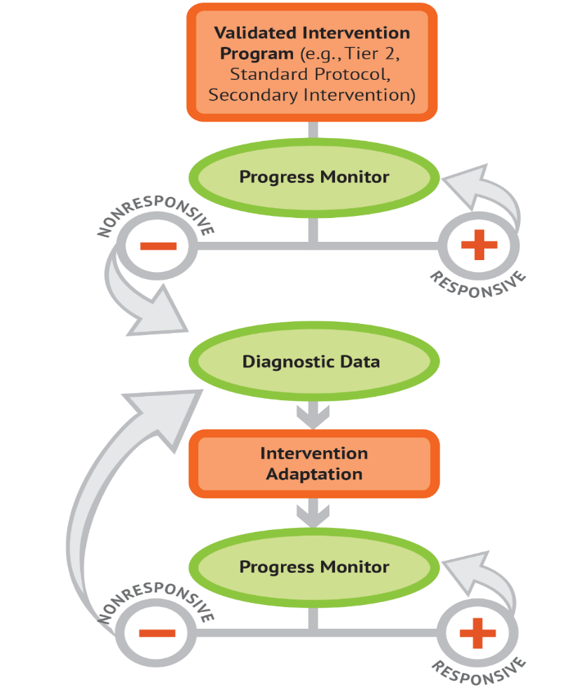
Using the Taxonomy of Intervention Intensity within the DBI Process
Evaluate current interventions
Select a new intervention
Intensify the intervention
Notes:
The seven dimensions of the Taxonomy of Intervention Intensity can help you make informed, systematic decisions in the context of the DBI process. The Taxonomy of Intervention Intensity primarily applies to the orange bubbles (validated intervention program and intervention adaptation) and that will be the focus of the presentation today. The Taxonomy of Intervention Intensity (Fuchs, Fuchs, & Malone, 2017) can be used to select or evaluate an intervention platform used as the validated intervention platform (this selection/evaluation process forms the foundation of the DBI process). The taxonomy also provides guidance on how to intensify, modify, and adapt the intervention during the intervention adaptation step of the DBI process. Essentially, the taxonomy provides explicit guidance in the “orange” areas on the DBI graphic, which allow teachers to progress monitor, collect relevant diagnostic data, progress monitor again, and make data-based decisions to suit students’ needs. Note that the taxonomy and DBI are NOT mutually exclusive—the taxonomy drives the DBI process.

Slide 9
Why start with a standardized, evidence-based program?
When properly aligned to students’ needs, they tend to work—teachers don’t need to “reinvent the wheel.”
They are efficient—teachers can plan instruction for groups rather than individual students.
Many require only a modest amount of training—often, paraeducators can help with delivery.
Often inexpensive (although cost may vary).
Notes:
In both the descriptions for Tier 2 and Tier 3, on the previous slide we discussed the importance of a standardized, evidence-based program. At Tier 2, it provides the intervention we are delivering, and at Tier 3, it is the foundation for our individualization. We know that there are no perfect interventions that will meet the unique needs of students with severe and persistent learning and behavioral needs, but there are a growing number of evidence-based standard protocol interventions that can be used as a starting place. What do we mean by standardized?
uses research-based instructional programs
provided in a specific manner to students
typically includes a step-by-step sequence
So why use evidence-based standard protocol interventions?
Review slide.
While this information provides some guidance on what we want to consider when looking at interventions, additional considerations can help us ensure that we are selecting appropriate interventions for our students or in the case where we may not have the flexibility to select something that is a perfect fit, understanding the limitations.

Slide 10
Can I still implement DBI if I don’t have a standardized, evidence-based program?
I can tell you’re struggling with fractions, Tony, but there aren’t any EBPs for kids in your grade. Maybe check back in a few years?
Notes:
Can I still implement DBI if I don’t have a standardized, evidence-based program? As you can see in the cartoon, the teacher is saying, “I can tell you’re struggling with fractions, Tony, but there aren’t any EBPs for kids in your grade. Maybe check back in a few years?” We know that in reality, we are not able to do this. We have students showing up at school every day and we have some areas that have limited or no EBPs. Our recommendation is to use a standardized, evidence-based program when it is available and consider augmenting current offerings if there are content areas where you have insufficient resources.
As Bryan Cook says in a module from the IRIS Center:
The number of available practices that meet EBP criteria are limited, but…
“Every evidence-based practice at some point started off as a non-evidence-based practice that we didn’t have enough research to tell whether it was evidence based. And so just because something’s not evidenced based, doesn’t necessarily mean that it’s ineffective.”
-Bryan Cook http://iris.peabody.vanderbilt.edu/module/ebp_01/cresource/q1/p01/transcript/#content
During the next section, we will introduce the Taxonomy of Intervention Intensity and discuss how you can use the dimensions to guide your understanding of the intervention you are providing. This applies both to a standard protocol intervention as well as those that you may need to design due to limitations in the availability a program.

Slide 11
Activity: Brainstorm Current Interventions
What interventions are you currently using? (Or what have you used in the past)?
How do you select interventions?
How do you decide how and when to make adaptations to an intervention with a particular student?
Handout
Notes:
Before we jump into the Taxonomy, take a minute to consider the interventions you currently have. Turn to the first handout in your workbook, and, individually or in teams, consider the interventions that you are currently using. Think about those you use regularly as well as the ones that might be on the shelf or in your cabinet. Once you have brainstormed your interventions, a take minute to consider the two additional questions. How do you select interventions, and how do you make adaptations to an intervention with a particular student if he or she is not responding.
Provide participants 5–10 minutes to brainstorm and address the questions.

Slide 12
Elements of Validated Intervention Platforms
Notes:
We are going start by talking about the elements of the validated intervention program. This is our foundation for the DBI process and in many cases may be the intervention we are providing at Tier 2.

Slide 13
Elements of Validated Interventions
Designed Based on Taxonomy of Intervention Intensity
Implemented With Fidelity
What
How
Notes:
As we think about our validated interventions, we need to consider two elements. The first is that they should be designed based on the Taxonomy of Intervention Intensity, and the second is that they should be conducted with fidelity. In other words, they focus on the what we are going to implement (click for animation) and how we will implement it (click for animation).
We will start by focusing on designing the intervention based on the Taxonomy of Intervention Intensity. Often, when we consider our intervention, we focus only on whether a study or two (or sometimes a colleague) has said it is effective or has an evidence base.

Slide 14
Validated Intervention Programs: Components to Consider
Opportunities to respond
Effect size
Evidence-based programs
Group size
Alignment with grade level standards
Explicit instruction and modeling
Frequency and duration of intervention
Concrete learning opportunities
Break tasks into smaller steps
Connection to Tier 1 instruction
It would be helpful if there was a framework to guide our thinking when we are deciding what interventions to use and how to adapt them.
Notes:
In reality, when we think about our validated intervention program, we want to consider a variety of factors (click for animations). The evidence base and effect size are just a couple of the things that we consider (review others as they appear on the slide). To help us guide our understanding, it would be helpful if we had a framework.

Slide 15
Key Considerations When Selecting or Evaluating Validated Interventions for DBI
Does evidence suggest that the intervention is expected to lead to improved outcomes (strength)?
Will the group size, duration, and frequency provide sufficient opportunities to respond (dosage)?
Does the intervention match to the student’s identified needs (alignment)?
Does it assist the student in generalizing the learned skills to general education or other tasks (attention to transfer)?
Does the intervention include elements of explicit instruction (comprehensiveness)?
Does the student have opportunities to develop the behavior skills needed to be successful (behavioral support)? Can the intervention be easily integrated into academic instruction (academic support)?
Can the intervention be individualized with a data-based process to meet student needs (individualization)?
Handout
Notes:
In other words, when we look at our validated intervention, it would be helpful to have a set of guiding questions of areas that we need to consider. On the slide, you see seven questions, which map to the seven dimensions of the Taxonomy of Intervention Intensity that we reviewed earlier. These seven dimensions were initially proposed in a 2017 article in TEACHING Exceptional Children, by Lynn and Doug Fuchs and Amelia Malone, to help educators consider the strengths and weaknesses of their intervention and guide intensification. Our understanding about these dimensions and the application of the dimensions to behavior was expanded upon through the work of the National Center on Intensive Intervention (NCII) and its technical work group.
But what do we need to consider when thinking about these dimensions?

Slide 16
Strength
How well does the intervention work for students with intensive intervention needs (students below the 20th percentile)?
Considerations:
Has this intervention been evaluated empirically using scientifically sound, rigorous methodology?
What were the effects of the study?
For group design studies: What is the reported standardized mean effect size for this intervention, and what does it look like for students with intensive needs (<20th percentile)?
For single-case design studies: Is it identified as a promising or effective program by a reputable source (e.g., NCII Tools Charts, WWC)?
Notes:
The first dimension is strength. As we discussed earlier, when we think about an evidence-based intervention, we often focus on the strength dimension. This dimension focuses on telling us how well the intervention works and whether we can expect to see results. Most interventions are validated for use with Tier 2 students (students <50th percentile), but to understand how an intervention would work for a student with more intensive needs, when possible we want to look for results reported for students <20th percentile. It is important to note that this disaggregated information is not always available for review.
When we consider strength, we are look at two things.
First, was the intervention evaluated empirically using scientifically sound, rigorous methodology? In other words, can we trust the outcomes of the study? These results must be assessed through the lens of high-quality research design. A study could be group design (more often seen for academic interventions) or single-subject design (more often seen for behavioral interventions).
Second, what were the effects of the study? When we look for the effects of the study for group-design studies, we are typically looking at the effect size, which provides a method for quantifying the strength of the intervention. If the study was single-subject design, look for performance data for students closest to your target student. Did he or she meet their benchmarks? Single-case studies are more typical for behavior.
Note: Based on the audience you may determine to further simplify or to enhance this section. Strength and understanding of effect sizes or the results of single-case studies is often challenging for educators who do not have a background with this information. The goal of describing this dimension is to help provide some initial guidance without giving too much information too soon. Additional modules in the series (focused on mathematics, reading, and behavior) provide deeper reviews of how to analyze strength and consideration for the content specific domains.

Slide 17
What to Look for When Examining the Published Evidence Base
Type/Source
Is the source reputable? Can it be trusted?
Population
Were the students included in the study similar to our students?
Desired Outcomes
Were the outcomes of interest relevant to our students?
Effect Size (for group design studies)
Does the evidence suggest that the intervention can produce the result we expect?
Notes:
To ensure that a validated intervention program is evidence-based, teams should convene to review the existing research on that particular program and the quality of the available research.
You can focus your efforts by looking at these areas when examining the evidence base:
First, consider the type of information and source from which you are gathering this information. Is the information coming from the intervention vendor or a reputable website? Also ask yourself, what type of evidence is available? Did the study involve experimental design, where the intervention group was compared to an equivalent control group? The better the study, the more we can trust the outcome data.
Next, consider the population. For which populations has the program been researched and found effective? Is the sample described? Is the population similar to or representative of your student population? Are there different effects for different population groups? This area might be especially important when we are thinking about students with intensive needs. As mentioned on the previous slide, often we find studies that look at the effectiveness of the intervention for students below the 50th percentile, but if we are focused on students with more intensive needs, we might want to see if there is evidence available that more closely matches our population, or students below the 20th percentile. In addition, for English learners you might want to consider whether there is evidence of effectiveness for students learning English.
It is important to consider whether or not the desired outcomes assessed in a study are relevant to the outcomes you hope to achieve with an intervention and in the expected direction.
Finally, consider the effects. Were the effects of the study large enough to be meaningful? We will provide a little more context about effect size on the following slides. As part of our review of effect sizes we may also want to consider whether the intervention has been replicated (e.g., has more than one study illustrated similar findings or results). When we analyze findings, we may need to consider the overarching body of evidence.

Slide 18
What’s an effect size?
A quantitative way to look at the strength of an intervention
Rule of thumb:
Strength | Effect Size
Small (minimum) | 0.25 to 0.34
Moderate | 0.35 to 0.49
Strong | 0.50 or larger
Notes:
Researchers will usually use two ways of describing the “success” or “efficacy” of their intervention. The first way is “statistical significance.” If something is statistically significant, it means that the likelihood of finding a particular result by chance is less than 5%. In other words, that it is highly unlikely that the results of the study are a fluke. Significance is important to consider because it helps guard against the costly mistake of labeling something as effective when it is not.
Statistical significance tells us if something is effective—it can’t tell us how effective that thing is. That’s where effect size comes in. An effect size is a standardized measure of the strength of an intervention. assessment. To conceptualize what an effect size is, consider an assessment that has an average score of 100 and standard deviation of 10 (meaning on average, scores between students vary by 10 points). An effect size of 1.0 would mean that intervention students scored, on average, 10 points higher on the end-of-intervention assessment.
Although a number of factors may impact the effect size, a general rule of thumb for educational effect sizes for academic outcomes is provided (review slide).
NOTE: Sawilowsky, S. S. (2009). New effect size rules of thumb. Journal of Modern Applied Statistical Methods, 8(2), 597 – 599. Available at: http://digitalcommons.wayne.edu/coe_tbf/4 revised the interpretation of effect sizes based on a review of the research and found d (.01) = very small, d (.2) = small, d (.5) = medium, d (.8) = large, d (1.2) = very large, and d (2.0) = huge.

Slide 19
Understanding Effect Size
Student Outcome | Early Elementary K–3 |  | Upper Grades 4–9
 | Mean ES | No. of Effects | Mean ES | No. of Effects
Comprehension | .46 | 25 | .09 | 37
Reading Fluency | .34 | 11 | .12 | 8
Word Reading | .56 | 53 | .20 | 22
Spelling | .40 | 24 | .20 | 5
Note: ES = effect size
(Wanzek et al., 2013)
Notes:
Effect sizes need to be interpreted in context (Hill, Bloom, Black, & Lipsey, 2008). Review the table.
As you can see in the table, a number of factors can impact the expected effect sizes, such as age, skill area, type of student, and type of assessments. For example, interventions for younger students that involve researcher-created measures and that focus on word reading would be expected to have higher effect sizes. As students get older, the expected effect sizes tend to get smaller as other variables come into play. Similarly, interventions that have been tested using standardized measures and those that focus on comprehension would also be expected to yield smaller effects.

Slide 20
How important are effect sizes?
Effect sizes are not always available
When available effect sizes must be interpreted with caution
Effect sizes can be impacted by:
Study conditions
Content studied
Type of student
Notes:
Depending on the study design, effect sizes may not be available. This is often the case with behavioral interventions that use single case design. Even when they are available, effect sizes must be interpreted with caution because effect sizes can be influenced by a number of factors including study conditions, the content studied, and the type of student. These effects were usually obtained under high levels of fidelity that are often difficult to achieve in authentic classroom settings. In addition, like on the previous slide, the effects were obtained for a specific group of students under controlled circumstances, which may or may not be similar to our student population or context. In other words, the effect size is one piece of information we can use to understand the intervention’s potential effect.

Slide 21
So how do we interpret effect sizes and strength?
Effect sizes, when available, provide a starting point for considering the strength of an intervention.
Information about the strength of the intervention can also be gathered based on information from reputable sources (e.g., NCII Tools Charts, WWC)
Effect sizes should be used with other dimensions of the taxonomy for the individual student or groups of students in a particular context.
Notes:
While effect sizes provide a starting point for considering the effectiveness of an intervention, they must be interpreted with caution. We can use information from reputable sources to supplement what we know from an effect size or provide us with information if an effect size is not available and it is also important to remember that the effect size is used along with information about the other dimensions of the taxonomy to help us determine whether the intervention is a good match for the individual student or group of students in a particular context.

Slide 22
Resources for Evaluating Evidence Base of Practices and Standardized Interventions
NCII Interventions Tools Chart
http://www.intensiveintervention.org/chart/instructional-intervention-tools
What Works Clearinghouse
http://ies.ed.gov/ncee/ wwc/findwhatworks.aspx
Best Evidence Encyclopedia
http://www.bestevidence.org/
Handout
Notes:
We will use these sites for an activity later in the session. Model how to navigate at least the first two resources. If you are unable to model the site during the presentation, review the content of the resources on the next couple of slides. Participants may also wish to locate the handout, which outlines the features of the resources modeled on this slide.
After modeling the resources, ask participants to share out at their tables, with a partner, or as a whole group, using prompts such as the following:
Have you accessed any of these resources to identify or evaluate your interventions?
If you haven’t accessed any of these resources, identify one that you will access and describe how you might use it.
Some notes:
On the tools chart—you will sometimes see a small u—this means that the researchers did not adjust for pretest means, and the information was not available for NCII to provide this correction.
On the tools chart—you will sometimes see a small star—that means the effect was significantly significant

Slide 23
Dosage
For academics, we consider the number of opportunities that a student must respond and receive corrective feedback.
For behavior, we consider the number of opportunities a student must (a) respond (i.e., practice/demonstrate skill), (b) receive positive feedback (e.g., praise, tokens, points), (c) exchange for backup reinforcers, and (d) receive corrective feedback.
Notes:
The second dimension is dosage.
Review slide.

Slide 24
Variables That Impact Dosage
Number of sessions (frequency of sessions)
Duration of sessions
Student-teacher ratio
Number of practice problems provided
Not just more
but how it is used
Notes:
When we think about dosage, we can consider a number of areas. We might think about the number of sessions (e.g., how many sessions per week the student received the intervention), the duration or length of the session, the student-teacher ratio, and the number of practice problems provided.
Time is an important consideration because it allows more instruction to take place, provides more practice with feedback because the teacher is present, and increases students’ engaged learning time. All of these accelerate student learning, particularly when they are combined with other dimensions that we will discuss as part of the Taxonomy. We know that students with more intensive needs often need many more practice opportunities. Gersten and colleagues (2008) estimated that students with more intensive needs need 10–30 more practice opportunities than their peers to learn new information. (Click for animation) Although time plays a major factor in dosage, note that it is important to not just focus on time, but on how that time is used. That is why we define dosage as opportunities to respond.
There is also no one-size-fits-all amount of time for intensive intervention. Instead, we must consider:
How far the student’s achievement is below grade level
The length and frequency of the previous interventions
The complexity of the learning tasks (e.g., letter naming in kindergarten is less cognitively complex than comprehension of a third-grade science textbook).
Student stamina and attention span
To maintain attention and engagement with younger students, staff may consider two sessions per day. Evidence suggests that students with intensive needs may benefit from 60−120 minutes of intervention per day. However, this time may be broken up into several sessions throughout the day (Vaughn et al., 2012).
A note of caution: If an intervention has been validated 1:1 or in pairs—but you intend to use it with a much larger group—you should not expect the same effect size or strength. Decreasing the dosage is likely to decrease the efficacy of an intervention just like any medicine or treatment. If you aren’t going to take something as prescribed—you can’t expect to reap the same benefits.

Slide 25
Alignment
A hammer is an effective tool, but not with a screw…
Notes:
The third dimension is alignment. As we see on this slide, a hammer is an effective tool, but not with a screw. It is important that we consider the alignment of the intervention to the needs of the student or group of students.

Slide 26
Alignment: Academics
To what extent does the intervention
address the full set of a specific student’s academic deficits,
not address skills the student has already mastered, and
incorporate a focus on grade level standards?
Notes:
For academics we want to consider: review slide.
Although alignment is important for all students, it is especially important to consider for students with intensive needs or those who need DBI. As noted previously, these students often need substantially more practice opportunities than their peers. If the intervention is using some of the time to cover skills they have already mastered or fails to focus on the foundational skills where they may have challenges, we will continue to perpetuate or even widen the gap and make it challenging for them to access their core instruction.
Note: In Assisting Students Struggling with Reading: Response to Intervention (RtI) and Multi-Tier Intervention in the Primary Grades: A Practice Guide from IES, under recommendation 3, the panelists suggest “In choosing an intervention program for tier 2, administrators should look for programs—either commercially available intervention curricula, commercially developed supplemental curricula, or intervention programs—that are compatible with their school’s core reading program and that provide intensive small group instruction in three to four foundational skills. Ideally, the intervention program has demonstrated its effectiveness through independent evaluations using rigorous experimental or quasi-experimental designs…. It is the opinion of the panel that an intervention curriculum that covers five to six skills per day may not provide the intensity necessary to improve reading achievement.” See more in Assisting Students Struggling with Reading: Response to Intervention (RtI) and Multi-Tier Intervention in the Primary Grades. https://ies.ed.gov/ncee/wwc/docs/practiceguide/rti_reading_pg_021809.pdf

Slide 27
Alignment: Behavior
How well the program
addresses school-wide expectations,
addresses classroom/teacher expectations,
addresses student’s skill deficits,
matches rewards to student’s preferences and/or function of problem behavior, and
does not address extraneous skills.
Notes:
When we consider alignment for behavior, we consider how well the program:
Review slide.

Slide 28
Attention to Transfer Academics
To what extent is an intervention systematically designed to
help students transfer skills they learn to other formats and contexts,
help students realize the connection between mastered and related skills, and
demonstrate efficacy on standardized measures or measures of generalization?
“generalization”
Notes:
The fourth dimension is attention to transfer. We define transfer as how skills taught in an intervention make their way into the classroom and students’ independent practice. In other words, we might think about how well students are able to generalize the skills from an intervention into their core instruction. Many of us have probably experienced a time where a student may demonstrate mastery of taught concepts in the intervention context but fails to demonstrate mastered skills when encountering even minor differences.
Students with and at risk for learning disabilities tend to struggle with generalization (recognizing that the skills and strategies they’ve learned can be applied in other contexts). In fact, this is one of the key components of an educational disability diagnosis (inability to learn from observational learning and independently apply taught skills). When we are thinking about attention to transfer within a specific intervention, we want to consider whether the intervention explicitly teaches students how to apply the skills taught during the intervention in other contexts and makes connections between mastered and related skills. We also might consider how well the outcomes for the intervention generalize to standardized measures or other measures of global skills.
An intervention is more intensive if it provides...
Opportunities for students to develop metacognition and self-regulation to apply strategies independently (look for embedded instruction where students monitor their strategy use, learn acronyms, use checklists, evaluate their work, set goals, make plans etc.)
Provides a variety of opportunities to practice that explicitly vary the context (different topics, genres, etc.)
Provides cumulative systematic review
An intervention is less intense if it
Provides nstruction only in the target skills without review
Does not vary the context in any way
Does not include self-regulation/metacognition practice or discussion
Some notes:
Teaching students with disabilities to transfer skills is VERY difficult—even interventions with a large amount of this built in, it may be insufficient
Can be adjusted during setup or implementation based on the needs of students
In the process of DBI, you will likely need to continually evaluate student generalization and transfer and make instructional adjustments

Slide 29
Attention to Transfer: Behavior
The extent to which an intervention emphasizes how and when a student uses skills across contexts/situations and includes opportunities to practice using skills across contexts/situations.
The program reinforces the use of skills across contexts/situations.
“generalization”
Notes:
For behavior, we are also focused on generalization of skills. We consider: review slide.

Slide 30
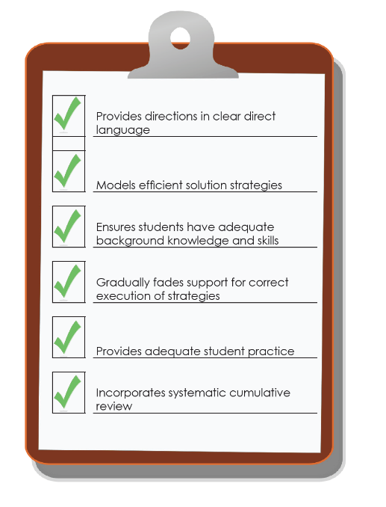
Comprehensiveness: Academics
Reflects the number of explicit instruction principles that the intervention incorporates. Examples:
Provides explanations in simple, direct language.
Models efficient strategies (e.g., decoding unknown words) instead of expecting students to discover strategies on their own.
Ensures that students have the necessary background knowledge and skills to succeed with these strategies.
Gradually fades support for students’ correct execution of these strategies.
Provides practice so that students use the strategies to generate many correct responses.
Incorporates systematic cumulative review.
Notes:
The fifth dimension is comprehensiveness. When we use the term “comprehensiveness,” we are asking you to think about the extent to which an intervention uses effective principles of explicit instruction.
Review slide.

Slide 31
Comprehensiveness = Explicit Instruction
Explicit instruction is “a way of teaching where the teacher selects an important objective, models the skills being taught, and provides scaffolded practice to help a student achieve mastery” (Kearns, 2018).
Explicit instruction has long been the gold standard when intervening with students with and at risk for learning disabilities (Ciullo, Sabrina Lo, Wanzek, & Reed, 2016; Scammacca, Roberts, Vaughn, & Stuebing, 2015).
Notes:
Explicit instruction is “a way of teaching where the teacher selects an important objective, models the skills being taught, and provides scaffolded practice to help a student achieve mastery” (Kearns, 2018). When working with students in need of intensive intervention (students with and at risk for significant academic deficits and learning disabilities), explicit instruction has been shown, time and time again, to be the most effective method of intervening.

Slide 32
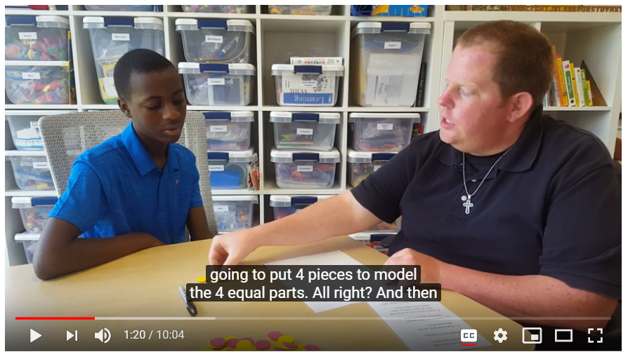
Video Example
Handout
View video: https://youtu.be/IJMlrvSkPE8
Notes:
Let’s take a quick look at this video. See if you can identify some of the explicit instruction principles discussed on slide 28 and included in the handout in your workbook.
Following the video ask participants to share out what they saw.

Slide 33
Comprehensiveness: Behavior
The extent to which the intervention includes a plan for
teaching appropriate behavior;
adjusting antecedent conditions to prevent problem behavior;
reinforcing appropriate behavior;
minimizing reinforcement for problem behavior;
fading supports;
monitoring fidelity;
working in conjunction with related services; and
communicating with parents.
Notes:
In behavior, we consider comprehensiveness the extent to which the intervention includes a plan for: Review slide.

Slide 34
Learn More About Explicit Instruction
View module: https://intensiveintervention.org/intensive-intervention-features-explicit-instruction
View module: https://intensiveintervention.org/instructional-delivery-math-course
Notes:
NCII has developed a number of resources focused on explicit instruction. Specifically, there is a four course module series that is part of the Features of Explicit Instruction Course Content. This course covers explicit instruction in detail and includes video lectures, video examples, activities, coaching materials, and more. There is also a segment of the Intensive Intervention in Mathematics Course Content that focuses on explicit instruction. That can be seen in Module 4 on instructional delivery.
To learn more about the empirical evidence you might wish to check out the two large metanalyses (cited on the previous slide) or check out the summary here: https://intensiveintervention.org/sites/default/files/Explicit_Webinar_Cited_Articles.pdf.

Slide 35
Behavioral Support in Academic Interventions
Behavioral support refers to the extent to which interventions incorporate
methods to promote self-regulation and executive function and
behavioral principles to minimize non-productive behavior.
Notes:
Behavior and academics go hand in hand. The most intense academic interventions incorporate behavioral support. Why? Because students experiencing academic challenges and failure often exhibit inappropriate or non-productive behavior. Students experiencing behavior or emotional challenges often struggle academically. It is common to work with students who have comorbid learning and behavior disabilities. The most comprehensive programs address both academics and behavior!
As a result, the sixth dimension in the Taxonomy of Intervention Intensity for academic interventions is behavioral support. This refers to the extent to which academic interventions are structured to promote self-regulation and executive functioning as a means of encouraging students with a history of academic failure to persevere with challenging academic content and supporting students to develop a mindset that involves perseverance, hard work, and high standards. It also means the program should incorporate behavioral principles that minimize non-compliant or disruptive behavior.

Slide 36
Caution: Treating underlying neurological or processing disorders separate from academic instruction is not supported by research.
Notes:
Review slide.
“Although some students with significant learning difficulties have underlying neurological or information-processing disorders, research does not support the notion that practitioners can identify these disorders (e.g., auditory processing disorders) and then treat them in isolation (e.g., training a child in auditory processing apart from his or her academic learning; Lyon, 1985; Mann, 1979),” (Vaughn et al., 2012, p. 10).
Intensive intervention should be supported by the best available research about what is likely to work for students. Practices that do not have research to support their use will likely be a waste of valuable instructional time.
BUT:
Cognitive processes are important and relevant for learning.
Problems with executive function and self-regulation negatively affect student learning.
Interventions should combine practices that reduce the impact of processing deficits with academic content, not treat them in isolation.
In other words, research that integrates understanding of executive functions with academic instruction has yielded the most positive benefits for students with intensive needs. That is, interventions need not prioritize cognitive processes before academic learning can occur. Rather, interventions should support both issues concurrently.

Slide 37
Self-Regulation and Executive Function
Self-Regulation
The ability to manage your emotions and behavior in accordance with the demands of the situation
Executive Function
A set of processes that all have to do with managing oneself and one's resources in order to achieve a goal
These make up the mental processes that enable us to plan, focus attention, remember instructions, and juggle multiple tasks successfully.
Notes:
Under behavior support for academic interventions, we consider the extent that the intervention incorporates self-regulation and executive function. These make up the mental processes that enable us to plan, focus attention, remember instructions, and juggle multiple tasks successfully. Self-regulation is the ability to manage your emotions and behavior in accordance with the demands of the situation and includes—
Planning and setting goals for learning
Monitoring learning and progress toward goals
Regulation of language and memory to support learning (e.g., self-talk, use of strategies)
Attention
Executive function is a set of processes that have to do with managing oneself and one’s resources in order to achieve a goal.
Why does poor self-regulation and executive function impede academic learning? Because students with deficits in these areas demonstrate minimal use of self-directed strategies—they need to be explicitly taught. Students often exhibit behavior problems because of inattention and poor impulse control. Their inattention makes intake of new information difficult, and their lack of monitoring of learning makes it difficult for students to be aware of what they do and do not know, and when they should request help.

Slide 38
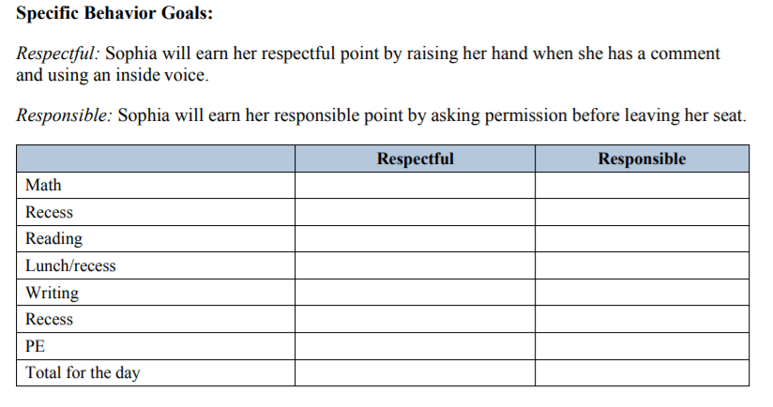
Strategies to Develop Perseverance
Behavior strategies available at https://intensiveintervention.org/intervention-resources/behavior-strategies-support-intensifying-interventions
Appropriate level of challenge
Behavior contracts
Points/rewards based on effort
Use of a timer to develop stamina
Goal setting
Notes:
Students who are experiencing academic challenges must learn to persist despite difficulty and failure. Most students in need of intensive intervention have already experienced years of failure. Many of these students will have developed “learned helplessness” and task avoidance (for good reason).
An intensive intervention platform should build in some of these strategies. In addition to the scaffolded support provided in the intervention, students should be able to accomplish the instructional objectives. If the instructional objectives and tasks are the right level of challenge, students are able to experience success and build both motivation and persistence.
Some examples of strategies that help develop perseverance include review slide.
Although some interventions may incorporate these strategies, you may also have these strategies already in place in your classroom, or you can find some examples of strategies on the NCII website that might help you to supplement your intervention.

Slide 39
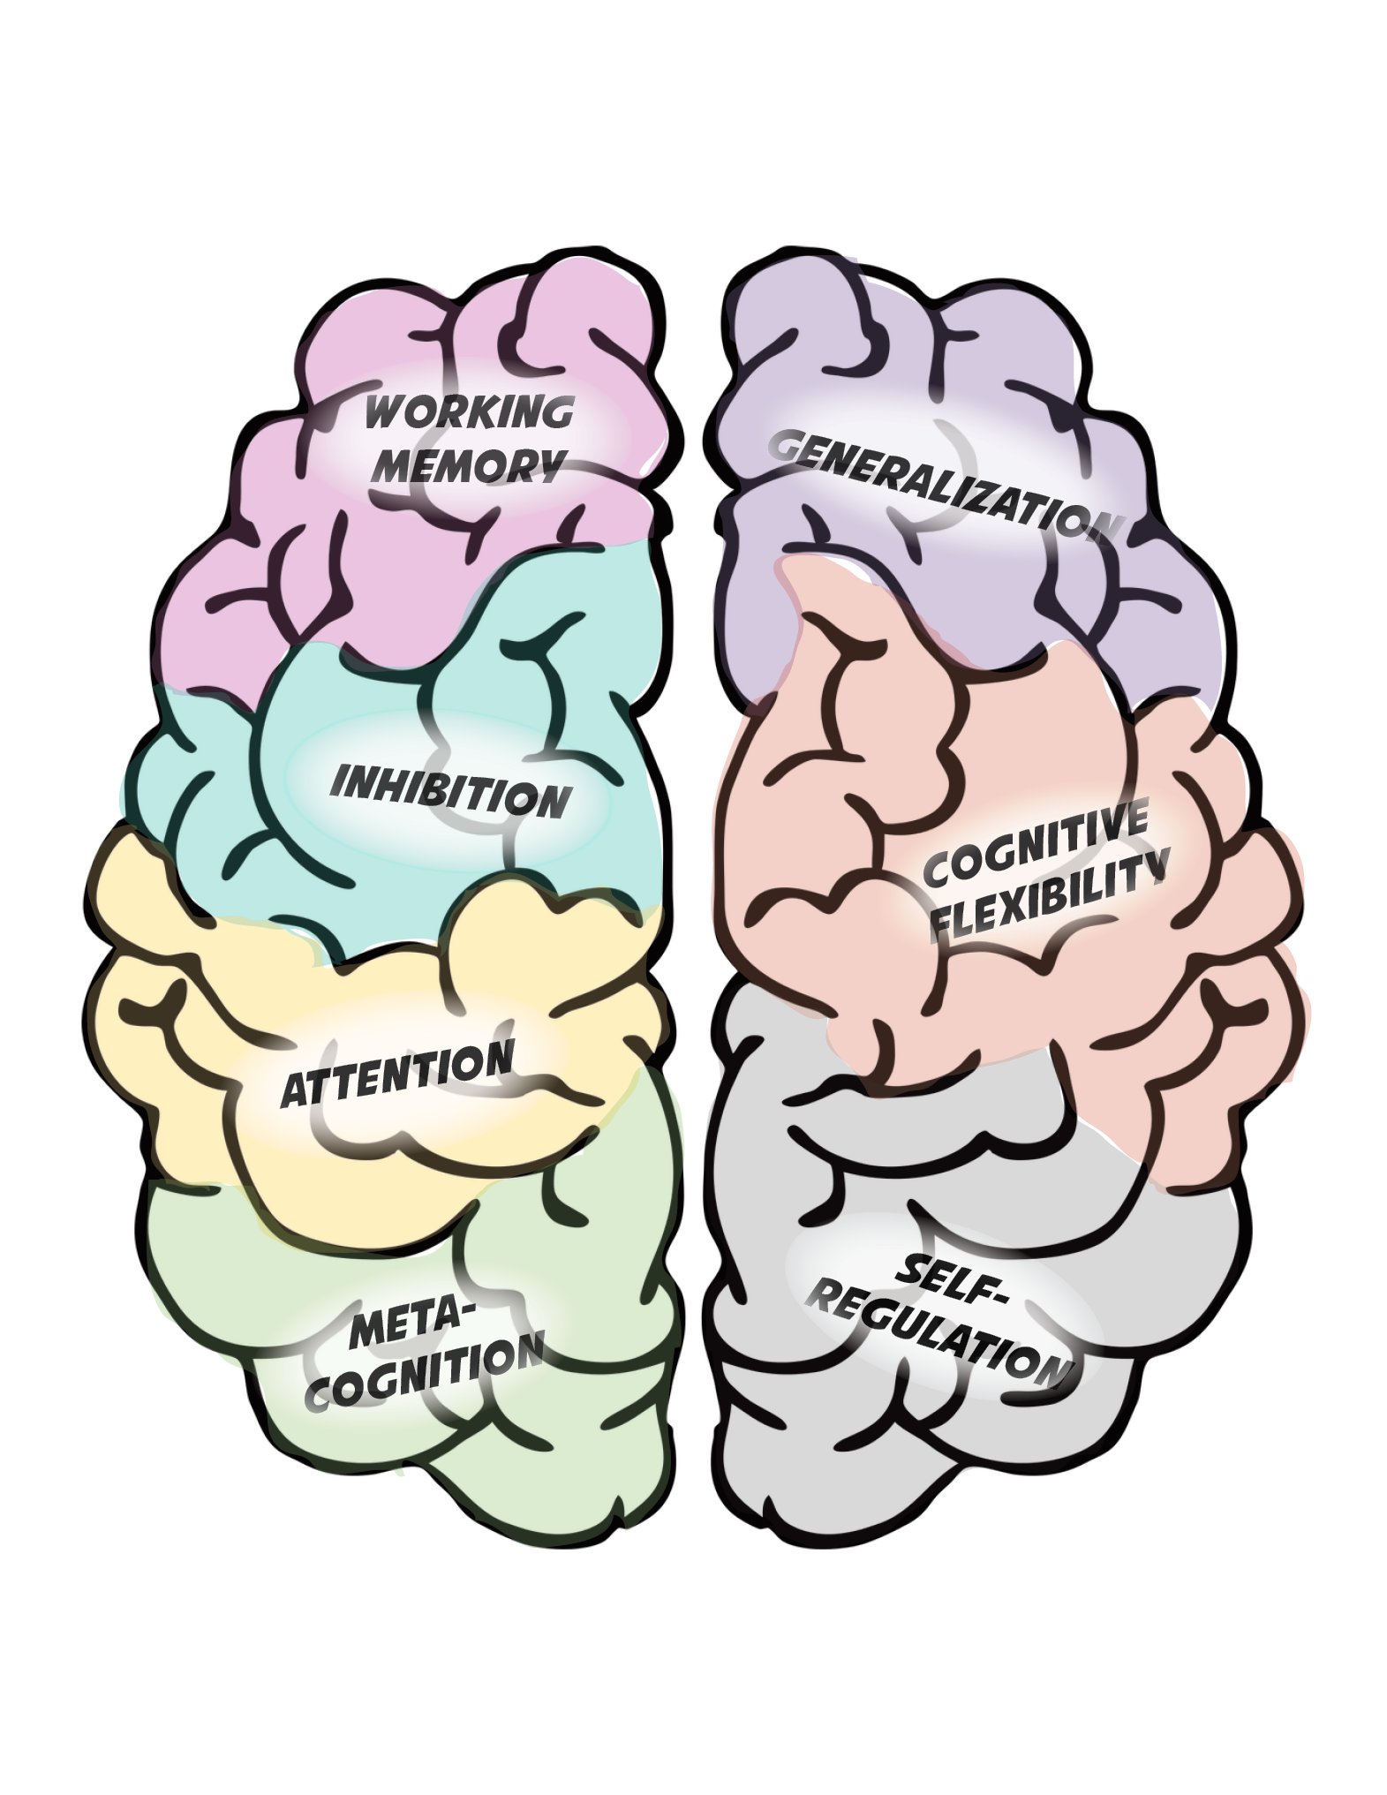
Methods to Promote Executive Function
Self-monitoring/self-evaluation instruction
“Think alouds” and strategy instruction to support metacognition
Checklists
Point systems
Training working memory/inhibition*
Transfer instruction
Games, media, engaging materials
Notes:
There are a variety of strategies you might find to promote executive function. The strategies listed on this slide are just a few. This is a rapidly developing research area.
*Note: Direct training of working memory/inhibition/memory has not yet been proven to improve academic performance, although research is still being done. It is possible that it could be a successful approach if researchers could identify a better way to do it.

Slide 40
Behavioral Principles That Minimize Non-Productive Behavior
Clear rules/expectations
Behavior contracts
Reinforcement systems
Checklists
Timers
Time management strategies
Notes:
These are just a few of the strategies that can minimize non-productive behavior.
Setting clear expectations for behavior is important—You might have such expectations or rules in place, but it’s important to review these procedures regularly within an intervention setting—especially when working with students with challenging behavior.
These clear expectations can be supported by having students sign behavior contacts.
Reinforcement systems can help to promote positive behavior, boost engagement, and minimize negative behaviors.
Checklists can help students to know what to expect.
Timers and strong time management procedures can ensure that there are few pauses in the execution of the lessons and that students stay on task and focused throughout.
You may have strong behavior management systems in place, or you may be working with a student using a very specific behavior plan. You should continue to use the system that works for you or that student. An intervention that sufficiently supports behavior is one that provides the raw material for good behavior—even if it’s the canvas on which to place your existing system.
You can’t expect a student to benefit from an academic behavior if their behavior prevents them from participating fully. It is essential to consider behavior when selecting and adjusting intervention platforms.

Slide 41
Learn More About Behavioral Supports
Notes:
NCII has recently released a set of course content focused on behavior support for intensive intervention. This resource includes an extensive amount of content to support educators in understanding how to support students in the classroom to maximize instruction. The course has eight modules that cover behavioral theory, strategies for supporting students’ behavioral needs, monitoring student progress and making decisions, and intensifying behavioral supports. The course content can be found on the NCII website at https://intensiveintervention.org/intensive-intervention-behavior-course.

Slide 42
Academic Support for Behavior Intervention
Are behavioral interventions easily integrated within the context of academic instruction?
Does it complement rather than supplant the academic focus?
Does it include procedures for reinforcing responses related to academic achievement (e.g., engagement, work completion)?
Notes:
As noted before, it is also important to consider how academics fit within behavioral supports. For the behavioral interventions, the sixth dimension in the Taxonomy of Intervention Intensity is academic support. For this we consider:
Review slide.

Slide 43
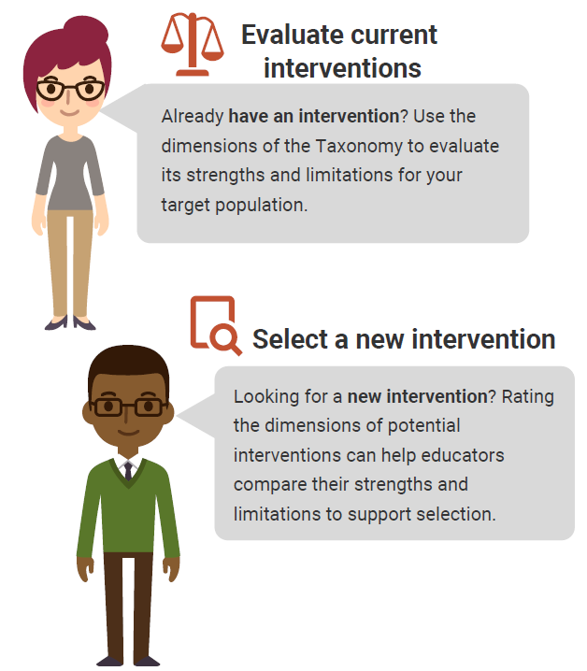
Using the Taxonomy to Find the Best Intervention
There are NO perfect interventions.
BUT
Using the Taxonomy of Intervention Intensity can help you understand the strengths and weaknesses of your current intervention and support your selection of a new intervention.
Notes:
There is no perfect intervention that will work for every student. Educators can use the dimensions of the taxonomy to learn about the strengths and weaknesses of their current intervention and guide the selection process for new interventions.
Rating an intervention across the dimensions can help us to quantify our assessment of the intervention’s strengths and weaknesses and document places where we may need to supplement the intervention. In addition, it can help us to compare interventions that we might be using or selecting to identifying one that might be a better fit for a student.

Slide 44
Rating an Intervention
The goal of rating an intervention is to provide a clear picture of the intervention:
There is no hard and fast rule for ratings.
Some dimensions will be easier to rate than others.
Ratings can help guide intensification.
0 | 1 | 2 | 3
Fails to Address Standard | Addresses Standard Minimally | Addresses Standard Moderately | Addresses Standard Well
Notes:
The goal of rating the intervention is to get a clear picture of the intervention. By rating each of these dimensions using a simple 0–3 scale, we can document how well the intervention meets the dimension. As you can see, a 0 would indicate that the intervention fails to address the dimension well, 1 would indicate that it minimally addresses the dimension, a 2 that it moderately addresses the dimension, and a 3 that it addresses the dimension very well. There is no exact science for this rating scale, and some of the dimensions are easier to rate than others. For the taxonomy focused on academic interventions, a rubric has been developed to guide the rating process. For behavioral interventions, a rating form was developed to help guide decisions.
In addition to helping us to understand the strengths and weaknesses of the intervention, the ratings can also help us to see where we may need to intensify or adjust the intervention in the future if the student or groups of students do not respond.

Slide 45
Activity, Part 1. Assessing Quality of the Validated Intervention Platform
In groups of two to three, select one academic intervention for the group from the list brainstormed earlier that is also included on one of the three websites described earlier.
Review the handout definitions for each dimension.
3. Rate the intervention as designed for each dimension (0–3).
4. Record your responses in the third column.
Handout
Notes:
In this activity, we are going to ask you to consider one of the academic interventions you brainstormed earlier and as a small group to do a brief rating of the intervention. You can use one of the three websites that we discussed to identify the strength and your knowledge of the intervention to judge dosage, alignment, attention to transfer, comprehensiveness, and behavioral support.
The handout in your workbook gives a place for you to note your rating and a brief review of what to consider for each dimension.
Provide groups 10–20 minutes to complete Part 1. If time, groups can review a second intervention.
Have teams share out any takeaways from the activity. Note that this activity is intended to introduce teams to the idea of reviewing an intervention. The other modules focused on reading, mathematics, and behavior provide additional guidance on rating for specific content areas.

Slide 46
Individualization
Note: This dimension is not rated.
A validated, data-based process for individualizing intervention, in which the special educator or interventionist systematically adjusts the intervention over time, in response to ongoing progress-monitoring data, to address the student’s complex learning needs.
Notes:
The individualization dimension is the final dimension of the Taxonomy. Review slide. This dimension is not one that we rate as we consider the initial validated platform. In fact, the individualization dimension becomes the ongoing DBI process for intensifying and individualizing the intervention based on data. While we don’t rate the individualization dimension when we consider the validated intervention program, we may want to consider whether the intervention is something that we can intensify and individualize. Some interventions, especially those that are computer-based programs, may be difficult to intensify and individualize, so we may want to take that into account when thinking about our intervention. We will talk more about individualization as we consider what to do when the student or group of students do not respond to the intervention.

Slide 47
Have we answered any questions?
What Does It Help Me KNOW? | What More Do I WANT to Know? | How Will I LEARN More?
Handout
Notes:
Flip back to the first handout where we did the revised KWL. Look at the questions you had in the second column. Are there any that have been answered? Do you have any new ones?
Discuss as a group.
This is typically a good place to break for lunch depending on how long you spent on defining the dimensions and the activities.

Slide 48
Elements of Validated Interventions
Designed Based on Taxonomy of Intervention Intensity
Implemented With Fidelity
Notes:
In the previous section, we focused on designing our validated intervention program using the dimensions of the taxonomy. In this section, we are going to focus on considerations for implementing the intervention with fidelity.

Slide 49
Why is fidelity important?
Ensures that instruction has been implemented as intended.
Allows us to link student outcomes to instruction.
Helps in the determination of intervention effectiveness and instructional decision making.
Positive student outcomes depend on level of fidelity of intervention implementation.
(Pierangelo & Giuliani, 2008)
Notes:
Why is fidelity important? If teachers aren’t consistent and accurate in delivering the validated intervention, they aren’t able to confidently explain a student's lack of response to an intervention. Did the student make insufficient progress because he or she required more intensive intervention? Or, did the student make insufficient progress because the validated intervention wasn’t delivered with fidelity? Without practicing consistency and integrity in intervention delivery, we can't link, or attribute, student outcomes to the instruction provided. Fidelity allows us to evaluate the effectiveness of the validated intervention and tells us when a student may require a more intensive level of intervention.
Furthermore, Pierangelo and Giuliani (2008) concluded that positive student outcomes are particularly dependent on aspects of fidelity within the framework of a tiered support system. One of these aspects is fidelity of implementation at the classroom or teacher level.

Slide 50
Five Elements of Fidelity
Student Engagement: How engaged and involved are the students in this intervention or activity?
Adherence: How well do we stick to the plan, curriculum, or assessment?
Program Specificity: How well is the intervention defined and different from other interventions?
Exposure/Duration: How often does a student receive an intervention? How long does an intervention last?
Handout
Quality of Delivery: How well is the intervention, assessment, or instruction delivered? Do you use good teaching practices?
(Dane & Schneider, 1998; Gresham et al., 1993; O’Donnell, 2008)
Notes:
This graphic provides one example of a way to think about fidelity and includes the elements of adherence, exposure, quality of delivery, program specificity, and student engagement.
Schools should have procedures in place to monitor the fidelity of their implementation of interventions. Although these don’t have to be formal, it is important to consider whether or not they’re implementing programs the way that they are intended to be delivered. In the midst of all of the responsibilities of educators, small checks can make a big difference in keeping services for students on track.
Note: The notes on each element on fidelity are animated to pop up with each click. Click ahead each time you discuss a new element of fidelity, and click again to close that element.
1. (Click) When we discuss adherence we are focused on how well we stick to the plan/curriculum/assessment, or implementing the plan/curriculum/assessment as it was intended to be implemented based on research. For a secondary intervention, this may mean how well teachers implement all pieces of an intervention in the way they were intended to be implemented. This doesn’t necessarily mean that teachers should follow a script word for word, but that covering certain content with appropriate pacing and relevant language and techniques are important. (Click)
2. (Click) Duration/Exposure refers to how often a student receives an intervention and how long an intervention lasts. When thinking about fidelity, we are considering whether the exposure/duration being used with a student matches the recommendation by the author/publisher of the curriculum.
In the case of secondary interventions, developers and researchers typically specify the required exposure/duration that is needed for the intervention to be effective for most students. If the intervention developer calls for the intervention 3 days a week for 45 minutes each day, is the student receiving this dosage? (Click)
3. (Click) Not only is it important to adhere to the plan/curriculum/assessment, but it is also important to look at the quality of delivery. This refers to how well the intervention, assessment, or instruction is delivered. For example, do you use good teaching practices? Quality instructional delivery also means that teachers are engaged in what they’re teaching and are animated in their delivery, not simply reading from a script. Providing teachers with constructive feedback on their instructional delivery is one way to improve the quality of delivery for secondary interventions. (Click)
4. (Click) Another component is program specificity, or how well the intervention is defined and how different it is from other interventions. Having clearly defined interventions/assessments allows teachers to more easily adhere to the program as defined. Is the intervention a good match for the student’s needs? Or does every low-level reader get the same intervention? (Click)
5. (Click) Just as quality of delivery is critical, it also is important to focus on student engagement, or how engaged and involved the students are in the intervention or activity. Following a prescribed program alone is often not enough. Consider whether or not competing behaviors make it difficult for students to take part in the intervention as designed. During the delivery of secondary interventions, teachers may need to use behavior management strategies to manage student behaviors, including providing choice, adding elements of competition, and offering frequent opportunities to respond. (Click)
Note: Throughout discussions of fidelity, it is important to ensure that teachers believe that they work in an open, non-threatening environment that values their skills and expertise and where they can learn from their colleagues. With a system of open communication and productive feedback, fidelity checks of classroom techniques and the essential components of multi-tiered systems of support can be a useful and supportive way for teachers to collaborate and become a stronger teaching network. This may be a useful discussion point for some groups.

Slide 51
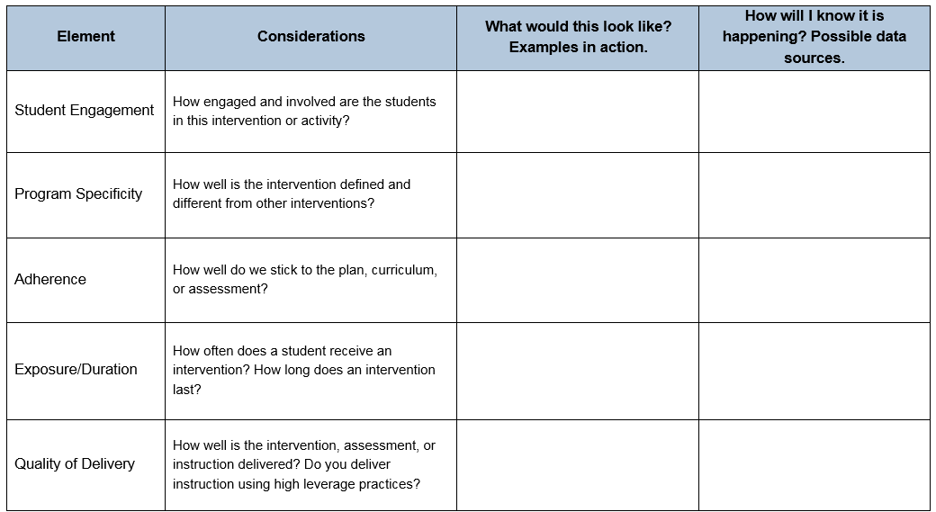
Activity. Five Elements of Fidelity
With your neighbor or table, complete the last two columns.
Handout
Notes:
Turn to the handout on fidelity and complete the last two columns with your neighbor or table.

Slide 52
Monitoring Intervention Fidelity of Implementation—Examples
Element | Data Source Examples
Adherence | Self-report, observation checklist
Duration/exposure | Self-report, observation
Quality of delivery | Observation, reflection, self-report on techniques used
Program specificity | Intervention component checklist
Student engagement | Student progress, student survey
Sources: Dane & Schneider, 1998; Mellard & Johnson, 2008; O’Donnell, 2008
Notes:
Refer participants to the last column of the Handout. Encourage participants to record examples of possible data sources presented on the slide. After presenting the slide content, provide participants 3–5 minutes to identify additional examples of what evidence could be used to assess if these elements of fidelity were addressed in the delivery of the intervention.
Review slide.

Slide 53
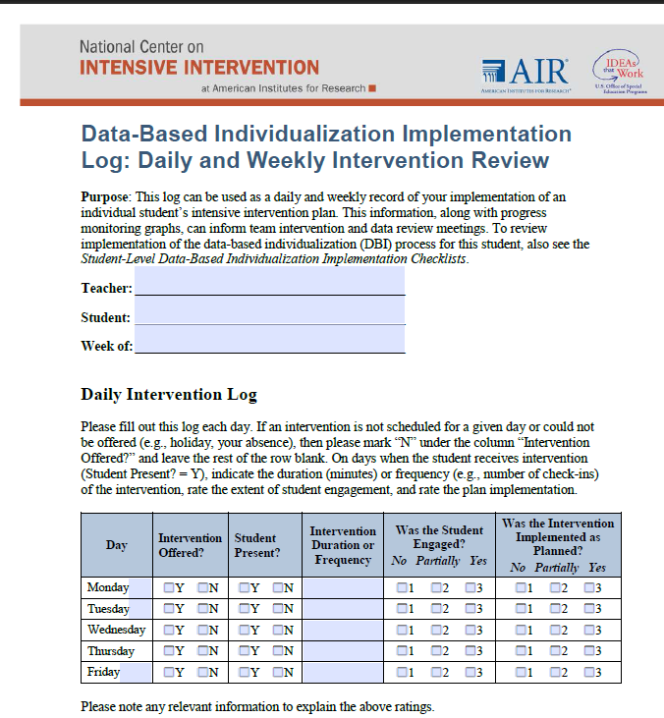
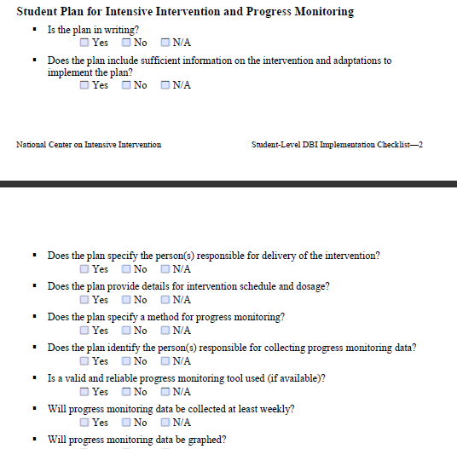
Tools to Monitor Fidelity of DBI
Handout
Notes:
NCII has developed a simple daily log to help interventionists document fidelity and guiding questions that can be used at the end of the week to consider whether the intervention was delivered for the student with fidelity.

Slide 54
Tools to Monitor Fidelity of DBI
Notes:
Specifically, the tool includes a table with the days of the week (click for animation) and allows educators to document whether the intervention was offered, whether the student was present, the amount of time the intervention was delivered (actual intervention delivery, not an estimate), whether the student was engaged, and whether the intervention was implemented as planned.
Together this information can be very helpful as educators refine their implementation and determine whether students are responsive to the intervention.

Slide 55
Fidelity and Individualization
What happens if you adapt an intervention?
When you adapt an intervention, fidelity is no longer focused on the intervention as designed by the vendor. Instead, fidelity refers to the extent to which you implement the intervention adaptation as designed.
Clearly documenting what adaptations have been made is essential when monitoring fidelity to an individualized intervention.
Notes:
Review slide.

Slide 56
Remember, Validated Interventions…
set the foundation for intensive intervention,
should be evidence based and implemented with fidelity, and
should allow for individualization for students not responding (Dimension 7).
Notes:
In summary, implementing effective validated interventions is crucial for schools to establish a foundation for intensive intervention. When validated interventions are designed based on the Taxonomy of Intervention Intensity and implemented with fidelity, schools are able to meet the needs of most at-risk students and obtain a clearer sense of which students require intensive intervention.

Slide 57
Using the Taxonomy of Intervention Intensity to Intensify and Individualize an Intervention
Notes:
In this section, we will focus on what to do when our validated intervention is not effective for a group of students or an individual student.

Slide 58
Monitor Whether the Intervention Was Effective
While implementing the intervention, collect progress monitoring data. With the team (or individually), evaluate the students' response to the validated intervention.
Notes:
(Click for animation) Once the validated intervention is in place. The second step is to monitor student progress to the intervention delivered with fidelity.

Slide 59
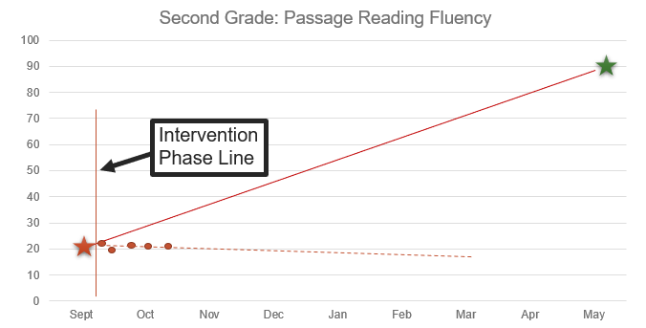
Progress Monitoring: Is this student responding to the intervention?
Notes:
Here is an example of progress monitoring data for a student. Is the student responding? In this case, we see that the student is not responding to the intervention.

Slide 60
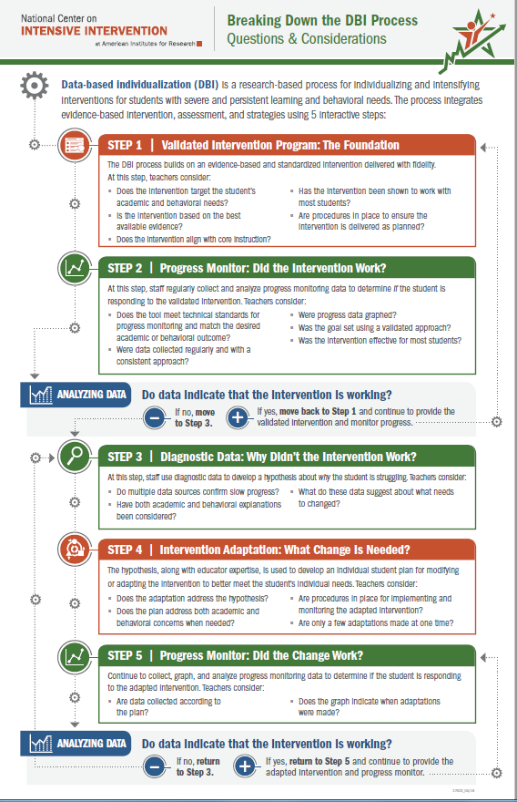
Decision-Making Considerations: Progress Monitoring Process
Does the progress monitoring tool meet technical standards for progress monitoring and match the desired academic or behavioral outcome?
Were data collected regularly and with a consistent approach?
Were progress data graphed?
Was the goal set using a validated approach?
Notes:
Based on that information, we may ask the following questions about our progress monitoring process and intervention. Review slide.

Slide 61
Decision-Making Considerations: Intervention
To what extent was the intervention expected to impact student growth?
Was the intervention delivered with fidelity for this student?
Was the intervention effective for most students?
Notes:
Review slide. The last question is important because it helps us to determine whether we make changes to the intervention on a group basis or for an individual student. If most students in the group are not responding to the intervention, we need to first think about what we need to do to make the intervention successful for most students.

Slide 62
Do I need a DBI team to implement DBI?
No. Individual teachers can independently implement DBI.
But three (or more) heads are always better than one when engaging in problem solving!
Notes:
Review slide. Click two times (first bullet, second bullet)

Slide 63
What do we do when most students aren’t responding?
Develop a hypothesis for why the intervention has not been successful for the group of students.
Check our fidelity of implementation:
Were there events or factors that limited our ability to implement the intervention as intended?
Were there group dynamics that created challenges for implementation?
Review our Taxonomy ratings:
Are there areas that might need to be intensified for the group?
Are we sure there was an alignment between student needs and the intervention?
Notes:
When most students are not responding, we want to first reconsider if there were any implementation challenges that impacted the intervention delivery. Was it delivered with the frequency, duration, and dose that was recommended? Were there group dynamics that impacted the interventionist’s ability to deliver the intervention? In addition, we want to look back at our taxonomy ratings to consider if there are areas where the intervention scored low that we might need to tweak for the whole group. Specifically, we might consider the alignment dimension to ensure that we matched the intervention to the students’ needs. In some limited cases, we might determine that we need to identify a different intervention.
Based on our review of this information and additional data, the team would develop a hypothesis for the type of change that needs to be made.

Slide 64
What should happen when a student doesn’t respond?
Team/teacher collects and analyzes informal diagnostic data and develops a hypothesis about why the student is not responding.
Notes:
If most students in the intervention are responding to the intervention but an individual student is not responding, we would consider moving into the individualization phase of DBI. In this case, the team or teacher will collect and analyze informal diagnostic data and develop a hypothesis about why the student is not responding.

Slide 65
Informal Diagnostic Assessment
Progress monitoring assessments help teams determine when an instructional change is needed.
Informal diagnostic assessments allow teams to use available data (e.g., progress monitoring data, informal skill inventories, work samples) to help determine the nature of the intervention change needed.
Notes:
Review slide. Diagnostic assessment does not have to be exhaustive. It is meant to identify skill deficits to guide us toward appropriate intervention adaptations.

Slide 66
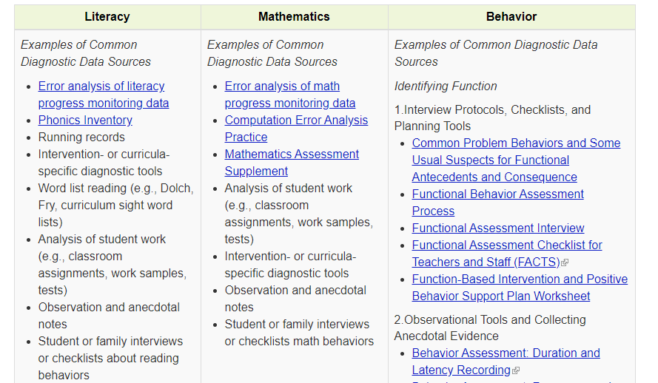
Informal Diagnostic Tools
Getting information from others, including parents and families, is essential as teams try to determine why a student is not responding.
Notes:
These are examples of data sources that might be used in diagnostic assessment. You might use one or more of these or a different data source.

Slide 67
Thinking Diagnostically: Integration of Academics and Behavior
Which came first?
A: Antecedent
B: Behavior
C: Consequence
Diagnostic assessment may reveal that an underlying academic deficit is causing the behavior to occur.
Skill deficit
Avoidance behavior
Removal from task
Notes:
As we consider diagnostic information, it is also really important to consider the intersection between academics and behavior. As you can see on the slide, this is often a “chicken or egg” situation. We know that students who struggle often use escape or avoidance behaviors to become removed from the task they are struggling with. If removed, the student then misses the instruction time and is likely to fall further behind.

Slide 68
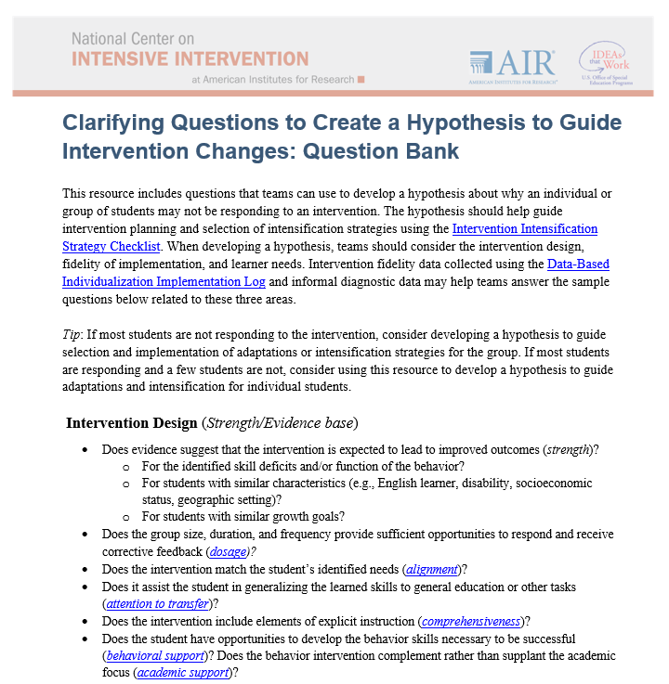
Developing the Hypothesis
The hypothesis drives the intensification strategy selection.
The taxonomy and this tool help teams develop a clear and more accurate hypothesis.
Handout
Notes:
This tool from NCII is designed to help teams in developing a hypothesis of why the student is not responding to the intervention. It provides guiding questions that the team might consider.

Slide 69
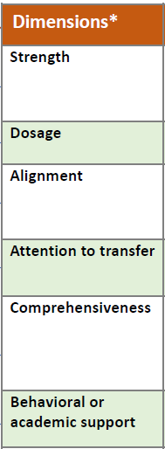
Responding to Non-Responders
Intensify and individualize the intervention to address the hypothesis.
Notes:
Once the hypothesis is developed by the team, the team brainstorms possible adaptations that address the hypothesis.

Slide 70
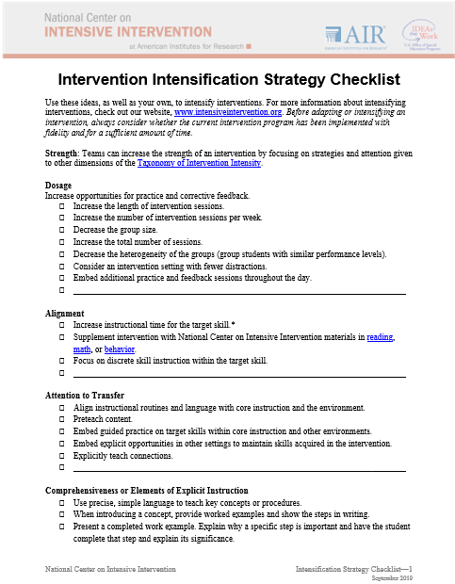
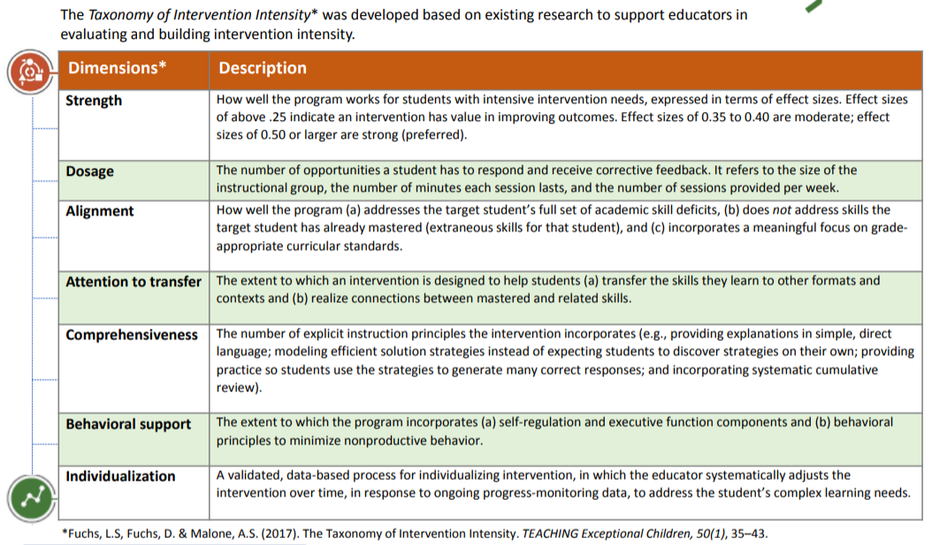
Adapting the Intervention
Tips for Successful Intensification!
Select strategies that address the hypothesis.
Handout
Notes:
To guide decisions about the types of intensification they might want to make, the team can use the dimensions of the Taxonomy of Intervention Intensity and the ratings they provided when analyzing the validated intervention program. They might also explore the Intensification Strategy Checklist from NCII that provides some areas to consider for intensifying across the dimensions of the taxonomy.

Slide 71
Activity, Part 2: Intensifying and Individualizing Validated Interventions
Get back into your same groups of two to three.
Imagine the group of students did not respond to the intervention. In the last column, brainstorm how two to three dimensions could be intensified for the group.
3. Review the Intensification Strategy Checklist for ideas.
4. Record your responses in the last column.
Handout
Notes:
In this activity, we are going to return to the handout and groups that we used earlier for rating our intervention. Based on your knowledge of the intervention and the ideas in the Intensification Strategy Checklist, consider some ways you could intensify the intervention across the different dimensions. You will have about 5–10 minutes for this activity.
Provide 5–10 minutes for this activity. Encourage participants to use the Intensive Strategy Checklist to identify possible intensification strategies for each dimension.

Slide 72
Think-Pair-Share
What were some ways you considered intensifying?
Which dimensions do you think would be easier to intensify?
Which dimensions are more challenging?
Notes:
Get up from your current group and find a partner from another group. Briefly share some of the ways you considered intensifying your intervention. Together discuss which dimensions you think would be easier to intensify and which might be more challenging.

Slide 73
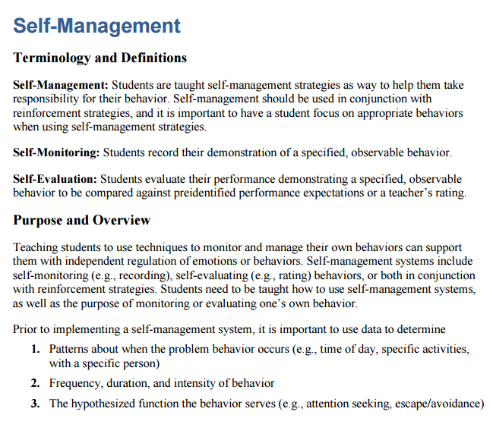
Tools for Intensifying Interventions
Notes:
NCII has also developed a series of sample lessons and strategies that can supplement interventions and extend practice opportunities around specific skills. There are lessons and activities for (click for animations) reading, (click for animations) mathematics, and (click for animations) strategies for behavior. (click for animations) For mathematics, video examples of the different instructional concepts are also available.

Slide 74
Intensifying the Intervention Along the Dimensions
Tips for Successful Intensification!
Select strategies that address the hypothesis.
Start by increasing opportunities for practice and feedback.
Make few but important changes.
Notes:
Review slide. Reinforce the need for additional practice opportunities for students with intensive needs.

Slide 75
What does this look like in practice?
A Reading Example
Notes:
Now we will look at what this might look like in practice using a case example in reading.

Slide 76
Using the Taxonomy to Intensify and Individualize an Intervention for Kelsey
Background: Kelsey presented serious reading problems at the beginning of second grade. Classroom assessments and diagnostic assessments identified three deficit areas: phonological awareness, word study, and reading fluency.
Intervention program: Kelsey’s teacher selected a research-validated program that addressed phonological awareness, word study, and fluency skills.
Notes:
Read slide.

Slide 77
Begin With a Validated Intervention!
Intervention Dimensions | Rating (0–3) | Evidence
Strength | 2 | ES = Between 0.35 and 0.49
Dosage | 2 | Group size: six students Session length: 20 minutes per session Frequency: five sessions per week
Alignment | 3 | Explicit instruction covering skills deficit areas, PA, word study, and fluency
Attention to transfer | 2 | Builds on previously learned skills; not clearly connected to Tier 1 content
Comprehensiveness | 2 | Includes three explicit instruction principles
Behavioral support | 1 | None found but doesn’t appear to be needed for student
Notes:
Kelsey’s teacher started by reviewing and rating her intervention. In the evidence column of the table, she noted what she used to make her decisions. (Click for animation). In the rating column, you can see the rating she provided for each dimension.
She gave a 2 for strength because the intervention showed moderate effects (between 0.35 and 0.49); a 2 for dosage because it was a daily intervention for 20 minutes with a moderate-sized group, allowing for multiple opportunities for peer practice and teacher feedback; a 3 for alignment as it clearly focused on three areas that Kelsey was struggling with; a 2 for attention to transfer as it builds on her previously learned skills but doesn’t clearly connect to her core instruction; a 2 for comprehensiveness as it includes three explicit instruction principles; and a 1 for behavior, although she isn’t concerned about this as Kelsey is currently not presenting with any major behavioral issues.

Slide 78
DBI requires ongoing progress monitoring to determine responsiveness.
Notes:
While implementing the intervention, the teacher collects progress monitoring data for Kelsey and the other students in the intervention.

Slide 79
Progress Monitoring Plan
Tool: Passage Reading Fluency (PRF)—second grade
Frequency: Weekly
Review Date: Four to six weeks
Baseline: 23 WRC
Target Goal (Spring Benchmark): 90 WRC
Notes:
Specifically, Kelsey’s teacher created the following plan for her progress monitoring. She is using the second-grade passage reading fluency measure, she collects data weekly, the team has determined that they will reconvene to review progress after 4–6 weeks.
Kelsey’s baseline was 23 words correct per minute and her target goal using the spring benchmark is 90 words correct per minute.

Slide 80
Progress Monitoring Graph
Spring Benchmark:
90 WRC
Notes:
This slide has animations.
On Kelsey’s graph, the teacher documents her baseline (23 words correct per minute) and her goal (click for animation) at 90 words correct per minute. She then (click for animation) draws a line between the two which will represent Kelsey’s progress.

Slide 81
Individual teacher or teams of teachers assess student’s responsiveness.
Notes:
After the 4–6 weeks of intervention implementation and data collection, Kelsey’s teacher meets with the team to determine how Kelsey is doing.

Slide 82
Progress Monitoring: Does Kelsey need DBI?
Intervention Phase Line
Notes:
Kelsey’s teacher has drawn a phase line to distinguish when the validated intervention (without adaptations) began. This allows the team to assess the impact of that “phase” of the intervention. Look at the data points following the intervention phase line. Did Kelsey respond to the intervention? Does she need DBI?
Using two common progress monitoring decision rules, we can confidently say that Kelsey is NOT responding to the validated platform. First, she has four consecutive data points below the goal line. In addition, the trend line, shown as dashed lines, indicates that she is not likely to meet her goal.

Slide 83
Decision-Making Considerations
To what extent was the intervention expected to impact student growth?
Is there sufficient evidence that the intervention was delivered with fidelity to Kelsey?
Are most students in the group responding?
What is the Kelsey’s level of engagement?
Others?
Notes:
In addition to just reviewing the data on Kelsey’s progress monitoring graph, the team also considered the following:

Slide 84
Delivered with fidelity?
Strong ratings for engagement
Duration ~ 20 minutes per session
Notes:
Here are the fidelity data collected during the intervention. When determining fidelity, the team or teacher determines the extent to which the students participated in the intervention. Review the fidelity data. What trends do you see? (click for animation of duration box, click again for animation of strong ratings of engagement)
Provide participants about one minute to review the data and share what they see with their neighbor. Overall, the data suggest that the student is participating in the intervention and the teacher believes the intervention was delivered as designed. Note that the average duration is about 20 minutes.

Slide 85
Diagnostic Data: What changes are needed to support Kelsey?
Notes:
Having reviewed the fidelity data and considered the other questions, the team decides that Kelsey is not responding to the intervention, but most of her peers are and they didn’t see any major issues with fidelity. Before making an adaptation to the intervention, they collected informal diagnostic data to help them to understand why Kelsey might not be responding and to guide their hypothesis.

Slide 86
Using Diagnostic Data to Develop Hypothesis to Intensify
Teacher reviews Kelsey’s classroom assessment data and conducts observations of her learning behavior. Behavior observations suggest that Kelsey struggles to master skills as quickly as her same-age peers and needs more practice than her peers.
Hypothesis: If Kelsey is provided additional opportunities of direct instruction, feedback, and practice on target skills, she would move to mastery of these skills more quickly.
Notes:
Review slide.
When describing the hypothesis click for animation. You will notice that the darker box is around dosage as we are primarily focused on adding more opportunities to respond, but that there are also call outs for alignment and comprehensiveness as we will focus our practice opportunities on the student’s skill gaps and use explicit instruction principles.

Slide 87
Intervention Adaptation: Use diagnostic data to adapt the intervention.
Notes:
Once Kelsey’s teacher has identified Kelsey’s needs through diagnostic assessment, she will adapt the intervention based on the hypothesis.

Slide 88
Rating Table
Intervention Dimensions | Rate | Evidence | Adaptation 1
Strength | 2 | ES = Between 0.35 to 0.49
Dosage | 2 | Group size: six students Session length: 20 minutes per session Frequency: five sessions per week | Provide 40 minutes each session in smaller group (3)
Alignment | 3 | Explicit instruction covering skills deficit areas, PA, word study and fluency
Attention to transfer | 2 | Builds on previously learned skills; not clearly connected to Tier 1 content
Comprehensiveness | 2 | Includes three explicit instruction principles
Behavioral support | 1 | None found but doesn’t appear needed for student
Notes:
The team makes the following changes. (Click for animation) The team will increase the length of the session to 40 minutes per day and will move Kelsey into a smaller group of three students who have similar needs. They believe this will enable Kelsey to have more interactions with the teacher.
Although there may be other changes that could help Kelsey, the team knows that it is important to make very few changes to the intervention so that she can assess the impact of the change.

Slide 89
Was the intervention adaptation delivered with fidelity?
Duration ~ 40 minutes per session
Notes:
The teacher implements the intervention with the new adaption, 40 minutes per session. She uses the DBI Daily Log to monitor the extent to which she implemented the adaptation with fidelity. How did she do? Any other concerns regarding fidelity of implementation? (Click to focus on intervention duration and frequency and click again to bring up the box suggesting the average duration was 40 minute)

Slide 90
Progress monitor and assess the impact of the adaptation.
Notes:
While the teacher collects daily fidelity data, she also continues to collect weekly progress monitoring data through implementation of the progress monitoring plan. Remember, the teacher is administering Passage Reading Fluency (PRF) each week.

Slide 91
Progress Monitoring: Is Kelsey responding to the intervention?
Intervention
Adaption 1 Phase Line
Notes:
Because the teacher made a change to the original intervention, she draws another phase line. This allows her to assess the impact of the intervention with the new adaptation in comparison to the intervention without the adaptation. How is Kelsey responding to the intervention with greater dosage? Is this sufficient progress?
In this case, Kelsey is making progress as indicated by the upward trend line (red dashed). However, the progress is not sufficient to help her reach her goal of 90 words read correctly. The team must reconvene to review additional diagnostic data and identify intensification strategies that will help Kelsey reach her goal.

Slide 92
DBI is an ongoing process based on student responsiveness to the intervention.
Notes:
(Click for animation) Review slide.

Slide 93
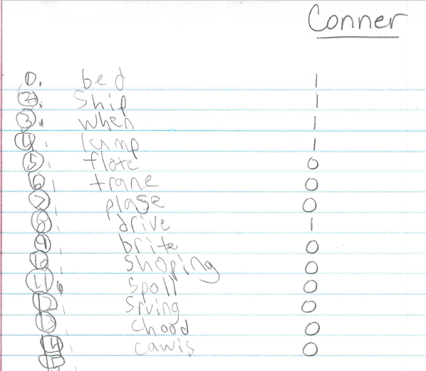
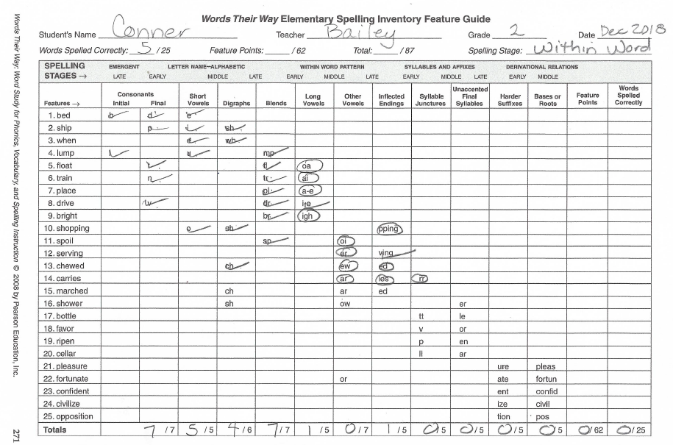
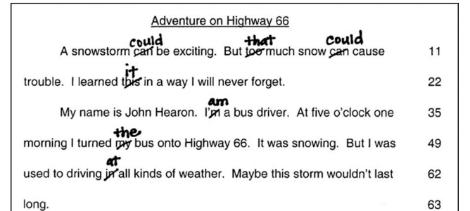
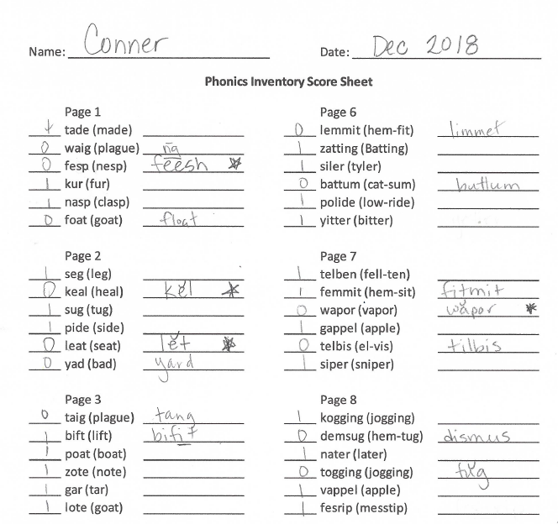
Informal Diagnostic Tools for Literacy
Consider a wide range of data sources to gather information about what literacy skill a student is struggling with.
Kelsey
Kelsey
Kelsey
Notes:
The teacher conducts some additional diagnostic assessments for Kelsey to understand the specific skill areas she is struggling with. (Click to bring up the different assessments)

Slide 94
What do you recommend?
Diagnostic data indicated Kelsey had difficulty applying decoding strategies to words with short and long vowels, especially “i” and “e.”
Observations also suggest that she needs the following instructional principles to benefit from decoding instruction:
Concrete, repeated opportunities to correctly practice the skill and receive feedback
Precise, simple language to introduce the lesson
Frequent checks for retention with reteaching as needed
Notes:
From the diagnostic data, the team finds that Kelsey is having success with phonological awareness but had difficulty applying decoding strategies to words with short and long vowels, especially “I” and “e,” and observations show that she needs concrete, repeated opportunities to correctly practice the skill and receive feedback; precise, simple language to introduce the lesson; and frequent checks for retention with reteaching as needed to benefit from decoding instruction:
They consider the intensification checklist and Taxonomy dimensions

Slide 95
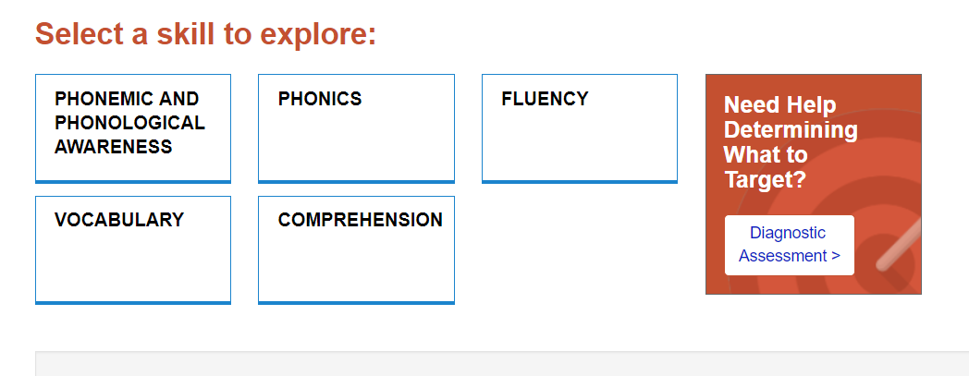
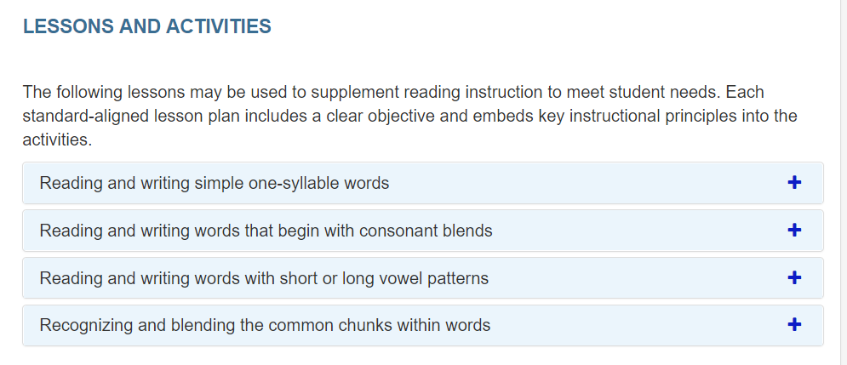
Lesson Plan Selection
Notes:
And review the sample lesson plans available from NCII and found that they have a series focused on phonics. She clicks on that button (click for animation) and sees that there are a variety of sample lessons and activities available (review lessons and activities)

Slide 96
NCII Intensive Intervention Resources
Notes:
They find one, Short or Long, that is designed to help students distinguish between long “e” and short “e” sounds and vowel patterns and sort them accordingly (including words that are “exceptions”).

Slide 97
Rating Table 2
Intervention Dimensions | Rate | Evidence | Adaptation 1 | Adaptation 2
Strength | 2 | ES = Between 0.35 and 0.49
Dosage | 2 | Group size: six students Session length: 20 minutes per session Frequency: five sessions per week | Provide 40 minutes each session in smaller group
Alignment | 3 | Explicit instruction covering skills deficit areas, PA, word study, and fluency
Attention to transfer | 2 | Builds on previously learned skills; not clearly connected to Tier 1 content
Comprehensiveness | 2 | Includes three explicit instruction principles |  | Provide additional explicit instructional strategies
Behavioral support | 1 | None found but doesn’t appear needed for student
Notes:
The team decides to maintain the dosage and group size change and add additional explicit instruction around the specific skill area using the sample lesson.

Slide 98
Progress Monitoring: Is Kelsey responding to the adapted intervention?
Intervention
Adaptation 1
Adaptation 2 Phase Line
Notes:
The teacher indicates the new adaptation with another phase line. The team reviews the data for this phase and determines that Kelsey is making some progress, but not sufficient progress to close the gap and reach her goal. The team collects additional diagnostic data and identifies how best to intensify the intervention based on that data.

Slide 99
DBI is an ongoing process.

Slide 100
Using Data to Intensify the Intervention
Behavior Strategies to Support Intensifying Interventions
Fidelity and observation data indicate that Kelsey has become easily frustrated and less engaged in the intervention than her peers. Data indicate that she can learn the skill if she attends to the task.
Hypothesis: If Kelsey was more engaged and able to control her frustration, she would benefit more from the intervention.
Notes:
While behavior was not initially an area that the team was concerned with, additional diagnostic data collected by the teacher indicate that over time Kelsey is becoming more frustrated and less engaged in the intervention. They hypothesize that if she was more engaged, she would get more benefit from the intervention. (click for animation) They visit the behavior strategies on the NCII website and identify a resource on self-management.

Slide 101
Rating Table 3
Intervention Dimensions | Rate | Evidence | Adapt 1 | Adapt 2 | Adapt 3
Strength | 2 | ES = Between 0.35 and 0.49
Dosage | 2 | Group size: six students Session length: 20 minutes per session Frequency: three to four sessions per week | Provide 40 minutes each session in smaller group
Alignment | 3 | Explicit instruction covering skills deficit areas, PA, word study, and fluency
Attention to transfer | 2 | Builds on previously learned skills; not clearly connected to Tier 1 content
Comprehensiveness | 2 | Includes three explicit instruction principles |  | additional explicit instructional strategies
Behavioral support | 1 | None found but doesn’t appear needed for student |  |  | Implement engagement and self-regulation strategy
Notes:
They record the intervention change under behavioral support.

Slide 102
Is Kelsey responding to the adapted intervention? What would you do?
Notes:
The teacher draws another phase line to indicate the new adaptation. Take a minute to turn to your neighbor and share what you would do next.
Provide pairs or small groups 1–2 minutes to discuss what they would do next. Have several share out.

Slide 103
Evaluation of Kelsey’s Progress: What would you do?
Kelsey’s reading is improving but not fast enough to achieve her goal.
Kelsey’s teacher may collect additional diagnostic data if needed to make an informed instructional change.
Kelsey’s teacher will continue to collect progress monitoring data and meet with the intervention team to evaluate progress and modify the plan as needed.
Team may consider whether the student has a disability, if not currently eligible for special education.
If a referral was made, DBI would continue through eligibility determination and individualized education program (IEP) development and implementation until the student is making adequate progress.
Notes:
Read slide.

Slide 104
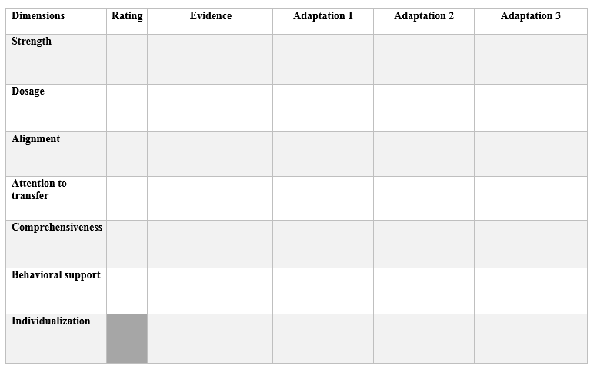
Activity: Using Tools to Intensify the Validated Platform for DBI
Identify a student you work with. Describe his or her specially designed instruction or intervention in Column 2.
Rate the intervention as IMPLEMENTED in Column 1.
Use available resources to identify how you could intensify the intervention IF the student does not respond.
Handout
Notes:
Optional activity. This final optional activity provides educators another time to rate and review an intervention they are using with a student and suggest changes for how they would adapt the intervention if the student does not respond.

Slide 105
Wrap-Up and Reflection
Notes:
Estimated delivery time: 10 min.

Slide 106
Learn More About the Taxonomy of Intervention Intensity
https://intensiveintervention.org/taxonomy-intervention-intensity
Notes:
If you are interested in learning more about the Taxonomy of Intervention Intensity, go to the NCII website, which includes a page focused on the Taxonomy. On that page, there are four recorded webinars that go in depth about applying the Taxonomy to different content areas. Additional resources will also be added to that page over time.

Slide 107
Resources to Support Intensification Decisions
Notes:
In addition to the webinars, you will be able to find a number of the resources we referenced today including the Intensification Strategy Checklist, dimension overview handout, and the handout focused on questions to develop a hypothesis.
Some of the other resources we referenced throughout the presentation are included on the next slides as a reminder and resource for you to reference.

Slide 108
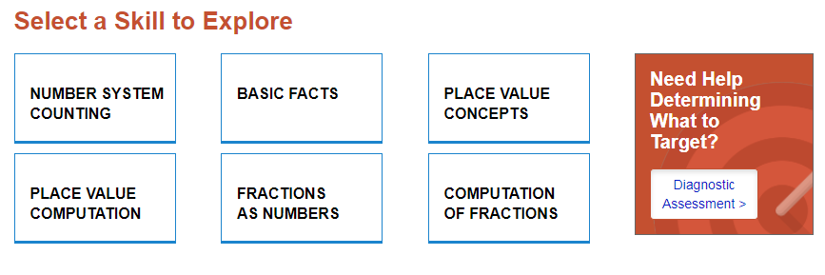
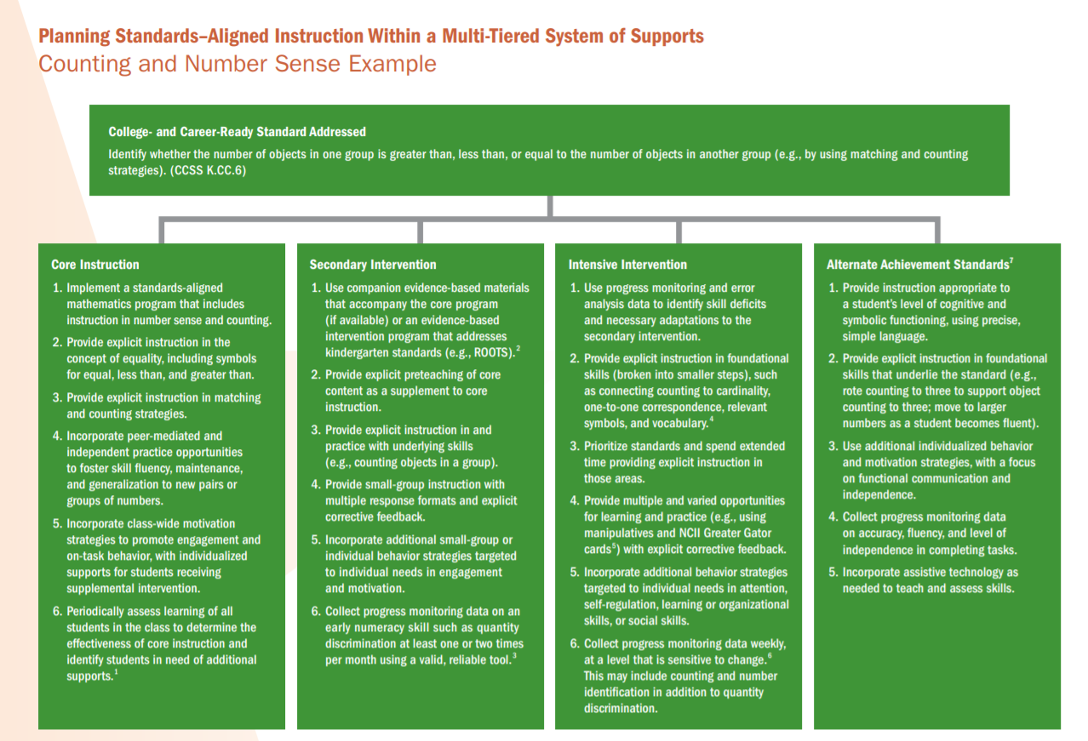
Resources to Support Intensification in Mathematics
Considerations for: Alignment, Attention to Transfer, Comprehensiveness, and Dosage
https://intensiveintervention.org/intensive-intervention-math-course
https://intensiveintervention.org/intervention-resources/mathematics-strategies-support-intensifying-interventions
Notes:
To support students who need more intensive support in mathematics, NCII has a series of sample lessons and activities aligned with different mathematics skill areas. This may help add additional practice opportunities or targeted support around a specific skill area that the student needs more support with. Examples of how to address standards across the levels of a tiered system of support can also help educators to consider the attention to transfer domain.
In addition, the Intensive Intervention in Mathematics course content offers a robust amount of information. Content covers the scope and sequence of skills within intervention, identifying strong evidence-based platforms (focus on the strength dimension), instructional delivery and instructional strategies, a focus on whole-number and rational-number content, and considerations for intensification.

Slide 109
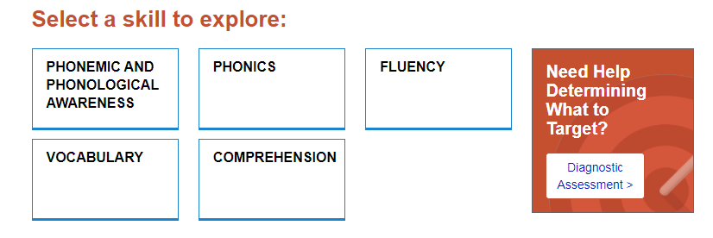
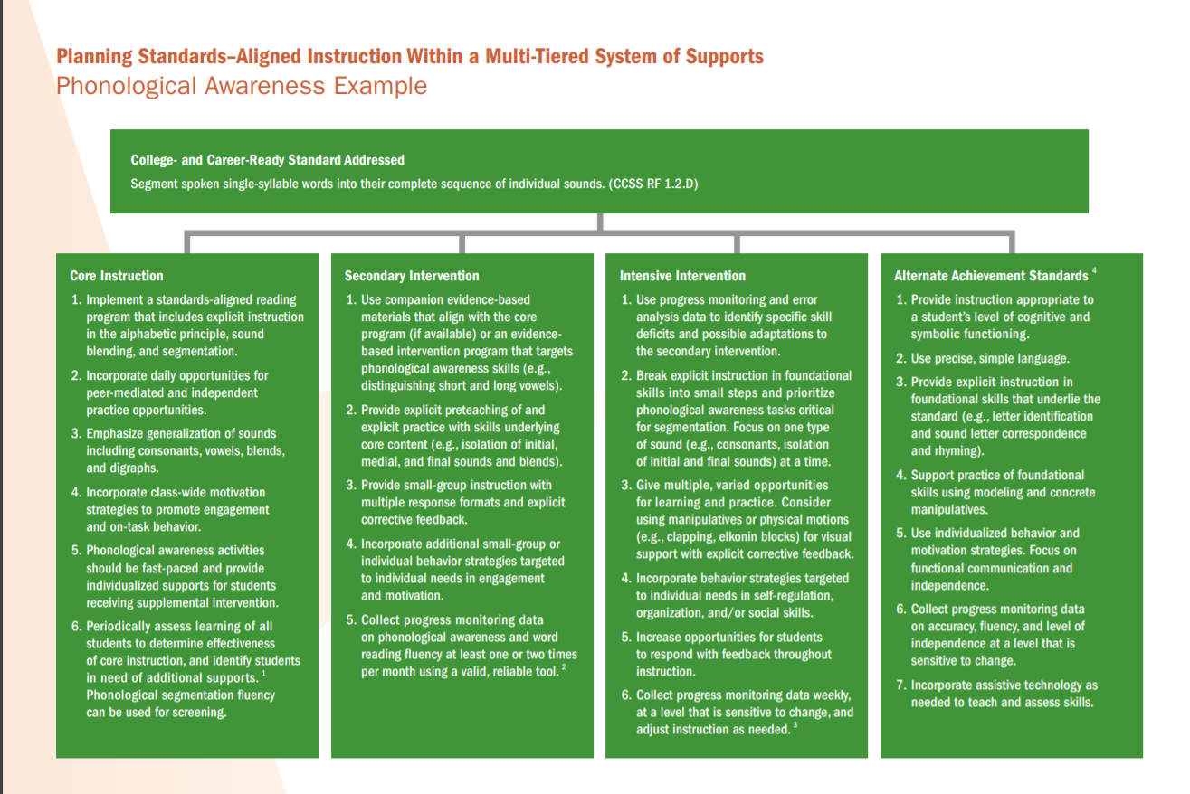
Resources to Support Intensification in Reading
Considerations for Alignment, Attention to Transfer, Comprehensiveness, and Dosage
https://intensiveintervention.org/intervention-resources/ literacy-strategies
Notes:
Like the mathematics resources, NCII has a collection of sample lessons for reading. These sample lessons include consideration for comprehensiveness and can be used to add additional practice opportunities for students. There are also illustrations about what instruction might look like across the tiers of intervention to support attention to transfer.

Slide 110
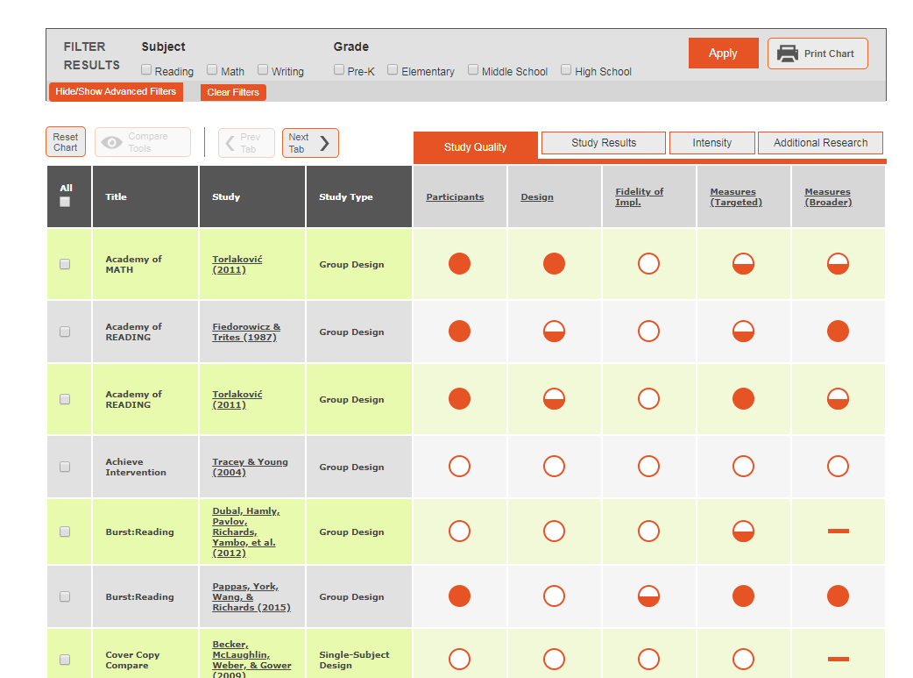
Resources to Evaluate Strength
Academic Intervention Tools Chart
https://charts.intensiveintervention.org/chart/instructional-intervention-tools
Behavior Intervention Tools Chart
https://charts.intensiveintervention.org/chart/behavioral-intervention-chart
Notes:
The Academic Intervention Tools Chart, seen here, was one of the tools we used to help us to evaluate the strength dimension. This is one of six tools charts on the NCII website. In addition to the NCII tools chart, you might also revisit the What Works Clearinghouse and Best Evidence Encyclopedia.

Slide 111
Resources to Support Intensification of Dosage
https://intensiveintervention.org/resource/strategies-scheduling-how-find-time-intensify-and-individualize-intervention
Notes:
This scheduling resource includes some strategies that might be helpful as you consider how to intensify within a busy school schedule, particularly as you think about the dosage dimension.

Slide 112
Resources to Learn More About Comprehensiveness
View module: https://intensiveintervention.org/intensive-intervention-features-explicit-instruction
View module: https://intensiveintervention.org/instructional-delivery-math-course
Notes:
If you are interested in learning more about comprehensiveness, the four-part module on Features of Explicit Instruction provides a wealth of content, examples, and resources. You can also find information and examples of explicit instruction in mathematics as part of Module 4 in the Intensive Intervention in Mathematics course.

Slide 113
Resources to Learn More and Intensify Behavior Support
https://intensiveintervention.org/intervention-resources/ behavior-strategies-support-intensifying-interventions
Notes:
NCII also includes information to support your consideration of the behavior support dimension. The behavior strategies can help support teachers working with students with primary academic deficits and challenging behaviors. Each strategy incorporates key terminology, an overview of the purpose, and all associated materials. The strategies also integrate approaches for intensification for students with more challenging behaviors.
The Behavior Support for Intensive Intervention Course Content also provides a deep review of how educators can support student behavior in the classroom. This eight-part module series includes video lectures, activities, and more.

Slide 114
Resources to Monitor Fidelity of Implementation
https://intensiveintervention.org/implementation-support/fidelity-resources
Notes:
As we discussed, it is important for educators to consider the dimensions when designing and intensifying intervention, but it is also important to consider the implementation of the intervention. These fidelity tools, including the daily/weekly log, provide tools to help educators to monitor fidelity of implementation over time.

Slide 115
Activity: Taxonomy K-W-L Revisited
What Does It Help Me KNOW? | What More Do I WANT to Know? | How Will I LEARN More?
Handout
Notes:
We have just spent the day getting to know more about the Taxonomy of Intervention Intensity and how it can be applied to review and rate a validated intervention and to guide intensification when a group of students or individual student does not adequately respond. Turn back to the Taxonomy K-W-L handout. Focus on the final two columns by noting what you want to know more about and how you will learn that information.

Slide 116
Things to Remember
DBI is ongoing and intense—relatively few students should need it (3 to 5 percent of the school population).
Academic and behavior supports do not exist in isolation.
There is no perfect intervention, but it is important to understand your intervention’s strengths and limitations and to start with a strong foundation.
Don’t make too many intervention adaptations at the same time.
Notes:
DBI is intense—relatively few students should need it.
If more than 3 percent to 5 percent of students in a school appear to require DBI, consider evaluating core instruction, school-wide behavior supports, and Tier 2 intervention programs.
DBI often takes sustained and iterative cycles of adaptation over time.
Academic and behavior supports do not exist in isolation.
They are often most successful when combined to meet students’ individual needs.
There is no perfect intervention.
We do have access to a growing repository of interventions that have shown evidence of effectiveness, but we need to consider the dimensions of the Taxonomy to guide our decision-making process and understand the multiple dimensions that can help to ensure that we have a strong intervention.
Even when we can’t start with a standardized program, the Taxonomy can guide our understanding of what we are providing.
Don’t make too many intervention adaptations at the same time.
It may be tempting to try everything at once because you want to help a student as soon as possible, but if you make all possible changes at the same time, you won’t know which ones the student needs (any improvement in performance could be the result of one or more adaptations). Fewer changes may also make implementation more sustainable.

Slide 117
Reflection
What am I most excited about? | What am I unsure or want to learn more about? | What changes will I make as a result of what I learned today?
Notes:
As we end the day, take a moment to reflect about what we covered. What are you most excited about? What questions do you still have? What changes will you make? Take 5 minutes to reflect and then share with a neighbor.

Slide 118
Reflection and Closing
Closing Questions or Comments?
Ticket Out the Door
What is the biggest “AHA” moment you had today?

Slide 119
Thank you!

Slide 120
References

Slide 121
References
Ciullo, S., Sabrina Lo, Y. L., Wanzek, J., & Reed, D. (2016). A synthesis of research on informational text reading interventions for elementary students with learning disabilities. Journal of Learning Disabilities, 49(3), 257–271.
Deno, S., & Mirkin, P. (1977). Data-based program modification: A manual. Reston, VA: The Council for Exceptional Children.
Fuchs, L. S., Fuchs, D., & Malone, A. S. (2017) The Taxonomy of Intervention Intensity. TEACHING Exceptional Children, 50(1), 35–43.
Gersten, R., Compton, D., Connor, C. M., Dimino, J., Santoro, L., Linan-Thompson, S., and Tilly, W. D. (2008). Assisting students struggling with reading: Response to Intervention and multi-tier intervention for reading in the primary grades: A practice guide. (NCEE 2009-4045). Washington, DC: U.S. Department of Education, Institute of Education Sciences, National Center for Education Evaluation and Regional Assistance. Retrieved from https://ies.ed.gov/ncee/wwc/Docs/PracticeGuide/rti_reading_pg_021809.pdf
Hill, C. J., Bloom, H. S., Black, A. R., & Lipsey, M. W. (2008). Empirical benchmarks for interpreting effect sizes in research. Child Development Perspectives, 2(3), 172–177.

Slide 122
References
Kearns, D. M. (2018). Intensive intervention course content: Features of explicit instruction. Washington, DC: U.S. Department of Education, Office of Special Education Programs, National Center on Intensive Intervention. Available at https://intensiveintervention.org/intensive-intervention-features-explicit-instruction
Lyon, G. R. (1985). Neuropsychology and learning disabilities. Neurology and Neurosurgery, 5, 1–8.
Mann, L. (1979). On the trail of process. New York, NY: Grune & Stratton.
Pierangelo, R., & Giuliani, G. (2008). Teaching students with learning disabilities: A step-by-step guide for educators. Thousand Oaks, CA: Corwin Press.
Scammacca, N. K., Roberts, G., Vaughn, S., & Stuebing, K. K. (2015). A meta-analysis of interventions for struggling readers in grades 4-12: 1980-2011. Journal of Learning Disabilities, 48(4), 369–390.
Vaughn, S., Wexler, J., Roberts, G., Barth, A. A., Cirino, P. T., Romain, M. A., … Denton, C. A. (2012). Effects of individualized and standardized interventions on middle school students with reading disabilities. Exceptional Children, 77(4), 391–407.

Slide 123
NCII Disclaimer
This presentation was produced under the U.S. Department of Education, Office of Special Education Programs, Award No. H326Q160001. Celia Rosenquist serves as the project officer. The views expressed herein do not necessarily represent the positions or policies of the U.S. Department of Education. No official endorsement by the U.S. Department of Education of any product, commodity, service, or enterprise mentioned in this webinar is intended or should be inferred

