Slide 1
The Taxonomy of Intervention Intensity:
June 25, 2018
An Case Example of Building Intervention Intensity in Reading
Meagan Walsh, M.Ed.
  Meagan Walsh, M.Ed., and Lynn Fuchs, Ph.D.
  Vanderbilt University

Slide 2
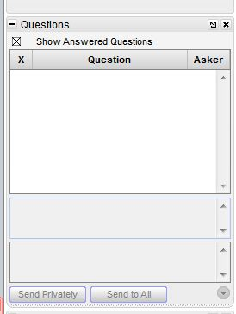
Webinar Format and Questions
Throughout the presentation, submit your questions
into the question pod.
  For technical issues and questions, a webinar team
  member will try to assist you as soon as possible.
  For content-related questions, there will be a time for
  Q&A at the end of the presentation. Submit your
  questions and we will share them with the presenters.
Notes:
Should also point out the additional resources available for participants. Blank taxonomy form, sample filled out taxonomy and graph. Participants will probably want to download these to their computers for reference.

Slide 3
Today’s Webinar
Review how the Taxonomy of Intervention Intensity can be used in the process of data-based individualization (DBI).
Present a reading example that illustrates how to implement DBI and the Taxonomy.
Notes:
Will provide a relatively brief overview and explanation of the taxonomy’s dimensions. For more detailed information see article in Teaching Exceptional Children, (Fuchs, L.S., Fuchs, D., & Malone, A. (2017). The taxonomy of intervention intensity. Teaching Exceptional Children, 50(1), 35-43.
Participants will also want to visit the NCII website for additional resources on DBI and the taxonomy. They may also want to check out the math webinar.
The focus of this webinar will be reading COMPREHENSION. There are fewer resources for comprehension intervention, and it can be slightly more difficult to treat. The students for whom such an intervention are a relatively small subset of students requiring reading intervention
During this webinar we will be providing only a brief review of DBI and the taxonomy—for a more in-depth explanation please see the brief webinar available in the “handouts” section

Slide 4
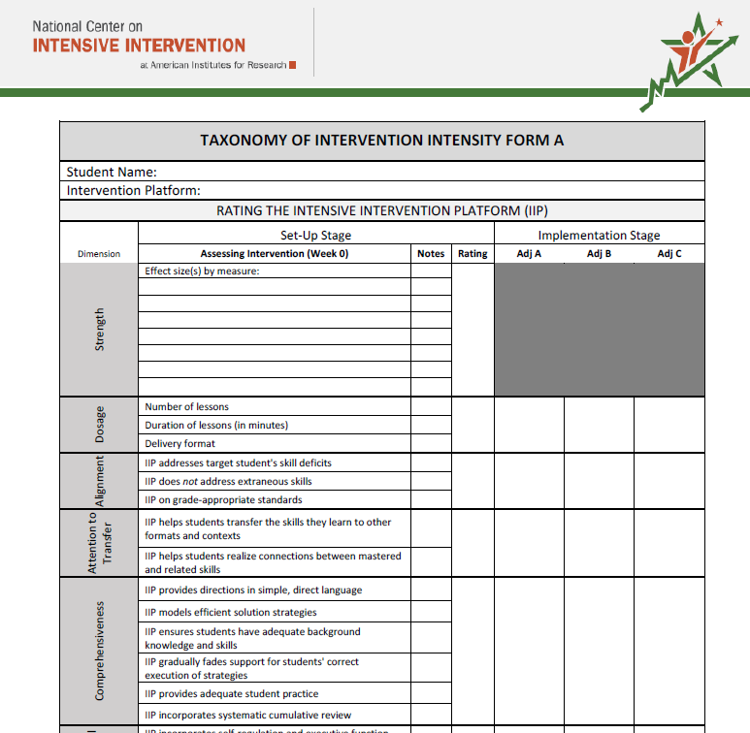
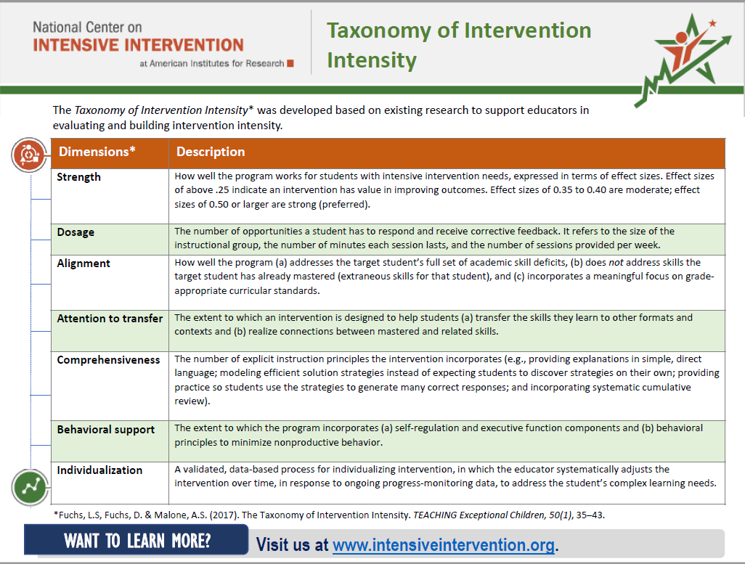
Webinar Materials for Download

Slide 5

Moderator and Presenter
Dr. Tessie Bailey, Principal Technical Assistance Consultant, American Institutes for Research (AIR), National Center on Intensive Interventions.
Meagan Walsh, M.Ed., is a doctoral student in the Department of Special Education at Vanderbilt University.

Slide 6
What Is the Taxonomy of Intensive Intervention?

Slide 7
The Taxonomy of Intensive Intervention
It is a system for describing an intervention in terms of seven dimensions along which intensity can vary.
It helps special educators and interventionists to identify best-match intervention platforms (in the DBI Set-Up Phase) …
…and to formulate adjustments to boost student progress (in the Implementation Phase).

Slide 8
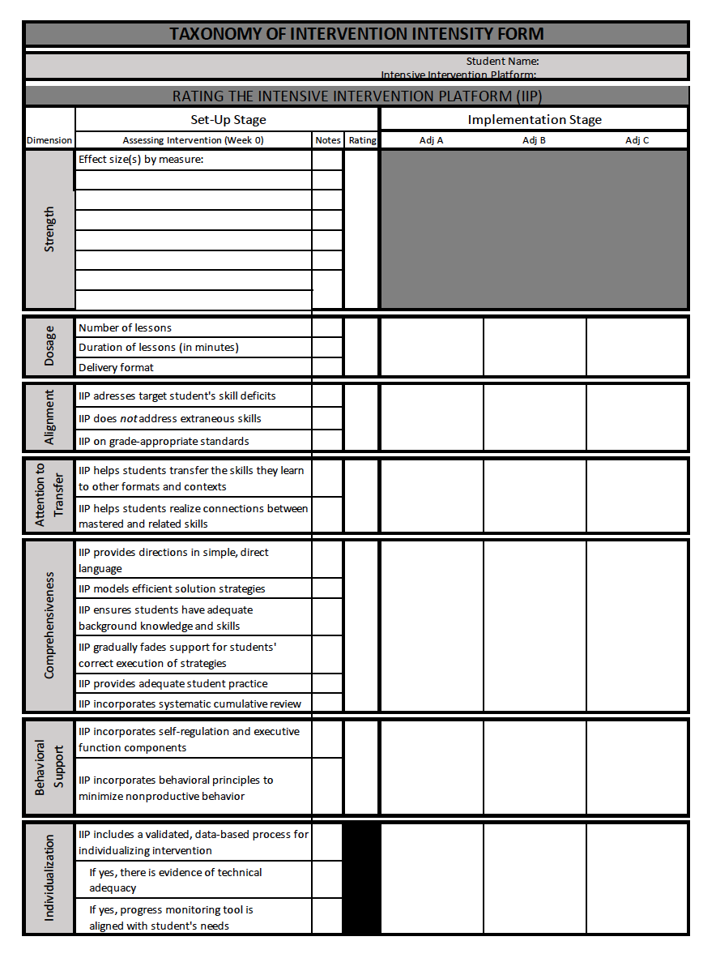
Taxonomy of Intervention Form
Step 1: Rate intensive intervention platform (IIP) to determine the best match.
Step 2: Use the taxonomy make instructional adjustments.
Notes:
You can find a draft PDF of the Taxonomy form in the handouts.
Using the form you can rate (ideally) several interventions on the 7 dimensions of the taxonomy to identify the best match.
Then you can use the taxonomy to adjust the intervention intensity during implementation.

Slide 9
Taxonomy Dimensions
Strength
Dosage
Alignment
Attention to Transfer
Comprehensiveness
Behavioral Support
Individualization
Notes:
The first dimension is Strength. This is used in the Set-Up Phase to identify the best-match intervention.
You consider if this intervention produces good results for students who require intensive intervention (disaggregated effect size)
Effect size tell us how much higher intervention students score at the end of intervention compared to students who did not receive the intervention.
Interventions effect sizes of .35 to .4 are considered moderate; effect sizes of .50+ are strong (These are merely rules of thumb)
It’s important to note that in the area of comprehension you can expect smaller effect sizes, especially when you’re talking about standardized measures. The What Works Clearinghouse identifies an effect size of .25 as substantively important in reading.
It’s also important to note that effect sizes in later grades also tend to be smaller.

Slide 10
When Is the Taxonomy of Intervention Intensity Used in the DBI Process?
PHASE A: Set-Up Phase
Step 1: Select a validated, best-match Tier 2
intervention to serve as the IIP.
Step 2: Make initial adjustments to the IIP to
address the student’s needs.
Step 3: Select a progress-monitoring system.
Step 4: Begin implementing the IIP.
Notes:
So the Taxonomy of Intervention intensity can help you in both Set up and Implementation phases of the DBI cycle.
In the Set Up phase the Taxonomy can be used to help practitioners identify the best match Tier 2 Intensive Intervention Platform and make initial adjustments to address the student’s needs.

Slide 11
When Is the Taxonomy of Intervention Intensity Used in the DBI Process?
PHASE B: Individualizing That Intervention
Step 5: Determine whether an adjustment is
needed. If so,
  Step 6: Collect diagnostic data.
  Step 7: Design an adjustment to the intervention
  to meet the student’s needs.
Step 8: Implement the adjustment.
Step 9: Repeat Steps 5–8.
Notes:
During the implementation phase—the taxonomy can be used to formulate targeted adjustments to the IIP on an ongoing basis to intensify the intervention based on progress monitoring data.

Slide 12

Reading Comprehension Example
Arianna
Notes:
The purpose of this webinar is Illustrate how to use DBI in conjunction with the Taxonomy to design an effective program for a student receiving intensive intervention in reading comprehension.
Arianna (not her real name or picture) will help us illustrate this process.

Slide 13
Purpose of Reading Example
Illustrate how to use DBI in conjunction with the Taxonomy to design an effective program for a student who receives intensive intervention in reading comprehension.

Slide 14

Student Profile: Arianna
Arianna has experienced persistent academic failure.
She participated in Tier 2 reading intervention in fourth grade.
By the end of the year, Arianna had made strong growth in reading fluency, but she had struggled to make any gains in comprehension.
The evaluation team determined that Arianna had a specific reading comprehension disability and recommended intensive reading intervention.
Notes:
Briefly describe the types of students who might fall into this category.

Slide 15
Reading Profile: Arianna
Recalls irrelevant or erroneous information from text
Struggles to identify most important information in text (main ideas)
Fails to use evidence from text to answer factual questions
Unable to integrate background knowledge with textual evidence to answer inferential questions
Cannot synthesize main ideas to identify themes and big ideas from text
Has more difficulty with nonfiction text, specifically those with unfamiliar structures
Demonstrates limited academic vocabulary and content area knowledge

Slide 16
Student Profile: Arianna
Reading strengths
  Word reading
  Fluency
Other academic concerns
  Science and social studies performance
  Failing grades across content areas
  Struggles with word problems in math
Behavior
  Quiet
  Appears distracted

Slide 17
DBI Phase A: Set-Up
Note: Slides with orange titles indicate steps in which the interventionist or special educator applies the Taxonomy.
Note: Slides.

Slide 18
Set-Up Phase, Step 1:
Select an IIP
With taxonomy in hand, Ms. Smith (Arianna’s interventionist) accesses the NCII tools chart in search of a validated Tier 2 IIP focused on reading comprehension.
She also remembers a presentation she saw at a professional conference about a new reading comprehension intervention being developed. She reaches out to the principal investigator for additional information about this IIP.
The researcher shares information and materials about this IIP: Reading Detectives. Ms. Smith decides to rate the IIP using the Taxonomy.

Slide 19

Set-Up Phase, Step 1:
Select an IIP (Reading Detectives)
Reading Detectives is a research-validated Tier 2 intervention.
  It contains 42 lessons (45 minutes each).
  It focuses exclusively on reading comprehension and nonfiction text.
  It provides explicit strategy instruction.
  The program offers training with a variety of nonfiction text structures.
  It is designed for students in the intermediate grades.
Notes:
Strategies taught include accessing text features; vocabulary; making main ideas; answering factual and inferential questions; clarifying concepts in text; and synthesizing themes.
The nonfiction texts included in the program are organized into instructional units ( Explorers, Animals, Civil Rights, Ancient Egypt, Olympics), are written at a 4th-5th grade level, and have a variety of text structures (comparative, problem/solution, descriptive, sequential).

Slide 20
Set-Up Phase, Step 1:
Select an IIP (Reading Detectives)
Lessons are designed to be delivered in pairs and follow a prescribed format.
Pre-reading: Students preview text features and vocabulary, skim text, and make predictions about theme and structure.
During reading: Students take turns reading paragraphs, creating main ideas, and connecting and clarifying concepts in text with partner support.
After reading: Students identify the theme of the text and answer factual and inferential questions.
Tutor support is scaffolded throughout the program and faded as students develop strategic skills.
Executive function components include asking students to recall previously created main ideas while reading, update theme predictions frequently, and self-monitor their use of strategies.

Slide 21
Set-Up Phase, Step 1:
Rate an IIP
Ratings
  0 (fails to address standard)
  1 (addresses standard minimally)
  2 (addresses standard moderately)
  3 (addresses standard well)
Notes:
Refer to the PDF in the handouts. There is a blank one as well as the sample one that was filled out for Arianna. We’ll rate each dimension using 0-3. As we talk, you might want to think about how you might rate the IIP using the blank form.

Slide 22
Set-Up Phase, Step 1:
Rate the IIP
 | Set-Up Stage
Dimension | Assessing Intervention (Week 0) | Notes | Rating
Strength | Effect size(s) by measure:
 | Far-Transfer Reading Comprehension Factor Score | 0.04
 | Near-Transfer Reading Comprehension | 0.47
 | Near Transfer-Main Idea/ Big Idea | 0.27
 | Near Transfer Factual | 0.49
 | Near Transfer Elaborative | 0.36
 | Near Transfer Text-Based Inference | 0.20
 | Knowledge Acquisition | 1.85
2
How would you rate the strength of this intervention?
Notes:
Far transfer refers to standardized, norm-referenced comprehension tests—not related to content or format of intervention
Near transfer: researcher created measure, measure concepts taught in tutoring with similar texts
Recall: Interventions effect sizes of .35 to .4 are considered moderate; effect sizes of .50+ are strong, based on this metric we see:
Small effect for main ideas/ big ideas, and text-based inferential questions
Moderate effect for near transfer reading comprehension overall, elaborative inference questions, and factual questions
Large effect for knowledge acquisition
Null effect for far-transfer
Based on the effect sizes, this intervention appears to have moderate strength: rating would be 2. (Moderate evidence)

Slide 23

Set-Up Phase, Step 1:
Rate the IIP
Dosage | Number of lessons | 42
 | Duration of lessons (in minutes) | 45
 | Delivery format | 2:1
3
How would you rate the Dosage Intensity?
Notes:
Recall that dosage refers to the number of opportunities a student has to respond. 45 minutes in a 2:1 would offer many opportunities to respond: far more than might be expected during whole class reading, or even in a small group intervention.
A look at a sample lesson shows that a single student might have as many as 225 opportunities to respond, this includes chances to read text, create main ideas, answer questions, discuss background knowledge, correct their partner etc.
Based on this, the intervention would probably receive a score of 3 for dosage intensity.

Slide 24

Set-Up Phase, Step 1:
Rate the IIP
Instructional Alignment | The IIP addresses target student's skill deficits. | 3
 | The IIP does not address extraneous skills. | 3
 | The IIP is on grade-appropriate standards. | 3
3
How would you rate the Instructional Alignment?
Notes:
Recall Arianna’s RC:
Recalls irrelevant or erroneous information from text
Struggles to identify most important information in text (Main Ideas)
Often fails to use evidence from text to answer factual questions.
Unable to integrate background knowledge with textual evidence to answer inferential questions.
Can not synthesize main ideas to identify themes and big ideas from text.
Has more difficulty with nonfiction text, specifically those with unfamiliar structures
Limited academic vocabulary and content area knowledge
Does this program address all of these deficits? YES—all!
Does this program address any extraneous skills such as fluency, word reading, or narrative text? No, none!
Does this program align to grade level standards? YES!

Slide 25

Set-Up Phase, Step 1:
Rate the IIP
Attention to Transfer | The IIP helps students transfer the skills they learn to other formats and contexts. | 2
 | The IIP helps students realize connections between mastered and related skills. | 2
2
How would you rate Attention to Transfer?
Notes:
What does the intervention do to promote transfer?
The intervention includes a checklist that students use during sessions, this checklist is printed on a bookmark so that students can take it back to class.
Each session begins with a discussion of how strategies learned in tutoring might be useful in other contexts
The strategies are taught so that students can use what they learned in one strategy to help them with the next strategy (ex. Using evidence to answer factual questions is taught in lesson 4—combining evidence from text with background knowledge is not taught until lesson 12.
There is moderate evidence of attention to transfer. There could be much more.
The lessons do not include fictional text and a variety of text formats (magazine, textbook, etc.) which might further promote transfer.

Slide 26
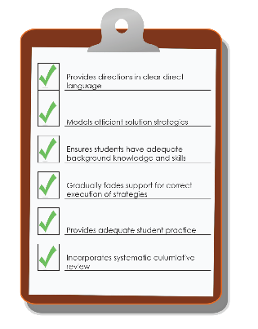
Set-Up Phase, Step 1:
Rate the IIP
Comprehensiveness | The IIP provides directions in simple, direct language. | 3
 | The IIP models efficient solution strategies. | 3
 | The IIP ensures students have adequate background knowledge and skills. | 3
 | The IIP gradually fades support for students’ correct execution of strategies. | 3
 | The IIP provides adequate student practice. | 2
 | The IIP incorporates systematic cumulative review. | 3
2.8
How would you rate Comprehensiveness?
Notes:
The IIP includes fully 42 fully scripted lessons.
Students are explicitly taught 6 high-impact comprehension strategies with simple efficient steps.
To support student background knowledge, prompts are provided for each elaborative inference question to help the tutor guide discussion. A media library accompanies each instructional unit to address gaps in student background knowledge. Moreover, the vocabulary instruction and thematic unit design is such that students are able to apply their background knowledge from earlier texts to help them comprehend later ones.
Feedback tables are provided to help the RA offer support and corrective feedback. Procedures are in place in the scripts to transfer control of corrections from the RA to the student partner, and eventually fade such support altogether.
Students have many opportunities to practice the strategies; however, they are always practicing the strategies in the company of their partner and the tutor. There could be more fully independent practice.
The program provides daily cumulative review and practice of taught strategies.

Slide 27

Set-Up Phase, Step 1:
Rate the IIP
Behavioral Support | The IIP incorporates self-regulation and executive function components. | 2
 | The IIP incorporates behavioral principles to minimize nonproductive behavior. | 2
2
How would you rate Behavioral Support?
Notes:
The intervention includes some strategies to support self-regulation and executive function-there could be more:
Recalling main ideas
Updating predictions
Small group size with frequent opportunities to respond
Use of checklist to self-regulate strategy use
The IIP does include some global behavioral principles to minimize nonproductive behavior:
Clear behavior guidelines reviewed at the beginning of every session
Point system with opportunity to earn rewards
These strategies are not student specific and could be more intense, but they provide a moderate level of behavioral support to begin.

Slide 28
Set-Up Phase, Step 1:
Rate the IIP
  Note. Ms. Smith does not rate the individualization dimension during setup.
Overall Rating | Strength | 2
 | Dosage | 3
 | Alignment | 3
 | Attention to Transfer | 2
 | Comprehensiveness | 2.8
 | Behavioral Support | 3
2.6
Notes:
Based on the overall ratings for each of the dimensions. Reading Detectives seems like an appropriately intense IIP to begin addressing Arianna’s needs.
The overall rating is 2.6. There are some dimensions with ratings of 2—these might be targets for future adjustments in order to increase the intensity of the IIP if Arianna fails to make adequate progress.

Slide 29
Set-Up Phase, Step 2:
Make Initial Adjustments to the IIP
What are the shortcomings of the Reading Detectives IIP for addressing Arianna’s needs?
  Attention to Transfer: The IIP focuses exclusively on nonfiction texts in a standard format (workbook).
  Comprehensiveness: All of the practice is completed with a partner.
  Behavioral Support: Arianna has trouble staying focused, and she has often becomes quiet and withdrawn when working with peers.
Notes:
Attention to Transfer: Ms. Smith is concerned that Arianna will not transfer taught strategies to other types of texts and instructional contexts.
Comprehensiveness: Ms. Smith is concerned that this may not provide Arianna with adequate opportunities for fully independent practice.
Behavioral Support: Ms. Smith is concerned that these behavioral concerns might not be addressed in the IIP if implemented as designed.

Slide 30
Set-Up Phase, Step 2:
Make Initial Adjustments to the IIP
At this point, Ms. Smith avoids major substantive changes until she can gauge Arianna’s response to the IIP via progress-monitoring data.

Slide 31
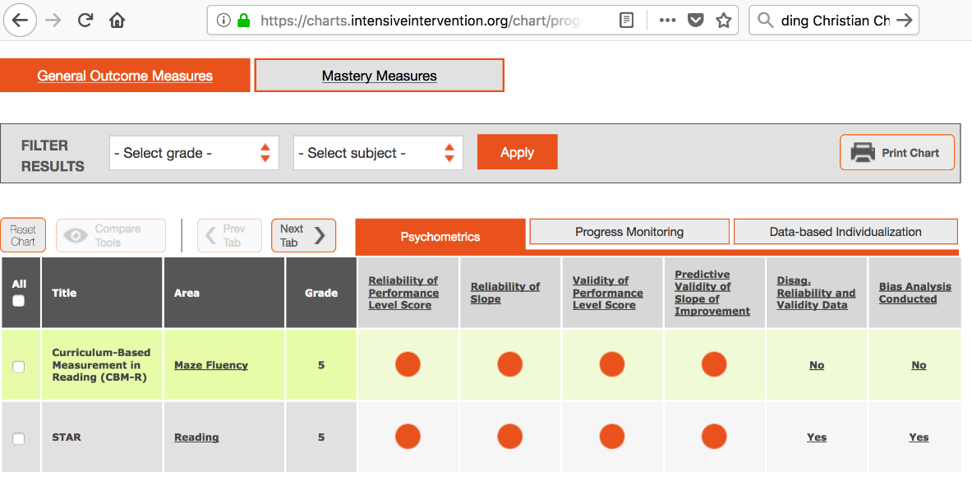
Set-Up Phase, Step 3:
Select a Progress-Monitoring System
Reading Detectives does not include a progress-
monitoring system.
Using the NCII tools chart, Ms. Smith identifies
CBM-R Maze Fluency as an appropriate
progress-monitoring tool.
Ms. Smith will progress monitor Arianna weekly,
and make instructional decisions every 6 weeks.
Notes:
STAR Reading is an online assessment. This would take approximately 15 minutes to administer each week.
The CBM-R Maze tool can be administered in 2.5 minutes.
Both have similar psychometric properties in terms of reliability and validity. The STAR does provide additional diagnostic information, which might make the process of making program adjustments easier.
Ms. Smith does not have funding available to cover the additional costs of paying for a subscription to STAR service. She opts instead for the CBM-R Maze Fluency as a progress monitoring tool—knowing she will need to do additional leg-work when making instructional decisions.
In math or reading fluency, a teacher would probably decide to evaluate progress and make educational decisions regarding program adjustment every 3 weeks. Comprehension typically grows more slowly. Six data points is the minimum necessary for establishing a trend with this progress monitoring tool.

Slide 32
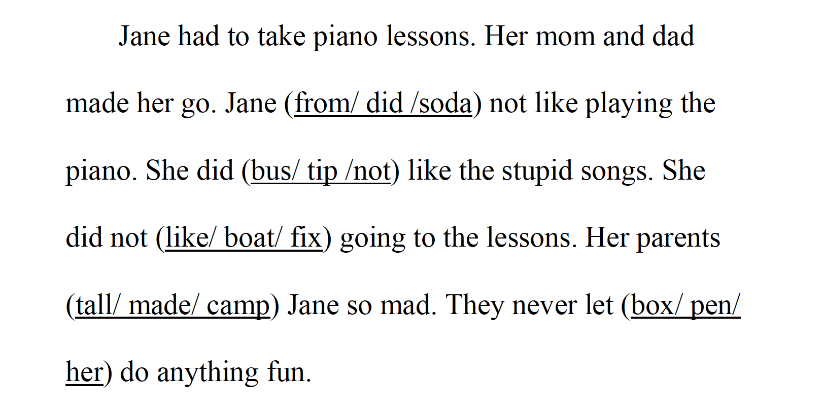
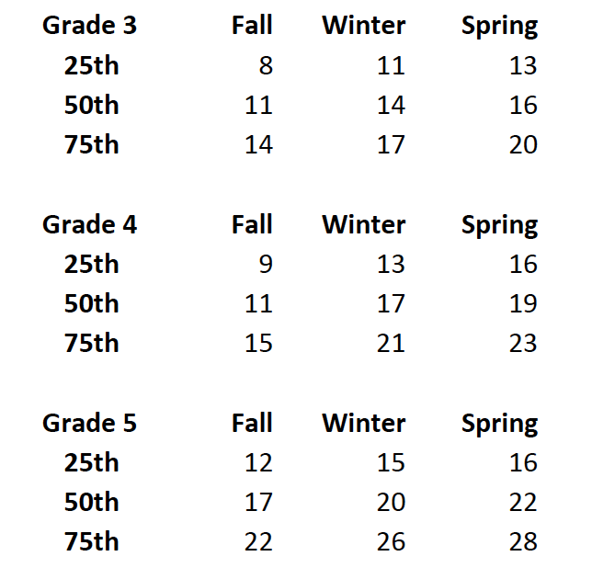
Set-Up Phase, Step 3:
Select a Progress-Monitoring System
Notes:
Ms. Smith gives Arianna a benchmark assessment at the start of the academic year. (3 passages given—median score is used)
In the Maze passages, every seventh word is removed and replaced by three options. Students receive a score for the number of correct restorations in 2.5 minutes.
Arianna attempts to identify the correct word to complete many of the sentences. However, she makes many errors. The rules of administration require that testing be discontinued after 3 incorrect restorations. As a result, despite relatively strong fluency, Arianna’s median score is only 6.
Because Arianna’s score falls so far below the 25th percentile for 5th grade students, Ms. Smith decides it would be best to monitor her using 4th grade probes.
She sets a goal slope of .25.

Slide 33
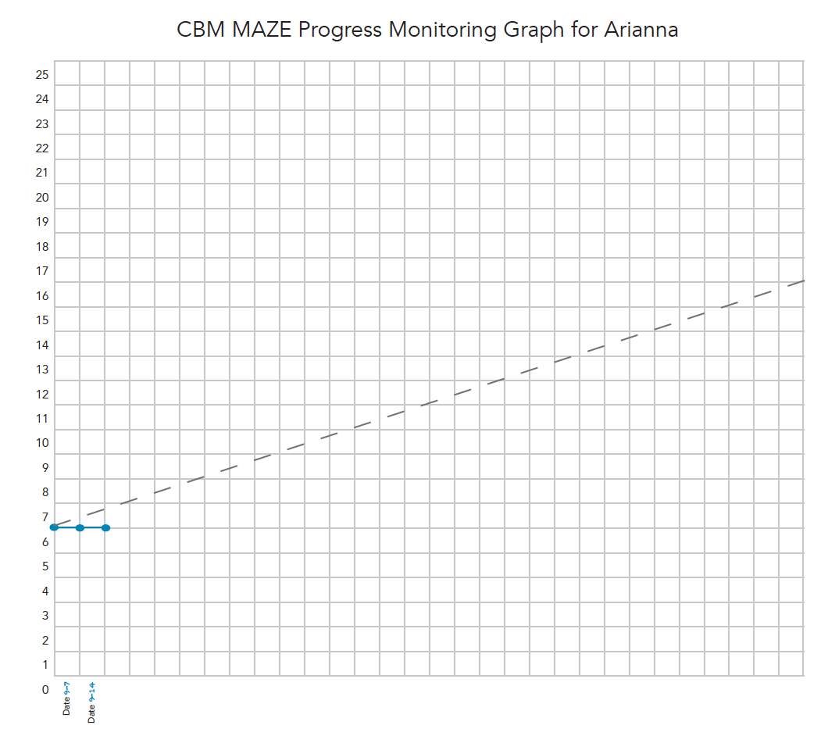
Set-Up Phase, Step 4: Begin Implementing the IIP
Ms. Smith begins implementing the intervention and collecting progress-monitoring data.
During the first 2 weeks, Ms. Smith primarily administers training lessons.
Arianna’s score on CBM-R Maze progress monitoring graph is unchanged for both weeks.
--Should Ms. Smith modify the IIP?--
--If yes, what dimension?--
NO

Slide 34
Trick Question ☺
Ms. Smith has not collected enough data to modify the IIP.
The data-utilization rules for CBM-R Maze Fluency indicate she needs to have at least six data points to establish a trend.
The first 2 weeks of the IIP are primarily training lessons; we would not expect to see significant change during these weeks.

Slide 35
DBI Phase B: Implementation Phase
NOTE: Slides with orange titles indicate steps in which the interventionist or special educator applies the Taxonomy.

Slide 36
Implementation Phase, Steps 5–9:
Use the Taxonomy to Make Adjustments to the Intervention During Implementation
Steps 5–9 in the implementation phase alternate between:
  Assessing data (gray titles) to evaluate whether Arianna’s intervention requires an adjustment and
  Applying the Taxonomy (orange titles) to design adjustments to the IIP.
Notes:
DBI = signature feature of special education

Slide 37
Implementation Phase, Steps 5–9:
Use the Taxonomy to Make Adjustments to the Intervention During Implementation
DBI: A validated process for individualizing intervention.
Ms. Smith collects progress-monitoring data weekly using CBM-R Maze Fluency to then apply validated decision rules on a regular basis (every 6 weeks) to determine whether the intervention is producing the target response for Arianna.
Whenever the data indicate Arianna is not on track to meet her goals, Ms. Smith will adjust the program to better address her needs.
Notes:
DBI = signature feature of special education

Slide 38
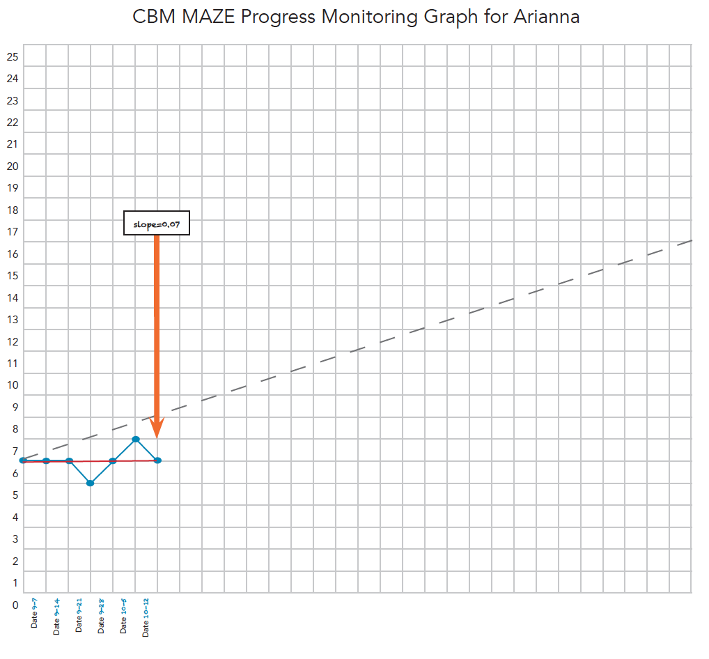
Determine When to Make an Adjustment to Intervention
During the first 6 weeks of treatment,
Ms. Smith notices:
  Arianna almost always waits for her
  partner to speak first and rarely
  participates in discussion.
  She is not able to cover all lesson
  components in the allotted 45-minute session.
  Arianna often seems to have trouble attending,
  especially when tasks become difficult.
-----Should Ms. Smith modify the IIP?-----
-----If yes, what dimension?-----
YES

Slide 39
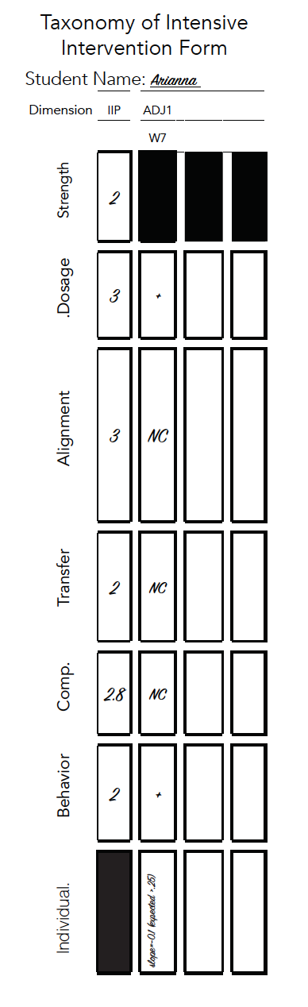
Formulate an Adjustment to the IIP When the Rate of Progress Is Inadequate
Ms. Smith should intensify and individualize Arianna’s program.
Arianna is not deriving any benefit from working with a partner. She cannot complete lessons during a single session.
  Dosage: Tutor Arianna 1:1 and introduce self-pacing.
Arianna is having difficulty attending and persisting during difficult tasks.
  Behavioral Support: Begin using a timer and awarding Arianna for time on task; add a self-regulation component.
Notes:
Based on the progress monitoring data we know that an adjustment is needed.
Let’s think about the diagnostic and anecdotal information we have.
Based on this information, we can make two adjustments using the taxonomy.
First we can adjust the dosage dimension.
Then we can adjust the Behavioral Support dimension.
It’s still pretty early in the intervention program to make more substantive adjustments such as to alignment, transfer, or comprehensiveness. Making quantitative and behavioral changes should be the first place we look when intensifying the program.

Slide 40
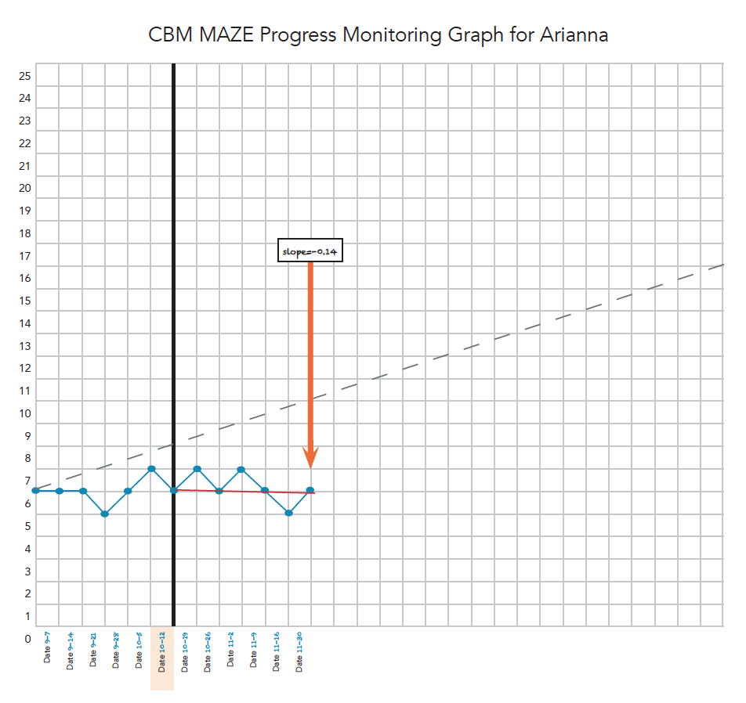
Implement Adjustment 1 and Progress Monitor to Determine When to Make Next Adjustment to Intervention
During weeks 7–12, Ms. Smith notes:
Arianna is having difficulty comprehending many of the words in the text beyond those identified as vocabulary words.
Arianna has limited background knowledge, which seems to limit her ability to make connections and inferences.
-----Should Ms. Smith modify the IIP?-----
-----If yes, what dimension?-----
YES

Slide 41
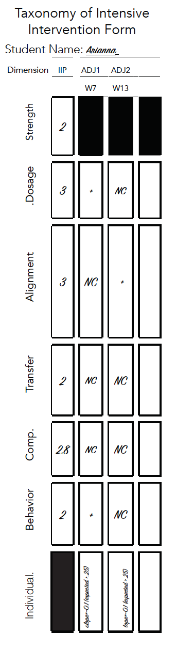
Formulate an Adjustment to the IIP When the Rate of Progress Is Inadequate
Ms. Smith should intensify and individualize Arianna’s program.
Based on her observations during intervention, she decides to focus on the Taxonomy’s alignment dimension:
  Ariana demonstrates gaps in academic vocabulary.
    ➸ Ms. Smith decides to add semantic feature analysis to each lesson.
  Arianna’s poor background knowledge is interfering with her inference making.
    ➸ Ms. Smith curates additional media resources to supplement the media library included in the IIP.

Slide 42

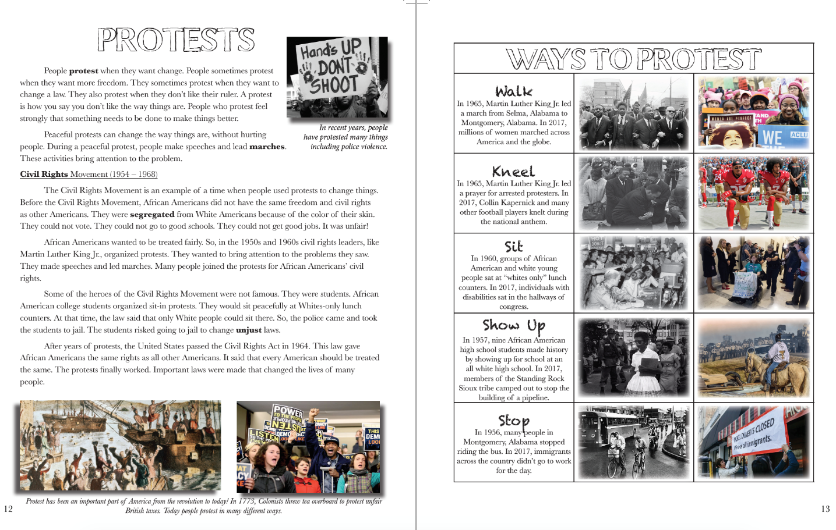
Formulate an Adjustment to the IIP When the Rate of Progress Is Inadequate
Important terms and ideas:
Change
Freedom
Laws
Peaceful
Speeches
Marches
Bring attention to a problem
Make things better
Civil Rights Movement
Segregation
No Jobs
Unjust
African Americans
MLK Jr.
Heroes
Students
Sit-in
Jail
Police
Protest
Notes:
This is example of semantic feature analysis
Anders, P. L., & Bos, C. S. (1986). Semantic feature analysis: An interactive strategy for vocabulary development and text comprehension. Journal of Reading, 29(7), 610-616.
Identify the important terms and concepts in a text.
Highlight the superordinate ideas.
Create a matrix with superordinate concepts at the top.
Give students a copy of the matrix to use while reading the text
As they encounter subordinate idea or term in the text. Briefly define the term and add it to the matrix.
Engage students in a discussion of whether that relationship relates positively (+), negatively (-), questionably (?), or does not relate at all (0) with each of the superordinate terms
Ask students why they rated something that way
Review chart after reading

Slide 43
Formulate an Adjustment to the IIP When the Rate of Progress Is Inadequate
 | Protest | Peaceful | Violence | Just (fair) | Unjust | Heroes | Laws
Change things | + | + | ? | + | - | + | +
Freedom | + | ? | - | + | - | + | ?
speeches | + | + | 0 | + | 0 | + | 0
Marches | + | + | - | + | - | + | +
Bring Attention to a problem | + | + | - | + | - | + | +
Segregated schools | - | - | + | - | + | - | +/-
Martin Luther King, Jr. | + | + | - | + | - | + | +
Notes:
This is example of semantic feature analysis
Anders, P. L., & Bos, C. S. (1986). Semantic feature analysis: An interactive strategy for vocabulary development and text comprehension. Journal of Reading, 29(7), 610-616.
Identify the important terms and concepts in a text.
Highlight the superordinate ideas.
Create a matrix with superordinate concepts at the top.
Give students a copy of the matrix to use while reading the text
As they encounter subordinate idea or term in the text. Briefly define the term and add it to the matrix.
Engage students in a discussion of whether that relationship relates positively (+), negatively (-), questionably (?), or does not relate at all (0) with each of the superordinate terms
Ask students why they rated something that way
Review chart after reading

Slide 44
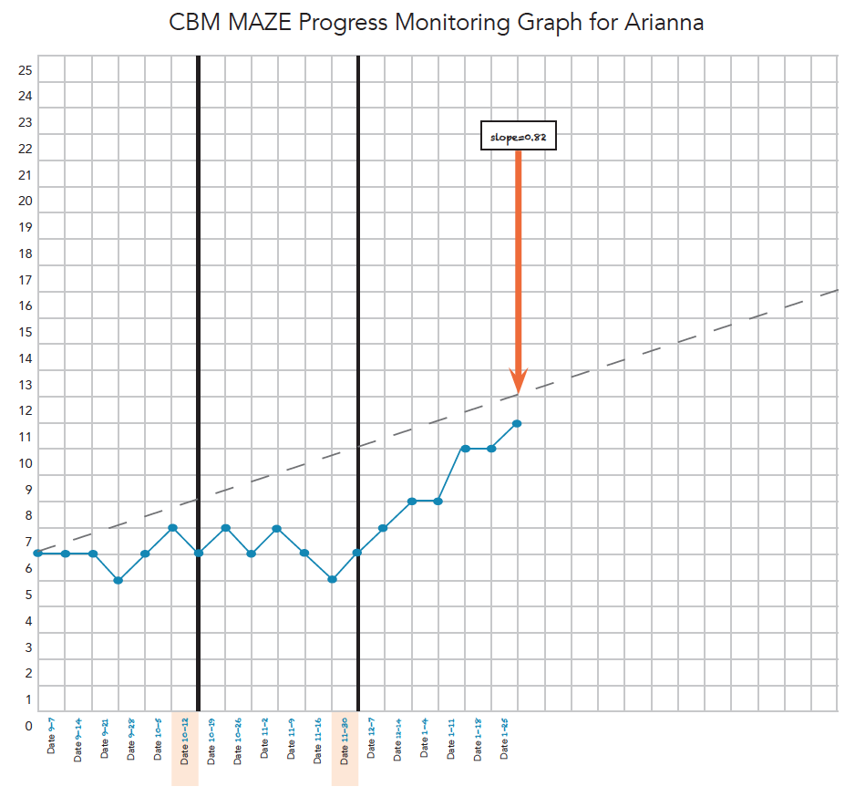
Implement Adjustment 2 and Progress Monitor to Determine When to Make Next Adjustment to Intervention
During weeks 13–18, Ms. Smith notes:
Arianna seems more confident in discussion.
She is making connections within and across texts and answering inferential texts.
She is beginning to identify main ideas independently.
She asks questions and seems engaged.
-----Should Ms. Smith modify the IIP?-----
-----If yes, what dimension?-----
NO

Slide 45
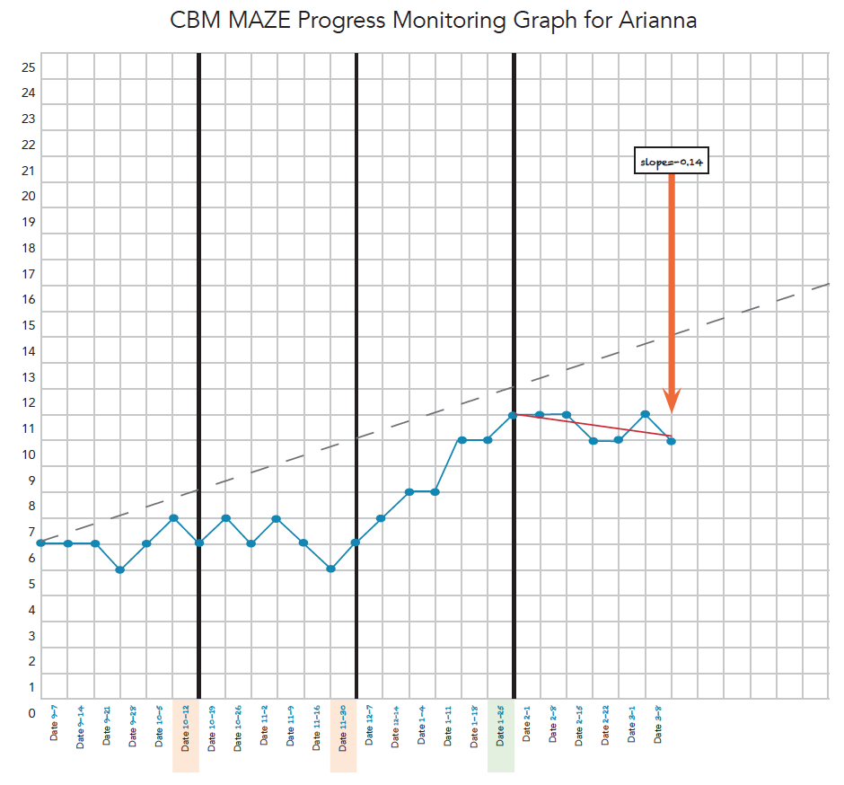
Progress Monitor to Determine When to Make Next Adjustment to Intervention
During weeks 19–24, Ms. Smith notes:
Arianna is doing much better during tutoring. She correctly answers many types of questions, she independently makes main ideas, she identifies themes, and she is engaged in discussions.
Arianna continues to struggle in her classes and continues to receive failing grades.
A universal screen revealed that her ORF has stagnated and has not improved since the beginning of the year.
-----Should Ms. Smith modify the IIP?-----
-----If yes, what dimension?-----
YES

Slide 46
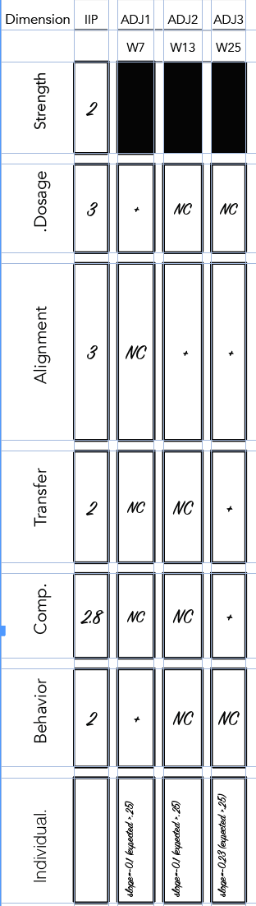
Formulate an Adjustment to the IIP When the Rate of Progress Is Inadequate
Ms. Smith should intensify and individualize Arianna’s program.
  Alignment: Arianna’s fluency has not improved.
  ➸Introduce some fluency practice (repeated reading).
  Transfer: Arianna is not transferring the skills learned in tutoring to other contexts.
  ➸Spend time with other types of text: fiction, etc.
  Comprehensiveness: During the set-up phase, Ms. Smith felt the program would be more comprehensive if it included more fully independent practice.
  ➸ Give Arianna additional practice assignments.

Slide 47
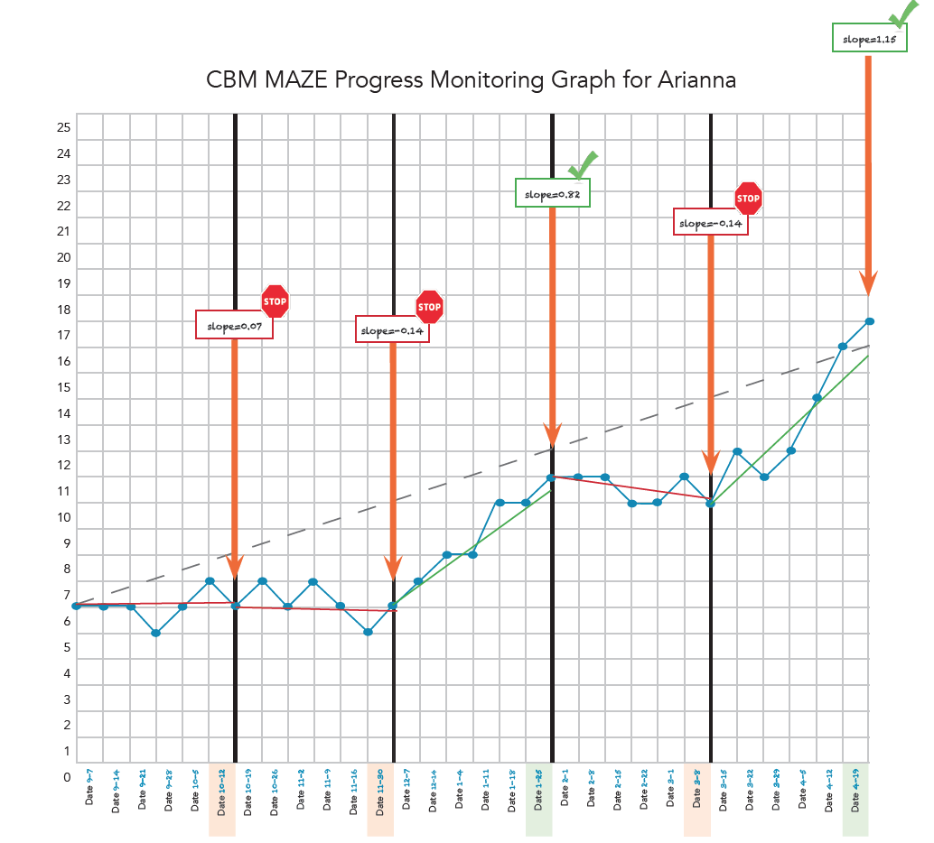
Implement Adjustment 3 and Progress Monitor to Determine When to Make Next Adjustment to Intervention
During weeks 25–30, Ms. Smith notes:
Arianna has made progress in tutoring.
She participates more in class discussions.
She attempts difficult tasks.
Her grades are improving in content area classes, although there is still work to be done.

Slide 48

Questions
  Stay tuned for an upcoming webinar focused on behavior intervention!

Slide 49
Taxonomy and NCII Resources
Relevant NCII resources
  Designing Intensive Intervention for Students With Severe and Persistent Academic Needs (DBI Training Series, Module 7)
  So What Do I Do Now? Strategies for Intensifying Intervention When Standard Approaches Don’t Work (webinar)
  Introduction to Data-Based Individualization: Considerations for Implementation in Academics and Behavior (DBI Training Series, Module 1)
  The Taxonomy of Intervention Intensity: A Case Study for Building Intervention Intensity in Math (webinar)
Notes:
NCII has developed several resources to help interventionists plan and implement intensive intervention programs. The Intensive Intervention Practice Categories highlight possible means of intensifying interventions: These Practice Categories include:
Change Intervention Dosage or Time
Change the Learning Environment to Promote Attention and Engagement
Combine Cognitive Learning Strategies with Academic Learning
Modify Delivery of Instruction

Slide 50
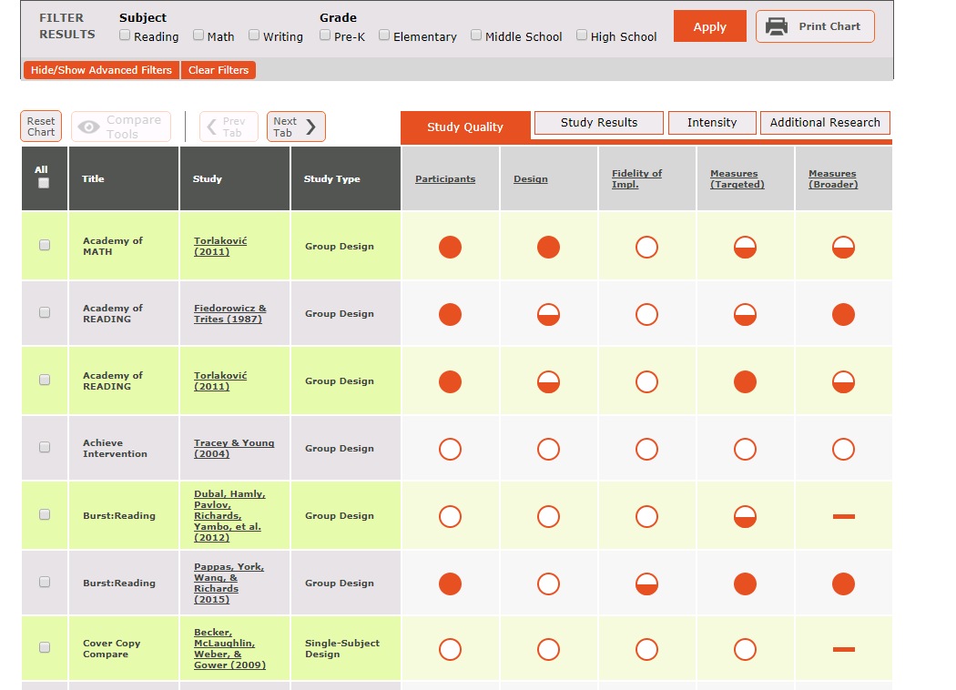
The NCII Tools Charts

Slide 51
Closing Slide

Slide 52
References
Anders, P. L., & Bos, C. S. (1986). Semantic feature analysis: An interactive strategy for vocabulary development and text comprehension. Journal of Reading, 29(7), 610–616.
Fuchs, D., Hendricks, E. Walsh, M.E., Fuchs, L.S., Gilbert, J.K., Zhang-Tracy, W., … Peng, P. (2018). Evaluating a multi-dimensional reading comprehension program and reconsidering the lowly reputation of tests of near-transfer. Learning Disabilities Research and Practice, 33(1), 11–23.
Fuchs, L. S., Fuchs, D., Hamlet, C. L., & Ferguson, C. (1992) Effects of expert system consultation within curriculum based measurement, using a reading MAZE task. Exceptional Children, 58(5), 436.
Fuchs, L. S., Fuchs, D., & Malone A. S. (2017). The taxonomy of intervention intensity. Teaching Exceptional Children, 50(1), 35–43.
National Center on Intensive Intervention. (2013). Data-based individualization: A framework for intensive intervention. Washington, DC: American Institutes for Research. Retrieved from https://files.eric.ed.gov/fulltext/ED575656.pdf
Therrien, W. J., & Kubina, R. M. (2006). Developing reading fluency with repeated reading. Intervention in School and Clinic, 41(3), 156–160.

Slide 53
NCII Disclaimer
This presentation was produced under the U.S. Department of Education, Office of Special Education Programs, Award No. H326Q160001. Celia Rosenquist serves as the project officer. The views expressed herein do not necessarily represent the positions or policies of the U.S. Department of Education. No official endorsement by the U.S. Department of Education of any product, commodity, service, or enterprise mentioned in this website is intended or should be inferred.

