Slide 1
Module 7
Rational-Number Content for Intensive Intervention

Slide 2
Slide 2
Video Link: https://youtu.be/vE0H2D57ZJQ

Slide 3
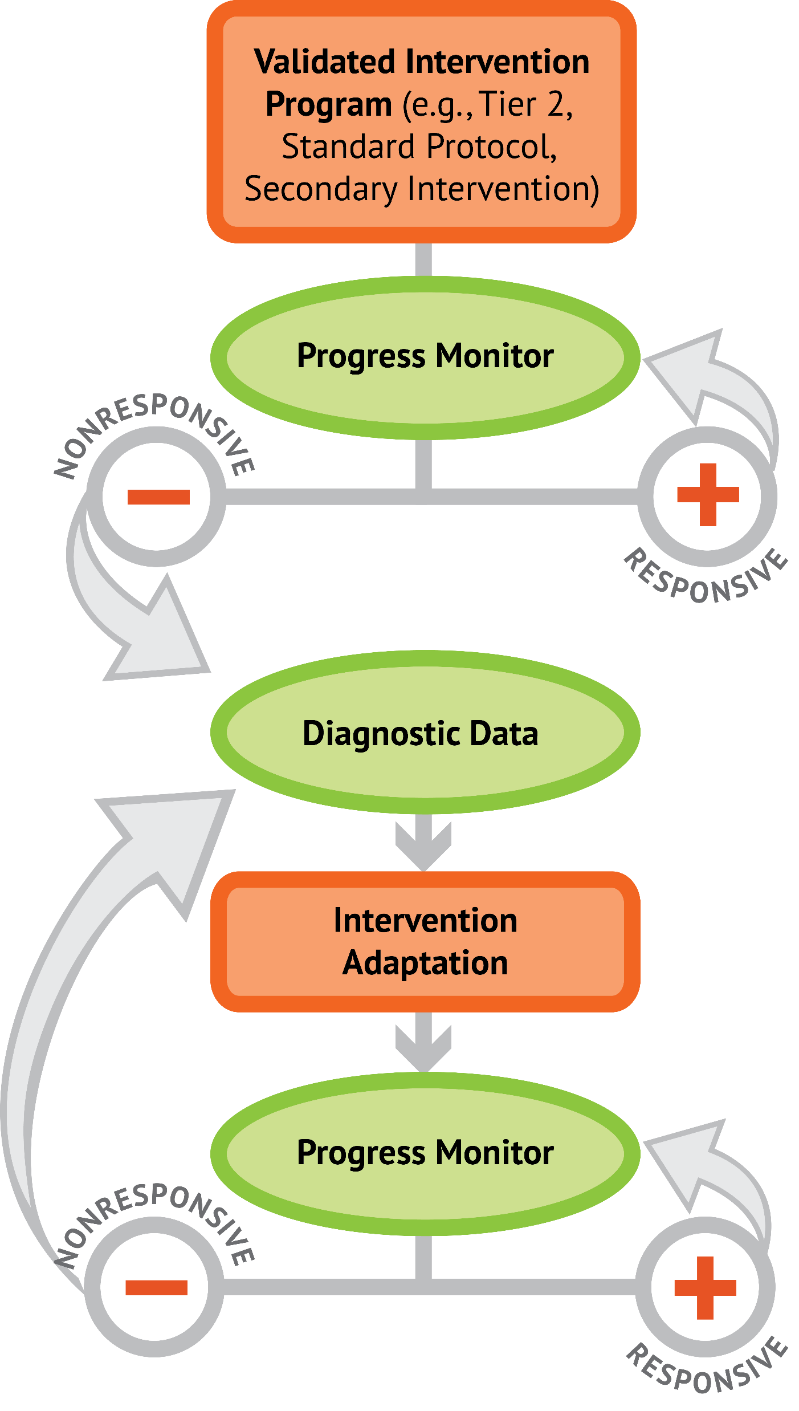
Slide 3
1: Developing a scope and sequence for intervention
2: Progress monitoring and determining response
3: Selecting evidence-based practices for the instructional platform
4: Instructional delivery: explicit instruction, multiple representations, language
5: Instructional strategies: fluency building, problem solving, motivation
6: Whole number content
7: Rational number content
8: DBI and mathematics: fidelity, adaptations

Slide 4
Objectives
PART 1: What rational-number core concepts should be included within intensive intervention?
PART 2: What rational-number procedures should be emphasized within intensive intervention?
PART 3: What does DBI look like with intensive interventions that focus on conceptual and procedural understanding of rational numbers?

Slide 5
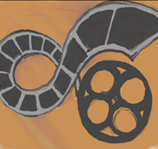
Activities
PART 1: What rational-number core concepts should be included within intensive intervention?
Use the length model
Use the area model
Use the set model
Share your favorite tools that you use when teaching fractions

Slide 6
Activities
PART 2: What rational-number procedures should be emphasized within intensive intervention?
Solve addition and subtraction problems using two different models
Solve multiplication and division problems using two different models
Reflect upon multiplicative schemas
Describe how fraction knowledge could be used within problem solving

Slide 7
Activities
PART 3: What does DBI look like with intensive interventions that focus on conceptual and procedural understanding of rational numbers?
Identify important components within intensive intervention
Make and share a video of your teaching

Slide 8
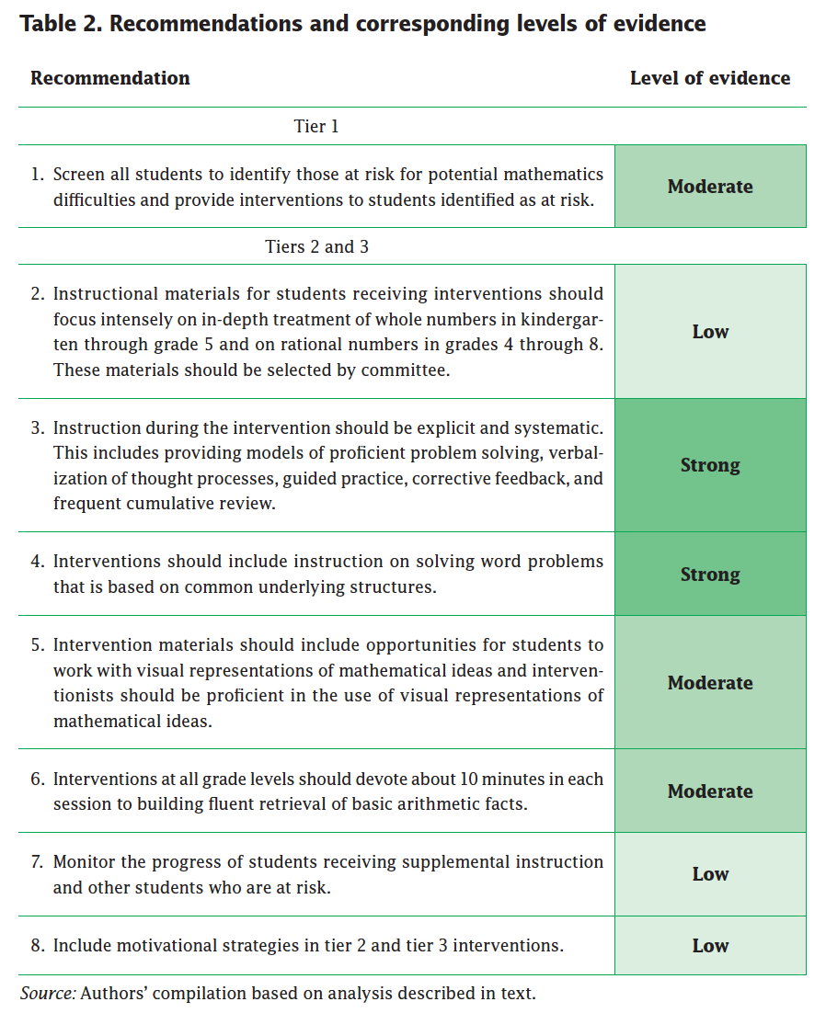
Slide 8
Explicit instruction
Multiple representations
Concise language
Fluency building
Problem solving instruction
Motivation component
Gersten et al. (2009)

Slide 9
Reading
Siegler, R., Carpenter, T., Fennell, F., Geary, D., Lewis, J., Okamoto, Y.,…Wray, J. (2010). Developing effective fractions instruction from kindergarten through 8th grade. Washington, DC: National Center for Education Evaluation and Regional Assistance, Institute of Education Sciences, U.S. Department of Education.

Slide 10
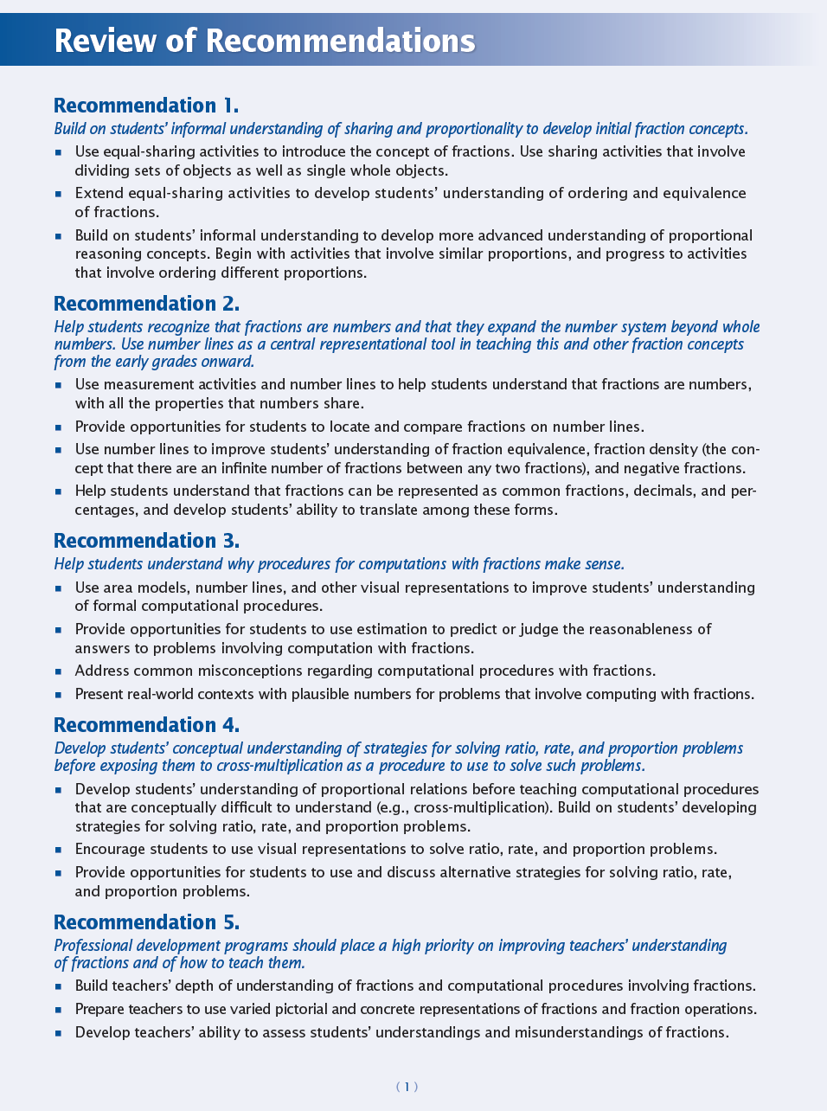
Slide 10

Slide 11
Classroom Application
List two ways to increase your modeling of rational-number concepts
List two ways to increase your modeling of rational-number procedures

Slide 12
Welcome!
Let’s get started on Module 7!

Slide 13
Slide 13
Part 1

Slide 14
What rational-number core concepts should be emphasized in intensive intervention?
Module 7, Part 1

Slide 15
Part 1 Objectives
In this part, you’ll learn—
Core concepts of fractions with the length, area, and set models
Core concepts of decimals

Slide 16
Rational-Number Concepts
Understanding the concepts of rational numbers is important to many other mathematical tasks, especially algebra.
Fractions
Decimals
Percentages

Slide 17
Slide 17
Fractions
Whole
Equal parts
Unit
Fraction
Proper fraction
Improper fraction
Mixed number
Numerator
Denominator
2
3
9
5
1
4
2

Slide 18
Slide 18
Note:
There are three models of fractions. Students should have familiarity with all three models.

Slide 19
Slode 19
Fractions
Length
2
3
0
1
Fraction bars or tiles

Slide 20
Slide 20
Fractions
Length
2
3
0
1
0
1
Cuisenaire rods

Slide 21
Slide 21
Fractions
Length
2
3
0
2
3
1
Number lines

Slide 22
Slide 22
Fractions
Length
Fractions appropriated by length. Helps students understand the magnitude of the fraction.
Can use or draw
Fraction tiles or bar
Cuisenaire rods
Number lines

Slide 23
Workbook Activity #1
Look at how the student represented 4/5.
How could you use the length model to help the student understand the fraction? Draw and write your response.

Slide 24
Slide 24
Fractions
Area
2
3
Fraction circles

Slide 25
Fractions
Area
2
3
Geoboards

Slide 26
Slide 26
Fractions
Area
2
3
Pattern blocks

Slide 27
Slide 27
Fractions
Area
Fractions appropriated by area.
Can use or draw:
Fraction circles
Geoboards
Pattern blocks

Slide 28
Workbook Activity #2
Look at how the student represented 4/5.
How could you use the area model to help the student understand the fraction? Draw and write your response.

Slide 29
Slide 29
Fractions
Set
2
3
Any two types of manipulatives

Slide 30
Slide 30
Fractions
Set
2
3
Two-color counters

Slide 31
Slide 31
Fractions
Set
Fractions appropriated by sets of items.
Can use or draw:
Any shapes or objects
Two-color counters

Slide 32
Workbook Activity #3
Look at how the student represented 4/5.
How could you use the set model to help the student understand the fraction? Draw and write your response.

Slide 33
A Few Considerations
The models of fractions should be introduced separately and practiced until students develop strong understanding.
Concrete manipulatives and other representations may help some, but not all, students. Your tool box needs to be full!

Slide 34
Why Is This Important?
Students see problems in textbooks and on assessments with pictorial representations of all three models.
Understanding fraction concepts is essentially the first gatekeeper to developing core knowledge about algebra.

Slide 35
Rational-Number Concepts
Understanding the concepts of rational numbers is important to many other mathematical tasks, especially algebra.
Fractions
Decimals
Percentages

Slide 36
Slide 36
Decimals
Percentages
Place value
Reading of decimals
”and”
Tenths, hundredths, thousandths

Slide 37
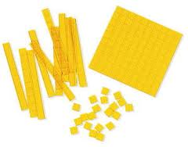
Slide 37
Decimals
Percentages
0.25 1.09 95%

Slide 38
Part 1’s Checklist: What rational-number core concepts should be emphasized in intensive intervention?
Teach the length model of fractions
Teach the area model of fractions
Teach the set model of fractions
Teach decimal and percentage concepts

Slide 39
Discussion Board
Share your favorite tools that you use when teaching about fractions. Describe why each tool is helpful and how you do modeling and practice with your students. You could share a video or print materials.

Slide 40
Slide 40
Part 2

Slide 41
What rational-number procedures should be emphasized in intensive intervention?
Module 7, Part 2

Slide 42
Part 2 Objectives
In this part, you’ll learn—
Computational models for addition, subtraction, multiplication, and division of fractions
Computational models for addition, subtraction, multiplication, and division of decimals

Slide 43
Slide 43
Note:
In this part, we focus on procedures (i.e., algorithms) for computation of rational numbers.
The concepts of operations (from the whole-number module) may be helpful for explanations about operations.

Slide 44
Operations
Addition
Subtraction
Multiplication
Division
Karp, Bush, & Dougherty (2014)
When focusing on rational-number computation, check that students do not have misconceptions about the operations.

Slide 45
Operations
Adding and multiplying answers are always greater
When multiplying by 10, just add 0 at the end
Subtracting and dividing answers are always less
In subtraction, you can’t take away a number that is greater from a number that is less
Karp, Bush, & Dougherty (2014)
Longer numbers are larger numbers

Slide 46
Slide 46
Addition
Fractions
1
5
3
5
+

Slide 47
Slide 47
Addition
Fractions
1
5
3
5
+

Slide 48
Slide 48
Addition
Fractions
1
2
1
4
+

Slide 49
Slide 49
Addition
Fractions
1
2
1
4
+

Slide 50
Slide 50
Addition
Fractions
1
2
1
4
+

Slide 51
Slide 51
Subtraction
Fractions
4
5
1
5
–

Slide 52
Slide 52
Subtraction
Fractions
7
8
2
4
–
Take away from this set
This is for reference

Slide 53
Slide 53
Subtraction
Fractions
7
8
2
4
–
Take away from this set
This is for reference

Slide 54
Workbook Activity #4
Solve the addition problem using two different fraction models.
Solve the subtraction problem using two different fraction models.

Slide 55
Slide 55
Multiplication
Fractions
1
2
4
4
×
One-half of four-fourths

Slide 56
Slide 56
Multiplication
Fractions
1
2
2
4
×
One-half of two-fourths

Slide 57
Slide 57
Multiplication
Fractions
1
2
3
4
×
One-half of three-fourths

Slide 58
Slide 58
Multiplication
Fractions
1
2
3
4
×

Slide 59
Slide 59
Multiplication
Fractions
1
2
3
4
×

Slide 60
Slide 60
Multiplication
Fractions
1
2
3
4
×

Slide 61
Slide 61
Division
Fractions
2
3
1
3
$$÷$$
1 set of one-third
2 sets of one-third

Slide 62
Slide 62
Division
Fractions
5
6
1
2
$$÷$$
1 set of one-half
Two-thirds set of one-half

Slide 63
Slide 63
Division
Fractions
5
6
1
2
$$÷$$

Slide 64
Slide 64
Division
Fractions
5
6
1
2
$$÷$$

Slide 65
Workbook Activity #5
Solve the multiplication problem using two different fraction models.
Solve the division problem using two different fraction models.

Slide 66
Slide 66
Decimals
Percentages
1.25
+ 0.95
2.04
– 1.64

Slide 67
Workbook Activity #6
Review the multiplicative schemas from the module on instructional strategies.
How could you use two different schemas to describe this problem?

Slide 68
Why Is This Important?
Students can often do the computation but have little understanding of how and why.
Understanding the different methods for solving computation problems fills your intensive intervention tool box.

Slide 69
A Few Considerations
Knowledge and fluency with mathematics facts increases efficiency with computation. (See the module about instructional strategies!)
Strong understanding of the operations with whole numbers leads to improved understanding of rational-number computation.

Slide 70
Part 2’s Checklist: What rational-number procedures should be emphasized in intensive intervention?
Understand different models for showing and drawing computation with fractions
Review place value concepts of decimals
Use appropriate language for describing rational numbers and the operations

Slide 71
Discussion Board
Reflect upon the word-problem schema of ratios and proportions. (This was covered in the module about instructional strategies.)
How could you use some of the information in this module to help students understand ratios, unit rate, proportions, and percentages better?

Slide 72
Slide 72
Part 3

Slide 73
What does DBI look like with intensive interventions that focus on conceptual and procedural understanding of rational numbers?
Module 7, Part 3

Slide 74
Part 3 Objectives
In this part, you’ll learn—
How concepts and procedures are practiced within intensive intervention that uses evidence-based practices

Slide 75
Where Are We?

Slide 76
Slide 76
Instructional Platform

Slide 77
Slide 77
Explicit instruction
Multiple representations
Concise language
Fluency building
Problem solving instruction
Motivation component
Gersten et al. (2009)

Slide 78
Let’s Watch Intensive Intervention

Slide 79
Slide 79
Video Link: https://youtu.be/U_VCN1H2JqM
Explicit instruction
Multiple representations
Concise language

Slide 80
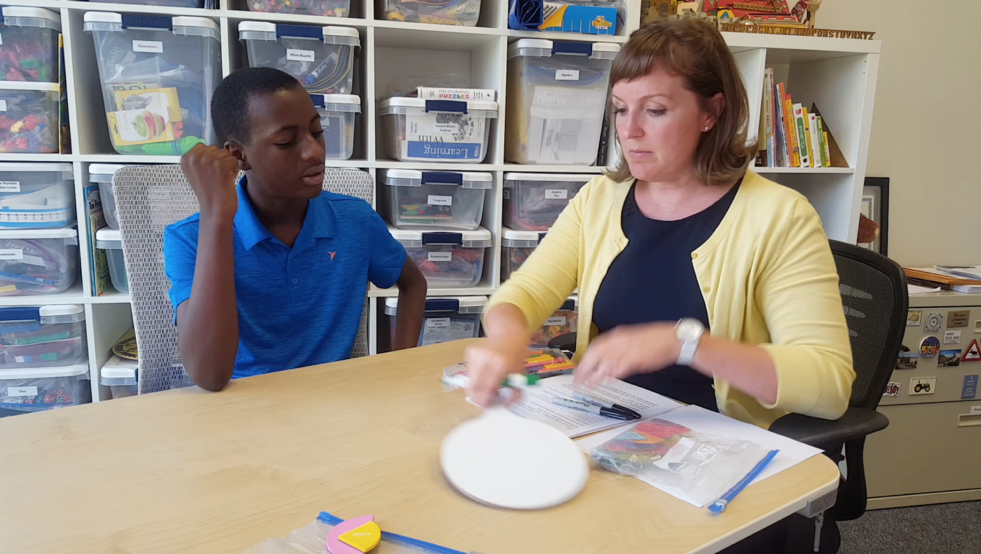
Slide 80
Concepts
Procedures

Slide 81
Slide 81
Video Link: https://youtu.be/fpbjHOJOfZc
Explicit instruction
Multiple representations
Concise language

Slide 82
Slide 82
Video Link: https://youtu.be/Tdwi5IWknYA
Explicit instruction
Multiple representations
Concise language

Slide 83
Slide 83
Video Link: https://youtu.be/8yW0wID_h9Y
Explicit instruction
Multiple representations
Concise language

Slide 84
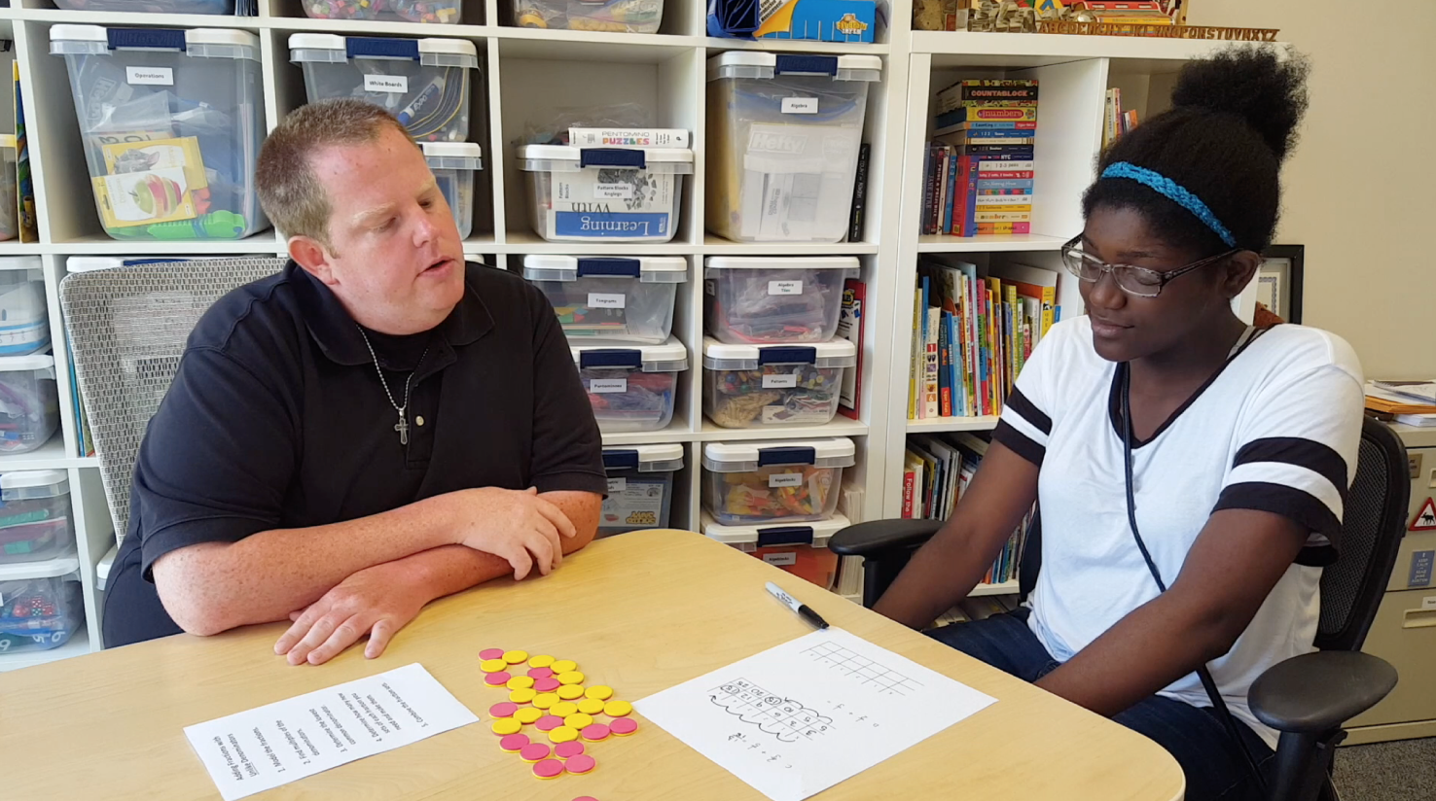
Slide 84
Concepts
Procedures

Slide 85
Slide 85
Workbook Activity #7
Explicit instruction
Read this intensive intervention lesson about fractions. Identify the listed components and how they are used.
Multiple representations
Concise language
Fluency building
Problem solving instruction
Motivation component
Fuchs et al. (2014)

Slide 86
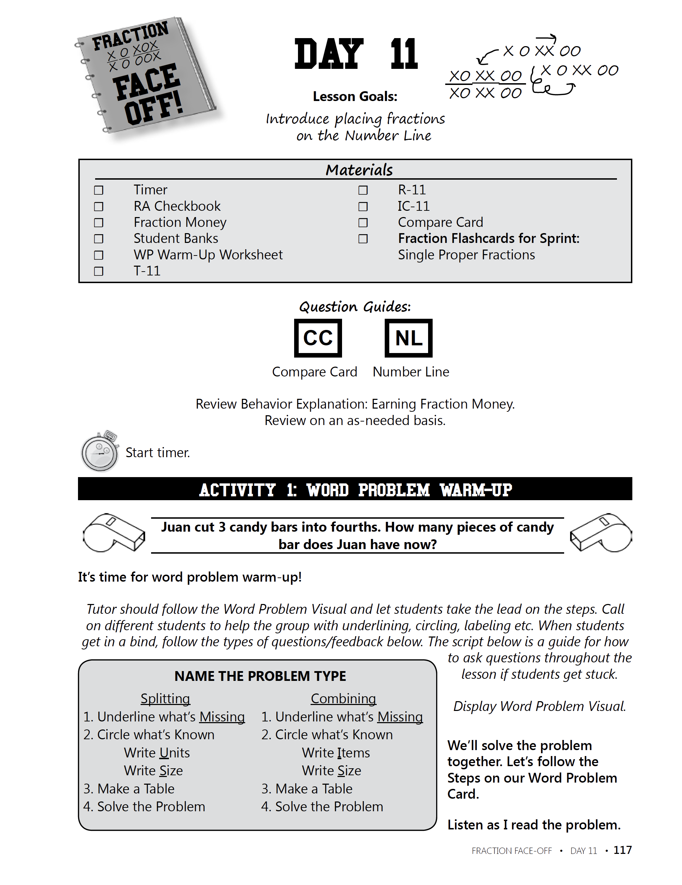
Slide 86
Fuchs et al. (2014)

Slide 87
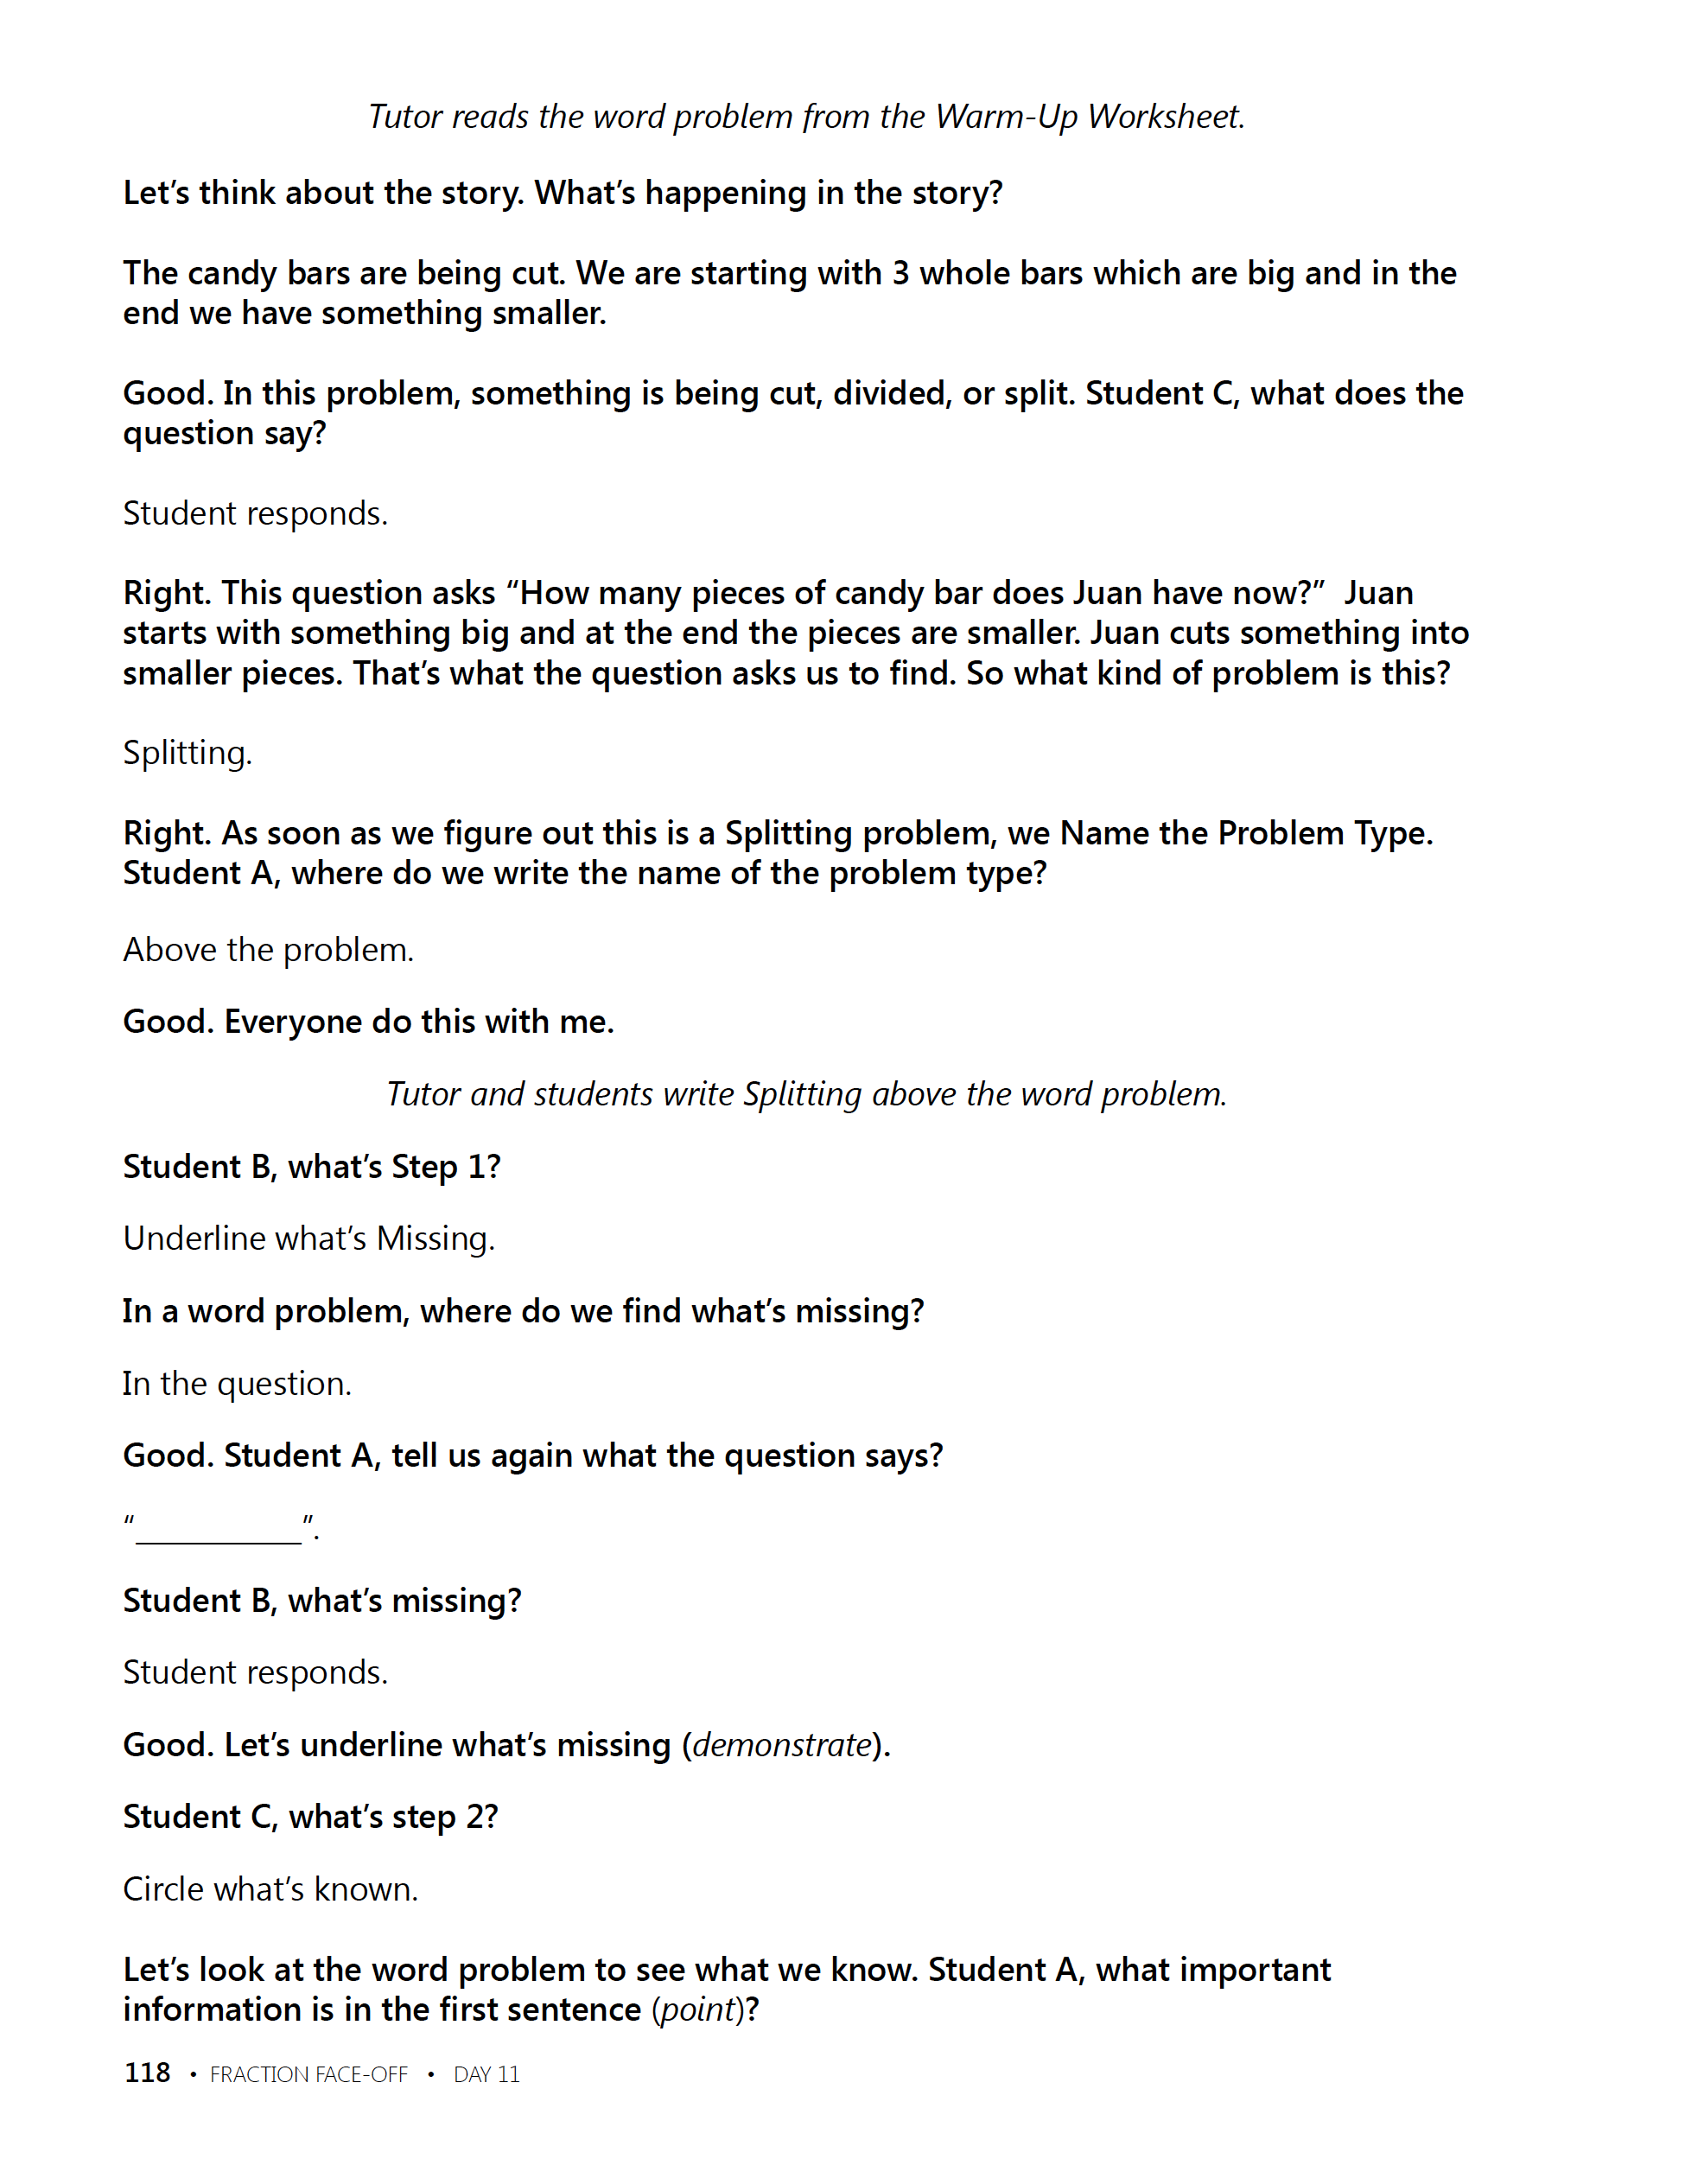
Slide 87
Fuchs et al. (2014)

Slide 88
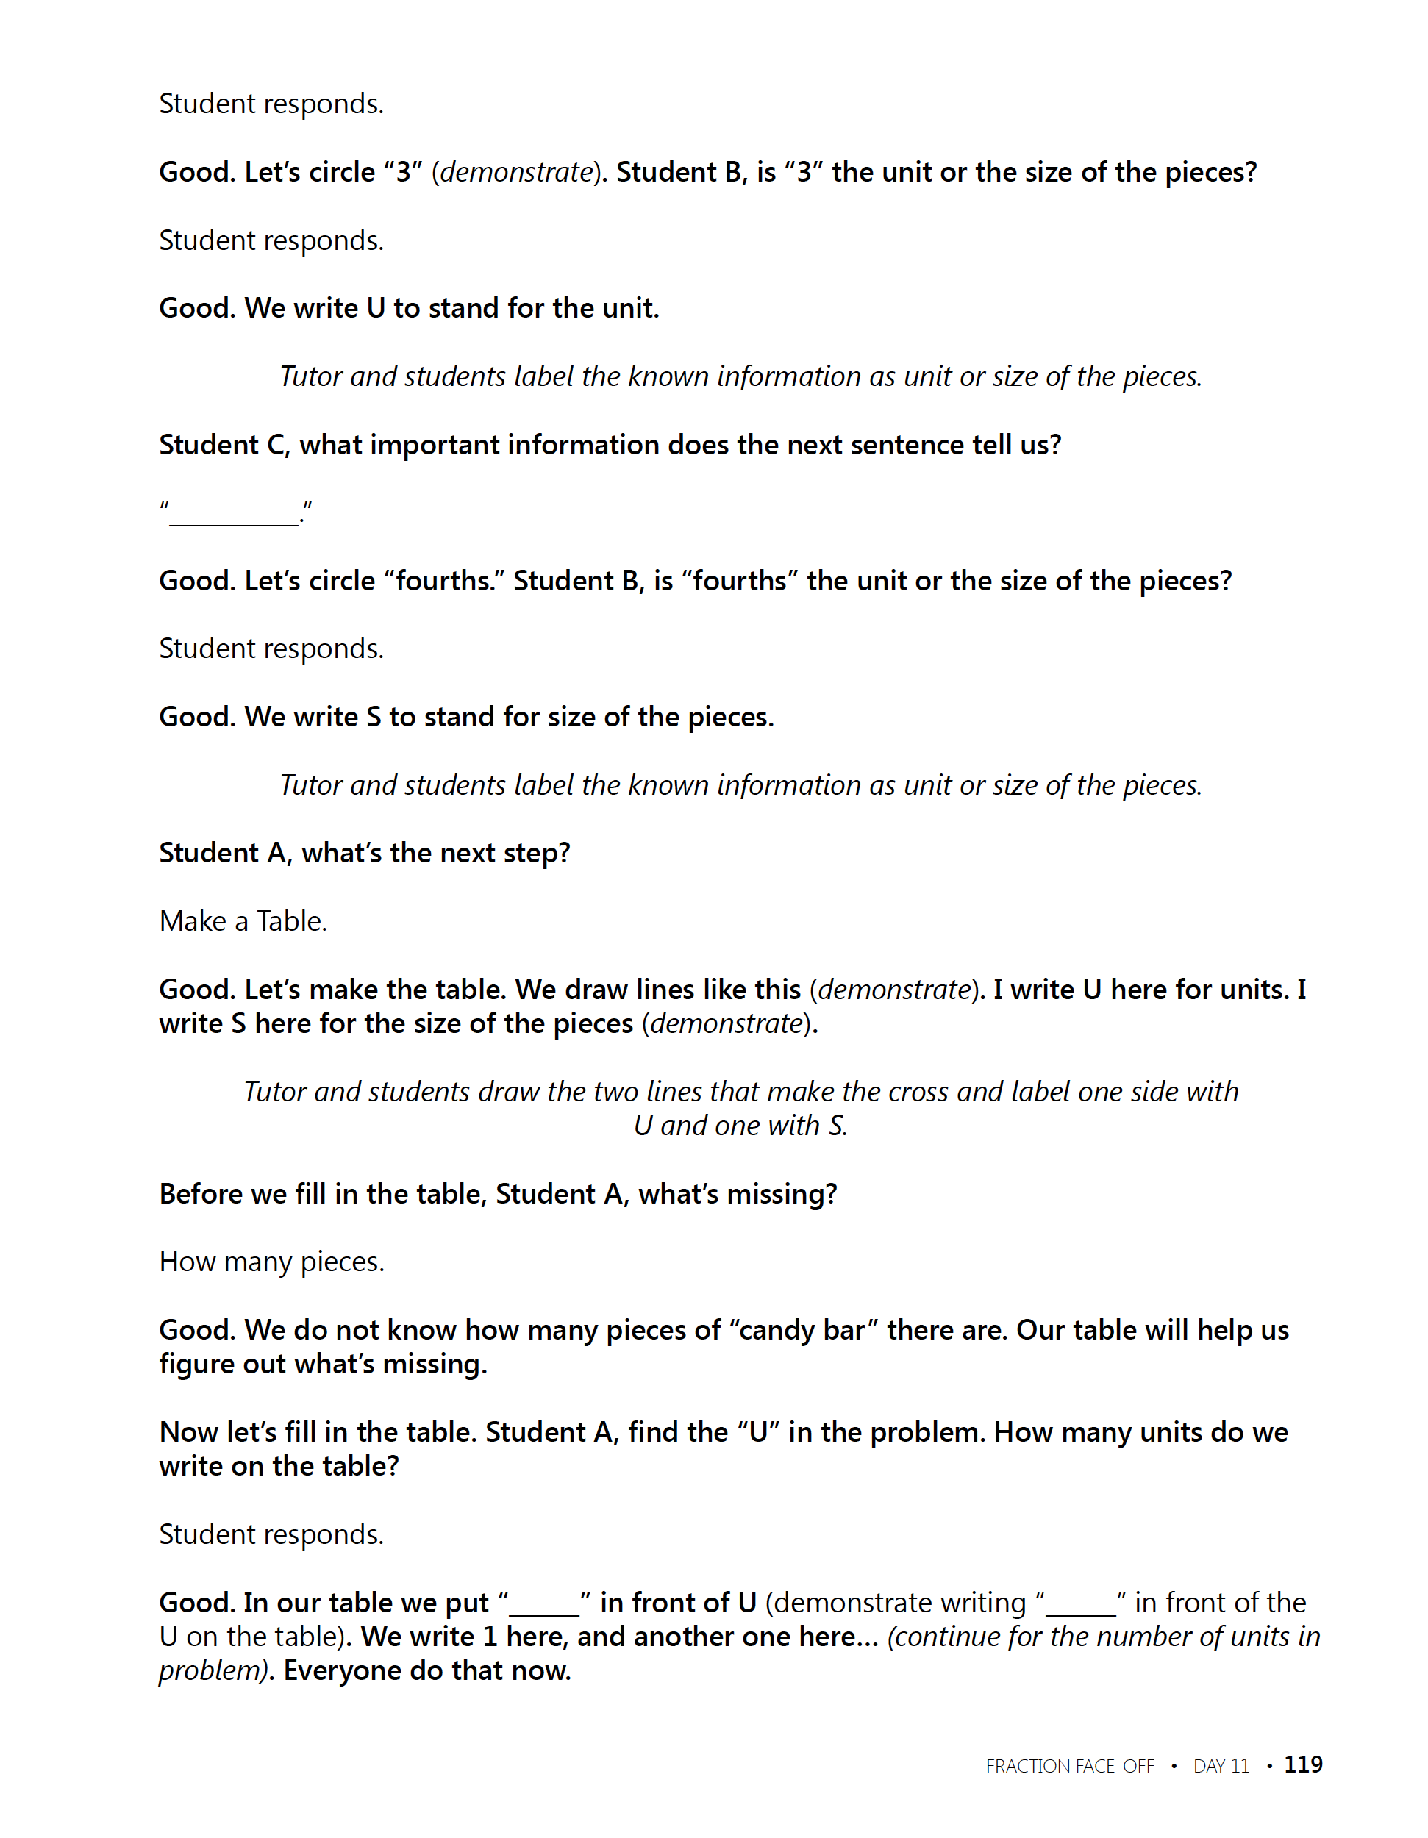
Slide 88
Fuchs et al. (2014)

Slide 89
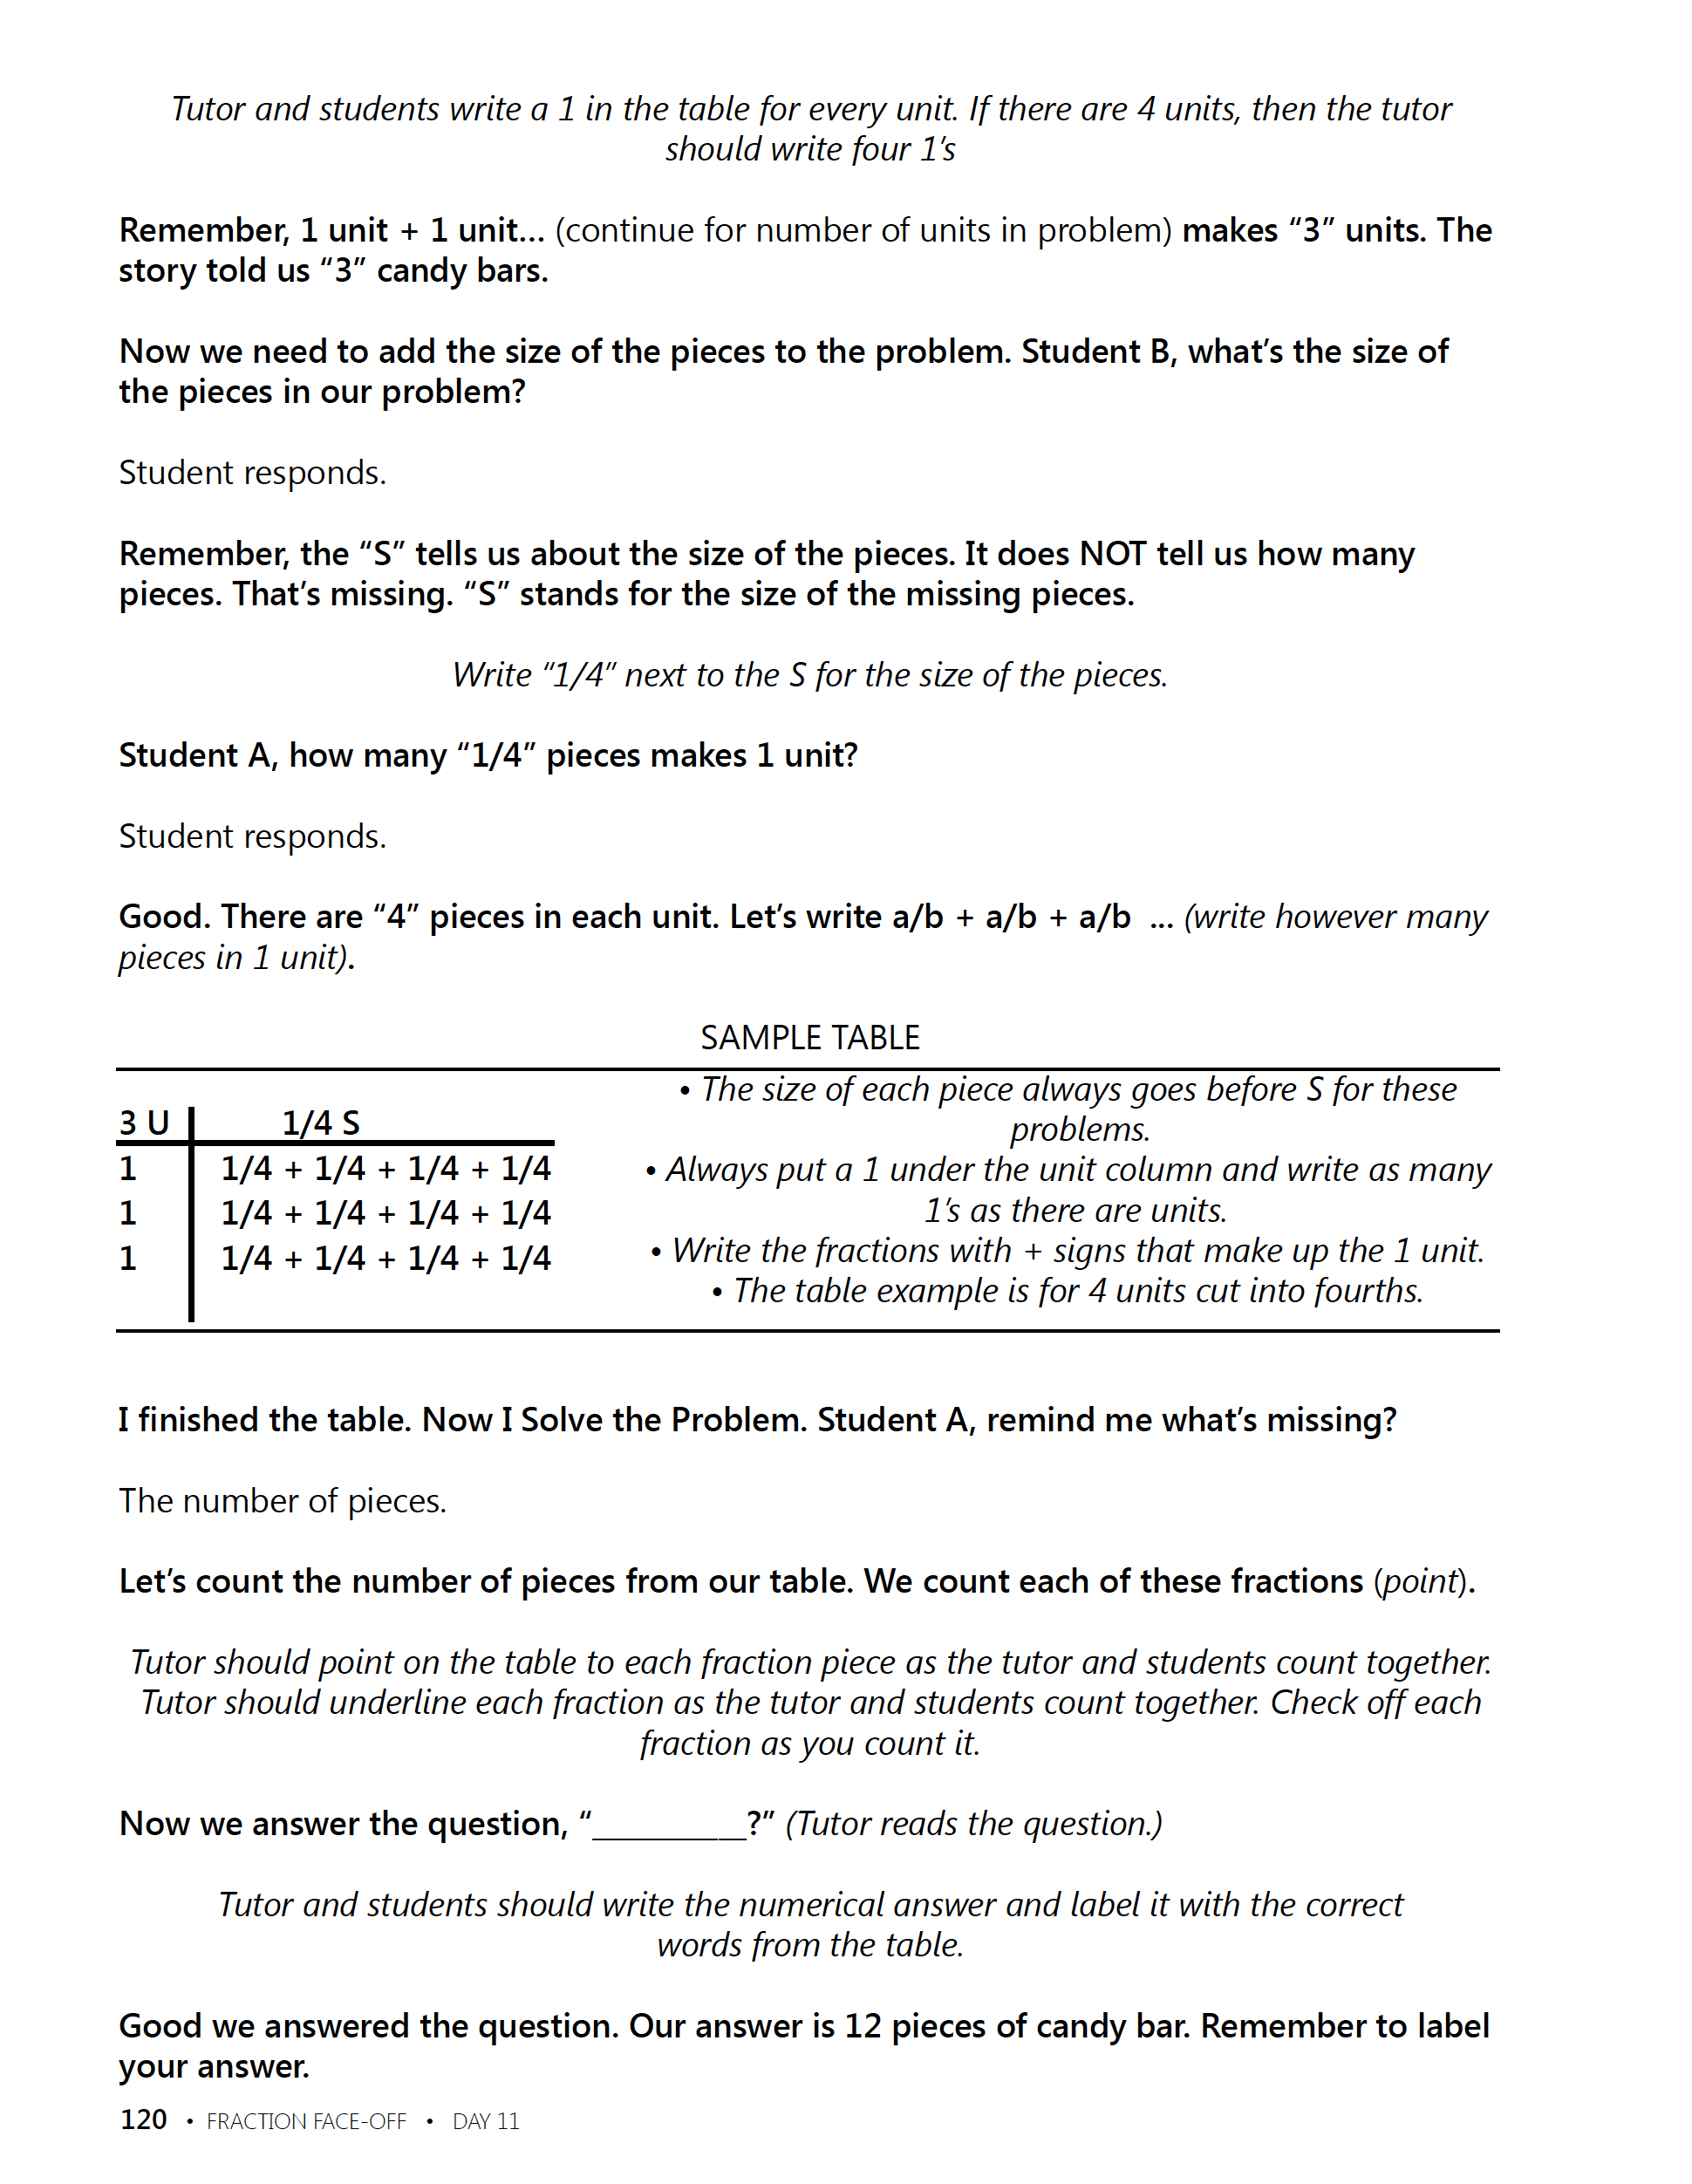
Slide 89
Fuchs et al. (2014)

Slide 90
Slide 90
Fuchs et al. (2014)

Slide 91
Slide 91
Fuchs et al. (2014)

Slide 92
Slide 92
Fuchs et al. (2014)

Slide 93
Slide 93
Fuchs et al. (2014)

Slide 94
Slide 94
Fuchs et al. (2014)

Slide 95
Slide 95
Fuchs et al. (2014)

Slide 96
Part 3’s Checklist: What does DBI look like with intensive interventions that focus on conceptual and procedural understanding of rational numbers?
Be explicit
Use multiple representations
Use precise and concise language
Include fluency building activities
Include a focus on problem solving
Utilize a motivation component

Slide 97
Discussion Board
Make a video of yourself teaching fractions, decimals, or percentages.
Share your experience with your classmates for examples and new understanding.

Slide 98
Slide 98
Closing

Slide 99
Objectives
PART 1: What rational-number core concepts should be included within intensive intervention?
PART 2: What rational-number procedures should be emphasized within intensive intervention?
PART 3: What does DBI look like with intensive interventions that focus on conceptual and procedural understanding of rational numbers?

Slide 100
Slide 100
Video Link: https://youtu.be/vE0H2D57ZJQ

Slide 101
Slide 101
1: Developing a scope and sequence for intervention
2: Progress monitoring and determining response
3: Selecting evidence-based practices for the instructional platform
4: Instructional delivery: explicit instruction, multiple representations, language
5: Instructional strategies: fluency building, problem solving, motivation
6: Whole number content
7: Rational number content
8: DBI and mathematics: fidelity, adaptations

Slide 102
Part 1
Understanding the concepts of rational numbers is important to many other mathematical tasks, especially algebra.
Fractions
Decimals
Percentages

Slide 103
Part 1’s Checklist: What rational-number core concepts should be emphasized in intensive intervention?
Teach the length model of fractions
Teach the area model of fractions
Teach the set model of fractions
Teach decimal and percentage concepts

Slide 104
Part 2
Addition
Subtraction
Multiplication
Division
Karp, Bush, & Dougherty (2014)
When focusing on rational-number computation, check that students do not have misconceptions about the operations.

Slide 105
Part 2’s Checklist: What rational-number procedures should be emphasized in intensive intervention?
Understand different models for showing and drawing computation with fractions
Review place value concepts of decimals
Use appropriate language for describing rational numbers and the operations

Slide 106
Slide 106
Explicit instruction
Multiple representations
Concise language
Fluency building
Problem solving instruction
Motivation component
Gersten et al. (2009)

Slide 107
Part 3’s Checklist: What does DBI look like with intensive interventions that focus on conceptual and procedural understanding of rational numbers?
Be explicit
Use multiple representations
Use precise and concise language
Include fluency building activities
Include a focus on problem solving
Utilize a motivation component

Slide 108
Classroom Application
List two ways to increase your modeling of rational-number concepts
List two ways to increase your modeling of rational-number procedures

Slide 109
Looking Ahead

Slide 110
Slide 110
1: Developing a scope and sequence for intervention
2: Progress monitoring and determining response
3: Selecting evidence-based practices for the instructional platform
4: Instructional delivery: explicit instruction, multiple representations, language
5: Instructional strategies: fluency building, problem solving, motivation
6: Whole number content
7: Rational number content
8: DBI and mathematics: fidelity, adaptations

Slide 111
Module 8
Powell, S. R., & Fuchs, L. S. (2015). Intensive intervention in mathematics. Learning Disabilities Research and Practice, 30, 182–192. doi:10.1111/ldrp.12087

Slide 112
See You Soon!

