Slide 1
Course Content Resource for Intensive Intervention
October 7, 2020
Faculty Professional Learning Series: Webinar #3
Lindsey Hayes, M.Ed., & Amy Colpo, M.P.P., American Institutes for Research
Jennifer Freeman, Ph.D., & Melissa Stalega, M.Ed., University of Connecticut

Slide 2
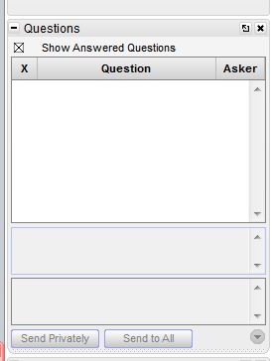
Webinar Format & Questions
Throughout the presentation, submit your questions into the question pod.
For technical issues/questions, a webinar team member will try to assist you as soon as possible.
For content related questions, there will be a time for Q&A at the end of the presentation. Submit your questions and we will share them with the presenters.

Slide 3
Faculty Professional Learning Series
Teacher preparation faculty and professional development providers will:
Learn from colleagues and NCII experts about available tools and resources to enhance coursework, field experiences, and professional development opportunities related to intensive intervention.
Share successes, challenges, and lessons learned from the process of enhancing preservice and inservice learning opportunities for educators responsible for delivering intensive intervention.

Slide 4
Agenda
Course content resources overview (20 min)
Course example: Behavior support for intensive intervention (15 min)
Course example: Reading intensive intervention (15 min)
Closing (10 min)

Slide 5
Intensive Intervention Course Content:
Overview of Purpose and Structure

Slide 6
Intensive Intervention Course Content
What Is It?
Suite of ready-to-use resources to create new or supplement existing teacher preparation coursework or professional development content on intensive intervention.
Designed for faculty and professional development providers.
Who Developed It?
National Center on Intensive Intervention
University of Connecticut
National Center on Leadership in Intensive Intervention
CEEDAR Center

Slide 7
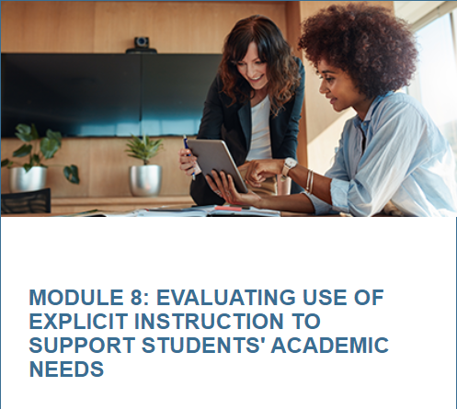
Course Topics
NCII has course content resources in the following topic areas:
Features of Explicit Instruction
Intensive Intervention in Mathematics
Intensive Intervention in Reading
Behavior Support for Intensive Intervention

Slide 8
Who Can Use These Resources?
Preservice educator preparation faculty
Inservice professional development providers
Educators or educator candidates seeking to enhance their skills in intensive intervention
Anyone focused on enhancing educators’ skills in intensive intervention for students with severe and persistent learning and behavioral needs!

Slide 9
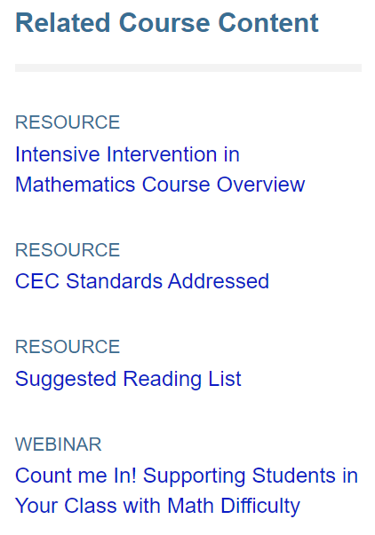
Course Landing Page

Slide 10
Course Overview

Slide 11
Related Course Content
Course Overview Document
Council for Exceptional Children (CEC) Standards Addressed
Suggested Reading List
Additional Resources

Slide 12
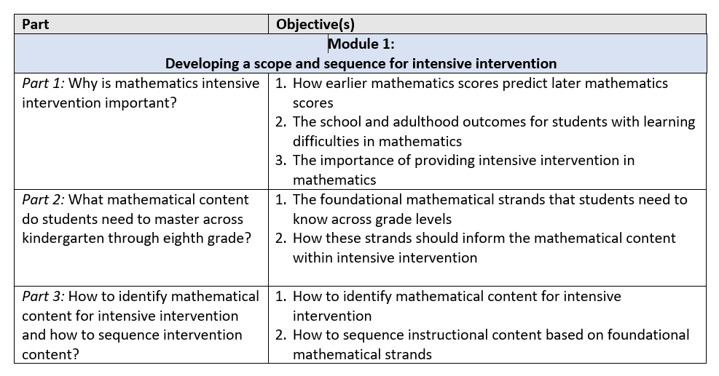
Course Overview Document

Slide 13
CEC Standards Addressed

Slide 14
Suggested Reading List

Slide 15
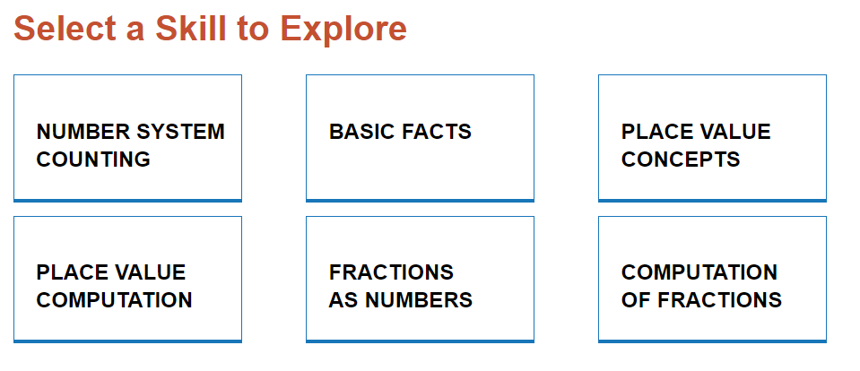
Additional Resources
Webinars
Sample lessons
Tools and tips
More!
Mathematics Strategies to Support Intensifying Interventions: Sample Lessons

Slide 16
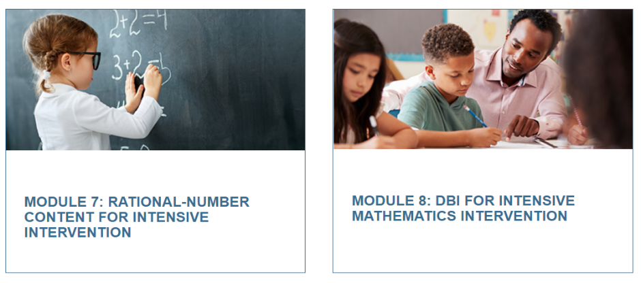
Modules

Slide 17
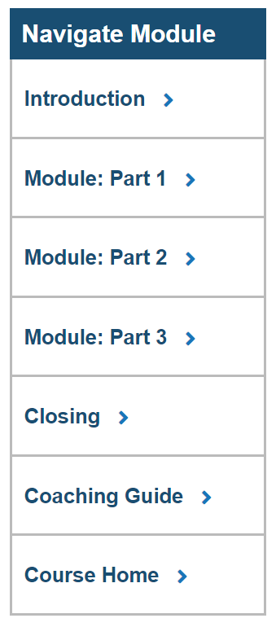
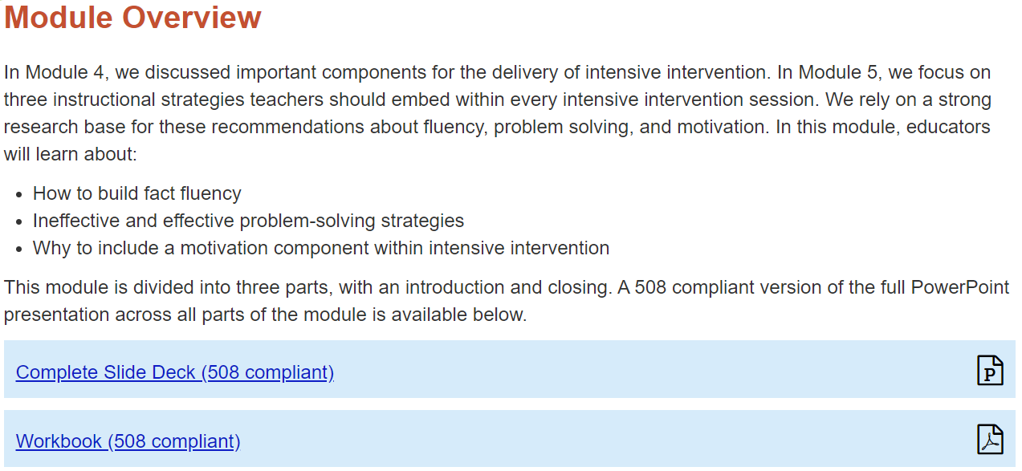
Module Landing Page

Slide 18
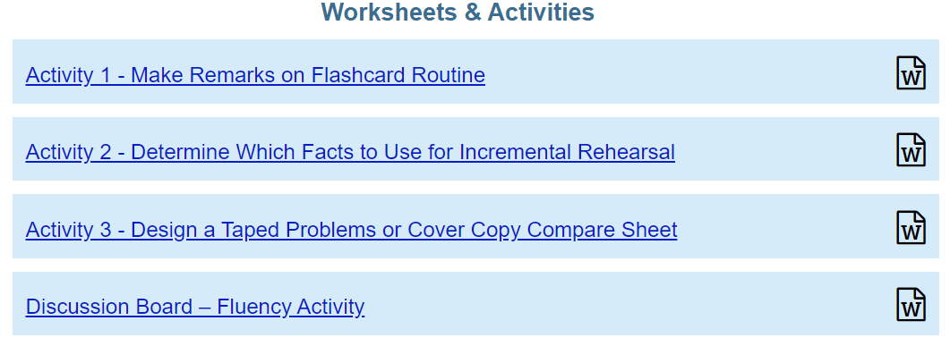
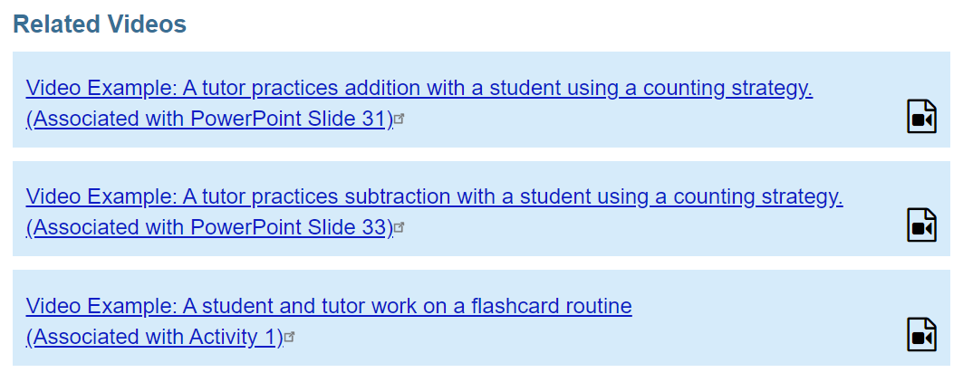
Example Module Section

Slide 19
Course Content Features
Evidence-Based
Multimedia
Application Activities
Assessments

Slide 20
Ways To Use Course Content Resources
Adopt the full module sequence to create a course or unit.
Select modules or parts of modules to supplement existing coursework or professional development materials.
Customize with state, district, or school context.
Experiment with timing:
Synchronous: Practice and discussion opportunities during virtual class.
Asynchronous: Prework for flipped classroom model.

Slide 21
Explicit Instruction Course Content
Module 1: Introduction to Intensive Intervention
Module 2: Progress Monitoring
Module 3: Diagnostic Assessment
Module 4: Using the Taxonomy of Intervention Intensity
Module 5: Modeling and Practicing to Help Students Reach Academic Goals
Module 6: Supporting Practices: Using Effective Methods to Elicit Frequent Responses
Module 7: Supporting Practices: Providing Immediate Specific Feedback and Maintaining a Brisk Pace
Module 8: Evaluating Use of Explicit Instruction to Support Students’ Academic Needs

Slide 22
Mathematics Course Content
Module 1: Developing a Scope and Sequence
Module 2: Mathematics Progress Monitoring
Module 3: Selecting and Evaluating Evidence-Based Practices
Module 4: Instructional Delivery
Module 5: Instructional Strategies
Module 6: Whole Number Content
Module 7: Rational Number Content
Module 8: Data-Based Individualization for Mathematics

Slide 23
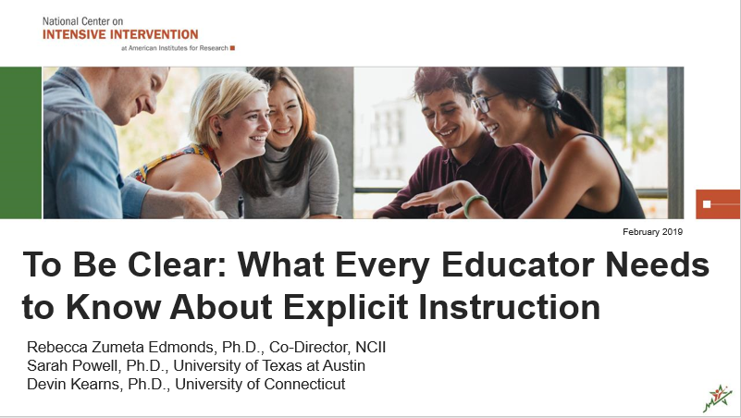
For More Information
To Be Clear: What Every Educator Needs to Know About Explicit Instruction
Make Your Course Count: Preparing Educators to Support Students with Math Difficulty

Slide 24
Course Example: Behavior Support for Intensive Intervention
Dr. Jennifer Freeman
Associate Professor
University of Connecticut

Slide 25
Behavior Modules 1-4
Foundational Theory
1-2
Importance of behavior support
Elements of behavioral theory
Antecedent and Instructional Strategies
3
Designing and structuring a classroom
Increasing Appropriate Behavior
4
Importance of acknowledgement and tips for using it effectively
Using theory to guide and adjust implementation
Defining and teaching expectations
Active engagement and instructional management practices
Specific positive feedback
Additional reinforcement strategies (e.g., group contingencies, token economies)
Adjusting your use of acknowledgement

Slide 26
Behavior Modules 5-8
Decreasing Inappropriate Behavior
5
Error correction strategies including planned ignoring, differential reinforcement, response cost, time out from reinforcement, and over correction
Tips for using error correction within a positive proactive framework
Measuring Behavior and Using Data
6-7
Selecting defining and measuring target behaviors and relevant dimensions of behavior
Using implementation data and student outcome data to guide and adjust implementation of practices
Intensifying Behavior Support
8
Tier 2 readiness and critical features
Key elements of individualized support
Designed to provide an overview of what to look for rather than fully train individuals for implementation

Slide 27
Supporting Resources
Based on key freely available resources from the Center on PBIS
Developed by national experts based on empirical research
Other aligned resources:

Slide 28
Behavior Course Elements
Courses have been piloted with both pre-service and in-service teachers and feedback was used to refine and further develop materials.
Each module includes:
Video instruction (segmented)
Downloadable workbook including:
Module checklist of all activities and suggested timelines
Guided notes and all module response activities
A brief content quiz to check for understanding of key concepts
Classroom application activities (for most modules) to be completed with a coach or a mentor

Slide 29
Behavior Course Tips
Modules are designed to be presented as a complete course; however, if needed individual modules can be used to supplement an existing course or as extra credit opportunities.
Suggested pacing is roughly one module per week or one semester.
Modules can be assigned as asynchronous class assignments prior to synchronous class discussions or application activities.
Content quizzes and response activities can be used as class assignments providing learners with additional feedback.
Application activities can be completed in clinic placements or in some cases role played during synchronous class meetings.

Slide 30
Questions?
jennifer.freeman@unconn.edu

Slide 31
Course Example: Intensive Intervention in Reading
Melissa Stalega
Doctoral Fellow
University of Connecticut

Slide 32
Intensive Intervention in Reading
Module | Contents
1: Introduction to Intensive Intervention in Reading | Why intensive intervention in reading is important Data-based individualization (DBI) in reading
3: Intervention Programs in Reading | How do intervention programs support students and teachers? What intervention programs are available for teaching reading? How to evaluate an intervention program’s materials and research evidence
4: How Does Progress Monitoring and Instructional Decision-Making Work in Reading? | How does the DBI process apply to reading? How to: select, administer and score CBMs in reading determine a student’s present level of performance select a goal determine the baseline to set a goal use progress monitoring to make instructional decisions
5: Diagnostic and Mastery Assessment in Reading | How to: identify specific reading skills or strategies that you need to teach create and implement CBA probes to help refine instructional focus and review student assessment performance use diagnostic data to inform content of instructional adaptations
6: Qualitative Adaptations for Teaching Word Reading* | How to: adapt reading instruction to improve instructional modeling & student practice elicit frequent responses and provide effective feedback during word reading instruction
7: Qualitative Adaptations for Teaching Comprehension* | How to adapt comprehension instruction to improve instructional modeling
*Modules 6 and 7 discuss implications for practice within explicit instruction including what is effective modeling, guided practice, supporting practices, and how can they be improved.

Slide 33
Reading Course Elements
Each module contains workbook activities that are a combination of multiple choice, journal entries, and discussion questions
Real video examples with explanation
Quizzes
Application activities
Recommended readings

Slide 34
Reading Course Tips
Utilize the discussion board on your learning management system (LMS)
Encourage feedback on discussion board posts from peers
Video record application activities/modeling a lesson and send to instructor and/or peers for feedback
Suggest debriefing after each quiz
Encourage classroom collaboration/partner work
Start a google doc to jot down ideas and discussion questions (e.g. What questions do you have about the readings? What are your biggest “takeaways” from this module?)

Slide 35
Questions? (2)

Slide 36
Website Tour

Slide 37
Faculty Learning Series Webpage
Access recordings, transcripts, and slide decks from past webinars at https://intensiveintervention.org/resource/faculty-professional-learning-series-intensive-intervention.
Materials from today’s webinar will be posted shortly.

Slide 38
Upcoming Webinars
Webinar #4: Continuous Program Improvement
December 1, 2020 from 3:00-4:00pm ET

Slide 39
Questions or Comments
Lindsey Hayes: lhayes@air.org
Amy Colpo: acolpo@air.org

Slide 40
NCII Disclaimer
This presentation was produced under the U.S. Department of Education, Office of Special Education Programs, Award No. H326Q160001. Celia Rosenquist serves as the project officer. The views expressed herein do not necessarily represent the positions or policies of the U.S. Department of Education. No official endorsement by the U.S. Department of Education of any product, commodity, service, or enterprise mentioned in this presentation is intended or should be inferred

