Slide 1
Recommendations and Resources for Preparing Educators in the Endrew F. Era
May 2019
Mitchell Yell, David Bateman, Tessie Bailey, and Teri Marx

Slide 2
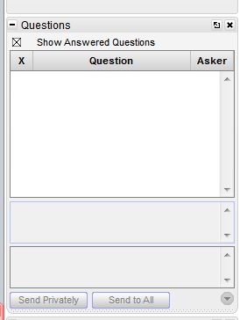
Webinar Format & Questions
Throughout the presentation, submit your questions into the question pod.
For technical issues/questions, a webinar team member will try to assist you as soon as possible.
For content related questions, there will be a time for Q&A at the end of the presentation. Submit your questions and we will share them with the presenters.

Slide 3
The National Center on Intensive Intervention
Our Mission: Build capacity of state and local educational agencies, universities, practitioners, and other stakeholders to support implementation of intensive intervention in reading, mathematics, and behavior for students with severe and persistent learning and/or behavioral needs.
Website: www.intensiveintervention.org

Slide 4
Introductions
Mitchell Yell, PhD, University of South Carolina, myell@sc.edu
David Bateman, PhD, Shippensburg University, DFBate@ship.edu
Tessie Rose Bailey, PhD, National Center on Intensive Intervention at AIR, tbailey@air.org
Teri Marx, PhD, National Center on Intensive Intervention at AIR, tmarx@air.org

Slide 5
Session Overview
Historical Context Leading to the Endrew F. Decision
Key Findings of Endrew F. (2017)
Endrew F. v. Douglas County School District Re-1, 137 S. Ct. 988.
Six Recommendations for Preparing Educators
Tools and Resources to Support Implementation of Recommendations
Question and Answer Session

Slide 6
Before we begin…
The primary requirement of the IDEA, and the obligation of school districts, is to provide special education programs that confer a free appropriate public education (FAPE).
For full article, see Yell, M. L., & Bateman, D. F. (2017). Free Appropriate Public Education and Endrew F. v. Douglas County School System (2017): Implications for Personnel Preparation. Teacher Education and Special Education, 42(1) 6–17.

Slide 7
Free Appropriate Public Education (FAPE)
Special education and related services that
(A) are provided at public expense,
(B) meet standards of the State educational agency,
(C) include an appropriate preschool, elementary, or secondary school education in the state involved, and
(D) are provided in conformity with the individualized education program. (IDEA, 20 U.S.C. § 1401(a)(18))

Slide 8
The U.S. Supreme Court Interprets the FAPE Mandate
Board of Education of the Hendrick Hudson School District v. Rowley (1982)
Procedural
Substantive
Endrew F. v. Douglas County School District R1 (2017)

Slide 9
Background: Endrew F.
Facts of the Case
Litigation
Administrative law judge (ALJ)-2012
U.S. District Court for the District of Colorado-2014
U.S. Circuit Court of Appeals for the 10th Circuit-2016
“The educational benefit mandated by the IDEA must merely be more than de minimis” (Endrew F., 2015, p. 1338).
U.S. Supreme Court-2017
Question presented: What is the level of educational benefit school districts must confer on children with disabilities to provide them with the free appropriate public education guaranteed by the IDEA? (Endrew F., 2017, Solicitor General).

Slide 10
Oral Arguments in Endrew F.: January 11, 2017
(
(L to R) Dr. Deb Ziegler, CEC’s Director of Policy & Advocacy; Katie Grady, CEC’s Policy & Advocacy Coordinator; Dr. Mitchell Yell & Dr. David Bateman attend oral arguments for Endrew F. v. Douglas County School District at the United States Supreme Court

Slide 11
Supreme Court Ruling: March 22, 2017
“To meet its substantive obligation under the IDEA, a school must offer an IEP reasonably calculated to enable a child to make progress appropriate in light of the child’s circumstances.” (Endrew F., 2017, p. 16)

Slide 12
The Final Chapter of Endrew F.
U.S. Circuit Court of Appeals for the 10th Circuit - 2017
U.S. District Court for the District of Colorado - 2018
Endrew’s “IEP was not appropriately ambitious because it did not give (Endrew) the chance to meet challenging objectives” (Endrew, 2018, p. 20).
After 7 years of litigation, the Douglas County School District paid $1.3 million from the District’s general fund to settle the case (Denver Post, 2/12/18).

Slide 13
Endrew F. Point 1
The Supreme Court rejected the “de minimis” or “trivial” educational benefit standard.

Slide 14
Endrew Quote
“A student offered an education program providing ‘merely more than de minimis' progress from year to year can hardly be said to have been offered an education at all”
-Endrew, 2017, p. 14-

Slide 15
Endrew Point 2
The Endrew F. decision did not replace or overturn the Rowley decision; rather, it clarified its FAPE standard.

Slide 16
FAPE Analysis Under Rowley/Endrew
In the development of an IEP, has the IEP Team complied with the procedures set forth in the IDEA?
Is the IEP reasonably calculated to enable the child to make progress that is appropriate in light of his or her circumstances?

Slide 17
Endrew Point 3
The Supreme Court’s decision emphasizes “progress.”

Slide 18
Endrew Quote 2
“The IEP must aim to enable the child to make progress. After all, the essential function of an IEP is to set out a plan for pursuing academic and functional advancement.” - Endrew F., 2017, p. 11-

Slide 19
Endrew F. Point 4
The Endrew F. decision provides guidance to administrators, educators, and IEP team members in developing IEPs that meet the Endrew standard.

Slide 20
Focus of Endrew
A focus on the particular child is at the core of the IDEA. The instruction offered must be “specially designed” to meet a child’s “unique needs” through an “individualized education program.” An IEP is constructed only after careful consideration of the child’s present levels of achievement, disability, and potential for growth.

Slide 21
Recommendations for Preparing Educators

Slide 22
Recommendation 1: Ensure that special education teachers and administrators are legally literate in special education.
Provide special education preservice teachers’ thorough grounding in special education law in coursework and a working knowledge of how to access current information on legal developments in special education.
Ensure professional development activities that keep special education teachers abreast of legal developments.
Encourage staff to join professional organizations (e.g., CEC) to stay up-to-date.

Slide 23
Recommendation 2: Ensure that general education teachers understand their responsibilities under the IDEA.
Provide general education teachers sufficient information on their rights and responsibilities in educating students with disabilities.
Ensure general education teacher possess the knowledge and skills to effectively differentiate instructional strategies for students with disabilities and implement accommodations and modifications that may be included in a students’ IEPs.

Slide 24
Recommendation 3: Ensure that special education teachers are equipped with strategies and procedures to involve a student’s parents in the special education process.
Emphasize this topic in special and general education teacher preparation programs.
Make parental involvement a priority for students in special education at the state, district, and school level.

Slide 25
Recommendation 4: Ensure that special education teachers can administer, understand, and interpret assessments that are relevant and meaningful in academic and/or functional areas.
Prepare teachers to understand student assessment serves as a baseline of student performance and they must continually conduct formative assessments of student progress during a school year.
NCII Tools and Resources Can Help!

Slide 26
Recommendation 5: Ensure that special education teachers understand and can develop ambitious and measurable annual goals.
Ensure the pre-service special education teachers can (a) explain the purpose of developing measurable annual goals, (b) develop goals that are measurable, and (c) measure student progress toward these goals.
Provide coaching and support to current special educators to write developing goals that are appropriately challenging.
NCII Tools and Resources Can Help!

Slide 27
Recommendation 6: Ensure that special education teachers can collect, understand, interpret, and react to progress monitoring data.
Provide sufficient practice opportunities in pre-service and in-service learning opportunities to master these skills.
Ensure special educators have access to valid and reliable tools that can be used to frequently monitor progress on IEP goals.
NCII Tools and Resources Can Help!

Slide 28
Endrew Quote 4
“If a child is not making expected progress toward his or her annual goals, the IEP team must revise, as appropriate, the IEP to address the lack of progress” Dept. of Education’s FAQ - Endrew F., question 15-

Slide 29
Tools and Resources to Support Implementation of Recommendations
National Center on Intensive Intervention (NCII)

Slide 30
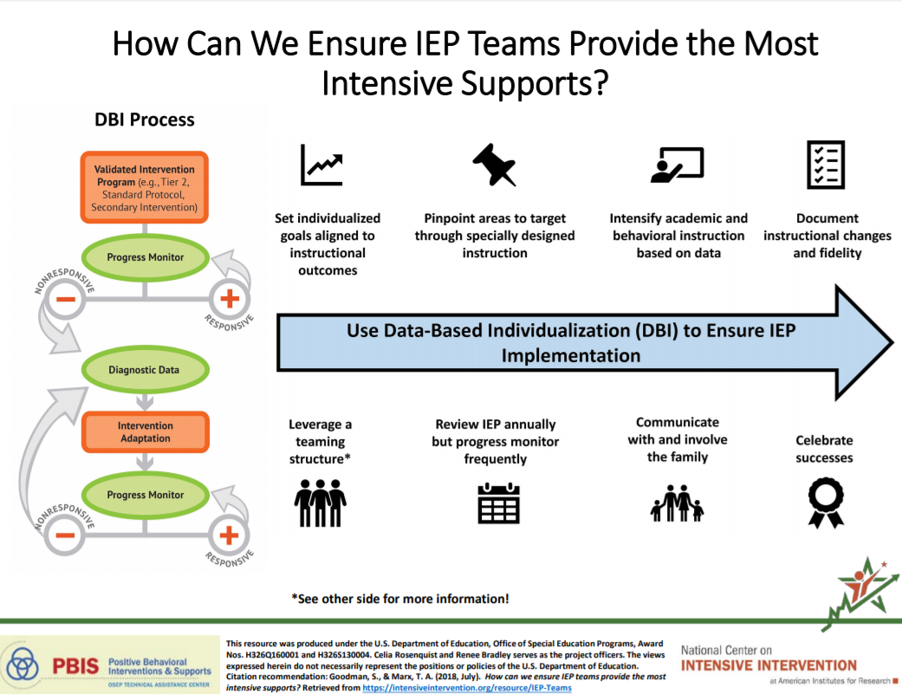
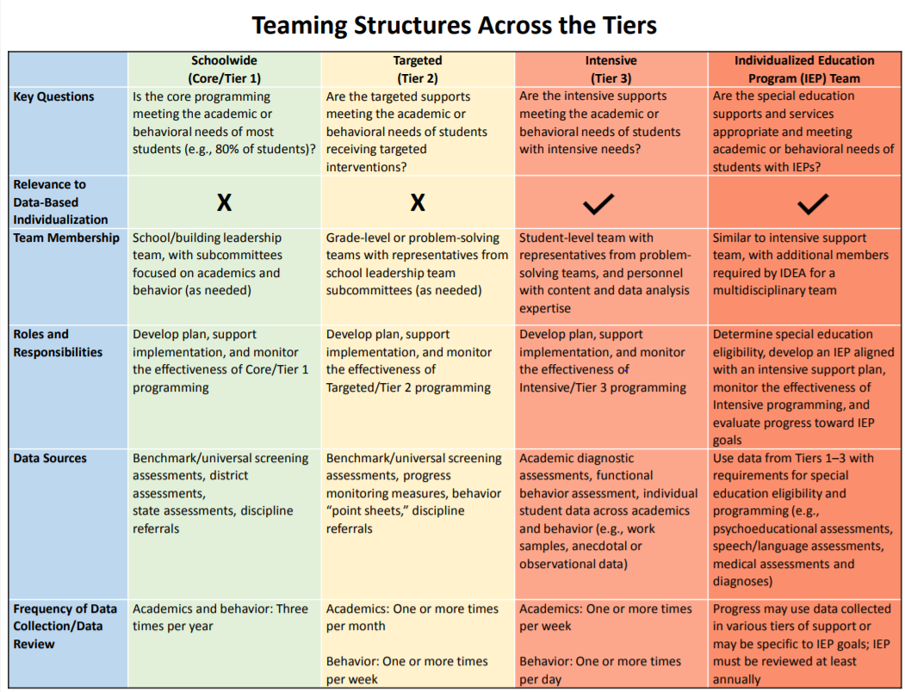
Suite of Special Education and DBI Products
Guidance Documents and Tools
Teaming resource (developed with PBIS Center)
Setting Ambitious Academic IEP Goals
Setting Ambitious Behavior IEP Goals
Intensive Intervention Book (May 2019)

Slide 31
Professional Development Resources
IRIS Module - Intensive Intervention (Part 2): Collecting and Analyzing Data for Data-Based Individualization
NCII DBI Professional Learning Series Module 3 - Monitoring Student Progress for Behavioral Interventions
NCII DBI Professional Learning Series Module 2 - Using Academic Progress Monitoring for Individualized Instructional Planning

Slide 32
Professional Development Resources
IRIS Module- IEPs: Developing High-Quality Individualized Education Programs
A detailed background of the circumstances leading up to Endrew, as well as how that decision translates into specific expectations and requirements for IEPs
Explanations of terminology and concepts from the Endrew ruling
Details of the IEP process and key takeaways for each step
An overview of the IEP’s required components
Common errors and pointers on how best to recognize and avoid them
Audio interviews

Slide 33
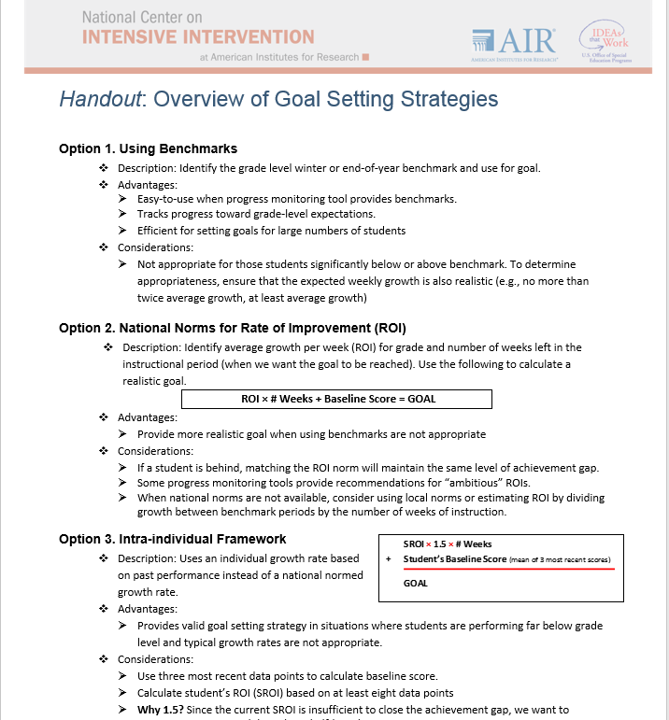
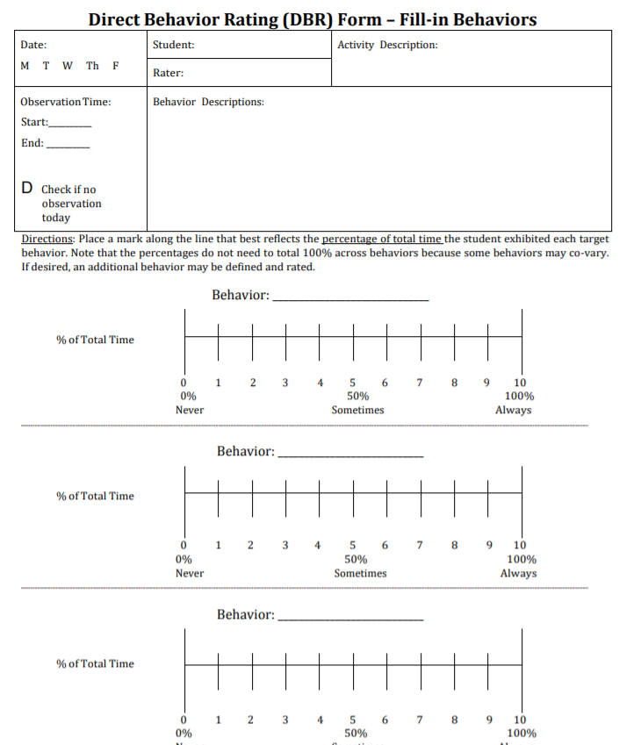
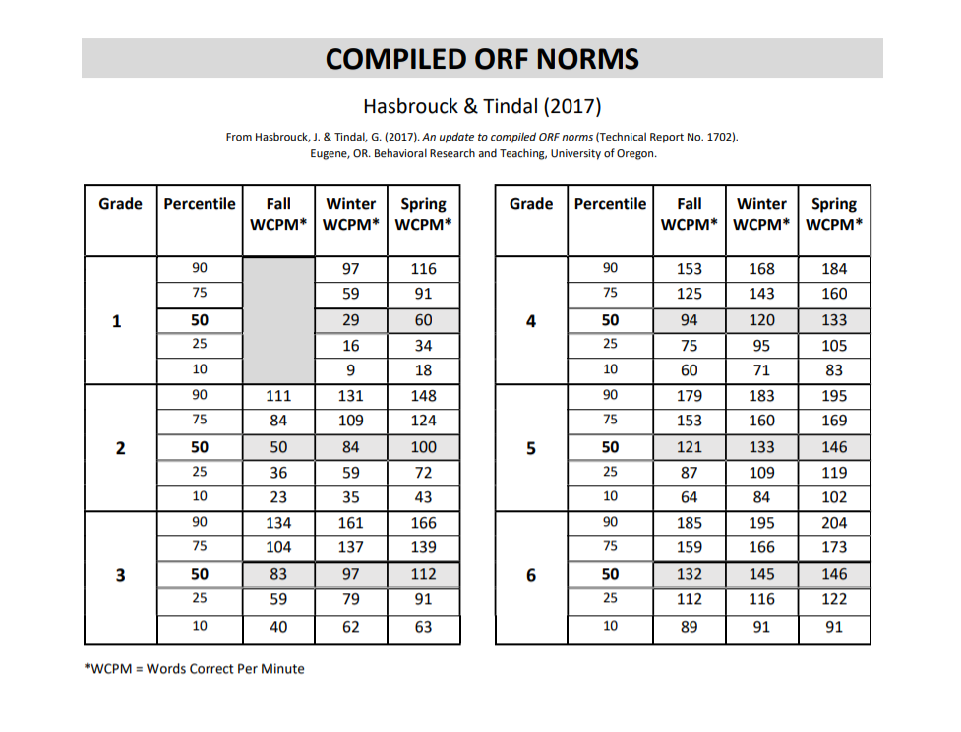
IEP Goal Setting Tools and Resources
Behavior Goals Using Direct Behavior Rating

Slide 34
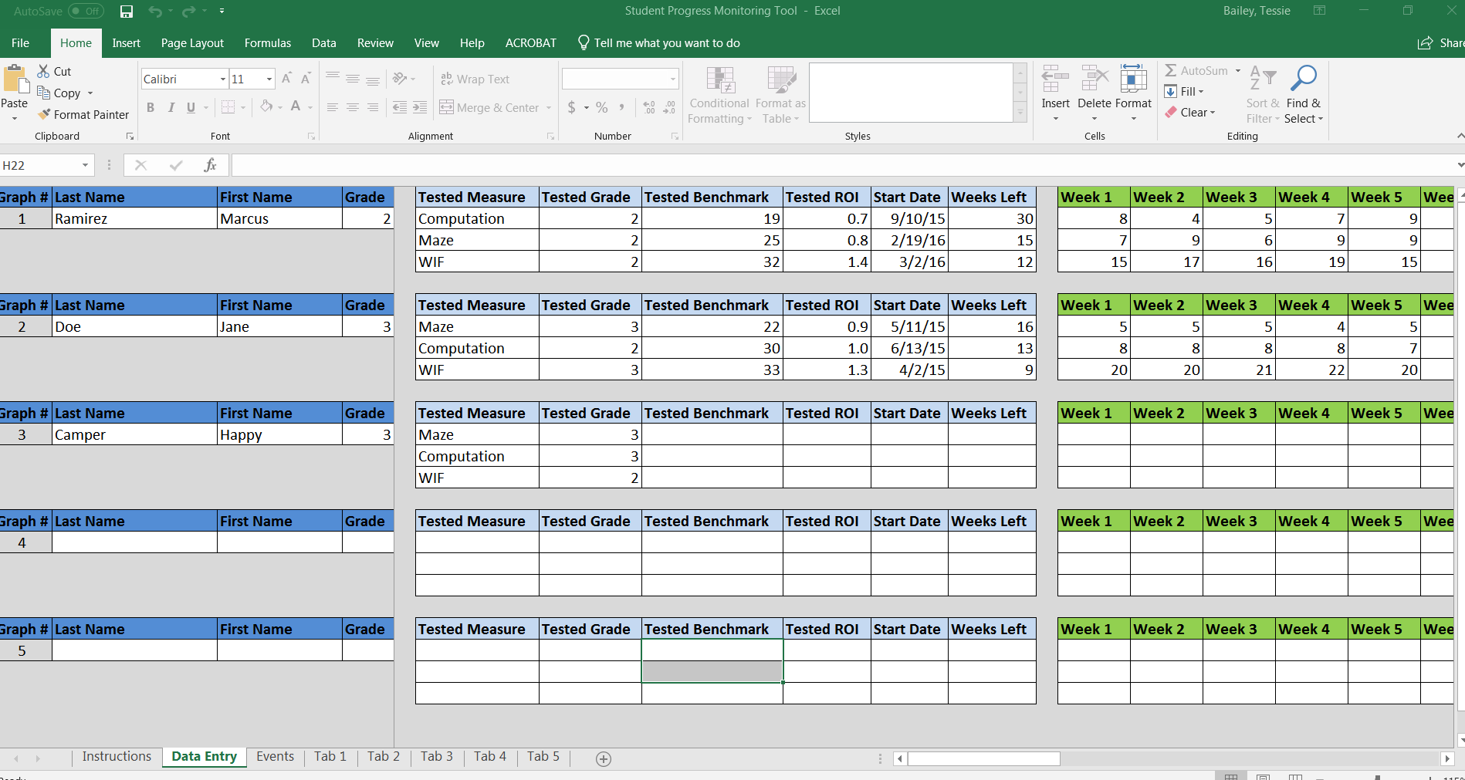
IEP Implementation Resources
Strategies for Scheduling: How to Find Time to Intensify and Individualize Intervention
Student IEP Progress Monitoring Tool for Data Collection and Graphing (Excel)
Taxonomy of Intervention Intensity – Designing and Intensifying Individualized Instruction

Slide 35
IEP Implementation Monitoring Tools

Slide 36
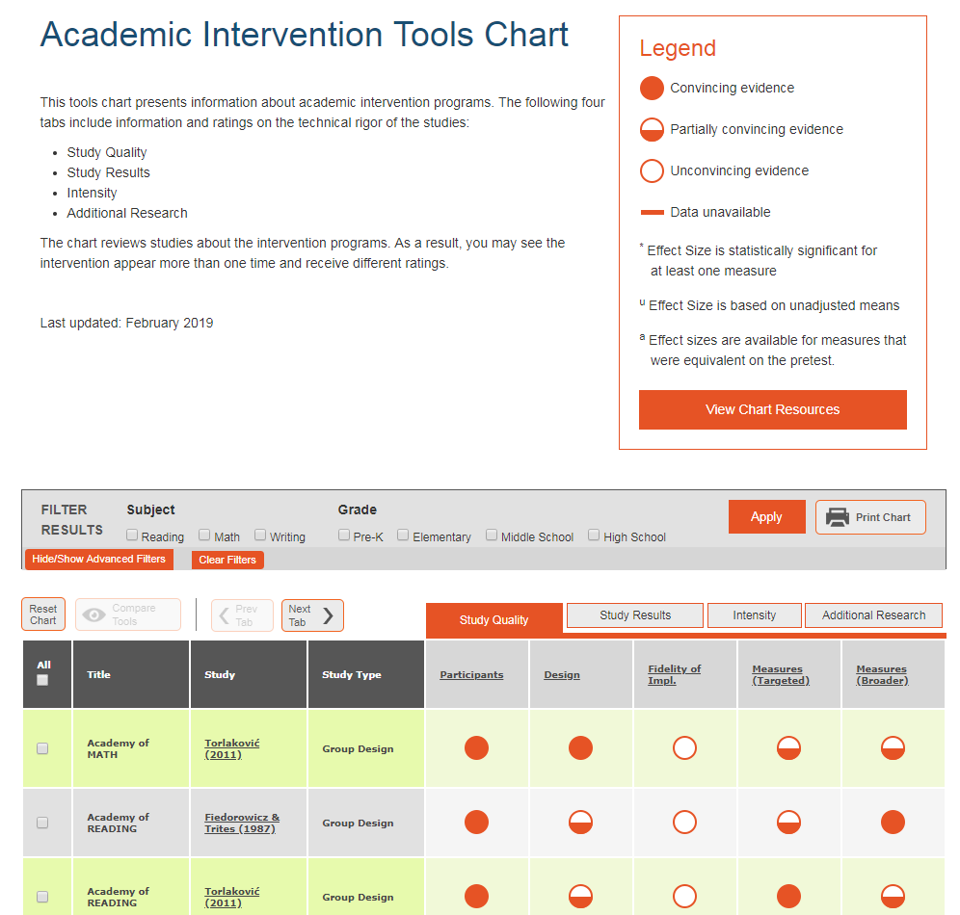
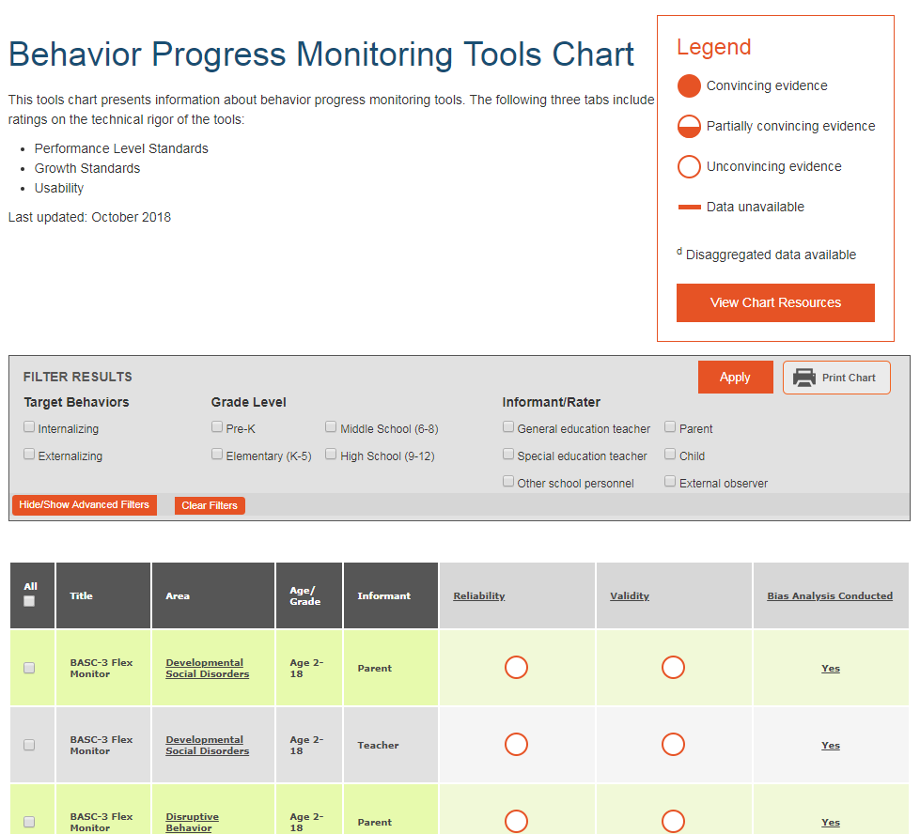
NCII Tools Charts for Progress Monitoring Tool Selection

Slide 37
Questions or COmments
Questions or Comments?

Slide 38
NCII Disclaimer
This presentation was produced under the U.S. Department of Education, Office of Special Education Programs, Award No. H326Q160001. Celia Rosenquist serves as the project officer. The views expressed herein do not necessarily represent the positions or policies of the U.S. Department of Education. No official endorsement by the U.S. Department of Education of any product, commodity, service, or enterprise mentioned in this webinar is intended or should be inferred

