Slide 1
Informal Academic Diagnostic Assessment: Using Data to Guide Intensive Instruction
Part 2: Reviewing Graphed Data
Notes:
While permission to reprint this publication is not necessary, the citation should be: National Center on Intensive Intervention (2014). Informal Academic Diagnostic Assessment: Using Data to Guide Intensive Instruction: Reviewing Graphed Data. Washington, DC: U.S. Department of Education, Office of Special Education Programs, National Center on Intensive Intervention.
Introduction to Part 2: This section is part 2 of the module, “Informal Academic Diagnostic Assessment: Using Data to Guide Intensive Instruction.” The following slides are intended to provide participants with guidance for reviewing progress monitoring data and determining if the instructional plan is working or if a change is needed.
The module is part of a series of training modules on Data-Based Individualization developed by the National Center on Intensive Intervention (NCII) and is aimed at district or school teams involved in initial planning for using DBI as a framework for providing intensive intervention in academics and behavior. The audience for this module may include the academic or behavior interventionists, special educators, school psychologists, counselors, and administrators, as appropriate. Before viewing this module, teams should be familiar with the content in the first four modules. For more information about these modules, please visit the DBI Training Series page on NCII’s website at: http://www.intensiveintervention.org/content/dbi-training-series.
Speaker notes for Title Slide:
Welcome participants to the training on Reviewing Progress Monitoring Data. Introduce yourself (or selves) as the facilitator(s) and briefly cite your professional experience with regard to intensive intervention and DBI. Explain that this section provides guidance on reviewing graphed progress monitoring data to determine if a student’s intervention is working or if a change is needed.
Instructions for using the speaker notes
Text formatted in standard font is intended to be read aloud or paraphrased by the facilitator.
Text formatted in bold is excerpted directly from the presentation slides.
Text formatted in italics is intended as directions or notes for the facilitator; italicized text is not meant to be read aloud.
Text formatted in underline indicates an appropriate time to click to bring up the next stage of animation in an animated slide.

Slide 2
Informal Academic Diagnostic Assessment: Using Data to Guide Intensive Instruction
Administering Academic Progress Monitoring Data
Reviewing Progress Monitoring Data
Miscue and Skills Analysis
Identifying Target Skills
Notes:
Remind participants that this section is part of a larger module titled “Informal Academic Diagnostic Assessment: Using Data to Guide Intensive Instruction.” This section will focus on reviewing progress monitoring data.

Slide 3
Purpose and Objectives
Purpose: To provide guidance on reviewing graphed progress monitoring data, helping teachers determine
If the student is responding sufficiently to the intervention
What type of intervention changes may be needed
Notes:
Review purpose and objectives.

Slide 4
Quick Review of Graphing
Why graph progress monitoring data?
Allows staff to see patterns and compare performance to goals
More accurate data analysis
Individualize instruction
Increased student achievement
4
Notes:
Why is it important to graph progress monitoring data? In order to truly analyze progress monitoring data, it is important that data are displayed visually, in a graph. Reviewing and analyzing progress monitoring data is important as it can help you to develop more effective and individualized instructional programs for students. Research shows that student achievement improves when teachers follow procedures for reviewing progress monitoring data and making instructional changes. In these next few slides, I’ll review some basic information about getting started with graphing data. These slides provide an overview of how to put these procedures in place to graph student data.

Slide 5
Quick Review of Graphing: The Basics
Plot student’s first few data points
Baseline data or starting point
5
Notes:
Begin by plotting the student’s first few data points. These represent the first few weeks of baseline data, or the student’s starting point.

Slide 6
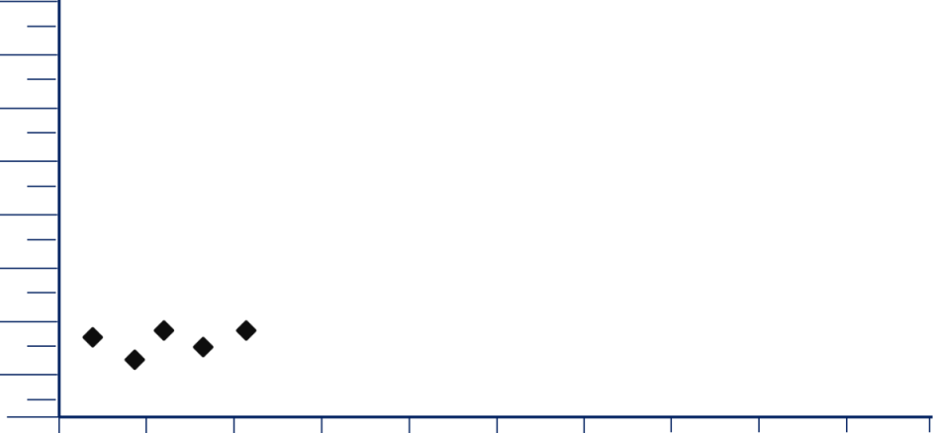
Quick Review of Graphing: The Basics
First 3 scores represent baseline
Draw vertical line after baseline
6
Notes:
First, look at the first three scores on the graph. Draw a dashed vertical line to show that these data points are “baseline data”, representing the student’s performance at the beginning of the year.

Slide 7
Quick Review of Graphing: The Basics
Determine a goal for your student’s performance at the end of the year.
7
Notes:
Read slide.
For help in selecting an appropriate end-of-the-year goal, see pages 15-19 of Progress Monitoring Training Manual (available at http://www.rti4success.org/video/implementer-series-what-progress-monitoring).

Slide 8
Quick Review of Graphing: The Basics
Draw a line connecting baseline performance to goal
This is the “goal line”
Shows the rate of progress a student must achieve to reach goal by the end of the year
Goal
8
Notes:
Now, draw a line connecting the baseline performance to the goal. This line, called the “goal line” shows the rate of progress a student must achieve to reach the goal by the end of the year.

Slide 9
Quick Review of Graphing: The Basics
Continue to collect and graph the student’s progress monitoring scores.
If four consecutive scores fall below the goal line, as shown here, you should change your instruction.
If scores are at or above the goal line, continue instruction and data collection.
Goal Line
9
Notes:
Read slide.

Slide 10
Quick Review of Graphing: The Basics
When you have at least six scores after baseline, you can use the scores to draw a “trend line” that represents the student’s rate of progress.
Goal Line
Trend Line
10
Notes:
Read slide.
For details of the procedure for drawing a trend line, see pages 11 – 14 in the RTI Center’s Progress Monitoring Manual (http://www.rti4success.org/video/implementer-series-what-progress-monitoring).

Slide 11
Quick Review of Graphing: The Basics
If the trend line is flat or going down…
Change your instructional program.
If the trend line is less steep than the goal line…
Adjust your instructional program to try to increase the student’s rate of improvement.
Goal Line
Trend Line
11
Notes:
Read slide.

Slide 12
Quick Review of Graphing: The Basics
When you make an instructional change, add a vertical line to the graph showing when you made the change.
Then continue collecting data to help you determine whether the instructional change has been effective.
Goal Line
12
Notes:
Read slide.

Slide 13
It’s time to make a change, but what should I do?
Observing data patterns can help guide your decision-making.

Slide 14
Potential Issues Impacting Progress
While reviewing student progress monitoring data, it is important to consider other issues that may be impacting progress:
Progress monitoring
Engagement/motivation
Fidelity
Instructional platform
14
Notes:
Read slide.

Slide 15
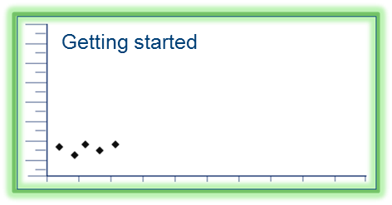
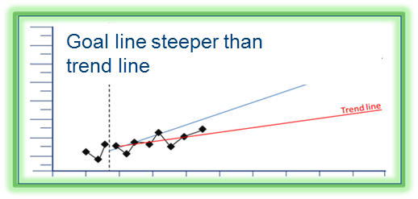
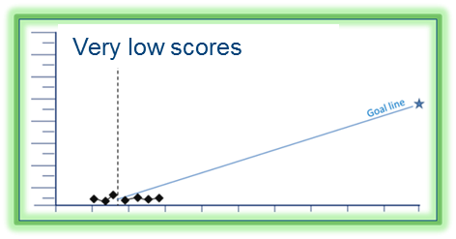
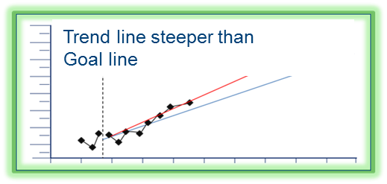
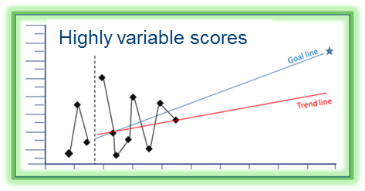
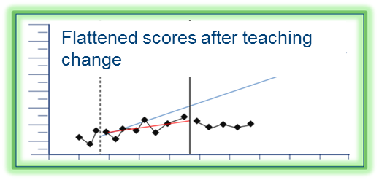
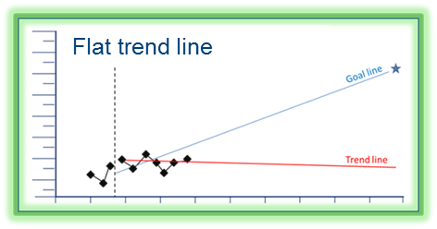
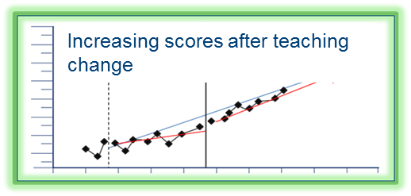
What can a graph tell you?
15
Notes:
The first step in using progress monitoring data to inform instructional decisions is to examine the graph. Reviewing graphed data not only tells us how a student is responding to an intervention, but it may also reveal patterns that indicate specific considerations for future data collection or intervention changes that may be necessary.
For more information about reviewing graphed progress monitoring data and using progress monitoring data to make intervention decisions, view the webinar “Data Rich, Information Poor? Making Sense of Progress Monitoring Data to Guide Intervention Decisions” at this link: http://www.intensiveintervention.org/webinar/2014february.

Slide 16
How do I know when a change is needed?
When you make your first decision based on progress monitoring data, ask yourself two questions:
Is the student’s performance improving?
If so, is the student’s performance improving sufficiently to meet the end of the year goal?
Notes:
Read slide.
A change is needed when you can determine that a student’s performance is not improving sufficiently to meet the end of the year goal.

Slide 17
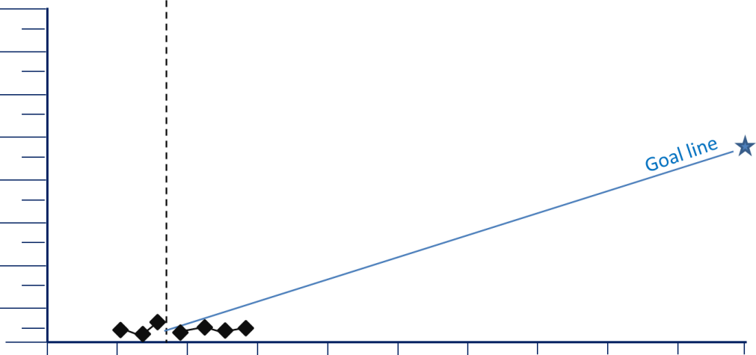
Graphs: Very low scores
The situation: Your student’s scores are very low, close to the bottom of the graph.
17
Notes:
The graph represents one particular trend that teachers may see in student progress monitoring data: very low scores. In this scenario, progress monitoring scores are very low and call very close to the bottom of the graph, and it is clear that the student is not making sufficient progress to meet the goal.

Slide 18
Consider…
Are there issues with your progress monitoring measure or process?
18
Notes:
Very low scores may indicate issues with your progress monitoring measure. Consider the following questions:
Is the measurement level too difficult for the student? Consider an easier level that will better reflect growth.
Is the student motivated to do well on the assessments? If not, consider adding a motivational component.
Does the measurement correspond to the content of your instruction? If not, consider a more appropriate measure.

Slide 19
Graphs: Highly variable scores
The situation: Your student’s scores are highly variable with a lot of “bounce” from day to day.
19
Notes:
This graph shows a trend where the student’s scores are highly variable and “bounce” from high to low from day to day. In this scenario, the trend line shows that the student is making some progress but it is difficult to say if the student will be able to consistently achieve the goal due to the high level of variation in scores.

Slide 20
Consider…
Are you using a technically sound (valid, reliable) measure?
20
Notes:
Highly variable scores could be an indication that the progress monitoring measure is not valid or reliable. Consider examining the research around the reliability and validity of the measure to ensure that it provides an accurate reflection of student progress. This could be found in information or a manual from the tool’s developer, on the developer’s website, or on the Center’s progress monitoring tools chart.

Slide 21
Consider…
Consistency: is the assessment occurring at the same time of day, days of the week, setting, etc.?
21
Notes:
Highly variable scores could also be an indication that the assessment is being administered inconsistently. Perhaps the student performs better in certain settings or during certain times of day than others. To ensure that consistency of assessment administration is not causing highly variable scores, make a plan for consistent administration. This should include how the assessment is delivered (e.g., the instructions the teacher uses to explain the assessment to the student), the day(s) of the week the assessment is delivered, time of day, and setting.

Slide 22
Consider…
Does the student’s engagement or motivation level vary from day to day?
22
Notes:
Additionally, the student’s engagement or motivation level may vary from day to day, which could also result in highly variable scores. If this is the case, try adding a strategy for engagement or motivation to the student’s plan, or including the student in his/her goal-setting and monitoring.

Slide 23
Graphs: Flat trend line
The situation: The trend line of your student’s scores is flat or going down, indicating that the student’s performance isn’t changing.
23
Notes:
This graph shows a trend where the trend line of a student’s scores is flat or is going down, indicating that the student’s performance isn’t changing. In this scenario, it is clear that the student is not making sufficient progress to meet the goal.

Slide 24
Consider…
Has the plan been implemented as intended?
Have other factors prevented the student from receiving the instruction as planned?
Scheduling conflicts?
Attendance?
Behavior/motivation?
24
Notes:
In this situation, you don’t have any evidence that your instructional plan is producing the results you want to see. You’ve given your plan a chance to work, but it hasn’t.
One possibility is that there have been problems with the implementation of your plan. For example, have scheduling conflicts reduced your instructional time? Does your student seem unmotivated during instruction? Is the setting distracting for the student? Does the interventionist need clarification or training in the intervention or plan? If this is the case, determine the specific barrier and create a plan for improving the fidelity of the intervention in that area. For instance, if there have been issues with the instructional time or setting, look for solutions to those problems. If the student seems unmotivated, consider adding a motivational element to your instruction, such as the possibility of earning prizes for on-task behavior. If the student appears motivated and there are no implementation issues, then change your instruction. You might address a different skill or perhaps try a different approach.
Note that flat scores that are also very low could be an indicator that the progress monitoring measure is too difficult and therefore won’t detect change.

Slide 25
Graphs: Goal line steeper than trend line
The situation: The trend line of your student’s scores is increasing, but not as steeply as the goal line.
25
Notes:
This graph displays a trend where the student’s scores are increasing but not as steeply as the goal line. In this scenario, the student is making progress and is benefitting from the intervention, but the rate of improvement is not fast enough for the student to reach the goal by the end of the year.

Slide 26
Consider…
Did the teacher use an appropriate procedure/method to set the goal?
26
Notes:
If you notice that this trend is occurring, it is important to first consider whether or not the teacher or team used an appropriate procedure/method to set the goal. Three common goal setting approaches include benchmarks, rate of improvement, and intra-individual goal setting. Each of these methods is appropriate in different scenarios. For students who are significantly behind their peers, it is especially important to consider whether the goal that was set is feasible and if the goal was set using an appropriate method.
For instance, does the goal represent a weekly growth rate that is significantly higher than the average rate of improvement for that grade level? If so, this may be an unrealistic goal and the teacher should not lower the goal but instead select a more appropriate goal setting method.

Slide 27
Consider…
Build on or modify the intervention or your approach to progress monitoring, rather than trying something completely different
27
Notes:
Once you have determined that the goal was set using an appropriate method, consider building on or modifying their approach rather than trying something completely different. We know that the student is responding to the instruction and that the teacher is doing something that works, so teachers should try to build on that to achieve even better progress. For example, continue to use the same instructional methods but increase the amount of instructional time, providing the student with more time for engaged practice opportunities with feedback. Additionally, consider incorporating new skills into the same instructional format.

Slide 28
Graphs: Trend line steeper than goal line
The situation: The trend line of your student’s scores is increasing more steeply than the goal line.
28
Notes:
This graph represents a scenario where the trend line from a student’s scores is increasing more steeply than the goal line. This is a good problem to have! This means that your student is improving at a faster rate than you originally estimated. Your instructional plan is working well for the student.

Slide 29
Consider…
Was the original goal ambitious enough?
29
Notes:
If a student is making faster growth than you originally anticipated, consider whether the original goal is ambitious enough. Research has shown that ambitious, but realistic goals, coupled with data-based decision making, lead to better student achievement. Consider raising the student’s goal to see if you can effect even better progress for your student.

Slide 30
Graphs: Scores flat after change
The situation: After an instructional change, your student’s scores do not improve.
30
Notes:
This graph shows a scenario where, after an instructional change, a student’s scores do not improve. This is a good opportunity to put experimental teaching into action. Think about what the graph is telling you about your student’s learning. (Pause for discussion and ask participants to share their thoughts.)
Under your first instructional intervention, the student was making some progress, but not sufficient progress to meet the end of the year goal. A change in instruction was indicated by the data. The vertical line on the graph shows when you made the change.

Slide 31
Consider…
Why might the original intervention have worked better for the student?
Use this insight to make an informed instructional change.
31
Notes:
We know that your original instructional intervention was more effective than the change that you made. You should change your instruction again, but this time, think back to your original intervention. Why might that intervention have worked better for your student? Use that insight to help you decide how to change your instruction this time. Then keep collecting data to see if it helps your student achieve better progress.

Slide 32
Graphs: Scores improving after change
The situation: After an instructional change, the trend line is steeper than before the change was made.
32
Notes:
This graph represents a scenario where the student’s trend line becomes steeper after an instructional change. If your graph looks like this, congratulations! You identified a progress monitoring measure and level that reflects your student’s progress, and your student’s steadily improving performance is on target to reach the end of the year goal. From the graph you can see that your first intervention was effective but that the change or modification that you made has been even more effective.

Slide 33
Consider…
What you’re doing is working.
Continue the intervention and monitor the student’s progress through the end of the year.
33
Notes:
This graph reveals that what you’re doing is working, and that there is no need to make an instructional change now. Remember to continue monitoring the student’s progress through the end of the year and to continue to evaluate data in order to ensure that the student is still responding sufficiently.

Slide 34
In Summary
Begin with a valid, reliable, and appropriate progress monitoring measure.
Graph your data to see patterns.
Ask questions about data patterns to arrive at hypothesis about student responsiveness.
Use your hypothesis to inform changes to intervention or assessment (if the data indicate that a change is needed).
Notes:
In summary, remember that an appropriate progress monitoring measure is valid, reliable, brief, sensitive to change, and measures the skill/behavior targeted by the intervention. The progress monitoring measure should also be able to be graphed. Displaying progress monitoring data visually allows teams to see whether or not students are on track to meet their goals and also detect patterns in performance. Ask questions about data patterns to arrive at a hypothesis about student responsiveness. You should then use this hypothesis to inform changes to the intervention or assessment, if the data indicate that a change is needed.

