Slide 1
Module 5
Consequence Strategies to Decrease Behavior
Jennifer Freeman, PhD
Don Briere, PhD
Brandi Simonsen, PhD

Slide 2
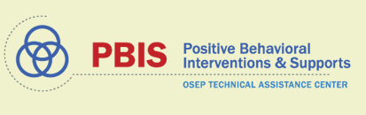
Acknowledgements
Much of the content shared in this module was developed by members of the OSEP-funded National Technical Assistance Center for Positive Behavioral Interventions and Supports.
Thank you to:
  Members of classroom workgroup:
    Brandi Simonsen, Jennifer Freeman, Jessica Swain-Bradway, Robert Putnam, Heather George, Steve Goodman, Barb Mitchell, Kimberly Yanek, Kathleen Lane & Jeffrey Sprague
  Members of the Northeast PBIS Network:
    Susannah Everett, Adam Feinberg, George Sugai, Brandi Simonsen & Jennifer Freeman

Slide 3
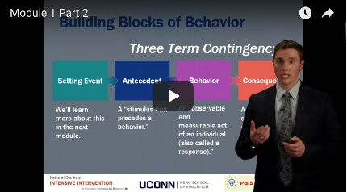
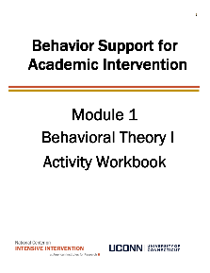

Orientation to Module Tools and Resources
Module Videos
Module Workbook
Module Readings and Additional Resources

Slide 4
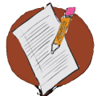
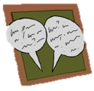

Orientation to Module Elements
Activities
Classroom Application Activities
  Can you apply the basic content presented in this module to your classroom context?
Module Quiz – Self Assessment
  Do you know the basic content presented in this module?
Coaching Activities
  Can you implement the content presented in this module in your classroom effectively?
Discussion Board Post
Stop and Jot

Slide 5
Getting the Most Out of This Module
Pre-service
Become fluent with content and basic theory
New Teachers
Focus on moving from knowledge to practice
Experienced Teachers
Use activities as a self-reflection opportunity
Consider how you might coach or teach the skills/content to a new teacher in your building
Set a new implementation goal for yourself
Review resources to extend your learning with respect to culturally and contextually relevant implementation
Look for examples of implementation in your clinic placements
Video record or ask for feedback on your implementation of key practices during your student teaching
Set implementation goals and either self-monitor or ask for peer/coach feedback on your use of key skills
When a practice isn’t working use your understanding of theory to help you modify or intensify a practice to improve outcomes

Slide 6
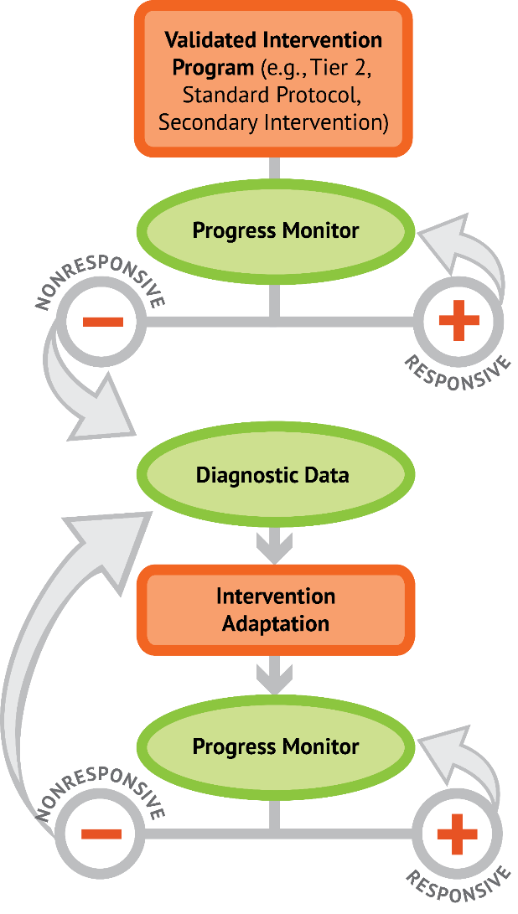

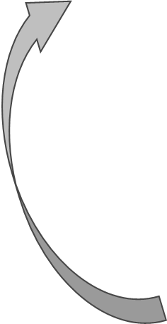
5 Critical Features of Classroom Management
5 Critical Features of Classroom Management
Implement with Fidelity
Implement with Fidelity
Progress Monitor
DBI for
Intensive Academic Need
_
+
Increased frequency, duration, or precision of
5 Critical Features of Classroom Management
Diagnostic Assessment
Intervention Adaptations
Progress Monitor
_
+
DBI for behavior

Slide 7
Module Objectives
By the end of Module 5 you should be able to:
    Describe consequence strategies to decrease behavior
    Establish a continuum of strategies to respond to inappropriate behavior.
    Planned Ignoring
    Differential Reinforcement
    Response Cost
    Time Out from Reinforcement
    Over Correction
Part 1
Part 2

Slide 8
Consequence Strategies to Decrease Behavior
Part 1
What are ways I can manage minor behaviors?

Slide 9
Module Objectives
By the end of Module 5 you should be able to:
    Describe consequence strategies to decrease behavior
    Establish a continuum of strategies to respond to inappropriate behavior.
    Planned Ignoring
    Differential Reinforcement
    Response Cost
    Time Out from Reinforcement
    Over Correction
Part 1
Part 2

Slide 10
Remember:
Punishment
  A punisher is a consequence stimulus that
    (a) decreases the future probability of a behavior;
    (b) is administered contingently on production of an inappropriate behavior; and
    (c) is administered immediately following the production of undesired or inappropriate behavior
  Like reinforcers, it can only be defined based on effects on future behavior

Slide 11
Punishment Reminders:
Punishment consequences should be used sparingly.
Consistency not size is important.
Punishment consequences should be selected individually.
Be sure the punisher functions to decrease the future likelihood of the student’s challenging behavior.
Logical consequences are often more effective.
Notes:
Note to Presenter: See page 195 MO SW-PBS 2012-13 Team Workbook for further explanation of some basic understandings of consequences.
Consequences are not punitive--Consequences paired with teaching of the alternative or desirable behavior can heighten behavior change. Effective consequences result in greater learning and often involve learning tasks or opportunities directly related to the inappropriate behavior. In this manner, they are similar to what we do when students are not making academic progress. We find additional practice or activities to help them learn and grow. Role-play or practice, reflecting on the behavior and the alterative, arranging a situation for the student to demonstrate the skill, and making amends for behavior that impacted others are all wonderful learning-based consequences. Effective consequences maintain student dignity and invite the student to take re­sponsibility for his/her behavior and be a part of the solution. Even though consequences can be educational, they are also mildly aversive. That is they require effort and should leave little incentive to repeat the inappropriate behavior. They need not be merely punitive.
Consistency, not size is important - It is not the size of the consequence that promotes behavior change, but the certainty that something will be done. This is a common misunderstanding as educators often look for a bigger consequence–that big one that will stop the behavior. It is not, however the severity of the consequence but the inevitability that a response will occur that promotes change.
Consequences should be selected individually - Consequences are best when they are selected to fit the individual child, the specific behavior and setting, the frequency, and the severity of the behavior. What fits one may not fit another. The best consequences are selected to match the individual learner’s needs.
Warning systems promote chronicity - Some inadvertently believe that warning systems (e.g., three strikes and you’re out) demonstrate fairness. In fact, warning systems can promote sneakiness or continued effort to try to get away with the behavior. With a continuum of strategies, we are better to immediately and swiftly use the least intrusive consequence for the frequency or severity of the behavior and increase our teaching efforts and use of instructionally based consequences as needed for subsequent occurrences.
Logical consequences are often more effective - A logical conse­quence is one that is a logical outcome of the student’s behavior, allowing the behavior and consequence to be eas­ily linked in the student’s mind. These consequences are often the result of situational contingencies (e.g., since you did not finish your work in class you will have homework; since we did not transition from one activity to an­other quickly, we will be delayed in getting our work done and will be late to _____; since you were running in the hall you will need to return and walk; since you offended Ms. Jones, you will need to find a way to re-build the rela­tionship, etc.) Developing a menu or continuum of consequences specific to each non-classroom area or for each classroom procedure will help you to avoid generic or illogical consequences such as the removal of recess or detentions, which tend to be over­used in many schools, while allowing you to use instructionally relevant and logical consequences.

Slide 12
Considerations for punishment procedures
Punishment without a positive, proactive, and instructional approach results in increased:
Aggression
Vandalism
Truancy
Dropouts
(Mayer & Sulzer-Azaroff, 1990; Skiba, Peterson, & Williams, 1997)

Slide 13
Positive Classroom Behavior Support (PCBS) Practices
Decision-Making Guide: 3 Key Questions
Are students still engaging in problem behavior?
Are behaviors minor or major expectation violations?
Well done! Monitor outcomes and adjust as needed
Use brief, specific error correction & other strategies
How many students are involved (many or few)?
Review, adjust & intensify CWPBIS. Ask for help!
Request additional (tier 2 & 3) support for students.
Are the foundations of effective PCBS in place?
Let’s explore this…
Yes
No
Are proactive and positive PCBS practices implemented consistently?
Minor
Major
Many
Few
Do data indicate that students are still engaging in problem behavior?

Slide 14
Use brief, specific error correction
& other strategies
Elementary Example:
After a student runs from their seat to the classroom door for lunch the teacher responds, “Please walk with a quiet body and voice to the door instead of running”
HS Example:
A student is observed texting in class, teacher responds, “Please don’t text during class; leave your phone in your locker.”
Non-Example:
Shouting, “No!” (This is not calm, neutral, or specific.)
A 5-min conversation about what the student was thinking. (This is not brief.)
Use brief, specific error correction & other strategies
Notes:
Talk through at least one scenario AFTER this

Slide 15
Quick Error Corrections
Error corrections should be:
contingent
specific
brief
occur immediately after the undesired behavior
tell learner exactly what they are doing incorrectly and what they should do differently in the future
after redirecting back to appropriate behavior, move on

Slide 16
Activity 5.1: Stop and Jot
Develop Brief Error Corrections
Write three (or more) specific brief error correction statements that you will use to correct inappropriate social behavior.
If you have extra time, consider how you would modify those statements based on students’ learning histories, age, ability/disability etc.
Please Pause Video & Complete Activity 5.1

Slide 17
Activity 5.1: Review
Welcome back!
Double check your brief error corrections:
  Are they specific?
  How did you re-direct the student back to the appropriate behavior?
  How will you modify these based on the individual needs of your students?

Slide 18
Additional Variations for Managing Minor Behaviors
Proximity Control
The strategic placement/movement by the teacher in order to encourage positive behavior.
The teacher is a source of protection and strength, helping the student to control impulses.
Non-Verbal Cue
Non-verbal techniques such as sustained eye contact, hand gestures, a handclap, finger snap, clearing one’s throat, etc. suggesting that the teacher is aware of the behavior and prepared to intervene if it continues.
Ignore, Attend, Praise
Uses the power of praise or positive feedback.
The teacher praises an appropriately behaving student in the proximity of a student who is not following expectations. The praise serves as a prompt.
When the student exhibits the desired behavior, attention and praise are then provided.

Slide 19
Considerations for Error Correction
Don’t overlook minor misbehavior; don’t avoid correcting and teaching.
Embrace correction as a tool to truly help students; correction is not punitive, it is instructional.
Create an expectation for correction, an environment where corrective feedback is the norm.
Always correct privately; use preferred adult behaviors that maintain respect for the student.
Notes:
Again, some cautions for using error correction effectively.

Slide 20
Considerations for Error Correction–Continued
When the student demonstrates the desired behavior, always follow with praise or positive feedback.
Use the strategy that is the least intrusive for the behavior and its frequency or severity.
When inappropriate behavior occurs, increase teaching (lessons, pre-corrects) and rates of encouragement (positive feedback).
When needed, pair instructional error correction strategies with an additional consequence (punishment).
Notes:
Highlight the first bullet and make the point that some students misbehave when they know the social skill but they don’t use the skill. We call this a performance deficit. Often students misbehave because they know they will get attention for it. So our job is to ensure students get enough positive feedback for demonstrating the desired behavior.

Slide 21
Additional Tools
(From the Resource Guide)

Slide 22
Remember Function?
Consider Function when you select your consequence strategy
Positive
Reinforcement
Negative
Reinforcement

Slide 23
Continuum of Error Corrections
Re-direct
Re-teach
Provide
Choice
Student
Conference
Brief, clear, private verbal reminder of the expected behavior. A re-statement of school-wide and non-classroom behavior, or classroom procedure.
Builds on the re-direct by specifically instructing the student on exactly what should be done.
Can be used when a re-direct or re-teaching have not worked.
A statement of two alternatives–the preferred or desired behavior or a less preferred choice.
Lengthier re-teaching or problem solving. Discusses the behavior of concern, teaches the desired behavior, provides reasons why it is important, and a plan is made for future use.
Can include role-play or practice.
The NCII Antecedent modification guide contains additional information about
providing choice

Slide 24
Consequence Strategies to Decrease Behavior
Part 2
What other strategies could be layered on top of brief error corrections?

Slide 25
Module Objectives
By the end of Module 5 you should be able to:
    Describe consequence strategies to decrease behavior
    Establish a continuum of strategies to respond to inappropriate behavior.
    Planned Ignoring
    Differential Reinforcement
    Response Cost
    Time Out from Reinforcement
    Over Correction
Part 1
Part 2

Slide 26
PCBS Practices
Decision-Making Guide: 3 Key Questions
Are students still engaging in problem behavior?
Are behaviors minor or major expectation violations?
Well done! Monitor outcomes and adjust as needed
Use brief, specific error correction & other strategies
How many students are involved (many or few)?
Review, adjust & intensify CWPBIS. Ask for help!
Request additional (tier 2 & 3) support for students.
Are the foundations of effective PCBS in place?
Now let’s explore here…
Yes
No
Are proactive and positive PCBS practices implemented consistently?
Minor
Major
Many
Few
Do data indicate that students are still engaging in problem behavior?

Slide 27
Planned Ignoring
Definition:
When a behavior that was previously reinforced by attention no longer is (i.e., the behavior is ignored). When implementing this strategy, if a behavior is maintained by adult attention, the teacher would ignore the behavior of interest.
Example:
Grant taps his pencil loudly at his desk during class and his teacher currently responds to him (i.e., provides attention) approximately 70% of the time (either + or -).
The teacher decides to ignore all pencil taps and instead only calls on Grant when his hand is raised.
Don’t forget to plan for an extinction burst….
What function of behavior might planned ignoring procedures address effectively?

Slide 28
Other Strategies to Respond to Minor Violations
 | Elementary Example: | HS Example: | Non-example:
Planned Ignoring | During a whole group activity, James shouts the teacher’s name to get her attention. The teacher ignores the callouts and proceeds with the activity. | During a lecture, Jen interrupts the teacher and loudly asks her question. The teacher ignores Jen until she quietly raises her hand. | A student is loudly criticizing a peer, resulting in other students laughing at the targeted peer. The teacher does nothing.
Notes:
Preview but don’t train

Slide 29
Guidelines for using planned ignoring
  Ignoring doesn’t work unless the student’s problem behavior functions to gain your attention
  Disruptive behavior will increase before decreasing (remember the “extinction burst”)
    Be sure you can handle the “peak” if you select to implement this strategy!
  Let others know about the plan
  Don’t forget to consistently praise student for appropriate behavior

Slide 30
Activity 5.2: Pause & Process
Develop a Planned Ignoring Procedure
Use the guided questions in your workbook to develop a planned ignoring procedure.
  Select a target behavior
  Develop an operational definition
  Identify the type of reinforcement that currently maintains the behavior (This should be teacher attention!)
  Develop a Planned Ignoring Procedure:
    What will you do when the behavior occurs?
    How will you acknowledge other appropriate behaviors?
    What will you do if/when an extinction burst occurs?
Please Pause Video & Complete Activity 5.2

Slide 31
Activity 5.2: Review
Welcome back!
Remember, when using planned ignoring, it is important to ensure you are ignoring a behavior and not the student in general.
Provide reinforcement and acknowledgement for other behaviors and only ignore the target behavior.

Slide 32
Differential Reinforcement
Definition: Providing reinforcement contingent on a student exhibiting an appropriate response (or behavior you wish to increase) while simultaneously withholding reinforcement contingent on inappropriate responses (i.e., placing challenging behavior(s) on extinction).
There are different types of differential reinforcement approaches to consider…
The NCII Reinforcement guide (linked here) includes additional information about DR procedures.

Slide 33
Types of Differential Reinforcement
DR…of lower rates of behavior (DRL)
DR…of other behaviors (DRO)
DR…of alternative behavior (DRA)
DR…of incompatible behavior (DRI)

Slide 34
DR of Lower Rates of Behavior
Definition:
Student receives reinforcement when the target behavior occurs at a lower rate
Example:
Nickolas usually gets out of his seat 5 times during a 20 minute independent task.
Under DRL he receives reinforcement when he gets out of his seat 4 or fewer times during a 20 minute independent task.

Slide 35
DR of Other Behaviors
Definition:
Student receives reinforcement for behavior whenever an undesirable (target) behavior is not emitted during a specific period of time.
Example:
Patricia receives reinforcement for every 10 minutes she does not call out an answer during class. (This happens even if she is not specifically engaged in appropriate behavior). She may still be off task – just not calling out.

Slide 36
DR of Alternative Behaviors
Definition:
Student receives reinforcement for performing an alternative appropriate behavior rather than the target inappropriate behavior.
Example:
Frank frequently doodles at his desk when he gets stuck on his math assignment. Now, he is provided reinforcement when he raises his hand at his desk to ask for math help.
(In this procedure, hand-raising and not working can be done at the same time.)

Slide 37
DR of Incompatible Behaviors
Definition:
Student receives reinforcement upon the occurrence of a behavior that is physically incompatible with or cannot be exhibited at the same time as the inappropriate behavior
Example:
Andrew is reinforced for sitting in his small group rather than walking around the classroom during instruction.
(Sitting is physically incompatible with walking around so an increase in sitting behavior will result in a decrease in walking behavior.)

Slide 38
Other Strategies to Respond to Minor Violations
 | Elementary Example: | HS Example: | Non-example:
Differential S^{R} | During a whole group activity, James shouts the teacher’s name to get her attention. Using this strategy the teacher ignores James’ callouts, but immediately calls on and praises James when he raises his hand, “That’s how we show respect! Nice hand raise.” (DRA) | “If we can make it through this discussion without inappropriate language, you can listen to music during your independent work time at the end of class.” (DRO) | The teacher reprimands students each time they engage in problem behavior and ignore appropriate behavior.
Notes:
Preview but don’t train

Slide 39
Activity 5.3: Discussion Board Post
Develop a Differential Reinforcement Plan
Use the guided questions in your workbook and discussion with your colleagues to develop a differential reinforcement plan
  Select a target behavior
  Develop an operational definition
  Identify the type of reinforcement that currently maintains the behavior (This should be gaining some form of attention!)
Post a quick summary of your notes from above and answer the following questions in your post:
  What differential reinforcement procedure(s) might you use to address your identified behavior? Explain how you would implement the procedure you have selected.
  Why did you choose this approach? What are the pros/cons of the different differential reinforcement procedure options?
Please Pause Video & Complete Activity 5.3

Slide 40
Activity 5.3: Review
Welcome back!
Remember the reinforcement guide (linked here) has guidelines for implementing DR procedures that you can reference if you want additional examples or guidance with these procedures.
For even more information see the IRIS module on differential reinforcement with even more examples and guidelines linked here!

Slide 41
Response Cost
Definition:
The withdrawal of specific amounts of a reinforcer contingent upon inappropriate behavior
Examples:
A wrong answer results in a loss of points.
Come to class without a pencil, buy one for 5 points.

Slide 42
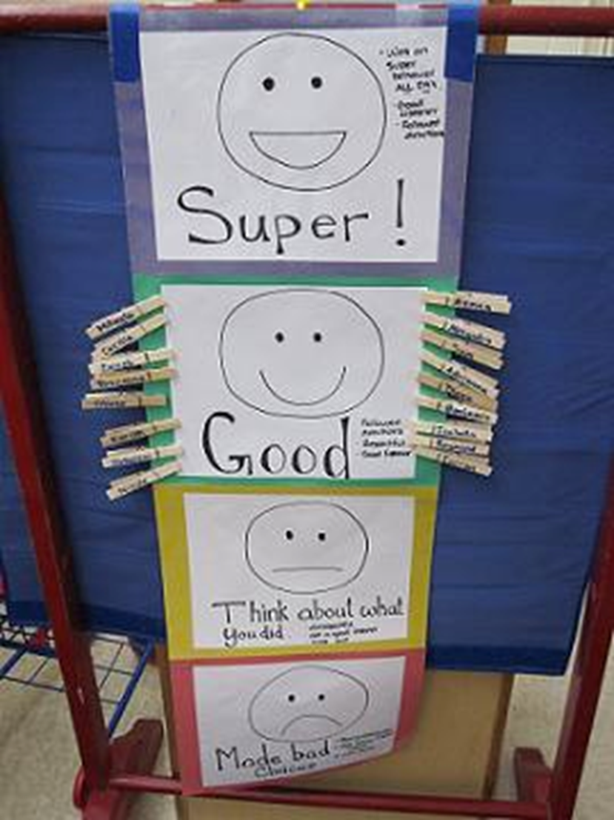
Other Strategies to Respond
 | Elementary Example: | HS Example: | Non-example:
Response Cost | When a student talks out, the teacher pulls the student aside, provides a quiet specific error correction, and removes a marble from his/her jar on the teacher’s desk. | When a student engages in disrespectful language, the teacher privately provides feedback and removes a point from the student’s point card. | The teacher publicly flips a card (from green to red) to signal the student has lost privileges. When asked why, the teacher states, “you know what you did.”
Notes:
Preview but don’t train

Slide 43
Guidelines for Using
Response Cost
Response cost procedures fit best within a token economy.
Usually works in the short term… only use when other procedures haven’t worked.
Must be pre-planned!
Generally, better to stick to the positives...
  Consider what happens if you were to continue to take away points?
  Consider how do you retrieve tokens once they have been given?
REMEMBER we always want a higher ratio of positives to negatives (4:1 minimum)!!!!
☺ ☺ ☺ ☺ : ☹

Slide 44
Guidelines for Using
Response Cost
Cautions:
  Negative balances (e.g., tokens) can result.
  Requires the physical removal of earned reinforcers, which may trigger additional challenging behaviors for some.
  “Hopelessness” and frustration may result for the student.
Consider: How is Response Cost different from Extinction?
  Response Cost is the LOSS of a previously earned reinforcer
  Extinction is the act of withholding reinforcement continent upon a target behavior.

Slide 45
Activity 5.4: Discussion Board Post
Develop a Response Cost Procedure
Use the guided questions in your workbook and discussion with your colleagues to develop a response cost procedure
  Select a target behavior
  Develop an operational definition
  Identify the type of reinforcement that currently maintains the behavior (Should be to gain something!)
  Post a quick summary of your notes from above and answer the following questions in your post:
  What will you do when the behavior occurs (e.g., what is the cost)?
  How will you acknowledge other appropriate behaviors (what are your reinforcers)?
  How will you ensure “earning” (i.e., reinforcement) outnumbers “costs” (i..e, punishers)?
Please Pause Video & Complete Activity 5.4

Slide 46
Activity 5.4: Review
Welcome back!
Remember, when using response cost
  Keep positives higher then negatives
  Pre-plan (and inform the student) of any response cost procedures

Slide 47
Time Out from Reinforcement
Definition:
A student is removed from a previously reinforcing environment or setting, to one that is not reinforcing
Examples:
A student who is disrupting English class by walking around the room flicking peers on the back is sent to a neighboring classroom (or the office) to work.
A student throws food/drink at another student during a basketball game and is asked to leave the event.
REMEMBER the environment the student is removed to cannot be reinforcing!!!
So, if the student receives adult attention in the office, which they find reinforcing, you have NOT put the student on time out.

Slide 48
Other Strategies to Respond
 | Elementary Example: | HS Example: | Non-example:
Time Out from S^{R} | After taking a ball from a peer during recess, the teacher removes the ball from the student, asks her to return to sit on the sideline, and reviews expectations before allowing her to resume recess with her peers. | When a student swears at her teacher during a preferred cooperative math game, the teacher removes the game and asks the student to return to their desk until they can demonstrate appropriate game-playing behavior. The student re-joins the math game after restating expectations. | Sending the student from an aversive classroom activity to the in-school suspension room, which is facilitated by a preferred adult and often attended by preferred peers for the remainder of the day.
Notes:
Preview but don’t train

Slide 49
Guidelines for using Time Out from Reinforcement
To be used correctly, time-out needs to actually be time away from reinforcement
Three Levels (or types) of time-out to consider that are used in instructional settings:
  Planned ignoring
    Systematic withholding of social attention
  Contingent observation
    Student remains in setting
    Easy for teacher to monitor student
  Exclusionary time-out
    Student is physically excluded from ongoing activity
    Usually associated with time-out room
Notes:
Preview but don’t train

Slide 50
Activity 5.5: Pause & Process
Develop a Time Out from Reinforcement Procedure
Use the guided questions in your workbook to develop a time out from reinforcement procedure
  Select a target behavior
  Develop an operational definition
  Identify the type of reinforcement that currently maintains the behavior
Develop a Time Out from Reinforcement Procedure:
    What will you do when the behavior occurs?
    How will you acknowledge other appropriate behaviors?
    How will you monitor this strategy’s effectiveness over time?
Please Pause Video & Complete Activity 5.5

Slide 51
Activity 5.5: Review
Welcome back!
Remember the effective use of timeout requires that the environment the student is removed from is reinforcing.
Removing a student from an aversive academic task or classroom activity could inadvertently reinforce their escape-motivated problem behaviors and result in additional academic gaps!

Slide 52
Over Correction
Over Correction is a behavior-reduction procedure that includes training in appropriate behavior
  Appropriate behavior is taught through an “exaggeration of experience”
  Student rectifies a behavior error, followed by extended practice of the appropriate behavior
Notes:
Preview but don’t train

Slide 53
Types of Over Correction
Restitutional overcorrection
  Student overcorrects effects of his behavior on environment
    Example: A student is seen spraying graffiti on a school locker after school one day. The next day, the student stays after school to clean the graffiti off of the school locker while also cleaning other lockers in that hallway.
Positive-practice overcorrection
  Student repeats an appropriate behavior contingent on the occurrence of an inappropriate behavior
    Example: An elementary student runs ahead of his class to the water fountain. The teacher has the class wait while the student goes back and demonstrates how to walk in the hallways, re-joining the class at the end of the line.
Notes:
Preview but don’t train

Slide 54
Tips for using overcorrection
As always consider the function of the behavior!
  Overcorrection may be effective for escape-motivated behaviors
  It may not be effective for attention-maintained behaviors (and over correction could even reinforce the problem behavior by providing additional attention)
Positive practice overcorrection procedures have the added benefit of increasing students’ fluency with the appropriate behavior.

Slide 55
Activity 5.6: Pause & Process
Develop an Over Correction Procedure
Use the guided questions in your workbook to develop an over correction procedure
  Select a target behavior
  Develop an operational definition
  Identify the type of reinforcement that currently maintains the behavior
Develop an Over Correction Procedure:
    What will you do when the behavior occurs?
    Which type of over correction procedure will you use and why?
    How will you monitor this strategy’s effectiveness over time?
Please Pause Video & Complete Activity 5.6

Slide 56
Activity 5.6: Review
Welcome back!
Remember to consider function when using over-correction (or any consequence strategy!)
Pre-planning like you’ve done in the activity will help ensure you are able to implement this strategy effectively!

Slide 57
Consequence Strategies to Decrease Behavior
Closing

Slide 58
Module Objectives
By the end of Module 5 you should be able to:
    Describe consequence strategies to decrease behavior
    Establish a continuum of strategies to respond to inappropriate behavior.
    Planned Ignoring
    Differential Reinforcement
    Response Cost
    Time Out from Reinforcement
    Over Correction
Part 1
Part 2

Slide 59
Review
PCBS Practices
Decision-Making Guide: 3 Key Questions
Are students still engaging in problem behavior?
Are behaviors minor or major expectation violations?
Well done! Monitor outcomes and adjust as needed
Use brief, specific error correction & other strategies
How many students are involved (many or few)?
Review, adjust & intensify CWPBIS. Ask for help!
Request additional (tier 2 & 3) support for students.
Are the foundations of effective PCBS in place?
Yes
No
Are proactive and positive PCBS practices implemented consistently?
Minor
Major
Many
Few
Do data indicate that students are still engaging in problem behavior?

Slide 60
Punishment Reminders:
Punishment consequences should be used sparingly.
Consistency not size is important.
Punishment consequences should be selected individually.
Be sure the punisher functions to decrease the future likelihood of the student’s challenging behavior.
Logical consequences are often more effective.
Notes:
Note to Presenter: See page 195 MO SW-PBS 2012-13 Team Workbook for further explanation of some basic understandings of consequences.
Consequences are not punitive--Consequences paired with teaching of the alternative or desirable behavior can heighten behavior change. Effective consequences result in greater learning and often involve learning tasks or opportunities directly related to the inappropriate behavior. In this manner, they are similar to what we do when students are not making academic progress. We find additional practice or activities to help them learn and grow. Role-play or practice, reflecting on the behavior and the alterative, arranging a situation for the student to demonstrate the skill, and making amends for behavior that impacted others are all wonderful learning-based consequences. Effective consequences maintain student dignity and invite the student to take re­sponsibility for his/her behavior and be a part of the solution. Even though consequences can be educational, they are also mildly aversive. That is they require effort and should leave little incentive to repeat the inappropriate behavior. They need not be merely punitive.
Consistency, not size is important - It is not the size of the consequence that promotes behavior change, but the certainty that something will be done. This is a common misunderstanding as educators often look for a bigger consequence–that big one that will stop the behavior. It is not, however the severity of the consequence but the inevitability that a response will occur that promotes change.
Consequences should be selected individually - Consequences are best when they are selected to fit the individual child, the specific behavior and setting, the frequency, and the severity of the behavior. What fits one may not fit another. The best consequences are selected to match the individual learner’s needs.
Warning systems promote chronicity - Some inadvertently believe that warning systems (e.g., three strikes and you’re out) demonstrate fairness. In fact, warning systems can promote sneakiness or continued effort to try to get away with the behavior. With a continuum of strategies, we are better to immediately and swiftly use the least intrusive consequence for the frequency or severity of the behavior and increase our teaching efforts and use of instructionally based consequences as needed for subsequent occurrences.
Logical consequences are often more effective - A logical conse­quence is one that is a logical outcome of the student’s behavior, allowing the behavior and consequence to be eas­ily linked in the student’s mind. These consequences are often the result of situational contingencies (e.g., since you did not finish your work in class you will have homework; since we did not transition from one activity to an­other quickly, we will be delayed in getting our work done and will be late to _____; since you were running in the hall you will need to return and walk; since you offended Ms. Jones, you will need to find a way to re-build the rela­tionship, etc.) Developing a menu or continuum of consequences specific to each non-classroom area or for each classroom procedure will help you to avoid generic or illogical consequences such as the removal of recess or detentions, which tend to be over­used in many schools, while allowing you to use instructionally relevant and logical consequences.

Slide 61
Activity 5.7: Discussion Board Post
Refine your punishment systems
Post your responses to the following questions:
  What will you do when you find you are using punishment procedures too frequently? (e.g., you are not maintaining a 4:1 ratio)
  How will you ensure you use the least intrusive procedure that is still effective?
  How will you ensure your system is as instructional and consistent as possible?
Please Pause Video & Complete Activity 5.7

Slide 62
Activity 5.7: Review
Welcome back!
Remember, when developing your punishment system, focus on selecting a consequence strategy that matches the function of the student’s behavior and make sure you are relying primarily on antecedent strategies to set students up for success!

Slide 63
Next Steps
Module 5 Quiz
Classroom Application Activity

