Slide 1
Building Social and Emotional Competencies Among Students with Intensive Needs
April 20, 2022
Mara Schanfield, Senior TA Consultant| Zach Weingarten, Senior Researcher

Slide 2
Presenters
Zach Weingarten, Ed.D., Senior Researcher, National Center on Intensive Intervention at American Institutes for Research
Mara Schanfield, Ed.M.,
Senior Technical Assistance Consultant, American Institutes for Research

Slide 3
Agenda
Overview and background on intensive intervention and social and emotional learning (SEL)
SEL strategies to support students with intensive needs
Resources to learn more about SEL and intensive intervention
Question and answer session

Slide 4
Feelings as a Function of Energy and Pleasantness
Pick the feeling(s) that best describes your current state.
How does that feeling impact the way you process information?
Images purchased from Thinkstock.com
Notes:
Graphic from Positive Psychology

Slide 5
Students Benefit from Adults’ Social and Emotional Competencies
Educator stress deeply affects mental health and wellbeing, job satisfaction, job turnover, and student outcomes (Greenberg et al, 2016).
Teachers who were mandated to teach SEL but did not cultivate their own practice worsened their students’ social and emotional skills. However, teachers who enhanced their own social and emotional skills not only improved their own well-being, but also improved the social, emotional and academic development of their students (Reyes, 2012).
Students learn SEL skills better when educators can effectively model these skills (Berman, 2018).
Teacher social and emotional competencies strongly influence the learning conditions and students’ motivation to learn (Jennings & Greenberg, 2009). ​

Slide 6
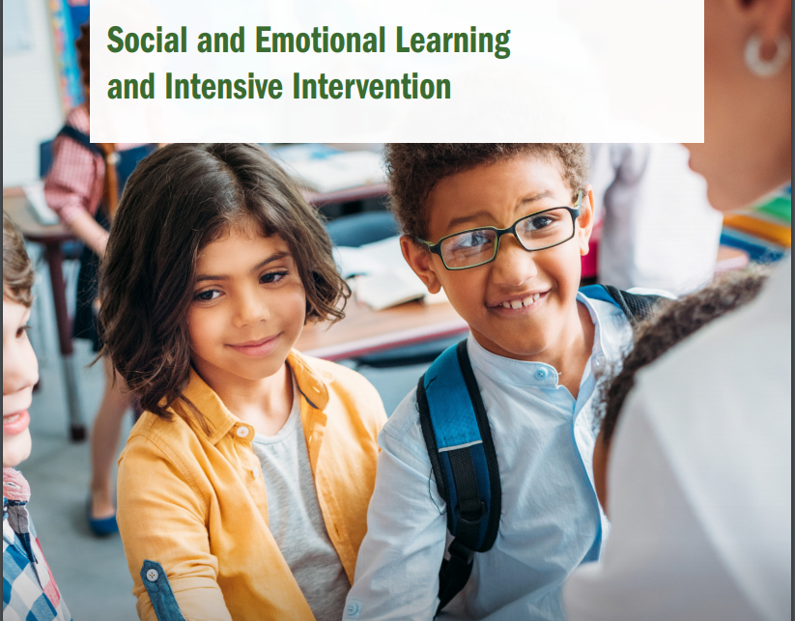
Connecting SEL and Intensive Intervention
How does SEL relate to intensive intervention?
What are effective strategies for building the social and emotional competencies of students with intensive needs?
https://intensiveintervention.org/resource/social-emotional-learning-and-intensive-intervention

Slide 7
What is Intensive Intervention?
Intensive intervention addresses severe and persistent learning and behavioral difficulties.
Characterized by increased intensity and individualization
Driven by data

Slide 8
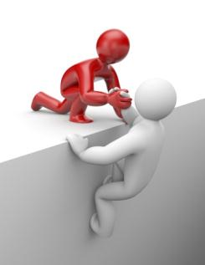
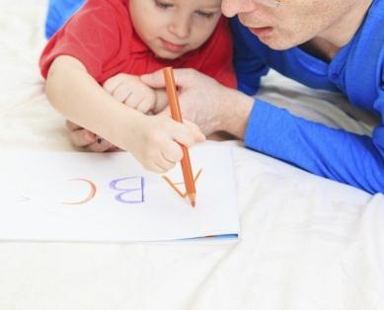
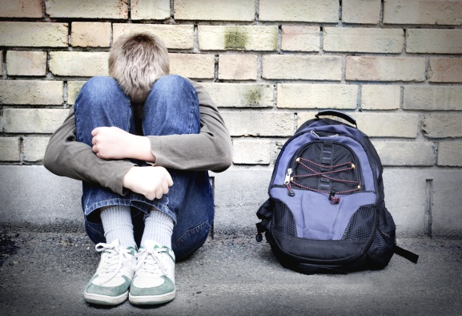
Why Do We Need Intensive Intervention?
Validated programs are not universally effective programs; 3% to 5% of students need more help (NCII, 2013).
Students with intensive needs often require 10–30 times as much practice as their peers to learn new information (Gersten et al., 2009).
For students with intensive needs, co-occurring academic and behavioral needs are the rule not the exception (Kuchle & Riley-Tillman, 2019) .

Slide 9
What is NCII’s Approach to Intensive Intervention?
Data-based individualization (DBI) is a research-based process for individualizing and intensifying interventions for students with severe and persistent learning and behavioral needs.
The process integrates evidence-based intervention, assessment, and strategies.

Slide 10
What is SEL?
Process
Practices
Competencies
Source: https://measuringsel.casel.org/wp-content/uploads/2018/11/Framework_EquitySummary-.pdf; Process by Rflor, partnership by Vectors Market, and Open Mindedness by Becris from the Noun Project

Slide 11
Does SEL Really Improve Student Outcomes?
A 2011 meta-analysis of 213 studies involving school-based, universal SEL programs including over 270,000 students in K-12 revealed:
Science Links SEL to Student Gains:
Social-emotional skills
Improved attitudes about self, others, and school
Positive classroom behavior
11 percentile-point gain on standardized achievement tests
Reduced Risks for Failure:
Conduct problems
Emotional distress
Durlak et al., 2011.

Slide 12
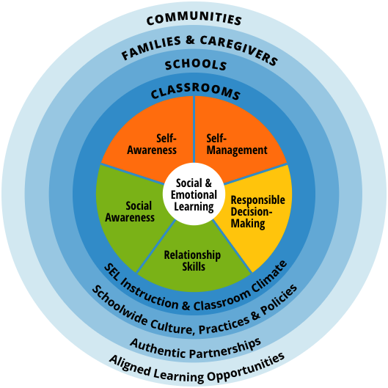
CASEL SEL Definition
“…the process through which all young people and adults acquire and apply the knowledge, skills, and attitudes to develop healthy identities, manage emotions and achieve personal and collective goals, feel and show empathy for others, establish and maintain supportive relationships, and make responsible and caring decisions” (CASEL, 2020).
Notes:
Adapted from CASEL free slide deck: https://docs.google.com/presentation/d/1Tb9WundNcsURexo2RTvVGVIVlzD_q9i6Vv4jcNtqZjI/edit#slide=id.gf17bfec626_3_102​

Slide 13
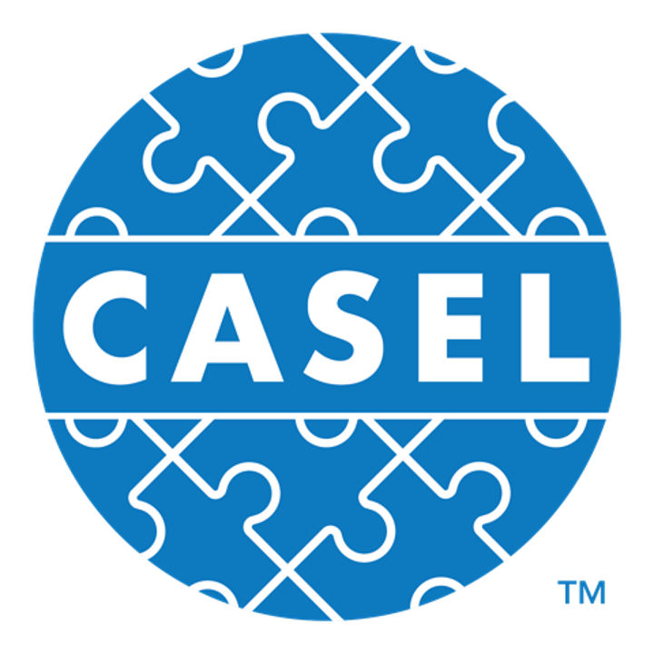
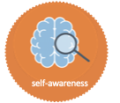
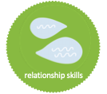
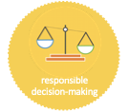
THE CASEL 5
Five broad, interrelated areas of competence
self-awareness
self-management
social awareness
relationship skills
responsible decision-making
Understand one’s own emotions, thoughts, and values and how they influence behavior across contexts.
Manage one’s emotions, thoughts, and behaviors in different situations and to achieve goals and aspirations.
Understand the perspectives of and empathize with others, including those from diverse backgrounds.
Establish and maintain healthy, supportive relationships and effectively navigate settings with diverse individuals/groups.
Make caring and constructive choices about personal behavior and social interactions across diverse situations.
Notes:
Adapted from CASEL free slide deck: https://docs.google.com/presentation/d/1Tb9WundNcsURexo2RTvVGVIVlzD_q9i6Vv4jcNtqZjI/edit#slide=id.gf17bfec626_3_102​

Slide 14
Connecting SEL and Intensive Intervention

Slide 15
SEL and Intensive Intervention
SEL provides a foundation for all students at Tier 1.
Social and emotional supports are embedded across all tiers based on student need.
Focus on a similar set of target skills that are aligned with the Tier 1 SEL program.
Develop a common language to promote consistency.

Slide 16
What Does SEL Look Like?
Engaging Instruction
Provide daily instruction that enhances social connections and personal reflection.
Explicit Skill Development
Target specific social and emotional skills during time set aside for SEL.
Embedded Content
Weave social and emotional skills and topics into existing academic lessons.
School Environment
Ensure that policies, organizational structures, and relationships promote a safe, supportive, culturally responsive, and engaging school environment.
Adapted from Dusenbury, Calin, Domitrovich, & Weissberg (2015)

Slide 17
How Can SEL Be Infused into the DBI Process?
Explicit SEL instruction
Embedded SEL supports
Engaging instruction
How can we intensify the SEL supports/instruction that we are providing?

Slide 18
SEL Strategies to Support Students with Intensive Needs

Slide 19
Example Strategies: Self-Awareness and Self-Management
Help students identify common behavioral triggers and potentially challenging situations in advance.
Use a group contingency strategy during academic instruction.
Provide opportunities for students to self-monitor their behavior and graph the data.

Slide 20
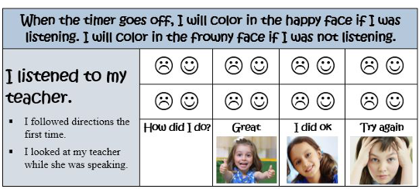
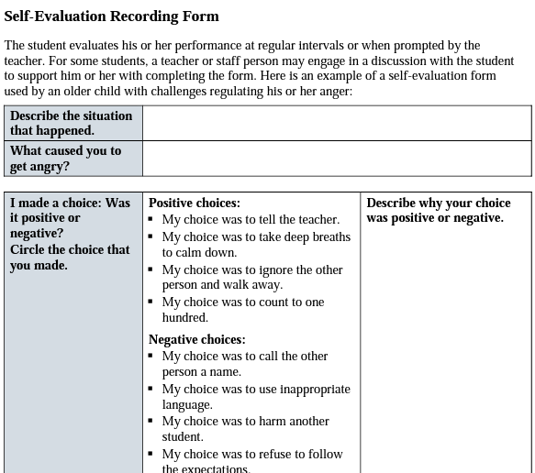
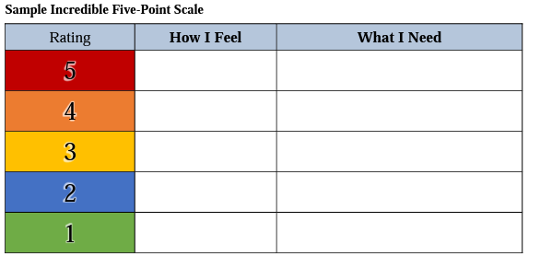
Sample Tools from NCII

Slide 21
Example Strategies: Social Awareness and Relationship Skills
Engage students in cross-age tutoring and mentoring.
Provide opportunities for students to practice relationship skills in small groups (e.g., lunch buddies, social skills groups).
Use role play to help students empathize with and understand the perspectives of others.
Notes:
Social Awareness
Teachers increase the likelihood that students will engage and persist in school when they establish positive relationships
Strategies to promote positive teacher-student relationships include—
Classroom structure and routines
Positive behavior management (e.g., communicating expectations, monitoring for problems, spending minimal time correcting students, using proactive disciplinary strategies like precorrection)
Student involvement in decision making
Regular positive feedback to all students about their social skills that indicates what they did well and how they can improve
Students with emotional and behavioral challenges also tend to have difficulties with self-regulation that impacts their ability to control impulses and regulate emotions. The school context, including peer and teacher relationships, are important pieces of improving social competence.
Note: SEL experts and advocates recommend the use of collaborative and self-directed work to provide opportunities to enhance SEL. Students with intensive needs also benefit from collaborative work and may benefit from more explicit routines and instruction in how to work collaboratively with others.
Relationship mapping is a strategy to identify students who lack supportive adult relationships at school. When students without strong links are identified, staff can volunteer to build relationships (e.g., using the two by ten strategy).
Discuss how these examples facilitate students’ relationship skills.
Note: SEL experts and advocates recommend the use of collaborative and self-directed work to provide opportunities to enhance SEL. Students with intensive needs also benefit from collaborative work and may benefit from more explicit routines and instruction in how to work collaboratively with others.
3 Es here

Slide 22
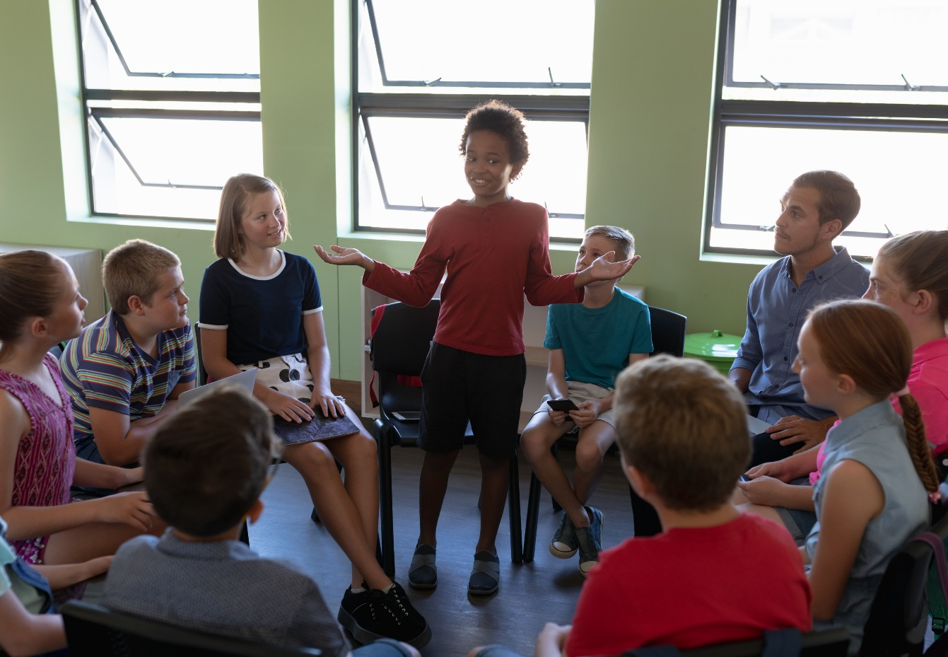
Foster Student Belonging
Recognize the strengths that students bring to the classroom.
Consider social dynamics of the classroom and the power of peers.
Include student voice.

Slide 23
Support and Enhance Peer Connections
Deliver instruction in ways that facilitate peer relationships.
Use cooperative learning and peer group strategies to provide opportunities for students to learn together and build friendships.
Biggs, E. E., & Carter, E. W. (2022). The Power of Peers. TIES Center. https://publications.ici.umn.edu/ties/peer-engagement/practice-guides/introduction

Slide 24
Partner with Families and Others to Support Intensive Intervention
Share information with families.
Invite parents to participate in the DBI process.
Ask parents and families for information about their child.

Slide 25
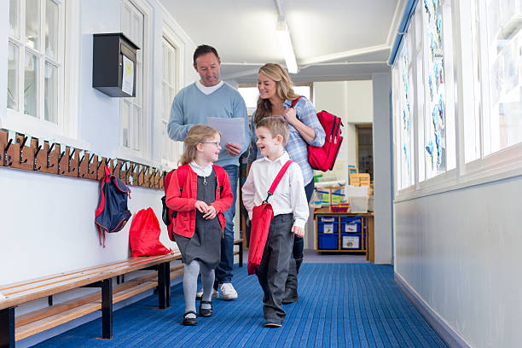
Example Strategies: Responsible Decision-Making
Partner with families to align reinforcement strategies across home and school.
Use a choice menu to help students practice responsible decision making.
Use a reflection sheet to prompt students to evaluate their behavior following a conflict.

Slide 26
Resources to Support SEL for Students with Intensive Needs

Slide 27
NCII SEL Brief
https://intensiveintervention.org/resource/social-emotional-learning-and-intensive-intervention

Slide 28
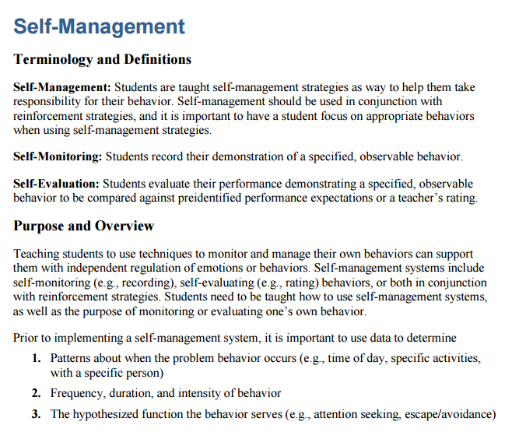
Resources to Learn More About Behavioral Principles and Strategies
https://intensiveintervention.org/implementation-intervention/behavior-strategies
https://intensiveintervention.org/intensive-intervention-behavior-course

Slide 29
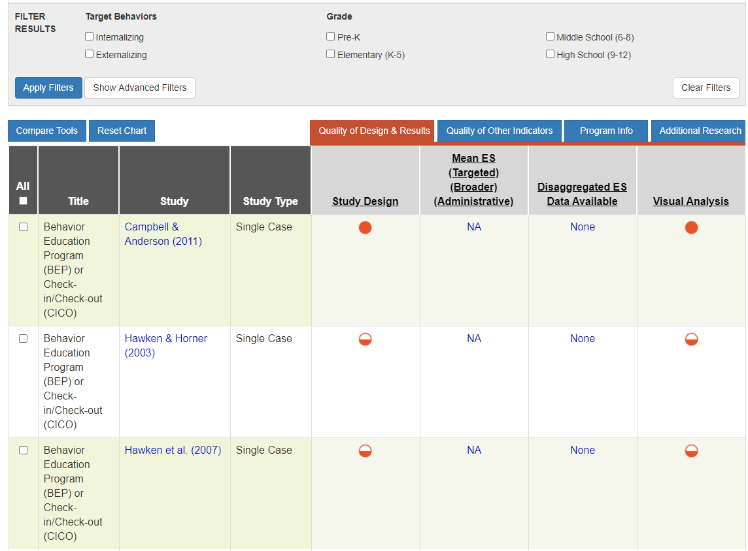
NCII Behavior Tools Charts
https://charts.intensiveintervention.org/bintervention

Slide 30
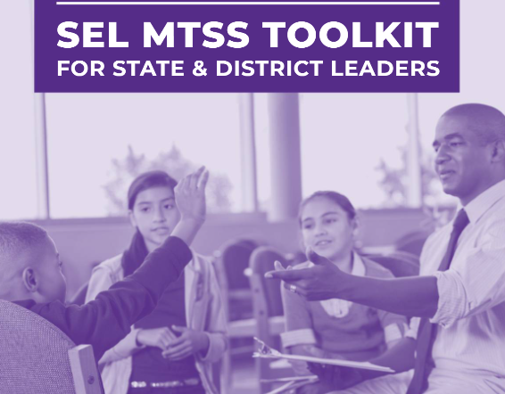
Integrating MTSS and SEL
https://mtss4success.org/resource/integrating-SEL-within-MTSS

Slide 31
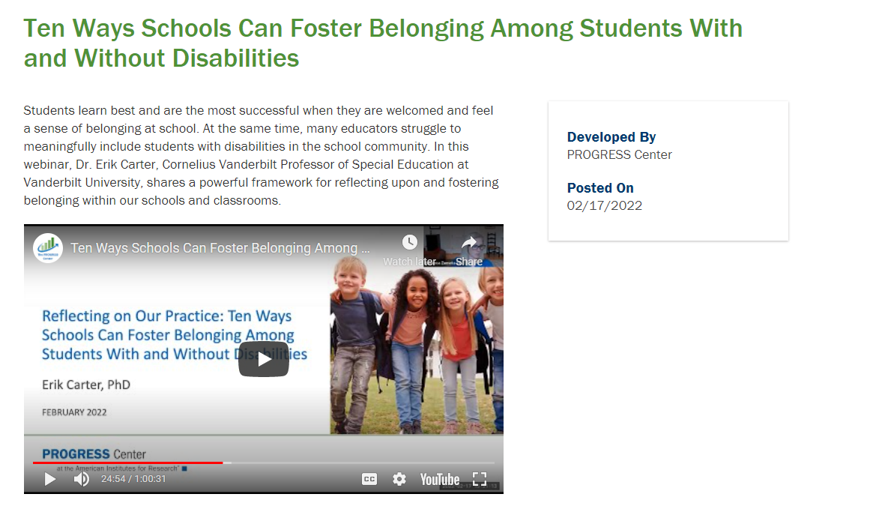
PROGRESS Center Webinar on Belonging
https://promotingprogress.org/resources/ten-ways-schools-can-foster-belonging

Slide 32
TIES Center Peer Engagement Resources
https://publications.ici.umn.edu/ties/peer-engagement/practice-guides/introduction

Slide 33
Questions

Slide 34
References
Bierman, K. L., & Sanders, M. T. (2021). Teaching explicit social-emotional skills with contextual supports for students with intensive intervention needs. Journal of Emotional and Behavioral Disorders, 29(1), 14-23.
Brackett, M. A., Patti, J., Stern, R., Rivers, S. E., Elbertson, N., Chisholm, C., & Salovey, P. (2009). A sustainable, skill-based model to building emotionally literate schools. In R. Thompson, M. Hughes, & J. B. Terrell (Eds.), Handbook of developing emotional and social intelligence: Best practices, case studies, and tools (pp. 329–358). New York, NY: Wiley.
Biggs, E. E., & Carter, E. W. (2022). The Power of Peers. TIES Center. https://publications.ici.umn.edu/ties/peer-engagement/practice-guides/introduction
Collaborative for Academic, Social, and Emotional Learning (CASEL). (n.d.). What is the CASEL framework?: A framework creates a foundation for applying evidence-based SEL strategies to your community. Retrieved from https://casel.org/fundamentals-of-sel/what-is-the-casel-framework/
Durlak, J. A., Taylor, R. D., Kawashima, K., Pachan, M. K., DuPre, E. P., & Celio, C. I., et al. (2007). Effects of positive youth development programs on school, family, and community systems. American Journal of Community Psychology, 39, 269–286.

Slide 35
References
Durlak, J. A., Weissberg, R. P., Dymnicki, A. B., Taylor, R. D., & Schellinger, K. B. (2011). The impact of enhancing students’ social and emotional learning: A meta-analysis of school-based universal interventions. Child Development, 82(1), 405–432.
Gersten, R., Compton, D., Connor, C.M., Dimino, J., Santoro, L., Linan-Thompson, S., and Tilly, W.D. (2009). Assisting students struggling with reading: Response to Intervention and multi-tier intervention for reading in the primary grades. A practice guide. (NCEE 2009-4045). Washington, DC: National Center for Education Evaluation and Regional Assistance, Institute of Education Sciences, U.S. Department of Education. Retrieved from https://ies.ed.gov/ncee/wwc/PracticeGuide/3
Jennings, J. A., & Greenberg, M. T. (2009). The prosocial classroom: Teacher social and emotional competence in relation to student and classroom outcomes. Review of Educational Research, 79( 1), 491–525. http://www.jstor.org/stable/40071173.
Jones, S., Bouffard, S., & Weissbourd, R. (2013). Educators’ social and emotional skills vital to learning. Phi Delta Kappan, 94(8). 62–65. Retrieved from https://www.district287.org/uploaded/A_Better_ Way/Jones_Educators_social_and_emotional_article_(1).pdf

Slide 36
References
Jones, D. E., Greenberg, M., & Crowley, M. (2015). Early Social-Emotional Functioning and Public Health: The Relationship Between Kindergarten Social Competence and Future Wellness. American journal of public health, 105(11), 2283–2290. doi:10.2105/AJPH.2015.302630
Kuchle, L. B., & Riley-Tillman, T. C. (2019). Integrating behavior and academics in intervention planning. In R.Z. Edmonds, A.G. Gandhi, & L.C. Danielson (Eds.). Essentials of intensive intervention (pp. 51-70). The Guilford Press.
National Center on Intensive Intervention. (2013). Data-based individualization: A framework for intensive intervention. Washington, DC: American Institutes for Research. Retrieved from https://intensiveintervention.uat.air.org/resource/data-based-individualization-framework-intensive-intervention
Smith, S. W., Poling, D. V., & Worth, M. R. (2018). Intensive intervention for students with emotional and behavioral disorders. Learning Disabilities Research & Practice, 33(3), 168–175.
Taylor, R., Oberle, E., Durlak, J., & Weissberg, R. (2017). Promoting positive youth development through school-based social and emotional learning interventions: A meta-analysis of follow-up effects. Child Development, 88(4).

Slide 37
Thank you

Slide 38
NCII Disclaimer
This presentation was produced under the U.S. Department of Education, Office of Special Education Programs, Award No. H326Q160001. Celia Rosenquist serves as the project officer. The views expressed herein do not necessarily represent the positions or policies of the U.S. Department of Education. No official endorsement by the U.S. Department of Education of any product, commodity, service, or enterprise mentioned in this resource is intended or should be inferred.

