Slide 1
Supporting English Learners With Intensive Needs
May 17, 2022
Donna Sacco, PhD| John J. Hoover, PhD |Tracy Spies, PhD

Slide 2
Presenters
Donna Sacco, PhD
Senior Technical Assistance Consultant, NCII, AIR
John Hoover, PhD
Independent Educational
Consultant, Retired Associate Professor, University of Colorado, Boulder & BUENO Center for Multicultural Education
Tracy Spies, PhD
Associate Professor of English Language Learning in the Department of Early Childhood, Multilingual, & Special Education, University of Nevada, Las Vegas

Slide 3
Webinar Objectives
Provide an overview of how data-based individualization (DBI) can support the unique needs of English learners (ELs).
Provide strategies for delivering culturally and linguistically sustaining intensive intervention.
Provide strategies for incorporating language supports as adaptations to intensive intervention for ELs.
Share resources to learn more about DBI and ELs.

Slide 4
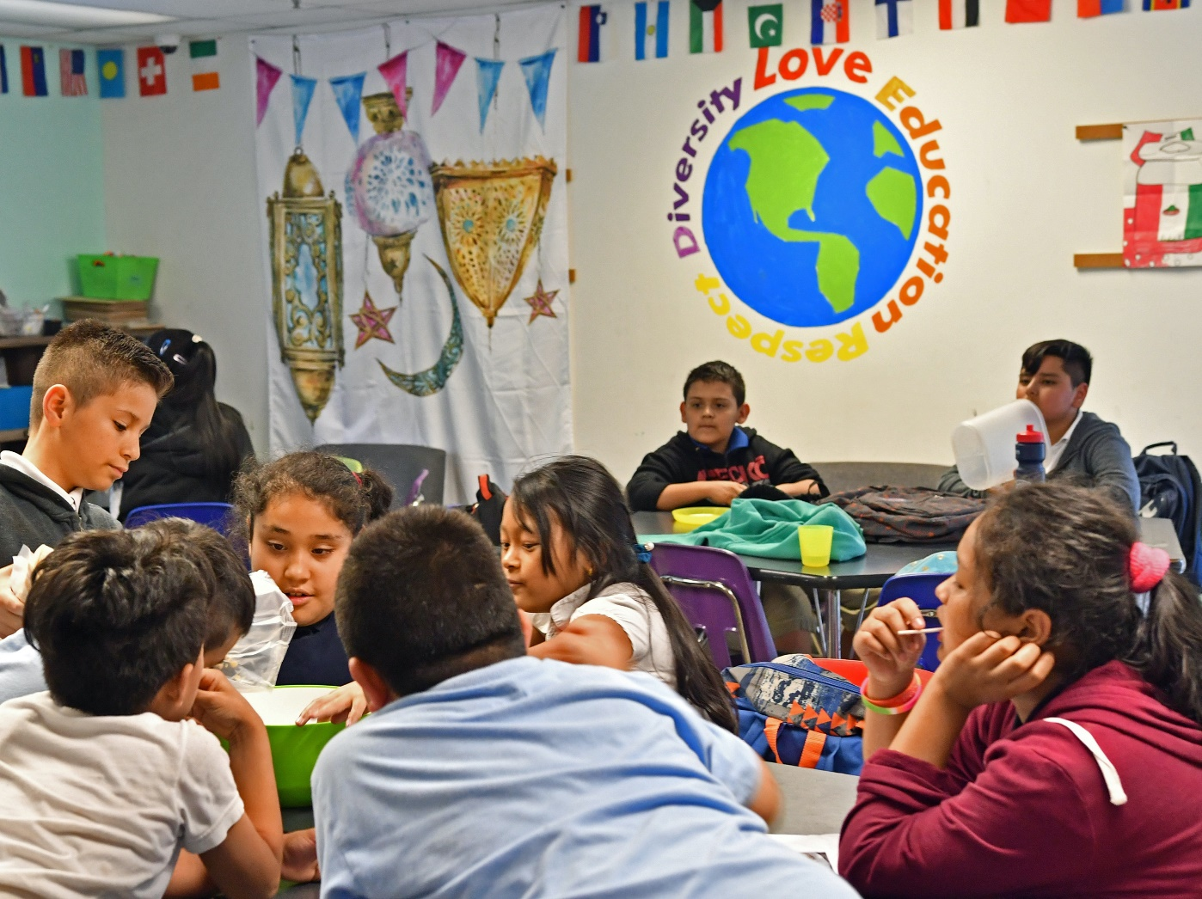
Outcomes
Attendees will learn strategies for delivering culturally and linguistically sustaining (CLS) practices within interventions and how to adapt and intensify interventions for ELs who are not making expected progress within a DBI framework.
Photo by Peter J. Tomlinson

Slide 5
When it comes to delivering instruction for ELs, which picture best describes you? Place your # in the chat and wait for the signal.
1
2
3
4
5

Slide 6
When it comes to data-based individualization (DBI), which picture best describes you? Place your # in the chat and wait for the signal.
1
2
3
4
5

Slide 7
Setting the Context
DBI for ELs

Slide 8
What Is Intensive Intervention?
Intensive intervention addresses severe and persistent learning and behavioral difficulties.
Driven by data
Characterized by increased intensity and individualization

Slide 9
Why Do We Need Intensive Intervention?
Validated programs are not universally effective programs; 3% to 5% of students need more help (NCII, 2013).
Students with intensive needs often require 10–30 times as much practice as their peers to learn new information (Gersten et al., 2009).
For students with intensive needs, co-occurring academic and behavioral needs are the rule not the exception (Kuchle & Riley-Tillman, 2019).

Slide 10
What Is NCII’s Approach to Intensive Intervention?
DBI is a research-based process for individualizing and intensifying interventions for students with severe and persistent learning and behavioral needs.
The process integrates evidence-based intervention, assessment, and strategies.

Slide 11
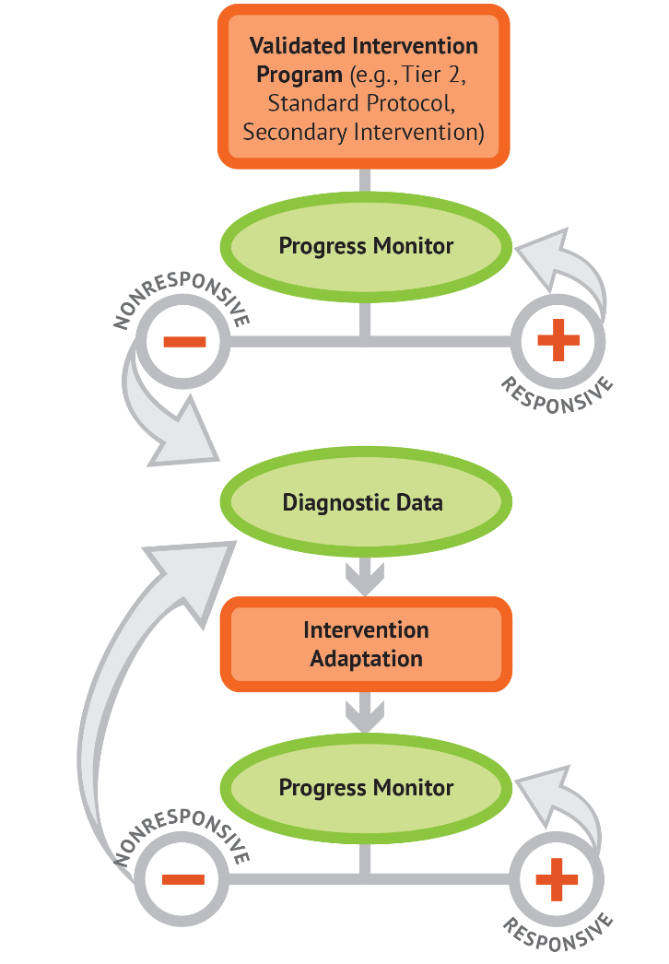
Remember: Individualizing instruction for students with disabilities is an ongoing process.

Slide 12
Culturally and Linguistically Sustaining Intensive Intervention
Delivering Instruction to Sustain Language and Cultural Qualities When Meeting Academic/Behavioral Needs

Slide 13
Valuing Cultural and Linguistic Diversity
To promote cultural and linguistic sustainability, the cultural and language diversity that ELs bring to schools and classrooms must be valued (Baca & Cervantes, 2004).
Cultural/linguistic sustainability builds upon cultural/linguistic responsiveness.

Slide 14
Distinguishing Culturally/Linguistically Responsive From Culturally/Linguistically Sustaining
Culturally/Linguistically Responsive | Culturally/Linguistically Sustaining
Refers to how one goes about directly teaching ELs (CDE Website) by drawing upon learner, family, and community qualities used “as capital to build upon” (Aceves & Orosco, 2014, p. 7) to provide relevant education. Views language and culture as assets used to shape the delivery of effective education. | Expands culturally/linguistically responsive teaching moving from a set of practices to a mindset that frames instruction seeking “to perpetuate and foster—to sustain—linguistic, literate, and cultural pluralism as part of the democratic project of schooling” (Paris, 2012, p. 93). Designed to support and perpetuate (i.e., sustain) ELs’ languages and cultural heritages.

Slide 15
Facilitating a Culturally and Linguistically Sustaining Mindset
Key Instructional Point
Delivery of CLS instruction within any type of educational setting (e.g., general class, push-in, pull-out, consultation supports) requires use of many best practices
1
Making Connections
(Build Background Knowledge/
Draw on Funds of Knowledge)
5
Collaboration
(General, ELD, SE Expertise/
Family Engagement)
2
Valuing Native Language
(Development and Usage)
Delivering
CLS Instruction
4
Linking Assessment and Instruction
(Use Multiple Sources and Data Points)
3
Differentiation
(Instruction and Behavior Management)
Sources:
Baca and Cervantes (2004)
Hoover and Patton (2017)

Slide 16
Perspective: CLS and Intensive Intervention
Helping ELs be successful with intensive intervention requires attention to CLS qualities and assets.
Intensive intervention becomes CLS when the approach used is
validated for use with ELs or
(b) adapted to incorporate cultural and linguistic qualities
leading to the simultaneous integration of appropriate language/cultural supports and delivery of the intervention.

Slide 17
Poll: Sustainability Focus in Education
Culturally and linguistically sustaining instruction builds on culturally responsive instruction by expanding the focus from drawing upon to sustaining one’s language and culture. In the poll, share which description represents your current perspective.

Slide 18
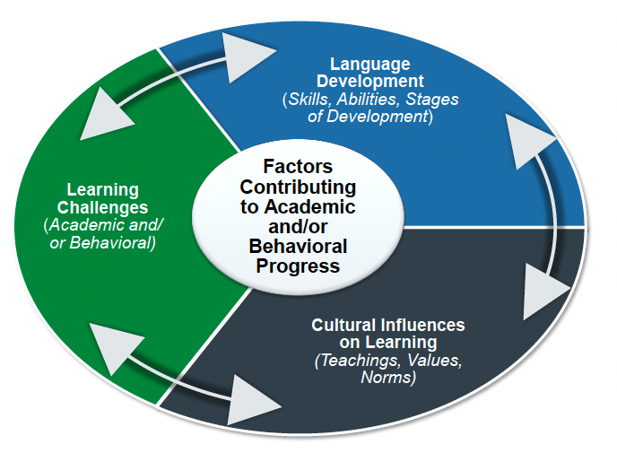
Interrelated Features Shaping Culturally & Linguistically Diverse Learner Progress
Key Point on Integrated Learning
When addressing ELs’ intensive learning needs, including dually-identified ELs with disabilities (e.g., dyslexia, autism, significant needs), it is essential for educators to consider students’
(a) language development,
(b) cultural assets, and
(c) learning challenges
in order to design and deliver appropriate intensive intervention.

Slide 19
Intensive intervention facilitates language development when it . . .
Y__ N __ Teaches toward language and content objectives.
Y__ N __ Assists students to use Native language to support learning in English (e.g., restating idea in first
language).
Y__ N __ Supports ELs' vocabulary development through word meanings and background knowledge.
Y__ N __Incorporates strategic uses of visual representations (e.g., Concept mapping; Graphic Organizers).
Y__ N __ Facilitates learner use of authentic and connected discourse (e.g., restating, building on learners’
input and sharing).
Y__ N __ Builds background knowledge and supports shared understanding of new concepts/learning.
Sources: Hoover and Patton (2017); Hoover et al. (2016); Hoover et al. (2014)

Slide 20
Intensive intervention values cultural assets when it . . .
Y__ N__ Accesses learners’ prior experiences and sustains cultural teachings.
Y__ N __ Incorporates learners’ cultural values and norms in instruction (e.g., adapting to new
cultural environment, eye contact expectations, multiple means).
Y__ N __ Structures culturally­ sustaining learning by teaching about the importance of various cultures.
Y__ N __ Incorporates home and community engagement (e.g., inviting community members,
conducting home visits).
Y__ N __ Seeks out and incorporates family and community funds of knowledge.
Y__ N __ Structures instructional delivery commensurate with cultural heritage/language proficiency
(e.g., cooperative learning, increased wait time, peer learning).
Sources: Hoover and Patton (2017); Hoover et al. (2016); Hoover et al. (2014)

Slide 21
Intensive intervention addresses academic and behavioral learning challenges when it . . .
Y__ N__ Values culturally preferred learning strategies, organizational preferences, and self-
management structures.
Y__ N__ Provides additional learning supports specific to ELs’ needs (e.g., extended time, repeated
instruction, task analysis, peer modeling).
Y__ N__ Incorporates multiple teacher instructional best practices (e.g., scaffolded instruction,
sheltered instruction, explicit instruction).
Y__ N__ Implements targeted differentiations that support cultural/linguistic ways of learning.
Y__ N__ Uses multiple student structures (e.g., paired­ learning, cooperative, native language peer).
Y__ N__ Is guided by learners’ language proficiency levels and culturally taught behaviors.
Sources: Hoover and Patton (2017); Hoover et al. (2016); Hoover et al. (2014)

Slide 22
Intervention Adaptations
Intensified or Different Language Supports for ELs

Slide 23
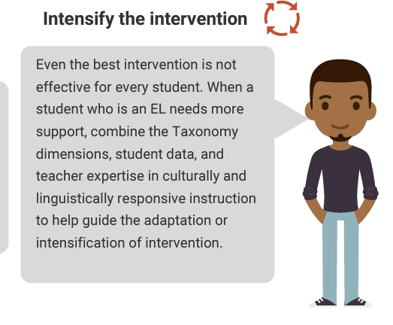
Using DBI to Include Adaptations for ELs

Slide 24
Key Considerations When Intensifying and Individualizing Programs
Does evidence suggest the components of the program are expected to lead to improved outcomes (strength)?
Will the group size, duration, and frequency provide sufficient opportunities to respond (dosage)?
Does the intervention program match to the student’s identified needs (alignment)?
Does it assist the student in generalizing the learned skills to general education or other tasks (attention to transfer)?
Does the intervention program include elements of explicit instruction (comprehensiveness)?
Does the student have opportunities to develop the behavior skills necessary to be successful (behavioral support)?
Source: Fuchs et al. (2017)

Slide 25
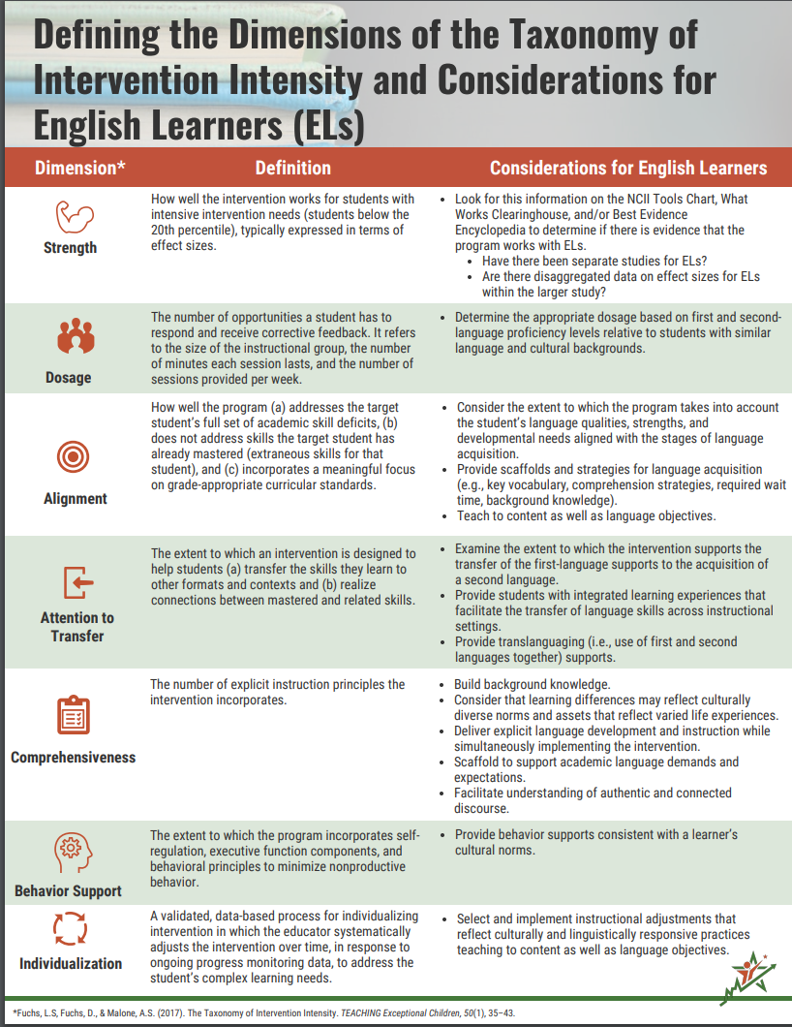
Defining the Dimensions of the Taxonomy of Intervention Intensity and Considerations for ELs

Slide 26
Dosage
Dimension | Definition | Considerations for ELs

Slide 27
Comprehensiveness
Dimension | Definition | Considerations for ELs

Slide 28
A Look at Language
How do students use language during intervention?
How can students who are developing language be better supported?

Slide 29
Examining the Language of the Intervention
Academic Language: the language of the discipline that students need to learn and use in order to participate and engage with content in meaningful ways
Language Functions
What students do with language
Language Demands
Language students use to participate in the learning

Slide 30
Identifying the Language Functions
The verb of the content standards help determine how students will use language to participate in the content learning.
CCSS.ELA-Literacy.RF.2.3 A
Distinguish long and short vowels when reading regularly spelled one-syllable words.
CCSS.Math.Content.6.RP.A.3.C
Find a percent of a quantity as a rate per 100; solve problems involving finding the whole, given a part and the percent.
Source: Common Core State Standards Initiative (2022)

Slide 31
WIDA: Key Language Uses
Recount/Narrate
Display knowledge or narrate experiences.
Summarize, report, and share experiences.
Explain
Clarify the “why” and ”how” of ideas, actions, and phenomena.
Describe processes, cause and effect, and results.
Source: World-Class Instructional Design and Assessment (2016)

Slide 32
WIDA: Key Language Uses
Argue
Persuade by making claims supported by evidence.
State opinions and construct arguments.
Discuss
Interact with others to build meaning.
Participate in discussions and projects.
Source: World-Class Instructional Design and Assessment (2016)

Slide 33
Pause and Ponder
How might you make adaptations to an intervention based on language functions?

Slide 34
Examining the Language of the Intervention
Academic Language: the language of the discipline that students need to learn and use in order to participate and engage with content in meaningful ways
Language Functions
What students do with language
Language Demands
Language students use to participate in the learning

Slide 35
Dimensions of Language
Discourse
Linguistic Complexity
Sentence
Language Forms and Conventions
Word Phrase
Vocabulary Usage
Source: World-Class Instructional Design and Assessment (2020)

Slide 36
Examining the Dimensions of Language
Discourse
How is the language organized?
How is the language connected?
Sentence Level (Syntax)
What grammatical structures are prevalent in the learning?
What conventions are prevalent in the identified area?

Slide 37
Examining the Dimensions of Language
General Academic Vocabulary
Which Tier 2 words are prevalent?
Discipline Specific Vocabulary
Which Tier 3 words are critical?

Slide 38
Considerations for Adapting Interventions
Increase opportunities to respond
Focus on the verbs of the standards
Embed opportunities to talk about the content (Baker et al., 2014)
Alter the way content is delivered
Change how student responds
Adjust feedback
Embed the WIDA key language uses
Use the key language uses to scaffold for students
Focus feedback on language use
Explicitly teach content-specific vocabulary (Baker et al., 2014)

Slide 39
Differentiated Language Supports
Sensory Supports | Graphic Supports | Interactive Supports
Real-life objects (realia) Manipulatives Pictures and photographs Illustrations, diagrams, drawings Magazines and newspapers Physical activities Videos Broadcasts Models and figures | Charts Graphic Organizers Tables Graphs Timelines Number lines | In pairs or partners In triads or small groups In a whole group Using cooperative grouping structures With the internet (websites) or software programs In the home language With mentors
Source: World-Class Instructional Design and Assessment (2014), p. 11 (Figure K)

Slide 40
Connecting Back to Sustainability Focus
Adhere to the principle that language and culture remain integral to teaching and learning and, therefore, should always be part of the decision making when reviewing student data and implementing a holistic approach to intensive intervention.
In summary, a sustainability mindset reflects delivery of intensive intervention so that ELs are appropriately supported culturally and linguistically to best make academic progress.

Slide 41
Resources to Support ELs With Intensive Needs

Slide 42
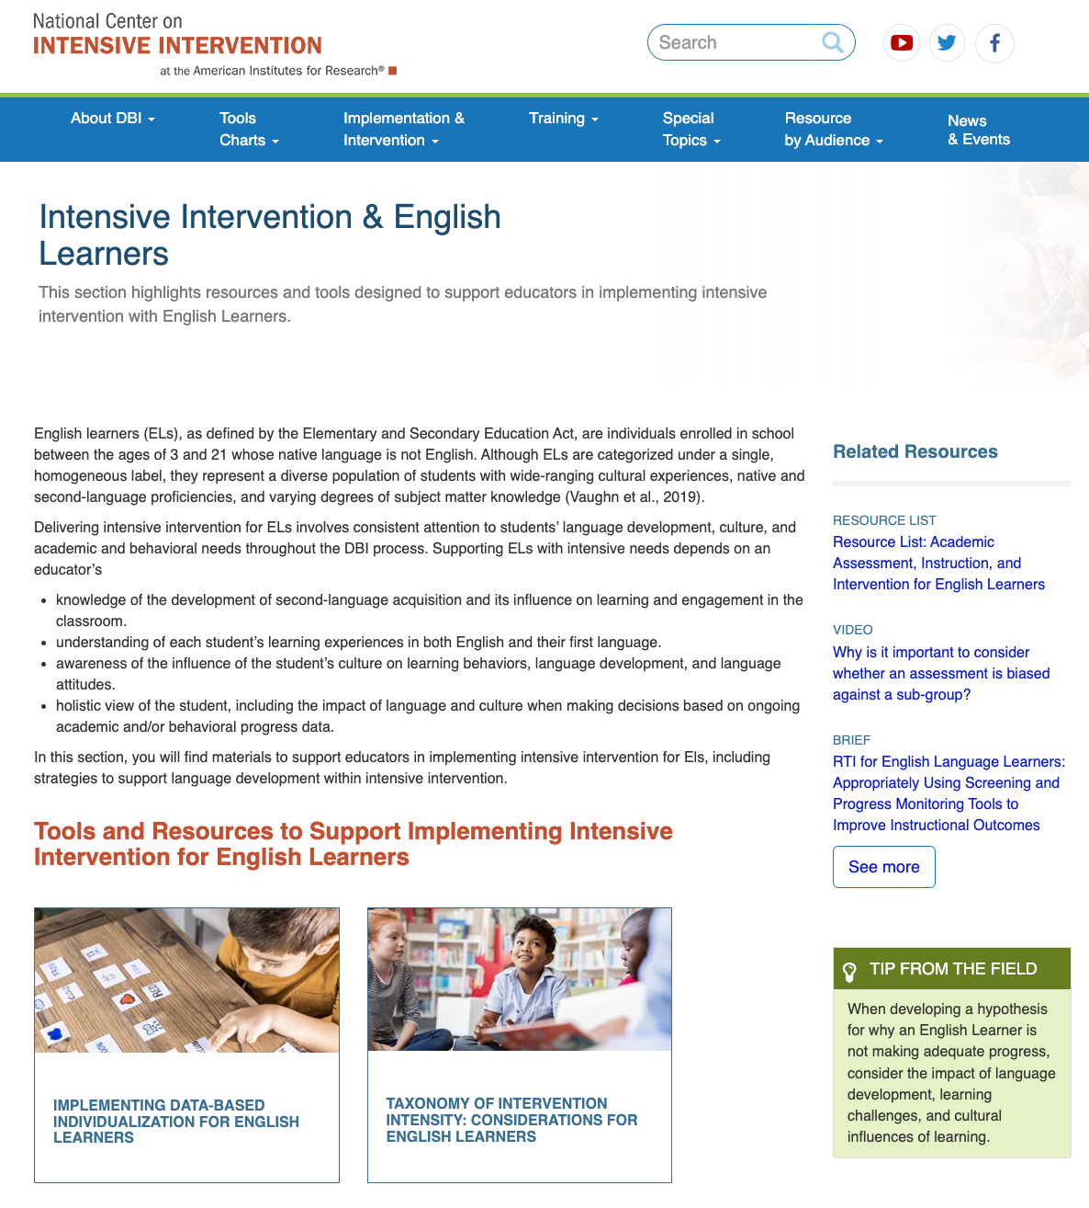
Intensive Intervention & ELs
https://intensiveintervention.org/special-topics/english-learners

Slide 43
Implementing Data-Based Individualization for English Learners Brief
https://intensiveintervention.org/resource/data-based-individualization-english-learners
Source: Sacco et al. (2021)

Slide 44
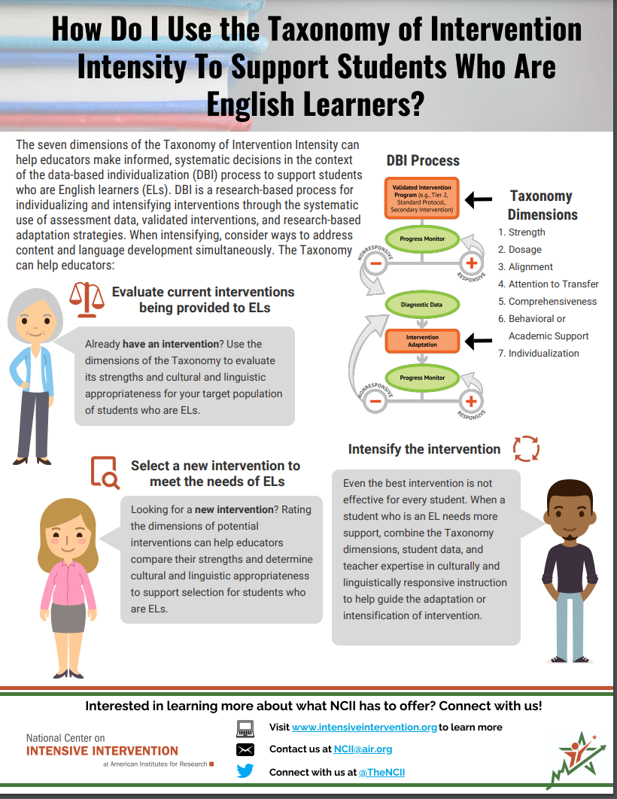
Taxonomy of Intervention Intensity for ELs
https://intensiveintervention.org/resource/taxonomy-considerations-english-learners

Slide 45
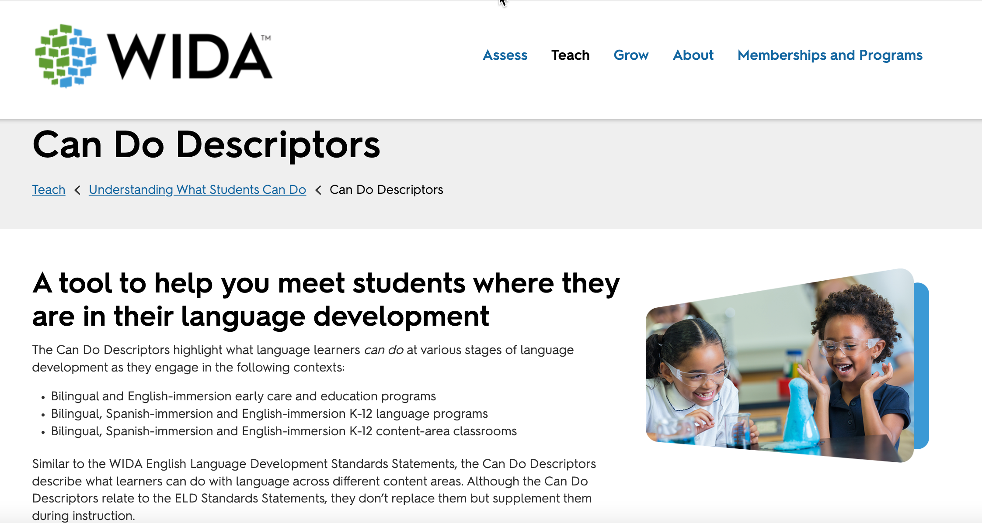
WIDA Can Do Descriptors Key Uses
https://wida.wisc.edu/teach/can-do/descriptors

Slide 46
WIDA Language Development Standards 2020
https://wida.wisc.edu/sites/default/files/resource/WIDA-ELD-Standards-Framework-2020.pdf

Slide 47
What Works Clearinghouse Practice Guide
https://ies.ed.gov/ncee/wwc/PracticeGuide/19

Slide 48
OSEP Model Demonstration Projects
https://www.mtss4els.org/
Ten Briefs:
https://www.mtss4els.org/resources/briefs
Source: Baker et al. (2014)

Slide 49
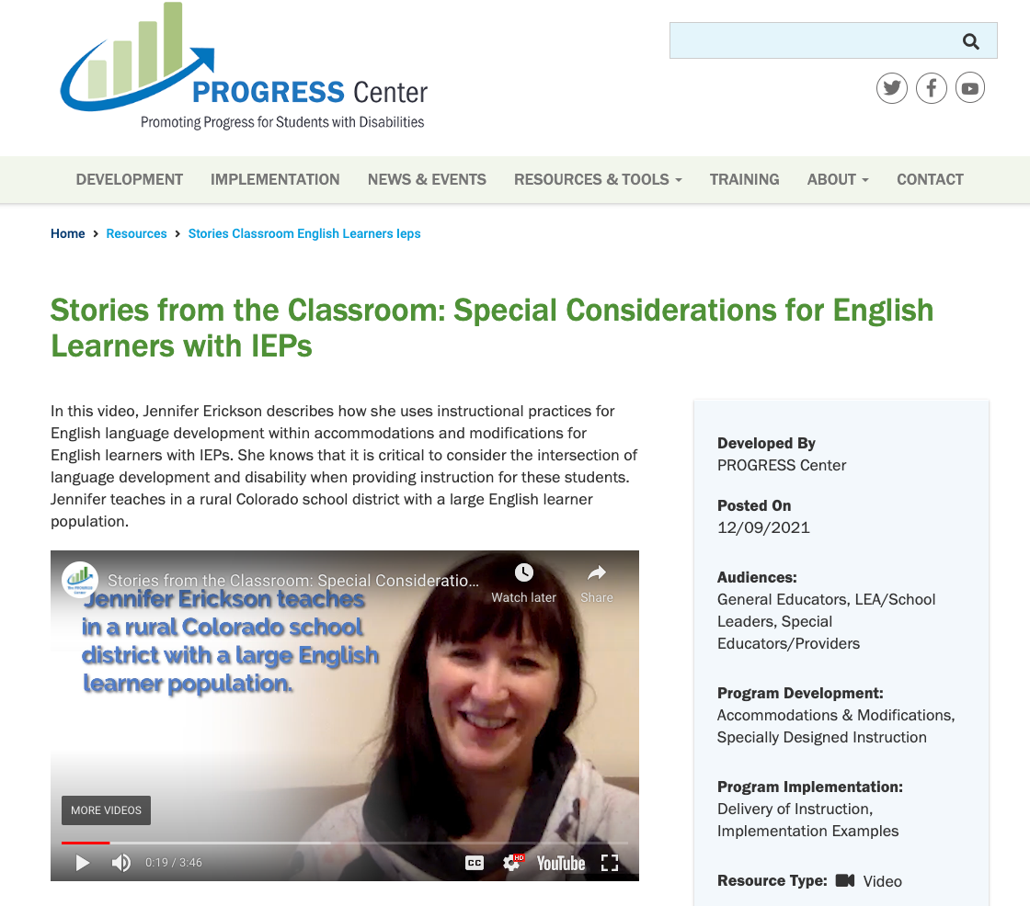
PROGRESS Center Stories From the Classroom
https://promotingprogress.org/resources/stories-classroom-english-learners-ieps
Source: Baker et al. (2014)

Slide 50
Questions and Comments

Slide 51
Thank You

Slide 52
NCII Disclaimer
This presentation was produced under the U.S. Department of Education, Office of Special Education Programs, Award No. H326Q260001. Celia Rosenquist serves as the project officer. The views expressed herein do not necessarily represent the positions or policies of the U.S. Department of Education. No official endorsement by the U.S. Department of Education of any product, commodity, service, or enterprise mentioned in this resource is intended or should be inferred.

Slide 53
References
Aceves, T. C., & Orosco, M. J. (2014). Culturally responsive teaching (Document No. IC-2). Collaboration for Effective Educator, Development, Accountability, and Reform Center, University of Florida. https://ceedar.education.ufl.edu/wp-content/uploads/2014/08/culturally-responsive.pdf
Baca, L. M., & Cervantes, H. T. (2004). The bilingual special education interface. Merrill Publishing.
Baker, S., Lesaux, N., Jayanthi, M., Dimino, J., Proctor, C. P., Morris, J., Gersten, R., Haymond, K., Kieffer, M. J., Linan-Thompson, S., & Newman-Gonchar, R. (2014). Teaching academic content and literacy to English learners in elementary and middle school (NCEE 2014-4012). National Center for Education Evaluation and Regional Assistance (NCEE), Institute of Education Sciences, U.S. Department of Education. https://ies.ed.gov/ncee/wwc/Docs/PracticeGuide/english_learners_pg_040114.pdf
Colorado Department of Education. (2022). Culturally responsive and sustaining education. https://www.cde.state.co.us/coreadingwriting/culturally-responsive-and-sustaining-pedagogy
Common Core State Standards Initiative. (2022). Common Core State Standards. http://www.corestandards.org/

Slide 54
References
Freeman-Green, S., Driver, M. K., Wang, P., Kamuru, J., & Jackson, D. (2021). Culturally sustaining practices in content area instruction for CLD students with learning disabilities. Learning Disabilities Research & Practice, 36(1), 12–25.
Fuchs, L. S., Fuchs, D., & Malone, A. S. (2017). The taxonomy of intervention intensity. TEACHING Exceptional Children, 50(1), 35–43.
Gersten, R., Compton, D., Connor, C. M., Dimino, J., Santoro, L., Linan-Thompson, S., & Tilly, W. D. (2009). Assisting students struggling with reading: Response to Intervention and multi-tier intervention for reading in the primary grades. A practice guide (NCEE 2009-4045). National Center for Education Evaluation and Regional Assistance, Institute of Education Sciences, U.S. Department of Education. https://ies.ed.gov/ncee/wwc/PracticeGuide/3
Hoover, J. J., & Patton, J. R. (2017). IEPs for ELs and other diverse learners. Corwin.
Hoover, J. J., Baca, L., & Klingner, J. K. (2016). Why do English learners struggle with reading? Distinguishing language acquisition from learning disabilities (2nd ed.). Corwin Press.
Hoover, J. J., Hopewell, S., & Sarris, J. (2014). Core ESL Instructional Practices (CEIP) Guide. University of Colorado BUENO Center.

Slide 55
References
Kuchle, L. B., & Riley-Tillman, T. C. (2019). Integrating behavior and academics in intervention planning. In R. Z. Edmonds, A. G. Gandhi, & L. C. Danielson (Eds.), Essentials of intensive intervention (pp. 51–70). The Guilford Press. ​
National Center on Intensive Intervention. (2013). Data-based individualization: A framework for intensive intervention. American Institutes for Research. https://intensiveintervention.org/resource/data-based-individualization-framework-intensive-intervention
Paris, D. (2012). Culturally sustaining pedagogy: A needed change in stance, terminology, and practice. Educational Researcher, 41(3), 93–97.
Sacco, D. M., Hoover, J. J., & Spies, T. (2021). Implementing data-based individualization for English learners. National Center on Intensive Intervention, American Institutes for Research.
World-Class Instructional Design and Assessment. (2016). WIDA can do descriptors (key uses edition): Grades 2-3. https://wida.wisc.edu/sites/default/files/resource/CanDo-KeyUses-Gr-2-3.pdf

Slide 56
References
World-Class Instructional Design and Assessment. (2014). 2012 amplification of the English language development standards: Kindergarten–grade 12. https://wida.wisc.edu/sites/default/files/resource/2012-ELD-Standards.pdf
World-Class Instructional Design and Assessment. (2020). WIDA English language development standards framework (2020 edition): Kindergarten – grade 12. https://wida.wisc.edu/sites/default/files/resource/WIDA-ELD-Standards-Framework-2020.pdf

