Slide 1
Mathematics Word Problem Solving in Late Elementary and Middle School
Evidence-Based Strategies and Approaches
for Teaching Problem Solving
Copyright © 20XX American Institutes for Research. All rights reserved.
Notes:
Introduction
This module is focused on the evidence-based strategies necessary for students to be successful in solving word problems. Specific strategies and practice of the strategies are part of the professional development. This module is designed to be completed during a full-day professional development, but could be shortened to half-day, if needed. The module is designed for interventionist, special educators, general education math teachers and leaders.
Instructions for using the speaker notes
• Text formatted in standard font is intended to be read aloud or paraphrased by the facilitator.
• Text formatted in bold is excerpted directly from the presentation slides.
• Text formatted in italics is intended as directions or notes for the facilitator; italicized text is not meant to be read aloud.
• Text formatted in underline indicates an appropriate time to click to bring up the next stage of animation in an animated slide.
Welcome participants to the training. Introduce yourself (or selves) as the facilitator(s) and briefly cite your professional experience in regard to mathematics instruction and intensive academic intervention in mathematics.
Although permission to reprint this publication is not necessary, the citation should be: i3 Intensive Intervention in Mathematics. (2020). Mathematics word problem solving in middle schools. Evidence-based strategies and approaches for teaching problem solving. Washington, DC: Education Innovation and Research Program, U.S. Department of Education.

Slide 2
Agenda
Discuss competing ideologies from general and special education mathematics research
Address what NOT to do when teaching and solving word problems
Teaching how to solve word problems
  Specific evidence-based strategies
  Exploring visual representations
  Exploring multiple strategies through worked example comparisons
Intervention approaches for word problem solving

Slide 3
Competing Ideas
Word Problem Solving and Mathematics Instruction

Slide 4
Special Education and General Education Frameworks
Special Education Framework:
Traditionally, special education research provides students with precise guidance on how to solve problems; provides a systematic way of solving the word problem with a mathematically correct equation or representation.
  Decreases demand on working memory
  Provides a framework for where to start
General Education Framework:
Students think about story content and generate their own solution strategies.
  Ability to make meaning in their own way
  Creates connections on “student terms”
Notes:
There are often disagreements on how to teach word problem solving. In the area of special education, we often provide a systematic way to solve the problem versus math education research, which allows more freedom, more space for students to work it out on their own. We need to consider how to align the two frameworks together so that students with disabilities and those at risk can be successful and generalize skills across problem types and settings.

Slide 5
What NOT to do
Before we discuss evidence-based practices, any thoughts about what you SHOULD NOT DO?
Notes:
[Read slide. Make a list of thoughts shared by participants.]

Slide 6
Common Practice to AVOID: KEY WORDS
Why don’t key word strategies work?
  No development of meaning making
  No building of structures for more advanced learning (decimals, fractions, algebra)
  Many problems do not have key words
  Students use key words inappropriately as a result of words having more than one meaning
  Multistep problems are impossible to solve with key words
Notes:
[Read slide.] Think about common key words that confuse students. For example, “more” or “together” means to add, “less” means to subtract, and “per” means to multiply. When students only look for these key words, for example, they lose the structure of the problem and often end up solving incorrectly due to overgeneralization.

Slide 7
Improving Mathematical Problem Solving in Grades 4 Through 8
Institute of Education Sciences
Practice Guide Findings: Five Recommendations

Slide 8

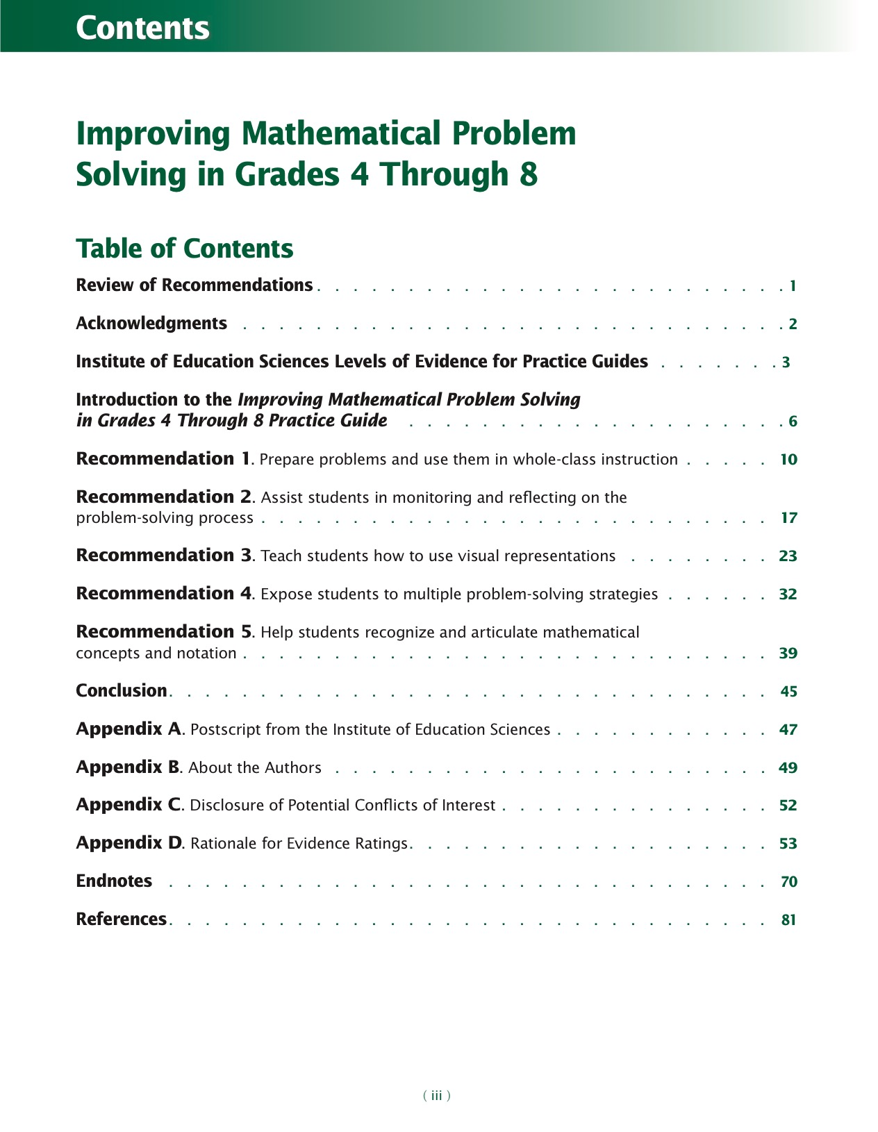
Slide 8
Source: Woodward, J., Beckmann, S., Driscoll, M., Franke, M., Herzig, P., Jitendra, A., . . . Ogbuehi, P. (2012)
Notes:
[Practice Guide is hyperlinked and available for free download.]
The Institute of Education Sciences (IES) publishes practice guides in education to bring the best available evidence and expertise to bear on current challenges in education. Authors of practice guides combine their expertise with the findings of rigorous research, when available, to develop specific recommendations for addressing these challenges. The authors rate the strength of the research evidence supporting each of their recommendations.
The goal of this practice guide is to offer educators specific, evidence-based recommendations that address the challenge of improving mathematical problem solving in grades 4 through 8. The guide provides practical, clear information on critical topics related to improving mathematical problem solving and is based on the best available evidence as judged by the authors.

Slide 9
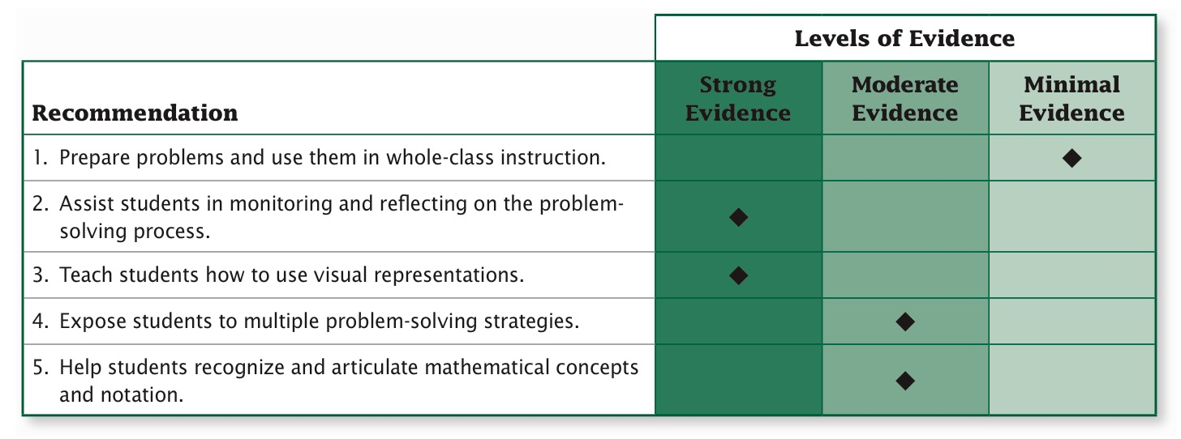
Improving Mathematical Problem Solving in Grades 4 Through 8
Notes:
[Read recommendations.]

Slide 10
Recommendation 1
Prepare problems and use them in whole-class instruction.
How to incorporate problems
into instruction
Notes:
Now we will review each recommendation in more detail.

Slide 11
Recommendation 1
Include both routine and non-routine problems in problem-solving activities.
Ensure that students will understand the problem by addressing issues that students might encounter with the problem’s context or language.
Consider students’ knowledge of mathematical content when planning lessons.
Notes:
[Read slide.]

Slide 12
Recommendation 1
Routine
Problems can be solved using methods familiar to students by replicating previously learned methods in a step-by-step fashion.
Procedural
Straightforward symbolic notation that may require multiple steps for solving word problems.
Non-routine
Problems for which there is not a predictable, well-rehearsed approach or pathway explicitly suggested by the task, task instructions, or a worked-out example.
Notes:
[Read slide.]

Slide 13
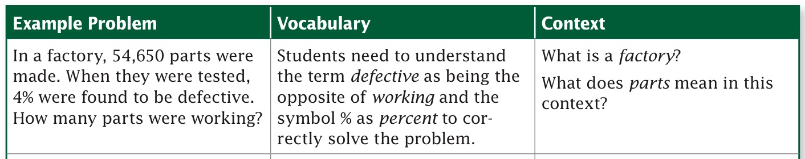
Recommendation 1
Understand the problem, context, and language (vocabulary).
  Choose problems with familiar contexts.
  Clarify unfamiliar language.
  Reword problems, drawing upon students’ experiences.
Notes:
[Read slide.]

Slide 14
Recommendation 1
Mathematical Content
  Consider operations needed to solve the problem.
  Mathematical vocabulary: especially important when solving problems related to geometry or other “math-oriented” scenarios.
    Perimeter
    Area
    Opposite sides of a rectangle are equal
    90 degrees in a triangle

Slide 15
Recommendation 2
Assist students in monitoring and reflecting on the problem-solving process.
Thinking through and reflecting on solving word problems and how to approach them

Slide 16
Recommendation 2
Provide students with a list of prompts to help them monitor and reflect during the problem-solving process.
Model how to monitor and reflect on the problem-solving process.
Use student thinking about a problem to develop students’ ability to monitor and reflect.
Notes:
Recommendation number two is similar to what we know about explicit, systematic instruction that includes demonstrate or model, guided practice, and then independent practice.

Slide 17
Recommendation 2: Sample Questions (Part 1)
What is the story about?
What is the problem asking?
What do I know about the problem so far? What information is given to me? How can this help me?
Which information in the problem is relevant?
In what way is this problem similar to problems I have previously solved?
What are the various ways that I might approach the problem?
Is my approach working?
Does the solution make sense?
What would I do differently next time?
Notes:
[Read slide.]

Slide 18
Recommendation 2: Sample Task List (Part 2)
Identify the “givens” and goals of the problem.
Identify the problem type.
Recall similar problems to help solve the current problem.
Use a visual to represent and solve the problem.
Solve the problem.
Check the solution.
Notes:
[Read slide.]

Slide 19
Recommendation 2: Model
Talk aloud as you go through the problem-solving steps.
Use some of the questions or other tasks to guide this modeling.
Notes:
[Read slide.]

Slide 20
Recommendation 2: Student Thinking
Assign a problem for students to work on.
Discuss the problem through solution methods the students chose.
Pull out information that addresses why a solution worked or didn’t work.
This can be challenging because students who struggle often don’t want to discuss their specific approaches or don’t know how to explain them.
Notes:
[Read slide.]

Slide 21
Recommendation 3
Teach students how to use visual representations.

Slide 22
Recommendation 3
Select visual representations that are appropriate for students and the problems they are solving.
Use think-alouds and discussions to teach students how to represent problems visually.
Show students how to convert the visually represented information into mathematical notation.
Notes:
[Read slide.] Avoid introducing a visual/manipulative when starting problem solving; it’s best if students have some experience before moving toward using these tools with word problems.

Slide 23

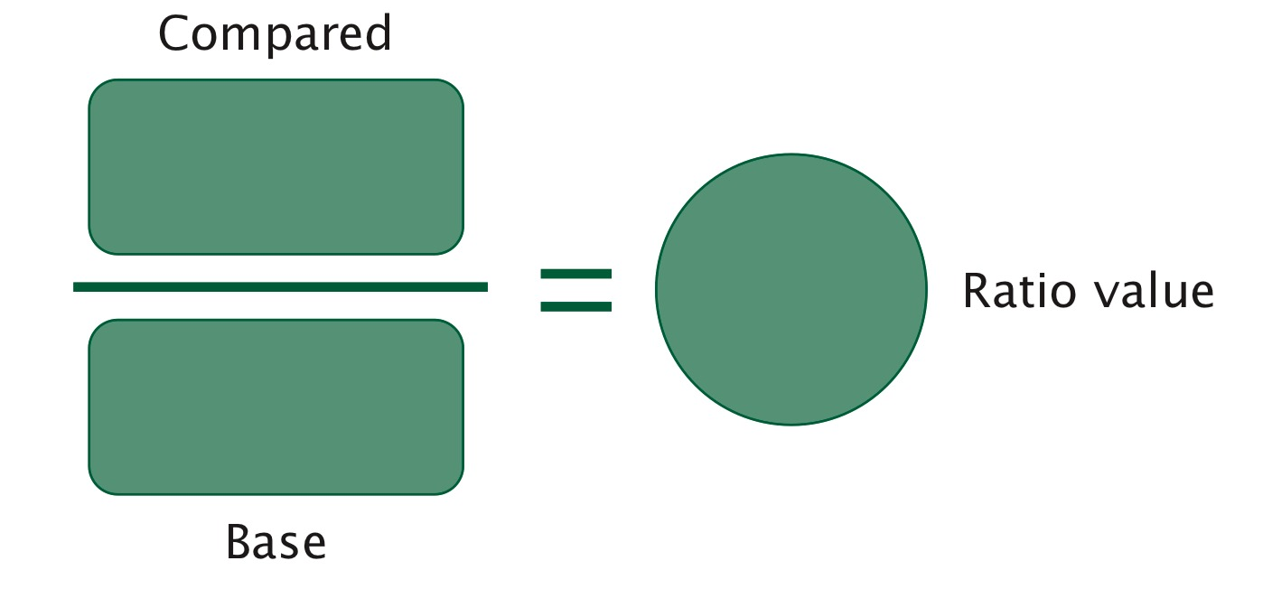
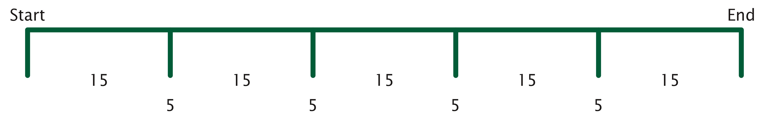
Recommendation 3: Visuals
Strip diagrams
Graphic organizers
Schematic diagram
Base 10 blocks
Counters
Notes:
Examples of visual representations that can be used within word problems.

Slide 24
Recommendation 3: Think-Alouds With Visuals
Model the approach and selection of which visual you’re applying and why.
Include rereading the problem throughout as a way to “check” that the problem is being solved correctly.
Reinforce what the question is asking; remind students that the goal is to answer that question.
Notes:
[Read slide.]

Slide 25
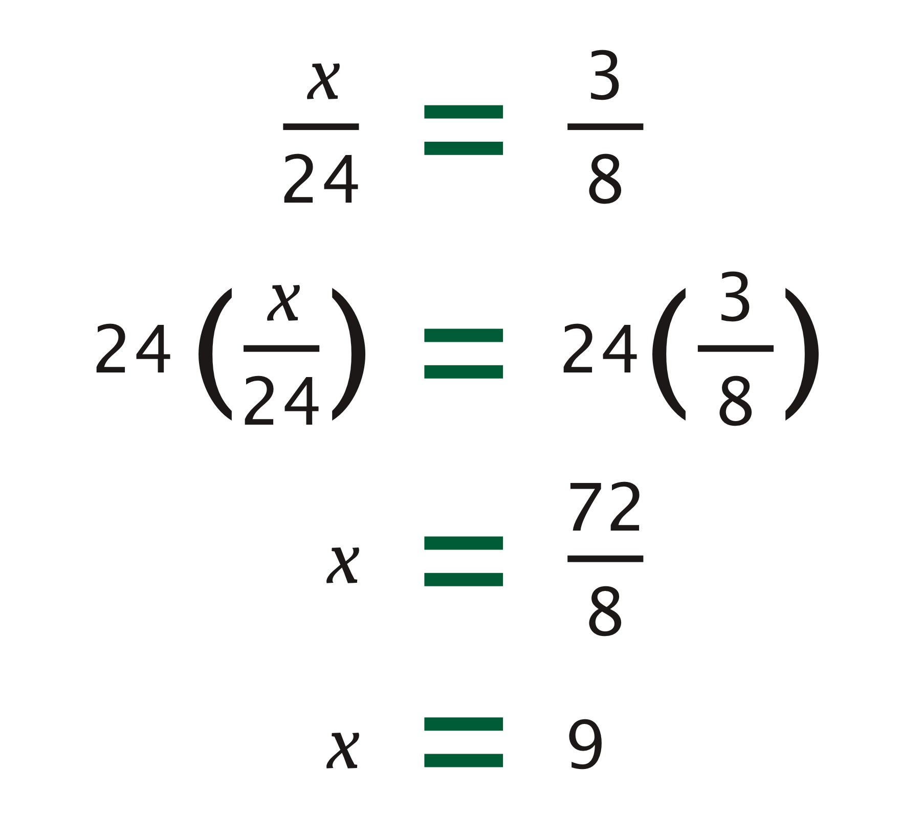
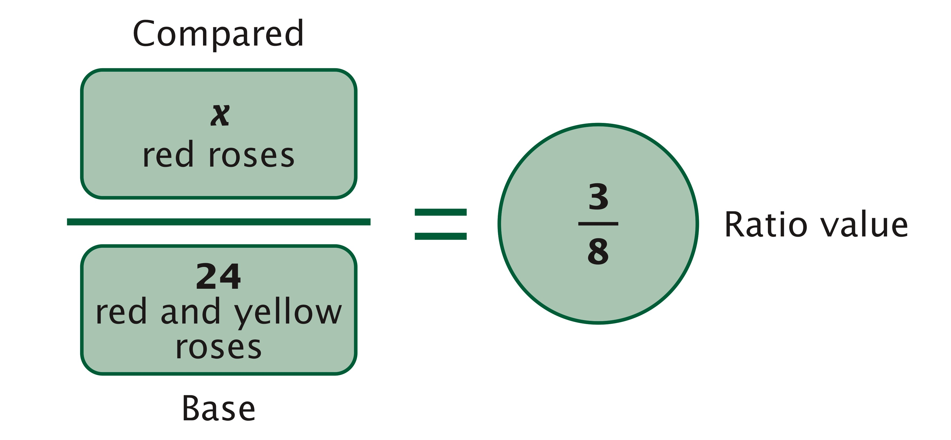
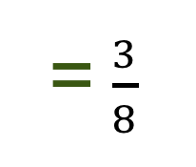
Recommendation 3: Visual to Equation
Monica and Bianca went to a flower shop to buy some roses. Bianca bought a bouquet with 5 pink roses. Monica bought a bouquet with two dozen roses, some red and some yellow. She has 3 red roses in her bouquet for every 5 yellow roses. How many red roses are in Monica’s bouquet?
x red roses
24 red and yellow roses
= $\frac{3}{8}$
Notes:
Example word problem and visual representation. [Read slide.]

Slide 26
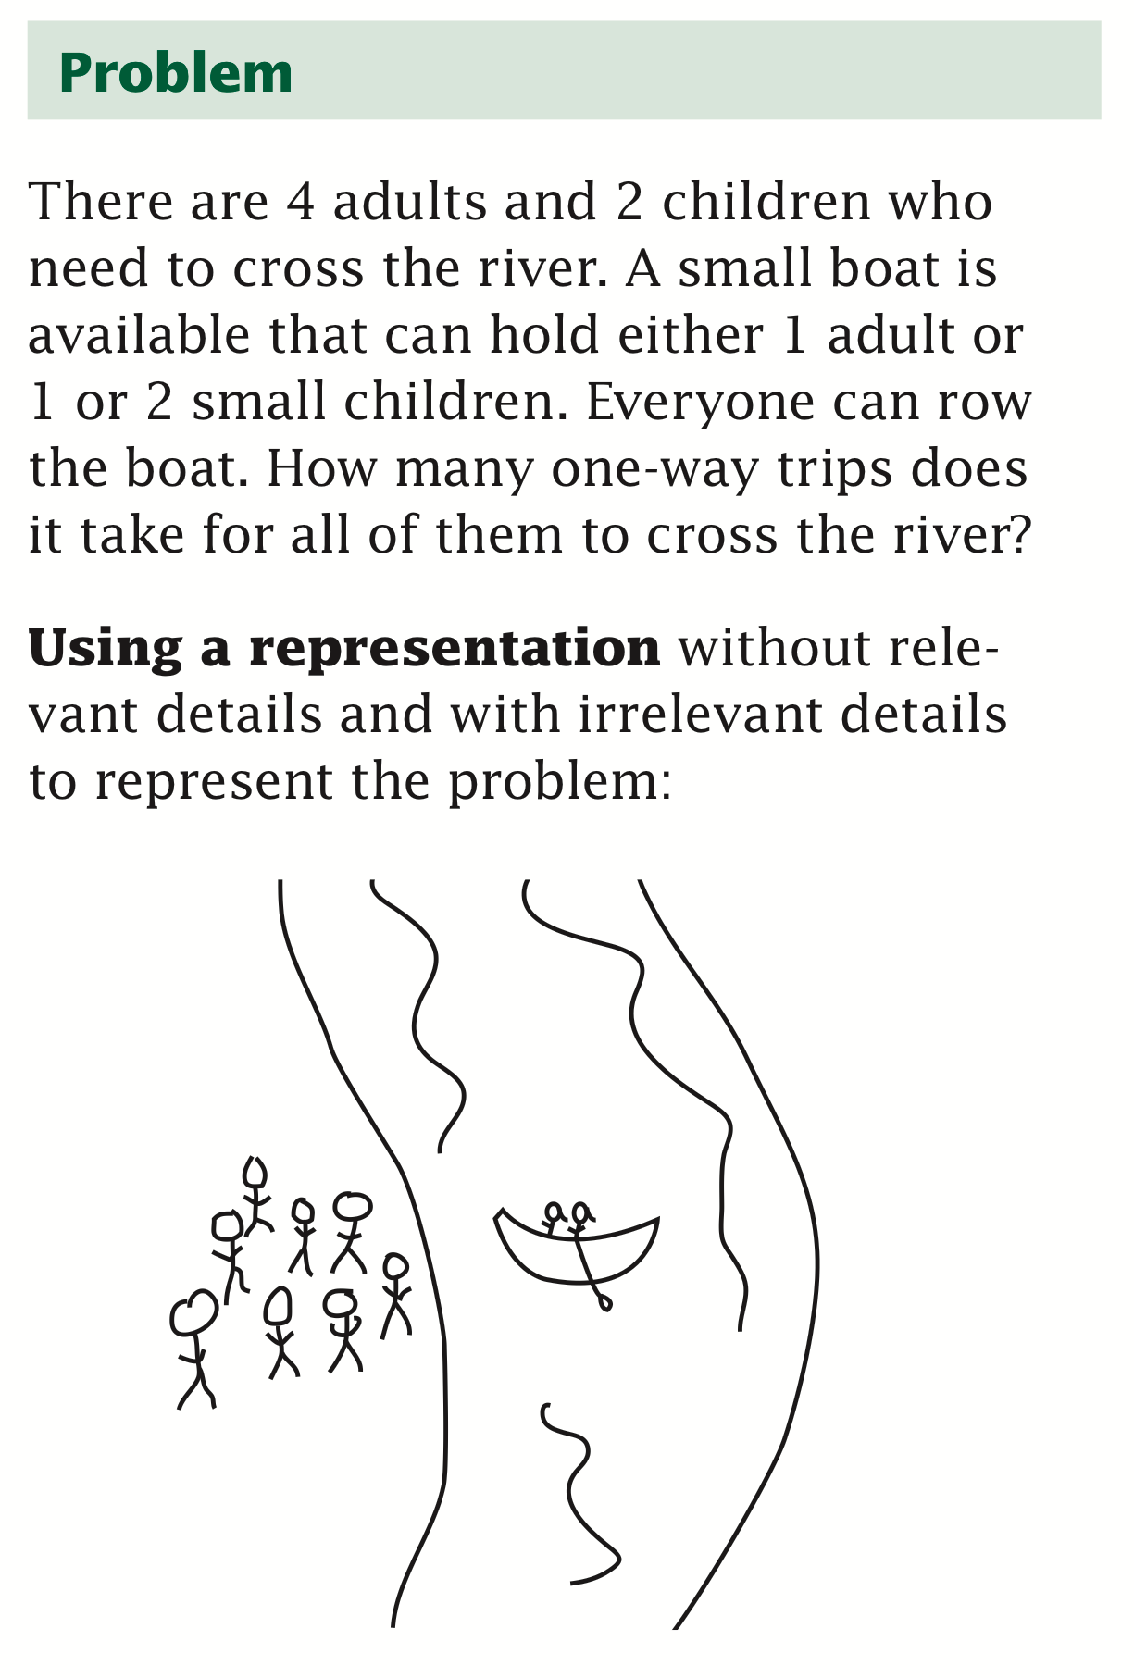
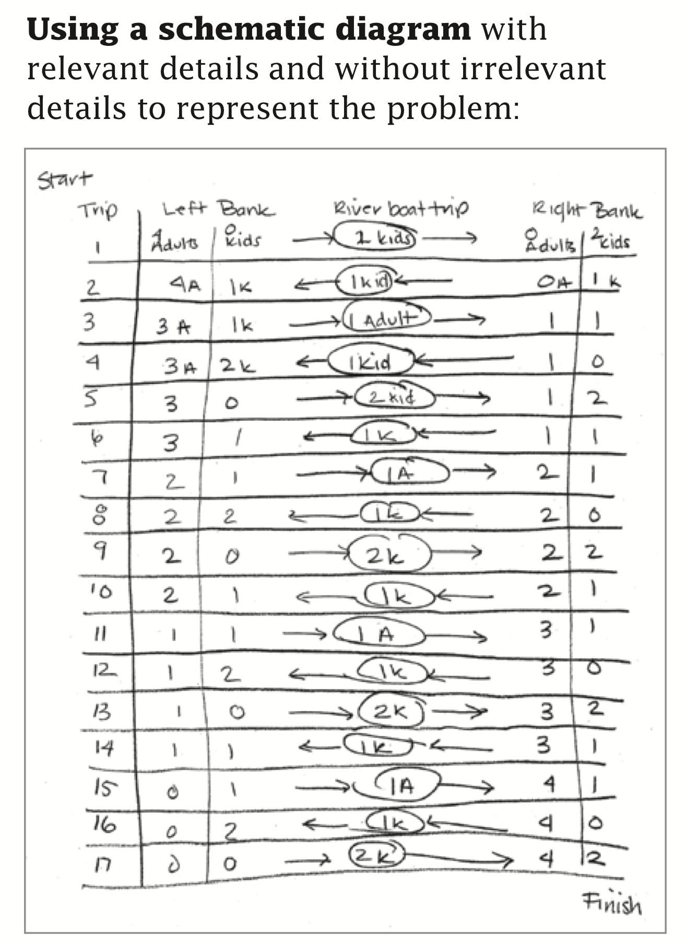
Recommendation 3: Example From Practice Guide
(See p. 30 of practice guide.)

Slide 27
Recommendation 4
Expose students to multiple problem-solving strategies.

Slide 28
Recommendation 4: Multiple Strategies
Provide instruction in multiple strategies.
Provide opportunities for students to compare multiple strategies in worked examples.
Ask students to share and generate multiple strategies for solving a problem.
Notes:
[Read slide.]

Slide 29
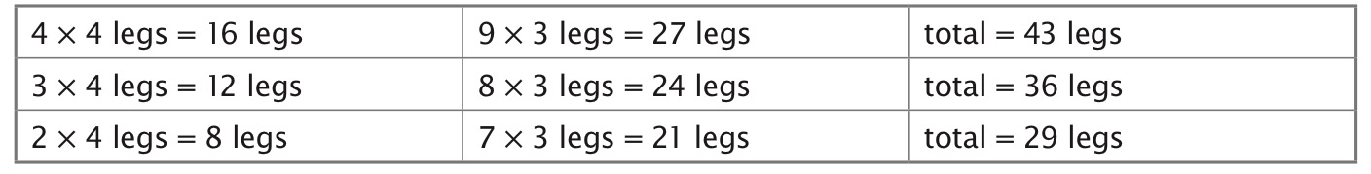
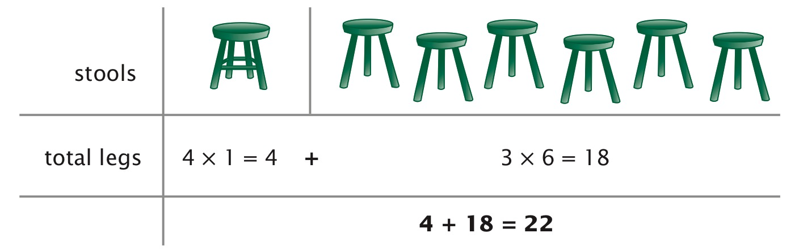
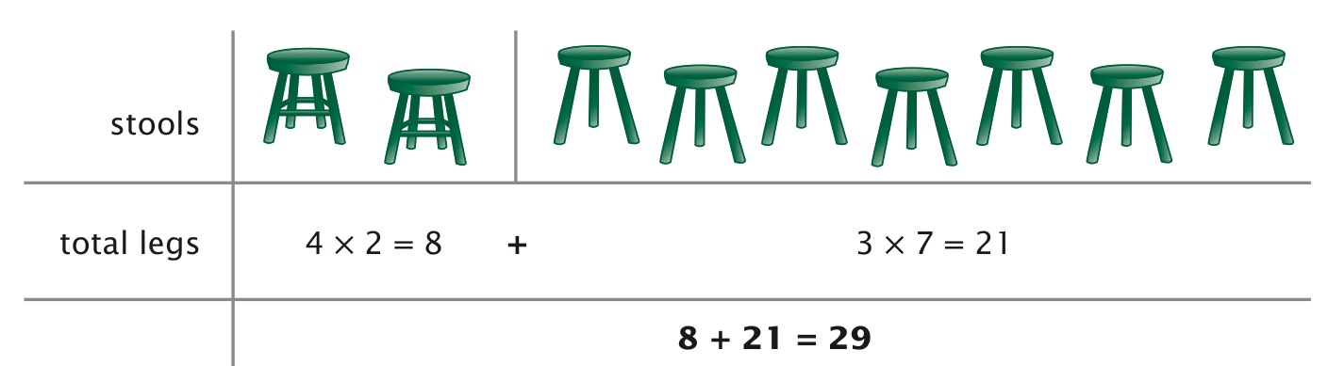
Recommendation 4: Provide Instruction
Ramona’s furniture store has a choice of 3-legged stools and 4-legged stools. There are five more 3-legged stools than 4-legged stools. When you count the legs of the stools, there are exactly 29 legs. How many 3-legged and 4-legged stools are there in the store?
#1
#2
(See p. 34 of practice guide.)

Slide 30

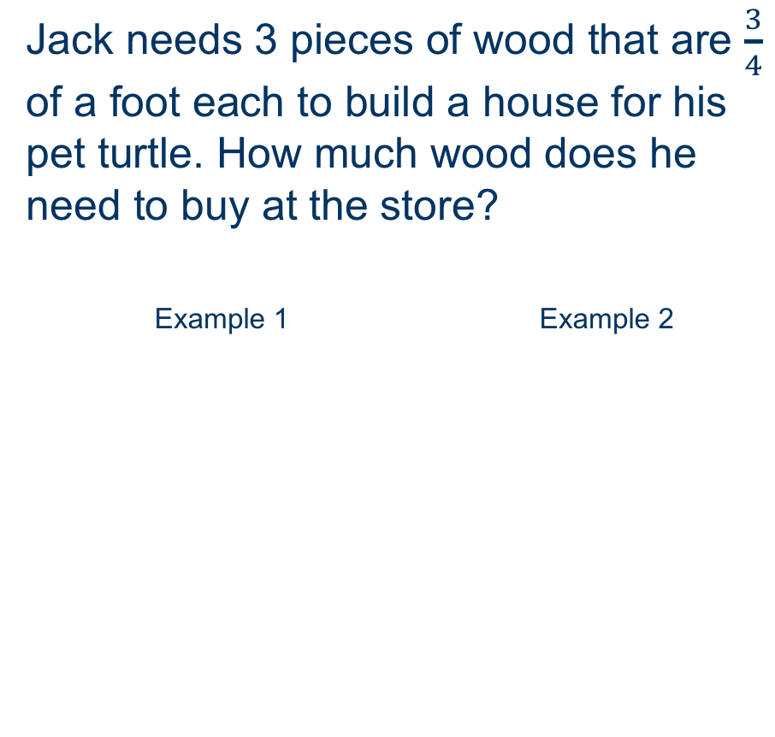
Recommendation 4: Compare Worked Examples
Suzi has a ribbon that is $\frac{2}{3}$ of a yard long. She cuts off $\frac{3}{4}$ of the ribbon to use for her art project. How long is the piece of ribbon she is using for her art project?
Jack needs 3 pieces of wood that are $\frac{3}{4}$ of a foot each to build a house for his pet turtle. How much wood does he need to buy at the store?
Example 1 Example 2
Notes:
[Read slide.] Click for animations. First, have participants complete these problems in two ways; then reveal the two solutions.

Slide 31
Recommendation 4: Share and Generate
This can be structured like the worked examples in which students share their solutions rather than the teacher presenting two separate methods.
Students must present and provide an explanation for their solution.
Challenges students to think about multiple ways to solve the problem before sharing.
Notes:
[Read slide.]

Slide 32
Recommendation 5
Help students recognize and articulate mathematical concepts and notation.

Slide 33
Recommendation 5
Describe relevant mathematical concepts and notation and relate them to the problem-solving activity.
Ask students to explain each step used to solve a problem in a worked example.
Help students make sense of algebraic notation.
Notes:
[Read slide.]

Slide 34
Recommendation 5: Concepts and Notation Related to Word Problems
This relates to Recommendation 3, which shows how to bridge from picture notation as it relates to the underlying concepts to more formal mathematical notation.
Notes:
[Read slide.]

Slide 35
Recommendation 5: Explain Each Step
We’ll do a task analysis to show how MANY steps can be involved in some word problems.
  What are some limitations you see with your students when they’re asked to explain what they’re doing?
  To help students become more efficient and articulate, providing prompts can be helpful (Recommendation 2: Provide prompts).
Notes:
[Read slide. Have participants share out loud.]

Slide 36
Recommendation 5: Algebraic Notation
Example 1
Jill sold some CDs and sold them all for the same price. If she sold 7 CDs and made $42, how much money did she get for each CD?
Algebraic notation: 7x = 42
Teacher asks:
  What does the 7 represent?
  What does the 42 represent?
  What does the x represent?
Notes:
[Read slide.]

Slide 37
Implications for Students With Intensive Learning Needs
Do you think multiple ways to solve a problem are best for your students who struggle?
Are there certain approaches you’ve used before? Like? Dislike?
Do you have issues with students identifying relevant versus irrelevant information?
How do visual representations support learning for students with intensive learning needs?
How does comparing worked examples support learning for students with intensive learning needs?
Notes:
[Read slide. Have participants first discuss at their tables and then share out.]

Slide 38
Exploring Visual Representations
Practice Guide Recommendation 3

Slide 39
Three How-to Steps
How-to Step 1: Select visual representations that are appropriate for students and the problems they are solving.
How-to Step 2: Use think-alouds and discussions to teach students how to represent problems visually.
How-to Step 3: Show students how to convert the visually represented information into mathematical notation.
Handout #1
Notes:
[Read slide, referring to the handout. Have participants read the bullet points on the first handout. Any questions? Things to discuss?]

Slide 40
Discussion Questions: Think About Your Current Practice
1. What purpose do visual representations serve in your classroom?
2. Why might you use a visual representation before teaching an equation (or mathematical notation) to represent and solve problems? What are the benefits of doing so?
Notes:
Visuals help learners organize problem information.
Visuals help learners work with problem information by decreasing text (especially good with learners who struggle with reading).
Visuals offer learners a way to see mathematical patterns that demonstrate problem structure.
Using a visual instead of mathematical notation might increase students’ ability to engage in problem solving, especially for problems that translate to and can be solved by complicated equations.

Slide 41
John Problem: Handout With Three Visual Representations
Individually Think about:
Which of the three visual representations presented are most similar to the visuals you use in your classroom?
Which of the three visuals do you think might work best for that problem, or would you choose something different altogether?
What is the rationale you would use in choosing?
Small-Group Discussion (2 or 3 participants):
Review your thoughts on the above questions and discuss.
Handout
#2
Notes:
[Read slide; refer to handout.]

Slide 42
When Is a Visual Appropriate?
Let’s focus on three visual representations:
  Schemas, tables, and strip diagrams
Review Handout 1: How-to Step 1
  Use a small set of representations; use consistently.
  Make sure they’re appropriate for the problem type.
    Some are better suited for problems than others; look at the examples with diagrams.
  Provide sufficient practice for students on a representation.
How does each of these representations make the information in the John problem easier to understand?
Notes:
[Facilitator should accept participants’ comments and add the three listed below if they are not addressed by participants.]
The schema and strip representations demonstrate the temporal nature (i.e., the element of something happening over time) of the word problem. This is shown through the pattern: 15, 5, 15, 5, 15, 5, 15, 5, 15 and with the labels “start”/”end” in the schema and the labels “mile 1” and “break” in the strip diagram;
The table organizes and represents the pattern (by showing 20, 40, 60 . . . on the right-hand side), which leads to problem solving without requiring an equation or additional mathematical notation;
All three visuals display the problem information so that the visual representation can be translated into mathematical notation. Both of these equations demonstrate the problem structure and could be generated from the schema, strip, or table.
x = total time
Equation 1: x = (5 $∙$ 15) + (4 $∙$ 5)
Equation 2: 4 (15 + 5) + 15 = x
Additional question prompts:
What did you see as the advantages and/or disadvantages with regard to student learning for each of the three visuals presented?
What did you see as the advantages and/or disadvantages with regard to your instruction for each of the three visuals presented?
After viewing the three types of visuals selected today, ask, “Do you have a preference for which type of visual is best suited to organize the information in this problem, and if so, why?”

Slide 43
Converting Information to Mathematical Notation
You should consider whether the visual representation you select will lead to a mathematical notation (e.g., an equation or expression).
You may want to consider whether the visual representation can lead to an accurate answer without requiring mathematical notation.
Reference Handout 2, John Problem: Explore Visuals: Schemas, Tables, and Strip Diagrams.
Notes:
[Remind participants: The schema and strip diagrams require mathematical notation to find the unknown, whereas the table can lead the problem solver to the unknown—thus, the answer to the problem. When/Why might you choose a visual that does NOT lead to mathematical notation?]

Slide 44
Questions to Guide Thinking for Selecting a Visual
Handout
#3
Let’s review:
  Guiding Questions
  Reflection Questions
Let’s apply the questions to the Money Problem.
  Work with a partner or individually.
  Be prepared to share with the large group how your visual helped to organize the information in the problem.
Notes:
[Refer to the two handouts for this slide: Guiding Question Handout and Money Handout. Change 3/8 to $24 if needed.]

Slide 45
Share With the Large Group
Have one team member from each small group share their decisions and selected visual.
Each group will share the following:
  Explain the decisions the group made while using the questions that need to be answered for selecting visual representations.
  Discuss whether or not the visual was converted to mathematical notation, and why (or why not) your group made the decision for it to lead to mathematical notation.
  Use the reflection questions to determine whether the visual met criteria.
Notes:
[Read slide.]

Slide 46
How-to Step 2: Use Think-Alouds
How-to Step 2 on page 26 of the practice guide states that when teachers are teaching a new visual representation, they should demonstrate how they selected the visual to represent the problem. Teachers should MODEL what they are thinking as they solve the problem.
Review the think-aloud on the Monica and Bianca problem in the practice guide.
Complete the Visual Representation Think-Aloud Check Sheet.
Whole Group: Discuss how well the think-aloud displays the teacher’s thinking as she selects the visual. Were all the questions addressed? How would you have included those missing elements?
Notes:
[Note: Facilitator can point out that numbers 8, 9, and 10 were not addressed in the think-aloud and are critical elements of a think-aloud that could summarize the teachers’ thinking when presenting visual representations to her students.]

Slide 47
Table Visual Representation for Monica and Bianca
Apply the criteria for selecting the visual for the Monica and Bianca problem represented with a table.
Then write a think-aloud for the Monica and Bianca problem using the table as the representation.
Work with a partner or individually on the two Monica and Bianca handouts.
Large-group discussion after completion of the activity:
  Tables vs. schema for Monica and Bianca problem
  Value of think-alouds, challenges you faced in writing the think-aloud
Handout
#4
Notes:
Does the alternative visual representation (table) lead to a mathematical notation/equation, and should it?
Would you agree or disagree with the teacher’s selection of the table visual representation for this problem, rather than the schema with proportions we viewed earlier? Why or why not?
[Facilitator to mention]: The table displays the pattern for how the ratio of red/yellow roses builds to 24 roses using a pattern where a consistent amount is added each time; this could help students visualize the part-part relationship in the problem.
Potential benefits to schema:
The schema setup is a precursor for solving ratio/proportion problems when finding an unknown quantity, x.

Slide 48
Exploring Multiple Solutions Through Worked Examples
Practice Guide Recommendation 4

Slide 49
Expose Students to Multiple Strategies
How-to Step 1: Provide instruction in multiple strategies.
How-to Step 2: Provide opportunities for students to compare multiple strategies in worked examples.
  We’ll discuss designing an activity for comparing worked examples as a means of exposing students to multiple strategies.
  Multiple solutions and students with difficulties or disabilities—what do you see as the issues?
Notes:
[Read slide.]

Slide 50
Current Practice
  Small-group discussion:
  Do any participants compare worked examples as an instructional tool?
  Do any participants require students to generate more than one solution for a problem? If so, how do you encourage this in your classroom?
  Share with the group:
  What was one idea you discussed regarding the use of multiple solutions as an instructional tool?
  What challenges do you currently face when teaching students to solve problems in multiple ways?
Notes:
[Read slide.]

Slide 51
Multiple Strategies Discussion Questions:
Practice Guide Recommendation 4
What are the advantages of teaching multiple strategies for problem solving?
What are the instructional benefits of comparing worked examples? How might this approach benefit your students?
The authors recommend employing unsuccessful strategies for solving problems. What are some of the benefits to students in doing that? Do you agree or disagree?
Notes:
[Give each participant a copy of the recommendations and have them read practice guide recommendation 4, pages 32–39.]
Be sure to reinforce the last bullet—do not design worked examples with incorrect answers but, rather, demonstrate approaching nonroutine problems where you may have to revise your approach.

Slide 52
Designing Worked Example Comparisons
Select a problem and generate two solutions.
Present two solutions side by side.
Select a problem that either:
  teaches something new or
  reviews critical learning before moving forward.
Compare solutions that either:
  compare a visual representation to an algorithm or
  compare two algorithms.
  Let’s look at the diagram and discuss the benefits of each approach and the overall benefits of comparing worked examples.
Handout
#5
Notes:
[Read slide. Diagram Handout: Explain how it’s used.]

Slide 53
Guiding Questions for Worked Example Comparisons
Let’s review six guiding questions for designing worked example comparisons (left-hand column).
ALWAYS compare two CORRECT solutions side by side.
Example 15 in the practice guide:
Let’s look at the practice guide.
Practice applying questions to this worked example.
Let’s complete the questions as a group and discuss.
  Some of these have been completed for you.
Handouts
#6 & #7
Notes:
[Read slide. Refer to the two handouts: Guiding Questions and Examining Example 15.]

Slide 54
Fraction Division Example: Read the Situation
Pairs, small groups, or individual—participant choice
Select two solutions from the four solutions provided.
(Okay to select something different if you prefer.)
Complete the questions for designing a worked example comparison.
Then, we’ll share with the large group how each small group designed the worked example comparison.
Handout
#8
Notes:
[Read slide. Have participants refer to the Fraction Division Handout.]

Slide 55
Comparing Solutions: Three Questions, Page 35
Review the questions in the practice guide.
Teacher models and then uses guided practice for comparing solutions.
What might be some issues in asking, “What are the similarities and differences?”
Discuss issues as a group.
Handout
#9
Notes:
Students may focus on superficial parts of the problem (all have + and = signs).

Slide 56
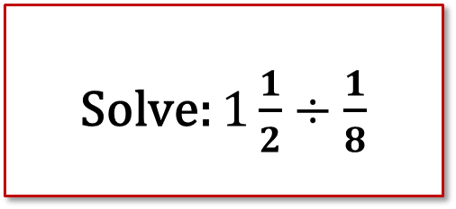
Comparing Solutions: Role-Play Activity
Solve: $1\frac{1}{2}÷\frac{1}{8}$
Look at the fraction division problem:
  Partner up.
  Choose two solutions.
  Role-play: Pretend one of you is the teacher and the other is the student.
    Write questions that will help students attend to the mathematical differences across solutions.
  Record questions that were more specific to share with the group.
Notes:
Students not knowing where to focus on the solutions—choose superficial features rather than mathematical differences.
Teachers should have a plan for which aspects of a solution to highlight in their think-aloud and then when eliciting answers from students.

Slide 57
Evidence-Based Intervention Approaches
DBI
Tier 2
Core Classroom Instruction

Slide 58
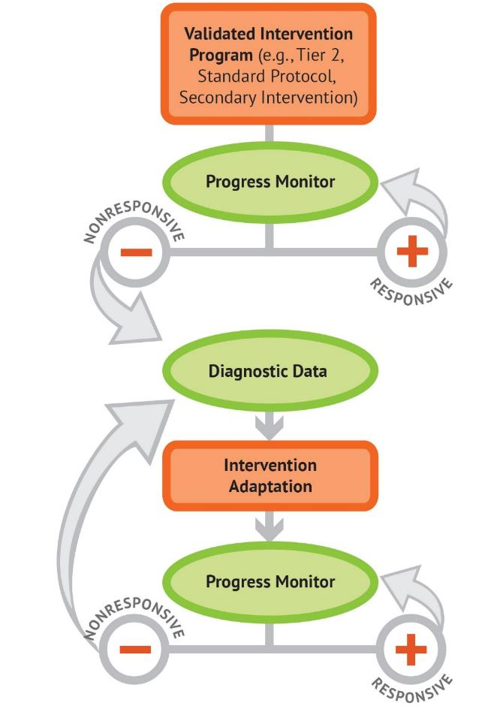
Data-Based Individualization
Notes:
The National Center on Intensive Intervention uses this graphic to illustrate the progression of DBI. We begin with a secondary intervention program, delivered with greater intensity, and progress monitor to determine the student’s response. If the student is responsive, we can continue the current intervention or consider reducing intensity as goals are met (depending on rate and duration of response and nature of skill deficits). If the student is not sufficiently responsive, we gather additional information through informal diagnostic assessment, which identifies student needs to guide intervention adaptations. We continue progress monitoring to make decisions about whether the student is responding to the adapted intervention.

Slide 59
Schema-Based and Schema-Broadening Instruction
Categorizing word problems into schemas or types
Apply similar solution methods to recognized and identified problems
Usually relies on structure or underlying mathematical content
Problem solving usually has students generate an equation or schematic diagram
Issues with TRANSFER: hence, “broadening”
Primary researchers in this area:
  Lynn Fuchs
  Asha Jitendra
Notes:
[Read slide.]

Slide 60
Vanderbilt Fuchs Lab
Schema-Based Instruction/ Schema-Broadening Instruction
Tier 2 Intervention:
Fraction Face-Off!
  Problems: Fractions (multiplicative)
Notes:
A schema is a way to organize information within a structured framework of known and unknown information. Schema-based instruction or schema-broadening instruction is a problem-solving strategy in which students identify the underlying structure or schema of the problem. Students then represent the schema using representation of diagrams or equations and then solve the word problem.

Slide 61

Fraction Face-Off
Fraction Face-Off!
Fourth-grade tutoring program
Source: Fuchs, L., Schumacher, R., Malone, A., & Fuchs, D. (2015).
Notes:
We will review just one type of word problem part of the Fraction Face-Off! intervention.

Slide 62
Word Problems: Multiplicative Reasoning
Word problem instruction uses schema-based instruction.
Students are taught to recognize and solve similar problem types and apply procedures appropriately.
Notes:
[Read slide.]

Slide 63
Word Problems: Splitting
U
S
Matt has 2 apples. He cut each apple into fifths. How many pieces of apple does Matt have?
U | S
2
10 pieces of apple
1
1
Notes:
[Read slide.]

Slide 64
Word Problems: Grouping
I
Keisha is making 4 necklaces for friends. For each necklace, she needs 1/3 yard of string. How many yards of string does Keisha need?
S
S
I
4
____ ____ ____ ____
yards of string
Notes:
[Read slide.]

Slide 65
Grouping: Non-unit Fractions
  Ray needs 2/3 of a cup of flour to make a loaf of bread. He’s making 4 loaves of bread. How many cups of flour does Ray need?
S
I
cups of flour
4
___ ___ ___ ___
Notes:
[Read slide.]

Slide 66
Jitendra’s Lab
Schema-Based Instruction

Slide 67
Schema-Based Instruction: No Missing Information First
A car travels 25 miles on a gallon of gas. It can travel 75 miles on 3 gallons of gas.
Linda answered 5 problems correctly, and Cindy correctly answered 15 problems. Linda correctly answered 1/3 as many problems as Cindy.
Source: Jitendra, DiPipi, & Perron-Jones. (2002).
Notes:
Two examples of the use of schema-based instruction.

Slide 68
Schema-Based Instruction
If 2 cans of icing cover 24 cupcakes, then 3 cans of icing will cover x cupcakes.
Handout
Which handout does this slide correspond to?
Source: Jitendra & Star. (2011).
Notes:
[Read slide. Refer to the handout.]

Slide 69
Montague’s Lab
Solve It!
Effective in core and special education classrooms.
Specifically researched with kids with learning disabilities.

Slide 70
Solve It!
Explicit instruction
Process modeling
Performance feedback
Assessing students individually is a big part of program success.
Source: Montague, Warger, & Morgan. (2000).
Notes:
Solve It! Is a curriculum that can be used in core mathematics as well as part of intervention and special education classrooms. It is explicit instruction that includes modeling, feedback, and assessment.

Slide 71
Solve It! Procedures
Students begin by reading the problem and identifying the important information.
Then students draw a diagram to match the schema of the problem.
Using the diagram, students devise a way to solve.
Prior to solve, students are taught to estimate, then compute.
Lastly, students check their work.

Slide 72
Conclusion

Slide 73
Closing
Word problems are not going away! Students will be expected to show mastery of computational skills within word problems.
Key words are NOT the way to solve problems. Teachers should not include key word instruction as part of word problem-solving strategies.
Students with mathematics difficulty need strategies that can be generalized across problem types, such as
  Cognitive strategy instruction
  Schema-based and schema-broadening instruction
Utilize recommendations from the Institute of Education Sciences in core mathematics instruction, as well as for intervention and special education.

Slide 74
References
Fuchs, L., Schumacher, R., Malone, A., & Fuchs, D. (2015). Fraction face-off! Fraction foundation tutoring program for fourth grade. Nashville, TN: Vanderbilt University.
Jitendra, A., DiPipi, C. M., & Perron-Jones, N. (2002). An exploratory study of schema-based word-problem instruction for middle school students with learning disabilities: An emphasis on procedural and conceptual understanding. The Journal of Special Education, 36(1), 23–38.
Jitendra, A. K., & Star, J. R. (2011). Meeting the needs of students with learning disabilities in inclusive mathematics classrooms: The role of schema-based instruction on mathematical problem-solving. Theory Into Practice, 50, 12–19.
Montague, M., Warger, C., & Morgan, T. H. (2000). Solve It! Strategy instruction to improve mathematical problem solving. Learning Disabilities Research and Practice, 15(2), 110–116.
Woodward, J., Beckmann, S., Driscoll, M., Franke, M., Herzig, P., Jitendra, A., . . . Ogbuehi, P. (2012). Improving mathematical problem solving in grades 4 through 8: A practice guide (NCEE 2012-4055). Washington, DC: National Center for Education Evaluation and Regional Assistance, Institute of Education Sciences, U.S. Department of Education. Retrieved from http:// ies.ed.gov/ncee/wwc/publications_reviews.aspx#pubsearch/

Slide 75
Disclaimer
This module was produced under the U.S. Department of Education, under the Investing in Innovation Fund (i3), Award No. U411C140029. The views expressed herein do not necessarily represent the positions or polices of the U.S. Department of Education. No official endorsement by the U.S. Department of Education of any product, commodity, service or enterprise mentioned in this website is intended or should be inferred.

Slide 76
End
1000 Thomas Jefferson Street NW
Washington, DC 20007-3835
General Information: 202-403-5000
www.air.org

