Slide 1
Connecting Intervention and Core Instruction
Instructional Strategies to Bridge Skills That Lead to Success
Middle School Level
Copyright © 2020 American Institutes for Research. All rights reserved.
Notes:
Introduction
This module is designed for interventionists, special educators, and general educators to review instructional strategies that students with mathematics difficulties (MD) need to be successful in both core instruction and intervention. Students with MD may make progress in intervention, but are still struggling in core because there is often not a bridge or support to show how instruction is connected to core. This module addresses these needs and identifies how all teachers need to support generalization and build upon mathematics trajectories in order for students to be successful.
Handouts are available, and not all slides are included in the handout materials. Slides that are in the handout materials have a star on the slide.
Instructions for using the speaker notes
• Text formatted in standard font is intended to be read aloud or paraphrased by the facilitator.
• Text formatted in bold is excerpted directly from the presentation slides.
• Text formatted in italics is intended as directions or notes for the facilitator; italicized text is not meant to be read aloud.
• Text formatted in underline indicates an appropriate time to click to bring up the next stage of animation in an animated slide.
Welcome participants to the training. Introduce yourself (or selves) as the facilitator(s) and briefly cite your professional experience in regard to mathematics instruction and intensive academic intervention in mathematics.
Although permission to reprint this publication is not necessary, the citation should be as follows: i3 Intensive Intervention in Mathematics. (2019). Connecting intervention and core instruction. Instructional strategies to bridge skills that lead to success. Washington, DC: Education Innovation and Research Program, U.S. Department of Education.

Slide 2
Agenda
Using Data-Based Individualization to Address Challenges for Students With Mathematics Difficulties in Intervention and Core Instruction
Understanding the Characteristics of Students With Mathematics Difficulties
Reviewing Critical Components of Algebraic Readiness
Understanding Math Trajectories
Notes:
[Read slide.]

Slide 3
Participants will:
Understand characteristics for students with math difficulty, as well as challenges in transitioning between and among core instruction and intervention.
Understand how to design and provide intensive intervention aligned with core instruction for students needing tiered instruction.
Review evidence-based practices (EBPs) for students receiving tiered instruction.
Notes:
[Read slide.]

Slide 4
Developing an Understanding of the Data-Based Individualization Process
Notes:
[The following four slides are all in the handout materials.]

Slide 5
What is Data-Based Individualization?
What is Data-Based Individualization?
Data-Based Individualization (DBI): A systematic method for using data to determine when and how to provide more intensive intervention¹:
DBI emerged from four decades of research on data-based program modification/experimental teaching programs that were first developed at the University of Minnesota (Deno & Mirkin, 1977) and expanded upon by others (e.g., Fuchs, Fuchs, & Hamlett, 1989).
Starts with a research-validated instructional platform.²
Valid, reliable progress-monitoring data drive intervention decisions.²
¹ See the 2014 special issue of Teaching Exceptional Children for illustrations.
² Visit https://intensiveintervention.org/resource/tools-chart-user-guide for examples.
Notes:
[Read slide.]

Slide 6
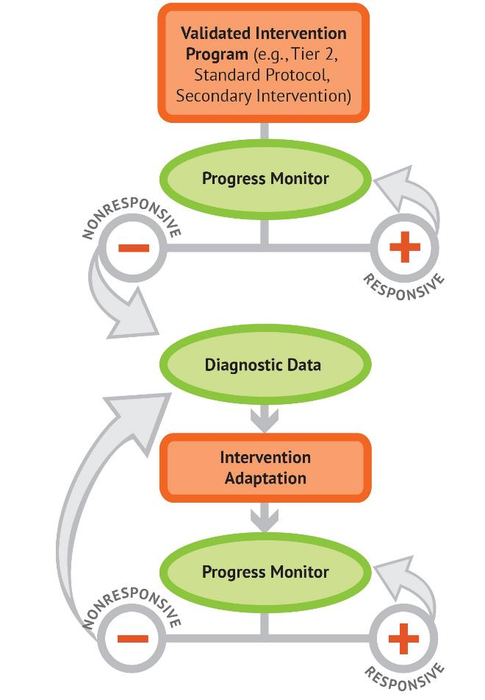
The DBI Process
Validated intervention program
Progress monitoring
Informal diagnostic assessment
Adaptation
Continued progress monitoring, with adaptations occurring whenever needed to ensure adequate progress
Notes:
[Animated slide. Click at underlined text.]
NCII uses this graphic to illustrate the progression of DBI. We begin with validated program that serves as the platform for intensification. Progress monitoring is used to determine the student’s response. If the student is responsive, we can continue the current intervention or consider reducing intensity as goals are met (depending on rate and duration of response and nature of skill deficits). If the student is not sufficiently responsive, we gather additional information through informal diagnostic assessment, which identifies student needs to guide intervention adaptations. We continue progress monitoring to make decisions about whether or not the student is responding to the adapted intervention.

Slide 7
Challenges With Intervention in Middle School
Students in middle school often have a long history of math difficulty
Lack of intervention materials for Grades 6–8
Misalignment between intervention and core instruction
Affects transitions between two instructional settings for students needing tiered math support
Notes:
Many middle school students with MD often lack or have weak foundational skills and little conceptual understanding. For many students, as they get older, they develop misconceptions due to the lack of conceptual understanding. These misconceptions often will need direct instruction, support from intervention, and many more examples to un-prove or to help the student develop the generalizations that will lead to conceptual understanding.
In addition to the skill deficits, many students in middle school have often received intervention for years—meaning these students may have holes or lack the ability to connect skills or strategies they learn in intervention to their core instruction. Thus, individualization, differentiation, generalization, and practice will be needed in both core instruction and intervention.

Slide 8
Core Instruction vs. Intervention
Materials differ because they are designed to meet different learning needs
Core Instructional Programs
Developed using research-based strategies.
Promote conceptual understanding of broad skills.
Quick unit pacing, often spiraling of skills.
Minimal vocabulary instruction.
Intervention Programs
Use EBPs that target specific foundational skills for students not responding to core instruction.
Promote procedural fluency and conceptual understanding.
Feature purposeful lesson pacing with more teacher flexibility.
Notes:
While intervention programs should contain these components, not all have been rigorously evaluated. Additionally, there are few available intervention resources at the middle school level, so teachers often need to create/pull resources they can use to focus on specific skill deficits.

Slide 9
Characteristics of Students With Math Difficulties

Slide 10
Working Memory
“…a limited capacity central executive system that interacts with a set of two passive store systems used for temporary storage of different classes of information” (Braddeley & Logie, 1999, p. 343)
Implications for Math Operations:
Number computations
Effective strategy use
Word problems
Multistep problems
Notes:
Working memory affects number computations, specifically strategy use. Often, students will use inefficient strategies, such as counting all, and do not remember or use the strategies correctly. When the student takes so much time and “clogs” the working memory, problem solving can provide a greater challenge, as well as multistep problems. Working memory affects word problem solving and multistep problem solving because the student must store so much information and can tire easily, thus “forgetting” to do additional steps or check the reasonableness of their answers.
Think of reading and fluency. When a student takes a long time to read, they get tired and comprehension lowers. This is also true of math and working memory.

Slide 11
Why Do Students Struggle?
Ineffective strategy use
Weaknesses in the following:
Retrieval or fluency
Procedures
Higher level or conceptual understanding
Arithmetic relations among numbers
Working memory can affect a child’s ability to apply strategies to effectively solve whole-number computations and word problems.
(Geary, 1993, 2005; Gray et al., 1999; Hecht et al., 2003; Impecoven-Lind & Foegen, 2010; Jayanthi, Gersten, & Baker, 2008; Raghubar, Barnes, & Hecht, 2009; Swanson & Jerman, 2006; Swanson et al., 2008)
Notes:
[Read slide.]

Slide 12
Number Sense
Understanding what numbers “mean” and the ability to manipulate, “see” patterns in numbers
Skills include
Counting
Decomposing
Magnitude comparisons
Links to advanced computational strategies
Precursor to fractions
(Geary, 2004; Siegler, 1988)
Notes:
Students with a strong number sense in early elementary school are more successful in later grades. A more developed number sense leads to flexibility of number decomposition (Siegler, 1988) and an understanding of counting principles, such as cardinality, order, and abstraction (Geary, 2004). The mastery of number sense, flexibility in counting, and decomposing is essential for long-term conceptual understanding.

Slide 13
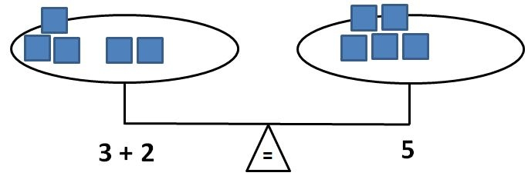
Symbols
Need to develop an understanding of the symbolic equivalence between numbers and symbols
Part of mathematical language
Explicitly teach operational symbols
Equals sign
Addition/subtraction
Multiplication/division
Fraction bars
Notes:
ACTIVITY: [This activity just shows how many symbols we use in mathematics.] Before reviewing this slide, ask participants to brainstorm all the symbols used in math (e.g., addition sign, multiplication sign, equals sign). Have each participant or table group go around and share their symbol list (one word per table).
[Click for animation.]
Teachers often move too quickly to symbolic representations and do not directly teach the meaning of math symbols. For example, for many students the equals sign means “answer” rather than “the same as.” A lack of a full understanding of the equals sign affects number sense and computational understanding. In the future, this can affect understanding of equations and can lead to challenges when trying to balance equations.

Slide 14
Whole-Number Computation
An efficient and accurate method for solving operational math problems to mastery
Includes both basic facts (addition, subtraction, multiplication, and division) and the ability to apply these skills to multistep computations
Need explicit instruction in strategies:
To understand the relationships between numbers
For conceptual understanding of how to solve efficiently
Notes:
Whole-number computation is important and a key foundational skill for students exiting elementary school, and should be part of instruction starting as early as kindergarten. For students receiving tiered support, whole-number computation can be challenging and may be impacted by working memory as well as a student’s understanding of how numbers are related to one another, such as the concept of part-part-whole within fact families, the understanding of how numbers are related, or how to use strategies efficiently. Often, students with MD have delays in both process or conceptual understanding as well as procedural fluency, which may result in inefficient or incorrect strategy use, thus leading to greater confusion.
What does mastery of facts mean? Ideally, by the end of Grade 5, if students were given an addition, subtraction, multiplication, and division sheet with 100 questions, they could correctly solve at least 80% of the problems on all sheets within 1 minute for each sheet.

Slide 15
Why do students struggle?
Pair of shoes
Pair of socks
Pair of pants
Vocabulary and language
Often not explicitly taught as part of core instruction.
Interventions do not always stress the use of mathematically precise language by students and/or teachers.
Polysemous words can cause confusion, especially as they pertain to meaning in standard English versus mathematics.
Difference, factor, product
Consider the role of language in this sentence:
The teacher said the student is mean.
The teacher, said the student, is mean.
3x⁴
(3x)⁴
(Molina, 2012)
Notes:
[Read slide. Click for animation.]

Slide 16
Instructional Language
Teachers tend to use vocabulary that has other meanings in English.
Give your little brother the “bigger half” of the cookie.
”Carry” the one.
“Borrow” the ten.
“Cancel” when simplifying a fraction or rational expression.
Think about this example: “Add these numbers up.”
12 6
+ 7
Notes:
[Read slide.]

Slide 17
Your Turn: Instructional Language
Solve mentally:
Write your answer: _________
What is the question you just answered? (You cannot use words or phrases that include “divide by” or “goes into.”)
What vocabulary is needed to
Understand the problem?
Provide the answer?
Talk about the problem?
Why would this type of problem be challenging for students with math difficulties?
10
$$\frac{1}{2}$$
This is where the disconnect often occurs for students receiving intervention and core!
Notes:
[Have participants complete the problem mentally, asking the questions on the slide for a group discussion.]
Think about the instructional differences between core and intervention. For students receiving both or transitioning from an alternative core to a grade-level core, the language is often the breaking point for full understanding.

Slide 18
Planning for Vocabulary Instruction Across Core and Intervention
Collaborate when planning new units to review critical vocabulary to
Ensure consistency between core and intervention.
Assess vocabulary.
Reteach vocabulary terms.
Explicitly preteach mathematically precise vocabulary from core during intervention.
Allow time for practice in using mathematically precise language.
Provide examples and nonexamples.
Include practice opportunities to develop generalization and transfer of understanding.
Include these opportunities in warm-up activities.
Model, correct, and provide feedback during instruction.
Allow independent activities.
Notes:
Vocabulary and language is a roadblock and challenge for so many students, and too often we provide the words in isolation alone. Students need multiple opportunities to practice with the words and to see how the critical, precise language is used across different examples and within word problems.

Slide 19
Critical Foundations of Algebra
What skills are we hoping students can obtain?
ALGEBRA

Slide 20
Major Algebra Topics
Symbols and Expressions
Polynomial expressions
Rational expressions
Arithmetic and finite geometric series
Linear Equations
Real numbers as points on a number line
Linear equations and linear inequalities and their graphs
Solving problems with linear equations
Graphing and solving problems
Quadratic Equations
Factors and factoring of quadratic polynomials with integers
Completing the square in quadratic expressions
Quadratic formula and factoring of general quadratic polynomials
Using the quadratic formula to solve problems
Notes:
[Read slide.]

Slide 21
Major Algebra Topics
Functions
Linear functions
Quadratic functions
Graphs of quadratic functions and completing the square
Polynomial functions
Simple nonlinear functions
Radical exponents, radical expressions, and exponential functions
Logarithmic functions
Trigonometric functions
Fitting simple mathematical models to data
Algebra of Polynomials
Roots and factorization of polynomials
Complex numbers and operations
Fundamental theorem of algebra
Binomial coefficients
Mathematical indication and the binomial theorem
Combinations and Finite Probability
Combinations and permutations
Notes:
[Review slide.]

Slide 22
Developing Foundations of Algebra
Foundational Numeracy Skills
Critical Middle School Math Concepts
High School Algebra Skills
Notes:
Mathematics is an area in which the skills are highly interconnected, and when students do not fully develop the foundational skills in elementary school, their learning becomes filled with misconceptions or they lack conceptual understanding. As math becomes more challenging, the holes and misconceptions in student understanding affect concept development in middle school, which can hinder student understanding of algebraic concepts in high school. This becomes a problem since algebra is considered the gateway to other math classes and is often the prerequisite for many postsecondary classes.

Slide 23
Critical Foundations of Algebra
Fluency With Whole Numbers
Automatic recall of addition, subtraction, multiplication, division facts
Standard algorithms
Estimation and reasonableness
Fluency With Fractions
Positive and negative fractions
Locate fractions on a number line
Computations of fractions
Decimals, fractions, and percentages
Geometry and Measurement
Slope if a straight line
Properties of two- and three-dimensional shapes
Volume, area, surface area
Notes:
[Read slide.] Students with MD often struggle with these skills due to poor foundational instruction, working memory, strategy use, and vocabulary. Thinking about the underlying trajectories can help address this problem.

Slide 24
Math Trajectories
Where are we starting? Where did we come from? Where are we going?

Slide 25
Math Trajectories
Math standards are not stand-alone skills.
Build upon standards within the same grade level.
Build upon standards across grade levels.
As students get older, the gaps within and across grade levels increase, leading to
Less conceptual understanding
Development of misconceptions
Greater need for intervention support
Notes:
[Read slide.]

Slide 26
Math Trajectories: Planning for Core
Beginning in core instruction, consider:
What are the prerequisite skills needed for students to be successful in _______?
How are skills related to one another?
How do I develop conceptual understanding and procedural fluency?
Notes:
While students with MD will often need more support, such as Tier 2 intervention, they will need support in core instruction. Additionally, students receiving intervention will need help to generalize and connect skills between settings.

Slide 27
Math Trajectories: Planning for Intervention
In planning for intervention:
What are the prerequisite skills needed for students to be successful in _______?
Do the students have mastery of these skills?
How can we develop the prerequisite skills aligned to the grade-level standard?
How can we “show” the students how the skills are connected and aligned during intervention?
What supports will the student need in core instruction to connect to the prerequisite skills?
Notes:
While it is recommended that Tier 2 intervention use a standardized program, as students get older, there are fewer materials, which means that intervention at the middle grades is often teacher-created “packages.” This type of package needs to consider math trajectories and connect them to grade-level standards.

Slide 28
Math Trajectories
What are the prerequisite skills needed for students to be successful in _______?
Achieve the Core
For example, Grade 6:
Ratios and Proportional Relationships
The Number System
Expressions and Equations
Geometry
Statistics and Probability
Notes:
[After the discussion of math trajectories, spend some time on the Achieve the Core website, examining the Coherence Map.]

Slide 29
Consider this problem:
Identify the vocabulary words that could cause confusion.
Why would students struggle with this problem?
What skills are needed to solve this problem?
Notes:
[Read and discuss the questions on the slide.]

Slide 30
Math Trajectories
Consider the prerequisite skills
Are these part of core instruction? When?
What data can I review that will identify whether the student has mastered these skills?
Planning for intervention
What skills do we need to explicitly teach in intervention to support access to and success in core instruction?
Notes:
[The picture is hyperlinked to the Achieve the Core Coherence Map. This is a free online resource that maps skills across grade levels using the Common Core State Standards. Participants will have time to dive into additional skills over the next few slides. Assign participants to Group 1 or Group 2, on the following slides. Participants will have the chance to spend some time examining the trajectories of the skills and begin to brainstorm skills to include within an intervention.]

Slide 31
Math Trajectories: Group 1
Common Core Standard 6.EE: Write and evaluate numerical expressions involving whole-number exponents.
Answer the following questions to determine skills to teach during intervention.
Consider the prerequisite skills.
Are these part of core instruction? When?
What data can I review that will identify whether the student has mastered these skills?
Planning for intervention
What skills do we need to explicitly teach in intervention to support access to and success in core instruction?
Notes:
[Have participants work and then discuss as a group. Allow about 15–20 minutes for the examination and discussion.]

Slide 32
Math Trajectories: Group 2
Common Core Standard 7.RP.A.3: Use proportional relationships to solve multistep ratio and percentage problems. Examples: simple interest, tax, markups and markdowns, gratuities and commissions, fees, percent increase and decrease, percent error.
Consider and answer the following questions to determine skills to teach during intervention.
Consider the prerequisite skills.
Are these part of core instruction? When?
What data can I review that will identify whether the student has mastered these skills?
Planning for intervention
What skills do we need to explicitly teach in intervention to support access to and success in core instruction?
Notes:
[Have participants work and then discuss as a group. Allow about 15–20 minutes for the examination and discussion.]

Slide 33
EBPs
Notes:
We know the end goal, and we can use the trajectories as a map to reach the goal, but how do we instruct students with MD? It is important to utilize EBPs to teach the concepts and skills for students to develop conceptual understanding and procedural fluency required to be successful in algebra.

Slide 34
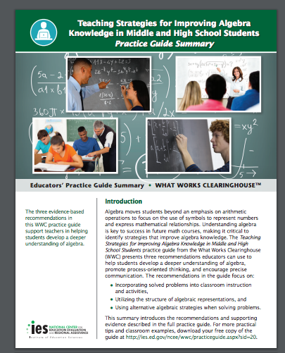
Teaching Strategies for Improving Algebra Knowledge in Middle and High School Students
Use solved problems to engage students in analyzing algebraic reasoning and strategies.
Teach students to use the structure of algebraic representations.
Teach students to intentionally choose from alternative algebraic strategies when solving problems.
(Star et al., 2015)
Notes:
[Read slide.]

Slide 35
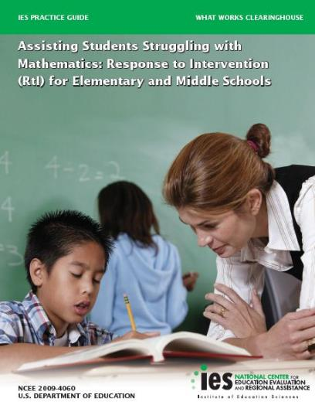
Assisting Students Struggling With Mathematics: Response to Intervention (RtI) For Elementary and Middle Schools
Materials for intervention should focus on
Whole numbers (Kindergarten–Grade 5)
Rational numbers (Grades 4–8)
Instruction should be explicit and systematic.
Instruction in solving word problems that is based on common, underlying structures.
Notes:
[Read slide.]

Slide 36
Assisting Students Struggling With Mathematics: RtI for Elementary and Middle Schools
Give opportunities for students to work with concrete materials and visual representations.
Intervention should include ~10 minutes of fact instruction and practice in each session.
Monitor the progress of students.
Include motivational strategies.
(Gersten et al., 2009)
Notes:
[Read slide.]

Slide 37
Connecting EBPs to Trajectories: Example

Slide 38
Integers
Model -6
How did you model -6?
How did you neighbor model -6?
Notes:
[First, ask participants to model independently and then share with a neighbor. Then click to show three additional models: number line, all negative integer chips, and six negative integer chips with one zero pair.]

Slide 39
Expand: Integers
Model 4 + 5
Model -4 + 5
Model -4 + -5
How did you model?
How did your models change with each problem?
Did anyone model differently?
Model 5 – 4
Model -5 – 4
Model -5 – (-4)
How did you model?
How did your models change with each problem?
Did anyone model differently?
Notes:
[Have participants model and share to compare models.]

Slide 40
Instruction: Reflect on the Integer Example
How does the use (or pictures) of integer chips help to develop conceptual understanding?
What is the role of the teacher during instruction?
What challenges do you foresee?
How is this instruction similar to core? different from core?
How can intervention support this instruction skill?
Notes:
[Read and discuss the questions on the slide.]

Slide 41
Solve
Write an equation that sums to 24.
Elenore wrote 12 + 12. Her elbow partner, Sam, wrote -8(-3). Elenore said that Sam was incorrect, but was not sure why Sam’s answer was wrong.
Another classmate, Matt, wrote 42 + -18. When the teacher asked Elenore if Matt was also correct, she said no because he included a negative number.
Do you agree with Elenore, Sam, or Matt? Why or why not?
At noon, the temperature outside was 25 degrees. By 8 p.m., the temperature had dropped 27 degrees. What was the temperature outside at 8 p.m., in degrees? Write an equation to solve.
Notes:
These are different types of word problems, rather than a typical read-and-solve. In the first example, the students are asked to write an equation. The students are then asked to read different answers and state whether they agree with Elenore, Sam, or Matt and why or why not. This type of problem forces students to think differently and analyze their own understanding by comparing their problem-solving method to others. [Give participants to solve and discuss the first problem.]
The second problem seems more like a traditional problem, but it does not actually ask the students to solve; rather, it wants the student to write an equation. This type of problem can be difficult for students with MD because students have to consider how to solve, rather than actually solving. [Give participants time to solve.]

Slide 42
Putting it All Together

Slide 43
Putting it All Together
Consider
Challenges faced by students with math difficulties
Goals of reaching algebra mastery
Prerequisite skills and math trajectories necessary for conceptual understanding and procedural fluency
Use of EBPs during intervention and core
Student discussions
Use of multiple representations
Language and vocabulary development
Explicit and systematic instruction
Challenges for teachers
Providing multiple practice opportunities
Asking questions that lead to student discussions
Providing time to address and develop mastery of prerequisite skills
Notes:
[Read slide.]

Slide 44
Build Conceptual Understanding and Mathematical Flexibility
Consider the tape diagram below.
What ratio(s) does the diagram represent?
Draw tape diagrams or use tiles to complete the table.
Orange Juice | Cranberry Juice
2
3 | 2
6
 | 17
n
Extend it:
Write a ratio word problem and show how to solve it using a tape diagram or tiles.
Notes:
Let’s think about this problem. This can be demonstrated with algebra tiles or a tape diagram. What are the prerequisite skills? Why is it important to show the math?

Slide 45
Sample Problem
In the past year and a half, Alfred’s dog gained an average of $\frac{1}{4}$ pound each month. Today, Alfred’s dog weighs 75.5 pounds. How much did the dog weigh a year and a half ago?
57.5 pounds
71.0 pounds
71.5 pounds
64.0 pounds
79.5 pounds
Solve it.
Describe to a partner how you solved.
Did anyone solve it differently?
Notes:
[Read slide and have participants solve and discuss.]

Slide 46
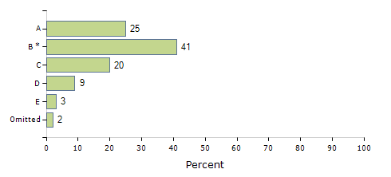
Think About Your Students
Why would this question be challenging?
How do you think most of your students would solve it?
How could you show this problem visually or with manipulatives?
Consider… Why do you think students answered in this way?
Notes:
This is the distribution of answers selected for the previous problem. Discuss how you could teach this problem and why the students selected A and C. What are the misconceptions?

Slide 47
Aligning Core Instruction to Intervention
Structure of class—core and intervention
Warm-up
Use this time to determine student skill levels
Adjust instruction
Connect to prerequisite skills
Instruction
Modeling with student participation
Think-alouds
Use of concrete-symbolic-abstract representations
Practice, practice, practice
Closure
Making connections across skills
Notes:
Consider how the core math class is set up. How can you address deficits during core instruction? What data can you use to identify students in need of additional support?

Slide 48
Selecting Skills
Determine students’ current skill level.
Meet students where they are and focus on building
Fluency with whole numbers
Fluency with fractions
Geometry and measurement
Coordinate instruction with core teacher
Preteach vocabulary
Use examples from core instruction, but change numbers to whole numbers/easier numbers for the students (e.g., positive rather than negative, whole numbers rather than fractions, all decimals rather than a combination of decimals and fractions)
Notes:
[Read slide.]

Slide 49
Selecting Skills: Example
You decide to paint your room. Your room has 300 square feet of wall space to paint. Sam says it took her 10 minutes to paint 25 square feet. At this rate, how many hours would it take Sam to paint your room? (Smarter Balanced, sample question online, n.d.)
Revised:
You want to paint your room. Your room is a perfect square. The length of one wall is 10 ft. The height of the wall is 8 ft. What is the area of one wall?
You want to make sure you have enough paint, so rather than remove the space for the door and the closet door, calculate the total area. What is the area of all four walls?
If it takes you 10 minutes to paint one wall, how long will it take to paint 4 walls?
Your friend wants to help. She said she can paint a wall in 10 minutes, too. With two of you, how long will it take to paint your room?
Notes:
[Read slide. This contains a sample question and then shows different ways to revise or scaffold to develop student understanding. The next three slides show assessment questions. Assign participants to an example to work through the questions on the slide.]

Slide 50
Example 1
What is the sum of 16.077 and 4.13?
(Common Core Standard 6.NS.3)
Consider the prerequisite skills
Are these part of core instruction? When?
What data can I review that will identify whether the student has mastered these skills?
Plan for intervention
What skills do we need to explicitly teach in intervention to support access to and success in core instruction?
How could you teach those skills in intervention?
Notes:
[Read slide and discuss.]

Slide 51
Example 2
What is the unit rate of the proportional relationship in the following equation?
f(x) = 2x
(Common Core Standard 7.2.2.1)
Consider the prerequisite skills
Are these part of core instruction? When?
What data can I review that will identify whether the student has mastered these skills?
Plan for intervention
What skills do we need to explicitly teach in intervention to support access to and success in core instruction?
How could you teach those skills in intervention?
Notes:
[Read slide and discuss.]

Slide 52
Example 3
Consider the prerequisite skills
Are these part of core instruction? When?
What data can I review that will identify whether the student has mastered these skills?
Plan for intervention
What skills do we need to explicitly teach in intervention to support access to and success in core instruction?
How could you teach those skills in intervention?
Notes:
[Read slide and discuss.]

Slide 53
Conclusion

Slide 54
In Summary
Intervention alone will not increase student understanding. Prerequisite skills need to be reviewed and practiced in core instruction, too.
Students with math difficulties need more exposure and practice; thus, explicit instruction is needed in both grade-level standards, as well as previous grade level skills.
Teachers need to review math trajectories to better understand how to meet all students’ needs within core and intervention classes.
Notes:
[Read slide.]

Slide 55
References
Baddeley, A. D., & Logie, R. H. (1999). Working memory: The multiple-component model. In A. Miyake & P. Shah (Eds.), Models of working memory: Mechanisms of active maintenance and executive control (p. 28–61). Cambridge University Press.
Deno S. L., & Mirkin, P. K. (1977). Data-based program modification: A manual. Reston, VA: Council for Exceptional Children.
Fuchs, L. S., Fuchs, D., & Hamlett, C. L. (1989). Effects of instrumental use of curriculum-based measurement to enhance instructional programs. RASE: Remedial & Special Education, 10(2), 43–52.
Geary, D. C. (1993). Mathematical disabilities: Cognitive, neuropsychological, and genetic components. Psychological Bulletin, 114(2), 345–362.

Slide 56
References (Cont’d)
Geary, D. C. (2005). The origin of mind: Evolution of brain, cognition, and general intelligence. American Psychological Association.
Gersten, R., Beckmann, S., Clarke, B., Foegen, A., Marsh, L., Star, J., & Witzel, B. (2009). Assisting students struggling with mathematics: Response to intervention (RtI) for elementary and middle schools (NCEE 2009-4060). Washington, DC: National Center for Education Evaluation and Regional Services, Institute of Education Sciences, U.S. Department of Education.
Gray, E., Pinto, M., Pitta, D., & Tall, D. (1999). Knowledge construction and diverging thinking in elementary & advanced mathematics. Educational Studies in Mathematics, 38, 111–133.

Slide 57
References (Cont’d)
Hecht, S., Close, L., & Santisi, M. (2003). Sources of individual differences in fraction skills. Journal of Experimental Child Psychology, 86, 277–302. doi:10.1016/j.jeep.2003.08.003
Impecoven-Lind, L. S., & Foegen, A. (2010). Teaching algebra to students with learning disabilities. Intervention in School and Clinic, 46(1), 31–37. doi:10.1177/1053451210369520
Jayanthi, M., Gersten, R., & Baker, S. (2008). Mathematics instruction for students with learning disabilities or difficulty learning mathematics: A guide for teachers. Portsmouth, NH: RMC Research Corporation, Center on Instruction.
Molina, C. (2012). The problem with math is English: A language-­focused approach to helping all students develop a deeper understanding of math. Hoboken. NJ: Jossey-Bass Publishing.

Slide 58
References (Cont’d)
Raghubar, K., Barnes, M., & Hecht, S. (2009). Working memory and mathematics: A review of developmental, individual difference, and cognitive approaches. Learning and Individual Differences, 20, 110–122. doi:10.1016/j.lindif.2009.10.005
Siegler, R. S. (1988). Strategy choice procedures and the development of multiplication skill. Journal of Experimental Psychology: General, 117(3), 258–275.
Star, J. R., Caronongan, P., Foegen, A., Furgeson, J., Keating, B., Larson, M. R., . . . Zbiek, R. M. (2015). Teaching strategies for improving algebra knowledge in middle and high school students (NCEE 2014-4333). Washington, DC: National Center for Education Evaluation and Regional Assistance (NCEE), Institute of Education Sciences, U.S. Department of Education. Retrieved from http://whatworks.ed.gov

Slide 59
References (Cont’d)
Swanson, H. L., & Jerman, O. (2006). Math disabilities: A selective meta-analysis of the literature. Review of Educational Research, 76(2), 249–274. doi:10.3102/00346543076002249
Swanson, H. L., Jerman, O., & Zheng, X. (2008). Growth in working memory and mathematical problem solving in children at risk and not at risk for serious math difficulties. Journal of Educational Psychology, 100(2), 343–379. doi:10.1037/0022-0663.100.2.343
Danielson, L., & Rosenquist, C. (2014). Introduction to the TEC special issue on data-based individualization Teaching Exceptional Children, 46(4), 6-12. doi: https://doi.org/10.1177/0040059914522965

Slide 60
Disclaimer
This module was produced under the U.S. Department of Education, under the Investing in Innovation Fund (i3), Award No. U411C140029. The views expressed herein do not necessarily represent the positions or polices of the U.S. Department of Education. No official endorsement by the U.S. Department of Education of any product, commodity, service or enterprise mentioned in this website is intended or should be inferred.

Slide 61
Authors
1000 Thomas Jefferson Street NW
Washington, DC 20007-3835
General Information: 202-403-5000
www.air.org

