Slide 1
Early Numeracy Intervention
Grades 1 and 2: Tier 2
Copyright © 2016 American Institutes for Research. All rights reserved.
Notes:
The purpose of this module is to review how to implement the Early Numeracy Intervention to use with students identified as in need of tiered support. This module could be shortened as needed by reducing the beginning slides with background information.
It would be helpful to have at least one lesson available for teachers to review while proceeding through the module as well as to use for practice.
Instructions for using the speaker notes
• Text formatted in standard font is intended to be read aloud or paraphrased by the facilitator.
• Text formatted in boldface is excerpted directly from the presentation slides.
• Text formatted in italics is intended as directions or notes for the facilitator; italicized text is not meant to be read aloud.
• Text formatted in underline indicates an appropriate time to click to bring up the next stage of animation in an animated slide.
Welcome participants to the training. Introduce yourself (or selves) as the facilitator(s) and briefly cite your professional experience in regard to mathematics instruction and intensive academic intervention in mathematics.
Although permission to reprint this publication is not necessary, the citation should be as follows: i3 Intensive Intervention in Mathematics. (2019). Early Numeracy Intervention. Grades 1 and 2: Tier 2 . Washington, DC: Education Innovation and Research Program, U.S. Department of Education.

Slide 2
Agenda
Early Numeracy Intervention (ENI)
Characteristics of Students With Mathematics Difficulties
Data-Based Individualization (DBI) Within an Multi-Tiered System of Support (MTSS) Framework
MTSS Recommendations
Modeling, Practice, and Planning
Notes:
[Read slides.]

Slide 3
Characteristics of Students With Mathematics Difficulties

Slide 4
Common Skill Deficits in Students With Mathematics Difficulties
Working Memory
Number Sense
Symbols
Whole Number Computation
Word Problem Solving
Self-Regulation
Notes:
[Overview of what will be discussed over the next few slides.]

Slide 5
Working Memory
“. . . a limited capacity central executive system that interacts with a set of two passive store systems used for temporary storage of different classes of information.”
(Braddeley & Logie, 1999, p. 343)
Implications for Math Operations:
Number computations
Effective strategy use
Word problems
Multistep problems
Notes:
Working memory affects number computations, specifically strategy use. Often, students will use inefficient strategies, such as counting all, and they do not remember or use the strategies correctly. When the student takes so much time and “clogs” the working memory, this makes problem solving a challenge, particularly multistep problems. Working memory affects word problem solving and multistep problems because the student has to store so much information and can tire easily, thus “forgetting” to do additional steps or check the reasonableness of their word problem answer.
Think of reading and fluency. When a student takes a long time to read, it suggests that they are using most of their mental energy to decode, leaving little energy for comprehension. This is also true of math and working memory, which may be why we often see problems with working memory as students get older and begin to complete multistep problems, beginning in Grades 2 and 3.
[Picture citation unsplash.com]

Slide 6
Number Sense
Understanding what numbers “mean” and the ability to manipulate, “see” patterns in numbers
Skills include—
Counting
Decomposing
Magnitude comparisons
Links to advanced computational strategies
Precursor to fractions
(Geary, 2004; Siegler, 1988)
Notes:
Students with a strong number sense in early elementary school are more successful in later grades. A more developed number sense leads to flexibility of number decomposition (Siegler, 1988) and an understanding of counting principles, such as cardinality, order, and abstraction (Geary, 2004). The mastery of number sense, flexibility in counting, and decomposing is essential for long-term conceptual understanding.

Slide 7
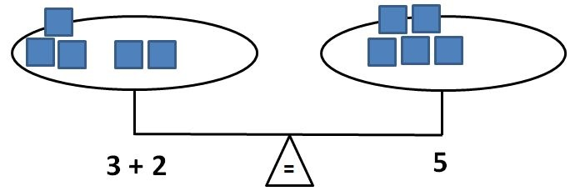
Symbols
Need to develop an understanding of the symbolic equivalence between numbers and symbols
Part of mathematical language
Explicitly teach operational symbols
Equals sign
Addition/subtraction
Multiplication/division
Fraction bars
Notes:
ACTIVITY: [This activity just shows how many symbols we use in mathematics.] Before reviewing this slide, ask participants to brainstorm all the symbols used in math (e.g., addition sign, multiplication sign, equals sign). Have each participant or table group go around and share their symbol list (one word per table).
[Click for animation.]
Teachers often move too quickly to symbolic representations and do not directly teach the meaning of math symbols. For example, for many students the equals sign means “answer” rather than “the same as.” A lack of a full understanding of the equals sign affects number sense and computational understanding. In the future, this can affect understanding of equations and can lead to challenges when trying to balance equations.

Slide 8
Whole Number Computation
An efficient and accurate method for solving an operational math problems to mastery
Includes both basic facts (addition, subtraction, multiplication and division) and the ability to apply these skills to multistep computations
Need explicit instruction in strategies to
Understand the relationships between numbers
Conceptual understanding of how to solve efficiently
Notes:
Whole number computation is important and a key foundational skill for students exiting elementary school and should be part of instruction starting as early as kindergarten. For students receiving tiered support, whole number computation can be challenging and may be impacted by working memory as well as a student’s understanding of how numbers are related to one another, such as the concept of part-part-whole within fact families, the understanding of how numbers are related, or how to use strategies efficiently. Often, students with math difficulty have delays in both process or conceptual understanding as well as procedural fluency, which may result in inefficient or incorrect strategy use, thus leading to greater confusion.
What does mastery of facts mean? Ideally, by the end of Grade 5, if students were given an addition, subtraction, multiplication, and division sheet with 100 questions, they could correctly solve at least 80% on all sheets within 1 minute for each sheet.

Slide 9
Word Problem Solving
Mix of numbers and words in which students apply mathematical skills
Challenges in solving word problems:
Vocabulary
Language
Multiple steps
Selecting correct algorithms
Need explicit instruction and practice using
Schema-based instruction which assists students in identifying the underlying structure of the problem
Strategies that can be applied to various word problems
Notes:
Word problem solving is often used as a means to apply and determine if students understand numbers. Word problems are often part of unit assessments and state assessments. For students with mathematics difficulty, word problem solving can be challenging as a result of reading deficits, lack of mathematics vocabulary, multiple steps that can be effected by working memory and remembering how to solve.
Students often need schema-based strategies to identify how to solve word problems. Schema-based strategies, alongside writing an equation to show the missing part (beginning, middle or end), enables the student to better understand the question and identify important numbers and words, rather than teaching key words, which expires.
A great example of when key words expire is a word problem from the National Assessment of Educational Progress (NAEP), in which the story asks students to identify how many pictures a child has taken on vacation. The problem states that the child took some pictures, deleted 32, and is now organizing the remaining 82. If a student applies key words, rather than understanding that we are trying to solve for the whole rather than a part (W – 32 = 82, which means the problem is solved by adding 32 + 82), this would result in the student subtracting 32 from 82.

Slide 10
Self-Regulation
The attitude and abilities required to act as the “primary causal agent in one’s life and to make choices regarding one’s actions free from undue external influence or interference.” (Wehmeyer, 1992, p. 305)
Includes three components:
Autonomy
Relatedness
Competence
Lack of self-regulation may lead to decreased academic achievement.
Should be embedded within interventions and core instruction.
Notes:
Self-regulation is often thought of as having three components: (1) autonomy: feeling that one is the owner of their behavior; (2) relatedness: connection between student and others; and (3) competence: understanding that challenging materials can be learned. When a student has good self-regulation, they have a sense of autonomy, meaning they can remember all the steps to solve, maintain on-task behavior, and understand how the math skills are linked to other skills.
Self-regulation is also the ability to determine if the answer is reasonable and if the strategy chosen is the most efficient for that type of problem. For students with math difficulty, explicit instruction and practice is needed for students to develop these much needed skills.

Slide 11
DBI Within an MTSS Framework
Notes:
[The following four slides are all in the handout materials.]

Slide 12
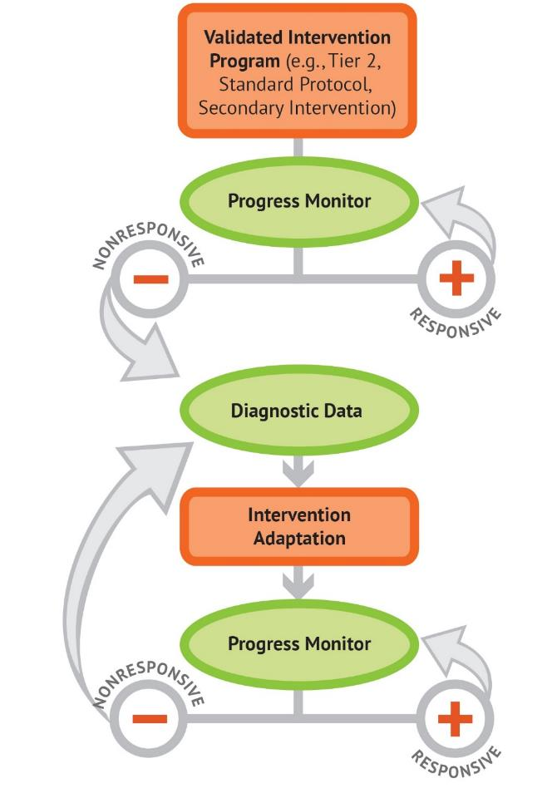
The DBI Process
Notes:
[Animated slide.]
The National Center on Intensive Intervention uses this graphic to illustrate the progression of data-based individualization (DBI). We begin with a secondary intervention program, delivered with greater intensity, and progress monitor to determine the student’s response. If the student is responsive, we can continue the current intervention or consider reducing intensity as goals are met (depending on rate and duration of response and nature of skill deficits). If the student is not sufficiently responsive, we gather additional information through informal diagnostic assessment, which identifies student needs to guide intervention adaptations. We continue progress monitoring to make decisions about whether the student is responding to the adapted intervention.

Slide 13
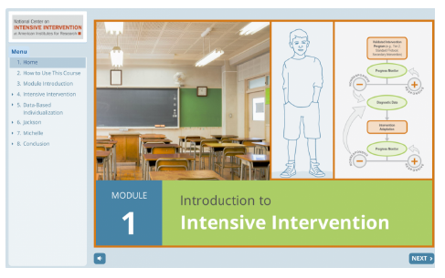
Introduction to Intensive Intervention
For additional information on the DBI process, check out the Introduction to Intensive Intervention module.
The self-paced module:
Defines intensive intervention and DBI;
Describes how intensive intervention fits within a tiered system such as MTSS, RTI (response to intervention), or PBIS (positive behavior intervention and supports); and
Demonstrates how intensive intervention can provide a systematic process to deliver specialized instruction for students with disabilities.
https://intensiveintervention.org/resource/self-paced-introduction-intensive-intervention
Notes:
[Read slide.]

Slide 14
Characteristics of Instruction Across the Tiers
 | Primary (T1) | Secondary (T2) | Intensive (T3)
Instruction/ Intervention Approach | Comprehensive research-based curriculum | Standardized, targeted small-group instruction | Individualized, based on student data
Group Size | Classwide (with some small-group instruction) | 3–7 students | No more than 3 students
Monitor Progress | Once per term | At least once per month | Weekly*
Population Served | All students | At-risk students | Students with significant and persistent learning needs
DBI is an approach to intensive intervention.
* Or as indicated by the assessment instructions.

Slide 15
DBI Process
Develop better understanding of students with mathematics difficulties.
Screen students to identify Tier 2.
Begin validated intervention program in mathematics.
National Center on Intensive Intervention (NCII)
Notes:
[Read slide.] ENI is considered a validated intervention program. Thus, it may serve as a Tier 2 intervention or as a platform for providing intensive intervention within the DBI process. In other words, ENI may be the intervention that the teacher adapts based on a student’s individual needs. To learn more about DBI, see https://intensiveintervention.org/resource/self-paced-introduction-intensive-intervention.

Slide 16
Early Numeracy Intervention

Slide 17
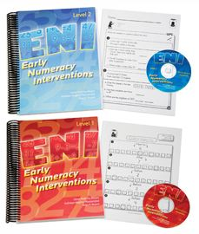
Early Numeracy Intervention
Diane Pedrotty Bryant, Kathleen Hughes Pfannenstiel, Brian Bryant
Notes:
[The intervention can be purchased from PRO-ED at https://www.proedinc.com/Products/14053/early-numeracy-intervention-eni-program-combo-levels-1--2.aspx. The material includes spiral-bound teacher manuals, two CD-ROMs containing student masters for each lesson, teacher masters for each lesson, and Unit Check progress monitoring measures.]

Slide 18
MTSS in Mathematics Recommendations
Screen all students to identify students in need of intervention
Skill areas include:
Whole numbers (K–5)
Rational numbers (Grades 4 and 5)
Instruction should be explicit and systematic
Include word problem solving
Use multiple representations
Devote time to fact instruction
Monitor progress
Include motivational strategies
(Gersten et al., 2009)
Notes:
In the creation and testing of ENI, the lessons and activities were aligned to the recommendations of the Practice Guide, targeting students who struggle. You will notice that the focus is on whole numbers, instruction is scripted, and systematically builds upon previously learned skills, and that embedding review, word problems, and specific facts are part of each unit, as well as suggestions to graph results and have students set goals to increase their own motivation and self-determination.

Slide 19
Components of ENI
A Tier 2 program developed to provide teachers with evidence-based instructional materials for teaching students who struggle with primary-level numeracy concepts and procedures, while applying to problem solving for Grades 1 and 2.
Contains:
Intervention Lessons
Student Masters
Teacher Masters
Materials
Progress Monitoring Tools
Notes:
[At this time, have teachers flip through the materials, both the teacher manual and the accompanying CDs.]

Slide 20
Lesson Components
Explicit and systematic
10 units
14 lessons per unit
2 lessons per intervention session
25–30 minutes total time
Each unit takes about 2–3 weeks to complete
Notes:
[Read slide.]

Slide 21
Lesson Components
Group size
3–6 students
Homogeneous (if possible)
Warm-up (one)
Quick (3 minutes)
Engagement and review of previously learned skills
Notes:
[Read slide. The group size is a suggestion and can be modified to best fit a school’s capacity.]

Slide 22
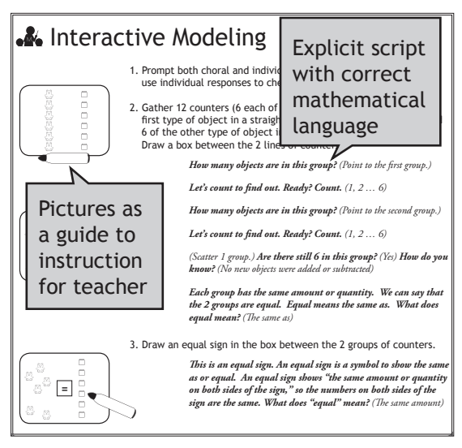
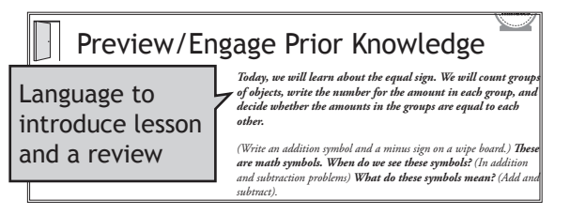
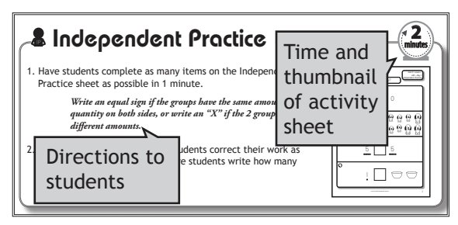
Lesson Components
Lesson (2 per day)
8–10 minutes
Preview/Engage Prior Knowledge
Interactive Modeling
Guided Practice
2 minutes
Independent Practice
Notes:
[Read slide.] Animations to show the different parts of the lesson. Have participants open to a lesson.

Slide 23
Lesson Components
Cover page
Skill
Objective
Vocabulary
Materials
Teacher scripting = BOLD
Sample student response = ITALICS
Icons in lesson match student pages
Notes:
[Have teachers find the icons in a lesson as an example.]

Slide 24
Content
Ordering and Comparing Numbers
0–99 (Level 1)
0–999 (Level 2)
Relationships of 10 (Level 1)
Place Value/Magnitude Comparison (Level 2)
Addition/Subtraction Facts
Word Problem Solving
Notes:
The content is linked to the Common Core State Standards for Mathematics, and an alignment table is located in the front section of the teacher manual.

Slide 25
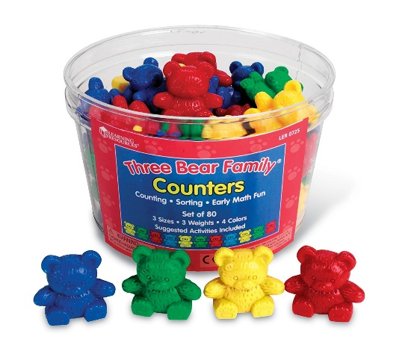
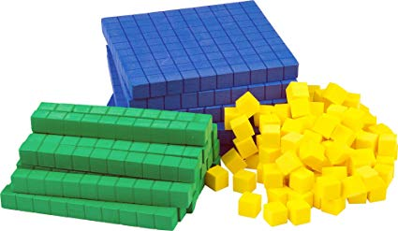
Classroom Materials
TIMER—for teacher
Essential to the pacing and flow of lesson
Counters (e.g., bears, turtles, connecting cubes)
Place-value mats
Place-value manipulatives
Flats, rods, units
Number lines
100 charts
Notes:
[Read slide.] The intervention was designed to be used with typical materials found in elementary math classrooms, such as counters, place-value mats, base-ten materials, number lines, and 100s charts. The CD that accompanies the materials also includes number lines, 100s charts, and place-value mats that can be printed and used.

Slide 26
Monitor Progress
Daily Checks—Independent Practice
Measures what was taught that day
Part of the lesson: Independent Practice (IP)
2 per day (1/lesson)
1 minute complete
1 minute self-correct
No IP for word problem solving to allow students extra time to practice problems
Unit Checks
Measures skills taught across the 14 lessons
Given at end of unit
Notes:
[Read slide.]

Slide 27
Self-Regulation
Students grade their own Daily Check/IP
Immediate feedback to student and teacher
Allows for correction
Unit Checks
Teacher can have student correct
Graph the results
Share with student
Check It or Change It
Notes:
[Read slide.] By having students grade their own work, they are receiving immediate feedback and can correct any mistakes. Many students like the idea of “check it or change it.” Meaning, if it is correct, they write a check mark (they might need directions the first time); if the answer is wrong, the students change the answer.
Unit Checks should be graded by the teacher following the completion of each unit.

Slide 28
Specific Skills Addressed Within ENI
Overview and Instructional Components to Consider

Slide 29
Sample Lessons Schedule and Skills
ASF: Addition and Subtraction Facts
OCN: Ordering and Comparing Numbers
ROT (Grade 1): Relationships of 10
PVMC (Grade 2): Place Value/Magnitude Comparisons
WPS: Word Problem Solving
Notes:
This is a suggested schedule and can easily be modified to meet the capacity of a school. For example, rather than teaching two lessons in one session (total time ~30 minutes), it could be split into two 15-minute sessions. You will also notice that word problem solving (WPS) lessons get the whole 25 minutes to allow students time to fully understand, draw pictures, and check answers, rather than limiting it to only 10 minutes.

Slide 30
Addition and Subtraction Fact (ASF) Strategies
Skill Progression
Strategy
Part-part-whole (PPW)
Fact families
Equals sign
+/− 0, 1, 2, 3
Count-on (+1, 2, 3)
Count-back (−1, 2, 3)
N – n and related
PPW mat
Doubles and related
Skip counting by 2
Doubles +1 and related
Neighbors on the number line
Make 10 and related
Make 10 on a ten-frame
Ten plus more and related
Building of ten answers using place-value materials
Make 10+ more and related
Make 10+ more on mat with ten-frame
Notes:
As mentioned previously, students need both conceptual understanding and procedural fluency of basic facts; thus, Additional and Subtract Fact strategies are taught explicitly four times in each unit. This curriculum shows the strategy for a specific math fact. For both Level 1 and Level 2, the strategies are introduced through concrete materials, pictorial representations, and then abstract representations. You will often use a mat, such as a part-part-whole mat, to help the students organize the tools.
For example, both Level 1 and Level 2 begin with the students understanding part-part-whole (PPW) and how numbers are related within an addition and subtraction equation. In the first unit, they are introduced to the term or the strategy of fact families.
Following PPW, the students are explicitly taught the equals sign and practice writing partner sentences, connecting the idea of different parts equals the same whole. For example 1 + 6 = 4 + 3.
Following the prerequisite skills, the students are taught strategies to solve computations. The students begin with count-on for addition and count-back for subtraction. This strategy, “Put the greater number in your head and count-on/back,” is used for numbers added to and subtracted from 1, 2, or 3.
Following mastery of this strategy, students use a PPW mat to show why a number subtracted from the same number always equals 0. For all these facts, the students solve and then write the other equations in the fact family. For example, 3 + 5 = 8, 5 + 3 = 8, 8 – 3 = 5 and 8 - 5 = 3.
Let’s practice the remaining strategies. For doubles, the students are first taught to identify a doubles fact. Then they make equal groups of two, so 6 + 6 would have six groups of 2. The students then count by 2s: 2, 4, 6, 8, 10, 12. So, 6 + 6 = 12 and 12 – 6 = 6.
Students are then able to apply their knowledge of doubles facts to solve doubles plus one. Again, they begin by identifying this type of fact by using a number line to find “neighbors,” such as 4 and 6 are the neighbors of 5. Then, using the number line, they first identify the “less than” number, double it, and then count up for the greater neighbor. For example, 6 + 7 are neighbors. First, I double 6, so 6 + 6 = 12. I then look at the neighbors of 12 – 11 and 13. Since 7 is the greater neighbor to 6, I need the greater neighbor of 12, which is 13. So, 6 + 7 = 13, 7 + 6 = 13, 13 – 6 = 7, and 13 – 7 = 6.
After this fact type, the students move to learn Make 10—all the pairs that equal 10 (1 + 9, 2 + 8, 3 + 7, 4 + 6, 5 + 5). Then the students practice 10 Plus More: 10 + 1, 10 + 2…10 + 10. Both of these skills will be needed to apply the Make 10 Plus More.
The last strategy tends to be the most challenging, but the students have been practicing and often learn it quickly with the help of materials and the Make Ten Plus More mat. For this strategy, the students use it for facts that cannot be solved with any previous strategy. This leaves: 4 + 7, 4 + 8, 4 + 9, 5 + 7, 5 + 8, 5 + 9, 6 + 8, 6 + 9, and their inverse. In Make 10 Plus More, the student identifies the greater number. Let’s use 5 + 9 as an example. First, the student builds the fact on the ten-frame on the mat. Which number is greater? (9) How many does 9 need to make 10? (1) Take one away from 5. What is the problem now? (10 + 4) What is 10 + 4? (14) What is 9 + 5? (14)

Slide 31
Fact Instruction
Things to keep in mind:
Mats are helpful for students to “stay organized.”
Manipulatives help students see the math.
Do not be afraid to bring them back or have on table as a reminder.
Organize in a ten-frame or in groups not scattered.
Having students repeat the strategy is IMPORTANT for self-regulation.
Should be repeated often.
Do not skip the question “How did you solve?”
Pacing
Not too fast, but not too slow.
Model how to count quickly and efficiently.
Use correct vocabulary and write in different directions.
Equation
Addend, part, whole
7 = 3 + 4; 3 + 4 = 6 + 1; 3 + 4 = 7
Notes:
[Read slide.]

Slide 32
Ordering, Comparing, and Building Numbers (OCN, ROT/PVMC)
Things to keep in mind:
Connect from manipulatives to number lines and 100s charts
The power of “SWITCH” strategy
Pacing when counting
Use place-value mat
Organization of materials
When building two numbers, make sure students can see all manipulatives
Build from left to right
Use correct vocabulary
Notes:
The SWITCH strategy was created by a first grader using the material. In counting place-value materials, many students are confused when switching from hundreds to tens or even tens to ones. For example, when counting the number 43, you start with the tens (i.e., ten, twenty, thirty, forty), then count the ones. For students who struggle, they will often continue counting by ten rather than switching to ones.
The student who inspired this strategy was quite excited to say “SWITCH” as a reminder for his peers! When using SWITCH, counting should sound like: ten, twenty, thirty, forty, SWITCH, forty-one, forty-two, forty-three. The word SWITCH is in both ENI Level 1 and Level 2 and is important for the teachers to model, and also to encourage students to use it, too.

Slide 33
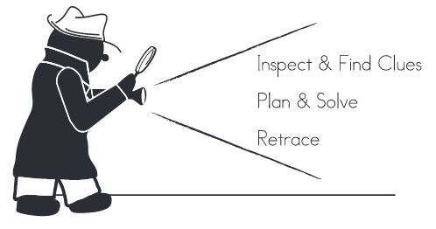
Math Scene Investigator
Cognitive Strategy Instruction
3 Steps
Inspect and find clues
Plan and solve
Retrace
Begins in Unit 2
Instruction in the strategy alone
Enables students to memorize the strategy before application
Common Anchor Across Units
Jenny (Level 1)
Spot the Dog (Level 2)
Picture used to introduce new type of problem
Pfannenstiel, K.H., Bryant, D.P., Bryant, B., & Porterfield, J. (2015)
Notes:
The Math Scene Investigator (MSI) is a cognitive strategy that guides students through the task of reading a problem, identifying the question and important information, planning how to solve by first writing an equation, solving the problem, and then checking or retracing their work. In the first until the students will be introduced to the strategy and will not solve any word problems until Unit 2. This is important as it allows time for the students to truly understand the cognitive strategy rather than learning it as they apply it.
[For additional information, see Pfannenstiel, K. H., Bryant, D. P., Bryant, B., & Porterfield, J. (2015). Cognitive Strategy Instruction for teaching word problems to primary-level struggling students. Intervention in School and Clinic, 50(1), 291–296.]

Slide 34
Modeling Time
YOU are the students
Think about . . .
Pacing
Questions asked
Wait time
Examples
Notes:
[This is a spot for the trainer to model a lesson; typically, an Ordering and Comparing Numbers or Place Value lesson is a good choice. It is important to show brisk pace, including counting numbers, as well as having participants complete following the teacher. Two sample lessons are available online: https://www.proedinc.com/Downloads/14033_SampleLesson.pdf (Level 1) and https://www.proedinc.com/Downloads/14034_SampleLesson.pdf (Level 2).]

Slide 35
Practice Time
Each person selects a different lesson
One person is the teacher; the other is the student
Change roles for second lesson
Thoughts?
Notes:
[Teachers practice with one another.]

Slide 36
Ideas!
Be organized.
Have materials for each student ready to go for session.
Do not skip around; lessons are systematic and build upon skills.
Use a timer.
3–6 students per group.
Use a group behavior management system.
Sheet protectors are GREAT for teacher sheets.
Use the script; the language and questions are important!
Maintain brisk pace. Just as in reading, model quick counting.
Notes:
[Read slide and encourage teachers to tackle math intervention the same way they organize small-group reading instruction.]

Slide 37
References
Baddeley, A. D., & Logie, R. H. (1999). Working memory: The multiple-component model. In A. Miyake & P. Shah (Eds.), Models of working memory: Mechanisms of active maintenance and executive control (pp. 28-61). New York, NY, US: Cambridge University Press.
Geary, D. (2004). Mathematics and learning disabilities. Journal of Learning Disabilities, 37(1), 4 – 15.
Gersten, R., Beckmann, S., Clarke, B., Foegen, A., Marsh, L., Star, J. R., & Witzel, B. (2009). Assisting students struggling with mathematics: Response to Intervention (RtI) for elementary and middle schools (NCEE 2009-4060). Washington, DC: National Center for Education Evaluation and Regional Assistance, Institute of Education Sciences, U.S. Department of Education. Retrieved from http://ies. ed.gov/ncee/wwc/publications/practiceguides/. Siegler, 1988
National Center on Intensive Intervention. (2015). DBI implementation rubric. Retrieved from https://intensiveintervention.org/sites/default/files/DBI_ImplemenRubric_2015.pdf

Slide 38
Disclaimer
This module was produced under the U.S. Department of Education, under the Investing in Innovation Fund (i3), Award No. U411C140029. The views expressed herein do not necessarily represent the positions or polices of the U.S. Department of Education. No official endorsement by the U.S. Department of Education of any product, commodity, service or enterprise mentioned in this website is intended or should be inferred.

Slide 39
AIR information
1000 Thomas Jefferson Street NW
Washington, DC 20007-3835
General Information: 202-403-5000
www.air.org

