Slide 1
Planning Intensive Intervention in Mathematics
Focus on Counting and Place-Value Concepts
Copyright © 2020 American Institutes for Research. All rights reserved.

Slide 2
Agenda
Using Data-Based Individualization to Address Challenges With Counting and Place Value
Data Review: Identifying Students With Difficulty
Vocabulary and Strategies for Counting and Place Value
Case Examples

Slide 3
Using DBI to Address Challenges With Counting and Place Value

Slide 4
Characteristics of Instruction Across the Tiers
 | Primary (T1) | Secondary (T2) | Intensive (T3)
Instruction/ Intervention Approach | Comprehensive, research-based curriculum | Standardized, targeted small-group instruction | Individualized, based on student data
Group Size | Classwide (with some small-group instruction) | 3–7 students | No more than 3 students
Monitor Progress | Once per term | At least once per month | Weekly
Population Served | All students | At-risk students | Significant and persistent learning needs
DBI is an approach to intensive intervention.

Slide 5
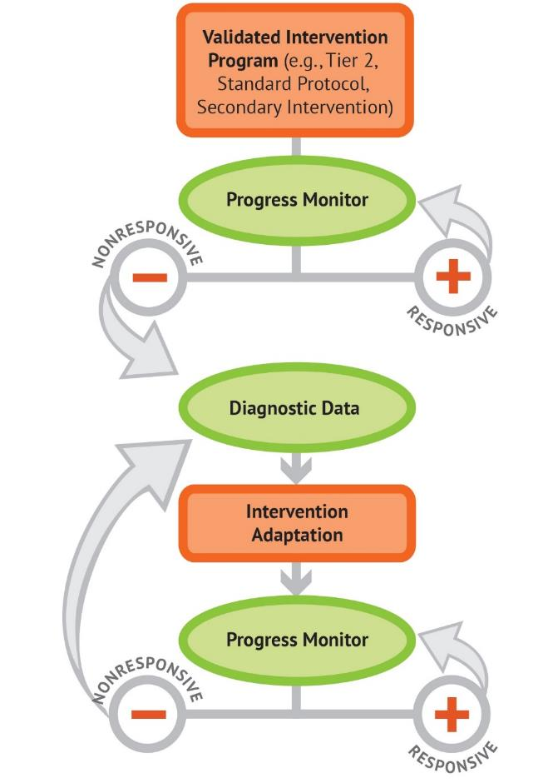
Five DBI Steps
Secondary intervention program, delivered with greater intensity
Progress monitoring
Informal diagnostic assessment
Adaptation
Continued progress monitoring, with adaptations occurring whenever needed to ensure adequate progress

Slide 6
DBI (Tier 3) Intensification
Review Types of Intensification

Slide 7
Categories of Practice for Organizing and Planning
Intensive Intervention
Change Dosage or Time
Change the Learning Environment to Promote Attention and Engagement
Combine Cognitive Processing Strategies With Academic Learning
Modify Delivery of Instruction
(Vaughn et al., 2012)

Slide 8
Mathematics Content, DBI in Mathematics, Data-Based Decisions, and Graph Analysis

Slide 9
Mathematics Vocabulary: Why Is it Important?
Mathematics texts are often challenging for struggling readers.
  Connected to conceptual understanding of mathematical thinking and skills
  Weakness for students with mathematics difficulty
  Can hinder understanding of word problems
Mathematics vocabulary is often part of practice standards in many states and in national college and career readiness standards.
It is a cornerstone of comprehension, and mathematics truly has its own language.
  Enhances achievement in mathematics as well as mathematics in other contexts
(Allen, 2007; Powell & Driver, 2014; Monroe, & Orme, 2002; Monroe & Pendergrass, 1997)

Slide 10
Common Vocabulary: Counting and Place Value
TERM | DEFINITION | GRADE LEVEL INTRODUCED
Number
Numeral
Digit
Counting
Cardinal Number
Ordinal Number
Even
Odd
Quantity

Slide 11
Common Vocabulary: Place-Value Skills
TERM | DEFINITION | GRADE LEVEL INTRODUCED
Value
Place
Place Value
Word Form
Standard Notation
Expanded Notation
Decimal
Decimal Point

Slide 12
Common Vocabulary: Counting and Place-Value Actions
TERM | DEFINITION | GRADE LEVEL INTRODUCED
Round
Estimate
Compare More Less Equal

Slide 13
Summary
Mathematics is a language that includes words and symbols.
Explicit instruction is vital to deep understanding and generalization of skills.
Teachers and students need to practice and use the correct language.
  Begin as soon as students enter school.
  Correct and model precise language.
Link mathematical vocabulary across units and skill areas.

Slide 14
From Counting to Place Value
Developing an Understanding of the Learning Progression

Slide 15
Critical Counting and Place-Value Skills
Fluency in Counting Numbers and Groups
  Discover and identify patterns within number sets.
  Subitize: Look at an array and identify the quantity.
  Create and count quantity of total groups and per group.
  Skip-count (2s, 5s, 10s) beginning with different numbers.
Representing Numbers
  Reading numbers
  Writing numbers
  Building numbers
Understanding Numbers in Relation to Their Place and Value
  Compare numbers.
  Place on number line.

Slide 16
Five Counting Principles: Trajectory of Counting to Place-Value Skills
One-to-one correspondence
Stable order
Cardinality
Abstraction
Order irrelevance
The last count represents the number of objects in a set.
Assign one (and only one) count to each object of a set.
The order in which objects are counted does not change the amount in the set.
The order in which students count is always the same; the order never changes: 1, 2, 3, …10.
Any collection of objects can be counted; not all objects have to be the same.

Slide 17
False Counting Assumptions
Standard Direction
  Counting MUST start at an end point.
Adjacency
  Items MUST be counted consecutively.
  Take 5 minutes at your table to discuss the following:
  How might these false counting assumptions hinder students’ understanding of place value?

Slide 18
Representing Numbers: Writing Numbers Correctly
Student Example
Consider the following:
Are the numbers in cardinal order?
Did the student form the numbers correctly?
What do you notice about digit formation?
Possible strategies:
Practice on trace paper.
Use dot paper (a step up from tracing).
Have an upper and lower line for boundaries.

Slide 19
Summary
Counting is a precursor for every other mathematical skill.
  Understanding patterns
  Understanding order
  Comparing numbers
Counting is part of the development of place-value skills.
  Naturally part of the understanding of the value of different digits
  Understanding link to the counting principles within rational as well as irrational numbers

Slide 20
Summary
Counting is within College- and Career-Ready Standards.
  Counting not explicitly stated, except for kindergarten
    Counting and Cardinality
    Precursor for other standards
  Number and Operations in Base 10
    Skip-counting
    Making and showing numbers
  Algebraic Readiness

Slide 21
DBI: Targeting Counting and Place-Value Skills
Case Examples

Slide 22
Common Errors in Counting and Place Value
Error Patterns
Does the student always write the number 3 backward or just sometimes?
When counting, does the student stop and think about the number that comes next at the same point?
When the student is building numbers, where are the consistent errors? In the hundreds? Tens? Ones?
Typical Counting Errors
Crossing decades (8, 9, 1 or 27, 28, 29, 20)
Switching from one value to the next (hundreds to tens, but continues counting as hundreds)
Low fluency or unable to touch and count (lacking one-to-one correspondence)

Slide 23
Common Errors in Counting and Place Value
Writing and Place Value
Numbers are backward (individual or place: 23 is written as 32).
Numbers are not the same relative size.
Does not write 0 to show no value (102 is written as 12).
Writes the value of each digit (132 is written as 10032 or 100302).

Slide 24
Common Errors in Counting and Place Value
Comparing
  Compares first digit, regardless of value (identifies 23 as less than 9).
  Orders sets of numbers inaccurately.
  Lacks sense of relationship between numbers or sets of numbers.
  Unable to use patterns to identify greater than or less than.
Computation
  Does not accurately count.
  Does not use strategies.
  Does not regroup or regroups when not needed.

Slide 25

Case Example: Your Student
Your Student
Class and Grade
Take a few minutes to think about a student whom you currently work with or have worked with in the past.
What are their strengths?
What are their deficits?
What instructional adjustments/changes have you made?
What data do you have?

Slide 26
Case Example: Jessie
Ms. Taylor
Grade: Kindergarten

Slide 27

Case Example 1: Jessie—Counting and Cardinality
Demographics
  Kindergarten
  Ms. Taylor’s class
Background
  Screened in early October and identified as needing Tier 2
  Receiving Tier 2 intervention
    Three days per week, four students in group.
    Targeted skills include one-to-one correspondence, counting finite
    sets of objects, and making groups.
  Progress monitoring
    Administered weekly.
    Work samples are collected each day as part of Tier 2 (independent practice).
    In addition, teacher worked with Jessie independently to test skills.

Slide 28
Mathematics Skill Trajectories
Kindergarten standards
  Number and Operations in Base 10
    Compose and decompose numbers 11–19.
  Counting and Cardinality
    Know number names and count sequence.
    Count to tell the numbers of objects.
    Compare numbers.
      Identify whether the number of objects in one group is greater than, less than, or equal to the number of objects in another group, e.g., by using matching and counting strategies.
      Compare two numbers between 1 and 10 presented as written numerals.
Tier 1/core focus (spring semester):
  Teen numbers (counting, comparing, decomposing)
  Introduce basic addition and subtraction
    Counting on or counting back.

Slide 29
Tier 2 Skills
Tier 2 Focus for Jessie
  Building, writing, saying, decomposing numbers 0–10
  Writing numbers 0–19
  Comparing numbers 0–19
  Answering “how many?” 0–19
  Introduce and focus on two numbers per week (through teens), while reviewing previous numbers.

Slide 30
Jessie: Progress Monitoring (Quantity Discrimination)
Raw Score—QD
Goal line (25th percentile score at end of year)

Slide 31
Jessie: Error Analysis and Diagnostic Data
Counting
When presented with a finite set of items, Jessie does not count correctly.
  Do the following when asked, “How many?”
    Correct only 50 percent of the time (numbers below 10).
    Correct < 50 percent (numbers between 11 and 19).
When given a number and asked to count that many objects, the counting gets ahead of touching an object. (This is a similar issue involving one-to-one correspondence on 2).
  Recounts all objects when more objects are added to a set (does not count on).

Slide 32
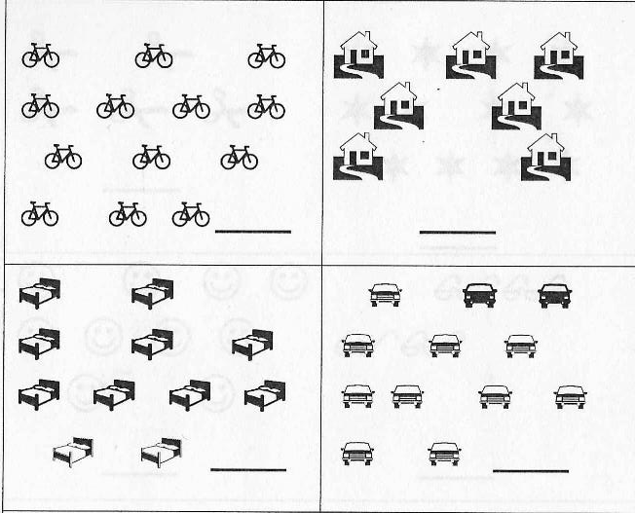
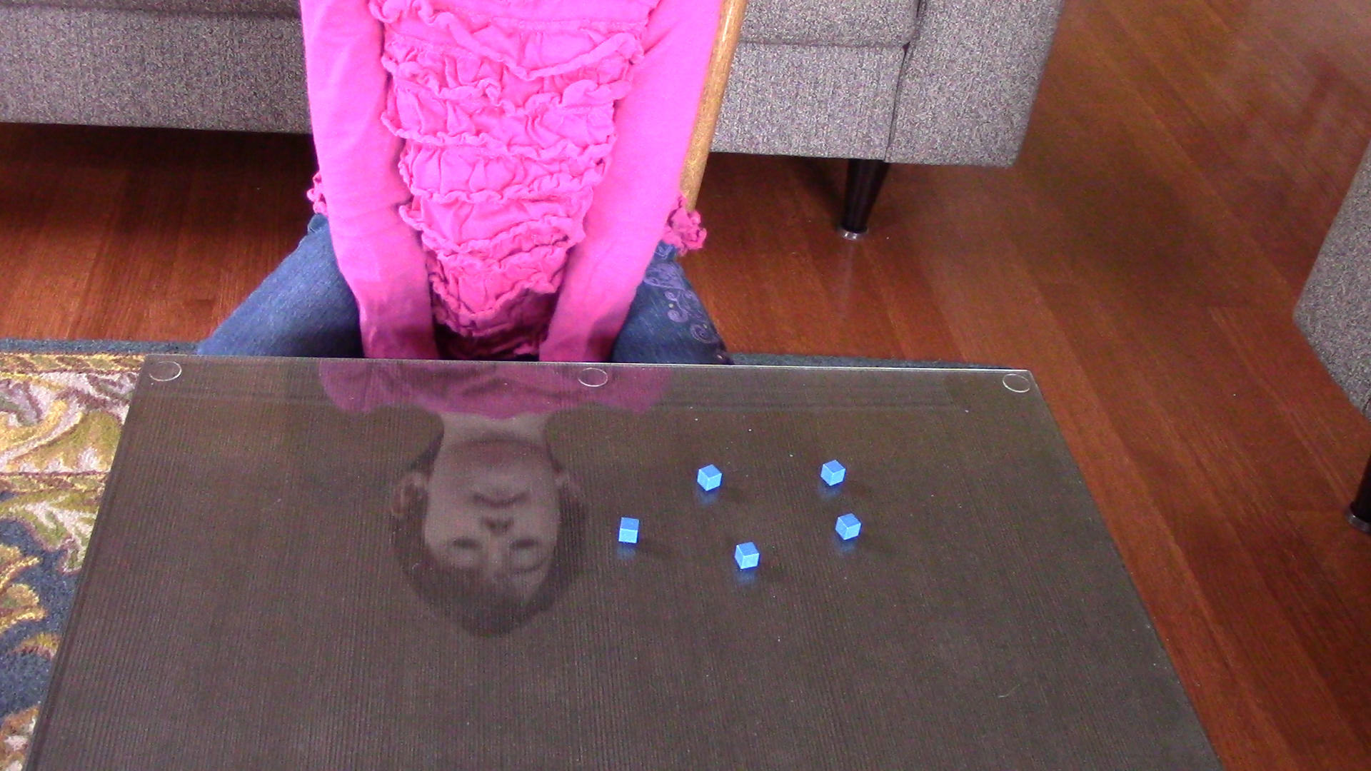
Jessie: Error Analysis and Diagnostic Data
12
7
5 + 4 =
“Count all or count on?”
10
13

Slide 33
Jessie: Error Analysis and Diagnostic Data
Comparing
Jessie fails to identify correct set of objects when given a more/less statement.
Early Addition and Subtraction (Combining, Taking Away, Equalizing)
When adding or subtracting numbers (within 10), Jessie often calculates incorrectly.
Jessie does not apply number family knowledge to her approach to simple addition.
Writing
Jessie can write numbers to 9 but often reverses numbers.

Slide 34
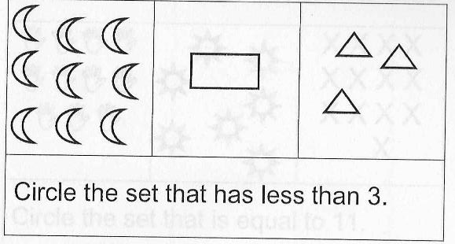
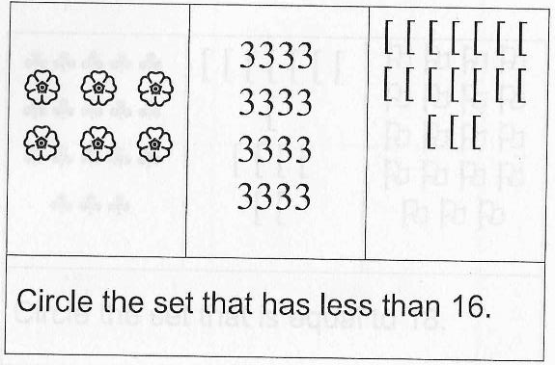
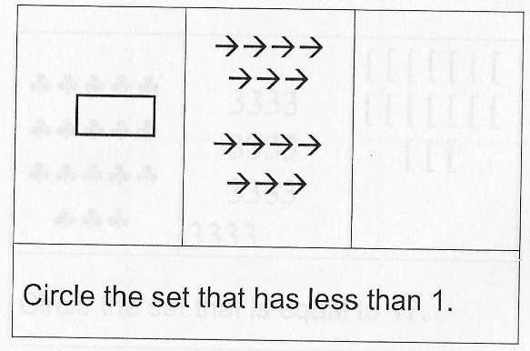
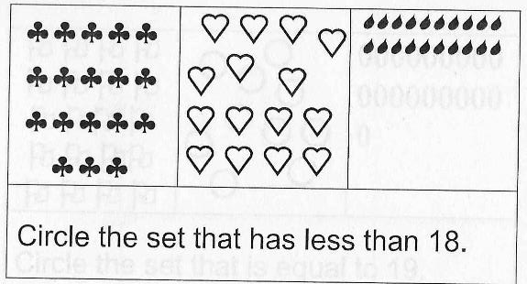
Jessie: Error Analysis and Diagnostic Data
5 + 5 + 3
“I can tell there’s way more moons but only one square.”
“I know it’s this one because it has 13.”
“I counted these points and got 18. The hearts are bigger, so it must be that one.”
“There’s zero things inside this small box.”

Slide 35
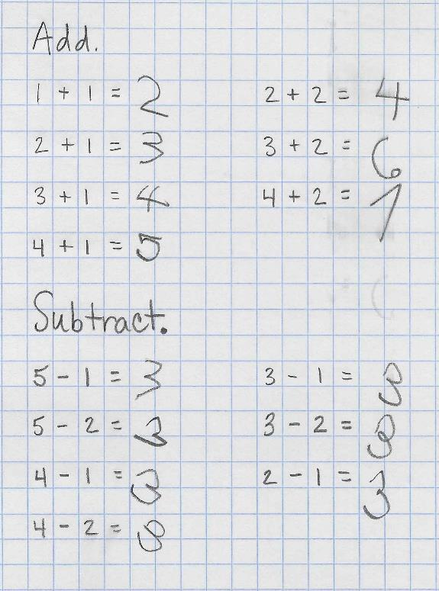
Jessie: Error Analysis and Diagnostic Data
Early addition and subtraction
(+/- 1, 2)
  How did Jessie do?
  Do you see any error patterns?

Slide 36
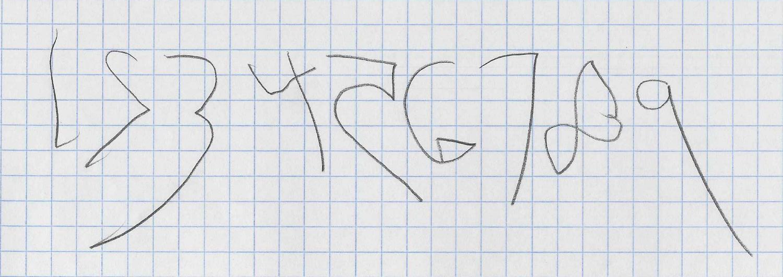
Jessie: Error Analysis and Diagnostic Data
Writing

Slide 37
Tier 3: How can DBI help us determine what additional changes or intensification are needed to support Jessie?
As a group, identify specific skills that you would focus Tier 3/DBI instruction. Consider the following skill areas:
Counting
Comparing
Addition and Subtraction; Decomposition of Numbers
Writing Numbers

Slide 38
Case Example: Jordan
Mr. Richardson
Grade: 1

Slide 39

Case Example 2: Jordan— Number and Operations in Base 10
Demographics
  Grade 1
  Mr. Richardson
Background
  Identified as Tier 2 at midyear of kindergarten.
    Received Tier 2 instruction February through May.
    Three days per week, 15 minutes each session, four to five students
    in group.
  Identified as Tier 2 at beginning of first grade.
  Receiving Tier 2 since late October.
    Three days per week, 25 minutes, five students in group.
    Targeted skills include making groups, skip-counting, making numbers
    using Base 10 manipulatives.

Slide 40
Tier 2 Skills
Tier 2 Focus
  Numbers 0–99
    New decade each week
  Building, writing, saying numbers
  Comparing numbers
  Addition and subtraction facts
  Addition and subtraction without regrouping (2 digit + 1 digit, 2 digit + 2 digit)

Slide 41
Selection of Mathematics Skills and Trajectories for Intervention
Analysis of skills
  Writing numbers incorrectly
  Not applying correct value to digit
  Counting incorrectly
  Inability to see patterns when counting
In reviewing the additional data collected and the standards, Jordan needs intensification targeting both Grade 1 and kindergarten skills.

Slide 42
Mathematics Skill Trajectories: Standards
Standards: Grade 1 and Below Grade Level
  Number and Operations in Base 10 (place value, counting prerequisite)
    Extend the counting sequence.
      Kindergarten: Compare numbers.
    Understand place value.
      Kindergarten: Know number names.
    Use place-value understanding and properties of operations to add and subtract.
      Kindergarten: Compose and decompose numbers.
  Operations and Algebraic Thinking (counting prerequisite)
    Represent and solve problems involving addition and subtraction.

Slide 43
Jordan: Progress Monitoring (M-COMP)
Raw Score—Math Computation
Goal line (25th percentile score at end of year)

Slide 44
Jordan: Error Analysis and Diagnostic Data
Observational Data
Moves very slowly when completing mathematics problems, regardless of skill presented.
  Often scores low when timed because he writes slowly and processes at a much slower rate.
Does not model or count numbers correctly.
Can count accurately from 0 to 50.
  Greater than 50 not always in order.
Skip-counts by 2s, 5s, and 10s.
  Only when starting with 2, 5, or 10.
  Unable to verbally describe what digit changes or the patterns in skip-counting.
When adding or subtracting, draws lines and only uses the “count all” strategy.

Slide 45


Jordan: Error Analysis and Diagnostic Data
Counting
Teacher: How many in all? Count them.
Jordan: 10, 20, 30, 40, 50, 60. This shows 60.
Teacher: How many in all? Count them.
Jordan: 10, 20. This is 20.
Teacher: How many in all? Count them.
Jordan: 1, 2, 3, 4, 5, 6, 7. This is 7.

Slide 46
Jordan: Error Analysis and Diagnostic Data
Counting and Writing
Teacher: Look at each picture and write the number that shows how many in all.

Slide 47
Jordan: Error Analysis and Diagnostic Data
Comparing
Jordan was told to circle the number that is greater or bigger in value. The student was given 1 minute and completed five items.
14 23 31 49
9 7 4 23
12 6

Slide 48
Jordan: Error Analysis and Diagnostic Data
3 8 1
+5 - 3 +9
12 7
+ 4 - 7
Computations: Jordan was given 1 minute.

Slide 49
Tier 3: How can DBI help us determine what additional changes or intensification are needed to support Jordan?
As a group, identify specific skills that you would focus Tier 3/DBI instruction. Consider the following skill areas:
Counting
Comparing
Addition and Subtraction; Decomposition of Numbers
Writing Numbers

Slide 50
Case Example: Trevor
Mrs. Wood
Grade: 2

Slide 51

Case Example 3: Trevor—Number and Operations in Base 10 and Operations and Algebraic Thinking
Demographics
  Grade 2
  Mrs. Wood
Background
  Did not receive Tier 2 in Grade 1; always performed just above the cutoff score.
    Score at end of Grade 1 was one point below cutoff score.
  Screened at beginning of year and identified as Tier 2.
    Three days per week, 25 minutes, six students in group.
    Often absent and has received a total of 14 days of Tier 2 instruction since mid-October.
    Targeted skills include skip-counting, making two- to three-digit numbers using Base 10 manipulatives and pictures, and basic facts.

Slide 52
Tier 2 Target Skills
Tier 2 Focus
Numbers 0–999
  New century every week
Building, writing, saying numbers
Comparing numbers
Addition and subtraction facts
Addition and subtraction with and without regrouping

Slide 53
Mathematics Skill Trajectories
Analysis of Skills
  Not counting correctly
  Flipping numbers; unable to order
  No clear pattern in how he is comparing numbers
  Errors in addition and subtraction
In reviewing additional data collected and comparing to the standards, Trevor needs intensification that targets foundational skills from both Grade 1 and kindergarten.
Standards: Grade 2 and Below Grade Level
  Number and Operations in Base 10
    Understand place value.
      Grade 1: Extend the counting sequence.
      Kindergarten: Compare numbers.
    Use place value understanding and properties of operations to add and subtract (also in Grade 1).
    Operations and Algebraic Thinking
      Represent and solve problems involving addition and subtraction (also in Grade 1).

Slide 54
Trevor: Progress Monitoring Data (M-COMP)
Raw Score—Math Computations
Goal line
(based upon national growth rate norms)

Slide 55
Trevor: Progress Monitoring Data (M-CAP)
Raw Score—Math Concepts and Application
Goal line
(based upon national growth rate norms)

Slide 56
Trevor: Error Analysis and Diagnostic Data
Observational data
  Rushes to get through work.
  Able to skip-count by 2s, 5s, and 10s, but only when starting with these digits.
  Can count to 100.
  Uses fingers to add and subtract.
  Able to make two-digit numbers but cannot accurately count.
  Cannot write the value of three-digit numbers.

Slide 57
Trevor: Error Analysis and Diagnostic Data
Counting and Writing
Mrs. Wood: I will say a number,
and you will write it.
    15
    3
    92
    114
    260
    75
    404

Slide 58
Trevor: Error Analysis and Diagnostic Data
Counting and Writing
Mrs. Wood: Continue the pattern: 2, 4, 6…
Trevor: 2, 4, 6, 8, 10, 12, 14, 15, 16, 17, 18, 19, 20
Mrs. Wood: Stop.
Mrs. Wood: Start counting by 10s.
Trevor: 10, 20, 30, 40…100
Mrs. Wood: Now count by 10s starting
at 124.
Trevor: 120, 130, 134, 135
Mrs. Wood: Count by 5s.
Trevor: 5, 10, 15, 20…100
Mrs. Wood: Now count by 5s, starting with 205.
Trevor: 210, 215…I don’t know anymore.

Slide 59

Trevor: Error Analysis and Diagnostic Data
Counting and Writing
Mrs. Wood: Look at each picture and write the number that shows
how many in all.

Slide 60
Trevor: Error Analysis and Diagnostic Data
Comparing
Trevor was told to circle the smaller number. He was given 1 minute and completed 25 problems, with a total of eight correct. Here is a sample of some of the items.
12 41 100 87
257 391 63 23
901 920

Slide 61
Trevor: Error Analysis and Diagnostic Data
28 6 17
+ 11 +2 - 8
1 43 15
+3 - 17 + 3
Computations: Trevor was given 1 minute.

Slide 62
Tier 3: How can DBI help us determine what additional changes or intensification are needed to support Trevor?
As a group, identify specific skills that you would focus Tier 3/DBI instruction. Consider the following skill areas:
Place value
Addition and Subtraction
Writing Numbers
Comparing and ordering numbers

Slide 63
Case Example: Julissa
Ms. Cantania
Grade: 3

Slide 64

Case Example 4: Julissa—Number and Operations in Base 10 and Operations and Algebraic Thinking
Demographics
  Grade 3
  Ms. Cantania
Background
  Received Tier 2 instruction in Grade 1 from October to May.
  Slightly above the cutoff score at the beginning of Grade 2.
  Moved to another district in January of her second-grade year.
  Receiving Tier 2 instruction since early October.
    Three days per week, 25 minutes, six students in group.
    Targeted skills include making groups and skip-counting, single-digit
    multiplication, addition and subtraction, building and writing three- to
    five-digit numbers.

Slide 65
Tier 2 Skills
Tier 2 Focus
  Numbers 1,000–999,999
    Little to no review of three-digit numbers
    Larger spans of numbers, with explicit instruction in how to build, write, and compare
      Less time spent in building and increased time in drawing or symbolic
  Reviewing of basic addition and subtraction facts
    Addition and subtraction with regrouping (2 digit + 1 digit, 2 digit + 2 digit)
  Beginning multiplication and division
    Making equal-sized groups
    Equal shares
    No remainders

Slide 66
Mathematics Skill Trajectories
Analysis of Skills
  Appears to have mastery of three-digit numbers, but is incorrectly generalizing to four-digit numbers
  Immature formation of numbers
  Incorrectly comparing numbers
  Can solve basic facts but is not regrouping
Julissa will receive exposure to the multistep operations, but needs mastery and understanding of place value to make the connections to Tier 1 content.

Slide 67
Mathematics Skill Trajectories and Standards
Standards: Grade 3 and Below Grade Level
  Number and Operations in Base 10
    Use place-value understanding and properties of operations to perform multidigit arithmetic.
    Grade 2: Understand place value, use place-value understanding and properties of operations to add and subtract.
  Operations and Algebraic Thinking
    Represent and solve problems involving multiplication and division.
    Solve problems involving four operations, and identify and explain patterns in arithmetic.
      Grade 2: Represent and solve problems involving addition and subtraction.

Slide 68
Julissa: Progress Monitoring Data (M-COMP)
Baseline
Tier 2
Raw Score—Math Computations
M-COMP

Slide 69
Julissa: Progress Monitoring Data (M-CAP)
Baseline
Tier 2
Raw Score—Math Concepts and Applications

Slide 70
Julissa: Error Analysis and Diagnostic Data
Observational Data
  Has some behavior issues in class, but likes to work in a small group and does not have any behavior concerns during instruction.
  Seeks teacher approval and will not continue working until the teacher gives feedback.
  Can make, write, and count up to three-digit numbers, but is not consistent with numbers greater than hundreds.
  High accuracy but low fluency for basic operations.
  Unable to add or subtract with regrouping.
  Can count by 2s, 5s, and 10s, but doesn’t seem to understand multiplication or equal shares.

Slide 71
Julissa: Error Analysis and Diagnostic Data
Writing, Counting, and Comparing
Mrs. Cantania: Write the following numbers in expanded notation: 962; 320; 1,761; 65,264.
Julissa:
  900 + 60 + 2
  300 + 20 + 0
  100 + 700 + 60 + 1
  65 + 200 + 60 + 4
Mrs. Cantania: Continue the pattern: 320, 330 …
Julissa: 340, 350, 360, 370, 380, 390, 100—I mean, 300.
Mrs. Cantania: Write these numbers in order from least to greatest: 4,987; 31; 650; 92,000.
Julissa: So, from biggest to smallest?
Mrs. Cantania: From least to greatest.
Julissa:

Slide 72
Julissa: Error Analysis and Diagnostic Data
371 450 37
+ 218 -237 + 2
42 81 68
+16 -29 -51
Computations: Julissa was given 1 minute.

Slide 73
Tier 3: How can DBI help us determine what additional changes or intensification are needed to support Julissa?
As a group, identify specific skills that you would focus Tier 3/DBI instruction. Consider the following skill areas:
Building, ordering and comparing numbers
Counting, skip counting
Addition and subtraction; with and without regrouping
Multiplication and division

Slide 74

Grades 4 and 5
Number and Operations in Base 10
Operations and Algebraic Thinking
Number and Operations—Fractions

Slide 75
Place-Value Skills: Upper Elementary
Tier 2 Focus
  Numbers up to six digits
  Decimals
    Grade 4: to the hundredths
    Grade 5: to the thousandths
  Comparing and ordering numbers
  Addition and subtraction with regrouping
  Multiplication and division: basic facts
  Multidigit multiplication
    Grade 4: 2–3 digit × 1–2 digit
    Grade 5: 2–4 digit × 1–3 digit
  Long division with and without remainders
    2–4 digit ÷ 1–2 digit

Slide 76
Place-Value Skills: Upper Elementary
Tier 3 Focus
  Mastery of addition and subtraction facts
    Multidigit addition and subtraction with and without regrouping
  Building numbers
    Smaller spans of numbers
    Concrete much longer than Tier 2
    Use of pictorial representations or drawings when comparing and ordering numbers
  Different notations: expanded and standard
  Explicit teaching of multiplication and division fact strategies
  Decimals
    Grade 4: to the tenths
    Grade 5: to the hundredths
  Multiplication
    Grade 4: 2 digit × 1–2 digit
    Grade 5: 2–3 digit × 1–2 digit

Slide 77
Mathematics Skill Trajectories
Standards: Grade 4 and Below Grade Level
  Number and Operations in Base 10
    Generalize place-value understanding for multidigit whole numbers.
    Use place-value understanding and properties of operations to perform multidigit arithmetic.
  Number and Operations—Fractions
    Understand decimal notation for fractions and compare decimal fractions.
  Operations and Algebraic Thinking
    Generate and analyze patterns.
    Use the four operations with whole numbers to solve problems.
    Grade 3: Represent and solve problems involving multiplication and division; identify and explain patterns in arithmetic.
    Grade 2: Represent and solve problems involving addition and subtraction.

Slide 78
Mathematics Skill Trajectories
Standards: Grade 5 and Below Grade Level
  Number and Operations in Base 10
    Understand the place-value system.
    Grade 4: Generalize place-value understanding for multidigit whole numbers.
    Perform operations with multidigit whole numbers with decimals to hundredths.
      Grade 4: Understand decimal notation for fractions, and compare decimal fractions.
  Operations and Algebraic Thinking
    Analyze patterns and relationships.
    Grade 4: Generate and analyze patterns; use the four operations with whole numbers to solve problems.
    Grade 3: Represent and solve problems involving multiplication and division; identify and explain patterns in arithmetic.
    Grade 2: Represent and solve problems involving addition and subtraction.

Slide 79
Error Analysis and Diagnostic Data: Activities
Collect data
  Includes valid, reliable progress monitoring assessments.
  Informal assessments
    Count out loud, beginning at different beginning numbers; count forward and backward.
    Identify patterns in counting.
    Compare and order small sets of numbers.
    Write numbers.
    Build and draw numbers.
Assess student vocalizations
  Ask students to explain thinking.
    Model think-alouds.
  Ask students to justify their answer with a model or picture.
  Have students identify similarities and differences to other strategies.

Slide 80
Proposed Intensification Strategies
Use data (both standardized and informal) to drive instruction.
  Apply the intensification activities reviewed in case examples.
Maintain concrete or pictorial representations much longer.
Incorporate multistep problems, but break down steps.
Create tools for self-monitoring such as checklists.
  These often work better in older grades because of reading ability.
  Model how to use them.
  Check that students are using them correctly.

Slide 81
Summary
Organizing intensification decisions into four categories of instructional practice may help you plan intervention and guide the changes you can make in the following areas:
  Time and dosage
  Learning environment
  Combining cognitive strategy instruction with academic learning
  Modifying instructional delivery
Make a small number of intervention changes at a time.
Use data to determine whether your intervention modifications are working for the student.

Slide 82

Case Example: Your Student
Think about the student you work with.
  What data do you have?
  What are the student’s strengths? Challenges?
  What types of intensification strategies have you already begun?
Now, think about your student in relation to the case examples we completed.
  What additional error or diagnosis data do you need to complete?
  How can you complete these data?
  What else can help you better understand the student’s strengths and weaknesses?
  How do you determine intensification activities?

Slide 83
References
Allen, J. (2007). Inside words. Portland, ME: Stenhouse.
Monroe, E. E., & Pendergrass, M. R. (1997). Effects of mathematical vocabulary instruction on fourth grade students. Reading Improvement, 32, 120–132.
Monroe, E. E., & Orme, M. (2002). Developing mathematical vocabulary. Preventing school failure: Alternative education for children and youth, 46(3), 139–142. doi:10.1080/10459880209603359
Powell, S., & Driver, M. (2014). The influence of mathematics vocabulary instruction embedded within addition tutoring for first-grade students with mathematics difficulty. Learning Disability Quarterly, 1–13. doi:10.1177/0731948714564574
Vaughn, S., Wanzek, J., Murray, C. S., & Roberts, G. (2012). Intensive interventions for students struggling in reading and mathematics: A practice guide. Portsmouth, NH: RMC Research Corporation, Center on Instruction. Retrieved from http://www.centeroninstruction.org/files/Intensive%20Interventions%20for%20Students%20Struggling%20in%20Reading%20%26%20Math.pdf

Slide 84
Disclaimer
This module was produced under the U.S. Department of Education, under the Investing in Innovation Fund (i3), Award No. U411C140029.
The views expressed herein do not necessarily represent the positions or polices of the U.S. Department of Education. No official endorsement by the U.S. Department of Education of any product, commodity, service or enterprise mentioned in this website is intended or should be inferred.

Slide 85
Slide 114
1000 Thomas Jefferson Street NW
Washington, DC 20007-3835
General Information: 202-403-5000
www.air.org

