Slide 1
Writing Better: What Teachers Can Do Today To Enhance Their Students’ Writing
Steve Graham, Arizona State University

Slide 2
NCII & CEC’s Division for Research

Slide 3
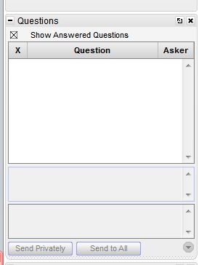
Webinar Format & Questions
Throughout the presentation, submit your questions into the question pod.
For technical issues/questions, a webinar team member will try to assist you as soon as possible.
For content related questions, there will be a time for Q&A at the end of the presentation. Submit your questions and we will share them with the presenters.

Slide 4
Presenter
Dr. Steve Graham is the Warner Professor in the Division of Leadership and Innovation in Teachers College at Arizona State University

Slide 5
Writing Better: What Teachers Can Do Today To Enhance Their Students’ Writing
Steve Graham
Arizona State University
Steve.graham@asu.edu

Slide 6
Promoting Young Children’s Writing
Write
Support
Teach
Connect
Create

Slide 7
Write
Increase how much students write
– 12 percentile jump

Slide 8
Action Steps
Action Steps
Students spend a minimum of an hour per day on writing
At least 30 minutes dedicated to teaching strategies, techniques, and skills
The remaining 30 minutes should be used for writing practice
Integrate writing practice into other content area instruction

Slide 9
Action Steps Continued
Practice Guides
Actions Steps Continued.
Help students understand the different purposes of writing
Expand students concept of audience

Slide 10
Write 2
Extended opportunities for writing
Writing for real audiences
Engaging in cycles of planning, translating, and reviewing
Personal responsibility and ownership
Creation of a supportive writing environment
– 16 percentile jump

Slide 11
Support – Clear Writing Goals
Involves assigning students specific goals for the written product they are to complete.
– 28 percentile jump

Slide 12
Support - Peers Working Together to Compose
Involves students working together to plan, draft, and/or revise their compositions.
– 31 percentile jump

Slide 13
Support - Pre-Writing Activities
Involves students engaging in activities (such as using a graphic organizer) designed to help them generate or organize ideas for their composition.
21 percentile jump

Slide 14
Support – Assessment
Assessment included adult feedback to students, peer feedback, self-assessment, and progress monitoring
Feedback
– 29 percentile jump
Self-Assessment
– 18 percentile jump

Slide 15
Support – Word Processing
Involves having students use word processing and related software to write.
– 18 percentile jump

Slide 16
Teach – Writing Strategies
Involves explicitly and systematically teaching students strategies for planning, revising, and/or editing text.
Instruction is designed to teach students to use these strategies independently.
Writing strategies range from processes such as brainstorming (which can be applied across genres) to strategies designed for specific types of writing, such as stories or persuasive essays.
– 35 percentile jump

Slide 17
Action steps again
Action Steps
Teach students strategies for the various components of the writing process
Gradually release writing responsibility from the teacher to the student
Guide students to select and use appropriate writing strategies
Encourage students to be flexible in their use of the components of the writing process

Slide 18
Techniques and strategies
Purpose | Specific Technique | How Students Can Use the Technique | Grade Range
Describe | sensory details | Use their five senses, as applicable: What did you see? How did it look? What sounds did you hear? What did you touch? How did it feel? What could you smell? What did you taste? | K–3
Persuade/analyze | TREE | As they write: Tell what they believe (State a topic sentence.) Provide three or more Reasons (Why do I believe this?) End it (Wrap it up right.) Examine (Do I have all my parts?) | 2–3

Slide 19
Strategies
Suspend Judgment
Consider each side before taking a position. Brainstorm ideas for and against the topic.
Did I list ideas for each side? If not, do this now.
Can I think of anything else? Try to write more!
Another point I haven’t considered yet is...
Take a Side
Read your ideas. Decide which side you believe in or which side can be used the make the strongest argument. Place a + on the side that shows your position.
Organize Ideas
Choose ideas that are strong and decide how to organize them for writing.
Put a star next to the ideas you want to use. Choose at least ___.
Choose at least ___ arguments to refute.
Number your ideas in the order you will use them.
Plan More as You Write
Continue to plan as you write. Use all four essay parts in DARE.
Develop your Topic Sentence
Add Supporting Ideas
Reject Arguments on the Other Side
End with a Conclusion

Slide 20
Teach – Transcription Skills
Explicitly teaching handwriting and spelling
– 21 percentile jump

Slide 21
Teach – Sentence Construction Skills
Involves teaching students to construct more complex and sophisticated sentences through exercises such as sentence combining where two or more basic sentences are combined into a single sentence.
– 19 percentile jump

Slide 22
What should we do about grammar?
WHAT SHOULD WE DO ABOUT GRAMMAR?
Provide Models (examples and non-examples)
Demonstrate How to Apply
Practice Together
Use in Context

Slide 23
Teach - Writing Knowledge
Explicitly teaching students the basic structure of different types of text
– 21 percentile jump

Slide 24
Connect – Reading & Learning
Use writing to support understanding of what is read
– 18 percentile jump

Slide 25
Note-taking: Concept Maps (Chang, Sung, & Chen, 2002)
Content Area: Science
Grade Level(s): 5
Scaffolded instruction:
Student were introduced to expert created models
Students filled in partially filled in expert models
Students were given word lists and concept links to help them create their own concept maps
Students independently created concept maps independently

Slide 26
Macrorules for Summarizing (Weisberg & Balajthy, 1990)
Content Area: Social Studies
Grade Level(s): 10-12
Delete material that is unimportant
Delete material that it repetitive
Substitute a superordinate term for subordinate ones (i.e., collapse lists)
Select a topic sentence
If there is no topic sentence, invent one
*Students were taught to underline and cross out information using different colors. Summary writing was modeled and explained

Slide 27
Create a Pleasant Writing Environment
Create a writing environment where students are free to take risks, their work and effort are appreciated, and writing is valued.

Slide 28
Some action steps
Practice Guides
Some Action Steps
Teachers should participate as members of the community by writing and sharing their writing
Give students writing choices
Praise Students Efforts and Accomplishments
Write for real purposes
Publish students’ writing, and extend the community beyond the classroom
Set realistic but challenging goals for students

Slide 29
Celebrating Students’ Writing
Star of the Day
Each student is celebrated on their special day
The Star of the Day, seated at the front of the class, answers interview questions
Each student in the class composes one sentence about the Star, and the sentences are combined and displayed on the bulletin board
Author’s Chair
Seated in a special chair, one student reads his or her work to the class
The teacher models positive feedback, such as:
I really like ________.
I could really picture _______, because ________.

Slide 30
Questions

Slide 31
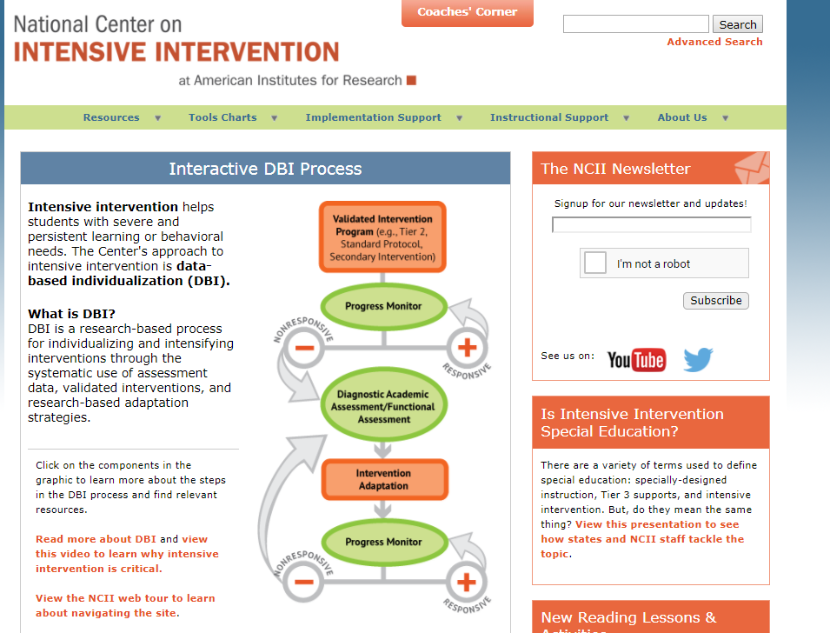
Connect to NCII
Visit the NCII website: intensiveintervention.org
Sign up for our newsletter and announcements
Follow us on YouTube and Twitter
YouTube Channel: National Center on Intensive Intervention
Twitter handle: @TheNCII

Slide 32
Connect to CEC’s DR
Visit the CEC’s DR website http://www.cecdr.org/home
Follow on Twitter & Facebook
Twitter handle @CECDResearch
Facebook: Division for Research CEC DR

Slide 33
Disclaimer
This presentation was produced under the U.S. Department of Education, Office of Special Education Programs, Award No. H326Q160001. Celia Rosenquist serves as the project officer.
The views expressed herein do not necessarily represent the positions or policies of the U.S. Department of Education. No official endorsement by the U.S. Department of Education of any product, commodity, service, or enterprise mentioned in this webinar is intended or should be inferred.
33

Slide 34
Address
1000 Thomas Jefferson Street NW
Washington, DC 20007-3835
www.intensiveintervention.org
ncii@air.org
Twitter: @TheNCII

