Slide 1
Strategies for Setting High-Quality Academic Individualized Education Program Goals
February 20, 2020
Tessie Bailey, Ph.D., and Zach Weingarten, Ed.D., American Institutes for Research
Thom Jones, Wyoming Department of Education
Justine Essex, Freedom Elementary School, Cheyenne, WY

Slide 2
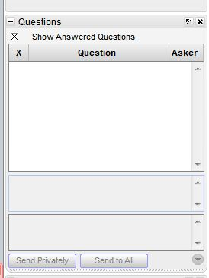
Webinar Format & Questions
Throughout the presentation, submit your questions into the question pod.
  For technical issues/questions, a webinar team member will try to assist you as soon as possible.
  For content related questions, there will be a time for Q&A at the end of the presentation. Submit your questions and we will share them with the presenters.

Slide 3





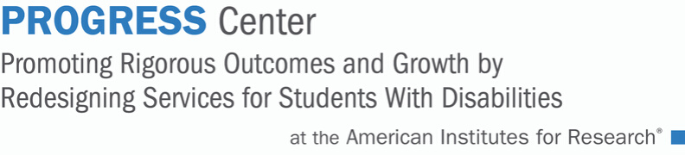

Introducing the PROGRESS Center
The PROGRESS Center provides information, resources, tools, and technical assistance services to support local educators in developing and implementing high-quality educational programs that enable children with disabilities to make progress and meet challenging goals, consistent with Endrew F. v. Douglas County School District (2017).
HOW WILL WE HELP IMPROVE OUTCOMES FOR STUDENTS WITH DISABILITIES?
Share current research,
policies, guidance, success stories, and experiences from students, parents, educators, and
other stakeholders.
Partner with selected
local educators to develop and implement high-quality educational programs.​
Provide tools, resources, and
training materials for ALL educators, leaders, and families.
Visit us at www.promotingPROGRESS.org to learn more!

Slide 4

Session Outcomes
Demonstrate how educators can use the Strategies for Setting High-Quality Academic IEP Goals and other related NCII resources to improve goal development.
Model three academic goal setting strategies.
Share local and state application of goal setting resources and their lessons learned.

Slide 5




Introductions
Tessie Bailey, Ph.D., Principal Consultant, National Center on Intensive Intervention at American Institutes for Research
Zach Weingarten, Ed.D., Researcher, National Center on Intensive Intervention at American Institutes for Research
Thom Jones, State Personnel Development Grant Director &
State Systemic Improvement Plan Coordinator, Wyoming Department of Education
Justine Essex, Special Education Teacher, Freedom Elementary School, Cheyenne, WY

Slide 6
A Call to Action: Endrew F. v. Douglas County School District (2017)
Addresses the “de minimis” educational benefit standard set in the 1982 Board of Education v. Rowley decision.
Requires that, “a school must offer an IEP reasonably calculated to enable a child to make progress appropriate in light of the child’s circumstances.” (Endrew, 2017, p. 16)

Slide 7
Developing IEP Goals
Common questions required to be answered in an IEP:
  What does the student need to know or be able to do? (GOAL)
  How will progress toward this annual goal be measured? (DATA)
Common pitfalls:
  Goals do not align with areas of need identified by present levels of academic and functional performance (PLAAFP; e.g., social skills; reading comprehension), but only address a small part (e.g., raising hand; sight word recognition).
  Progress is typically measured by observational trials or anecdotal notes and data are not easily interpreted for responsiveness.

Slide 8
Strategies for Setting High-Quality Academic IEP Goals
Zach Weingarten, Ed.D.

Slide 9





Steps for Goal Setting
Select a Target and Measure
Establish Baseline Performance
Choose a Strategy for Setting the Goal
Write a Measurable Goal

Slide 10
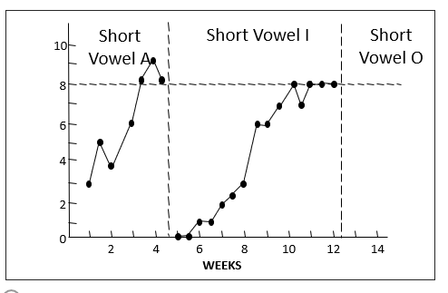

Step 1: Select the Target and Measure
Determine target behavior
Identify a measure
Single Skill Measure
General Outcome Measure

Slide 11
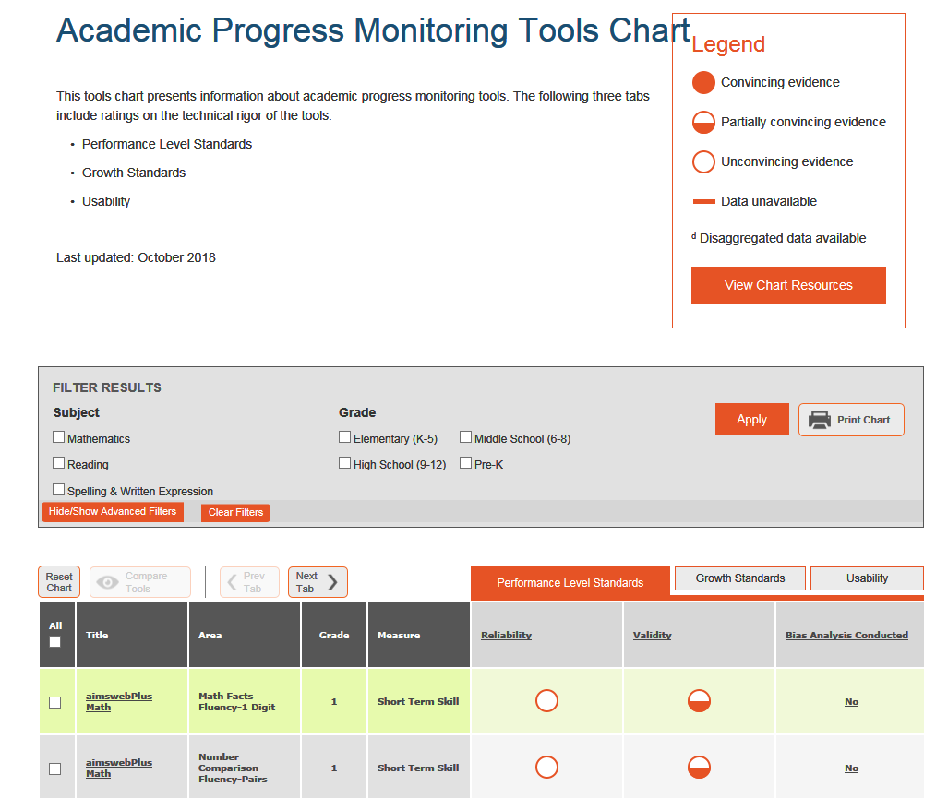
Identify a Measure: Key Characteristics
Have sufficient number of alternate forms of equal and controlled difficulty.
Specify minimum acceptable growth.
Provide benchmarks for minimum acceptable end-of-year performance.
Have reliability and validity information for the performance-level score and for growth for students with intensive needs.

Slide 12
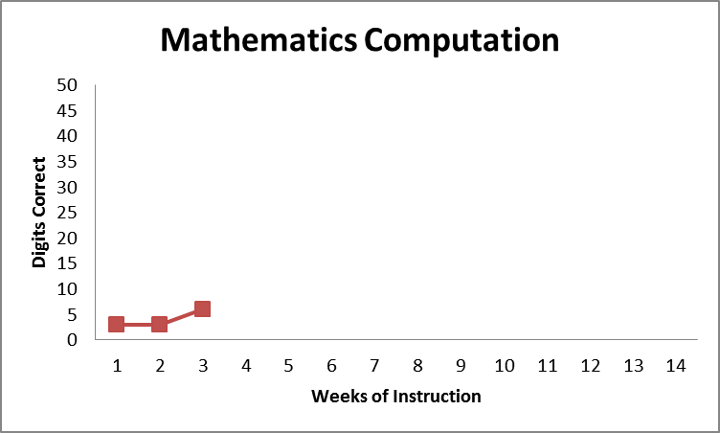
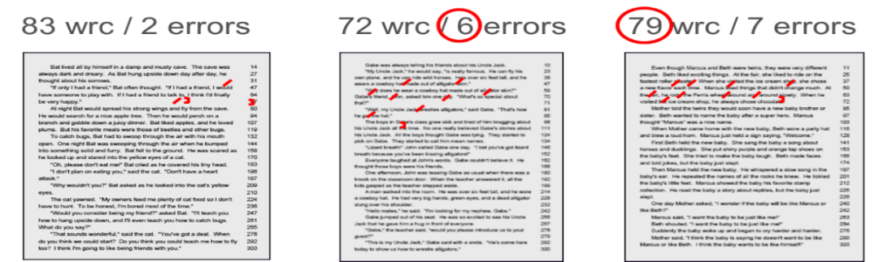
Step 2: Establish a Baseline
Set the baseline using same tool that will be used for progress monitoring.
Approaches:
Option 1. Use the student’s score from universal screening.
  Option 3. Calculate the average of three consecutive progress monitoring scores collected during separate testing sessions.
  Option 2: Administer three progress monitoring probes in one testing session and select the median score.
Baseline Mean =
(3 + 3 + 6)/3 = 4

Slide 13
Using the Baseline to Inform the PLAAFP
The student’s baseline score should be used when writing the present levels of academic achievement and functional performance (PLAAFP) statement in the student’s IEP. For example:
In addition to quantitative data, PLAAFP statements should also include qualitative data such as teacher and parent observations related to the area of need (Hedin & DeSpain, 2018).
  “When given a standardized passage at the second-grade level, Chris currently reads 55 words correct per minute, with 93% accuracy.”

Slide 14
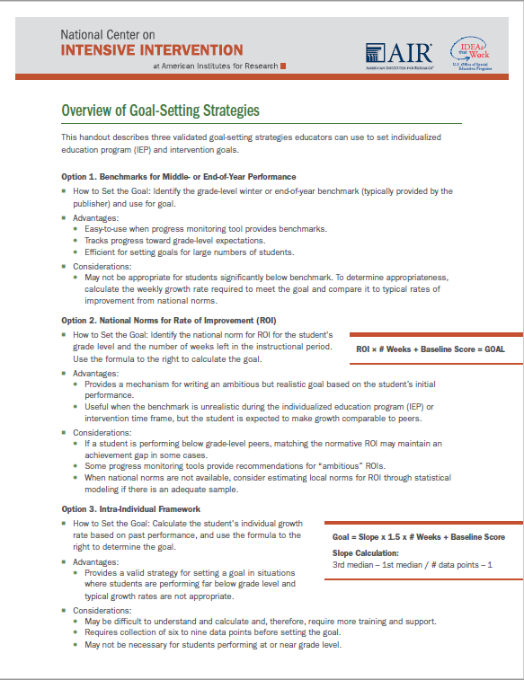
Step 3: Choose a Strategy for
Setting the Goal
There are three validated approaches to setting goals:
Benchmarks
National norms for weekly ROI
Intra-individual framework

Slide 15
Option 1: Benchmarks for Middle- or End-of-Year Performance
Spring Benchmark:
90 WRC

Slide 16
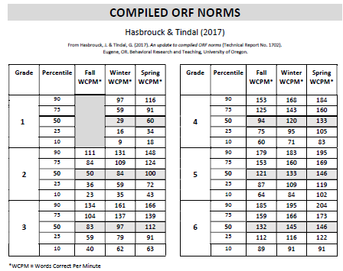
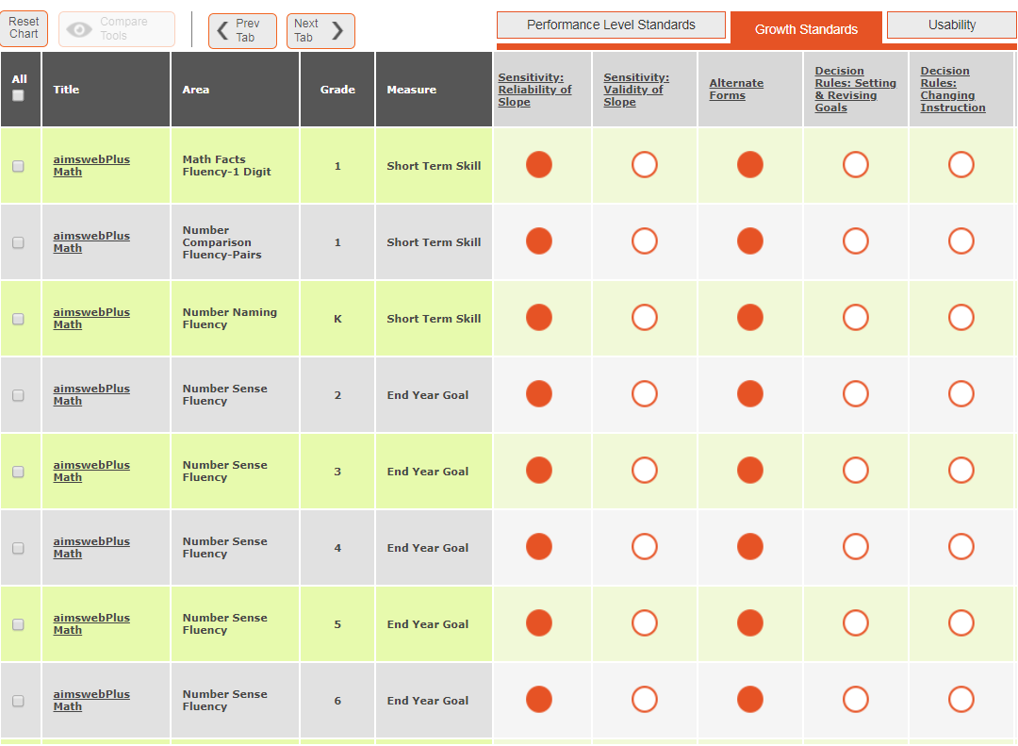
Where do you find benchmarks?
Published Research
Publisher Data Systems
NCII Resource: https://intensiveintervention.org/resource/update-compiled-orf-norms
NCII Resource: https://charts.intensiveintervention.org/chart/progress-monitoring

Slide 17
Option 2: National Norms for Rate of Improvement
Standard Formula for Calculating Goal Using Rate of Improvement (ROI):
ROI x # Weeks + Baseline Score = GOAL
ROI =
2 Digits/
Week
10 Weeks
Baseline = 30 Digits
GOAL = 50 Digits
X
+
=

Slide 18
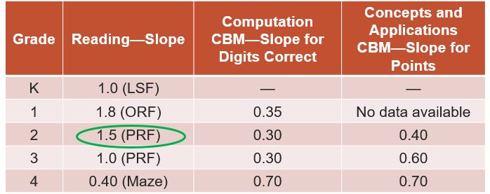
How do I set goals using ROI?
ROI × # Weeks + Baseline Score = GOAL
67=Goal
1.5
10 left in instructional period
Calculate baseline (50+55+52)/3=
157/3=52
1.5 × 10 + 52 = Goal
Target Growth = 15
Baseline
Note: This example is used for illustrative purposes only. Please check with your tool’s publisher for weekly ROI for each tool by grade level.

Slide 19

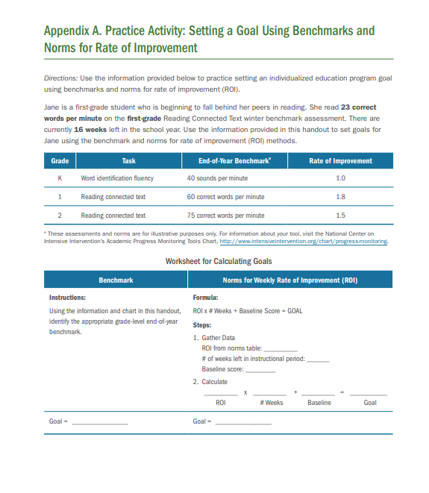
Practice Opportunity: Goal Setting -- Jane
Jane is a 1st grader identified for intervention.
Use the information provided to set a goal based on benchmark and ROI.
Note: Answers are found in the back of the resource.

Slide 20
Option 3: Intra-Individual Framework
Often used for students performing far below grade level or with very low skills, where typical growth rates are not appropriate.
Use three most recent data points to calculate baseline score.
Calculate student’s ROI (SROI) based on at least eight data points.

Slide 21
Setting a Goal Using an Intra-Individual Framework
SROI = 1.0 WRC
GOAL = 34 WRC
Baseline = 19 WRC

Slide 22
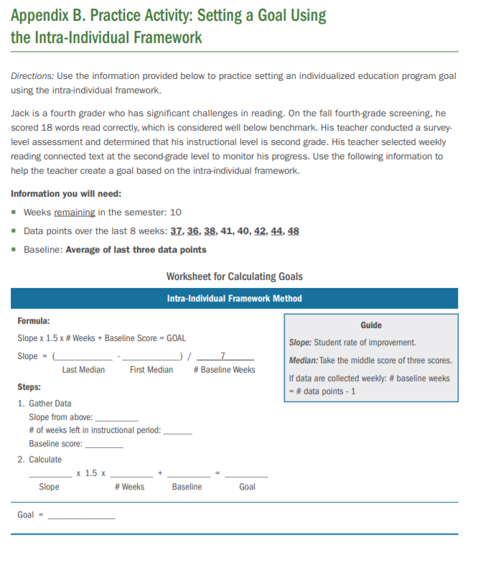
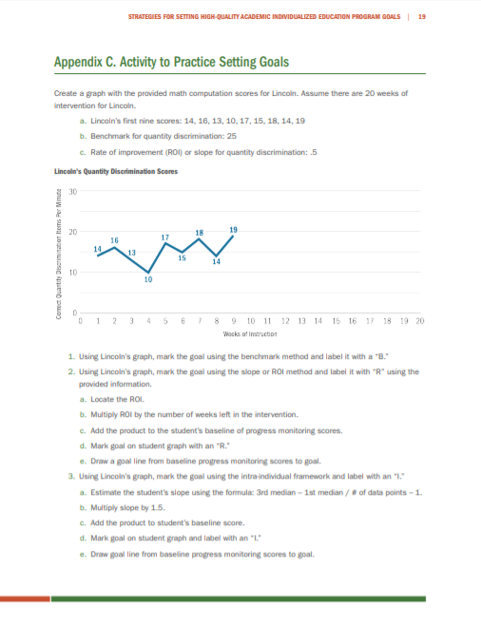
Practice Opportunities: Goal Setting – Jack (Reading) and Lincoln (Math)
Note: Answers are found in the back of the resource.

Slide 23
Step 4: Write a Measurable Goal
Quality IEP goals address the condition, or context in which the skill will be performed, target behavior, and level of proficiency/time frame.
Sample template for IEP structure:
When given [grade level and tool], the student will [observable behavior and goal] [level of proficiency and time frame].

Slide 24
When writing goals remember…
Component | May include… | Examples
Condition | Material/Tool Grade level Setting Timing | When given 30 first-grade sight words…. When given a third-grade reading passage…
Target Behavior | Observable behavior Target goal | Student will read 30 of 30 sight words… Student with read 60 words correctly…
Level of Proficiency/ Timeline | Accuracy Timeline Number of trials | 95% accuracy Three consecutive probes By spring benchmarking

Slide 25
Goal Setting in Action: Reflections from Practitioners
Thom Jones, Wyoming Department of Education
Justine Essex, Freedom Elementary School

Slide 26
Panel Questions
Describe your context that prompted the use of this and related resource.
How are you using this and other goal setting resources?
What impact has this had on your work and student performance?
What are your future plans related to goal setting?
What are lessons learned from improving the quality of goal setting practices?

Slide 27
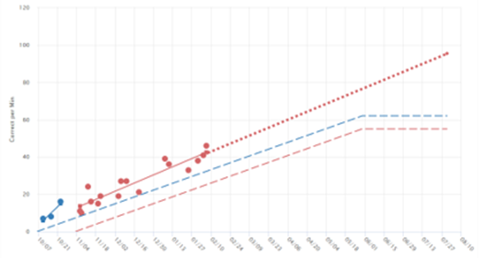
Early Reading – Letter Names PM Report

Slide 28
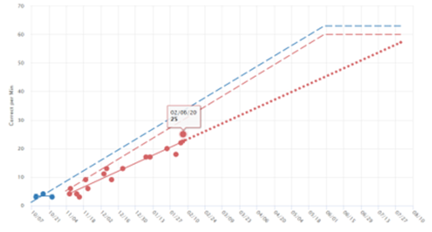
Early Reading – Letter Sounds PM Report

Slide 29
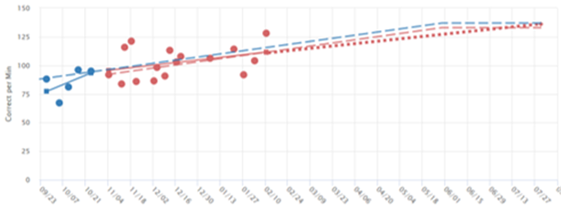
CBM English Reading PM Report

Slide 30
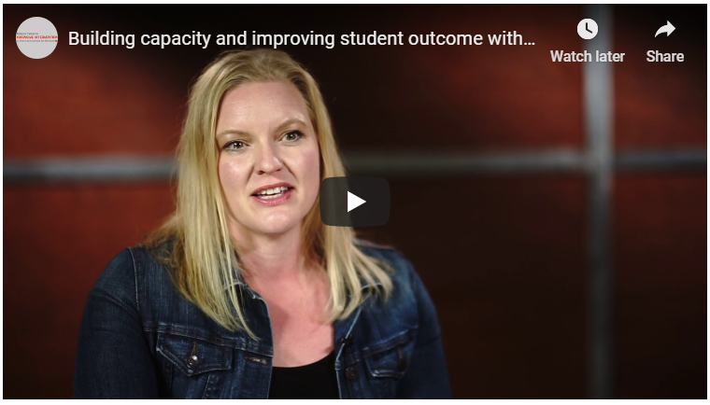
Learn More: Building capacity and improving student outcomes with DBI - Wyoming’s implementation story
Location: https://intensiveintervention.org/voices-from-the-field/building-capacity-and-improving-student-outcome-dbi-wyomings-implementation

Slide 31
Questions & Answers

Slide 32
Closing and Additional Resources

Slide 33
Goals Should….
focus on student behavior, not educator behavior.
be monitored with enough frequency to determine progress and make timely instructional/intervention decisions.
be measured using an objective, valid, and reliable measure (e.g., curriculum based measure, Direct Behavior Rating, systematic direct observation) rather than a more subjective measure (e.g., teacher anecdotal notes).
be realistic, yet ambitious.

Slide 34

Similarities and Differences:
Academic and Behavioral Progress Monitoring
Similarities:
    Answering the same question—is what we’re doing working?
    Need to have baseline data
Differences:
    There aren’t benchmarks or specified rates of improvement in behavior
https://intensiveintervention.org/resource/high-quality-behavior-IEP-goals

Slide 35
Save the Date: Upcoming Webinar for Behavior Goal Setting
When: March 13, 2020 from 12-1pm ET
What: Dr. Teri A. Marx from the National Center on Intensive Intervention and the PROGRESS Center, as well as Dr. Faith G. Miller from the University of Minnesota—Twin Cities, will share how to set ambitious behavioral goals for students by using a valid, reliable progress monitoring measure, and write measurable and realistic goals focused on the replacement behavior.
Register: https://register.gotowebinar.com/register/402891152233241100

Slide 36
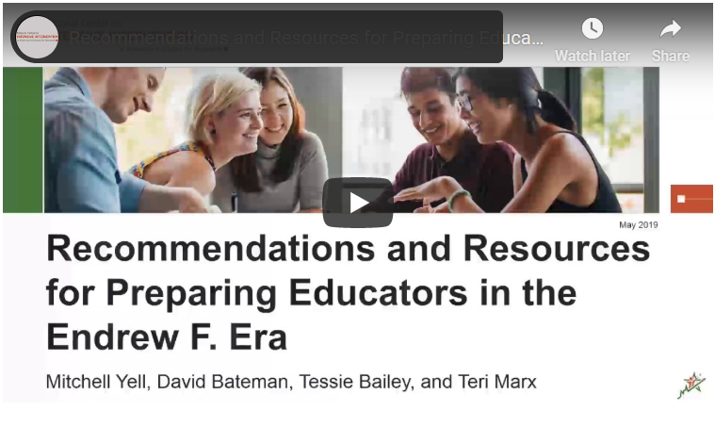
Want to Learn More?
GUIDE: Strategies for Setting High-Quality Academic Individualized Education Program Goals. In this guide, we explain how educators can establish IEP goals that are measurable, ambitious, and appropriate in light of the student's circumstances.
WEBINAR: Recommendations and Resources for Preparing Educators in the Endrew Era. In this webinar, Drs. Mitch Yell and David Bateman provide an overview of Endrew’s impact on individualized instruction for students with disabilities and share six recommendations for preparing educators to meet the clarified requirements under Endrew.

Slide 37
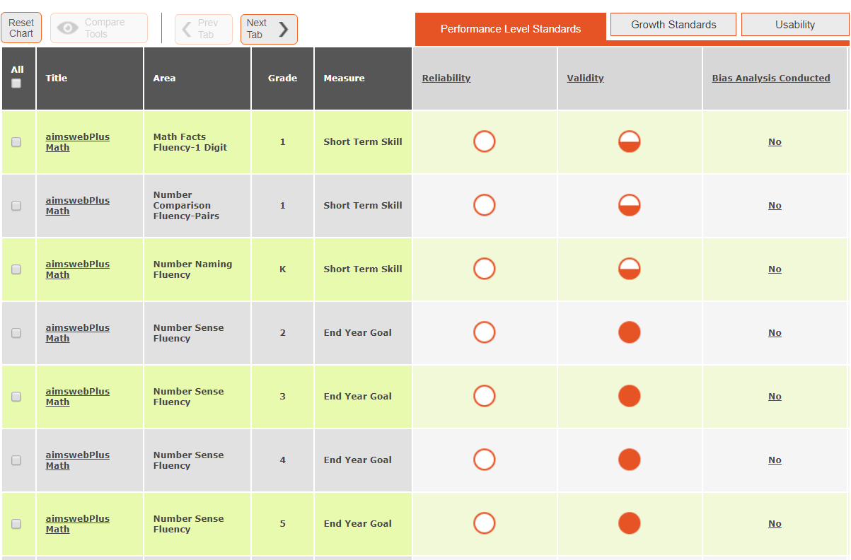
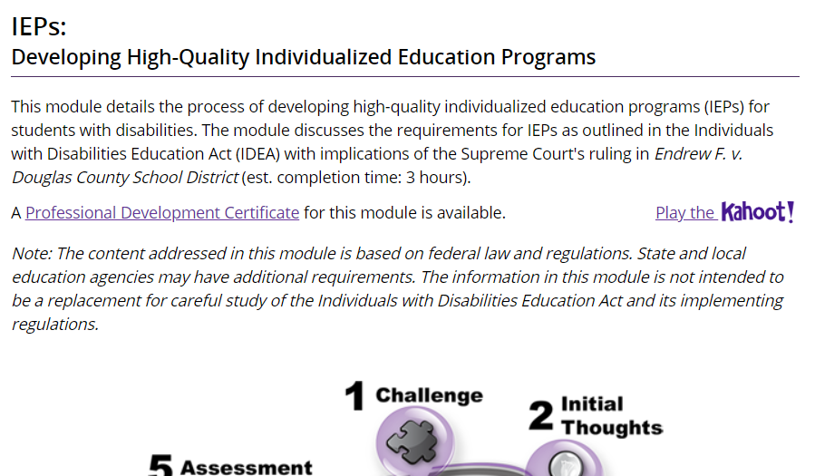

Want to Learn More?
NCII Academic Progress Monitoring Tools Chart. These charts display expert ratings on the technical rigor of assessments.
IRIS Module: IEPs: Developing High-Quality Individualized Education Programs. This module details the process of developing high-quality IEPs for students with disabilities. (est. completion time: 3 hours).
IRIS Module: IEPs: How Administrators Can Support the Development and Implementation of High-Quality IEPs. This module is designed for school administrators and offers guidance on how to support and facilitate the development and implementation of high-quality IEPs, including the monitoring of student progress.

Slide 38

Want to Learn More? Visit us at…
www.intensiveintervention.org
www.promotingPROGRESS.org

Slide 39
Tessie Bailey, Ph.D.
Zach Weingarten, Ed.D.
Principal Consultant
American Institutes for Research
tbailey@air.org
Senior Researcher
American Institutes for Research
zweingarten@air.org

Slide 40
References
Endrew F. v. Douglas County School District, 580 U.S. ____ (2017).
Hedin, L. & DeSpain, S. (2018). SMART or not? Writing specific, measurable IEP goals. TEACHING Exceptional Children, 51(2), 100-110.

Slide 41
NCII Disclaimer
This presentation was produced under the U.S. Department of Education, Office of Special Education Programs, Award Nos. H326Q160001 and H326C190002. Celia Rosenquist and David Emenheiser serve as the project officers, respectively. The views expressed herein do not necessarily represent the positions or policies of the U.S. Department of Education. No official endorsement by the U.S. Department of Education of any product, commodity, service, or enterprise mentioned in this presentation is intended or should be inferred.

