Slide 1
Diagnostic and Mastery Assessment in Reading
Module 5 – Introduction

Slide 2
Overview
Part 1: Diagnostic assessment
Part 3: Curriculum-Based Assessment (CBA)
Part 4: Integrating Diagnostic and Progress Monitoring Data to Inform Instruction
Closing: What are the next steps?
Note: There is no Part 2 in this module. The content originally covered in Part 2 is covered in other modules.

Slide 3
Objectives
Part 1:
Identify specific reading skills or strategies that you need to teach
Part 3:
Develop and use curriculum-based assessment (CBA) probes to help refine instructional focus and determine if students are learning what is taught
Part 4:
Use diagnostic data to inform content of instructional adaptations
Closing:
Bring everything together to inform instructional adaptations when indicated by progress monitoring data

Slide 4
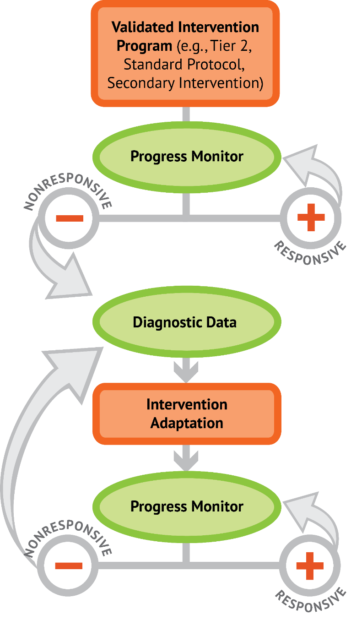
Reviewing the DBI process

Slide 5
Let’s add reading to the model
How are students responding to intervention (within “big idea” areas of reading)?
CBM
(General Outcome Measure)
Diagnostic Assessment
(e.g., CORE Assessment Battery)
What specific reading skills or strategies do I teach?
How do I refine my instructional focus and determine if students are mastering what I teach?
Specific Skills
CBM with Error Analysis
+
Curriculum-based Assessment (CBA)

Slide 6
A review of progress monitoring tools
General outcome measures (GOM), such as CBM
Evaluate overall progress toward meeting the grade-level expectations
  Example: Word identification fluency for first grade
Sample the range of skills for a grade
  Example: Math concepts and applications for a specific grade
Should be tested by researchers
Mastery measures
Evaluate progress toward mastery of a specific skill that is only part of what is expected in that subject
Can be designed by teachers, given some assistance

Slide 7
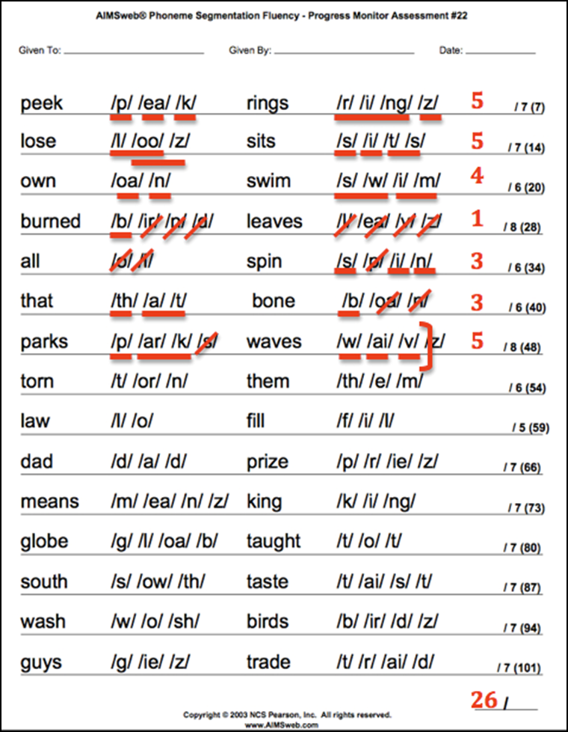
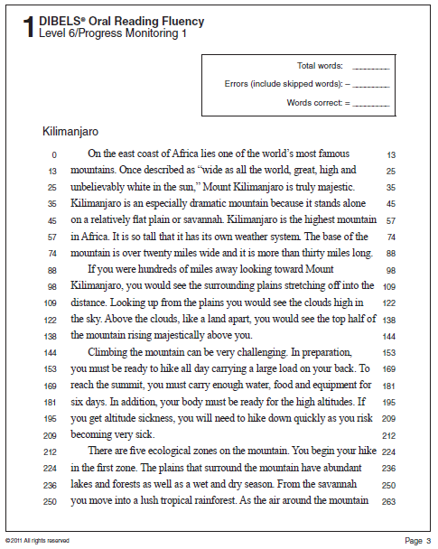
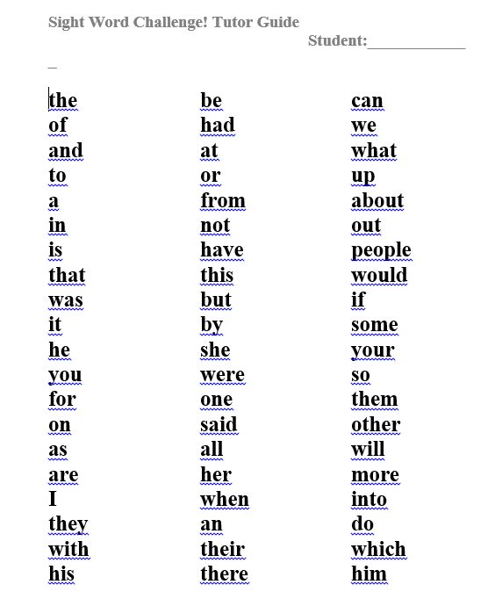
CBM or mastery?
CBM
CBM
Mastery
phonemic segmentation fluency
oral reading fluency
knowledge of particular letter sounds

Slide 8
Distinguishing types of assessments in reading
General Outcome Measures (CBM)
Identifies specific reading skills to teach
Diagnostic Assessment
(e.g., CORE Assessment Battery)
Mastery Measures
Indicates whether or not I need to refine how I am teaching.
Specific Skills
CBM with Error Analysis
+
Curriculum-based Assessment (CBA)

Slide 9
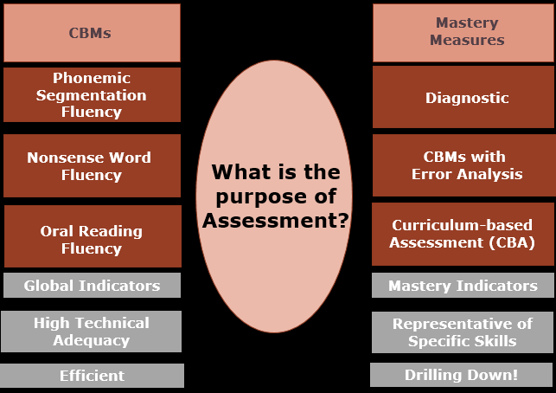
DBI in reading requires the strategic use of both CBMs and mastery assessment
Examples
What is the purpose of Assessment?
Features

Slide 10

The Big Picture
Revisit Case Study: Zane
3rd Grade
Receives Special Education Services for Learning Disability– Reading
25 minutes of small group instruction 3x a week
Strengths | Weaknesses
Motivated to read– especially about animals | Fluency
Receptive to corrective feedback | Frequently guesses at words, errors increase when text is not in an interest area
Has made a lot of progress in decoding from words lists | Consistent difficulties with affixes and multisyllabic words

Slide 11

The Big Picture
Revisit Case Study: Zane
What to target? – Use Diagnostics
Zane’s teacher, Ms. Smith, decides to continue explicit phonics instruction, phonemic awareness, and word attack. She also decides she really needs to increase his practice with passage reading and fluency, incorporating repeated oral reading, partner reading, and guided reading.
However, Ms. Smith isn’t sure where to start with her phonics instruction or what his independent and instructional reading levels are. Thus, Ms. Smith decides to administer several diagnostic assessments to Zane in order to decide what to teach…She uses the CORE Phonics Survey.

Slide 12
The Big Picture
Revisit Case Study: Zane
After 7 Weeks of Instruction– Zane needs a change to instruction

Slide 13
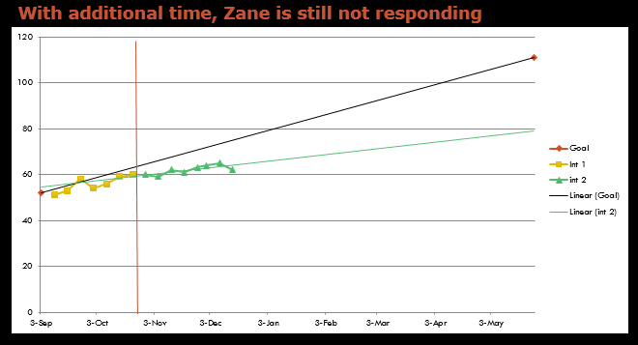
The Big Picture
Revisit Case Study: Zane

Slide 14
The Big Picture
Revisit Case Study: Zane
What to do? – Ms. Smith:
Has been using mastery assessments as she has gone and notes that Zane is reading the specific word types she has taught in word lists.
Looks at Zane’s errors on his ORF and notes that, although he is reading the instructed word types in word lists to mastery, he is still making errors on the word types within passages (ORF).
Again uses the Core Phonics Survey and finds his performance to be very similar to his first attempt at the diagnostic assessment. This indicates that Zane is also struggling with maintenance.

Slide 15
Activity 5.1: Pause & Process
Turn to your workbook and answer the following questions:
What forms of assessment do you currently use?
Of the assessments you currently use, what type are they (CBM or Mastery)?
How do the different types of assessment you currently use influence your instruction?

Slide 16
Diagnostic assessment
Module 5 – Part 1

Slide 17
Part 1 Objective
Part 1 Objective
You will learn how to:
Identify specific reading skills or strategies that you need to teach

Slide 18
Let’s look at diagnostic assessment
General Outcome Measures (CBM)
Diagnostic Assessment
(e.g., CORE Assessment Battery)
Specific Skills
CBM with Error Analysis
+
Curriculum-based Assessment (CBA)

Slide 19
Diagnostic assessment
Aligns with “big ideas” in reading
Is used to inform instructional planning
Helps determine areas of strength and areas of instructional need
Is criterion-referenced. . .
What specific reading skills do I teach?

Slide 20
Criterion-referenced
These assessments are intended to determine whether or not a student has mastered a certain set of skills (90% accuracy or better).
Once the student has mastered the skills, different criterion (e.g., different skills) need to be assessed.
  EXAMPLES: An assessment may identify what letter names the student has mastered and which ones the student has not. Once the student has mastered all letter names then this assessment is no longer needed.
  *HOWEVER, you may do an occasional letter name probe to be sure the student has maintained their letter name knowledge.
Skills that are assessed should be the skills needed for proficient reading and this tells the teacher what content on which they need to focus their instruction.

Slide 21
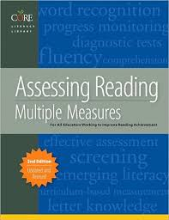
For example: CORE Literacy Library
Phonological Awareness
Decoding and Word Attack
Spelling
Fluency
Vocabulary
Comprehension
Aligns with “big ideas” in reading for K-12.
Consortium on Reading Excellence (2008). Assessing reading: Multiple measures for all educators working to improve reading achievement. Novato, VA: Arena Press.

Slide 22
CORE Phonics Survey – Record Form
Skills to review:_________________________________________________________________________________________________________
Skills to teach:__________________________________________________________________________________________________________
Is used to inform instructional planning

Slide 23
CORE Reading Assessment Profile, Grades 4-8
 | FALL | WINTER | SPRING
CORE Reading Maze Comprehension | ___/___ | ___/___ | ___/___
MASI-R Oral Reading Fluency Measures (Through Grade 6 Only) Benchmark: 50th percentile, in WCPM, +/- 10 | wcpm____ Target = 71 | wcpm____ Target = 92 | wcpm___ Target = 107
CORE Vocabulary Screening | ___/___ | ___/___ | ___/___
San Diego Quick Assessment of Reading Ability Independent Level: 1 error Instructional Level: 2 errors Frustration Level: 3+ errors
CORE Graded High Frequency Word Survey Benchmark: 21-24 Strategic: 18-20 Intensive: 0-17
CORE Phoneme Deletion Test (Administered if indicated by results on other tests.) | ____/20 | ____/20 | ____/20
CORE Phoneme Segmentation Test (Administered if indicated by results on other tests.) | ____/15 | ____/15 | ____/15
CORE Phonics Survey – Reading and Decoding (Administer E – K as diagnostics if indicated) Short vowels in CVC words | ____/15 | ____/15 | ____/15
Consonant blends with short vowels | ____/15 | ____/15 | ____/15
Short vowels, digraphs, and –tch trigraphs | ____/15 | ____/15 | ____/15
R-controlled vowels | ____/15 | ____/15 | ____/15
Long vowel sounds | ____/15 | ____/15 | ____/15
Variant vowels | ____/15 | ____/15 | ____/15
Low frequency vowel and consonant spellings | ____/15 | ____/15 | ____/15
Multisyllabic words | ____/24 | ____/24 | ____/24
Helps determine areas of strength and need

Slide 24
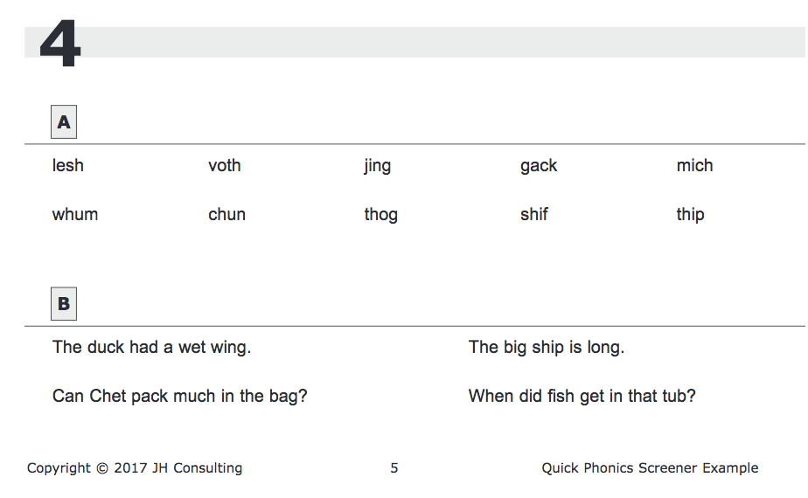
For example: Quick Phonics Screener

Slide 25
Other Resources
More examples and links can be found at the National Center on Intensive Intervention:
https://intensiveintervention.org/intensive-intervention/diagnostic-data/example-diagnostic-tools
Do you want to learn more?
https://intensiveintervention.org/intensive-intervention/diagnostic-data

Slide 26
Activity 5.2– Quiz
In your workbook, answer the following question.
Which of the following statements are true? Check your answers.
Diagnostic assessments…
align with “big ideas” in reading
are used to inform instructional planning
help determine areas of strength and areas of instructional need
are criterion-referenced

Slide 27
Activity 5.2– Quiz
Review
In your workbook, answer the following question.
Which of the following statements are true? Check your answers.
Diagnostic assessments…
align with “big ideas” in reading
are used to inform instructional planning
help determine areas of strength and areas of instructional need
are criterion-referenced

Slide 28
Activity 5.3– Stop & Jot
In your workbook, complete the following assignment.
Review a scored copy of the CORE Phonics Survey.
Give examples to illustrate how this diagnostic assessment:
  aligns with the “big ideas in reading”
  is used to inform instructional planning
  helps determine areas of strength and areas of instructional need
  is criterion-referenced
Would you spend your time teaching letter names? Why or why not?
What decoding skills would you first target in your instruction?

Slide 29
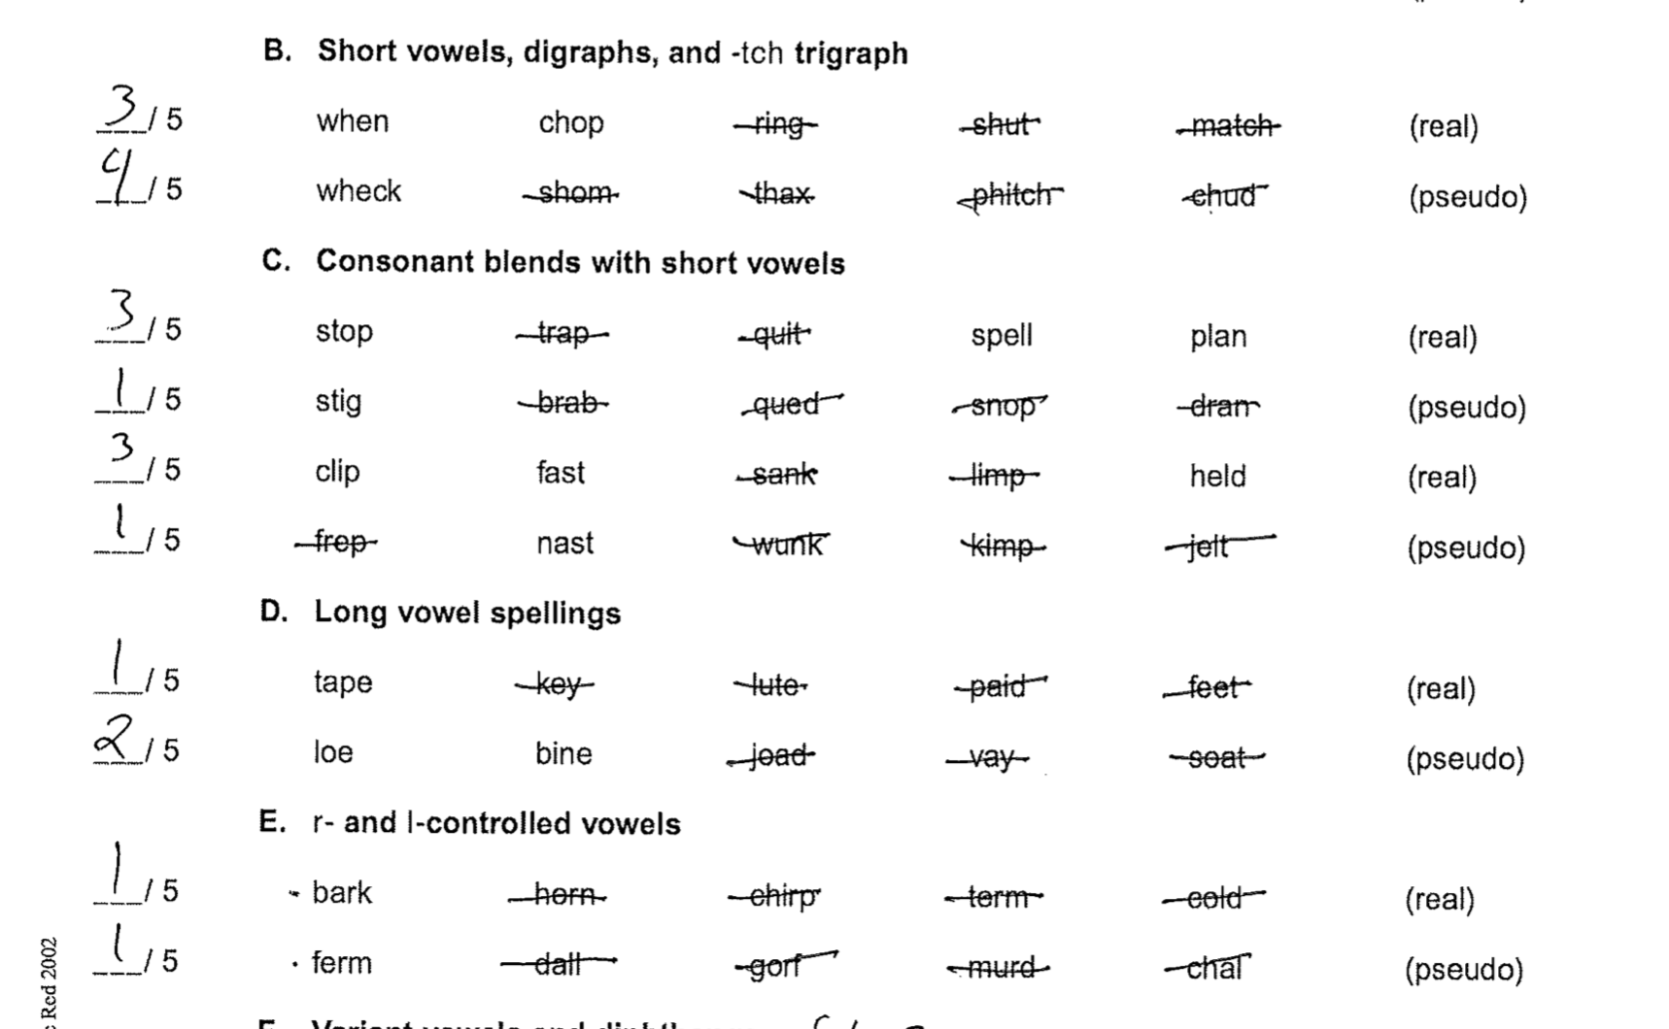
Activity 5.3– Stop & Jot continued…
Take a few moments to examine the student’s performance on this part of the CORE. See if you can identify patterns of mistakes within each section (B, C, D, E). What would you target first in instruction? Second?

Slide 30
Curriculum-Based Assessment (CBA)
Module 5 – Part 3

Slide 31
Part 3 Objective
Part 3 Objective
You will learn how to:
Develop and use curriculum-based assessment (CBA) probes to help refine instructional focus and determine if students are learning what is taught

Slide 32
We’ll continue thinking about specific skills
General Outcome Measures (CBM)
Diagnostic Assessment
(e.g., CORE Assessment Battery)
Specific Skills
CBM with Error Analysis
+
Curriculum-based Assessment
(CBA)

Slide 33
Curriculum-Based Assessment (CBA)
Describe mastery of a single skill in a series of short-term instructional objectives.
Represent a logical, not an empirical hierarchy of skills.
Are often district/school developed probes of content mastery.
Include multiple equivalent probes that sample from key skill(s) in unit/intervention.
Used to document mastery of specific content/skills.
Can document progress toward curriculum goals (e.g., given 10 nonwords with vowel digraphs and dipthongs, student A will correctly read 10/10 over 3 consecutive days).

Slide 34
Curriculum-Based Assessment (CBA)
Curriculum-based assessment may be defined as the practice of obtaining direct and frequent measures of a student’s performance on a series of sequentially arranged objectives derived from the curriculum used in the classroom.
(Idol, 1983; Blankenship, 1985)

Slide 35
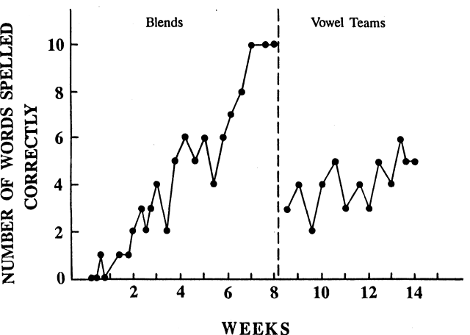
CBA: Graph

Slide 36
CBA
. . .is highly instructionally-aligned and often integrated with instruction.
Sometimes it’s even hard to tell what is instruction and what is assessment.

Slide 37
Difference between CBA & CBM?
 | CBM | CBA
Purpose: | Assess general performance within a content area (reading, math, writing) | Assess progress in learning specific skills/curriculum (reading CCVC words)
Creator: | Researcher created and standardized | Typically teacher created
Validity: | Are predictive of overall performance with standardized assessments | Validity depends upon the skill(s) of the teacher—unknown

Slide 38
What do mastery probes look like?
Given a two-page narrative with grade level text, Jorge will correctly fill in story map (e.g., 11 out of 12 possible points) over two consecutive trials.

Slide 39
What do scoring criteria look like?
Probe:
cake, kite, make, snake, bike, rate, like, lake, fake
Criterion:
-Decode 9/10 or 10/10 words for mastery.
-Decode 8/10 words to 7/10 words for instructional level.
-Decode 6/10 words or less for failure level; assess prerequisite skill level: discrimination of long/short vowels (vowels: a, i).

Slide 40
CBA—key components
Define the specific literacy skill(s) you are assessing and how frequently assessment will occur
Provide a lesson/unit objective that is measurable
Include criteria for mastery
Develop administration directions to ensure uniformity
Select items that test the specific skill(s)
Create assessments by randomly selecting a pre-set number of items

Slide 41
An example of how we create and use CBA probes. . .
Select material for assessment
    Material must be aligned with singular learning objective
    Material must be on the student’s instructional level
Create alternative forms
  Determine scoring
Implement CBA assessment
    Pre
    During
    Post
Review student assessment performance
    Are students performing at mastery, instructional, or frustration levels?

Slide 42
Select material for assessment
Curriculum
Kindergarten early reading curriculum
Assessment
Identify 5 randomly selected words, from a list of words that start with m, p, f, c, t, s, d, and l, for pre/post and weekly assessment.
Lessons 1-25 Identifying first sounds
When given a word, students will write the letter that corresponds to the first sound.
m, p, f, c, t, s, d, l

Slide 43
An example of how we create and use CBA probes. . .
Select material for assessment
    Material must be aligned with singular learning objective
    Material must be on the student’s instructional level
Create alternative forms
  Determine scoring
Implement CBA assessment
    Pre
    During
    Post
Review student assessment performance
    Are students performing at mastery, instructional, or frustration levels?

Slide 44
Create alternative probes
When given a word, students will write the letter that corresponds to the first sound. 1 point/correct response.
List 1
List 2
List 3
List 4
List 5
List 6
map
pig
fan
sun
tap
dad
lap
tap
cat
can
fun
mop
sat
mud
lid
man
sum
Sam
lot
fat
fan
lip
Dan
tag
cap
pat
tab
tip
mom
sip

Slide 45
An example of how we create and use CBA probes. . .
Select material for assessment
    Material must be aligned with singular learning objective
    Material must be on the student’s instructional level
Create alternative forms
  Determine scoring
Implement CBA assessment
    Pre
    During
    Post
Review student assessment performance
    Are students performing at mastery, instructional, or frustration levels?

Slide 46
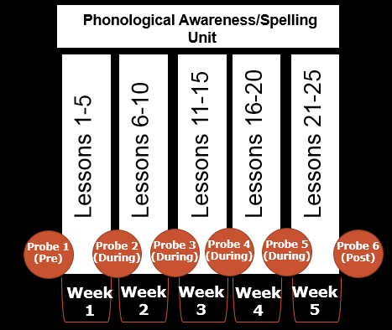
Implement CBA assessment
Lessons 26-30

Slide 47
An example of how we create and use CBA probes. . .
Select material for assessment
    Material must be aligned with singular learning objective
    Material must be on the student’s instructional level
Create alternative forms
  Determine scoring
Implement CBA assessment
    Pre
    During
    Post
Review student assessment performance
    Are students performing at mastery, instructional, or frustration levels?

Slide 48
Review student assessment performance
    Are students performing at mastery, instructional, or frustration levels?
Levels
Independent (Mastery)
Instructional
Frustration
90-100% known
70-85% known
Below 70%

Slide 49
Select material for assessment
Curriculum
Fourth grade spelling curriculum.
Approximately 400 words are taught in the curriculum.
Assessment
Randomly select 20 words, from the total 400 words, for pre/post and weekly assessment.

Slide 50
Create alternative probes
List 1
List 2
List 3
deal
land
those
bubble
meant
travel
price
whistled
upon
best
making
hard
classes
tease
world
one
during
screen
weekly
partly
cities
we’ve
suddenly
busiest
car
finer
putting
Monday
circus
scold
thousand
nail
thirty
scare
august
shoes
ours
proud
aged
doesn’t
toothbrush
chicken
together
quite
plenty
again
chain
more
add
follow
man
oil
sack
show
fifteen
mouse
spray
women
mean
wrong

Slide 51
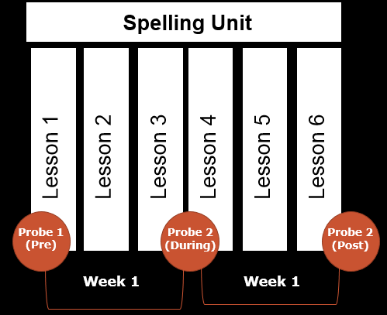
Implement CBA assessment

Slide 52
Review student assessment performance
    Are students performing at mastery, instructional, or frustration levels?
Levels
Independent (Mastery)
Instructional
Frustration
90-100% known
70-85% known
Below 70%

Slide 53
Select material for assessment
Curriculum
First grade comprehension
Assessment
Have students complete a graphic organizer with key story grammar elements for pre/post and weekly assessment.
Students will identify the following story grammar elements:
  Who
  What happened-first
  What happened-next
  What happened-end
Students will indicate whether they liked a story (and tell why)

Slide 54
Create alternative probes
The same graphic organizer is used at the end of the week after a story is discussed across four lessons. 2 points/item.
Story 1
Lessons 1-4
Story 2
Lessons 5-8
Story 3
Lessons 9-12
Story 4
Lessons 13-16
Story 5
Lessons 17-20
(page 1-front)
(page 2-back)

Slide 55
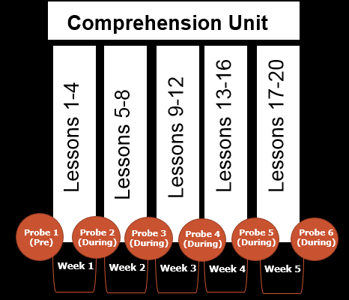
Implement CBA assessment

Slide 56
Review student assessment performance
    Are students performing at mastery, instructional, or frustration levels?
Levels
Independent (Mastery)
Instructional
Frustration
98-100% known
93-97% known
Below 93%

Slide 57
Activity 5.5– Application
Summarize By Developing Your Own CBA Probes
In your workbook:
Select material for assessment
Material must be aligned with singular learning objective
Material must be on the student’s instructional level
Create alternative forms
Determine scoring
Implement CBA assessment
Pre
During
Post
Review student assessment performance
Are students performing at mastery, instructional, or frustration levels?

Slide 58
Where to get material for your CBA probe
Search the web for “Reading Word Lists”
Refer to “The Reading Teacher’s Book of Lists” by Kress and Fry
Refer to “The CORE Reading Sourcebook” by Honig, Diamond and Gutlohn

Slide 59
Integrating Diagnostic and Progress Monitoring Data to Inform Instruction
Module 5 – Part 4

Slide 60
Part 4 Objective
Part 4 Objective
You will learn how to:
Use diagnostic data to inform content of instructional adaptations

Slide 61

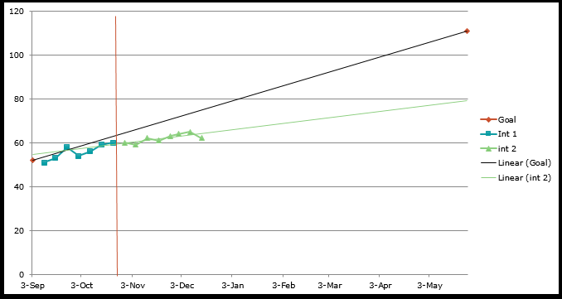
Revisit Case Study: Zane
Zane will not meet his goal. How do we make informed changes to instruction?

Slide 62
Instructional Decision Making
What are the steps?
Step 1
Check your fidelity of implementation
Check dosage

Slide 63
Instructional Decision Making
What are the steps?
Step 2
Diagnostics to check content of intervention

Slide 64
Instructional Decision Making
What are the steps?
Step 3
Check your mastery assessments

Slide 65
Activity 5.6– Stop & Jot
In your workbook, jot down your thoughts:
What are some possible adaptations you could make to promote transfer and maintenance?

Slide 66

Revisit Case Study: Zane
What are some adaptations for Zane?
Promote maintenance with increased and distributed practice
Promote transfer via increased practice reading at the sentence-passage level

Slide 67
Diagnostic and Mastery Assessment in Reading
Module 5 – Next Steps

Slide 68
Summary of Key Points
Part 1: Diagnostic assessment
Part 3: Curriculum-Based Assessment (CBA)
Part 4: Integrating Diagnostic and Progress Monitoring Data to Inform Instruction
Closing: What are the next steps?
Note: There is no Part 2 in this module. The content originally covered in Part 2 is covered in other modules.

Slide 69
Journal Entry for Classroom Application
Think about what Mastery Assessments you could use in your own classroom or field experience.
In a journal entry, answer the following questions:
How would you decide what content to focus on?
First steps in creating materials?
When and to whom will you administer these measures?

Slide 70
References
Consortium on Reading Excellence (2008). Assessing reading: Multiple measures for all educators working to improve reading achievement. Novato, VA: Arena Press.
Diagnostic Data. (n.d.). Retrieved from https://intensiveintervention.org/intensive- intervention/diagnostic-data.
Example Diagnostic Tools. (n.d.). Retrieved from https://intensiveintervention.org/intensive- intervention/diagnostic-data/example-diagnostic-tools.
Honig, B., Diamond, L., & Gutlohn, L. (2018). The Core Reading Sourcebook. Oakland, CA: Arena Press.
Kress, J. E., & Fry, E. (2016). The Reading Teacher's Book of Lists. San Francisco, CA: Jossey- Bass, a Wiley brand.

