Slide 1
How Does Progress Monitoring and Instructional Decision Making Work Within Reading?
Module 4 – Introduction

Slide 2
Overview
Part 1: Overview of Data Based Instruction in reading
Part 2: Selecting an appropriate Curriculum-Based Measure (CBM) as well as administration and scoring of CBM
Part 3: Present Level of Performance and Goal Creation
Part 4: Utilizing data to make instructional decisions
Part 5: Putting it all together

Slide 3
Objectives
You will learn…
Part 1:
How the DBI process applies to reading
Part 2:
What is CBM?
How to select an appropriate CBM reading
How to administer and score common CBMs in reading
How to select assessments for progress monitoring in reading
Part 3:
How to determine a baseline starting point
How to set a goal using CBM

Slide 4
Objectives
You will learn…
Part 4:
How to use data to make instructional decisions including determining if:
students are responding to intervention
students are meeting short and long-term performance goals
students are making progress at an acceptable rate
instruction needs to be adjusted or changed
Part 5:
How to combine all components of DBI in reading to make better decisions about student intervention

Slide 5
Overview of Data Based Instruction in reading
Module 4 – Part 1

Slide 6
Part 1 Objective
You will learn…
How the DBI process applies to reading

Slide 7
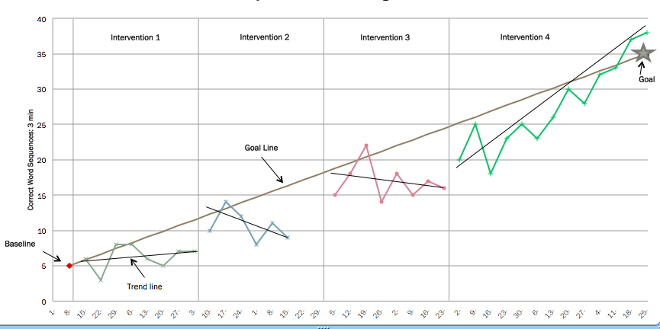
Overview of Data Based Instruction in Reading

Slide 8
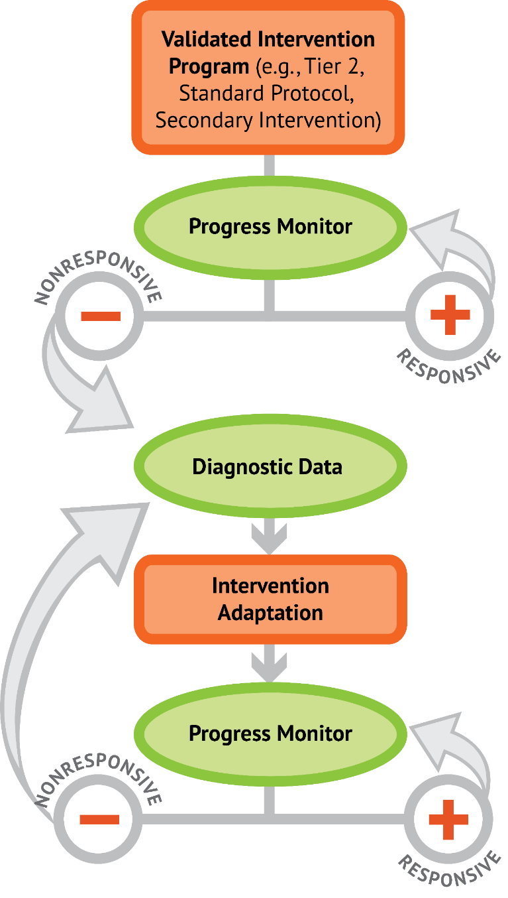
Overview of DBI in Reading
Present Level of Performance
Set Ambitious Long-Term Goal
Implement Quality Instruction with Fidelity
Progress Monitor
Use Decision Rules

Slide 9
Case Study: Zane DBI in Action

Slide 10
Case Study: Zane DBI in Action
3rd Grade
Receives Special Education Services for Learning Disability– Reading
25 minutes of small group instruction 3x a week
Strengths | Weaknesses
Motivated to read– especially about animals | Fluency
Receptive to corrective feedback | Frequently guesses at words, errors increase when text is not in an interest area
Has made a lot of progress in decoding from words lists | Consistent difficulties with affixes and multisyllabic words

Slide 11
Case Study: Zane What to target?
Zane’s teacher, Ms. Smith, decides to continue explicit phonics instruction, phonemic awareness, and word attack. She also decides she really needs to increase his practice with passage reading and fluency, incorporating repeated oral reading, partner reading, and guided reading.
However, Ms. Smith isn’t sure where to start with her phonics instruction or what his independent and instructional reading levels are. Thus, Ms. Smith decides to administer several diagnostic assessments to Zane in order to decide what to teach…she uses CORE Phonics Survey.

Slide 12
Case Study: Zane Let’s Get Started
Ms. Smith:
Decides to use Oral Reading Fluency to establish Zane’s Present Level of Performance
She also decides to start with 2nd grade level passages
Establish Zane’s baseline:
Words Read Correctly: 50, 56, 52
Median: 52
Zane’s baseline or Present Level of Performance is 52 wcpm

Slide 13
Case Study: Zane Let’s Create a Goal
Zane’s present level of performance is 52 words read correctly a minute at 91% accuracy
Ms. Smith uses DIBELS ORF and the recommended benchmark goal for the end of the year, so his goal is to read 111 words correctly a minute with 95% or better accuracy.
Zane’s IEP goal reads: by May 13th, Zane will read 111 words or more correctly per minute across 3 consecutive weeks with 95% accuracy or better.

Slide 14
Case Study: Zane Now Let’s Graph and Monitor Progress

Slide 15
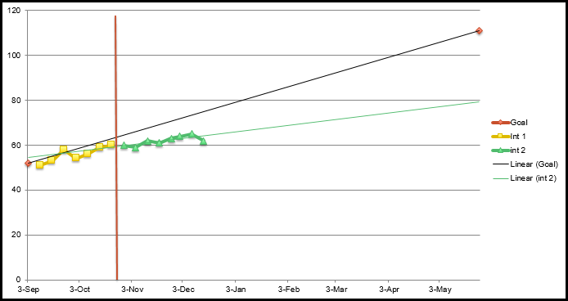
Case Study: Zane Continue checking

Slide 16
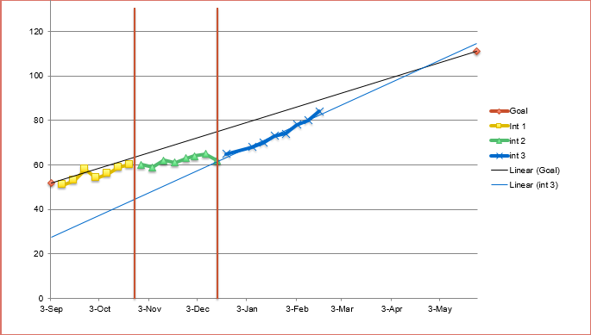
Case Study: Zane And…

Slide 17
Activity 4.1 – Pause & Process
Review this Brief about Data-Based Instruction (DBI): https://intensiveintervention.org/sites/default/files/DBI_Framework.pdf
Write a brief response to each question below:
What barriers do you see in relation to teachers implementing the assessment components of DBI?
What, specifically, do you feel you need to know more about to implement the assessment components of DBI and hope to learn in this module?

Slide 18
Selecting an appropriate Curriculum-Based Measure (CBM) as well as administration and scoring of CBM
Module 4 – Part 2

Slide 19
Part 2 Objectives
You will learn…
What is CBM?
How to select an appropriate CBM reading
How to administer and score common CBMs in reading
How to select assessments for progress monitoring in reading

Slide 20
How progress monitoring informs intervention
How are students responding to intervention?
CBM as a General Outcome Measure
Diagnostic Assessment
What specific reading skills or strategies do I teach?
How do I refine my instructional focus and determine if students are mastering what I teach?
CBM with Error Analysis
+
Mastery Assessment

Slide 21
The focus of this module is on progress monitoring data and CBM
CBM as a General Outcome Measure
Diagnostic Assessment
CBM with Error Analysis
+
Mastery Assessment

Slide 22
CBM progress monitoring answers the following questions:
Are students responding to the intervention?
Are students meeting short- and long-term performance goals?
Are students making progress at an acceptable rate?
Does the instruction need to be adjusted or changed (adapted)?

Slide 23
A review of progress monitoring tools
General outcome measures (GOM), such as CBM
Evaluate overall progress toward meeting the grade-level expectations
Describes an individual student’s long-term growth and development
Provides an initial step in decision-making for designing and evaluating interventions
Should be tested by researchers
Mastery measures
Evaluate progress toward mastery of a specific skill that is only part of what is expected in that subject
Can be designed by teachers, given some assistance

Slide 24
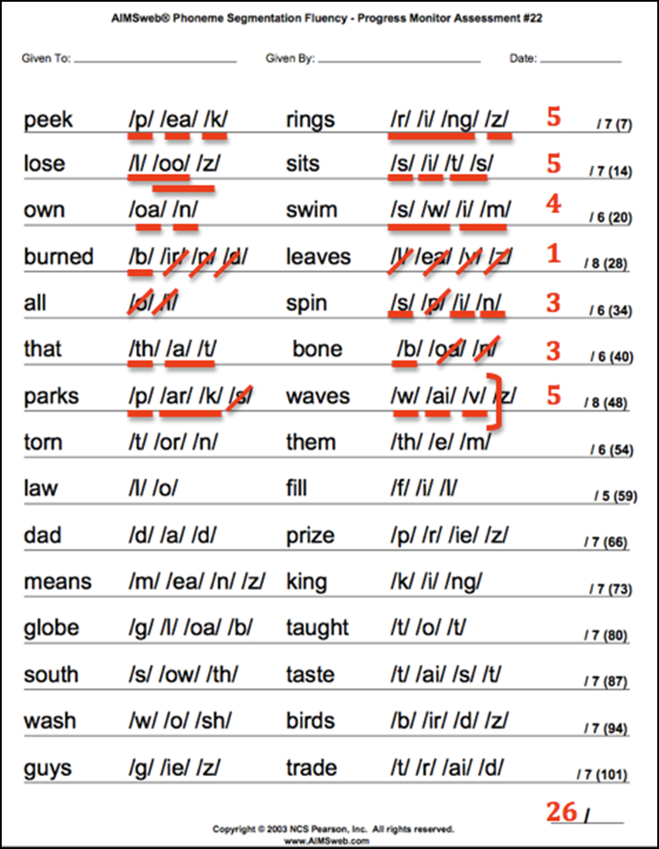
General outcome or mastery?
General outcome
phonemic segmentation fluency

Slide 25
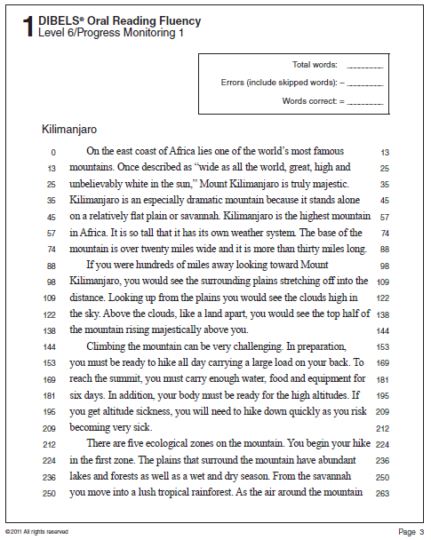
General outcome or mastery?
General outcome
phonemic segmentation fluency

Slide 26
Activity 4.2 – Stop & Jot
What is the difference between a GOM like CBM and a Mastery assessment?
Provide an example of each.

Slide 27
Selecting an Appropriate CBM How do CBMs align with the “big ideas” in reading?
The 5 “Big Ideas” in Reading:
Phonological Awareness
Decoding
Vocabulary
Fluency
Comprehension

Slide 28
Phonological awareness
Measures | Recommended Grades
Initial Sound Fluency (ISF) | Kindergarten
First Sound Fluency (FSF), also called Letter Sound Fluency (LSF)
Phonemic Segmentation Fluency (PSF)

Slide 29
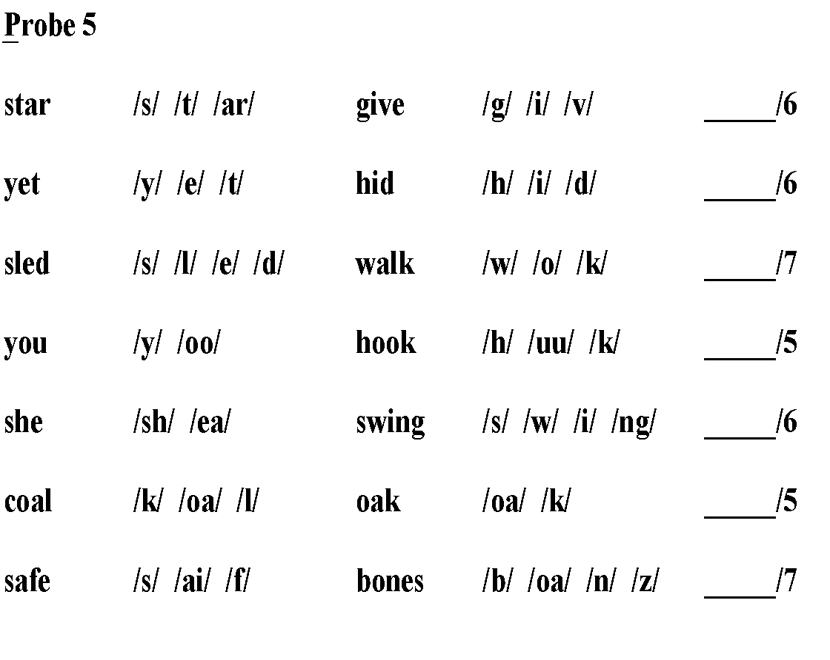
Phonemic segmentation fluency
Total

Slide 30
Selecting an Appropriate CBM How do CBMs align with the “big ideas” in reading?
The 5 “Big Ideas” in Reading:
Phonological Awareness
Decoding
Vocabulary
Fluency
Comprehension

Slide 31
Decoding (Alphabetic Understanding)
Measures | Recommended Grades
Nonsense Word Fluency (NWF) | Late K-1
Word Identification Fluency (WIF) | 1
Oral Reading Fluency (ORF), also called Passage Reading Fluency (PRF) | 1-4 (and sometimes beyond)

Slide 32
Selecting an Appropriate CBM How do CBMs align with the “big ideas” in reading?
The 5 “Big Ideas” in Reading:
Phonological Awareness
Decoding
Vocabulary
Fluency
Comprehension

Slide 33
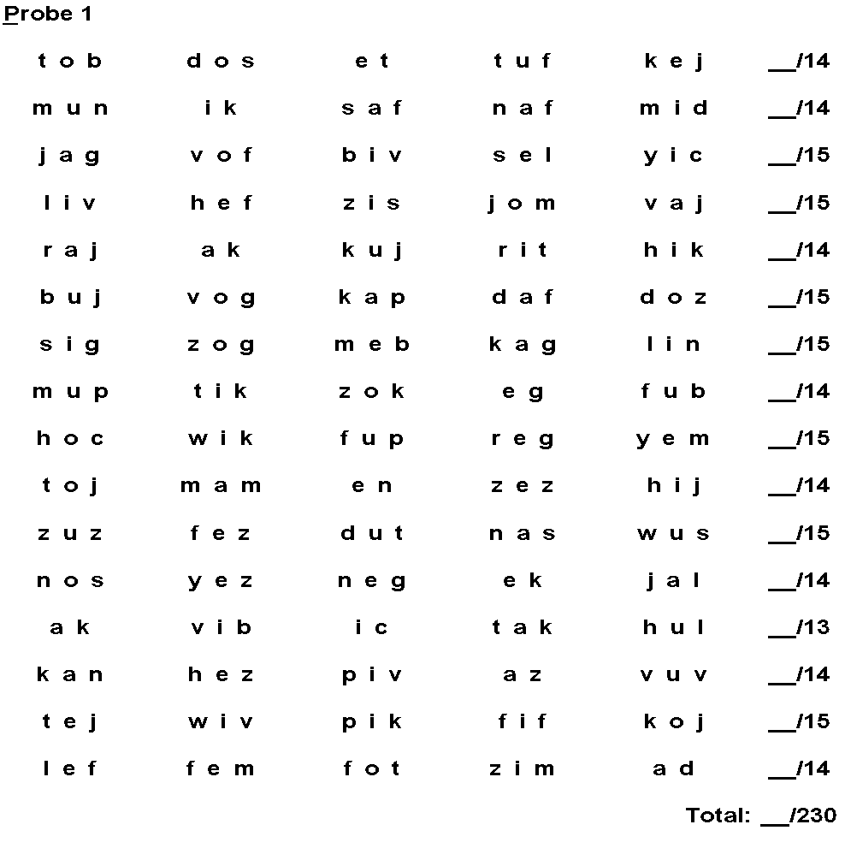
Nonsense word fluency
Pseudowords like:
tob
dos
et
tuf
kej
mun
ik

Slide 34
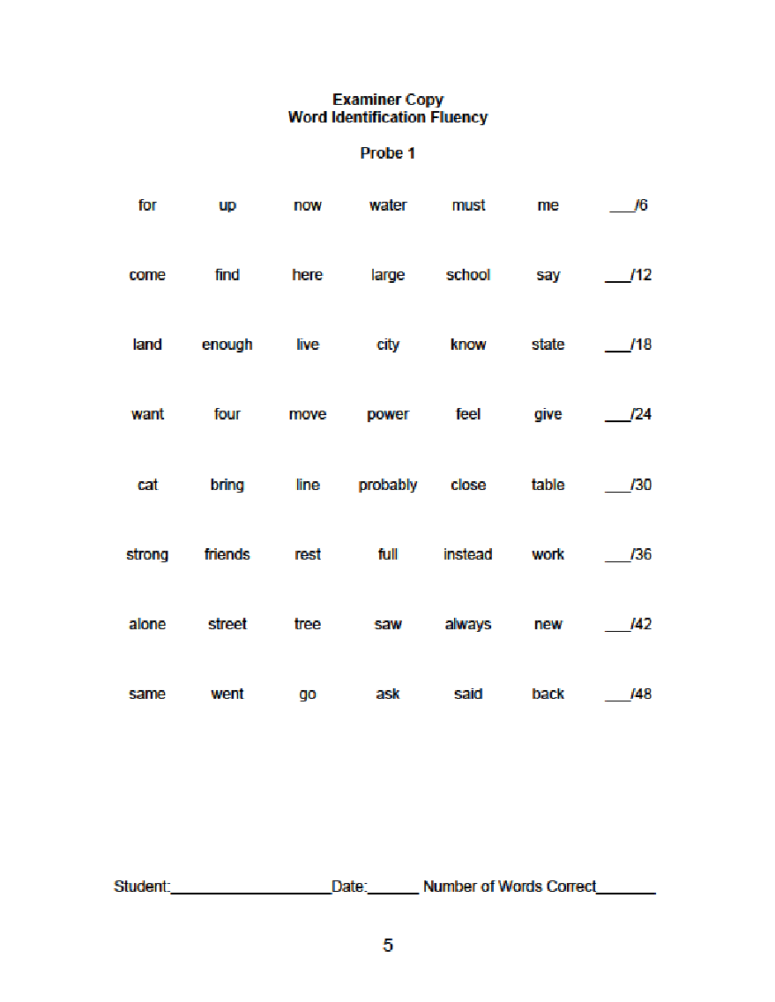
Word identification fluency
Real words like:
for
up
now
water
must
me
come

Slide 35
Oral reading fluency

Slide 36
Selecting an Appropriate CBM How do CBMs align with the “big ideas” in reading?
The 5 “Big Ideas” in Reading:
Phonological Awareness
Decoding
Vocabulary
Fluency
Comprehension

Slide 37
Comprehension
Measures | Recommended Grades
Oral Reading Fluency (ORF), also called Passage Reading Fluency (PRF) (sometimes with comprehension questions) | 1-4 (and sometimes beyond)
MAZE, also called DAZE | 4, 5, 6 (and sometimes beyond)

Slide 38
Oral reading fluency

Slide 39
MAZE
Kicking Stones
Have you ever had nothing to do? Sometimes when I have nothing to (do/can/so), I take a walk. That’s when (to/I/do) kick stones. I look for cans (to/bet/kit) kick. If I can’t find any (you/cans/pal) to kick, I just kick stones. (He/I/Be) look for big stones to kick. (Be/I/Me) walk down the road kicking one (kiss/stone/from) after another. This means I have (wishful/nothing/pressed) else I can think of dong.

Slide 40
How can you find CBMs for progress monitoring?
The National Center on Intensive Intervention conducts annual reviews of tools and interventions in screening, progress monitoring, and academic intervention programs.
https://charts.intensiveintervention.org/chart/progress-monitoring

Slide 41
Activity 4.3 – Stop & Jot
Case Study 1: John
John is a first grade student who is still struggling with a few letter names and many letter sounds. He also struggles with orally blending and segmenting spoken language. The majority of his instruction will focus upon phonological awareness and early reading skills, which CBM should you use (phoneme segmentation fluency, oral reading fluency, word identification fluency)?
Phoneme Segmentation Fluency

Slide 42
Activity 4.3 – Stop & Jot
Case Study 2: Cynthia
Cynthia is a 6th grade student identified as having a reading disability. Her fluency instructional level is 5th grade and she scores around the 10th percentile in fluency (bottom 10% of all 5th graders in number of words read correctly in a minute). She has particular struggles with vocabulary and comprehension as well as retelling what she has read. In other words, her decoding skills are about one grade level behind but her vocabulary and comprehension skills are several grade levels behind. Which CBM should you use (oral reading fluency, word identification fluency, MAZE/DAZE)?
DAZE

Slide 43
Administration and Scoring
The next section is a review on administration and scoring Oral Reading Fluency CBM, with a focus on DIBELS Oral Reading Fluency (DORF).

Slide 44
Choosing a level with Oral Reading Fluency: Grade Level or Instructional Level?
Assessment options:
Grade level—for screening
Instructional level—for progress monitoring
If a students’ performance is well below grade-level expectations, grade-level probes are unlikely to be sensitive to growth. Off-level (or instructional level) assessment is warranted in these cases.

Slide 45
How do you determine the right instructional level?
Administer three ORF passages at the grade level at which you expect the student to be functioning by the end of the year.
If the student reads <10 correct words per minute (wcpm), consider a different CBM
If 10-50 wcpm, but <85-89% correct, administer three passages at the next lower level.
If 10-50 wcpm and above 90% accurate, use that level.
If >50 wcpm, move to the highest level of text where the student reads 10-50 cwpm (but not higher than grade level).

Slide 46
Administering ORF with fidelity
Follow the administration directions exactly
Follow the directions the same way every time
Keep the environment the same (a quiet place, without obvious distractions)
Keep the amount of encouragement the same before assessment (you can discuss progress after)
Score the same way every time
Right is right: there is no credit for “but they’re so close!”
Accent, dialect, and articulation-related pronunciation differences do not count as errors if the student follows the same pattern consistently
Count the last response they give for an item as their answer (even if they changed a correct word to an incorrect one: the last is what they went with in the end)

Slide 47
DIBELS ORF administration directions
Follow these directions exactly each time with each student. Say the words in bold italic type verbatim.
 | I would like you to read a story to me. Please do your best reading. If you do not know a word, I will read the word for you. Keep reading until I say “stop.” Be ready to tell me all about the story when you finish. (Place the passage in front of the student.)
 | Begin testing. Put your finger under the first word (point to the first word of the passage). Ready, begin.
During benchmark assessment, three passages are administered if the student reads 10 or more words correctly on the first passage. When administering the second and third passages, use the following shortened directions:
 | Now read this story to me. Please do your best reading. Ready, begin.

Slide 48
During the testing
Start the stopwatch after the student says the first word of the passage. (If the student is silent or struggles for 3 seconds with the first word of the passage, then mark the word as incorrect, say the word, and start the stopwatch.)
Follow along and mark the student’s responses in the scoring booklet according to the scoring rules.
At the end of 1 minute, place a bracket ( ] ) in the text after the last word provided by the student.
Say, Stop and remove the passage.

Slide 49
DORF notes
Do not read the title.
If the student reaches the end of the page before the minute is up, turn the page and continue on the next page.
Scores are not pro-rated.
If the student is in the middle of a sentence at the end of 1 minute, you may allow the student to finish the sentence, but only score the words said up to the end of 1 minute..

Slide 50
Scoring rules
1 | Leave blank any words the student reads correctly.
2 | Put a slash ( / ) through any errors.

Slide 51
Scoring rule: #1
Leave blank any words the student reads correctly. Inserted words are not counted. To be counted as correct, words must be read as whole words and pronounced correctly for the context of the sentence.
If the student reads a proper noun with correct pronunciation or with any reasonable phonetic pronunciation, it is counted as correct.
Abbreviations must be read the way they would be pronounced in conversation.
Numerals must be read correctly within the context of the sentence.
Hyphenated words count as two words if both parts can stand alone.
A word is scored as correct if it is initially misread but the student self-corrects within 3 seconds. Mark SC above the word and score as correct.

Slide 52
Scoring rule: #2
Put a slash ( / ) through any errors
Errors include words read incorrectly, substitutions, skipped words, hesitations of more than 3 seconds, words read out of order, and words that are sounded out but not read as a whole word.
If a student reads the same word incorrectly multiple times in the story, it counts as an error each time.
Students should read contractions as they are printed on the page.
If a student skips a row, draw a line through the entire row and count the omitted words as errors.

Slide 53
Wait rule
Maximum time for each word is 3 seconds.
If the student does not read a word within 3 seconds, say the word and mark the word as incorrect.
If necessary, indicate for the student to continue with the next word.

Slide 54
Discontinue rule part 1: DORF
If the student does not read any words correctly in the first row of the first passage, discontinue administering the passage and record a score of zero (0).
Do not administer Retell
Do not administer passages 2 and 3

Slide 55
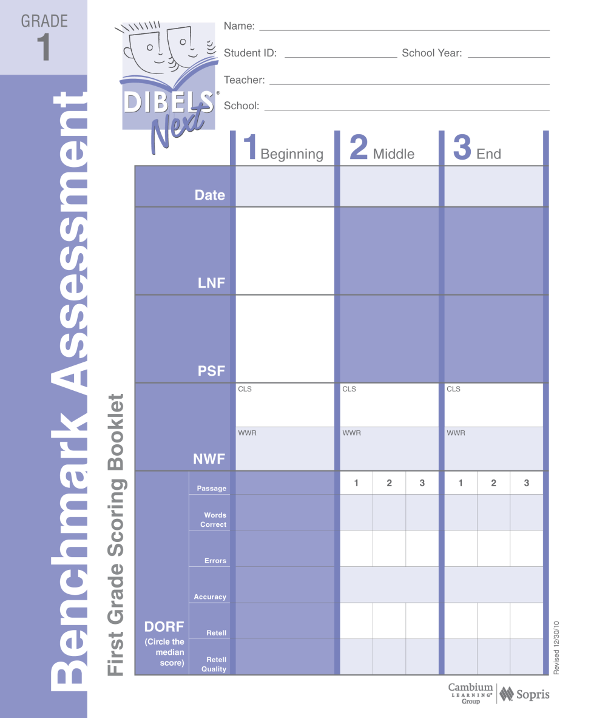
Discontinue rule part 2: Fewer than ten (10) words in first passage
If the student reads fewer than 10 words per minute in the first passage, do not administer Retell and do not administer passages 2 and 3.
Record the score from the first passage.
8

Slide 56
Reminders
These reminders may be given as often as needed:
If the student stops reading (and it’s not a hesitation on a specific item), say, Keep going.
If the student loses her/his place while reading, point.

Slide 57
Note
The student is not penalized for differences in pronunciation of words due to dialect, articulation delays or impairments, or for pronunciations due to speaking a first language other than English.

Slide 58
Video Example
https://youtu.be/1zZXnVo9Hxo

Slide 59
Video Example continued…
https://youtu.be/BL179vdsszg

Slide 60
Other Resources to Provide Scoring Practice with ORF
https://dibels.uoregon.edu/
https://iris.peabody.vanderbilt.edu/module/rpm/cresource/q1/p04/#content

Slide 61
Present Level of Performance and Goal Creation
Module 4 – Part 3

Slide 62
Part 3 Objectives
You will learn…
How to determine a baseline starting point
How to set a goal using CBM

Slide 63
Present Level of Performance and Goal Setting
Now that you are able to select an appropriate CBM, administer and score it…your 1st step is to establish a present level of performance.

Slide 64
PLEP
Administer 3 different probes within 24 hours.
Use the median (middle) score as the baseline
Example:
12, 11, 20: median is
15, 20, 17: median is
What is the student’s baseline if their scores are:
69, 71, 73
12
17

Slide 65
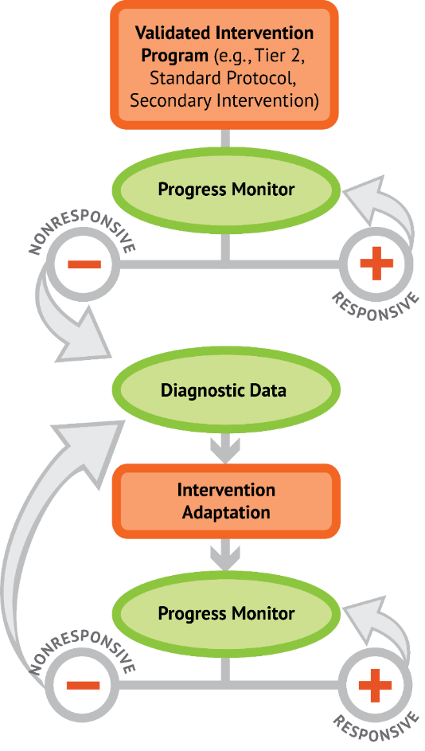
Setting an Ambitious Long-Term Goal
An ambitious yet realistic long-term goal is needed to help us evaluate the effectiveness of our instruction.
This module provides goal setting basics
REMEMBER!—we want to set goals that help our students close the gap and catch up with their peers….not just maintain their current rate of learning

Slide 66
Goal Setting
Determine the end-date of the instructional period in which you will monitor progress.
The instructional period is often the end of the semester or school year.
For students receiving special educational services, the end date is often the end of the IEP cycle.
Determine the level at which you expect the student to perform at the end of this instructional period (Ambitious & Reasonable).
This level is the student’s long-term goal.

Slide 67
Goal Setting
There are two general methods for setting goals:
Using Benchmarks
Assuming the student’s baseline is established in fall, you can use winter or spring (end of year) benchmarks to create your goal.
Benchmarks are established via the performance of the general population.
Using Weekly Rates of Improvement
This method can be used if the student’s IEP date does not align well with a winter or spring (end of year) benchmark.
Multiply the Weekly Rate of Improvement you want your student to achieve by the number of weeks until the end goal date and add this score to their baseline.

Slide 68
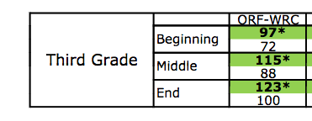
Goal Setting-Benchmarks-DORF
Max is a 3rd grader that reads 60 words correctly per minute as their baseline on DORF at the beginning of the year.
Is Max at-risk?
YES!

Slide 69
Goal Setting-Benchmarks-DORF
Max is a 3rd grader that reads 60 words correctly per minute as their baseline on DORF at the beginning of the year.
What benchmark should Max shoot for?
123

Slide 70
Goal Setting-Benchmarks-DORF
Max is a 3rd grader that reads 60 words correctly per minute as their baseline on DORF at the beginning of the year.
Max’s Goal:
By the end of the year, Max will read at least 123 words correctly in one minute on 2 consecutive 3rd grade DORF forms while maintaining 90% or better accuracy.

Slide 71
Goal Setting-ROI-DORF
Max is a 3rd grader that reads 60 words correctly per minute as their baseline on DORF at the beginning of the year.
DORF suggest an ROI of 1.5 or greater.

Slide 72
Goal Setting-ROI-DORF
Max is a 3rd grader that reads 60 words correctly per minute as their baseline on DORF at the beginning of the year.
Let’s assume you decide an ROI of 2 is good for Max and you will deliver 16 weeks of instruction.
Baseline + (ROI x Weeks)= 60 + (2 x 16) = 92
Goal: By (date), Max will read 92 WRC per minute using 3rd grade DORF for 2 consecutive data points while maintaining 90% or better accuracy.

Slide 73
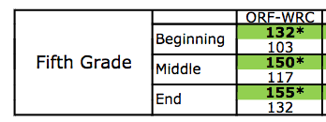
Activity 4.4– Stop & Jot
Now you try it! Create an End of Year Benchmark.
Anna is a 5th grade student. Her baseline in the beginning of the year on DORF was 95 wcpm.
Is she at-risk?
Write down her goal for the end of the year.
By the end of the year, Anna will read 155 or more wcpm on 2 consecutive DORFs while maintaining 90% or better accuracy.

Slide 74
What about accuracy goals?
Accuracy goals should target 95% accuracy or better. DIBELS provides suggested accuracy goals.
Accuracy goals would be good for students who attempt to read too quickly and make many mistakes, such as readers who routinely guess at words. However, we recommend tracking wcpm even if employing an accuracy goal.

Slide 75
Utilizing data to make instructional decisions
Module 4 – Part 4

Slide 76
Part 4 Objectives
You will learn…
How to use data to make instructional decisions including determining if:
students are responding to intervention
students are meeting short and long-term performance goals
students are making progress at an acceptable rate
instruction needs to be adjusted or changed

Slide 77
Utilizing data to make instructional decisions
Recall that progress monitoring answers the following questions:
Are students responding to the intervention?
Are students meeting short- and long-term performance goals?
Are students making progress at an acceptable rate?
Does the instruction need to be adjusted or changed?

Slide 78
We’ll discuss instructional decision making
How to decide if students are responding to an intervention and whether we need to make an adaptation?

Slide 79
Terminology we’ll use to examine graphs
Trend (ROI)
Goal
Adaptation
Aimline

Slide 80
Decision Rules
Level
Trend
Variability

Slide 81
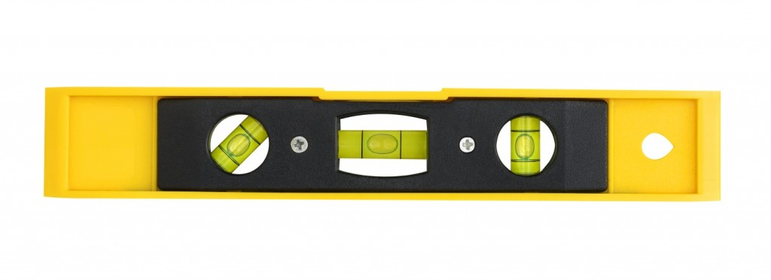
Level
Level . . . Compare student’s data points to the goal line
Ask yourself:
Are most points above the goal line?....increase goal
Are most points below the goal line?......make a change
Are most points near the goal line?....keep as is

Slide 82
Level - Example #1
Keep as-is
Goal Line

Slide 83
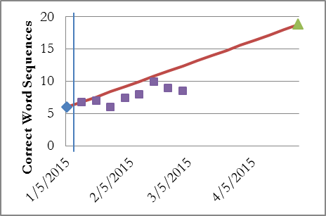
Level - Example #2
Change-Adapt Instruction
Goal Line
Goal Line

Slide 84
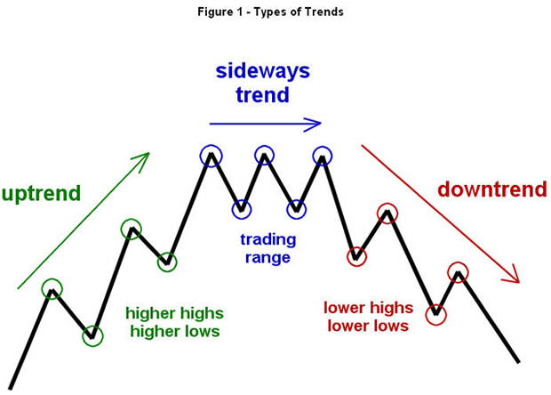
Trend
Trend . . . compare student’s rate of growth (the trend line) against the aim or goal line
Ask yourself:
Is the trend line above or steeper than the aim line?......increase goal
Is the trend line the same as or even with the aim line?......keep as is
Is the trend line below or flatter than the aim line?.......change instruction

Slide 85
Trend – Example #1 (with trend line)
Keep as-is
Goal Line

Slide 86
Trend – Example #2 (with trend line)
Change-Adapt Instruction
Goal Line

Slide 87
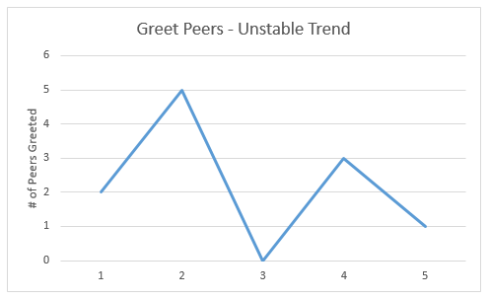
Variability
Variability . . . the amount of “bounce” between data points around the goal line
Ask yourself:
Is there a lot of variability between scores?
Are the scores relatively stable?

Slide 88
Variability – Example #1
Drop the low score, re-evaluate and keep as-is

Slide 89
Variability – Example #2
Collect 2-3 more data points

Slide 90
In Summary: Your Decisions Are
Raise the Goal
Keep as-is
Adapt Instruction

Slide 91
General Guidelines
8 data points for 1st decision
6 data points for any subsequent decision, unless…..
If you keep as-is, re-evaluate every 2-4 weeks

Slide 92
Let’s Practice! – Example #1
Goal Line
Identify the following: Level, Trend, Variability, and Decision

Slide 93
Let’s Practice! – Example #2
Identify the following: Level, Trend, Variability, and Decision

Slide 94
Let’s Practice! – Example #3
Identify the following: Level, Trend, Variability, and Decision

Slide 95
Misconception Alert!
Decision RULES are not really rules, but guidelines.
They are meant to guide your thinking and promote timely changes to instruction.
They are not inflexible requirements.
HOWEVER, this does not mean you can ignore the rules and keep instruction despite the data’s trend.
DO NOT lower the goal except in very rare circumstances, such as you incorrectly established a baseline that was too high.

Slide 96
Putting it all together
Module 4 – Part 5

Slide 97
Part 5 Objectives
You will learn…
How to combine all components of DBI in reading to make better decisions about student intervention

Slide 98
Activity 4.5– Application Activity
Putting It All Together
You will need Excel for this task
Open the Excel file to graph the data
Write the answers to the questions in your Workbook

Slide 99
Activity 4.5– Application Activity continued…
Putting It All Together
Your student's name is Celeste. She is a 4th grade student identified as having a learning disability in reading. You decide to use DIBELS Oral Reading Fluency (DORF). You give her 3 forms of DORF in fall and her WRC per minute were 50, 55, and 53. Her average %WRC per minute across all 3 probes was 89%. You decide to continue progress monitoring her using DORF once a week and use Enhanced Core Reading Instruction (Fien et al., 2015; Smith et al., 2016) as her intervention. You need to make a decision after 8 data-points (weeks). Her WRC per Minute and %WRC per minute for each week are on the next slide.

Slide 100
Activity 4.5– Application Activity continued…
Putting It All Together
Week | WCPM | %WCPM
1 | 55 | 88%
2 | 57 | 89%
3 | 51 | 85%
4 | 60 | 90%
5 | 63 | 91%
6 | 65 | 90%
7 | 68 | 92%
8 | 50 | 85%

Slide 101
Activity 4.5– Application Activity continued…
Putting It All Together
In Tab 1 in Excel:
1. Create a graph using Celeste’s data
2. Use benchmarks found below to create a long-term goal
https://intensiveintervention.org/sites/default/files/2017%20ORF%20NORMS%20PDF.pdf
3. You should have a goal line starting at her baseline
4. You should have a vertical line indicating Intervention 1 with a description of the intervention
5. You should have her 8 weeks of WCPM and %WCPM data graphed with a trend line for WCPM only

Slide 102
HOW TO CREATE A GRAPH IN EXCEL
https://youtu.be/SHd2XGyADE0

Slide 103
Activity 4.5– Application Activity continued…
Putting It All Together
In your Workbook write down the answers to the following questions:
1. What was Celeste's baseline?
2. Is Celeste at-risk in reading?
3. Write your goal for Celeste. It should match your goal line in the graph and be written exactly as "By (date), Celeste will read at least (a number) of words correctly per minute on 3 consecutive trials as measured by 4th grade DORF.
4. According to the NCII tools for elementary reading Academic Intervention, is Enhanced Core Reading Instruction (Fien et al., 2015; Smith et al., 2016) a good intervention to start with? Why or why not?
5. Look at Celeste's weekly data in response to your intervention, should you keep or change the intervention? Why or why not?

Slide 104
Additional Graphing Resource
Student Progress Monitoring Tool for Data Collection and Graphing
Intensiveintervention.org/resource/student-progress-monitoring-tool-data-collection-and-graphing-excel

Slide 105
How Does Progress Monitoring and Instructional Decision Making Work Within Reading?
Module 4 – Closing

Slide 106
Classroom Application: Progress monitoring using ORF
Select a student to progress monitor using ORF (or other appropriate measure). The student may be one of the students who is already receiving intensive intervention, OR you may select another student who you teach.
Monitoring of your “case study student” will be conducted 2x/week throughout the course.
Use Excel to enter and graph your data
Routinely look at the data (e.g., every 4 data points).
Use the decision rules presented in this module to make decisions.

Slide 107
Reading: Progress monitoring briefs
Read Progress Monitoring Briefs #1-3 from the National Center on Response to Intervention.
Information provided in these Briefs will help you implement your Classroom Application.
. . .If you’re interested in communicating data to parents, Brief #4 is provided for your information (it is not required reading).

Slide 108
References
Academic Progress Monitoring Tools Chart. (n.d.). Retrieved from https://charts.intensiveintervention.org/chart/progress-monitoring.
Hasbrouck, J. & Tindal, G. (2017). An update to compiled ORF norms (Technical Report No. 1702). Eugene, OR. Behavioral Research and Teaching, University of Oregon.
How should Ms. Begay assess her students' reading levels and progress? (n.d.). Retrieved from https://iris.peabody.vanderbilt.edu/module/rpm/cresource/q1/p04/#content.
National Center on Intensive Intervention. (2013), Data-based individualization: A framework for Intensive intervention. Washington, DC: Office of Special Education Programs, U.S. Department of Education
University of Oregon Center. (n.d.). UO DIBELS® Data System. Retrieved from https://dibels.uoregon.edu/.

