Slide 1
Virtual Lesson
Writing Intervention
Dr. Natasha Feinberg, Professor Rhode Island College, RI
Notes:
The following PowerPoint provides the structure for writing intervention that is being provided virtually.
The Simple View of Writing (Berninger & Amtmann, 2002) has informed this work.
The Simple View of Writing addresses three major components of writing instruction: Transcription, Text Generation, and Self-Regulation.
At the transcription level, we begin with simple letter-sound correspondence. The student matches phonemes to their graphemes. Word lists that are organized by phonics skill are available in Phonics and Spelling through Phoneme-Grapheme Mapping by Kathryn Grace. The phonics skill that is highlighted may be practiced through a short, connected piece of text.
Transcription is continued at the word and sentence level through word reading, writing and reading simple sentences, and direct instruction in grammar.
The final portion of the intervention moves to Text Generation, which focuses on being able to write in a larger quantity while maintaining a sense of organization. DBI TLC out of the University of Missouri provides specific writing intervention activities that may be used here. The Writing Revolution by Hochman and Wexler is also a resource for specific activities.
Resource:
Berninger, V.W. & Amtmann, Dagmar. (2003). Preventing written expression disabilities through early and continuing assessment and intervention for handwriting and/or spelling problems: Research into practice. Handbook of learning disabilities (p. 345–363). The Guilford Press.

Slide 2
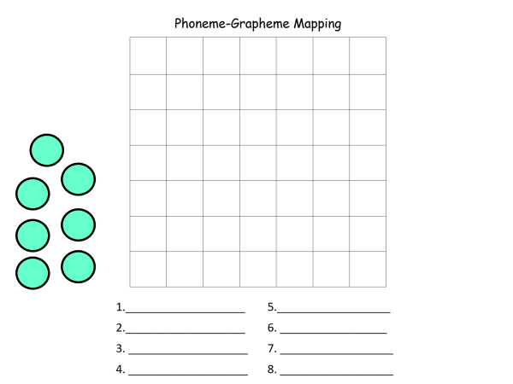
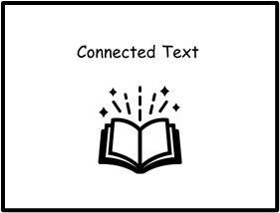
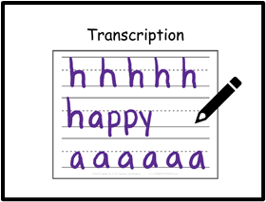
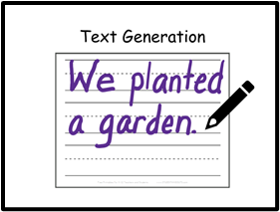
Schedule
Stay with me.
Listen and follow directions the first time.
Have fun!

Slide 3
Phoneme-Grapheme Mapping

Slide 4
Connected Text

Slide 5
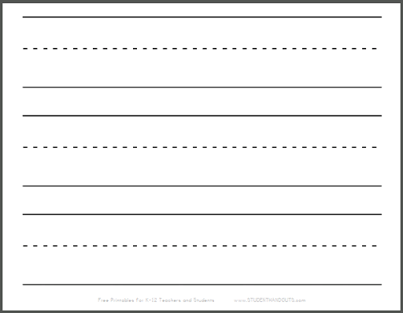
Transcription

Slide 6
Text Generation

