Slide 1
Data Rich, Information Poor?
Making Sense of Progress Monitoring Data to Guide Intervention Decisions
Lynn Fuchs, Ph.D., Vanderbilt University
Lee Kern, Ph.D., Lehigh University

Slide 2
Purpose
Help educators understand how to review progress monitoring and other accessible data to guide intervention planning for students with intensive needs in behavior and academics.

Slide 3
We will discuss
Common progress monitoring measures in academics and behavior
Key considerations for optimizing data collection
Structured questioning for analyzing progress monitoring data patterns:
    What patterns do the data reveal?
    What might the data reveal about the student’s needs?
    What adaptations may be needed to make the intervention more effective?

Slide 4
1. Common Progress Monitoring Measures in Academics and Behavior

Slide 5
Quick Review:
What is progress monitoring?
A standardized method of ongoing assessment that allows you to
  Measure student response to instruction/intervention
  Evaluate growth and facilitate instructional planning
For more information about progress monitoring:
  www.intensiveintervention.org; www.rti4success.org
    Tools
    Charts
    Training modules

Slide 6
Why Implement
Progress Monitoring?
Data allow us to
Estimate the rates of improvement (ROI) over time and set goals.
Compare the efficacy of different forms of instruction.
Identify students who are not demonstrating adequate progress.
Determine when an instructional change is needed and help to hypothesize potential sources of need.

Slide 7
Progress Monitoring Tools Should Be
  Brief assessments
  Repeated measures that capture student learning or behavior over time
  Measures of grade, age, or instructionally appropriate outcomes
  Reliable and valid

Slide 8
Common Progress Monitoring Measures: Academics
Reading
Letter Sound Fluency
Word Identification Fluency
Oral Reading Fluency; Passage Reading Fluency
Maze
Mathematics
Number Identification
Quantity Discrimination
Missing Number
Computation Curriculum-Based Measures
Concepts and Applications Curriculum-Based Measures

Slide 9
Common Progress Monitoring Measures: Behavior
Systematic Direct Observation
Direct Behavior Rating

Slide 10
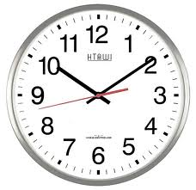

Common Progress Monitoring Measures: Behavior
Event-Based
Frequency
Time-Based
Whole- interval
Partial- interval
Momentary time
sampling
Latency
Duration
Systematic Direct Observation
10

Slide 11
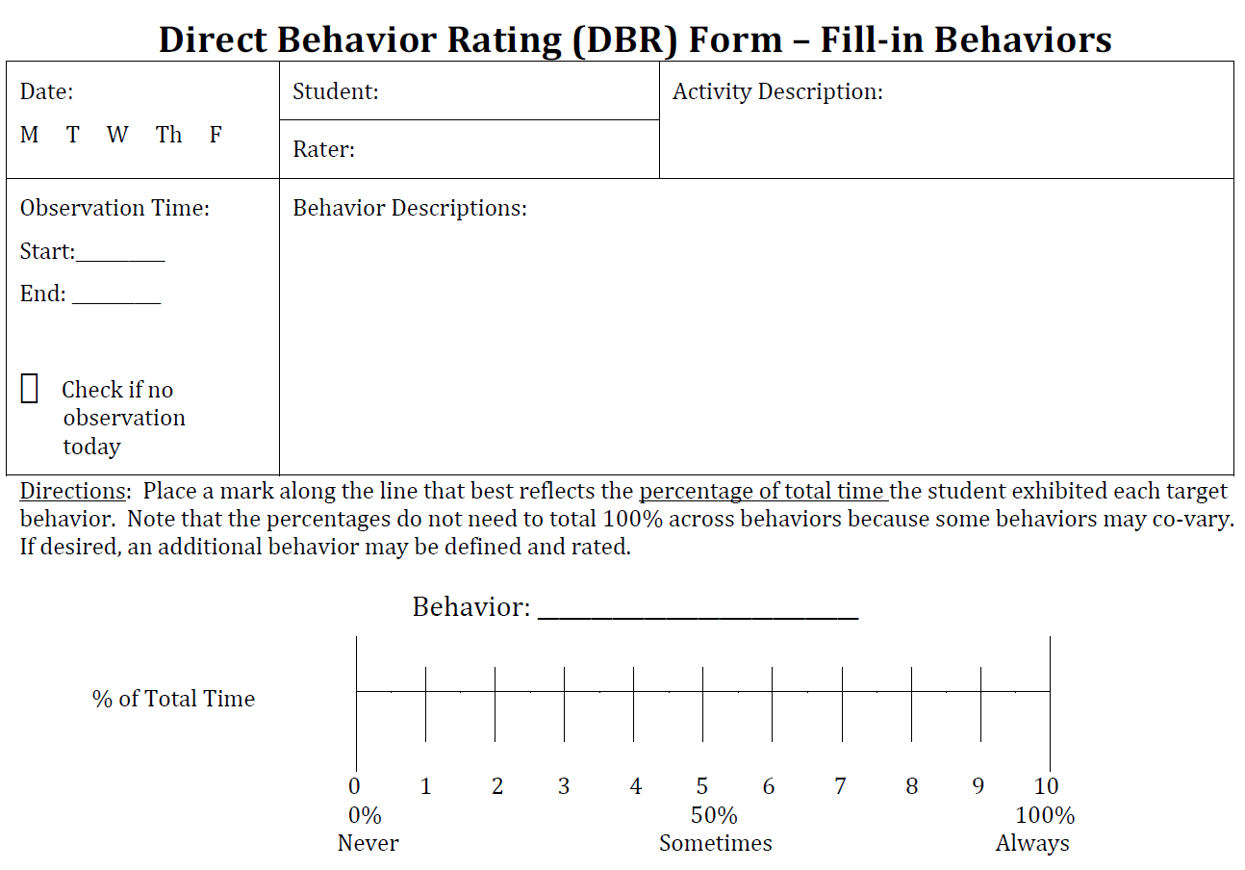
Common Progress Monitoring Measures: Behavior
M
Tu
W
Th
F
Direct Behavior Rating

Slide 12
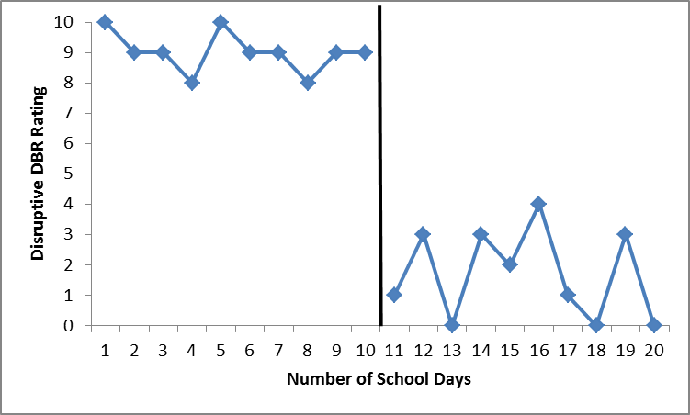
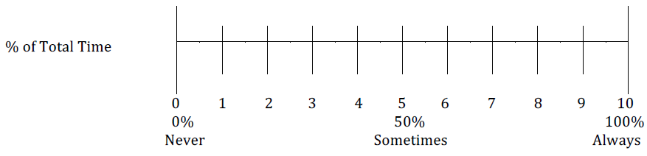
Graphing Progress Monitoring Data
Disruptive
Place a mark along the line that best reflects the percentage of total time the student was disruptive during mathematics today.
Interpretation: The student displayed disruptive behavior during 30 percent of small-group science instruction today.

Slide 13
2. Key Considerations for Optimizing Data Collection

Slide 14
Common Challenges: Academic Data
Aligning measure to content of instruction
Sensitivity to change
Distinguishing from other classroom-based and diagnostic assessments
Frequency of data collection

Slide 15
Common Challenges: Behavior Data
Defining target behavior
Aligning measure with target behavior
Consistency of administration and frequency of data collection

Slide 16
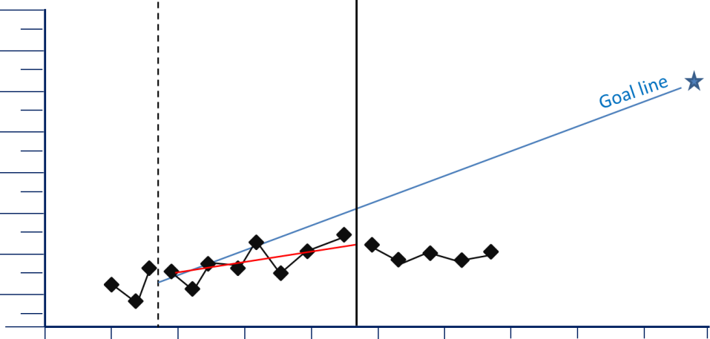
3. Structured Questioning for Analyzing Progress Monitoring Data Patterns

Slide 17
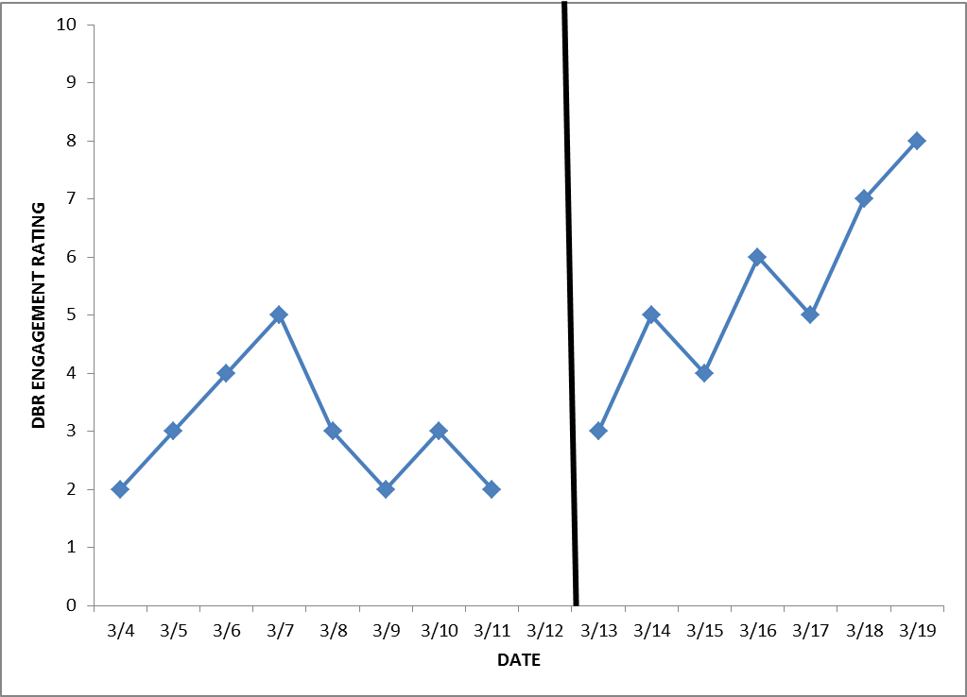
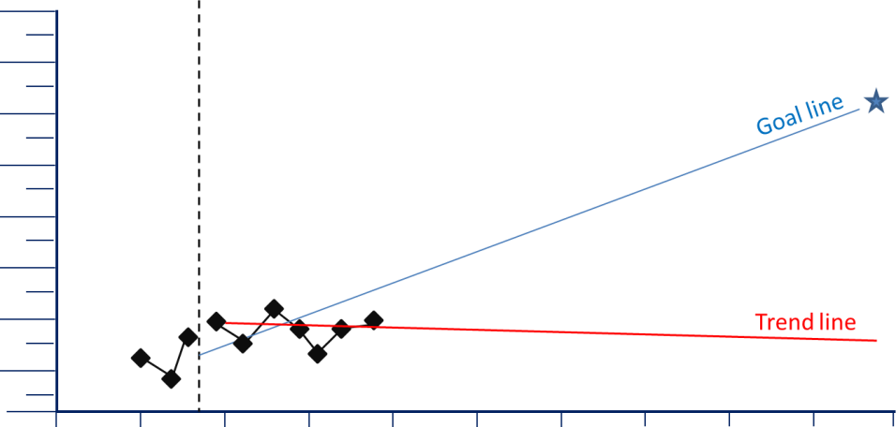
What can a graph tell you?

Slide 18
Use Structured Questioning to Arrive at a Hypothesis
Data and assessment
Dosage and fidelity
Content and intensity

Slide 19
Structured Questioning
Data and assessment
Dosage and fidelity
Content and intensity
I
Am I collecting data often enough?
Is the progress monitoring tool sensitive to change?
Does the measure align to the content of the intervention?
Am I collecting data at the right level?

Slide 20
Structured Questioning
Data and assessment
Dosage and fidelity
Content and intensity
I
Did the student receive the right dosage of the intervention?
Did the student receive all components of the intervention, as planned?
Did other factors prevent the student from receiving the intervention as planned? (Example: absences, behavior issues, scheduling challenges, group size, staff training)

Slide 21
Structured Questioning
Data and assessment
Dosage and fidelity
Content and intensity
I
Is the intervention an appropriate match given the student’s skill deficits or target behavior?
Is the intensity of the intervention appropriate, given the student’s level of need, or are adaptations or intensifications needed?
Are academic and behavioral issues interrelated?

Slide 22
Trend: Improvement in Scores
After Change (Behavior)
Pre-intervention
After intervention change
The situation:
Responding improves more after an intervention change, with an ascending trend.

Slide 23
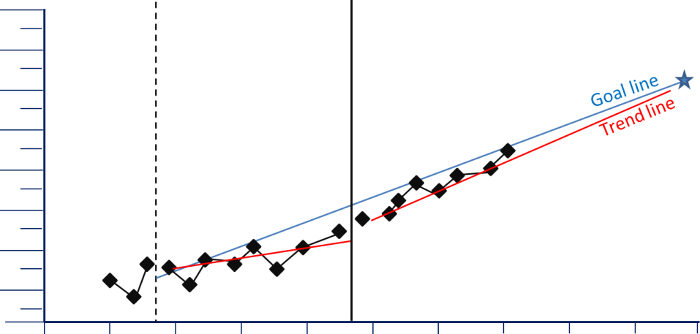
Trend: Improvement in Scores
After Change (Academic)
The situation:
Scores improve more after an intervention change, making the trend line steeper than it was.

Slide 24
What could this pattern be telling you?
This is good news!
The student is steadily improving and is on target to reach the end of year goal.
Continue to monitor progress to ensure ongoing improvement.
Consider creating a more ambitious goal if the student continues to outperform the goal.

Slide 25
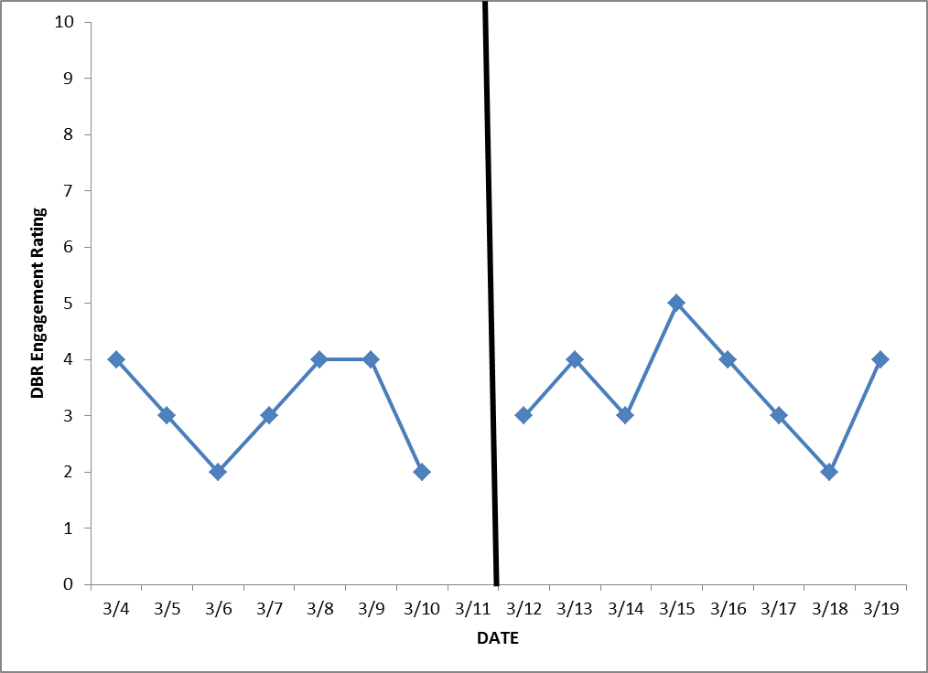
Trend: Flat Line (Behavior)
After intervention change
Pre-intervention
The situation:
The data from the intervention phase is similar to pre-intervention or baseline, creating a flat or stable trend.

Slide 26
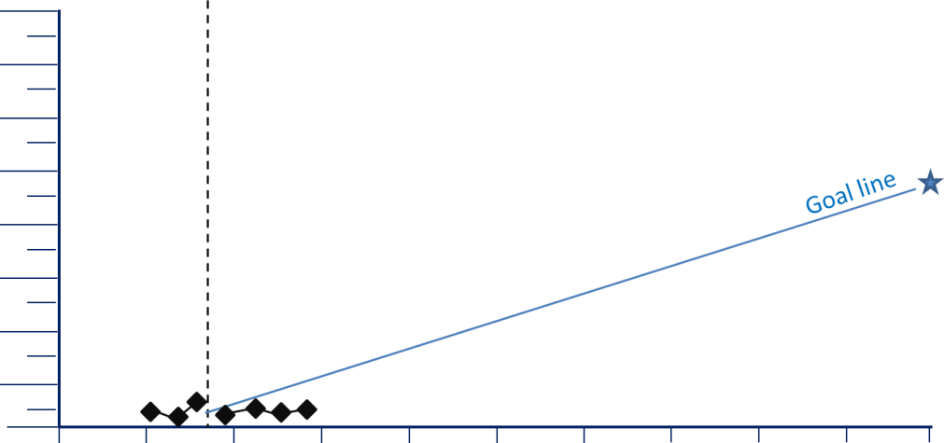
Trend: Flat Line (Academic)
The situation:
Data in the intervention phase is similar to the baseline phase, creating a flat trend line.

Slide 27
What could this pattern be telling you?
The student is not responding to the intervention.
The progress monitoring tool is not appropriate.
The student has not received the intervention with fidelity.
The intervention is not an appropriate match for the student’s needs.

Slide 28
Data and assessment
Dosage and fidelity
Content and intensity
Target specific student need or function of behavior and determine more appropriate match.
Add motivational or behavioral component.
Add academic supports.
Modify schedules of reinforcement.
Select progress monitoring measure that aligns with intervention.
Ensure progress monitoring tool is sensitive to change.
Ensure the behavior measurement reflects the behavior you need to change.
Address barriers to adequate dosage and fidelity.

Slide 29
Trend: Highly Variable (Behavior)
Pre-intervention
After intervention change
The situation:
The data from the intervention phase is similar to pre-intervention or baseline, creating a variable trend.
Disruptive DBR Rating
Number of School Days

Slide 30
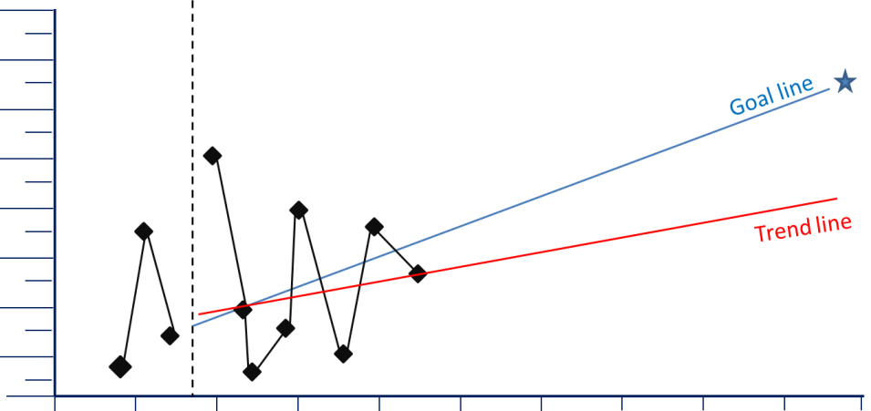
Trend: Highly Variable (Academic)
The situation:
Scores are highly variable, with significant changes from day to day.

Slide 31
What could this pattern be telling you?
The progress monitoring tool is not reliable.
Administration of the assessment is inconsistent.
Engagement and motivation vary greatly by day.
Other situational or external factors affect performance or behavior.

Slide 32
Data and assessment
Dosage and fidelity
Content and intensity
Verify that progress monitoring tool has evidence of reliability.
Ensure consistency of administration.
Ensure consistency of intervention delivery and dosage.
Create plan to help student manage situational factors.
Add motivational or behavioral component.

Slide 33
Trend: Slow Rate of Improvement (Behavior)
Engagement DBR Rating
Pre-intervention
After intervention change
The situation:
The data in the intervention phase is increasing but slowly, creating a gradual ascending trend.
Number of School Days

Slide 34
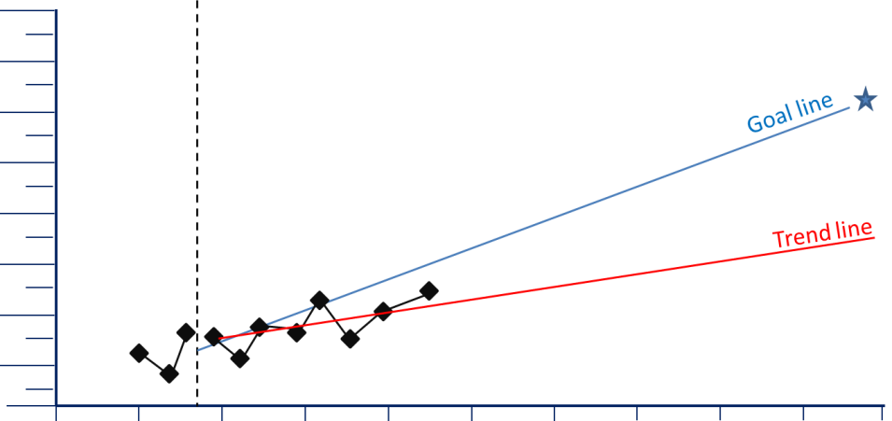
Trend: Slow Rate of Improvement (Academic)
The situation:
The student’s scores are improving,
but not as steeply as the goal line.

Slide 35
What could this pattern be telling you?
The student is making some progress, but at a slow rate.
Continuation will not result in student reaching goal.
The goal is inappropriate for the measure being used or student characteristics.
The student requires an intervention change to increase intensity.

Slide 36
Data and assessment
Dosage and fidelity
Content and intensity
Set feasible goal by researching rate of improvement.
Increase intensity by increasing frequency or duration of intervention or decreasing group size.
Increase intensity by
  Providing more frequent opportunities for feedback
  Adding explicit instruction in skill deficit area
  Adding practice opportunities

Slide 37
In Summary
  Begin with a valid, reliable, and appropriate progress monitoring measure.
  Graph your data to see patterns.
  Ask questions about data patterns to arrive at hypothesis about student responsiveness.
  Use your hypothesis to inform changes to intervention or assessment (if the data indicate that a change is needed).

Slide 38
Additional Resources
Center on Response to Intervention: www.rti4success.org
National Center on Intensive Intervention, DBI Training Series: http://www.intensiveintervention.org/content/dbi-training-series
National Center on Student Progress Monitoring: http://www.studentprogress.org/

Slide 39

Questions and Discussion

Slide 40
National Center on Intensive Intervention (NCII)
E-Mail: NCII@air.org
1050 Thomas Jefferson Street, NW
Washington, DC 20007- 3835
Website: www.intensiveintervention.org
While permission to redistribute this webinar is not necessary, the citation should be:
National Center on Intensive Intervention. (2014). Data Rich, Information Poor? Making Sense of Progress Monitoring Data to Guide Intervention Decisions. Washington, DC: U.S. Department of Education, Office of Special Education Programs, National Center on Intensive Intervention.

Slide 41
National Center on Intensive Intervention
This webinar was produced under the U.S. Department of Education, Office of Special Education Programs, Award No. H326Q110005. Celia Rosenquist serves as the project officer.
The views expressed herein do not necessarily represent the positions or policies of the U.S. Department of Education. No official endorsement by the U.S. Department of Education of any product, commodity, service or enterprise mentioned in this presentation is intended or should be inferred.

