Slide 1
Using the Taxonomy of Intervention Intensity Within the Data-Based Individualization Process: A Mathematics Example
Notes:
Welcome to the National Center on Intensive Intervention’s (NCII’s) module on using the Taxonomy of Intervention Intensity to design and intensify math intervention. This module is expected to take 2.5–3 hours. It includes slides, speakers’ notes, and a workbook of activities.
This module is intended for individuals and teams who are interested in learning dimensions to consider when selecting a strong validated mathematics platform and considering intensification. Additional modules focused on introducing the taxonomy of intervention intensity, applying the taxonomy for reading, and behavior also are available. For more information about the data-based individualization (DBI) process, you may want to direct participants to the following resources:
Self-paced online module introducing intensive intervention: https://intensiveintervention.org/resource/self-paced-introduction-intensive-intervention
Read about the DBI process in detail: https://intensiveintervention.org/sites/default/files/DBI_Framework.pdf
Explore DBI topics: https://intensiveintervention.org/intensive-intervention
Handout—Breaking Down the DBI Process: Questions & Considerations: https://intensiveintervention.org/sites/default/files/NCII-placemat-508.pdf
Dr. Chris Lemons explains intensive intervention and why they are important: https://intensiveintervention.org/resource/what-are-intensive-interventions-and-why-are-they-important
Preferred citation:
While permission to reprint this publication is not necessary, the citation should be: National Center on Intensive Intervention. (2020). Using the Taxonomy of Intervention Intensity within the DBI process: A mathematics example. Washington, DC: U.S. Department of Education, Office of Special Education Programs, National Center on Intensive Intervention.
Facilitators: Introduce yourself and provide a brief summary of your background before moving on.
Tips for using the speaker’s notes:
Text formatted in standard font provides a sample script for the facilitator.
Text formatted in italics is intended as directions, notes, or background information for the facilitator. This includes notes for animations within the slide deck.
Slides that reference handouts that can be found in the speaker notes are noted with a banner indicating the handout.

Slide 2
Learner Outcomes
At the end of the session, participants will be able to:
Define the dimensions of the Taxonomy of Intervention Intensity and explain how they support the data-based individualization (DBI) process.
Apply the dimensions of the taxonomy to evaluate or select a validated mathematics intervention program.
Use the taxonomy to intensify a math intervention for a student who is not responsive.
Access existing resources to support evaluation and intensification.
Notes:
In this presentation, you will be introduced to the Taxonomy of Intervention Intensity and learn how it supports the DBI process by helping to provide explicit guidance on how to select and evaluate validated mathematics intervention programs to best meet students’ needs and intensify or adapt those interventions when students or groups of students do not adequately respond.
At the end of the session you will be able to:
Define the dimensions of the Taxonomy of Intervention Intensity (Taxonomy) and explain how they support the DBI process.
Apply the dimensions of the taxonomy to evaluate or select a validated mathematics intervention program.
Use the taxonomy to intensify a math intervention for a student who is not responsive.
Access existing resources to support evaluation and intensification.
This presentation is intended to focus specifically on mathematics intervention. Additional modules provide an overview of the taxonomy as well as deeper reviews of reading and behavior content. To access these modules, visit the NCII website (https://intensiveintervention.org/taxonomy-intervention-intensity).

Slide 3
Agenda
Review: The DBI process
Go deep: The taxonomy dimensions in mathematics
Case example: Using the Taxonomy of Intervention Intensity to support the DBI process in mathematics
Behavior Support
Strength
Dosage
Alignment
Transfer
Comprehensiveness
Notes:
Review slide. Based on available time and focus, adjust the agenda to meet your needs.
Although the time frame may vary, this is intended to be a half-day (2.5–3 hours) training. The actual time for the session will depend on time spent on activities.
Presenters can adapt this presentation to the needs of your participants based on the objectives of your training session, the needs of the participants, their experience with DBI and the taxonomy, and time available. You may consider adapting the content along the following lines:
Begin with the introduction, and spend more time helping participants understand the DBI process and the taxonomy more generally (in this case you may find it helpful to draw from the Taxonomy Overview module or other DBI trainings).
Go deep into each of the taxonomy dimensions.
Pick and choose the dimensions where participants want more support.

Slide 4
Activity: Taxonomy K-W-L
What Does It Help Me KNOW? | What More Do I WANT to Know? | How Will I LEARN More?
Handout
Notes:
Each of you will have two handouts in your workbook. The first looks like this and includes brief definitions for each of the seven dimensions of the Taxonomy of Intervention Intensity. You will notice that the handout is two-sided. On one side, the dimensions are defined in the context of academics, and on the backside, the same seven dimensions are defined in the context of behavior. The second handout looks like this (click for animations). Many of you are likely familiar with a K-W-L (for Know, Want to Know, Learn). This is a slightly modified version that includes space for you to document what you know from reviewing the resource, what questions you have or what you want to learn more about, and finally how you will learn more. For the next activity, you will focus on the first two columns (click for animation). Using the taxonomy overview handout, individually document what you know from reviewing the handout and what you want to know more about. You will have about 5–7 minutes to do this. Once you have completed documenting what you know and want to know more about, turn to your neighbor or tablemates and share some of the things that you documented.
Provide about 5–7 minutes for individual review, provide about 3–5 minutes for table/partner talk, and then provide time for group share-out. Note how you will address questions throughout the training.

Slide 5
Data-Based Individualization
A systematic method for using data to determine when and how to provide more intensive intervention.
An ongoing process—not a single intervention.
Intended for students with severe and persistent learning and behavioral needs.
Notes:
Before we focus in on the dimensions of the Taxonomy of Intervention Intensity, we would like to provide a brief review of the data-based individualization (DBI) process. DBI is a research-based process for individualizing and intensifying interventions through the systematic use of assessment data, validated interventions, and research-based adaptation strategies. DBI is the technical term for what many good teachers do naturally through the problem-solving process: frequently review student data and make changes to their teaching based on what works for students. DBI, however, makes this process systematic, explicit, and tailored to meet the needs of individual students through a multistep process that gradually intensifies instruction and support.
DBI has its origins in data-based program modification/experimental teaching, first developed at the University of Minnesota (Deno & Mirkin, 1977).
DBI is intended as an ongoing process, not a single intervention, and it is intended for a small percentage of students with severe and persistent learning and behavioral needs, including those who:
Are not making adequate progress in their current intervention program (often, a Tier 2, evidence-based intervention)
Are not meeting individualized education program (IEP) goals
Have persistently low academic achievement
Have high-intensity/frequency behavior

Slide 6
Five DBI Steps
Validated intervention program, delivered with fidelity
Progress monitoring
Informal diagnostic assessment
Adaptation to validated intervention
Continued progress monitoring, with adaptations occurring whenever needed to ensure adequate progress
Notes:
The DBI process includes five iterative steps:
Step 1: The DBI process builds on a validated intervention program delivered with fidelity. The validated intervention program is typically an evidence-based standard-protocol intervention.
Step 2: Regular progress-monitoring data are collected to determine whether the student is responding or not responding to the intervention. If the student is responsive, the teacher continues to provide the validated intervention program and monitors student progress until the student reaches expectations. If the data suggest that the student is not responding while other students who have received the intervention have responded, then the teacher moves to the next step of the process.
Step 3: To determine why the student is not responding, diagnostic data are collected and reviewed to identify specific skill deficits or behavior concerns that are affecting the student’s progress. These may include data from informal and formal academic and behavior measures. These data are used to develop a hypothesis about why the student is not responding.
Step 4: The hypothesis along with educators’ expertise are used to develop an individual student plan for modifying or adapting the intervention to better meet the student’s individualized needs.
Step 5: While implementing the intervention adaptations, the teacher continues to collect progress-monitoring data at regular intervals to determine responsiveness. Students whose data indicate responsiveness continue with the adapted intervention. Students whose data indicate nonresponse return to Step 3, where the teacher will analyze additional data and consider further adaptations.

Slide 7
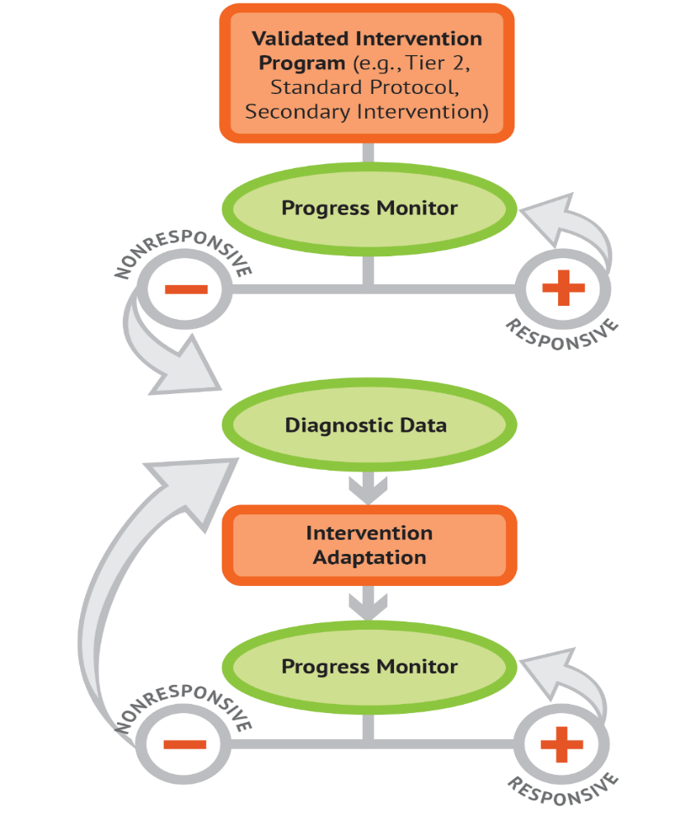
Using the Taxonomy of Intervention Intensity Within the DBI Process
Evaluate current interventions.
Select a new intervention.
Intensify the intervention.
Notes:
The seven dimensions of the Taxonomy of Intervention Intensity can help you make informed, systematic decisions in the context of the DBI process. The taxonomy primarily applies to the orange bubbles (the validated intervention program and intervention adaptation), which will be the focus of the presentation today. The taxonomy (Fuchs, Fuchs, & Malone, 2017) can be used to select or evaluate an intervention platform used as the validated intervention platform (this selection/evaluation process forms the foundation of the DBI process). The taxonomy also provides guidance on how to intensify, modify, and adapt the intervention during the intervention adaptation step of the DBI process. Note that the taxonomy and DBI are NOT mutually exclusive—the taxonomy drives the DBI process.

Slide 8
Activity: Brainstorm Current Math Interventions
What interventions are you currently using with these students? (Or what have you used in the past?)
How do you select interventions?
How do you decide how and when to make adaptations to an intervention for an individual student?
Handout
Notes:
As we start this presentation, let’s take some time to brainstorm the current math interventions that you have in place. As you brainstorm, note any of the interventions that are standard intervention protocols or prepackaged interventions (in contrast to interventions that may be a mixture of several strategies). Use the handout in your workbook to document any available interventions, how interventions are selected, and how you decide when to make adaptations to an intervention for a particular student.
Provide participants about 5–7 minutes to complete this activity in teams. Once the teams have completed the activity, have a couple of teams share out some of the interventions they are using, and how they select and adapt them.

Slide 9
Validated Intervention Program
Why start with a standardized, evidence-based program?
When properly aligned to students’ needs, they tend to work—teachers don’t need to “reinvent the wheel.”
They are efficient—teachers can plan instruction for groups rather than individual students.
Many require only a modest amount of training—often, paraeducators can help with delivery.
Often inexpensive, although costs can vary.
Notes:
In the previous activity, we had you brainstorm your currently available interventions and note any standardized interventions available. Although we know that there are no perfect interventions, there are a growing number of evidence-based standard protocol interventions that can be used as a starting place. What do we mean by standardized? A standardized intervention uses research-based instructional programs, is provided in a specific manner to students, and typically includes a step-by-step sequence.
So, why use evidence-based standard protocol interventions?
Review slide bullets.

Slide 10
Can I still implement DBI if I don’t have a standardized, evidence-based program (EBP)?
I can tell you’re struggling with fractions, Tony, but there aren’t any EBPs for kids in your grade. Maybe check back in a few years?
Notes:
One question you might have is “Can I still implement DBI if I don’t have a standardized, evidence-based program?” As you can see in the cartoon, the teacher is saying, “I can tell you’re struggling with fractions, Tony, but there aren’t any EBPs for kids in your grade. Maybe check back in a few years?” In reality, we are not able to do this. We have students showing up at school every day and we have some areas that have limited or no EBPs. Our recommendation is to use a standardized, evidence-based program when it is available and consider augmenting current offerings if there are content areas where you have insufficient resources.
As Bryan Cook says in a module from the IRIS Center:
The number of available practices that meet EBP criteria are limited, but…
“Every evidence-based practice at some point started off as a non-evidence-based practice that we didn’t have enough research out yet to tell whether it was evidenced based. And so just because something’s not evidenced based doesn’t necessarily mean that it’s ineffective.”
-Bryan Cook http://iris.peabody.vanderbilt.edu/module/ebp_01/cresource/q1/p01/transcript/#content
During the next section, we will introduce the Taxonomy of Intervention Intensity and discuss how the you can use the dimensions to guide your understanding of the intervention you are providing. This applies both to a standard protocol intervention as well as those that you may need to design due to limitations in available programs.

Slide 11
Validated Intervention Programs: Components to Consider
Effect size
Evidence-based programs
Opportunities to respond
Group size
Alignment with grade-level standards
Explicit instruction and modeling
Frequency and duration of intervention
Concrete learning opportunities
Break tasks into smaller steps
Connection to Tier 1 instruction
It would be helpful if there was a framework to guide our thinking when we are deciding what interventions to use and how to adapt them.
Notes:
As we think about our validated interventions, we need to consider two elements. The first is that they should be designed based on the Taxonomy of Intervention Intensity, and the second is that they should be conducted with fidelity. In other words, what we are going to implement and how we will implement it?
Often, when we consider our intervention, we focus only on whether a study or two (or sometimes a colleague) has said that it is effective or has an evidence base. In fact, as we think about our validated interventions, we want to consider (click for animations and review as they appear). To help us guide our understanding, it would be helpful if we had a framework….

Slide 12
Key Considerations When Selecting or Evaluating Validated Interventions for DBI
Does evidence suggest that the intervention is expected to lead to improved outcomes (strength)?
Will the group size, duration, and frequency provide sufficient opportunities to respond (dosage)?
Does the intervention match the student’s identified needs (alignment)?
Does it assist the student in generalizing the learned skills to general education or other tasks (attention to transfer)?
Does the intervention include elements of explicit instruction (comprehensiveness)?
Does the student have opportunities to develop the behavior skills needed to be successful (behavioral support)? Can the intervention be easily integrated into academic instruction (academic support)?
Can the intervention be individualized with a data-based process to meet student needs (individualization)?
Handout
Notes:
…or set of guiding questions that we need to consider. On the slide, you see a series of questions. These questions map to the seven dimensions of the Taxonomy of Intervention Intensity that we looked at earlier. These seven dimensions were initially proposed in a 2017 article in TEACHING Exceptional Children, by Lynn and Doug Fuchs and Amelia Malone, to help educators consider the strengths and weaknesses of their intervention and guide intensification. Our understanding about these dimensions and their application to behavior was expanded upon through the work of the National Center on Intensive Intervention (NCII) and their technical work group.
Review slide.

Slide 13
Taxonomy of Intervention Intensity
Strength
Dosage
Alignment
Attention to Transfer
Comprehensiveness
Behavioral/Academic Support
Individualization
Fuchs, Fuchs, & Malone (2017)
Notes:
In subsequent sections of the presentation, we will explore each of these dimensions in depth and discuss how you can use the dimensions to better understand your intervention and the areas that you may need to intensify or adjust over time to better meet students’ needs.

Slide 14
Taxonomy Ratings Rubric
0 | 1 | 2 | 3
Fails to Address Standard | Addresses Standard Minimally | Addresses Standard Moderately | Addresses Standard Well
Handout
Notes:
As we walk through each taxonomy dimension, we’ll also discuss how you and your intervention team would go about rating that dimension of a validated intervention program. Rating the intervention can help us to better understand the strengths and weaknesses of our intervention across each of the dimensions. Take a minute to review the rubric and note any areas where you have questions. As we discuss each of the dimensions of the taxonomy, we’ll practice rating aspects of interventions on each dimension together. As you can see, the rating scale we will use ranges from 0 (fails to address standard) to 3 (addresses standard well).
Please note that there are no “hard and fast rules” for rating the degree to which an intervention addresses a standard. A rater must consider the characteristics and needs of the student as well as the intervention context. In other words, ratings are sometimes relative rather than absolute. Today, we’ll do our best to provide diverse examples that illustrate a variety of scenarios.
Provide participants with 3–5 minutes to review the rating rubric.

Slide 15
Strength
Notes:
The first dimension we will discuss is strength.

Slide 16
Strength
How well does the intervention work for students with intensive intervention needs (students below the 20th percentile)?
Considerations:
Has this intervention been evaluated empirically using scientifically sound, rigorous methodology?
What were the effects of the study?
For group design studies: What is the reported standardized mean effect size for this intervention, and what does it look like for students with intensive needs (<20th percentile)?
For single-case design studies: Is it identified as a promising or effective program by a reputable source?
Notes:
As we discussed earlier, when we think about an evidence-based intervention, we often focus on the strength dimension. This dimension tells us how well the intervention works and whether we can expect to see results.
When we consider strength, we are focused on two things.
First, was the intervention evaluated empirically using scientifically sound, rigorous methodology? In other words, can we trust the outcomes of the study? These results must be assessed through the lens of high-quality research design. A study could be group design (more often seen for academic interventions) or single-subject design (more often seen for behavioral interventions).
Second, what were the effects of the study? When we look at the effects of the study, for group-design studies, we are typically looking at the effect size, which provides a method for quantifying the strength of the intervention. If the study was single-subject design, we look for performance data for students closest to the target student. Did he or she meet their benchmarks? Most interventions are validated for use with Tier 2 students (students <50th percentile), but to understand how an intervention would work for a student with more intensive needs, when possible, we want to look for results reported for students <20th percentile. It is important to note that this disaggregated information is not always available for review.
Note: Based on the audience, you may decide to further simplify or enhance this section. Strength and understanding of effect sizes or the results of single-case studies is often challenging for educators who do not have a background in this information.

Slide 17
What to Look for When Examining the Published Evidence Base
Type/Source
Is the source reputable? Can it be trusted?
Population
Were the students included in the study similar to our students?
Desired Outcomes
Were the outcomes of interest relevant to our students?
Effect Size (for group design studies)
Does the evidence suggest that the intervention can produce the result we expect?
Notes:
To ensure that a validated intervention program is evidence-based, teams should convene to review the existing research on that particular program and the quality of the available research.
You can focus your efforts by looking at these areas when examining the evidence base:
First, consider the type of information and source from which you are gathering this information. Is the information coming from the intervention vendor or a reputable website? Also ask yourself, what type of evidence is available? Did the study involve experimental design, where the intervention group was compared with an equivalent control group? The better the study, the more we can trust the outcome data.
Next, consider the population. For which populations has the program been researched and found effective? Is the sample described? Is the population similar to or representative of your student population? Are there different effects for different population groups? This area might be especially important when we are thinking about students with intensive needs. As mentioned on the previous slide, often we find studies that look at the effectiveness of the intervention for students below the 50th percentile, but if we are focused on students with more intensive needs, we might want to see if there is evidence available that more closely matches our population, or students below the 20th percentile. In addition, for English learners you might want to consider whether there is evidence of effectiveness for students learning English.
It is important to consider whether the desired outcomes assessed in a study are relevant to the outcomes you hope to achieve with an intervention and in the expected direction.
Finally, consider the effects. Were the effects of the study large enough to be meaningful? As part of our review of effect sizes, we also may want to consider whether the intervention has been replicated (e.g., Has more than one study illustrated similar findings or results?). When we analyze findings, we may need to consider the overarching body of evidence.

Slide 18
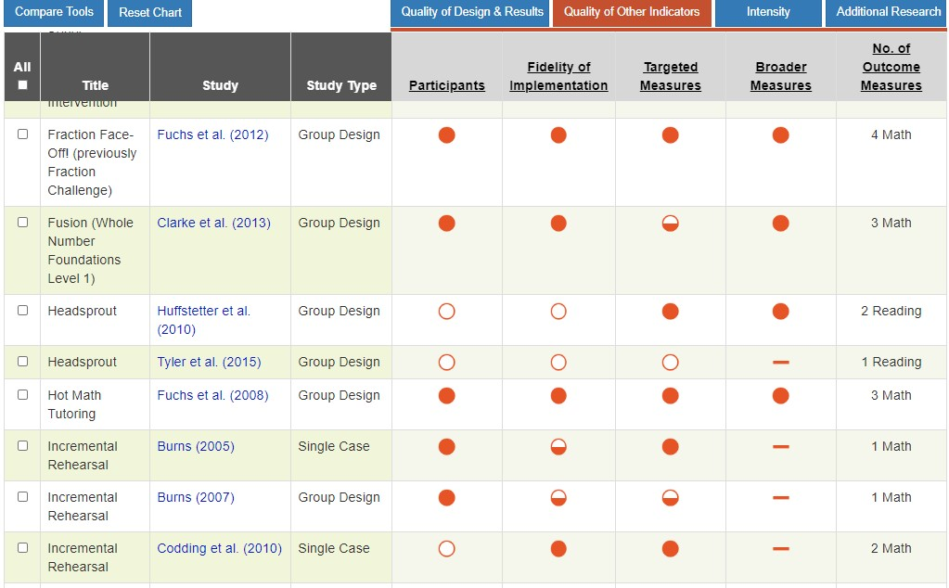
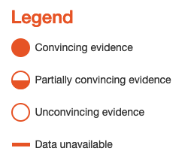
Look at the Evidence: NCII Tools Chart
Notes:
Before looking at the reported effects of an intervention, ask, “Was this intervention empirically tested? The quality of the research design is closely related to assessing whether the strength of the intervention is believable.
Yes—It was tested by means of a randomized controlled trial, an appropriate quasi-experimental design, or single-case research design.
No—This intervention is based on a case study, descriptive information, or anecdote.
You can use the National Center on Intensive Intervention’s Academic Intervention Tools Chart to examine the quality of evidence for interventions. In this example, by looking at the study quality for Fraction Face-Off!, it looks promising. When you have more open circles—the quality of the research is weak, and you should interpret the intervention strength with caution. When you have more closed circles--the quality of the research is strong, and you can interpret the reported strength with confidence. The NCII tools chart is interactive so you can click on a circle to see additional data.
Our example includes a group-design study. You should ask a few key questions about the study that could potentially threaten the internal validity of a group design study:
Did random assignment occur? Were groups deemed equivalent on a performance variable and/or demographic variables before the study commenced?
Were the outcome measures researcher designed, or were they a mix of researcher-designed measures and standardized assessments?
Did effects generalize to more general assessments of mathematics performance, such as state-level tests?
How was risk status conceptualized?

Slide 19
What is an effect size?
A quantitative way to look at the strength of an intervention
Several factors impact the effect size. The general rule of thumb provided below can be used as a starting point, but other factors should be considered.
Strength | Effect Size
Small (minimum) | 0.25 to 0.34
Moderate | 0.35 to 0.49
Strong | 0.50 or larger
Notes:
Researchers will usually use two ways of describing the “success” or “efficacy” of their intervention. The first way is “statistical significance.” If something is statistically significant, it means that the likelihood of finding a particular result by chance is less than 5%. In other words, that it is highly unlikely that the results of the study are a fluke. Significance is important to consider because it helps guard against the costly mistake of labeling something as effective when it is not.
Statistical significance tells us if something is effective—it can’t tell us how effective that thing is. That’s where effect size comes in. An effect size is a standardized measure of the strength of an intervention. To conceptualize what an effect size is, consider an assessment that has an average score of 100 and a standard deviation of 10 (meaning, on average, scores between students vary by 10 points). An effect size of 1.0 would mean that intervention students scored, on average, 10 points higher on the end-of-intervention measure.
Although several factors may impact the effect size, a general rule of thumb for educational effect sizes for academic outcomes is provided (review slide). We can use these as a starting place to consider the effectiveness of the intervention.

Slide 20
How important are effect sizes?
Effect sizes are not always available.
When available, effect sizes must be interpreted with caution.
Effect sizes can be impacted by:
Study conditions
Content studied
Study population
Notes:
Depending on the study design, effect sizes may not be available. This is often the case with behavioral interventions that use a single-case design. Even when they are available, effect sizes must be interpreted with caution and in context (Hill, Bloom, Black, & Lipsey, 2008) because they can be influenced by several factors, including study conditions, the content studied, and the type of student.
For example, interventions for younger students, that involve researcher-created measures administered shortly after the intervention would be expected to have higher effect sizes. As students get older, the expected effect sizes tend to get smaller. Similarly, interventions that have been tested using standardized measures also would be expected to yield smaller effects. In addition, it is easier to find larger effects when measures are proximal or more directly related to the intervention compared with measures that may incorporate more global measures.
The study conditions also can influence effect sizes. Effects from research studies were usually obtained under high levels of fidelity that are often difficult to achieve in authentic classroom settings. In addition, lower effect sizes could be statistically significant in one study and not significant in another study. Because sample size largely drives the differences between groups, this must be taken into account.
In other words, the effect size is one piece of information we can use to understand the intervention’s potential effect, but it is not the only piece of information we consider.

Slide 21
Strength Rating Scale
0 | 1 | 2 | 3
Fails to Address Standard | Addresses Standard Minimally | Addresses Standard Moderately | Addresses Standard Well
No validated studies No effect size can be determined Reported effect size is < 0.2 | Effect size is 0.2 - 0.34 (researcher-designed measure) | Effect size is 0.35 - 0.55 (researcher-designed measure) -OR- Effect size is 0.2 - 0.3 (standardized measure) | Effect size ≥0.55 (researcher-designed measure) -OR- Effect size ≥ 0.3 (standardized measure)
Notes:
So, how can you use an effect size to rate an intervention’s strength. Although we know we have to be cautious with effect sizes, we can use them to help us think about the strength of the intervention. Specifically, we might look at the following rubric to help us think about our effect sizes.
Reminder: This is not a hard and fast rule. Note that the values listed above are only relevant if the effect size reflects a significant difference between conditions. For example, if a study reports a nonsignificant effect size of 0.30, then the rating must be 0. This does not mean that there is not a potential for group differences, but the example study in question was not sufficiently powered to detect a significant difference between groups.
Some notes:
On the tools chart, you will sometimes see a small u—this means that the researchers did not adjust for pretest means, and the information was not available for NCII to provide this correction. The highest rating you would give an intervention with a “u” next to its effect size is 2.
On the tools chart, you will sometimes see a small star—that means the effect was significantly significant. If the authors report a moderate, but statistically significant, effect size, rate it as 3.

Slide 22
Rating Strength: Demonstration
Notes:
Let’s look at a snapshot of study results for Fraction-Face Off!. The screenshot on the top shows the Quality of Design and Results tab of the chart and the screenshot on the bottom shows the Quality of Other Indicators tab. Starting at the bottom right, we can see that there were four outcomes reported in this randomized controlled trial. It appears that some measures were “targeted” (meaning they were more closely aligned to the content taught during the intervention) and that at least one of the measures was a “broader-based” measure. This typically means it’s either a standardized assessment or some type of measure assessing student performance in a broader way than testing students on the content they’re learning. From this screen, we cannot differentiate this.
Note that visual analysis is never applicable for group-design studies (only single-subject research designs), so this category is marked as “not applicable.”
Researchers do not disaggregate performance data by demographic groups, but they DO disaggregate data for students below the 20th percentile. This is extremely important, especially if the study sample also includes students above the bottom quartile. If a Tier 2 intervention is equally efficacious for students below the bottom quartile, and those above the bottom quartile, that provides an additional level of confidence that the reported strength of the intervention can potentially positively impact students in need of more intensive intervention.

Slide 23
Rating Strength: Demonstration
Notes:
Let’s now look at the reported effect sizes for Fraction-Face Off!. Researchers reported on four measures. Three of the four measures were “targeted” outcomes, and one measure was a “broader-based” assessment. The effect sizes range from 1.13 to 2.49. For the targeted measures, the average effect size among the three assessments is 1.81. Each of these outcomes has a p-value <.001.
So, what does this mean? The p-value of an outcome tells you whether the reported outcome is statistically significant. This is a measure of how different the intervention group was from the control group. Both groups would theoretically grow in their mathematics skills over the course of the academic year, so we need to ensure that an observed empirical difference translates to a mathematical difference in means. What do effect sizes tell us? Let’s take a closer look.

Slide 24
Rating Strength: Demonstration
0 | 1 | 2 | 3
Fails to Address Standard | Addresses Standard Minimally | Addresses Standard Moderately | Addresses Standard Well
No validated studies No effect size can be determined Reported effect size is < 0.1 | Effect size is 0.2 - 0.34 (researcher-designed measure) | Effect size is 0.35 - 0.55 (researcher-designed measure) -OR- Effect size is 0.2 - 0.3 (standardized measure) | Effect size ≥0.55 (researcher-designed measure) -OR- Effect size ≥ 0.3 (standardized measure)
✔︎
Notes:
All reported effects are positive and statistically significant. All measures were researcher-designed. (*Note that the National Assessment of Educational Progress items were from a standardized assessment, but those items grouped together are not a published standardized assessment.) All measures show a large effect (click for animation), so I would rate this intervention as a “3” (click for animation) on strength. This intervention appears to have potential to produce a positive effect.

Slide 25
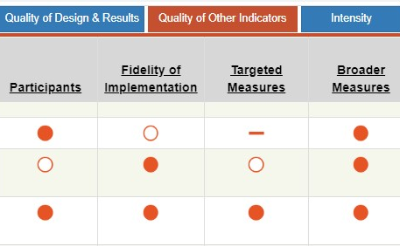
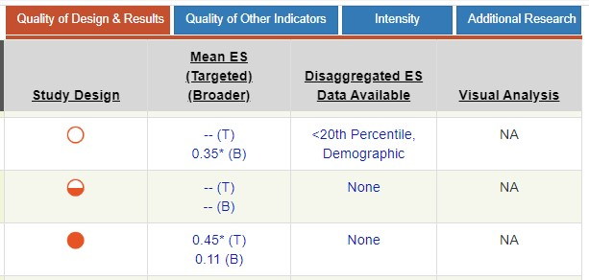
Rating Strength: Guided Practice
1
2
3
Notes:
Let’s work through this together. Here is a comparison of three different math interventions for elementary students. Before we rate the effect sizes, let’s look at the study quality. Of the three interventions, which one appears to have the highest quality? (3). Yes; the evaluation of this intervention was rigorous—that means I can have more confidence in the results.
Interventions 1 and 2 have more open circles than the third—that means that we can’t have as much confidence in the reported results. In fact, both interventions fail to report effect sizes, even though they report between one and six mathematics outcomes. Both interventions would likely be scored 0 on the strength rating scale.
Intervention 3 has high-quality ratings. We can be fairly confident in their findings because their methodology was strong. They report on seven mathematics outcomes. There is an asterisk next to the effect size in the targeted category. This means the difference between groups was statistically significant. However, this study does not disaggregate data for the bottom quartile. Let’s take a closer look at the results of this study.

Slide 26
Rating Strength: Guided Practice
Notes:
Taking a closer look at the effects by measure, it appears that intervention students outperformed control students on three of the five targeted measures, focusing on calculations or proficiency with word problems. Intervention students did not outperform control students on the two broader measures. Do nonsignificant effects automatically discount the overall strength of the intervention? (No.) You must be mindful of the measures used to assess the intervention. Sometimes, it’s incredibly difficult to get a student to move on broader and standardized measures. That does NOT mean the intervention shouldn’t be considered.

Slide 27
Rating Strength: Guided Practice
0 | 1 | 2 | 3
Fails to Address Standard | Addresses Standard Minimally | Addresses Standard Moderately | Addresses Standard Well
No validated studies No effect size can be determined Reported effect size is < 0.1 | Effect size is 0.2 - 0.34 (researcher-designed measure) | Effect size is 0.35 - 0.55 (researcher-designed measure) -OR- Effect size is 0.2 - 0.3 (standardized measure) | Effect size ≥0.55 (researcher-designed measure) -OR- Effect size ≥ 0.3 (standardized measure)
✔︎
✔
Notes:
Two of the three measures with positive effects were researcher-designed. (*Note: Story problems was not designed by the researchers conducting the study, but by researchers in another group. However, this measure has not been standardized. WJ-Calculations is the only standardized measure.) Because both of the researcher-designed effect sizes were on the higher end of the “2” rating scale (click for animation) and the effect size on the standardized assessment was in the “3” category (click for animation), I would rate this intervention as a “3” on strength (click for animation). The effect sizes on the other measures were positive, but not statistically significant. Given the quality of the study, this intervention appears to have potential to produce a positive effect.

Slide 28
So, how do we interpret effect sizes and strength?
Effect sizes, when available, provide a starting point for considering the strength of an intervention.
Information about the strength of the intervention also can be gathered based on information from reputable sources (e.g., NCII Tools Charts, What Works Clearinghouse).
Effect sizes should be used with other dimensions of the taxonomy for individual students or groups of students in a particular context.
Notes:
Although effect sizes provide a starting point for considering the effectiveness of an intervention, they must be interpreted with caution. We can use information from reputable sources to supplement what we know from an effect size or provide us with information if an effect size is not available. It also is important to remember that the effect size is used along with information about the other dimensions of the taxonomy to help us determine whether the intervention is a good match for the individual student or group of students in a particular context.

Slide 29
Dosage
Notes:
Next, we will look at the dosage dimension.

Slide 30
Dosage
Dosage refers to the number of opportunities that a student has to respond and receive corrective feedback. Each of these might impact dosage:
Number of sessions (frequency of sessions)
Duration of sessions
Student-teacher ratio
Number of practice problems provided
Notes:
Dosage refers to the number of opportunities that a student has to respond and receive corrective feedback. When we think about dosage, we can consider several areas. We might think about the number of sessions (e.g., how many sessions per week the student received the intervention), the duration or length of the session, the student-teacher ratio, and the number of practice problems provided.
Time is an important consideration because it allows more instruction to take place, provides more practice with feedback because the teacher is present, and increases students’ engaged learning time. All of these accelerate student learning, particularly when they are combined with other dimensions that we will discuss as part of the taxonomy. We know that for students with more intensive needs, they often need many more practice opportunities. Although time plays a major factor in dosage, note that it is important to not just focus on time, but on how that time is used. That is why we define dosage as opportunities to respond.
There also is no one-size-fits-all amount of time for intensive intervention. Evidence suggests that students with intensive needs may benefit from 60–120 minutes of intervention per day. However, this time may be broken up into several sessions throughout the day (Vaughn et al., 2012).
Instead, we must consider:
How far the student’s achievement is below grade level
The length and frequency of the previous interventions
The complexity of the learning tasks
Student stamina and attention span (To maintain attention and engagement, particularly with younger students, staff may consider two sessions per day.)

Slide 31
Tips for Evaluating Dosage
Review the content available on the NCII Tools Chart or similar review (if possible).
Access the materials/lessons (if possible).
Choose two lessons each from the beginning, middle, and end of the program—count how many times the student has to respond and receive feedback.
Think about your capacity to create smaller groups: Will you be able to deliver the intervention one-on-one or do you need to adapt the dosage suggested in the manual for a larger group?
Notes:
So, how can you rate an intervention’s dosage?
Sites like the NCII Intervention Tools Charts includes a review of the target duration, frequency, and group size of the intervention. This information can provide an overview of information about dosage. As we are focused on opportunities to respond, that alone is often not sufficient, but it may be all that we have access to. If possible, it is helpful to examine the opportunities for students to respond by reviewing materials or lessons. In some cases, it might be difficult to truly determine the number of opportunities to respond just by looking at a lesson, as it is subjective. Another thing to keep in mind and a note of caution is that if an intervention has been validated one-on-one or in pairs—but you intend to use it with a much larger group—you should account for that when considering dosage and not expect the same effect size or strength. Decreasing the dosage is likely to decrease the efficacy of an intervention just like any medicine or treatment. If you aren’t going to take something as prescribed, you can’t expect to reap the same benefits. Similarly, you might increase the dosage by using peers (especially, if those peers have a better grasp of the skill being taught and can provide good feedback).

Slide 32
Dosage Rating Scale
0 | 1 | 2 | 3
Fails to Address Standard | Addresses Standard Minimally | Addresses Standard Moderately | Addresses Standard Well
Same as Tier I (opportunities to respond and receive corrective feedback are similar to Tier 1) | Slightly more than Tier 1 (e.g., 2-3x more opportunities to respond and receive corrective feedback) | Same as Tier 2 (e.g., 4-5x more opportunities to respond and receive corrective feedback) | Substantially more than Tier 2 (>5x more opportunities to respond and receive corrective feedback)
Notes:
Review rating scale.
Let’s think back to the Fraction Face-Off! example we looked at under Strength. If a student is already receiving Tier 2 math instruction, we need to ensure the dosage is greater than what they are already receiving. The rating scale compares the dosage with what’s already occurring in the classroom. In the Tier 1 setting, how many times would you (the teacher) be able to provide immediate, corrective feedback to a student in a whole-class (not centers) setting during a typical core math block? Think about this specifically related to the student’s target deficits. Would you have time to teach, reteach, and potentially redirect when the student does not understand the content being taught? Maybe the student writes down what you’re saying but has no ability to perform the requested task. Likely, you have very little (if any) time to provide corrective feedback despite the fact that it is clear the student has math deficits that are preventing them from moving further in the math curriculum. When assessing the dosage, consider what the student is already receiving. Is the dosage of the intervention greater than or less than what the student is already receiving? The rating scale uses Tier 1 as a jumping-off point. It could be that the student is already receiving Tier 2 services. If that’s the case, the dosage rating must reach a “3” to be greater than what the student currently receives.
Using Tier 1 as the baseline, ask yourself:
How does the dosage of the intervention compare with the math instruction typically received in Tier 1?
Are there more or fewer opportunities to respond and get corrective feedback?

Slide 33
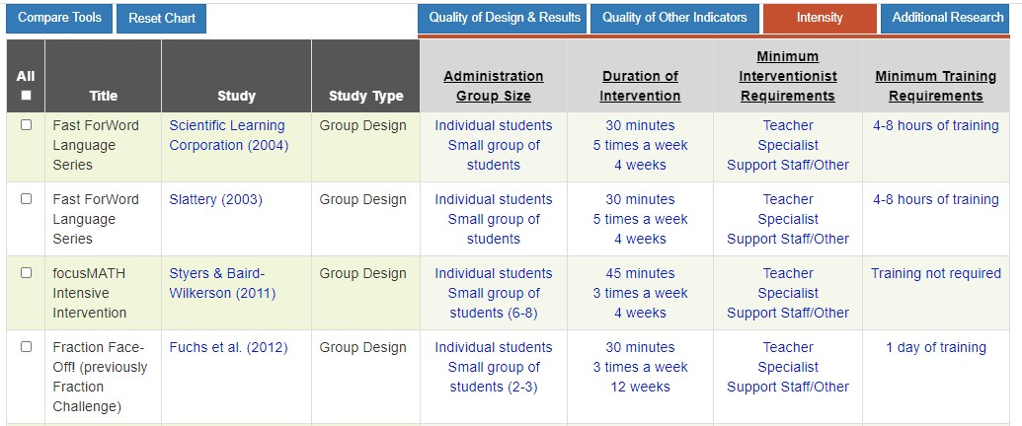
Rating Dosage: Demonstration
Notes:
As noted previously, the NCII Tools Chart can provide you with information about group size as well as session duration and frequency. This can be a starting point for some information about dosage, but it doesn’t actually tell us the number of opportunities students have to respond. By clicking on individual interventions you may be able to learn more about lesson format and make an educated guess about the number of opportunities a student might have to respond.

Slide 34
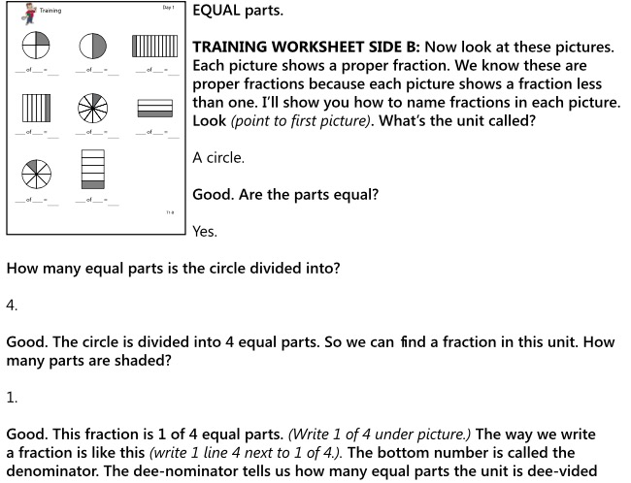
Rating Dosage: Demonstration
Excerpt from Fraction Face-Off!
Notes:
Let’s look at Fraction Face-Off! further. Here’s a snapshot of a sample lesson. (Note: There’s no need to read these lessons or examples.). Within this lesson, the question/answer format allows for about six opportunities to respond and receive corrective feedback for EACH problem. The guided practice portion of this lesson had eight problems--so there were about 48 opportunities to respond in just one section. Lesson scripts are set up such that a student is asked multiple questions within the problem-solving process to allow the teacher to check for understanding at each stage. Now, of course, opportunities to respond vary based on the number of students. This intervention was validated using dyads of students, so the opportunities to respond would be half.

Slide 35
Rating Dosage: Demonstration
0 | 1 | 2 | 3
Fails to Address Standard | Addresses Standard Minimally | Addresses Standard Moderately | Addresses Standard Well
Same as Tier I (opportunities to respond and receive corrective feedback are similar to Tier 1) | Slightly more than Tier 1 (e.g., 2-3x more opportunities to respond and receive corrective feedback) | Same as Tier 2 (e.g., 4-5x more opportunities to respond and receive corrective feedback) | Substantially more than Tier 2 (>5x more opportunities to respond and receive corrective feedback)
Notes:
Fraction Face-Off! is clearly more than Tier 1. In fact, if implemented to a single student, the intervention would provide greater than 5 times the number of opportunities to respond. But, given that it was tested on dyads of students (thus providing fewer opportunities for individual students to respond), we might provide an estimate of “2” on the rating scale.
If you did not have access to sample lessons, it’s difficult to assess how many opportunities the intervention provides for students to respond and receive corrective feedback. You may be able to request a sample from a publisher or find sample lessons available for review on the internet.

Slide 36
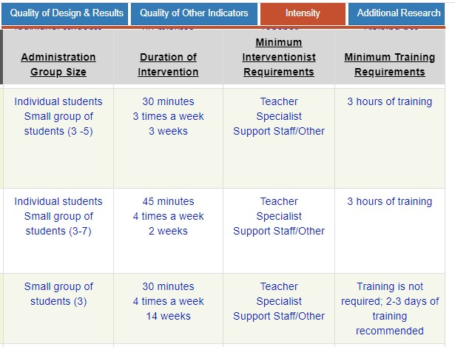
Rating Dosage: Guided Practice
1
2
3
Notes:
Script: Let’s rate three different interventions based on the information provided on the NCII website. Let’s assume we do not have access to sample lessons.

Slide 37
Rating Dosage: Guided Practice Intervention 1
0 | 1 | 2 | 3
Fails to Address Standard | Addresses Standard Minimally | Addresses Standard Moderately | Addresses Standard Well
Same as Tier I (opportunities to respond and receive corrective feedback are similar to Tier 1) | Slightly more than Tier 1 (e.g., 2-3x more opportunities to respond and receive corrective feedback) | Same as Tier 2 (e.g., 4-5x more opportunities to respond and receive corrective feedback) | Substantially more than Tier 2 (>5x more opportunities to respond and receive corrective feedback)
Notes:
(Talk through the different features provided and rate the dosage with teachers.) Without access to sample lessons, we can only consider the general information about the structure of lessons (group size, frequency) to estimate the dosage dimension. In this case, we had an intervention that is delivered individually or in small groups of 3–5 students. It is recommended to be delivered for 30 minutes 3 times a week. We don’t know how many more opportunities to respond and receive corrective feedback from the information we have but, taken together, we would estimate a dosage rating of “2.”

Slide 38
Rating Dosage: Guided Practice Intervention 2
0 | 1 | 2 | 3
Fails to Address Standard | Addresses Standard Minimally | Addresses Standard Moderately | Addresses Standard Well
Same as Tier I (opportunities to respond and receive corrective feedback are similar to Tier 1) | Slightly more than Tier 1 (e.g., 2-3x more opportunities to respond and receive corrective feedback) | Same as Tier 2 (e.g., 4-5x more opportunities to respond and receive corrective feedback) | Substantially more than Tier 2 (>5x more opportunities to respond and receive corrective feedback)
Notes:
Talk through the different features provided and rate the dosage with teachers.) This one is much harder to rate because we don’t have access to sample lessons. However, given that it was tested with a larger group of students, I’d guess it’s about 2–3 times more opportunities to respond even though it is delivered daily for 45–60 minutes. Overall, we might estimate a dosage rating of ”1.”

Slide 39
Rating Dosage: Guided Practice Intervention 3
0 | 1 | 2 | 3
Fails to Address Standard | Addresses Standard Minimally | Addresses Standard Moderately | Addresses Standard Well
Same as Tier I (opportunities to respond and receive corrective feedback are similar to Tier 1) | Slightly more than Tier 1 (e.g., 2-3x more opportunities to respond and receive corrective feedback) | Same as Tier 2 (e.g., 4-5x more opportunities to respond and receive corrective feedback) | Substantially more than Tier 2 (>5x more opportunities to respond and receive corrective feedback)
Notes:
(Talk through the different features provided and rate the dosage with teachers Given that this intervention was tested with a very small group of students and delivered almost daily, we can guess it likely provides greater than 5 times more opportunities to respond. So we might estimate the dosage rating at a three.

Slide 40
Alignment
Notes:
The third dimension of the taxonomy is alignment.

Slide 41
Alignment: Academics
To what extent does the intervention…
Address the full set of a specific student’s academic deficits?
Not address skills the student has already mastered?
Incorporate a focus on grade-level standards?
Notes:
Although alignment is important for all students, it is especially important to consider for students with intensive needs or those who need DBI. As noted previously, these students often need substantially more practice opportunities than their peers. If the intervention is using some of the time to cover skills they have already mastered or fails to focus on the foundational skills where they may have challenges, we will continue to perpetuate or even widen the gap and make it challenging for them to access their core instruction. So, within the alignment domain, we consider the following: (a) the percentage of target students’ skill deficits that are addressed in the intervention (information from the student’s evaluation may be helpful), (b) the percentage of extraneous skills covered, and (c) the percentage of grade-level state standards addressed.

Slide 42
Tips for Aligning Interventions: Identifying a Student’s Intervention Needs
Conduct a diagnostic assessment (e.g., Test of Early Mathematics Ability [TEMA], Diagnostic Online Math Assessment [DOMA], skill analysis).
What are this student's skills and weakness related to…
Number System Counting?
Basic Facts?
Place Value Concepts?
Place Value Computation?
Fractions As Numbers?
Computation of Fractions?
Notes:
In a lot of schools and districts in the country, Tier 2 intervention may be one size fits all. For an intervention to be intense, it needs to be aligned to the needs of the individual student. This means that you need a full picture of their strengths and weaknesses. There are several different math skills that students may struggle with. Using diagnostic data can help you to determine the specific skill areas that students are struggling with so that you can align the intervention to their specific needs.

Slide 43
Slide 66
Example: Identifying a Scope and Sequence
Where student IS
Where student NEEDS TO BE
Explain why addition and subtraction strategies work, using place value and the properties of operations.
Understand that the two digits of a two-digit number represent amounts of tens and ones.
Use addition and subtraction within 100 to solve one- and two-step word problems…
Fluently add and subtract within 100 using strategies based on place value, properties of operations, and/or relationships.
Apply properties of operations as strategies to multiply and divide….
Fluently multiply and divide within 100, using strategies such as the relationship between multiplication and division…
Use multiplication and division within 100 to solve word problems…
Fluently add and subtract multi-digit whole numbers using the standard algorithm.
Find whole number quotients and remainders with up to four-digit dividends and one-digit divisors, using strategies based on place value, the properties of operations, and/or the relationship between multiplication and division.
Solve multi-step word problems posed with whole numbers and having whole-number answers using the four operations…
Understand that the three digits of a three-digit number represent amounts of hundreds, tens, and ones.
Fluently multiply multi-digit whole numbers using the standard algorithm.
continuum of mathematics learning
Developing a Scope and Sequence (Intensive Intervention in Mathematics: Module 1): https://intensiveintervention.org/developing-scope-and-sequence-math-course
Notes:
As illustrated in this example of developing a scope and sequence (Intensive Intervention in Mathematics Module 1), you can see the variety of skills that students need to move from where they are to where they need to be. (Review slide by clicking through animation.)

Slide 44
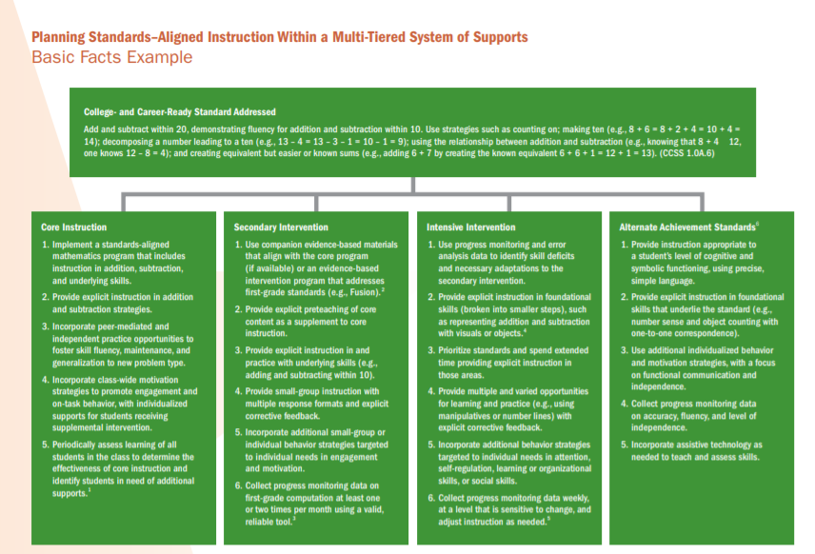
Examples: Alignment to Grade-Level Curriculum
Example of Pirate Math
Pirate Math from Evidence-Based Intervention Network review available at http://ebi.missouri.edu/wp-content/uploads/2014/01/EBI-Brief-Template-Pirate-Math.pdf
Notes:
In general…
An intervention is aligned to grade-level curriculum if it:
Provides instruction for prerequisite skills required for content taught in core instruction.
Allows students to practice the grade-level skill on instructional-level text.
Provides more opportunities to respond and receive feedback on grade-level skills.
An intervention would not be aligned to the grade-level curriculum if it:
Provides instruction on some skills but neglects others.
Replaces core instruction so that students do not have the opportunity to develop background knowledge, vocabulary, and so on from grade-level content.
The sample handout from NCII provides an example of how a grade-level standard for Basic Facts might be addressed across tiers of support.. To see more examples of other content areas, visit https://intensiveintervention.org/standards-relevant-instruction-multi-tiered-systems-support-mtss-or-response-intervention. You also can see the example of how Pirate Math is aligned to standards on the evidence-based intervention website.

Slide 45
Alignment Rating Scale
0 | 1 | 2 | 3
Fails to Address Standard | Addresses Standard Minimally | Addresses Standard Moderately | Addresses Standard Well
Does not align to student’s needs. | Only address SOME of a student’s deficits, overemphasizes already mastered skills, and is not aligned to grade-level standards. | Addresses MOST of a student’s deficits, does not overemphasize already mastered skills, and aligns to curriculum standards. | Addresses ALL of a student’s deficits, does not overemphasize already mastered skills, and aligns to curriculum standards.
Notes:
Review scale.
It is important to continuously consider alignment. During implementation, you may find that the intervention becomes more or less aligned (sort of like clothing when you are on a diet). Students may master some skills—and therefore need less practice—or new deficits might appear.

Slide 46
Rating Alignment: Jackson
Handout
Math Skills | Mastered | Needs
Basic facts | X
Single-digit multiplication | X
Multidigit multiplication |  | X
Multidigit division |  | X
Fraction magnitude understanding |  | X
Understanding place value | X
Converting metric measurement units | X
Addition/subtraction of decimals | X
Comparing decimals | X
Proportional reasoning |  | X
Word-problem solving |  | X
Fraction calculations |  | X
Notes:
Let’s look at an example. In your handouts you have a handout that highlights skills that Jackson has mastered and some where he still needs support. Take a minute to review those areas.
Give participants an opportunity to look over Jackson’s strengths and weaknesses. Participants will need to keep this information in mind for the next slide.
Note that this isn't an inclusive list of all math skills and is used for demonstration purposes only.

Slide 47
Rating Alignment: Guided Practice
Handout
1
Fraction calculations (with multiplication practice)
Part-whole understanding of fractions
2
Addition/subtraction of decimals and fractions
Place value and comparing decimals
3
Proportion word problems
Fraction-magnitude understanding
Comparing decimals
Change word problems
Fraction calculations (with multiplication practice)
Notes:
Now, let’s look at three examples of intervention programs. Which of these interventions would be most aligned to Jackson’s skill needs?
Demonstrate: Does #1 align?
Does it address all his needs?
Multidigit multiplication. NO
Multidigit division. NO
Fraction magnitude understanding. NO
Proportional reasoning. NO
Word-problem solving. NO
Fraction calculations. YES
Does it include intervention around any mastered skills?
Basic facts. NO
Single-digit multiplication. SOME
Understanding place value. NO
Converting metric measurement units. NO
Addition/subtraction of decimals. NO
Comparing decimals. YES
Intervention #1 addresses only one of Jackson’s deficits and largely focuses on skills already mastered. This should receive a 1 for alignment.
Demonstrate: Does #2 align?
Does it address all his needs?
Multidigit multiplication. NO
Multidigit division. NO
Fraction magnitude understanding. NO
Proportional reasoning. NO
Word-problem solving. YES
Fraction calculations. SOME
Does it include intervention around any mastered skills?
Basic facts. NO
Single-digit multiplication. NO
Understanding place value. YES
Converting metric measurement units. NO
Addition/subtraction of decimals. YES
Comparing decimals. YES
Intervention #2 addresses some, but not all, of Jackson’s deficits and includes several skills on the mastered list. If aligned with grade-level standards, this would receive a 1.5.
Guided practice (Engage participants in a guided discussion related to Intervention #3’s alignment.)
Does it address all his needs?
Multidigit multiplication. NO
Multidigit division. NO
Fraction magnitude understanding. YES
Proportional reasoning. YES
Word-problem solving. YES
Fraction calculations. YES
Does it include intervention around any mastered skills?
Basic facts. NO
Single-digit multiplication. SOME
Understanding place value. NO
Converting metric measurement units. NO
Addition/subtraction of decimals. NO
Comparing decimals. NO
How would you rate this intervention?
If aligned to grade-level standards? It partially addresses Jackson’s deficits and minimally focuses on a mastered skill. If it aligned to standards, it would receive a score of 2.5.
The specific numeric rating is less important than the ability to compare the three interventions to each other. #1 is the least aligned, with a score of 0–1. Intervention #2 is partially aligned, so it would have a score somewhere around 1–2. Intervention #3 is the most aligned and would have a score of 2–3. In terms of alignment, Intervention #3 is the most intense.

Slide 48
Making Adjustments to Intervention Alignment
You can make adjustments to an intervention's alignment as you consider the validated intervention program.
If you are working with more than one student, you may have to choose a program that is only minimally or moderately aligned and then adjust in the following ways:
You can choose to skip or abbreviate instruction in previously mastered skills.
You may choose to supplement the program with additional instruction to ensure that all needs are being met.
You may choose to apply the intervention’s instructional components to grade-level texts to improve curriculum alignment.
Notes:
Unlike strength, alignment is something that you can adjust before and during intervention implementation. Remember that when interventions were validated in the research setting, they did not do this (provided it was a group design study). If individual adjustments had been made, it would have been impossible to interpret results.
The DBI process allows you to make the adjustments necessary to take a validated Tier 2 intervention and intensify it to meet your students’ needs. If the intervention as designed is not intensive enough in terms of alignment, you can make it more so by doing the things above.
Review slide.

Slide 49
Attention to Transfer
Notes:
The fourth dimension is attention to transfer.

Slide 50
Evaluating Attention to Transfer Intensity
To what extent does the intervention…
Help students transfer skills they learn to other formats and contexts?
Help students realize the connection between mastered and related skills?
Demonstrate efficacy on standardized measures or measures of generalization?
“generalization”
Notes:
The fourth dimension is attention to transfer. We define transfer as how skills taught in an intervention make their way into the classroom and students’ independent practice. In other words, we might think about how well students are able to generalize the skills from an intervention into their core instruction. Many of us have probably experienced a time where a student demonstrated mastery of taught concepts in the intervention context but failed to demonstrate mastered skills when encountering even minor differences.
Students with and at risk for learning disabilities tend to struggle with generalization (recognizing that the skills and strategies they’ve learned can be applied in other contexts). In fact, this is one of the key components of an educational disability diagnosis (inability to learn from observational learning and independently apply taught skills). When we are thinking about attention to transfer within a specific intervention, we want to consider whether the intervention explicitly teaches students how to apply the skills taught during the intervention in other contexts and makes connections between mastered and related skills. We also might consider how well the outcomes for the intervention generalize to standardized measures or other measures of global skills.
An intervention is more intensive if it provides:
Opportunities for students to develop metacognition and self-regulation to apply strategies independently (look for embedded instruction where students monitor their strategy use, learn acronyms, use checklists, evaluate their work, set goals, make plans, and so on)
A variety of opportunities to practice that explicitly vary the context (different topics, genres, and so on)
Cumulative systematic review
An intervention is less intense if it provides…
Instruction only in the target skills without review
Does not vary the context in any way
Does not include self-regulation/metacognition practice or discussion
Some notes:
Teaching students with disabilities to transfer skills is VERY difficult—even for interventions with a large amount of this built in, it may be insufficient.
Can be adjusted during set-up or implementation based on the needs of students.
In the process of DBI, you will likely need to continually evaluate student generalization and transfer and make instructional adjustments.

Slide 51
Tips to Consider When Evaluating Attention to Transfer
Does it include self-regulation instruction?
Are teaching strategies used across contexts?
Does it include cumulative review opportunities?
Are students able to practice skills with multiple representations (e.g., concrete, representational, abstract)?
Are there examples of evidence of transfer from standardized assessments, state measures, and so on?
Notes:
As with other dimensions, the best way to assess the intensity of an intervention is to spend time with the materials.
Look for things like checklists and independent use of strategies.
Look for discussions about how skills might be used outside of the intervention setting.
Look to see if skills are reviewed continually or taught in isolation.
Look at the types of texts, activities, and worksheets.
Does it include self-regulation instruction? Are teaching strategies used across contexts? Are students taught the steps in a strategy? Do students use a checklist or some other method to monitor their own use of a strategy? Are there opportunities to incorporate goal setting, discussion, acronyms, self-evaluation, and so on? Basically, students are taught to take ownership of the strategy or skill. They can explain the steps in the strategy. They can evaluate their own performance. They can apply the skill or strategy with independence and automaticity.
Does it include cumulative review opportunities? Are skills taught early in the intervention continually reviewed throughout? The cumulative review should build on the overall scope and sequence of reading skills.
Are students able to practice skills with multiple representations (e.g., concrete, representational, abstract)?
Are there examples of evidence of transfer from standardized assessments, state measures, and so on?

Slide 52
Enhancing Transfer
Introduce strategies in the context of a favorite activity.
Begin each session with a discussion of strategy use outside of the intervention.
Use a strategy checklist during the session.
Use acronyms.
End the session with a reminder to practice strategies.
Students receive a new strategy sticky note after each session.
Students regularly receive a new strategy bookmark.
Walsh, Fuchs, Patton, Fuchs, & Lehman (2019)
Notes:
Let’s look at an example from an experimental intervention. The research team developing this intervention struggled for several years to improve instructional transfer. In this year (the fifth year of an iterative project), these are some of the strategies they tried to promote self regulation. Review slide.

Slide 53
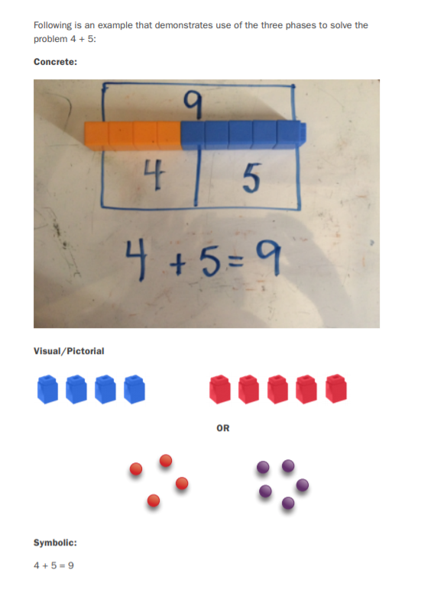
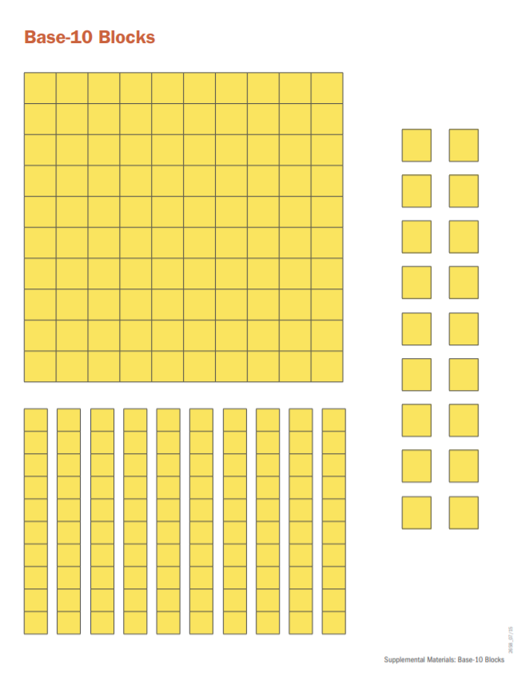
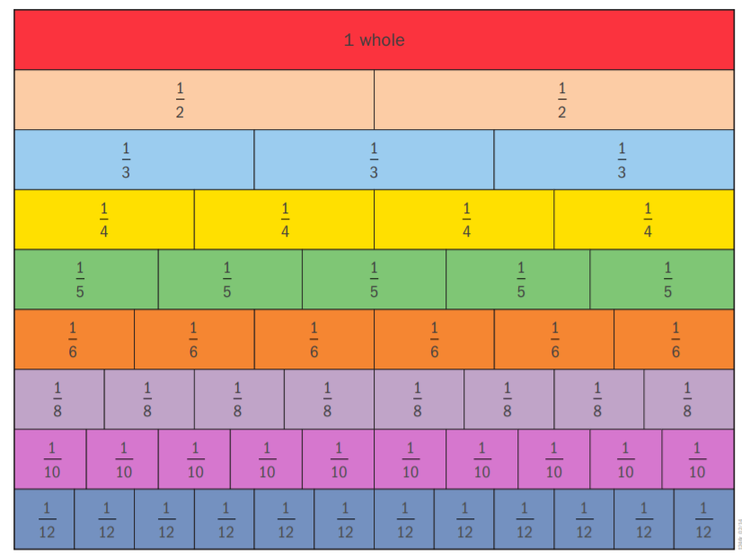
Example: Multiple Representations
Multiple representations
Concrete
Representational
Abstract
Notes:
Here are some other examples highlighting ways in which interventions may incorporate attention to transfer. Using multiple representations to teach mathematics allows students to understand mathematics conceptually, often as a result of developing or “seeing” an algorithm or strategy on their own. By building strong conceptual understanding, students can better generalize skills and understand algorithms (Gersten et al., 2009; Jones, Inglis, Gilmore, & Evans, 2013; Miller & Hudson, 2007). Moving through each phase is essential for every skill area, not just for early foundational skills (Jayanthi, Gersten, & Baker, 2008; National Mathematics Advisory Panel, 2008; Stein, Kinder, Silbert, & Carnine, 2005; Woodward, 2006). A description of the three phases follows.
1. Concrete: In this phase, students use three-dimensional manipulatives to solve problems and to gain a better conceptual understanding of a concept. Examples of manipulatives include counting bears, snap cubes, base-10 blocks, real or plastic money, clocks, fraction tiles, geoboards, Algeblocks, algebra tiles, and others. It is helpful to use a variety of manipulatives (if possible) to teach concepts so that students can generalize the concept being taught. Using an assortment of manipulatives is not always possible, however; some concepts can only be taught using a specific manipulative. It is important to note that although students may demonstrate proper use of a manipulative, this does not mean that they understand the concepts behind the use of the manipulative. Explicit instruction and student verbalizations, such as explaining the concept or demonstrating use of the manipulative while they verbally describe the mathematical procedure, should accompany all manipulative use.
2. Representational/Visual/Pictorial: Students use two-dimensional pictures, drawings, or diagrams to solve problems. These pictures, drawings, or diagrams may be given to students or they may draw them when presented with a problem. These representations should be used to connect and solve the same concepts previously taught using concrete objects. Representational models also may be presented virtually through websites or tablet applications. With a virtual representation, students move the image with a mouse or with their hands.
3. Abstract/Symbolic: During this phase, students are expected to solve problems through the use of numbers and symbols rather than with the use of concrete objects or visual representations. Students are often expected to memorize facts and algorithms as well as to build fluency.
Adapted from the National Center on Intensive Intervention. (2016). Principles for designing intervention in mathematics. Washington, DC: U.S. Department of Education, Office of Special Education.

Slide 54
Attention to Transfer Rating Scale
0 | 1 | 2 | 3
Fails to Address Standard | Addresses Standard Minimally | Addresses Standard Moderately | Addresses Standard Well
Does not promote transfer. | Promotes transfer in 1 of the following ways: Promotes self-regulation and goal setting Cumulative review Varied contexts | Promotes transfer in 2–3 of the following ways: Promotes self-regulation and goal setting Cumulative review Varied contexts | Promotes transfer in all of the following ways: Promotes self-regulation and goal setting Cumulative review Varied contexts Provides empirical evidence of transfer
Notes:
Review slide.

Slide 55
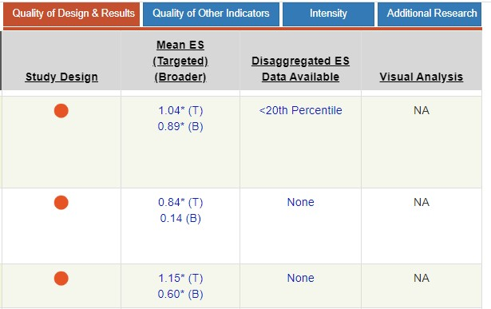
Rating Attention to Transfer: Demonstration
NCII Tools Chart
Notes:
Although it is hard to rate attention to transfer without having access to intervention materials to see how it incorporates cumulative review, self-regulation and strategy instruction, and use of varied context, one way to look at attention to transfer on the NCII Tools Chart is by looking at the mean aggregated effect sizes for broader measures on the study results tab. Broader measures are those measures that are not directly aligned to the intervention instruction. These might include general math measures or a math problem-solving measure for numeracy concepts-focused intervention.
Notice on the chart above: The first intervention boasts a large average effect size on broader (transfer) measures of .89. This means that there is clear empirical evidence of transfer. If the intervention includes activities to promote self-regulation and goal setting, cumulative review, and varied contexts, I’d be inclined to rate this intervention’s promotion of transfer as a 3.
The second intervention has a small, insignificant effect size on broader (transfer) measures of .14.
The third intervention has a moderately large effect size on broader (transfer) measures of .60. This means that there is clear empirical evidence of transfer. If the intervention includes activities to promote self-regulation and goal setting, cumulative review, and varied contexts, I’d be inclined to rate this intervention’s promotion of transfer as a 3. Note that even though there is a difference between 0.60 and 0.89, both effects are significant and robust.

Slide 56
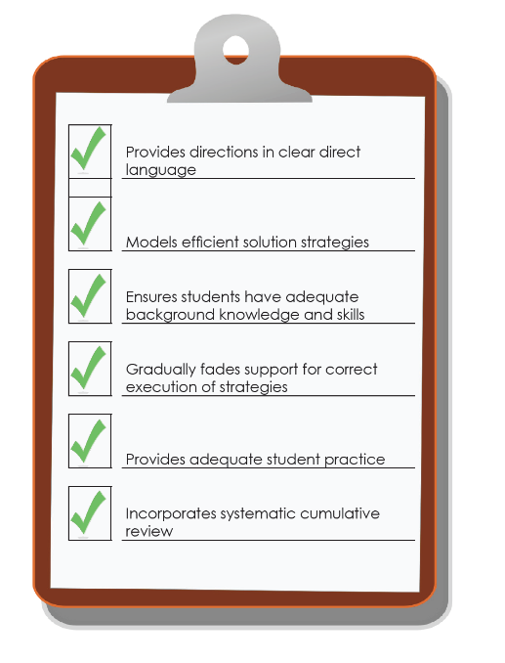
Comprehensiveness
Notes:
The next dimension is comprehensiveness. . When we use the term “comprehensiveness,” we are asking you to think about the extent to which an intervention uses effective principles of explicit instruction.

Slide 57
Comprehensiveness = Explicit Instruction
Explicit instruction is “a way of teaching where the teacher selects an important objective, models the skills being taught, and provides scaffolded practice to help a student achieve mastery” (Kearns, 2018).
Explicit instruction has long been the gold standard when intervening with students with and at risk for learning disabilities (Ciullo, Sabrina Lo, Wanzek, & Reed, 2016; Scammacca, Roberts, Vaughn, & Stuebing, 2015).
Notes:
Explicit instruction is “a way of teaching where the teacher selects an important objective, models the skills being taught, and provides scaffolded practice to help a student achieve mastery” (Kearns, 2018). When working with students in need of intensive intervention (students with and at risk for significant academic deficits and learning disabilities), explicit instruction has been shown, time and time again, to be the most effective method of intervening.
When considering how comprehensive the intervention is, we consider several principles.

Slide 58
Explicit Instruction Principle #1
Uses clear and direct language.
Examine lessons: Do you see clear scripting that introduces directions and strategy steps using clear, direct language?
Notes:
Review slide.
If the instructional materials provided with an intervention do not include clear, concise scripting when introducing new strategies and giving directions, then this explicit instruction principle is missing.
Some notes about this:
Scripts aren’t bad! Implementing DBI is HARD. It requires a lot of mental energy to systematically select, monitor progress, and adjust interventions to the needs of individual students. Thinking of the most concise, clear words to say in every lesson can take energy away from the real work of interventionists. Think of your favorite actors. The script is a jumping-off point; truly great actors breathe new life into a script. Great teachers can do that too!
Scripts support all implementers! Often, due to the finite resources of a school or district, the individuals charged with delivering intensive intervention sessions are paraprofesisonals. Paraprofessionals often have varied job requirements that might include lunch and recess duty, toileting, behavior management, and so on. Coming up with the most concise way to introduce a strategy shouldn’t be one of their jobs.
Using a scripted intervention platform allows for consistency/fidelity in implementation (it is not reliant on your presence).

Slide 59
Example: Clear, Direct Language
Example from Math Strategies to Support Intensifying Interventions:
https://intensiveintervention.org/intervention-resources/mathematics-strategies-support-intensifying-interventions
Notes:
This slide highlights an example script (noted in italics) that is being used as the teacher models a strategy for counting on in one of NCII’s sample math lessons and activities.

Slide 60
Slide 83
Example: Clear, Direct Language
precise
“The denominator is the number of equal parts that make the whole.”
“A difference problem is two amounts compared for the difference.”
“To show the fraction, look at the denominator. A denominator of 5 means I need to break the whole into 5 equal parts.”
concise
“To use partial sums, add the hundreds, then add the tens, then add the ones. Finally, add all the partial sums.”
Instructional Delivery (Intensive Intervention in Mathematics: Module 4): https://intensiveintervention.org/instructional-delivery-math-course
Notes:
Another essential component of clear, direct language for mathematics is the use of precise and concise language. This example comes from the Instructional Delivery Module that is part of the Intensive Intervention in Mathematics Course.
Review slide.

Slide 61
Slide 79
Instead of…
Say…
“And the last one is 10.”
“8, 9, 10. We’ll stop counting there but we could count more.”
“What number is in the tens place?”
“What digit is in the tens place?”
“Six hundred and forty-eight”
“Six hundred forty-eight”
“Bigger number and smaller number”
“Number that is greater and the number that is less”
Hughes et al. (2016)
Instructional Delivery (Intensive Intervention in Mathematics: Module 4): https://intensiveintervention.org/instructional-delivery-math-course
Notes:
This is another example of the importance of clear and direct language in mathematics from the same module.
The Instructional Delivery (Intensive Intervention in Mathematics: Module 4: https://intensiveintervention.org/instructional-delivery-math-course) includes example video lectures of this content and expands upon this content with other examples. You may consider reviewing that module and including some of the video or expanding on this content if needed.

Slide 62
Explicit Instruction Principle #2
Models efficient solution strategies.
Examine lessons/curriculum scope and sequence:
What strategies are being taught?
Do you see clear steps for each strategy?
Notes:
Review slide.
We are talking here about the specific steps that students take to complete a skill. There are many ”evidence-based strategies” that teachers might use in the classroom. That’s not what we are talking about here.
What should you look for:
Complex skills or strategies are broken down into logical steps or instructional units (Explicit Instruction rubric: Moylan, Johnson, Crawford, & Sheng, 2017).
Steps are clear, simple, and memorable.
What you will probably find:
Posters displaying the strategies
Acronyms, such as mnemonics
Numbered steps

Slide 63
Example: Teach Students Attack Strategies
RIDGES
Read the problem.
I know statement.
Draw a picture.
Goal statement.
Equation development.
Solve the equation.
R-CUBES
Read the problem.
Circle key numbers.
Underline the question.
Box action words.
Evaluate steps.
Solve and check.
Instructional Strategies (Intensive Intervention in Mathematics: Module 5 https://intensiveintervention.org/instructional-strategies-math-course
Notes:
This example also comes from the Intensive Intervention in Mathematics Course. In this example, you can see some ways teachers might use as attack strategies for solving problems.
Additional content and examples can be found in Instructional Strategies (Intensive Intervention in Mathematics: Module 5 (https://intensiveintervention.org/instructional-strategies-math-course).

Slide 64
Explicit Instruction Principle #3
Ensures that students have adequate background knowledge and skills.
Does the curriculum review necessary background knowledge and skills?
Are additional supports provided where necessary?
Notes:
Review slide. You may or may not find this. Some programs provide multiple levels—you are expected to choose the most appropriate level based on student abilities. Each level makes assumptions about a student’s prerequisite skills.
However, the most comprehensive programs build this in.

Slide 65
Explicit Instruction Principle #4
Gradually fades support for correct execution of strategies.
Look for guided practice.
Look for specific feedback routines.
Look for instructions on how to fade those feedback routines.
Notes:
Review slide. A comprehensive program should provide clear directions and modeling for specific strategies. Then, it should provide a clear mechanism for monitoring and providing feedback as students develop mastery of that strategy.
Look for instructions about what to say if students get the right answer.
Look for ”checks for understanding.”
Look for detailed instructions on correcting and remediating errors.
Look for how and when those routines should be faded. Eventually, students should master the skills. Are there clear explanations about what constitutes mastery? You might find a ”system of least prompts.” If students perform the strategy perfectly, you would be instructed to give only specific praise. If they struggle, your first step would be to remind them of the strategy step. If they continue to struggle, you might guide their use of that strategy step (maybe with specific questions or prompts). If students can’t do it even with this support, you might be instructed to provide direct modeling.
Look for a clear procedure from moving from teacher directed to student directed.

Slide 66
Explicit Instruction Principle #5
Provides adequate student practice.
How many practice opportunities are there?
What are the feedback procedures?
Notes:
Review slide. You should have looked at this when you rated the dosage. Look at the number of times a student gets to attempt a strategy or skill on their own. As with the last principle, the key to intensive intervention practice is direct, immediate feedback (as opposed to the whole-class environment). There should be procedures in place for how to monitor student independent practice and how to provide support as necessary.

Slide 67
Explicit Instruction Principle #6
Incorporates systematic cumulative review.
Do students continue to practice skills and strategies taught early in the program throughout?
Is there a systematic nature to the way that strategies are introduced?
Notes:
Review slide. Students with and at risk for severe learning deficits require LOTS of practice. They may master a skill one day, or week, or month; then, after a short break, forget everything you taught them. It is really important that a multicomponent intervention includes review. If you are using a series of single-component interventions, you might have to review previously taught strategies yourself.
If you are dealing with a multicomponent intervention, there should be a clear scope and sequence that details how and when strategies are to be introduced.

Slide 68
Comprehensiveness Rating Scale
0 | 1 | 2 | 3
Fails to Address Standard | Addresses Standard Minimally | Addresses Standard Moderately | Addresses Standard Well
Does not incorporate any principles of explicit instruction. | Incorporates 1–2 of the principles of explicit instruction. | Incorporates 3–4 of the principles of explicit instruction. | Incorporates 5–6 of the principles of explicit instruction.
Principles of Explicit Instruction:
Provides directions in clear, direct language.
Models efficient solution strategies.
Ensures that students have adequate background knowledge and skills.
Gradually fades support for correct execution of strategies.
Provides adequate practice opportunities.
Incorporates systematic cumulative review.
Notes:
When you rate the comprehensiveness dimension, you should examine lessons and materials to identify how many principles of explicit instruction are present. An intervention should be rated 0 if you can’t find any. An intervention that incorporates all or nearly all of the principles would be rated a 3.

Slide 69
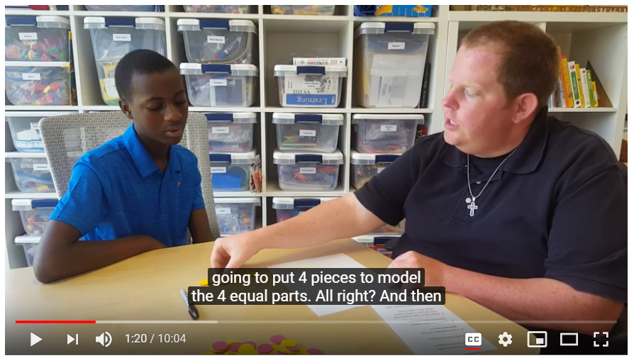
Video Example: Explicit Instruction Principles
Document the explicit instruction principles that you see in this video.
Handout
View video: https://youtu.be/IJMlrvSkPE8
Notes:
In this video, you will see examples of explicit instruction principles. How many of the principles do you see when viewing this example? Use the handout to jot down any instances that you notice.

Slide 70
Additional Resources to Learn More
View module: https://intensiveintervention.org/instructional-delivery-math-course
Notes:
Module 4 of the Intensive Intervention in Mathematics Course Content includes additional information about providing explicit mathematics instruction. You also may check out the Explicit Instruction Course Content if you need additional support about understanding explicit instruction.

Slide 71
Behavioral Support
Notes:
The extent to which behavioral support is provided is the next dimension of the taxonomy.

Slide 72
Behavioral Support in Academic Interventions
Behavioral support refers to the extent to which interventions incorporate—
Methods to promote self-regulation and executive function, and
Behavioral principles to minimize nonproductive behavior.
Notes:
Behavior and academics go hand in hand. The most intense academic interventions incorporate behavioral support. Why? Because students experiencing academic challenges and failure often exhibit inappropriate or nonproductive behavior. Students experiencing behavior or emotional challenges often struggle academically. It is common to work with students who have comorbid learning and behavior disabilities. The most comprehensive programs address both academics and behavior!
As a result, the sixth dimension in the Taxonomy of Intervention Intensity for academic interventions is behavioral support. This refers to the extent to which academic interventions are structured to promote self-regulation and executive functioning as a means of encouraging students with a history of academic failure to persevere with challenging academic content and supporting students to develop a mindset that involves perseverance, hard work, and high standards. It also means the program should incorporate behavioral principles that minimize noncompliant or disruptive behavior.

Slide 73
Behavior Support Rating Scale
0 | 1 | 2 | 3
Fails to Address Standard | Addresses Standard Minimally | Addresses Standard Moderately | Addresses Standard Well
Does not incorporate behavioral supports. | Incorporates 1 of the following behavioral supports: Strategies to develop perseverance with challenging academic content Methods to promote attention, engagement, and other aspects of executive function Behavioral principles that minimize noncompliant or disruptive behavior | Incorporates 2 of the following behavioral supports: Strategies to develop perseverance with challenging academic content Methods to promote attention, engagement, and other aspects of executive function Behavioral principles that minimize noncompliant or disruptive behavior | Incorporates all of the following behavioral supports: Strategies to develop perseverance with challenging academic content Methods to promote attention, engagement, and other aspects of executive function Behavioral principles that minimize noncompliant or disruptive behavior
Notes:
Review scale.

Slide 74
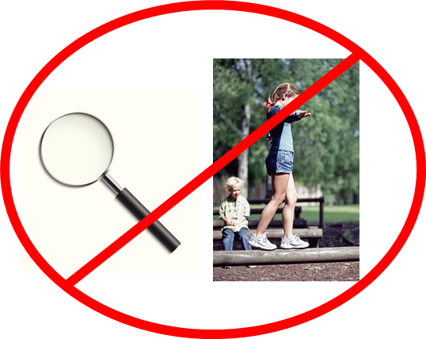
Caution: Treating underlying neurological or processing disorders separate from academic instruction is not supported by research.
Notes:
Review slide.
“Although some students with significant learning difficulties have underlying neurological or information-processing disorders, research does not support the notion that practitioners can identify these disorders (e.g., auditory processing disorders) and then treat them in isolation (e.g., training a child in auditory processing apart from his or her academic learning; Lyon, 1985; Mann, 1979)” (Vaughn et al., 2012, p. 10).
Intensive intervention should be supported by the best available research about what is likely to work for students. Practices that do not have research to support their use will likely be a waste of valuable instructional time.
BUT:
Cognitive processes are important and relevant for learning.
Problems with executive function and self-regulation negatively affect student learning.
Interventions should combine practices that reduce the impact of processing deficits with academic content, not treat them in isolation.
In other words, research that integrates understanding of executive function with academic instruction has yielded the most positive benefits for students with intensive needs. That is, interventions need not prioritize cognitive processes before academic learning can occur. Rather, interventions should support both issues concurrently.

Slide 75
Self-Regulation and Executive Function
Self-Regulation
The ability to manage your emotions and behavior in accordance with the demands of the situation
Executive Function
A set of processes that all have to do with managing oneself and one's resources in order to achieve a goal
These make up the mental processes that enable us to plan, focus attention, remember instructions, and juggle multiple tasks successfully.
Notes:
Under behavior support for academic interventions, we consider the extent that the intervention incorporates self-regulation and executive function. These make up the mental processes that enable us to plan, focus attention, remember instructions, and juggle multiple tasks successfully. Self-regulation is the ability to manage your emotions and behavior in accordance with the demands of the situation and includes:
Planning and setting goals for learning
Monitoring learning and progress toward goals
Regulation of language and memory to support learning (e.g., self-talk, use of strategies)
Attention
Executive function is a set of processes that have to do with managing oneself and one’s resources in order to achieve a goal.
Why does poor self-regulation and executive function impede academic learning? Because students with deficits in these areas demonstrate minimal use of self-directed strategies, they need to be explicitly taught. Students also often exhibit behavior problems because of inattention and poor impulse control. Their inattention makes intake of new information difficult, and their lack of monitoring of learning makes it difficult for students to be aware of what they do and do not know, and when they should request help.

Slide 76
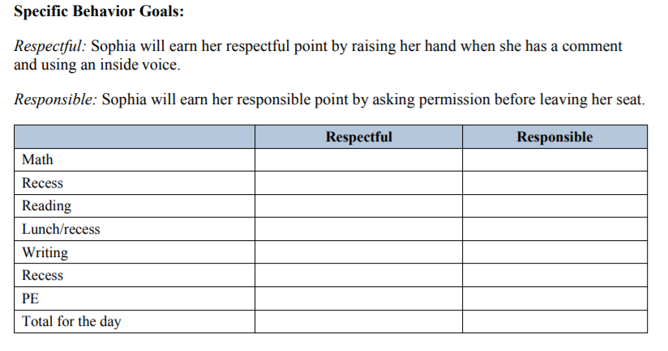
Strategies to Develop Perseverance
Behavior strategies available at https://intensiveintervention.org/intervention-resources/behavior-strategies-support-intensifying-interventions
Appropriate level of challenge
Behavior contracts
Points/rewards based on effort
Use of a timer to develop stamina
Goal setting
Notes:
Students who are experiencing academic challenges must learn to persist despite difficulty and failure. For most students in need of intensive intervention, they have already experienced years of failure. Many of these students will have developed “learned helplessness” and task avoidance (for good reason).
An intensive intervention platform should build in some of these strategies. In addition to the scaffolded support provided in the intervention, students should be able to accomplish the instructional objectives. If the instructional objectives and tasks are the right level of challenge, students can experience success and build both motivation and persistence.
Some examples of strategies that help develop perseverance include… Review slide.
Although some interventions may incorporate these strategies, you also may have these strategies already in place in your classroom, or you can find some examples of strategies on the NCII website that might help you to supplement your intervention.

Slide 77
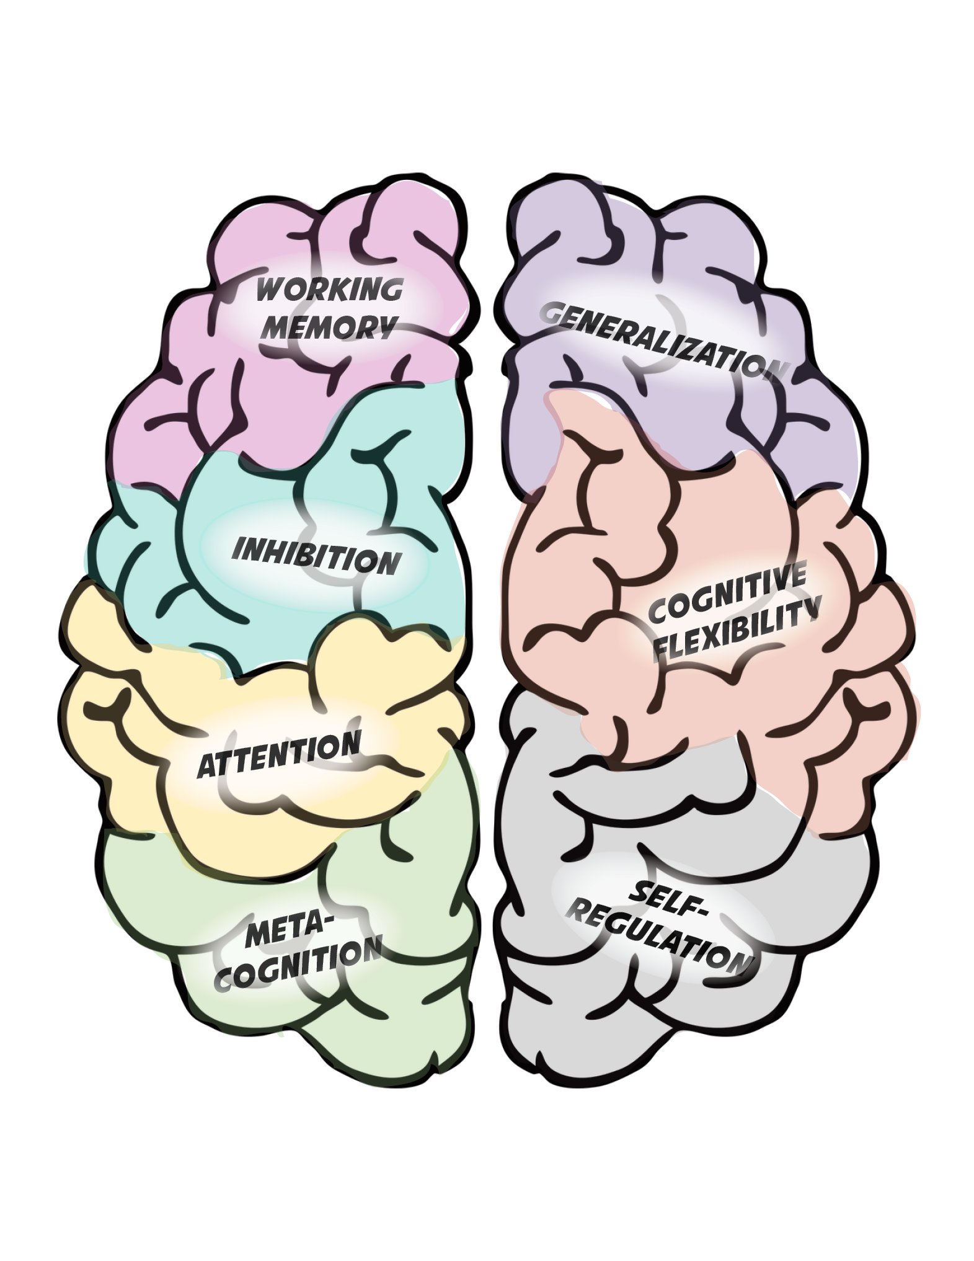
Methods to Promote Executive Function
Self-monitoring/self-evaluation instruction
“Think-alouds” and strategy instruction to support metacognition
Checklists
Point systems
Transfer instruction
Games, media, engaging materials
Notes:
There are a variety of strategies you might find to promote executive function. The strategies listed on this slide are just a few. This is a rapidly developing research area.
*Note: Direct training of working memory/inhibition/memory has not yet been proven to improve academic performance, although research is still being done. It is possible that it could be a successful approach if researchers could identify a better way to do it.

Slide 78
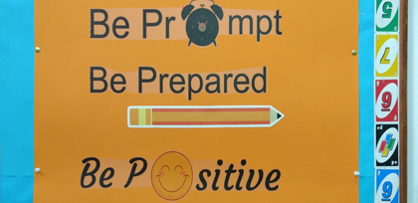
Behavioral Principles That Minimize Nonproductive Behavior
Clear rules/expectations
Behavior contracts
Reinforcement systems
Checklists
Timers
Time management strategies
Notes:
These are just a few of the strategies that can minimize nonproductive behavior.
Setting clear expectations for behavior is important. You might have such expectations or rules in place, but it’s important to review these procedures regularly within an intervention setting, especially when working with students with challenging behavior.
These clear expectations can be supported by having students sign behavior contracts.
Reinforcement systems can help to promote positive behavior, boost engagement, and minimize negative behaviors.
Checklists can help students to know what to expect.
Timers and strong time management procedures can ensure that there are few pauses in the execution of the lessons and that students stay on task and focused throughout.
You may have strong behavior management systems in place, or you may be working with a student with a very specific behavior plan. You should continue to use the system that works for you or that student. An intervention that sufficiently supports behavior is one that provides the raw material for good behavior—even if it’s the canvas on which to place your existing system.
You can’t expect a student to benefit from instruction if their behavior prevents them from participating fully. It is essential to consider behavior when selecting and adjusting intervention platforms.

Slide 79
Slide 184
Example: Behavior Support
Instructional Strategies (Intensive Intervention in Mathematics: Module 5) https://intensiveintervention.org/instructional-strategies-math-course
Notes:
Here is an example from Module 5, Part 3, in the Intensive Intervention in Mathematics Course Content. This provides an example of Fraction Face-Off! Do you see examples of behavioral supports in this description? Turn and talk to a neighbor. Provide 1–3 minutes for pairs to discuss this behavior example.
(From Fraction Face-off available at https://frg.vkcsites.org/what-are-interventions/math_intervention_manuals/)

Slide 80
Demonstration: Intervention Embedding Behavioral Support
Developing Perseverance:
Behavior contract
Point system
Gradual increase in difficulty
Scaffolded support
Promoting Executive Function:
Checklists to promote self-regulation
Transfer activities
Activities to promote engagement (e.g., games)
Minimizing Nonproductive Behavior
Clear rules/expectations
Reinforcement system
Time management strategies
Notes:
Let’s think about the behavioral support embedded in the intervention described here.
1. Look at the strategies used to develop perseverance. Do they seem adequate to you? Can you think of others?
2. Now, think about the strategies used to promote executive function. Do these seem adequate to you?
3. Now, look at the strategies to minimize nonproductive behavior. Do these seem adequate to you?
We could probably all think of additional strategies in each of these areas. However, for the purpose of rating this dimension, we are just looking to see that there are strategies to support each area. Are there? [Yes]. So, this intervention would receive a score of 3.

Slide 81
Learn More About Behavioral Supports
Notes:
NCII has released a set of course content focused on behavior support for intensive intervention. This resource includes an extensive amount of content to support educators in understanding how to support students in the classroom to maximize instruction. The course has eight modules that cover behavioral theory, strategies for supporting students’ behavioral needs, monitoring student progress and making decisions, and intensifying behavioral supports. The course content can be found on the NCII website at https://intensiveintervention.org/intensive-intervention-behavior-course.

Slide 82
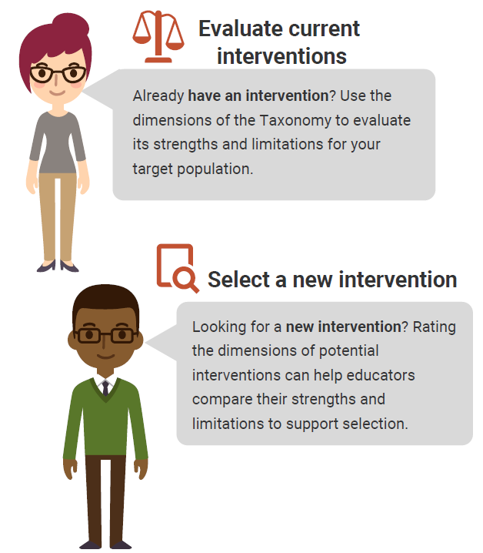
Using the Taxonomy to Find the Best Intervention
There are NO perfect interventions.
BUT
Using the Taxonomy of Intervention Intensity can help you understand the strengths and weaknesses of your current intervention and support your selection of a new intervention.
Notes:
There is no perfect intervention that will work for every student. Educators can use the dimensions of the taxonomy to learn about the strengths and weaknesses of their current intervention and guide the selection process for new interventions.
Rating an intervention across dimensions can help us to quantify our assessment of the intervention’s strengths and weaknesses and document places where we may need to supplement the intervention. In addition, it can help us to compare interventions that we might be using or selecting to identify one that might be a better fit for a student.

Slide 83
Rating the Validated Intervention Program
Ratings provide estimates for the strengths and weaknesses of the intervention on a 0–3 scale.
Some dimensions will be easier to rate than others.
There is no hard and fast rule for ratings.
Ratings can help guide intensification.
0 | 1 | 2 | 3
Fails to Address Standard | Addresses Standard Minimally | Addresses Standard Moderately | Addresses Standard Well
Notes:
There is no perfect intervention that will work for every student. The six dimensions of the taxonomy that we just discussed provide a foundation for how we want to think about features of our intervention. By rating each of those dimensions using a simple 0–3 scale, we can document the strengths and weaknesses of those interventions. As we discussed, there is not an exact science for this rating scale, and some of the dimensions are easier to rate than others. Getting a clear picture of the intervention can really help us to see where we may need to intensify or adjust the intervention in the future if the student or groups of students do not respond.

Slide 84
Activity, Part 1. Assessing Quality of the Validated Intervention Platform
In groups of 2–3, select one math intervention from the list brainstormed earlier.
Review the handout definitions for each dimension and the rating rubric.
Rate the intervention as designed for each dimension (0–3).
Record your responses in the third column.
Handout
Notes:
In this activity, consider one of the academic interventions you brainstormed earlier and, as a small group, do a brief rating of the intervention. If possible, use the NCII website to identify the strength (you also might visit the What Works Clearinghouse or Best Evidence Encyclopedia sites) and your knowledge of the intervention to judge dosage, alignment, attention to transfer, comprehensiveness, and behavioral support. Because alignment is dependent on the skill needs of a specific student, instead, consider the overarching areas that the intervention focuses on and the needs of students in your school or those with whom you regularly work.
The handout in your workbook provides a place for you to note your rating and a brief review of what to consider for each dimension.
Provide groups 5–10 minutes to complete Part 1. If time allows, groups can review a second intervention.
Have teams share out any takeaways from the activity. Were some areas easier to rate than others?

Slide 85
Things to consider…
How do I support my English language learners?
Start with the best match for the mathematics need, then embed language supports.
What if my intervention scores low on some dimensions?
If the math content is appropriate, then consider additional supports you could add to address other areas.
What if it isn’t an exact fit for what I need?
Start with what you have and consider ways you can adapt it.
Notes:
Review slide.

Slide 86
Individualization
A validated, data-based process for individualizing intervention, in which the special educator or interventionist systematically adjusts the intervention over time, in response to ongoing progress-monitoring data, to address the student’s complex learning needs.
Notes:
The individualization dimension is the final dimension of the taxonomy. Review slide. This dimension is not one that we rate as we consider the initial validated platform. In fact, the individualization dimension becomes the ongoing DBI process for intensifying and individualizing the intervention based on data. Although we don’t rate the individualization dimension when we consider the validated intervention program, we may want to consider whether the intervention is something that we can intensify and individualize. Some interventions, especially those that are computer-based programs, may be difficult to intensify and individualize, so we may want to take that into account when thinking about our intervention. We will talk more about individualization as we consider what to do when the student or group of students do not respond to the intervention.

Slide 87
A Note About Fidelity
Selecting an intervention that gets high ratings on the dimensions of the taxonomy provides a good starting place, but it is only as intense as its implementation.
Fidelity is important because it:
Ensures that instruction has been implemented as intended.
Allows us to link student outcomes to instruction.
Helps in the determination of effectiveness and instructional decision making.
Notes:
Review slide.

Slide 88
Turn and Talk
To what extent do these situations affect implementation in your school or district?
Instructional disruptions (testing, special events, intervention session cut short)
Larger-than-designed group size
Fewer sessions than intended
Lack of engagement
Others?
Notes:
Provide groups 3–5 minutes to discuss, then share out.

Slide 89
Five Elements of Fidelity
Student engagement: How engaged and involved are the students in this intervention or activity?
Adherence: How well do we stick to the plan, curriculum, or assessment?
Program specificity: How well is the intervention defined and different from other interventions?
Exposure/Duration: How often does a student receive an intervention? How long does an intervention last?
Handout
Quality of delivery: How well is the intervention, assessment, or instruction delivered? Do you use good teaching practices?
(Dane & Schneider, 1998; Gresham, Gansle, & Noell,1993; O’Donnell, 2008)
Notes:
This graphic provides one example of a way to think about fidelity, and includes the elements of adherence, exposure, quality of delivery, program specificity, and student engagement.
Schools should have procedures in place to monitor the fidelity of their implementation of interventions. Although these don’t have to be formal, it is important to consider whether the programs are being implemented in the way that they are intended to be delivered. In the midst of all the responsibilities of educators, small checks can make a big difference in keeping services for students on track.
Note: The notes on each element on fidelity are animated to pop up with each click. Click ahead each time you discuss a new element of fidelity and click again to close that element.
1. (Click) When we discuss adherence, we are focused on how well we stick to the plan/curriculum/assessment or implement the plan/curriculum/assessment as it was intended to be implemented based on research. For a secondary intervention, this may mean how well teachers implement all pieces of an intervention in the way they were intended to be implemented. This doesn’t necessarily mean that teachers should follow a script word for word, but that covering certain content with appropriate pacing and relevant language and techniques are important. (Click)
2. (Click) Duration/Exposure refers to how often a student receives an intervention and how long an intervention lasts. When thinking about fidelity, we are considering whether the exposure/duration being used with a student matches the recommendation by the author/publisher of the curriculum.
In the case of secondary interventions, developers and researchers typically specify the required exposure/duration that is needed for the intervention to be effective for most students. If the intervention developer calls for the intervention 3 days a week for 45 minutes each day, is the student receiving this dosage? (Click)
3. (Click) Not only is it important to adhere to the plan/curriculum/assessment, but it also is important to look at the quality of delivery. This refers to how well the intervention, assessment, or instruction is delivered. For example, do you use good teaching practices? Quality instructional delivery also means that teachers are engaged in what they’re teaching and animated in their delivery, not simply reading from a script. Providing teachers with constructive feedback on their instructional delivery is one way to improve the quality of delivery for secondary interventions. (Click)
4. (Click) Another component is program specificity, or how well the intervention is defined and how different it is from other interventions. Having clearly defined interventions/assessments allows teachers to more easily adhere to the program as defined. Is the intervention a good match for the student’s needs? Or does every low reader get the same intervention? (Click)
5. (Click) Just as quality of delivery is critical, it also is important to focus on student engagement, or how engaged and involved the students are in the intervention or activity. Following a prescribed program alone is often not enough. Consider whether competing behaviors make it difficult for students to take part in the intervention as designed. During the delivery of secondary interventions, teachers may need to use behavior management strategies to manage student behaviors, including providing choice, adding elements of competition, and offering frequent opportunities to respond. (Click)
Note: Throughout discussions of fidelity, it is important to ensure that teachers believe that they work in an open, nonthreatening environment that values their skills and expertise and where they can learn from their colleagues. With a system of open communication and productive feedback, fidelity checks of classroom techniques and the essential components of Multi-Tiered Systems of Support can be a useful and supportive way for teachers to collaborate and become a stronger teaching network. This may be a useful discussion point for some groups.

Slide 90
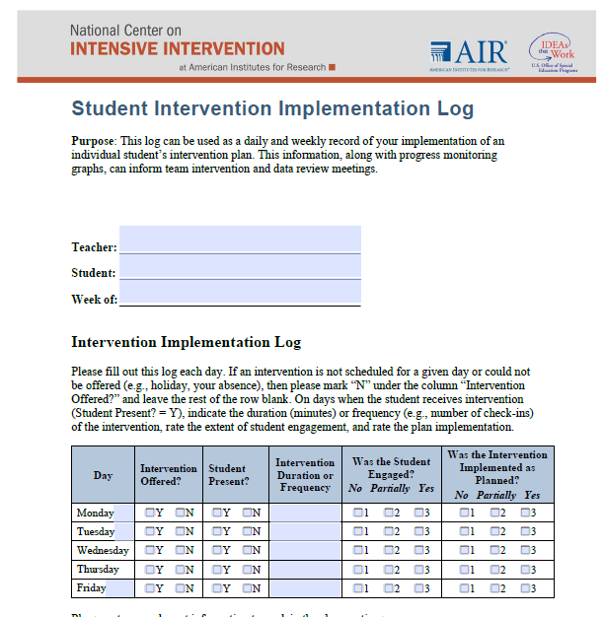
A Tool to Measure Fidelity
https://intensiveintervention.org/sites/default/files/DBI_Weekly_Log_508.pdf
Notes:
Although some interventions may provide a fidelity monitoring tool, if your intervention does not provide this resource, NCII has developed a quick log that can be used by individual teachers to monitor fidelity to the intervention. This log includes a place for teachers to mark whether the intervention was offered, if the student was present, the amount of time the intervention was provided, whether the student was engaged, and whether the intervention was implemented as planned. Note that there are many factors that may impact the ability to deliver an intervention with fidelity:
You may have a fire drill, snow day, or other event that impacts the delivery of the session.
A behavioral issue from the student or a fellow student in the intervention may distract from instructional delivery time.
You may be absent, and the substitute may not have the same knowledge level.
Although many of these factors are outside of your control, it is important to document these to use when making decisions about the student’s response to the intervention.

Slide 91
What Does This Look Like in Practice? A Math Example
Notes:
Now that we have considered and practiced how to rate a validated intervention program, let’s look at an example.

Slide 92
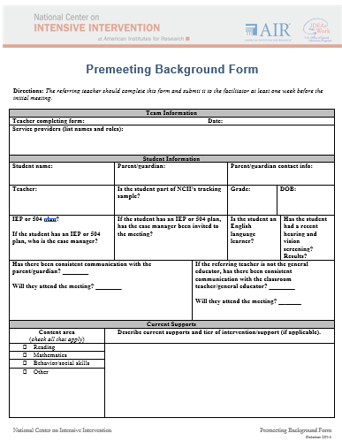
Using the Taxonomy and DBI to Support Jackson
Notes:
Ms. Williams is a special education teacher at Oakridge Elementary School, where she works with Jackson. Jackson is a fifth-grade student who has experienced persistent failure in mathematics. At the end of fourth grade, the evaluation team diagnosed him with a mathematics learning disability and recommended intensive mathematics intervention. Though Jackson had previously been receiving some support at the start of fifth grade, Ms. Williams remained concerned. She brought Jackson to the intensive intervention/DBI team at her school so they could analyze available math interventions to ensure they matched his needs. To guide the process, she brought information about Jackson to the team using the NCII Premeeting Background Form.

Slide 93
Do I need a DBI team to implement DBI?
No. Individual teachers can independently implement DBI.
But three (or more) heads are always better than one when engaging in problem solving!
Notes:
Although Ms. Williams does not need a team to implement DBI, she recognizes the value of the different expertise of her DBI team members in helping her analyze and develop an intervention that works for Jackson.

Slide 94
About Jackson
Math difficulties:
Whole-number multiplication and division (especially multidigit)
Fraction and decimal topics
Proportional reasoning
Word-problem solving
Behavioral difficulties:
Escape behaviors when confronted with difficult tasks (e.g., getting out of his seat, refusing to work, engaging in off-task conversations)
Notes:
The team discusses Jackson. Ms. Williams highlights Jackson’s math and behavioral difficulties. Specifically Jackson struggles with… Read slide.

Slide 95
Intervention Description
Key components of the intervention
Research-validated intervention that receives high marks on study quality and results
13 weeks, 39 lessons (35 minutes each)
Covers whole-number multiplication, fraction-magnitude understanding (comparing fractions, ordering fractions, placing fractions on the number line, fraction equivalencies), proportional reasoning, word-problem solving, and fraction calculations
Includes an executive function component
In this example, the team selects one intervention, but it may be helpful for the team to consider more than one intervention to identify the best fit.
Notes:
The current intervention that Ms. Williams is using includes evidence that the intervention has shown to have high marks for study quality and results. The intervention is intended to last about 13 weeks, with 39 lessons at about 35 minute a lesson. The length of the lesson is a good fit for the intervention block they have at Oakridge. The content of the intervention covers whole-number multiplication, fraction-magnitude understanding (comparing fractions, ordering fractions, placing fractions on the number line, fraction equivalencies), proportional reasoning, word-problem solving, and fraction calculations. In addition, there is an executive function component that teaches students metacognitive strategies to self-regulate their behavior, set academic goals, and develop a positive mindset to persevere through challenging tasks.
In this example, the team is considering just one intervention, but in some cases a team might consider multiple interventions and compare the ratings to identify an intervention that fits the student’s needs.

Slide 96
Ms. Williams and Colleagues Rate Dimensions and Provide Justification
Intervention Dimensions | Rating (0–3) | Evidence
Strength | 3 | Effect size: between 0.83 and 1.20
Dosage | 2.5 | Group size: 2:1 Session length: 35 minutes per session Frequency: three to four sessions per week
Alignment | 2 | Program doesn’t address decimal concepts, division of whole numbers, and multidigit addition. Covers most topics.
Attention to transfer | 2 | Builds on previously learned skills; makes some connections to core content.
Comprehensiveness | 2 | Includes adequate introduction to new concepts, repeated learned content, and systematic cumulative review. May need more background knowledge; concerns about fading support.
Behavioral support | 2 | Incorporates self-regulation and behavioral principles but might need more to meet Jackson’s needs.
Notes:
The team further analyzes the intervention against the dimensions of the taxonomy and uses a 0–3 rating scale to rate how the intervention meets each of the components. The ratings provide the team with an understanding of the intervention and will help guide intensification if needed. There is no perfect intervention. (Click for animation)
For strength, the team gives the intervention a rating of 3 as they noted that the study results showed effect sizes of between 0.83 and 1.20. As you might remember from the rubric, we typically think about an effect size of 0.25 standard deviations indicating that an intervention has value in improving outcomes. Effect sizes of 0.35 to 0.40 are moderate; effect sizes of 0.50 or larger are strong.
Next, the team looks at dosage. Here, they are really focused on the opportunities that Jackson will have to respond and receive corrective feedback. In this case, they believe the small group size and duration/frequency will provide Jackson with many opportunities to respond, but they rate it a little lower as they think Jackson might need more than the 2:1 support. They give this intervention a 2 for Jackson as they note that this might be something that they will need to intensify.
Next, the team considers alignment. Here, they are looking at the match to Jackson’s needs and whether there are components that focus on things that Jackson has already mastered. For a student like Jackson, who needs a lot of support in several areas, if the intervention covers a lot of content that he has already mastered, it wouldn’t be a great fit. In addition, Ms. Williams and her colleagues may want to consider whether this connects to grade-appropriate standards. In this case, they are mostly pleased that the intervention fits Jackson’s needs, but they are a little concerned as the program does not address some of the areas where Jackson struggles, including decimal concepts, division of whole numbers, and multidigit addition.
As the team considers a rating for attention to transfer, they note that the intervention builds upon previously learned skills and makes some connections to core content. For this dimension, they are really focused on whether it is systematically designed to help Jackson transfer the skills he learns in the intervention to other formats and contexts. The intervention helps students realize connections between mastered and related skills.
Next, the team looks at comprehensiveness. This dimension reflects the number of explicit instruction principles that the intervention incorporates. These may include the following:
Provides explanations in simple, direct language.
Models efficient strategies (e.g., decoding unknown words) instead of expecting students to discover strategies on their own.
Ensures that students have the necessary background knowledge and skills to succeed with those strategies.
Gradually fades support for students’ correct execution of those strategies.
Provides practice so that students use the strategies to generate many correct responses.
Incorporates systematic cumulative review.
Overall, the team gives the intervention a 2. They think it does an adequate job of introducing new concepts and repeating learned content through systematic review but believe there may be a need for additional support for building background knowledge and that the fading support provided may be difficult for Jackson.
Last, the team looks at behavioral support. They know that Jackson has shown escape behaviors for difficult tasks, so they want to ensure that the intervention incorporates strategies to address this. Although they note that this intervention does incorporate self-regulation and behavioral principles, they are not sure it will be enough for Jackson and therefore give this intervention a 2.

Slide 97
Considerations for Individualization
Although the team does not rate the intervention for individualization, they consider how the intervention could be intensified.
Are there any challenges to intensifying the intervention?
Are there components that they think might need to be intensified to better meet Jackson’s needs?
Notes:
The team doesn’t rate the final dimension, individualization, but they do consider whether the intervention can be easily intensified and adapted to better meet Jackson’s needs.

Slide 98
There Are No Perfect Interventions!
Although the team scored the intervention highly, they noted some places where there were shortcomings:
Alignment
Comprehensiveness
Behavioral support
Places with lower ratings provide good opportunities for intensification if needed.
Notes:
The team also realizes from their review that there is no perfect intervention that will map specifically to Jackson’s needs. They note a few areas where this intervention may fall short:
Alignment: Does not cover decimal concepts, division of whole numbers, and multidigit multiplication.
Comprehensiveness: Must fill in gaps for background knowledge; program’s guidance for fading support will need to be modified to ensure that Jackson correctly executes (and remembers) the strategies taught.
Behavioral support: Behavioral system in place will need to be strengthened to adequately support Jackson and minimize nonproductive behavior.
The team keeps these in mind as areas they may need to address and intensify.

Slide 99
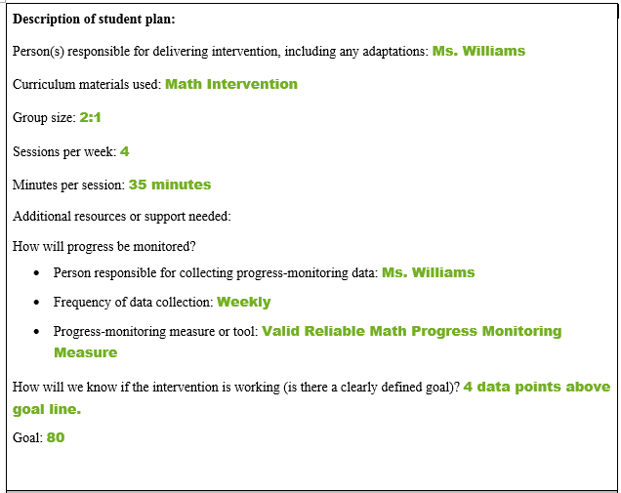
Implementing the Intervention
To guide implementation, the team outlines an intervention plan for Jackson. The plan includes the following information:
Who: interventionist, classroom teacher
What: intervention being implemented
When: intervention time, frequency, and duration
Where: setting (small group, location)
Why: intervention’s match to student need
How: intervention implementation per intervention requirements
Notes:
The team documents the intervention in an intervention plan that lays out:
Who: interventionist, classroom teacher
What: intervention being implemented
When: intervention time, frequency, and duration
Where: setting (small group, location)
Why: intervention’s match to student need
How: intervention implementation per intervention requirements
This will help Ms. Williams ensure that she implements the plan with fidelity.

Slide 100
Monitoring Fidelity
Ms. Williams monitors the implementation fidelity and considers—
Student engagement
Adherence to critical components
Exposure/Duration
Quality of delivery
Program specificity
Notes:
Ms. Williams uses NCII’s Data-Based Individualization Implementation Log: Daily and Weekly Intervention Review to monitor fidelity. She considers engagement, adherence to critical components of the intervention, the exposure/duration of the intervention, the quality of the delivery, and how well the intervention is defined.
Although Ms. Williams sees that Jackson has attended all the intervention periods, she notices that he hasn’t always been engaged and instead has noted that he often acts out. This acting out has impacted her ability to implement the intervention as planned.

Slide 101
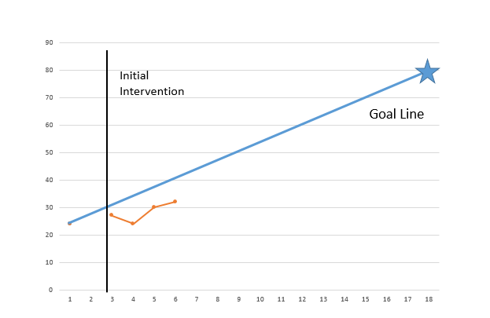
Monitoring Progress
Ms. Williams collects and graphs progress- monitoring data weekly using a reliable and valid progress-monitoring measure.

Slide 102
Evaluating the Intervention
Notes:
The team analyzes the data that Ms. Williams collected and determines that Jackson is not making adequate progress.

Slide 103
When Do We Intensify?
Student need persists despite:
Intervention implementation with fidelity and for appropriate frequency/duration
Evidence of effectiveness with similar students
Use of a valid and reliable progress-monitoring tool that is sensitive to student change and matched to the correct measurement outcome
Notes:
Review slide.

Slide 104
Why Might We Need to Intensify?
Validated programs are not universally effective programs; 3 to 5% of students need more help (NCII, 2013).
Students with intensive needs often require 10–30 times as much practice as their peers to learn new information (Gersten et al., 2008).
Notes:
What we know about many validated programs is that they are not universally effective. Even after implementing them with fidelity, 3 to 5% of students will need more help. Those students with intensive needs often require upwards of 10 to 30 times as much practice as their peers when they are learning new information.
Note: Although the previous slide highlighted poor outcomes for students with disabilities, not all students with intensive needs have an identified disability. For example, the practice guide by Gersten et al. (2008) reflects data that include students without disabilities.

Slide 105
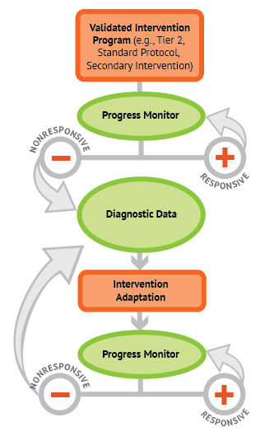
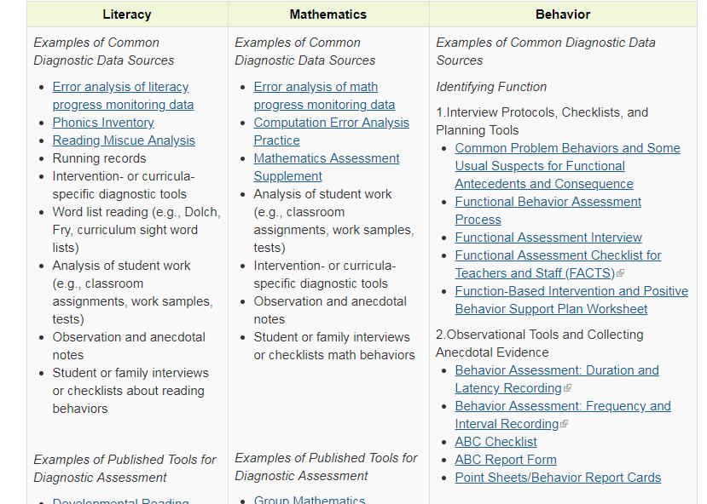
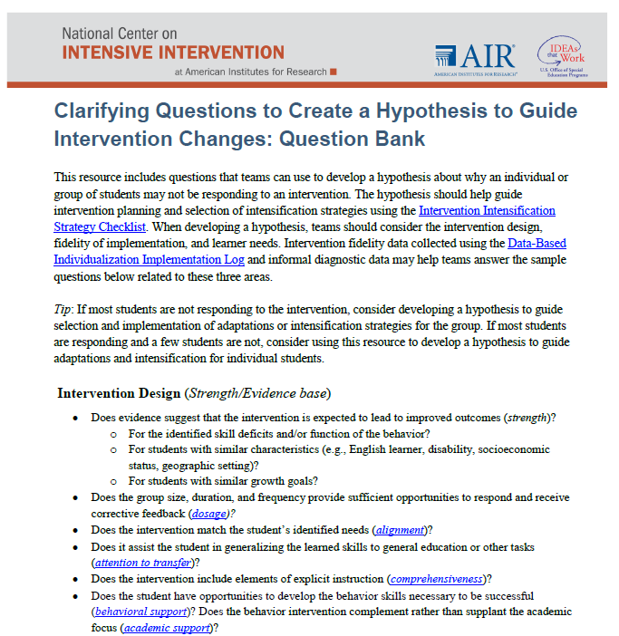
How Do We Know What Needs to be Intensified?
Conduct or review diagnostic data.
Develop a hypothesis.
Notes:
To determine how they need to intensify the intervention for Jackson, the team considers collecting additional diagnostic data in order to develop a hypothesis for why Jackson is not responding.

Slide 106
Thinking Diagnostically: Integration of Academics and Behavior
Which came first?
A: Antecedent
B: Behavior
C: Consequence
Diagnostic assessment may reveal that an underlying academic deficit is causing the behavior to occur.
Skill deficit
Avoidance behavior
Removal from task
Notes:
As the team considers diagnostic information, they realize that it also is really important to consider the intersection between academics and behavior. As you can see on the slide, this is often a chicken or egg situation. We know that students who struggle often use escape or avoidance behaviors to become removed from the task they are struggling with. If removed, the student then misses the instruction time and is likely to fall further behind. The team wants to consider whether behavior might be impacting Jackson’s math performance.

Slide 107
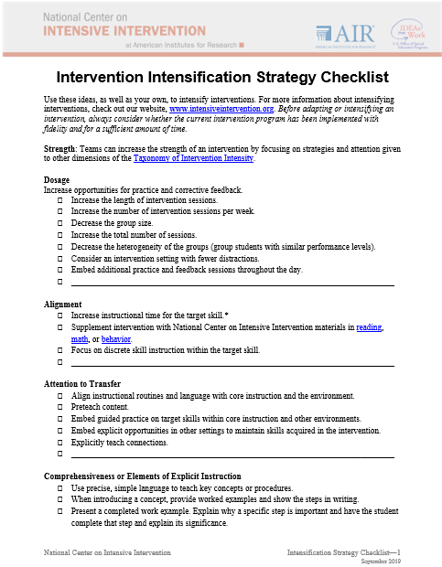
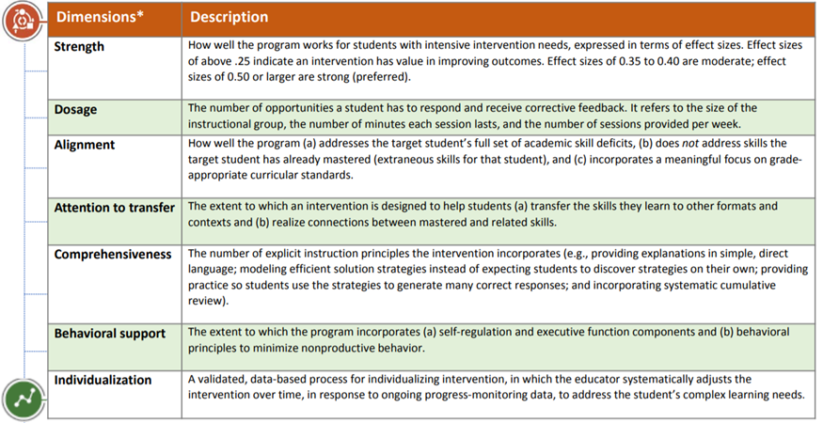
How Do We Know How To Intensify?
Review the taxonomy and intensification checklist to identify how to intensify to address the hypothesis.
Handout
Notes:
To guide decisions about the types of intensification they might want to make, the team can use the dimensions of the Taxonomy of Intervention Intensity and the ratings they provided when analyzing the validated intervention program. They also might explore the Intervention Intensification Strategy Checklist form from NCII, which provides some areas to consider for intensifying across dimensions of the taxonomy.

Slide 108
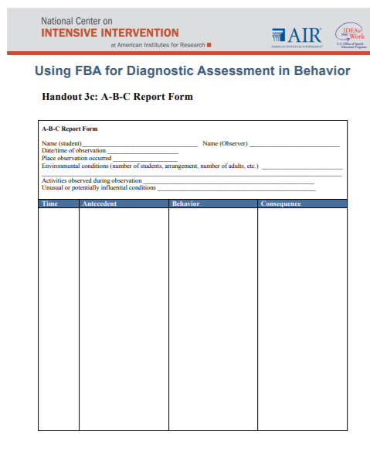
The Team Focuses on the Behavioral Impact
Notes:
Based on the review of the data, the team was most concerned with addressing the behavioral component due to engagement issues. They collected additional data using the A-B-C report form. The team then hypothesized that providing Jackson with some choice about the structure of the session could enhance his engagement in the content and improve his performance.

Slide 109
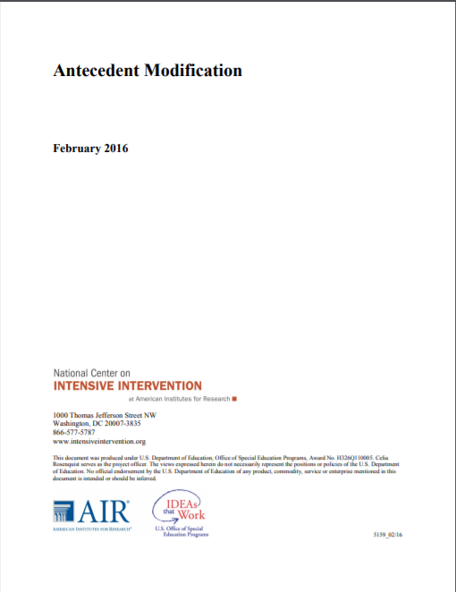
Determine Adaptation
Intervention Dimensions | Rate (0–3) | Evidence | Adaptation 1
Strength | 3 | Effect size = Between 0.83 and 1.20
Dosage | 2.5 | Group size: 2:1 Session length: 35 minutes per session Frequency: three to four sessions per week
Alignment | 2 | Program doesn’t address decimal concepts, division of whole numbers, and multi-digit addition. Covers most topics.
Attention to transfer | 2 | Builds on previously learned skills; makes some connections to core content
Comprehensiveness | 2 | Includes adequate introduction to new concepts, repeated learned content, and systematic cumulative review. May need more background knowledge and concerns about fading support.
Behavioral support | 2 | Incorporates self-regulation and behavioral principles but might need more to meet Jackson’s needs | Increase behavioral supports
Notes:
Using the A-B-C data, the team decided to add a behavioral strategy to the intervention. They reviewed the behavioral strategy resources on the NCII website and looked specifically at the Antecedent Modification guide. They decided to allow Jackson to choose. Specifically, they considered providing choice on the tasks to complete, the sequence of tasks to be completed, materials to use, where to complete the tasks, when to complete the tasks, and with whom to complete the tasks. In this case, they allowed Jackson to select the sequence of the tasks to be completed so that he could help define the structure of the intervention session.
Note that they decided not to modify content at this time.

Slide 110
Intervention Adaptation Implementation
Document adaptations to the plan.
Implement the revised plan.
Collect progress monitoring data.
Monitor fidelity.
Who: interventionist, classroom teacher
What: specify the adaptation
When: intervention time, frequency, and duration (including increases or adjustments)
Where: setting changes (group size or location adjustments)
Why: hypothesized impact of the intervention adaptation on student outcomes
How: systematically making adjustments, documenting changes, and monitoring progress
Notes:
The team documented the revision in their individual intervention plan and collected monitoring and progress data throughout implementation.

Slide 111
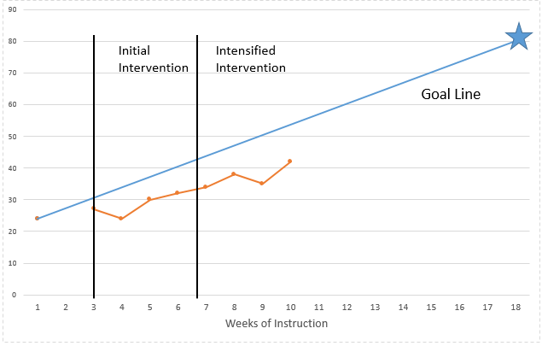
Evaluating the Intensified Intervention
Notes:
The team once again reviewed the fidelity and progress data. They saw great improvement with student engagement within the intervention and believed that the behavioral component they added helped Jackson to stay engaged, but they continued to be concerned about his progress.

Slide 112
How Do We Know What Needs to be Intensified?
Conduct or review additional diagnostic data.
Develop a hypothesis.
Notes:
This time, the team looked deeper into the math content.
The team hypothesis was that Jackson is struggling to respond because he is overwhelmed with new content, struggles to differentiate between the number of parts (numerator) and the size of parts (denominator), and grapples with single-digit multiplication, which slows down the lesson.

Slide 113
How Do We Know How To Intensify?
Review the taxonomy to identify how to intensify to address the hypothesis.
Notes:
To address these challenges, the team decided to focus on intensifying alignment and comprehensiveness.

Slide 114
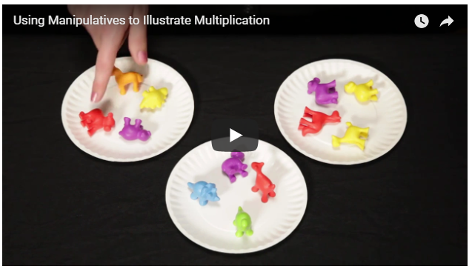
Determine Adaptation
Intervention Dimensions | Rate (0–3) | Evidence | Adaptation 1 | Adaptation 2
Strength | 3 | Effect size = Between 0.83 and 1.20
Dosage | 2 | Group size: 2:1 Session length: 35 minutes per session Frequency: three to four sessions per week
Alignment | 2 | Program doesn’t address decimal concepts, division of whole numbers, and multi-digit addition. Covers most topics. |  | Focus on missing skills
Attention to transfer | 2 | Builds on previously learned skills; makes some connections to core content
Comprehensiveness | 2 | Includes adequate introduction to new concepts, repeated learned content, and systematic cumulative review. May need more background knowledge and concerns about fading support. |  | Use manipulatives and additional practice opportunities with support
Behavioral support | 2 | Incorporates self-regulation and behavioral principles but might need more to meet Jackson’s needs
Notes:
Ms. Williams and the team adjusted the alignment to focus on missing skills and include manipulatives and additional practice opportunities.

Slide 115
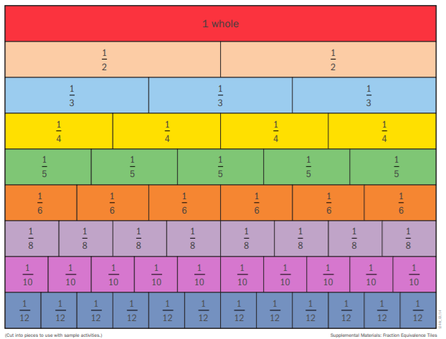
Intensification Strategy 1: Review Reteach With Manipulatives
Fraction Tiles
Numerator: the number of equal parts in a fraction
Denominator: how many equal parts the unit is divided into
$$\frac{\text{number}}{\text{size}}=\frac{a}{b}$$
Notes:
Ms. Williams adds 5 minutes of conceptual practice with manipulatives (fraction tiles) to help Jackson differentiate between the numerator and denominator.

Slide 116
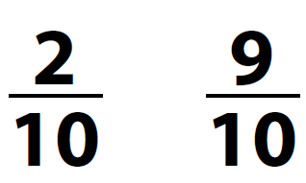
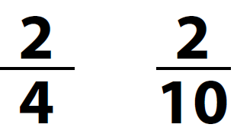
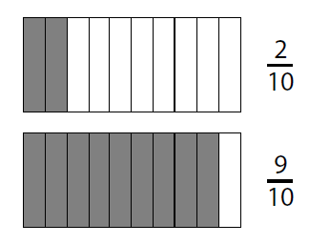
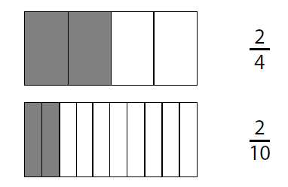
Reinforce and Practice: Flashcards
Same Denominator
Same Numerator
Notes:
She reinforces this practice with a flashcard activity that requires Jackson to differentiate between the numerator and denominator.

Slide 117
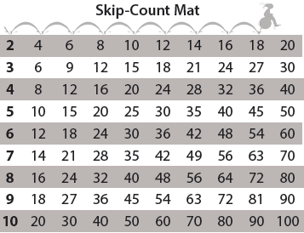
Extra Practice: Multiplication Strategy
Use a fact you know and add on:
6 $×$ 6 = 36
6 $×$ 7 = 36 + 6 = 42
Extra practice
Notes:
She adds 5 minutes of multiplication strategy instruction, including practice with skip counting and adding on.

Slide 118
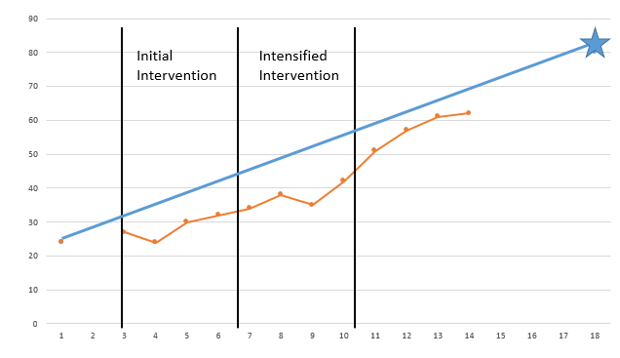
Is Jackson responding to the adapted intervention? What would you do?
Notes:
Provide pairs or small groups 1–2 minutes to discuss what they would do next. Have several share out.

Slide 119
DBI is ongoing.
Taxonomy Dimensions
Strength Dosage Alignment Attention to transfer Comprehensiveness Behavioral or academic support Individualization
Building/Intensifying
Notes:
Ms. Williams and the team will continue to update the intervention plan, monitor progress/fidelity, and determine responsiveness.
If a student isn’t making ambitious growth, despite an intensified plan, don’t fret! As a reminder, DBI is an ongoing and iterative process that may require multiple rounds of adaptation. Using the taxonomy to systematically build an intensified intervention plan can help educators as they support students with intensive academic/behavioral needs.

Slide 120
Activity, Part 2: Intensifying and Individualizing Validated Interventions
Get back into your same groups of 2–3.
Imagine that the group of students did not respond to the intervention. In the last column, brainstorm how 2–3 dimensions could be intensified for the group.
Review the Intensification Strategy Checklist for ideas.
Record your responses in the last column.
Handout
Notes:
In this activity, we are going to return to the handout and groups that we used earlier for rating our intervention. Based on your knowledge of the intervention and the ideas in the Intensification Strategy Checklist, consider some ways you could intensify the intervention across the different dimensions. You will have about 5–10 minutes for this activity.
Provide 5–10 minutes for this activity. Encourage participants to utilize the Intensive Strategy Checklist to identify possible intensification strategies for each dimension.

Slide 121
Think-Pair-Share
What were some ways you considered intensifying?
Which dimensions do you think would be easier to intensify?
Which dimensions are more challenging?
Notes:
Get up from your current group and find a partner from another group. Briefly share some of the ways you considered intensifying your intervention. Together, discuss which dimensions you think would be easier to intensify and which might be more challenging.

Slide 122
Review and Wrap-Up

Slide 123
Learn More About the Taxonomy of Intervention Intensity
https://intensiveintervention.org/taxonomy-intervention-intensity
Notes:
If you are interested in learning more about the Taxonomy of Intervention Intensity, the NCII website includes a page focused on the taxonomy. On that page, there are four recorded webinars that go deeper into applying the taxonomy to different content areas. Additional resources also will be added to that page over time.

Slide 124
Resources to Support Intensification Decisions
Notes:
In addition to the webinars, you will be able to find several of the resources we referenced today, including the Intensification Strategy Checklist, dimension overview handout, and the handout focused on questions to develop a hypothesis.

Slide 125
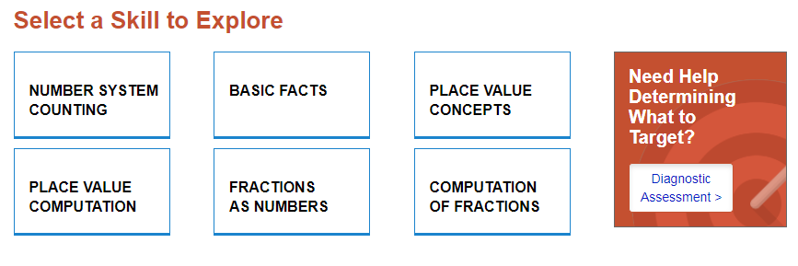
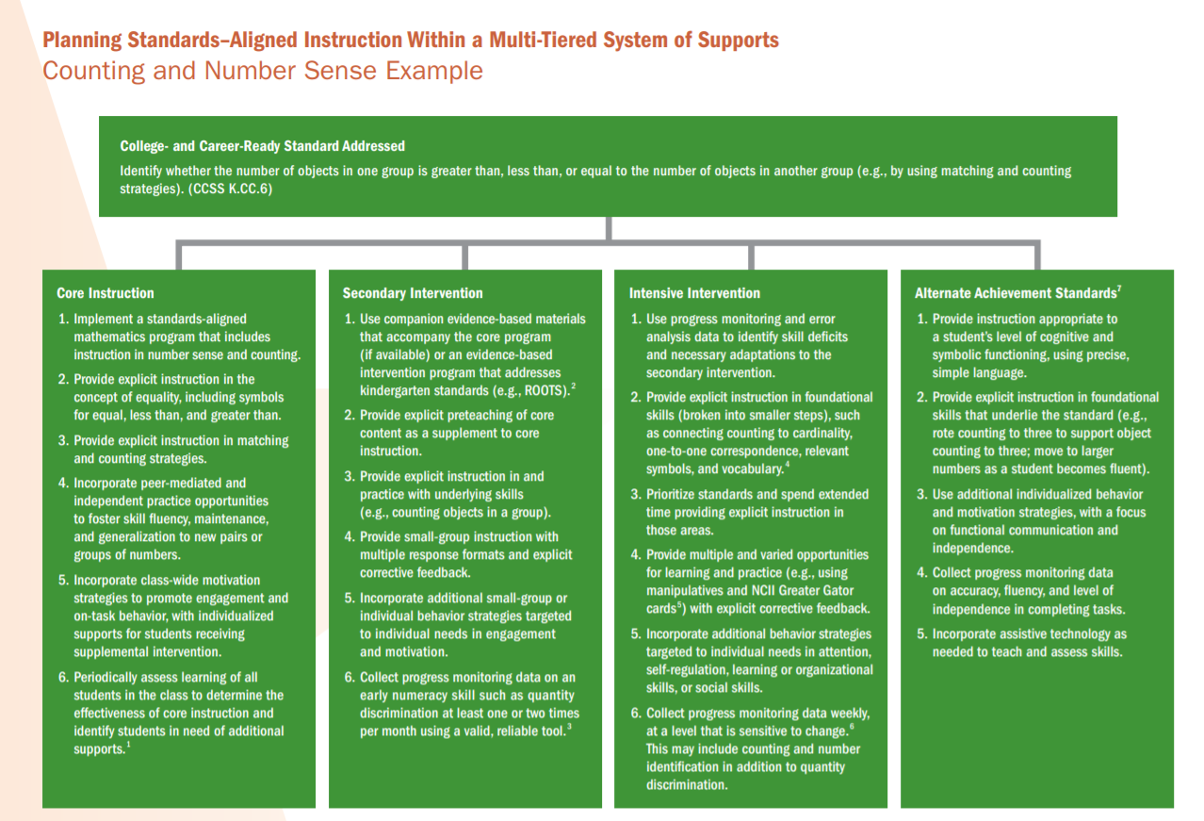
Resources to Support Intensification in Mathematics
Considerations for Alignment, Attention to Transfer, Comprehensiveness, and Dosage
https://intensiveintervention.org/intensive-intervention-math-course
https://intensiveintervention.org/intervention-resources/mathematics-strategies-support-intensifying-interventions
Notes:
To support students who need more intensive support in mathematics, NCII has a series of sample lessons and activities aligned with different mathematics skill areas. These may help increase additional practice opportunities or targeted support for a specific skill area that the student needs more help with. Examples of how to address standards across the levels of a tiered system of support also can help educators to consider the attention to transfer domain.
In addition, the Intensive Intervention in Mathematics Course Content provides a robust amount of information. Content covers the scope and sequence of skills within the intervention, identifying strong evidence-based platforms (focus on the strength dimension), instructional delivery and instructional strategies, a focus on whole-number and rational-number content, and considerations for intensification.

Slide 126
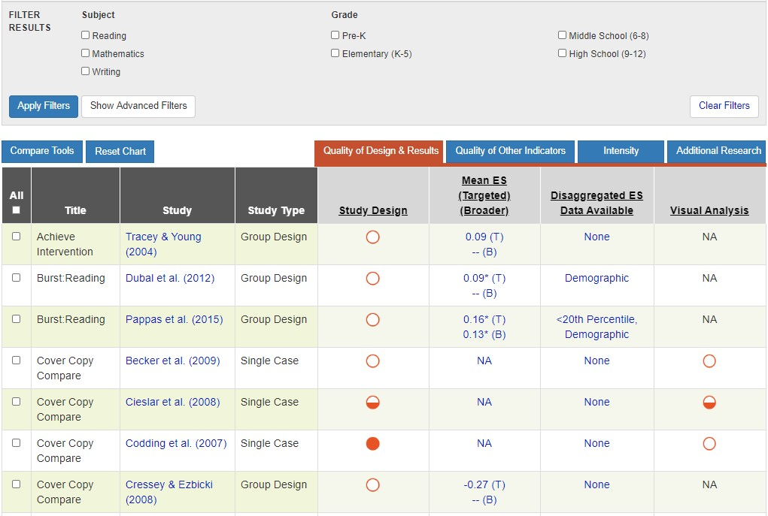
Resources to Evaluate Strength
Academic Intervention Tools Chart
https://charts.intensiveintervention.org/aintervention
Notes:
The Academic Intervention Tools Chart, seen here, was one of the tools we used to help us to evaluate the strength dimension. This is one of six tools charts on the NCII website. In addition to the NCII tools charts, you also might want to visit the What Works Clearinghouse and Best Evidence Encyclopedia sites.

Slide 127
Resources to Support Intensification of Dosage
https://intensiveintervention.org/resource/strategies-scheduling-how-find-time-intensify-and-individualize-intervention
Notes:
This scheduling resource includes some strategies that might be helpful as you consider how to intensify within a busy school schedule, particularly as you think about the dosage dimension.

Slide 128
Resources to Learn More About Comprehensiveness
View module: https://intensiveintervention.org/intensive-intervention-features-explicit-instruction
View module: https://intensiveintervention.org/instructional-delivery-math-course
Notes:
If you are interested in learning more about comprehensiveness, the four-part module, Features of Explicit Instruction Course Content, provides a wealth of content, examples, and resources. You also can find information and examples of explicit instruction in mathematics as part of Module 4 in the Intensive Intervention in Mathematics Course Content.

Slide 129
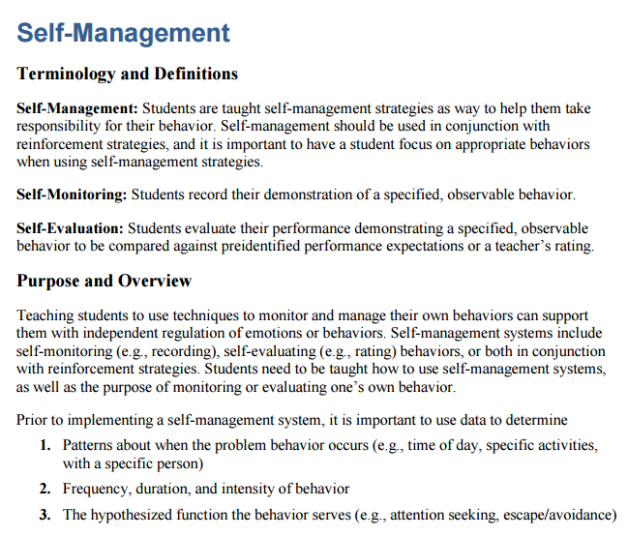
Resources to Learn More About and Intensify Behavior Support
https://intensiveintervention.org/intervention-resources/ behavior-strategies-support-intensifying-interventions
https://intensiveintervention.org/intensive-intervention-behavior-course
Notes:
NCII also includes information to support your consideration of the behavior support dimension. The behavior strategies can help support teachers working with students who have primary academic deficits and challenging behaviors. Each strategy incorporates key terminology, an overview of the purpose, and all associated materials. The strategies also integrate approaches for intensification for students with more challenging behaviors.
Behavior Support for Intensive Intervention also provides a deep review of how educators can support student behavior in the classroom. This eight-part module series includes video lectures, activities, and more.

Slide 130
Resources to Monitor Fidelity of Implementation
https://intensiveintervention.org/implementation-support/fidelity-resources
Notes:
As we discussed, it is important for educators to consider the dimensions when designing and intensifying intervention, but it also is important to consider the implementation of the intervention. These fidelity tools, including the daily/weekly log, provide tools to help educators monitor fidelity of implementation over time.

Slide 131
Activity: Taxonomy K-W-L
What Does It Help Me KNOW? | What More Do I WANT to Know? | How Will I LEARN More?
Handout
Notes:
Return to the handouts we used at the start of this session. Consider what was discussed today. On your K-W-L handout, take about 5–10 minutes to note what the document helps you know and what you want to know more about.

Slide 132
Taxonomy of Intervention Intensity: Review
Notes:
The Taxonomy of Intervention Intensity is designed to support special educators and interventionists in understanding their validated intervention program. For those students who do not respond to the intervention as designed, the taxonomy can be used to help teams and educators make decisions about how the intervention can be individualized to better meet their needs. Future training modules will illustrate how the taxonomy can be applied to intensify an intervention.

Slide 133
Things to Remember
DBI is ongoing and intense—relatively few students should need it (3 to 5% of the school population).
Academic and behavior supports do not exist in isolation.
There is no perfect intervention, but it is important to understand your intervention’s strengths and limitations and to start with a strong foundation.
Don’t make too many intervention adaptations at the same time.
Notes:
DBI is intense—relatively few students should need it.
If more than 3 to 5% of students in a school appear to require DBI, consider evaluating the core instruction, schoolwide behavior supports, and Tier 2 intervention programs.
DBI often takes sustained and iterative cycles of adaptation over time.
Academic and behavior supports do not exist in isolation.
They are often most successful when combined to meet students’ individual needs.
There is no perfect intervention.
We do have access to a growing repository of interventions that have shown evidence of effectiveness, but we need to consider the dimensions of the taxonomy to guide our decision-making process and understand the multiple dimensions that can help to ensure that we have a strong intervention.
Even when we can’t start with a standardized program, the taxonomy can guide our understanding of what we are providing.
Don’t make too many intervention adaptations at the same time.
It may be tempting to try everything at once because you want to help a student as soon as possible, but if you make all possible changes at the same time, you won’t know which ones work for the student (any improvement in performance could be the result of one or more adaptations). Fewer changes also may make implementation more sustainable.

Slide 134
Reflection
What am I most excited about? | What am I unsure of or want to learn more about? | What changes will I make as a result of what I learned today?
Notes:
As we end the day, take a moment to reflect on what we covered. What are you most excited about? What questions do you still have? What changes will you make? Take 5 minutes to reflect and then share with a neighbor.

Slide 135
Thank you!
Thank you!

Slide 136
References
Ciullo, S., Sabrina Lo, Y. L., Wanzek, J., & Reed, D. (2016). A synthesis of research on informational text reading interventions for elementary students with learning disabilities. Journal of Learning Disabilities, 49(3), 257–271.​
Dane, A. V., & Schneider, B. H. (1998). Program integrity in primary and early secondary prevention: Are implementation effects out of control? Clinical Psychology Review, 18, 23–45.
Deno, S., & Mirkin, P. (1977). Data-based program modification: A manual. Reston, VA: The Council for Exceptional Children.​
Fuchs, L. S., Fuchs, D., & Malone, A. S. (2017) The Taxonomy of Intervention Intensity. TEACHING Exceptional Children, 50(1), 35–43.​
Gersten, R., Chard, D. J., Jayanthi, M., Baker, S. K., Morphy, P., & Flojo, J. (2009). Mathematics instruction for students with learning disabilities: A meta-analysis of instructional components. Review of Educational Research, 79(3), 1202–1242.
Gersten, R., Compton, D., Connor, C. M., Dimino, J., Santoro, L., Linan-Thompson, S., & Tilly, W. D. (2008). Assisting students struggling with reading: Response to intervention and multi-tier intervention for reading in the primary grades: A practice guide. (NCEE 2009-4045). Washington, DC: U.S. Department of Education, Institute of Education Sciences, National Center for Education Evaluation and Regional Assistance. Retrieved from https://ies.ed.gov/ncee/wwc/Docs/PracticeGuide/rti_reading_pg_021809.pdf​

Slide 137
References
Gresham, F. M., Gansle, K. A., & Noell, G. H. (1993). Treatment integrity in applied behavior analysis with children. Journal of Applied Behavior Analysis, 26(2), 257–263.
Hill, C. J., Bloom, H. S., Black, A. R., & Lipsey, M. W. (2008). Empirical benchmarks for interpreting effect sizes in research. Child Development Perspectives, 2(3), 172–177.
Hughes, E. M., Powell, S. R., & Stevens, E. A. (2016). Supporting clear and concise mathematics language: Instead of that, say this. Teaching Exceptional Children, 49, 7–17. http://dx.doi.org/10.1177/0040059916654901
Jayanthi, M., Gersten, R., & Baker, S. (2008). Mathematics instruction for students with learning disabilities or difficulty learning mathematics: A guide for teachers. Portsmouth, NH: RMC Research Corporation, Center on Instruction.
Jones, I., Inglis, M., Gilmore, C., & Evans, R. (2013). Teaching the substitutive conception of the equals sign. Research in Mathematics Education, 15(1), 34–49.
Kearns, D. M. (2018). Intensive intervention course content: Features of explicit instruction. Washington, DC: U.S. Department of Education, Office of Special Education Programs, National Center on Intensive Intervention. Available at https://intensiveintervention.org/intensive-intervention-features-explicit-instruction​

Slide 138
References
Lyon, G. R. (1985). Neuropsychology and learning disabilities. Neurology and Neurosurgery, 5, 1–8.​
Mann, L. (1979). On the trail of process. New York, NY: Grune & Stratton.​
Miller, S. P., & Hudson, P. J. (2007). Using evidence-based practices to build mathematics competence related to conceptual, procedural, and declarative knowledge. Learning Disabilities Research & Practice, 22(1), 47–57.
National Center on Intensive Intervention. (2013). Data-based individualization: A framework for intensive intervention. Washington, DC: U.S. Department of Education, Office of Special Education Programs.
National Center on Intensive Intervention. (2016). Principles for designing intervention in mathematics. Washington, DC: U.S. Department of Education, Office of Special Education Programs.
National Mathematics Advisory Panel. (2008). Foundations for success: The final report of the National Mathematics Advisory Panel. Washington, DC: U.S. Department of Education.
O’Donnell, C. L. (2008). Defining, conceptualizing, and measuring fidelity of implementation and its relationship to outcomes in K–12 curriculum intervention research. Review of Educational Research, 78(1), 33–84.

Slide 139
References
Stein, M., Kinder, D., Silbert, J., & Carnine, D. (2005). Designing effective mathematics instruction: A direct instruction approach (4th ed.). Upper Saddle River, NJ: Pearson.
Vaughn, S., Wexler, J., Roberts, G., Barth, A. A., Cirino, P. T., Romain, M. A., … Denton, C. A. (2012). Effects of individualized and standardized interventions on middle school students with reading disabilities. Exceptional Children, 77(4), 391–407.
Walsh, M. E., Fuchs, D., Patton, S. A., Lehman, P., & Fuchs, L. S. (2019). Improving outcomes for struggling third graders in nonfiction reading comprehension intervention: Small successes and enduring challenges. Poster presented at the annual conference of the Pacific Coast Research Conference, San Diego, CA.
Woodward, J. (2006). Developing automaticity in multiplication facts: Integrating strategy instruction with timed practice drills. Learning Disability Quarterly, 29(4), 269–289.

Slide 140
NCII Disclaimer
This presentation was produced under the U.S. Department of Education, Office of Special Education Programs, Award No. H326Q160001. Celia Rosenquist serves as the project officer. The views expressed herein do not necessarily represent the positions or policies of the U.S. Department of Education. No official endorsement by the U.S. Department of Education of any product, commodity, service, or enterprise mentioned in this webinar is intended or should be inferred

