Slide 1
Hello! Welcome to “What Does it Really Take? Frequently Asked Questions about Implementing Intensive Intervention” The webinar will begin shortly. We appreciate your patience

Slide 2
What Does it Really Take? Frequently Asked Questions about Implementing Intensive Intervention

Slide 3
Introductions
Chris Lemons, Ph.D. – Senior Advisor to the National Center on Intensive Intervention and Assistant Professor in the Department of Special Education at Peabody College of Vanderbilt University
T. Chris Riley-Tillman, Ph.D. – Trainer for the National Center on Intensive Intervention and Professor at the University of Missouri College of Education
Teri Marx, Ph.D. - Researcher at the American Institutes for Research and Technical Assistance Liaison for Rhode Island for the National Center on Intensive Intervention

Slide 4
Webinar Format/Structure
The panelists are prepared to answer questions that were submitted in advance of today’s webinar
Panelists welcome additional questions that are applicable to the topic and a broad audience
Please submit questions during this webinar through the “Submit a Question” feature in your chat box

Slide 5
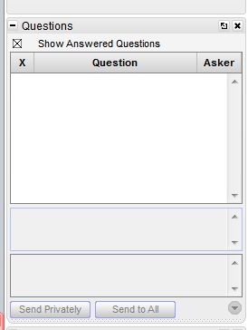
Question Box
Please direct questions to the question box. A webinar team member will try to assist you as soon as possible.

Slide 6
Frequently Asked Questions

Slide 7
Intensive Intervention: FAQs
Description, Practicality, and Scheduling
Aligning Academic and Behavioral Interventions
Data Use and Student Planning

Slide 8
Intensive Intervention: Description, Practicality & Scheduling

Slide 9
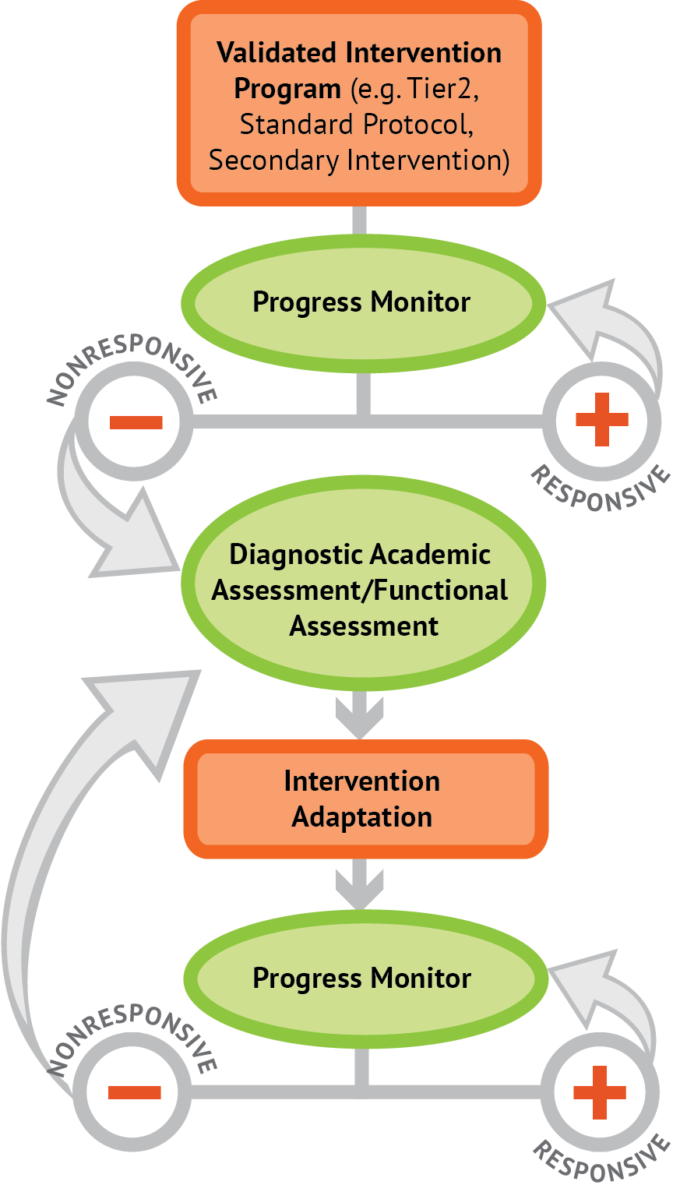
What is intensive intervention?
Intensive intervention is designed to address severe and persistent learning or behavior difficulties. Intensive interventions should be—
Driven by data
Characterized by increased intensity (e.g., smaller group, expanded time) and individualization of academic instruction and/or behavioral supports

Slide 10
Who needs intensive intervention?
Students with disabilities who are not making adequate progress in their current instructional program
Students who present with very low academic achievement and/or high-intensity or high-frequency behavior problems (typically those with disabilities)
Students in a tiered intervention system who have not responded to secondary intervention programs delivered with fidelity

Slide 11
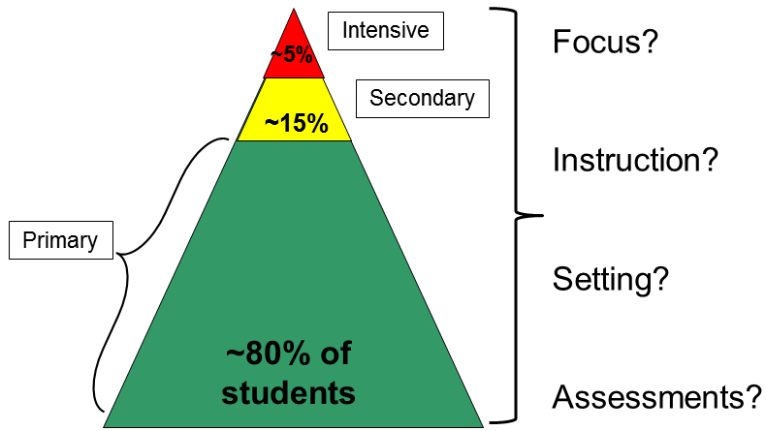
How does intensive intervention fit into RTI/MTSS systems?

Slide 12
What is the relationship between Tiers I, II, & III? When and how do students move between Tiers?

Slide 13
Audience Questions

Slide 14
How do we get buy in from teachers, staff, district administrators, etc.?
Strategies for success
Establish vision and goals for DBI
Promote staff buy-in by:
Making DBI relevant, shaping culture and expectations
Involving staff in decision making
Provide supporting structures and resources
Including assessments, interventions, professional development, staff time

Slide 15
Intensive Intervention: Academic and Behavioral Integration

Slide 16
Can I do academic and behavioral interventions at the same time?
Skill deficit
Avoidance behavior
Removal from task

Slide 17
I have tried several behavioral interventions. Why do you think they haven’t been successful?
Tier 3 (5 percent)
Functionally based
Tier 2 (15 percent)
Functionally related small groups and individuals
Tier 1 (80 percent)
Evidence-based curricula
Tier I: Whole-school best practices
Tier II: Functionally related small- group practices
Tier III: Individually functionally based practices
Source: Evidence Based Intervention Network (http://ebi.missouri.edu)/

Slide 18
Audience Questions

Slide 19
Intensive Intervention: Data Use & Student Planning

Slide 20
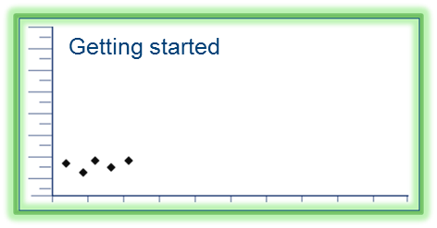
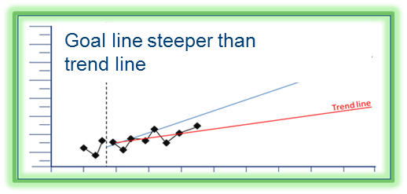
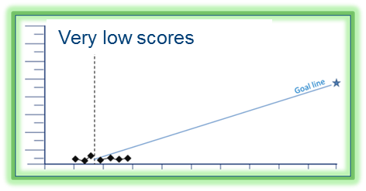
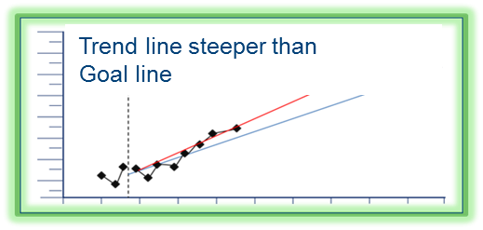
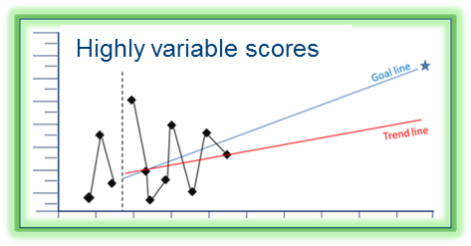
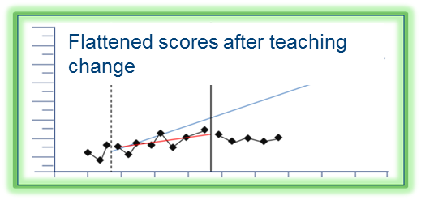
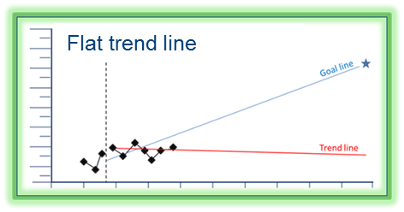
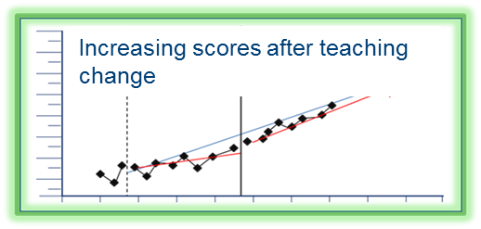
How much data do we need before adapting an intervention? How long should I do intensive intervention?

Slide 21
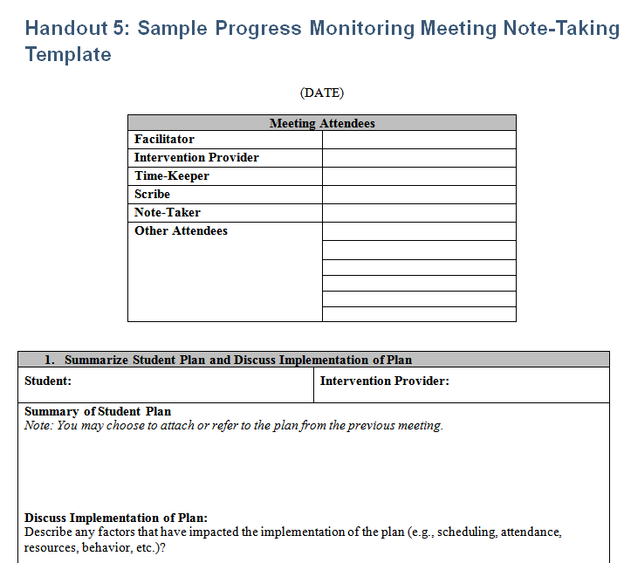
How detailed should student plans be (objectives, frequency, duration, roles)?
http://www.intensiveintervention.org/tools-support-intensive-intervention-data-meetings

Slide 22
What are key intervention and assessment elements to focus on?

Slide 23
Wrap Up and Discussion

Slide 24
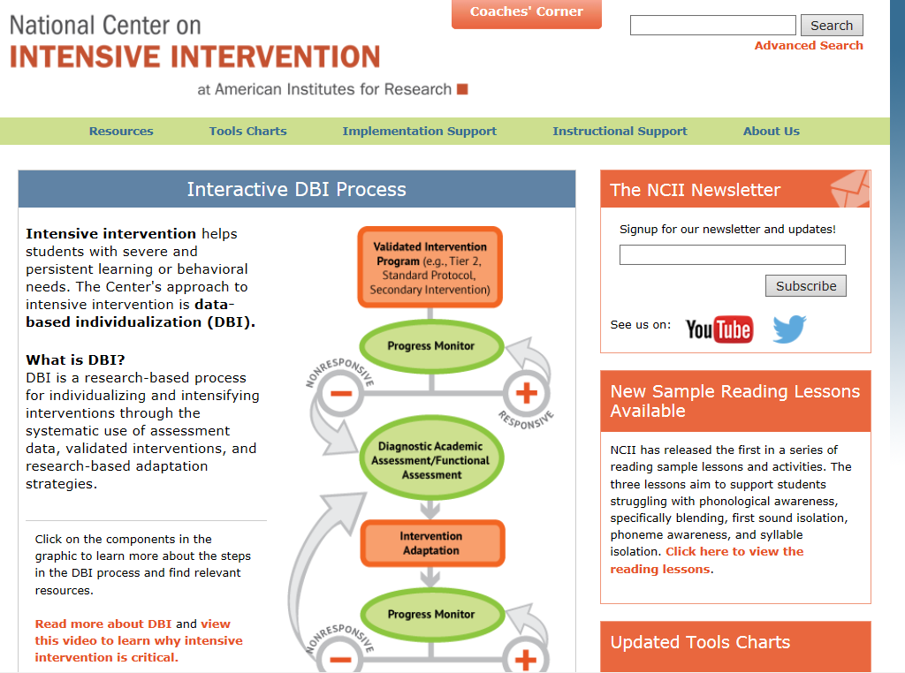
website
Find additional answers by visiting the NCII website.
www.intensiveintervention.org

Slide 25
Connect to NCII
Sign up on our website intensiveintervention.org to receive our newsletter and announcements
Follow us on YouTube and Twitter
YouTube Channel: National Center on Intensive Intervention
Twitter handle: @TheNCII

Slide 26
Disclaimer
This webinar was produced under the U.S. Department of Education, Office of Special Education Programs, Award No. H326Q110005. Celia Rosenquist serves as the project officer.
The views expressed herein do not necessarily represent the positions or policies of the U.S. Department of Education. No official endorsement by the U.S. Department of Education of any product, commodity, service, or enterprise mentioned in this webinar is intended or should be inferred.
26

Slide 27
Contact US
National Center on Intensive Intervention
1000 Thomas Jefferson Street NW
Washington, DC 20007-3835
www.intensiveintervention.org
ncii@air.org
@TheNCII

