Slide 1
The Taxonomy of
Intervention Intensity:
A Case Study for Building Intervention Intensity in Math
    Amelia Malone and Lynn Fuchs, Vanderbilt University

Slide 2
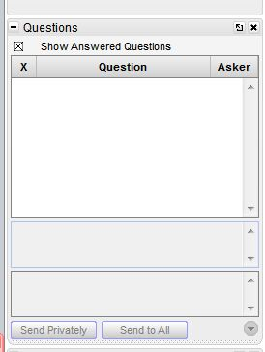
Webinar Format & Questions
Throughout the presentation, submit your questions into the question pod.
  For technical issues/questions, a webinar team member will try to assist you as soon as possible.
  For content related questions, there will be a time for Q&A at the end of the presentation. Submit your questions and we will share them with the presenters.

Slide 3
Today’s Webinar
Provide an overview of Data-Based Individualization and its link to the Taxonomy of Intervention Intensity.
Explain the Taxonomy’s dimensions.
Present a mathematics case study that illustrates how to implement DBI and the Taxonomy.
  Today’s focus is mathematics intervention.
  Upcoming webinars will focus on reading intervention and behavior intervention.
Notes:
Taxonomy can systematize the process by which special educators and related personnel (a) first set up the intensive intervention process and (b) then monitor the student’s response and systematically improve the program to match the target student’s individual needs

Slide 4


Presenters
Dr. Lynn Fuchs is the Dunn Family Chair in Psychoeducational Assessment, Department of Special Education at Vanderbilt University.
Dr. Amelia Malone is a Research Associate in the Department of Special Education at Vanderbilt University.

Slide 5
Data-Based Individualization and The Taxonomy of Intervention Intensity:
How They Are Linked

Slide 6
What’s Data-Based Individualization (DBI)?

Slide 7
Data-Based Individualization (DBI):
A Validated Process for Intensifying Intervention
Two Phases with Nine Steps
PHASE A: Setting Up the Intensive Intervention
Step 1: Select a validated, best-match Tier 2 program as the “platform” for intensive intervention.
Step 2: Make initial adjustments to this intervention platform to address the student’s needs.
Step 3: Select a validated progress-monitoring system.
Step 4: Begin implementing the intervention platform and begin collecting the progress-monitoring data.

Slide 8
Data-Based Individualization (DBI)
Two Phases with Nine Steps
PHASE B: Individualizing the intervention
Step 5: On an ongoing basis, analyze the progress-monitoring data to determine whether the intervention platform needs to be adjusted to boost student progress. If so,
  Step 6: Collect diagnostic data describing the student’s strengths and weaknesses.
  Step 7: Design an adjustment to the intervention platform to address the student’s needs.
Step 8: Implement the adjusted intervention and continue collecting PM data.
Step 9: On an ongoing basis, cycle through Steps 5-8.
Notes:
Data-Based Individualization (DBI) is a systematic method for using data to determine when and how to provide more intensive intervention.
Origins in data-based program modification/experimental teaching were first developed at the University of Minnesota (Deno & Mirkin, 1977).
It is a process not a single intervention program or strategy.
It is not a one-time fix but an ongoing process comprising intervention and assessment adjusted over time.

Slide 9
What’s the Taxonomy of Intensive Intervention?

Slide 10
The Taxonomy of Intensive Intervention
A system for describing an intervention in terms of seven dimensions along with intensity can vary.
This helps special educators and interventionists identify best-match intervention platforms (in the DBI Set-Up Phase) and formulate adjustments to boost student progress (in the Implementation Phase).

Slide 11
Seven Dimensions of Intervention Intensity

Slide 12

Dimension 1: Strength
How well the intervention works for students with intensive intervention needs.
Look for interventions that report sizes specifically for students who require intensive intervention.
Notes:
The first dimension is Strength. This is used in the Set-Up Phase to identify the best-match intervention.
You consider if this intervention produces good results for students who require intensive intervention (disaggregated effect size)
Effect size tell us how much higher intervention students score at the end of intervention compared to students who did not receive the intervention.
Interventions effect sizes of .35 to .4 are considered moderate; effect sizes of .50+ are strong

Slide 13

Dimension 2: Dosage
The number of opportunities a student has to respond and receive corrective feedback during the intervention’s lessons.
If this information is not provided in the manual, review selected lessons from the intervention.
Notes:
The second dimension is Dosage: the number of opportunities a student has to respond and receive corrective feedback during the intervention’s lessons.
Factors that effect dosage include:
The size of the instructional group, the number of minutes each session lasts, the number of sessions per week, and the number of times during lesson EACH student gets to respond to questions or practice items.
If this information is not in the manual, you can get a sense of how many responses per student in each lesson by reading two lessons near the beginning, two from middle, and two from the end of the intervention and counting how many times each student has to respond and receive feedback.

Slide 14

Dimension 3: Alignment
The extent to which the program:
  Addresses the student’s full set of academic needs.
  Does not address skills the student has already mastered.
  Also incorporates a focus on grade-appropriate curricular standards.
Notes:
(Read slide.)
Alignment is important because many academic interventions address a restricted set of skills. For example, an intervention may address calculation skills but the student’s difficulties include calculations as well as word problems.
On the other hand, some interventions address skills that the student is already strong in. For example, an intervention may address calculations and word problems, but the student’s difficulty is specifically word problems.
Also, aligning interventions to grade level standards is important because this should help the student participate in Tier 1 instruction. Interventions may need to be adapted to address grade-level standards even as the program remediates foundational skills.

Slide 15

Dimension 4: Attention to
Transfer
The extent to which an intervention is designed to help students
  Transfer the skills they learn to other formats and contexts.
  Realize connections between mastered and related skills.
Notes:
Transfer is a major obstacle for students with severe learning problems.
Teachers should consider:
Whether the intervention explicitly teaches students how to apply the skills taught during intervention in other contexts
Whether the intervention explicitly teaches students how to recognize how to recognize a broad range of problems as solvable using the strategies they learned.

Slide 16

Dimension 5: Comprehensiveness
The number of explicit instruction principles the intervention incorporates.
Examine sample lessons and note the use of explicit instruction principles.
Notes:
Comprehensiveness refers to the number of explicit instruction principles that are include in the intervention.
This includes:
Providing explanations in simple, direct language
Modeling efficient strategies
Ensuring students have sufficient background knowledge and skills to succeed with those strategies
Gradually fading support for students’ correct execution of those strategies
Providing sufficient amounts of practice
Incorporating systematic cumulative review
Teachers can examine sample lessons from the intervention and note how many and how well these explicit instruction principles are applied

Slide 17

Dimension 6: Behavioral Support
The extent to which interventions incorporate
  Methods to promote self-regulation and executive function.
  Behavioral principles to minimize nonproductive behavior.
Notes:
The extent to which behavioral support is provided is the next dimension of the taxonomy.
This includes methods to promote self regulation / executive functioning:
This means encouraging students with a history of academic failure to persevere with challenging academic content
And supporting students to develop a mindset that involves perseverance, hard work, and high standards.
This also means the program should incorporate behavioral principles that minimize noncompliant or disruptive behavior
Teachers should examine the intervention protocol and determine the extent to which the intervention includes these kinds of support.

Slide 18
Dimension 7: Individualization
A validated, data-based process for individualizing intervention, in which the special educator or interventionist systematically adjusts the intervention over time, in response to ongoing progress-monitoring data, to address the student’s complex learning needs.

Slide 19
The Special Educator/Interventionist Uses the Taxonomy in Both Phases of the DBI Process: The Set-Up Phase and the Implementation Phase

Slide 20
Data-Based Individualization (DBI):
A Validated Process for Intensifying Intervention
Two Phases with Nine Steps
PHASE A: Setting Up the Intensive Intervention
Step 1: Select a validated, best-match Tier 2 intervention to serve as the intervention platform.
Step 2: Make initial adjustments to the intervention platform to address the student’s needs.
Step 3: Select a validated progress-monitoring system.
Step 4: Begin implementing the intervention and collecting the progress-monitoring data.
Notes:
Data-Based Individualization (DBI) is a systematic method for using data to determine when and how to provide more intensive intervention.
Origins in data-based program modification/experimental teaching were first developed at the University of Minnesota (Deno & Mirkin, 1977).
It is a process not a single intervention program or strategy.
It is not a one-time fix but an ongoing process comprising intervention and assessment adjusted over time.
Five Steps to DBI
1. Validated intervention program, delivered with greater intensity
2. Progress monitoring
3. Diagnostic data – formerly known as informal diagnostic assessment and functional behavior assessment
4. Adaptation
5. Continued progress monitoring
Key Points to Remember
• DBI is a validated process and not a single intervention program or strategy.
• DBI is not a one-time fix. It is not a single static intervention program.

Slide 21
Data-Based Individualization (DBI)
Two Phases with Nine Steps
PHASE B: Individualizing that intervention
Step 5: On an ongoing basis, analyze the progress-monitoring data to determine whether the intervention platform needs to be adjusted in order to boost progress. If so,
  Step 6: Collect diagnostic data describing the student’s strengths and weaknesses.
  Step 7: Design an adjustment to the intervention to meet the student’s needs.
Step 8: Implement the intervention with the adjustment and continue collecting PM data.
Step 9: On an ongoing basis, cycle through Steps 5-8.

Slide 22
Mathematics Case Study

Slide 23
Purpose of Mathematics Case Study
Illustrate how to use DBI in conjunction with the Taxonomy to design an effective program for a student who receives intensive intervention in mathematics.

Slide 24

Jackson

Slide 25
Student Profile: Jackson
Jackson is a fifth-grade student who has experienced persistent failure in mathematics.
At the end of fourth grade, the evaluation team diagnoses him with a mathematics learning disability and recommends intensive mathematics intervention.

Slide 26
Student Profile: Jackson
Math difficulties:
  Whole-number multiplication and division (especially multi-digit)
  Fraction and decimal topics
  Proportional reasoning
  Word-problem solving
Behavioral difficulties:
  Escape behaviors when confronted with difficult tasks (e.g., getting out of his seat, refusing to work, engaging in off-task conversations)

Slide 27
Set-Up Phase
Note: Slides with orange titles indicate steps in which the
interventionist or special educator applies the Taxonomy.

Slide 28
Set-Up Phase, Step 1:
Select and Rate an Intensive Intervention Platform
Jackson’s interventionist, Ms. Williams, uses the Taxonomy in conjunction with the NCII Tools Chart to grade the available programs in terms of Jackson’s needs. She identifies the research-validated Tier 2 intervention, Super Solvers, as a potential intensive intervention platform to meet Jackson’s needs.
In the Set-Up Phase, she rates the intensive intervention on the first 6 dimensions (she does not rate the individualization dimension during the Set-Up Phase).

Slide 29
Set-Up Phase, Step 1:
Select an Intensive Intervention Platform (Super Solvers)
Super Solvers is a research-validated Tier 2 intervention
  13 weeks, 39 lessons (35 minutes each)
  Topics include whole-number multiplication, fraction-magnitude understanding (comparing fractions, ordering fractions, placing fractions on the number line, fraction equivalencies), proportional reasoning, word-problem solving, and fraction calculations.
  It includes an executive function component: Teaching students meta-cognitive strategies to self-regulate their behavior, set academic goals, and develop a positive mindset to persevere through challenging tasks.
  It’s aligned with Jackson’s needs.

Slide 30
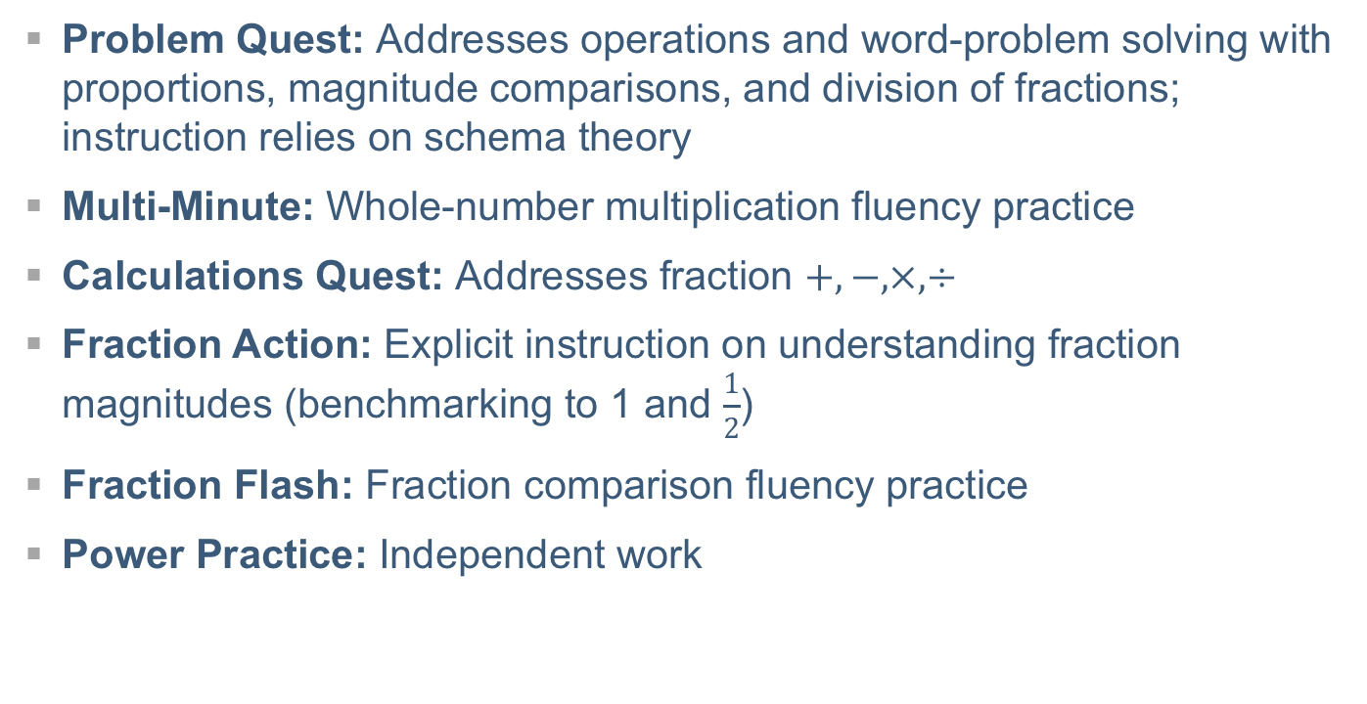
Set-Up Phase, Step 1:
Select an Intensive Intervention Platform (Super Solvers)
Problem Quest: Addresses operations and word-problem solving with proportions, magnitude comparisons, and division of fractions; instruction relies on schema theory
Multi-Minute: Whole-number multiplication fluency practice
Calculations Quest: Addresses fraction $+, −, ×, ÷$
Fraction Action: Explicit instruction on understanding fraction magnitudes (benchmarking to 1 and $\frac{1}{2}$)
Fraction Flash: Fraction comparison fluency practice
Power Practice: Independent work

Slide 31
Set-Up Phase, Step 1:
Select an Intensive Intervention Platform (Super Solvers)
Includes two progress-monitoring tools to be administered before intervention, every 2 weeks during intervention, and after intervention:
  Super Challenge (20 items) tests student understanding of fraction-magnitude topics—comparing, ordering, number line
  Conquer Calculations (12 items) tests student proficiency with fraction calculations—addition, subtraction, multiplication, and division

Slide 32
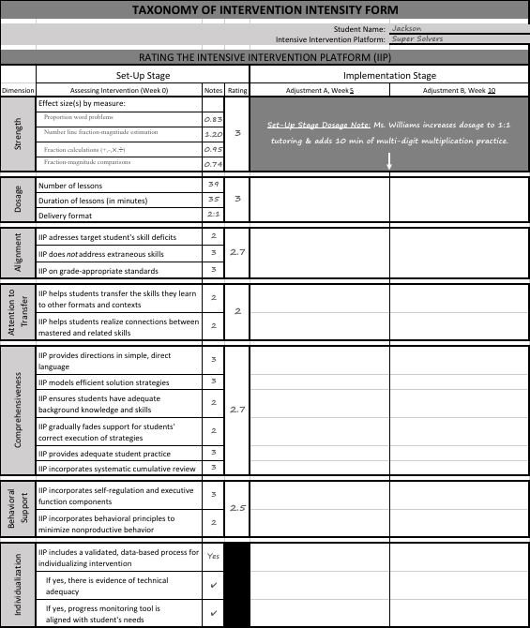
Set-Up Stage, Step 1:
Rating the Intensive
Intervention Platform
Ratings:
0 (fails to address standard)
1 (addresses standard minimally)
2 (addresses standard moderately)
3 (addresses standard well)
Super Solvers = 2.7

Slide 33
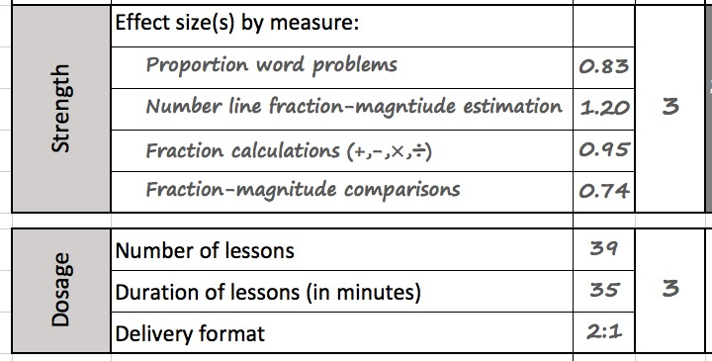
Set-Up Phase, Step 1:
Rate the Intensive Intervention Platform

Slide 34
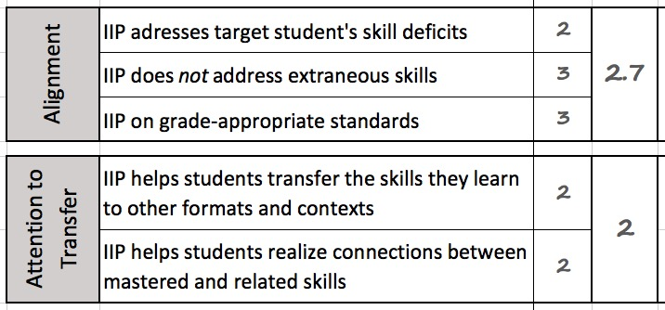
Set-Up Phase, Step 1:
Rate the Intensive Intervention Platform
Notes:
In terms of alignment, the Tier II intervention does not address some of Jackson’s mathematics difficulties. Most notably, the program does not cover decimal concepts, division of whole numbers, and multi-digit multiplication. However, the program covers the majority of the topic areas he struggles with, so Ms. Williams plans to modify content as needed during the implementation stage to address all of his needs.

Slide 35
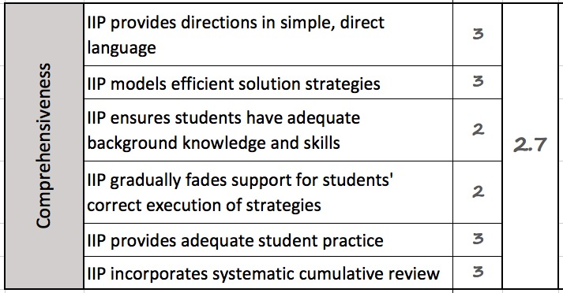
Set-Up Phase, Step 1:
Rate the Intensive Intervention Platform
Notes:
In terms of comprehensiveness, although the IIP includes adequate introduction of new concepts, repetition of learned content, and systematic cumulative review, Ms. Williams worries that Jackson is so far behind that she will need to fill in a number of gaps in background knowledge. Given Jackson’s difficulty with keeping track of his work, she is also concerned that the program’s guidance for slowing fading support will need to be slightly modified to ensure Jackson correctly executes (and remembers) the strategies taught.

Slide 36
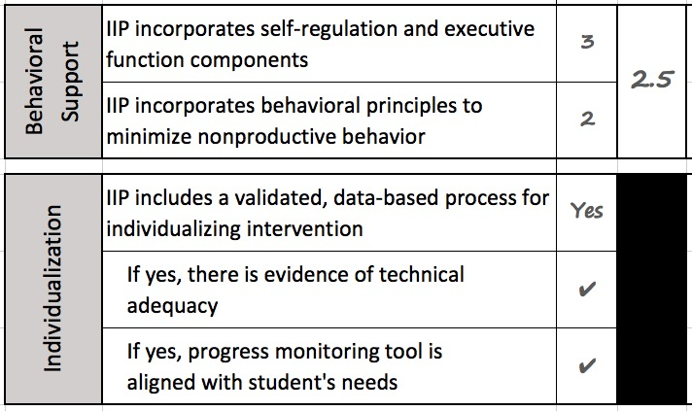
Set-Up Phase, Step 1:
Rate the Intensive Intervention Platform
Notes:
In terms of behavioral support, Ms. Jackson feels that the behavioral system in place will need to be strengthened to adequately support Jackson and minimize nonproductive behavior. She opts to implement the behavior system as designed in the implementation stage, so she can determine whether she needs to intensify behavioral supports during the first intensification period.

Slide 37
Set-Up Phase, Step 2:
Make Initial Adjustments to the Intervention Platform
What are the shortcomings of the Super Solvers intensive intervention platform for addressing Jackson’s needs?
  Alignment: Does not cover decimal concepts, division of whole numbers, and multi-digit multiplication.
  Comprehensiveness: Must fill in gaps for background knowledge; program’s guidance for fading support will need to be modified to ensure Jackson correctly executes (and remembers) the strategies taught.
  Behavioral support: Behavioral system in place will need to be strengthened to adequately support Jackson and minimize nonproductive behavior.

Slide 38
Set-Up Phase, Step 2:
Make Initial Adjustments to the Intervention Platform
At this point, Mrs. Williams’s avoids major substantive changes until she can gauge Jackson’s response to the IIP via progress-monitoring data.
  She increases the dosage to 1:1 tutoring in light of the severity of Jackson’s math and behavior deficits.
  She also opts to delay a focus on decimal concepts, division of whole numbers, and multi-digit multiplication until Jackson shows improvement on the foundational concepts taught in Super Solvers.

Slide 39
Set-Up Phase, Step 3:
Select a Progress-Monitoring System
Ms. Williams selects the progress-monitoring system that comes with and is aligned with Super Solvers. This system has adequate reliability and validity.
This progress-monitoring system includes two types of tests:
  Super Challenge (20 items) assesses different forms of fraction magnitude understanding (e.g., number line placement, ordering problems).
  Conquer Calculations (12 items) assesses fraction calculations: addition, subtraction, multiplication, and division.
Each type of test is administered before intervention starts and then every 2 weeks.
Whenever the data indicate Jackson is not on track to meet his goal, Ms. Williams will adjust the program.
Notes:
Ms. Williams has not collected enough data to modify the intervention before implementation, and changing dosage to 1:1 should be sufficient to begin implementing the intervention and collecting PM data. She should implement the intervention for a minimum of four weeks before making a data-based decision to modify instruction.

Slide 40
Set-Up Phase, Step 4: Begin Implementing Intervention and Collecting Progress-Monitoring Data
Ms. Williams begins implementing the intervention and collecting progress-monitoring data.
On the first day of intervention, before the first lesson, Ms. Williams administers Super Challenge 1 and Conquer Calculations 1.
  Jackson scores 0 points on Super Challenge.
  Jackson scores 1 point on Conquer Calculations.

Slide 41
Set-Up Phase, Step 4: Begin Implementing Intervention and Collecting Progress-Monitoring Data
-----Should Ms. Williams modify the IIP now?-----
-----If yes, what dimension?-----
NO

Slide 42
Trick Question ☺
Ms. Williams has not collected enough data to modify the intensive intervention platform.
Her two initial change to the intensive intervention platform should be sufficient to get implementation started.
The data-utilization rules for Super Solvers indicate she needs to implement the intervention for a minimum of 3 weeks before making a data-based decision to modify instruction.

Slide 43
Implementation Phase

Slide 44
Implementation Phase, Steps 5-9:
Use the Taxonomy to Make Adjustments to the Intervention During Implementation
Data-based individualization (DBI): A validated process for individualizing intervention.
Ms. Williams collects progress-monitoring data frequently (Super Challenge and Conquer Calculations) to then apply validated decision rules on a regular basis (every 3 weeks) to determine whether the intervention is producing the target response for Jackson.
  Whenever the data indicate Jackson is not on track to meet his goals, Ms. Williams will adjust the program to better address his needs.
Notes:
DBI = signature feature of special education

Slide 45
Implementation Phase, Steps 5-9:
Use the Taxonomy to Make Adjustments to the Intervention During Implementation
The implementation phase steps (5-9) alternate between
Assessing data (gray titles) to evaluate whether Jackson’s intervention requires an adjustment
Applying the taxonomy (orange titles) to design adjustments to the intensive intervention platform.
Notes:
DBI = signature feature of special education

Slide 46
Determine When to Make an Adjustment to Intervention
Wait at least 3 weeks to make first adjustment.
Ms. Williams delivers Lessons 1–9 and administers Super Challenge 2 on Lesson 9.
  Jackson scores 1 point.
Jackson’s rate of progress is inadequate. He is becoming frustrated with the difficulty of the material and is struggling to remember the concepts taught. He shuts down and refuses to answer subsequent questions. Ms. Williams spends much of her time reteaching content and reviewing vocabulary.

Slide 47
Determine When to Make an Adjustment to Intervention
-----Should Ms. Williams modify the IIP?-----
-----If yes, what dimension?-----
YES

Slide 48
Formulate an Adjustment to the Intervention Platform When the Rate of Progress is Inadequate
Ms. Williams should intensify/individualize Jackson’s program. Based on her observations during intervention, she decides to focus on the Taxonomy’s behavioral support dimension:
  Increase behavioral check interval to six times during the lesson.
  Track the number of praise statements given during the lesson to ensures a 4:1 ratio between behavior-specific praise statements and reprimands. She specifically ties praise statements to correctly defining fraction vocabulary words to incentivize him to learn these terms.
Note that she does not to modify content at this time.

Slide 49
Implement Adjustment 1 and Progress Monitor to Determine When to Make Next Adjustment to Intervention
Ms. Williams delivers Lessons 10–15 and administers Super Challenge 3 on Lesson 15.
  Jackson scores 2 points.
His progress is still inadequate.
Jackson is overwhelmed with new content.
He struggles to differentiate between number of parts (numerator) and size of parts (denominator).
He is struggling with single-digit multiplication, which slows down the lesson.

Slide 50
Implement Adjustment 1 and Determine When to Make an Adjustment to Intervention
-----Should Ms. Williams modify the IIP?-----
-----If yes, what dimension?-----
YES

Slide 51
Formulate an Adjustment to the Intervention Platform When the Rate of Progress is Inadequate
Ms. Williams should intensify/individualize Jackson’s program. Based on her observations during intervention, she decides to focus on the Taxonomy’s alignment dimension:
  Ms. Williams adds 5 minutes of conceptual practice with manipulatives (fraction tiles) to help Jackson differentiate between the numerator and denominator. She reinforces this practice with a flashcard activity that requires Jackson to differentiate between numerator and denominator.
  She adds 5 minutes of multiplication strategy instruction, including practice with skip counting and adding on.

Slide 52
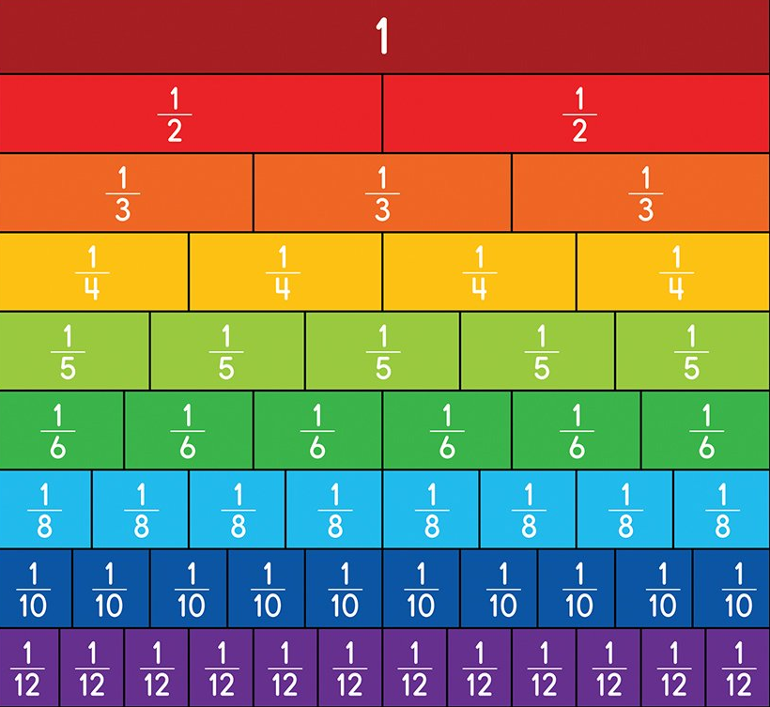
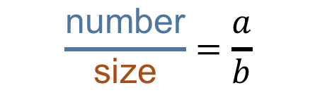
Formulate an Adjustment to the Intervention Platform When the Rate of Progress is Inadequate
Fraction Tiles
Numerator: the number of equal parts in a fraction
Denominator: how many equal parts the unit is divided into
$$\frac{\text{number}}{\text{size}}=\frac{a}{b}$$
Review/reteach

Slide 53
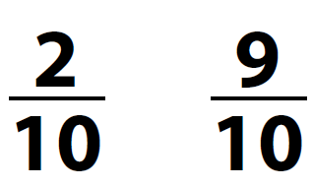
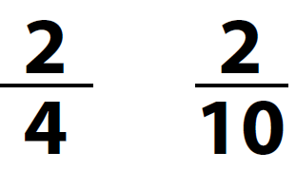
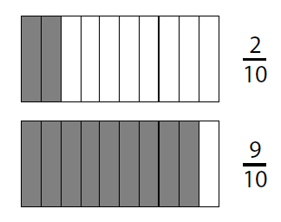
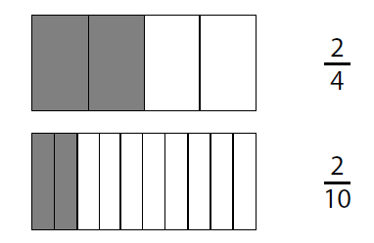
Formulate an Adjustment to the Intervention Platform When the Rate of Progress is Inadequate
Same Denominator
Same Numerator
Extra practice

Slide 54
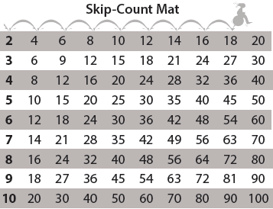
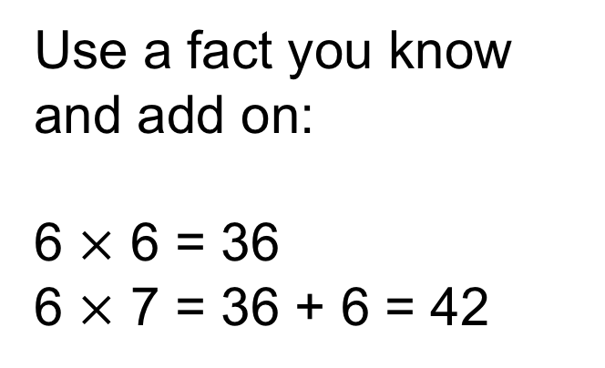
Formulate an Adjustment to the Intervention Platform When the Rate of Progress is Inadequate
Use a fact you know and add on:
6 $×$ 6 = 36
6 $×$ 7 = 36 + 6 = 42
Extra practice

Slide 55
Implement Adjustment 2 and Determine When to Make an Adjustment to Intervention
Ms. Williams delivers Lessons 16-21 and administers Conquer Calculations 2 on Lesson 18 and Super Challenge 4 on Lesson 21.
  Jackson scores 3 points on Conquer Calculations.
  Jackson scores 6 points on Super Challenge.
Jackson is making progress (see progress-monitoring chart).
Note that calculations instruction began on Lesson 16, so he has not received sufficient instruction to expect a high score on the Conquer Calculations.

Slide 56
Super graph challenge

Slide 57
Implement Adjustment 2 and Determine When to Make an Adjustment to Intervention
-----Should Ms. Williams modify the IIP?-----
-----If yes, what dimension?-----
NO

Slide 58
Implement Adjustment 2 and Determine When to Make an Adjustment to Intervention
Ms. Williams should not intensify/individualize Jackson’s program because he is making adequate progress at this time. He is approaching his goal line on his Super Challenge graph.
But Jackson did need further adjustments as he mastered basic fraction magnitude understanding and required additional structure to learn other components of the program.

Slide 59

Steps 5-9 Recap: Assessing Data and Formulating Adjustments (Applying the Taxonomy)
Interventionists use DBI during the implementation phase to determine when and how to individualize the intervention platform, thereby making it increasingly intensive.
Applying DBI in combination with the Taxonomy is like climbing a flight of stairs. It is a process of ebbs, flows, and modifications.

Slide 60
Super graph challenge2

Slide 61
Taxonomy and NCII Resources
Fuchs, L. S., Fuchs, D., & Malone A. S. (2017). The taxonomy of intervention intensity. Teaching Exceptional Children, 50(1), 35–43.
Relevant NCII resources:
  Designing Intensive Intervention for Students With Severe and Persistent Academic Needs (DBI Training Series, Module 7)
  So What Do I Do Now? Strategies for Intensifying Intervention When Standard Approaches Don’t Work (webinar)
  Introduction to Data-Based Individualization: Considerations for Implementation in Academics and Behavior (DBI Training Series, Module 1)
Notes:
NCII has developed several resources to help interventionists plan and implement intensive intervention programs. The Intensive Intervention Practice Categories highlight possible means of intensifying interventions: These Practice Categories include:
Change Intervention Dosage or Time
Change the Learning Environment to Promote Attention and Engagement
Combine Cognitive Learning Strategies with Academic Learning
Modify Delivery of Instruction

Slide 62
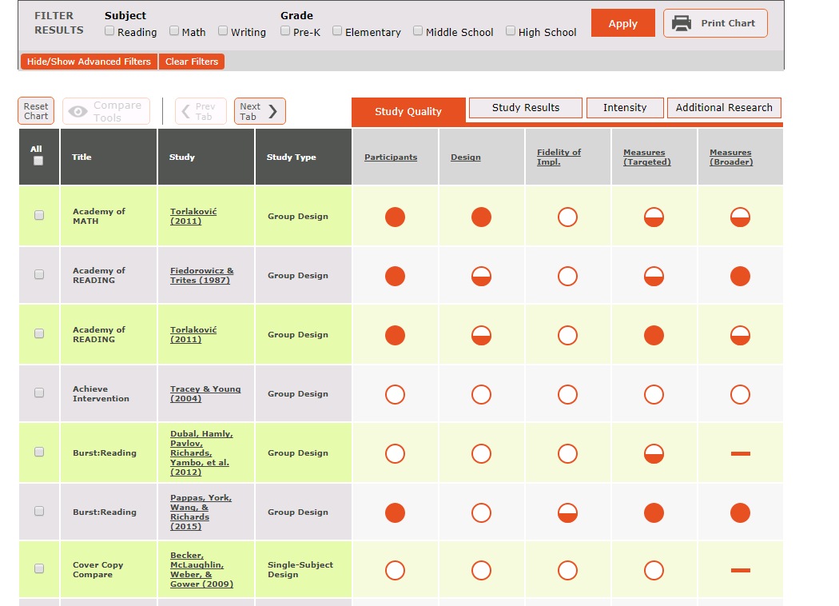
The NCII Tools Charts

Slide 63

Questions?

Slide 64
Disclaimer
This presentation was produced under the U.S. Department of Education, Office of Special Education Programs, Award No. H326Q160001. Celia Rosenquist serves as the project officer.
The views expressed herein do not necessarily represent
the positions or policies of the U.S. Department of Education. No official endorsement by the U.S. Department of Education of any product, commodity, service, or enterprise mentioned in this webinar is intended or should be inferred.
64

Slide 65

Connect to NCII
Sign up on our website to receive our newsletter and announcements.
Follow us on YouTube and Twitter:
  YouTube Channel: National Center on Intensive Intervention
  Twitter handle: @TheNCII

Slide 66
Contact US
National Center on Intensive Intervention
1000 Thomas Jefferson Street NW
Washington, DC 20007-3835
www.intensiveintervention.org
ncii@air.org

