Slide 1
Module 6
Whole-Number Content for Intensive Intervention

Slide 2
Slide 2
Video Link: https://youtu.be/22w3zjTzGQM

Slide 3
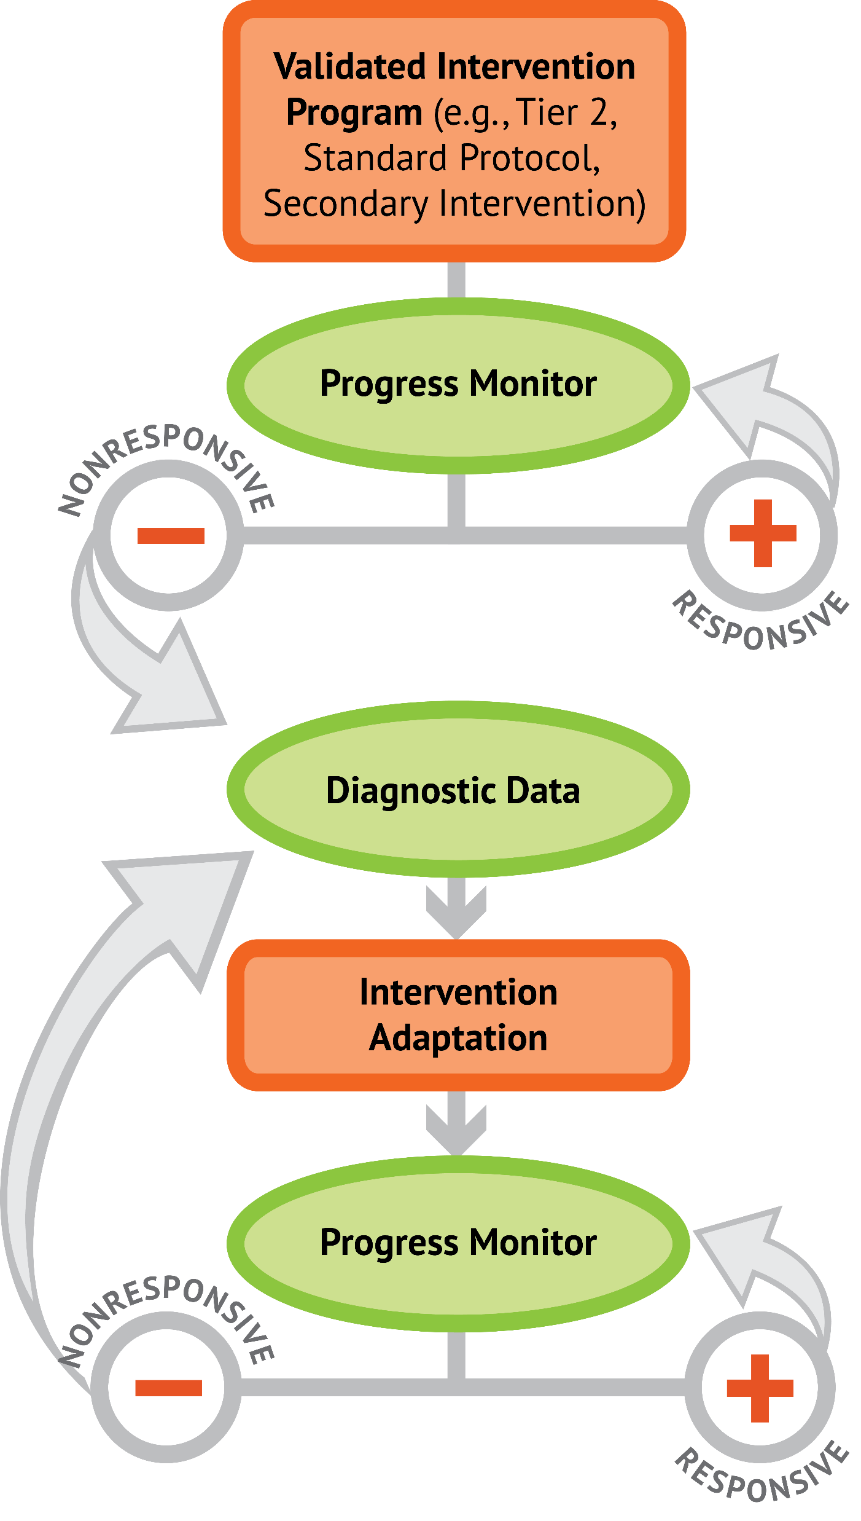
Slide 3
1: Developing a scope and sequence for intervention
2: Progress monitoring and determining response
3: Selecting evidence-based practices for the instructional platform
4: Instructional delivery: explicit instruction, multiple representations, language
5: Instructional strategies: fluency building, problem solving, motivation
6: Whole number content
7: Rational number content
8: DBI and mathematics: fidelity, adaptations

Slide 4
Objectives
PART 1: What whole-number core concepts should be included within intensive intervention?
PART 2: What whole-number procedures should be emphasized within intensive intervention?
PART 3: What does DBI look like with intensive interventions that focus on conceptual and procedural understanding of whole numbers?

Slide 5
Activities
PART 1: What whole-number core concepts should be included within intensive intervention?
Describe and draw the addition and subtraction
Discuss student interpretations of addition and subtraction
Describe and draw multiplication and division
Look at multiplication and division within word problems

Slide 6
Activities
PART 2: What whole-number procedures should be emphasized within intensive intervention?
Solve addition and subtraction problems using different algorithms
Solve multiplication and division problems using different algorithms
Connect procedures to word-problem schemas
Make a video for a parent

Slide 7
Activities
PART 3: What does DBI look like with intensive interventions that focus on conceptual and procedural understanding of whole numbers?
Identify important components within intensive intervention
Make and share a video of your teaching an alternate algorithm

Slide 8
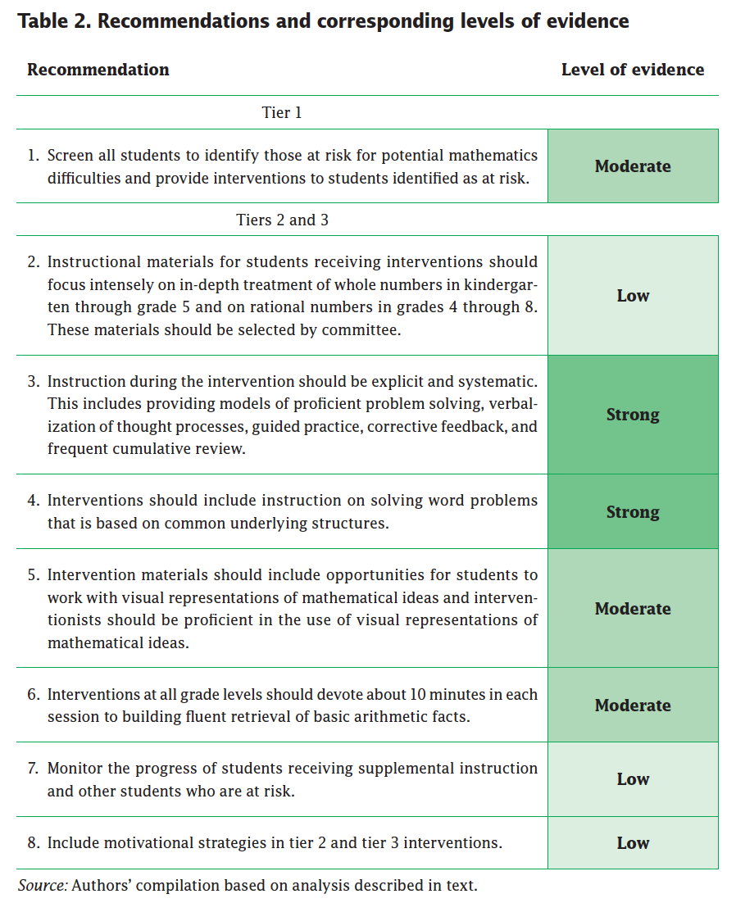
Slide 8
Explicit instruction
Multiple representations
Concise language
Fluency building
Problem solving instruction
Motivation component
Gersten et al. (2009)

Slide 9
Reading
Powell, S. R., & Fuchs, L. S. (2012). Early numerical competencies and students with mathematics difficulty. Focus on Exceptional Children, 44(5), 1–16.

Slide 10
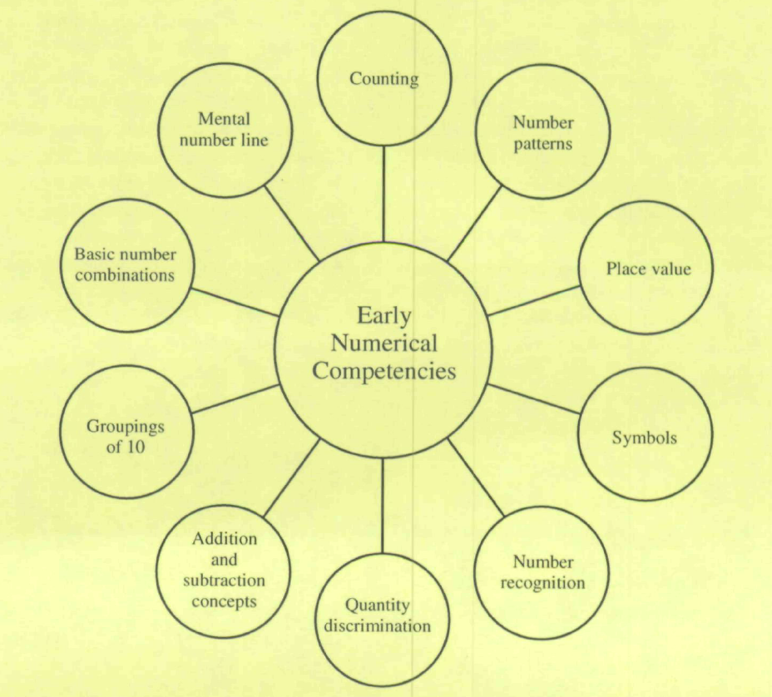
Slide 10

Slide 11
Classroom Application
List two ways to increase your modeling of whole-number concepts
List two ways to increase your modeling of whole-number procedures

Slide 12
Welcome!
Let’s get started on Module 6!

Slide 13
Slide 13
Part 1

Slide 14
What whole-number core concepts should be emphasized in intensive intervention?
Module 6, Part 1

Slide 15
Part 1 Objectives
In this part, you’ll learn:
Core concepts of addition, subtraction, multiplication, and division

Slide 16
Whole-Number Concepts
Understanding the concepts of whole numbers is foundational to many other mathematical tasks.
Addition
Subtraction
Multiplication
Division

Slide 17
Slide 17
Note:
These concepts are related to the schemas discussed in the instructional strategies module.
These concepts should be emphasized within problem solving and when solving abstract problems.

Slide 18
Slide 18
Addition
Part-part-whole
(Total)
Join
(Change increase)

Slide 19
Slide 19
Addition
Part-part-whole
(Total)
Count one set
Count another set
Put sets together
Count all for the sum
2 + 3 = 5

Slide 20
Slide 20
Addition
Join
(Change increase)
Start with a set
Add another set
Count to the sum
2 + 3 = 5

Slide 21
Workbook Activity #1
Look at problem A.
5 + 6 = __
Describe and draw two conceptual understandings of addition.
Part-part-whole
(Total)
Join
(Change increase)

Slide 22
Slide 22
Subtraction
Separate
(Change decrease)
Compare
(Difference)

Slide 23
Slide 23
Subtraction
Separate
(change decrease)
Start with a set
Take away (i.e., separate) from that set
Count the difference
5 – 3 = 2

Slide 24
Slide 24
Subtraction
Compare
(Difference)
Create one set
Create other set
Compare the difference
5 – 3 = 2

Slide 25
Workbook Activity #1
Look at problem B.
8 – 3 = __
Describe and draw two conceptual understandings of subtraction.
Separate
(Change decrease)
Compare
(Difference)

Slide 26
Slide 26
Workbook Activity #2
Read about how each student interprets addition and subtraction.
How does Martin interpret addition?
What would be another way to explain addition to Martin?
How does Lola interpret subtraction?
What would be another way to explain subtraction to Lola?

Slide 27
Slide 27
Multiplication
Equal groups
Comparison

Slide 28
Slide 28
Multiplication
Equal groups
Show the groups
Show the amount within each group
Count product
3 × 2 = 6

Slide 29
Slide 29
Multiplication
Equal groups
Show the groups
Show the amount within each group
Count product
3 × 2 = 6

Slide 30
Slide 30
Multiplication
Comparison
Start at 0
Move in increments based on the number in each group
3 × 2 = 6

Slide 31
Workbook Activity #3
Look at problem A.
2 × 4 = __
Describe and draw two conceptual understandings of multiplication.
Equal groups
Comparison

Slide 32
Slide 32
Division
Partitive
Measurement

Slide 33
Slide 33
Division
Partitive
Show the dividend
Divide equally among divisor
Count quotient
6 ÷ 3 = 2

Slide 34
Slide 34
Division
Measurement
Show the dividend
Make groups of the divisor
Count the groups
6 ÷ 3 = 2

Slide 35
Workbook Activity #3
Look at problem B.
10 ÷ 5 = __
Describe and draw two conceptual understandings of division.
Partitive
Measurement

Slide 36
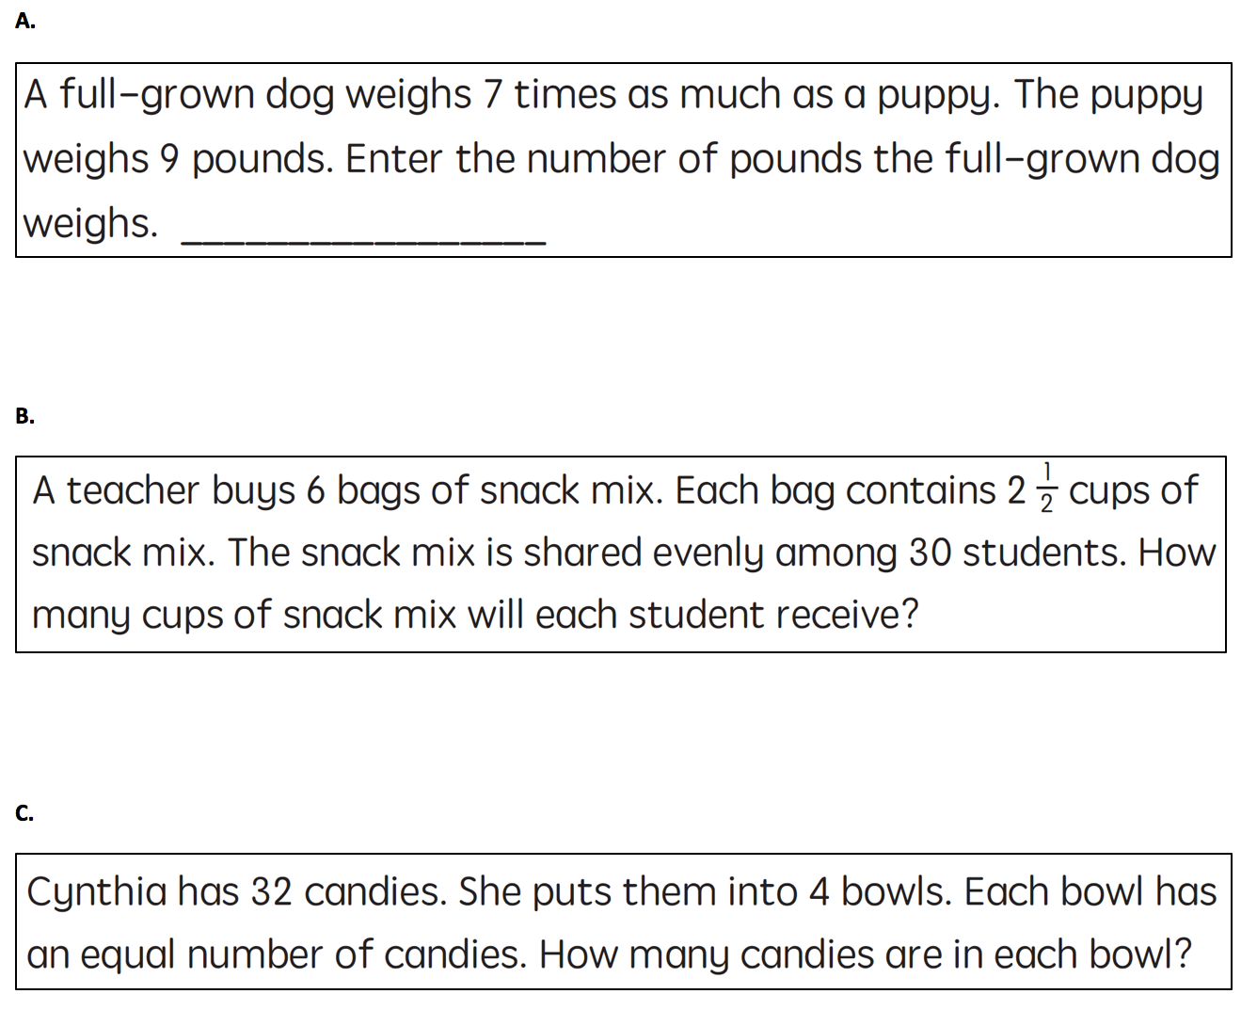
Workbook Activity #4
Look at these word problems.
What concepts of multiplication should be emphasized?
What concepts of division should be emphasized?

Slide 37
Why Is This Important?
Understanding the concepts of the operations helps fill your intensive intervention tool box.
You might not need to use this knowledge all of the time, but it’s necessary to have an extensive tool box for intensive intervention.

Slide 38
A Few Considerations
Concepts of the operations may not be taught simultaneously.
Introduction: Concepts should be taught separately.
Review:
Concepts can be taught together.
Use problem-solving scenarios to help students understand the differences between concepts.
The concepts of the operations can also be used with multi-digit whole numbers and rational numbers.

Slide 39
Part 1’s Checklist: What whole-number core concepts should be emphasized in intensive intervention?
Teach the part-part-whole and join concepts of addition
Teach the separate and compare concepts of subtraction
Teach the equal groups and comparison concepts of multiplication
Teach the partitive and measurement concepts of division

Slide 40
Slide 40
Part 2

Slide 41
What whole-number procedures should be emphasized in intensive intervention?
Module 6, Part 2

Slide 42
Part 2 Objectives
In this part, you’ll learn—
Place value and regrouping concepts related to procedures
Multiple algorithms for addition, subtraction, multiplication, and division of whole numbers

Slide 43
Slide 43
Note:
In this part, we focus on procedures (i.e., algorithms) for computation of multi-digit numbers.
See the module on instructional strategies for information about fluency building.

Slide 44
Place Value
Addition
Subtraction
Multiplication
Division
After learning the concepts of the operations with mathematics facts, students start to solve multi-digit problems and learn the procedures used to solve such problems.

Slide 45
Place Value
Solving problems with multi-digit numbers requires an understanding of place value.
“The system by which the value of a digit is determined by the position it occupies relative to the decimal point.”
One of the most important mathematical concepts that students learn.
Stein et al. (1997)
604

Slide 46
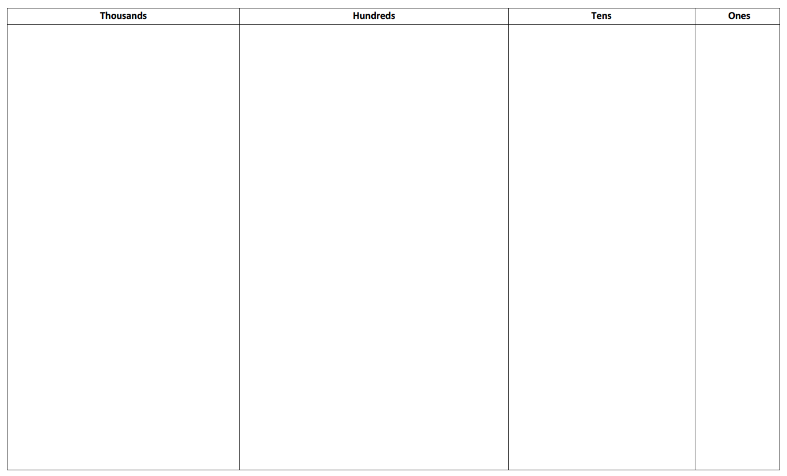
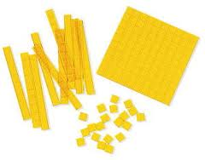
Place Value
16 2,309
Students should name the place value of each digit within a number.

Slide 47
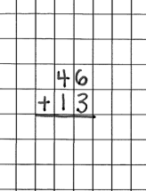
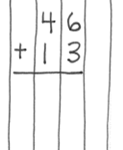
Computation
4 6
+ 1 3
Work on vertical presentation:
Graph paper
Notebook paper (turned sideways)
Highlighters
Bookmarks

Slide 48
Regrouping
10 ones
1 ten
“carry”
Regroup
Trade
Exchange
10 tens
1 hundred
1 ten
10 ones
“borrow”
Regroup
Trade
Exchange
1 hundred
10 tens

Slide 49
Why Is This Important?
It’s important to teach computational procedures and corresponding concepts within intensive intervention.
Your intensive intervention tool box should include multiple algorithms for solving multi-digit problems.

Slide 50
Slide 50
Addition
Standard
Partial Sums
7 4
+ 1 8
7 4
+ 1 8

Slide 51
Slide 51
Subtraction
Standard
Partial Differences
Add Up
3 1 5
– 9 6
3 1 5
– 9 6
3 1 5
– 9 6

Slide 52
Workbook Activity #5
Solve the addition problem using two different algorithms.
Solve the subtraction problem using two different algorithms.

Slide 53
Slide 53
Multiplication
Standard
Partial Products
Area
2 6
× 1 7
2 6
× 1 7
2 6
× 1 7

Slide 54
Slide 54
Division
Standard
Partial Quotients
1 6 ) 8 9 4
1 6 ) 8 9 4

Slide 55
Workbook Activity #6
Solve the multiplication problem using two different algorithms.
Solve the division problem using two different algorithms.

Slide 56
Workbook Activity #7
Review the multiplicative schemas from the module on instructional strategies.
How could you use two different schema to describe this problem?

Slide 57
Why Is This Important?
Understanding the different methods for solving computation problems fills your intensive intervention tool box.
Modeling and practicing alternate algorithms may be helpful to some students; it may be confusing the others.

Slide 58
A Few Considerations
A strong understanding of place value is necessary for using most computational algorithms.
Regrouping concepts may be taught in isolation or combined with instruction on the algorithms.

Slide 59
A Few Considerations
Knowledge of and fluency with mathematics facts increases efficiency with computation. (See the module about instructional strategies!)
Strong place value and computational skill with whole numbers leads to better understanding of computation with decimals.

Slide 60
Part 2’s Checklist: What whole-number procedures should be emphasized in intensive intervention?
Teach place value concepts
Teach regrouping concepts and use appropriate language for describing regrouping
Understand different algorithms for solving multi-digit computation problems in addition, subtraction, multiplication, and division

Slide 61
Discussion Board
Suppose that you’re teaching multi-digit addition, subtraction, multiplication, or division (you choose). You want to explain to a parent or guardian how to use an alternate algorithm.
Take a picture listing the steps or make a brief video of you explaining one alternate algorithm, just as you would to the parent or guardian.
Upload the picture or video and discuss this with your colleagues.

Slide 62
Slide 62
Part 3

Slide 63
What does DBI look like with intensive interventions that focus on conceptual and procedural understanding of whole numbers?
Module 6, Part 3

Slide 64
Part 3 Objectives
In this part, you’ll learn—
How concepts and procedures are practiced within intensive intervention that uses evidence-based practices

Slide 65
Where Are We?

Slide 66
Slide 66
Instructional Platform

Slide 67
Slide 67
Explicit instruction
Multiple representations
Concise language
Fluency building
Problem solving instruction
Motivation component
Gersten et al. (2009)

Slide 68
Let’s Watch Intensive Intervention

Slide 69
Slide 69
Video Link: https://youtu.be/l80S7oe8g3s
Explicit instruction
Multiple representations
Concise language

Slide 70
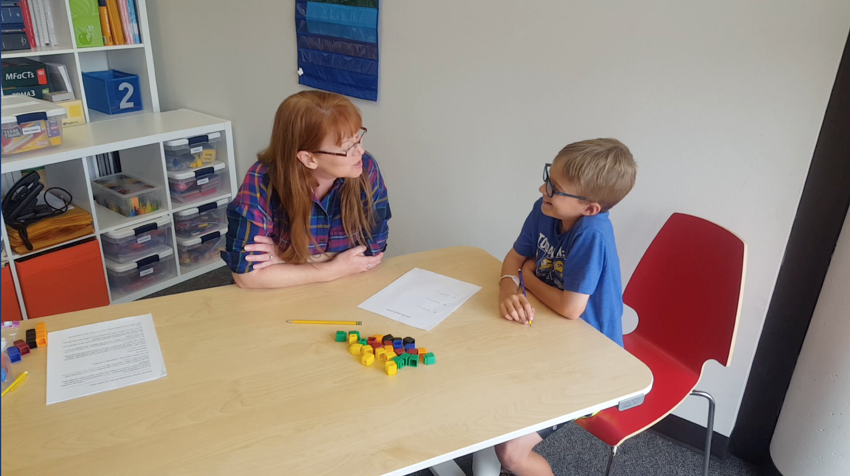
Slide 70
Concepts
Procedures

Slide 71
Slide 71
Video Link: https://youtu.be/4f4LlaTNQZs
Explicit instruction
Multiple representations
Concise language

Slide 72
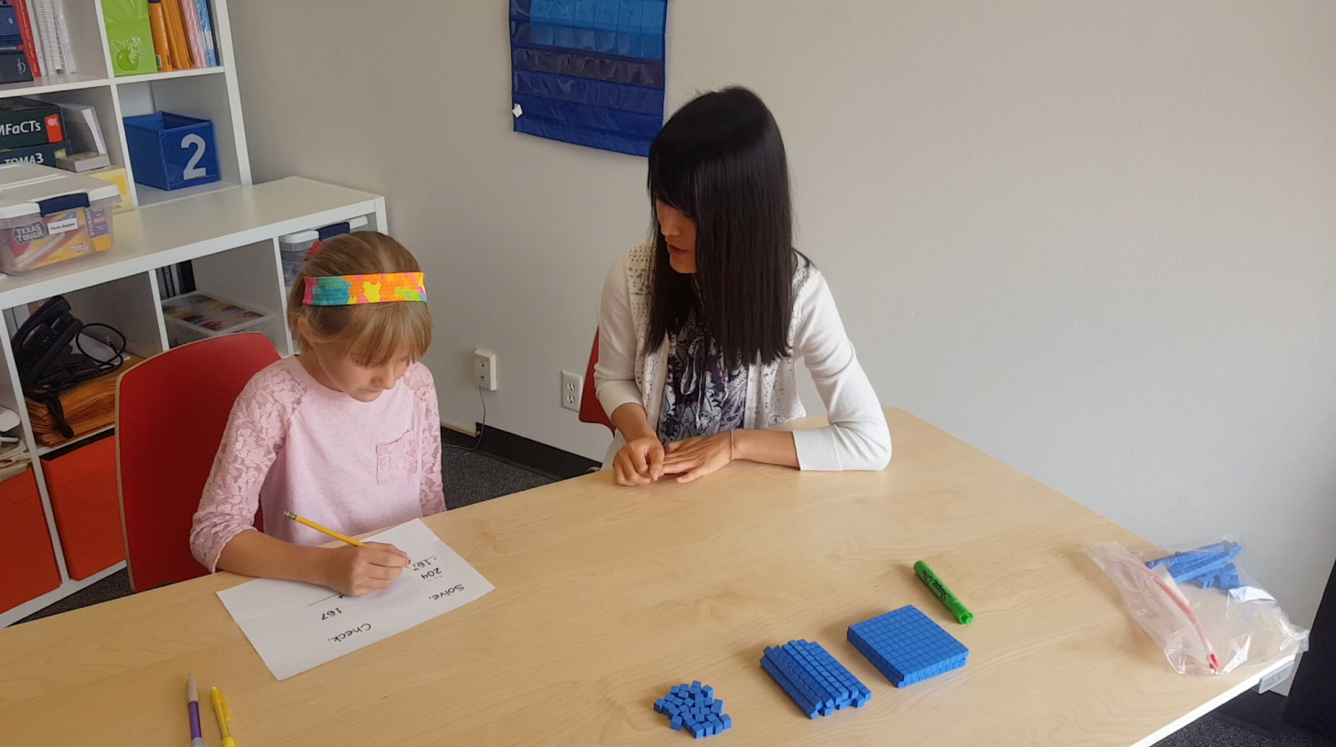
Slide 72
Concepts
Procedures

Slide 73
Slide 73
Workbook Activity #8
Explicit instruction
Read this intensive intervention lesson about computation. Identify the listed components and how they are used.
Multiple representations
Concise language
Fluency building
Problem solving instruction
Motivation component
Fuchs et al. (2014)

Slide 74
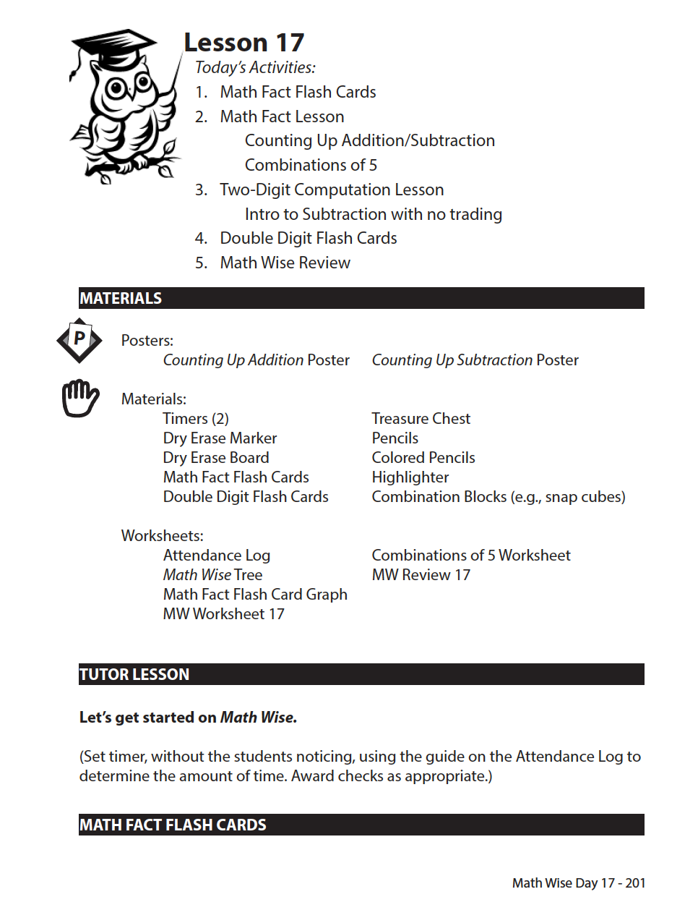
Slide 74
Fuchs et al. (2014)

Slide 75
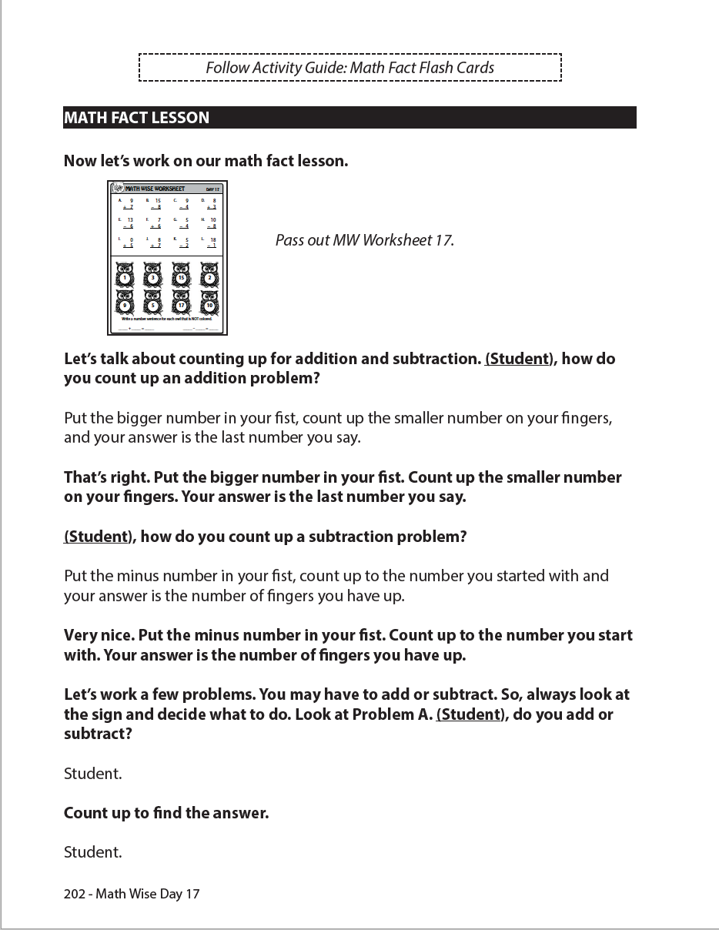
Slide 75
Fuchs et al. (2014)

Slide 76
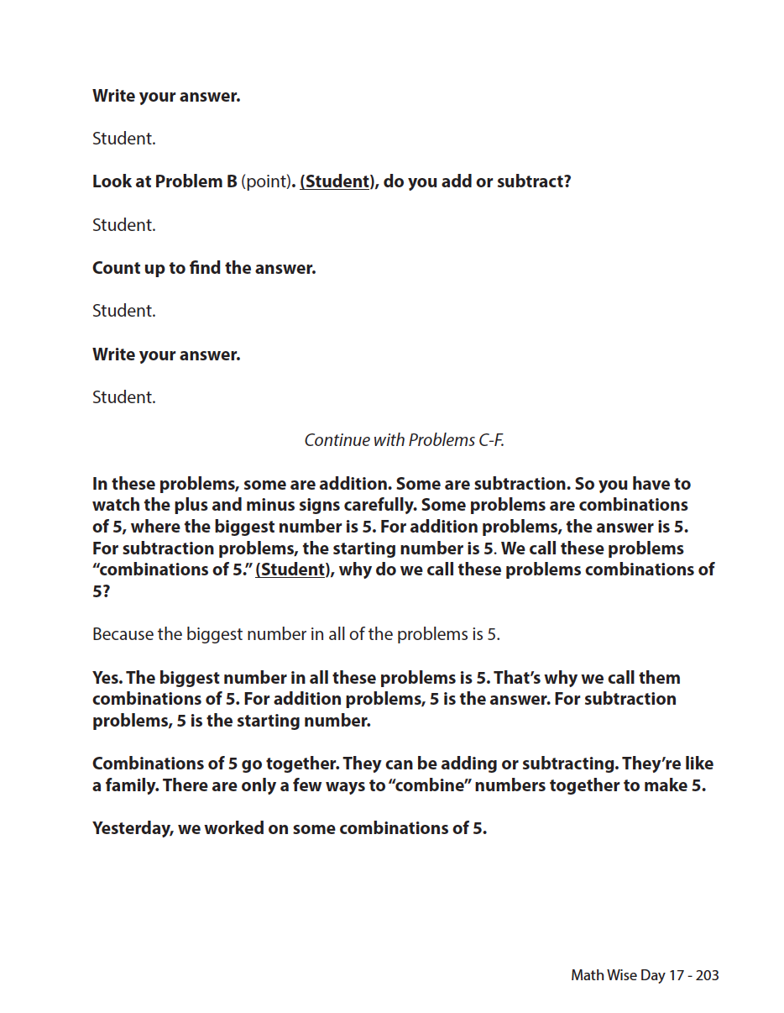
Slide 76
Fuchs et al. (2014)

Slide 77
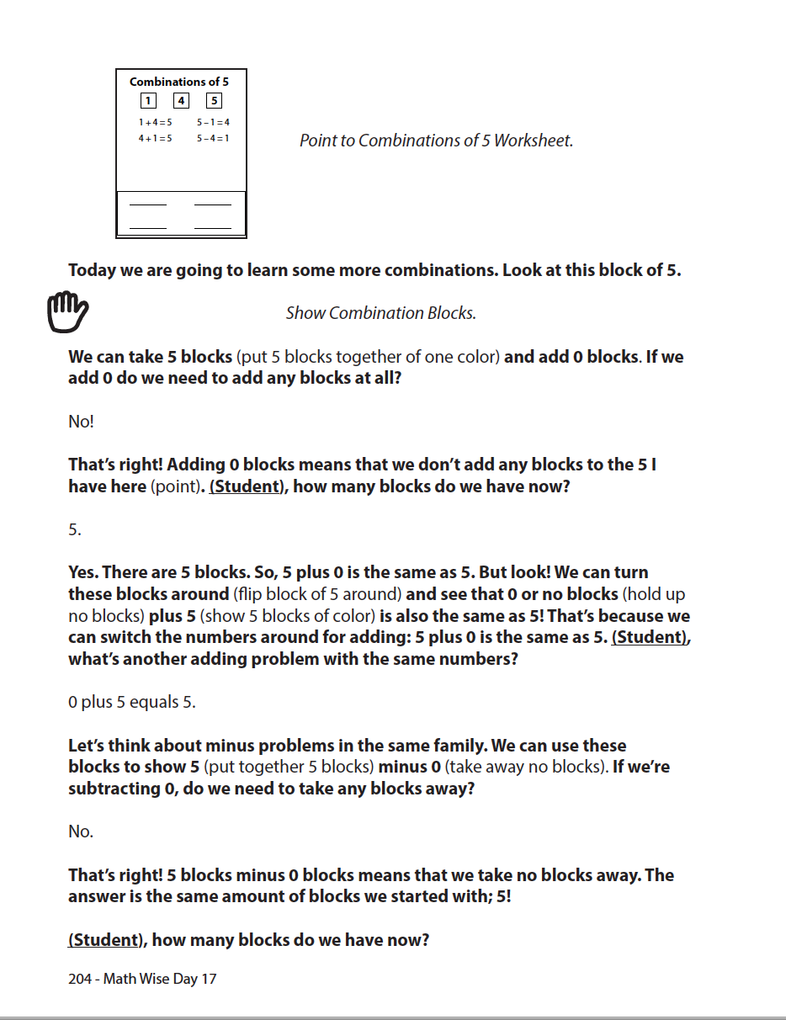
Slide 77
Fuchs et al. (2014)

Slide 78
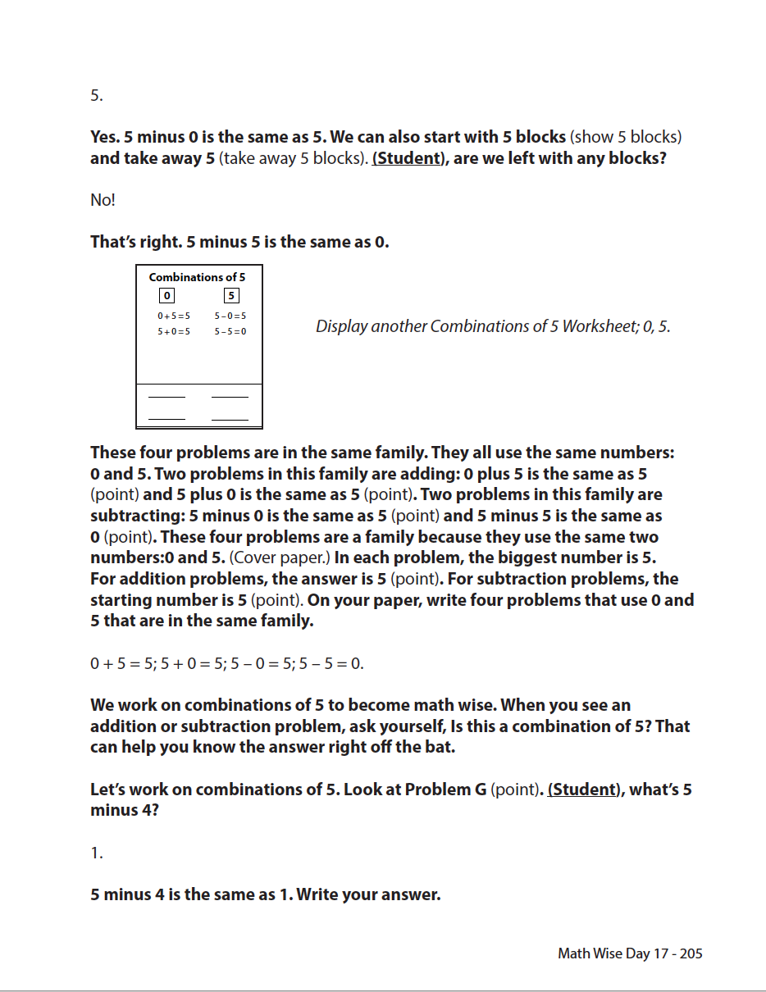
Slide 78
Fuchs et al. (2014)

Slide 79
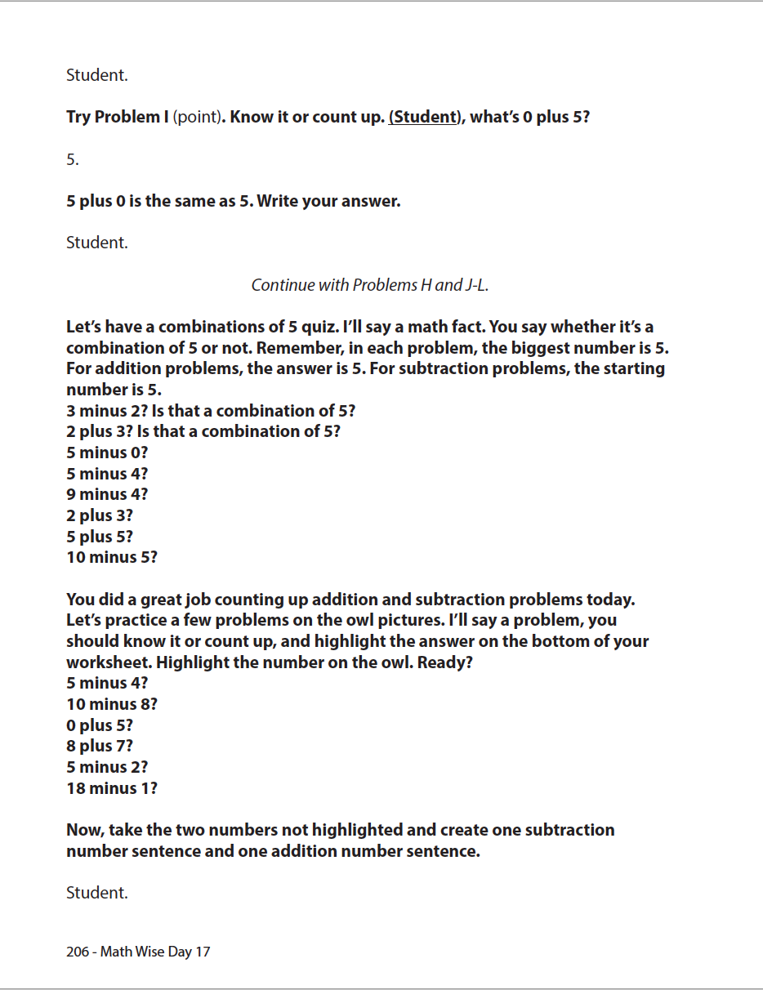
Slide 79
Fuchs et al. (2014)

Slide 80
Slide 80
Fuchs et al. (2014)

Slide 81
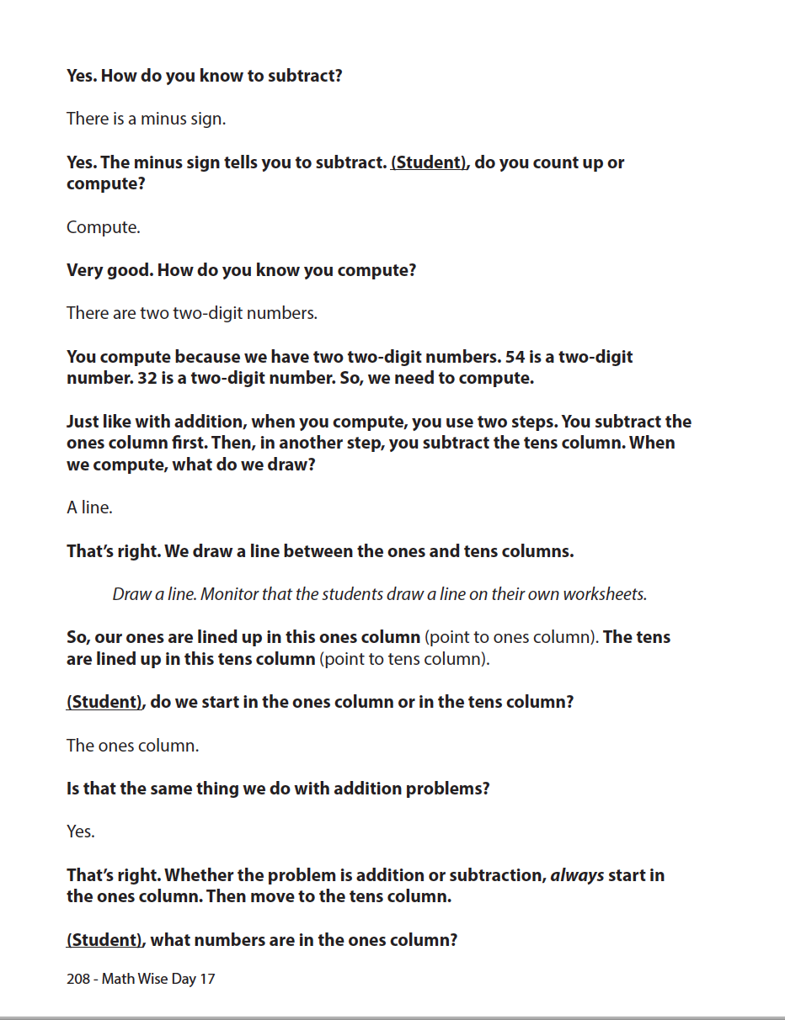
Slide 81
Fuchs et al. (2014)

Slide 82
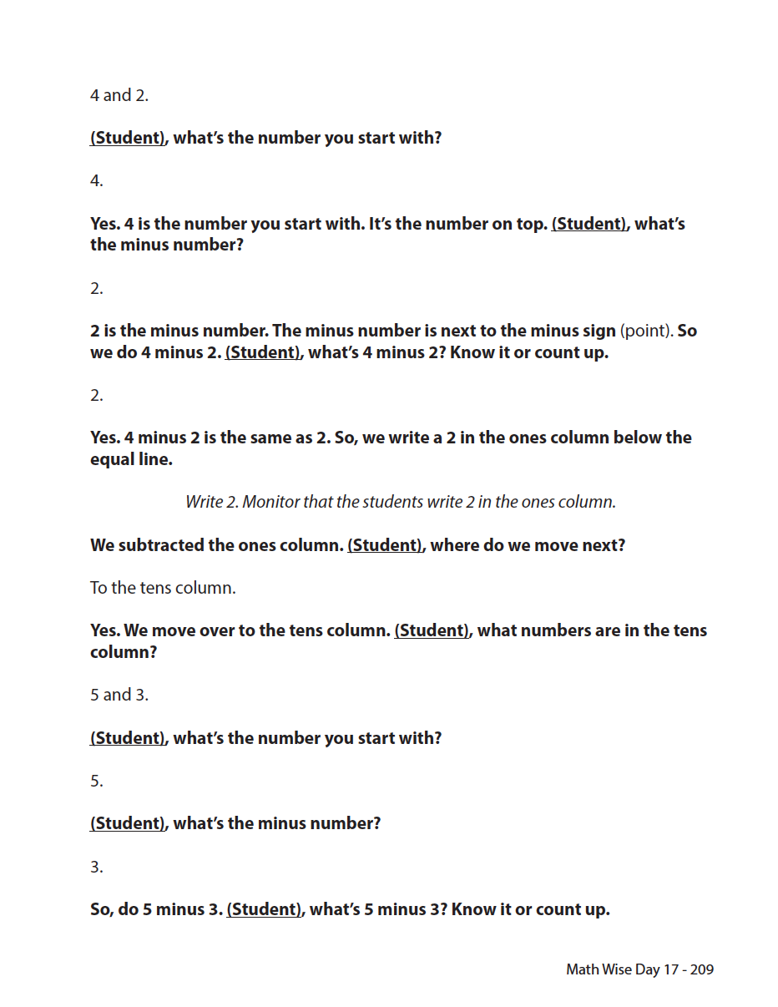
Slide 82
Fuchs et al. (2014)

Slide 83
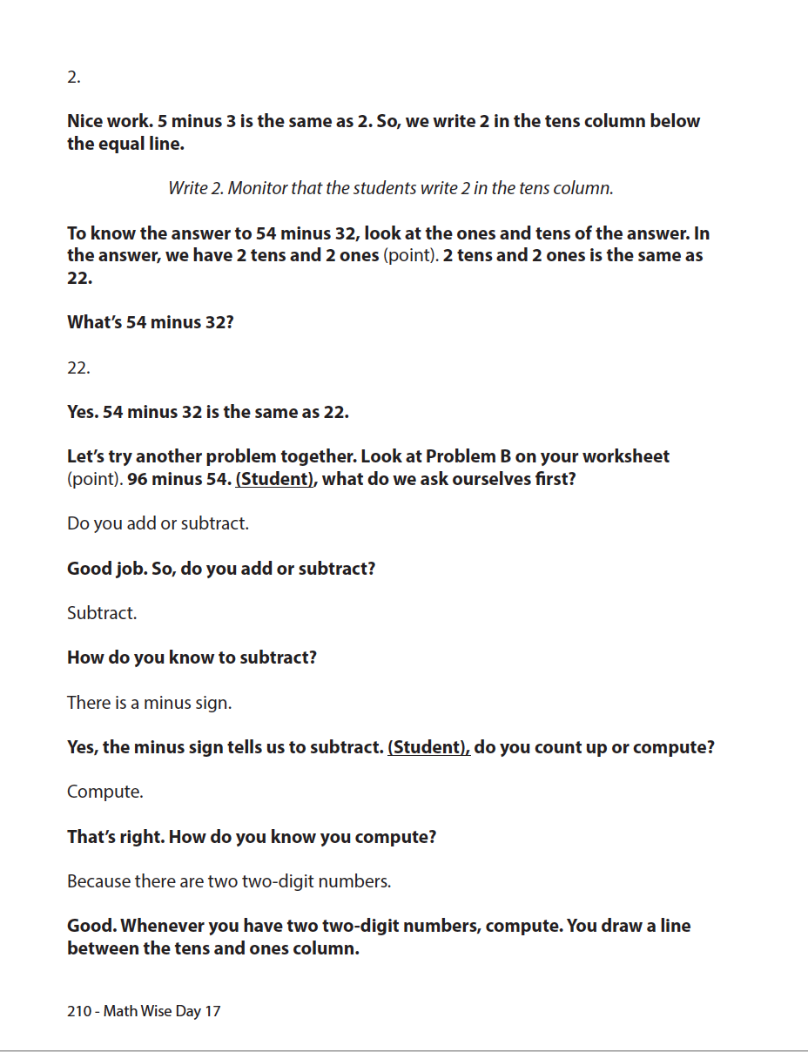
Slide 83
Fuchs et al. (2014)

Slide 84
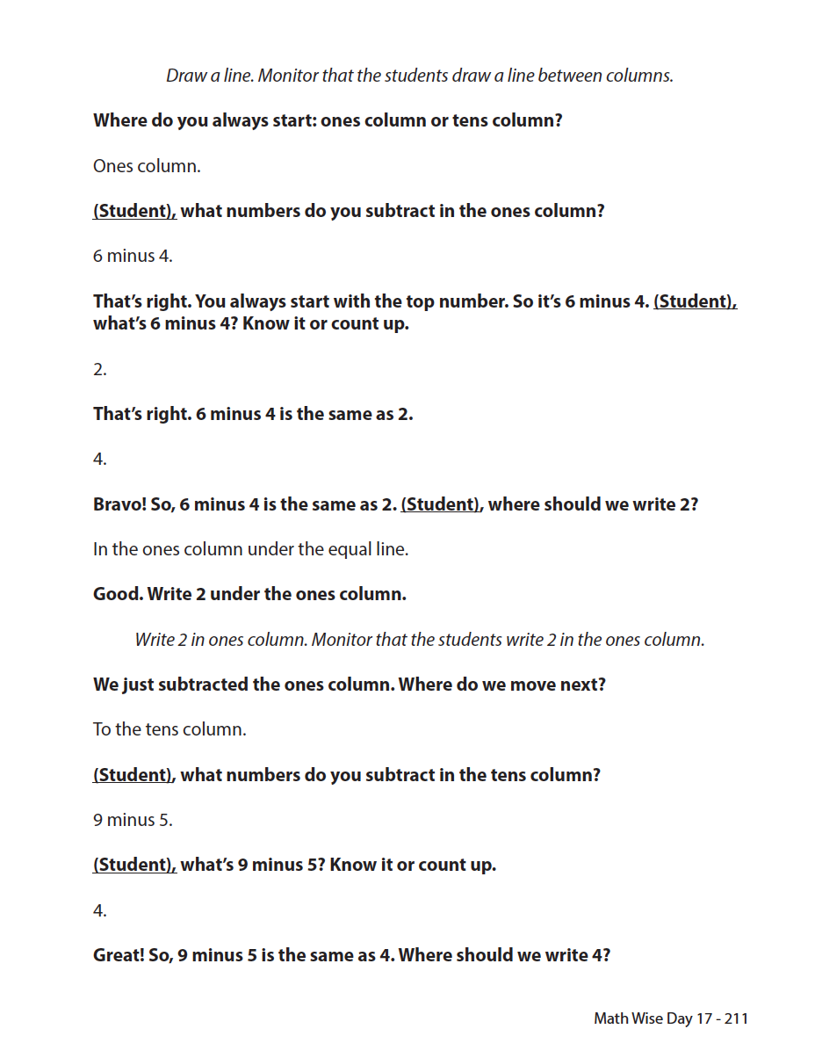
Slide 84
Fuchs et al. (2014)

Slide 85
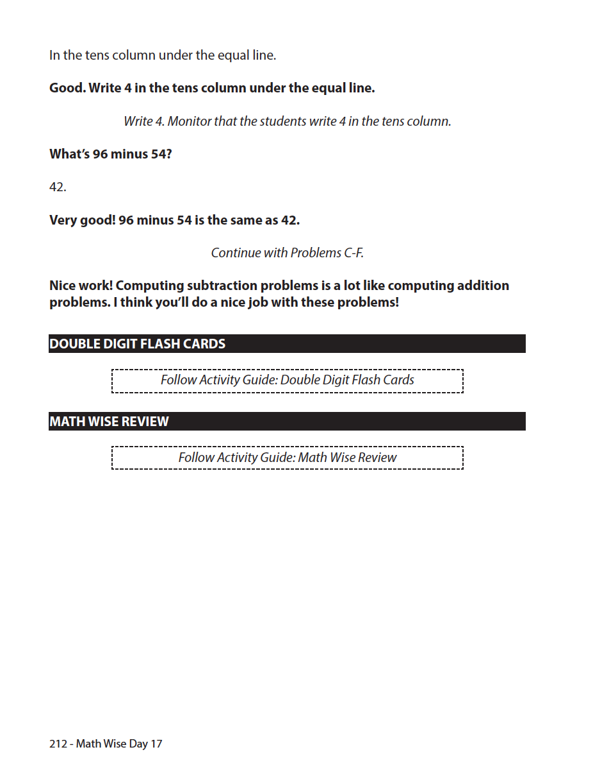
Slide 85
Fuchs et al. (2014)

Slide 86
Part 3’s Checklist: What does DBI look like with intensive interventions that focus on conceptual and procedural understanding of whole numbers?
Be explicit
Use multiple representations
Use precise and concise language
Include fluency building activities
Include a focus on problem solving
Utilize a motivation component

Slide 87
Discussion Board
Make a video of yourself solving a multi-digit addition, subtraction, multiplication, or division problem using nonstandard algorithms.
Share your experience with your classmates for examples and new understanding.

Slide 88
Slide 88
Closing

Slide 89
Objectives
PART 1: What whole-number core concepts should be included within intensive intervention?
PART 2: What whole-number procedures should be emphasized within intensive intervention?
PART 3: What does DBI look like with intensive interventions that focus on conceptual and procedural understanding of whole numbers?

Slide 90
Slide 90
Video Link: https://youtu.be/22w3zjTzGQM

Slide 91
Slide 91
1: Developing a scope and sequence for intervention
2: Progress monitoring and determining response
3: Selecting evidence-based practices for the instructional platform
4: Instructional delivery: explicit instruction, multiple representations, language
5: Instructional strategies: fluency building, problem solving, motivation
6: Whole number content
7: Rational number content
8: DBI and mathematics: fidelity, adaptations

Slide 92
Part 1
Understanding the concepts of whole numbers is foundational to many other mathematical tasks.
Addition
Subtraction
Multiplication
Division

Slide 93
Part 1’s Checklist: What whole-number core concepts should be emphasized in intensive intervention?
Teach the part-part-whole and join concepts of addition
Teach the separate and compare concepts of subtraction
Teach the equal groups and comparison concepts of multiplication
Teach the partitive and measurement concepts of division

Slide 94
Part 2
Addition
Subtraction
Multiplication
Division
After learning the concepts of the operations with mathematics facts, students start to solve multi-digit problems and learn the procedures used to solve such problems.

Slide 95
Part 2
10 ones
1 ten
“carry”
Regroup
Trade
Exchange
10 tens
1 hundred
1 ten
10 ones
“borrow”
Regroup
Trade
Exchange
1 hundred
10 tens

Slide 96
Part 2’s Checklist: What whole-number procedures should be emphasized in intensive intervention?
Teach place value concepts
Teach regrouping concepts and use appropriate language for describing regrouping
Understand different algorithms for solving multi-digit computation problems in addition, subtraction, multiplication, and division

Slide 97
Slide 97
Explicit instruction
Multiple representations
Concise language
Fluency building
Problem solving instruction
Motivation component
Gersten et al. (2009)

Slide 98
Part 3’s Checklist: What does DBI look like with intensive interventions that focus on conceptual and procedural understanding of whole numbers?
Be explicit
Use multiple representations
Use precise and concise language
Include fluency building activities
Include a focus on problem solving
Utilize a motivation component

Slide 99
Classroom Application
List two ways to increase your modeling of whole-number concepts.
List two ways to increase your modeling of whole-number procedures.

Slide 100
Looking Ahead

Slide 101
Slide 101
1: Developing a scope and sequence for intervention
2: Progress monitoring and determining response
3: Selecting evidence-based practices for the instructional platform
4: Instructional delivery: explicit instruction, multiple representations, language
5: Instructional strategies: fluency building, problem solving, motivation
6: Whole number content
7: Rational number content
8: DBI and mathematics: fidelity, adaptations

Slide 102
Module 7
Siegler, R., Carpenter, T., Fennell, F., Geary, D., Lewis, J., Okamoto, Y.,…Wray, J. (2010). Developing effective fractions instruction from kindergarten through 8th grade. Washington, DC: National Center for Education Evaluation and Regional Assistance, Institute of Education Sciences, U.S. Department of Education.

Slide 103
See You Soon!

