Slide 1
Module 5
Intensive Mathematics Intervention: Instructional Strategies

Slide 2
Slide 2
Link to Video: https://youtu.be/lasMPfdDH7c

Slide 3
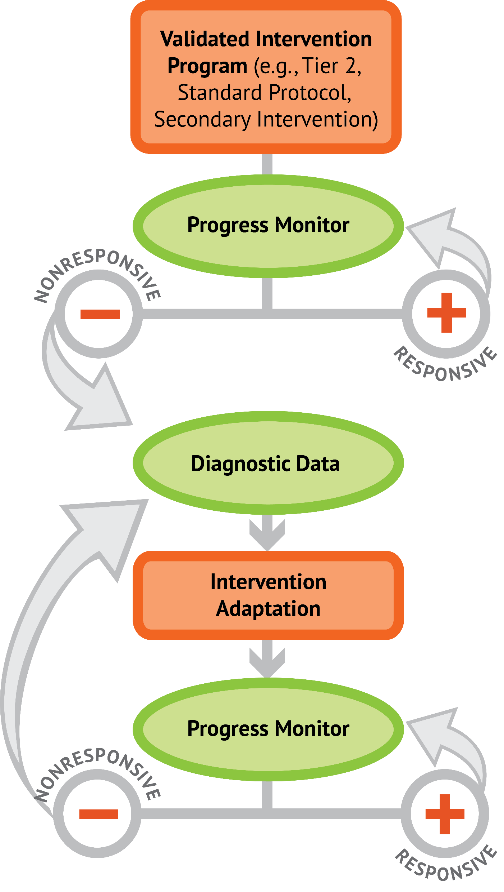
Slide 3
1: Developing a scope and sequence for intervention
2: Progress monitoring and determining response
3: Selecting evidence-based practices for the instructional platform
4: Instructional delivery: explicit instruction, multiple representations, language
5: Instructional strategies: fluency building, problem solving, motivation
6: Whole number content
7: Rational number content
8: DBI and mathematics: fidelity, adaptations

Slide 4
Objectives
PART 1: How do you build fact fluency within intensive intervention?
PART 2: How do you incorporate effective problem-solving strategies within intensive intervention?
PART 3: How do you incorporate a motivational component within intensive intervention?

Slide 5
Activities
PART 1: How do you build fact fluency within intensive intervention?
Identify and comment on a flash card routine
Determine set of facts for incremental rehearsal
Design a Cover, Copy, Compare or Taped Problems
Share a fluency-building activity that you use with your students

Slide 6
Activities
PART 2: How do you incorporate effective problem-solving strategies within intensive intervention?
Identify key words within word problems
Identify schemas of additive word problems
Identify schemas of multiplicative word problems
Share word problem attack strategies

Slide 7
Activities
PART 3: How do you incorporate a motivational component within intensive intervention?
Identify motivational system within intervention
Helpful motivational tools

Slide 8
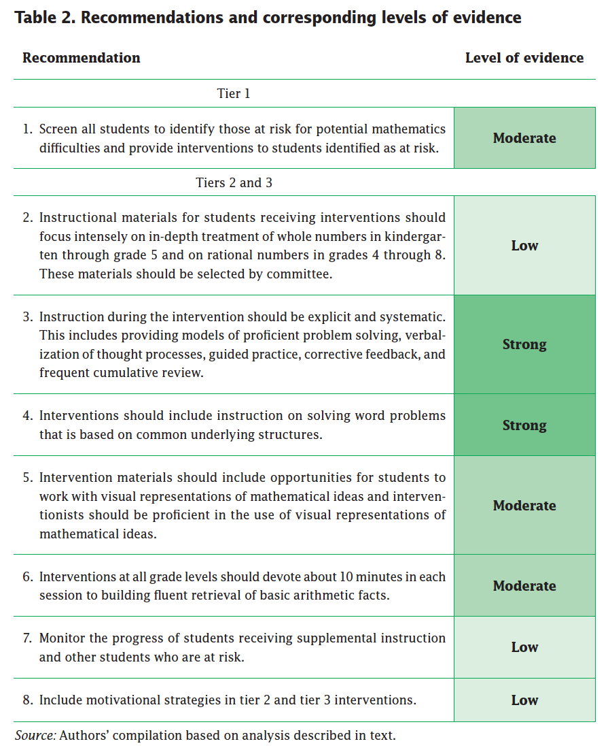
Slide 8
Explicit instruction
Multiple representations
Concise language
Fluency building
Problem solving instruction
Motivation component
Gersten et al. (2009)

Slide 9
Reading
Woodward, J., Beckmann, S., Driscoll, M., Franke, M., Herzig, P., Jitendra, A.,..Ogbuehi, P. (2012). Improving mathematical problem solving in grades 4 through 8. Washington, DC: National Center for Education Evaluation and Regional Assistance, Institute of Education Sciences, U.S. Department of Education.

Slide 10
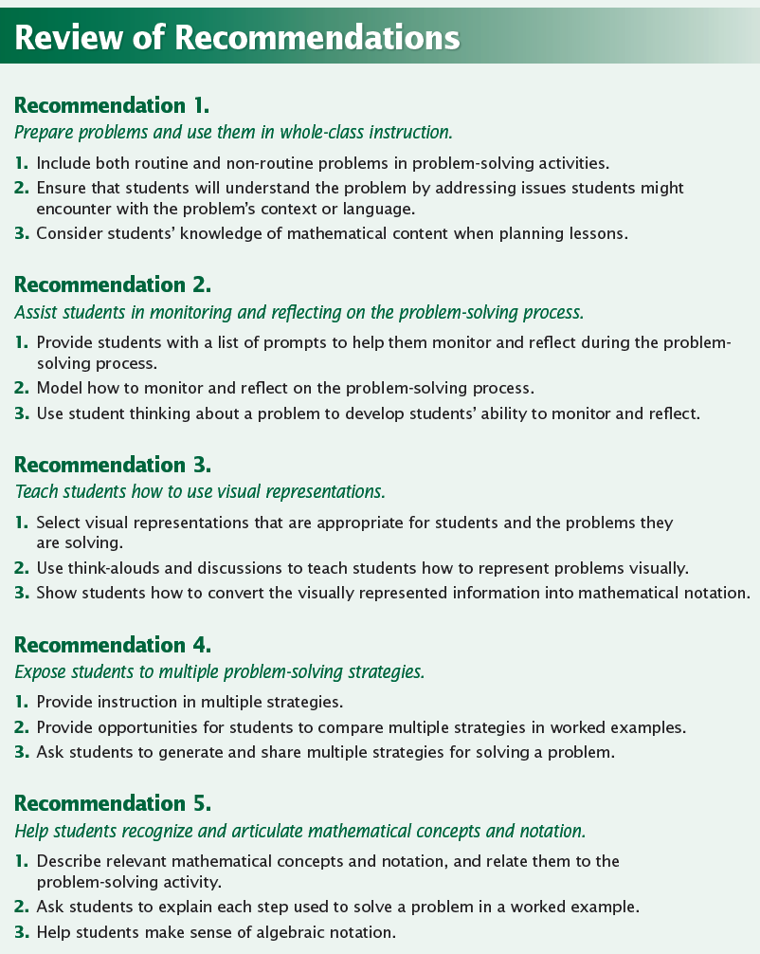
Slide 10

Slide 11
Classroom Application
Identify the word problems that your students will be asked to solve on high-stakes assessments.
Teach an attack strategy.
Teach the schemas.

Slide 12
Welcome!
Let’s get started on Module 5!

Slide 13
Slide 13
Part 1

Slide 14
How do you build fact fluency within intensive intervention?
Module 5, Part 1

Slide 15
Part 1 Objectives
In this part, you’ll learn—
How to build fluency with the operations of addition, subtraction, multiplication, and division

Slide 16
Facts
There are 390 facts.
Addition
Subtraction
Multiplication
Division

Slide 17
Why Emphasize the Facts?
Lack of mastery of basic facts influences higher-level mathematics performance and confidence with mathematics

Slide 18
Slide 18
Addition
100 addition basic facts
Single-digit addends sum to a single- or double-digit number
5 (addend)
+ 4 (addend)
9 (sum)

Slide 19
Slide 19
Subtraction
100 subtraction basic facts
Subtrahend and difference are single-digit numbers and minuend is single- or double-digit number
16 (minuend)
– 8 (subtrahend)
8 (difference)

Slide 20
Instruction on the Facts
Students must understand the concepts of addition and subtraction
Students should learn and use strategies to solve the facts
Students should develop fluency with facts

Slide 21
Students must understand the concepts of addition and subtraction
Part-part-whole
(Total)
Join
(Change increase)
Separate
(Change decrease)
Compare
(Difference)

Slide 22
Students should learn and use strategies to solve the facts
+ | 0 | 1 | 2 | 3 | 4 | 5 | 6 | 7 | 8 | 9
0 | 0 | 1 | 2 | 3 | 4 | 5 | 6 | 7 | 8 | 9
1 | 1 | 2 | 3 | 4 | 5 | 6 | 7 | 8 | 9 | 10
2 | 2 | 3 | 4 | 5 | 6 | 7 | 8 | 9 | 10 | 11
3 | 3 | 4 | 5 | 6 | 7 | 8 | 9 | 10 | 11 | 12
4 | 4 | 5 | 6 | 7 | 8 | 9 | 10 | 11 | 12 | 13
5 | 5 | 6 | 7 | 8 | 9 | 10 | 11 | 12 | 13 | 14
6 | 6 | 7 | 8 | 9 | 10 | 11 | 12 | 13 | 14 | 15
7 | 7 | 8 | 9 | 10 | 11 | 12 | 13 | 14 | 15 | 16
8 | 8 | 9 | 10 | 11 | 12 | 13 | 14 | 15 | 16 | 17
9 | 9 | 10 | 11 | 12 | 13 | 14 | 15 | 16 | 17 | 18

Slide 23
Students should learn and use strategies to solve the facts
Zero Facts
+ | 0 | 1 | 2 | 3 | 4 | 5 | 6 | 7 | 8 | 9
0 | 0 | 1 | 2 | 3 | 4 | 5 | 6 | 7 | 8 | 9
1 | 1 | 2 | 3 | 4 | 5 | 6 | 7 | 8 | 9 | 10
2 | 2 | 3 | 4 | 5 | 6 | 7 | 8 | 9 | 10 | 11
3 | 3 | 4 | 5 | 6 | 7 | 8 | 9 | 10 | 11 | 12
4 | 4 | 5 | 6 | 7 | 8 | 9 | 10 | 11 | 12 | 13
5 | 5 | 6 | 7 | 8 | 9 | 10 | 11 | 12 | 13 | 14
6 | 6 | 7 | 8 | 9 | 10 | 11 | 12 | 13 | 14 | 15
7 | 7 | 8 | 9 | 10 | 11 | 12 | 13 | 14 | 15 | 16
8 | 8 | 9 | 10 | 11 | 12 | 13 | 14 | 15 | 16 | 17
9 | 9 | 10 | 11 | 12 | 13 | 14 | 15 | 16 | 17 | 18
A number plus zero is the number itself
Facts remaining: 100 – 19 = 81

Slide 24
Students should learn and use strategies to solve the facts
Plus One
+ | 0 | 1 | 2 | 3 | 4 | 5 | 6 | 7 | 8 | 9
0 | 0 | 1 | 2 | 3 | 4 | 5 | 6 | 7 | 8 | 9
1 | 1 | 2 | 3 | 4 | 5 | 6 | 7 | 8 | 9 | 10
2 | 2 | 3 | 4 | 5 | 6 | 7 | 8 | 9 | 10 | 11
3 | 3 | 4 | 5 | 6 | 7 | 8 | 9 | 10 | 11 | 12
4 | 4 | 5 | 6 | 7 | 8 | 9 | 10 | 11 | 12 | 13
5 | 5 | 6 | 7 | 8 | 9 | 10 | 11 | 12 | 13 | 14
6 | 6 | 7 | 8 | 9 | 10 | 11 | 12 | 13 | 14 | 15
7 | 7 | 8 | 9 | 10 | 11 | 12 | 13 | 14 | 15 | 16
8 | 8 | 9 | 10 | 11 | 12 | 13 | 14 | 15 | 16 | 17
9 | 9 | 10 | 11 | 12 | 13 | 14 | 15 | 16 | 17 | 18
A number plus one is the next number
Facts remaining: 81 – 17 = 64

Slide 25
Students should learn and use strategies to solve the facts
Plus Two
+ | 0 | 1 | 2 | 3 | 4 | 5 | 6 | 7 | 8 | 9
0 | 0 | 1 | 2 | 3 | 4 | 5 | 6 | 7 | 8 | 9
1 | 1 | 2 | 3 | 4 | 5 | 6 | 7 | 8 | 9 | 10
2 | 2 | 3 | 4 | 5 | 6 | 7 | 8 | 9 | 10 | 11
3 | 3 | 4 | 5 | 6 | 7 | 8 | 9 | 10 | 11 | 12
4 | 4 | 5 | 6 | 7 | 8 | 9 | 10 | 11 | 12 | 13
5 | 5 | 6 | 7 | 8 | 9 | 10 | 11 | 12 | 13 | 14
6 | 6 | 7 | 8 | 9 | 10 | 11 | 12 | 13 | 14 | 15
7 | 7 | 8 | 9 | 10 | 11 | 12 | 13 | 14 | 15 | 16
8 | 8 | 9 | 10 | 11 | 12 | 13 | 14 | 15 | 16 | 17
9 | 9 | 10 | 11 | 12 | 13 | 14 | 15 | 16 | 17 | 18
A number plus two can be solved by skip counting
Facts remaining: 64 – 15 = 49

Slide 26
Students should learn and use strategies to solve the facts
Doubles
+ | 0 | 1 | 2 | 3 | 4 | 5 | 6 | 7 | 8 | 9
0 | 0 | 1 | 2 | 3 | 4 | 5 | 6 | 7 | 8 | 9
1 | 1 | 2 | 3 | 4 | 5 | 6 | 7 | 8 | 9 | 10
2 | 2 | 3 | 4 | 5 | 6 | 7 | 8 | 9 | 10 | 11
3 | 3 | 4 | 5 | 6 | 7 | 8 | 9 | 10 | 11 | 12
4 | 4 | 5 | 6 | 7 | 8 | 9 | 10 | 11 | 12 | 13
5 | 5 | 6 | 7 | 8 | 9 | 10 | 11 | 12 | 13 | 14
6 | 6 | 7 | 8 | 9 | 10 | 11 | 12 | 13 | 14 | 15
7 | 7 | 8 | 9 | 10 | 11 | 12 | 13 | 14 | 15 | 16
8 | 8 | 9 | 10 | 11 | 12 | 13 | 14 | 15 | 16 | 17
9 | 9 | 10 | 11 | 12 | 13 | 14 | 15 | 16 | 17 | 18
A number added to itself
Facts remaining: 49 – 7 = 24

Slide 27
Students should learn and use strategies to solve the facts
?
Near Doubles
+ | 0 | 1 | 2 | 3 | 4 | 5 | 6 | 7 | 8 | 9
0 | 0 | 1 | 2 | 3 | 4 | 5 | 6 | 7 | 8 | 9
1 | 1 | 2 | 3 | 4 | 5 | 6 | 7 | 8 | 9 | 10
2 | 2 | 3 | 4 | 5 | 6 | 7 | 8 | 9 | 10 | 11
3 | 3 | 4 | 5 | 6 | 7 | 8 | 9 | 10 | 11 | 12
4 | 4 | 5 | 6 | 7 | 8 | 9 | 10 | 11 | 12 | 13
5 | 5 | 6 | 7 | 8 | 9 | 10 | 11 | 12 | 13 | 14
6 | 6 | 7 | 8 | 9 | 10 | 11 | 12 | 13 | 14 | 15
7 | 7 | 8 | 9 | 10 | 11 | 12 | 13 | 14 | 15 | 16
8 | 8 | 9 | 10 | 11 | 12 | 13 | 14 | 15 | 16 | 17
9 | 9 | 10 | 11 | 12 | 13 | 14 | 15 | 16 | 17 | 18
A double plus or minus one
Facts remaining: 42 – 12 = 30

Slide 28
Students should learn and use strategies to solve the facts
?
Make Ten
+ | 0 | 1 | 2 | 3 | 4 | 5 | 6 | 7 | 8 | 9
0 | 0 | 1 | 2 | 3 | 4 | 5 | 6 | 7 | 8 | 9
1 | 1 | 2 | 3 | 4 | 5 | 6 | 7 | 8 | 9 | 10
2 | 2 | 3 | 4 | 5 | 6 | 7 | 8 | 9 | 10 | 11
3 | 3 | 4 | 5 | 6 | 7 | 8 | 9 | 10 | 11 | 12
4 | 4 | 5 | 6 | 7 | 8 | 9 | 10 | 11 | 12 | 13
5 | 5 | 6 | 7 | 8 | 9 | 10 | 11 | 12 | 13 | 14
6 | 6 | 7 | 8 | 9 | 10 | 11 | 12 | 13 | 14 | 15
7 | 7 | 8 | 9 | 10 | 11 | 12 | 13 | 14 | 15 | 16
8 | 8 | 9 | 10 | 11 | 12 | 13 | 14 | 15 | 16 | 17
9 | 9 | 10 | 11 | 12 | 13 | 14 | 15 | 16 | 17 | 18
When an addend is 8 or 9, make 10 and add on
Facts remaining: 30 – 18 = 12

Slide 29
Students should learn and use strategies to solve the facts
+ | 0 | 1 | 2 | 3 | 4 | 5 | 6 | 7 | 8 | 9
0 | 0 | 1 | 2 | 3 | 4 | 5 | 6 | 7 | 8 | 9
1 | 1 | 2 | 3 | 4 | 5 | 6 | 7 | 8 | 9 | 10
2 | 2 | 3 | 4 | 5 | 6 | 7 | 8 | 9 | 10 | 11
3 | 3 | 4 | 5 | 6 | 7 | 8 | 9 | 10 | 11 | 12
4 | 4 | 5 | 6 | 7 | 8 | 9 | 10 | 11 | 12 | 13
5 | 5 | 6 | 7 | 8 | 9 | 10 | 11 | 12 | 13 | 14
6 | 6 | 7 | 8 | 9 | 10 | 11 | 12 | 13 | 14 | 15
7 | 7 | 8 | 9 | 10 | 11 | 12 | 13 | 14 | 15 | 16
8 | 8 | 9 | 10 | 11 | 12 | 13 | 14 | 15 | 16 | 17
9 | 9 | 10 | 11 | 12 | 13 | 14 | 15 | 16 | 17 | 18
Make sure students understand:
The commutative property
That addition and subtraction are inverse operations

Slide 30
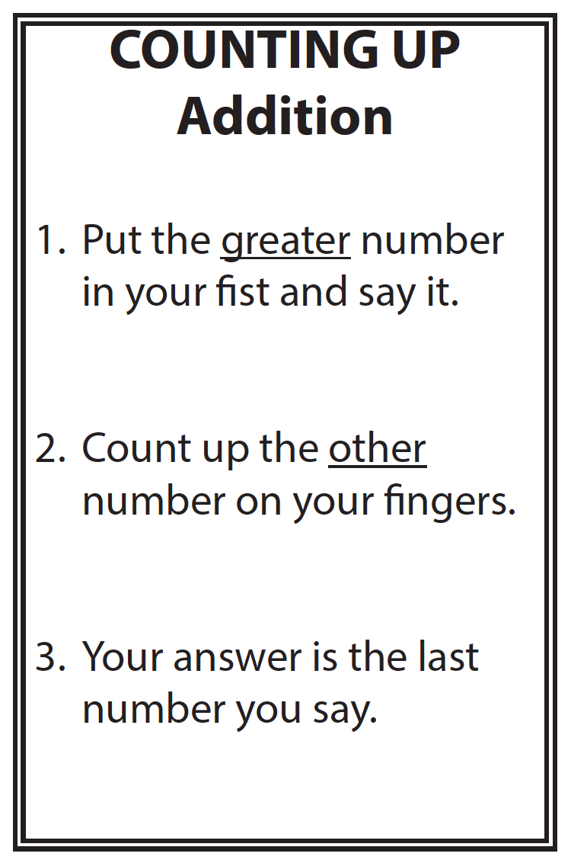
Students should learn and use strategies to solve the facts
4 + 3 = __
9 + 2 = __
6 + 8 = __

Slide 31
Slide 31
Link to Video: https://youtu.be/fA3JIsXEW30

Slide 32
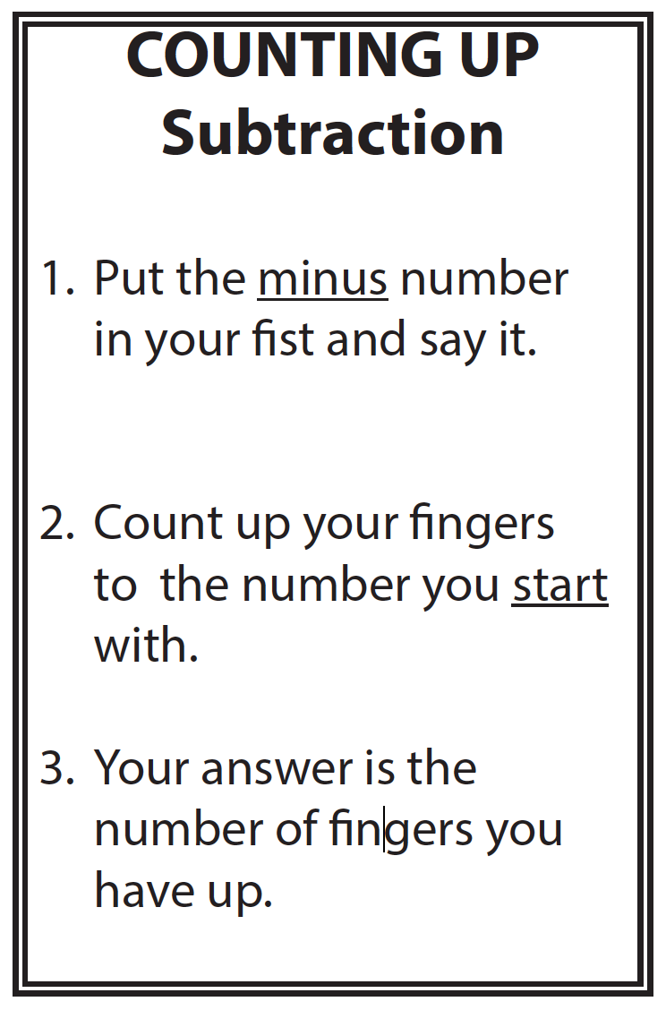
Students should learn and use strategies to solve the facts
5 – 3 = __
11 – 7 = __
15 – 9 = __

Slide 33
Slide 33
Link to Video: https://youtu.be/opMQZUWV7U8

Slide 34
Students should develop fluency with facts

Slide 35
Facts
There are 390 facts.
Addition
Subtraction
Multiplication
Division

Slide 36
Slide 36
Multiplication
100 multiplication basic facts
Multiplication of single-digit factors results in a single- or double-digit product
2 (factor)
× 3 (factor)
6 (product)

Slide 37
Slide 37
Division
90 division basic facts
Divisor and quotient are single-digit numbers and dividend is single- or double-digit number
8 ÷ 4 = 2
(dividend) (divisor) (quotient)

Slide 38
Instruction on the Facts
Students must understand the concepts of multiplication and division
Students should learn and use strategies to solve the facts
Students should develop fluency with facts

Slide 39
Students must understand the concepts of multiplication and division
Equal groups
Comparison
Partitive
Measurement

Slide 40
Students should learn and use strategies to solve the facts
x | 0 | 1 | 2 | 3 | 4 | 5 | 6 | 7 | 8 | 9
0 | 0 | 0 | 0 | 0 | 0 | 0 | 0 | 0 | 0 | 0
1 | 0 | 1 | 2 | 3 | 4 | 5 | 6 | 7 | 8 | 9
2 | 0 | 2 | 4 | 6 | 8 | 10 | 12 | 14 | 16 | 18
3 | 0 | 3 | 6 | 9 | 12 | 15 | 18 | 21 | 24 | 27
4 | 0 | 4 | 8 | 12 | 16 | 20 | 24 | 28 | 32 | 36
5 | 0 | 5 | 10 | 15 | 20 | 25 | 30 | 35 | 40 | 45
6 | 0 | 6 | 12 | 18 | 24 | 30 | 36 | 42 | 48 | 54
7 | 0 | 7 | 14 | 21 | 28 | 35 | 42 | 49 | 56 | 63
8 | 0 | 8 | 16 | 24 | 32 | 40 | 48 | 56 | 64 | 72
9 | 0 | 9 | 18 | 27 | 36 | 45 | 54 | 63 | 72 | 81

Slide 41
Students should learn and use strategies to solve the facts
Zero Facts
x | 0 | 1 | 2 | 3 | 4 | 5 | 6 | 7 | 8 | 9
0 | 0 | 0 | 0 | 0 | 0 | 0 | 0 | 0 | 0 | 0
1 | 0 | 1 | 2 | 3 | 4 | 5 | 6 | 7 | 8 | 9
2 | 0 | 2 | 4 | 6 | 8 | 10 | 12 | 14 | 16 | 18
3 | 0 | 3 | 6 | 9 | 12 | 15 | 18 | 21 | 24 | 27
4 | 0 | 4 | 8 | 12 | 16 | 20 | 24 | 28 | 32 | 36
5 | 0 | 5 | 10 | 15 | 20 | 25 | 30 | 35 | 40 | 45
6 | 0 | 6 | 12 | 18 | 24 | 30 | 36 | 42 | 48 | 54
7 | 0 | 7 | 14 | 21 | 28 | 35 | 42 | 49 | 56 | 63
8 | 0 | 8 | 16 | 24 | 32 | 40 | 48 | 56 | 64 | 72
9 | 0 | 9 | 18 | 27 | 36 | 45 | 54 | 63 | 72 | 81
A number multiplied by zero is zero
Facts remaining: 100 – 19 = 81

Slide 42
Students should learn and use strategies to solve the facts
One Facts
x | 0 | 1 | 2 | 3 | 4 | 5 | 6 | 7 | 8 | 9
0 | 0 | 0 | 0 | 0 | 0 | 0 | 0 | 0 | 0 | 0
1 | 0 | 1 | 2 | 3 | 4 | 5 | 6 | 7 | 8 | 9
2 | 0 | 2 | 4 | 6 | 8 | 10 | 12 | 14 | 16 | 18
3 | 0 | 3 | 6 | 9 | 12 | 15 | 18 | 21 | 24 | 27
4 | 0 | 4 | 8 | 12 | 16 | 20 | 24 | 28 | 32 | 36
5 | 0 | 5 | 10 | 15 | 20 | 25 | 30 | 35 | 40 | 45
6 | 0 | 6 | 12 | 18 | 24 | 30 | 36 | 42 | 48 | 54
7 | 0 | 7 | 14 | 21 | 28 | 35 | 42 | 49 | 56 | 63
8 | 0 | 8 | 16 | 24 | 32 | 40 | 48 | 56 | 64 | 72
9 | 0 | 9 | 18 | 27 | 36 | 45 | 54 | 63 | 72 | 81
A number multiplied by one is the number itself
Facts remaining: 81 – 17 = 64

Slide 43
Students should learn and use strategies to solve the facts
Two Facts
x | 0 | 1 | 2 | 3 | 4 | 5 | 6 | 7 | 8 | 9
0 | 0 | 0 | 0 | 0 | 0 | 0 | 0 | 0 | 0 | 0
1 | 0 | 1 | 2 | 3 | 4 | 5 | 6 | 7 | 8 | 9
2 | 0 | 2 | 4 | 6 | 8 | 10 | 12 | 14 | 16 | 18
3 | 0 | 3 | 6 | 9 | 12 | 15 | 18 | 21 | 24 | 27
4 | 0 | 4 | 8 | 12 | 16 | 20 | 24 | 28 | 32 | 36
5 | 0 | 5 | 10 | 15 | 20 | 25 | 30 | 35 | 40 | 45
6 | 0 | 6 | 12 | 18 | 24 | 30 | 36 | 42 | 48 | 54
7 | 0 | 7 | 14 | 21 | 28 | 35 | 42 | 49 | 56 | 63
8 | 0 | 8 | 16 | 24 | 32 | 40 | 48 | 56 | 64 | 72
9 | 0 | 9 | 18 | 27 | 36 | 45 | 54 | 63 | 72 | 81
A number multiplied by two is an addition double
Facts remaining: 64 – 15 = 49

Slide 44
Students should learn and use strategies to solve the facts
Five Facts
x | 0 | 1 | 2 | 3 | 4 | 5 | 6 | 7 | 8 | 9
0 | 0 | 0 | 0 | 0 | 0 | 0 | 0 | 0 | 0 | 0
1 | 0 | 1 | 2 | 3 | 4 | 5 | 6 | 7 | 8 | 9
2 | 0 | 2 | 4 | 6 | 8 | 10 | 12 | 14 | 16 | 18
3 | 0 | 3 | 6 | 9 | 12 | 15 | 18 | 21 | 24 | 27
4 | 0 | 4 | 8 | 12 | 16 | 20 | 24 | 28 | 32 | 36
5 | 0 | 5 | 10 | 15 | 20 | 25 | 30 | 35 | 40 | 45
6 | 0 | 6 | 12 | 18 | 24 | 30 | 36 | 42 | 48 | 54
7 | 0 | 7 | 14 | 21 | 28 | 35 | 42 | 49 | 56 | 63
8 | 0 | 8 | 16 | 24 | 32 | 40 | 48 | 56 | 64 | 72
9 | 0 | 9 | 18 | 27 | 36 | 45 | 54 | 63 | 72 | 81
Skip counting can be used to determine multiples of five
Facts remaining: 49 – 13 = 36

Slide 45
Students should learn and use strategies to solve the facts
Nine Facts
x | 0 | 1 | 2 | 3 | 4 | 5 | 6 | 7 | 8 | 9
0 | 0 | 0 | 0 | 0 | 0 | 0 | 0 | 0 | 0 | 0
1 | 0 | 1 | 2 | 3 | 4 | 5 | 6 | 7 | 8 | 9
2 | 0 | 2 | 4 | 6 | 8 | 10 | 12 | 14 | 16 | 18
3 | 0 | 3 | 6 | 9 | 12 | 15 | 18 | 21 | 24 | 27
4 | 0 | 4 | 8 | 12 | 16 | 20 | 24 | 28 | 32 | 36
5 | 0 | 5 | 10 | 15 | 20 | 25 | 30 | 35 | 40 | 45
6 | 0 | 6 | 12 | 18 | 24 | 30 | 36 | 42 | 48 | 54
7 | 0 | 7 | 14 | 21 | 28 | 35 | 42 | 49 | 56 | 63
8 | 0 | 8 | 16 | 24 | 32 | 40 | 48 | 56 | 64 | 72
9 | 0 | 9 | 18 | 27 | 36 | 45 | 54 | 63 | 72 | 81
Various strategies can be used to remember multiplication with nines
Facts remaining: 36 – 11 = 25

Slide 46
Students should learn and use strategies to solve the facts
Squares
x | 0 | 1 | 2 | 3 | 4 | 5 | 6 | 7 | 8 | 9
0 | 0 | 0 | 0 | 0 | 0 | 0 | 0 | 0 | 0 | 0
1 | 0 | 1 | 2 | 3 | 4 | 5 | 6 | 7 | 8 | 9
2 | 0 | 2 | 4 | 6 | 8 | 10 | 12 | 14 | 16 | 18
3 | 0 | 3 | 6 | 9 | 12 | 15 | 18 | 21 | 24 | 27
4 | 0 | 4 | 8 | 12 | 16 | 20 | 24 | 28 | 32 | 36
5 | 0 | 5 | 10 | 15 | 20 | 25 | 30 | 35 | 40 | 45
6 | 0 | 6 | 12 | 18 | 24 | 30 | 36 | 42 | 48 | 54
7 | 0 | 7 | 14 | 21 | 28 | 35 | 42 | 49 | 56 | 63
8 | 0 | 8 | 16 | 24 | 32 | 40 | 48 | 56 | 64 | 72
9 | 0 | 9 | 18 | 27 | 36 | 45 | 54 | 63 | 72 | 81
Facts remaining: 25 – 5 = 20

Slide 47
Students should learn and use strategies to solve the facts
x | 0 | 1 | 2 | 3 | 4 | 5 | 6 | 7 | 8 | 9
0 | 0 | 0 | 0 | 0 | 0 | 0 | 0 | 0 | 0 | 0
1 | 0 | 1 | 2 | 3 | 4 | 5 | 6 | 7 | 8 | 9
2 | 0 | 2 | 4 | 6 | 8 | 10 | 12 | 14 | 16 | 18
3 | 0 | 3 | 6 | 9 | 12 | 15 | 18 | 21 | 24 | 27
4 | 0 | 4 | 8 | 12 | 16 | 20 | 24 | 28 | 32 | 36
5 | 0 | 5 | 10 | 15 | 20 | 25 | 30 | 35 | 40 | 45
6 | 0 | 6 | 12 | 18 | 24 | 30 | 36 | 42 | 48 | 54
7 | 0 | 7 | 14 | 21 | 28 | 35 | 42 | 49 | 56 | 63
8 | 0 | 8 | 16 | 24 | 32 | 40 | 48 | 56 | 64 | 72
9 | 0 | 9 | 18 | 27 | 36 | 45 | 54 | 63 | 72 | 81
Make sure students understand:
The commutative property
That multiplication and division are inverse operations

Slide 48
Students should learn and use strategies to solve the facts

Slide 49
Students should develop fluency with facts

Slide 50
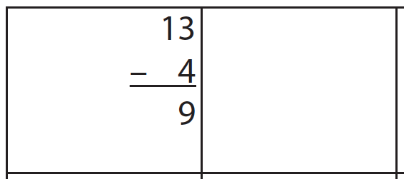
Students should develop fluency with facts
Cover, Copy, Compare
Student is presented with sheet of answered problems (10-12 problems)
1. Read fact and COVER it
2. COPY fact answer
3. Uncover and COMPARE answers
13
- 4
9

Slide 51
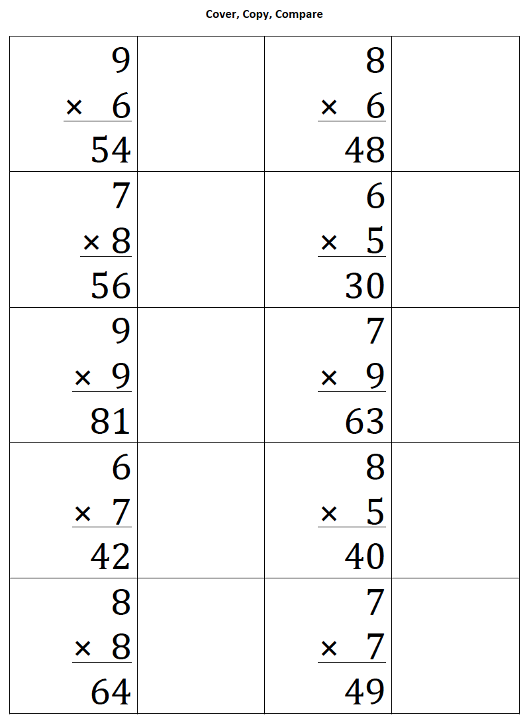
Students should develop fluency with facts
Cover, Copy, Compare
Student is presented with sheet of answered problems (10-12 problems)
1. Read fact and COVER it
2. COPY fact answer
3. Uncover and COMPARE answers

Slide 52
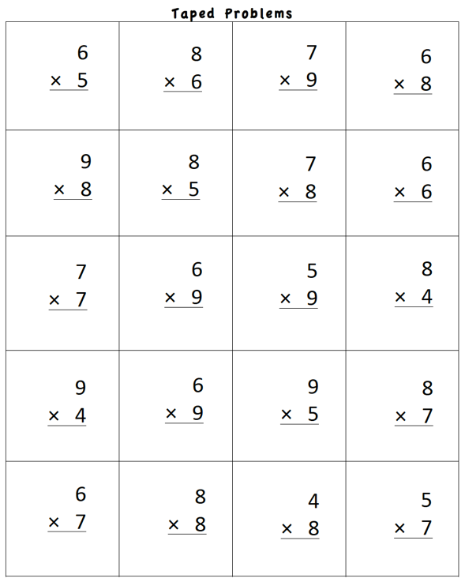
Students should develop fluency with facts
Taped Problems
Create a sheet of 12-24 problems
Make a recording
Read the problem
Pause (1-5 seconds)
Share the answer
Student listens
Student tries to “beat the tape”

Slide 53
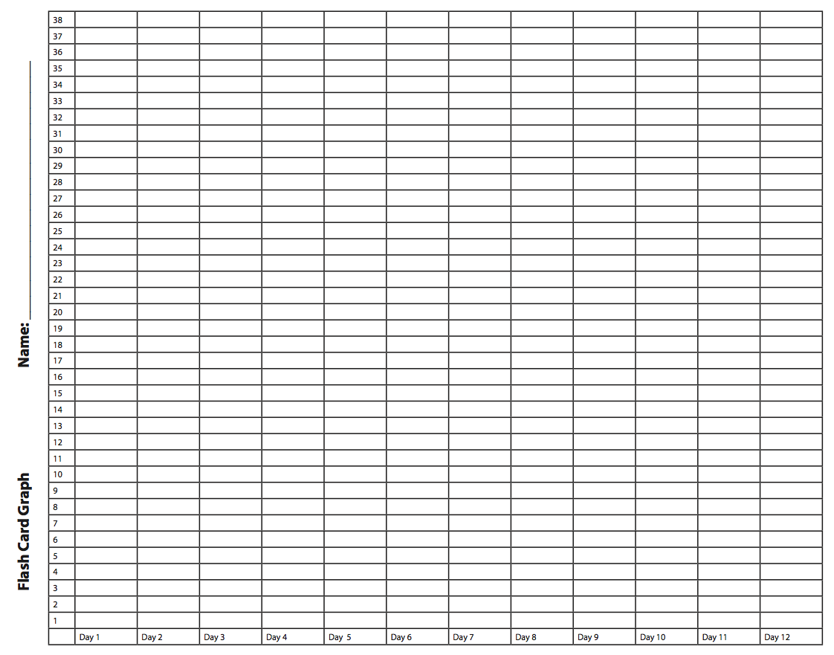
Students should develop fluency with facts
Flash Cards
Start with a small set of flash cards.
Time for 1 minute.
If student answers incorrectly, have them correct answer.
Count correctly answered cards.
Optional: Time for 1 minute to beat score.
Graph highest score.

Slide 54
Video
Workbook Activity #1
Watch this tutor use a flash card routine.
What’s the routine?
How does the student practice?
How could you incorporate this strategy into your intensive intervention?
Link to Video: https://youtu.be/hTLa2dxvzI8

Slide 55
Students should develop fluency with facts
Flash Cards (Incremental Rehearsal)
Use a small set of facts
2-4 unknown
6-8 known
Work on set for 1-2 min
Acknowledge correct answer or state correct answer and have student repeat it

Slide 56
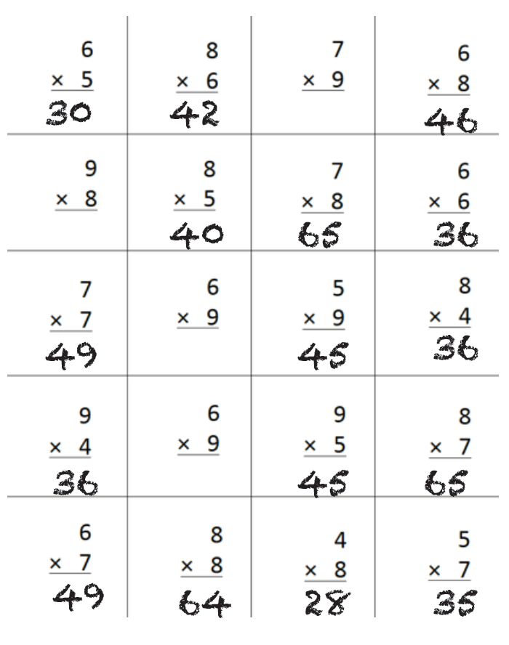
Workbook Activity #2
Look at this student’s answers to a multiplication test.
Which facts would you select for Incremental Rehearsal?
2-4 unknown
6-8 known

Slide 57
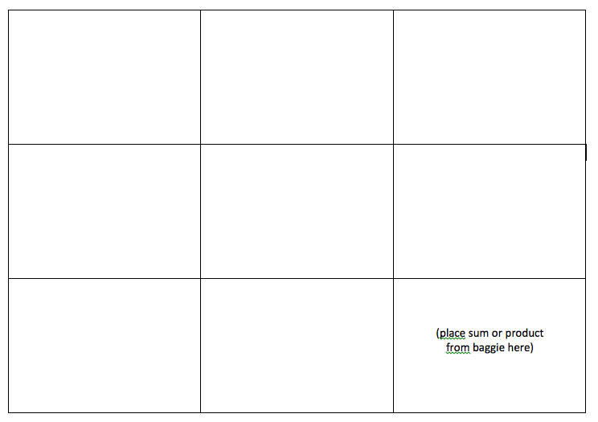
Students should develop fluency with facts
4
Magic Squares
12
8
5
6
1
3
3
6

Slide 58
Students should develop fluency with facts
Magic Squares
5
1
6
3
3
6
8
4
12

Slide 59
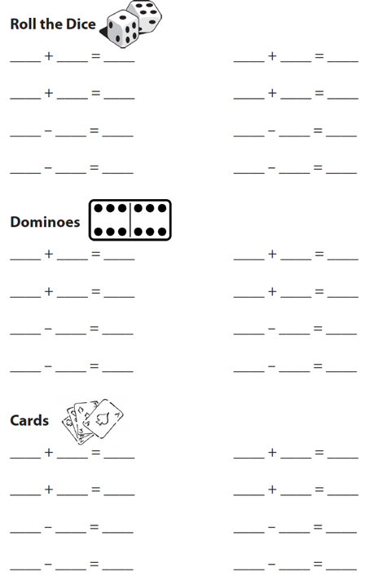
Students should develop fluency with facts
Dice, Dominoes, Cards

Slide 60
Students should develop fluency with facts
Games

Slide 61
Students should develop fluency with facts
Technology
Use programs that track mastery.
Use programs that provide corrective feedback.

Slide 62
Workbook Activity #3
Design your own Cover, Copy, Compare or Taped Problems to use within intensive intervention.

Slide 63
A Few Considerations
Fact practice should occur regularly (i.e., every time intensive intervention occurs).
Facts practice can and should be brief (1-2 minutes).
Practice facts that students need to learn.
Practice facts in small, meaningful sets.

Slide 64
Part 1’s Checklist: How to build fact fluency within intensive intervention?
Teach the concepts of the operations
Teach strategies to understand how facts fit together
Practice building fluency with a variety of activities and games

Slide 65
Discussion Board
What are some of your favorite fluency building activities?

Slide 66
Slide 66
Part 2

Slide 67
How do you incorporate effective problem-solving strategies within intensive intervention?
Module 5, Part 2

Slide 68
Part 2 Objectives
In this part, you’ll learn—
Ineffective problem-solving strategies
Different types of attack strategies
Additive and multiplicative schemas

Slide 69
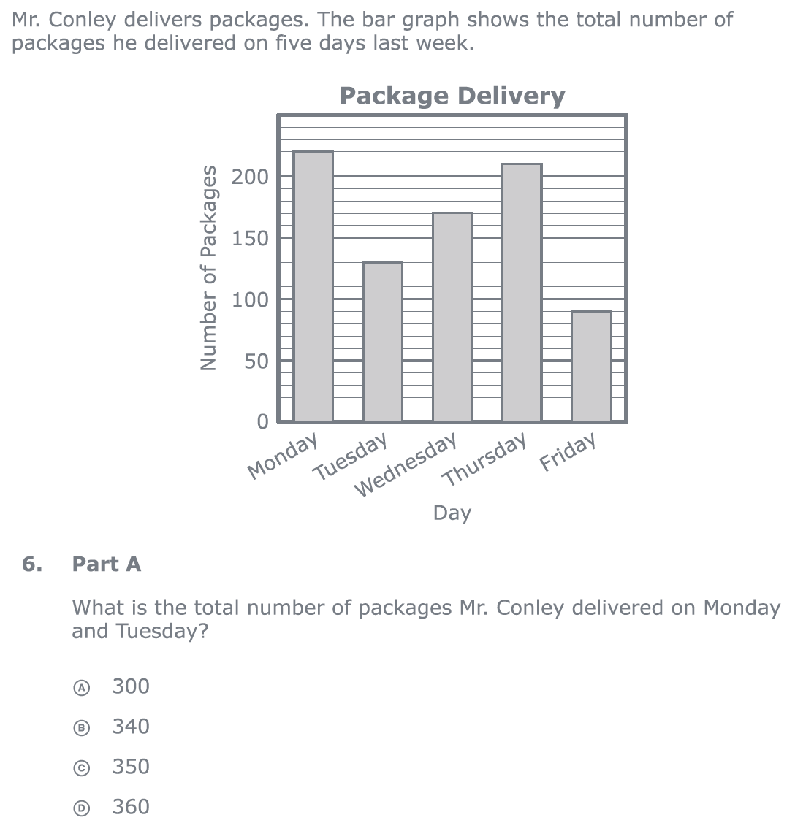
Why Problem Solving?
Students have to reason and problem solve within mathematics.
Problem solving is the primary method in which students demonstrate mathematical competency.
PARCC third-grade release item (2015)

Slide 70
Slide 70
Note:
In this Module, our focus on problem solving involves word problems.

Slide 71
What Do We Know About Word Problems?
Students with mathematics difficulty often find word problem challenging.
Reading the problem
Understanding vocabulary
Identifying relevant information
Ignoring irrelevant information
Fuchs, Fuchs, Stuebing, Fletcher, Hamlett, & Lambert (2008); Jitendra, Rodriguez, Kanive, Huang, Church, Corry, & Zaslofksy (2013)
Interpreting charts and graphs
Identifying appropriate operation
Performing computations

Slide 72
Slide 72
Reading the problem
Understanding vocabulary
Identifying relevant information
Ignoring irrelevant information
Interpreting charts and graphs
Identifying appropriate operation
PARCC third-grade release item (2015)
Performing computations

Slide 73
How Should We Teach Problem Solving?
Don’t use key words tied to operations
Do teach students an attack strategy
Do teach students schemas

Slide 74
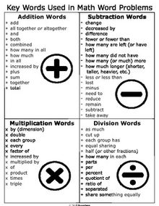
Don’t use key words tied to operations

Slide 75
1. Don’t use key words tied to operations
Addition
Sum
Plus
And
Total
Increase
More
Raise
Combined
In all
Altogether
Extra
Kasey made $42, and Mandy made $37. How much money did they make altogether?
Kasey and Mandy made $79 altogether. If Kasey made $42, how much money did Mandy make?

Slide 76
1. Don’t use key words tied to operations
Becky has $70 more than Perla. If Becky has $120, how much money does Perla have?
Becky has $70 more than Perla. If Perla has $50, how much money does Becky have?
Subtraction
More than
Less than
Decrease
Difference
Reduce
Change
Left
Remain
Dropped
Lost
Nearer

Slide 77
1. Don’t use key words tied to operations
Multiplication
Product
Of
Multiplied
Times
As much
Lost
By
Twice
Multiplication
Product
Of
Matt baked 18 cookies. His brother baked twice as many. How many cookies did his brother bake?
Matt’s brother baked twice as many cookies as Matt. If Matt’s brother baked 36 cookies, how many did Matt bake?

Slide 78
1. Don’t use key words tied to operations
Rachel wants to share 36 brownies with 6 friends. How many brownies will each friend receive?
Rachel shared brownies with 6 friends. Each friend ate 6 brownies. How many brownies did Rachel have to start with?
Division
Divide
Evenly
Cut
Split
Each
Every
Out of
Shared
Average
Ratio
Quotient

Slide 79
Slide 79
Note:
Students need to understand key words. But, key words should not be directly tied to operations.

Slide 80
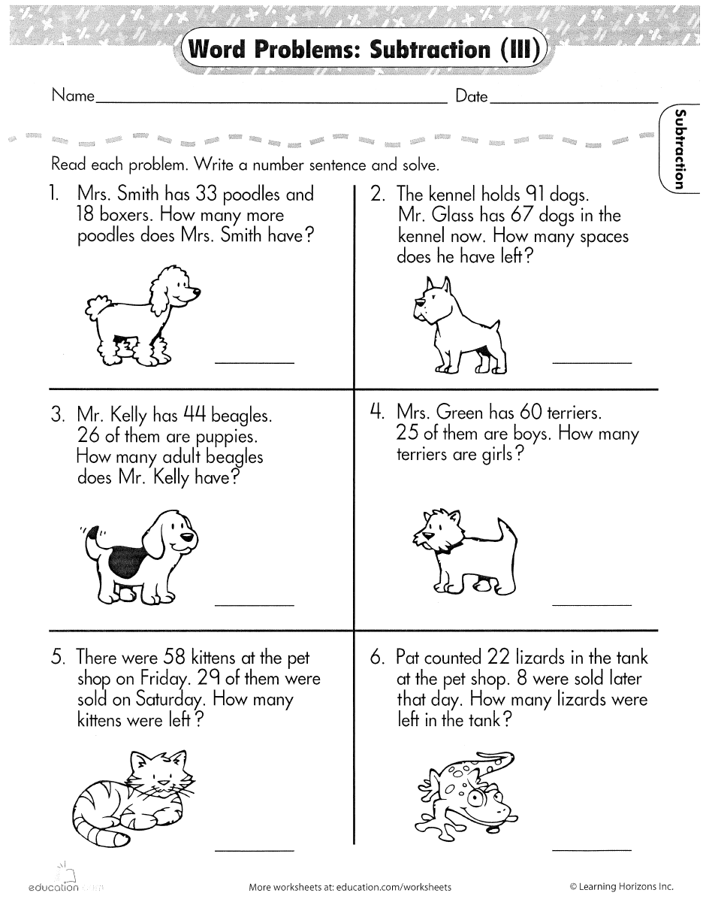
Slide 80

Slide 81
Workbook Activity #4
Look at several problems.
Identify the key words used within each of the problems.
Describe how teaching students to identify these key words may be problematic.

Slide 82
How Should We Teach Problem Solving?
Don’t use key words tied to operations
Do teach students an attack strategy
Do teach students schemas

Slide 83
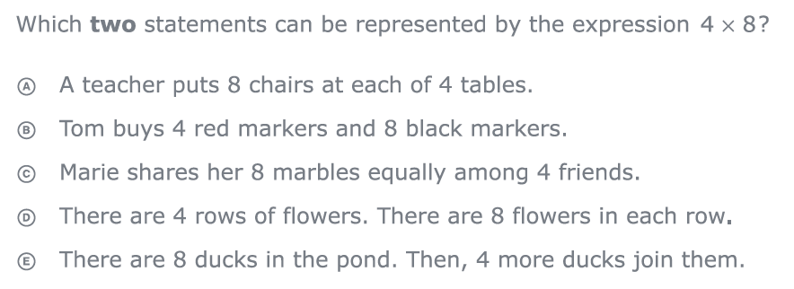
2. Do teach students an attack strategy
Regardless of the word problem (i.e., routine word problems, instructional word problems), students need an attack strategy for working through the problem.
PARCC third-grade release items (2015)

Slide 84
2. Do teach students an attack strategy
RIDGES
Read the problem.
I know statement.
Draw a picture.
Goal statement.
Equation development.
Solve the equation.
R-CUBES
Read the problem.
Circle key numbers.
Underline the question.
Box action words.
Evaluate steps.
Solve and check.

Slide 85
2. Do teach students an attack strategy
RIDE
Read the problem.
Identify the relevant information.
Determine the operation and unit for the answer.
Enter the correct numbers and calculate, then check the answer.
SOLVE
Study the problem.
Organize the facts.
Line up the plan.
Verify the plan with computation.
Examine the answer.

Slide 86
2. Do teach students an attack strategy
SIGNS
Survey questions
Identify key words
Graphically draw problem
Note operations
Solve and check
UPSCheck
Understand
Plan
Solve
Check

Slide 87
How Should We Teach Problem Solving?
Don’t use key words tied to operations
Do teach students an attack strategy
Do teach students schemas

Slide 88
3. Do teach students schemas
When teaching about word problems, students should learn the schema of the word problem.
Structure
Problem type
Jitendra & Star (2011); Riley & Greeno (1988); Van de Walle, Karp, & Bay-Williams (2010)
Additive
Multiplicative
Total
Equal Groups
Difference
Comparison
Change
Ratios/
Proportions

Slide 89
Slide 89
Additive
Total
Parts put together into a total
Emily saw 4 cardinals and 5 blue jays. How many birds did Emily see?
4 + 5 = ?
Emily saw 9 birds. If 4 of the birds were cardinals, how many were blue jays?
4 + ? = 9
Emily saw 9 birds. 5 of the birds were blue jays, how many were cardinals?
5 + ? = 9

Slide 90
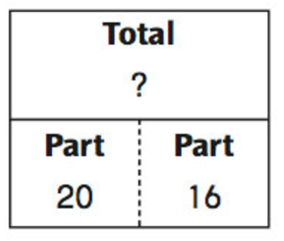
Slide 90
Additive
Total
Total equation:
P1 + P2 = T
Total graphic organizer:
Fuchs et al. (2008); Griffin & Jttendra (2009)
(part)
(part)
(total)

Slide 91
Slide 91
Additive
Total
Megan baked 28 sugar cookies and 24 chocolate chip cookies. Enter the total number of cookies Megan baked in all?
Grade 3 Smarter Balanced

Slide 92
Slide 92
Additive
Total
A banana farm received a total of 12 millimeters of rain in March and April. If 11 millimeters of rain fell on the farm in March, how many millimeters of rain fell on the farm in April?
Grade 2 IXL

Slide 93
Slide 93
Additive
Total
“Are parts put together for a total?”

Slide 94
Slide 94
Additive
Difference
Greater and less amounts compared for a difference
Shinead has 9 apples. Amanda has 4 apples. How many more apples does Shinead have? (How many fewer?)
9 – 4 = ?
Shinead has 5 more apples than Amanda. If Amanda has 4 apples, how many does Shinead have?
? – 4 = 5
Amanda has 5 fewer apples than Shinead. Shinead has 9 apples. How many apples does Amanda have?
9 – ? = 5

Slide 95
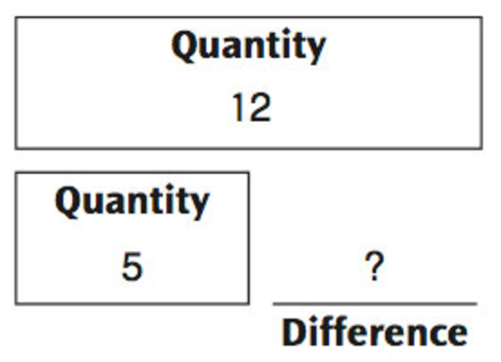
Slide 95
Additive
Difference
Difference equation:
G – L = D
Difference graphic organizer:
Fuchs et al. (2008); Griffin & Jttendra (2009)
(greater)
(less)
(difference)

Slide 96
Slide 96
Additive
Difference
Jana has 107 wooden beads and 68 glass beads. How many more wooden beads than glass beads does Jana have?
Grade 3 Smarter Balanced

Slide 97
Slide 97
Additive
Difference
Farmer Hank has 6 more cows than horses. He has 4 horses. He also has 9 chickens. How many cows does he have?

Slide 98
Slide 98
Additive
Total
“Are parts put together for a total?”
Additive
Difference
“Are amounts compared for a difference?”

Slide 99
Slide 99
Additive
Change
An amount that increases or decreases
Shannah had $4. Then she got $3 for cleaning her room. How much money does Shannah have now?
4 + 3 = ?
Shannah has $4. Then she earned money for cleaning her room. Now Shannah has $7. How much money did she earn?
4 + ? = 7
Shannah had some money. Then she made $3 for cleaning her room. Now she has $7. How much money did Shannah start with?
? + 3 = 7

Slide 100
Slide 100
Additive
Change
An amount that increases or decreases
Micaela had $9. Then she spent $2 on candy. How much money does Micaela have now?
9 – 2 = ?
Micaela had $9. She spent some money on candy. Now Micaela has $7. How much money did Micaela spend on candy?
9 – ? = 7
Micaela had some money. Then she spent $2 on candy. Now she has $7. How much money did Micaela start with?
? – 2 = 7

Slide 101
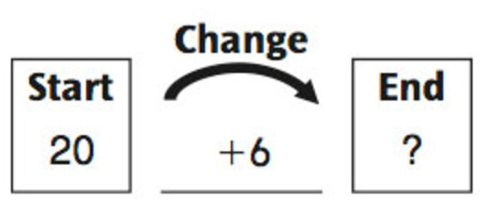
Slide 101
Additive
Change
Change equation:
ST +/– C = E
Change graphic organizer:
(change)
Fuchs et al. (2008); Griffin & Jttendra (2009)
(begin)
(end)

Slide 102
Slide 102
Additive
Change
A bus had 13 passengers. At the next stop, more passengers got on the bus. Now, there are 28 passengers. How many passengers got on the bus?

Slide 103
Slide 103
Additive
Total
“Are parts put together for a total?”
Additive
Difference
“Are amounts compared for a difference?”
Additive
Change
“Does an amount increase or decrease?”

Slide 104
Slide 104
Additive
Total
The animal park has 12 zebras, 25 monkeys, and some giraffes. If the total number of zebras, monkeys, and giraffes at the park is 50, how many giraffes are there?

Slide 105
Slide 105
Additive
Change
There were some people on a train. 19 people get off the train at the first stop. 17 people get on the train. Now, there are 63 people on the train. How many people were on the train to begin with?

Slide 106
Slide 106
Total
Grade 4 Smarter Balanced

Slide 107
Slide 107
Change
Grade 3 PARCC

Slide 108
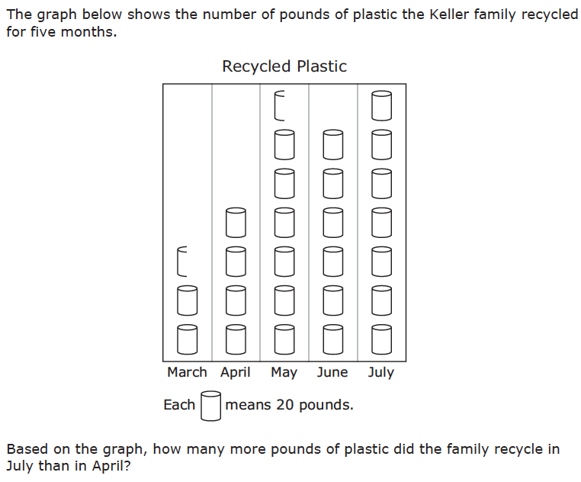
Slide 108
Difference
Grade 3 STAAR

Slide 109
Slide 109
Total
Grade 5 Smarter Balanced

Slide 110
Slide 110
Change
Grade 4 Smarted Balanced

Slide 111
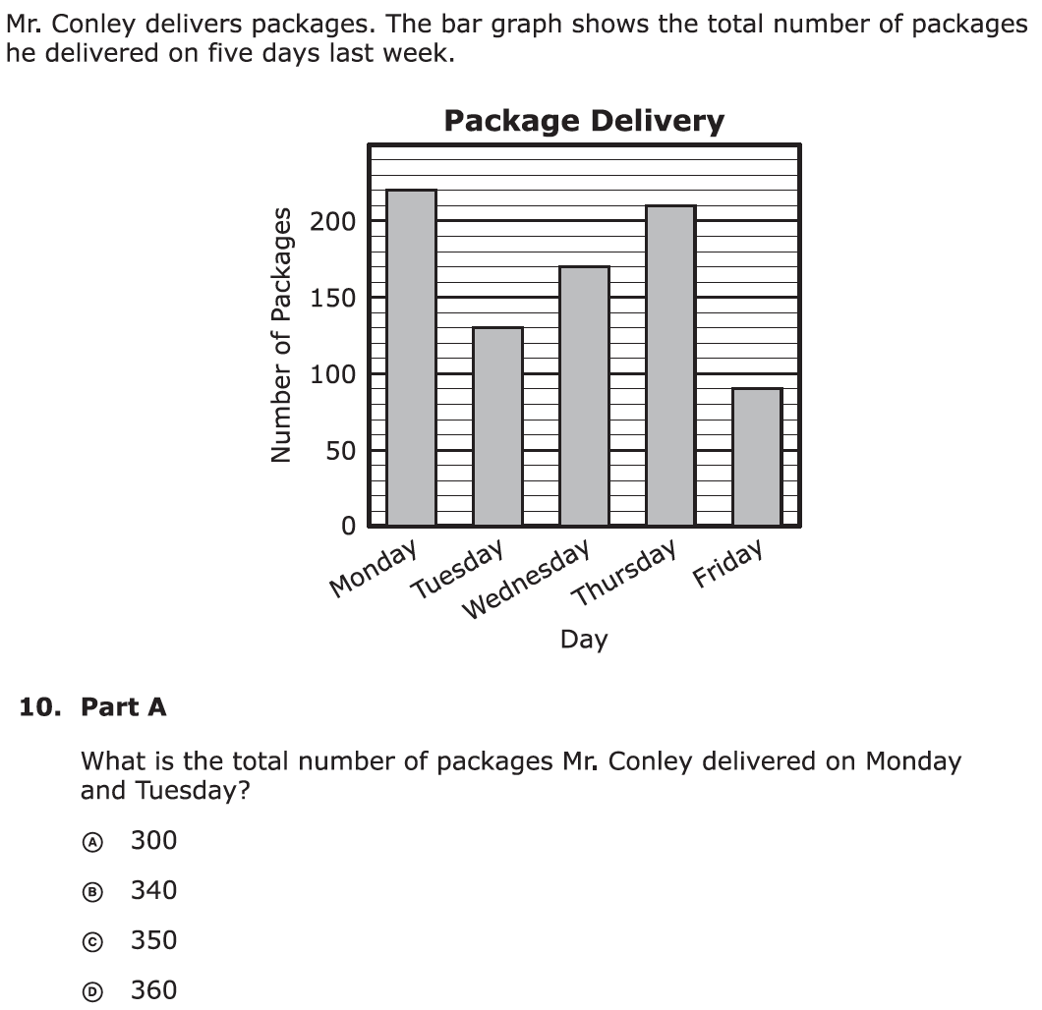
Slide 111
Total
Grade 3 PARCC

Slide 112
Slide 112
Change
Grade 1 K5Learning

Slide 113
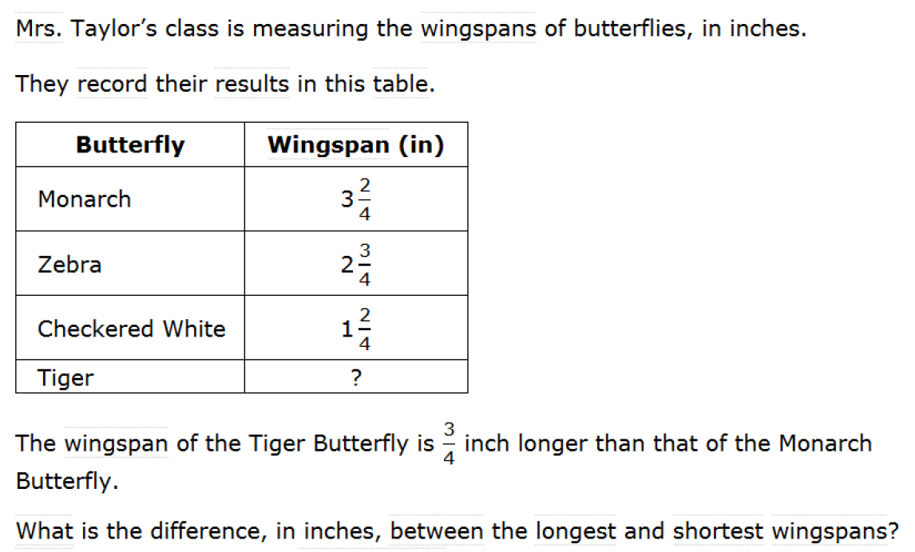
Slide 113
Difference
Grade 4 Smarted Balanced

Slide 114
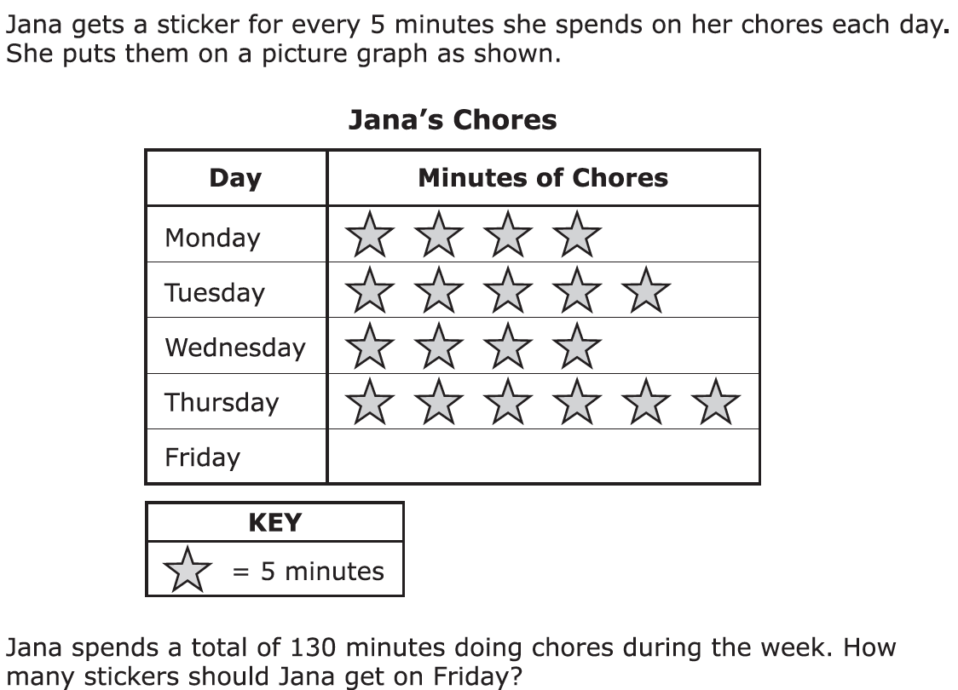
Slide 114
Total
Grade 3 PARCC

Slide 115
Slide 115
Change
Grade 2 WorksheetPlace

Slide 116
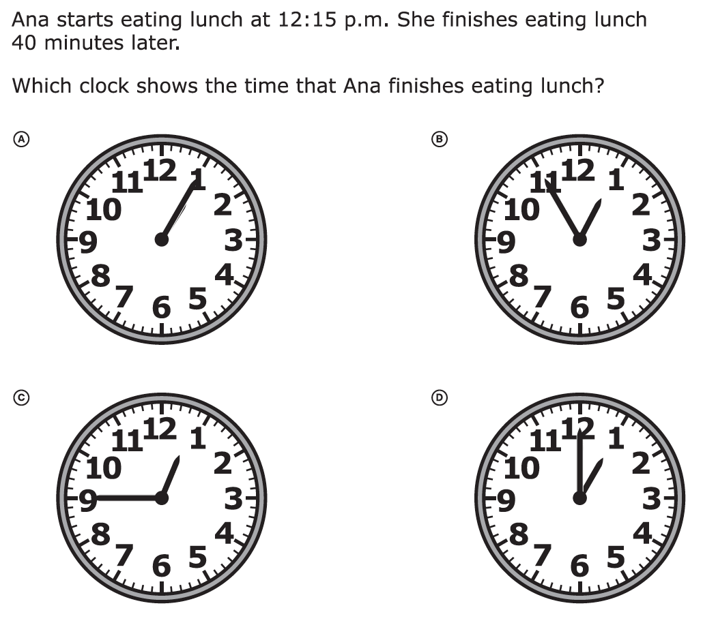
Slide 116
Change
Grade 3 PARCC

Slide 117
Slide 117
Difference
Grade 3 Smarter Balanced

Slide 118
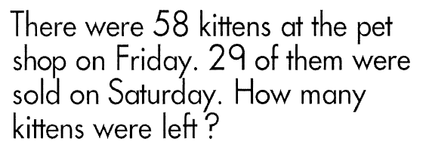
Slide 118
Change
Grade 2 Learning Horizons

Slide 119
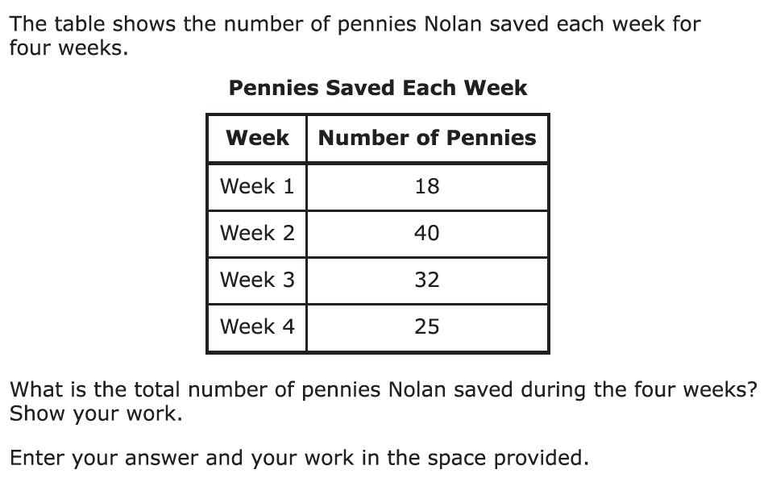
Slide 119
Total
Grade 3 PARCC

Slide 120
Slide 120
Change
Grade 3 STAAR

Slide 121
Slide 121
Difference
Grade 3 PARCC

Slide 122
Slide 122
Change

Slide 123
Slide 123
Total
Grade 2 Learning Horizons

Slide 124
Slide 124
Change
Grade 2 Math Aids

Slide 125
Slide 125
Change
Grade 5 STAAR

Slide 126
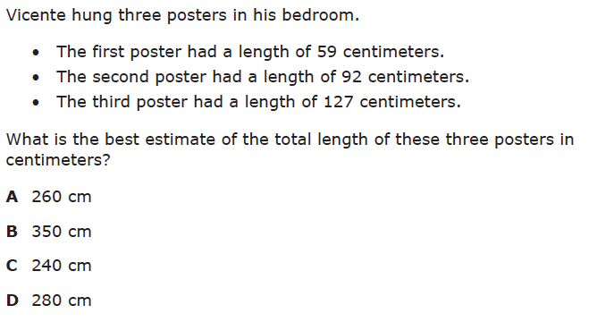
Slide 126
Total
Grade 3 STAAR

Slide 127
Workbook Activity #5
In this activity, you’ll identify the schemas of several additive word problems.
Read the word problem.
Identify the schema.
Solve the problem using the schema.

Slide 128
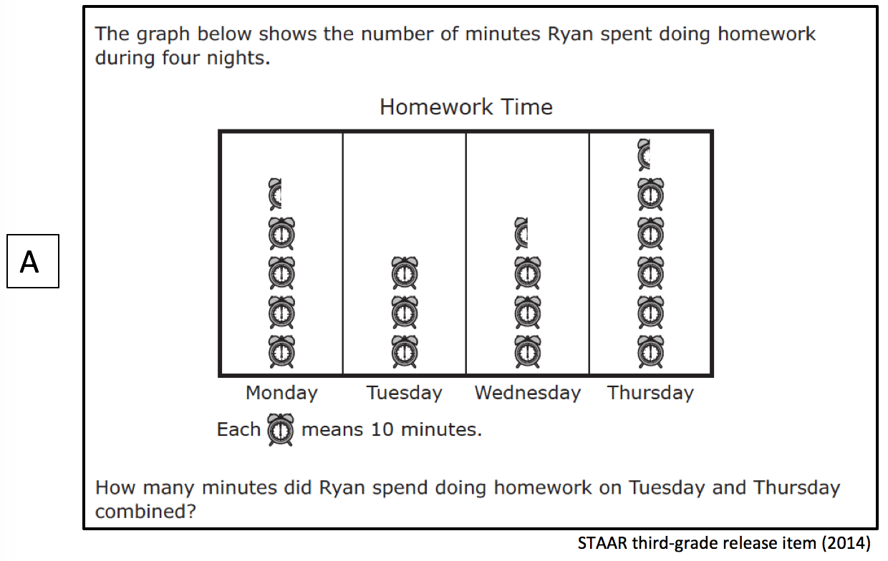
Workbook Activity #5

Slide 129
Workbook Activity #5

Slide 130
Workbook Activity #5

Slide 131
Workbook Activity #5

Slide 132
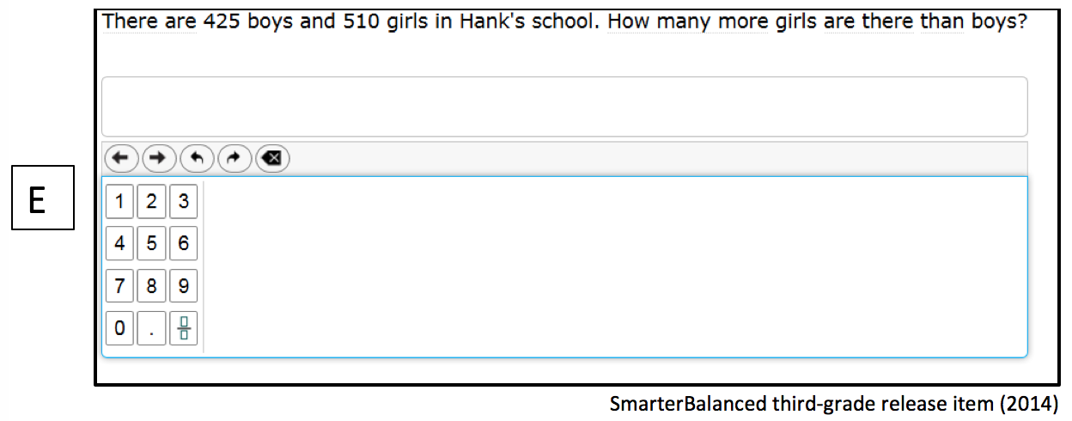
Workbook Activity #5

Slide 133
3. Do teach students schemas
When teaching about word problems, students should learn the schema of the word problem.
Structure
Problem type
Jitendra & Star (2011); Riley & Greeno (1988); Van de Walle, Karp, & Bay-Williams (2010)
Additive
Multiplicative
Total
Equal Groups
Difference
Comparison
Change
Ratios/
Proportions

Slide 134
Slide 134
Multiplicative
Equal Groups
Groups of a number (in each group) for a product
Mark has 2 bags of apples. There are 6 apples in each bag. How many apples does Mark have altogether?
2 × 6 = ?
Mark has 12 apples. He wants to share them equally among his 2 friends. How many apples will each friend receive?
2 × ? = 12
Mark has 12 apples. He put them into bags containing 6 apples each. How many bags did Mark use?
? × 6 = 12

Slide 135
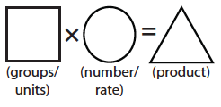
Slide 135
Multiplicative
Equal Groups
Equal groups graphic organizer:

Slide 136
slide 136
Multiplicative
Equal Groups
Cade has 4 boxes. He puts 9 models cars in each box. Enter the total number of model cars Cade put in these boxes.
Grade 3 PARCC

Slide 137
Slide 137
Multiplicative
Equal Groups
Jane bought 24 light bulbs. The light bulbs come in packs of 4. How many packs of light bulbs did Jane buy?
Grade 3 STAAR

Slide 138
Slide 138
Multiplicative
Equal Groups
“Are there groups with an equal number in each group?”

Slide 139
Slide 139
Multiplicative
Comparison
Set multiplied by a number of times for a product
Jill picked 6 apples. Mark picked 2 times as many apples as Jill. How many apples did Mark pick?
6 × 2 = ?
Mark picked 12 apples. He picked 2 times as many apples as Jill. How many apples did Jill pick?
? × 2 = 12
Mark picked 12 apples, and Jill picked 6 apples. How many times as many apples did Mark pick as Jill did?
6 × ? = 12

Slide 140
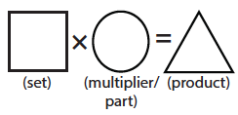
Slide 140
Multiplicative
Comparison
Comparison graphic organizer:

Slide 141
Slide 141
Multiplicative
Comparison
If a scuba diver could carry 36 coins to the surface in one trip, how many trips would it take to carry 108 coins?

Slide 142
Slide 142
Multiplicative
Comparison
Isabella has 2 times as many DVDs as Emma. Emma has 6 DVDs. How many DVDs does Isabella have?
Grade 4 Smarter Balanced

Slide 143
Slide 143
Multiplicative
Equal Groups
“Are there groups with an equal number in each group?”
Multiplicative
Comparison
“Is a set compared a number of times?”

Slide 144
Slide 144
Multiplicative
Ratios/Proportions
If, this set is to that set…
Then, this set is to that set…
IF
THEN
Jitendra & Star (2011)

Slide 145
Slide 145
Multiplicative
Ratios/Proportions
There are 176 slices of bread in 8 loaves. If there are the same number of slices in each loaf, how many slices of bread are in 5 loaves?

Slide 146
Slide 146
Multiplicative
Ratios/Proportions
A sea turtle made 460 dives in 12 hours. At this rate, how many dives did the sea turtle make in 3 hours?

Slide 147
Slide 147
Multiplicative
Equal Groups
“Are there groups with an equal number in each group?”
Multiplicative
Comparison
“Is a set compared a number of times?”
Multiplicative
Ratios/Proportions
“Are there relationships among quantities?”

Slide 148
Slide 148
Equal Groups
Grade 4 PARCC

Slide 149
Slide 149
Comparison
Grade 4 Smarter Balanced

Slide 150
Slide 150
Equal Groups
Grade 4 STAAR

Slide 151
Slide 151
Ratios/Proportions
Grade 6 Smarter Balanced

Slide 152
Slide 152
Equal Groups
Grade 3 STAAR

Slide 153
Slide 153
Equal Groups
Grade 4 PARCC

Slide 154
Slide 154
Comparison
Grade 4 PARCC

Slide 155
Slide 155
Ratios/Proportions
Grade 5 STAAR

Slide 156
Slide 156
Equal Groups
Grade 4 STAAR

Slide 157
Slide 157
Ratios/Proportions
Grade 5 Smarter Balanced

Slide 158
Slide 158
Ratios/Proportions
Grade 6 Smarter Balanced

Slide 159
Slide 159
Comparison
Grade 4 Smarter Balanced

Slide 160
Slide 160
Ratios/Proportions
Grade 6 PARCC

Slide 161
Slide 161
Equal Groups
Grade 4 STAAR

Slide 162
Workbook Activity #6
In this activity, you’ll identify the schemas of several multiplicative word problems.
Read the word problem.
Identify the schema.
Solve the problem using the schema.

Slide 163
Workbook Activity #6

Slide 164
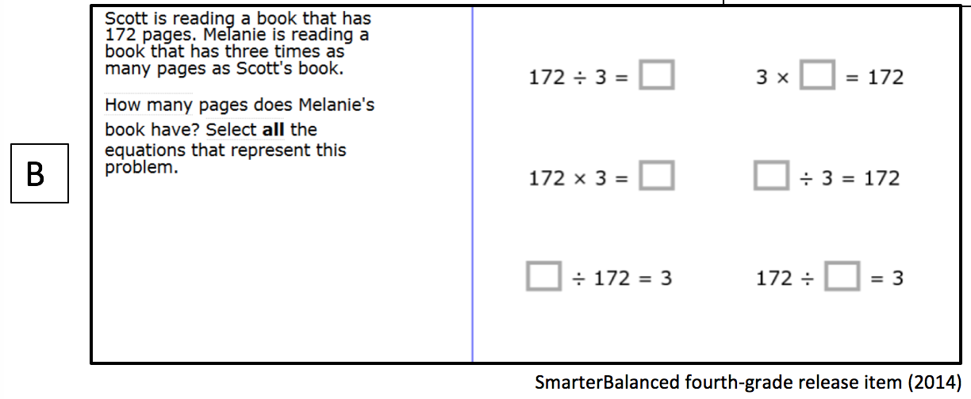
Workbook Activity #6

Slide 165
Workbook Activity #6

Slide 166
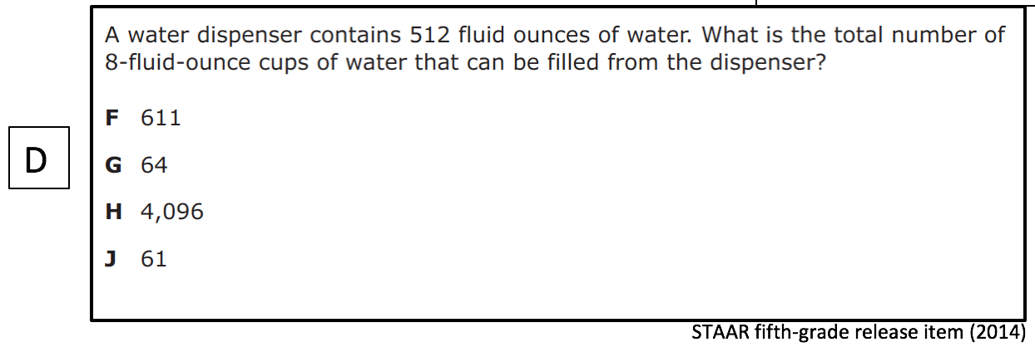
Workbook Activity #6

Slide 167
Workbook Activity #6

Slide 168
Video
What does problem solving look like within intensive intervention?
Here’s an example of intensive intervention about additive word problems. Notice how the teacher uses precise language to describe each of the additive schemas. This teacher also uses gestures to emphasize the structure of each of the word-problem schemas.

Slide 169
Slide 169
Link to Video: https://youtu.be/KpWCX0x1CVw

Slide 170
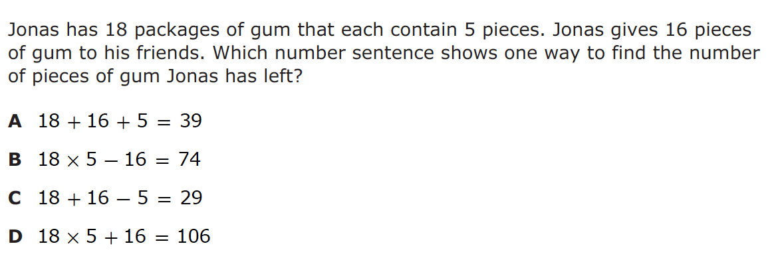
A Few Considerations
Many word problems combine schemas.
STAAR third-grade release item (2014)

Slide 171
A Few Considerations
Word problems aren’t always open response items. Students must understand how equations and pictures represent word problems.
STAAR third-grade release item (2014)

Slide 172
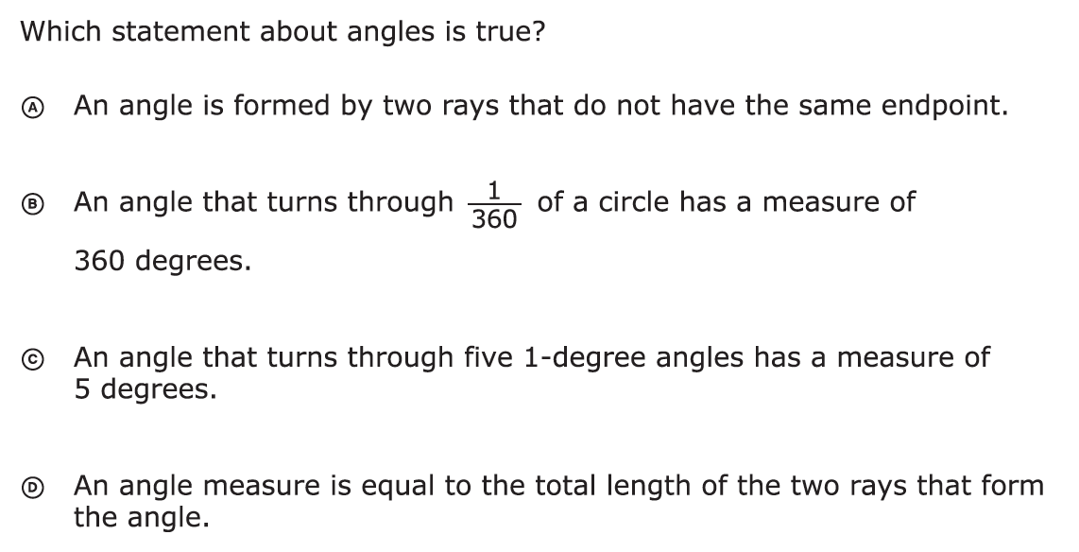
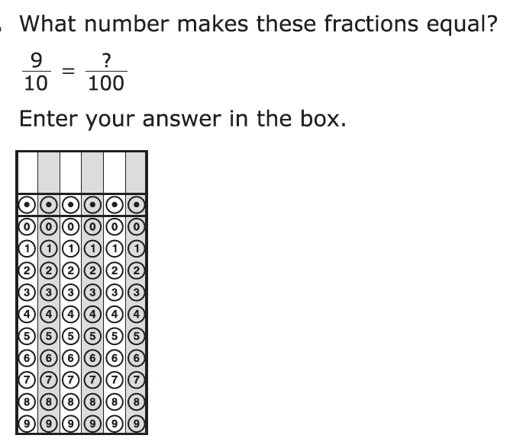
A Few Considerations
Not all word problems are routine. Many word problems are instructional. Your attack strategy should work with both.
PARCC fourth-grade release items (2014)

Slide 173
Part 2’s Checklist: How do you incorporate effective problem-solving strategies within intensive intervention?
Don’t use key words tied to operations
Do teach students an attack strategy
Do teach students schemas
Do explicitly teach problem solving
Do provide problem-solving instruction regularly (i.e., several times a week)
Do practice schemas that students will encounter regularly

Slide 174
Discussion Board
Now that you’ve learned about different types of word problems, what would be an effective attack strategy to use during intensive intervention?
Create your own poster (to use during intensive intervention) to remind students of the attack strategy. Share with your colleagues!

Slide 175
Journal Entry
Reflect upon your previous instruction related to word-problem solving.
What practices might you discontinue?
What practices might you continue?
What are the most important takeaways from this part of the module?

Slide 176
Slide 176
Part 3

Slide 177
How do you incorporate a motivational component within intensive intervention?
Module 5, Part 3

Slide 178
Part 3 Objectives
In this part, you’ll learn—
Different methods for incorporating a motivational component within intensive intervention

Slide 179
Where Are We?

Slide 180
Slide 180
Instructional Platform

Slide 181
Slide 181
Explicit instruction
Multiple representations
Concise language
Fluency building
Problem solving instruction
Motivation component
Gersten et al. (2009)

Slide 182
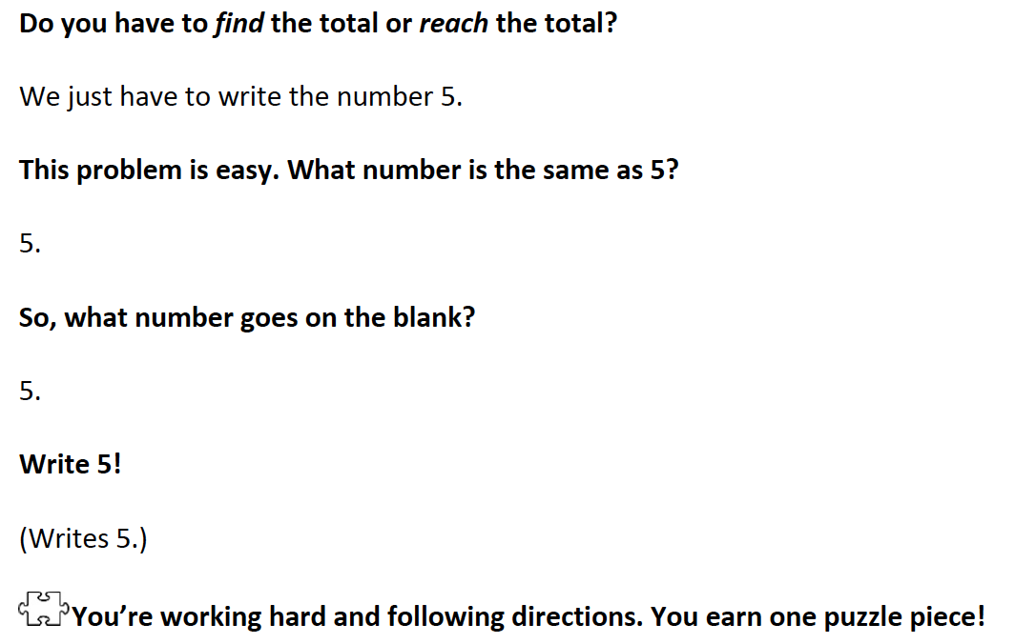
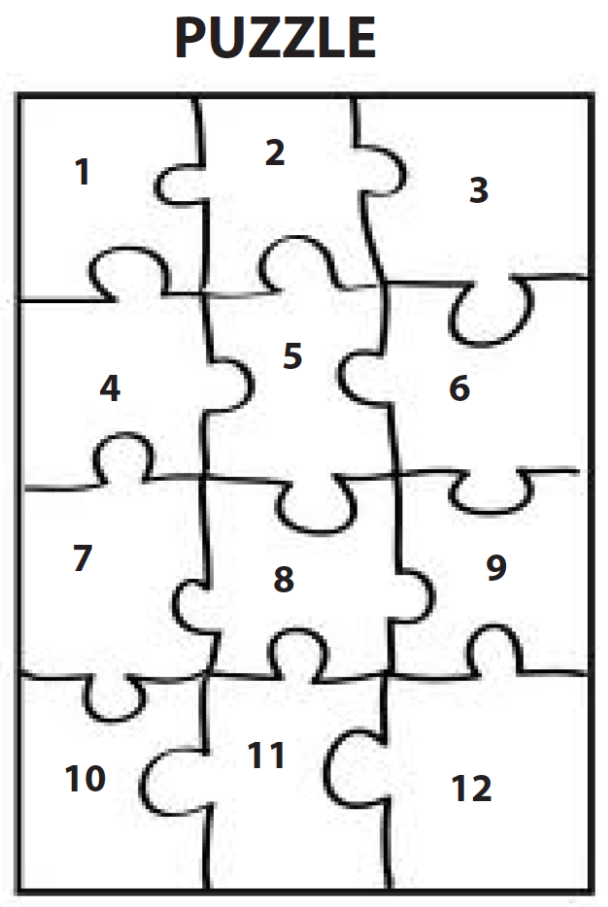
Slide 182
Powell, Driver, & Julian (2015)

Slide 183
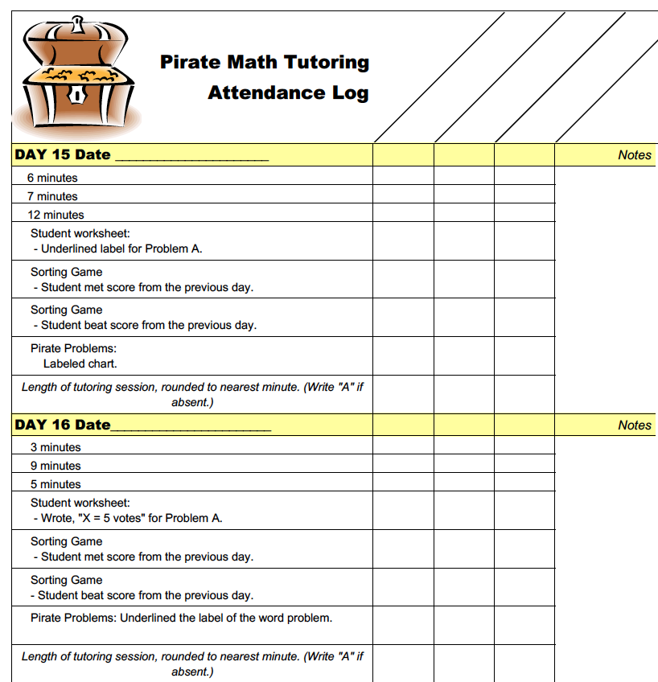
Slide 183
Fuchs et al. (2014)

Slide 184
Slide 184
Fuchs, Schumacher, & Fuch. (2014)

Slide 185
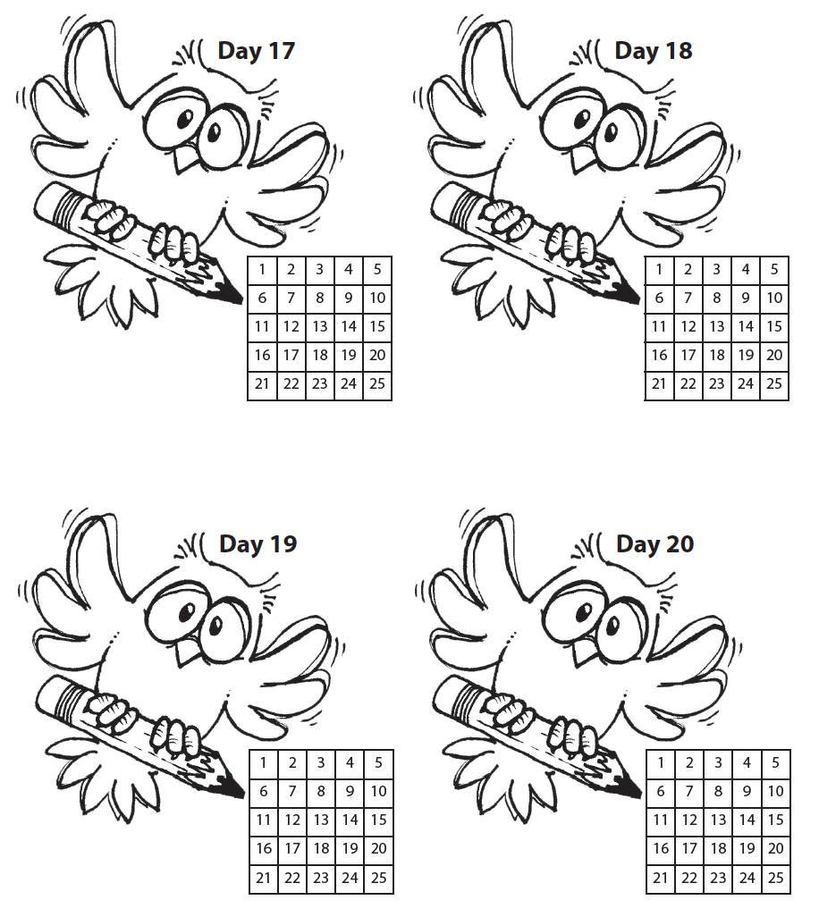
Slide 185
Fuchs et al. (2014)

Slide 186
Motivational Component
on task
keep attention
regulate behavior

Slide 187
Slide 187
Workbook Activity #7
Read this intensive intervention lesson about problem solving. How is the motivation system introduced? How often is it used throughout the lesson?

Slide 188
Part 3’s Checklist: How do you incorporate a motivational component within intensive intervention?
Utilize a motivational component, when necessary

Slide 189
Discussion Board
Share a motivational strategy that you find helpful to use with a student. Share a video of the strategy in use or share the materials that you use in the classroom.

Slide 190
Slide 190
Closing

Slide 191
Objectives
PART 1: How do you build fact fluency within intensive intervention?
PART 2: How do you incorporate effective problem-solving strategies within intensive intervention?
PART 3: How do you incorporate a motivational component within intensive intervention?

Slide 192
Slide 192
Video Link: https://youtu.be/lasMPfdDH7c

Slide 193
Slide 193
1: Developing a scope and sequence for intervention
2: Progress monitoring and determining response
3: Selecting evidence-based practices for the instructional platform
4: Instructional delivery: explicit instruction, multiple representations, language
5: Instructional strategies: fluency building, problem solving, motivation
6: Whole number content
7: Rational number content
8: DBI and mathematics: fidelity, adaptations

Slide 194
Part 1
Addition
Subtraction
Multiplication
Division
Students must understand the concepts
Students should learn and use strategies to solve the facts
Students should develop fluency with facts

Slide 195
Part 1’s Checklist: How to build fact fluency within intensive intervention.
Teach the concepts of the operations (see Module 6)
Teach strategies to understand how facts fit together
Practice building fluency with a variety of activities and games

Slide 196
Part 2
SOLVE
Study the problem.
Organize the facts.
Line up the plan.
Verify the plan with computation.
Examine the answer.
SIGNS
Survey questions
Identify key words
Graphically draw problem
Note operations
Solve and check

Slide 197
Part 2
When teaching about word problems, students should learn the schema of the word problem.
Structure
Problem type
Jitendra & Star (2011); Riley & Greeno (1988); Van de Walle, Karp, & Bay-Williams (2010)
Additive
Multiplicative
Total
Equal Groups
Difference
Comparison
Change
Ratios/
Proportions

Slide 198
Part 2’s Checklist: How do you incorporate effective problem-solving strategies within intensive intervention?
Don’t use key words tied to operations
Do teach students an attack strategy
Do teach students schemas
Do explicitly teach problem solving
Do provide problem-solving instruction regularly (i.e., several times a week)
Do practice schemas that students will encounter regularly

Slide 199
Part 3
on task
keep attention
regulate behavior

Slide 200
Part 3’s Checklist: How do you incorporate a motivational component within intensive intervention?
Utilize a motivational component, when necessary

Slide 201
Slide 201
Instructional Platform
Abstract
Representational
Concrete
Modeling
Practice
Clear Explanation
Guided
Practice
Planned
Examples
Independent Practice
Supporting Practices
Asking the right questions
Eliciting frequent responses
Providing immediate specific feedback
Maintaining a brisk pace

Slide 202
Slide 202
Instructional Platform
INSTRUCTIONAL DELIVERY
Explicit instruction
Multiple representations
Concise language
INSTRUCTIONAL STRATEGIES
Fluency building
Problem solving instruction
Motivation component

Slide 203
Slide 203
Explicit instruction
Multiple representations
Concise language
Fluency building
Problem solving instruction
Motivation component
Gersten et al. (2009)

Slide 204
Classroom Application
Identify three word problems that your students may be presented with on an assessment.
Determine your attack strategy.
Determine the schemas that need to be taught.

Slide 205
Looking Ahead

Slide 206
Slide 206
1: Developing a scope and sequence for intervention
2: Progress monitoring and determining response
3: Selecting evidence-based practices for the instructional platform
4: Instructional delivery: explicit instruction, multiple representations, language
5: Instructional strategies: fluency building, problem solving, motivation
6: Whole number content
7: Rational number content
8: DBI and mathematics: fidelity, adaptations

Slide 207
Module 6
Powell, S. R., & Fuchs, L. S. (2012). Early numerical competencies and students with mathematics difficulty. Focus on Exceptional Children, 44(5), 1–16.

Slide 208
See You Soon!

