Slide 1
How to Teach Mathematics and Make Adaptations Within a DBI Framework

Slide 2
Webinar Format & Questions
Throughout the presentation, submit your questions into the question pod.
For technical issues/questions, a webinar team member will try to assist you as soon as possible.
For content related questions, there will be a time for Q&A at the end of the presentation. Submit your questions and we will share them with the presenters.

Slide 3
Welcome!
Sarah R. Powell
University at Texas Austin
Samantha Bos
University at Texas Austin
Rachel Juergensen
University of Missouri Columbia

Slide 4
Webinar Series

Slide 5
Essential Questions
What high-quality mathematics instruction can you use in an instructional platform?
What instructional adaptations can you make within DBI?

Slide 6
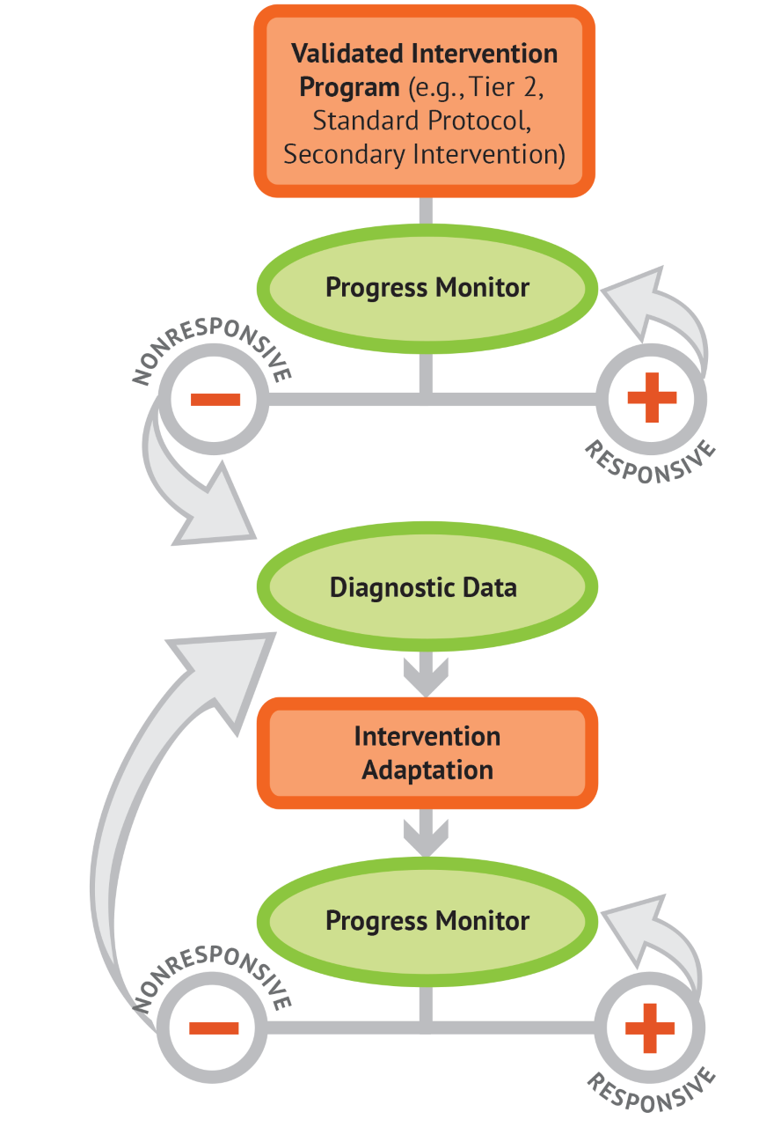
DBI Review
Two primary components
Assessment
Instruction

Slide 7
DBI Process
You start with your instruction,
and we call this the instructional platform.
You start progress monitoring.
You can use information from diagnostics and other sources (e.g., error analysis) to determine appropriate adaptations.
For students not on track to meet goals,
you make adaptations to your instruction.
After you implement some adaptations,
you continue to progress monitor.

Slide 8
Instructional Platform

Slide 9
Instructional Platform
The instructional platform is the jumping off point for instruction
What would you put in your instructional platform?

Slide 10
Instructional Platform
INSTRUCTIONAL DELIVERY
Explicit Instruction
Multiple Representations
Precise Language
INSTRUCTIONAL STRATEGIES
Fluency Building
Problem Solving Instruction
Motivation Component

Slide 11
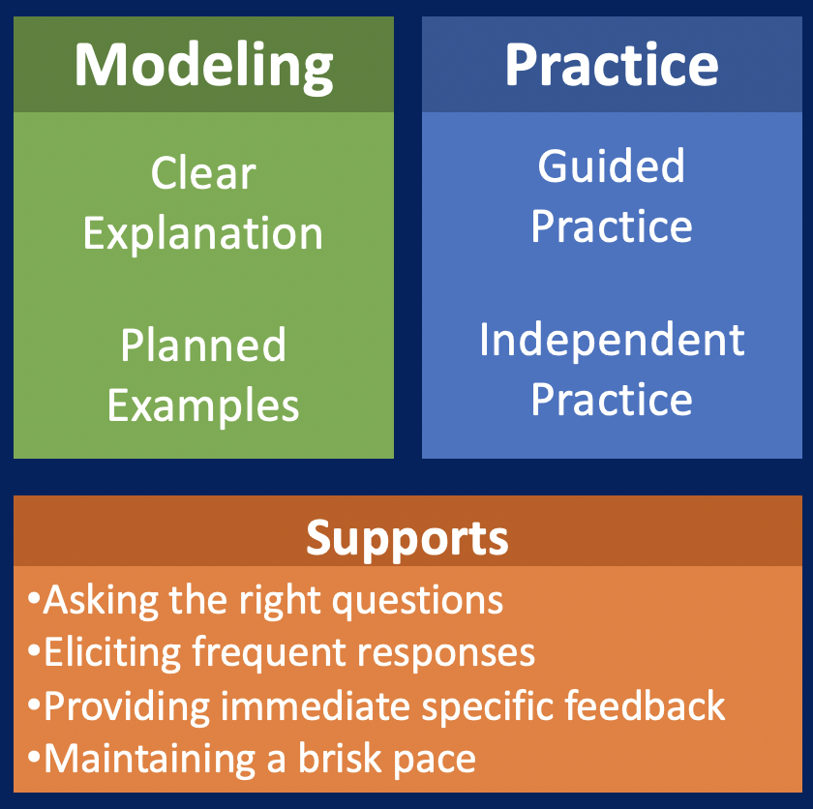
Evidence of the Practice
Explicit Instruction
Multiple Representations

Slide 12
Explicit Instruction
Notes:
To access the explicit instruction video, Hold CTRL and click on the video icon in the corner.
Or go here: https://youtu.be/A23rVJZLqAQ

Slide 13
Modeling, Practice, Supports
Modeling
Practice
Clear Explanation
Guided
Practice
Planned
Examples
Independent Practice
Supports
Asking the right questions
Eliciting frequent responses
Providing immediate specific feedback
Maintaining a brisk pace

Slide 14
Clear Explanation
Goal and Importance
Model Steps
Precise Language

Slide 15
Modeling Clear Explanation
“To solve 26 plus 79, I first decide about the operation. Do I add, subtract, multiply or divide?”
“The word plus tells me to add. Adding means to combine two quantities. I know that I can decompose 26 and 79 and use the partial sums strategy.
“First, I add 20 plus 70. What’s 20 plus 70?”
“20 plus 70 is 90. I write 90 right here.”
“Then I add 6 plus 9. What’s 6 plus 9?”
“6 plus 9 is 15. So, I write 15 here.”
“Finally, we add the partial sums: 90 and 15. 90 plus 15 is 105. So, 26 plus 79 equals 105.”

Slide 16
Use Examples …
“Today, we are learning about division. This is important because sometimes you want to share things with your friends so that everyone has the same amount.”
24.6 / 6
28 $÷$ 7
½
35 $)$ 5
.5
… and Use Examples and Non-Examples
32 $÷$ 8
42 $÷$ 7
25 $−$ 5

Slide 17
Teacher and student practice together

Slide 18
Student practices with teacher support

Slide 19
Supports
Low-Level and High-Level
Classwide, Individual, Partner, Write on Paper, Write on Whiteboard, Thumbs Up
Affirmative and Corrective
Planned and Organized

Slide 20
Modeling, Practice, Supports
Modeling
Practice
Supports
Introduction of material
Review of material
Modeling
Practice
Modeling
Practice
Supports
Supports

Slide 21
Video Example

Slide 22
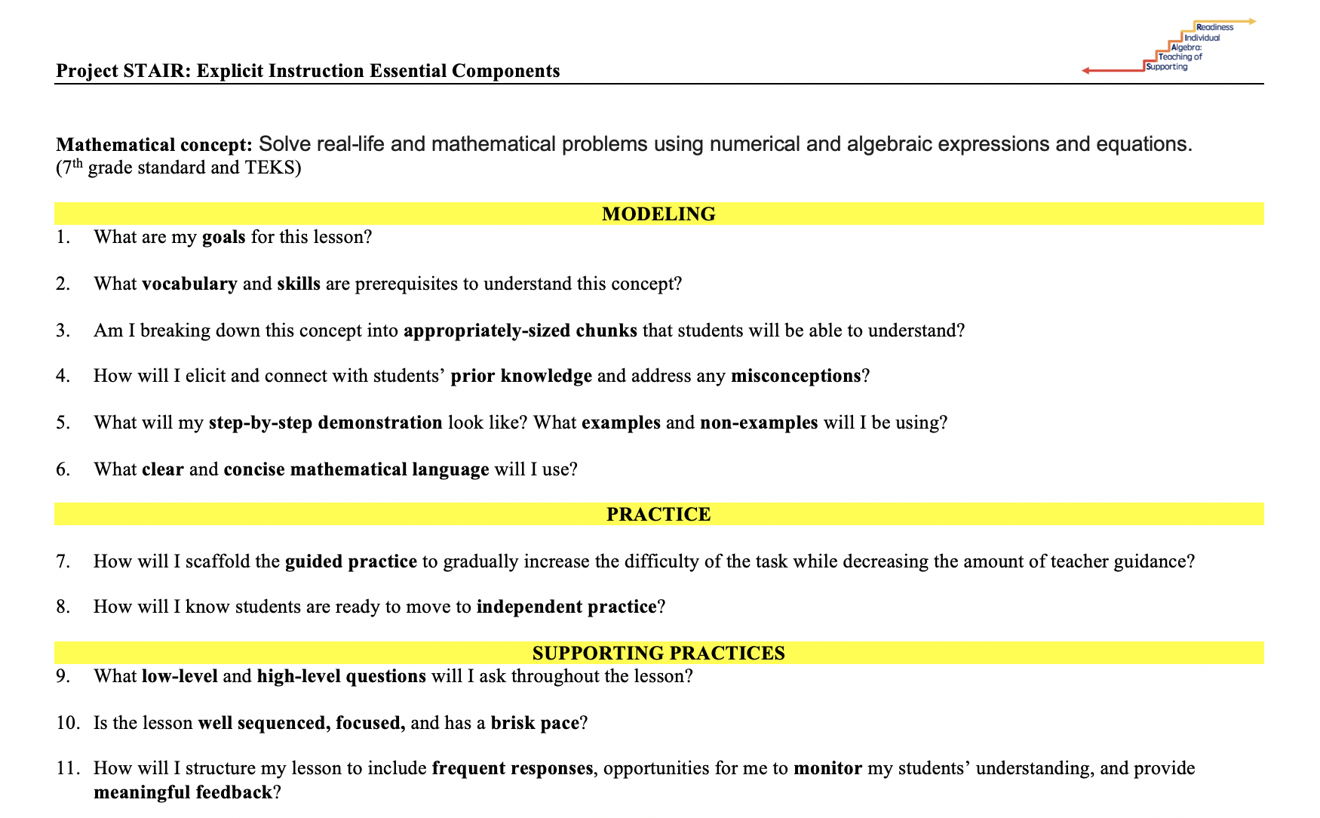
Explicit Instruction Essential Components
Planful
Anticipatory
Reflective

Slide 23
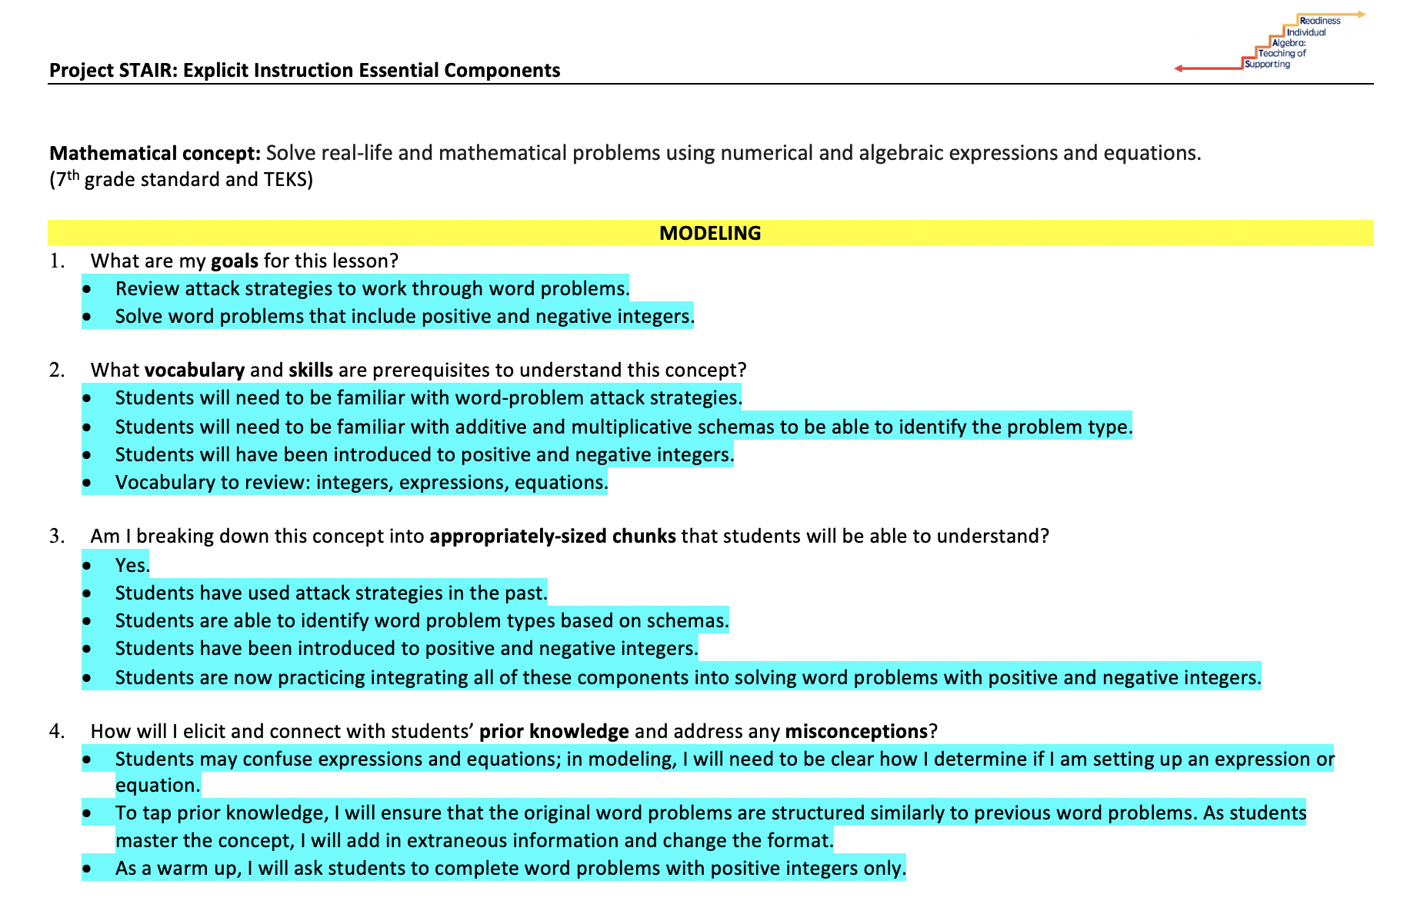
Explicit Instruction Essential Components
Role Play or Reflect
Choose a challenging component
Practice with a peer
Give candid and supportive feedback

Slide 24
Want More Explicit Instruction?

Slide 25
Why is explicit instruction important to use with your students?

Slide 26
Multiple Representations

Slide 27
Multiple Representations
Abstract
Pictorial
Concrete

Slide 28
Three-dimensional objects
Abstract
Pictorial
Concrete

Slide 29
Two-dimensional images
Abstract
Pictorial
Concrete

Slide 30
Numerals and symbols and words
Abstract
Pictorial
Concrete
$\frac{1}{2}$(b • h)
$\frac{1}{3}(π$r²)h
(x + 2)(x + 3)

Slide 31
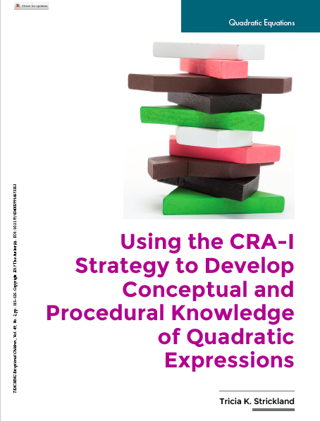
Multiple Representations: Aren’t Those for Elementary Kids?
https://journals.sagepub.com/doi/10.1177/0040059916673353

Slide 32
Multiple Representations Essential Components
Planful
Anticipatory
Reflective

Slide 33
Multiplying Linear Expressions Part 1: Using Algebra Blocks

Slide 34
Want More Multiple Representations?

Slide 35
What are some of your favorite hands-on or virtual representations?
Pictorial
Concrete
Abstract

Slide 36
Considerations
How do you see either explicit instruction or multiple representations fitting into what you’re already doing?
What do you see as possible challenges to using explicit instruction or multiple representations?
How will you address those challenges?

Slide 37
Instructional Platform
The instructional platform is the jumping off point for instruction
Progress-monitoring data help you determine whether the platform is sufficient or needs adaptations
Adaptations to Platform

Slide 38
Instructional Adaptations

Slide 39
Implement with Greater Fidelity
Embed Behavioral Supports
Increase Dosage
Adapt Mathematics Content
Utilize Explicit Instruction
Explicitly Teach Transfer

Slide 40
Implement with Greater Fidelity
Create a checklist of key components of the intervention

Slide 41
Embed Behavioral Supports
Operationally define the behavior you want to see
What does it look like?
What does it sound like?
Communicate this definition with the students
Find out what is reinforcing to the student
Reinforce the behavior you want to see

Slide 42
Increase Dosage
What do I do? | What might it look like?
Increase intervention session length | 15 min twice per week -> 30 min twice per week
Increase the number of sessions per day | 15 min in the a.m. -> 15 min in the a.m. and p.m.
Increase the number of sessions per week | 2 times per week -> 4 times per week
Increase the number of weeks overall | 6 week intervention -> 10 week intervention

Slide 43
Adapt Mathematics Content
Whole-class adjustments
Engage students in discourse
Provide worked examples
Chunk problems into smaller steps
Teach math vocabulary
Practice fact fluency
Teacher alternate algorithms
Encourage alternate methods and solutions
Use multiple representations

Slide 44
Utilize Explicit Instruction

Slide 45
Explicitly Teach Transfer
Teach students to use already-learned skills on more difficult problems
Morgan spent $42 for shoes. This was $14 less than twice what they spent for a shirt. How much was the shirt?
Pat wanted to organize their button collection. There were 42 buttons in the collection. 14 buttons were lost from a container that had twice as many than what were originally in the container. How many buttons were in the container?

Slide 46
Want More About Adaptations?

Slide 47
Remote Learning

Slide 48
How to Use Practices in Remote Instruction
Support | What it looks like in person: | What it looks like in remote learning:
Multiple Representations | Hands-on manipulatives | Virtual manipulatives
Explicit Instruction | Modeling in person | Modeling in a video for asynchronous learning. Model using a virtual whiteboard or document camera for synchronous learning.

Slide 49
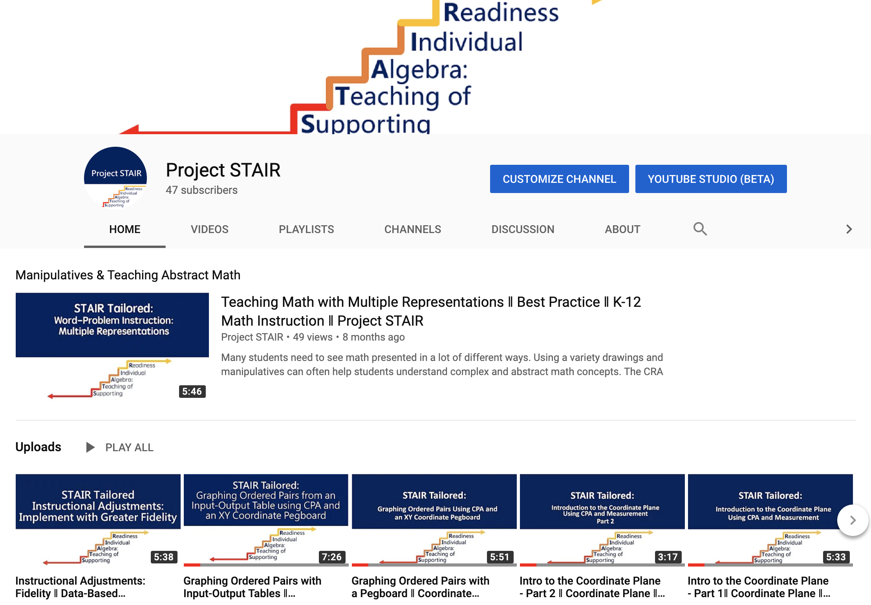
Video Access

Slide 50
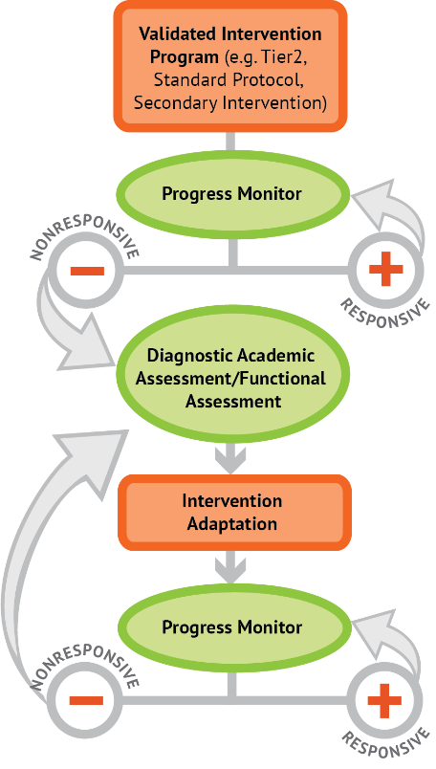
Which strategies will you start to use immediately?

Slide 51
Questions? Thank you!

