Slide 1
Slide 1
Explicit Instruction
Evaluating use of explicit instruction to support students’ academic needs
Module 8

Slide 2
Slide 2
Module Objectives
You will learn how to:
Identify evidence of explicit instruction
Evaluate effective use of explicit instruction
Reflect on your own use of explicit instruction

Slide 3
The Explicit Instruction Framework
Modeling
Practice
Clear Explanation
Guided
Practice
Planned Examples
Independent Practice
Supporting Practices
Using effective methods to elicit frequent responses
Providing immediate specific feedback
Maintaining a brisk pace

Slide 4
Master Checklist
Explicit Instruction
Supporting Practices
Create Objectives
  Select a goal from IEP or standards
  Choose an objective that is the next step toward the goal
  Limit the objective to one singular next step toward the goal
  Describe a learning outcome in behavioral term that assesses mastery of the objective
Elicit a Response
  Maintain or check accuracy of processing
  Match the learning outcome
  Match student abilities
  Match the desired response format
  Maximize student involvement
Provide Modeling
  Give clear explanations
  Model multiple planned examples
  Use supporting practices
Provide Feedback
  Immediate: delivered as soon as possible
  Specific: tied directly to students’ actions
Provide Practice
  Provide guided practice
  Provide independent practice
Maintain a Brisk Pace
  Move on when students are ready
  Use the supporting practices

Slide 5
Why is it important to identify elements of explicit instruction?
If
  students do not respond…
And
  you diagnose the problem relates to the absence of explicit instruction…
How do you know what type of explicit instruction adaptation to make?

Slide 6
Module Activities

Slide 7
Evaluate a Lesson
How It Works
You will watch a video clip of a lesson
Use your time table to jot down what you observe (e.g., modeling, guided practice)
Refer back to the times you recorded to evaluate the lesson
Use your checklist to evaluate what you see

Slide 8
Slide 8
Explicit Instruction
Evaluating use of explicit instruction to support students’ academic needs
Part 1: How do you know you have created the right objectives and provided effective modeling?

Slide 9
Slide 9
Part 1 Objectives
You’ll learn how to:
Identify clear objectives and modeling
Evaluate clear objectives and effective modeling
Reflect upon your own use of objectives and modeling

Slide 10
Master Checklist
Explicit Instruction
Supporting Practices
Create Objectives
  Select a goal from IEP or standards
  Choose an objective that is the next step toward the goal
  Limit the objective to one singular next step toward the goal
  Describe a learning outcome in behavioral term that assesses mastery of the objective
Elicit a Response
  Maintain or check accuracy of processing
  Match the learning outcome
  Match student abilities
  Match the desired response format
  Maximize student involvement
Provide Modeling
  Give clear explanations
  Model multiple planned examples
  Use supporting practices
Provide Feedback
  Immediate: delivered as soon as possible
  Specific: tied directly to students’ actions
Provide Practice
  Provide guided practice
  Provide independent practice
Maintain a Brisk Pace
  Move on when students are ready
  Use the supporting practices

Slide 11
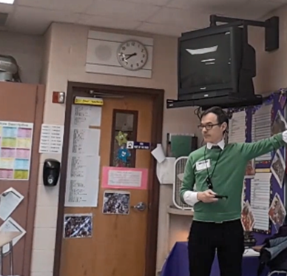
Evaluate a Lesson: World Knowledge
Context: 6th grade co-taught English Language Arts class
Text concerns Ellis Island
Text relates to teachers’ unit on immigration
Text follows their reading of Travels with Charley, a book that features a funny immigration anecdote.
General purpose:
Provide students with essential background knowledge to support their reading of a text on Ellis Island

Slide 12
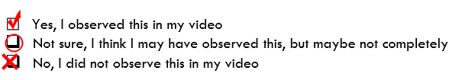
Evaluate a Lesson: World Knowledge
As you watch the video, think about:
What is the objective?
Where do you see evidence of modeling?
Time (Estimate) | Observation (Modeling)

Slide 13


Evaluate a Lesson: World Knowledge
Link to Video: https://youtu.be/XSvUhquKaCk?t=3

Slide 14
Evaluate a Lesson: World Knowledge
Objectives
  Create Objectives
  Choose objectives based on student performance relative to goals.
  Select a goal from IEP or standards
  Choose an objective that is the next step toward the goal
  Write focused objectives that describe the specific learning outcome.
  Limit the objective to one singular next step toward the goal
  Describe a learning outcome in behavioral term that assesses mastery of the objective
Lesson Objectives:
SWBAT identify the purpose and key characteristics of Ellis Island
SWBAT explain how families’ names could be changed when they came to Ellis Island

Slide 15

Evaluate a Lesson: World Knowledge
Objectives
  Create Objectives
  Choose objectives based on student performance relative to goals.
  Select a goal from IEP or standards
  Choose an objective that is the next step toward the goal
  Write focused objectives that describe the specific learning outcome.
  Limit the objective to one singular next step toward the goal
  Describe a learning outcome in behavioral term that assesses mastery of the objective
The goals of identifying Ellis Island’s purpose and role in changing names relates to the teachers’ unit on immigration and the specific text they have selected for this unit based on their ELA standards and needs of their students

Slide 16
Evaluate a Lesson: World Knowledge
Objectives
  Create Objectives
  Choose objectives based on student performance relative to goals.
  Select a goal from IEP or standards
  Choose an objective that is the next step toward the goal
  Write focused objectives that describe the specific learning outcome.
  Limit the objective to one singular next step toward the goal
  Describe a learning outcome in behavioral term that assesses mastery of the objective
They are just beginning this text, so it is appropriate to be learning these new concepts. The objectives relate back to students’ prior experience with Travels with Charley as well, so learning these facts is a good next step relative to that.

Slide 17

Evaluate a Lesson: World Knowledge
Objectives
  Create Objectives
  Choose objectives based on student performance relative to goals.
  Select a goal from IEP or standards
  Choose an objective that is the next step toward the goal
  Write focused objectives that describe the specific learning outcome.
  Limit the objective to one singular next step toward the goal
  Describe a learning outcome in behavioral term that assesses mastery of the objective
It simply is not singular. There’s no way around it. I tried to teach two separate things in the same lesson.

Slide 18
Evaluate a Lesson: World Knowledge
Objectives
  Create Objectives
  Choose objectives based on student performance relative to goals.
  Select a goal from IEP or standards
  Choose an objective that is the next step toward the goal
  Write focused objectives that describe the specific learning outcome.
  Limit the objective to one singular next step toward the goal
  Describe a learning outcome in behavioral term that assesses mastery of the objective
The way that students will demonstrate mastery is not specified. So, this video—of my own teaching (and here I am teaching this course!)—does not have a clear learning outcome to show mastery. Big miss!

Slide 19
Evaluate a Lesson: World Knowledge
Objectives
  Create Objectives
  Choose objectives based on student performance relative to goals.
  Select a goal from IEP or standards
  Choose an objective that is the next step toward the goal
  Write focused objectives that describe the specific learning outcome.
  Limit the objective to one singular next step toward the goal
  Describe a learning outcome in behavioral term that assesses mastery of the objective
Better Objective (just one!):
SWBAT explain the way in which immigrant families’ names were sometimes changed at Ellis Island (by explaining this to a partner).

Slide 20
Evaluate a Lesson: World Knowledge
Modeling
  Provide Modeling
  Give clear explanations
    Match the explanation to the learning outcome
    Design the explanation so that it is correct, clear and concise
    Use the explanation consistently
    Model multiple planned examples
      Show all the steps or provide unique examples
      Verbalize your thinking
      Have students observe
      Use supporting practices
Time | Observation
:17 - :33 | Clear Explanation
1:39 – 2:00 | Clear Explanation?
2:56 – 4:00 | Planned Example?
4:11 – 4:47 | Clear Explanation
5:36 – end | Clear Explanation
Let’s return to our time stamps..

Slide 21
Let’s Review:
Modeling for different types of knowledge
Declarative Knowledge
No
often a few seconds to a minute
Key idea is described clearly and concisely
The key idea is written out or stated as designed
Teacher elaborates or gives examples
Teacher illustrates examples with images and words
Teacher gives multiple illustrative examples linked to key idea
 | Procedural Knowledge | Declarative Knowledge
Are there multiple steps? | Yes | No
How long does the model take? | sometimes a few seconds often multiple minutes | often a few seconds to a minute
Explanation
How is it designed? | Each step is described clearly and concisely (in bite-size “chunks”) | Key idea is described clearly and concisely
How is it shown? | Steps are written out in order or stated as designed | The key idea is written out or stated as designed
Planned Examples
How are they used? | Teacher uses worked examples | Teacher elaborates or gives examples
How are they shown? | Teacher illustrates worked examples | Teacher illustrates examples with images and words
How are multiple models used? | Teacher models multiple worked examples | Teacher gives multiple illustrative examples linked to key idea
Notes:
As a review, in Module 5 we talked about modelling Procedural Knowledge vs. Declarative Knowledge

Slide 22
Evaluate a Lesson: World Knowledge
Modeling
  Provide Modeling
  Give clear explanations
    Match the explanation to the learning outcome
    Design the explanation so that it is correct, clear and concise
    Use the explanation consistently
    Model multiple planned examples
      Show all the steps or provide unique examples
      Verbalize your thinking
      Have students observe
      Use supporting practices
The key idea was to introduce the students to the challenges immigrants often faced when they arrived at Ellis Island. This is a prelude to an upcoming text.
I do a good job of explaining what is going to be seen in each video example. But I don’t have a specific statement that represents the key idea that I can repeat again and again.

Slide 23
Evaluate a Lesson: World Knowledge
Modeling
  Provide Modeling
  Give clear explanations
    Match the explanation to the learning outcome
    Design the explanation so that it is correct, clear and concise
    Use the explanation consistently
    Model multiple planned examples
      Show all the steps or provide unique examples
      Verbalize your thinking
      Have students observe
      Use supporting practices
When modeling, you should provide multiple planned examples. I really never completely modeled it! I presented an example with the video and asked students to identify the concept. However, it was highly scaffolded, so it was arguably a model that looked like practice. So… maybe one model. But not multiple!

Slide 24
Evaluate a Lesson: World Knowledge
Modeling
  Provide Modeling
  Give clear explanations
    Match the explanation to the learning outcome
    Design the explanation so that it is correct, clear and concise
    Use the explanation consistently
    Model multiple planned examples
      Show all the steps or provide unique examples
      Verbalize your thinking
      Have students observe
      Use supporting practices
When modeling, you should use the supporting practices. Throughout the video clip, I elicit frequent responses with questions such as “what does it say?,” “where would they go?.” I also provided immediate feedback following partner discussions and video examples.

Slide 25

Evaluate a Lesson: World Knowledge
Review
  Create Objectives
  Choose objectives based on student performance relative to goals.
  Select a goal from IEP or standards
  Choose an objective that is the next step toward the goal
  Write focused objectives that describe the specific learning outcome.
  Limit the objective to one singular next step toward the goal
  Describe a learning outcome in behavioral term that assesses mastery of the objective
  Provide Modeling
  Give clear explanations
    Match the explanation to the learning outcome
    Design the explanation so that it is correct, clear and concise
    Use the explanation consistently
    Model multiple planned examples
      Show all the steps or provide unique examples
      Verbalize your thinking
      Have students observe
      Use supporting practices

Slide 26
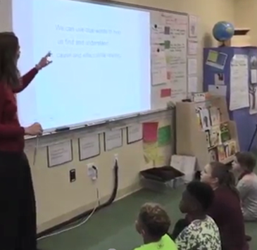
Activity 8.1 – Evaluate a Lesson
Context: 3rd grade whole class
Students are using the text “Backpacks Mean Backaches” and a graphic organizer
Students have already learned the meaning of “cause” and “effect”
Students have already learned the list of clue words for both “cause” and “effect”
General purpose:
Teach students how to use clue words to identify the cause and effect in text
Notes:
These videos are part of professional learning community (PLC) materials for the IES practice guide Foundational Skills to Support Reading for Understanding in Kindergarten Through 3rd Grade prepared for the Institute of Education Sciences (IES) under Contract ED-IES-12-C-0011 by the Regional Educational Laboratory Southeast administered by Florida State University.

Slide 27
Activity 8.1 – Evaluate a Lesson
As you watch the video, think about:
What is the objective?
Where do you see evidence of modeling?
Time (Estimate) | Observation (Modeling)

Slide 28
Cause and Effect
Link to Video: https://youtu.be/3w3zLUBsF0k?t=157 (stop at 03:50)
Notes:
These videos are part of professional learning community (PLC) materials for the IES practice guide Foundational Skills to Support Reading for Understanding in Kindergarten Through 3rd Grade prepared for the Institute of Education Sciences (IES) under Contract ED-IES-12-C-0011 by the Regional Educational Laboratory Southeast administered by Florida State University.

Slide 29
Activity 8.1 – Evaluate a Lesson
Objectives
  Create Objectives
  Choose objectives based on student performance relative to goals.
  Select a goal from IEP or standards
  Choose an objective that is the next step toward the goal
  Write focused objectives that describe the specific learning outcome.
  Limit the objective to one singular next step toward the goal
  Describe a learning outcome in behavioral term that assesses mastery of the objective
Lesson Objective:
Students can use clue words to help find and understand cause and effect while reading

Slide 30
Activity 8.1 – Evaluate a Lesson
Objectives
  Create Objectives
  Choose objectives based on student performance relative to goals.
  Select a goal from IEP or standards
  Choose an objective that is the next step toward the goal
  Write focused objectives that describe the specific learning outcome.
  Limit the objective to one singular next step toward the goal
  Describe a learning outcome in behavioral term that assesses mastery of the objective

Slide 31

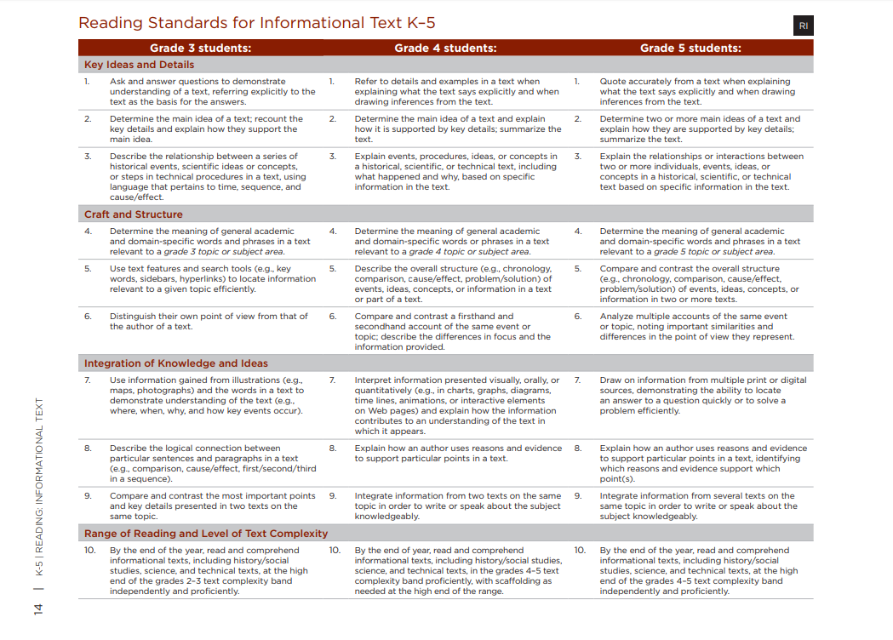
Activity 8.1 – Evaluate a Lesson
Objectives
Describe the logical connection between particular sentences and paragraphs in a text (e.g., comparison, cause/effect, first/second/third in a sequence).

Slide 32

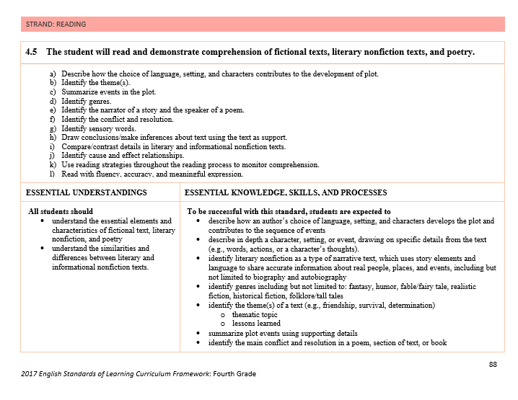
Activity 8.1 – Evaluate a Lesson
Objectives
Identify cause/effect relationships

Slide 33
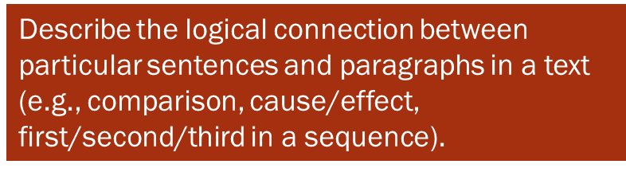
Activity 8.1 – Evaluate a Lesson
Objectives
  Create Objectives
  Choose objectives based on student performance relative to goals.
  Select a goal from IEP or standards
  Choose an objective that is the next step toward the goal
  Write focused objectives that describe the specific learning outcome.
  Limit the objective to one singular next step toward the goal
  Describe a learning outcome in behavioral term that assesses mastery of the objective
In this teacher’s state—which uses the Common Core State Standards—this is a 3rd grade standard. If this teacher were in Virginia, this might be considered a fourth grade standard.
In this group of students, the objective matches the students’ instructional level, so it is appropriate for this group.

Slide 34
Activity 8.1 – Evaluate a Lesson
Objectives
  Create Objectives
  Choose objectives based on student performance relative to goals.
  Select a goal from IEP or standards
  Choose an objective that is the next step toward the goal
  Write focused objectives that describe the specific learning outcome.
  Limit the objective to one singular next step toward the goal
  Describe a learning outcome in behavioral term that assesses mastery of the objective
The teacher’s objective is a good next step toward the goal. Students have already learned the meaning of “cause” and “effect” as well as the list of clue words for each. Now, the students are going to identify cause and effect examples in text. This is a way to check understanding.

Slide 35
Activity 8.1 – Evaluate a Lesson
Objectives
The objective is probably one singular next step, but—as written—it has three parts, (1) using clue words, (2) finding causes and effects, and (3) understanding cause and effect.
The third part should be mastered already based on prior lessons. The first two parts can probably be combined—the lesson is about finding causes and effects using clue words and categorizing. … but maybe this is still two things… a bit tricky…
  Create Objectives
  Choose objectives based on student performance relative to goals.
  Select a goal from IEP or standards
  Choose an objective that is the next step toward the goal
  Write focused objectives that describe the specific learning outcome.
  Limit the objective to one singular next step toward the goal
  Describe a learning outcome in behavioral term that assesses mastery of the objective

Slide 36
Activity 8.1 – Evaluate a Lesson
Objectives
The objective says that students will “use” clue words, but it is not clear what it means to use them. It is also unclear what it means to “understand” cause and effect. It seems that they should already know this based on the prior lesson. It is probably extraneous then, but it is confusing.
  Create Objectives
  Choose objectives based on student performance relative to goals.
  Select a goal from IEP or standards
  Choose an objective that is the next step toward the goal
  Write focused objectives that describe the specific learning outcome.
  Limit the objective to one singular next step toward the goal
  Describe a learning outcome in behavioral term that assesses mastery of the objective

Slide 37
Activity 8.1 – Evaluate a Lesson
Objectives
  Create Objectives
  Choose objectives based on student performance relative to goals.
  Select a goal from IEP or standards
  Choose an objective that is the next step toward the goal
  Write focused objectives that describe the specific learning outcome.
  Limit the objective to one singular next step toward the goal
  Describe a learning outcome in behavioral term that assesses mastery of the objective
Better Objectives:
SWBAT categorize sentence components as causes and effects using clue words like because and since.
SWBAT locate cause and effect statements in texts using clue words.

Slide 38
Activity 8.1 – Evaluate a Lesson
Modeling
  Provide Modeling
  Give clear explanations
    Match the explanation to the learning outcome
    Design the explanation so that it is correct, clear and concise
    Use the explanation consistently
    Model multiple planned examples
      Show all the steps or provide unique examples
      Verbalize your thinking
      Have students observe
      Use supporting practices
Time | Observation
:09 - :31 | Clear Explanation?
:33 – end | Planned Example?
Let’s return to our time stamps..

Slide 39
Activity 8.1 – Evaluate a Lesson
Modeling
  Provide Modeling
  Give clear explanations
    Match the explanation to the learning outcome
    Design the explanation so that it is correct, clear and concise
    Use the explanation consistently
    Model multiple planned examples
      Show all the steps or provide unique examples
      Verbalize your thinking
      Have students observe
      Use supporting practices
When modeling, you should give a clear explanation. In the beginning, the teacher tells the students that they will use blue to mark the “cause” and green to mark the “effect”. However, she does not state how students are to do this. For example, she does not say “circle the cause in blue”. She also does not list finding the clue words as an initial step. It is unclear exactly what the exact steps are.

Slide 40
Activity 8.1 – Evaluate a Lesson
Modeling
  Provide Modeling
  Give clear explanations
    Match the explanation to the learning outcome
    Design the explanation so that it is correct, clear and concise
    Use the explanation consistently
    Model multiple planned examples
      Show all the steps or provide unique examples
      Verbalize your thinking
      Have students observe
      Use supporting practices
The teacher provides one example sentence on the board. She tells students to find the clue words, but she does not model doing this herself.
She does not lead step-by-step. She states, “I am going to circle it [the clue word] in blue”. But this is the only step she verbalizes.
She does not verbalize her thinking. We do not get to see how the cause was identified. She says what the cause is, and she underlines it, but does not explain why. Students are providing her with the answer without getting the opportunity to sit back and truly observe.

Slide 41
Activity 8.1 – Evaluate a Lesson
Modeling
  Provide Modeling
  Give clear explanations
    Match the explanation to the learning outcome
    Design the explanation so that it is correct, clear and concise
    Use the explanation consistently
    Model multiple planned examples
      Show all the steps or provide unique examples
      Verbalize your thinking
      Have students observe
      Use supporting practices
We do not see much use of the supporting practices. The teacher attempts to elicit response by asking questions, but for majority of the time, students are quiet. At other times, only 1 child responds at a time.
The teacher provides the answer by stating “this word is the clue word” or “this is the cause,” but she does not provide an explanation.

Slide 42


Activity 8.1 – Evaluate a Lesson
Review
  Create Objectives
  Choose objectives based on student performance relative to goals.
  Select a goal from IEP or standards
  Choose an objective that is the next step toward the goal
  Write focused objectives that describe the specific learning outcome.
  Limit the objective to one singular next step toward the goal
  Describe a learning outcome in behavioral term that assesses mastery of the objective
  Provide Modeling
  Give clear explanations
    Match the explanation to the learning outcome
    Design the explanation so that it is correct, clear and concise
    Use the explanation consistently
    Model multiple planned examples
      Show all the steps or provide unique examples
      Verbalize your thinking
      Have students observe
      Use supporting practices
Notes:
These videos are part of professional learning community (PLC) materials for the IES practice guide Foundational Skills to Support Reading for Understanding in Kindergarten Through 3rd Grade prepared for the Institute of Education Sciences (IES) under Contract ED-IES-12-C-0011 by the Regional Educational Laboratory Southeast administered by Florida State University.

Slide 43
Slide 43
Part 1 Wrap-Up
Key Points:
Craft your objective carefully
Plan a precise explanation and well-aligned examples
Self-reflect

Slide 44
Checklist for Objectives
Choose objectives based on student performance relative to goals.
Select a goal from IEP or standards
Choose an objective that is the next step toward the goal
Write focused objectives that describe the specific learning outcome.
Limit the objective to one singular next step toward the goal
Describe a learning outcome in behavioral terms that assesses mastery of the objective

Slide 45
Checklist: Modeling
Give clear explanations
  Match the explanation to the learning outcome
  Design the explanation so that it is correct, clear, and concise
  Use the explanation consistently
Model multiple planned examples
  Show all the steps or provide unique examples
  Verbalize your thinking
  Have students observe
Use supporting practices

Slide 46
Slide 46
Self-Reflect
Don’t expect that you will be perfect the first time you try
So, when you plan,
  Try your best
  Use the checklist to guide you
  Set goals
When you reflect on your lesson,
  Use the checklist to help you review your lesson without judgment
    “Did I follow the checklist?” – good!
    “Was that lesson good?” – bad!
  Remember that there is always room to grow

Slide 47
Slide 49
Activity 8.2 – Prepare your lesson
Activity 8.3 – Try out your lesson
Prepare your lesson
Try out your lesson
Review an upcoming lesson.
Create your objective(s)
Write a clear objective with a specific learning outcome
Prepare a good model
Write a clear explanation of the procedure or information
Write a description of the models used
Plan to do your lesson.
Review your clear objective
Review your clear explanation and write it out to review as you teach
Adjust your plan so it is less than 10 minutes long
Do the lesson
Videotape your lesson
Work from your written plan
Focus on the explanation and teacher-led model
Teach just 10 minutes

Slide 48
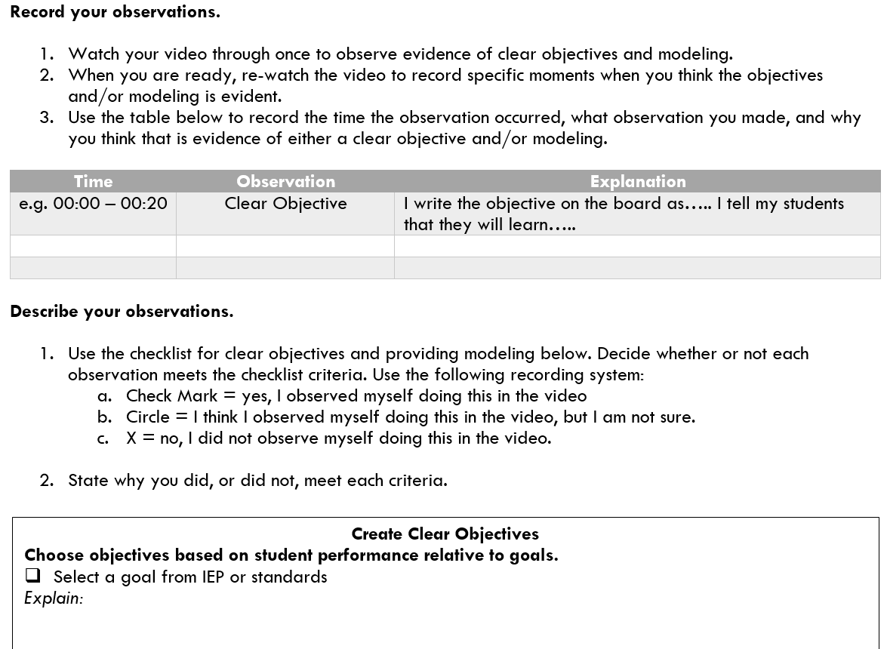
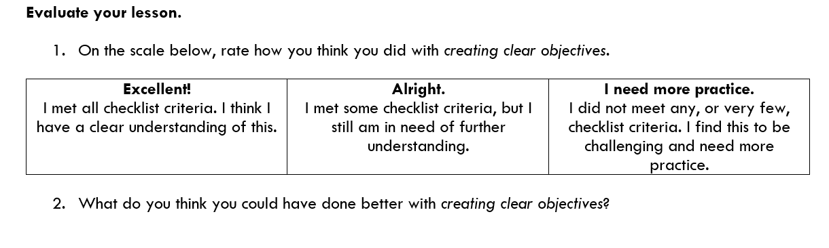
Activity 8.4 – Self-Reflect
Watch your video.
Record specific evidence of objectives and modeling.
Describe what you see.
Evaluate the effective use of objectives and modeling.
Meet to discuss your self-reflection.

Slide 49
Slide 49
Explicit Instruction
Evaluating use of explicit instruction to support students’ academic needs
Part 2: How do you know you have effectively implemented practice?

Slide 50
Slide 50
Part 2 Objectives
You’ll learn how to:
Identify practice
Evaluate practice
Reflect upon your own use of practice

Slide 51
Master Checklist
Explicit Instruction
Supporting Practices
Create Objectives
  Select a goal from IEP or standards
  Choose an objective that is the next step toward the goal
  Limit the objective to one singular next step toward the goal
  Describe a learning outcome in behavioral term that assesses mastery of the objective
Elicit a Response
  Maintain or check accuracy of processing
  Match the learning outcome
  Match student abilities
  Match the desired response format
  Maximize student involvement
Provide Modeling
  Give clear explanations
  Model multiple planned examples
  Use supporting practices
Provide Feedback
  Immediate: delivered as soon as possible
  Specific: tied directly to students’ actions
Provide Practice
  Provide guided practice
  Provide independent practice
Maintain a Brisk Pace
  Move on when students are ready
  Use the supporting practices

Slide 52
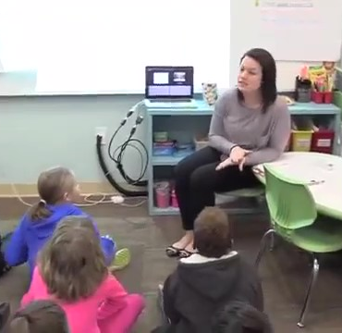
Evaluate a Lesson: Main Idea
Context: 1st grade whole class
Engaging in a main idea activity
Students use pictures and a smart board
General purpose:
SWBAT identify the main idea in a story using steps
Notes:
These videos are part of professional learning community (PLC) materials for the IES practice guide Foundational Skills to Support Reading for Understanding in Kindergarten Through 3rd Grade prepared for the Institute of Education Sciences (IES) under Contract ED-IES-12-C-0011 by the Regional Educational Laboratory Southeast administered by Florida State University.

Slide 53
Main Idea
Link to Video: https://youtu.be/MXLek726ww4?t=74
Notes:
These videos are part of professional learning community (PLC) materials for the IES practice guide Foundational Skills to Support Reading for Understanding in Kindergarten Through 3rd Grade prepared for the Institute of Education Sciences (IES) under Contract ED-IES-12-C-0011 by the Regional Educational Laboratory Southeast administered by Florida State University.

Slide 54
Evaluate a Lesson: Main Idea
Guided Practice
  Provide Guided Practice
  Lead students in steps toward learning outcome
  Procedural task: execute each step separately
  Knowledge task: address each unit (e.g. vocabulary word) one at a time
  Provide appropriate prompts
    Design a variety of prompt types linked to task and likely student need
    Change level of prompting in response to student’s progress
  Observe and provide immediate feedback
  Watch students carefully
  Interpret the meaning of errors
  Provide feedback that aligns with the type of error
Time | Observation
Beg – 1:23 | Guided
1:33 – End | Independent?
Let’s return to our time stamps..

Slide 55
Evaluate a Lesson: Main Idea
Guided Practice
  Provide Guided Practice
  Lead students in steps toward learning outcome
  Procedural task: execute each step separately
  Knowledge task: address each unit (e.g. vocabulary word) one at a time
  Provide appropriate prompts
    Design a variety of prompt types linked to task and likely student need
    Change level of prompting in response to student’s progress
  Observe and provide immediate feedback
  Watch students carefully
  Interpret the meaning of errors
  Provide feedback that aligns with the type of error
In guided practice, the teacher leads the student step-by-step. The teacher clearly lists the steps on the board as well as states each step before the students complete them.

Slide 56
Evaluate a Lesson: Main Idea
Guided Practice
With the wedding photo, the teacher does not provide any prompts. She simply states a step, a student responds, and they continue. You do see her providing some prompts (or “mini-reminders”) to pairs. But more on that later…
We do not see any evidence of communication between student and teacher that requires prompting. So it is not clear whether or not her limited use of prompting meets student needs.
  Provide Guided Practice
  Lead students in steps toward learning outcome
  Procedural task: execute each step separately
  Knowledge task: address each unit (e.g. vocabulary word) one at a time
  Provide appropriate prompts
    Design a variety of prompt types linked to task and likely student need
    Change level of prompting in response to student’s progress
  Observe and provide immediate feedback
  Watch students carefully
  Interpret the meaning of errors
  Provide feedback that aligns with the type of error

Slide 57
Evaluate a Lesson: Main Idea
Guided Practice
  Provide Guided Practice
  Lead students in steps toward learning outcome
  Procedural task: execute each step separately
  Knowledge task: address each unit (e.g. vocabulary word) one at a time
  Provide appropriate prompts
    Design a variety of prompt types linked to task and likely student need
    Change level of prompting in response to student’s progress
  Observe and provide immediate feedback
  Watch students carefully
  Interpret the meaning of errors
  Provide feedback that aligns with the type of error
The teacher does not provide any feedback. She listens to a response, and then moves on. Occasionally, she’ll repeat a response, but does not say whether or not it was correct.

Slide 58
Evaluate a Lesson: Main Idea
  Provide Independent Practice
  Review expectations and resources for meeting the learning outcome
  Select objective-linked practice items that lead to 90-95% accuracy
  Review expectations for meeting learning outcome
  Remind students how they self-prompt
  Allow student to work without support
  Limit guidance from teacher
  Monitor throughout independent practice
  Give mini-reminders and record points of confusion
  Observe and provide immediate and delayed feedback
  Check for understanding throughout
  Provide feedback following completion of task
Time | Observation
Beg – 1:23 | Guided
1:33 – End | Independent?
Let’s return to our time stamps..

Slide 59
Evaluate a Lesson: Main Idea
  Provide Independent Practice
  Review expectations and resources for meeting the learning outcome
  Select objective-linked practice items that lead to 90-95% accuracy
  Review expectations for meeting learning outcome
  Remind students how they self-prompt
  Allow student to work without support
  Limit guidance from teacher
  Monitor throughout independent practice
  Give mini-reminders and record points of confusion
  Observe and provide immediate and delayed feedback
  Check for understanding throughout
  Provide feedback following completion of task
When providing independent practice, you should review expectations and resources for meeting the learning outcome. At the beginning of the independent practice, the teacher reviews each step, and gives students a second to think about each step to themselves.

Slide 60
Evaluate a Lesson: Main Idea
  Provide Independent Practice
  Review expectations and resources for meeting the learning outcome
  Select objective-linked practice items that lead to 90-95% accuracy
  Review expectations for meeting learning outcome
  Remind students how they self-prompt
  Allow student to work without support
  Limit guidance from teacher
  Monitor throughout independent practice
  Give mini-reminders and record points of confusion
  Observe and provide immediate and delayed feedback
  Check for understanding throughout
  Provide feedback following completion of task
When providing independent practice, you should allow students to work without support. The teacher does do this, to an extent. Students work in pairs and while some pairs work completely on their own, the teacher circles around to a couple of pairs to provide some guidance. You can hear her stating reminders such as “what is step #1?” “step #2?”.

Slide 61
Evaluate a Lesson: Main Idea
  Provide Independent Practice
  Review expectations and resources for meeting the learning outcome
  Select objective-linked practice items that lead to 90-95% accuracy
  Review expectations for meeting learning outcome
  Remind students how they self-prompt
  Allow student to work without support
  Limit guidance from teacher
  Monitor throughout independent practice
  Give mini-reminders and record points of confusion
  Observe and provide immediate and delayed feedback
  Check for understanding throughout
  Provide feedback following completion of task
The teacher does check for understanding. Immediately following the pairs’ discussion, she re-groups and reviews student responses.
She does not, however, always provide feedback. She does provide feedback with the first student, by repeating what she heard, “the most important ‘who’ is me”. However, when the next two students respond, she does not provide any feedback.

Slide 62
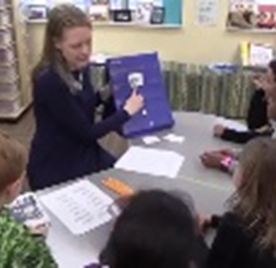
Activity 8.5 – Evaluate a Lesson
Context: 1st grade small group
Students are engaging in decodable words in isolation and in text activity
Students are using letter-cards and pocket charts
Notes:
These videos are part of professional learning community (PLC) materials for the IES practice guide Foundational Skills to Support Reading for Understanding in Kindergarten Through 3rd Grade prepared for the Institute of Education Sciences (IES) under Contract ED-IES-12-C-0011 by the Regional Educational Laboratory Southeast administered by Florida State University.

Slide 63
Decoding Words
Link to Video: https://youtu.be/qJuj-UqKhJw?t=65 (stop at 05:50)
Notes:
These videos are part of professional learning community (PLC) materials for the IES practice guide Foundational Skills to Support Reading for Understanding in Kindergarten Through 3rd Grade prepared for the Institute of Education Sciences (IES) under Contract ED-IES-12-C-0011 by the Regional Educational Laboratory Southeast administered by Florida State University.

Slide 64
8.5 – Evaluate a Lesson
Guided Practice
Time | Observation
Beginning – :29 | Guided
:45 – 1:21 | Guided
1:49 – 2:04 | Independent
2:21 – 3:00 | Independent
3:17 - end | Independent
  Provide Guided Practice
  Lead students in steps toward learning outcome
  Procedural task: execute each step separately
  Knowledge task: address each unit (e.g. vocabulary word) one at a time
  Provide appropriate prompts
    Design a variety of prompt types linked to task and likely student need
    Change level of prompting in response to student’s progress
  Observe and provide immediate feedback
  Watch students carefully
  Interpret the meaning of errors
  Provide feedback that aligns with the type of error
Let’s return to our time stamps..

Slide 65
Activity 8.5 – Evaluate a Lesson
Guided Practice
  Provide Guided Practice
  Lead students in steps toward learning outcome
  Procedural task: execute each step separately
  Knowledge task: address each unit (e.g. vocabulary word) one at a time
  Provide appropriate prompts
    Design a variety of prompt types linked to task and likely student need
    Change level of prompting in response to student’s progress
  Observe and provide immediate feedback
  Watch students carefully
  Interpret the meaning of errors
  Provide feedback that aligns with the type of error
Throughout the clip, the teacher provides clear directions and students respond, with her guidance. For example, “when I point to EE I want you to say E”.

Slide 66
Activity 8.5 – Evaluate a Lesson
Guided Practice
  Provide Guided Practice
  Lead students in steps toward learning outcome
  Procedural task: execute each step separately
  Knowledge task: address each unit (e.g. vocabulary word) one at a time
  Provide appropriate prompts
    Design a variety of prompt types linked to task and likely student need
    Change level of prompting in response to student’s progress
  Observe and provide immediate feedback
  Watch students carefully
  Interpret the meaning of errors
  Provide feedback that aligns with the type of error
The teacher provides gestural prompts, pointing to the letters, EE and EA. She also uses her finger to guide students to read each word.

Slide 67
Activity 8.5 – Evaluate a Lesson
Guided Practice
  Provide Guided Practice
  Lead students in steps toward learning outcome
  Procedural task: execute each step separately
  Knowledge task: address each unit (e.g. vocabulary word) one at a time
  Provide appropriate prompts
    Design a variety of prompt types linked to task and likely student need
    Change level of prompting in response to student’s progress
  Observe and provide immediate feedback
  Watch students carefully
  Interpret the meaning of errors
  Provide feedback that aligns with the type of error
When providing guided practice, you should observe and provide immediate feedback. The teacher does a nice job of watching the students with each response. She doesn’t provide much feedback aside from “good” at the end, but the students also do not make any errors.

Slide 68
8.5 – Evaluate a Lesson
Independent Practice
Time | Observation
Beginning – :29 | Guided
:45 – 1:21 | Guided
1:49 – 2:04 | Independent
2:21 – 3:00 | Independent
3:17 - end | Independent
  Provide Independent Practice
  Review expectations and resources for meeting the learning outcome
  Select objective-linked practice items that lead to 90-95% accuracy
  Review expectations for meeting learning outcome
  Remind students how they self-prompt
  Allow student to work without support
  Limit guidance from teacher
  Monitor throughout independent practice
  Give mini-reminders and record points of confusion
  Observe and provide immediate and delayed feedback
  Check for understanding throughout
  Provide feedback following completion of task
Let’s return to our time stamps..

Slide 69
8.5 – Evaluate a Lesson
Independent Practice
  Provide Independent Practice
  Review expectations and resources for meeting the learning outcome
  Select objective-linked practice items that lead to 90-95% accuracy
  Review expectations for meeting learning outcome
  Remind students how they self-prompt
  Allow student to work without support
  Limit guidance from teacher
  Monitor throughout independent practice
  Give mini-reminders and record points of confusion
  Observe and provide immediate and delayed feedback
  Check for understanding throughout
  Provide feedback following completion of task
The teacher selects independent activities that link directly to guided practice. The students use a known routine to apply the new knowledge—but she had not done this during guided practice. However, students exhibit very little difficulty completing the tasks. It seems like accuracy is over 90% (but it’s a bit hard to know).

Slide 70
8.5 – Evaluate a Lesson
Independent Practice
  Provide Independent Practice
  Review expectations and resources for meeting the learning outcome
  Select objective-linked practice items that lead to 90-95% accuracy
  Review expectations for meeting learning outcome
  Remind students how they self-prompt
  Allow student to work without support
  Limit guidance from teacher
  Monitor throughout independent practice
  Give mini-reminders and record points of confusion
  Observe and provide immediate and delayed feedback
  Check for understanding throughout
  Provide feedback following completion of task
The teacher limits support while students complete the tasks on their own. She only provides little reminders such as “say E as you underline”.

Slide 71
8.5 – Evaluate a Lesson
Independent Practice
  Provide Independent Practice
  Review expectations and resources for meeting the learning outcome
  Select objective-linked practice items that lead to 90-95% accuracy
  Review expectations for meeting learning outcome
  Remind students how they self-prompt
  Allow students to work without support
  Limit guidance from teacher
  Monitor throughout independent practice
  Give mini-reminders and record points of confusion
  Observe and provide immediate and delayed feedback
  Check for understanding throughout
  Provide feedback following completion of task
After practice, the teacher re-groups to go over what the students completed. When they have mastered the first task, she continues to a different task where they can apply what they have learned in a new way.

Slide 72
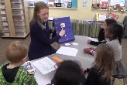

Activity 8.5
Review
Provide Guided Practice
  Lead student in steps toward the learning outcome
  Provide appropriate prompts
  Observe and provide immediate feedback
Provide Independent Practice
  Review expectations and resources for meeting the learning outcome
  Allow student to work without support
  Observe and provide immediate and delayed feedback
Notes:
These videos are part of professional learning community (PLC) materials for the IES practice guide Foundational Skills to Support Reading for Understanding in Kindergarten Through 3rd Grade prepared for the Institute of Education Sciences (IES) under Contract ED-IES-12-C-0011 by the Regional Educational Laboratory Southeast administered by Florida State University.

Slide 73
Slide 73
Part 2 Wrap-Up
Know the difference between guided and independent practice
Know when students are ready for independent practice
Keep your checklist handy when creating your plan for practice

Slide 74
Slide 74
Activity 8.6 – Prepare your lesson
Activity 8.7 – Try out your lesson
Try out your lesson
Prepare your lesson
Review an upcoming lesson.
Prepare guided practice.
Lead students in steps toward the learning outcome
Provide appropriate prompts
Observe and provide immediate feedback
AND / OR
Prepare independent practice.
Review expectations and resources for meeting the learning outcome
Allow student to work without support
Observe and provide immediate and delayed feedback
Plan to do your lesson.
Review your plan
Adjust your plan so it is less than 10 minutes long
Do the lesson
Videotape your lesson
Work from your written plan
Teach just 10 minutes

Slide 75
Activity 8.8 – Self-Reflect
Watch your video.
Record specific evidence of guided and/or independent practice.
Describe what you see.
Evaluate your use of practice.
Meet with your coach to discuss your self-reflection.

Slide 76
Slide 76
Explicit Instruction
Evaluating use of explicit instruction to support students’ academic needs
Part 3: How do you know you have effectively used the supporting practices?

Slide 77
Slide 77
Part 3 Objectives
You’ll learn how to:
Identify use of supporting practices
Evaluate use of supporting practices
Reflect upon your own use of supporting practices

Slide 78
Master Checklist
Explicit Instruction
Supporting Practices
Create Objectives
  Select a goal from IEP or standards
  Choose an objective that is the next step toward the goal
  Limit the objective to one singular next step toward the goal
  Describe a learning outcome in behavioral term that assesses mastery of the objective
Elicit a Response
  Maintain or check accuracy of processing
  Match the learning outcome
  Match student abilities
  Match the desired response format
  Maximize student involvement
Provide Modeling
  Give clear explanations
  Model multiple planned examples
  Use supporting practices
Provide Feedback
  Immediate: delivered as soon as possible
  Specific: tied directly to students’ actions
Provide Practice
  Provide guided practice
  Provide independent practice
Maintain a Brisk Pace
  Move on when students are ready
  Use the supporting practices

Slide 79
Checklist
The methods used to elicit a response should:
Maintain or check accuracy of processing
Match the learning outcome
Match student abilities
Match the desired response format
Maximize student involvement

Slide 80
Effective methods for eliciting responses
Whip Around
Choral Response
Hand Signals
Cued Retell
White Boards
Response Cards
Turn & Talk
Stop & Jot
Individual Response

Slide 81
Match the method of eliciting responses to the learning outcome
  Examine the Bloom’s Taxonomy level of learning outcome.
    Ask questions that elicit responses at that level.
    Ask questions that support the learning outcome.

Slide 82
Match the method of eliciting responses to student abilities
  Think about what students have already processed – build on the foundation
  Think about what students know now and what they will be learning – sequence appropriately
  Think about how students might respond to a question or instruction – phrase purposefully

Slide 83
Use the most efficient approach
Number of students involved
Time taken
Notes:
Get as many students involved as we can.
…. but we don’t always do this…
Some methods take more time than others, and time matters too…
Involve many students!
Students are more likely to pay attention when they are involved.
Ways to do this: (list on slide and review what each entails: call- and- response, partner responses, fist-to-five, holding up fingers, thumbs up/thumbs down, whip around-pass )
It is important to directly involve as many students as possible……because
more students will be involved in cognitively processing the lesson content!

Slide 84
Checklist: Providing feedback
When providing feedback, it should be:
Immediate: delivered as soon as possible after response
Specific: tied directly to students’ actions

Slide 85
Types of feedback
Affirmative
  Praise a correct response
Corrective
  Correct an incorrect response
Reset
Redirect an off-topic response

Slide 86
Strategies for delivering feedback
Affirmative Feedback
Reinforce and Restate
Corrective Feedback
You say it, they repeat it
Give the answer and give a choice
Revoicing
Reset Feedback
Stop a long response
Ask the question a different way

Slide 87
Checklist: Maintaining a brisk pace
To maintain a brisk pace, you should:
Move on when students are ready
Use the other supporting practices

Slide 88
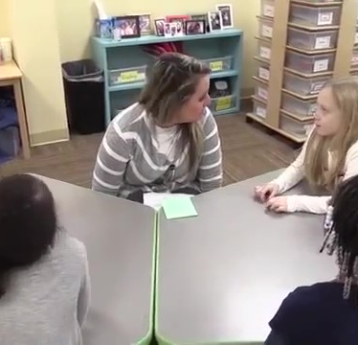
Evaluate a Lesson: Syllables
Context: Kindergarten small group
Students are doing a syllable activity
Students have already learned what syllables are
Students have manipulatives to use
General purpose:
SWBAT break apart a word into two syllables using manipulatives
SWBAT blend two syllables together to form a word using manipulatives
Notes:
These videos are part of professional learning community (PLC) materials for the IES practice guide Foundational Skills to Support Reading for Understanding in Kindergarten Through 3rd Grade prepared for the Institute of Education Sciences (IES) under Contract ED-IES-12-C-0011 by the Regional Educational Laboratory Southeast administered by Florida State University.

Slide 89
Evaluate a Lesson: Syllables
Link to Video: https://youtu.be/gaodKlCjwUg?t=60
Notes:
These videos are part of professional learning community (PLC) materials for the IES practice guide Foundational Skills to Support Reading for Understanding in Kindergarten Through 3rd Grade prepared for the Institute of Education Sciences (IES) under Contract ED-IES-12-C-0011 by the Regional Educational Laboratory Southeast administered by Florida State University.

Slide 90
Evaluate a Lesson: Syllables
Elicit Frequent Responses
  Elicit Frequent Responses
  Maintain or check accuracy of processing
  Match the learning outcome
  Match the student abilities
  Match the desired response format
  Maximize student involvement
Let’s return to our time stamps..

Slide 91
Evaluate a Lesson: Syllables
Elicit Frequent Responses
First syllable. Ap-. Second syllable. –ple.
Say “flower”. Flower.
1:29
0:17
Blend it back together. Puppet.
Break flower apart. Flow-er.
1:19
Let’s try “puppet”. First syllable “pup-”. Pup-pet.
0:22
1:15
I’m going to blend it back together. Flow-er.
Let’s blend it back together. Apple.
0:29
1:10
Now let’s read it. Flower.
Let’s try “apple”. Apple.
0:32
1:08
The word is “monkey”. Say “monkey” Monkey.
Let’s blend it back together. Turtle.
1:03
0:47
Let’s break it apart. Tur-tle.
Separate the word by syllable. Mon-key.
Now blend it back together. Monkey.
1:00
Say “turtle”. Turtle.
0:52
0:55
0:58

Slide 92
Evaluate a Lesson: Syllables
Elicit Frequent Responses
  Elicit Frequent Responses
  Maintain or check accuracy of processing
  Match the learning outcome
  Match the student abilities
  Match the desired response format
  Maximize student involvement
The teacher implements a variety of methods for eliciting responses. Each student a set of manipulatives to demonstrate breaking apart and blending syllables. She also has students say the word and syllables each time.
Remember, during practice, we want students to be involved as much as possible. This means an average of at least 1 response per minute. During this lesson, we rarely see students sitting and waiting.

Slide 93
Evaluate a Lesson: Syllables
Elicit Frequent Responses
  Elicit Frequent Responses
  Maintain or check accuracy of processing
  Match the learning outcome
  Match the student abilities
  Match the desired response format
  Maximize student involvement
Students have already learned about syllables. Now, students are applying what they have learned about syllables by using manipulatives. The teacher asks students to move their manipulatives to demonstrate understanding of how to break syllables apart and put them back together. They say the syllables out loud, as they move each manipulative so the teacher can check for understanding.

Slide 94
Evaluate a Lesson: Syllables
Elicit Frequent Responses
  Elicit Frequent Responses
  Maintain or check accuracy of processing
  Match the learning outcome
  Match the student abilities
  Match the desired response format
  Maximize student involvement
Throughout the lesson, students are continuously responding by verbally stating a word and/or syllable or using manipulatives to demonstrate understanding. There is a high rate of responding and a high rate of success. Students go through each step with minimal errors. This indicates that the type of response the teacher is eliciting, matches the student abilities.

Slide 95
Evaluate a Lesson: Syllables
Elicit Frequent Responses
  Elicit Frequent Responses
  Maintain or check accuracy of processing
  Match the learning outcome
  Match the student abilities
  Match the desired response format
  Maximize student involvement
The teacher elicits both verbal and physical response formats. Students say words and syllables out loud. Students also move manipulatives to demonstrate breaking syllables apart and blending them back together.

Slide 96
Evaluate a Lesson: Syllables
Elicit Frequent Responses
  Elicit Frequent Responses
  Maintain or check accuracy of processing
  Match the learning outcome
  Match the student abilities
  Match the desired response format
  Maximize student involvement
Remember that we want to balance the time taken for response to the number of students directly involved. This teacher is working with 5 students. This is considered a relatively small group. We observe at least 1 response per minute, with all students responding each time. Though it may be OK to take a little more time with each response in this case, the teacher maximized engagement by having all students participate and respond each time.

Slide 97
Evaluate a Lesson: Syllables
Provide Feedback
  Provide Feedback
Immediate: delivered as soon as possible after response
Specific: tied directly to students’ actions
Time | Observation
1:11 | Affirmative? (“good job”?)
1:16 | Corrective?
1:24 | Reset
1:33 | Corrective
End | Affirmative? (“good job”?)
Let’s return to our time stamps..

Slide 98
Evaluate a Lesson: Syllables
Provide Feedback
  Provide Feedback
Immediate: delivered as soon as possible after response
Specific: tied directly to students’ actions
After each response, the teacher provides some indication of feedback. Whether that is simply just “OK”, or “good”, there is acknowledgement of each response. So it is immediate feedback that is delivered as soon as possible. But, is it specific? ...

Slide 99
Evaluate a Lesson: Syllables
Provide Feedback
  Provide Feedback
Immediate: delivered as soon as possible after response
Specific: tied directly to students’ actions
This one’s tricky. At first glance, you may think there are some examples of affirmative feedback in there. But, what exactly does the teacher say? She says “good job”. That’s a “don’t” when delivering feedback. Other times the teacher just says “OK” and moves on. Is this affirmative feedback?
How about corrective feedback? Does the teacher do this? She recognizes at the end that the students are moving too fast for her to accurately assess understanding. So she slows it down and has students try again. When she corrects the response, she leads the students step-by-step and models.

Slide 100
Evaluate a Lesson: Syllables
Maintain a Brisk Pace
  Maintain a Brisk Pace
Move on when students are ready
Use the other supporting practices
This is an example of guided practice. But are the students ready for “You Do”? In the video, the students are able to replicate steps in the procedure with limited guidance or prompting. Although we do see at the end the students experience difficulty with “apple”. So, it seems like the teacher is moving at the right pace here.

Slide 101
Evaluate a Lesson: Syllables
Maintain a Brisk Pace
  Maintain a Brisk Pace
Move on when students are ready
Use the other supporting practices
We already examined the other supporting practices so we know that the teacher does this. She elicits frequent responses, and she provides immediate feedback. Although, if you recall, her feedback can be more specific.

Slide 102
Evaluate a Lesson: Syllables
Review
  Elicit Frequent Responses
  Maintain or check accuracy of processing
  Match the learning outcome
  Match the student abilities
  Match the desired response format
  Maximize student involvement
  Provide Feedback
Immediate: delivered as soon as possible after response
Specific: tied directly to students’ actions
  Maintain a Brisk Pace
Move on when students are ready
Use the other supporting practices
Notes:
These videos are part of professional learning community (PLC) materials for the IES practice guide Foundational Skills to Support Reading for Understanding in Kindergarten Through 3rd Grade prepared for the Institute of Education Sciences (IES) under Contract ED-IES-12-C-0011 by the Regional Educational Laboratory Southeast administered by Florida State University.

Slide 103
Slide 103
Part 3 Wrap-Up
Reflect on your instruction and decide where you most need to improve
Increase your use of those practices and see how it goes
Iteratively build these skills

Slide 104
Activity 8.9 – Self-Reflect
Watch your video from Part 2.
Record specific evidence of the supporting practices.
Describe what you see.
Evaluate the effective use of supporting practices.
What did you notice? What do you think you need to work on?

Slide 105
Slide 105
Activity 8.10 – Prepare your lesson
Activity 8.11 – Try out your lesson
Try out your lesson
Prepare your lesson
Review your self-reflection in the previous activity.
Review an upcoming lesson.
Prepare a plan for using supporting practices.
How are you going to elicit responses, provide feedback, and maintain a brisk pace?
Identify the areas you really want to focus on.
Plan to do your lesson.
Review your plan
Adjust your plan so it is less than 10 minutes long
Do the lesson
Videotape your lesson
Work from your written plan
Teach just 10 minutes

Slide 106
Slide 106
Explicit Instruction
Evaluating use of explicit instruction to support students’ academic needs
Closing: A final review and summary

Slide 107
Slide 107
Closing
Objectives
You will:
Reflect on effective explicit instructional practices in collaboration with others and on your own
Articulate why explicit instruction is important in the DBI framework
Review all of the elements of the explicit instruction checklist

Slide 108
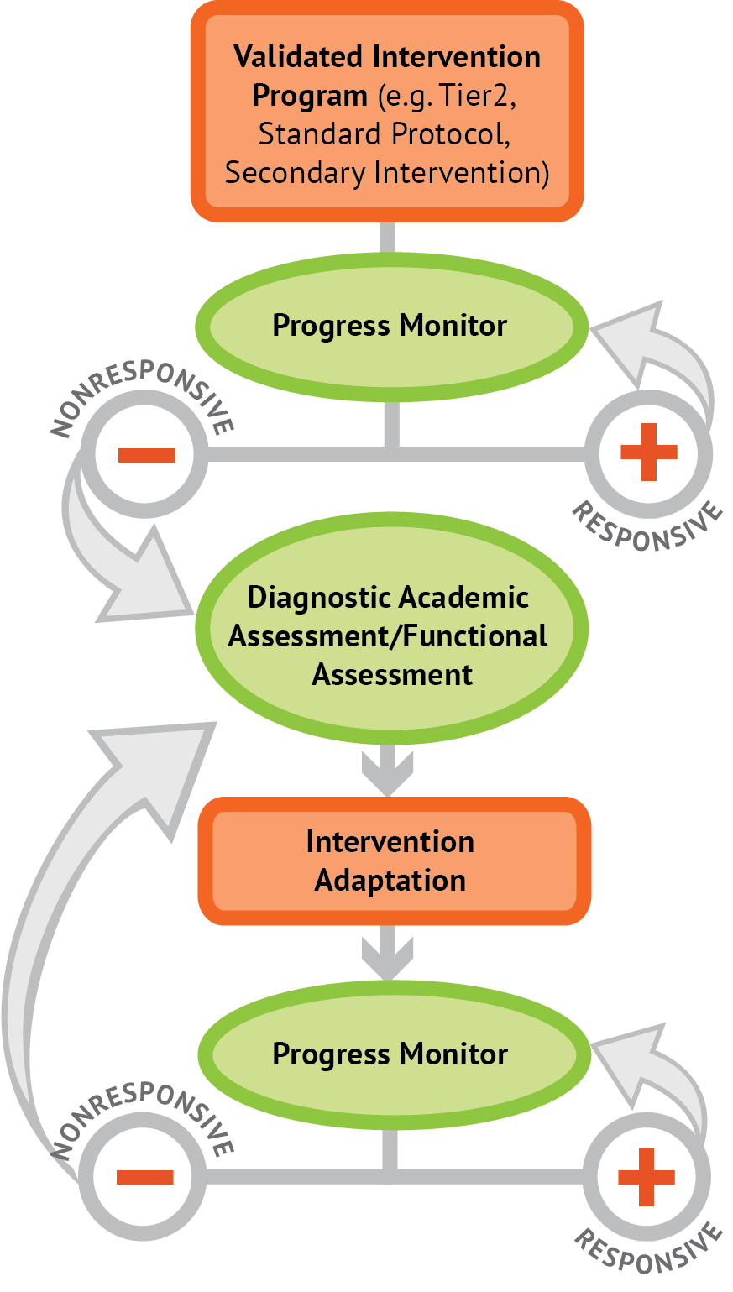
Activity 8.13 – Stop & Jot
I’ve talked about explicit instruction in DBI for 3 9/10 modules… so it’s your turn…
Describe how explicit instruction fits into the DBI framework.

Slide 109
Activity 8.13 – Stop & Jot
Review
My thoughts:
  Addressing explicit instruction is an adaptation made when students do not respond to instruction
  When we review diagnostic data, we may see a pattern of errors that reflects:
    confusion about concepts
    inability to perform tasks we think we taught
  When we see these patterns, we ask whether we need to change our instruction to increase success
    Often we need to increase explicitness
  Then, we decide what elements of explicit instruction we should change first by comparing our instruction to the checklist

Slide 110
Activity 8.14
The Explicit Instruction Framework

Slide 111
Activity 8.15
Now You Are the Master of the Checklist
Explicit Instruction
Supporting Practices
Create Objectives
Elicit a Response
Provide Modeling
Provide Feedback
Provide Practice
Maintain a Brisk Pace

Slide 112
Activity 8.16 – Discussion Board Post
Post your video from Part 3
Provide context for your lesson
Evaluate a peer’s video using the checklists
  Identify the objective
  Find evidence of modeling and practice
  Find evidence of supporting practices
Provide feedback about the explicitness of the instruction:
  Where is there the most evidence?
After getting feedback, write your explicit instruction goals
Then, provide supportive feedback to peers about their goals

Slide 113
Goodbye and good luck

