Slide 1
Title 1
Supporting Practices
Providing immediate specific feedback and maintaining a brisk pace
Module 7

Slide 2
Slide 2
Supporting Practices
Providing immediate specific feedback and maintaining a brisk pace
Introduction: How do the supporting practices maximize engagement?

Slide 3
Slide 3
Module 7 Objectives
You will learn:
How the supporting practices maximize engagement
How to provide immediate specific feedback:
  Delivered as soon as possible after response (immediate)
  Tied directly to students’ actions (specific)
How to maintain a brisk pace:
  Move on when students are ready
  Use other supporting practices
How to adapt a program lesson to make it more explicit by incorporating the supporting practices

Slide 4
Explicit Instruction Model
Modeling
Practice
Clear Explanation
Guided
Practice
Planned
Examples
Independent Practice
Supporting Practices
Using effective methods to elicit frequent responses
Providing immediate specific feedback
Maintaining a brisk pace

Slide 5
Supporting Practices
Supporting Practices
Using effective methods to elicit frequent responses
Providing immediate specific feedback
Maintaining a brisk pace
Providing immediate specific feedback
Maintaining a brisk pace

Slide 6



Engagement

Slide 7
Defining “Engagement” & “Supporting Practices”
Engagement
when students’ cognitive effort is focused on processing lesson content
Supporting practices
evidence-based techniques to maximize student engagement

Slide 8
Define “feedback”
I want all students to quickly show me that they are processing content. I’ll elicit a choral response.
Information provided to a student after a response or action
Exhibit!
The word is exhibit.
What’s the word?
Question/Instruction
Exhibit!
That’s right!
The word is exhibit.
Everyone? …
[pause]
[gesture toward students]
Exhibit!
Feedback
Method
Response

Slide 9
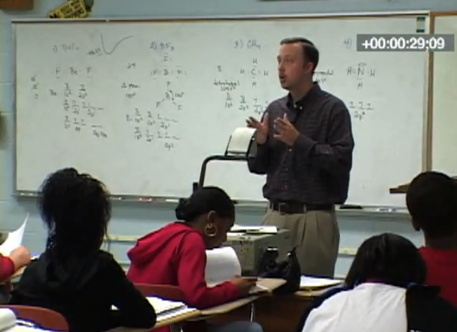
Providing immediate specific feedback and maintaining a brisk pace
Are the students engaged?
Pay attention to how the teacher:
  Provides feedback
  Paces the instruction

Slide 10
Providing immediate specific feedback and maintaining a brisk pace
https://vimeo.com/8277941

Slide 11
Providing immediate specific feedback and maintaining a brisk pace
Are the students engaged?
Pay attention to how the teacher:
  Provides feedback
  Paces the instruction

Slide 12
Checklist: Providing feedback
When providing feedback, it should be:
Immediate: delivered as soon as possible after response
Specific: tied directly to students’ actions

Slide 13
Checklist: Maintaining a brisk pace
To maintain a brisk pace, you should:
Move on when students are ready
Use the other supporting practices

Slide 14
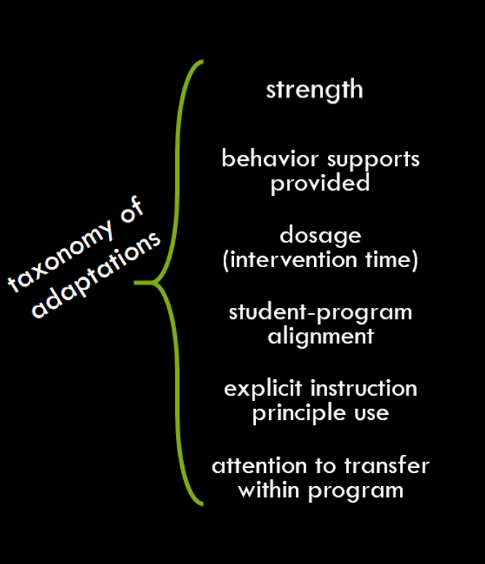
Module in the context of the DBI framework
Provide immediate specific feedback
Maintain a brisk pace

Slide 15
Activity 7.1
Stop & Jot
Think specifically about providing immediate specific feedback and maintaining a brisk pace
Why are the that increase engagement and high quality instructional interactions so important?
Supporting Practices

Slide 16
Why are the Supporting Practices so important?
“Even when you have crafted an exquisite, well-structured lesson or adopted a curriculum material with explicit lessons of high quality, it is still possible that some students may not be totally riveted to your every word or deeply processing the lesson content.”
Archer & Hughes (2011) p.131
Archer, A. L., & Hughes, C. A. (2011). Explicit instruction:
Effective and efficient teaching. New York: Guilford Press.

Slide 17
Module 7 Activities
Notes:
Himmele, W., & Himmele, P. (2012). How to know what students know: Total participation techniques get all students engaged with content, giving teachers feedback about what they know. Educational Leadership. 58-62.

Slide 18
Slide 18
Module 7 Classroom Application
Application Activity
Journal Entry Assignment
Select one supporting practice that you will focus on for the Classroom Application activity and briefly explain why you selected that practice.
Briefly describe an upcoming lesson (including an overview of the lesson plan and identification of the learning outcome).
Explain how you will adapt the lesson to make it more explicit by incorporating the selected supporting practice.
Implement the lesson described in the Journal Entry Assignment.
After implementing, reflect with your coach about the lesson.
  Were you successful in implementing the supporting practice?
  Were students engaged?
  How might you adjust future instruction?

Slide 19
Slide 19
Supporting Practices
Providing immediate specific feedback and maintaining a brisk pace
Part 1: How should feedback be provided?

Slide 20
Slide 20
Part 1 Objectives
You will learn:
Why it is important to provide immediate specific feedback
How to provide immediate specific feedback

Slide 21
Module in the context of the DBI framework
Provide immediate specific feedback
Provide feedback that is immediate and specific

Slide 22
Checklist: Providing feedback
When providing feedback, it should be:
Immediate: delivered as soon as possible after response
Specific: tied directly to students’ actions

Slide 23
Why are we learning this?
Engagement
when students’ cognitive effort is focused on processing lesson content

Slide 24
Providing immediate feedback
What does “immediate” mean?
Deliver feedback as soon as possible after a student responds
Discrete Task
Complex Task

Slide 25
Why provide immediate feedback?
Teach expectations quickly
Prevent inaccurate practice
Increase rate of student mastery
Ensure successful learning

Slide 26
Providing specific feedback
What does “specific” mean?
Tie directly to students’ actions

Slide 27
Why provide specific feedback?
Teach expectations clearly
Remove ambiguity of feedback
Ensure successful learning

Slide 28
Types of student responses
8 x 5 = ?
40
Correct
85
Incorrect
Multiply
Off-topic

Slide 29
Types of feedback
Affirmative
  Praise a correct response
Corrective
  Correct an incorrect response
Reset
Redirect an off-topic response

Slide 30
Aligning feedback to the response
8 x 5 = ?
40
Great job!
8 x 5 does equal 40!
Correct
Affirmative
85
8 x 5 equals 40.
What does 8 x 5 equal?
Incorrect
Corrective
Multiply
We are multiplying.
Let me ask a different way:
What is the product of 8 x 5?
Off-topic
Reset

Slide 31
Activity 7.2
Stop & Jot
In your workbook, jot down an example of a time when you implemented each of the following in your classroom:
  Provide affirmative feedback to a student’s correct response
  Provide corrective feedback to a student’s incorrect response
  Provide reset feedback to a student’s off-topic response

Slide 32
Strategies for delivering feedback
Affirmative Feedback
Reinforce and Restate
Corrective Feedback
You say it, they repeat it
Give the answer and give a choice
Revoicing
Reset Feedback
Stop a long response
Ask the question a different way

Slide 33


Strategies for delivering feedback
Affirmative Feedback
Don’t
Do
Affirm immediately
Use your face, body language, and/or language to show positivity
Praise malleable factors (effort, listening, studying)
Praise in a way that relates to the content
Praise intra-individual improvement (within student)
Tell students they are smart
Give praise for hard work if they did not put in hard work
Just tell students that a response is correct
Only say “good job!”

Slide 34
Strategies for delivering feedback
Affirmative Feedback
Reinforce and Restate
What polygon is this?
Point to the hexagon on the board.
A hexagon.
You’re right!
This is a hexagon.

Slide 35

Activity 7.3
Analyze a Video Example
Affirmative Feedback
What is the first step you would take in solving this equation?
Reinforce and Restate
Link to Video: https://youtu.be/9Hp_xXvf3CM
Add 3 to each side of the equation to start simplifying it.
???
Axelson Academy (2017)

Slide 36
Activity 7.3
Review
Affirmative Feedback
What is the first step you would take in solving this equation?
Reinforce and Restate
Link to Video: https://youtu.be/rpqdAIsygzU
Add 3 to each side of the equation to start simplifying it.
Yes! You would add 3 to each side of the equation.
Axelson Academy (2017)

Slide 37
Strategies for delivering feedback
Affirmative Feedback
Reinforce and Restate
Corrective Feedback
You say it, they repeat it
Give the answer and give a choice
Revoicing
Reset Feedback
Stop a long response
Ask the question a different way

Slide 38
Strategies for delivering feedback
Corrective Feedback
Don’t
Do
Explain the skill or strategy the student is missing
Prompt the student to answer the question again, correctly
Explain why the correct response is correct
Use a positive tone to validate the student
Model the correct response
Just tell students that a response is wrong
Try to make a student feel okay about an error by talking at length about it

Slide 39
Strategies for delivering feedback
Corrective Feedback
You say it, they repeat it
Give the answer and give a choice
Revoicing
What polygon is this?
Point to the hexagon on the board.
A pentagon.
This is a hexagon. What polygon is it?
A hexagon.
Right! This polygon is a hexagon because it has 6 sides.
Affirmative

Slide 40
Activity 7.4
Analyze a Video Example
Corrective Feedback
What is the square root of 64?
You say it, they repeat it
Give the answer and give a choice
Revoicing
Link to Video: https://youtu.be/uoVKK9CeNjU
4
???
Axelson Academy (2017)

Slide 41
Activity 7.4
Review
Corrective Feedback
What is the square root of 64?
You say it, they repeat it
Give the answer and give a choice
Revoicing
Link to Video: https://youtu.be/b6ILxHurKR0
4
The square root of 64 is 8. What is the square root of 64?
Axelson Academy (2017)

Slide 42
Strategies for delivering feedback
Corrective Feedback
You say it, they repeat it
Give the answer and give a choice
Revoicing
What polygon is this?
Point to the hexagon on the board.
A pentagon.
I agree that a pentagon is a polygon. A pentagon has 5 sides. A hexagon has 6 sides. Is this a hexagon or a pentagon?
A hexagon.
Yes, this polygon is a hexagon.
Affirmative

Slide 43
Activity 7.5
Analyze a Video Example
Corrective Feedback
What is the chemical symbol for sodium?
You say it, they repeat it
Give the answer and give a choice
Revoicing
Link to Video: https://youtu.be/gOX-i8IrMJk
NaCL
???
Axelson Academy (2017)

Slide 44
Activity 7.5
Review
Corrective Feedback
What is the chemical symbol for sodium?
You say it, they repeat it
Give the answer and give a choice
Revoicing
Link to Video: https://youtu.be/dryVPygMqBg
NaCL
The chemical symbol for sodium is Na. Is the chemical symbol for sodium Na or NaCL?
Axelson Academy (2017)

Slide 45
Strategies for delivering feedback
Corrective Feedback
You say it, they repeat it
Give the answer and give a choice
Revoicing
Why did Corduroy feel sad?
He felt sad because he lost his shoe.
I hear you saying that Corduroy felt sad because he lost his shoe.
Is that what you mean?
No, he had lost a button.
That is one good reason why he was sad!
Affirmative

Slide 46
Activity 7.6
Analyze a Video Example
Corrective Feedback
What is an equation that equals 20?
You say it, they repeat it
Give the answer and give a choice
Revoicing
Link to Video: https://youtu.be/nLFXXgO_zVk
4 and 4 and 4 and 4 and 4 is 20.
???
Axelson Academy (2017)

Slide 47
Activity 7.6
Review
What is an equation that equals 20?
Corrective Feedback
You say it, they repeat it
Give the answer and give a choice
Revoicing
4 and 4 and 4 and 4 and 4 is 20.
Link to Video: https://youtu.be/jpqUUN3Ut-4
So what I hear you saying is that 4 + 4 + 4 + 4 + 4 = 20. Is that what you’re saying?
Yeah, 4 x 5 = 20.
Axelson Academy (2017)

Slide 48
Correction Procedures
Many programs contain specific correction procedures for delivering corrective feedback in a systematic way.
Correction Procedure:
Know the sound (repeat sound; ‘point and hold’ under continuous sound for 2-3 seconds/’point and tap’ under stop sound).
Tell me the sound (signal student response; ‘point and hold’ under continuous sound for 2-3 seconds/’point and tap’ under stop sound).
Again, tell me the sound (signal student response; ‘point and hold’ under continuous sound for 2-3 seconds/’point and tap’ under stop sound).
That’s right (repeat sound; ‘point and hold’ under continuous sound for 2-3 seconds/’point and tap’ under stop sound).
(Repeat until firm.)

Slide 49
Strategies for delivering feedback
Affirmative Feedback
Reinforce and Restate
Corrective Feedback
You say it, they repeat it
Give the answer and give a choice
Revoicing
Reset Feedback
Stop a long response
Ask the question a different way

Slide 50
Strategies for delivering feedback
Reset Feedback
Don’t
Do
Listen carefully to the student’s answer to be sure it’s off-topic before providing feedback
Use a positive tone
Validate the student’s response if it’s on track
Prompt the student to answer the question correctly
Cut a student off too early
Assume the student is not paying attention

Slide 51
Strategies for delivering feedback
Reset Feedback
Stop a long response
Ask the question a different way
What polygon is this?
Point to the hexagon on the board.
I am not totally sure, but I think I know what it might be. So, it has six sides.
Let’s get someone to help us.

Slide 52
Activity 7.7
Analyze a Video Example
What is a major theme in To Kill a Mockingbird?
Reset Feedback
Stop a long response
Ask the question a different way
Well, there are a lot of themes because the characters are very complicated. Atticus is a lawyer so he deals with a lot of issues and he wants to help people…
Link to Video: https://www.youtube.com/watch?v=BlKGa1OidJI
???
Axelson Academy (2017)

Slide 53
Activity 7.7
Review
What is a major theme in To Kill a Mockingbird?
Reset Feedback
Stop a long response
Ask the question a different way
Well, there are a lot of themes because the characters are very complicated. Atticus is a lawyer so he deals with a lot of issues and he wants to help people…
Link to Video: https://youtu.be/JGeujB6oLyk
Ok so let’s ask someone to help us with that.
Axelson Academy (2017)

Slide 54
Strategies for delivering feedback
Reset Feedback
Stop a long response
Ask the question a different way
What important things should we say about this shape?
Point to the hexagon on the board.
Well, it’s green, and it’s pretty big. It’s symmetrical, too!
Those things are true. Let me ask a more specific question: What is the name of this polygon?
Oh, is it a hexagon?

Slide 55
Activity 7.8
Analyze a Video Example
Reset Feedback
When we think about the Washington Monument, what should we remember about it?
Stop a long response
Ask the question a different way
Link to Video: https://youtu.be/nPQHLKRaPfk
Well, it’s really tall, like over 500 feet. And the elevator gets used a lot, so it sometimes has trouble and they’re closing to fix it.
???
Axelson Academy (2017)

Slide 56
Activity 7.8
Review
Reset Feedback
When we think about the Washington Monument, what should we remember about it?
Stop a long response
Ask the question a different way
Link to Video: https://youtu.be/wgfUIolKrpo
Well, it’s really tall, like over 500 feet. And the elevator gets used a lot, so it sometimes has trouble and they’re closing to fix it.
Let me ask that a different way: why was the Washington Monument built?
Axelson Academy (2017)

Slide 57
Lead teacher demonstration
Link to Video: https://youtu.be/21MDmZQhrsA
Context:
Ms. Pollack is a 3rd grade special educator teaching a geometry lesson about shape properties.
Learning outcome:
SWBAT identify polygons that are quadrilaterals.

Slide 58
Example of providing immediate specific feedback
Because it is a shape, like a polygon, and some polygons are round but some aren’t…
Four!!
Square

Slide 59
Non-Example of providing immediate specific feedback
Because it is a shape, like a polygon, and some polygons are round but some aren’t…
Four!!
Square

Slide 60
Activity 7.9
Stop & Jot
How often do you provide students with immediate feedback?
How often do you provide students with specific feedback?
0%
25%
50%
75%
100%
0%
25%
50%
75%
100%

Slide 61
Activity 7.10
Analyze a Curriculum Example
Review the curriculum example in your workbook.
For each response elicited, write an example of affirmative, corrective, and reset feedback you may give depending on student response.

Slide 62
Activity 7.10
Review
Check Accuracy of Processing
Maintain Processing
Show the following words and use each in a sentence: asks, asked, asking, decides, decided, deciding, hunts, hunted, hunting, spots, spotted, spotting, carries, carried, carrying.
Give the students the same words. Invite them to identify and underline the base words in each word and circle the ending.
Student 1: asked
Student 2: deciding
Student 3: This says hunts because it’s h-u-n-t-s and if I read those sounds together it says hunts.
Student 4: spots
Student 5: Well, I think for this one, that we have to underline the base word so if I look at spotting I know the base word might be spot, so…
Student 6: carries

Slide 63
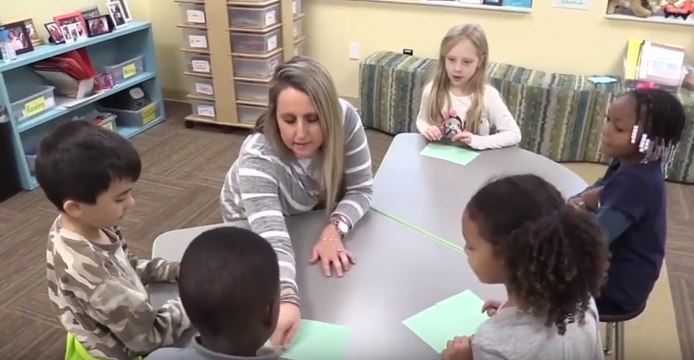
Real video example
Does Ms. O provide students with immediate specific feedback?
These videos are part of professional learning community (PLC) materials for the IES practice guide Foundational Skills to Support Reading for Understanding in Kindergarten Through 3rd Grade prepared for the Institute of Education Sciences (IES) under Contract ED-IES-12-C-0011 by the Regional Educational Laboratory Southeast administrated by Florida State University.

Slide 64
Provide immediate specific feedback
Link to Video: https://youtu.be/gaodKlCjwUg?t=60 (stop at 02:12)
These videos are part of professional learning community (PLC) materials for the IES practice guide Foundational Skills to Support Reading for Understanding in Kindergarten Through 3rd Grade prepared for the Institute of Education Sciences (IES) under Contract ED-IES-12-C-0011 by the Regional Educational Laboratory Southeast administrated by Florida State University.

Slide 65
Did Ms. O provide students with immediate specific feedback?
Does Ms. O provide students with immediate specific feedback?
How might you adapt this instruction to provide more specific feedback?
These videos are part of professional learning community (PLC) materials for the IES practice guide Foundational Skills to Support Reading for Understanding in Kindergarten Through 3rd Grade prepared for the Institute of Education Sciences (IES) under Contract ED-IES-12-C-0011 by the Regional Educational Laboratory Southeast administrated by Florida State University.

Slide 66
Slide 66
Part 1 Wrap-Up
Complete Online Activities
Activity 7.11: Discussion Board Post
Activity 7.12: Module 7 Part 1 Quiz

Slide 67
Activity 7.11
Discussion Board Post
Write a post in which you respond to one of the 3 questions below with a correct, incorrect, or off-topic response. Be sure to indicate which question you are answering.
1. Given the following data set, explain how you would calculate the median. {15, 38, 22, 65, 49, 28, 17, 35}
2. Identify the stages of the water cycle.
3. Write a definition for the word strategy.
Respond to your classmates’ posts by providing specific feedback based on their responses.

Slide 68
Activity 7.12
Quiz
Complete the Module 7 Part 1 quiz to demonstrate your understanding of providing immediate, specific feedback.
When you’re finished, you can watch the quiz answer video for an explanation of the correct responses.

Slide 69
Activity 7.12
Quiz
Which of the following is NOT a method for providing corrective feedback?
  You say it, they repeat it
  Reinforce and restate
  Revoicing
  Give the answer and give a choice
True or False: If a student gives an off-topic response to a question, the teacher should provide reset feedback.

Slide 70
Activity 7.12
Quiz
For each student response, decide which type of feedback the teacher should provide:
Affirmative
Corrective
Reset
Mr. L is a 2nd grade special educator teaching a reading lesson about decoding. The learning outcome is that SWBAT decode words with the common prefixes re- and un-.
T: “Today we will learn how to read words with prefixes re- and -un. Who can remind me what a prefix is?” [S: a group of letters that come before a root word.]
T: “This is the prefix re-. When re- appears at the beginning of a word, it usually means again.” Point to the word replay. “Louis, read the word.” [S: relay]
T: Point to the word redo. “Alec, read the word.” [S: redo]
T: Point to the word resize. “Aby, read the word.” [S: Well, I think this word means to do it again because it has re…]

Slide 71
Activity 7.12
Quiz
For each student response, decide which type of feedback the teacher should provide based on whether the task was discrete or complex:
Discrete – provide feedback immediately
Complex – provide feedback after short delay
Ms. B is a 6th grade special educator teaching a lesson about evaluating numerical expressions using algebraic thinking. The learning outcome is that SWBAT accurately evaluate expressions that use parentheses.
  T: “Today we will learn about how to evaluate expressions that contain parentheses. Who can tell me, according to PEMDAS, expressions within _____ should be solved first? Larissa?” [S: exponents?]
  T: “So, if we have the expression 2 + (5 – 1) x 3, what would we do first?” [S: 2 + 5 = 7 because we read left to right so we have to do that first.]
  T: “Let’s take a look at this expression: 4 x (1 + 1). Who can evaluate this expression?” [S: 8]
  T: “Alright everyone, it’s your turn. Evaluate the 5 expressions on the worksheet. Remember – parentheses first!” [S: complete assignment]

Slide 72
Slide 72
Supporting Practices
Providing immediate, specific feedback and maintaining a brisk pace
Part 2: How can a brisk pace be maintained?

Slide 73
Slide 73
Part 2 Objective
You will learn:
How to maintain a brisk pace

Slide 74
Module in the context of the DBI framework
Maintain a brisk pace

Slide 75
Checklist: Maintaining a brisk pace
To maintain a brisk pace, you should:
Move on when students are ready
Use the other supporting practices

Slide 76
Why maintain a brisk pace?
“The true art of pacing lies in creating a sense of urgency and also not leaving your students in the dust.”
https://www.edutopia.org/blog/
instructional-pacing-tips-rebecca-alber

Slide 77
Activity 7.13
Stop & Jot
What does a “brisk” pace look like in your classroom?

Slide 78
Maintaining a brisk pace
When have I done enough modeling?
Move on
when students
are ready
Modeling
Practice
Clear Explanation
Guided
Practice
Planned
Examples
Independent Practice
When are students ready for practice?
When have students mastered the skill/objective?

Slide 79
Deciding when to move on
Are students are able to identify the steps in the procedure or the key aspects of the skill?
Are students are able to replicate steps in the procedure or the key aspects of the skill with limited guidance or prompting?
I Do
Modeling
Practice
Clear Explanation
Guided
Practice
We Do
Planned
Examples
Independent Practice
You Do

Slide 80
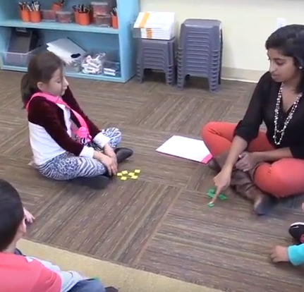
Activity 7.14
Analyze a Video Example
Ms. A is teaching a lesson on sentence segmentation. This part of the lesson is Guided Practice (We Do).
Decide whether or not the students in Ms. A’s class are ready to move to Independent Practice (You Do). Explain why or why not.
Is Ms. A maintaining a brisk pace? Why or why not?
These videos are part of professional learning community (PLC) materials for the IES practice guide Foundational Skills to Support Reading for Understanding in Kindergarten Through 3rd Grade prepared for the Institute of Education Sciences (IES) under Contract ED-IES-12-C-0011 by the Regional Educational Laboratory Southeast administrated by Florida State University.

Slide 81
Activity 7.14
Link to Video: https://youtu.be/qc6qMzRL4Fg?t=66
These videos are part of professional learning community (PLC) materials for the IES practice guide Foundational Skills to Support Reading for Understanding in Kindergarten Through 3rd Grade prepared for the Institute of Education Sciences (IES) under Contract ED-IES-12-C-0011 by the Regional Educational Laboratory Southeast administrated by Florida State University.

Slide 82
Activity 7.14
Review
Ms. A is teaching a lesson on sentence segmentation. This part of the lesson is Guided Practice (We Do).
Decide whether or not the students in Ms. A’s class are ready to move to Independent Practice (You Do). Explain why or why not.
Is Ms. A maintaining a brisk pace? Why or why not?
These videos are part of professional learning community (PLC) materials for the IES practice guide Foundational Skills to Support Reading for Understanding in Kindergarten Through 3rd Grade prepared for the Institute of Education Sciences (IES) under Contract ED-IES-12-C-0011 by the Regional Educational Laboratory Southeast administrated by Florida State University.

Slide 83
Maintaining a brisk pace
Am I effectively eliciting frequent responses?
Use the other
supporting
practices
Supporting Practices
Am I providing immediate specific feedback?
Using effective methods to elicit frequent responses
Providing immediate specific feedback
Maintaining a brisk pace

Slide 84
Lead teacher demonstration
Link to Video: https://youtu.be/IiJBSUNGMGc
Context:
Ms. Pollack is a 4th grade special educator teaching a math lesson about perpendicular lines.
Learning outcome:
SWBAT identify perpendicular lines based on the definition of perpendicular lines.

Slide 85
Example: Maintaining a brisk pace
perpendicular lines
two lines that meet at a 90° angle

Slide 86
Non- Example: Maintaining a brisk pace
perpendicular lines
two lines that meet at a 90° angle

Slide 87
Curriculum Example
Sounding Out
Sounding Out Strategy Stages:
Stage #1: Teacher models the Sounding Out Strategy.
Stage #2: Together, teacher and students use the Sounding Out Strategy.
Stage #3: Students use the Sounding Out Strategy on their own.
Overview of Words and Stages in Lesson 12, Task 4:
sack – Stages #1, #2, and #3
If students are having difficulty with the Sounding Out Strategy and need more teacher modeling, then continue using Stages #1, #2 and #3.
sick – Stages #2 and #3
can – Stages #1, #2, and #3 (Blending with a stop sound at the beginning of word.)
cat – Stages #1, #2, and #3 (Blending with a stop sound at the beginning of word.)
me – Stage #3
man – Stage #3
in – Stage #3
fin – Stage #3
Move on when students are ready
  Transition to Guided Practice when students can identify the steps in the procedure
  Transition to Independent Practice when students can replicate the steps in the procedure with limited prompting
Use the other supporting practices
  Use effective methods to elicit frequent responses
  Provide immediate, specific feedback

Slide 88
Activity 7.15
Analyze a Curriculum Example
Review the curriculum example in your workbook.
Decide whether or not the curriculum example sets the teacher up for maintaining a brisk pace. Explain your decision.

Slide 89
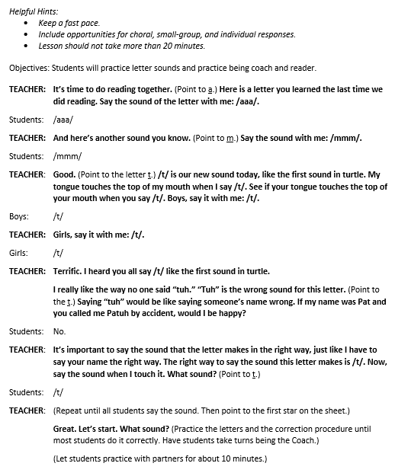
Activity 7.15 Review
Check Accuracy of Processing
Maintain Processing
Move on when students are ready
  Transition to Guided Practice when students can identify the steps in the procedure
  Transition to Independent Practice when students can replicate the steps in the procedure with limited prompting
Use the other supporting practices
  Use effective methods to elicit frequent responses
  Provide immediate, specific feedback

Slide 90
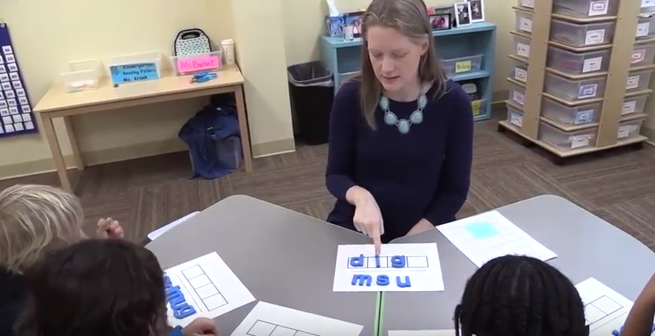
Real video example
Does Ms. C-G maintain a brisk pace?
These videos are part of professional learning community (PLC) materials for the IES practice guide Foundational Skills to Support Reading for Understanding in Kindergarten Through 3rd Grade prepared for the Institute of Education Sciences (IES) under Contract ED-IES-12-C-0011 by the Regional Educational Laboratory Southeast administrated by Florida State University.

Slide 91
Maintain a brisk pace
Link to Video: https://youtu.be/4Tm2U2zOQ_M?t=32
These videos are part of professional learning community (PLC) materials for the IES practice guide Foundational Skills to Support Reading for Understanding in Kindergarten Through 3rd Grade prepared for the Institute of Education Sciences (IES) under Contract ED-IES-12-C-0011 by the Regional Educational Laboratory Southeast administrated by Florida State University.

Slide 92
Real video example
Does Ms. C-G maintain a brisk pace?
  Did she move on when students were ready?
  Did she use the other supporting practices?
These videos are part of professional learning community (PLC) materials for the IES practice guide Foundational Skills to Support Reading for Understanding in Kindergarten Through 3rd Grade prepared for the Institute of Education Sciences (IES) under Contract ED-IES-12-C-0011 by the Regional Educational Laboratory Southeast administrated by Florida State University.

Slide 93
Slide 93
Part 2 Wrap-Up
Complete Online Activities
Activity 7.16: Journal Entry
Activity 7.17: Module 7 Part 1 Quiz

Slide 94
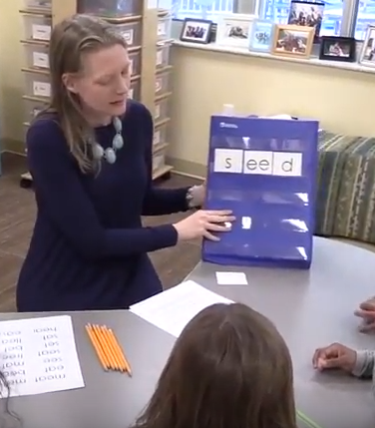
Activity 7.16
Journal Entry
1st grade
Decoding lesson
Does the teacher maintain a brisk pace?
  Does the teacher move on when students are ready?
  Does the teacher use the other supporting practices?
These videos are part of professional learning community (PLC) materials for the IES practice guide Foundational Skills to Support Reading for Understanding in Kindergarten Through 3rd Grade prepared for the Institute of Education Sciences (IES) under Contract ED-IES-12-C-0011 by the Regional Educational Laboratory Southeast administrated by Florida State University.
Notes:
Start at 0:42 - Play until 4:10

Slide 95
Activity 7.16
Video
Link to Video: https://youtu.be/qJuj-UqKhJw?t=42
These videos are part of professional learning community (PLC) materials for the IES practice guide Foundational Skills to Support Reading for Understanding in Kindergarten Through 3rd Grade prepared for the Institute of Education Sciences (IES) under Contract ED-IES-12-C-0011 by the Regional Educational Laboratory Southeast administrated by Florida State University.

Slide 96
Activity 7.17
Quiz
Complete the Module 7 Part 2 quiz to demonstrate your understanding of maintaining a brisk pace.
When you’re finished, you can watch the quiz answer video for an explanation of the correct responses.

Slide 97
Activity 7.17
Quiz
True or False: If students are able to replicate steps in the procedure with limited guidance or prompting, the teacher should move to Guided Practice.
True or False: To maintain a brisk pace, the teacher always limits the amount of feedback provided to the student to save time.

Slide 98
Activity 7.17
Quiz
True or False: The teacher moves to Guided Practice when students are ready.
True or False: The teacher moves to Independent Practice when students are ready.
True or False: The teacher elicits frequent responses.
True or False: The teacher provides immediate, specific feedback
Mr. L is a 2nd grade special educator teaching a reading lesson about decoding. The learning outcome is that SWBAT decode words with the common prefixes re- and un-.
T: “Today we will learn how to read words with prefixes re- and -un. Who can remind me what a prefix is?” [S: “a group of letters that come before a root word.”] T: “Right!”
T: “This is the prefix re-. When re- appears at the beginning of a word, it usually means again.” Point to the word replay. “Louis, read the word.” [S: “relay”]
T: Point to the word redo. “Alec, read the word.” [S: “red”]
T: Point to the word resize. “Aby, read the word.” [S: Well, I think this word means to do it again because it has re…]
T: “Now it’s your turn to read words with a partner.”

Slide 99
Activity 7.17
Quiz
True or False: The teacher moves to Guided Practice when students are ready.
True or False: The teacher moves to Independent Practice when students are ready.
True or False: The teacher elicits frequent responses.
True or False: The teacher provides immediate, specific feedback
Ms. B is a 6th grade special educator teaching a lesson about evaluating numerical expressions using algebraic thinking. The learning outcome is that SWBAT accurately evaluate expressions that use parentheses.
T: “Today we will learn about how to evaluate expressions that contain parentheses. Who can tell me, according to PEMDAS, expressions within _____ should be evaluated first? Larissa?” [S: “parentheses” T: “You’re right, we evaluate expressions in parentheses first.”
T: “So, if we have the expression 2 + (5 – 1) x 3, we would compute (5 – 1) first because it’s inside the parentheses. Why would we compute (5 – 1) first, everyone? [S: “because it’s inside the parentheses.”] T: “That’s right! We first compute what’s inside the parentheses.
T: “Let’s take a look at this expression: 4 x (1 + 1). Who can tell me the first step in evaluating this expression?” [S: “1+1”] T: “Good work!”
T: “Alright everyone, it’s your turn. Evaluate the 5 expressions on the worksheet. Remember – parentheses first!” [S: complete assignment]

Slide 100
Slide 100
Supporting Practices
Providing immediate, specific feedback and maintaining a brisk pace
Part 3: How can you use the Supporting Practices to make adaptations to a program?

Slide 101
Slide 101
Part 3 Objective
You will learn:
How to adapt a lesson from a program to make it more explicit by incorporating the supporting practices

Slide 102
Module in the context of the DBI framework
Use effective methods to elicit frequent responses
Provide immediate specific feedback
Maintain a brisk pace

Slide 103
Slide 103
Activity 7.18
Let Me Start It
Ms. J teaches a 2nd grade small-group lesson on high-frequency word reading
Students receive small-group reading instruction 5 times a week for 30 min.
The teacher is currently implementing a program with fidelity, but students are not meeting aim lines on progress monitoring measures
The School Data Team is meeting next week to decide how to adapt this intervention along the explicit instruction principle use dimension of the taxonomy of adaptations – with a specific focus on the Supporting Practices
These videos are part of professional learning community (PLC) materials for the IES practice guide Foundational Skills to Support Reading for Understanding in Kindergarten Through 3rd Grade prepared for the Institute of Education Sciences (IES) under Contract ED-IES-12-C-0011 by the Regional Educational Laboratory Southeast administrated by Florida State University.

Slide 104
Activity 7.18
Let Me Start It
High Frequency Words: Lesson 16
Objective: SWBAT read group and example within 1 second
New Words: group, example
Today we will learn two new words: group and example.
The first word is group.
What’s the word?
Spell group.
Write group on your white board.
What’s the word you wrote?
The next word is example.
What’s the word?
Spell example.
Write example on your white board.
What’s the word?
Practice Activity
(Add group and example to the word card pile. Shuffle the cards and present them to students one at a time. Students should read the word quickly.)
(Move to the next part of the lesson when students can correctly read the word within one second.)
Notes:
Start video at 0:39

Slide 105
Activity 7.18
Let Me Start It
Link to Video: https://youtu.be/kLmkg_IYY6g?t=38
These videos are part of professional learning community (PLC) materials for the IES practice guide Foundational Skills to Support Reading for Understanding in Kindergarten Through 3rd Grade prepared for the Institute of Education Sciences (IES) under Contract ED-IES-12-C-0011 by the Regional Educational Laboratory Southeast administrated by Florida State University.
Notes:
Start video at 0:39

Slide 106

Let Activity 7.18
Let Me Start It
The methods used to elicit a response do maintain or check accuracy of processing. The teacher often asks students to repeat the word. Then, the teacher asks each student to practice reading words. During this time, she checks for accuracy of processing.
The methods used to elicit a response should:
Maintain or check accuracy of processing
Match the learning outcome
Match student abilities
Match the desired response format
Maximize student involvement
When providing feedback, it should be:
Immediate: delivered as soon as possible after response
Specific: tied directly to students’ actions
To maintain a brisk pace, you should:
Move on when students are ready
Use the other supporting practices
The methods used to elicit a response during the “new words” part of the lesson do not match the learning outcome. The learning outcome is that SWBAT read group and example within one second. Spelling those words, though also important, does not directly match nor support the learning outcome of reading the words. Rather than having students spell the word, the teacher should consider adapting the program to allow students time practicing remembering or identifying the word.
Notes:
Start video at 0:39

Slide 107
Activity 7.18
And now that you’ve finished it
The methods used to elicit a response should:
Maintain or check accuracy of processing
Match the learning outcome
Match student abilities
Match the desired response format
Maximize student involvement
When providing feedback, it should be:
Immediate: delivered as soon as possible after response
Specific: tied directly to students’ actions
To maintain a brisk pace, you should:
Move on when students are ready
Use the other supporting practices

Slide 108
Slide 108
Supporting Practices
Providing immediate, specific feedback and maintaining a brisk pace
Closing: What are the next steps?

Slide 109
Slide 109
Supporting Practices
Let’s Review
Using effective methods to elicit frequent responses
Providing immediate specific feedback
Maintaining a brisk pace

Slide 110
Module in the context of the DBI framework
Use effective methods to elicit frequent responses
Provide immediate specific feedback
Maintain a brisk pace

Slide 111
Checklist: Eliciting responses
The methods used to elicit a response should:
Maintain or check accuracy of processing
Match the learning outcome
Match student abilities
Match the desired response format
Maximize student involvement

Slide 112
Checklist: Providing feedback
When providing feedback, it should be:
Immediate: delivered as soon as possible after response
Specific: tied directly to students’ actions

Slide 113
Checklist: Maintaining a brisk pace
To maintain a brisk pace, you should:
Move on when students are ready
Use the other supporting practices

Slide 114
Module 7 Activities

Slide 115
Slide 115
Module 7 Classroom Application
Application Activity
Journal Entry Assignment
Select one supporting practice that you will focus on for the Classroom Application activity and briefly explain why you selected that practice.
Briefly describe an upcoming lesson (including an overview of the lesson plan and identification of the learning outcome).
Explain how you will adapt the lesson to make it more explicit by incorporating the selected supporting practice.
Implement the lesson described in the Journal Entry Assignment.
After implementing, reflect with your coach about the lesson.
  Were you successful in implementing the supporting practice?
  Were students engaged?
  How might you adjust future instruction?

