Slide 1
Slide 1
Supporting Practices:
Using Effective Methods to Elicit Frequent Responses
Module 6

Slide 2
Slide 2
Supporting Practices:
Using Effective Methods to Elicit Frequent Responses
Introduction: How do the supporting practices maximize engagement?

Slide 3
Slide 3
Module 6 Objectives
You will learn:
How the supporting practices maximize engagement
Various methods to elicit responses
How to use these methods to elicit frequent responses that:
  Maintain or check accuracy of processing
  Match the learning outcome
  Match student abilities
  Elicit a variety of response formats (when appropriate)
  Maximize student involvement

Slide 4
Explicit Instruction Model
Modeling
Practice
Clear Explanations
Guided
Practice
Planned
Examples
Independent Practice
Supporting Practices
Using effective methods to elicit frequent responses
Providing immediate specific feedback
Maintaining a brisk pace

Slide 5
Supporting Practices
Supporting Practices
Using effective methods to elicit frequent responses
Providing immediate specific feedback
Maintaining a brisk pace
Using effective methods to elicit frequent responses

Slide 6



Engagement

Slide 7
Defining “Engagement” & “Supporting Practices”
Engagement:
when students’ cognitive effort is focused on processing lesson content
Supporting practices:
evidence-based techniques to maximize student engagement

Slide 8
Define “elicit a response”
I want all students to quickly show me that they are processing content. I’ll elicit a choral response.
a method for getting students to provide a response
Exhibit!
The word is exhibit.
What’s the word?
Question/Instruction
Exhibit!
Everyone? …
[pause]
[gesture toward students]
Exhibit!
Method
Response

Slide 9
Using effective methods to elicit frequent responses
Different methods are effective in different situations, but methods should always elicit responses that:
  Maintain or check accuracy of processing
  Match the learning outcome
  Match student abilities
  Elicit a variety of response formats (when appropriate)
  Maximize student involvement

Slide 10
Using effective methods to elicit frequent responses
Asking a question
Everyone, what sound does the letter k make?
Turn and talk: What is the sum of 4+1?
Tim, if a shape has five sides, it’s called a ___?
Giving an instruction
Write the letter that makes the sound /k/.
Show me on your fingers the sum of 4+1.
Make a pentagon with your geoboard.
Point to the word that has a silent e.

Slide 11
Using effective methods to elicit frequent responses
Maximize opportunities to respond
Our goal is for students to be engaged

Slide 12
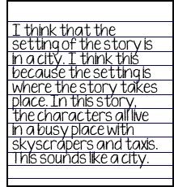

Using effective methods to elicit frequent responses
verbal
written
physical
H
/c/ - /a/ - /t/
cat
M
B

Slide 13
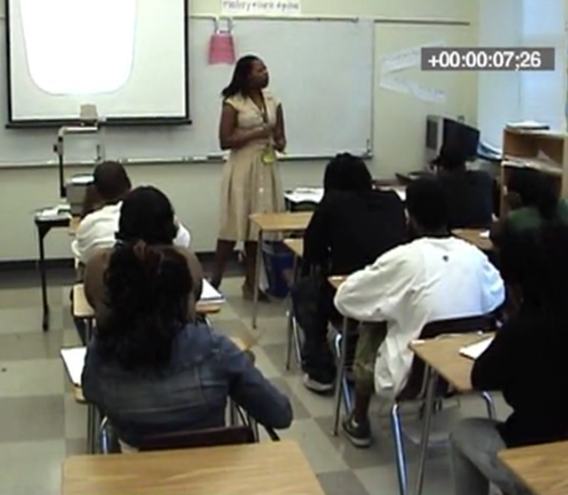
Using effective methods to elicit frequent responses
Are the students engaged?

Slide 14
Using effective methods to elicit frequent responses
Embed Video Here

Slide 15
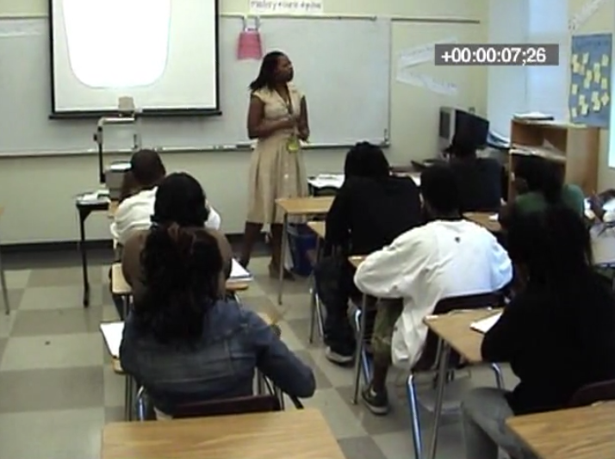

Using effective methods to elicit frequent responses
360 degrees.
Blair, what’s the measure of all angles on an equilateral triangle?
Blair
Mira
Chelsea
Class
Michael

Slide 16
Checklist
The methods used to elicit a response should:
Maintain or check accuracy of processing
Match the learning outcome
Match student abilities
Match the desired response format
Maximize student involvement

Slide 17
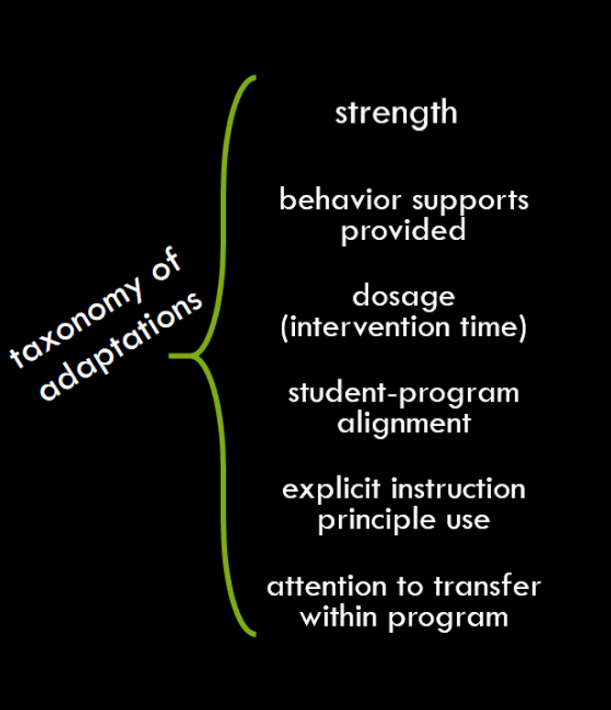
Module in the context of the DBI framework
Use effective methods to elicit frequent responses

Slide 18
Activity 6.1
Stop & Jot
Why are the that increase engagement and high quality instructional interactions so important?
Supporting Practices

Slide 19
Why are the Supporting Practices so important?
“Even when you have crafted an exquisite, well-structured lesson or adopted a curriculum material with explicit lessons of high quality, it is still possible that some students may not be totally riveted to your every word or deeply processing the lesson content.”
Archer & Hughes (2011) p.131
Archer, A. L., & Hughes, C. A. (2011). Explicit instruction:
Effective and efficient teaching. New York: Guilford Press.

Slide 20
Module 6 Activities

Slide 21
Slide 21
Classroom Application Preview
Application Activity
Journal Entry Assignment
Look at the list of methods for eliciting responses and choose 2 that you would like to use more often.
For each method, give an example of a recent lesson where you wished you elicited a response differently.
Briefly describe an upcoming lesson and how you can use these methods to elicit responses.
Implement the lesson described in the last part of the Journal Entry Assignment.
After implementing, reflect with your coach about the effectiveness of the methods you used to elicit responses.

Slide 22
Slide 22
Supporting Practices:
Using Effective Methods to Elicit Frequent Responses
Part 1: What are the methods and purposes for eliciting responses?

Slide 23
Slide 23
Part 1 Objectives
You will learn:
Methods for eliciting responses
The two purposes for eliciting responses

Slide 24
Module in the context of the DBI framework
Use effective methods to elicit frequent responses
Elicit responses that either maintain processing or assess understanding

Slide 25
Checklist
The methods used to elicit a response should:
Maintain or check accuracy of processing
Match the learning outcome
Match student abilities
Match the desired response format
Maximize student involvement

Slide 26
Why are we learning this?
Engagement:
when students’ cognitive effort is focused on processing lesson content

Slide 27
Effective methods for eliciting responses
Whip Around | Choral Response | Hand Signals | Cued Retell | White Boards | Response Cards | Turn & Talk | Stop & Jot | Individual Response

Slide 28
Effective methods for eliciting responses
Whip Around | Choral Response | Hand Signals | Cued Retell | White Boards | Response Cards | Turn & Talk | Stop & Jot | Individual Response
Whip Around
Ask a question with many possible responses
Go up and down the rows and ask for student responses without any interruption
Students are allowed to pass if response has already been said

Slide 29
Effective methods for eliciting responses
Whip Around | Choral Response | Hand Signals | Cued Retell | White Boards | Response Cards | Turn & Talk | Stop & Jot | Individual Response
Choral Response
Ask a question
Allow thinking time
Ask for everyone’s response after a signal

Slide 30
Effective methods for eliciting responses
Whip Around | Choral Response | Hand Signals | Cued Retell | White Boards | Response Cards | Turn & Talk | Stop & Jot | Individual Response
Hand Signals
Ask a question
Allow thinking time
Ask for everyone’s response after a signal
Responses include:
  Thumbs Up-Down
  Fist-to-Five
  Fingers as Number

Slide 31
Effective methods for eliciting responses
Whip Around | Choral Response | Hand Signals | Cued Retell | White Boards | Response Cards | Turn & Talk | Stop & Jot | Individual Response
Cued Retell
Students work in partners
One partner explains a concept that was recently taught while the other partner listens and provides prompting/support when necessary

Slide 32
Effective methods for eliciting responses
Whip Around | Choral Response | Hand Signals | Cued Retell | White Boards | Response Cards | Turn & Talk | Stop & Jot | Individual Response
White
Boards
Ask a question
Each student writes the answer on his/her own white board
When signaled, students display their answers to the question on the white boards

Slide 33
Effective methods for eliciting responses
Whip Around | Choral Response | Hand Signals | Cued Retell | White Boards | Response Cards | Turn & Talk | Stop & Jot | Individual Response
Response Cards
Give each student a response card
  They can be preprinted, write-on, or blank
Ask a question
When signaled, each student holds up his/her own response card to display their response to the question

Slide 34
Effective methods for eliciting responses
Whip Around | Choral Response | Hand Signals | Cued Retell | White Boards | Response Cards | Turn & Talk | Stop & Jot | Individual Response
Turn &
Talk
Ask a question and provide thinking time
Ask students to get into partners to discuss the answer to the question
Call on students to share what his/her partner said

Slide 35
Effective methods for eliciting responses
Whip Around | Choral Response | Hand Signals | Cued Retell | White Boards | Response Cards | Turn & Talk | Stop & Jot | Individual Response
Stop &
Jot
After long periods of teacher talk, ask a comprehension question
Allow students to synthesize what they have learned thus far by stopping and jotting (writing a quick response)

Slide 36
Effective methods for eliciting responses
Whip Around | Choral Response | Hand Signals | Cued Retell | White Boards | Response Cards | Turn & Talk | Stop & Jot | Individual Response
Individual Response
Cold Call:
Ask a question directly to an individual student following teacher instruction
Friendly Cold Call:
Ask students to put a thumbs up on the desk if he/she wouldn’t mind being called on and call on one of them

Slide 37
Activity 6.2
Stop & Jot
In your workbook, circle the methods that you already use in your instruction.
Whip Around | Choral Response | Hand Signals
Cued Retell | White Boards | Response Cards
Turn & Talk | Stop & Jot | Individual Response

Slide 38
Two broad purposes
Maintain processing
Check accuracy of processing

Slide 39
Maintain processing
Involve students as often as possible
Modeling
Practice
4 responses
per minute
≥ 1 response
per minute
00:56
Our goal is to keep students’ heads in the game
00:52
01:01
00:59
00:54
00:53
00:57
00:58
01:02
01:03
00:55
01:00

Slide 40
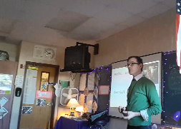
Maintaining processing in modeling
What types of methods does the teacher use to elicit responses?
How many times does the teacher elicit responses?
Does the rate at which the teacher elicits responses meet the criteria for frequency during modeling?
Devin Kearns

Slide 41
Maintaining processing in modeling
Link to Video: https://youtu.be/bl9KMJKzCew
(stop at 01:00)
The first word is exhibit. What’s the word?
When they arrive on Ellis Island, what do they do?
0:08
0:58
An exhibit is a display. What is it?
… people getting off of a ferry. They are what?
0:12
When you go to a museum, they have lots of what?
0:45
Getting off or disembarking. What are they doing?
0:20
The second word is disembark. What’s the word?
0:40
Disembark means you get off. What does it mean?
What are they doing?
0:27
0:36
Devin Kearns
0:30

Slide 42
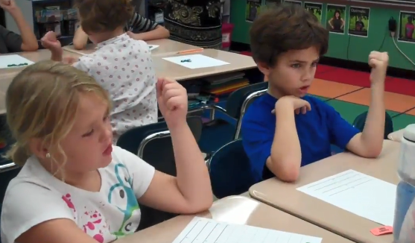
Maintaining processing in guided practice
What types of methods does the teacher use to elicit responses?
How many times does the teacher elicit responses?
Does the rate at which the teacher elicits responses meet the criteria for frequency during guided practice?
Axelson Academy (2017)

Slide 43

Maintaining processing in guided practice
Link to Video: https://youtu.be/LqxLhTAEe-w?t=6 (stop at 0:45)
Catch it
Double check
Move your tokens
Thumbs up
Axelson Academy (2017)

Slide 44
Maintaining processing in guided practice
Catch it
Double check
What types of methods does the teacher use to elicit responses?
How many times does the teacher elicit responses?
Does the rate at which the teacher elicits responses meet the criteria for frequency during guided practice?
Move your tokens
Thumbs up
Axelson Academy (2017)

Slide 45
Check accuracy of processing
Assess understanding as you teach
Adapt instruction based on informal formative assessment

Slide 46
Checking accuracy of processing
Lesson 54, Exercise 6
Learning outcome:
Comprehension:
Draw inferences
Note details
After you read this whole section without making more than 2 errors, we’ll make some inferences and note some details.
Modified learning outcome:
SWBAT answer questions to identify key details.
We are going to read the story in parts. After we read each part, we will stop to answer questions to check our understanding.

Slide 47
Checking accuracy of processing
Lesson 54, Exercise 6
George pushed the shovel into the ground. “Clink.” He tossed the dirt aside. And there it was, the corner of a treasure chest.
Nadine began to dig. Slowly the dirt was cleared from the chest. It was rusty, and there were a couple of holes in it. George put his finger in one of the holes. Then he brought out a round coin. It looked like a black penny.
“What’s that?” Lily asked.
George said, “I’ll show you what that is.” He rubbed the coin on the leg of his pants. Then he held up the coin. It was shining like the sun. It was bright. IT WAS GOLD.
What did George’s shovel hit?
What did George find in the hole?
How did he remove the coin?
How did George remove the black?
What did they find?

Slide 48
Effective methods for eliciting responses
Whip Around | Choral Response | Hand Signals | Cued Retell | White Boards | Response Cards | Turn & Talk | Stop & Jot | Individual Response
Maintain | Maintain | Maintain |  | Maintain | Maintain |  | Maintain | Maintain
Check Accuracy |  | Check Accuracy | Check Accuracy | Check Accuracy | Check Accuracy | Check Accuracy |  | Check Accuracy

Slide 49
Activity 6.3
Pause & Process
Write the two purposes for eliciting responses in your own words.

Slide 50
Lead teacher demonstration
Link to Video: https://youtu.be/rLLn2HblB4g?t=45
(stop at 05:01)
Context:
Ms. Pollack is a 3rd grade special educator teaching a geometry lesson about shape properties.
Learning outcome:
SWBAT identify polygons that are quadrilaterals.

Slide 51
Eliciting responses to maintain processing

Slide 52
Eliciting responses to check accuracy of processing

Slide 53
Non-example
Quadrilateral:
a polygon with four sides

Slide 54
Activity 6.4
Analyze Curricular Materials
Review the curriculum example in your workbook.
Identify the purpose for each response elicited.

Slide 55
Activity 6.4
Review
Check Accuracy of Processing
Maintain Processing
There are some sounds we need to know (‘show and hold’ 1 finger for each continuous sound for 2-3 seconds) mmm, aaa, sss, rrr.
These are called continuous sounds.
What are these sounds called? (signal student response: continuous sounds).
We say or hold continuous sounds for 2-3 seconds.
Why are they called continuous sounds? (signal student response: because we say or hold these sounds for 2-3 seconds).
Maintain Processing
Maintain Processing

Slide 56
Activity 6.4
Review
I am going to say some sounds and I want you to tell me whether each sound is a continuous sound or a stop sound. Remember, we say or hold continuous sounds for 2-3 seconds and we say stop sounds ‘quick and soft’.
First sound (‘show and hold’ 1 finger for 2-3 seconds) aaa (as in ‘at’).
Is it a continuous sound or a stop sound? Show me your response card. (signal student response: continuous sound).
Tell your partner why (signal student response: we say or hold continuous sounds for 2-3 seconds).
Check Accuracy of Processing
Check Accuracy of Processing

Slide 57
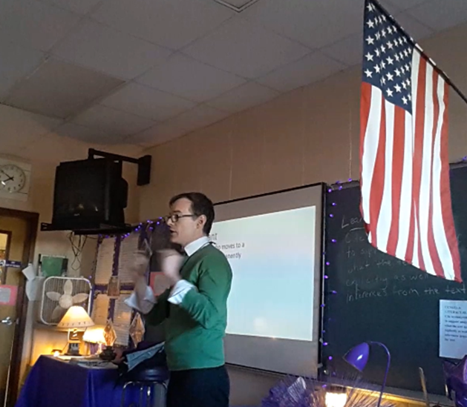
Real video example
Identify the purpose for each response elicited:
  Maintain Processing
  Check Accuracy of Processing
Devin Kearns

Slide 58
Purposes for eliciting responses
Link to Video: https://youtu.be/bl9KMJKzCew?t=61 (stop at 02:26)
Devin Kearns

Slide 59
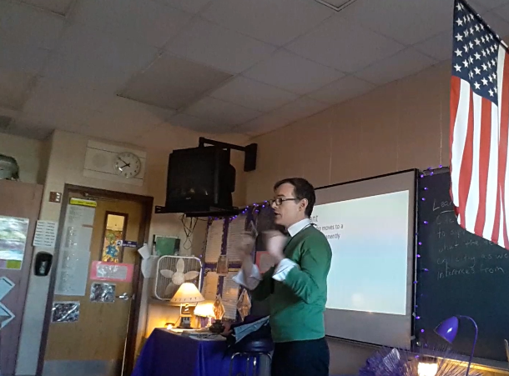
What were the purposes for eliciting responses?
Identify the purpose for each response elicited:
  Maintain Processing
  Check Accuracy of Processing
What does permanently mean? Tell your partner what permanently means.
Devin Kearns

Slide 60
Slide 60
Part 1 Wrap-Up
Complete Online Activities
Activity 6.5: Discussion Board Post
Activity 6.6: Module 6 Part 1 Quiz

Slide 61
Activity 6.5
Discussion Board Post
Give an example of how you might elicit a response to either:
  maintain processing or
  check accuracy of processing
Be sure to include the learning outcome and any necessary context information.
Do not include the purpose. Respond to your classmates’ posts by identifying the purpose within their examples.

Slide 62
Activity 6.6
Quiz
Complete the Module 6 Part 1 quiz to demonstrate your understanding of the different purposes for eliciting responses.
When you’re finished, you can watch the quiz answer video for an explanation of the correct responses.

Slide 63
Activity 6.6
Quiz
What purpose for eliciting responses may also be stated as “keeping students’ heads in the game”?
  Maintaining processing
  Supporting practices
  Checking for accuracy of processing
  Keeping students engaged
True or False: You should elicit responses to check for accuracy of processing because student responses can help inform your instruction.

Slide 64
Activity 6.6
Quiz
Mrs. T is a 1st grade special educator teaching a math lesson about the commutative property of addition. The learning outcome is that SWBAT apply the commutative property to successfully solve addition problems. Identify the purpose of each response elicited:
T: “Today we will learn about the commutative property of addition. What property will we learn about?”
T: “We will learn about the commutative property using the equation 7+5=12. Read this equation with me.”
T: “Since 7+5=12, we can use the commutative property to know that 5+7 also = 12. What does 5+7 equal?”
T: “I know that 9+6=15. Using the commutative property, what does 6 plus 9 equal? Turn and whisper to your partner.”

Slide 65
Activity 6.6
Quiz
Mr. M is a 7th grade special educator teaching a lesson about text features. The learning outcome is that SWBAT identify three text features: headings, picture captions, and maps. Identify the purpose of each response elicited:
  T: “Today we will learn about 3 new text features. Who can remind me of the text feature we learned about yesterday?”
  T: “A heading is similar to a title. It comes before a passage of text and tells us what the passage is about. Point to a heading in the article on your desk.”
  T: “Now we’ll learn about picture captions. What will we learn about?”
  T: “Maps are most often found in non-fiction text, like textbooks or news articles. Where are you more likely to find a map, in a chapter book or in an encyclopedia?”

Slide 66
Slide 66
Supporting Practices:
Using Effective Methods to Elicit Frequent Responses
Part 2: Does the method of eliciting a response match the learning outcome?

Slide 67
Slide 67
Part 2 Objective
You will learn:
How to match the method of eliciting a response to a learning outcome

Slide 68
Module in the context of the DBI framework
Use effective methods to elicit frequent responses
Use methods to elicit responses that match the learning outcome(s)

Slide 69
Checklist
The methods used to elicit a response should:
Maintain or check accuracy of processing
Match the learning outcome
Match student abilities
Match the desired response format
Maximize student involvement

Slide 70
Why are we learning this?
Engagement:
when students’ cognitive effort is focused on processing lesson content
Maintain processing
Check accuracy of processing
Are students processing the right concepts?

Slide 71
Match the method of eliciting responses to the learning outcome
  Examine the Bloom’s Taxonomy level of learning outcome.
    Ask questions that elicit responses at that level.
    Ask questions that support the learning outcome.

Slide 72
Bloom’s Taxonomy
Evaluating
Analyzing
Creating
Applying
Understanding
Remembering
Anderson, L. W. and Krathwohl, D. R., et al (Eds..) (2001) A Taxonomy for Learning, Teaching, and Assessing: A Revision of Bloom’s Taxonomy of Educational Objectives. Allyn & Bacon. Boston, MA (Pearson Education Group)

Slide 73
Match learning outcome
Examine the Bloom’s Taxonomy level of learning outcome.
  Ask questions that elicit responses at that level.
  Ask questions that support the learning outcome.
Evaluating
Analyzing
Creating
Applying
Understanding
Remembering
Match the level of processing the learning outcome requires
to the level of processing
your question requires
Anderson, L. W. and Krathwohl, D. R., et al (Eds..) (2001) A Taxonomy for Learning, Teaching, and Assessing: A Revision of Bloom’s Taxonomy of Educational Objectives. Allyn & Bacon. Boston, MA (Pearson Education Group)

Slide 74
Match learning outcome
Examine the Bloom’s Taxonomy level of learning outcome.
  Ask questions that elicit responses at that level.
  Ask questions that support the learning outcome.
Evaluating
Analyzing
Creating
Applying
Understanding
Remembering
Ask questions that
support
the
learning
outcome
Anderson, L. W. and Krathwohl, D. R., et al (Eds..) (2001) A Taxonomy for Learning, Teaching, and Assessing: A Revision of Bloom’s Taxonomy of Educational Objectives. Allyn & Bacon. Boston, MA (Pearson Education Group)

Slide 75
Effective methods for eliciting responses
Whip Around | Choral Response | Hand Signals | Cued Retell | White Boards | Response Cards | Turn & Talk | Stop & Jot | Individual Response
Whip Around | Choral Response | Hand Signals | Cued Retell | White Boards | Response Cards | Turn & Talk | Stop & Jot | Individual Response
 |  |  |  |  |  |  |  | Cre
 |  |  |  |  |  |  | Eva | Eva
 |  |  |  |  |  | Ana | Ana | Ana
 |  |  |  | App | App | App | App | App
 |  | Und | Und | Und | Und | Und | Und | Und
Rem | Rem | Rem | Rem | Rem | Rem | Rem | Rem | Rem
Evaluating
Analyzing
Creating
Applying
Understanding
Remembering

Slide 76
Activity 6.7
Pause & Process
Given the learning outcome below:
  Identify the Bloom’s Taxonomy level of the learning outcome
  Write one question/instruction that elicits a response at that level
  Write one question/instruction that supports the learning outcome
SWBAT use finger counting to add numbers with sums of 2-10.

Slide 77
Lead teacher demonstration
Link to Video: https://youtu.be/7nsZjwmhIPQ?t=58 (stop at 02:35)
Context:
Ms. Pollack is a 1st grade special educator teaching a reading lesson about CVC word reading.
Learning outcome:
SWBAT read CVC words.

Slide 78
Example of using methods to elicit responses that match the learning outcome
Embed Video Here
dad
log
kit
pen

Slide 79
Non-Example of using methods to elicit responses that match the learning outcome
dad
log
name
kit
pen
tale

Slide 80
Activity 6.8
Stop & Jot
Why might it be problematic to use methods to elicit responses that don’t match the learning outcome?

Slide 81
Using methods to elicit responses that match the learning outcome
  The Magic E Rule
  Rule
  If a word has a vowel-consonant-E pattern, the vowel says its long sound.
  Learning outcome
  SWBAT correctly state the magic E rule and read words that contain a magic E accurately.

Slide 82
Slide 82
  Learning outcome: SWBAT correctly state the magic E rule and read words that contain a magic E accurately.
Examine the Bloom’s Taxonomy level of learning outcome.
  Ask questions that elicit responses at that level.
  Ask questions that support the learning outcome.
Evaluating
Analyzing
Creating
Applying
Understanding
Remembering
  Use the rule correctly
  State the rule

Slide 83
Slide 83
  Learning outcome: SWBAT correctly state the magic E rule and read words that contain a magic E accurately.
Examine the Bloom’s Taxonomy level of learning outcome.
  Ask questions that elicit responses at that level.
  Ask questions that support the learning outcome.
Evaluating
Analyzing
Creating
Applying
Understanding
Remembering
What is this word? (point at lake)
  Use the rule correctly
What is the magic E rule?
  State the rule

Slide 84
Slide 84
  Learning outcome: SWBAT correctly state the magic E rule and read words that contain a magic E accurately.
Examine the Bloom’s Taxonomy level of learning outcome.
  Ask questions that elicit responses at that level.
  Ask questions that support the learning outcome.
Evaluating
Analyzing
Creating
Applying
Understanding
Remembering
When you see vowel-consonant-E, what does the vowel say?
What is this word? (point at fame)
  Use the rule correctly
Turn and tell your partner what the Magic E Rule is.
  State the rule

Slide 85
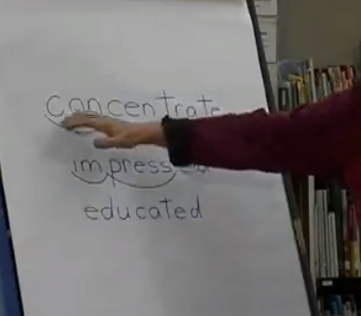
Real video example
Dr. Anita Archer
2nd Grade Vocabulary Lesson
Learning outcome: SWBAT read the word concentrate and determine whether a scenario matches the definition.
Did the methods Dr. Archer use to elicit responses match the learning outcome?
Archer, A. L.
https://explicitinstruction.org/video-elementary/elementary-video-4/

Slide 86
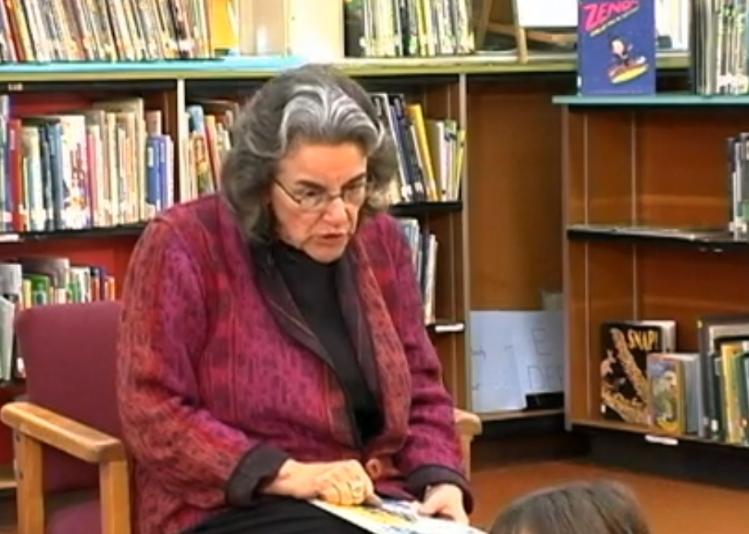
Matching to learning outcome
Link to Video: https://explicitinstruction.org/video-elementary/elementary-video-4/ (stop at 02:08)
Archer, A. L.
https://explicitinstruction.org/video-elementary/elementary-video-4/

Slide 87
Activity 6.9
Analyze a Video Example
Give an example of a question that Dr. Archer asked that matched the learning outcome.
Learning outcome: SWBAT read the word concentrate and determine whether a scenario matches the definition.
Archer, A. L.
https://explicitinstruction.org/video-elementary/elementary-video-4/

Slide 88
Real video example
Dr. Anita Archer
2nd Grade Vocabulary Lesson
Learning outcome: SWBAT read the word concentrate and determine whether a scenario matches the definition.
Did the methods Dr. Archer used to elicit responses match the learning outcome?
Archer, A. L.
https://explicitinstruction.org/video-elementary/elementary-video-4/

Slide 89
Slide 89
Part 2 Wrap-Up
Complete Online Activities
Activity 6.10: Journal Entry
Activity 6.11: Module 6 Part 2 Quiz

Slide 90
Activity 6.10
Journal Entry
Write a Journal Entry in which you:
  Explain a learning outcome relevant to your students
  Identify the level of Bloom’s Taxonomy of the learning outcome
  Write two questions that elicit responses that match the learning outcome
  Write two questions that elicit responses that support the learning outcome

Slide 91
Activity 6.11
Quiz
Complete the Module 6 Part 2 quiz to demonstrate your understanding of eliciting responses that match the learning outcome.
When you’re finished, you can watch the quiz answer video for an explanation of the correct responses.

Slide 92
Activity 6.11
Quiz
True or False: It is important to identify the level of Bloom’s Taxonomy of the learning outcome to determine the types of questions to ask your students.
When eliciting responses that match the learning outcome, you should:
  Determine the level of Bloom’s Taxonomy of the learning outcome
  Ask questions at the same level as the learning outcome
  Ask questions at one level above the learning outcome
  A and B

Slide 93
Activity 6.11
Quiz
For each response elicited in the following scenarios, decide whether the method used to elicit the response:
Is matched to the learning outcome because it matches the Bloom’s taxonomy level of the learning outcome.
Is matched to the learning outcome because it supports the learning outcome.
Is not matched to the learning outcome

Slide 94
Activity 6.11
Quiz
Mrs. T is a 1st grade special educator teaching a math lesson about the commutative property of addition. The learning outcome is that SWBAT apply the commutative property to successfully solve addition problems.
T: “Today we will learn about the commutative property of addition. What property will we learn about?”
T: “How is the commutative property of addition different from the associative property?”
T: “Since 7+5=12, we can use the commutative property to know that 5+7 also = 12. What does 5+7 equal?”
T: “I know that 9+6=15. Using the commutative property, what does 6 plus 9 equal? Turn and whisper to your partner.”

Slide 95
Activity 6.11
Quiz
Mr. M is a 7th grade special educator teaching a lesson about text features. The learning outcome is that SWBAT describe three text features: headings, picture captions, and maps.
  T: “Today we will learn about 3 new text features. Who can remind me of the text feature we learned about yesterday?”
  T: “A heading is similar to a title. It comes before a passage of text and tells us what the passage is about. Point to a heading in the article on your desk.”
  T: “Now we’ll learn about picture captions. Why do you think we are learning about picture captions today?”
  T: “Maps are most often found in non-fiction text, like textbooks or news articles. Where are you more likely to find a map, in a chapter book or in an encyclopedia?”

Slide 96
Slide 96
Supporting Practices:
Using Effective Methods to Elicit Frequent Responses
Part 3: Does the method of eliciting a response match student abilities?

Slide 97
Slide 97
Part 3 Objective
You will learn:
How to match the method of eliciting a response to student abilities

Slide 98
Module in the context of the DBI framework
Use effective methods to elicit frequent responses
Use methods to elicit responses that match student abilities

Slide 99
Checklist
The methods used to elicit a response should:
Maintain or check accuracy of processing
Match the learning outcome
Match student abilities
Match the desired response format
Maximize student involvement

Slide 100
Match the method of eliciting responses to student abilities
  Think about what students have already processed – build on the foundation
  Think about what students know now and what they will be learning – sequence appropriately
  Think about how students might respond to a question or instruction – phrase purposefully

Slide 101
Why ask low-order questions?
Create
Analyze
Evaluate
Of course, our goal is for students to
BUT
“Although higher-order questions…are superior, low-order questions, at least to some degree, do appear to serve the positive functions of
(a) engaging students at high rates of responding,
(b) providing students with high rates of success, and
(c) increasing student achievement levels.”
Ellis & Worthington (1994) p. 87

Slide 102
Build on the foundation
ultimate
goal is to ask
The
but it requires a solid foundation.
We have to establish a foundation first.
higher-level questions,

Slide 103

Slide 103
Memories are stored in neural networks.
Neurons build new connections by processing new information and adding it to the network.
Asking remembering questions will build the neural networks that support understanding objectives (and so on).
This is how memory works…

Slide 104
What is the level of correct responses we want when students are learning?
80%
During I Do and We Do
90% to 95%
During You Do
Some studies showed correct response rates lower than 10%.
Ellis & Worthington (1994)

Slide 105
Activity 6.12
Stop & Jot
Think about your correct response rate for each of the following instances:
  When you are modeling, how often do students respond correctly?
  When your students are practicing with your guidance, how often do they respond correctly?
  When your students are practicing independently, how often do they respond correctly?
0%
25%
50%
75%
100%
0%
25%
50%
75%
100%
0%
25%
50%
75%
100%

Slide 106
Sequence appropriately
Why do you ask students questions they are unlikely to know the answers to?
I want to build critical thinking skills. If I just give students the answers, they won’t think critically.

Slide 107

Never ask if students know what you’re about to teach
High school geometry
Lesson begins.
T writes “congruence” on the board
Middle school mathematics
Lesson begins.
T writes the following on the board:
$$\frac{2}{3}∙\frac{1}{2}$$
T: What do you think congruence means?
T: OK. What are we going to do?
S: To be next
S: I know, I know, I know!
S: We’re going to cross-multiply

Slide 108

Start with remembering and understanding to build the foundation
Ask lower-level, easier questions at the beginning!
Work your way up to the harder ones!
In behavioral terms, use “high p requests”
Kathleen Lane, Ph.D.
Professor of Special Education
University of Kansas
http://iris.peabody.vanderbilt.edu/module/bi2/cresource/q3/p03/

Slide 109
Phrase purposefully
Students respond in ways you do not want
If you ask a poorly worded question
Students do not
respond at all
If you phrase your question effectively
Students respond
in ways you
would expect

Slide 110
Don’t ask rhetorical questions
Question
Likely Answer
Any questions?
No.
Does that make sense?
Yes.

Slide 111
Lead teacher demonstration
Context:
Mr. Kearns is a 7th grade special educator teaching a history lesson about the beginning of World War I. Students have already demonstrated proficiency with identification of European countries and describing various types of governments from the WWI era.
Learning outcome:
SWBAT explain how Archduke Franz Ferdinand and Kaiser Wilhelm II impacted the start of World War I.

Slide 112
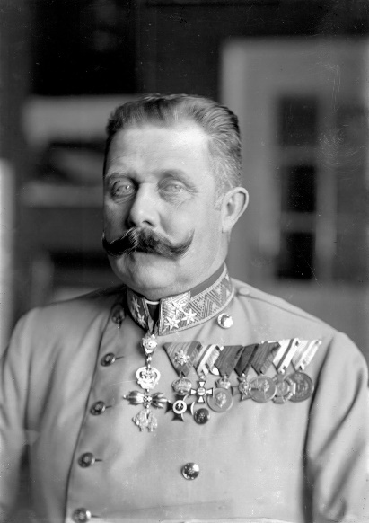
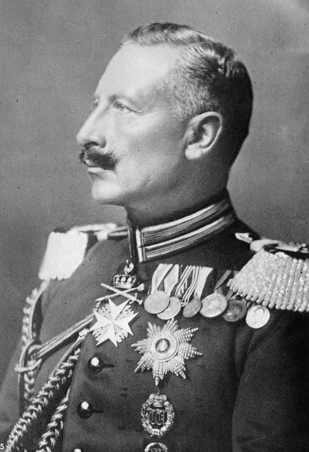


Example of using methods to elicit a response that match student abilities
Link to Video: https://youtu.be/oVCwtrnJ5-M
Archduke Franz Ferdinand
Austria-Hungary
Kaiser Wilhelm II
Germany/Prussia

Slide 113
Non-Example of using methods to elicit a response that match student abilities
Link to Video: https://youtu.be/7ohPpwRuV9Y
Archduke Franz Ferdinand
Austria-Hungary
Kaiser Wilhelm II
Germany/Prussia

Slide 114
Curriculum example
Learning Outcome: SWBAT identify the properties of a bar graph.
After the class builds a birthday graph, teacher asks:
What do you notice here?
Do you notice any groups larger than others?
Do you notice the
largest group?
What else?

Slide 115
Activity 6.13
Analyze a Curriculum Example
What are some other questions you might ask (or instructions you might give) to elicit responses that match student abilities in this lesson?
Write 3 more questions/instructions.
What do you notice here?
Do you notice any groups larger than others?
Do you notice the largest group?
What else?

Slide 116
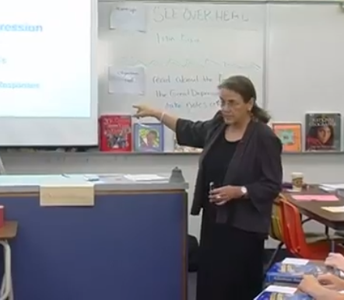
Real video example
Dr. Anita Archer
8th Grade Social Studies Class
Teaching background knowledge about the Great Depression
Did the methods Dr. Archer used to elicit responses match student abilities?
Archer, A. L.
https://explicitinstruction.org/video-secondary-main/secondary-video-5/

Slide 117
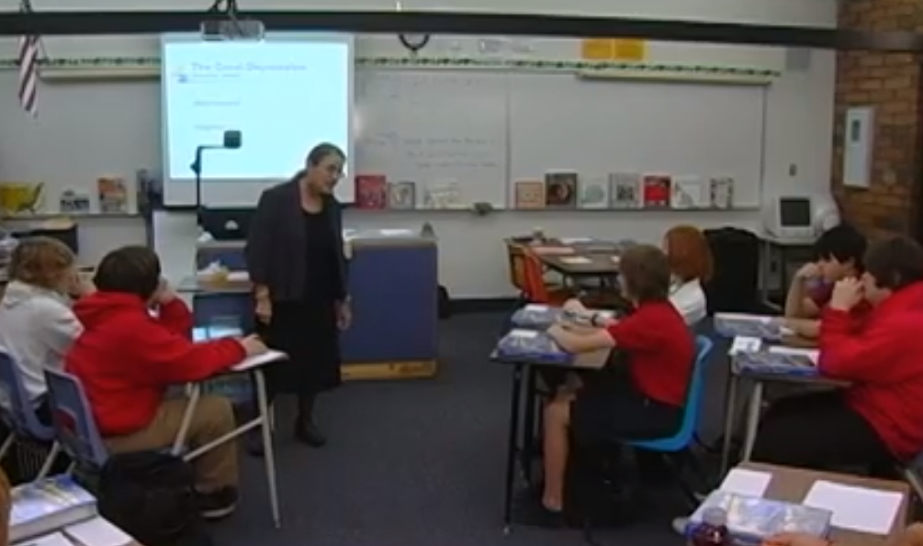
Matching student ability
Link to Video: https://explicitinstruction.org/video-secondary-main/secondary-video-5/
(stop at 01:23)
Archer, A. L.
https://explicitinstruction.org/video-secondary-main/secondary-video-5/

Slide 118
Did the methods of eliciting responses match student ability?
Build on a foundation
Sequence appropriately
Phrase purposefully
Archer, A. L.
https://explicitinstruction.org/video-secondary-main/secondary-video-5/

Slide 119
Slide 119
Part 3 Wrap-Up
Complete Online Activities
Activity 6.14: Partner Work
Activity 6.15: Module 6 Part 3 Quiz

Slide 120
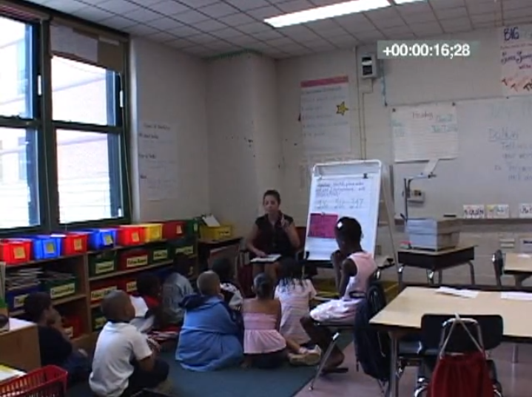
Activity 6.14
Partner Work
Watch the 3rd grade math video lesson. Work with a partner to analyze the video lesson to determine whether or not the methods that the teacher uses to elicit responses are matched to student abilities. Use the questions in your workbook to guide your analysis.
Learning Outcome:
SWBAT identify place value
for ones, tens, and hundreds.
https://vimeo.com/8277860

Slide 121
Activity 6.15
Quiz
Complete the Module 6 Part 3 quiz to demonstrate your understanding of eliciting responses that match the learning outcome.
When you’re finished, you can watch the quiz answer video for an explanation of the correct responses.

Slide 122
Activity 6.15
Quiz
True or False: We want students to be answering higher-order questions, so the best type of question to ask is a “creating” question because it’s at the top of Bloom’s taxonomy.
When eliciting responses that match student abilities, you should:
  Build on a foundation c) Phrase purposefully
  Sequence appropriately d) All of the above
True or False: It is important to frequently ask students, “does this make sense?”
During You Do (Independent Practice), students should respond correctly:
  50-55% of the time c) 90-95% of the time
  80% of the time d) 100% of the time

Slide 123
Activity 6.15
Quiz
Mrs. T is a 1st grade special educator teaching a math lesson about the commutative property of addition. The learning outcome is that SWBAT apply the commutative property to successfully solve addition problems.
T: “Today we will learn about the commutative property of addition. What property will we learn about?”
T: “How is the commutative property of addition different from the associative property?”
T: “Since 7+5=12, we can use the commutative property to know that 5+7 also = 12. What does 5+7 equal?”
T: “I know that 9+6=15. Using the commutative property, what does 6 plus 9 equal? Turn and whisper to your partner.”

Slide 124
Activity 6.15
Quiz
Based on the previous scenario, decide whether each of the following statements are true or false:
The questions/instructions build on a foundation.
The questions/instructions are sequenced appropriately.
The questions/instructions are phrased purposefully.
T: “Today we will learn about the commutative property of addition. What property will we learn about?”
T: “How is the commutative property of addition different from the associative property?”
T: “Since 7+5=12, we can use the commutative property to know that 5+7 also = 12. What does 5+7 equal?”
T: “I know that 9+6=15. Using the commutative property, what does 6 plus 9 equal? Turn and whisper to your partner.”

Slide 125
Activity 6.15
Quiz
Mr. M is a 7th grade special educator teaching a lesson about text features. The learning outcome is that SWBAT identify and describe three text features: headings, picture captions, and maps.
  T: “Today we will learn about 3 new text features. Who can remind me of the text feature we learned about yesterday?”
  T: “A heading is similar to a title. It comes before a passage of text and tells us what the passage is about. Point to a heading in the article on your desk.”
  T: “Now we’ll learn about picture captions. Why do you think we are learning about picture captions today?”
  T: “Maps are most often found in non-fiction text, like textbooks or news articles. Do you have any questions?”

Slide 126
Activity 6.15
Quiz
Based on the previous scenario, decide whether each of the following statements are true or false:
The questions/instructions build on a foundation.
The questions/instructions are sequenced appropriately.
The questions/instructions are phrased purposefully.
  T: “Today we will learn about 3 new text features. Who can remind me of the text feature we learned about yesterday?”
  T: “A heading is similar to a title. It comes before a passage of text and tells us what the passage is about. Point to a heading in the article on your desk.”
  T: “Now we’ll learn about picture captions. Why do you think we are learning about picture captions today?”
  T: “Maps are most often found in non-fiction text, like textbooks or news articles. Do you have any questions?”

Slide 127
Slide 127
Supporting Practices:
Using Effective Methods to Elicit Frequent Responses
Part 4: Does the method of eliciting a response match the desired response format?

Slide 128
Slide 128
Part 4 Objectives
You will learn:
How to match the method of eliciting a response to the desired response format

Slide 129
Module in the context of the DBI framework
Use effective methods to elicit frequent responses
Use methods to elicit responses that match the desired response format

Slide 130
Checklist
The methods used to elicit a response should:
Maintain or check accuracy of processing
Match the learning outcome
Match student abilities
Match the desired response format
Maximize student involvement

Slide 131
Responses can be…
verbal
written
physical
H
/c/ - /a/ - /t/
cat
M
B

Slide 132
Activity 6.16
Stop & Jot
Stop and jot an example of a question/instruction you may ask/give to elicit a response using each type of response format:
  Verbal
  Written
  Physical

Slide 133
Lead teacher demonstration
Link to Video: https://youtu.be/vP2iSc03AD8
Context:
Ms. Pollack is a 4th grade special educator teaching a math lesson about arrays.
Learning outcome:
SWBAT use arrays to represent the concept that each row contains an equal number of items.

Slide 134
Example of matching the desired response format
There are 3 squares ___ _______ row.

Slide 135
Non-Example of matching the desired response format
There are 3 squares ___ _______ row.

Slide 136

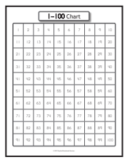



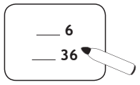

Curricular example
Beginning Numbers
Make your wipe board match mine.
What number? (6)
Is this missing number before, after, or next to 6? (Before)
Point to the number 6 on the hundreds chart and circle it.
What number comes before 6? (5)
Write it.
Erase your hundreds chart.

Slide 137
Activity 6.17
Analyze a Curriculum Example
Now it’s your turn!
Review the next section of the lesson plan.
Underline each time the teacher elicits a response.
For each response elicited, identify the desired response format (verbal, written, or physical)

Slide 138

Activity 6.17
Review
Make your wipe board match mine.
What number? (36)
Do we need to find the number before 36 or after 36? (Before)
How do you know? (Missing space is not after 36)
Point to the number 36 on the hundreds chart and circle it.
What number comes before 36? (35)
Write it.
Write a blank after 36. What number comes after 36? (37)
Write it.
Erase your wipe board and the hundreds chart.

Slide 139
Curricular example
Let’s Read!
Tell students that a cause is what makes something happen. Invite a volunteer to come forward. Have the student push a pencil or other object across your desk. Ask, Why did the ____ move? It was pushed. Say, The cause is that ________ pushed it.
Tell students that an effect is what happens. Invite another student to come forward and push the object across your desk. What happened when ________ pushed the _______ ? It moved across the desk. Say, The effect is that the ____ moved.

Slide 140
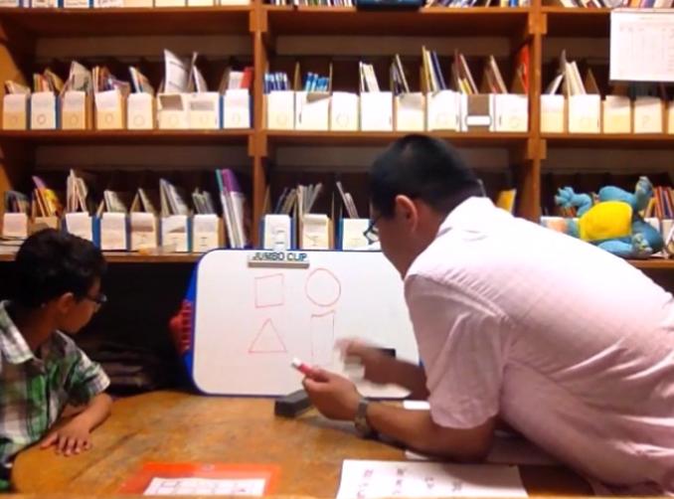
Real video example
Mr. Xin Xu
1st grade geometry lesson
What types of response formats does Mr. Xu elicit?
Xin Xu

Slide 141
Matching the desired response format
Link to Video: https://youtu.be/8t12oS-ZRG0
Xin Xu

Slide 142
Matching the desired response format Review
Physical
Verbal
1
1
2
2
3
3
4
4
5
Xin Xu

Slide 143

Activity 6.18
Analyze a Video Example
What questions/instructions could Mr. Xu have asked/given to elicit responses using a written response format?
Xin Xu

Slide 144
Slide 144
Part 4 Wrap-Up
Complete Online Activities
Activity 6.19: Discussion Board
Activity 6.20: Module 6 Part 4 Quiz

Slide 145
Activity 6.19
Discussion Board Post
Develop a brief sample lesson plan that you might teach to students.
Include at least 3 questions/ instructions that you might ask/give to elicit responses from students during the lesson.
Be sure to include the lesson objective and any necessary context information.
Do not identify the response formats. Respond to your classmates’ posts by identifying the response formats of each elicited response within their examples.

Slide 146
Activity 6.20
Quiz
Complete the Module 6 Part 4 quiz to demonstrate your understanding of eliciting responses that match the learning outcome.
When you’re finished, you can watch the quiz answer video for an explanation of the correct responses.

Slide 147
Activity 6.20
Quiz
True or False: No matter what you are teaching, you should always elicit responses that elicit a variety of response formats.
The response format that is most effective is:
  Verbal
  Written
  Physical
  They are all effective depending on the context

Slide 148
Activity 6.20
Quiz
For each response elicited in the following scenario, identify the response format as either:
verbal b) written
physical
Mrs. T is a 1st grade special educator teaching a math lesson about the commutative property of addition. The learning outcome is that SWBAT apply the commutative property to successfully solve addition problems.
T: “Today we will learn about the commutative property of addition. What property will we learn about?”
T: “We will learn about the commutative property using the equation 7+5=12. Read this equation with me.”
T: “Since 7+5=12, we can use the commutative property to know that 5+7 also = 12. What does 5+7 equal? Write the sum on your whiteboard.”
T: “I know that 9+6=15. Using the commutative property, what does 6 plus 9 equal? Turn and whisper to your partner.”

Slide 149
Activity 6.20
Quiz
For each response elicited in the following scenario, identify the response format as either:
verbal b) written
physical
Mr. M is a 7th grade special educator teaching a lesson about text features. The learning outcome is that SWBAT identify three text features: headings, picture captions, and maps.
  T: “Today we will learn about 3 new text features. Who can remind me of the text feature we learned about yesterday?”
  T: “A heading is similar to a title. It comes before a passage of text and tells us what the passage is about. Point to a heading in the article on your desk.”
  T: “Now we’ll learn about picture captions. Quickly jot the phrase picture captions in your notes.”
  T: “Maps are most often found in non-fiction text, like textbooks or news articles. Where are you more likely to find a map, in a chapter book or in an encyclopedia?”

Slide 150
Slide 150
Supporting Practices:
Using Effective Methods to Elicit Frequent Responses
Part 5: Does the method of eliciting a response maximize student involvement?

Slide 151
Slide 151
Part 5 Objective
You will learn:
How to elicit responses that maximize student engagement

Slide 152
Module in the context of the DBI framework
Use effective methods to elicit frequent responses
Elicit responses that maximize student engagement

Slide 153
Checklist
The methods used to elicit a response should:
Maintain or check accuracy of processing
Match the learning outcome
Match student abilities
Match the desired response format
Maximize student involvement

Slide 154
Use the most efficient approach
Number of students directly involved
Number of students directly involved
Time taken
Number of students directly involved
Time taken
Time taken

Slide 155

Activity 6.21
Stop & Jot
15%
35%
40%
30%
Can someone raise their hand and tell me…?
35%
60%
100%
65%

Slide 156
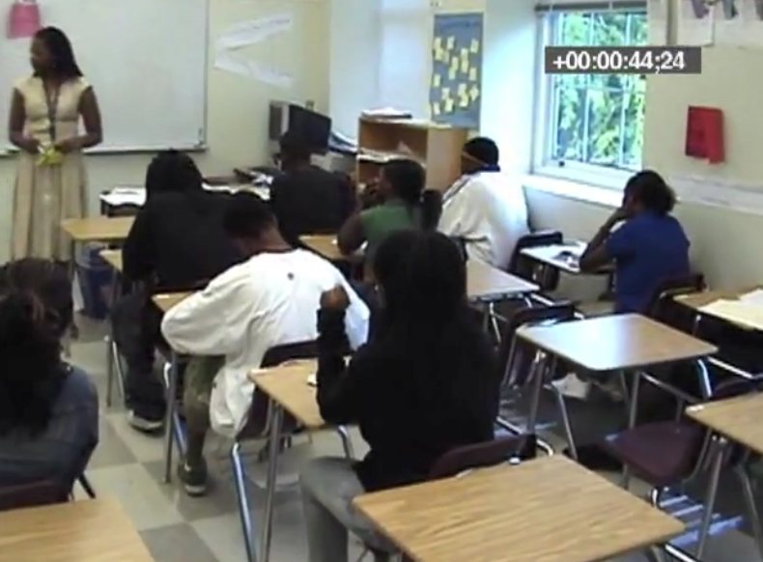

Activity 6.22
Analyze a Video Example
Watch the videos of Ms. M and Ms. W
Note how many students participate in each review lesson.
Compare the videos of Ms. W and Ms. M. Which teacher is eliciting responses more effectively? Why?
Ms. M
Ms. W

Slide 157
Ms. M
Embed Video Here

Slide 158
Ms. W
Embed Video Here

Slide 159
Activity 6.22
Review
So knowing that all angles are 60 degrees, then we know what about our sides? Chelsea?
Ms. M
0:44
And this last one is the length of the Xs,
so what does this block represent? Natalia?
Ms. W
0:54

Slide 160
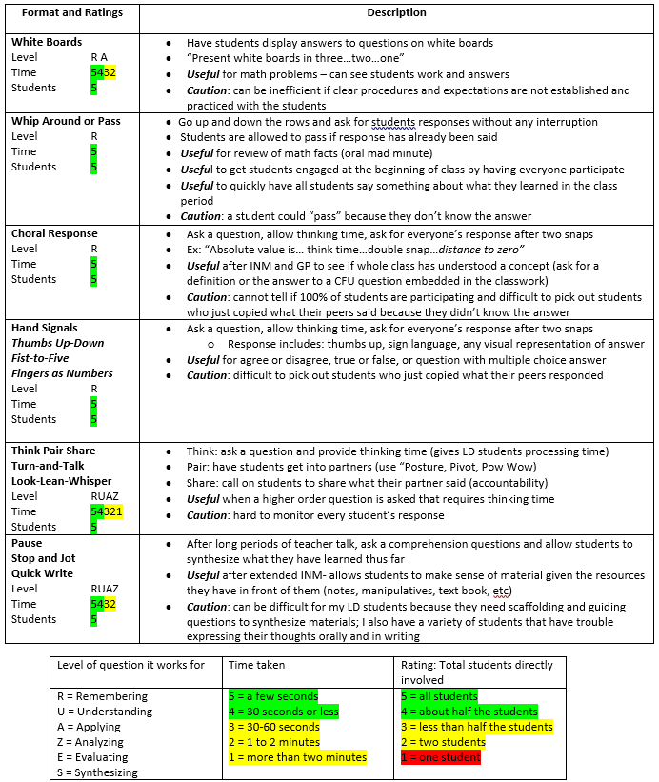
Eliciting responses card
Choral Response Level R Time 5 Students 5 | Ask a question, allow thinking time, ask for everyone’s response after a signal Ex: “Absolute value is… think time…double snap…distance to zero” Useful see if whole class has understood a concept (ask for a definition or the answer to a CFU question embedded in the classwork) Caution: cannot tell if 100% of students are participating and difficult to pick out students who just copied what their peers said because they didn’t know the answer
Level of question it works for | Time taken | Rating: Total students directly involved
R = Remembering U = Understanding A = Applying Z = Analyzing E = Evaluating S = Synthesizing | 5 a few seconds 4 30 seconds or less 3 30-60 seconds 2 1 to 2 minutes 1 more than two minutes | 5 all students 4 about half the students 3 less than half the students 2 two students 1 one student

Slide 161
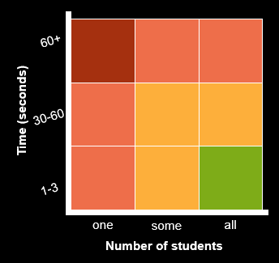
Balance number of students and time

Slide 162
Balance number of students and time
Choral Response
Good for questions that involve remembering
How many students?
How much time?
Good balance?

Slide 163
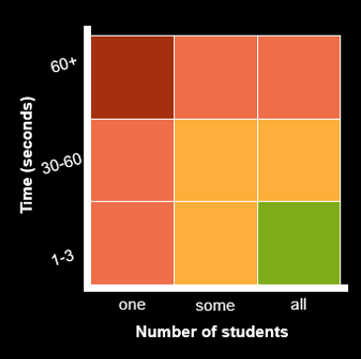
Balance number of students and time
Individual Response
(i.e. cold call, friendly cold call)
Good for questions that involve applying/analyzing
How many students?
How much time?
Good balance?

Slide 164
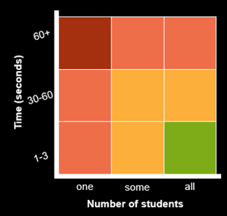
Balance number of students and time
Turn & Talk
Good for questions at multiple levels
understanding
How many students?
How much time?
Good balance?

Slide 165

Activity 6.23
Pause & Process
Which methods are most efficient?
Plot the remaining methods for eliciting responses on the graph in your workbook.
Turn & Talk | Choral Response | Individual Response
Cued Retell | White Boards | Response Cards
Whip Around | Stop & Jot | Hand Signals
Individual Response
Turn & Talk
Choral Response

Slide 166
Activity 6.23
Review
Some variables may affect the ability of the method to maximize student engagement…
Which methods are most efficient?
Plot the remaining methods for eliciting responses on the graph in your workbook.
Turn & Talk | Choral Response | Individual Response
Cued Retell | White Boards | Response Cards
Whip Around | Stop & Jot | Hand Signals
Individual Response
Turn & Talk
Choral Response

Slide 167
Some variables may affect the ability of the method to maximize student engagement…
The methods used to elicit a response should:
Maintain or check accuracy of processing
Match the learning outcome
Match student abilities
Match the desired response format
Maximize student involvement

Slide 168
Remember: PURPOSE
Effective methods for eliciting responses
Whip Around | Choral Response | Hand Signals | Cued Retell | White Boards | Response Cards | Turn & Talk | Stop & Jot | Individual Response
Maintain | Maintain | Maintain |  | Maintain | Maintain |  | Maintain | Maintain
Check Accuracy |  | Check Accuracy | Check Accuracy | Check Accuracy | Check Accuracy | Check Accuracy |  | Check Accuracy

Slide 169
Remember: LEVEL
Effective methods for eliciting responses
Whip Around | Choral Response | Hand Signals | Cued Retell | White Boards | Response Cards | Turn & Talk | Stop & Jot | Individual Response
Whip Around | Choral Response | Hand Signals | Cued Retell | White Boards | Response Cards | Turn & Talk | Stop & Jot | Individual Response
 |  |  |  |  |  |  |  | Cre
 |  |  |  |  |  |  | Eva | Eva
 |  |  |  |  |  | Ana | Ana | Ana
 |  |  |  | App | App | App | App | App
 |  | Und | Und | Und | Und | Und | Und | Und
Rem | Rem | Rem | Rem | Rem | Rem | Rem | Rem | Rem
Evaluating
Analyzing
Creating
Applying
Understanding
Remembering

Slide 170
Lead teacher demonstration
Link to Video: https://youtu.be/_XrR83kdLP0
Context:
Ms. Pollack is a 4th grade special educator teaching a math lesson about parallel lines.
Learning outcome:
SWBAT identify parallel lines based on the definition of parallel lines.

Slide 171
Example of maximizing student engagement
parallel lines
two lines that are always the same distance apart and never touch

Slide 172
Non-Example of maximizing student engagement
parallel lines
two lines that are always the same distance apart and never touch

Slide 173
Curriculum example
Decoding Detectives
Orally segment words into syllables.
Point to the title of the story. The name of this story is A Shadow. The word shadow has two parts, so it is a two-syllable word. Listen for the two syllables in this word. Pause between syllables. shad ow
The beginning sound in the word shadow is /sh/. Listen for the /sh/ sound in the beginning of this word: shadow.
Look at me. Wait until all the students look at you.
Listen to each word I say. If you hear the /sh/ sound in the word, put your thumb up. If you do not hear the /sh/ sound, put your thumb down.
Listen: shine. Do you hear a /sh/ in shine? Yes, you hear /sh/ in shine.
Listen: some. Do you hear /sh/ in some? No, you do not hear /sh/ in some.
Continue in the same manner with these words: shake, choose, mashes, fizzes
Identify /sh/ sounds in spoken words at the beginning, middle, or end of the word.

Slide 174
Curriculum example
Decoding Detectives
Point to the title of the story. The name of this story is A Shadow. The word shadow has two parts, so it is a two-syllable word. Listen for the two syllables in this word. Pause between syllables. shad ow

Slide 175
Balance number of students and time
60+
No responses (as written)
Time (seconds)
30-60
1-3
one
some
all
Number of students

Slide 176
Activity 6.24
Analyze a Curriculum Example
Point to the title of the story. The name of this story is A Shadow. The word shadow has two parts, so it is a two-syllable word. Listen for the two syllables in this word. Pause between syllables. shad ow
To complete this lesson using explicit instruction, how would you elicit responses? You can use these words as examples:
shut ting show down shat ter shush es shal low

Slide 177
Activity 6.24
Review
Point to the title of the story. The name of this story is A Shadow. The word shadow has two parts, so it is a two-syllable word. Listen for the two syllables in this word. Pause between syllables. shad ow
To complete this lesson using explicit instruction, how would you elicit responses? You can use these words as examples:
shut ting show down shat ter shush es shal low
Let’s do some together. I will say a word, and you say it. Then, we will clap and say the syllables one at a time. Ready?
Shovel. What word? Shovel. Good, let’s clap and say the syllables one at a time. Together, shuh-vel (clap-clap). Good! Let’s do some more. Repeat with showdown and shushes.
Now, it’s your turn. We’ll say the words, and you can clap and say the syllables on your own. Listen, shatter. What word? Shatter. Clap and say. Shatter. Repeat with shallow and shiny.
Add a turn-and-talk?
Add cold call?

Slide 178
Curriculum example
Decoding Detectives
The beginning sound in the word shadow is /sh/. Listen for the /sh/ sound in the beginning of this word: shadow.
Look at me. Wait until all the students look at you.
Listen to each word I say. If you hear the /sh/ sound in the word, put your thumb up. If you do not hear the /sh/ sound, put your thumb down.
Listen: shine. Do you hear a /sh/ in shine? Yes, you hear /sh/ in shine.
Listen: some. Do you hear /sh/ in some? No, you do not hear /sh/ in some.
Continue in the same manner with these words: shake, choose, mashes, fizzes

Slide 179
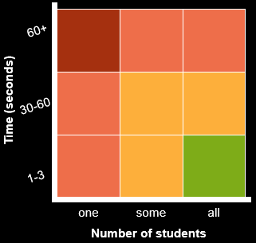
Balance number of students and time
Hand Signals
Listen to each word I say. If you hear the /sh/ sound in the word, put your thumb up. If you do not hear the /sh/ sound, put your thumb down.
Listen: shine. Do you hear a /sh/ in shine?
Listen: some. Do you hear /sh/ in some?

Slide 180

Maximizing student involvement
Ms. Didion
3rd grade resource room
Math lesson on features of a graph
Do the methods of eliciting response that Ms. Didion uses maximize student involvement?
Why/why not?
If not, how could she elicit responses differently to maximize student engagement?

Slide 181
Maximizing student involvement
Link to Video: https://youtu.be/uQ9qOGpqoqo

Slide 182
Maximizing student involvement
Do the methods of eliciting response that Ms. Didion used maximize student involvement?
Why/why not?
If not, how could she have elicited responses differently to maximize student engagement?

Slide 183
Slide 183
Part 5 Wrap-Up
Complete Online Activities
Activity 6.25: Journal Entry
Activity 6.26: Module 6 Part 5 Quiz

Slide 184
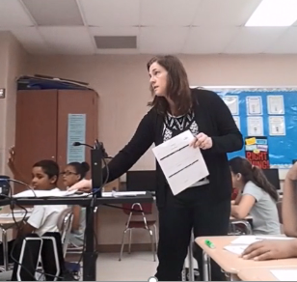
Activity 6.25
Journal Entry
Ms. Crandall: 6th grade
Reading Comprehension lesson using a main idea strategy
Does Ms. Crandall use methods to elicit responses that maximize student engagement? Why?
For at least 5 of the responses elicited, describe:
Which method is used
The number of students involved
The amount of time taken
Whether or not student engagement was maximized
Jen Crandall

Slide 185
Activity 6.25
Video
Link to Video: https://youtu.be/Se1GeXDZJlw
Jen Crandall

Slide 186
Activity 6.26
Quiz
Complete the Module 6 Part 5 quiz to demonstrate your understanding of eliciting responses that match the learning outcome.
When you’re finished, you can watch the quiz answer video for an explanation of the correct responses.

Slide 187
Activity 6.26
Quiz
True or False: Choral response is always the most effective method for maximizing student engagement.
Methods for eliciting responses that typically involve all students include:
  Cold call
  Turn and talk
  Hand signals
  B & C

Slide 188
Activity 6.26
Quiz
For the following scenario, match the method used to each elicited response:
White Boards b) Turn and Talk
Individual Response d) Choral Response
Mrs. T is a 1st grade special educator teaching a math lesson about the commutative property of addition. The learning outcome is that SWBAT apply the commutative property to successfully solve addition problems. Identify the response format for each response elicited:
T: “Today we will learn about the commutative property of addition. What property will we learn about, Shamar?”
T: “We will learn about the commutative property using the equation 7+5=12. Read this equation with me.”
T: “Since 7+5=12, we can use the commutative property to know that 5+7 also = 12. What does 5+7 equal? Write the sum on your whiteboard.”
T: “I know that 9+6=15. Using the commutative property, what does 6 plus 9 equal? Turn and whisper to your partner.”

Slide 189
Activity 6.26
Quiz
For the following scenario, decide whether the method used to elicit a response maximized student engagement.
Yes – student engagement was maximized
No – student engagement was not maximized
Mr. M is a 7th grade special educator teaching a lesson about text features. The learning outcome is that SWBAT identify three text features: headings, picture captions, and maps. Identify the response format for each response elicited:
  T: “Today we will learn about 3 new text features. Who can remind me of the text feature we learned about yesterday?”
  T: “A heading is similar to a title. It comes before a passage of text and tells us what the passage is about. Point to a heading in the article on your desk.”
  T: “Now we’ll learn about picture captions. Alicia, can you please come write the phrase picture captions on the board?”
  T: “Maps are most often found in non-fiction text, like textbooks or news articles. Where are you more likely to find a map, in a chapter book or in an encyclopedia? Show one finger if you think chapter book and two fingers if you think encyclopedia.”

Slide 190
Slide 190
Supporting Practices:
Using Effective Methods to Elicit Frequent Responses
Closing: What are the next steps?

Slide 191
Module in the context of the DBI framework
Use effective methods to elicit frequent responses

Slide 192
Checklist
The methods used to elicit a response should:
Maintain or check accuracy of processing
Match the learning outcome
Match student abilities
Match the desired response format
Maximize student involvement

Slide 193
Module 6 Activities

Slide 194
Slide 194
Module 6 Classroom Application
Application Activity
Journal Entry Assignment
Look at the list of methods for eliciting responses and choose 2 that you would like to use more often.
For each method, give an example of a recent lesson where you wished you elicited a response differently.
Briefly describe an upcoming lesson and how you can use these methods to elicit responses.
Implement the lesson described in the last part of the Journal Entry Assignment.
After implementing, reflect with your coach about the effectiveness of the methods you used to elicit responses.

