Slide 1
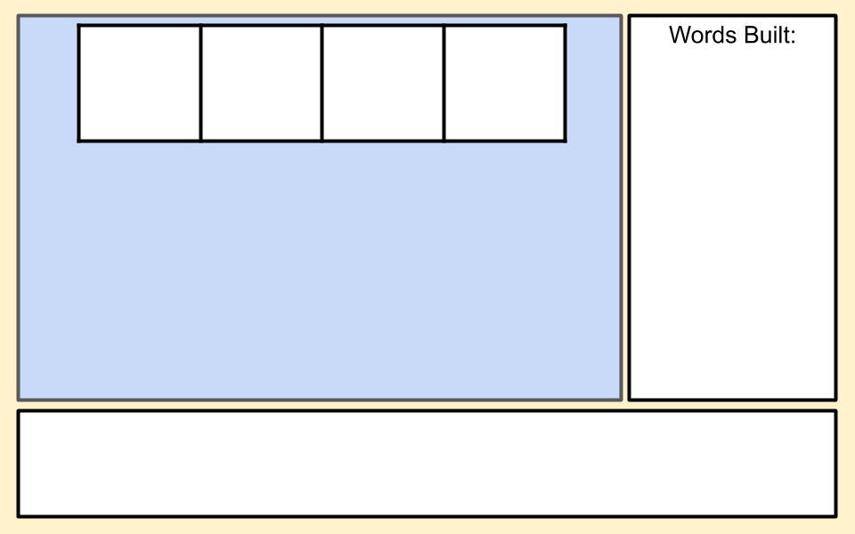
Example Phoneme word building
Type words here.
b
i
t
d
r
p
s
a
Type silly sentence here.

Slide 2
Blank Phoneme word building
Type words here.
Type silly sentence here.

