Slide 1

Strategies for Setting Data-Driven Behavioral Individualized Education Program Goals
March 2020
Teri Marx, Ph.D., American Institutes for Research
Faith G. Miller, Ph.D., University of Minnesota—Twin Cities

Slide 2
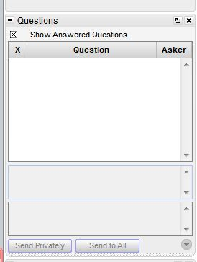
Webinar Format & Questions
Throughout the presentation, submit your questions into the question pod.
  For technical issues/questions, a webinar team member will try to assist you as soon as possible.
  For content related questions, there will be a time for Q&A at the end of the presentation. Submit your questions and we will share them with the presenters.

Slide 3






Introducing the PROGRESS Center
The PROGRESS Center provides information, resources, tools, and technical assistance services to support local educators in developing and implementing high-quality educational programs that enable children with disabilities to make progress and meet challenging goals, consistent with Endrew F. v. Douglas County School District (2017).
HOW WILL WE HELP IMPROVE OUTCOMES FOR STUDENTS WITH DISABILITIES?
Share current research,
policies, guidance, success stories, and experiences from students, parents, educators, and
other stakeholders.
Partner with selected
local educators to develop and implement high-quality educational programs.​
Provide tools, resources, and
training materials for ALL educators, leaders, and families.
Visit us at www.promotingPROGRESS.org to learn more!

Slide 4

Session Outcomes
Participants will understand how progress monitoring supports the delivery of intensive intervention.
Participants will learn how to use data to set realistic goals behavioral IEP goals.

Slide 5


Introductions
Teri Marx, Ph.D., Senior Researcher, National Center on Intensive Intervention at American Institutes for Research
Faith Miller, Ph.D., Associate Professor of Educational Psychology at University of Minnesota—Twin Cities

Slide 6
No Time Like the Present
Recent Supreme Court ruling – potential implications:
  In the future, progress (documented through data) on an IEP could be the foundation for ascertaining if the FAPE standard was met.
  Pushes educators to provide higher quality instruction to ensure that students with disabilities meet challenging standards.

Slide 7
Introduction to Data-Based Individualization

Slide 8


What Is Intensive Intervention?
Intensive intervention addresses severe and persistent learning and behavioral difficulties.
Characterized
by increased intensity and individualization
Driven by data

Slide 9
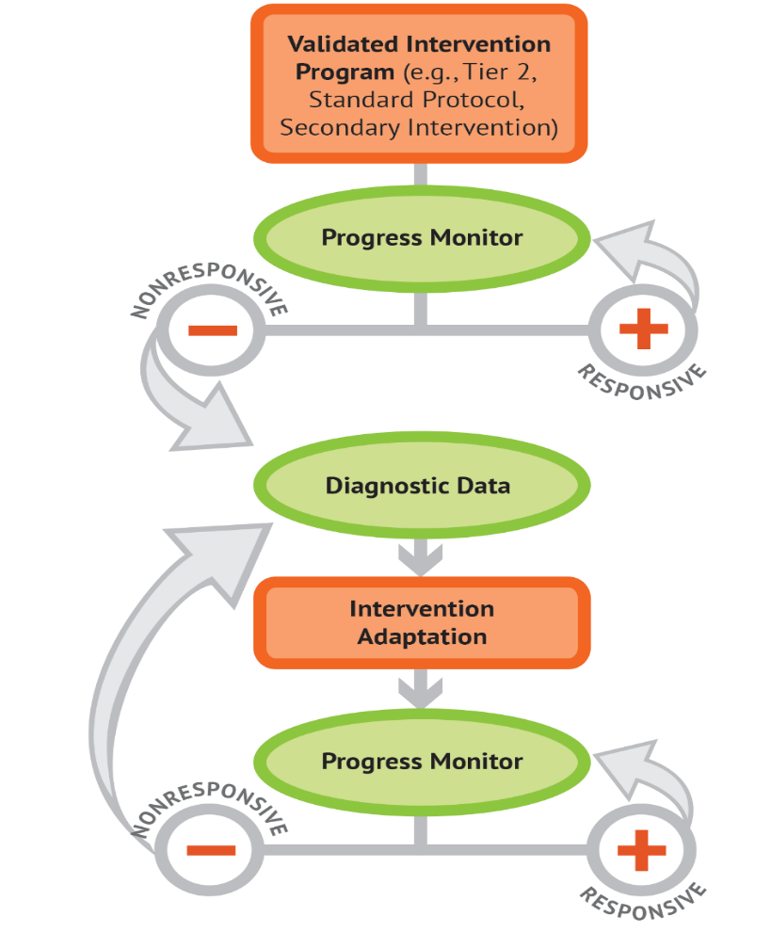
Intensive Intervention through Data-Based Individualization (DBI)
DBI Process
Is a process for delivering intensive intervention
Origins in experimental teaching
Is not a one-time fix
a systematic method for using data to determine when and how to provide more intensive or specialized intervention
Integrates data-based decision making across academics and social behavior
National Center on Intensive Intervention (2013)

Slide 10
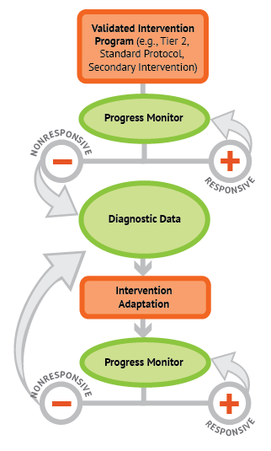
Five DBI Steps
Validated intervention program, delivered with greater intensity to the group
Progress monitoring
Informal diagnostic assessment
Adaptation to validated intervention
Continued progress monitoring, with adaptations occurring whenever needed to ensure adequate progress

Slide 11
How does DBI support implementation of special education requirements?
When implemented as part of MTSS, DBI can help schools implement special education requirements within a comprehensive support system.
Referral & Eligibility Requirements
Ensure provision of intensive interventions to rule out lack of instruction.
Provide formal progress monitoring data that can be provided to parents.
Compare student performance to peers.
IEP Development & Implementation
Provide data for PLAAFPS.
Set more realistic IEP goals.
Design specially designed instruction.
Provide estimates of level of service needed.

Slide 12
Before we begin individualizing…
STEP 1: Start with a standardized, validated intervention program
STEP 2: Develop a progress monitoring plan, which includes an ambitious goal.

Slide 13
Setting Goals Based on Logical Practices
Team members must know…
  How the goal was set
  Why the goal was set that way
  The intensity of the intervention provided to meet the goal
Knowing the goal helps educators select appropriate interventions to help students reach the goal.

Slide 14
Behavioral Progress Monitoring and Goal Setting

Slide 15

NEW RESOURCE!
The guide covers:
components of quality behavioral IEP goals;
how to know which behavior(s) should be addressed through an IEP goal;
information about behavior(s) of concern;
how to set goals and progress monitor;
common challenges and solutions; and
additional resources and tools.
https://intensiveintervention.org/resource/high-quality-behavior-IEP-goals

Slide 16
The Fatal Flaw
“When I was a school social worker, I collected a lot of data. I observed students, interviewed parents and teachers, collected information through rating scales. I then put information on FBA forms in the IEP using those data. I created data-informed behavior support plans—really quality plans. But, after that, I stopped collecting data…” ~ Teri Marx
Takeaway: Continue collecting data!

Slide 17
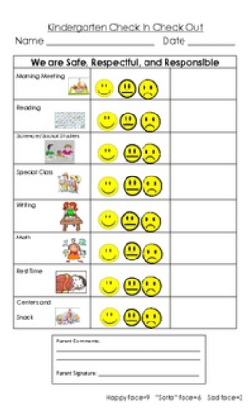
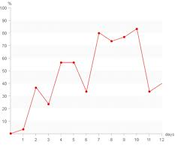
Fixing the Fatal Flaw
Progress Monitor

Slide 18
What does IDEA say about IEP goals?
Under Sec. 300.320(a)(2)(i-ii), the Individuals with Disabilities Education Act (IDEA) requires that the IEP include a “statement of measurable annual goals,” including academic and functional goals that
  “(A) Meet the child’s needs that result from the child’s disability to enable the child to be involved in and make progress in the general education curriculum; and
  (B) Meet each of the child’s other educational needs that result from the child’s disability.”
For children with disabilities who take alternate assessments aligned to alternate academic achievement standards, the statement of measurable annual goals also will include “a description of benchmarks or short-term objectives” [IDEA, Sec. 300.320(a)(2)(ii)].

Slide 19
What do quality behavioral IEP goals include?*
Components | Examples | Sample Goal Language
Time Frame | When mastery will be obtained | By the end of the academic year…
Assessment Condition | Task Material/Tool Grade Level Setting/Timing | When presented a difficult task... During whole group math instruction... During social skills instruction…
Target Behavior | Observable behavior | Student will use a learned strategy to de-escalate… Student will appropriately ask for help… Student will appropriately seek peer attention…
Supports needed (if applicable) | None Reminder Prompt | Independently… With no more than two reminders needed… When prompted…
Level of Proficiency/ Timeline | Accuracy Timeline Number of trials | From 50% accuracy to 80% accuracy… At least 80% of the instructional period… During 8 of 10 peer interactions…
Measurement | Direct observation Direct Behavior Rating Frequency Counts | As measured by weekly, 20-minute systematic direct observations. As measured by Direct Behavior Rating. As measured by daily frequency counts
* Check with your state or district regulations, policy, and/or guidance first.

Slide 20
The Goal Should….
address the present levels of performance identified through data collection (i.e., A, B, C checklists, target behavior interviews, classroom observation)
focus on the replacement behavior—measuring what the student will be doing, not on the behavior change.
Why is this a non-example?
While we certainly want loud outbursts to decrease (and can continue to measure this target behavior), an IEP goal should focus on the outcome—what we expect the student to learn and be able to do after a skill/ replacement behavior is taught to the student.
Example: Miranda will increase the frequency of raising her hand in class.
Non-example: Miranda will decrease the frequency of loud outbursts in class.

Slide 21
The Goal Should….
focus on student behavior, not educator behavior.
be monitored with enough frequency to determine progress and make timely instructional/intervention decisions.
be measured using an objective, valid, and reliable measure (e.g., Direct Behavior Rating, systematic direct observation) rather than a more subjective measure (e.g., teacher anecdotal notes).
be realistic, yet ambitious.

Slide 22
Replacement vs. Target Behavior
While a behavioral IEP goal should focus on the replacement behavior, we can simultaneously monitor progress on the student’s target behavior as a way to determine if/when a change to the student’s program is needed.
Collecting data on both target and replacement behaviors also allows the IEP team to provide more timely information to parents and families.

Slide 23



How do we know which behavior to…
Identify
Prioritize
Operationalize

Slide 24
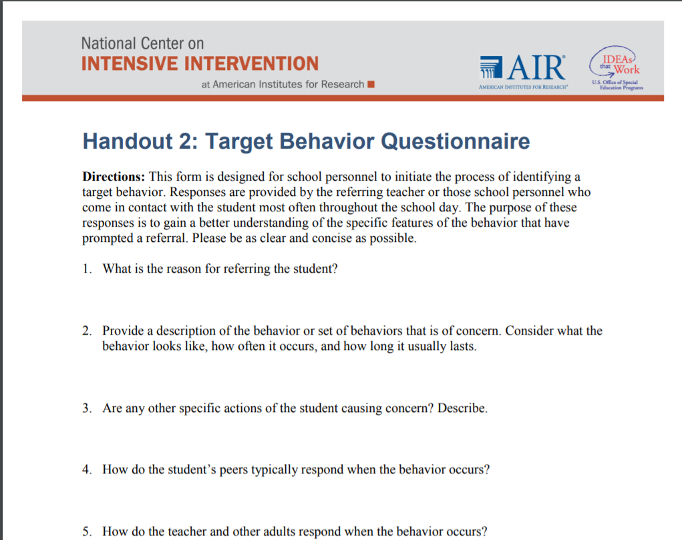
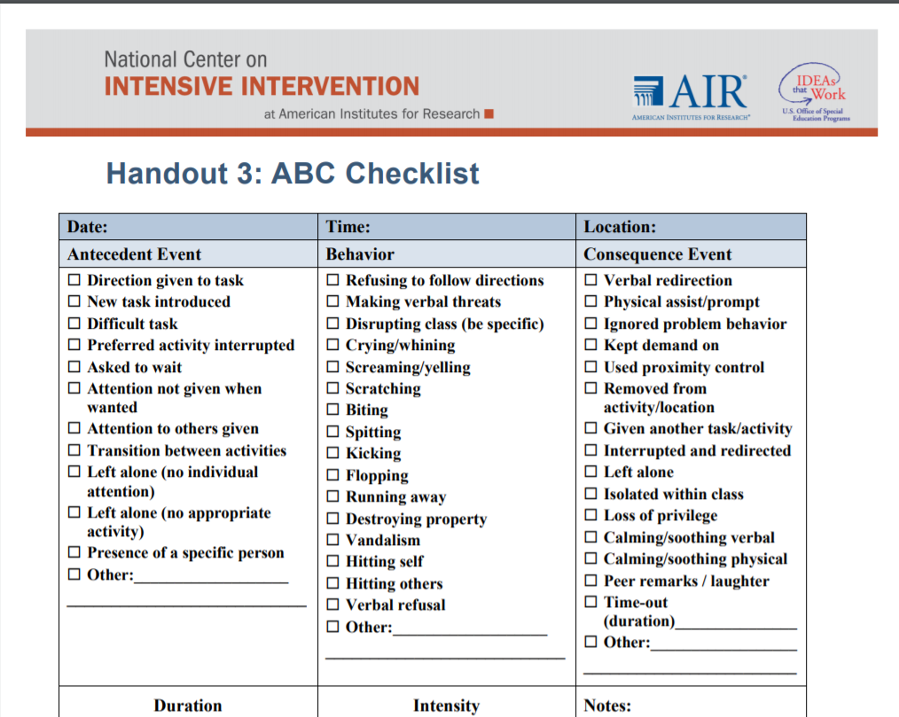
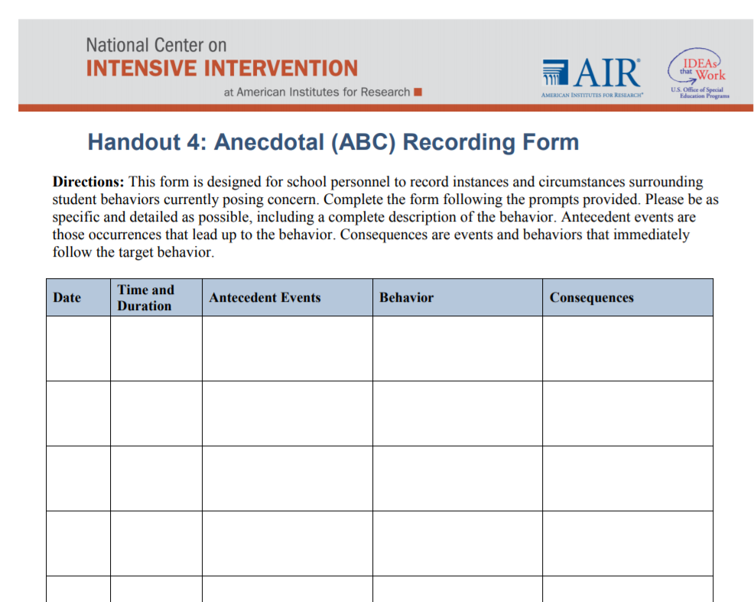
Identify
Gather information on the context and features of behaviors of concern.
Questions to be addressed through this process include:
What does the behavior look like?
When does the behavior occur?
Why does the student present the behavior?
24

Slide 25
Prioritize
If a student demonstrates multiple challenging behaviors, prioritize which behavior(s) should be addressed (e.g., high intensity, increased frequency, dangerous, or self-injurious). Prioritizing only a few will make—
  Data collection more feasible.
  Data analysis and decision making more efficient.
  Data-based individualization more effective, as decisions will be based on the most important behavior(s) for a given student.
25

Slide 26
Operationalize
Well-written target behavior definitions:​
  Use objective language referring only to observable characteristics of the behavior.​
  Allow for the behavior to be readily measured.​
  Delineate the boundaries of what the behavior includes and does not include.
Bad​ | Better​ | Best​
Sarah loses control.​ | Sarah cries and tantrums.​ | Sarah cries, flops to the floor, kicks feet, pounds fists on floor, and/orgrabs at objects.​
Tara is disruptive.​ | Tara makes inappropriate comments during class.​ | Tara curses at teacher or peers, talks excessively about unrelated tasks/work, or insults peers during class.​
Robin has been acting withdrawn.​ | Robin is not engaging with peers.​ | Robin sits quietly by herself at her desk and does not speak with other students, even those who approach her to engage.​

Slide 27
Identifying the Function
Why is the student engaging in the behavior?
  Is it to get something (e.g., attention from peers/ teacher)?
  Is it to avoid something (e.g., difficult task)?
  Is it because the student doesn’t have the necessary skills (e.g., academic, functional, or social-emotional)?
Behaviors are not just problematic to others, like disruptive behavior. They also include behaviors that are problematic to the student, such as internalizing/ withdrawing; social skills, organizational, or attention deficits; or a lack of engagement.

Slide 28
Selecting a Functionally-Relevant Replacement Behavior
Stated in terms of what you want the student to do
Something the student can do or learn to do
Supported by the natural environment

Slide 29
Focus the Goal on the Replacement Behavior
Component | May include… | Examples
Condition | Material/Tool Grade level Setting Timing | When given verbal prompts…
Replacement Behavior | Observable behavior Target goal | Student will ask for help within one minute…
Criterion for Acceptable Performance | Accuracy Number of trials | For at least 80% of the math period (as measured by DBR academic engagement rating)
Timeline | Daily Monthly Quarterly | By the end of the quarter.

Slide 30
Don’t forget to teach replacement behaviors!
“Moreover, Wehby and Kern (2014) pointed out that a frequent criticism of the FBA process is the unitary focus of problem behavior when multiple forms most likely exist. Notably, conducting an FBA and creating FBA-derived interventions would not include the targeting of the five important [social emotional learning] SEL domains…” (Smith, Poling, & Worth, 2018, p. 170).
This is the focus of specially-designed instruction!

Slide 31
Goal Setting and Progress Monitoring
Four Steps

Slide 32
Step 1: Determine the Measurement
Tool/Approach (e.g., observation, Direct Behavior Rating [DBR])
Scale for measurement (e.g., 1-10 rating, frequency count, percent of time)
Frequency of data collection (e.g., hourly, daily, weekly)
Context for assessment (e.g., setting, individual responsible)
Decision/evaluation rules (i.e., how will we know if the student is responsive? And, by when?)

Slide 33
Common Tools for Progress Monitoring
Systematic Direct Observation
Direct Behavior Rating (DBR)

Slide 34

What is DBR?
A tool that involves a brief rating of a target behavior following a specified observation period.

Slide 35
DBR Standard Behaviors
School Success
Academically Engaged
Non-Disruptive
Respectful
(Chafouleas, Riley-Tillman, Christ, & Sugai, 2009)
Permission for using DBR form as part of this module granted by authors for educational purposes only.
www.directbehaviorratings.org

Slide 36
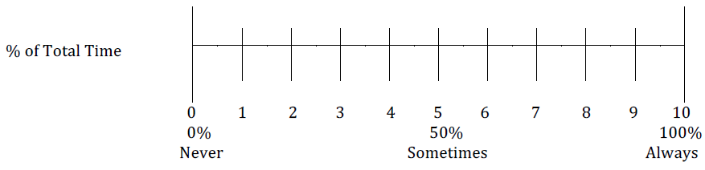
Academic Engagement Example
Academically Engaged
Place a mark along the line that best reflects the percentage of total time the student was academically engaged during math today.
Interpretation: The teacher estimated that the student displayed academically engaged behavior during 60 percent of large-group math instruction today.
Slide adapted from Chafouleas (2011) with permission.

Slide 37
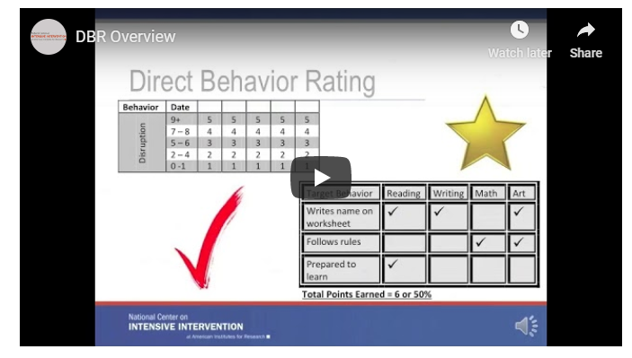
Learn more about DBR
https://intensiveintervention.org/resource/direct-behavior-rating-overview

Slide 38
Ensure there are Decision/Evaluation Rules
Regardless of the assessment you use, be sure there are clear decision rules. For example:
  Jacob will be deemed non-responsive if his DBR rating for verbal aggression in math class averages more than 5 for a one-month period following introduction of the intervention.
  Jacob will be deemed responsive if his DBR rating for verbal aggression in math class averages less than 5 for a one-month period.
  The school team will review the data at the end of the month to determine whether Jacob was responsive and will decide on next steps.
Check with State regulations related to IEP goal development.
38

Slide 39
Step 2: Establish Baseline of Student Performance
Unless there is an ethical reason to begin immediate intervention, we should collect at least 5 data points to establish baseline performance.​
Ideally, data would demonstrate stability​
Highly variable data may suggest a need to collect additional baseline data and revisit the operationally defined behaviors(s) and anchors for accuracy
Collect At least 5 data points PRIOR to intervening

Slide 40
Establishing Baseline – DBR Example
The piloting of the DBR tool will provide information that can be useful for establishing evaluation rules.
    The school team and teacher must define responsiveness up front to assist with evaluation.
    Because the process is individualized, it is difficult to give firm rules on what constitutes responsiveness—this will vary based on the target behavior and current levels of performance.
    Make goals ambitious, but feasible to obtain.

Slide 41
Step 3: Set a Measurable and Realistic Goal
Not realistic and ambitious
  100% accuracy/frequency,
  50% accuracy/frequency
Realistic and ambitious
  at or around 80-90% (for behaviors we want to increase) or
  10-20% (for behaviors we want to decrease)
Rate/level that that exceeds peer expectations or could occur by chance
Rate/level that is commensurate with typical peers’ performance.

Slide 42
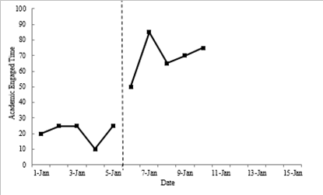
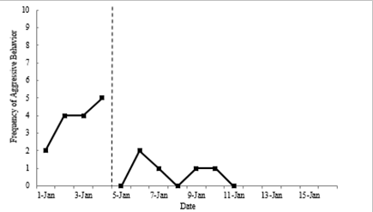
Examples of Graphed Data
Increasing Academically Engaged Time
Decreasing Frequency of Aggressive Behavior
Goal line
Goal line
Always include a goal line on the graph to help you visualize progress!
Any changes to goals should be made in consultation with the student’s team including their parent/family

Slide 43
Step 4: Evaluate Progress Using Graphed Data

Slide 44
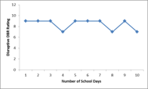
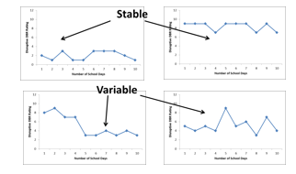
Data Evaluation Methods and Features​
Visual analysis of examining the emergent data pattern, including the:​
  Level of the data​
  Trend of the data​
  Variability of the data
ASCENDING
DESCENDING
LEVEL

Slide 45
Making Decisions Based on Data
If the student is meeting their goal consistently at the initial review date, consider:
  Gradually increasing the goal.
  Gradually fading supports but continue to collect data.
If the student is not making adequate progress toward their goal, consider:
  Reviewing data to adapt or intensify instruction/intervention.
  Changing the reinforcer or increasing the schedule of reinforcement.
  Revisiting A, B, C data to ensure the intervention is addressing the correct function.

Slide 46
Summary

Slide 47
Developing IEP Goals
Common questions required to be answered in an IEP:
  What does the student need to know or be able to do? (GOAL)
  How will progress toward this annual goal be measured? (DATA)
Common pitfalls:
  Goals do not align with areas of need identified by PLAAFP (i.e., social skills; reading comprehension), but only address a small part (i.e., raising hand; sight word recognition)
  Progress is typically measured by observational trials or anecdotal notes and data are not easily interpreted for responsiveness

Slide 48
Making the IEP Feasible
With a Valid and Reliable Progress Monitoring Tool:
  Can set a measurable goal that is comparable to baseline performance.
  Data are collected frequently, allowing educators to determine student responsiveness more readily.
  Data are graphed, allowing special educators and/or related service providers to provide visual data (evidence) for quarterly progress updates and annual goals.
  Allows flexibility if the needs change over time.

Slide 49
Questions & Answers

Slide 50

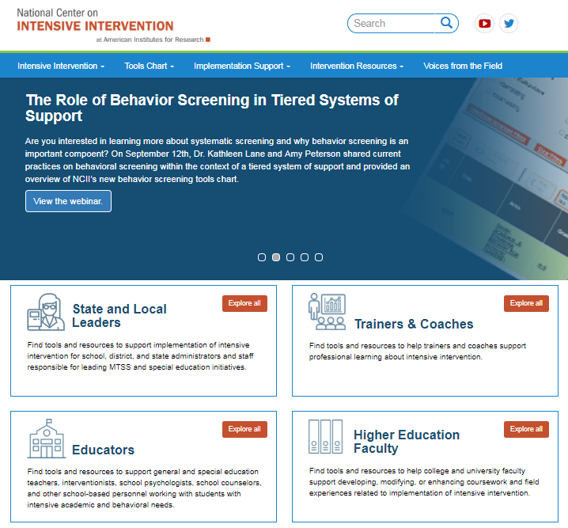
Resources to Learn More!
NCII’s website www.intensiveintervention.org has a wealth of resources to support this process!

Slide 51
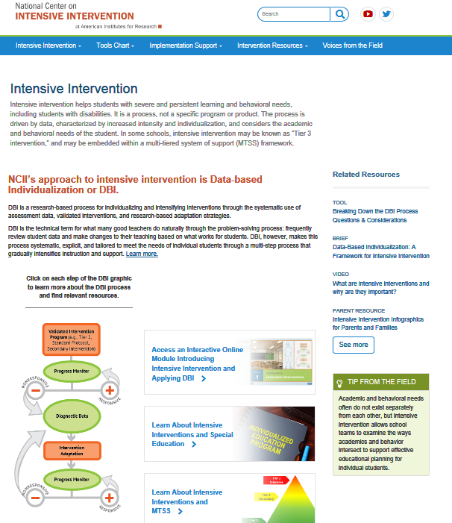
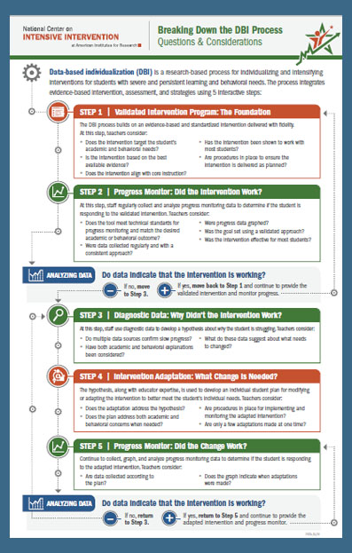
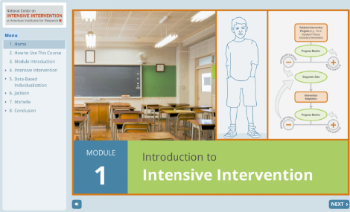
Introduction to DBI/Intensive Intervention
Self-paced Module
Web Toolkit
One page overview

Slide 52


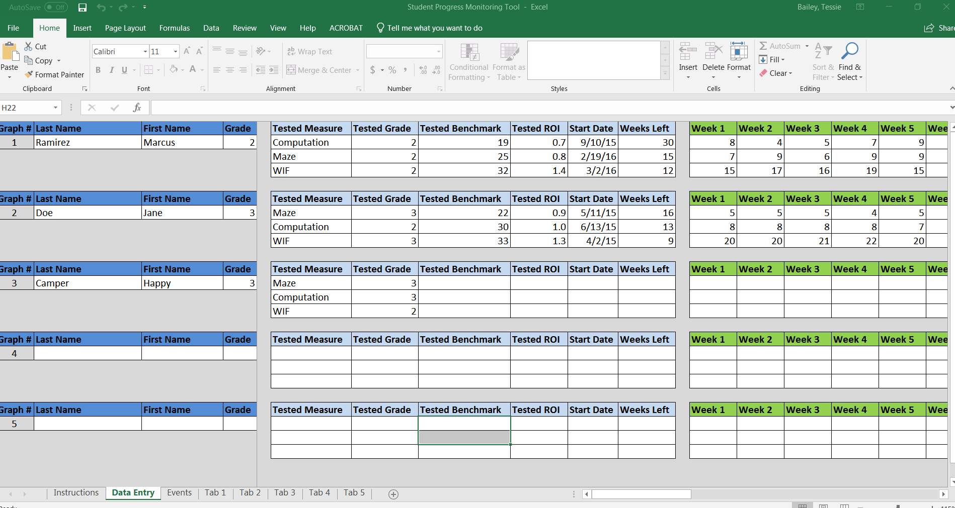
Tools to Support IEP Development and Goal Setting
https://intensiveintervention.org/resource/student-progress-monitoring-tool-data-collection-and-graphing-excel
https://intensiveintervention.org/resource/high-quality-academic-IEP-goals
https://intensiveintervention.org/resource/recommendations-and-resources-preparing-educators-endrew-era

Slide 53

Thank you!

Slide 54
Disclaimer
This presentation was produced under the U.S. Department of Education, Office of Special Education Programs, Award Nos. H326Q160001 and H326C190002. Celia Rosenquist and David Emenheiser serve as the project officers, respectively. The views expressed herein do not necessarily represent the positions or policies of the U.S. Department of Education. No official endorsement by the U.S. Department of Education of any product, commodity, service, or enterprise mentioned in this presentation is intended or should be inferred.

