Slide 1
Module 7
Data-Based Decision Making
Jennifer Freeman, PhD
Don Briere, PhD
Brandi Simonsen, PhD

Slide 2
Acknowledgements
Much of the content shared in this module was developed by members of the OSEP funded National Technical Assistance Center for Positive Behavioral Interventions and Supports.
Thank you to:
  Members of classroom workgroup:
    Brandi Simonsen, Jennifer Freeman, Jessica Swain-Bradway, Robert Putnam, Heather George, Steve Goodman, Barb Mitchell, Kimberly Yanek, Kathleen Lane & Jeffrey Sprague
  Members of the Northeast PBIS Network:
    Susannah Everett, Adam Feinberg, George Sugai, Brandi Simonsen & Jennifer Freeman

Slide 3
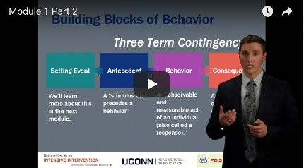
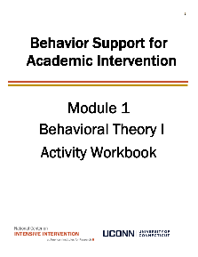

Orientation to Module Tools and Resources
Module Videos
Module Workbook
Module Readings and Additional Resources

Slide 4



Orientation to Module Elements
Activities
Module Quiz – Self Assessment
  Do you know the basic content presented in this module?
Coaching Activities
  Can you implement the content presented in this module in your classroom effectively?
Discussion Board Post
Workbook Quiz
Stop and Jot

Slide 5
Getting the Most Out of This Module
Pre-service
Become fluent with content and basic theory
New Teachers
Focus on moving from knowledge to practice
Experienced Teachers
Use activities as a self-reflection opportunity
Consider how you might coach or teach the skills/content to a new teacher in your building
Set a new implementation goal for yourself
Review resources to extend your learning with respect to culturally and contextually relevant implementation
Look for examples of implementation in your clinic placements
Video record or ask for feedback on your implementation of key practices during your student teaching
Set implementation goals and either self-monitor or ask for peer/coach feedback on your use of key skills
When a practice isn’t working, use your understanding of theory to help you modify or intensify a practice to improve outcomes

Slide 6
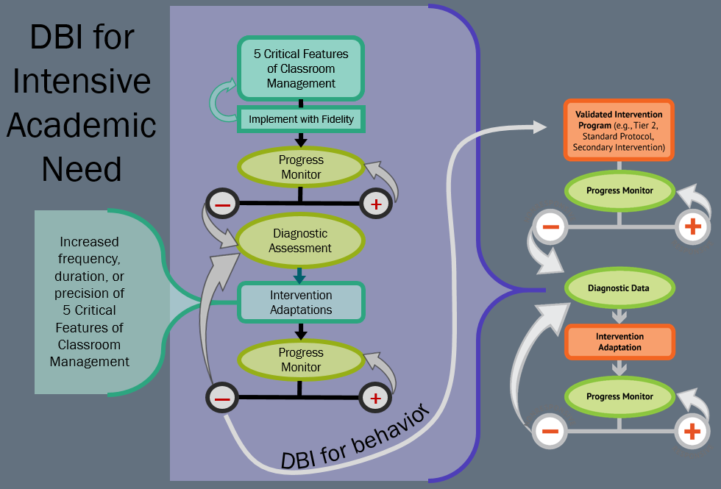
DBI for Intensive Academic Need

Slide 7
Module Objectives
By the end of Module 7 you should be able to:
Describe why we use data for decision making
Determine if core features of classroom management practices are in place with fidelity
Determine if all individuals in your classroom are achieving desired outcomes
Develop an action plan to enhance or intensify support as needed
  Develop precision problem statements and goals
  Generate preventative and effective solutions to chronic minor problems in your classroom

Slide 8
Data-Based Decision Making
Part 1
How do we know if core features of classroom management are in place with fidelity?

Slide 9
Why Use Data For Decision Making?
Decisions are more likely to be effective and efficient when they are based on data.
The quality of decision making depends most on the first step: defining the problem to be solved with precision and clarity.
Data help place the “problem” in the context rather than in the students.

Slide 10
General Process for Identifying Classroom Problems/Issues
What data to monitor
  Student Academic and Behavior Outcomes
  Fidelity of implementation
    Are we doing what we planned to do?
What question to answer
  Do we have a problem?
What questions to ask of Level, Trend, Peaks
  How do our data compare with last week/month/year?
  How do our data compare with school and grade level norms?
  How do our data compare with our preferred/expected status?
If a problem is identified, then ask
  What are the data we need to make a good decision?

Slide 11
PBIS Technical Guide on Using Data to Support Implementation of Positive Classroom Behavior Support
PBIS Technical Guide on Using Data to Support Implementation of Positive Classroom Behavior Support
DATA

Slide 12
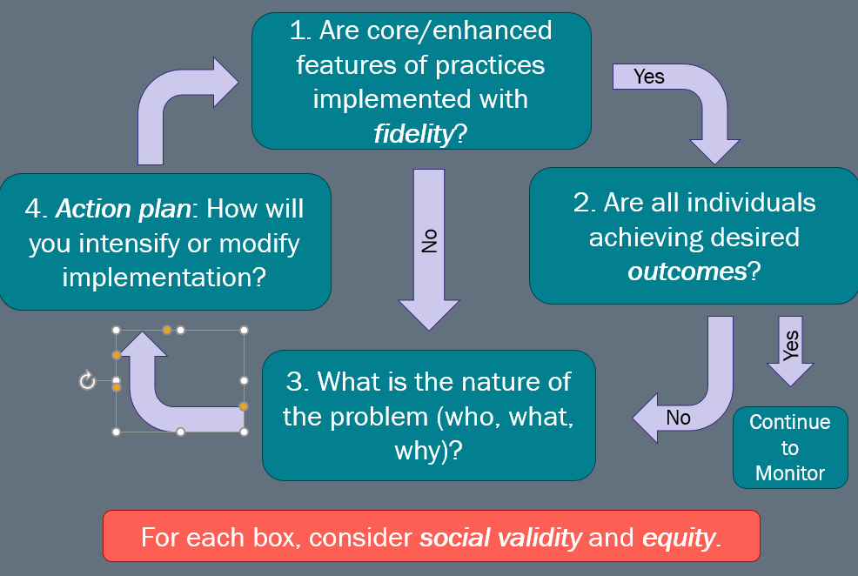
How to establish whether an action plan is needed.

Slide 13
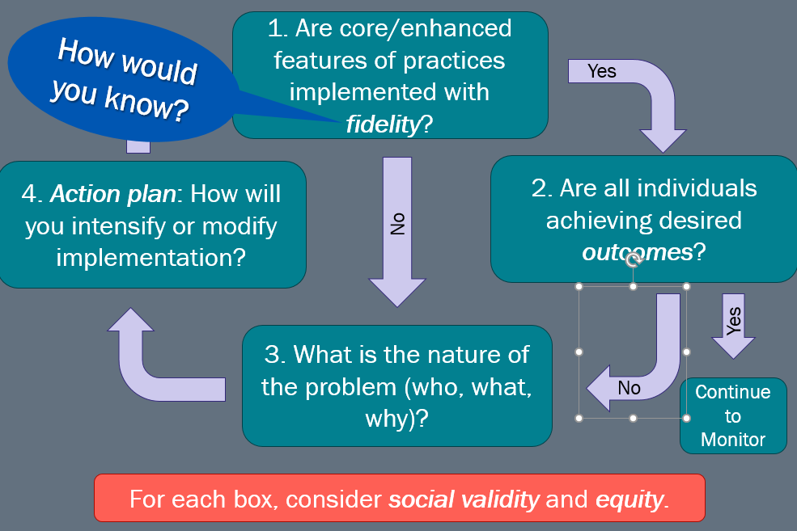
How would you know it is with fidelity?

Slide 14
Think about step 1
1. Are core/enhanced features of practices implemented with fidelity?
How would you know?
Self-Assessment
Direct observation checklists
Direct observation of specific skills
Self-management of specific skills
Page 7

Slide 15
Activity 7.1
Activity 7.1: Discussion Board Post
Self-Assessment
A closer look at one tool….available free at nepbis.org
  (updated measures will be posted there)
Complete the Classroom Management Assessment, included in your workbook, for your classroom (or for a classroom with which you’re familiar).
Write a discussion post identifying 1-2 areas of strength and 1-2 areas for improvement
Discuss common areas of strength and improvement with your colleagues

Slide 16
Activity 7.1: Review
Celebrate your areas of strength!
After completing this self-assessment consider going back and reviewing content from previous modules to strengthen your implementation.
Consider options for recruiting support for areas of need
  Self
  Peer
  Coach
  Administrator

Slide 17
Data-Based Decision Making
Part 2
How do we know if students are achieving desired outcomes?

Slide 18
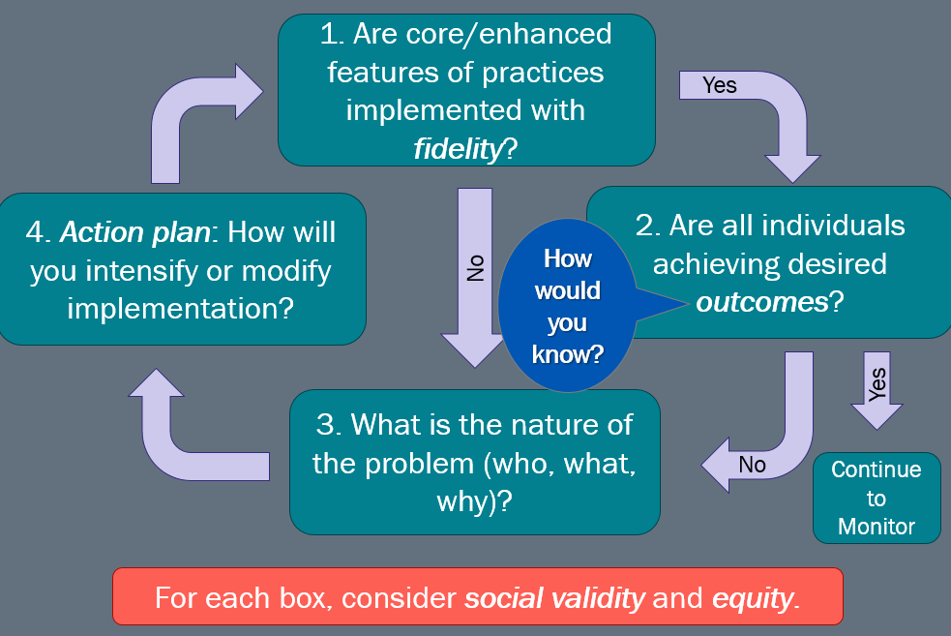
Think about step 2

Slide 19
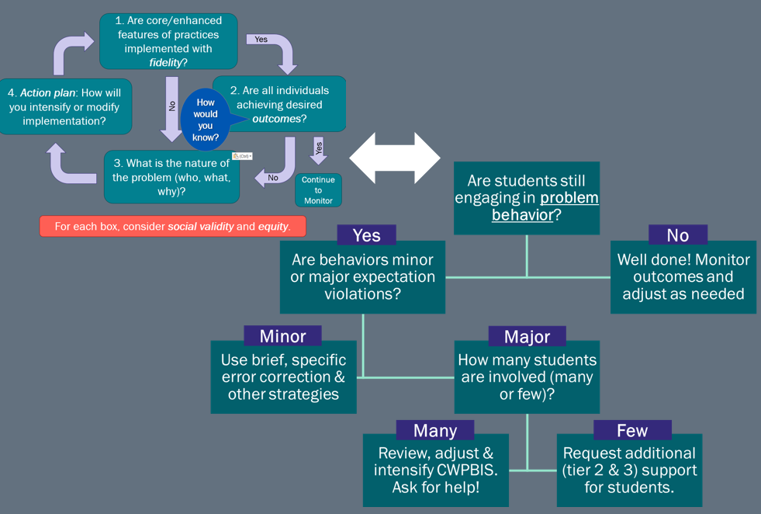
Extended diagram

Slide 20
DBR for Outcomes
2. Are all individuals achieving desired outcomes?
How would you know?
Direct Behavior Ratings (DBR)
Grades/Work Samples
Attendance
Anecdotal Reports (ABC Charts)
Direct Observation
  Event Based Systems (Tally)
  Time (Duration/Latency)
  Time Based Estimates
    Partial/Whole Interval Recording
    Momentary Time Sampling
Page 8

Slide 21
Direct Behavior Rating
Completed directly after a defined observation period
Focused on 3 Key behaviors:
  Academic Engagement
  Respectful
  Disruptive
Rated on a scale of 1-10
Can be used to progress monitor
Can be adapted to whole class use

Slide 22
Assessing Outcomes
2. Are all individuals achieving desired outcomes?
How would you know?
Are students still engaging in problem behavior?
Many
Major
Few
Direct Behavior Ratings (DBR)
Grades/Work Samples
Attendance
Anecdotal Reports (ABC Charts)
Direct Observation
  Event Based Systems (Tally)
  Time (Duration/Latency)
  Time Based Estimates
    Partial/Whole Interval Recording
    Momentary Time Sampling

Slide 23
Activity 7.2: Stop and Jot
Measuring student behavior
Review the data collection strategies you used in Module 6
Write notes regarding the following in your workbook:
  What you would add/change based on the content we just discussed?
  Which of these data collection strategies have you seen others use?
  Which are you most likely to use and why?

Slide 24
Activity 7.2: Review
Remember to balance precision with practicality when choosing measurement tools
More data is not necessarily better! Only collect what you will use to guide decision making!
Prioritize the use of existing data sources when possible

Slide 25
Data-Based Decision Making
Part 3
How do we use data to define the nature of the problem?

Slide 26
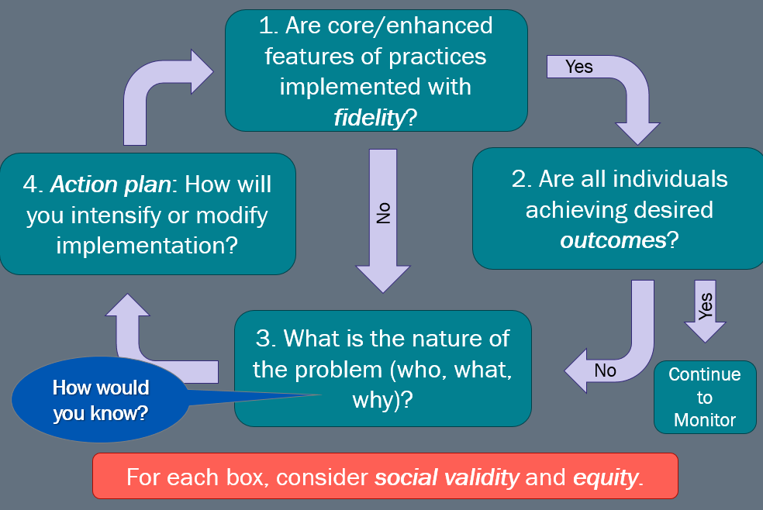
Think about part 3

Slide 27

PCBS Practices
Decision-Making Guide: 3 Key Questions
Are students still engaging in problem behavior?
Are behaviors minor or major expectation violations?
Well done! Monitor outcomes and adjust as needed
Use brief, specific error correction & other strategies
How many students are involved (many or few)?
Review, adjust & intensify CWPBIS. Ask for help!
Request additional (tier 2 & 3) support for students.
Yes
No
Minor
Major
Many
Few
(OSEP, 2015)

Slide 28
Do data indicate that students are still engaging in problem behavior?
Do data indicate that students are still engaging in problem behavior?
Are students still engaging in problem behavior?
Are behaviors minor or major expectation violations?
Frequency
Rate
Duration
Latency
Topography
Force
Locus
How would you know?
(OSEP, 2015)

Slide 29
Major vs. Minor: One Example
Staff Managed are Minors | Office Managed are Majors
Minors Inappropriate Language Physical Contact Defiance/Insubordination/ Non-Compliance Disrespect Disruption Dress Code Technology Violation Property Misuse Tardy Consequences are determined by staff | Majors Abusive/Inappropriate Language Fighting Physical Aggression Defiance/Insubordination Harassment/Intimidation Inappropriate Display of Affection Vandalism/Property Destruction Lying/Cheating Skipping Technology Violation Dress Code Theft Arson Weapons Tobacco Alcohol/Drugs
Example
Note: Many of these terms are subjective! Use what you learned in Module 6 to develop operational definitions of these. Use the dimensions of behavior to help you differentiate between major and minor infractions

Slide 30
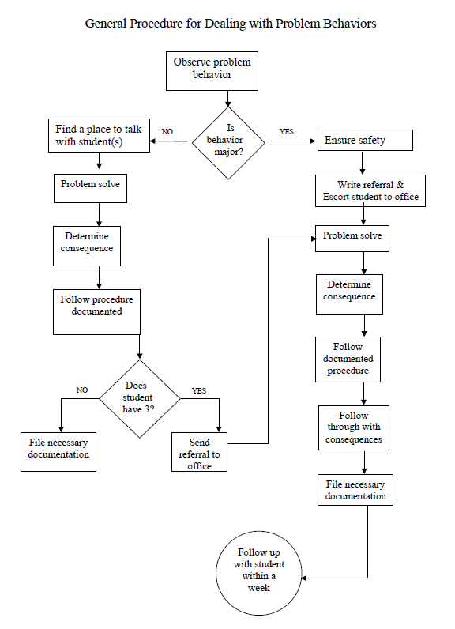
Major vs. Minor
General Process
&
Predictable System
More information and examples are available at www.pbisapps.org in the SWIS Resources section

Slide 31
Activity 7.3
Activity 7.3: Discussion Board Post
Major vs. Minor
  How would you define minor vs. major behavior for your classroom given the age, ability, developmental level, etc., of your students?
  How have you seen your school define minor vs. major? Have you agreed?
  What would be your own decision tree?
  Discuss with your colleagues/classmates the similarities and differences in your definitions

Slide 32
Activity 7.3: Review
Defining levels of problem behaviors is essential to helping keep your responses to those behaviors consistent.
It is also important to communicate your definitions with others on your team.
Good operational definitions help support this!

Slide 33
Do data indicate that students are still engaging in problem behavior?
Do data indicate that students are still engaging in problem behavior?
Are students still engaging in problem behavior?
Are behaviors minor or major expectation violations?
Use brief, specific error correction & other strategies
Yes
Minor
(OSEP, 2015)

Slide 34
Do data indicate that students are still engaging in problem behavior part 2
Do data indicate that students are still engaging in problem behavior?
Are students still engaging in problem behavior?
Are behaviors minor or major expectation violations?
How many students are involved (many or few)?
Yes
Major
How would you know?
(OSEP, 2015)

Slide 35
Further defining the nature of the problem
3. What is the nature of the problem (who, what, why)?
Problems often are framed in a “primary” form.
That form creates concern, but it is not a useful form for problem solving.
    Frame primary problems based on initial review of data
    Use more detailed review of data to build “Solvable Problem Statements”

Slide 36
Precise Problem Statements
3. What is the nature of the problem (who, what, why)?
Precise problem statements include information about the following questions:
  What is the problem behavior?
  How often is the problem happening?
  Where is the problem happening?
  Who is engaged in the behavior?
  When is the problem most likely to occur?
  Why is the problem sustaining?
What are the data we need for a decision?

Slide 37
Primary vs. Precision Statements
3. What is the nature of the problem (who, what, why)?
Primary Statements
Precision Statement
Too many students off task.
November has more office referrals than October.
Tardiness is increasing.
The class is out of control.
Student disrespect is disrupting instruction.
There are more students off task during small group instruction this week than last. This typically includes 3-4 of the 6 students in the group. Off task behavior is most likely to occur toward the end of the lesson when the teacher is working with 1 student and others are asked to follow along, and the off task behavior appears to be related to getting teacher attention.

Slide 38
Precision Statement Example
3. What is the nature of the problem (who, what, why)?
There are more students off task during small group instruction this week than last. This typically includes 3-4 of the 6 students in the group. Off task behavior is most likely to occur toward the end of the lesson when the teacher is working with 1 student and others are asked to follow along, and the off task behavior appears to be related to getting teacher attention.
  What? More students off task
  Where? Small group instruction
  Who? 3-4 of 6 students
  When? End of lesson when teacher is working with 1 student
  Why? Getting access to teacher attention

Slide 39
Activity 7.4: Stop and Jot
Precision Problem Statements
Develop a precision problem statement for a recurring but minor problem behavior in your class
Does your statement answer all the critical questions?
  What?
  Where?
  Who?
  When?
  Why?

Slide 40
Activity 7.4: Review
In some cases you may need to collect additional data to develop a clear precision problem statement. Review content in module 6 and parts 1 and 2 of this module to help you select appropriate measures if needed.

Slide 41
Data-Based Decision Making
Part 4
How do we intensify our plan to improve outcomes?

Slide 42
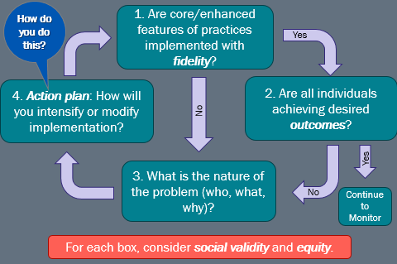
Think about part 4

Slide 43
Many data indicate problem behavior
Do data indicate that students are still engaging in problem behavior?
Are students still engaging in problem behavior?
Are behaviors minor or major expectation violations?
Review, adjust, & intensify CWPBIS. Ask for help!
How many students are involved (many or few)?
Yes
Major
How?
Many
(OSEP, 2015)

Slide 44
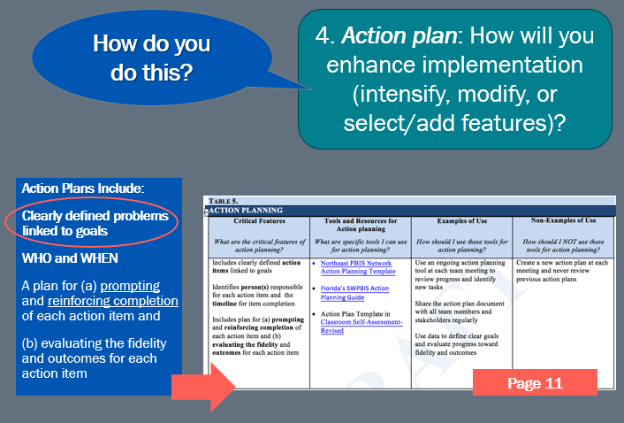
Think about an action plan

Slide 45
Defining Goals
Define the problem with precision
Measure of the problem (level, amount)
Define what would be considered “good”
Use the goal to guide the solution
  How can we move from where we are to where we want to be?

Slide 46
Defining Goals
General Problem | Precision Statement | Goal
Students are off task during small group instruction | 3-4 students are off task at the end of a lesson while the teacher works with one student. Currently, teacher reminds them to follow along when they are off task | 5/6 students will stay on task when the teacher needs to work with 1 student

Slide 47
Activity 7.5: Stop and Jot
Goal Statements
Use your precision problem statement to develop a goal.
Does your goal clearly define the problem, current status and your desired outcome in observable/measurable terms?
General Problem | Precision Statement | Goal

Slide 48
Activity 7.5: Review
Is your goal observable and measurable?
How will you know when you’ve reached it?
Keep goals high but achievable!

Slide 49
Using Data to Develop Solutions
Prevention—How can we avoid the problem context?
  Schedule change, curriculum change, etc.
Teaching—How can we define, teach, and monitor what we want?
  Teach appropriate behavior
  Use problem behavior as negative example
Recognition—How can we systematically reward positive behavior?
Extinction—How can we prevent problem behavior
from being rewarded?
Consequences—How can we systematically correct
problem behavior?
How will we collect and use data to evaluate:
  Implementation fidelity
  Impact on student outcomes
See Antecedent strategies in module 3
See teaching strategies in module 3
See reinforcement strategies in module 4
See punishment strategies in module 5
See measurement strategies in modules 6-7

Slide 50
Solution Development Example
Solution Component | Action Step(s)
Prevention | Plan individual support for beginning of lesson. Provide specific task for other students while working with one. Prompt students to remind them of on-task expectations.
Teaching | Re-teach classroom expectation for on-task behavior. Teach a “getting help” routine for students to use if they need help and the teacher is not available.
Recognition | Target on task behavior with class-wide reinforcement system and intensify reinforcement at the end of the lesson.
Extinction | If a student is off task but does not use “getting help routine” use planned ignoring to so you don’t provide teacher attention at this time.
Corrective Consequence | When a student is off task consider having them complete work before being able to access a more preferred activity.
Data collection | Use this plan as a fidelity checklist Use DBR to monitor on-task behaviors

Slide 51
Activity 7.6: Pause and Process
Solution Development
Using the 5 critical features of classroom management (and the strategies that fit within each) we’ve discussed in this course, your precision problem statement, and your goal from activities 7.4 and 7.5, jot at least one intervention idea in each box of the solution development table in your workbook.
Remember to start with prevention and teaching!

Slide 52
Activity 7.6: Review
Review the content in modules 1-5 to help you complete this activity or to provide additional ideas for addressing each component of your solution plan!

Slide 53
Few data indicates problem behavior
Do data indicate that students are still engaging in problem behavior?
Are students still engaging in problem behavior?
Are behaviors minor or major expectation violations?
Request additional (tiers 2 & 3) support for students.
How many students are involved (many or few)?
We’ll provide an overview of Tiers 2 and 3 in Module 8
Yes
Major
Few
(OSEP, 2015)

Slide 54
Are students still engaging in problem behavior?
Do data indicate that students are still engaging in problem behavior?
Are students still engaging in problem behavior?
Are behaviors minor or major expectation violations?
Request additional (tiers 2 & 3) support for students.
Review, adjust & intensify CWPBIS. Ask for help!
Use brief, specific error correction & other strategies
How many students are involved (many or few)?
Well done! Monitor outcomes and adjust as needed
Yes
No
Yes
Minor
Major
(OSEP, 2015)
Many
Few

Slide 55
Visit resources at pbis.org for social validity and equity
1. Are core/enhanced features of practices implemented with fidelity?
Yes
Not covered in
this course.
Please see resources at PBIS.org
4. Action plan: How will you intensify or modify implementation?
No
2. Are all individuals achieving desired outcomes?
Yes
3. What is the nature of the problem (who, what, why)?
Continue to Monitor
For each box, consider social validity and equity.

Slide 56
Next Steps
Module 7 Quiz
Classroom Application Activity

