Slide 1
Module 3
Antecedent and
Instructional Strategies
Jennifer Freeman, PhD
Don Briere, PhD
Brandi Simonsen, PhD

Slide 2
Acknowledgements
Much of the content shared in this module was developed by members of the OSEP funded National Technical Assistance Center for Positive Behavioral Interventions and Supports.
Thank you to:
  Members of classroom workgroup:
    Brandi Simonsen, Jennifer Freeman, Jessica Swain-Bradway, Robert Putnam, Heather George, Steve Goodman, Barb Mitchell, Kimberly Yanek, Kathleen Lane & Jeffrey Sprague
  Members of the Northeast PBIS Network:
    Susannah Everett, Adam Feinberg, George Sugai, Brandi Simonsen & Jennifer Freeman

Slide 3
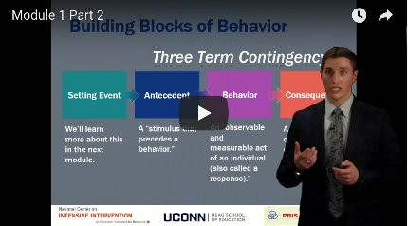
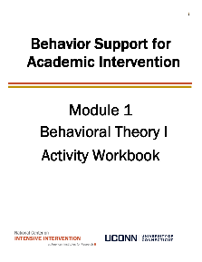

Orientation to Module Tools and Resources
Module Videos
Module Workbook
Module Readings and Additional Resources

Slide 4

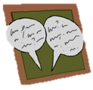

Orientation to Module Elements
Activities
Classroom Application Activities
  Can you apply the basic content presented in this module to your classroom context?
Module Quiz – Self Assessment
  Do you know the basic content presented in this module?
Coaching Activities
  Can you implement the content presented in this module in your classroom effectively?
Discussion Board Post
Stop and Jot

Slide 5
Getting the Most Out of This Module
Pre-service
Become fluent with content and basic theory
New Teachers
Focus on moving from knowledge to practice
Experienced Teachers
Use activities as a self-reflection opportunity
Consider how you might coach or teach the skills/content to a new teacher in your building
Set a new implementation goal for yourself
Review resources provided to extend your learning with respect to culturally and contextually relevant implementation
Look for examples of implementation in your clinic placements
Video record or ask for feedback on your implementation of key practices during your student teaching
Set implementation goals and either self-monitor or ask for peer/coach feedback on your use of key skills
When a practice isn’t working, use your understanding of theory to help you modify or intensify a practice to improve outcomes

Slide 6
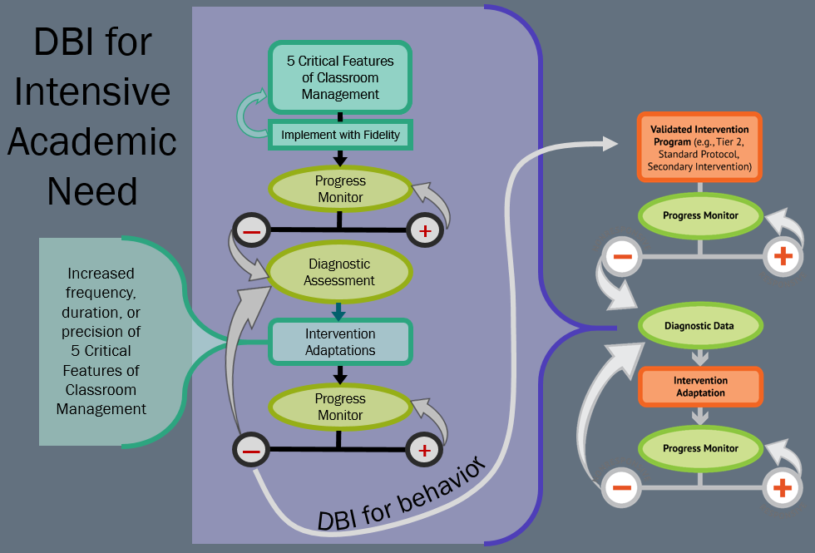
DBI for Intensive Academic Need

Slide 7
Module Objectives
By the end of Module 3 you should be able to :
Part 1 | Maximize structure in your classroom Define and give examples of physical layout Define and give examples of classroom routines
Part 2 & 3 | Post, teach, prompt, review, monitor, and reinforce a small number of positively stated expectations Operationally define classroom expectations within routines using a matrix Design a social skills lesson plan that contains the critical elements
Part 4 | Actively engage students in observable ways

Slide 8
Antecedent and Instructional Strategies
Part 1
What are the 5 critical features of effective classroom management

Slide 9
Proactive and Reactive Classroom Management
SETTING EVENT
MANIPULATIONS
ANTECEDENT
MANIPULATIONS
WAYS TO TEACH
BEHAVIORS
CONSEQUENCE
MANIPULATIONS
Minimize the likelihood the SE will happen
Neutralize the effects if SE does occur
Withhold the Antecedent when SE is present
Add prompts and increase reinforcement for desired behaviors when SE is present
WAYS TO
MAKE
PROBLEM
BEHAVIOR
IRRELEVANT
(PROMPTS)
WAYS TO
MAKE
PROBLEM
BEHAVIOR
INEFFICIENT
(SHAPING & CHAINING)
WAYS TO
MAKE
PROBLEM
BEHAVIOR
INEFFECTIVE
Reactive Classroom Management Strategies
Proactive Classroom Management Strategies

Slide 10
Five Critical Features of Evidence-Based Classroom Management
1. Maximize Structure
2. Establish, Post, Teach, Review, Monitor, and Reinforce Expectations
3. Actively Engage Students in Observable Ways
4. Use a Continuum of Strategies to Acknowledge Appropriate Behavior
5. Use a Continuum of Strategies to Discourage Inappropriate Behavior
Remember:
Each classroom or instructional group is different and each of these practices must be implemented in a contextually and culturally relevant way
(Simonsen et al., 2008)

Slide 11
Classroom Management…
…is NOT a magic fix
  …is NOT re-design of individual students
…IS re-designing & improving learning and teaching environments with attention to function
…IS a change in behavior of implementers (adults…that’s YOU!)

Slide 12

Resource Alert!
“Supporting and responding to Student Behavior: Evidence-Based Classroom Strategies for Teachers”
Before jumping into content, let’s preview the features of this resource
Developed by: Brandi Simonsen, Jennifer Freeman, Steve Goodman, Barbara Mitchell, Jessica Swain-Bradway, Brigid Flannery, George Sugai, Heather George, Bob Putnam, &Renee Bradley et al. (OSEP)

Slide 13
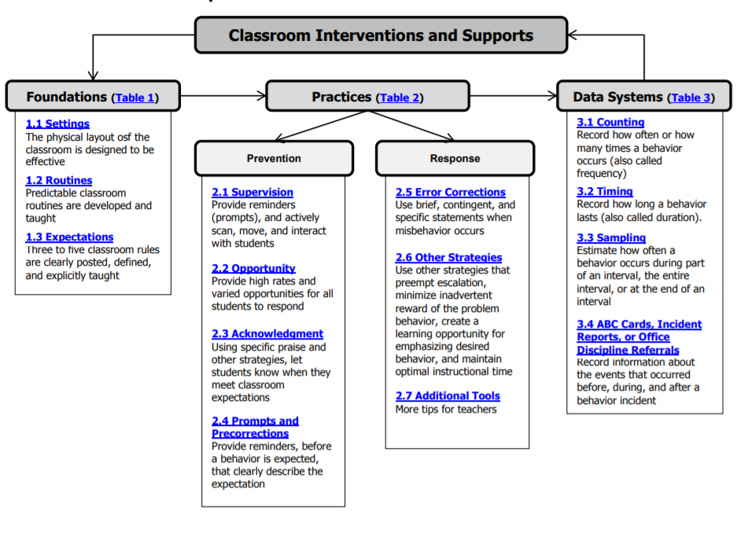
Interactive Map of Core Features

Slide 14
Self-Assessment

Slide 15
Decision Making Guide

Slide 16
Tables with Definitions, Examples,
Non-Examples, and Resources

Slide 17
Additional Tools

Slide 18
Scenarios to Illustrate Implementation

Slide 19
Antecedent and Instructional Strategies
Part 2
How do I maximize structure in my classroom?

Slide 20
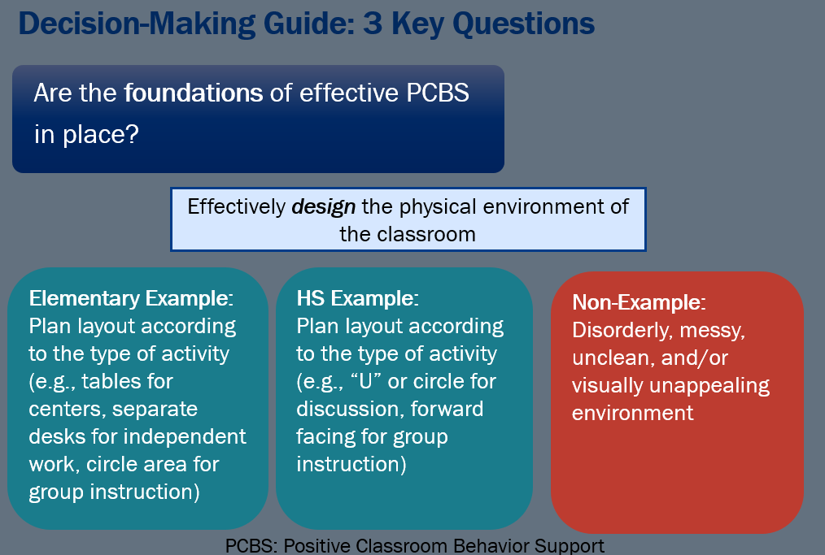
Decision Making Guide: 3 Key Questions – are the foundations of PCBS in place?

Slide 21
How Do I Design the Physical Environment?
Design environment to (a) elicit appropriate behavior and (b) minimize crowding and distraction:
  Arrange furniture to allow easy traffic flow.
  Seating arrangements (groups, individual, etc.)
  Ensure adequate supervision of all areas.
  Designate staff and student areas.

Slide 22
Examples of Physical Arrangements for Small Group Instruction
Group vs Individual Work
Staff and Student Areas
Adequate Supervision
Traffic Flow

Slide 23
Activity 3.1: Stop and Jot
Design your space
Plan your classroom environment
  Design your physical space to facilitate your daily activities
  Consider visual access to all students at all times (active supervision)
  Think about non-academic daily routines/needs (e.g., pencil sharpening, access to necessary materials, bathroom breaks)
Please Pause Video & Complete Activity 3.1

Slide 24
Activity 3.1: Review
Did you consider ways to
  Minimize crowding and distraction?
  Facilitate active supervision?
Remember small changes to the physical environment can have a big impact on student behavior!

Slide 25
Are the foundations of effective PCBS ub place – Design and Routines
Are the foundations of effective PCBS in place?
Effectively design the physical environment of the classroom
+
Develop & teach predictable classroom routines.
Elementary Example:
Establish routines and procedures for:
Arrival and dismissal
Transitions between activities
Accessing help
What to do after work is completed
HS Example:
Consider routines and procedures for:
Turning in work
Accessing materials
Making up missed work
Transitions/ interruptions
Non-Example:
Assuming students automatically know routines and procedures without instruction and feedback

Slide 26
How do I Develop Predictable Routines?
Develop Predictable Routines and Schedule
  Teacher routines
  Administration time
  Personal time
  Student routines
        Student directed activities
        Whole group activities
        Independent activities
Make smooth, rapid transitions between activities throughout the class activity and day; teach/practice transition behaviors

Slide 27
Activity 3.2: Discussion Board
Develop routines
Review the linked examples
Review and share your classroom routines.
  What routines do you currently have established in your own classroom
  What routines would you like to establish in your own classroom?
Please Pause Video & Complete Activity 3.2

Slide 28
Activity 3.2: Review
We hope you now have many different examples of classroom routines from your colleagues.
As you consider identifying new routines to establish in your classroom, remember to include routines for access to online resources for both students and families.

Slide 29
Antecedent and Instructional Strategies
Part 3
How do I define and teach my expectations?

Slide 30
Foundations of effective PCBS – Design, Routines and Expectations
Are the foundations of effective PCBS in place?
Effectively design the physical environment of the classroom
+
Develop & teach predictable classroom routines.
+
Post, define, & teach 3-5 positive classroom expectations.
Elementary Example:
Poster of Be Safe, Kind, & Ready
Matrix to define for each classroom routine.
Teach engaging lessons for each expectation
HS Example:
Student-created poster of Citizenship, Achievement, & Grit
Engage students in developing the matrix and teaching each lesson using video, etc.
Non-Example:
Assuming students will already know your expectations
Having more than 5 expectations
Listing only behaviors you do NOT want from students

Slide 31
How do I Post, Define and Teach Expectations?
Three Steps:
Establish Expectations
Identify Routines
Create Examples
Establish / Post
Teach
Prompt
Monitor
Evaluate

Slide 32
Expectations vs. Rules
Establish / Post
Expectations are
  Broadly stated
  Apply to all people in all settings
  Describe the general ways people should behave
Rules
  Describe specific behaviors
  May apply to a limited number of settings
  May clarify behavior for a specific setting

Slide 33
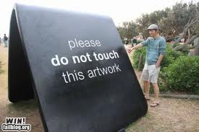
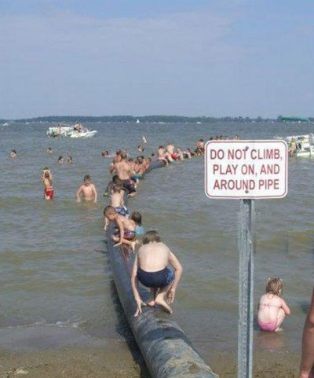
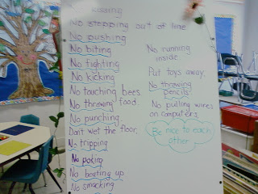
Establish and Post
Establish / Post
  Define 3-5 expectations for your classroom
  Positively stated
    Tell students what you want them to do rather than what not to do
    Avoid “loopholes”
  Easy to remember
    Aligned to school-wide expectations

Slide 34
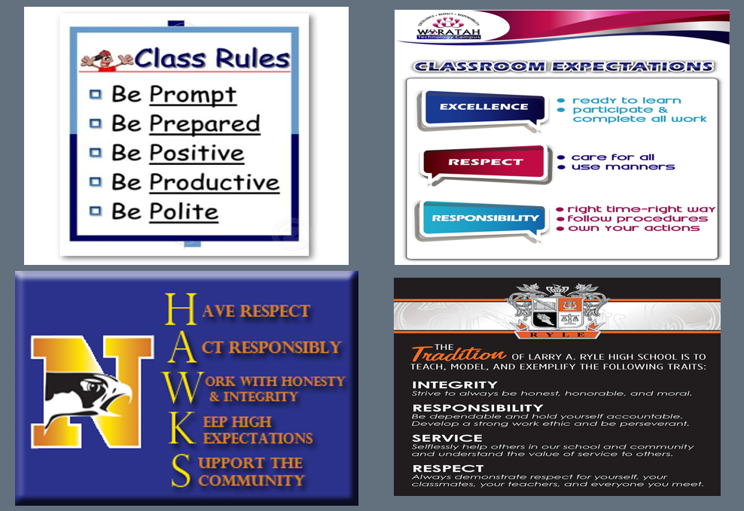
Classroom rules and expectations

Slide 35
Activity 3.3: Stop and Jot
Develop expectations
What are your classroom expectations?
  If you are working in a school or classroom that has defined 3-5 positively stated expectations, what are they? Do your classroom expectations align?
  If you are not, what expectations might you use in your own classroom?
Please Pause Video & Complete Activity 3.3

Slide 36
Activity 3.3: Review
Double check your expectations.
  Are they positively stated?
  Are they easy to remember?
  Are they mutually exclusive?

Slide 37
Establisj/Post – Define Expectations with routines
Define Expectations
within Routines
Establish / Post
Operationally define what the expectations look like across all the routines and settings in your classroom.
  One way to do this is in a matrix format.
  This matrix should complement your school-wide matrix, but be specific to your classroom setting.
  A matrix can be flexible across ages, and time.

Slide 38
Rules within Routines Matrix
Routines
 | Entering Classroom | Seat Work | Small Group Activity | Leaving Classroom
Respect
Responsibility
Safety
Expectations
Listen to Others
Use Kind Words
Positively Stated Behavior Examples
(You will need 2-3 examples for each box for your activity)
Stay on Topic
Actively Participate
Use Materials Carefully
Stay in your personal space

Slide 39
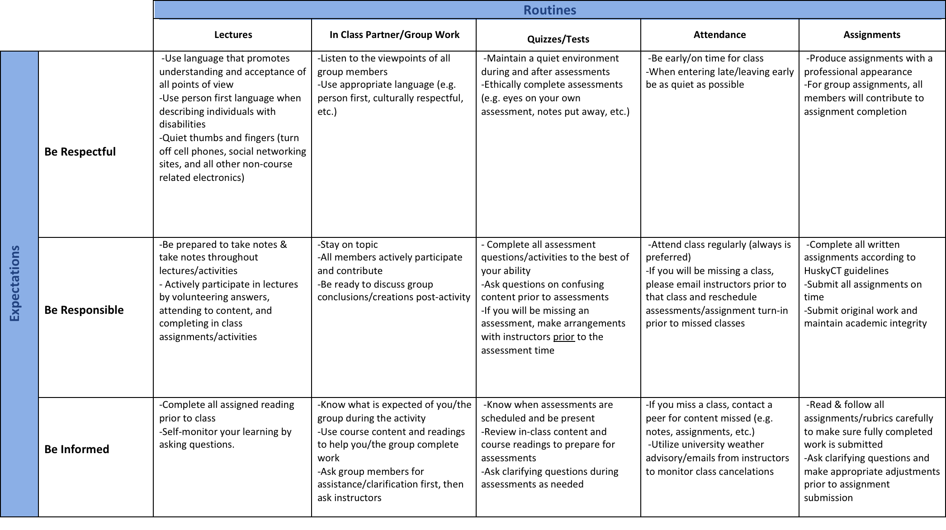
Expectations and Routines Chart

Slide 40
Establishing Expectations Chart

Slide 41
Classroom Matrix Examples
More Classroom Matrix Examples
 |  | ROUTINES
 |  | Entering Classroom | Warm-ups | Sight- reading | Ensemble singing | Leaving classroom
Be Respectful |  | Use walking feet and a quiet voice Begin to set up chairs Get chorus folder | Follow adult directions Use appropriate singing voice Sing when it is your time to do so | Be attentive Follow music Use appropriate rhythm/melodic syllables | Be attentive Hold music up Use appropriate singing voice | Use walking feet and a quiet voice Wait your turn Put your chair away Put folder away
Be Responsible |  | Be on time Sit in a spot where you will be successful Have a pencil | Participate appropriately in stretches Participate appropriately in singing | Mark music with pencil Do your best work | Be an active member of our ensemble Participate in singing | Make sure all materials are back in place Walk back to class
Be Safe |  | Keeps hands to yourself Maintain personal space Be aware of surroundings | Sit correctly on chairs Keeps hands to yourself Stand with excellent posture Be aware of your personal space | Model acceptance of everyone’s best effort Offer constructive criticism for all Keep hands to yourself | Model acceptance of everyone’s best effort Keep hands to yourself Self- evaluate before evaluating whole class | Keep hands to yourself Maintain personal space Be aware of surroundings

Slide 42
More classroom matrix examples
More Classroom Matrix Examples
 |  | ROUTINES
 |  | Whole Group Instruction | Group Work | Individual Work | Upon Arrival | Free Time
Be Respectful |  | Raise hand when wanting to talk Sit in assigned seat Listen when teacher is talking | Use low volume voices Keep Hands to self | If needing to talk Use low volume voices Follow directions Keep hands to self | Sit in assigned seat Enter the classroom Keep hands to self | Use materials appropriately Keep hands to self
Be Responsible |  | Have Homework ready Come with a pencil everyday Be safe with classroom supplies | Come with needed materials Use time wisely Be safe with materials | Ask your neighbor for help Stay on task Come prepared | Take out all necessary materials Be on time Come ready to learn | Put away any materials Ask if wanting to leave the classroom
Be Accepting |  | Be open to other’s opinions Use kind words | Listen to everyone’s input Let everyone contribute Help others in group | Help other if they need it Use kind words Be accepting of yourself by doing your best | Greet others nicely Help other’s become prepared Be patient when waiting for class to begin | Use kind words Cooperate with others Share materials

Slide 43
More classroom matrix examples
More Classroom Matrix Examples
 |  | ROUTINES
 |  | Hallway | Entering Classroom/homeroom | Warm-Up/Bell ringer (individual at desk) | Mini lesson (on rug in front of classroom) | Partner/Group Activities (around classroom) | Exit Ticket (individual at desk)
Be Kind |  | Silent voices Quiet feet Silent greetings | Say good morning to the teacher and your peers Think before you speak | Speak when it is your turn Use silent voices | Do not disrupt the lesson Raise your hands with concerns or questions | Think before you speak Share any materials or equipment Use quiet voices Encourage each other | Speak when it is your turn Use silent voices
Be Safe |  | Walk at all times in line order Look where you’re going Keep hands to yourself | Use quiet feet to walk one at a time through the doors Keep your body calm Keep hands, feet, and objects to yourself | Keep your body calm Keep hands, feet, and objects to yourself Sit in your seat properly | Keep hands, feet, and objects to yourself Sit on the rug properly (criss cross apple sauce) in assigned spot Keep your body calm | Use classroom furniture and materials properly Keep your hands, feet, and objects to yourself Keep your body calm | Keep your body calm Sit in your seat properly Keep hands, feet, and objects to yourself Use quiet feet
Be responsible |  | Put away jackets, hats, gloves, and backpack in locker Use lockers safely Pay attention Stay with your class Use water fountain appropriately | Bring binder to class Sit in your assigned seat first Then put any notes from parents, permission slips, and/or homework in the correct bin on teacher’s desk Listen to the morning announcements | Follow directions on warm-up/bell ringer Focus on learning Work diligently Have a book to read silently if you finish early | Follow directions the first time Focus on learning Be attentive to the teacher Do not have side conversations | Follow directions the first time Have a pencil ready Keep binder and desk organized Work diligently | Follow directions on exit ticket Keep desk organized Work diligently Hand in exit ticket to teacher Have a book to read silently if you finish early

Slide 44
Activity 3.4: Classroom Application
Develop a classroom matrix
Brainstorm and share examples of behaviors for your classroom behavior matrix. You will need 2-3 positively stated, discrete behaviors per box of your matrix.
First, fill in the behavior expectations you identified in Activity 4.3 in the left-hand column.
Second, identify 5-7 classroom routines by writing them in the boxes on the top row.
Third, enter your 2-3 positively state examples of behaviors within each box of the matrix.
Review your matrix with a peer or a coach using the rubric in your workbook
Please Pause Video & Complete Activity 3.4

Slide 45
Activity 3.4: Review
Now that your classroom matrix is developed double check to be sure you have:
  2-3 positively stated expectations for each box
  We will use this matrix as the “scope and sequence” for teaching the behavioral expectations in your class.

Slide 46
Establish, post, teach, review, monitor and Reinforce
Establish, Post, Teach, Review, Monitor, and reinforce a small number of positively stated expectations.
Three Steps:
Establish Expectations
Identify Routines
Create Examples
Establish / Post
Teach
Prompt
Monitor
Evaluate

Slide 47
Academic teaching example: addition
Teach
“A+B=C where C is the sum or total of A and B combined…”
“Work with another partner & do these 3 examples….”
ADJUST for
Efficiency
DEFINE
Simply
“I noticed that everyone got #1 & #3 correct. #2 was tricky because we had to carry the one….”
MONITOR &
ACKNOWLEDGE
Continuously
MODEL
PRACTICE
In Setting
“Watch me use these manipulatives,…If A = 6 & B = 2, then C = 8….”
“Work w/ your partner & determine the total or sum for these 3 examples……”

Slide 48
Social Behavior teaching example:
Being cut in line
Teach
“If someone cuts you in line, you should remain calm and think about the situation…”
“You got it. Tomorrow let’s figure out what else you might do in these situations.”
ADJUST for
Efficiency
DEFINE
Simply
“That was great. What would that look like if you were cut in line in the classroom? In the store?”
MONITOR &
ACKNOWLEDGE
Continuously
MODEL
PRACTICE
In Setting
“Watch. This is how I would respond if someone cut me in line….”
“Tell me how you would respond if someone cut you in line at the water fountain.” “In line for a snack.”

Slide 49
Rules in the context of routines – model and lead
Teach
Rules in the context of routines
MODEL
Teach expectations directly.
  Define rule in operational terms—tell students what the rule looks like within routine.
  Provide students with examples and non-examples of rule-following within routine.
Actively involve students in lesson—game, role-play, etc. to check for their understanding.
LEAD

Slide 50
Rules in the context of routines - test
Teach
Rules in the context of routines
TEST
Provide opportunities to practice rule following behavior in the natural setting.
A separate lesson plan should be developed for teaching each expectation in the context of each routine. That is, a separate lesson would be created for each box in the matrix.

Slide 51
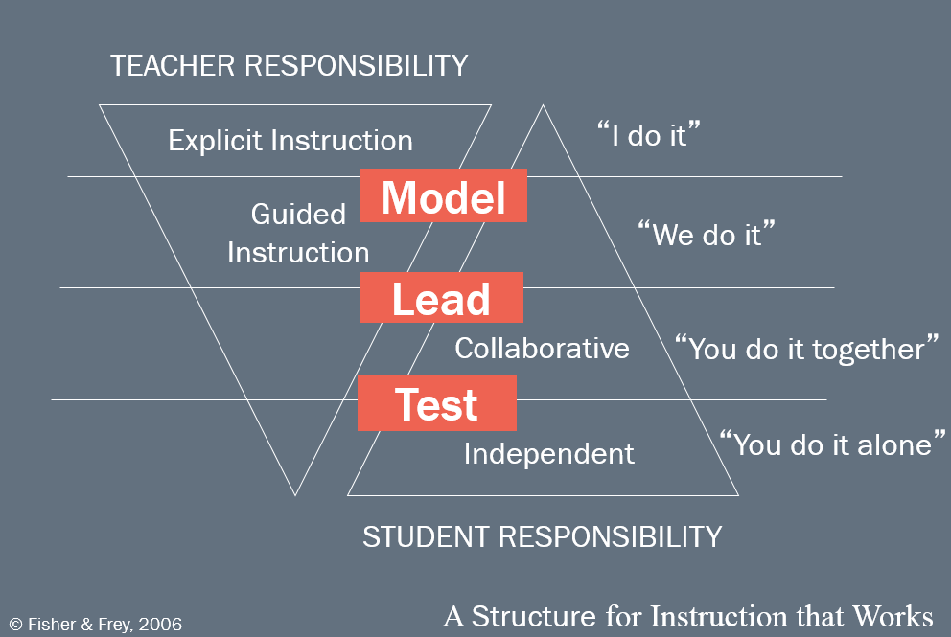
Teacher responsibility and Student responsibility

Slide 52

What is the ultimate goal of all instruction – focus on phases of learning
What is the ultimate goal of all instruction?
Focus on phases of learning
Acquisition
Fluency
Maintenance
Generalization
“Increase accuracy of new skill”
“Increase rate of correct responses to ‘automatic’ or functional level”
“Perform skill overtime without reteaching”
“Stimulus generalization”
“Response adaptation”
(Simonsen & Myers, 2015)

Slide 53
Establish, Post, Teach, Review, Monitor and Reinforce
Establish, Post, Teach, Review, Monitor, and reinforce a small number of positively stated expectations.
Three Steps:
Establish Expectations
Identify Routines
Create Examples
Establish / Post
Teach
Prompt
Monitor
Evaluate

Slide 54
What behavioral procedures are involved in teaching
What behavioral procedures are involved in teaching?
Types of Prompts
Antecedent
Behavior
Consequence
Verbal
Presenting an additional stimulus to increase the probability that the S^{D} will occasion the desired response
Visual
Gestural
Guidelines:
Choose the “just right” prompt (not too much, not too little)
Fade as quickly as possible
Prompting
Modeling
Physical Guidance
(Simonsen & Myers, 2015)

Slide 55
More Examples of Prompts
Physical Guidance
Visual
Gestural
Modeling
Verbal

Slide 56
Activity 3.5: Stop and Jot
Plan your prompts
Plan your prompts
Describe how you prompt expected behavior throughout the classroom routines you identified on your matrix
Consider specifically what it will look like for one expectation and one routine
Please Pause Video & Complete Activity 3.5

Slide 57
Activity 3.5: Review
Remember the goal of prompting is to increase the likelihood the student engages in a particular behavior. Remember, whenever we use prompts we want to consider the following:
Choose the “just right” prompt (not too much, not too little)
Fade as quickly as possible

Slide 58
Establish, post, teach, review, monitor and reinforce
Establish, Post, Teach, Review, Monitor, and reinforce a small number of positively stated expectations.
Three Steps:
Establish Expectations
Identify Routines
Create Examples
Establish / Post
Teach
Prompt
Monitor
Evaluate

Slide 59
Monitor – Students behavior in natural context
Monitor
Students’ behavior in natural context
Active Supervision (Colvin, Sugai, Good, Lee, 1997):
Move around
Look around (Scan)
Interact with students
  Reinforce
  Correct

Slide 60
Activity 3.6: Stop and Jot
Plan your active supervision
Plan your active supervision
  Describe how you will move, scan, and interact throughout the classroom routines you identified on your matrix
  Consider specifically what it will look like for the one expectation and one routine you selected
Please Pause Video & Complete Activity 3.6

Slide 61
Activity 3.6: Review
Does your plan include moving, scanning, and interacting?
Are there times of the day or specific instructional routines that you will target for increasing your active supervision?
Why did you choose those times?

Slide 62
Establish, post, teach, review, monitor and reinforce
Establish, Post, Teach, Review, Monitor, and reinforce a small number of positively stated expectations.
Three Steps:
Establish Expectations
Identify Routines
Create Examples
Establish / Post
Teach
Prompt
Monitor
Evaluate

Slide 63
Evaluate – The effect of instruction
Evaluate
The Effect of Instruction
Collect data and reflect on outcomes:
  Are rules being followed?
  If there are errors,
    who is making them?
    where are the errors occurring?
    what kind of errors are being made?
Summarize data (look for patterns)
Use data to make decisions
Recall Module 3
More on this in Module 7

Slide 64
A good plan brings everything together
Establish, Post, Teach, Review, Monitor, and reinforce a small number of positively stated expectations.
A Good Lesson Plan Brings This All Together
Three Steps:
Establish Expectations
Identify Routines
Create Examples
Establish / Post
Teach
Prompt
Monitor
Evaluate

Slide 65
Lesson plans should include:
Social Skills Lesson Plans
A brief explanation of the expectation and routine.
A statement (i.e., operational definition) of what it looks like to follow the expectation within the routine, including both positive and negative teaching examples.
A demonstration of expectation-following behavior (model).
Activities that provide students with guided practice (lead).
Opportunities for students to independently demonstrate expected behavior in the natural context (test).

Slide 66
Activity 3.7: Classroom Application
Lesson Study: Social Skills Lesson Planning
Review the linked lesson plans in your workbook
Following your review, reflect on the provided examples. What do you think? Could you see lessons like this helping in your classroom/subject area? Why or why not?
Select 1 box of your matrix
Apply content draft of a social skills lesson plan (included in your workbook)
Review your lesson plan with a peer or your coach using the attached rubric; then share your lesson plan with your peers.

Slide 67

Activity 3.7: Review
Does your lesson plan include clear model, lead, test components?
If you would like additional examples or guidance on teaching social skills check out this resource from the IRIS center.
http://iris.peabody.vanderbilt.edu/wp-content/uploads/pdf_case_studies/ics_norms.pdf

Slide 68
Antecedent and Instructional Strategies
Part 4
How do I use active engagement and instructional strategies to prevent problem behavior?

Slide 69
3 Key Questions in PCBS practices decision making guide
PCBS Practices Decision-Making Guide:
3 Key Questions
Are the foundations of effective PCBS in place?
Are proactive and positive PCBS practices implemented consistently?
Do data indicate that students are still engaging in problem behavior?

Slide 70
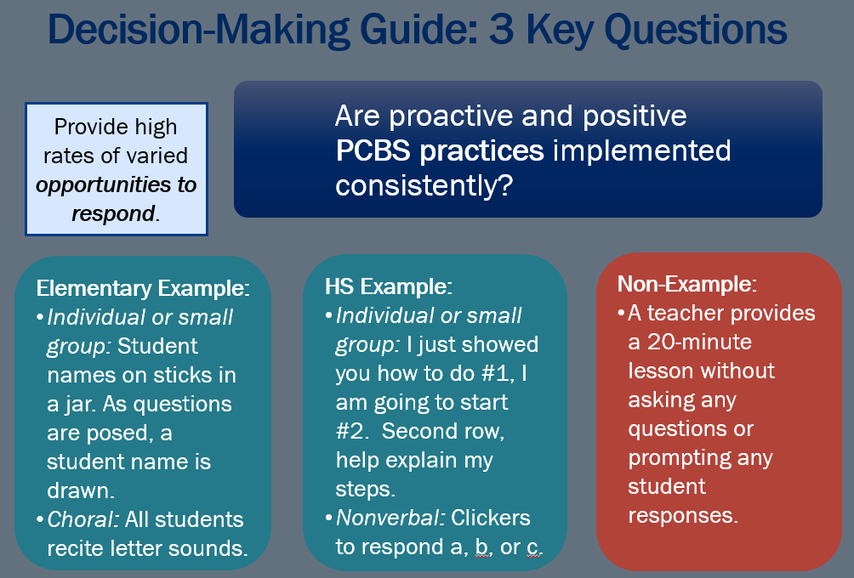
3 Key Questions – Are proactive and positive PCBS practices implemented consistently

Slide 71
How do I Actively Engage Students?
Provide high rates of opportunities to respond (OTRs)
Consider a variety of observable ways to engage students
Link engagement with outcome objectives

Slide 72
Range of evidence-based practices that promote active engagement
Computer Assisted Instruction
Class-wide Peer Tutoring
Choral Responding
Response Cards
Non-Verbal
Guided Notes
Electronic Clickers

Slide 73
Activity 3.8: Stop and Jot
Plan a range of OTRs
What other strategies have you seen?
  Describe a range of strategies you will use to provide students opportunities to respond (OTRs)
  Consider strategies to support yourself in ensuring you provide these at a high rate to all students.

Slide 74
Activity 3.8: Review
Remember that strategies to promote active engagement are just one element of good instruction
  For example computer assisted instruction may produce higher rates of opportunities to respond, but it should also be used strategically and should not replace instruction.

Slide 75
Instructional Classroom Management
Instructional classroom management is a proactive approach
“one acts before a problem occurs rather than reacting after the problem” (p. 47)
(Darch & Kame’enui, 2004)

Slide 76
Task dimensions
History
Response form
Modality
Complexity
Schedule
Variation
New? Familiar? Old?
Yes/No? Choice? Production?
Oral? Motor? Written?
Easy? Hard?
Abbreviated? Extended?
Varied? Unvaried?
(Darch & Kame’enui, 2004, p. 52)

Slide 77
Consider Task Dimensions…
…before instruction.
Plan tasks to promote appropriate student engagement.
Which ”task” is more likely to occasion problem behavior?
A
History: New
Response Form: Production
Modality: Written
Complexity: Hard
Schedule: Extended
Variation: Unvaried
B
His tory: Old
Response Form: Yes/No
Modality: Oral
Complexity: Easy
Schedule: Abbreviated
Variation: Varied
(Darch & Kame’enui, 2004)

Slide 78
Consider Task Dimensions…
……during instruction.
Continuously monitor form, modality, and schedule and adjust based on your learner’s performance.
…after instruction.
Ask, “Based on (a) the structure of the learning activity,(b) the type of academic errors, and (c) the level of disruptive behavior, what adjustments do I need to make in the nature or structure of the task for improved learning and behavior?” (p. 64)
(Darch & Kame’enui, 2004)

Slide 79
Additional Instructional Considerations
Give students choices
Vary tasks
Decrease “down time” (e.g., short wait time between class activities).
Intersperse easier tasks (high-probability of correct responding) when asking students to perform harder tasks (lower probability of correct responding).
Match tasks to the students’ instructional levels—don’t give impossible tasks.
  (Adapted from Munk & Repp, 1994)

Slide 80
Activity 3.9: Discussion Board
Consider instructional management
  Use the MO SW-PBS resource to guide your conversation
  How have you used or observed teachers use instructional management strategies before, during, and after a lesson?

Slide 81
Activity 3.9: Review
We hope you have some helpful new examples of ways you can use instructional design to support student behavior.
Remember to look for ways to:
  Provide choice
  Vary tasks
  Decrease downtime
  Intersperse easier and more difficult tasks

Slide 82
Opportunities to Respond and Prompts
Are proactive and positive PCBS practices implemented consistently?
Provide high rates of varied opportunities to respond.
+
Use prompts and active supervision.
Elementary Example:
Before students begin seatwork, provide a reminder about how to access help and materials, if needed.
Poster of expected behaviors.
HS Example:
Review of group activity participation rubric prior to the start of group work.
Sign above the homework (HW) basket with checklist for handing in HW.
Non-Example:
While teaching a lesson, a student calls out and the educator states, “Instead of calling out, I would like you to raise your hand.”

Slide 83
Presenting additional stimulus
Establish, Post, Teach, Review, Monitor, and reinforce a small number of positively stated expectations.
Presenting an additional stimulus to increase the probability that the S^{D} will occasion the desired response
Three Steps:
Establish Expectations
Identify Routines
Create Examples
Establish / Post
Teach
Prompt
Monitor
Evaluate
Verbal
Remember
Visual
Gestural
Modeling
Physical Guidance

Slide 84
Proactive and Positive PCBS Practices
Are proactive and positive PCBS practices implemented consistently?
Provide high rates of varied opportunities to respond.
+
Use prompts and active supervision.
Elementary Example:
While students are working independently in centers, scan and move around the classroom, checking in with students.
HS Example:
While monitoring students, move around the area, interact with students, and observe behaviors of individuals and the group.
Non-Example:
Sitting or standing where you cannot see the entire room / space, such as with your back to the group or behind your desk.

Slide 85
Establish, post, teach, review, monitor and reinforce
Establish, Post, Teach, Review, Monitor, and reinforce a small number of positively stated expectations.
Active Supervision
Move around
Look around (Scan)
Interact with students
  Reinforce
  Correct
Three Steps:
Establish Expectations
Identify Routines
Create Examples
Establish / Post
Teach
Prompt
Monitor
Evaluate
Remember
(Colvin, Sugai, Good, Lee, 1997)

Slide 86
Cultural and Contextually Relevant Social Skills Instruction
When teaching social skills (just like academics) it is essential to consider students’ background, disability status, and language needs in the lesson content and structure, so they can access the same instruction as their peers.
Use Explicit Instruction
  Clarifies student learning experiences and teaching objectives
  Include examples relevant to students’ lives
Build and Prime Background Knowledge
  Creates shared foundational schema to optimize student learning
Increase Opportunities to respond
  Provides high degree of student engagement and practice
Provide Performance Feedback
  Supports teacher knowledge of student progress and provides opportunities to correct mis-understandings
See the equity resources at PBIS.org for more information
Adapted from Chaparro, Nese, & McIntosh, 2015

Slide 87
Looking ahead to module 4
Are proactive and positive PCBS practices implemented consistently?
Provide high rates of varied opportunities to respond.
+
Use prompts and active supervision.
+
Acknowledge behavior with specific praise & other strategies.
….focus of module 4

Slide 88
Module Objectives
By the end of Module 3 you should be able to :
Part 1 | Maximize structure in your classroom Define and give examples of physical layout Define and give examples of classroom routines
Part 2 & 3 | Post, teach, prompt, review, monitor, and reinforce a small number of positively stated expectations Operationally define classroom expectations within routines using a matrix Design a social skills lesson plan that contains the critical elements
Part 4 | Actively engage students in observable ways
Remember: All of the strategies for preventing problem behavior we’ve talked about in this module apply for whole classroom, small group, and even individual instruction.

Slide 89
What’s next
  Complete Workbook
  Module 3 Quiz

