Slide 1
Focusing on the Function of Behavior Within the Context of DBI
Notes:
Introduction to the module
As a follow up to the Behavior Basics: Understanding Principles of Behavior module (https://intensiveintervention.org/resource/behavior-basics), this module introduces function of behavior and then provides suggestions for how you can use this understanding within the context of a data-based individualization (DBI) process.
The audience for this module may include the behavior support team, interventionists, special educators, school psychologists, counselors, and administrators.
While we do provide a brief review of behavior basics in this module, we recommend ensuring participants have a complete understating of the basic principles of behavior prior to engaging with this presentation. NCII’s Behavior Basics: Understanding Principles of Behavior module provides foundational knowledge of what behavior is, how behavior is defined, and what environmental factors influence behavior. This foundational knowledge is core to understanding behavior, supporting students with challenging behavior, and later, diagnosing the function of behavior to develop and adapt effective behavioral interventions. We recommend participants be familiar with data-based individualization as well. More information about NCII’s approach to intensive intervention can be found in the NCII concept paper Data-Based Individualization: A Framework for Intensive Intervention. The concept paper is available at http://www.intensiveintervention.org/sites/default/files/Data-based_Individualization_A_Framework.pdf.
Instructions for using the speaker notes
Text formatted in standard font is intended to be read aloud or paraphrased by the facilitator.
Text formatted in italics is intended as directions or notes for the facilitator; italicized text is not meant to be read aloud.
Preferred citation:
While permission to reprint this publication is not necessary, the citation should be: National Center on Intensive Intervention. (2022).Thinking functionally about behavior. U.S. Department of Education, Office of Special Education Programs, National Center on Intensive Intervention.

Slide 2
Today’s Agenda
Learner Outcomes
Setting the Scene
Review of Behavioral Principles
Function of Behavior
Diagnostic Behavioral Assessment
Review
Notes:
This training is an introduction to the core concepts of function rather than an in-depth training on conducting FBAs. We do not consider this module a quick fix or “how-to guide” for behavioral diagnostic assessments. More specifically, we do not expect individuals to be able to conduct behavioral assessments following this training. Rather, it is our hope that after completing this module, you feel more comfortable with the steps involved and with being a member of a team that will conduct behavioral assessments.
Read the slide.
The agenda may be changed to fit the time frame and the focus of the training.
This module takes 1.5 hours to complete (including the slide presentation and the integrated activities).
The Thinking Functionally About Behavior Workbook should be provided to participants during this presentation.

Slide 3
Learner Outcomes
By the end of this session, you will be able to do the following:
List three ways the function of behavior is important.
Name at least four common functions of behavior.
Describe how a function can be used within the diagnostic behavioral assessment process.
Notes:
The purpose of this training is to gain foundational knowledge of how all behavior serves a purpose or function. This foundational knowledge is core to understanding behavior, supporting students with challenging behavior, and diagnosing the function of behavior and developing effective behavioral interventions.
Read the slide.

Slide 4
Setting the Scene
Notes:
We will begin by reviewing a couple of classroom scenarios.

Slide 5
Mr. Robinson’s Perspective
Mr. Robinson is a seventh-grade reading interventionist. He has growing concerns about his sixth-period group, specifically his student Jasmine. Jasmine is always talking to her peers during instruction and shouting out. Mr. Robinson believes he has tried everything—politely asking her to stop, providing a correction when Jasmine calls out, and speaking with Jasmine in the hallway. He admits he has even yelled a few times. His team recommended a token economy for Jasmine, but that has not worked either. He is frustrated and thinks this is impacting his ability to teach and other students’ ability to learn.
Notes:
Read the slide. Remind participants that the scenario is also in their workbook.

Slide 6
Pause and Reflect
Take a moment to reflect on the scenario presented in the previous slide. In what ways can you relate to Mr. Robinson? What would you do in his situation?
Notes:
Read the prompt.
Allow participants 2 minutes to independently reflect on the prompt. Bring the group back together and briefly allow participants time to share. The scenario is included in the workbook if participants want to look back over it as they reflect.

Slide 7
Jasmine’s Perspective
Jasmine is in Mr. Robinson’s sixth-period reading intervention group. Jasmine often feels like Mr. Robinson only pays attention to the students who get the answers right. Jasmine is struggling with reading and has not been getting many answers correct lately. However, Mr. Robinson does pay attention to her when she talks to her friends or when she calls out. Sometimes he even speaks with her in the hallway! Jasmine wants to be a good student and she knows she shouldn’t be calling out, but how else can she get Mr. Robinson to pay attention to her?
Notes:
Read the slide. Remind participants that the scenario is also in their workbook.

Slide 8
Pause and Reflect
Take a moment to reflect on the scenario presented in the previous slide. In what ways are Mr. Robinson’s and Jasmine’s perspectives of the same situation different? How could these differences impact Mr. Robinson’s approach?
Notes:
Read the prompt.
Allow participants 2 minutes to independently reflect on the prompt. Bring the group back together and briefly allow participants time to share. The scenario is included in the workbook if participants want to look back over it as they reflect.

Slide 9
Understanding the Function of Behavior
Understanding the function of behavior is important to:
ensure teachers do not inadvertently reinforce problem behavior;
help identify, teach, and reinforce socially and contextually appropriate replacement behaviors; and
guide individualization of behavior support.
Notes:
Read the slide.

Slide 10
Review of Behavioral Principles
Notes:
It is important to have some foundational knowledge of behavioral principles and how they relate to the function of behavior.

Slide 11
Turn and Talk: Behavior
With a partner, discuss any assumptions you’ve made about a student’s behavior in the past.
Notes:
Read the prompt.
Allow partners 2 minutes to discuss, bring the group back together, and have participants share their ideas.

Slide 12
Behavior Is Learned
Do not assume children know the rules, expectations, or social skills.
Every social interaction you have with a child teaches him or her something.
Notes:
The most basic concept in behavior is that it is learned.
Read the slide.

Slide 13
Behavior Communicates a Need
Children engage in behavior to “get” or “avoid” something.
Determining what the student is trying to get or avoid is determined by observing what happens prior to and immediately after the behavior.
Notes:
Behavior also communicates some kind of need. The most basic function or reason for problem behavior is to get or avoid (something).

Slide 14
Review: Three-Term Contingency
A
B
C
Antecedent
Behavior
Consequence
Notes:
Let’s review the three-term contingency. The three-term contingency helps to put behavior in context by describing the relationship among a behavior, the events immediately preceding it, and the consequences following it, and the environmental context. The three-term contingency is sometimes referred to as the ABCs of behavior or the ABC model. Antecedent, Behavior, Consequence. We will look at each element of the contingency.

Slide 15
Antecedents in the Three-Term Contingency
An antecedent is any event that happens immediately before a behavior occurs.
A
B
C
Notes:
The A in the three-term contingency model refers to antecedents. Antecedents refer to anything that happens immediately before the behavior occurs. Antecedents affect behavior. Therefore, sometimes you will hear an antecedent referred to as the trigger.
In the scenario we discussed earlier, Mr. Robinson not paying attention to Jasmine was an antecedent, or trigger, for Jasmine’s behavior.

Slide 16
Behavior in the Three-Term Contingency
Behavior is the observable, measurable actions of an individual.
A
B
C
Notes:
Behavior is the core component around which the rest of the three-term contingency is built.
From our scenario earlier, Jasmine’s behaviors include talking to her peers during instruction, forgetting directions, and shouting out.

Slide 17
How can we define behavior?
Operational definition: Breaking down a broad concept of behavior into its observable and measurable components.
An observable definition describes what the student does, not what student does not do.
A measurable definition describes something an observer can count.
Notes:
When defining behavior, keep the focus on observable and measurable elements that are relevant to behavioral goals and that can be progress monitored.

Slide 18
Consequences in the Three-Term Contingency
A consequence is any event that happens immediately after a behavior occurs.
A
B
C
Notes:
A consequence is what happens immediately after a behavior occurs. Consequences impact how a behavior is maintained. It is important that we don’t confuse consequences with disciplinary action. There is a tendency to refer to a disciplinary action that is administered following a behavior when asked what consequence followed the behavior. A consequence, when conceptualizing behavior, simply refers to what happens immediately after the behavior occurs. A consequence may reinforce or punish a behavior, or it may not have any behavior-altering properties.
From our scenario earlier, the consequences that occurred directly after Jasmine engaged in challenging behavior were that Mr. Robinson asked her to stop, provided a correction, or spoke with her in the hallway. Collectively, Mr. Robinson's actions provided some form of attention after Jasmine engaged in challenging behavior.

Slide 19
Types of Consequences
Reinforcement increases behavior
Consequence
decreases behavior
Notes:
Consequences can increase or decrease behavior. If the consequence is desired or meets the needs of the student, the behavior is likely to increase. If the consequence is undesirable or does not meet the needs of the student, the behavior is likely to decrease.

Slide 20
Positive and Negative Reinforcement
Positive reinforcement: Adding something pleasant or desirable to make a target behavior more likely to occur.
Negative reinforcement: Taking away something unpleasant or undesirable to make a target behavior more likely to occur.
Notes:
There are two types of reinforcement: positive and negative. Both lead to an increase in behavior. Positive reinforcement has occurred when after a behavior, something desirable is gained. Negative reinforcement has occurred when after a behavior, something that is disliked or aversive is removed or avoided. In both cases, the behavior increases because the outcome was preferred by or met a need of the student.
Remember: Reinforcement always maintains or increases a behavior. The terms positive and negative are not value judgments. The terms indicate how the reinforcement works. A good way to think about positive and negative reinforcement is to think in terms of add and subtract. Positive reinforcement occurs when something positive or functional FROM THE STUDENT’S PERSPECTIVE is added or gained following the behavior that leads to the maintenance or increase in the behavior. Negative reinforcement occurs when something unpleasant FROM THE STUDENT’S PERSPECTIVE is removed or taken away from the environment that leads to the maintenance or increases the behavior. In both cases, there is an increase in the behavior.
Thinking about the big picture, reducing problem behaviors requires a clear understanding of what is reinforcing a behavior. Most behavior results in either getting something or avoiding something. If we can observe what a student gains or avoids, we can begin to hypothesize the function or purpose of the behavior.

Slide 21
Turn and Talk: Which is the best example of reinforcement?
As Nathan and Shara argue over a toy, Nathan hits Shara. Shara lets go of the toy and Nathan takes it. Nathan hits peers more frequently during play time the next day.
As Nathan and Shara argue over a toy, Nathan hits Shara. Shara lets go of the toy and Nathan takes it.
As Nathan and Shara argue over a toy, Nathan hits Shara.
Notes:
Read the prompt.
Allow partners 2 minutes to discuss, bring the group back together, and have participants share their ideas.
The answer is 1 because it increased Nathan’s hitting.

Slide 22
Positive and Negative Punishment
Positive punishment: Adding something unpleasant or undesirable that makes a behavior less likely to occur.
Negative punishment: Removing something pleasant or desirable that makes a behavior less likely to occur.
Notes:
Punishment has occurred if it leads to a decrease in behavior. Just like with reinforcement, we categorize punishment as positive or negative.
Read the slide.
Many disciplinary actions used in schools have little to no impact on reducing the behavior. Consider the student who is frequently sent to in-school suspension. If frequent visits to in-school suspension haven’t reduced the occurrence of the problem behavior, the in-school suspension is not punishment. It is just an ineffective disciplinary procedure. It is possible that going to in-school suspension may actually be reinforcing the problem behavior by allowing the student to escape the classroom.

Slide 23
Turn and Talk: Which is the best example of punishment?
Lola’s teacher praises her for raising her hand. Lola raises her hand more often in science class.
Lola raises her hand to answer a question in science class.
Lola raises her hand to answer a question in her science class. Her teacher loudly praises her for raising her hand. Lola is embarrassed by the praise. She doesn’t raise her hand for the rest of the week.
Notes:
Read the prompt.
Allow partners 2 minutes to discuss, bring the group back together, and have participants share their ideas.
The answer is 3 because it decreased Lola’s hand raising.

Slide 24
Reminder: Reinforcement and Punishment
Whether a behavior is reinforced or punished depends on the learner and the future occurrences of behavior.
Reinforcement has occurred only if the behavior maintains or increases.
Punishment has occurred only if the behavior decreases or stops.
Notes:
This slide is a final note or reminder about reinforcement. Review the slide.

Slide 25
Why Does This Matter?
Antecedents and consequences can be changed to help reduce problem behavior and increase prosocial behavior.
A
B
C
Understanding function helps us identify how to change antecedents and consequences.
Notes:
Read the slide.

Slide 26
Function of Behavior
Notes:
Now that we reviewed some of the basic principles of behavior, let’s discuss how we can apply that knowledge to understanding the function of behavior.

Slide 27
What is the function of behavior?
Behavior always serves a purpose or function (i.e., to obtain a desired outcome or goal).
Notes:
The basic assumption is that behavior always serves a purpose or function (i.e., typically a behavior is present because you are either trying to get access to something or avoid something).

Slide 28
Example of Functions
Access to attention, tangibles, a preferred activity, or sensory stimulation
Avoidance of tasks, specific environment or situations, social interaction, or unpleasant sensory stimulation
Notes:
Read the slide.

Slide 29
Common Functions of Behavior
To Access, Obtain, or Get: | To Avoid or Escape From:
Peer attention | Difficult task
Adult attention | Boring task
Desired activity | Easy task
Desired object or items | Physical demand
Sensory stimulation (e.g., auditory, tactile) | Nonpreferred activity
 | Peer attention
 | Staff attention
 | Reprimands
Notes:
This slide lists a common function of behavior. It is not an exhaustive list but one that shows some common reasons why we see challenging behaviors emerge and how they differ if the functions differ.
Review the examples.

Slide 30
Function and the Three-Term Contingency
A
B
C
A student engages in a behavior and the consequence may provide access to something preferred or escape from something nonpreferred. If so, the problem behavior is reinforced and maintained.
Notes:
We can use the three-term contingency, specifically identifying consequences, to help us think about the function of behavior. We can think about the function of behavior for both prosocial behavior and challenging behavior. Let’s look at a couple of examples on the next few slides.

Slide 31
Example of Function
Ms. Hernandez tells the students to raise their hand when they want to answer a question.
Joanie raises her hand during math class.
Ms. Hernandez smiles, thanks Joanie for raising her hand, and asks her for her response. Joanie raises her hand every day.
Maintaining Consequence and Function
Notes:
Let’s use an example from Ms. Hernandez’s math class. Read the slide. This is an example of a function of behavior in which a prosocial behavior is reinforced.
Read the slide.

Slide 32
What is a possible function of Joanie’s behavior?
To Access, Obtain, or Get: | To Avoid or Escape From:
Peer attention | Difficult task
Adult attention | Boring task
Desired activity | Easy task
Desired object or items | Physical demand
Sensory stimulation (e.g., auditory, tactile) | Nonpreferred activity
 | Peer attention
 | Adult attention
 | Reprimands
Notes:
In the example on the previous slide, the consequence that occurs immediately after Joanie raises her hand is that Ms. Hernandez smiles, thanks Joanie for raising her hand, and asks her for her response. Looking at the chart above, does this consequence allow Joanie to access anything?
Allow participants a moment to respond. Click to reveal circle.

Slide 33
What is a possible function of Joanie’s behavior?
To Access, Obtain, or Get: | To Avoid or Escape From:
Peer attention | Difficult task
Adult attention | Boring task
Desired activity | Easy task
Desired object or items | Physical demand
Sensory stimulation (e.g., auditory, tactile) | Nonpreferred activity
 | Peer attention
 | Adult attention
 | Reprimands
Notes:
Joanie is able to access adult attention from Ms. Hernandez after she raises her hand.

Slide 34
Another Example of Function
Mr. Young asks each student to read independently.
Xiamora loves reading with a buddy. She loudly complains.
Mr. Young lets Xiamora read with a friend.
Maintaining Consequence and Function
Notes:
More commonly, we consider the function of behavior when considering the reason why problem behaviors occur. Let’s look at an example from Mr. Young’s class.
Read the slide.

Slide 35
What is a possible function of Xiamora’s behavior?
To Access, Obtain, or Get: | To Avoid or Escape From:
Peer attention | Difficult task
Adult attention | Boring task
Desired activity | Easy task
Desired object or items | Physical demand
Sensory stimulation (e.g., auditory, tactile) | Nonpreferred activity
 | Peer attention
 | Adult attention
 | Reprimands
Notes:
What is a possible function of Xiamora loudly complaining? Here, we may have a couple of options.
Allow participants a moment to respond. Click next slide to reveal circles.

Slide 36
What is a possible function of Xiamora’s behavior?
To Access, Obtain, or Get: | To Avoid or Escape From:
Peer attention | Difficult task
Adult attention | Boring task
Desired activity | Easy task
Desired object or items | Physical demand
Sensory stimulation (e.g., auditory, tactile) | Nonpreferred activity
 | Peer attention
 | Adult attention
 | Reprimands
Notes:
After Xiamora complains, her teacher allows her to read with a friend. This gives her access to peer attention and a desired activity. In addition, she is able to avoid a boring task (i.e., reading independently). Xiamora’ s behavior may be maintained by multiple functions, but we need to collect more data to confirm our hypothesized function.

Slide 37
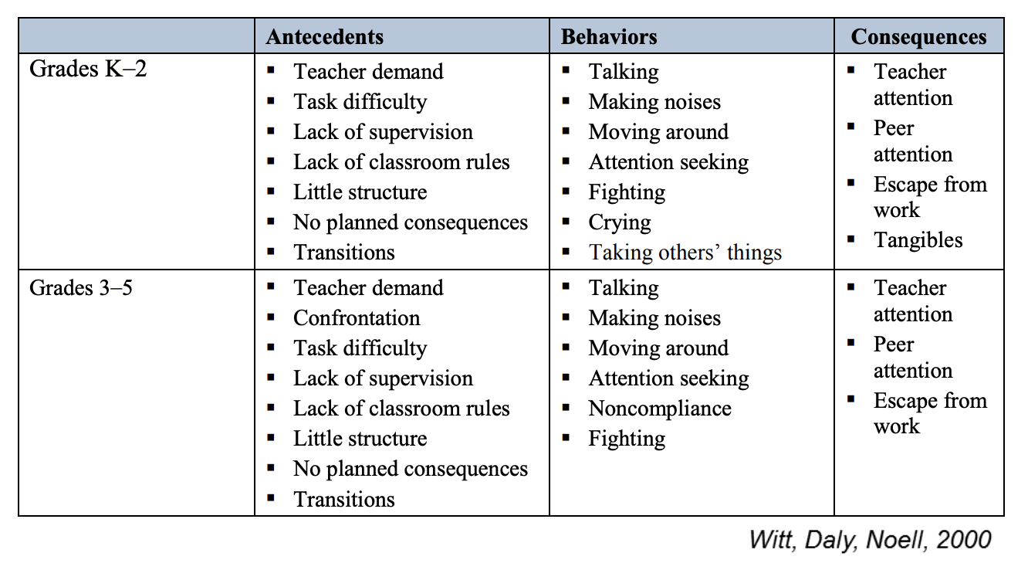
Problem Behaviors and Some Usual Suspects for Functional Antecedents and Consequences
Witt,. C, Daly, E. M., & Noell, G. H. (2000). Functional assessments: A step-by-step guide to solving academic and behavior problems. Longmont, CO: Sopris W
Notes:
Here is a resource that shows an example of common antecedents, behaviors, and consequences. Let’s take a closer look at an example in Grades 3–5. (Note: This example can be adjusted depending on the audience.)
Take a moment to reflect on the ABCs listed. What stands out to you? Is there anything missing?

Slide 38
Activity 1: Function of Behavior
Workbook
Notes:
Let’s go to the workbook. Turn to the Function of Behavior activity.
For this activity, you will do the following:
Read the scenario.
Determine what behavior is being maintained, what the student is either getting or avoiding, and what a potential function the behavior may be.
Write your answer to each question.
The activity includes two main scenarios (Scenario 1 and Scenario 2), and we estimate 5–7 minutes per scenario. Assign as many scenarios as time permits. The activity can be completed independently, in partners, or in small groups. If time is limited, you may choose to assign individuals/groups/partners to complete one of the scenarios, so each group works on something different.
The activity also includes two additional scenarios (Scenario 3 and Scenario 4) that can be used if time permits. These scenarios ask participants to identify the antecedents, behavior, and consequences before identifying the function of behavior. These can be completed independently, as a jigsaw activity, or as a group.

Slide 39
Activity 1: Time to Share
Notes:
Allow participants time to share their work on the Function of Behavior activity. Depending on how much time there is, this can be done as a whole group, think-pair-share, or jigsaw.
Guidance on correct options:
Scenario 1: Access to peer attention
Scenario 2: Access to peer attention; Escape from difficult task

Slide 40
Why determine a behavior’s function?
Because we know:
behaviors always serve a function,
behaviors are contextual and vary by individual, and
identifying a behavior’s function can help us pinpoint a plan to reduce problem behavior and increase prosocial behavior.
Notes:
Why is the function of behavior important?
There are two reasons: Behavior does not occur in isolation, and there is always a reason and a purpose for behavior. Behavior is also contextual. It will vary from individual to individual and can be affected by context (e.g., activity, demand, location, time of day, mastery of skill).

Slide 41
Diagnostic Behavioral Data and Data-Based Individualization (DBI)
When do we consider the function of behavior?
Notes:
Now that we have a basic understanding of function, let’s consider when we would apply this knowledge within the DBI process.

Slide 42
Function and Diagnostic Behavioral Data
Function is a key part of diagnostic behavior data and can be used to:
develop a hypothesis for why the student is not responding,
develop function-based interventions, and
determine how to adapt an intervention.
Notes:
Read the slide.

Slide 43
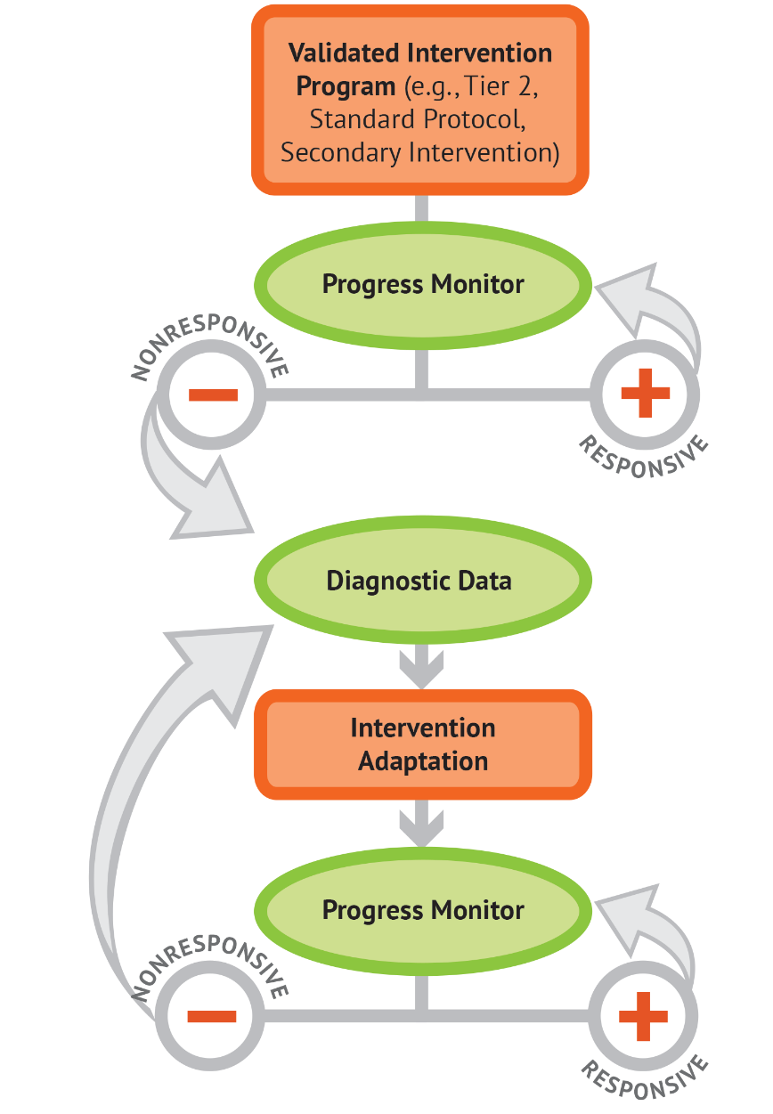
Function and DBI
https://intensiveintervention.org/
Notes:
Within the DBI process, identifying the function of behavior is an important part of the diagnostic data and intervention adaptation steps. Within the diagnostic data step, the function helps to develop the hypothesis for why the student is not responding. This information is used to plan how the intervention needs to be adapted to help reduce problem behavior and increase prosocial behavior.

Slide 44
Diagnostic Behavioral Data
A common way to collect diagnostic behavioral data is through a functional behavioral assessment (FBA) to identify the function of behavior.
Notes:
A Functional Behavioral Assessment (FBA) is a common form of diagnostic behavioral assessment that focuses specifically on identifying the function of behavior.

Slide 45
FBAs
Informal
Formal
Want to learn more about conducting FBAs?​
Center on PBIS FBA Guide​
IRIS Center Module on FBA
Notes:
Potential types of diagnostic behavioral assessment can fall along a continuum from less formal to more formal.
While we will not be covering the procedures to conduct an FBA in the scope of this module, here are some other resources where you can learn more.

Slide 46
Function-Based Interventions
When adapting interventions, we use function to change A, B, and C.
Antecedent
Problem behavior
Maintaining consequence and function
Targeted Routine
FUNCTION
Function should guide the selection of prevention strategies.
Notes:
Whether using an FBA or something else, a behavioral diagnostic assessment can be used to adapt an intervention. It is really important to remember that in order for an intervention to be successful in changing behavior, it needs to specifically address the function of the behavior. This can be achieved by selecting function-based components when planning adaptations.
For example, if you identified the function of behavior as an escape from a difficult task, adapting an intervention by adding components to increase teacher attention is not likely to yield successful outcomes. Instead, it may be more effective to adapt the intervention by building in breaks or adding in extra time for skill practice.

Slide 47
Turn and Talk: Considering Function
With a partner, discuss any experience you’ve had with considering the function of behavior when adapting interventions.
Notes:
Read the prompt.
Allow partners 2 minutes to discuss, bring the group back together, and have participants share their ideas.

Slide 48
When can we consider function as part of diagnostic behavior assessment?
As part of the DBI process
When developing an Individualized Education Program (IEP)
When developing a Behavior Intervention Plan (BIP)
Notes:
In addition to DBI, considering function within diagnostic assessment can also be helpful for developing Behavior Intervention Plans (BIPs) within the context of Individualized Education Programs (IEPs).

Slide 49
Review
Notes:
The information covered today provides a basic understanding of function of behavior. Recognition of how these concepts operate can influence how we structure environments to be proactive and preventative, as well as inform how we respond to behavior and design interventions. The concepts are the foundation of procedures employed to gather and analyze diagnostic and functional data and to design and refine function-based interventions.

Slide 50
Review: Big Ideas
Behavior is learned, serves a function, and is related to the context in which it occurs.
Understanding function of behavior is one component of DBI and diagnostic behavioral assessment.
Functions of behavior include access to or avoidance of attention, tasks, activities, or sensory stimulation.
Notes:
Review the slide.

Slide 51
Pause and Reflect
How will you apply the concepts related to the function of behavior you learned today?
Notes:
Read the prompt.
Allow participants 2 minutes to reflect on the prompt. Bring the group back together and briefly allow participants time to share.

Slide 52
Questions?

Slide 53
Related Resources
Behavior Basics
NCII Behavior Basics: Understanding Principles of Behavior
NCII Defining, Measuring, and Monitoring Behavior
Conducting an FBA
Center on PBIS FBA Guide
IRIS Center Module on FBA
NCII Using an ABC Report Form with an FBA
NCII ABC Checklist
Notes:
If you want to learn more about basic principles of behavior or how to conduct an FBA, please check out these resources from NCII, Center on PBIS, and IRIS Center.

Slide 54
NCII Disclaimer
This presentation was produced under the U.S. Department of Education, Office of Special Education Programs, Award No. H326Q160001. Celia Rosenquist serves as the project officer. The views expressed herein do not necessarily represent the positions or policies of the U.S. Department of Education. No official endorsement by the U.S. Department of Education of any product, commodity, service, or enterprise mentioned in this module is intended or should be inferred.

Slide 55
PRESENTER’S NAME

