Slide 1
Hello, All! We will be starting the webinar at the top of the hour! Thanks for your patience.

Slide 2
The Taxonomy of Intervention Intensity:
September 20, 2018
A Case Example of Building Intervention Intensity in Behavior
Joe Wehby, Ph.D., and Joey Staubitz, Ph.D, BCBA-D
  Meagan Walsh, M.Ed., and Lynn Fuchs, Ph.D.
  Vanderbilt University

Slide 3
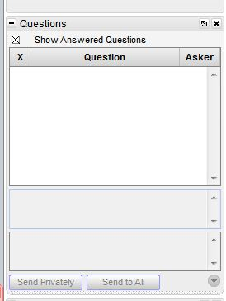
Webinar Format & Questions
Throughout the presentation, submit your questions into the question pod.
  For technical issues/questions, a webinar team member will try to assist you as soon as possible.
  For content related questions, there will be a time for Q&A at the end of the presentation. Submit your questions and we will share them with the presenters.
Notes:
Should also point out the additional resources available for participants. Blank taxonomy form, sample filled out taxonomy and graph. Participants will probably want to download these to their computers for reference.

Slide 4
Today’s Webinar
Review how the Taxonomy of Intervention Intensity can be used in the process of data-based individualization (DBI).
Present a behavior example that illustrates how to implement DBI and the Taxonomy.
Notes:
Will provide a relatively brief overview and explanation of the taxonomy’s dimensions. For more detailed information see article in Teaching Exceptional children, (Fuchs, L.S., Fuchs, D., & Malone, A. (2017). The taxonomy of intervention intensity. Teaching Exceptional Children, 50 (1), 35-43.
Participants will also want to visit the NCII website for additional resources on DBI and the taxonomy. They may also want to check out the math webinar.
The focus of this webinar will be reading COMPREHENSION. There are fewer resources for comprehension intervention, and it can be slightly more difficult to treat. The students for whom such an intervention are a relatively small subset of students requiring reading intervention
During this webinar we will be providing only a brief review of DBI and the taxonomy—for a more in-depth explanation please see the brief webinar available in the “handouts” section

Slide 5
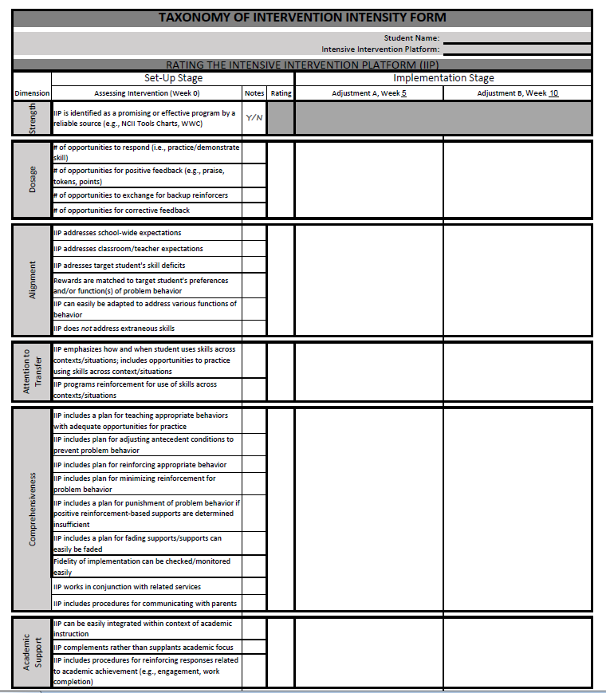
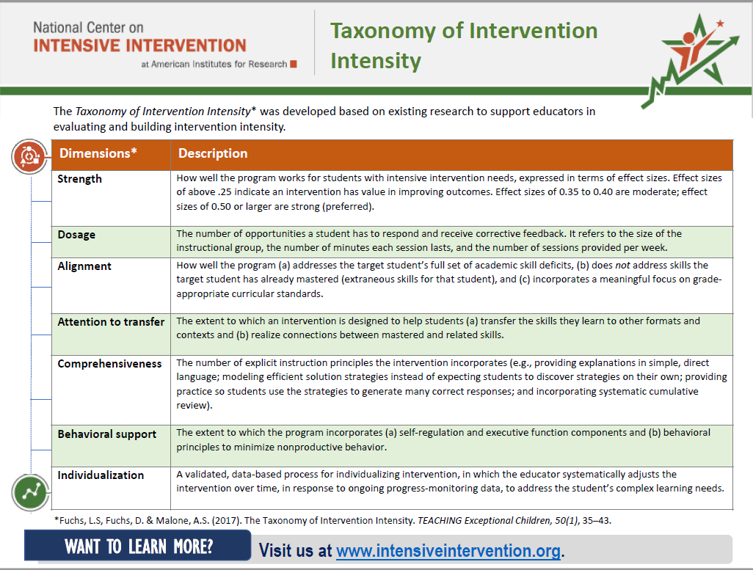
Webinar Materials for Download

Slide 6


Presenters
Dr. Joseph Wehby is the Chair of the Department of Special Education at Vanderbilt University.
Joey Staubitz, Ph.D, BCBA-D is a faculty member in the Department of Special Education at Vanderbilt University.

Slide 7
What’s the Taxonomy of Intensive Intervention?

Slide 8
The Taxonomy of Intensive Intervention
A system for describing an intervention in terms of seven dimensions along which intensity can vary.
This helps special educators and interventionists identify best-match intervention platforms (in the DBI Set-Up Phase) …
…and formulate adjustments to boost student progress (in the Implementation Phase).

Slide 9
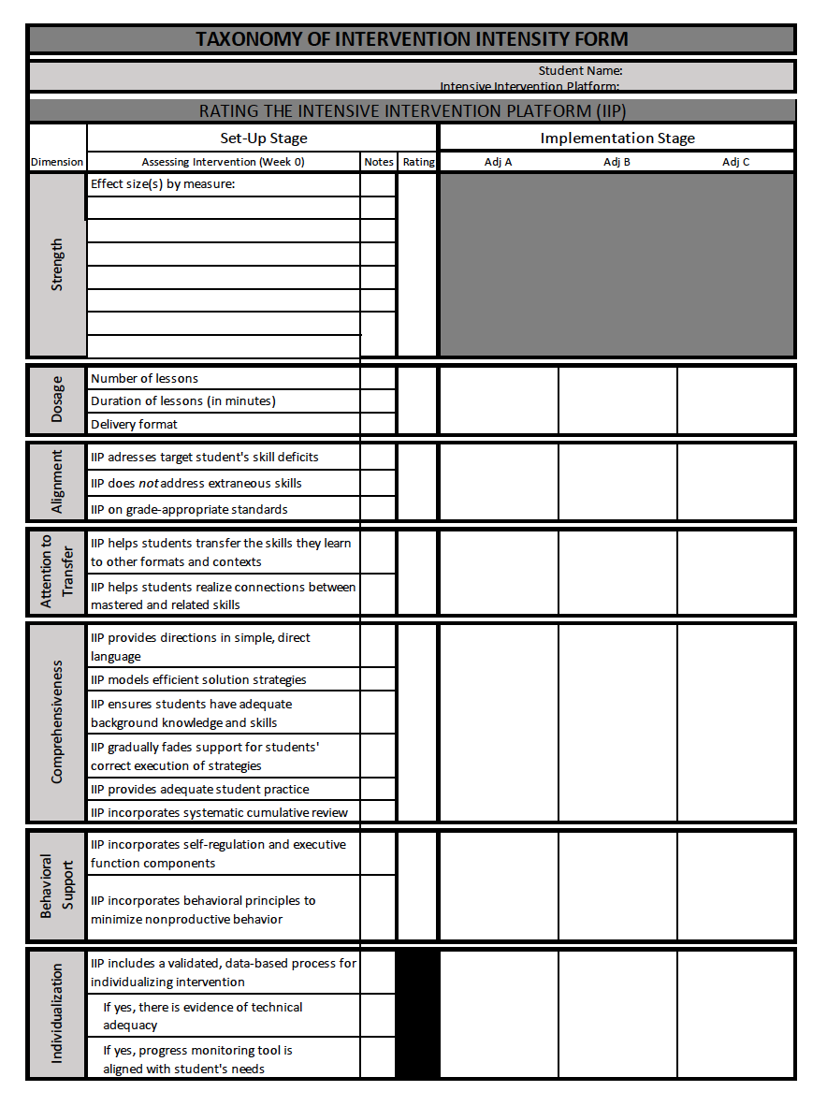
The Taxonomy of Intensive Intervention
A system for describing an intervention in terms of seven dimensions along which intensity can vary.
This helps special educators and interventionists identify best-match intervention platforms (in the DBI Set-Up Phase) …
…and formulate adjustments to boost student progress (in the Implementation Phase).

Slide 10
Taxonomy Dimensions
Strength
Dosage
Alignment
Attention to Transfer
Comprehensiveness
Behavioral Support
Individualization
Notes:
The first dimension is Strength. This is used in the Set-Up Phase to identify the best-match intervention.
You consider if this intervention produces good results for students who require intensive intervention (disaggregated effect size)
Effect size tell us how much higher intervention students score at the end of intervention compared to students who did not receive the intervention.
Interventions effect sizes of .35 to .4 are considered moderate; effect sizes of .50+ are strong (These are merely rules of thumb)
It’s important to note that in the area of comprehension you can expect smaller effect sizes, especially when you’re talking about standardized measures. The What Works Clearinghouse identifies an effect size of .25 as substantively important in reading.
It’s also important to note that effect sizes in later grades also tend to be smaller.

Slide 11
When is the Taxonomy of Intervention Intensity Used in the DBI Process?
PHASE A: Setting Up the Intensive Intervention
Step 1: Select a validated, best-match Tier 2 intervention to serve as the intervention platform.
Step 2: Make initial adjustments to the intervention platform to address the student’s needs.
Step 3: Select progress-monitoring system.
Step 4: Begin implementing the IIP.
Notes:
So the Taxonomy of Intervention intensity can help you in both Set up and Implementation phases of the DBI cycle.
In the Set Up phase the Taxonomy can be used to help practitioners identify the best match Tier-2 Intensive Intervention Platform and make initial adjustments to address the student’s needs.

Slide 12
When is the Taxonomy of Intervention Intensity Used in the DBI Process?
PHASE B: Individualizing that intervention
Step 5: Determine if an adjustment is needed. If so,
  Step 6: Collect diagnostic data
  Step 7: Design an adjustment to the intervention to meet the student’s needs.
Step 8: Implement the adjustment.
Step 9: Repeat Steps 5-8.
Notes:
During the implementation phase—the taxonomy can be used to formulate targeted adjustments to the IIP on an ongoing basis to intensify the intervention based on progress monitoring data.

Slide 13
Questions?

Slide 14

Carlos

Slide 15
Student Profile: Carlos, 3rd grade
Carlos has experienced persistent behavioral difficulties
  Disruptive during times he is expected to work independently
  Inappropriately comments to teachers and peers
Diagnosis of Attention Deficit/Hyperactivity Disorder (ADHD)
Participated in Tier 2 social skills program throughout second grade
By the end of the year, Carlos acquired new skills that he displayed during group sessions and leisure time (e.g., lunch, recess)
However, Carlos continued to engage in disruptive behavior during academic work time
Notes:
Already eligible for SPED? FBA on file?

Slide 16
Student Profile: Carlos, 3rd grade
Behavioral difficulties
  Target behaviors:
    Verbally and passively (e.g., putting head down) refuses to complete work
    Wanders the classroom, touching teachers’ and others’ materials
    Makes inappropriate comments toward his teacher when redirected and toward peers when they look in his direction during independent work time
Notes:
Specifically…

Slide 17
Student Profile: Carlos, 3rd grade
Behavioral strengths
  Enjoys one-on-one interactions with adults
  Cooperative during non-academic periods (e.g., related arts, lunch, recess)
Mild academic concerns: Deficits in reading comprehension
  Recalls irrelevant or erroneous information from text
  Often fails to use evidence from text to answer factual questions
  Limited vocabulary and content knowledge

Slide 18
Set-Up Phase

Slide 19
Set-Up Phase, Step 1: Select and Rate an Intensive Intervention Platform
With taxonomy in hand, Ms. Harper (Carlos’s interventionist) accesses the NCII tools chart in search of a validated Tier 2 intensive intervention platform (IIP) for Carlos.
Ms. Harper reviews NCII tools chart for program options, selecting “externalizing behavior” and “elementary age” as filters that match Carlos’s characteristics.
She notes that four studies on the Behavior Education Program (BEP)/Check In/Check Out have been reviewed and had outcomes rated as convincing (n=2) or partially convincing (n=2).
Ms. Harper decides to rate the IIP using the Taxonomy.
Notes:
Who is Ms. Harper? Classroom teacher? SPED teacher?

Slide 20
Set-Up Phase, Step 1:
Select and Rate an IIP (Check In/Check Out)
Check In/Check Out (CICO) is a research-based Tier 2 Intervention that involves the following major components:
  Adherence to school-wide expectations is individually monitored during each subject throughout the school day.
  3-point scale is used for monitoring with a score of 0 corresponding to “did not meet expectations,” 1 indicating “met some expectations,” and 2 indicating “met expectations.”
  Student checks in with a designated coach at arrival, receives a Daily Progress Report (DPR), and reviews the daily point goal with coach.
  Student checks out with the coach at dismissal, and together they calculate points earned.
  Coach delivers reward if student met point goal.
  Student takes their DPR home for parent signature.

Slide 21
Set-Up Stage, Step 1:
Rating the Intensive Intervention Platform
Ratings:
0 (fails to address standard)
1 (addresses standard minimally)
2 (addresses standard moderately)
3 (addresses standard well)

Slide 22
Set-Up Phase, Step 1:
Rating the Intensive Intervention Platform
Dimension | Set-Up Stage
 | Assessing Intervention (Week 0) | Notes | Rating
Strength | IIP is identified as a promising or effective program by a reliable source (e.g., NCII Tools Charts, WWC)
Y
Notes:
Ms. Harper reviews NCII tools chart for program options, selecting “externalizing behavior” and “elementary age” as filters that match Carlos’s characteristics.
Notes that four studies on the Behavior Education Program (BEP)/Check In/Check Out have been reviewed and had outcomes rated as convincing (n=2) or partially convincing (n=2). Because there is research indicating the IIP is promising, Ms. Harper marks “Y” for the “strength” dimension and can proceed to rating the other dimensions of the taxonomy. If she had determined that insufficient evidence existed to indicate the IIP is promising for treating intensive behavioral needs, she would select a different IIP before proceeding.

Slide 23
Set-Up Phase, Step 1:
Rating the Intensive Intervention Platform
Dosage | # of opportunities to respond (i.e., practice/demonstrate skill)
 | # of opportunities for positive feedback (e.g., praise, tokens, points)
 | # of opportunities to exchange for backup reinforcers
 | # of opportunities for corrective feedback
2
2
2
2
2
How would you rate the Dosage Intensity?
Notes:
Students in CI/CO check in and out with a designated adult in the morning and afternoon, during which time they discuss and practice skills related to the school-wide expectations. Check ins are necessarily brief, but are specifically designated for pre-correction and practicing skills. [3]
Between morning check in and afternoon check out, students receive feedback on their performance from classroom teachers at a handful of natural transition points throughout the day. The classroom teacher rates the target student on the degree to which he or she followed each school-wide expectation in a given time period. For example, at the end of the math block, a teacher would provide a rating of 2 = met expectations, 1 = somewhat met expectations, or 0 = did not meet expectations during math along with corresponding praise and corrective feedback. [2, 2]
At daily afternoon checkout, students debrief with their mentor and calculate points earned. If a student met their point goal, they access a pre-determined reward. [2]

Slide 24
Set-Up Phase, Step 1:
Rating the Intensive Intervention Platform
Alignment | IIP addresses school-wide expectations
 | IIP addresses classroom/teacher expectations
 | IIP addresses target student's skill deficits
 | Rewards are matched to target student’s preferences; function(s) of behavior
 | IIP can easily be adapted to address various functions of behavior
 | IIP does not address extraneous skills
3
2
1
2.3
2
3
2
How would you rate the Alignment of the IIP?
Notes:
In CICO, point ratings are precisely aligned with school-wide expectations. [3]
While classroom expectations are typically broadly aligned with school-wide expectations, alignment with classroom or teacher expectations depends on the individual teacher. At its outset, CICO doesn’t take into account individual teacher expectations. [2]
Carlos’s specific skill deficits certainly fall within the boundaries of the school-wide expectations, but they aren’t identified or specifically targeted by the IIP. However, CICO Coaches do provide opportunities for students to practice specific skills each day at check in [1].
Students at Carlos’s school may choose from a variety of reward options when they meet their point goal, but do not have an opportunity to inform the options on the menu [2].
CICO can be easily adapted to address various functions of problem behavior by changing the type of reward earned and teaching specific skills (e.g., requesting a break [Breaks are Better]). [3]
In general, CICO begins simply with opportunities to earn points based on the extent to which a student met school-wide expectations. [3]

Slide 25
Set-Up Phase, Step 1:
Rating the Intensive Intervention Platform
Attention to Transfer | IIP emphasizes how and when student uses skills across contexts/situations; includes opportunities to practice using skills across context/situations
 | IIP programs reinforcement for use of skills across contexts/situations
3
3
3
How would you rate Attention to Transfer?
Notes:
CICO involves opportunities to practice and receive feedback for use of skills related to meeting SW expectations across the school day (i.e., in all relevant contexts), not just in one classroom or at one time of day [3].
Students also have opportunities to earn points during all parts of the school day [3].

Slide 26
Set-Up Phase, Step 1:
Rating the Intensive Intervention Platform
Comprehensiveness | IIP includes a plan for teaching appropriate behaviors with adequate opportunities for practice
 | IIP includes plan for adjusting antecedent conditions to prevent problem behavior
 | IIP includes plan for reinforcing appropriate behavior
 | IIP includes plan for minimizing reinforcement for problem behavior
 | IIP includes a plan for punishment of problem behavior if positive reinforcement-based supports are determined insufficient
 | IIP includes a plan for fading supports/supports can easily be faded
 | Fidelity of implementation can be checked/monitored easily
 | IIP works in conjunction with related services
 | IIP includes plan for communicating with parents
2
1
3
0
0
2
3
3
3
3
How would you rate Comprehensiveness?
Notes:
CICO involves designated opportunities for teaching and practicing appropriate behavior – this one of the primary functions of morning check in [3]
CICO does not involve any planning related to adjusting antecedents to problem behavior, although noncontingent attention from the coach may decrease attention-maintained problem behavior [1]
The point system and daily point goals structure reinforcement for desirable behavior [3]
However, outside of delivering points commensurate with performance, there are no specific procedures for responding to problem behavior to avoid inadvertent reinforcement [0]
No specific punishment procedures are included in the CICO protocol [0]
Supports can be easily faded, for example, the number of check ins or opportunities for feedback from teachers could be gradually reduced across the day or week. The number of opportunities to access backup reinforcers could also be thinned. [3]
Fidelity of implementation can be checked easily by viewing the Daily Progress Report [3]
CICO would enhance, rather than interfere, with other services (e.g., related service providers may easily embed the intervention during sessions; progress can inform other intervention procedures) [3]
Each day, the DPR is sent home after checkout for a parent. Coaches check for parent signature at check in each morning [3]

Slide 27
Set-Up Phase, Step 1:
Rating the Intensive Intervention Platform
Academic Support | IIP can be easily integrated within context of academic instruction
 | IIP complements rather than supplants academic focus
 | IIP includes procedures for reinforcing responses related to academic achievement (e.g., engagement, work completion)
3
3
2.7
2
How would you rate Academic Support?
Notes:
At the end of a session, teachers provide feedback on student performance during academic instruction [3]
Feedback is delivered at natural transition points, minimizing disruption to academic routines [3]
Feedback (e.g., praise, points) are programmed to reinforce a variety of behaviors related to academic engagement, but could be specified further [2]

Slide 28
Set-Up Phase, Step 1:
Rating the Intensive Intervention Platform
Note: Ms. Harper does not rate the individualization dimension during set-up
Overall Rating | Strength | Y
 | Dosage | 2
 | Alignment | 2.3
 | Attention to Transfer | 3
 | Comprehensiveness | 2
 | Academic Support | 2.7
2.4
Notes:
Based on the overall ratings for each of the dimensions, Check In/Check Out seems like an appropriately intense IIP to begin addressing Carlos’s needs.
The overall rating is 2.4. There are several dimensions with ratings of 2 —these might be targets for future adjustments in order to increase the intensity of the IIP if Carlos fails to make adequate progress.

Slide 29
Set-Up Phase, Step 2:
Make Initial Adjustments to the IIP
What are the shortcomings of the CICO IIP for addressing Carlos’s needs?
Dosage
Alignment
Comprehensiveness

Slide 30
Set-Up Phase, Step 2:
Make Initial Adjustments to the IIP
What are the shortcomings of the CICO IIP for addressing Carlos’s needs?
Dosage:
The IIP involves morning and afternoon check ins with the coach, but only a handful of opportunities for teacher feedback in between at hourly intervals. Ms. Harper is concerned that Carlos may need teacher feedback more often, and opportunities to earn points for shorter periods of time.
In addition, Ms. Harper thinks that calculating points at end-of-day checkout to see whether Carlos earned his reward may result in consequences that are too delayed. Carlos may not understand how his behavior throughout the day translates into what he earns.

Slide 31
Set-Up Phase, Step 2:
Make Initial Adjustments to the IIP
What are the shortcomings of the CICO IIP for addressing Carlos’s needs?
Alignment:
CICO is not directly aligned with Carlos’s classroom teacher’s expectations, thus Carlos may continue to engage in behaviors that his teacher does not find acceptable.
Although CICO has built-in time for teaching and practicing skills, it does not specify a procedure for identifying specific skill deficits related to problem behavior. Ms. Harper anticipates that she may need to incorporate individualization procedures (i.e., conduct a Functional Behavior Assessment [FBA]) to identify specific replacement behaviors to teach and reinforce.
An FBA may also yield information Ms. Harper can use to improve the alignment of rewards with Carlos’s preferences and function(s) of Carlos’s problem behavior.

Slide 32
Set-Up Phase, Step 2:
Make Initial Adjustments to the IIP
What are the shortcomings of the CICO IIP for addressing Carlos’s needs?
Comprehensiveness:
The IIP falls short on several elements of the Comprehensiveness dimension (e.g., plan for teaching appropriate behaviors, antecedent adjustments, and minimizing reinforcement for problem behavior)
Ms. Harper anticipates needing results of a diagnostic assessment (i.e., FBA) to inform changes related to Comprehensiveness, should Carlos fail to make progress after initial adjustments
Note: Diagnostic assessment (i.e., FBA) may be necessary to inform adjustments to address elements of the Alignment and Comprehensiveness dimensions

Slide 33
Set-Up Phase, Step 2:
Make Initial Adjustments to the IIP
At this point, Ms. Harper avoids major substantive changes until she can gauge Carlos’s response to the IIP using progress monitoring data.

Slide 34
Set-Up Phase, Step 3:
Select a Progress-Monitoring System
CICO has a built-in progress monitoring system
  Points earned on DPR
Ms. Harper will progress monitor Carlos’s points daily
Ms. Harper will make intervention decisions weekly
Notes:
Or bi-weekly?

Slide 35
Set-Up Phase, Step 3:
Select a Progress-Monitoring System
Before Ms. Harper begins implementing the intervention, she asks his classroom teacher to assign points using the DPR without Carlos’s knowledge for one week
This allows her to capture a picture of Carlos’s baseline performance

Slide 36
Set-Up Phase, Step 4: Begin Implementing Intervention and Collecting Progress-Monitoring Data
Ms. Harper begins implementing the intervention
She graphs the percentage of points Carlos earns daily
NEEDS MORE INFORMATION
Can Ms. Harper judge the effectiveness of the IIP at this point? Y/N
Notes:
No; Ms. Harper needs more data. She needs to wait to see whether daily percentages continue to increase on their own without additional intensification.

Slide 37
Implementation Phase

Slide 38
Implementation Phase, Steps 5-9:
Use the Taxonomy to Make Adjustments to the Intervention During Implementation
Data-based individualization (DBI): A validated process for individualizing intervention.
Ms. Harper collects progress-monitoring data daily using points earned on the DPR, then applies decision rules on a regular basis (every week) to determine whether the intervention is producing the target pattern in responding for Carlos.
  Whenever the data indicate Carlos is not on track to meet his goals, Ms. Harper will adjust the program to better address his needs.

Slide 39
Implementation Phase, Steps 5-9:
Use the Taxonomy to Make Adjustments to the Intervention During Implementation
The implementation phase steps (5-9) alternate between
Assessing data (gray titles) to evaluate whether Carlos’s intervention requires an adjustment
Applying the taxonomy (green titles) to design adjustments to the intensive intervention platform.

Slide 40
Determine When to Make an Adjustment to Intervention
During the first week of treatment, Ms. Harper notices…
  Carlos tended to earn 2s on his DPR during the first subject or two of the day, but as the day wore on earned 1s and 0s
  During morning check in, Carlos had trouble identifying examples of what following school-wide expectations looked like in his classroom.
  Carlos received an office discipline referral (ODR) for putting his head down and refusing to work during language arts class
Notes:
Carlos’s performance improved from baseline for the first few days (exceeding daily point goal of 80%), but then returned to baseline levels.

Slide 41
Determine When to Make an Adjustment to Intervention
Should Ms. Harper intensify/individualize the IIP? Y or N? If Y, on what dimension?
YES
Notes:
Carlos’s performance improved from baseline for the first few days (exceeding daily point goal of 80%), but then returned to baseline levels.

Slide 42
Formulate an Adjustment to the IIP When the Rate of Progress is Inadequate
Dosage | # of opportunities to respond (i.e., practice/demonstrate skill) | 2 | 2
 | # of opportunities for positive feedback (e.g., praise, tokens, points) | 2
 | # of opportunities to exchange for backup reinforcers | 2
 | # of opportunities for corrective feedback | 2
Ms. Harper should intensify/individualize Carlos’s program.
Based on her observations during intervention, she decides to begin by focusing on elements of the Taxonomy’s dosage and alignment dimensions that do not require diagnostic assessment
Alignment | IIP addresses school-wide expectations | 3 | 2.3
 | IIP addresses classroom/teacher expectations | 2
 | IIP addresses target student's skill deficits | 1
 | Rewards are matched to target student’s preferences; function(s) of problem behavior | 2
 | IIP can easily be adapted to address various functions of behavior | 3
 | IIP does not address extraneous skills | 2

Slide 43
Formulate an Adjustment to the IIP When the Rate of Progress is Inadequate
Dosage | # of opportunities to respond (i.e., practice/demonstrate skill) | 2 | 2
 | # of opportunities for positive feedback (e.g., praise, tokens, points) | 2
 | # of opportunities to exchange for backup reinforcers | 2
 | # of opportunities for corrective feedback | 2
Dosage:
  Increase the number of opportunities for feedback and exchange for backup reinforcers by adding a midday goal and check in with Carlos
  Increase opportunities for practicing examples of following expectations
Alignment | IIP addresses school-wide expectations | 3 | 2.3
 | IIP addresses classroom/teacher expectations | 2
 | IIP addresses target student's skill deficits | 1
 | Rewards are matched to target student’s preferences; function(s) of problem behavior | 2
 | IIP can easily be adapted to address various functions of behavior | 3
 | IIP does not address extraneous skills | 2
Notes:
To address dosage…

Slide 44
Formulate an Adjustment to the IIP When the Rate of Progress is Inadequate
Alignment:
  During check ins, Ms. Harper and Carlos will discuss and practice procedures for beginning independent work
    For each subject area, students need to
      Retrieve a textbook
      Retrieve their journal from the shelf
      Have a sharpened pencil ready
      Return to seat within 1 minute
  Carlos can earn a 2 for “Be Responsible” only when he has followed the above procedure for beginning independent practice as well as other relevant expectations
Dosage | # of opportunities to respond (i.e., practice/demonstrate skill) | 2 | 2
 | # of opportunities for positive feedback (e.g., praise, tokens, points) | 2
 | # of opportunities to exchange for backup reinforcers | 2
 | # of opportunities for corrective feedback | 2
Alignment | IIP addresses school-wide expectations | 3 | 2.3
 | IIP addresses classroom/teacher expectations | 2
 | IIP addresses target student's skill deficits | 1
 | Rewards are matched to target student’s preferences; function(s) of problem behavior | 2
 | IIP can easily be adapted to address various functions of behavior | 3
 | IIP does not address extraneous skills | 2
Notes:
Ms. Harper works with Carlos’s teacher to identify a classroom-specific procedure that has been troublesome
To address alignment, Ms. Harper works with Carlos’s teacher to come up with several examples of what following each school-wide expectation specifically looked like in the teacher’s classroom. Specifically, the “be responsible” rule
She can increase the IIP’s alignment with classroom expectations at the same time as she addresses some of Carlos’s skill deficits (i.e., following specific classroom expectations).

Slide 45
Implement Adjustment 1 and Progress Monitor to Determine When to Make Next Adjustment to Intervention
During week 3 of implementation, Ms. Harper observes that…
  Carlos earned his daily point goal (80%) only twice, although his performance was more consistent
  Carlos’s teacher noted across several days that Carlos refused to complete independent work in language arts class; is very concerned
  Carlos received another ODR for inappropriate commenting and verbal aggression toward the teacher when he refused to complete work
Notes:
In week 3, Carlos earned points more consistently, but still only made his daily point goal of >80% twice.

Slide 46
Implement Adjustment 1 and Progress Monitor to Determine When to Make Next Adjustment to Intervention
Should Ms. Harper intensify/individualize the IIP? Y or N? If Y, on what dimension?
YES
Notes:
In week 3, Carlos earned points more consistently, but still only made his daily point goal of >80% twice.

Slide 47
Formulate an Adjustment to the IIP When the Rate of Progress is Inadequate
Ms. Harper should intensify/individualize Carlos’s program. Based on her observations during intervention, she decides to focus on the Taxonomy’s individualization dimension to inform changes to address the comprehensiveness dimension.
Individualization | IIP may be individualized with results of diagnostic behavioral assessment (i.e., FBA) | Y
 | If yes, progress monitoring tool is aligned with student's needs
Notes:
Ms. Harper must also begin to collect progress monitoring data specific to Carlos’s behavior targeted for FBA (i.e., refusal to complete work and inappropriate commenting)
She elects to design a Direct Behavior Rating system for Carlos’s classroom teacher to use

Slide 48
Formulate an Adjustment to the IIP When the Rate of Progress is Inadequate
Although Carlos’s DPR data hover around 80%, the classroom teacher is concerned about Carlos’s active refusal to complete work, which is accompanied by inappropriate commenting and other disruptive behavior (e.g., wandering around the room, touching teachers’ materials) during the reading/language arts block
  Ms. Harper works with Carlos’s teacher to develop a definition of his target behaviors
  She asks Carlos’s classroom teacher to record Direct Behavior Ratings (DBR) at the end of language arts each day
    DBRs reflect the estimated percentage of time in which Carlos engaged in target behaviors
Ms. Harper also begins gathering information as part of a basic Functional Behavior Assessment (FBA)
  Teacher and student interviews
  ABC data
  Record review

Slide 49
Formulate an Adjustment to the IIP When the Rate of Progress is Inadequate
While Ms. Harper conducted the FBA for a period of two weeks, she graphed Carlos’s classroom teacher’s DBR data
Baseline data indicated that Carlos was engaging in disruptive behavior (e.g., refusal, inappropriate commenting) for about 25% of the reading/language arts block each day
  Typically during independent work time

Slide 50
Formulate an Adjustment to the IIP When the Rate of Progress is Inadequate
Outcomes of FBA
Ms. Harper’s ABC data indicated that when Carlos put his head down or commented inappropriately
  He often escaped work, at least temporarily
  Sometimes received help from the teacher in initiating the assignment
Ms. Harper learned from interviewing Carlos that
  Carlos feels that work in language arts class is overwhelming – the assignments are long and sometimes he doesn’t know where to begin
  He often “missed” the teacher’s explanation of what to do, and didn’t understand the written instructions
  Carlos really values breaks from hard work and time to listen to his music

Slide 51
Formulate an Adjustment to the IIP When the Rate of Progress is Inadequate
Outcomes of FBA
Results of record review also indicated
  In combination, Carlos’s ADHD diagnosis and deficits in reading comprehension may contribute to
    Difficulty attending to and understanding instructions
    Difficulty completing independent work in language arts, particularly when assignments require reading comprehension

Slide 52
Formulate an Adjustment to the IIP When the Rate of Progress is Inadequate
Outcome of FBA: Hypothesis statement
  When presented with independent work in language arts, Carlos refuses to complete work and comments inappropriately to the teacher to escape demands and access help from the teacher.

Slide 53
Formulate an Adjustment to the IIP When the Rate of Progress is Inadequate
Outcome of FBA: Hypothesis statement
  When presented with independent work in language arts, Carlos refuses to complete work and comments inappropriately to the teacher to escape demands and access help from the teacher.
Ms. Harper now has the information she needs to individualize the IIP
Individualization | IIP may be individualized with results of diagnostic behavioral assessment (i.e., FBA) | Y
 | If yes, progress monitoring tool is aligned with student's needs | Y

Slide 54
Formulate an Adjustment to the IIP When the Rate of Progress is Inadequate
Ms. Harper first revisits the Comprehensiveness dimension of the IIP to apply the results of her FBA
  Plan for teaching and practicing appropriate behaviors
  Antecedent adjustments to prevent problem behavior
  A plan for minimizing reinforcement for problem behavior
Comprehensiveness | IIP includes a plan for teaching appropriate behaviors with adequate opportunities for practice | 2 | 2
 | IIP includes plan for adjusting antecedent conditions to prevent problem behavior | 1
 | IIP includes plan for reinforcing appropriate behavior | 3
 | IIP includes plan for minimizing reinforcement for problem behavior | 0
 | IIP includes a plan for punishment of problem behavior if positive reinforcement-based supports are determined insufficient | 0
 | IIP includes a plan for fading supports/supports can easily be faded | 3
 | Fidelity of implementation can be checked/monitored easily | 3
 | IIP works in conjunction with related services | 3
 | IIP includes plan for communicating with parents | 3
Note: Ms. Harper wouldn’t address punishment until she has ruled out the effectiveness of a plan that relies on positive behavior supports

Slide 55
Formulate an Adjustment to the IIP When the Rate of Progress is Inadequate
The IIP includes a designated time for teaching and facilitating practice of replacement behaviors (i.e., morning and midday check-ins)
  However, results of the FBA inform what additional skill deficits need to be addressed
  In addition, results inform what rewards Carlos may earn by meeting point goals in terms of match to function of problem behavior and preference
Alignment | IIP addresses school-wide expectations | 3 | 2.3
 | IIP addresses classroom/teacher expectations | 2
 | IIP addresses target student's skill deficits | 1
 | Rewards are matched to target student’s preferences and/or function(s) of problem behavior | 2
 | IIP can easily be adapted to address various functions of behavior | 3
 | IIP does not address extraneous skills | 2

Slide 56

Formulate an Adjustment to the IIP When the Rate of Progress is Inadequate
Ms. Harper decides to
  Develop a procedure for the classroom teacher to use to check Carlos’s understanding prior to beginning a language arts assignment [antecedent adjustment]
  Help Carlos practice asking for help by role playing during morning and mid-day check ins [plan for teaching; alignment with student skill deficits]
I need help getting started. Can you repeat the instructions?
Notes:
Ms. Harper collaborated with the classroom teacher to identify a method of requesting that the teacher would find appropriate, as well as to identify a procedure for Carlos to access music as a reward that was aligned with the teacher’s expectations in the classroom.

Slide 57

Formulate an Adjustment to the IIP When the Rate of Progress is Inadequate
Ms. Harper also decides to
  Offer a 5-min break/music pass contingent on earning his midday and end of day point goals [alignment with function; preference]
    Carlos may use the pass during the last few minutes of a subject only if he has finished his work in that subject
  When Carlos engages in target behaviors, teacher will provide a brief gestural prompt (i.e., raised hand) but otherwise withhold help until Carlos asks appropriately [minimize reinforcement for problem behavior]
Great work, Gator!
This coupon is good for 5 minutes of time to listen to music.
Notes:
Ms. Harper collaborated with the classroom teacher to identify a method of requesting that the teacher would find appropriate, as well as to identify a procedure for Carlos to access music as a reward that was aligned with the teacher’s expectations in the classroom.

Slide 58
Implement Adjustment 2 and Progress Monitor to Determine When to Make Next Adjustment to Intervention
During weeks 6-7 of implementation, Ms. Harper observes that
  Carlos’s point data show an increase in level
NOT ENOUGH INFORMATION
Should Ms. Harper intensify/ individualize the IIP? Y or N? If Y, on what dimension?
Notes:
In week 3, Carlos earned points more consistently, but still only made his daily point goal of >80% twice.

Slide 59
Implement Adjustment 2 and Progress Monitor to Determine When to Make Next Adjustment to Intervention
Trick question! Ms. Harper wouldn’t make a decision about whether to adjust treatment based on Carlos’s point data alone.
She needs to evaluate progress monitoring data related to Carlos’s disruptive behavior
Carlos’s target behaviors have decreased to acceptable levels
Ms. Harper and the classroom teacher will continue to monitor disruption via Direct Behavior Ratings

Slide 60
Implement Adjustment 2 and Progress Monitor to Determine When to Make Next Adjustment to Intervention
Should Ms. Harper intensify/individualize the IIP? Y or N? If Y, on what dimension?
NO

Slide 61
Implement Adjustment 2 and Progress Monitor to Determine When to Make Next Adjustment to Intervention
During weeks 6-7, Ms. Harper notes
  Carlos hasn’t received an ODR since week 4
  Carlos is consistently meeting his daily point goal
  Carlos is engaging in minimal disruptive behavior and his teacher reports he is
    Requesting help appropriately (but frequently)
    Completing all independent work in the language arts block
Ms. Harper plans to
  Continue to work with the teacher to address Carlos’s reading comprehension skill deficits (reduce need for help during independent work in language arts)
  Raise expectations for Carlos by increasing his daily point goal from 80% to 85%
  Continue to monitor his progress using the DPR and fade supports as he is successful

Slide 62
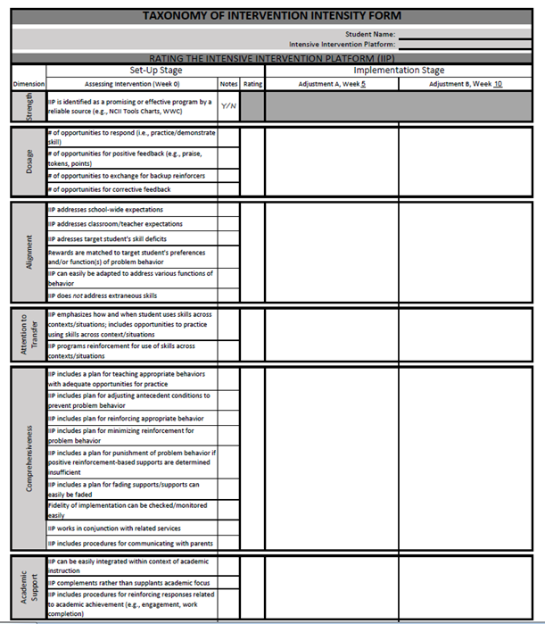

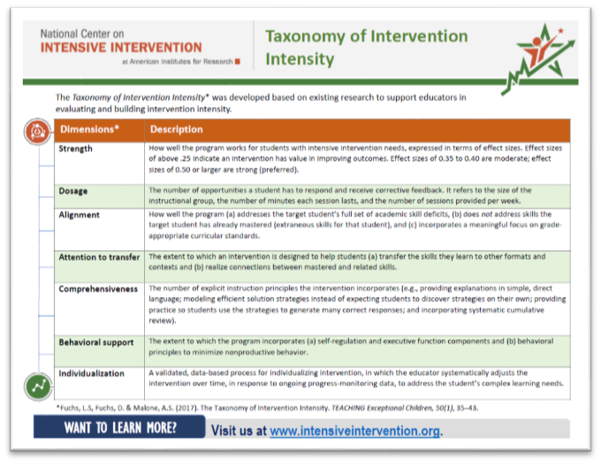
Questions

Slide 63
Taxonomy and NCII Resources
  Introduction to Data-Based Individualization: Considerations for Implementation in Academics and Behavior (DBI Training Series, Module 1)
  Designing Intensive Intervention for Students With Severe and Persistent Academic Needs (DBI Training Series, Module 7)
  So What Do I Do Now? Strategies for Intensifying Intervention When Standard Approaches Don’t Work (webinar)
  The Taxonomy of Intervention Intensity: A Case Study for Building Intervention Intensity in Math (webinar)
  The Taxonomy of Intervention Intensity: A Case Study for Building Intervention Intensity in Reading (webinar)
Notes:
NCII has developed several resources to help interventionists plan and implement intensive intervention programs. The Intensive Intervention Practice Categories highlight possible means of intensifying interventions: These Practice Categories include:
Change Intervention Dosage or Time
Change the Learning Environment to Promote Attention and Engagement
Combine Cognitive Learning Strategies with Academic Learning
Modify Delivery of Instruction

Slide 64
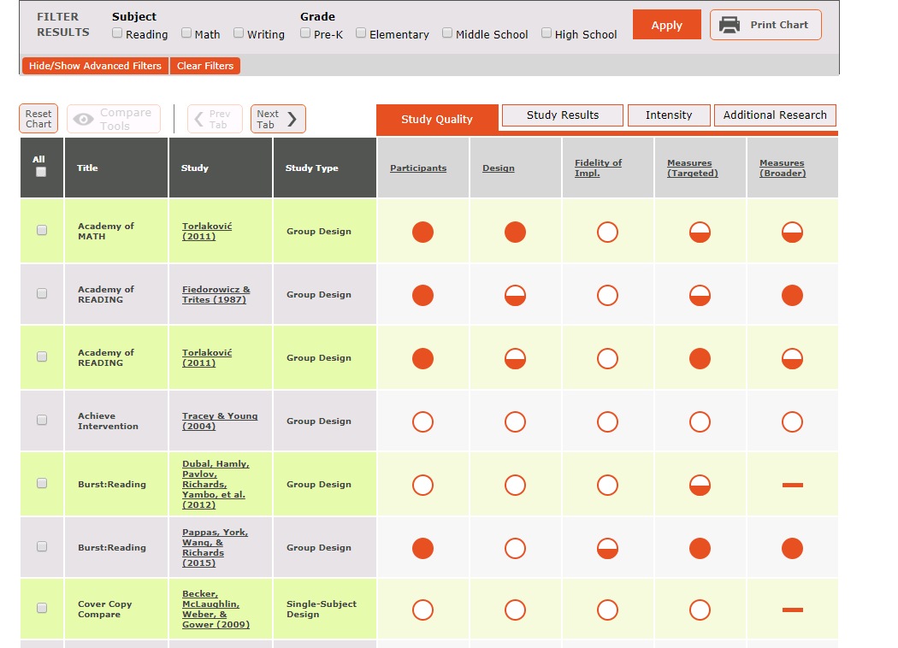
The NCII Tools Charts

Slide 65
Closing Slide

Slide 66
References
Fuchs, L. S., Fuchs, D., & Malone A. S. (2017). The taxonomy of intervention intensity. Teaching Exceptional Children, 50(1), 35–43.
National Center on Intensive Intervention. (2013). Data-based individualization: A framework for intensive intervention. Produced by the American Institutes for Research. Retrieved from https://eric.ed.gov/?q=ED575656.

Slide 67
NCII Disclaimer
This presentation was produced under the U.S. Department of Education, Office of Special Education Programs, Award No. H326Q160001. Celia Rosenquist serves as the project officer. The views expressed herein do not necessarily represent the positions or policies of the U.S. Department of Education. No official endorsement by the U.S. Department of Education of any product, commodity, service, or enterprise mentioned in this website is intended or should be inferred.

