Slide 1
What Does it Take to Meet the Needs of Struggling Readers? An Overview of Essential Practices for Intensifying Literacy Instruction
April 2021
Kim St. Martin, Ph.D. | Sharon Vaughn, Ph.D.

Slide 2
Webinar Format & Questions
Throughout the presentation, submit your questions into the chat.
For technical issues and questions, a webinar team member will try to assist you as soon as possible.
For content related questions, there will be a time for Q&A at the end of the presentation. Submit your questions and we will share them with the presenters.

Slide 3
Acknowledgements
St. Martin, K., Vaughn, S., Troia, G., Fien, & H., Coyne, M. (2020). Intensifying literacy instruction: Essential practices. Lansing, MI: MiMTSS Technical Assistance Center, Michigan Department of Education.
You can access the document by visiting NCII: Intensifying Essential Practices
It is also available on the MiMTSS TA Center’s website

Slide 4
Poll 1
Let’s take a moment to get to know who is here today!

Slide 5
Structure of the Guide
The contents of the Intensifying guide serve as the foundation for establishing policy, allocating resources, and providing professional learning to support a range of learners with literacy difficulties including, but not limited to, students with disabilities.
Practices in the guide are identified as targeted to leaders (district and school administrators), or teachers (general education and special education) and interventionists.

Slide 6
Relationship to MTSS
Within an MTSS framework, the information in this guide would be categorized as Tier 2 and Tier 3 supports
It is important to remember most students who receive Tier 2 and Tier 3 supports spend the majority of their time in the classroom/core subject setting (Tier 1), so the contents within this guide are relevant across all tiers
We must not forget the importance of high-quality Tier 1 (class-wide) instruction and curriculum resources
We must meaningfully distinguish the level of intensity for Tier 2 and Tier 3 intervention supports
We must make decisions about students’ response to intervention instruction

Slide 7
Reading, Writing - “Literacy”
The term “literacy” is commonly used in education and it is important for people to know reading and writing are their own distinct but interconnected set of skills.
Reading and writing are two unique skill clusters, so each is recognized as a valuable element to educators’ instruction.
The goals is to integrate mechanisms for reading and writing.

Slide 8
Essential Practices
Knowledge and use of a learning progression for developing skilled readers and writers
Design and use of an evidence-based intervention platform as the foundation for effective intervention
On-going data-based decision making for providing and intensifying interventions
Adaptations to increase the instructional intensity of the intervention
Infrastructures (systems) to support students with severe and persistent literacy needs

Slide 9
Systems…Not Necessarily Viewed as Glamorous
“Place a good person in a bad system, and the system will win every time.” – Seymour Sarason
MTSS is the system - the framework, that nests the evidence-based practices, programs, assessments, and procedures to support people in their use
Systems may not be viewed as glamorous as learning about practices and programs BUT – in their absence, implementation and outcomes will suffer

Slide 10
Essential Practice 1
Knowledge and use of a learning progression for developing skilled readers and writers

Slide 11
Simple View of Reading
(Gough & Tunmer, 1986; Hoover & Gough, 1990; Tunmer & Hover, 2019)

Slide 12
Simple View of Reading: Beginning Readers
(Barker, Farry-Thorn, Seidenberg, 2020)

Slide 13
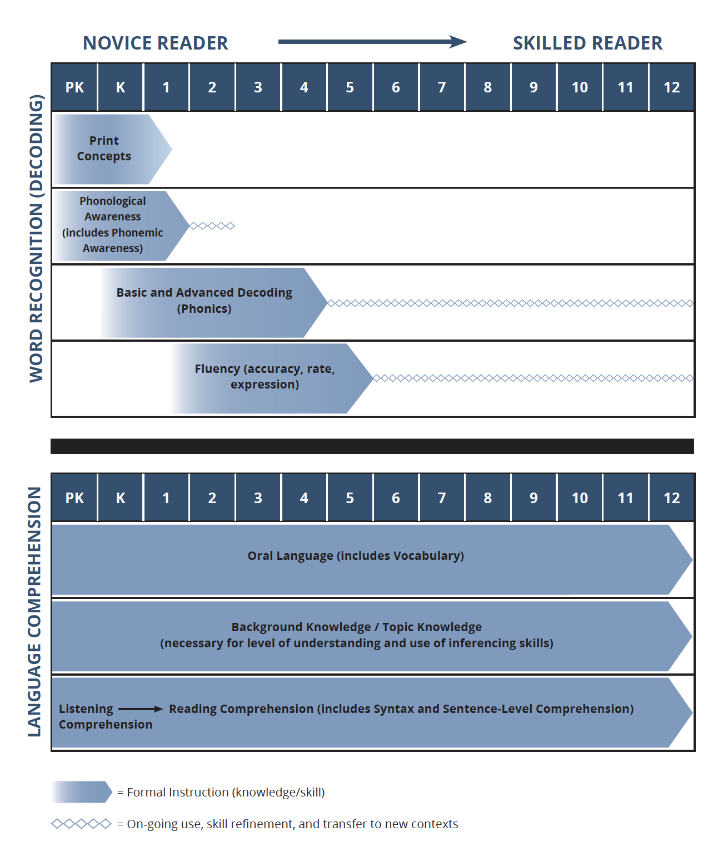
Reading Learning Progression
Reading learning progression:
Represents the things students need in each of the two components to be skillful readers

Slide 14
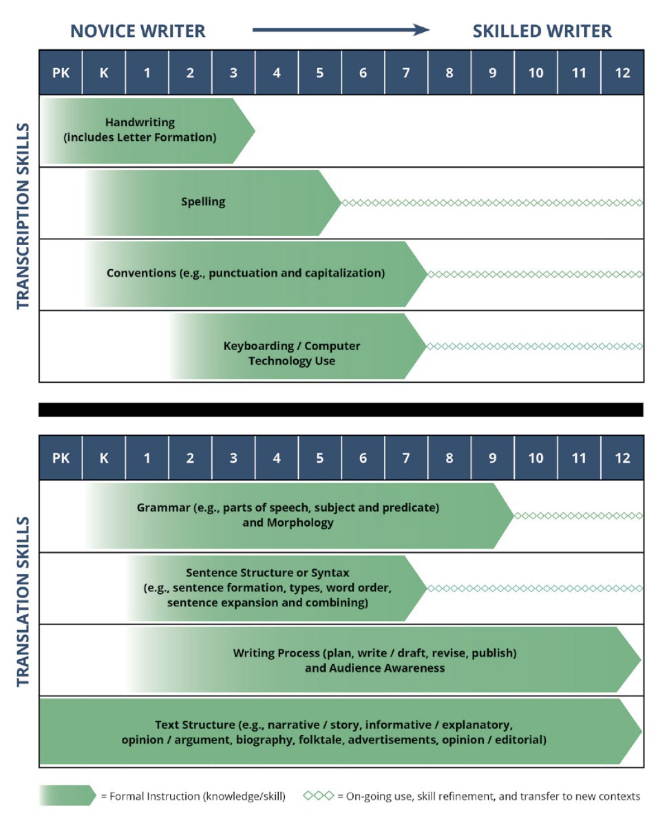
Practice 1: Reading and Writing Learning Progression (cont.)
Writing Progression
Framed around the components of the Simple View of Writing (Berninger, V. W., & Amtmann, D., 2003)

Slide 15
Learning Progression Take-Aways
Developing skillful readers and writers requires instruction in specific skills that need to be carefully sequenced and built upon throughout students’ educational careers
The things that need to be taught can be organized by the components in the Simple View of Reading and Simple View of Writing
If educators are uncertain about how learning to read and learning to write develop, and how best to teach the necessary skills, their ability to provide intervention that is designed to accelerate outcomes is limited

Slide 16
Poll 2
Reflect on peoples’ understanding of the Simple View of Reading and the Reading Learning Progression.

Slide 17
Essential Practice 2
Design and use of an evidence-based intervention platform as the foundation for effective intervention

Slide 18
Defining an Intervention Platform
“Collection of practices or programs that have been intentionally reviewed and selected to be used as the foundation, or building blocks, for customizing intervention” (p. 13)

Slide 19
Intervention Platform (cont.)
Intervention platform resources are not intended to be developed by individual teachers
“Designing effective reading and writing intervention materials requires significant expertise in the content area, instructional design principles, and learning science. It also requires a significant amount of time.”(p.13)

Slide 20
Taxonomy of Intervention Intensity
Purpose: To support educators in evaluating AND building intervention intensity
Interventions are evaluated based on the dimensions (left column)
The dimensions are used to build intervention intensity (take the carefully selected intervention curricula and choose a dimension or two to adapt the instruction)

Slide 21
Reviewing and Evaluating Interventions: Key Considerations
Does evidence suggest that the intervention is expected to lead to improved outcomes (strength)?
Will the group size, duration, and frequency provide sufficient opportunities to respond (dosage)?
Does the intervention match to the student’s identified needs (alignment)?
Does it assist the student in generalizing the learned skills to general education or other tasks (attention to transfer)?

Slide 22
Key Considerations (cont.)
Does the intervention include elements of explicit instruction (comprehensiveness)?
Does the student have opportunities to develop the behavior skills needed to be successful (behavioral support)? Can the intervention be easily integrated into academic instruction (academic support)?
Can the intervention be individualized with a data-based process to meet student needs (individualization)?

Slide 23
Resource

Slide 24
Let’s Chat
What benefits are there in using the dimensions of intervention intensity (taxonomy) to guide intervention selection and evaluation?

Slide 25
Essential Practice 4
Adaptations to increase the instructional intensity of the intervention

Slide 26
Example Individualized Intensive Intervention Plan

Slide 27
Dimensions of Intervention Intensity
The following dimensions of intervention intensity are considered for adaptations to individualize and intensify the intervention instruction
Alignment
Dosage (lesson design dosage and structural dosage like group size)
Comprehensiveness
Attention to Transfer
Behavioral Support

Slide 28
Alignment Adaptations
The teacher determines the ways the current intervention matches the student’s needs
Based on the analysis of student data, an alignment adaptation could be:
Supplement the current intervention (e.g., adding an additional strategy or intervention curriculum resource)
Modify the existing intervention to better align with the needs (as indicated by the student’s data)

Slide 29
Alignment Adaptation Example
A student is receiving intensive intervention to address advanced decoding skills (reading multi-syllable words)
The student can apply the strategy to accurately read words; however, when reading irregular words, the word’s pronunciation does not match the pronunciation of the word storied in her mental dictionary (“set for variability”)
The student could benefit from the teacher modifying the existing intervention by pulling back in an intervention lesson component that had been faded a few lessons ago that was designed to prepare students to adjust the pronunciation of the word to account for the word stored in her mental dictionary
The teacher uses words from the current passage the student will be reading to practice this (mountain, persevered)

Slide 30
Dosage Adaptations
Two types of dosage adaptations:
Lesson design dosage adaptations
Structural dosage adaptations:

Slide 31
Lesson Design Dosage Adaptations
The teacher creates the conditions to increase the number of practice opportunities for students
This begins to blend into the “comprehensiveness” intervention intensity dimension
Example: The teacher tightens-up the student active participation procedures to:
Ensure adequate think time is provided
Include more partner responses with the student who needs more practice opportunities (teacher monitors this student’s responses and provides feedback)
Reduce the amount of teacher talk to make more time for practice opportunities

Slide 32
Structural Dosage Adaptations
Increase the number of intervention sessions
Increase the number of instructional minutes by adding time to the intervention session
Reduce the number of students participating in the intervention group
Increase the ratio of adults to students (e.g., paraeducator is with the teacher during the intervention instruction and is able to assist the teacher in monitoring and providing feedback for practice opportunities)

Slide 33
Comprehensiveness Adaptations
Comprehensiveness = elements of explicit instruction
Teacher could adjust the intervention instruction by:
Using clearer, more concise instructional language
Providing an additional model
Giving more practice opportunities
Improving the gradual fading of instructional support
Providing sufficient independent practice and cumulative review

Slide 34
Attention to Transfer (“Generalization”) Adaptations
The teacher incorporates words or text that are being used in the student’s classes into the intervention lesson
The student’s classroom teacher(s) are provided information about the intervention strategy (e.g., how to use it, how to prompt the student to use it), so students are being asked to use it in the appropriate contexts outside of the intervention class/time

Slide 35
Behavioral Support Adaptations
Additional behavior supports can be incorporated into the intervention instruction to increase students’ overall motivation, engagement, and success
Types of adaptations:
Adjust the organization and physical environment of the classroom setting where intervention is occurring
Include strategies to help the student persist in completing intervention lesson components and activities
Incorporate ways for students to monitor their engagement in the lesson
Include strategies to reduce off-task behavior
Refer to pages 22-23 for examples of the types of adaptations

Slide 36
Let’s Chat Again!
What do you see as benefits in using the process described to adapt and intensify intervention instruction in your school/district setting?

Slide 37
MTSS: Access. Equity. All.
“Once you learn to read you will be forever free.” – Fredrick Douglass
Reading provides the ultimate pathway to opportunity. Whether it is an opportunity to enjoy, learn, share experiences, or broaden horizons – reading is the gift that allows all of these things to occur (p.1).

Slide 38
Questions

Slide 39
Resources

Slide 40
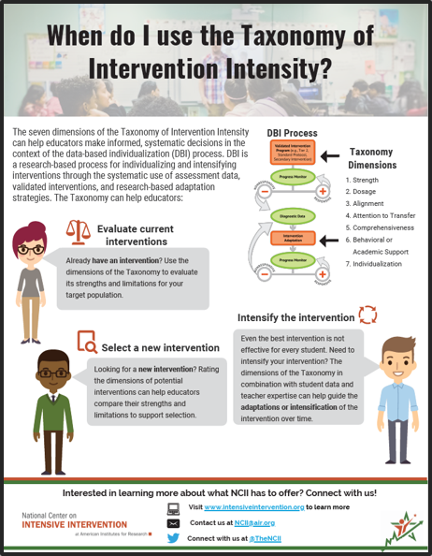
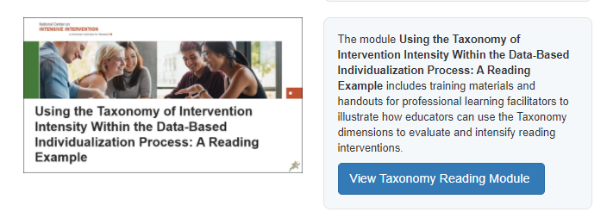
Taxonomy Resources
Taxonomy Webpage: https://intensiveintervention.org/taxonomy-intervention-intensity

Slide 41
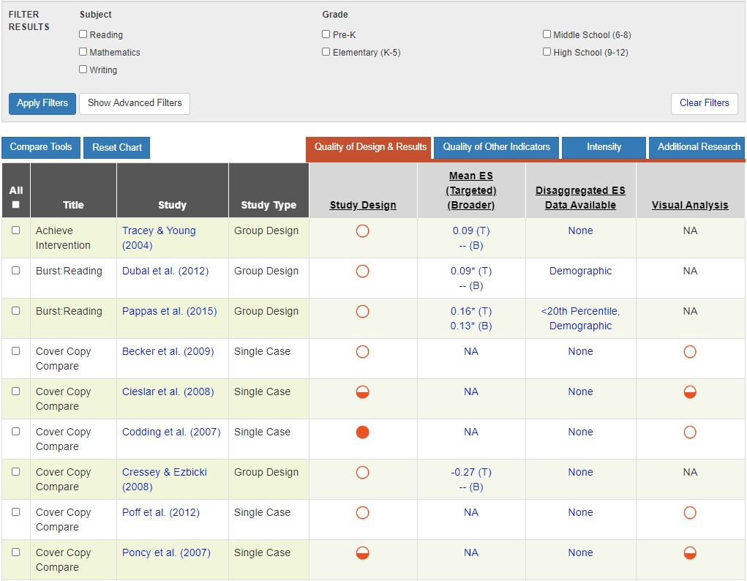
Resources to Evaluate Strength
Academic Intervention Tools Chart
https://charts.intensiveintervention.org/ chart/instructional-intervention-tools

Slide 42
Resource to Support Intensification of Dosage
Source: https://intensiveintervention.org/resource/strategies-scheduling-how-find-time-intensify-and-individualize-intervention.

Slide 43
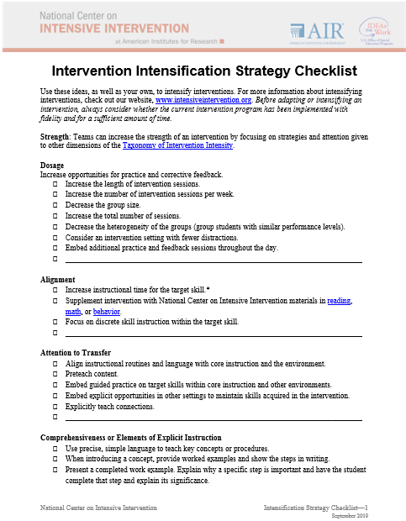
Resources to Support Individualization Decisions

Slide 44
Literacy Strategies to Support Intensifying Interventions
https://intensiveintervention.org/intervention-resources/literacy-strategies
Notes:
.

Slide 45
MiMTSS Website
https://mimtsstac.org/

Slide 46
The Meadows Center
https://meadowscenter.org/

Slide 47
Thank you
Thank you!

Slide 48
NCII Disclaimer
This presentation was produced under the U.S. Department of Education, Office of Special Education Programs, Award No. H326Q160001. Celia Rosenquist serves as the project officer. The views expressed herein do not necessarily represent the positions or policies of the U.S. Department of Education. No official endorsement by the U.S. Department of Education of any product, commodity, service, or enterprise mentioned in this webinar is intended or should be inferred.

