Slide 1
Qualitative Adaptations for Teaching Comprehension
Module 7 – Introduction

Slide 2
Objectives
You will learn…
Part 1:
What effective modeling looks like in intensive reading interventions for comprehension.
How to adapt comprehension instruction to improve instructional modeling.
Parts 2 & 3:
How to provide effective practice opportunities, elicit frequent responses, and give effective feedback during comprehension instruction.
How to adapt comprehension instruction to improve these practices.

Slide 3
Module Orientation
In this module, you will learn…
How to provide effective modeling in intensive comprehension interventions.
How to provide effective practice opportunities in intensive comprehension interventions.
How to elicit frequent responses and provide feedback in intensive comprehension interventions.

Slide 4

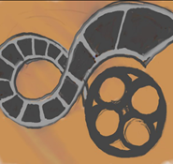

Module Orientation
Module Orientation
Workbook Activities:
Reflect on examples of effective and ineffective instructional delivery from curriculum samples and videos of classroom instruction
Analyze curriculum samples and case study videos of real classroom instruction.
Online Activities:
Submit a journal entry discussing your evaluation of a video.

Slide 5
Big Ideas in Reading

Slide 6
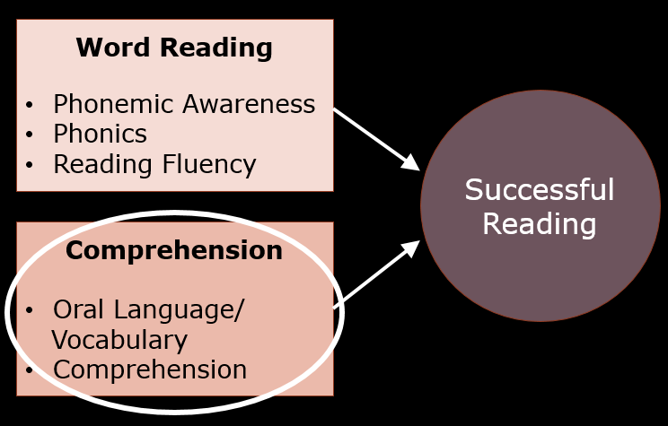
Big Ideas in Reading

Slide 7
Why We’re Learning This
Why We’re Learning This
WHAT we teach
HOW we teach

Slide 8
Explicit Instruction
I Do
Modeling
Practice
Clear Explanation
Guided
Practice
We Do
Planned
Examples
Independent Practice
You Do
Supporting Practices
Asking the right questions
Eliciting frequent responses
Providing immediate specific feedback
Maintaining a brisk pace

Slide 9
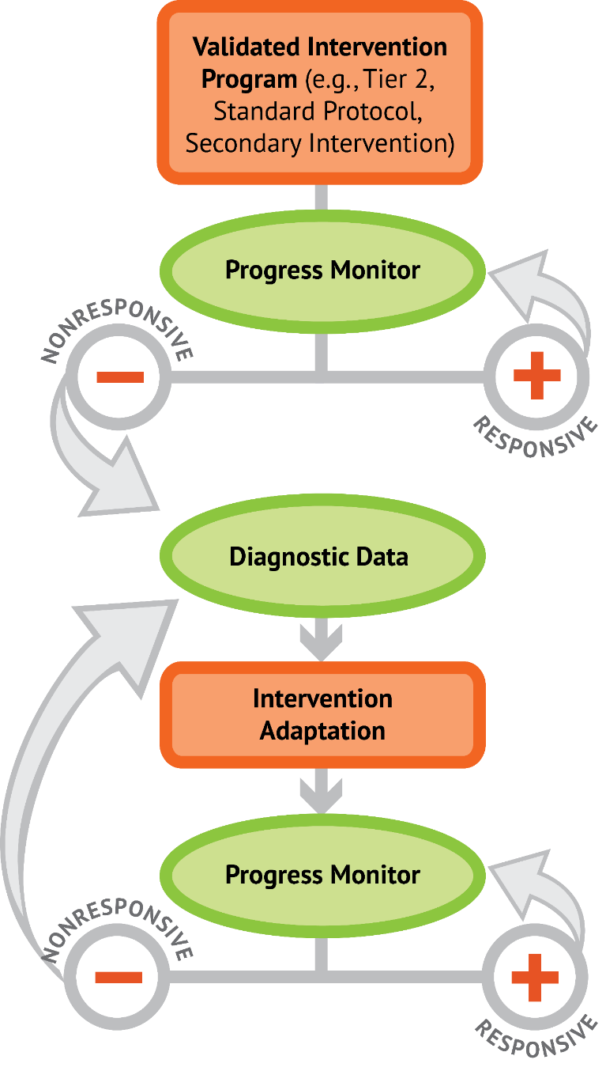
DBI
Qualitative Adaptations:
Explicit Instruction

Slide 10
Welcome!
Welcome!
We are excited to start on the Module!

Slide 11
Qualitative Adaptations in Comprehension: Modeling
Module 7 – Part 1

Slide 12
Part 1 Objectives
You will learn…
What effective modeling looks like in intensive reading interventions for comprehension.
How to adapt comprehension instruction to improve instructional modeling.

Slide 13
Explicit Instruction
I Do
Modeling
Practice
Clear Explanation
Guided
Practice
We Do
Planned
Examples
Independent Practice
You Do
Supporting Practices
Asking the right questions
Eliciting frequent responses
Providing immediate specific feedback
Maintaining a brisk pace

Slide 14
Explicit Instruction
I Do
Modeling
Clear Explanation
Planned
Examples

Slide 15
Modeling: Why We’re Learning This
Students experiencing reading difficulties will not discover effective or efficient reading skills and strategies.
The strategies that expert readers rely on are effectively hidden from students experiencing reading difficulties.
The role of modeling is to let students
“in on the secret” of reading success by making skills and strategies explicit.

Slide 16
Effective Models
Focus on a singular objective
Explain with clear, concise, consistent language
Model/demonstrate the skill/strategy
(show the thinking)
Select appropriate examples to model
Model additional examples
(use multiple models)

Slide 17
Effective Models
Focus on a singular objective
Explain with clear, concise, consistent language
Model/demonstrate the skill/strategy
(show the thinking)
Select appropriate examples to model
Model additional examples
(use multiple models)

Slide 18
Focus on a singular objective
X
Focus on a singular objective
“Today we are going to learn strategies for identifying the main idea and summarizing what we’ve read.”

Slide 19
Focus on a singular objective
X
Focus on a singular objective
“Today we are going to learn story structure”

Slide 20

Focus on a singular objective
Focus on a singular objective
“Today we are going to learn more about our story map”

Slide 21
Question Answer Relationship
Focus on a singular objective
Question Answer Relationship
Right There - The answer is easy to find in the reading. The words used to make up the question are right there in the same sentence.
Think & Search - The answer to the question is in the reading/ The answer is made up of information that comes from more than one sentence or paragraph. You have to put together information from different parts of the text to find the answer.
Author and You - The answer to the question is not in the reading. Think about what the author tells you and what you already know.
On My Own - The answer to the question is not in the reading. You can answer the question by thinking about what you already know.

Slide 22
Effective Models
Focus on a singular objective
Explain with clear, concise, consistent language
Model/demonstrate the skill/strategy
(show the thinking)
Select appropriate examples to model
Model additional examples
(use multiple models)

Slide 23
Effective Models
Focus on a singular objective
Explain with clear, concise, consistent language
Model/demonstrate the skill/strategy
(show the thinking)
Select appropriate examples to model
Model additional examples
(use multiple models)

Slide 24
Explain with clear, concise, consistent language
Explain with clear, concise, consistent language
We are going to figure out the main idea of a group of sentences. There are two steps in thinking of a main-idea sentence.
First we name the person in the paragraph.
Second, we tell the main thing that the person did in all the sentences.

Slide 25
Model/demonstrate the skill/strategy
(show the thinking)
Model/demonstrate the skill/strategy
(show the thinking)
We are going to figure out the main idea of a group of sentences. There are two steps in thinking of a main-idea sentence.
First we name the person in the paragraph.
Second, we will tell the main thing that the person did in all the sentences.

Slide 26
Model/demonstrate the skill/strategy
(show the thinking)
X
Model/demonstrate the skill/strategy
(show the thinking)
Albert Einstein enjoyed sailing. He liked to play the violin. He had fun putting together jigsaw puzzles. He liked riding his bicycle everywhere
Now its my turn to come up with a main-idea sentence for this paragraph: Albert Einstein enjoyed doing many different things.

Slide 27
Model/demonstrate the skill/strategy
(show the thinking)
Model/demonstrate the skill/strategy
(show the thinking)
Albert Einstein enjoyed sailing. He liked to play the violin. He had fun putting together jigsaw puzzles. He liked riding his bicycle everywhere
Now its my turn to come up with a main-idea sentence for this paragraph:
First, I have to name the person the sentences are about. That’s easy. The sentences are about Albert Einstein.
Then, I have to figure out the main thing that the person did in all the sentences, how all the things that Albert Einstein did are related to each other.
Hmmm, I think he enjoyed all of them. That’s it; that’s the main idea: Albert Einstein enjoyed doing many different things.

Slide 28
Effective Models
Focus on a singular objective
Explain with clear, concise, consistent language
Model/demonstrate the skill/strategy
(show the thinking)
Select appropriate examples to model
Model additional examples
(use multiple models)

Slide 29
Effective Models
Focus on a singular objective
Explain with clear, concise, consistent language
Model/demonstrate the skill/strategy
(show the thinking)
Select appropriate examples to model
Model additional examples
(use multiple models)

Slide 30
Select appropriate examples to model
Select appropriate examples to model
We are going to figure out the main idea of a group of sentences. There are two steps in thinking of a main-idea sentence.
First we name the person in the paragraph.
Second, we tell the main thing that the person did in all the sentences.
Albert Einstein enjoyed sailing. He liked to play the violin. He had fun putting together jigsaw puzzles. He liked riding his bicycle everywhere

Slide 31
Select appropriate examples to model
Select appropriate examples to model
We are going to figure out the main idea of a group of sentences. There are two steps in thinking of a main-idea sentence.
First we name the person in the paragraph.
Second, we will tell the main thing that the person did in all the sentences.
When Benjamin Banneker was twenty-one, he took apart a pocket watch to see how it worked. He built a clock entirely out of wood, carving all the gears by hand. He also built the first American-made striking clock.

Slide 32
Select appropriate examples to model
X
Select appropriate examples to model
We are going to figure out the main idea of a group of sentences. There are two steps in thinking of a main-idea sentence.
First we name the person in the paragraph.
Second, we will tell the main thing that the person did in all the sentences.
Blue whales are marine mammals. They can be 90 feet long and weight 100 tons. Blue whales are now endangered. People have written laws to protect these majestic creatures.

Slide 33
Activity 7.1
Evaluate a Lesson
Activity 7.1
Evaluate a Lesson
LESSON 8: Making Inferences
TEACH/MODEL
Explain that as they read, students can think about what they already know from their own lives and what is in the story to make inferences about things or figure out what the author does not say directly.
Use Rabbit Bakes a Cake to model their strategy.
Ask: “How will Rabbit know how to make the cake?”
Model: “I know that many people use recipes, or written directions, when they cook. In the picture, I see that Rabbit is reading a cookbook; cookbooks have recipes in them. So I can make the inferences that Rabbit will use a recipe to make the cake.”
Practice/Apply: Remind children to make inferences if they have trouble understanding words or ideas as they read.
Effective Models
Focus on a singular objective
Explain with clear, concise, consistent language
Model/demonstrate the skill/strategy
(show the thinking)
Select appropriate examples to model
Model additional examples
(use multiple models)

Slide 34
Making Inferences
LESSON 8: Making Inferences
TEACH/MODEL
Explain that as they read, students can think about what they already know from their own lives and what is in the story to make inferences about things or figure out what the author does not say directly.
Use Rabbit Bakes a Cake to model their strategy.
Ask: “How will Rabbit know how to make the cake?”
Model: “I know that many people use recipes, or written directions, when they cook. In the picture, I see that Rabbit is reading a cookbook; cookbooks have recipes in them. So I can make the inferences that Rabbit will use a recipe to make the cake.”
Practice/Apply: Remind children to make inferences if they have trouble understanding words or ideas as they read.
Effective Models
Focus on a singular objective
Explain with clear, concise, consistent language
Model/demonstrate the skill/strategy
(show the thinking)
Select appropriate examples to model
Model additional examples
(use multiple models)

Slide 35
Making Inferences
LESSON 8: Making Inferences
TEACH/MODEL
Explain that as they read, students can think about what they already know from their own lives and what is in the story to make inferences about things or figure out what the author does not say directly.
Use Rabbit Bakes a Cake to model their strategy.
Ask: “How will Rabbit know how to make the cake?”
Model: “I know that many people use recipes, or written directions, when they cook. In the picture, I see that Rabbit is reading a cookbook; cookbooks have recipes in them. So I can make the inferences that Rabbit will use a recipe to make the cake.”
Practice/Apply: Remind children to make inferences if they have trouble understanding words or ideas as they read.
Effective Models
Focus on a singular objective
Explain with clear, concise, consistent language
Model/demonstrate the skill/strategy
(show the thinking)
Select appropriate examples to model
Model additional examples
(use multiple models)

Slide 36
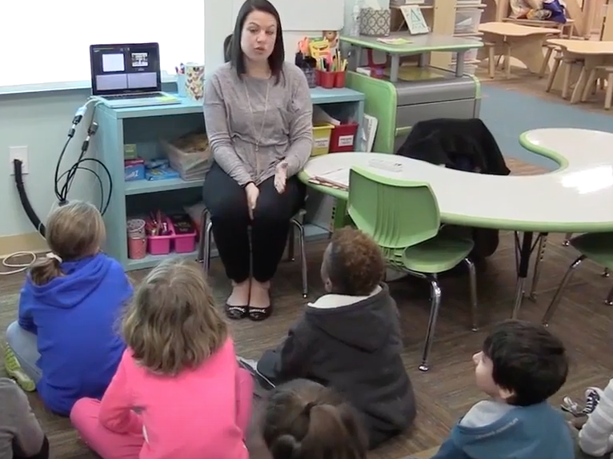
Activity 7.2
Evaluate a Video
Activity 7.2
Evaluate a Video
Effective Models
Focus on a singular objective
Explain with clear, concise, consistent language
Model/demonstrate the skill/strategy
(show the thinking)
Select appropriate examples to model
Model additional examples
(use multiple models)
Main Idea

Slide 37
Activity 7.2
https://youtu.be/e4D8wCGHpyw

Slide 38
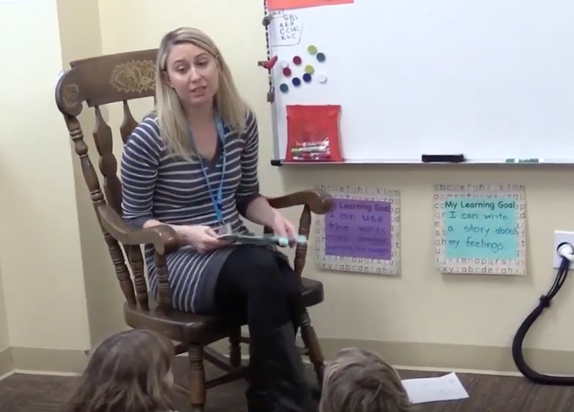
Activity 7.3
Evaluate a Video
Activity 7.3
Evaluate a Video
Effective Models
Focus on a singular objective
Explain with clear, concise, consistent language
Model/demonstrate the skill/strategy
(show the thinking)
Select appropriate examples to model
Model additional examples
(use multiple models)
Predicting

Slide 39
Activity 7.3
https://youtu.be/HXJTW7Gka-g

Slide 40
Qualitative Adaptations in Comprehension: Guided Practice, Eliciting Responses, and Providing Feedback
Module 7 – Part 2 & 3

Slide 41
Part 2 & 3 Objectives
You will learn…
How to provide effective practice opportunities, elicit frequent responses, and provide effective feedback during comprehension instruction.
How to adapt comprehension instruction to improve these practices.

Slide 42
Explicit Instruction
I Do
Modeling
Practice
Clear Explanation
Guided
Practice
We Do
Planned
Examples
Independent Practice
You Do
Supporting Practices
Asking the right questions
Eliciting frequent responses
Providing immediate specific feedback
Maintaining a brisk pace

Slide 43
Explicit Instruction
Practice
Guided
Practice
We Do
Independent Practice
You Do

Slide 44
Practice:
Why We’re Learning This
Successful comprehension requires active and strategic application of complex strategies.
Effective instruction guides students through practicing the steps of these strategies while thinking aloud and interacting with text.

Slide 45
Effective Guided Practice
Focus on same singular objective
(using similar examples)
Guide students through the skill/strategy
Provide ”just right” amount of guidance
(based on students’ skills)
Provide clear prompts and supports

Slide 46
Effective Guided Practice
Focus on same singular objective
(using similar examples)
Guide students through the skill/strategy
Provide ”just right” amount of guidance
(based on students’ skills)
Provide clear prompts and supports

Slide 47
Focus on a singular objective (using similar examples)
X
Focus on a singular objective (using similar examples)
Question Answer Relationship
Right There - The answer is easy to find in the reading. The words used to make up the question are right there in the same sentence.
Think & Search
Author and You
On My Own
I just showed you how to answer “right there” questions in this paragraph. Now lets see if you can answer them in our science article.

Slide 48
Focus on a singular objective (using similar examples)
Focus on a singular objective (using similar examples)
Question Answer Relationship
Right There - The answer is easy to find in the reading. The words used to make up the question are right there in the same sentence.
Think & Search
Author and You
On My Own
I just showed you how to answer “right there” questions in this paragraph. Now lets see if you can answer them in the next paragraph.

Slide 49
Effective Guided Practice
Focus on same singular objective
(using similar examples)
Guide students through the skill/strategy
Provide ”just right” amount of guidance
(based on students’ skills)
Provide clear prompts and supports

Slide 50
Effective Guided Practice
Focus on same singular objective
(using similar examples)
Guide students through the skill/strategy
Provide ”just right” amount of guidance
(based on students’ skills)
Provide clear prompts and supports

Slide 51
Explain with clear, concise, consistent language
Explain with clear, concise, consistent language
We are going to figure out the main idea of a group of sentences. There are two steps in thinking of a main-idea sentence.
First we name the person in the paragraph.
Second, we will tell the main thing that the person did in all the sentences.

Slide 52
Model/demonstrate the skill/strategy
(show the thinking)
Model/demonstrate the skill/strategy
(show the thinking)
Albert Einstein enjoyed sailing. He liked to play the violin. He had fun putting together jigsaw puzzles. He liked riding his bicycle everywhere.
Now its my turn to come up with a main-idea sentence for this paragraph:
First, I have to name the person the sentences are about. That’s easy. The sentences are about Albert Einstein.
Then, I have to figure out main thing that the person did in all the sentences, how all the things that Albert Einstein did are related to each other.
Hmmm, I think he enjoyed all of them. That’s it, that’s the main idea: Albert Einstein enjoyed doing many different things.

Slide 53
Guide students through the skill/strategy
X
Guide students through the skill/strategy
When Benjamin Banneker was 21, he took apart a pocket watch to see how it worked. He built a clock entirely out of wood, carving all the gears by hand. He also built the first American-made striking clock.
Now its your turn to come up with a main-idea sentence for this paragraph.
Who can tell me the main idea?

Slide 54
Guide students through the skill/strategy
Guide students through the skill/strategy
When Benjamin Banneker was 21, he took apart a pocket watch to see how it worked. He built a clock entirely out of wood, carving all the gears by hand. He also built the first American-made striking clock.
Now its your turn to come up with a main-idea sentence for this paragraph.
What is the first step in telling the main idea?
Student: First, I name the person in the sentences.
Yes, who is the person?
Student: The person is Benjamin Banneker.
Great job naming the person!

Slide 55
Guide students through the skill/strategy
Guide students through the skill/strategy
When Benjamin Banneker was 21, he took apart a pocket watch to see how it worked. He built a clock entirely out of wood, carving all the gears by hand. He also built the first American-made striking clock.
What is the 2nd step in telling the main idea?
Student: The next step is to tell what the person did in all the sentences. Let’s see, all the sentences seem to be about clocks or making clocks. I think the main idea sentence would be Benjamin Banneker built clocks.
Yes! You found the main idea!

Slide 56
Effective Guided Practice
Focus on same singular objective
(using similar examples)
Guide students through the skill/strategy
Provide ”just right” amount of guidance
(based on students’ skills)
Provide clear prompts and supports

Slide 57
Effective Guided Practice
Focus on same singular objective
(using similar examples)
Guide students through the skill/strategy
Provide ”just right” amount of guidance
(based on students’ skills)
Provide clear prompts and supports

Slide 58
Provide ”just right” amount of guidance
Provide ”just right” amount of guidance
Scaffolded Guided Practice
Strategy
Step-by-Step ---- Flexible Application
Text
Constrained ---------- Authentic

Slide 59
Effective Guided Practice
Focus on same singular objective
(using similar examples)
Guide students through the skill/strategy
Provide ”just right” amount of guidance
(based on students’ skills)
Provide clear prompts and supports

Slide 60
Effective Guided Practice
Focus on same singular objective
(using similar examples)
Guide students through the skill/strategy
Provide ”just right” amount of guidance
(based on students’ skills)
Provide clear prompts and supports

Slide 61
Provide clear prompts and supports
Provide clear prompts and supports
Finding the main idea
Name the person the sentences are about.
Tell what the person did in all the sentences.
What is the first step in telling the main idea?

Slide 62
Provide clear prompts and supports
Provide clear prompts and supports
Question Answer Relationship
Right There - The answer is easy to find in the reading. The words used to make up the question are right there in the same sentence.
Think & Search
Author and You
On My Own
Underline the question words in the paragraph.

Slide 63
Provide clear prompts and supports
Provide clear prompts and supports
“Today we are going to use our story map”

Slide 64
Explicit Instruction
I Do
Modeling
Practice
Clear Explanation
Guided
Practice
We Do
Planned
Examples
Independent Practice
You Do
Supporting Practices
Asking the right questions
Eliciting frequent responses
Providing immediate specific feedback
Maintaining a brisk pace

Slide 65
Explicit Instruction
Supporting Practices
Asking the right questions
Eliciting frequent responses
Providing immediate specific feedback
Maintaining a brisk pace

Slide 66
Explicit Instruction
Supporting Practices
Asking the right questions
Eliciting frequent responses
Providing immediate specific feedback
Maintaining a brisk pace

Slide 67
Eliciting Responses and Feedback:
Why We’re Learning This
Student Learning
Eliciting Frequent = Maximizes opportunities to
Responses learn and student engagement
Providing Immediate = Ensures learning is happening
Specific Feedback

Slide 68
Eliciting Frequent Reponses
Select most appropriate response format
  (type of response, number of students, time)
Maximize engagement and opportunities to practice

Slide 69
Opportunities to Learn and Practice
Response Format
Select most appropriate response format
Maximize engagement and opportunities to practice
Opportunities to Learn and Practice
Response Format
Response
Verbal, Written, Gesture
Students
Individual, Pair, Group
Time
Short ------------- Long

Slide 70
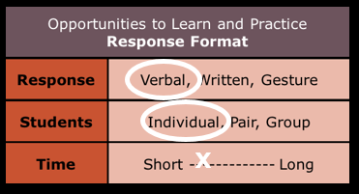
Finding the main idea
Select most appropriate response format
Maximize engagement and opportunities to practice
Finding the main idea
What’s the first step in telling the main idea?
Student: First I name the person in the sentences.
Yes, who is the person?
Student: The person is Benjamin Banneker.

Slide 71
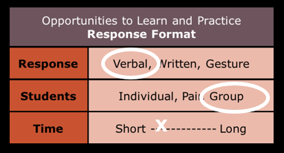
Finding the main idea
Select most appropriate response format
Maximize engagement and opportunities to practice
Finding the main idea
Everyone, what’s the first step in telling the main idea?
Students: Name the person in the sentences.

Slide 72
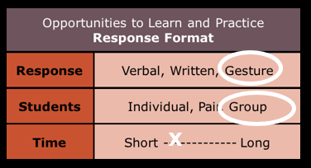
Finding the main idea
Select most appropriate response format
Maximize engagement and opportunities to practice
Finding the main idea
Everyone, what’s the first step in telling the main idea?
Students: Name the person in the sentences.
Put your thumbs up if you think you know the person in the sentences.

Slide 73
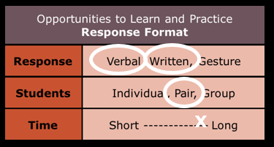
Finding the main idea
Select most appropriate response format
Maximize engagement and opportunities to practice
Finding the main idea
Everyone, what’s the first step in telling the main idea?
Students: Name the person in the sentences.
Put your thumbs up if you think you know the person in the sentences.
Talk with your partner about the person, and write the name on your main idea sheet.

Slide 74
Immediate Specific Feedback
Provide immediate feedback
Affirm correct responses
Correct incorrect responses
(and provide additional practice)

Slide 75
Immediate Specific Feedback
Provide immediate feedback
Affirm correct responses
Correct incorrect responses
(and provide additional practice)

Slide 76
Affirm Correct Responses
Affirm Correct Responses
When Benjamin Banneker was 21, he took apart a pocket watch to see how it worked. He built a clock entirely out of wood, carving all the gears by hand. He also built the first American-made striking clock.
Now its your turn to come up with a main-idea sentence for this paragraph.
What is the first step in telling the main idea?
Student: First I name the person in the sentences.
Yes, who is the person?
Student: The person is Benjamin Banneker.
Great job naming the person!

Slide 77
Immediate Specific Feedback
Provide immediate feedback
Affirm correct responses
Correct incorrect responses
(and provide additional practice)

Slide 78
Immediate Specific Feedback
Provide immediate feedback
Affirm correct responses
Correct incorrect responses
(and provide additional practice)

Slide 79
Provide Immediate Feedback
X
Provide Immediate Feedback
When Benjamin Banneker was 21, he took apart a pocket watch to see how it worked. He built a clock entirely out of wood, carving all the gears by hand. He also built the first American-made striking clock.
Now its your turn to come up with a main-idea sentence for this paragraph.
Who can tell me the main idea?
Student: Benjamin Banneker took apart a pocket watch.

Slide 80
Correct Incorrect Responses
Correct Incorrect Responses
When Benjamin Banneker was 21, he took apart a pocket watch to see how it worked. He built a clock entirely out of wood, carving all the gears by hand. He also built the first American-made striking clock.
What is the 2nd step in telling the main idea?
Student: The next step is to tell what the person did in the first sentence.
The next step is to tell what the person did in all the sentences. What is the 2nd step?
Student: Oh yeah, the next step is to tell what the person did in all the sentences. Let’s see, all the sentences seem to be about clocks or making clocks. I think the main idea sentence would be Benjamin Banneker built clocks.
Yes! You found the main idea!

Slide 81
Activity 7.4
Evaluate a Video
Activity 7.4
Evaluate a Video
Effective Guided Practice
Focus on same singular objective
(using similar examples)
Guide students through the skill/strategy
Provide ”just right” amount of guidance
(based on students’ skills)
Provide clear prompts and supports
Eliciting Responses & Providing Feedback
Select most appropriate response format
  (type of response, number of students, time)
Maximize engagement and opportunities to practice
(# opportunities per minute)
Main Idea

Slide 82
Activity 7.4
https://youtu.be/7CZu79naWkE

Slide 83
Activity 7.5
Evaluate a Lesson
Activity 7.5
Evaluate a Lesson
Effective Models
Focus on a singular objective
Explain with clear, concise, consistent language
Model/demonstrate the skill/strategy
(show the thinking)
Select appropriate examples to model
Model additional examples
(use multiple models)
Effective Guided Practice
Focus on same singular objective
(using similar examples)
Guide students through the skill/strategy
Provide ”just right” amount of guidance
(based on students’ skills)
Provide clear prompts and supports
Eliciting Responses & Providing Feedback
Select most appropriate response format
  (type of response, number of students, time)
Maximize engagement & opportunities to practice
(# opportunities per minute)
Summarizing
Teach: Ask students to tell the story of a recent class field trip or activity. Ask students: Did you tell every detail about the day, or did you choose the most important ideas? Point out that choosing the most important ideas of a story and telling them in a few sentences is called summarizing.
Practice: Have students reread the first section of today’s selection and have then summarize the section. Invite students to share their summarization with the class.

Slide 84
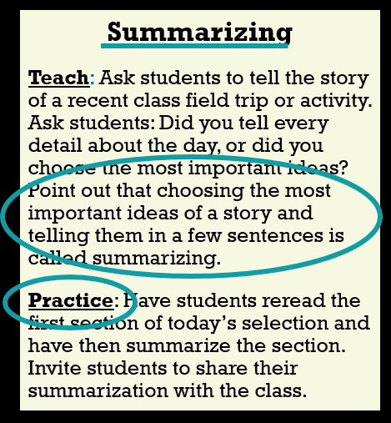
Activity 7.5
Evaluate a Lesson
Activity 7.5
Evaluate a Lesson
Effective Models
Focus on a singular objective
Explain with clear, concise, consistent language
Model/demonstrate the skill/strategy
(show the thinking)
Select appropriate examples to model
Model additional examples
(use multiple models)
Effective Guided Practice
Focus on same singular objective
(using similar examples)
Guide students through the skill/strategy
Provide ”just right” amount of guidance
(based on students’ skills)
Provide clear prompts and supports
Eliciting Responses & Providing Feedback
Select most appropriate response format
  (type of response, number of students, time)
Maximize engagement & opportunities to practice
(# opportunities per minute)

Slide 85
Effective Models
Introduce: Think about how you would tell someone the story of our recent field trip. Would you tell every single thing, or just the most important parts? Point out that choosing the most important ideas of a story and telling them in a few sentences is called summarizing.
Teach: Read aloud the the first two paragraphs of the selection. Model your thinking about summarizing the important ideas:
”Although there are many details in this section, I try to narrow them down to just the most important ideas. Here are three important ideas: Each year, the puffins return to Iceland to lay their eggs and raise chicks. When the puffins get big enough to leave their nests, some become confused and land in the village. Children of the village then help them get to sea.”
(Lesson repeats same modeling and think aloud procedure with the next two paragraphs)
Effective Models
Focus on a singular objective
Explain with clear, concise, consistent language
Model/demonstrate the skill/strategy
(show the thinking)
Select appropriate examples to model
Model additional examples
(use multiple models)
Effective Guided Practice
Focus on same singular objective
(using similar examples)
Guide students through the skill/strategy
Provide ”just right” amount of guidance
(based on students’ skills)
Provide clear prompts and supports
Eliciting Responses & Providing Feedback
Select most appropriate response format
  (type of response, number of students, time)
Maximize engagement & opportunities to practice
(# opportunities per minute)

Slide 86
Practice
Practice: Read aloud the next two paragraphs of the selection.
Teacher: “Now you are going to practice summarizing the important ideas. Everyone, what do you do when you summarize?”
Students: “You tell just the important ideas.”
Teacher: “Yes, that’s right, you just tell the important ideas. Everyone, write down one important idea” (provide wait time) Maria, what is one important idea from these paragraphs?”
Student: (Student identifies an important idea.)
Teacher: “Great job telling an important idea. Now, write down another important idea?”
(Teacher completes this practice example and gives students guided practice with two more examples. Teacher corrects any errors immediately by modeling the correct response and giving students a second opportunity to respond correctly)
Effective Models
Focus on a singular objective
Explain with clear, concise, consistent language
Model/demonstrate the skill/strategy
(show the thinking)
Select appropriate examples to model
Model additional examples
(use multiple models)
Effective Guided Practice
Focus on same singular objective
(using similar examples)
Guide students through the skill/strategy
Provide ”just right” amount of guidance
(based on students’ skills)
Provide clear prompts and supports
Eliciting Responses & Providing Feedback
Select most appropriate response format
  (type of response, number of students, time)
Maximize engagement & opportunities to practice
(# opportunities per minute)

Slide 87
Journal Entry
Journal Entry
Analyze Modeling, Practice, and Supporting Practices
(Evaluate a Video Lesson)
Select one of the following two videos from the http://explicitinstruction.org/ website.
“Read Aloud: Wolf! – Second grade”
http://explicitinstruction.org/video-elementary/elementary-video-3/
“Vocabulary and Background Knowledge Frontloading – Fifth Grade”
http://explicitinstruction.org/video-secondary-main/9-vocabulary-and- background-knowledge-frontloading-5th-grade/
2.Identify which of the two videos you selected. Describe how the teacher models and practices language comprehension during instruction and what supporting practices are used during instruction. Which of the criteria from the Checklist are/are not included or fully implemented? How does the quality of the instructional model, practice, and supporting practices affect student reading performance? As you discuss the video, be as specific as you can about any details related to vocabulary and comprehension.
3.Based on this Module, discuss how you would improve the instruction used in the teacher’s lesson. If you were working with the teacher as an instructional coach, what are your recommendations, based on the Module 7 Checklist, to help the teacher improve his/her instruction?

Slide 88
Qualitative Adaptations for Teaching Comprehension
Module 7 – Closing

Slide 89
Overview
Overview
1.
Intro to Reading and DBI
2.
Big Ideas in Reading
3.
4.
Intervention Programs in Reading
5.
Progress Monitoring and Instructional Decision Making
6.
Mastery Assessment
7.
Adapting and Intensifying Word Reading Intervention
Adapting and Intensifying Comprehension Intervention

