Slide 1
Intervention Programs for Reading
Module 3 – Introduction

Slide 2
Objectives
You will learn…
Part 1:
How intervention programs support students and teachers
What are intervention options for teaching reading
Part 2:
How to evaluate an intervention program’s materials
Part 3:
How to evaluate an intervention program’s research evidence

Slide 3
Intervention Programs for Reading
Module 3 – Part 1

Slide 4
Part 1 Objectives
You will learn…
How intervention programs support students and teachers.
What are intervention options for teaching reading.

Slide 5
Intervention
Intensive Intervention

Slide 6
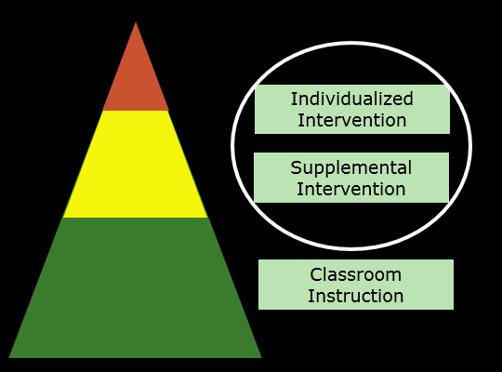
MTSS/RTI

Slide 7
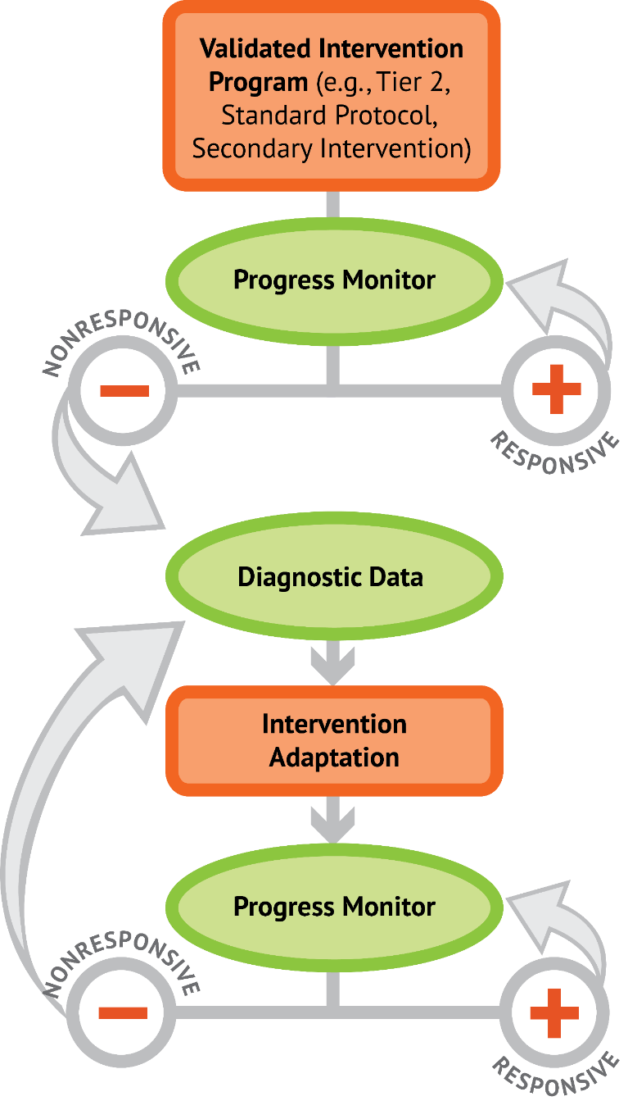
DBI
Validated Intervention Program

Slide 8

Intervention Programs

Slide 9
Intervention Programs
Support Teachers
What intervention programs do for you

Slide 10
Intervention Programs
Support Teachers
  Schedules, organizes, and integrates content over time
  Selects examples for you
  Breaks down skills so that you can more easily model and demonstrate them
  Provides language for providing clear explanations to reduce confusion
  Provides all learning materials

Slide 11
Intervention Programs
Support Teachers
  Schedules, organizes, and integrates content over time
  Selects examples for you
  Breaks down skills so that you can more easily model and demonstrate them
  Provides language for providing clear explanations to reduce confusion
  Provides all learning materials

Slide 12
Intervention Programs
Support Teachers
  Schedules, organizes, and integrates content over time
  Selects examples for you
  Breaks down skills so that you can more easily model and demonstrate them
  Provides language for providing clear explanations to reduce confusion
  Provides all learning materials

Slide 13
Intervention Programs
Support Teachers
  Schedules, organizes, and integrates content over time
  Selects examples for you
  Breaks down skills so that you can more easily model and demonstrate them
  Provides language for providing clear explanations to reduce confusion
  Provides all learning materials

Slide 14
Intervention Programs
Support Teachers
  Schedules, organizes, and integrates content over time
  Selects examples for you
  Breaks down skills so that you can more easily model and demonstrate them
  Provides language for providing clear explanations to reduce confusion
  Provides all learning materials

Slide 15
Intervention Programs
Support Teachers
What intervention programs allow you to do

Slide 16
Intervention Programs
Support Teachers
  Focus on teaching content, not designing it
  Focus on how students are responding, so you can correct, expand, elaborate
  Maintain a fast appropriate pace – to maximize engaged learning time
  Save planning time for data-based decision making (and individualization), rather than lesson development

Slide 17
Intervention Programs
Support Teachers
  Focus on teaching content, not designing it
  Focus on how students are responding, so you can correct, expand, elaborate
  Maintain a fast appropriate pace – to maximize engaged learning time
  Save planning time for data-based decision making (and individualization), rather than lesson development

Slide 18
Intervention Programs
Support Teachers
  Focus on teaching content, not designing it
  Focus on how students are responding, so you can correct, expand, elaborate
  Maintain a fast appropriate pace – to maximize engaged learning time
  Save planning time for data-based decision making (and individualization), rather than lesson development

Slide 19
Intervention Programs
Support Teachers
  Focus on teaching content, not designing it
  Focus on how students are responding, so you can correct, expand, elaborate
  Maintain a fast appropriate pace – to maximize engaged learning time
  Save planning time for data-based decision making (and individualization), rather than lesson development

Slide 20
Intervention Programs
Support Students
How intervention programs support student reading success

Slide 21
Intervention Programs
Support Students
  Aligned to students’ needs
  Provide consistency across teachers and grades
  Have evidence of effectiveness

Slide 22
Intervention Programs
Support Students
  Aligned to students’ needs
  Provide consistency across teachers and grades
  Have evidence of effectiveness

Slide 23
Intervention Programs
Support Students
  Aligned to students’ needs
  Provide consistency across teachers and grades
  Have evidence of effectiveness

Slide 24
Part 1 Objectives
You will learn…
How intervention programs support students and teachers.
What are intervention options for teaching reading.

Slide 25
Intervention Options
Intervention Options
for Teaching Reading
Evidence-supported program
Evidence-supported practice
Promising program or practice

Slide 26
Intervention Options
Evidence-supported program
  Single component (reading fluency) or multi-component (phonics, comprehension).
  Complete program (multiple lessons, scope and sequence, detailed lesson plans)
  Research has evaluated the program implemented with fidelity.

Slide 27
Intervention Options
Evidence-supported program
  Single component (reading fluency) or multi-component (phonics, comprehension).
  Complete program (multiple lessons, scope and sequence, detailed lesson plans)
  Research has evaluated the program implemented with fidelity.

Slide 28
Intervention Options
Evidence-supported program
  Single component (reading fluency) or multi-component (phonics, comprehension).
  Complete program (multiple lessons, scope and sequence, detailed lesson plans)
  Research has evaluated the program implemented with fidelity.

Slide 29
Evidence-supported program
Evidence-supported program

Slide 30
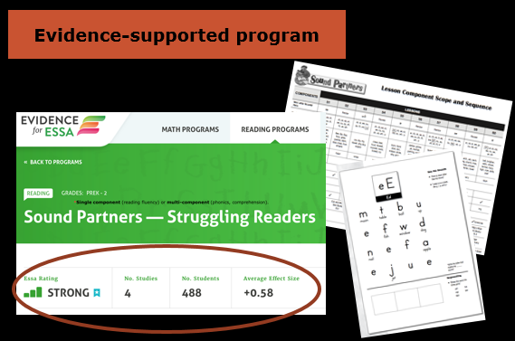
Evidence-supported program

Slide 31

Evidence-supported program

Slide 32
Intervention Options
Intervention Options
for Teaching Reading
Evidence-supported program
Evidence-supported practice

Slide 33
Intervention Options
Evidence-supported practice
  Strategy or Approach (may have general guidelines, but no scope and sequence or detailed lesson plans)
  Outlines an approach (explicit instruction), a strategy (asking and answering questions), or content (phonemic awareness)
  Research has evaluated the practice, not the materials

Slide 34
Intervention Options
Evidence-supported practice
  Strategy or Approach (may have general guidelines, but no scope and sequence or detailed lesson plans)
  Outlines an approach (explicit instruction), a strategy (asking and answering questions), or content (phonemic awareness)
  Research has evaluated the practice, not the materials

Slide 35
Intervention Options
Evidence-supported practice
  Strategy or Approach (may have general guidelines, but no scope and sequence or detailed lesson plans)
  Outlines an approach (explicit instruction), a strategy (asking and answering questions), or content (phonemic awareness)
  Research has evaluated the practice, not the materials

Slide 36
Evidence-supported practice
Evidence-supported practice

Slide 37
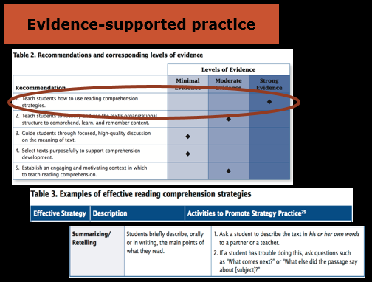
Evidence-supported practice

Slide 38
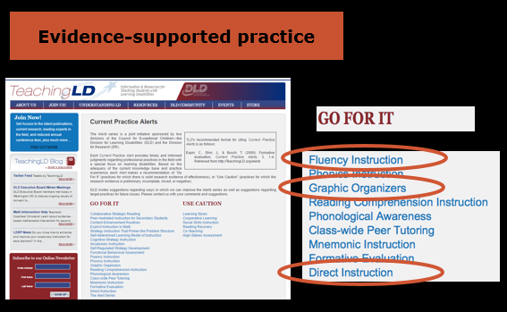
Evidence-supported practice

Slide 39
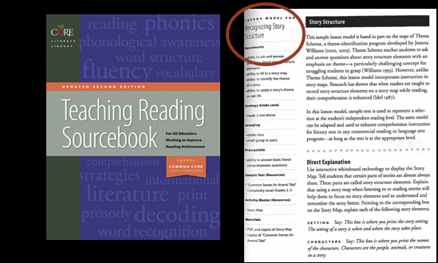
Evidence-supported practice
Evidence-supported practice

Slide 40
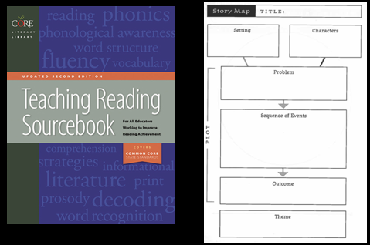
Evidence-supported practice
Evidence-supported practice

Slide 41
Intervention Options
Intervention Options
for Teaching Reading
Evidence-supported program
Evidence-supported practice
Promising program or practice

Slide 42
Intervention Options
Promising program or practice
  Program or practice that is consistent with existing theory and research on reading development and reading instruction
  There is little existing research demonstrating positive effects of the program or practice

Slide 43
Intervention Options
Promising program or practice
  Program or practice that is consistent with existing theory and research on reading development and reading instruction
  There is little existing research demonstrating positive effects of the program or practice

Slide 44
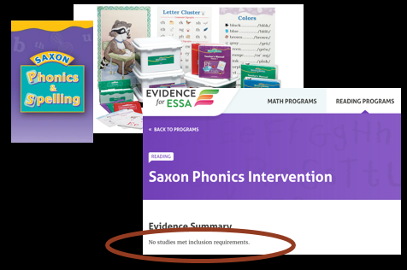
Promising program or practice
Promising program or practice

Slide 45
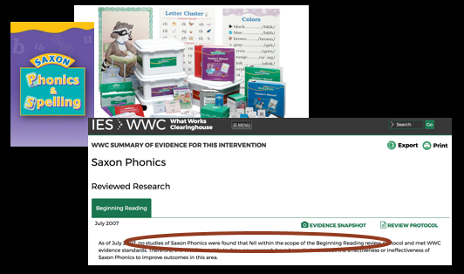
Promising program or practice
Promising program or practice

Slide 46
Intervention Options
Intervention Options
for Teaching Reading
Evidence-supported program
Evidence-supported practice
Promising program or practice

Slide 47
Intervention Options
Evidence-supported program
Evidence-supported practice
Promising program or practice
Examples
Phonics Foundations: A phonics program with a clear scope and sequence and detailed lesson plans
Early Interventions in Reading: A phonics program reviewed favorably by the What Works Clearinghouse
Question Answer Relationships (QAR): An effective comprehension strategy evaluated in multiple peer reviewed journals

Slide 48
Activity 3.1
Workbook Activity
Activity 3.1
Workbook Activity
Evidence-supported program
Evidence-supported practice
Promising program or practice

Slide 49
Intervention Programs for Reading
Module 3 – Part 2

Slide 50
Part 2 Objectives
You will learn…
How to evaluate an intervention program’s materials.

Slide 51
Intervention Options
Intervention Options
for Teaching Reading
Evidence-supported program
Evidence-supported practice
Promising program or practice

Slide 52
DBI
Validated Intervention Program

Slide 53

Evaluating a Program:
Materials
Think Like a Detective

Slide 54
Evaluating a Program:
Materials
  Program Overview
  Look across lessons
    (scope and sequence)
  Look within lessons
    (explicit instruction)
  Program implementation

Slide 55

Corrective Reading and Sound Partners

Slide 56
Evaluating a Program:
Materials
  Program Overview
  Look across lessons
    (scope and sequence)
  Look within lessons
    (explicit instruction)
  Program implementation

Slide 57
Program Overview
  Name of the program
  Publisher
  Grade level
  Content Focus

Slide 58
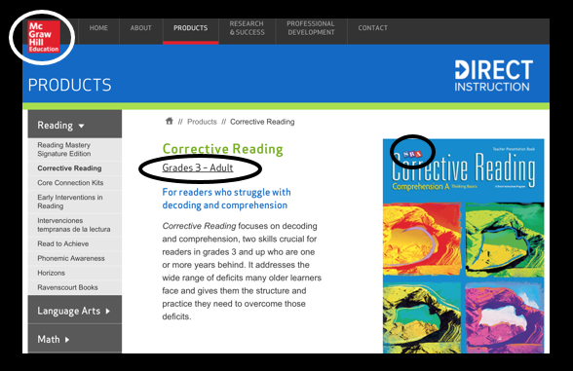
Corrective Reading

Slide 59
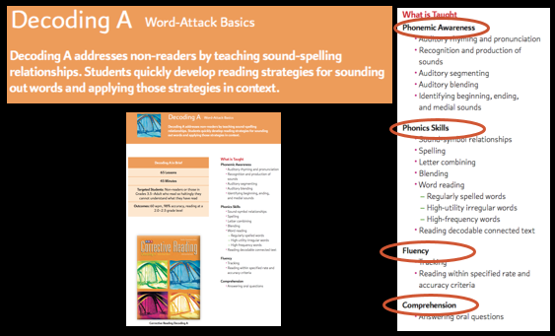
Corrective Reading

Slide 60
Program Overview
(Activity 3.2)
  Name of the program
  Publisher
  Grade level
  Content Focus

Slide 61
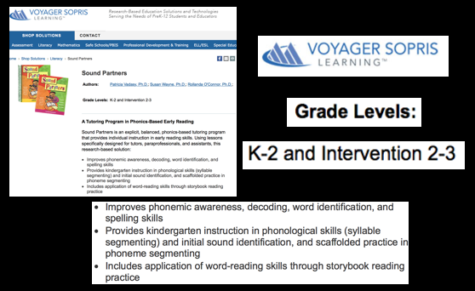
Sound Partners

Slide 62
Evaluating a Program:
Materials
  Program Overview
  Look across lessons
    (scope and sequence)
  Look within lessons
    (explicit instruction)
  Program implementation

Slide 63
Look Across Lessons:
Scope and Sequence
  Specific outcomes
  Scope & sequence
  Systematic introduction of skills, and strategies
  Adequate review

Slide 64
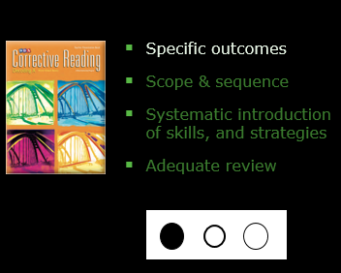
Look Across Lessons:
Scope and Sequence

Slide 65
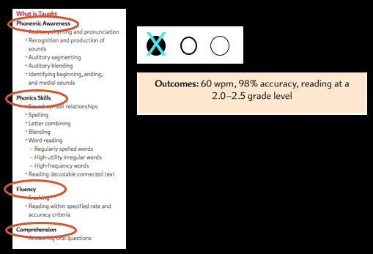
Corrective Reading

Slide 66
Look Across Lessons:
Scope and Sequence
  Specific outcomes
  Scope & sequence
  Systematic introduction of skills, and strategies
  Adequate review

Slide 67
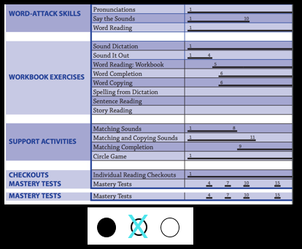
Corrective Reading

Slide 68
Look Across Lessons:
Scope and Sequence
  Specific outcomes
  Scope & sequence
  Systematic introduction of skills, and strategies
  Adequate review

Slide 69
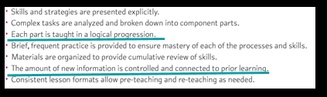
Corrective Reading

Slide 70
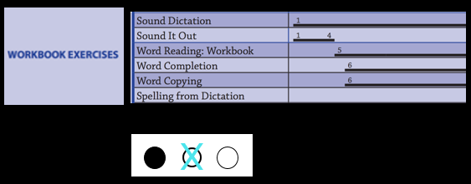
Corrective Reading

Slide 71
Corrective Reading

Slide 72
Look Across Lessons:
Scope and Sequence
  Specific outcomes
  Scope & sequence
  Systematic introduction of skills, and strategies
  Adequate review

Slide 73
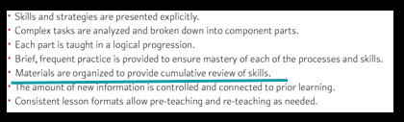
Corrective Reading

Slide 74
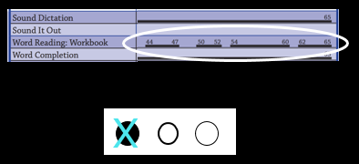
Corrective Reading

Slide 75
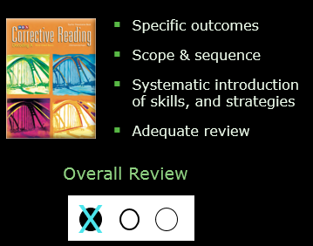
Look Across Lessons:
Scope and Sequence

Slide 76
Look Across Lessons
(Activity 3.3)
  Specific outcomes
  Scope & sequence
  Systematic introduction of skills, and strategies
  Adequate review

Slide 77
Look Across Lessons:
Scope and Sequence
  Specific outcomes
  Scope & sequence
  Systematic introduction of skills, and strategies
  Adequate review

Slide 78
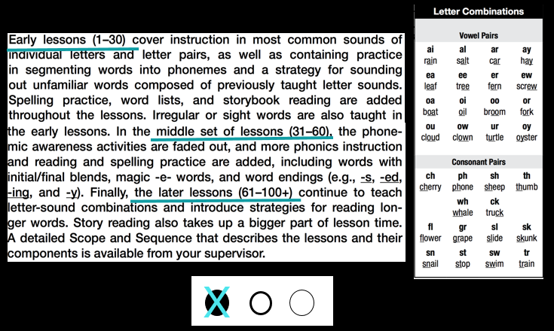
Sound Partners

Slide 79
Look Across Lessons:
Scope and Sequence
  Specific outcomes
  Scope & sequence
  Systematic introduction of skills, and strategies
  Adequate review

Slide 80
Sound Partners
X

Slide 81
Look Across Lessons:
Scope and Sequence
  Specific outcomes
  Scope & sequence
  Systematic introduction of skills, and strategies
  Adequate review

Slide 82
Sound Partners
X

Slide 83
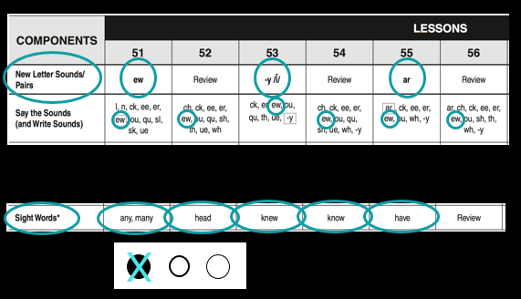
Sound Partners

Slide 84
Look Across Lessons:
Scope and Sequence
  Specific outcomes
  Scope & sequence
  Systematic introduction of skills, and strategies
  Adequate review

Slide 85
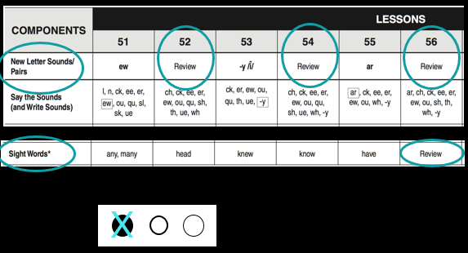
Sound Partners

Slide 86
Look Across Lessons:
Scope and Sequence
  Specific outcomes
  Scope & sequence
  Systematic introduction of skills, and strategies
  Adequate review
Overall Review
X

Slide 87
Evaluating a Program:
Materials
  Program Overview
  Look across lessons
    (scope and sequence)
  Look within lessons
    (explicit instruction)
  Program implementation

Slide 88
Look Within Lessons:
Explicit Instruction
  Clear objectives
  Modeling
  Guided practice
  Student engagement

Slide 89
Look Within Lessons:
Explicit Instruction
Are lesson designed to maximize student learning?
Are lesson designed to maximize effective teaching?

Slide 90
Corrective Reading and Sound Partners

Slide 91
Look Within Lessons:
Explicit Instruction
  Clear objectives
  Modeling
  Guided practice
  Student engagement

Slide 92
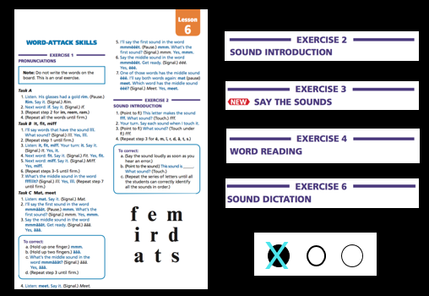
Corrective Reading

Slide 93
Look Within Lessons:
Explicit Instruction
  Clear objectives
  Modeling
  Guided practice
  Student engagement

Slide 94
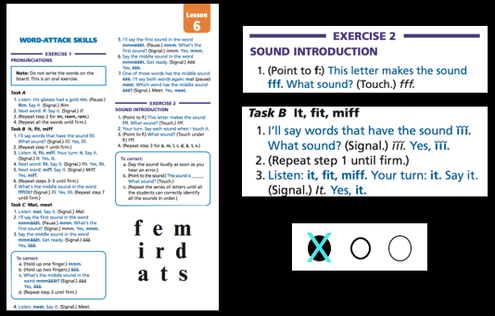
Corrective Reading

Slide 95
Look Within Lessons:
Explicit Instruction
  Clear objectives
  Modeling
  Guided practice
  Student engagement

Slide 96
Corrective Reading

Slide 97
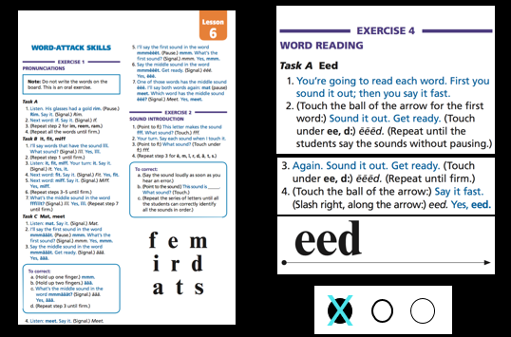
Corrective Reading

Slide 98
Look Within Lessons:
Explicit Instruction
  Clear objectives
  Modeling
  Guided practice
  Student engagement

Slide 99
Corrective Reading
X

Slide 100
Look Within Lessons:
Explicit Instruction
  Clear objectives
  Modeling
  Guided practice
  Student engagement
Overall Review
X

Slide 101
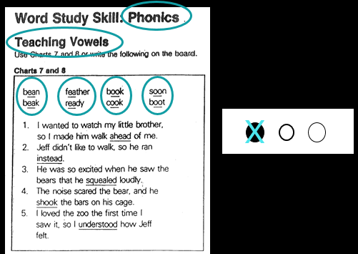
Non Example

Slide 102
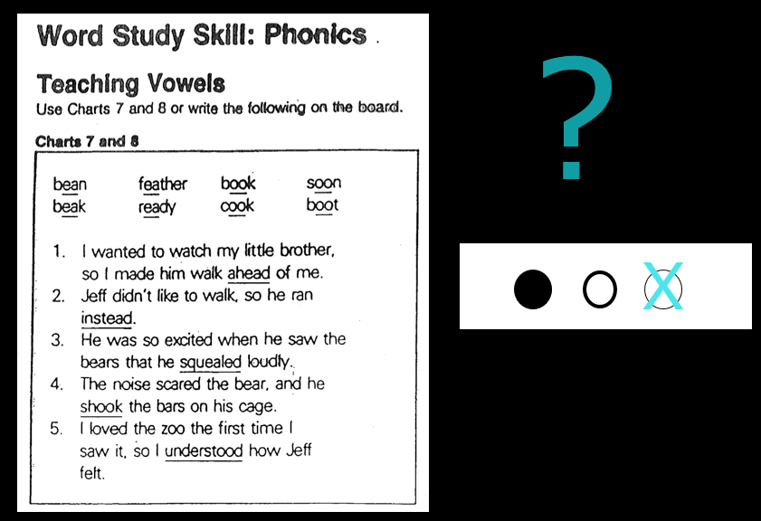
Non Example

Slide 103
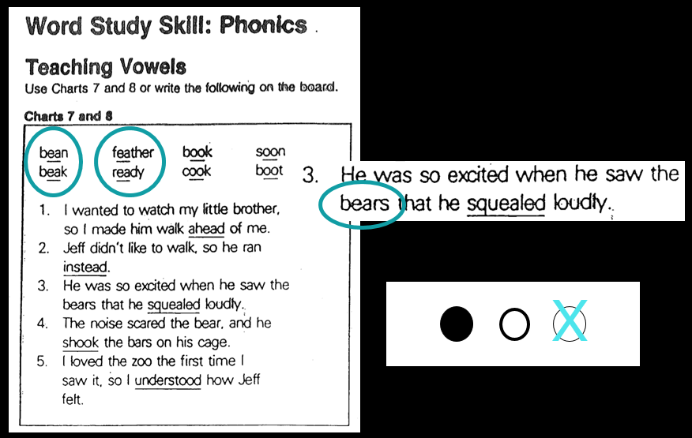
Non Example

Slide 104
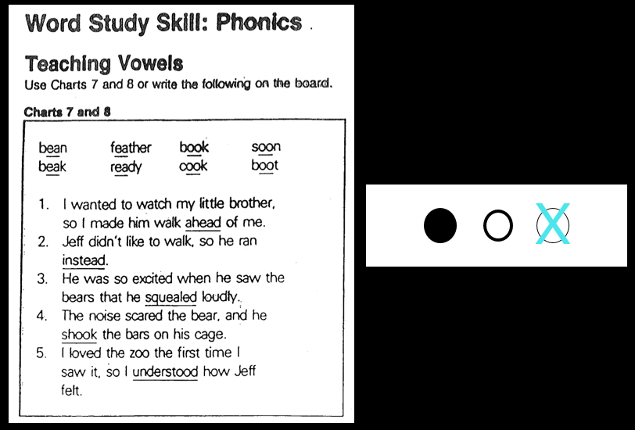
Non Example

Slide 105
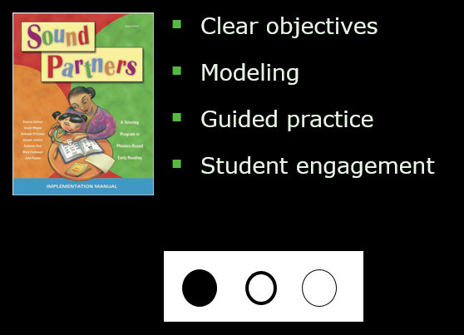
Look Within Lessons
(Activity 3.4)

Slide 106
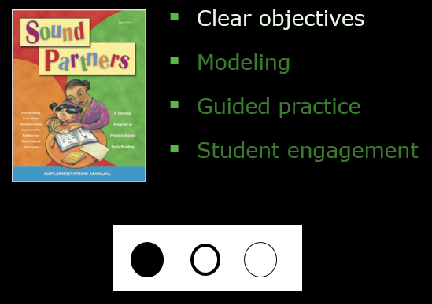
Look Within Lessons:
Explicit Instruction

Slide 107
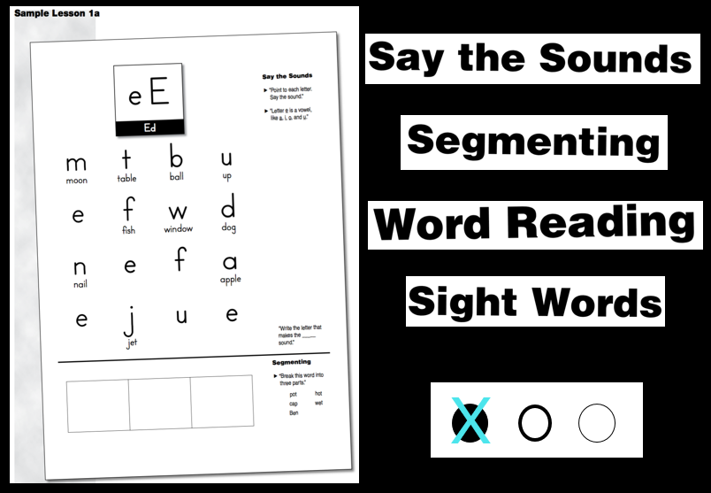
Sound Partners

Slide 108
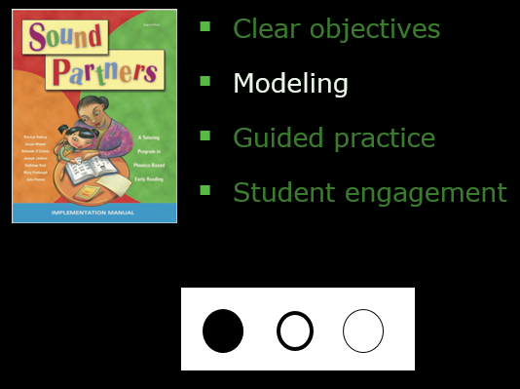
Look Within Lessons:
Explicit Instruction

Slide 109
Sound Partners

Slide 110
Sound Partners
X

Slide 111
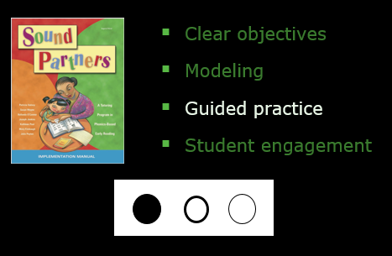
Look Within Lessons:
Explicit Instruction

Slide 112
Sound Partners

Slide 113
Sound Partners
X

Slide 114
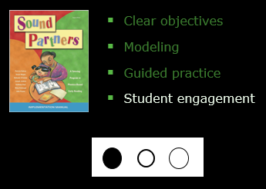
Look Within Lessons:
Explicit Instruction

Slide 115
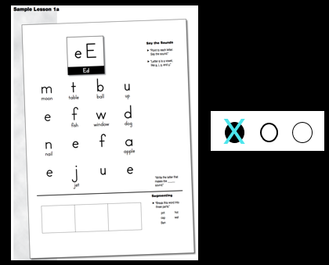
Sound Partners

Slide 116
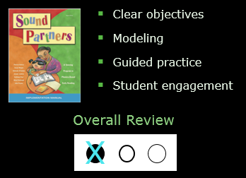
Look Within Lessons:
Explicit Instruction

Slide 117
Evaluating a Program:
Materials
  Program Overview
  Look across lessons
    (scope and sequence)
  Look within lessons
    (explicit instruction)
  Program implementation

Slide 118
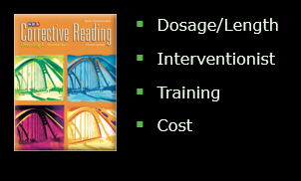
Program Implementation

Slide 119
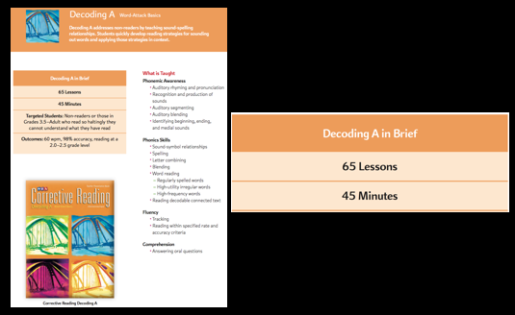
Corrective Reading

Slide 120
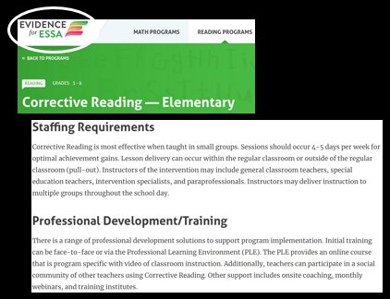
Corrective Reading

Slide 121
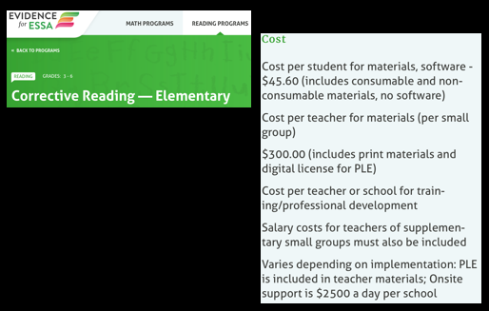
Corrective Reading

Slide 122
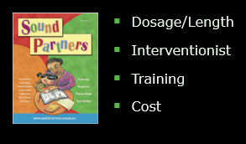
Program Implementation
(Activity 3.5)

Slide 123
Evaluating a Program:
Materials
Activity 3.5:
Reading Intervention Review
  Program Overview
  Look across lessons
    (scope and sequence)
  Look within lessons
    (explicit instruction)
  Program implementation

Slide 124
Intervention Programs for Reading
Module 3 – Part 3

Slide 125
Part 2 Objectives
You will learn…
How to evaluate an intervention program’s research evidence.

Slide 126
Intervention Options
Intervention Options
for Teaching Reading
Evidence-supported program
Evidence-supported practice
Promising program or practice

Slide 127
DBI
Validated Intervention Program

Slide 128
Evaluating a Program:
Materials
Think Like a Detective

Slide 129
Evaluating a Program:
Research
  Independent review
  High quality studies
  Positive effects

Slide 130

Corrective Reading and Sound Partners

Slide 131
Evaluating a Program:
Research
  Independent review
  High quality studies
  Positive effects

Slide 132
Independent Evaluation

Slide 133
Independent Evaluation

Slide 134
Independent Evaluation

Slide 135

Independent Evaluation

Slide 136
Corrective Reading

Slide 137
Corrective Reading

Slide 138
Corrective Reading

Slide 139
Independent Evaluation
X

Slide 140
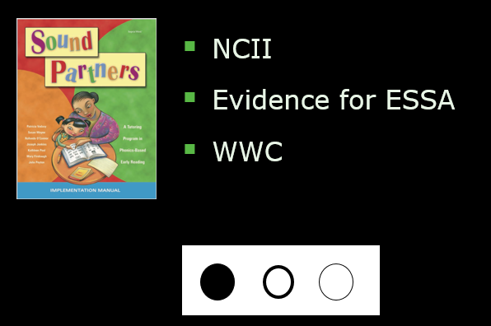
Independent Evaluation
(Activity 3.6)

Slide 141
Sound Partners

Slide 142
Sound Partners

Slide 143
Sound Partners

Slide 144
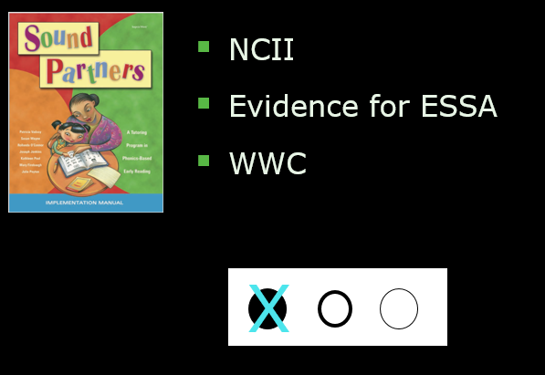
Independent Evaluation
(Activity 3.6)

Slide 145
Evaluating a Program:
Research
  Independent review
  High quality studies
  Positive effects

Slide 146
High Quality Studies
  Evidence for ESSA
  WWC
  Other sources

Slide 147
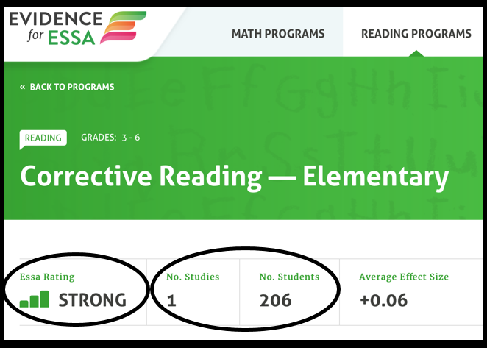
Corrective Reading

Slide 148
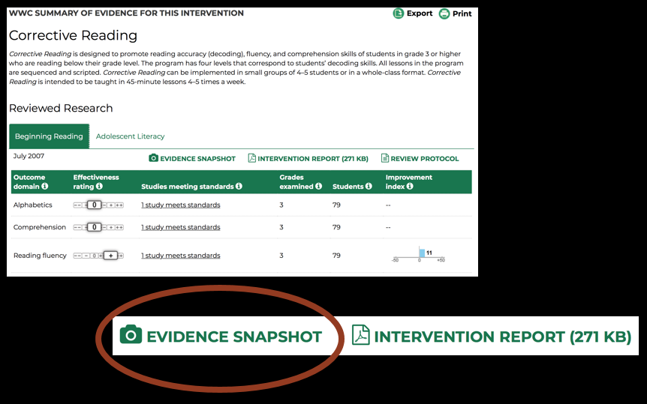
Corrective Reading

Slide 149
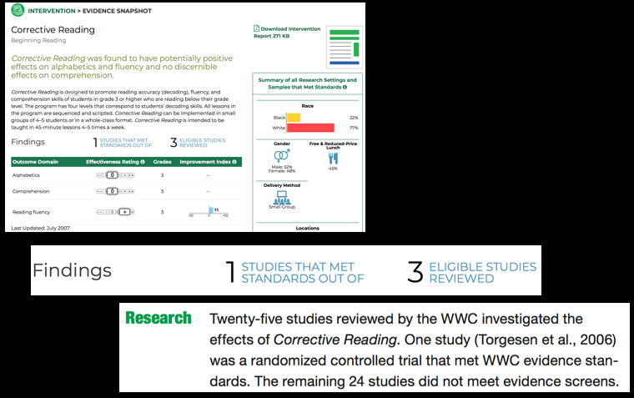
Corrective Reading

Slide 150
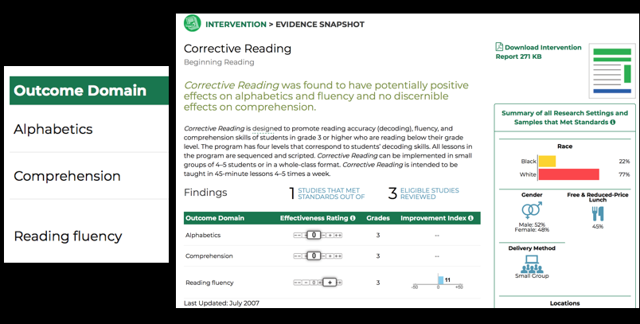
Corrective Reading

Slide 151
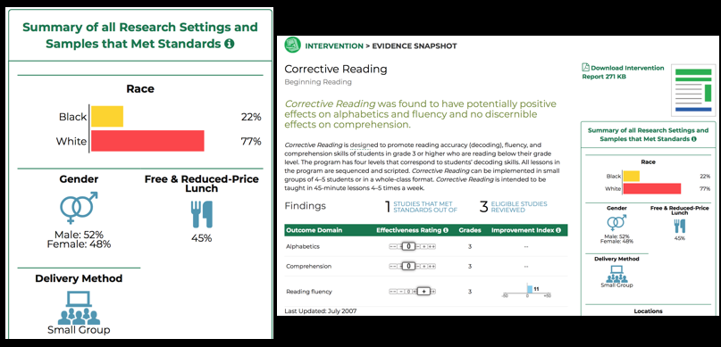
Corrective Reading

Slide 152

NCII Website Screen Shot

Slide 153

Corrective Reading

Slide 154

High Quality Studies

Slide 155

High Quality Studies
(Activity 3.7)

Slide 156

Sound Partners

Slide 157

Sound Partners

Slide 158

Sound Partners

Slide 159

Sound Partners

Slide 160

Sound Partners

Slide 161

High Quality Studies
(Activity 3.7)

Slide 162
Evaluating a Program:
Research
  Independent review
  High quality studies
  Positive effects

Slide 163
Positive Effects
  Evidence for ESSA
  WWC
  Other sources

Slide 164

Corrective Reading

Slide 165

Corrective Reading

Slide 166

Corrective Reading

Slide 167

Corrective Reading

Slide 168

NCII Website Screen Short

Slide 169

Positive Effects

Slide 170

Positive Effects
(Activity 3.8)

Slide 171

Sound Partners

Slide 172

Sound Partners

Slide 173

Sound Partners

Slide 174

Sound Partners

Slide 175

Positive Effects
(Activity 3.8)

Slide 176
Evaluating a Program:
Research
Reading Intervention Review
  Independent review
  High quality studies
  Positive effects

Slide 177
Intervention Programs for Reading
Module 3 – Closing

Slide 178


Looking Ahead
Looking Ahead

Slide 179
References
Engelmann, S., Carnine, L., & Johnson, G. (2008). Corrective reading: Decoding A. Columbus, OH: SRA/McGraw-Hill.
Vadasy, P. F. (2005). Sound Partners: A Tutoring Program in Phonics-Based Early Reading: Implementation Manual. Boston, MA: Sopris West Educational Services.

