Slide 1
Introduction to Intensive Intervention in Reading
Module 1 – Introduction

Slide 2
Objectives
Objectives
You will learn…
Part 1:
Why reading intervention is important
Part 2:
How data-based individualization (DBI) applies to reading

Slide 3
Introduction to Intensive Intervention in Reading
Module 1 – Part 1

Slide 4
Part 1 Objectives
Why reading intervention is important

Slide 5

Pictures of children
Ruth
Colin

Slide 6
Importance of Reading
Importance of Reading
  Reading is essential
  Teaching reading is urgent
  Teaching reading is complex
  We know how to teach almost all students to read

Slide 7
Importance of Reading
Importance of Reading
  Reading is essential
  Teaching reading is urgent
  Teaching reading is complex
  We know how to teach almost all students to read

Slide 8
Reading is Essential
Reading is Essential
  Reading is essential to success in our society
  Increasing demands for literacy
  Increasing demands on schools

Slide 9
Quote
“If you can't read, you don't choose; others make choices for you”
Jonathan Kozol

Slide 10
Importance of Reading
Importance of Reading
  Reading is essential
  Teaching reading is urgent
  Teaching reading is complex
  We know how to teach almost all students to read

Slide 11
Importance of Reading
Importance of Reading
  Reading is essential
  Teaching reading is urgent
  Teaching reading is complex
  We know how to teach almost all students to read

Slide 12
Teaching Reading is Urgent
Teaching Reading is Urgent
  The Nation’s Report Card
  approximately a third of third graders are performing below a “basic” level in reading.
            National Assessment of Educational Progress (NAEP)

Slide 13

Image of children

Slide 14
The Achievement Gap in Reading
The Achievement Gap in Reading

Slide 15
Activity 1.1 – Examine the Achievement Gap
Look at the graph that highlights the achievement gap in reading.
What do you notice?
What does this tell you about the need for intensive intervention in reading?

Slide 16
The Achievement Gap in Reading
The Achievement Gap in Reading

Slide 17
Teaching Reading is Urgent
Teaching Reading is Urgent
  Students with learning disabilities, including dyslexia.

Slide 18
Image of Children

Slide 19
Importance of Reading
Importance of Reading
  Reading is essential
  Teaching reading is urgent
  Teaching reading is complex
  We know how to teach almost all students to read

Slide 20
Importance of Reading
Importance of Reading
  Reading is essential
  Teaching reading is urgent
  Teaching reading is complex
  We know how to teach almost all students to read

Slide 21
Teaching Reading is Complex
Teaching Reading is Complex

Slide 22
Components of Successful Reading
Components of Successful Reading
Fluency
Comprehension
Oral Language/
Vocabulary
Phonemic
Awareness
Phonics

Slide 23
Quote
“To every problem there is a simple solution…
...that doesn’t work”
Mark Twain

Slide 24
Quote
“To every problem there is a simple solution…
...that doesn’t work”
Mark Twain

Slide 25
Teaching Reading IS Rocket Science

Slide 26
Teaching Reading is Complex
Teaching Reading is Complex
  Schools are Complex

Slide 27
Importance of Reading
Importance of Reading
  Reading is essential
  Teaching reading is urgent
  Teaching reading is complex
  We know how to teach almost all students to read

Slide 28
Importance of Reading
Importance of Reading
  Reading is essential
  Teaching reading is urgent
  Teaching reading is complex
  We know how to teach almost all students to read

Slide 29
Teaching Students to Read
Teaching Students to Read
  We know more about teaching reading than any other area of education
    Science of reading development and reading disabilities
    Effective practices in assessment, instruction, and intervention

Slide 30
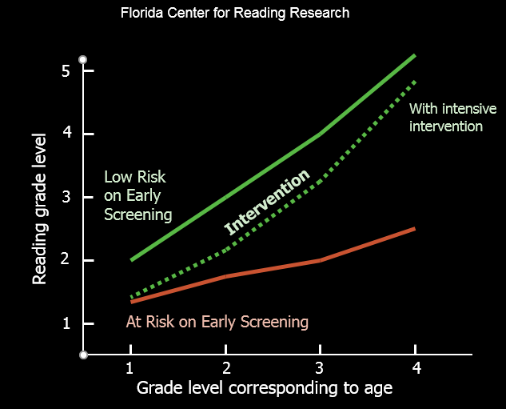
Florida Center for Reading Research

Slide 31
Image of children
Ruth
Colin

Slide 32
Activity 1.2 – Journal Entry
Imagine you are speaking to an administrator about the importance of intensive intervention in reading.
What are 3 takeaways you have learned from Part 1 of Module 1, that you would emphasize?
How would you summarize these 3 important points for the administrator?

Slide 33
Intensive Intervention in Reading
Module 1 – Part 2

Slide 34
Part 2 Objective
You will learn…
How Data-based Individualization (DBI) applies to reading

Slide 35
Video Link
[Insert https://youtu.be/nxdSRLJsQMw Video here]

Slide 36
DBI: Data-based
Individualization
DBI: Data-based
Individualization
  DBI is a process for intensifying and individualizing intervention through the systematic use of assessment data, validated interventions, and research-based adaptation strategies.

Slide 37
DBI: Data-based
Individualization
DBI: Data-based
Individualization
intensive intervention
data based decision making
SBRR
individualization/differentiation
MTSS/RTI
structured literacy

Slide 38
DBI: Data-based
Individualization
DBI: Data-based
Individualization
  So what’s different about DBI?

Slide 39
DBI: Data-based
Individualization
DBI: Data-based
Individualization
  Research-validated tools and strategies implemented with fidelity
  Systematic data-based process for adjusting instruction to meet individual needs

Slide 40
DBI: Data-based
Individualization
DBI: Data-based
Individualization
  Standardization
  Individualization

Slide 41
DBI: Data-based
Individualization
DBI: Data-based
Individualization
  Standardization
  Individualization

Slide 42
DBI: Data-based
Individualization
DBI: Data-based
Individualization
  Individualization
  Standardization

Slide 43
DBI: Data-based
Individualization
DBI: Data-based
Individualization
  Standardization Individualization

Slide 44
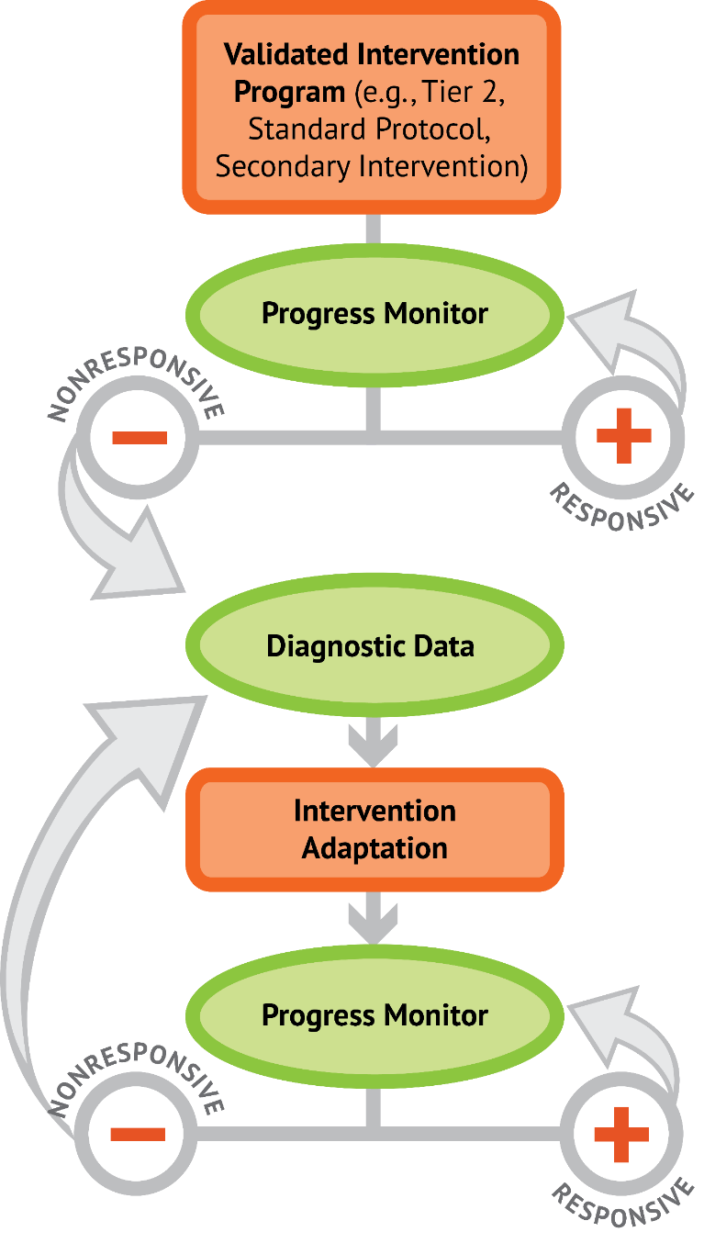
DBI

Slide 45
DBI: Data-based
Individualization
DBI: Data-based
Individualization
  MTSS/RTI
  Special Education

Slide 46
MTSS/RTI
Individualized
Intervention
Supplemental
Intervention
Classroom
Instruction

Slide 47
Special Education

Slide 48
DBI
Validated Intervention Program

Slide 49
Validated Intervention Program
Start with something that has a good chance of working

Slide 50
Validated Intervention Program
Intervention Options
for Teaching Reading
Evidence-supported program
Evidence-supported practice
Promising program or practice

Slide 51

Validated Intervention Program

Slide 52
Validated Intervention Program:
MTSS/RTI
  3rd grade student new to the school
  identified through universal screening
  small group Tier 2 intervention
  Intervention Program A
  3x per week, group of 6, general education teacher
Isabella

Slide 53
Validated Intervention Program:
Special Education
  referred for evaluation by 3rd grade teacher
  eligible for special education with a learning disability in reading
  IEP includes small group reading intervention
  Intervention Program A
  4x per week, group of 5, special education teacher
Matt

Slide 54
Activity 1.3 – Stop & Jot
Watch the video on the next slide and jot down thoughts about the use of validated intervention programs in your workbook.

Slide 55
Activity 1.3 – Stop & Jot
[Insert https://youtu.be/d00vGGFGchQ video here]

Slide 56
Validated Intervention Program
“I have a small group of students who really need support with comprehension, so I looked at the National Center for Intensive Intervention website and found a program that specifically targets comprehension. I didn't read the studies, but I was able to determine that the program was evaluated with students with similar needs, and at similar grades as my students. I spent a while reading the manual and watching training videos online - so I feel like I've been able to implement the program correctly. I know fidelity is important, so I’m trying to teach the way it is written - following the scope and sequence and the script"

Slide 57
Activity 1.4 – Stop & Jot
Watch the video on the next slide and jot down thoughts about the use of validated intervention programs in your workbook.

Slide 58
Activity 1.4 – Stop & Jot
[Insert https://youtu.be/V73nfOVITjg video here]

Slide 59
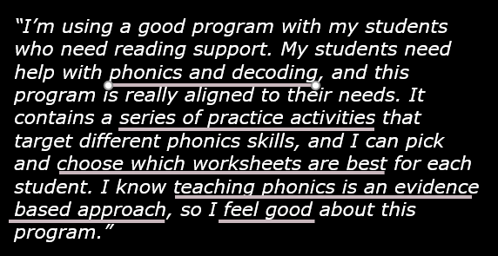
Validated Intervention Program

Slide 60
Validated Intervention Programs
Validated Intervention Programs
  Module
  How intervention programs support students and teachers.
  What are intervention options for teaching reading.
  How to evaluate an intervention program’s materials.
  How to evaluate an intervention program’s research evidence.

Slide 61
DBI
Progress
Monitor

Slide 62
Progress Monitoring
  Is the intervention working?
  Are students making progress at an acceptable rate?
  Do I need to adjust or intensify instruction?
Notes:
Remember, the purpose of qualitative adaptations within the Data Based Individualizion process is to increase the effectiveness of our instruction by adjusting the way we teach content. What we teach is important, but how we teach is especially critical for students experiencing reading difficulties. When we thinking about qualitative adaptations, we think about how we adapt the way we teach reading

Slide 63
Progress Monitoring
Progress Monitoring
general outcome measures
Curriculum-Based Measurement
screening/benchmarking
mastery assessment
diagnostic assessment
summative assessment

Slide 64
Progress Monitoring
Progress Monitoring
general outcome measures
Curriculum-Based Measurement

Slide 65
Progress Monitoring
Progress Monitoring
general outcome measures
  Evaluate overall progress toward meeting grade-level expectations
  Program-independent assessments developed by researchers
  Short probes, multiple forms, administered often, graphed

Slide 66
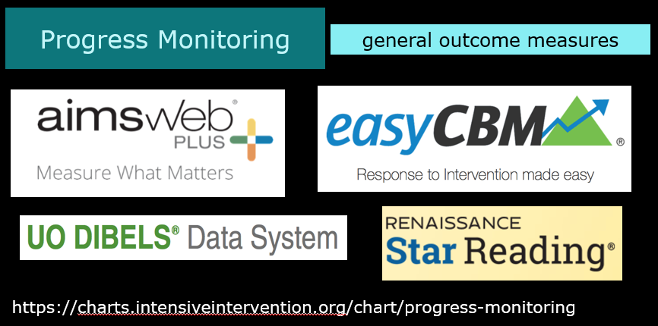
Progress Monitoring General Outcome Measures

Slide 67
Progress Monitoring:
  3rd grade student new to the school
  identified through universal screening
  small group Tier 2 intervention
  Intervention Program A
  3x per week, group of 6, general education teacher
Isabella

Slide 68
Progress Monitoring

Slide 69
Validated Intervention Program:
Special Education
  referred for evaluation by 3rd grade teacher
  eligible for special education with a learning disability in reading
  IEP includes small group reading intervention
  Intervention Program A
  4x per week, group of 5, special education teacher
Matt

Slide 70
Progress Monitoring

Slide 71
Activity 1.5 – Stop & Jot
Watch the video on the next slide and jot down thoughts about the use of progress monitoring in your workbook.

Slide 72
Activity 1.5 – Stop & Jot
[Insert https://youtu.be/Vd6slv1JMW4 video here]

Slide 73
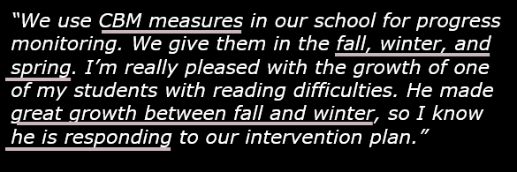
Progress Monitoring

Slide 74
Activity 1.6 – Stop & Jot
Watch the video on the next slide and jot down thoughts about the use of progress monitoring in your workbook.

Slide 75
Activity 1.6 – Stop & Jot
[Insert https://youtu.be/svaYTdIg9HI video here]

Slide 76
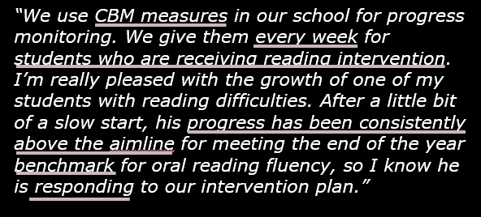
Progress Monitoring

Slide 77
Progress Monitoring
Progress Monitoring
  Module
  How to select, administer, and score reading CBMs.
  How to determine a baseline and set goals.
  How to use data to make instructional decisions.

Slide 78
DBI
Diagnostic

Slide 79
Diagnostic & Mastery Assessments
  Why is the student not responding to the intervention?
  What specific reading skills and strategies does the student need?
  Is the student learning the content that I’m teaching?
  What information can help inform decisions about adjusting or intensifying instruction?

Slide 80
Diagnostic/Mastery Assessment
Diagnostic/Mastery Assessment
Skill inventory
CBM error analysis
Program assessment
CBA probes
standardized assessments

Slide 81
Diagnostic/Mastery Assessment
Diagnostic/Mastery Assessment
Skill inventory
CBM error analysis
Program assessment
CBA probes

Slide 82
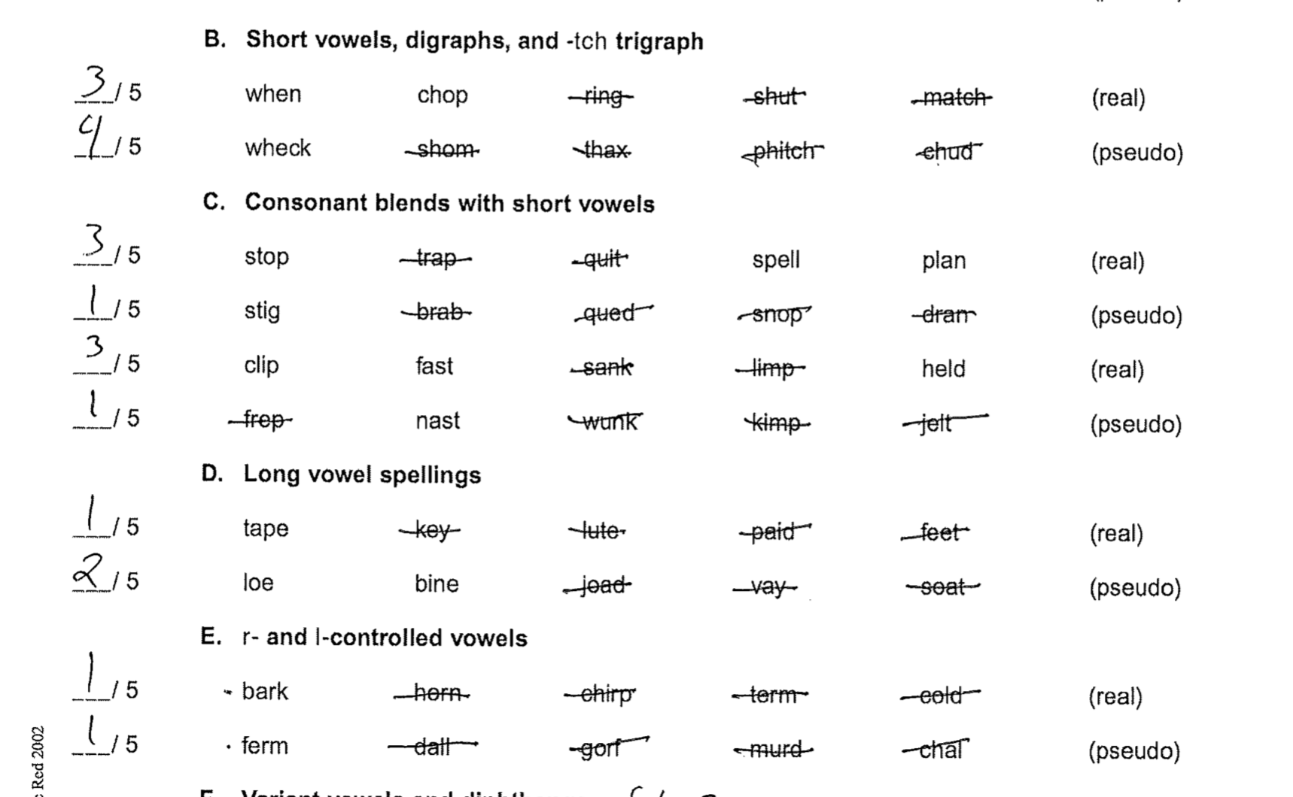
Diagnostic & Mastery Assessments
Skill inventory

Slide 83
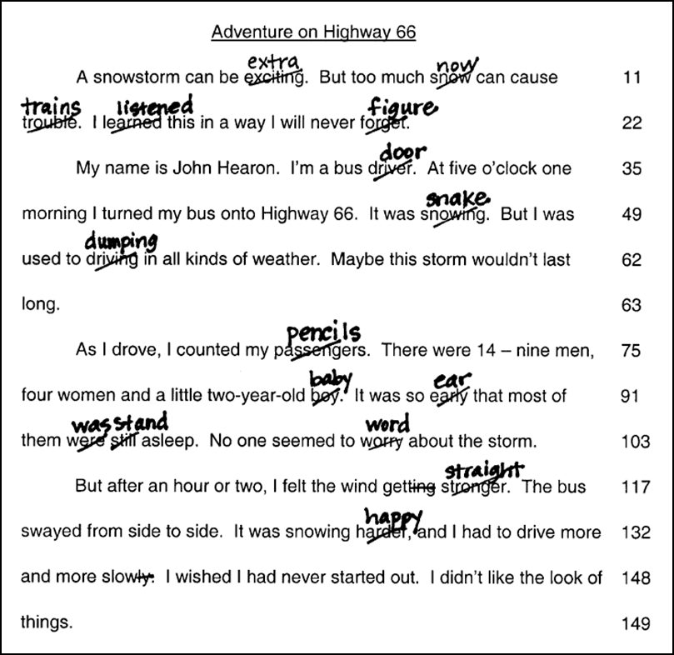
Diagnostic & Mastery Assessments
CBM error analysis

Slide 84
Diagnostic & Mastery Assessments
Program specific assessments
CBA probes
List 1
List 2
List 3
map
pig
fan
sun
tap
dad
lap
tap
cat
can
fun
mop
sat
mud
lid

Slide 85
Validated Intervention Program:
Special Education
  referred for evaluation by 3rd grade teacher
  eligible for special education with a learning disability in reading
  IEP includes small group reading intervention
  Intervention Program A
  4x per week, group of 5, special education teacher
Matt

Slide 86
Progress Monitoring

Slide 87
Diagnostic/Mastery Assessment
Diagnostic & Mastery Assessments
  CBM error analysis
  Program Assessment
  Skills inventory
  Difficulties with vowel combinations, polysyllabic words, automaticity, and fluency.
Matt

Slide 88
Activity 1.7 – Stop & Jot
Watch the video on the next slide and jot down thoughts about the use of diagnostic & mastery assessment in your workbook.

Slide 89
Activity 1.7 – Stop & Jot
[Insert https://youtu.be/5yWtujA9u2g video here]

Slide 90
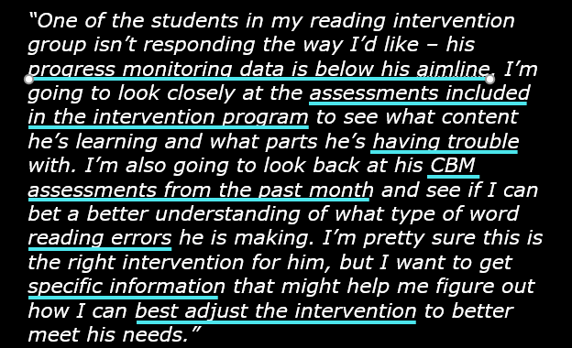
Diagnostic & Mastery Assessments

Slide 91
Activity 1.8 – Stop & Jot
Watch the video on the next slide and jot down thoughts about the use of diagnostic & mastery assessment in your workbook.

Slide 92
Activity 1.8 – Stop & Jot
[Insert https://youtu.be/SKeQ-9p6jhU video here]

Slide 93
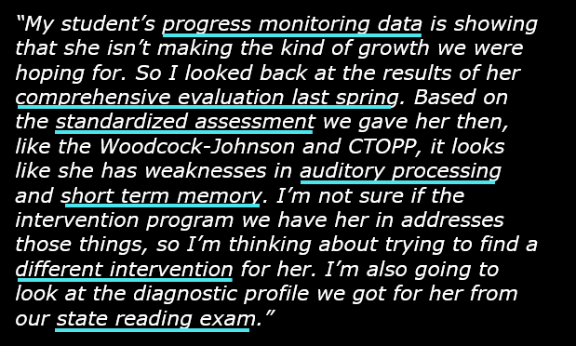
Diagnostic & Mastery Assessments

Slide 94
Diagnostic/Mastery Assessment
Diagnostic/Mastery Assessment
  Module
  How to identify specific skills and strategies to teach.
  How to use diagnostic and mastery assessment data to make decisions about adjusting or intensifying instruction.

Slide 95
DBI
Intervention Adaptation

Slide 96
Intervention Adaptations
Don’t need to start over

Slide 97
Intervention Adaptations
Intensity

Slide 98
Intervention Adaptations
Intervention Adaptations
Structural Adaptations
Instructional Adaptations

Slide 99
Intervention Adaptations
Intervention Adaptations
Structural Adaptations
  Time/Dosage
  Scheduling
  Group size
  Interventionist training/support
  Behavior supports

Slide 100
Intervention Adaptations:
Structural Adaptations
  Intervention Program A
  4x per week, group of 5, special education teacher
Matt

Slide 101
Intervention Adaptations:
Structural Adaptations
  Intervention Program A
  4x per week, group of 5, special education teacher
  Time/Dosage
  Scheduling
  Group size
  Interventionist training/support
  Behavior supports
Matt

Slide 102
Intervention Adaptations:
Structural Adaptations
  Intervention Program A
  4x per week, group of 5, special education teacher
  Time/Dosage
  Scheduling
  Group size
  Interventionist training/support
  Behavior supports
Matt

Slide 103
Intervention Adaptations:
Structural Adaptations
  Intervention Program A
  4x per week, group of 5, special education teacher
  Time/Dosage
  Scheduling
  Group size
  Interventionist training/support
  Behavior supports
Matt

Slide 104
Intervention Adaptations:
Structural Adaptations
  Intervention Program A
  4x per week, group of 5, special education teacher
  Time/Dosage
  Scheduling
  Group size
  Interventionist training/support
  Behavior supports
Matt

Slide 105
Intervention Adaptations:
Structural Adaptations
  Intervention Program A
  4x per week, group of 5, special education teacher
  Time/Dosage
  Scheduling
  Group size
  Interventionist training/support
  Behavior supports
Matt

Slide 106
Activity 1.9 – Stop & Jot
Watch the video on the next slide and jot down thoughts about the use of structural adaptations in your workbook.

Slide 107
Activity 1.9 – Stop & Jot
[Insert https://youtu.be/fCmiAUHduak video here]

Slide 108
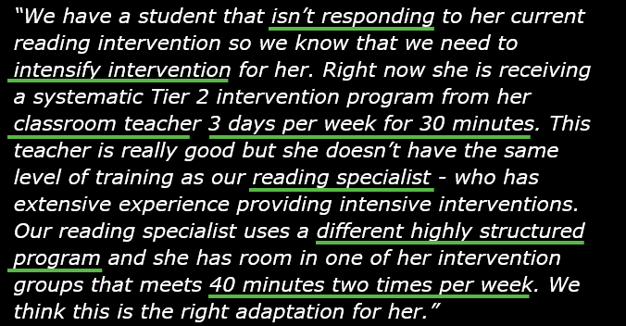
Intervention Adaptations:
Structural Adaptations

Slide 109
Activity 1.10 – Stop & Jot
Watch the video on the next slide and jot down thoughts about the use of structural adaptations in your workbook.

Slide 110
Activity 1.10 – Stop & Jot
[Insert https://youtu.be/dHM9GYtZ8Xg video here]

Slide 111
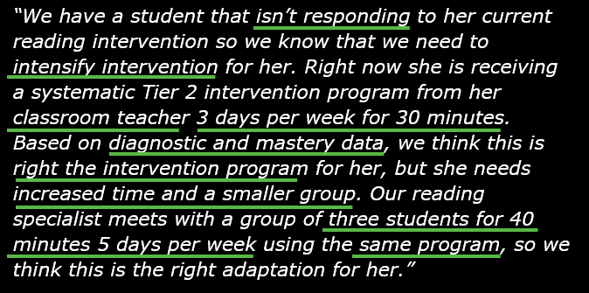
Intervention Adaptations:
Structural Adaptations

Slide 112
Intervention Adaptations
Intervention Adaptations
Structural Adaptations
Instructional Adaptations

Slide 113
Intervention Adaptations
Intervention Adaptations
Instructional Adaptations

Slide 114
Intervention Adaptations
Intervention Adaptations
Instructional Adaptations
  What we teach

Slide 115
Intervention Adaptations
Intervention Adaptations
Instructional Adaptations
  What we teach
  How we teach

Slide 116
Intervention Adaptations
Intervention Adaptations
Instructional Adaptations

Slide 117
Intervention Adaptations
Intervention Adaptations
Instructional Adaptations
  Effective models
  Effective guided practice
  Eliciting frequent responses
  Immediate specific feedback

Slide 118
Intervention Adaptations:
Instructional Adaptations
  Intervention Program A
Matt

Slide 119

Intervention Adaptations:
Instructional Adaptations
“Have student practice reading CVC words”

Slide 120
Intervention Adaptations:
Instructional Adaptations
  Effective models
  Effective guided practice
  Eliciting frequent responses
  Immediate specific feedback
“Have student practice reading CVC words”

Slide 121
Intervention Adaptations:
Instructional Adaptations
  Effective models
  Effective guided practice
  Eliciting frequent responses
  Immediate specific feedback
“Have student practice reading CVC words”

Slide 122
Intervention Adaptations:
Instructional Adaptations
  Effective models
  Effective guided practice
  Eliciting frequent responses
  Immediate specific feedback
“Have student practice reading CVC words”

Slide 123
Intervention Adaptations:
Instructional Adaptations
  Effective models
  Effective guided practice
  Eliciting frequent responses
  Immediate specific feedback
“Have student practice reading CVC words”

Slide 124
Intervention Adaptations:
Instructional Adaptations
  Intervention Program A
  Difficulties with vowel combinations, polysyllabic words, automaticity, and fluency.
  Effective models
  Effective guided practice
  Eliciting frequent responses
  Immediate specific feedback
Matt

Slide 125
Activity 1.11 – Stop & Jot
Watch the video on the next slide and jot down thoughts about the use of instructional adaptations in your workbook.

Slide 126
Activity 1.11 – Stop & Jot
[Insert https://youtu.be/43rSU5pQCGU video here]

Slide 127
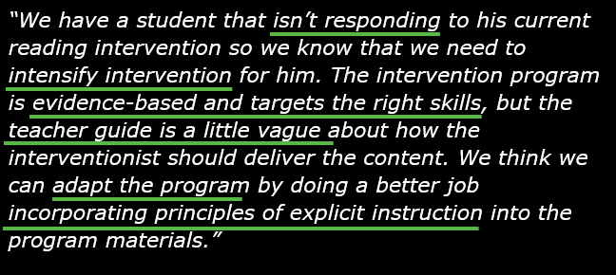
Intervention Adaptations:
Instructional Adaptations

Slide 128
Activity 1.12 – Stop & Jot
Watch the video on the next slide and jot down thoughts about the use of instructional adaptations in your workbook.

Slide 129
Activity 1.12 – Stop & Jot
[Insert https://youtu.be/yrl2yqfwmaQ video here]

Slide 130
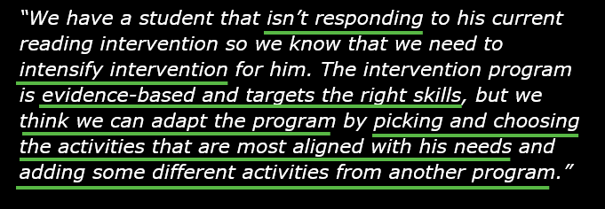
Intervention Adaptations:
Instructional Adaptations

Slide 131
Intervention Adaptations
Intervention Adaptations
  Module
  How to adapt interventions to include effective models, practice opportunities, frequent responses, and specific feedback.

Slide 132
DBI
Progress
Monitor

Slide 133
Intervention Adaptations
  Intervention Program A
  Progress Monitoring and Diagnostic Assessment
  Structural Adaptations
  Instructional Adaptations
Matt

Slide 134
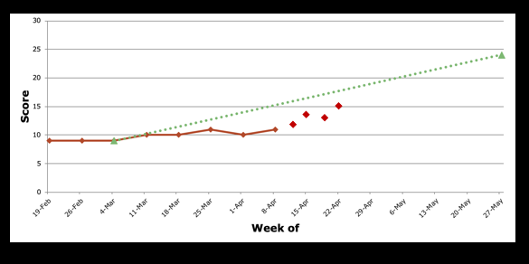
Progress Monitoring

Slide 135
DBI

Slide 136
Introduction to Intensive Intervention in Reading
Module 1 – Closing

Slide 137
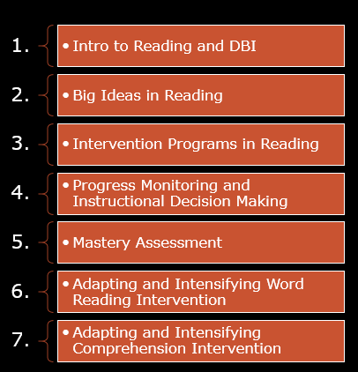

Looking Ahead
Looking Ahead

Slide 138
References
NAEP Nations Report Card - National Assessment of Educational Progress - NAEP. (n.d.). Retrieved from http://nces.ed.gov/nationsreportcard/.
Academic Intervention Tools Chart. (n.d.). Retrieved from https://charts.intensiveintervention.org/chart/instructional-intervention-tools.
Academic Progress Monitoring Tools Chart. (n.d.). Retrieved from https://charts.intensiveintervention.org/chart/progress-monitoring.

