Slide 1
Using the Taxonomy of Intervention Intensity Within the Data-Based Individualization Process: A Reading Example
Notes:
Welcome to the National Center on Intensive Intervention’s (NCII’s) module on using the Taxonomy of Intervention Intensity to design and intensify reading intervention. This module requires 2.5–3 hours to complete. It includes slides, speakers’ notes, and a workbook of activities.
This module is intended for individuals and teams who are interested in learning more about how to design and implement intensive reading interventions as a part of the data-based individualization (DBI) process. Specifically, this training focuses on what to consider when selecting a strong validated reading platform and planning intensification. Additional modules focused on introducing the taxonomy of intervention intensity and applying the taxonomy to math and behavior intervention also are available. For more information about the DBI process, you may want to direct participants to the following resources:
Self-paced online module introducing intensive intervention: https://intensiveintervention.org/resource/self-paced-introduction-intensive-intervention
Read about the DBI process in detail: https://intensiveintervention.org/sites/default/files/DBI_Framework.pdf
Explore DBI topics: https://intensiveintervention.org/intensive-intervention
Handout—Breaking Down the DBI Process: Questions & Considerations: https://intensiveintervention.org/sites/default/files/NCII-placemat-508.pdf
Dr. Chris Lemons explains intensive intervention and why they are important: https://intensiveintervention.org/resource/what-are-intensive-interventions-and-why-are-they-important
Preferred citation:
Author permission to reprint this publication is not necessary, and the citation should be as follows: National Center on Intensive Intervention. (2020). Using the taxonomy of intervention intensity within the data-based individualization process: A reading example. Washington, DC: U.S. Department of Education, Office of Special Education Programs, National Center on Intensive Intervention.
Facilitators: Introduce yourself and provide a brief summary of your background before moving on.
Tips for using the speaker’s notes:
Text formatted in standard font provides a sample script for the facilitator.
Text formatted in italic is intended as directions, notes, or background information for the facilitator. This includes notes for animations within the slide deck.
Slides that reference handouts that can be found in the participant workbook are noted with a banner indicating handout.

Slide 2
Learner Outcomes
At the end of the session, participants will be able to—
Define the dimensions of the Taxonomy of Intervention Intensity and explain how they support the data-based individualization (DBI) process.
Use the taxonomy to evaluate or select a validated reading intervention program.
Use the taxonomy to intensify a reading intervention for a student who is not responsive.
Access existing resources to support the evaluation and intensification of a reading intervention.
Notes:
In this presentation, you will be introduced to the Taxonomy of Intervention Intensity and learn how it supports the DBI process. You will receive explicit guidance on how to select and evaluate validated intervention programs to best meet students’ needs and intensify or adapt those interventions when students or groups of students do not adequately respond.
At the end of the session, you will be able to <read slide>.
This presentation is intended to focus specifically on reading interventions. Additional modules provide an overview of the taxonomy as well as deeper reviews of mathematics and behavior content. To access these modules, visit the NCII website at https://intensiveintervention.org/taxonomy-intervention-intensity.

Slide 3
Agenda
What is the Taxonomy of Intervention Intensity, and how does it support the DBI process?
Go deeper: Explore the taxonomy dimensions as they relate to reading.
Case Example: Using the taxonomy to support the DBI process in reading.
Behavior Support
Strength
Dosage
Alignment
Transfer
Comprehensiveness
Notes:
Review slide.
Presenters may adapt this presentation to the needs of their participants. Based on the objectives of your training session, the needs of the participants, their experience with DBI and the taxonomy, and time, you may choose any of the following:
Begin with the introduction and spend more time helping participants understand the DBI process and the taxonomy more generally.
Go deep into each taxonomy dimension.
Pick and choose the dimensions where participants want more support.
Work through the practice examples and access the specific dimensions as participants need help.

Slide 4
Activity: Taxonomy K-W-L
What does it help me KNOW? | What more do I WANT to know? | How will I LEARN more?
Handout
Notes:
You have two handouts in your workbook. The first looks like what you see on the slide and includes brief definitions for all seven dimensions of the Taxonomy of Intervention Intensity. This handout is two sided. On one side, the dimensions are defined in the context of academics; on the other side, the same seven dimensions are defined in the context of behavior. The second handout looks like this (click for animations). Many of you are likely familiar with a K-W-L (for Know, Want to Know, Learn) chart. This slightly modified version includes space for you to document what you know from reviewing the resource, what questions you have or what you want to learn more about, and finally how you will learn more. For the next activity, you will focus on the first two columns (click for animation). Using the taxonomy overview handout, individually document what you know from reviewing the handout and what you want to know more about. You will have about 5–7 minutes to do this. After documenting what you know and want to know more about, turn to your neighbor or tablemates and share some of the things that you wrote.
Provide about 5–7 minutes for individual review, provide about 3–5 minutes for table/partner talk, and then provide time for group share out. Note that you will address questions throughout the training.

Slide 5
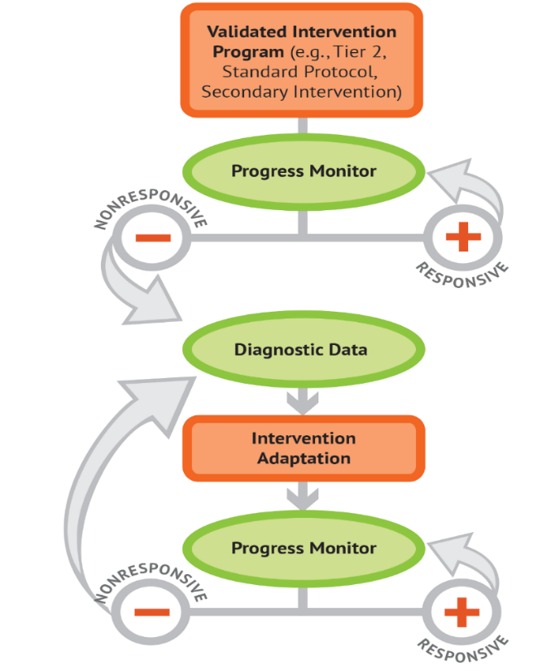
What Is Data-Based Individualization?
A systematic method for using data to determine when and how to provide more intensive intervention.
An ongoing process—not a single intervention.
Intended for students with severe and persistent learning and behavioral needs.
Notes:
Before we focus on the dimensions of the Taxonomy of Intervention Intensity, we will briefly review the DBI process. DBI is a research-based process for individualizing and intensifying interventions by systematically using assessment data, validated interventions, and research-based adaptation strategies. DBI is the technical term for what many good teachers do naturally through the problem-solving process: frequently reviewing student data and making changes to their teaching based on what works for students. DBI, however, makes this process systematic, explicit, and tailored to meet the needs of individual students through a multistep process that gradually intensifies instruction and support.
DBI has its origins in data-based program modification/experimental teaching, which was first developed at the University of Minnesota (Deno & Mirkin, 1977).
DBI is intended as an ongoing process, not a single intervention. It is intended for a small percentage of students with severe and persistent learning and behavioral needs, including those who
are not making adequate progress in their current intervention program (often, a Tier 2, evidence-based intervention),
are not meeting individualized education program goals,
have persistently low academic achievement, and
have high-intensity/frequency behavior.

Slide 6
Five DBI Steps
Validated intervention program, delivered with fidelity
Progress monitoring
Informal diagnostic assessment
Adaptation to a validated intervention
Continued progress monitoring, with adaptations occurring whenever needed to ensure adequate progress
Notes:
The DBI process includes five iterative steps:
The DBI process builds on validated intervention programs delivered with fidelity. A validated intervention program is an evidence-based standard protocol intervention.
Regular progress monitoring data are collected to determine whether a student is responding or not responding to an intervention. If the student is responsive, the teacher continues to provide the validated intervention program and monitor progress until the student reaches expectations. If the data suggest that the student is not responding while other students who have received the intervention have responded, then the teacher moves to the next step of the process.
To determine why the student is not responding, diagnostic and functional data are collected and reviewed to identify specific skill deficits or behavior concerns that are affecting the student’s progress. These data may include data from informal and formal academic and behavior measures. They are used to develop a hypothesis about why the student is not responding.
The hypothesis and educators’ expertise are used to develop an individual student plan for modifying or adapting the intervention to better meet the student’s individualized needs.
While implementing the intervention adaptations, the teacher continues to collect progress monitoring data at regular intervals to determine responsiveness. Students whose data indicate responsiveness continue with the adapted intervention. Students whose data indicate nonresponse return to Step 3, where the teacher will analyze additional data and consider additional adaptations.
This module will focus primarily on how interventions are selected and how to formulate adaptations within the DBI process.

Slide 7
The Taxonomy of Intervention Intensity: A Tool to Support DBI
Evaluate current interventions.
Select a new intervention.
Intensify the intervention.
Notes:
The seven dimensions of the Taxonomy of Intervention Intensity can help you make informed, systematic decisions in the context of the DBI process. The taxonomy primarily applies to the orange bubbles (validated intervention program and intervention adaptation) and will be the focus of today’s presentation. The Taxonomy of Intervention Intensity (Fuchs, Fuchs, & Malone, 2017) can be used to select or evaluate an intervention platform used as the validated intervention platform (this selection/evaluation process forms the foundation of the DBI process). The taxonomy also provides guidance on how to intensify, modify, and adapt the intervention during the intervention adaptation step of the DBI process. Essentially, the taxonomy provides explicit guidance in the “orange” areas on the graphic, which allows teachers to progress monitor, collect relevant diagnostic data, progress monitor again, and make data-based decisions to suit students’ needs. The taxonomy and DBI are not mutually exclusive; the taxonomy drives the DBI process.

Slide 8
Activity: Brainstorm Current Reading Interventions
What reading interventions are you currently using with students who have intensive reading needs? (Alternatively, what have you used in the past?)
How do you select reading interventions?
How do you decide when and how to adapt a reading intervention to meet a student’s individual needs?
Handout
Notes:
As we start to think about the taxonomy, let’s brainstorm about the current reading interventions that you have in place. As you brainstorm, note whether any of these interventions are standard intervention protocols or prepackaged interventions (in contrast to interventions that may be a mixture of strategies). Use Handout 3 to document any available interventions, how interventions are selected, and how you decide when to make adaptations to an intervention for a particular student.
Provide participants about 5–7 minutes to complete this activity in teams. Once the teams have completed the activity, have a couple share out some of the interventions they are using and how they select and adapt them.

Slide 9
Validated Intervention Program
Why start with a standardized, evidence-based program?
When properly aligned to students’ needs, evidence-based programs tend to work; teachers don’t need to “reinvent the wheel.”
These programs are efficient; teachers can plan instruction for groups rather than individual students.
Many programs require only a modest amount of training. Often, paraeducators can help with delivery.
Often they are inexpensive but costs can vary.
Notes:
In the previous activity, you brainstormed about your currently available interventions and noted any standardized interventions available. Although we know that no intervention is perfect, a growing number of evidence-based, standard protocol interventions can be used as a starting place. What do we mean by standardized? A standardized intervention
uses research-based instructional techniques;
is provided in a specific manner to students, specified by the developers; and
typically includes a step-by-step sequence.
So why use evidence-based standard protocol interventions?
Review slide.

Slide 10
Can I still implement DBI if I don’t have a standardized, evidence-based program?
I can tell you’re struggling with fractions, Tony, but there aren’t any evidence-based programs for kids in your grade. Maybe check back in a few years?
Notes:
One question you might have is, “Can I still implement DBI if I don’t have a standardized, evidence-based program?” As you can see on the slide, the teacher is saying, “I can tell you’re struggling with fractions, Tony, but there aren’t any EBPs for kids in your grade. Maybe check back in a few years?” We know that, in reality, we cannot say this. Yet we have students showing up at school every day, and some areas have limited or no evidence-based programs. Our recommendation is to use a standardized evidence-based program when it is available and consider augmenting current offerings if you have content areas with insufficient resources.
As Bryan Cook says in a module from the IRIS Center (http://iris.peabody.vanderbilt.edu/module/ebp_01/cresource/q1/p01/transcript/#content): The number of available practices that meet EBP criteria are limited, but . . . “Every evidence-based practice at some point started off as a non-evidence-based practice that we didn’t have enough research out yet to tell whether it was evidenced-based. And so just because something’s not evidenced-based doesn’t necessarily mean that it’s ineffective.”
In the next section, we will introduce the Taxonomy of Intervention Intensity and discuss how you can use the dimensions to guide your understanding of the interventions you are providing. This taxonomy applies both to a standard protocol intervention as well as those that you may need to design because of limitations in the availability of a program.

Slide 11
Validated Intervention Programs: Components to Consider
Effect size
EBPs
Group size
Opportunities to respond
Alignment with grade-level standards
Frequency and duration of intervention
Explicit instruction and modeling
Concrete learning opportunities
Break tasks into smaller steps
Connection to Tier 1 instruction
It would be helpful if there was a framework to guide our thinking when we are deciding what interventions to use and how to adapt them.
Notes:
As we think about our validated interventions, we need to consider two elements: An intervention should be designed based on the Taxonomy of Intervention Intensity, and it should be conducted with fidelity. In other words, what we are going to implement and how we will implement it.
Often, when we consider our interventions, we focus only on whether a study or two (or sometimes a colleague) has said it is effective or has an evidence base. In fact, as we think about our validated interventions, we want to consider (click for animations and review components as they appear). To help us guide our understanding, it would be helpful if we had a framework . . .

Slide 12
Key Considerations When Selecting or Evaluating Validated Interventions for DBI
Does evidence suggest that the intervention is expected to lead to improved outcomes (strength)?
Will the group size, duration, and frequency provide sufficient opportunities to respond (dosage)?
Does the intervention match the student’s identified needs (alignment)?
Does the intervention assist the student in generalizing the learned skills to general education or other tasks (attention to transfer)?
Does the intervention include elements of explicit instruction (comprehensiveness)?
Does the student have opportunities to develop the behavior skills needed to be successful (behavioral support)? Can the intervention be easily integrated into academic instruction (academic support)?
Can the intervention be individualized with a data-based process to meet student needs (individualization)?
Handout
Notes:
…or set of guiding questions that to consider. On this slide you see a series of questions that map to the seven dimensions of the Taxonomy of Intervention Intensity that we looked at earlier. These seven dimensions were initially proposed in a 2017 article in TEACHING Exceptional Children, by Lynn and Doug Fuchs and Amelia Malone, to help educators consider the strengths and weaknesses of their interventions and guide intensification. Our understanding about these dimensions and the application of the dimensions to behavior was expanded on through the work of the NCII and its technical workgroup.
Review slide.

Slide 13
Taxonomy Dimensions
Strength
Dosage
Alignment
Attention to transfer
Comprehensiveness
Behavioral support
Individualization
Notes:
The Taxonomy of Intervention Intensity is a system for describing an intervention in terms of seven dimensions along which intensity can vary. In subsequent sections of the presentation, we will explore each of these dimensions in depth and discuss how you can use the dimensions to better understand your intervention and the areas that you may need to intensify or adjust over time to better meet students’ needs.

Slide 14
Taxonomy Ratings
0 | 1 | 2 | 3
Fails to address standard | Addresses standard minimally | Addresses standard moderately | Addresses standard proficiently
Handout
Notes:
As we walk through each taxonomy dimension, we’ll also discuss how you and your intervention team would rate that dimension of a validated intervention program. Take a minute to review the rubric and note any areas you have questions about. As we discuss each dimension of the taxonomy, we’ll practice rating interventions on each dimension together. As you can see, the rating scale we will use ranges from 0 (fails to address standard) to 3 (addresses standard proficiently).
Please note that no “hard and fast rules” exist for rating the degree to which a validated intervention program addresses a standard. A rater must consider the characteristics and needs of the student as well as the intervention context. In other words, ratings are sometimes relative rather than absolute. We’ll do our best to provide diverse examples today that illustrate a variety of scenarios.
Provide participants with 3–5 minutes to review the rating rubric.

Slide 15
Strength
Notes:
The first dimension we will discuss is strength.

Slide 16
Strength
How well does the intervention work for students with intensive intervention needs (i.e., students below the 20th percentile)?
Considerations:
Has this intervention been evaluated empirically using scientifically sound, rigorous methodology?
What were the effects of the study?
For group design studies: What is the reported standardized mean effect size for this intervention, and what does it look like for students with intensive needs?
For single-case design studies: Is it identified as a promising or effective program by a reputable source?
Notes:
The dimension of strength focuses on how well the intervention works and whether we can expect to see results. Most interventions are validated for use with students at or below the 50th percentile, but to understand how an intervention would work for a student with more intensive needs, when possible, we want to look for results reported for students below the 20th percentile. It is important to note that such disaggregated information is not always available for review.
When we consider strength, we focus on two things.
Was the intervention evaluated empirically using scientifically sound, rigorous methodology? In other words, can we trust the outcomes of the study? These results must be assessed through the lens of high-quality research design. A study could be a group design (more often seen for academic interventions) or a single-subject design (more often seen for behavioral interventions).
What were the effects of the study? When we look for the effects of the study for group-design studies, we are typically looking at the effect size, which provides a method for quantifying the strength of the intervention. If the study was a single-subject design, look for performance data for students closest to your target student. Did they meet their benchmarks?
Note: Based on the audience, you may determine to further simplify or enhance this section. Strength and understanding of effect sizes or the results of single-case studies often are challenging for educators who do not have a background with this information. The goal of describing this dimension is to help provide some initial guidance without providing too much information too soon.

Slide 17
What to Look for When Examining the Published Evidence Base
Type/Source: Is the source reputable? Can it be trusted?
Population: Were the students included in the study similar to our students?
Desired Outcomes: Were the outcomes of interest relevant to our students?
Effect Size (for group design studies): Does the evidence suggest that the intervention can produce the result we expect?
Notes:
To ensure that a validated intervention program is evidence based, teams should convene to review the existing research on that particular program and the quality of the available research. You can focus your efforts by looking at the following areas when examining the evidence base:
Consider the type of information and the source from which you are gathering this information. Is the information coming from the intervention vendor or a reputable website? Also, what type of evidence is available? Did the study involve experimental design, where the intervention group was compared with an equivalent control group? The better the study, the more we can trust the outcome data.
Consider the population. For which populations has the program been researched and found effective? Is the sample described? Is the population similar to (or representative) of your student population? Do different population groups have different effects? This area might be especially important when we are thinking about students with intensive needs. As mentioned on the previous slide, we often find studies that look at the effectiveness of the intervention for students below the 50th percentile, but if we are focused on students with more intensive needs, we might want to see if evidence is available that more closely matches our population, or students below the 20th percentile. In addition, for English learners, you might want to consider whether the study has evidence of effectiveness for students learning English.
Importantly, consider whether the desired outcomes assessed in a study are relevant to the outcomes you hope to achieve with an intervention and in the expected direction.
Consider the effects. Were the effects of the study large enough to be meaningful? We will provide more context about effect size on the following slides. As part of our review of effect sizes, we may want to consider whether the intervention has been replicated (e.g., has more than one study illustrated similar findings or results). When we analyze findings, we may need to consider the overarching body of evidence.

Slide 18
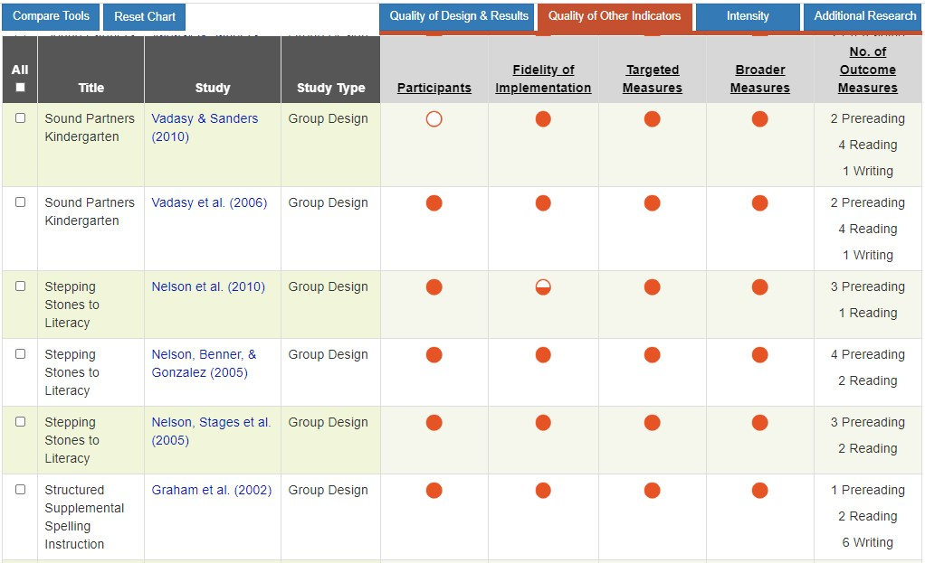
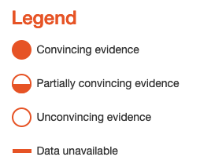
Look at the Evidence: NCII Tools Chart
https://charts.intensiveintervention.org/aintervention
Notes:
Before looking at the reported effects of an intervention, ask, “Was this intervention empirically tested? The quality of the research design is closely related to assessing whether the strength of the intervention is believable. ​
Yes—It was tested by means of a randomized controlled trial, an appropriate quasi-experimental design, or single-case research design.​
No—This intervention is based on a case study, descriptive information, or anecdote. ​
You can use the National Center on Intensive Intervention’s Academic Intervention Tools Chart to examine the quality of evidence for interventions. In this example, by looking at some of the quality indicators for Sound Partners, Kindergarten, it looks promising. When you have more open circles—the quality of the research is weak, and you should interpret the intervention strength with caution. When you have more closed circles--the quality of the research is strong, and you can interpret the reported strength with confidence. The NCII tools chart is interactive so you can click on a circle to see additional data. ​
Our example includes a group-design study. You should ask a few key questions about the study that could potentially threaten the internal validity of a group design study:
Did random assignment occur? Were groups deemed equivalent on a performance variable and/or demographic variables before the study commenced?
Were the outcome measures researcher designed, or were they a mix of researcher-designed measures and standardized assessments?
Did effects generalize to more general assessments of mathematics performance, such as state-level tests?
How was risk status conceptualized?

Slide 19
What Is Effect Size?
It is a quantitative way to look at the strength of an intervention.
Rules of thumb:
Strength | Effect size
Small (minimum) | 0.25 to 0.34
Moderate | 0.35 to 0.49
Strong | 0.50 or larger
Notes:
Researchers usually use two ways to describe the success or “efficacy” of an intervention. The first way is “statistical significance.” If something is statistically significant, it means that the likelihood of finding a particular result by chance is quite rare, generally less than 5%. In other words, it is highly unlikely that the results of the study are a fluke. Significance is important to consider because it helps guard against the costly mistake of labeling something as effective when it is not.
Statistical significance tells us if something is effective, but it can’t tell us how effective that thing is. That’s where effect size comes in. An effect size is a standardized measure of the strength of an intervention. To conceptualize what an effect size is, consider an assessment that has an average score of 100 and a standard deviation of 10 (meaning, on average, that scores between students vary by 10 points). An effect size of 1.0 would mean that intervention students scored, on average, 10 points higher on the end-of-intervention assessment.
Although multiple factors may impact the effect size, a general rule of thumb for educational effect sizes for academic outcomes appears on the slide (review slide). We can use these rules of thumb as a starting place to consider the effectiveness of an intervention.

Slide 20
How important are effect sizes?
Effect sizes are not always available.
When available, effect sizes must be interpreted with caution.
Effect sizes can be impacted by:
Study conditions
Content studied
Study population
Notes:
Depending on the study design, effect sizes may not be available. This is often the case with behavioral interventions that use a single-case design. Even when they are available, effect sizes must be interpreted with caution and in context (Hill, Bloom, Black, & Lipsey, 2008) because they can be influenced by several factors, including study conditions, the content studied, and the type of student.
For example, interventions for younger students, that involve researcher-created measures administered shortly after the intervention would be expected to have higher effect sizes. As students get older, the expected effect sizes tend to get smaller. Similarly, interventions that have been tested using standardized measures also would be expected to yield smaller effects. In addition, it is easier to find larger effects when measures are proximal or more directly related to the intervention compared with measures that may incorporate more global measures.
The study conditions also can influence effect sizes. Effects from research studies were usually obtained under high levels of fidelity that are often difficult to achieve in authentic classroom settings. In addition, lower effect sizes could be statistically significant in one study and not significant in another study. Because sample size largely drives the differences between groups, this must be taken into account.
In other words, the effect size is one piece of information we can use to understand the intervention’s potential effect, but it is not the only piece of information we consider.

Slide 21
Strength Rating Scale
0 | 1 | 2 | 3
Fails to address standard | Addresses standard minimally | Addresses standard moderately | Addresses standard well
No validated studies No effect size can be determined Reported effect size is < .2 | Effect size is 0.2 - 0.34 (researcher-designed measure) | Effect size is 0.35 - 0.55 (researcher-designed measure) OR Effect size is 0.2 - 0.3 (standardized measure) | Effect Size > 0.55 (researcher-designed measure) OR Effect Size > 0.3 (standardized measure)
Notes:
So how can you use an effect size to rate an intervention’s strength? Although we must be cautious with effect sizes, we can use them to help us think about the strength of the intervention. Specifically, we might look at the rubric on the slide to help us think about effect sizes.
Reminder: This scale is not a hard and fast rule. Effect sizes need to be interpreted in context (Hill, Bloom, Black, & Lipsey, 2008). Interventions for younger students—that involve researcher-created measures—would be expected to have higher effect sizes. As students get older, the expected effect sizes tend to get smaller. Similarly, interventions that have been tested using standardized measures would be expected to yield smaller effects.
Lower effect sizes could be statistically significant in one study and not significant in another study. Because sample size largely drives the differences between groups, sample size must be taken into account. Note that the values listed on the slide are relevant only if the effect size reflects a significant difference between conditions. For example, if a study reports a nonsignificant effect size of 0.30, then the rating must be 0. Yet, this rating does not mean that there is no potential for group differences. But the example study in question was not sufficiently powered to detect a significant difference between groups.
Some notes:
On the tools chart, you will sometimes see a small u. This means that researchers did not adjust for pretest means, and the information was not available for NCII to provide this correction. The highest rating you would give an intervention with a “u” next to its effect size is 2.
On the tools chart, you will sometimes see a small star, which means the effect was statistically significant. If the authors report a moderate but statistically significant effect size, rate the intervention as 3.

Slide 22
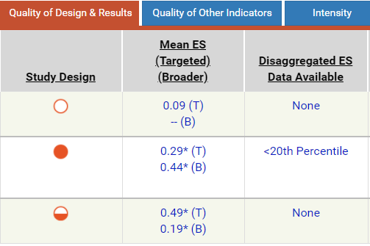
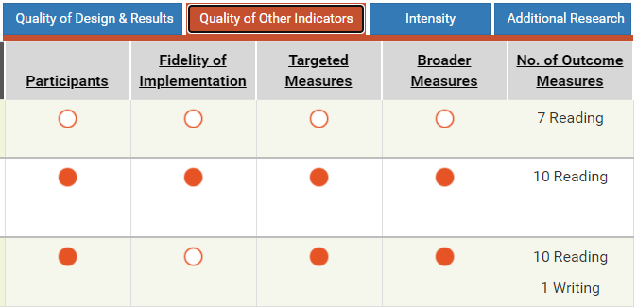
Rating Strength: Demonstration
1
2
3
Notes:
Here is a comparison of three reading interventions for elementary students. Before we rate the effect sizes, let’s look at the study quality. Of the three interventions, which appears to have the highest quality? [2] Yes, the evaluation of this intervention was rigorous, which means that you can have more confidence in the results.
Intervention 1 has all open circles; we can’t place much confidence in the reported results. The study reports a mean effect size of 0.09 on the targeted measures, the effect size is not significant, and is based on research that is not high quality. This intervention would receive a 0 rating for strength.
Intervention 2 has high quality ratings. You can be pretty confident in the findings because the study’s methodology was strong. We also see a little star next to the mean effect sizes for both targeted and broad measures, indicating that the results were significant (are unlikely to be attributed to chance). The strong methodological quality and significance gives us more confidence in these results. The mean effect size of 0.29 on targeted measures is slightly below the threshold for a 3; however the mean effect size on the broader measures of .44 meets the criteria for a 3. In addition, if you look at the participants column, you can see that there is convincing evidence that the participants were at risk in the area of the intervention, in other words, students in need of intensive intervention. Based on this information I would rate this intervention a 3 for strength.
Intervention 3 is a bit trickier to rate. Three quality ratings are rated with solid circles, one rating shows a half circle, and one rating is an open circle. The effect sizes of .49 and .19 are both statistically significant Had the circles all been full, you might be inclined to give this a rating of 3. However, there were some concerns with the study design and the fidelity of implementation in this study, so I would give this intervention a score of 1.
If I were selecting an intervention based on strength alone, I would choose intervention 2. However, the Taxonomy of Intervention Intensity has seven dimensions, and strength is only one thing to consider.

Slide 23
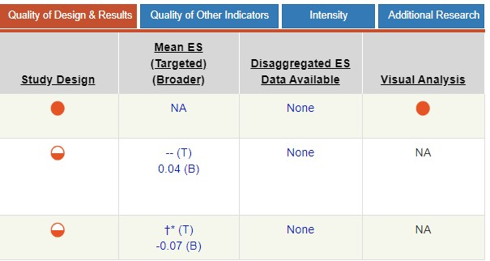
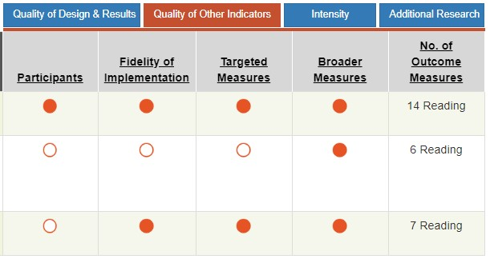
Rating Strength: Guided Practice
1
2
3
Notes:
Let’s work through this together. Here are three reading interventions for middle school. Based on quality alone, does any intervention have unconvincing evidence or poor research quality? [2] Intervention 2 has open circles for three of the quality indicators, and a half circle for one indicator. Even without the effect size information, I would be cautious about interpreting the strength of this intervention because the effect size is based on a study with questionable methods. What would you rate this intervention? [0] Why? The quality of the study provides unconvincing evidence, and the effect size is very small and nonsignificant. Also the results aren’t disaggregated for students below the 20th percentile.
Look at Study 1. Do the study quality ratings provide you with convincing evidence? [Yes] That means the study was scientifically sound. Now look at the results. How would you interpret this? This study was a single-case research design, which means that the authors did not look at group means. So, we have to think about strength in another way. This study was conducted with three participants. All three participants were assessed at baseline, prior to intervention. Then the intervention was introduced one at a time for each participant. When the intervention was introduced, each student had an immediate level trend, which means that each student’s score jumped up. The students’ scores all had generally increasing trends after that. In terms of a single-case design, these results show a strong functional relationship. The researchers established that the intervention caused the change in performance. But, by design, with the small sample size (three students), we must be careful about generalizing the results. If the students in the study are just like the students you plan to implement the intervention with, you might give this study a score of 3. However, the intervention reported in this study was provided to younger students, not students in middle school. So, I would give it a score of 1 because I can see that the intervention appears effective, but I can’t tell whether it would be effective for middle school students.
Finally, let’s look at Study 3. Is the evidence convincing? [Somewhat] There is convincing and somewhat convincing evidence for most of the indicators. Looking closer at the participants, the study involved 109 participants selected for the study because their scores fell below the 40th percentile on the DIBELS (Dynamic Indicators of Basic Early Literacy Skills) and MAP (Measures of Academic Progress) reading tests. Because disaggregated results were not provided, we can’t be sure how students below the 20th percentile might do. Look at the effect sizes reported. How would you rate these results? (Allow participant response.) This is a fluency intervention. The targeted measures are measures that specifically measured fluency. The cross symbol indicates that a mean effect size could not be reported because at least one effect size could not be calculated. However, we see that at least one of the targeted measures was statistically significant. The broader measures are standardized comprehension measures. So, if we plan to use this intervention as a fluency intervention, let’s look at the targeted effect sizes alone. How would you rate this? First you would want to click into the study to find out more information about the effect sizes. Looking at those effect sizes, I would probably score this a 1. The intervention is being provided to older students, so I would expect a smaller effect size, and some of the effect sizes are significant. However, I don’t really know how this intervention would work for a student who has not responded to other Tier 2 fluency interventions.
As mentioned previously, a hard and fast rule for measuring strength does not exist. You need to consider context and methodological quality. Also recognize that this is only one dimension; there may be other compelling reasons for choosing an intervention.

Slide 24
So How Do We Interpret Effect Sizes and Strength?
Effect sizes, when available, provide a starting point for considering the strength of an intervention.
Information about the strength of the intervention also can be gathered based on information from reputable sources (e.g., NCII Tools Charts, What Works Clearinghouse).
Effect sizes should be used with other dimensions of the taxonomy for the individual student or groups of students in a particular context.
Notes:
Although effect sizes provide a starting point for considering the effectiveness of an intervention, they must be interpreted with caution. We can use information from reputable sources to supplement what we know from an effect size or provide us with information if an effect size is not available. It also is important to remember that the effect size is used along with information about the other dimensions of the taxonomy to help us determine whether the intervention is a good match for the individual student or group of students in a particular context.

Slide 25
Dosage
Notes:
Next, we will look at the dosage dimension.

Slide 26
Intervention Dosage
Dosage refers to the number of opportunities that students have to respond and receive corrective feedback. Each of the following might impact dosage:
Number of sessions (frequency of sessions)
Duration of sessions
Student-teacher ratio
Number of practice problems provided
Notes:
Dosage refers to the number of opportunities that a student has to respond and receive corrective feedback. Dosage is more than just the number and duration of sessions. All students participate in core instruction daily for 45–90 minutes per day. Intensive interventions should be more intense. There should be fewer students in an intervention group. The sessions should be provided with greater frequency and should last longer than Tier 1 and Tier 2.
Thought activity:
Think about how Tier 2 and Tier 3 interventions are provided in your school(s). Do students in Tiers 2 and 3 receive more than students in Tier 1? How much more? If the students in Tier 2 are in a larger group than the students in Tier 1, then the dosage is not more intense. If every student in the building is getting the same number of minutes regardless of their tier, then the intervention dosage is not more intense. This concept is really important. Just because you call something an intervention doesn’t make it so. If your Tier 3 students or students in special education are being served in groups of 10 or more during a portion of the core reading block, is that really a stronger dose than what the Tier 1 students are getting?
However, there are a finite number of minutes in a day and adults in a building. What do you do with the Tier 1 and, to a lesser extent, the Tier 2 students while the Tier 3 students are receiving intensive intervention? These are challenging questions, and, indeed, most schools in the country are wrestling with these questions.
Think of it like a medication. You can increase the number of pills you take per day, or you can increase the number of milligrams of active ingredients in each pill. We can increase the number of sessions, the duration of those sessions, and the teacher-student ratio to a point. If resources do not allow you to increase the frequency, duration, or ratio, you may need to increase the number of opportunities to respond by increasing the number of practice problems provided or finding ways to increase the amount of feedback given.

Slide 27
Tips for Evaluating Dosage
Access the materials/lessons (if possible).
Choose two lessons each from the beginning, middle, and end of the program. Count how many times the student has to respond and receive feedback.
Think about your capacity to create smaller groups: Will you be able to deliver the intervention one-on-one? Do you need to adapt the dosage suggested in the manual for a larger group?
Notes:
So, how can you rate the dosage of an intervention?
The NCII Intervention Tools Charts includes a review of the target duration, frequency, and group size of the intervention. This information can provide an overview of information about dosage.
It’s not always possible to access intervention materials in advance. In that case, you must make your best guess.
Opportunities to respond can be subjective for reading: Is it the number of words read, the number of questions answered, or the number of discussion points? You will probably want to base your count on the target area for a given student:
For a student with a phonological deficit, you might look for opportunities for the student to practice decoding and encoding words, for example.
For fluency, you might look at the number of words the student will be able to read and, if necessary, receive corrective feedback on. Following along while another student reads would not count.
For comprehension, you should focus on strategies practiced, questions answered, and opportunities for discussion.
If a particular intervention was validated on small groups, pairs, or one-on-one but you will implement it in larger groups, you should account for this when considering the dosage. Similarly, you might increase the dosage by using peers (especially if those peers are stronger readers and capable of providing good feedback).
A note of caution, however: If an intervention has been validated in a one-on-one setting (e.g., reading recovery) or in pairs but you intend to use it with a much larger group, you should not expect the same effect size or strength. Decreasing the dosage will likely decrease the efficacy of an intervention, just as in any medicine or treatment. If you aren’t going to take something as prescribed, you can’t expect to reap the same benefits.

Slide 28
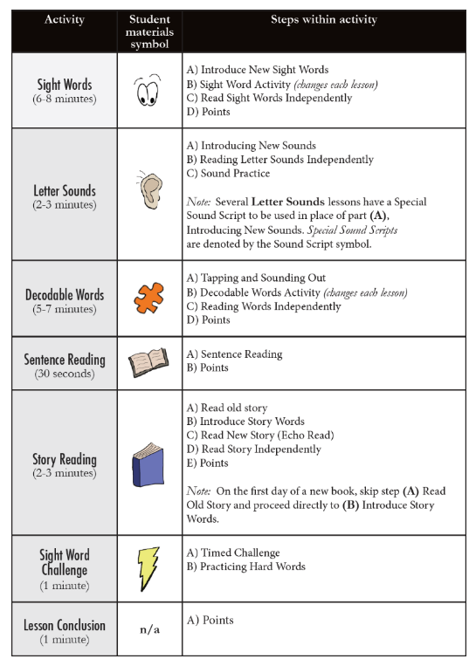
Rating Dosage: Demonstration
104
105
154
136
137
136
Source: Excerpt from the Nashville Early Reading Project (Fuchs et al., 2016; ©Vanderbilt University).
Notes:
Here is an example from the Nashville Early Reading Project (Fuchs et al. 2016). This intervention is a word reading intervention designed to be implemented with first graders. It also includes a supplemental comprehension program. However, for this example, we will talk only about the word-reading components.
As implemented by the researchers, the intervention is designed to be delivered one-on-one for 92 sessions, with each session lasting 20 minutes. Three aspects of dosage—ratio, frequency, and duration—are easy to find. However, to fully rate the dosage, you would need to look closely at the actual materials. Remember that dosage is “the number of opportunities a student has to respond and receive corrective feedback.”
Note: If you are in a position to select or purchase curricular materials for your school, it’s a good idea to request sample materials rather than basing your decision solely on things such as the ratio, frequency, or duration. It’s a good idea to look at a couple of lessons from early in the program, a couple of lessons from the middle, and a couple of lessons from the end.
Looking at the lessons carefully, you would find the number of opportunities that a student has to read a word or letter pattern and receive feedback from the teacher. I’ve done this by looking at six lessons: the first two, the middle two, and the last two. I counted the number of times that a student was asked to decode, encode, read a word, or identify a letter and receive feedback. The average number of opportunities to respond for these six lessons is approximately 129 (not counting additional games or progress monitoring checks).
If implementing this intervention with a pair of students, you would need to divide 129 in half because you would probably alternate. If implementing with a larger group, you would have to subdivide 129 even further.
When considering dosage, you should think about the context—the number of times a student receives individual corrective feedback from a teacher in Tier 2 and Tier 1. Are the number of times more than Tier 1? More than Tier 2?

Slide 29
Rating Dosage: Demonstration
0 | 1 | 2 | 3
Fails to address standard | Addresses standard minimally | Addresses standard moderately | Addresses standard well
Same as Tier 1. | Slightly more than Tier 1. Examples: Medium-sized group (10–15 students) 30 minutes, two times per week Students have two to three times more opportunities to respond and receive corrective feedback. | More than Tier 1. Examples: Small group (4–6 students) 30 minutes, three times per week Students have four to five times more opportunities to respond and receive corrective feedback. | Substantially more than Tier 2. Examples: 1–3 students 35 minutes, four to five times per week Students have greater than five times more opportunities to respond and receive corrective feedback.
Notes:
Now think about the example intervention and a typical first-grade classroom in your school or district.
How many times would a teacher be able to provide immediate, corrective feedback to a student during a typical core reading block specifically related to the student’s target deficits? (Perhaps a student reads a paragraph, writes a word, or identifies a sight word; such activity would not count times when a student works independently and does not receive instruction from the teacher.)
How does the dosage of the intervention compare with typical Tier 1?
Moderately more time (an additional 20 minutes on top of the core reading block)
Approximately five times more opportunities to respond
Far smaller student-teacher ratio
Given the nature of the intervention (decoding) and the age of the student (first grade), I would probably rate it as a 2.
Dosage is relatively easy to intensify (at least conceptually).
In this intervention, I could include more practice with letter sounds or sight words, such as going through each practice another time or add additional practice with previously seen sight words. I could play more games and read more books with target words. I could have the student encode words in addition to decoding.
If this intervention was a small-group intervention, I could increase the dosage by decreasing the number of students in the group or working with a student one-on-one.
If I was meeting with a student three times per week, I could increase the frequency to daily.
Of course, all these examples are easier said than done, given the constraints of teachers’ schedules and building resources, but it’s important to point it out because you might find an intervention that you rate strongly on other dimensions but less so for dosage. You can always increase the dosage prior to implementation.

Slide 30
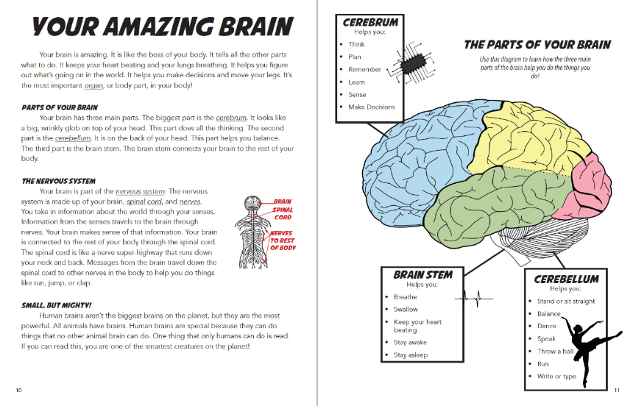
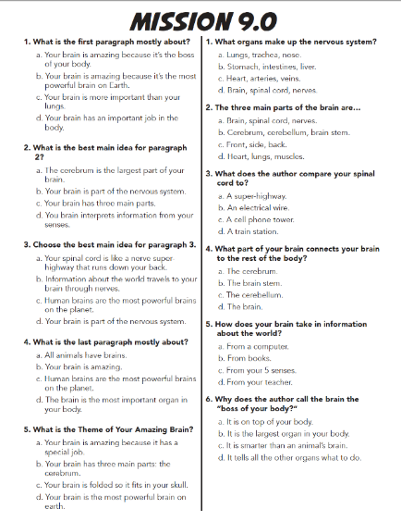
Rating Dosage: Guided Practice
42 sessions
Students meet in pairs with a tutor for 45 minutes
Source: Reading PI: Nonfiction Comprehension Intervention, Grade 3. Fuchs, Walsh, Patton, & Fuchs, 2019 ©The Fuchs Research Group
Notes:
A comprehension intervention is a little trickier to rate than a word reading intervention, so here’s a comprehension example.
This text and instructional worksheet are from a third-grade reading comprehension intervention. Because the intervention is focused exclusively on comprehension, I will focus on the comprehension aspects of dosage.
In the early program, students would spend three instructional sessions on a single text:
Day 1: Students prepare to read the text.
Students would identify text features (this example text has eight).
Students would discuss each text feature in detail—reading captions, answering questions posed by the tutor, and identifying the purpose.
Students would then define each vocabulary word (this example text has two review words and four new words).
Students would then identify the text structure based on the title and features and make a prediction about the theme of the text.
Students would activate and evaluate their background knowledge related to the predicted theme.
Students would select videos to supplement their background knowledge from a media library.
Students would discuss each video—how it improves their background knowledge or engagement with the text.
Day 2: Students read the text.
Students read each paragraph.
Students identify pronouns and connect them to their antecedent.
Students identify the main idea of each paragraph.
Students answer inline questions from the tutor.
Students update their predictions about the theme from the previous day.
Students use videos to supplement their background knowledge.
Day 3: Students work as a team to answer questions about the text.
Students identify the big idea of the text.
Students identify the type of question.
Students look for evidence in the text.
When evidence is insufficient to answer the question, students activate their background knowledge and make inferences.
Sometimes, students must access video resources to answer a question for which they have limited background knowledge.
Mid Program: Students complete all the previous steps but spend only 2 days on a text.
Late Program: Students complete all the previous steps in a single day.
Students work in pairs: As one student practices each strategy, the partner’s job is to provide feedback. If the partner’s feedback is incorrect, the tutor steps in and provides additional support.

Slide 31
Rating Dosage: Guided Practice
0 | 1 | 2 | 3
Fails to address standard | Addresses standard minimally | Addresses standard moderately | Addresses standard well
Same as Tier I (opportunities to respond and receive corrective feedback are similar to Tier 1) | Slightly more than Tier 1 (e.g., 2-3x more opportunities to respond and receive corrective feedback) | Same as Tier 2 (e.g., 4-5x more opportunities to respond and receive corrective feedback) | Substantially more than Tier 2 (>5x more opportunities to respond and receive corrective feedback)
Notes:
Now think about this comprehension intervention for third-grade students and what happens in a typical third-grade classroom.
How many times would a teacher be able to provide immediate, corrective feedback to a student during a typical core reading block (specifically related to the student’s target deficits)?
How does the dosage of the intervention compare with a typical Tier 1 or Tier 2 intervention?
Much more time—especially when you consider the amount of time dedicated specifically to comprehension and facilitated discussion
Opportunities to respond in a comprehension intervention are hard to quantify numerically, but the number of opportunities that a teacher would have to specifically check the comprehension of a student in real time is far more than in a small-group or whole-group setting, especially when you consider that a student with a comprehension deficit is likely to hang back and not offer answers.
Far smaller student-teacher ratio
How would you rate this intervention’s dosage? [3]

Slide 32
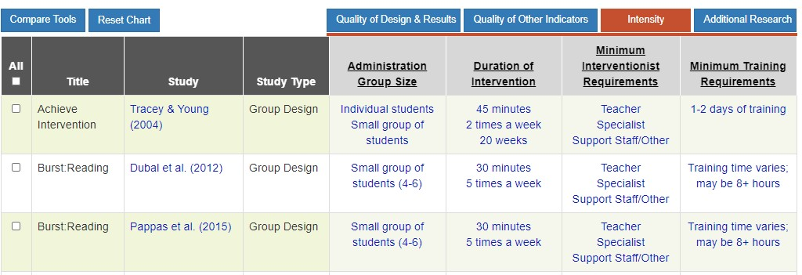
What If I Don’t Have Access to the Lesson Materials?
Notes:
The NCII Tools Chart can provide information about group size as well as session duration and frequency. By clicking on individual interventions, you may be able to learn more about the lesson format and make an educated guess about the number of opportunities a student might have to respond.

Slide 33
Alignment
Notes:
The third dimension of the taxonomy is alignment.

Slide 34
Alignment: Academics
To what extent does the intervention . . .
address the full set of a specific student’s academic deficits?
not address skills the student has already mastered?
incorporate a focus on grade-level standards?
Notes:
It is important to consider alignment because many academic interventions address a restricted set of skills. For example, an intervention may address only word reading, but a student’s difficulties might include word reading and comprehension. On the other hand, some interventions address skills that a student has already mastered. For example, an intervention may address word reading, but the student has a deficit related to comprehension only.
Also, aligning interventions to grade-level standards is important because such alignment should help the student participate in Tier 1 instruction. Interventions may need to be adapted to address grade-level standards even as the program remediates foundational skills. For more on this concept, refer to standards-relevant instruction work across tiers at https://intensiveintervention.org/standards-relevant-instruction-multi-tiered-systems-support-mtss-or-response-intervention.

Slide 35
Identifying a Student’s Intervention Needs
Conduct a diagnostic assessment.
What are the student’s skills and weaknesses related to . . .
phonemic and phonological awareness?
decoding?
fluency?
vocabulary?
comprehension?
spelling/writing?
Notes:
In many schools and districts across the country, Tier 2 interventions may be one size fits all. A reading specialist provides a Tier 2 intervention to all students who fail to meet a benchmark (e.g., think Read180). Some students receiving that intervention have deficits in word reading alone, others in comprehension alone. Some students have deficits primarily in spelling and writing but adequate reading. Many students have deficits in several areas. If a Tier 2 intervention is addressing only word reading, did the student with only comprehension deficits actually receive an intervention?
This problem gets bigger when we look across academic areas. How does your district make choices about mathematics versus reading interventions? Does your school offer mathematics interventions? If you are working in the older grades or in a secondary school, do you provide interventions in science or social studies?
For an intervention to be intense, it must be aligned to the needs of the individual student. For a student who is not meeting benchmarks, you need a full picture of the student’s strengths and weaknesses. Proficient reading is not a single skill; it is a complex process. Students are likely to have a variety of strengths and weaknesses. If you are using something like DIBELS or AIMSweb oral reading fluency as your primary method of identifying students who aren’t meeting benchmarks, you will need a more thorough diagnostic assessment. Four of the items talk about word reading, but comprehension is treated like a single skill—which it is not! A good diagnostic assessment should give you in-depth information about all of these areas, including comprehension.

Slide 36
Alignment Rating Scale
0 | 1 | 2 | 3
Fails to address standard | Addresses standard minimally | Addresses standard moderately | Addresses standard well
Does not align to a student’s needs. | Only addresses some of a student’s deficits, overemphasizes already mastered skills, and is not aligned to grade-level standards. | Addresses most of a student’s deficits, does not overemphasize already mastered skills, and aligns to curriculum standards. | Addresses all of a student’s deficits, does not overemphasize already mastered skills, and aligns to curriculum standards.
Notes:
Review scale.
It is important to continuously consider alignment. During implementation, you may find that the intervention becomes more or less aligned (sort of like clothing when you are on a diet). Students may master some skills—and therefore need less practice—or new deficits might appear.

Slide 37
Example: Jasmine
Literacy strand | Mastered | Needs
Phonics and phonological awareness | Short vowels, long vowels, r-controlled vowels, diphthongs Single consonants, consonant blends, and consonant diagraphs Can segment and blend sounds
Decoding | Most one- and two-syllable words | Multisyllabic words Frequently makes mistakes when reading words with suffixes and prefixes
Fluency | Relatively accurate reading Strong prosody | 50 words per minute (below the 25th percentile for third grade)
Vocabulary |  | Content area vocabulary Academic vocabulary
Comprehension | Retells Answers literal questions | Inference making Synthesis
Handout
Notes:
Give participants an opportunity to look over Jasmine’s strengths and weaknesses. Participants will need to keep this information in mind for slide 40.
To align to Jasmine’s instructional needs, an intensive intervention would include some decoding and fluency (mostly focused on multisyllabic words and increasing her reading rate), and lots of comprehension and vocabulary support.
For the sake of time, this chart does not include strengths and weaknesses related to spelling and writing, but those should be considered when selecting a literacy intervention.

Slide 38
Alignment Rating Examples
0 | 1 | 2 | 3
Fails to address standard | Addresses standard minimally | Addresses standard moderately | Addresses standard well
A decoding or fluency intervention for a student with comprehension deficit | An intervention focused on decoding only for a student with deficits in all areas of reading | An intervention that includes fluency, decoding, and phonics for a student with a deficit in all areas of reading | An intervention that includes instruction in all deficit areas
Notes:
Here are some examples of the types of interventions that would fall under each rating for alignment.
Rating 0 examples:
If a student has a comprehension-only deficit and receives a decoding or fluency intervention, the intervention is not addressing the deficit skill. It is addressing only mastered skills. The intervention is not aligned.
If you provide a phonics intervention focused on short and long vowels for a student who can already decode most single-syllable words (short and long vowels), then the intervention is targeting only the student’s mastered skills—it’s not aligned.
If you remove an older student from the core reading curriculum to provide a fluency and decoding intervention but do not give the student exposure to any of the grade-level texts, it is not aligned—even if the student’s deficits are in decoding and fluency only. Schema building is an important part of reading. The high school standards require students to read specific pieces of literature (e.g., Shakespeare, nonfiction). If you provide only remedial reading and do not provide access to those texts, students will miss out on the knowledge and vocabulary that those texts provide.
If a student has a reading deficit but receives a mathematics intervention, then the student is not receiving an intensive intervention in reading. This might seem really simple, but it is one of the biggest challenges that schools face when providing intensive intervention. Reading and math disabilities often are comorbid, meaning that students often have both. Deciding how to prioritize support or to provide both types of support is not easy.
Rating 1 examples:
If a student has deficits in all areas of reading, then ideally the student should be receiving support for all deficit areas. If an intervention addresses only one of many deficits, it is only minimally aligned.
If a great deal of the time spent in intervention related to previously mastered skills, then it is only minimally aligned. The phonics intervention may include instruction on a student deficit such as r-controlled vowels but also spend a lot of time on short and long vowels (something a student has already mastered). All the time on previously mastered skills would be wasted time.
If an intervention replaces a portion of core reading or if students read only text at their instructional level, they could miss out on essential schema that could exacerbate the gap between themselves and their peers. If the teacher is working on decoding multisyllabic words and a student can’t identify all the letters and letter sounds, then it is reasonable for the student to work on the prerequisite skill instead. It’s a balancing act.
Rating 2 examples:
If an intervention covers most but not all of a student’s deficits, it is moderately aligned.
An intervention may include some instruction in previously mastered skills, but most of the content should be devoted to deficit areas to be moderately aligned.
An intervention that provides instruction in prerequisite skills can be aligned to the general curriculum—provided it doesn’t supplant grade-level content. Students still need to build background knowledge. Phonics, decoding, and fluency are prerequisite skills—even for older students. A student with a deficit in these areas should still receive support in them, regardless of age or grade level. However, that student still needs a chance to participate in discussions about and learn about grade-level content (e.g., science, social studies, vocabulary).
Rating 3 examples:
An intervention that includes instruction in all deficit areas: A comprehension intervention for a student with a comprehension-only deficit. Or a fluency intervention that includes instruction in all phonics/word-reading deficit areas.
Most interventions that provide instruction in all student deficit areas are aligned with the curricular standards because they provide essential instruction in prerequisite skills, provided that the student still has access to the vocabulary, content, and schema building of grade-level texts.

Slide 39
Alignment to Grade-Level Curriculum
Read grade-level text orally with accuracy, appropriate rate, and expression on successive readings (CCSS RF 1.4.B).
Core instruction | Secondary instruction | Intensive intervention
Reading program includes fluency practice on appropriate grade-level texts Teacher models fluent reading Benchmark assessment of all students | Use companion materials that align with the core program at students’ instructional level More opportunities for practice Prioritize prerequisite skill instruction Progress monitor weekly | More opportunities for repeated reading practice on texts at students’ instructional level Provide support for underlying processes Progress monitor and make adaptations to the fluency program as indicated Continue to provide exposure to grade-level text when appropriate
Source: https://intensiveintervention.org/sites/default/files/FluenExample_508.pdf
Notes:
This chart shows how grade-level standards for fluency might be addressed across tiers of support. To see more examples of other content areas, see https://intensiveintervention.org/standards-relevant-instruction-multi-tiered-systems-support-mtss-or-response-intervention.
An intervention is aligned to grade-level curriculum if
it provides instruction for prerequisite skills required for content taught in core instruction,
allows students to practice the grade-level skill on instructional-level text, and
provides more opportunities to respond and receive feedback on grade-level skills.
An intervention would not be aligned to the grade-level curriculum if
it provides instruction on some skills but neglects others (in upper grades, exclusive focus on decoding and fluency without any additional support for comprehension) or
replaces core instruction such that students do not have the opportunity to develop background knowledge, vocabulary, and more from grade-level content because of exclusive focus on texts at the instructional level.

Slide 40
Rating Alignment: Guided Practice
Intervention 1
Vocabulary activities—includes defining words and morphology
Comprehension: literal, inferential, and synthesis; mix of fiction and nonfiction text
Intervention 2
Morphology and reading multisyllabic words
Repeated reading
Intervention 3
Word work: reading words with r-controlled vowels, diphthongs, etc.
Comprehension: literal, inferential, and synthesis; mix of fiction and nonfiction text
Repeated reading
Answering who, what, where, when, why, and how questions
Repeated reading
Handout
Notes:
Now let’s look at three examples of intervention programs. Which of these interventions would be most aligned to Jasmine’s skill needs?
Does Intervention 1 align?
Does it address all of her needs?
Practice decoding multisyllabic words [Yes, morphology]
Fluency practice [Yes, repeated reading]
Vocabulary [Yes, inclusion of nonfiction texts ensures access to some content area vocabulary]
Comprehension focused on inference making and synthesis [Yes]
Does it include intervention related to any mastered skills?
Phonological/phonemic awareness [No]
Decoding of one- and two-syllable words [No]
Fluency practice focused on reading with expression and accuracy [No]
Literal comprehension instruction [Some]
Intervention 1 addresses all of Jasmine’s deficits and includes almost no unnecessary instruction. At the very least, this intervention would receive a 2 for alignment. If aligned to grade-level standards, it would receive a score of 3.
Does Intervention 2 align?
Does it address all of her needs?
Practice decoding multisyllabic words [Yes, morphology]
Fluency practice [Yes, repeated reading]
Vocabulary [No]
Comprehension focused on inference making and synthesis [No, although answering may tap inference making on some level]
Does it include intervention related to any mastered skills?
Phonological/phonemic awareness [No]
Decoding of one- and two-syllable words [No]
Fluency practice focused on reading with expression and accuracy [No]
Literal comprehension instruction [Yes]
Intervention 2 addresses most but not all of Jasmine’s needs. It generally doesn’t address mastered skills, but it does include some literal comprehension instruction, which Jasmine doesn’t need. Because it only partially meets the first two characteristics of alignment, the highest rating this intervention could receive would be a 2—if the intervention was aligned to grade-level curriculum standards.
Guided Practice (Engage participants in a guided discussion related to Intervention 3’s alignment.)
Does it address all of her needs?
Practice decoding multisyllabic words [No]
Fluency practice [Yes, repeated reading]
Vocabulary [No]
Comprehension focused on inference making and synthesis [Yes]
Does it include intervention related to any mastered skills?
Phonological/phonemic awareness [Yes]
Decoding of one- and two-syllable words [No]
Fluency practice focused on reading with expression and accuracy [No]
Literal comprehension instruction [Some]
How would you rate this intervention?
If aligned to grade-level standards? It partially addresses Jasmine’s deficits and includes some mastered skills. If it is aligned to standards, it would receive a score of 1.5.
If not aligned to grade-level standards? It would probably receive a score of 0.
If it is partially aligned with grade-level standards? It would probably receive a score of 1.
The specific numeric rating is less important than the ability to compare the three interventions. Intervention 1 is the most aligned with a score between 2 and 3. Intervention 2 is partially aligned, so it would have a score somewhere between 1 and 2. Intervention 3 is the least aligned and would have a score between 0 and 1.5. In terms of alignment, Intervention 1 is the most intense.

Slide 41
Rating Alignment: Guided Practice
Read about the QuickReads intervention on the NCII website. Find out more about the program by visiting the publisher’s website.
Recall Jasmine’s intervention needs: decoding multisyllabic words, fluency, content/academic vocabulary, inference making, and text synthesis
How would you rate this intervention’s alignment?
0 | 1 | 2 | 3
Does not align to the student’s needs. | Only addresses some of the student’s deficits, overemphasizes already mastered skills, and is not aligned to grade-level standards. | Addresses most of the student’s deficits, does not overemphasize already mastered skills, and aligns to curriculum standards. | Addresses all of the student’s deficits, does not overemphasize already mastered skills, and aligns to curriculum standards.
Notes:
1. Help participants navigate to the description of QuickReads (Vadasy & Sanders, 2008) on the NCII Tools Chart.
2. Participants should read the description of the intervention on the NCII website. To learn more, they might visit the Pearson website.
3. Ask participants to discuss in small groups how they might rate this intervention’s alignment for Jasmine. When they are done, ask the groups to share their thoughts.
4. If necessary, help participants see that the program should be rated as a 2.
The program addresses most of Jasmine’s deficits: It is focused on nonfiction text (content area vocabulary) and is primarily a fluency intervention, although it has some comprehension activities. The comprehension activities included focus on vocabulary and literal comprehension. Explicit instruction is not provided in inference making and text synthesis.
The program does not overemphasize previously mastered skills: The third-grade level text is focused on single-syllable decoding (a previously mastered skill)—but mostly in connected text.
The program aligns to curriculum standards: Because the program requires only 15 minutes per day, it would not be expected to supplant core instruction. Jasmine would receive instruction in essential prerequisite skills, and she would receive access to nonfiction content and vocabulary.
5. Ask participants to discuss what they might do to improve the alignment. Ideas might include adding inference/main idea instruction or including decoding support for multisyllabic words.
6. Ask participants if they can think of a student for whom such an intervention would not be aligned. Example answers:
A student with minimal phonological awareness/phonics knowledge (student who does not yet recognize most letters and vowels)
A student with adequate fluency who demonstrates a comprehension-only deficit

Slide 42
Intensifying Alignment
You can make adjustments to an intervention’s alignment before implementing the DBI process.
Especially if you are working with more than one student, you may have to choose a program that is only minimally or moderately aligned and then adjust it in the following ways:
You can choose to skip or abbreviate instruction in previously mastered skills.
You may choose to supplement the program with additional instruction to ensure that all needs are being met.
You may choose to apply the intervention instructional components to grade-level texts to improve the curriculum alignment.
Notes:
Unlike strength, alignment is something that you can adjust before and during intervention implementation. Remember that when interventions were validated in the research setting, they did not make alignment adjustments (provided it was a group-design study). If individual adjustments had been made, it would have been impossible to interpret the results.
The DBI process allows you to make the adjustments necessary to take a validated Tier 2 intervention and intensify it to meet your students’ needs. If the intervention as designed is not intensive enough in terms of alignment, you can make it more so by doing the things listed on the slide.

Slide 43
Attention to Transfer
Notes:
The fourth dimension is attention to transfer.

Slide 44
Instructional Transfer
Image created by Meagan Walsh for the NCII webinar, The Taxonomy of Intervention Intensity: A Case Example for Building Intervention Intensity in Reading.
Notes:
Defining transfer: The degree to which skills/strategies/content can be expected to generalize to other settings.
Some nonacademic examples:
I work on my basketball shooting and dribbling --> I start scoring in games.
I practice scales and chords --> I learn to play a Chopin sonata.
I attend a safe driving workshop --> I improve my driving.
Imagine you are providing a reading intervention focused on beginning phonics (CVC, CVVC, CVCe, and basic sight words) to an older emergent reader. You are working with this student one-on-one.
When you are working together on a single skill, you would expect almost 100% performance by the end of the session on that skill. [No transfer]
At the end of the program, if you gave the student a posttest, you would expect near 80% performance across all taught skills. [Direct transfer]
On a word reading benchmark assessment (think Oral Reading Fluency or Next Step Forward [Scholastic] probe), you should expect some improvement but to a lesser degree. [Near Transfer]
Why? On a grade-level benchmark assessment, there will be many other sight words and phonetic patterns than those taught in intervention.
On a standardized test (grade-level normed, comprehension + word reading), you would expect a very small improvement if any at all. [Far Transfer]
Ask participants to think about the skills assessed on their state high-stakes test for Grades 3, 4, or 5. An intervention designed for a student reading at an emergent level will improve that student’s reading, but it will not necessarily translate to improved test scores.
Under the VERY BEST conditions, we would expect diminishing transfer as you move from assessments that are aligned with your intervention to assessments that are less aligned. Students with and at risk for learning disabilities have specific difficulty with generalization, which means it is even harder for them to transfer a skill they are taught in intervention to their high-stakes test.
This pattern can be expected whether we are talking about assessments or contexts.
When a child is working with you in a small group or even one-on-one, you will see growth, possibly even tremendous growth.
When you look at that same child in a reading class, you will probably see growth but perhaps to a lesser degree. (If you are the student’s regular classroom teacher as well as the interventionist, you may see less of a drop.)
When that student moves to science, social studies, mathematics, or an elective, you may find much smaller improvements.
When that student reads at home or individually, you might not see any improvement at all.
Instructional transfer is VERY hard to accomplish (speaking from the perspective of a curriculum designer and special educator).
More intense interventions make a concerted effort.
The most intense interventions demonstrate evidence of transfer (results on standardized assessments, measures of generalization).

Slide 45
Evaluating Attention to Transfer
To what extent does the intervention . . .
help students transfer skills they learn to other formats and contexts?
help students realize the connection between mastered and related skills?
demonstrate efficacy on standardized measures or measures of generalization?
Notes:
Transfer: How skills taught in intervention make their way into the classroom and students’ independent practice (related words: automaticity, fluency, independence, generalization).
Students at risk for learning disabilities tend to struggle with transfer and generalization (recognizing that the skills and strategies they’ve learned can be applied in other contexts). In fact, this is a key component of an educational disability diagnosis (inability to learn from observational learning and independently apply taught skills).
Students may demonstrate mastery of taught concepts in the intervention context but fail to demonstrate mastered skills in the following areas:
Different text length (single paragraph, multiple paragraph, book)
Different text format (font, features, size, color)
Different content (Students may have mastered skills while reading texts about space but fail to demonstrate any of the skills with a text about animals.)
Different phonetic pattern or word type (Students can decode a particular vowel pattern in single-syllable words but not multisyllabic words. Students can decode at the word level but struggle when reading connected text.)
Different instructional context (Students apply a strategy in one classroom but not another. Students fail to apply strategies when reading independently.)
Different subject area (Students struggle to apply reading strategies during content area instruction.)
As students learn new skills, they may struggle to connect the skills they learn to other mastered skills (forgetting lists of sight words previously learned, forgetting that they know a comprehension strategy when a new one is taught)
An intervention is more intensive if it provides the following:
Opportunities for students to develop metacognition and self-regulation to apply strategies independently (look for embedded instruction where students monitor, for example, their strategy use, learn acronyms, use checklists, evaluate their work, set goals, make plans)
Provides a variety of opportunities to practice that explicitly vary the context (e.g., different topics, genres)
Provides cumulative systematic review
An intervention is less intense if it provides the following:
Instruction only in the target skills without review
Does not vary the context in any way
Does not include self-regulation/metacognition practice or discussion
Additional notes:
Teaching students with disabilities to transfer skills is VERY difficult—even interventions with a large amount of this built in may be insufficient.
Can be adjusted during setup or implementation based on the needs of students.
In the process of DBI, you will likely need to continually evaluate student generalization and transfer and make instructional adjustments.

Slide 46
Attention to Transfer Rating Scale
0 | 1 | 2 | 3
Fails to address standard | Addresses standard minimally | Addresses standard moderately | Addresses standard well
Does not promote transfer. | Promotes transfer in one (1) of the following ways: Promotes self-regulation and goal setting Cumulative review Varied contexts | Promotes transfer in 2-3 of the following ways: Promotes self-regulation and goal setting Cumulative review Varied contexts | Promotes transfer in all of the following ways: Promotes self-regulation and goal setting Cumulative review Varied contexts Empirical evidence of transfer
Notes:
Here are some examples of the types of interventions that would fall under each rating for attention to transfer.
Self-Regulation Instruction: Students are taught the steps in a strategy; students use a checklist or some other method to monitor their own use of a strategy (may make use of, for example, goal setting, discussion, acronyms, self-evaluation). Basically, students are taught to take ownership of the strategy or skill. They can explain the steps in the strategy. They can evaluate their own performance. They can apply the skill or strategy with independence and automaticity.
Cumulative Review: Skills taught early in the intervention are continually reviewed throughout. The cumulative review should build on the overall scope and sequence of reading skills.
Varied Contexts: Students practice the skill with different
instructional procedures (phonics, e.g., CVC word games, encode, decode, read in context, whole group, partner, individual practice),
formats (e.g., font, layout, size, color),
text genres and structures, and
text subjects.
Evidence of Transfer:
Standardized test (Gates MacGinitie Reading Test, Woodcock-Johnson, Woodcock Reading Mastery Test, Kaufman Test of Educational Achievement, Iowa Test of Basic Skills, Gray Oral Reading Test)
State criterion referenced test
MAP test
Less formal: Lexile, Developmental Reading Assessment, Fountas-Pinnell (interpret with caution)

Slide 47
Rating Attention to Transfer: Demonstration
Promoting self-regulation:
Introduce strategies in the context of a favorite activity.
Begin each session with a discussion of strategy use outside the intervention.
Use a strategy checklist during the session.
Use of acronyms.
End session with a reminder to practice strategies.
Students receive a new strategy sticky note after each session.
Students regularly receive a new strategy bookmark.
Source: Walsh, Fuchs, Patton, Fuchs, and Lehman (2019).
Notes:
Let’s look at an example (experimental) intervention. For this example, we are looking at a third-grade reading comprehension intervention focused on a nonfiction text. Students were taught a series of nonfiction comprehension strategies.
The research team developing this intervention struggled for several years to improve instructional transfer. In the fifth year of an iterative project, the strategies show here are some of the strategies they tried to promote self-regulation. Review slide.

Slide 48
The Strategies
Source: Walsh, Fuchs, Patton, Lehman, & Fuchs, 2019
Notes:
During the first session of the intervention, students interview each other. They ask about, for example, favorite activities. Based on the activities they identify, students receive personalized strategy charts and discussion pointers.
For example, if a student liked to run, the student might get the strategy chart on this slide. The instructor might introduce the strategies using scripting such as this:
“The Best Detectives Always think. They think before, during, and after reading. To be good at anything, you have to work before, during, and after. Think about track. You have to work before, during, and after the race. Usain Bolt is the fastest man in the world, but he still practices all the time. He puts on his track gear. He stretches. He warms up. He listens to his favorite prerace music mix. He gets situated in the blocks. If he didn’t do any of these things, he would probably beat most of us in a race. But to be a world champion, he does all of these things every single time. Good readers use prereading strategies every time they read. They understand the importance of preparing to read.”
This script is intended to help students self-regulate and take ownership of the strategies themselves.

Slide 49
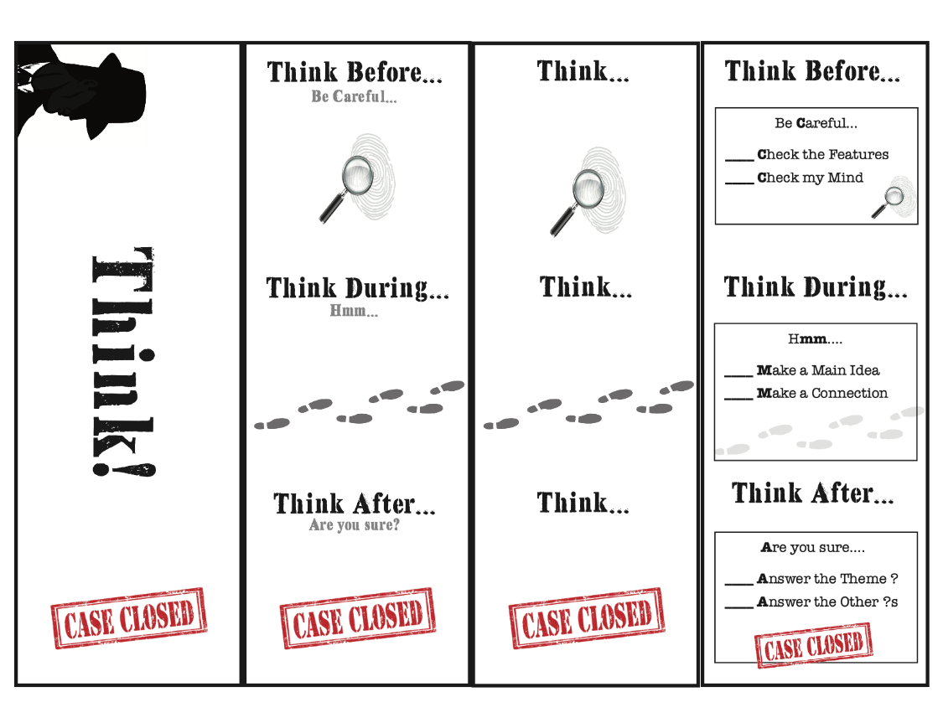
Promoting Transfer
Source: Reading PI: Nonfiction Comprehension Intervention, Grade 3. Fuchs ,Walsh, Patton, & Fuchs,2019 ©The Fuchs Research Group.
Notes:
Students received a daily sticky note, as shown here. This note could be used as a checklist during the session; then students took the note back to class to use whenever they were reading. Students brought the note back to tutoring to discuss which strategies they’d used and how the strategies helped them.
During the first few weeks, students also received a (personalized) bookmark to remind them of the importance of using strategies before, during, and after reading.
During Weeks 3–6, students received a bookmark listing all the strategies for them to keep.
During Weeks 6–9, students received a bookmark meant to remind them of their strategies without listing them.
At the end of the program (Week 12), students received a bookmark meant to remind them to think like detectives.
The use of sticky notes and bookmarks outside tutoring was intended to foster generalization (transfer) and self-regulation. So this study’s authors included explicit self-regulation.

Slide 50
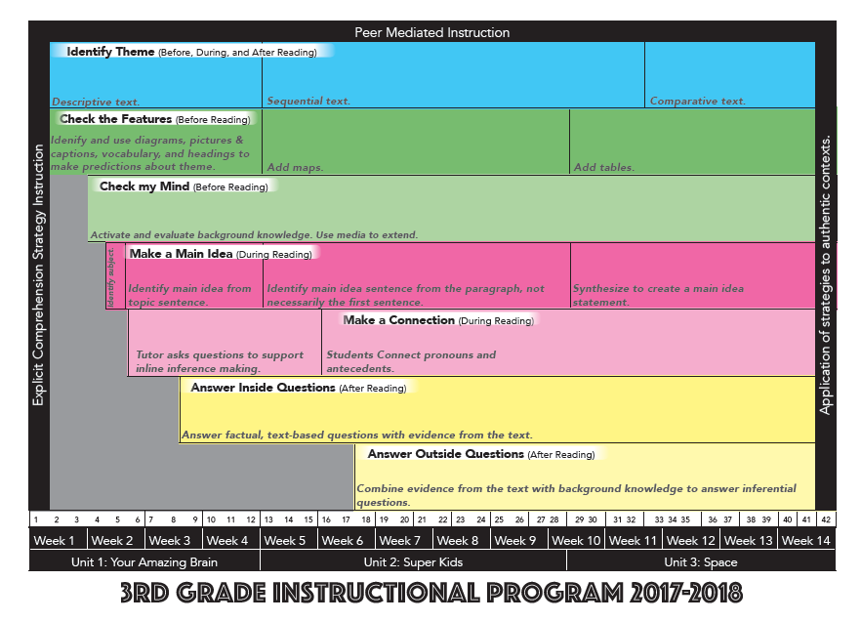
Cumulative Review
Source: Walsh, Fuchs, Patton, Lehman, & Fuchs, 2019
Notes:
In this curriculum, strategies are introduced one at a time. The scope and sequence of strategy instruction is shown on the slide. Students are taught that the primary goal of reading nonfiction is to identify the theme (what the author wants them to learn, i.e., the hidden message). Identifying the theme is the blue bar. Students are taught that the goal of all other strategies is to help them identify the theme.
Students continue to practice all taught strategies throughout the program. Scaffolded support is provided throughout the program and faded as students develop independence. By the end of the program, students are practicing all of the strategies independently with limited tutor support.
This scope and sequence shows that the intervention designers developed the program specifically to help students recognize the connections between mastered and recently taught skills. It also shows a plan to foster independence and provides for constant cumulative review.

Slide 51
Varied Contexts
Source: Reading PI: Nonfiction Comprehension Intervention, Grade 3. Fuchs, Walsh, Patton, & Fuchs ,2019 ©The Fuchs Research Group, Vanderbilt University
Notes:
The program uses 19 texts arranged in three instructional units. Each unit includes a student workbook and features a different nonfiction text structure. Texts include a variety of nonfiction text features (e.g., diagrams, maps, charts, pictures/captions, glossary, table of contents, headings), are presented in full color, and are designed to mimic authentic texts. Each unit also includes a media library to promote the development of background knowledge and schema. The topics of the texts were chosen to be appealing to third graders to improve engagement.
The curriculum includes a variety of nonfiction texts designed to give students exposure to different nonfiction text features, topics, and content areas. In terms of nonfiction texts, the curriculum makes a concerted effort to expose students to a variety of contexts. However, this curriculum does not include fictional texts. I might be concerned about this if I’m thinking about transfer. Also, the texts used are specifically designed for the program to have main ideas, clear themes, and foster inference making. Other nonfiction texts aren’t written in this way.

Slide 52
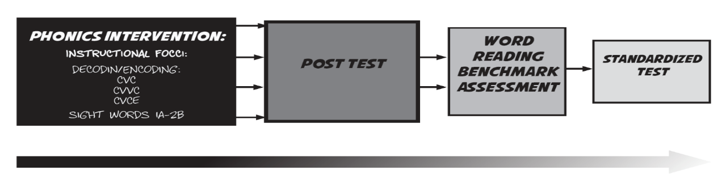
Evidence of Transfer
Walsh et al. (2019)
Notes:
Effects from the experimental curriculum described here are mixed, as you can see on this slide.
Recall the earlier graphic:
We might think of the knowledge assessment (a collection of multiple-choice questions about vocabulary and content that students read during the program) and the main idea measure (students directly demonstrating the main idea strategy as taught) as posttest measures. These are essentially direct demonstrations of what was taught in the intervention; no transfer is required. On these measures, we see very large, significant effects.
On the near transfer or proximal reading comprehension measure, we see a modest but significant effect. This measure is a composite. The first part includes three researcher created, novel, content-related texts with questions meant to tap the main idea, theme, literal ability, and inferential ability. The second part is made up of only the expository items from the Gates MacGinitie Reading Test (Form T).
On the far transfer measures: On the full Gates MacGinitie Form S, we see a nonsignificant null effect.
Despite the study authors’ best efforts, we see diminishing returns in terms of transfer.

Slide 53
Guided Practice: Rating Attention to Transfer
0 | 1 | 2 | 3
Fails to address standard | Addresses standard minimally | Addresses standard moderately | Addresses standard well
Does not promote transfer. | Promotes transfer in one (1) of the following ways: Promotes self-regulation and goal setting Cumulative review Varied contexts | Promotes transfer in 2-3 of the following ways: Promotes self-regulation and goal setting Cumulative review Varied contexts | Promotes transfer in all of the following ways: Promotes self-regulation and goal setting Cumulative review Varied contexts Empirical evidence of transfer
Notes:
If we look carefully at the experimental third-grade comprehension intervention, we see that it does include self-regulation instruction and cumulative review. There is an attempt to include varied contexts by exposing students to a variety of nonfiction text structures, features, and formats. However, this intervention is exclusively focused on nonfiction, so we might expect that students would have a hard time applying their strategies to fiction.
We see evidence of efficacy (strength), but we don’t see evidence of transfer in the studies’ results, which indicates that although the authors moderately addressed this standard, they shouldn’t get a 3.
If I selected this intervention to serve as my intensive intervention platform with a student or group of students, I might recognize this as a weakness—something that I’m going to have to adjust either at the onset or later on. I might implement an intervention like this one and pay close attention to whether students are generalizing the skill. If they aren’t, I might make instructional adjustments—such as adding more fictional texts, using the strategies with a science textbook—to further promote transfer.

Slide 54
Where to Look for Evidence of Transfer?
Look at the curriculum:
Do you see self-regulation or transfer instruction?
Do you see cumulative review?
Do you see varied opportunities for practice?
Look at the NCII Tools Chart.
Notes:
As with other dimensions, the best way to assess the intensity of an intervention is to spend time with the materials.
Look for things such as checklists and the independent use of strategies.
Look for discussions about how skills might be used outside the intervention setting.
Look to see if skills are reviewed continually or taught in isolation.
Look at the types of texts, activities, and worksheets:
If phonics or word reading, look to see if students only read the words in isolation or as part of connected text and trade books.
If comprehension, look for a variety of text types.
Look for opportunities for students to work without immediate feedback (progress monitoring versus independent practice).
Then visit the NCII Tools Chart and see what the empirical evidence says . . . does it work?

Slide 55
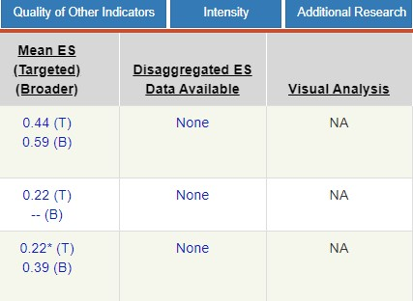
Looking for Evidence of Transfer
Source: NCII Academic Tools Chart.
Notes:
On the NCII Tools Chart, under the Study Results tab, you can look at the mean aggregated effect sizes for broader measures. Broader measures are those measures that are not directly aligned to the intervention instruction. These might include general reading measures, such as the Woodcock-Johnson Reading Composite, or a reading comprehension measure for fluency-focused intervention.
On the chart shown on the slide, the first intervention boasts a moderate-large average effect size on broader (transfer) measures of .39. However it’s not significant, and the little u superscript indicates that the means were not adjusted for the pretest. This means that there is no clear empirical evidence of transfer. If the intervention includes activities to promote self-regulation and goal setting, cumulative review, and varied contexts, I’d be inclined to rate this intervention’s promotion of transfer as a 2.
The second intervention has a large, significant average effect size on broader (transfer) measures of .59. Notice that the effect on broader measures is actually larger than the effect on the targeted measures.
For the third intervention, there are no broader (transfer) measures reported, so there is no empirical evidence of transfer.

Slide 56
Guided Practice: Looking for Evidence of Transfer
Source: NCII Academic Tools Chart.
Notes:
Let’s look at three interventions and see if we find evidence of transfer. I’ve selected three programs on the NCII Tools Chart and then clicked the “compare tools” button so that I can compare the interventions side by side.
Notice that the first intervention has a large significant effect on broader (transfer) measures, the second intervention has a moderate effect on transfer measures, and the third has essentially no effect. Let’s look closer to see if we can find evidence of promoting transfer, cumulative review, and varied contexts.
Let’s look closely at two of these interventions to see if they include promoting goal setting and self-regulation, cumulative review, and varied contexts.

Slide 57
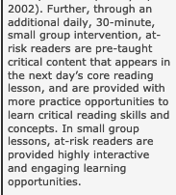
Look Closer at Each Intervention: Enhanced Core Reading Instruction
Look for evidence of self-regulation and goal-setting instruction.
Look at the intervention description and information about fidelity. Do you see anything about self-regulation or goal setting?
Look at the sample materials.
Look for evidence of cumulative review.
Look for evidence of varied contexts.
Source: https://charts.intensiveintervention.org/chart/academic-intervention-chart/13697.
Notes:
Demonstration:
Click on the hyperlink and navigate to the study description on the NCII website. Look at the descriptive and fidelity information. There is no mention of self-regulation and goal setting. Look at the sample materials. Notice that there is no mention of goal setting or self-regulation. However, this product was developed by researchers at University of Oregon—the same lab responsible for DIBELS. It’s likely that the researchers are envisioning that this intervention would be used within a context where some form of DIBELS progress monitoring and goal setting is already in place. However, this presumption is not clear from the product description. If I were thinking about this intervention, I would probably want to add this element prior to implementation. At the very least, I would want to learn more about this.
In the product description, we see evidence of cumulative review. Notice that the purpose of the small-group lesson is to preteach critical content for the next day’s core reading. The content of intervention is designed to reinforce core concepts by preteaching and then reviewing those same skills.
We see evidence of varied contexts because the purpose of the intervention is to provide varied practice opportunities—more chances to see and practice skills learned during core instruction.
Recall the effects reported for broader (transfer) measures: .44*.
This intervention would receive a rating of 2 if I can’t find any evidence of self-regulation instruction/goal setting and a rating of 3 if I can.

Slide 58
Look Closer at Each Intervention: Quick Reads
Look for evidence of self-regulation and goal setting instruction.
Look at the intervention description and information about fidelity. Do you see anything about self-regulation or goal setting?
Look at the sample materials.
Look for evidence of cumulative review.
Look for evidence of varied contexts.
Consider the empirical evidence of transfer: .21*
Source: https://charts.intensiveintervention.org/chart/academic-intervention-chart/13649.
Notes:
Guided practice: Help participants do the following:
Click on the hyperlink and navigate to the study description on the NCII website. Look at the descriptive and fidelity information. There is no mention of self-regulation and goal setting. Look at the sample materials. Help participants find the portion of the materials description that describes the self-motivated and self-monitored readers. Talk about how this promotes transfer.
In the product description, we see evidence of cumulative review. Notice how the texts are thematically arranged to promote schema building. Notice also how the lessons use a systematic format to help students develop the routine and review it across time.
Look at the product materials. Look at the descriptions of the texts. Texts are provided on a variety of high-interest, age-appropriate topics. So there is varied content, but all the texts are nonfiction and follow a prescribed format. Is the context varied enough? Allow participants to decide for themselves whether this represents enough of a varied context to promote transfer.
Recall the effects reported for broader (transfer) measures: .21*.
What rating would you give this? If necessary, return to the rating rubric slide. Participants might choose to rate this intervention as a 2 or a 3. Engage participants in a discussion about how either rating is appropriate.

Slide 59
Rating Attention to Transfer: Guided Practice
Navigate to the description of Read Naturally on the NCII Tools Chart.
Look for evidence of self-regulation and goal setting instruction.
Look at the intervention description and information about fidelity. Do you see anything about self-regulation or goal setting?
Look at the sample materials.
Look for evidence of cumulative review.
Look for evidence of varied contexts.
Consider the empirical evidence of transfer: -0.07
How would you rate this intervention for promoting transfer?
Source: https://www.readnaturally.com/.
Notes:
This slide is hidden but may be used for additional practice.
Guided practice: Encourage participants to talk through each step.
Encourage participants to look at the fidelity description. If necessary help them notice that many of the steps in the lessons are student directed. Student selects a story. Student identifies key words. Student practices until they can pass. The student takes a quiz. The teacher mainly acts as a monitor.
Encourage participants to think about whether this intervention includes cumulative review. Essentially, students are working on only one thing—fluency (although students do take comprehension quizzes). The lessons are the same each time, so there is some review. However, explicit links are lacking between previously mastered skills (i.e., vocabulary, decoding, phonics) and background knowledge.
Encourage participants to think about whether the program offers varied contexts. They may notice on the Read Naturally website that the program is available in a variety of formats (online, iPad, or paper). Is there enough information to determine the types of texts and whether this type of practice will transfer to other types of texts?
Encourage participants to talk about the mean effect size for broader (transfer) measures. Does this constitute empirical evidence of transfer? [No]
Encourage participants to decide on a rating and share it with the group based on their discussion. They may rate this intervention between 1 and 2. There is evidence of some self-regulation and goal setting. They also may decide that there is sufficient cumulative review and varied contexts. This intervention could not be rated as a 3 or a 0.

Slide 60
Intensifying to Promote Transfer
You can make adjustments.
Provide self-regulation and goal-setting instruction.
Give additional cumulative review.
Use the instructional routines with other content and in other contexts.
However, if you don’t see evidence of transfer, you can’t expect transfer to happen automatically!
Notes:
Like dosage and alignment, you can make adjustments to promote transfer. These are some things you might try. (Review slide.)
A note of caution: Students with and at risk for learning disabilities really struggle with generalization and transfer, even with all these strategies. Don’t think that you can simply add goal setting and expect students to apply the intervention strategies in another setting. Also, if you are providing a targeted intervention in fluency, don’t expect comprehension gains for a comprehension-only student. Finally, don’t think that the student will automatically apply what was learned in reading intervention to other academic areas.

Slide 61
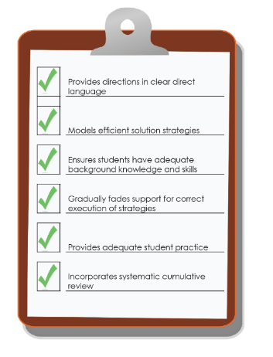
Comprehensiveness
Notes:
The next dimension is comprehensiveness. When we use the term “comprehensiveness,” we are asking you to think about the extent to which an intervention uses effective principles of explicit instruction.

Slide 62
Comprehensiveness = Explicit Instruction
Explicit Instruction has long been the gold standard when intervening with students with and at risk for learning disabilities (Ciullo, Lo, Wanzek, & Reed, 2016; Scammacca, Roberts, Vaughn, & Stuebing, 2015).
Explicit instruction is “a way of teaching where the teacher selects an important objective, models the skills being taught, and provides scaffolded practice to help a student achieve mastery” (Kearns, 2018, 0:37).
A comprehensive intervention is one that uses effective explicit instruction principles.
Learn more about explicit instruction on the NCII website.
Notes:
When we use the term comprehensiveness, we are asking you to think about the extent to which an intervention uses effective principles of explicit instruction.
Explicit instruction is distinct from more implicit, constructivist approaches. This is not to say that those approaches don’t have merit; rather, when working with students in need of intensive intervention (students with and at risk for significant academic deficits and learning disabilities), explicit instruction has been shown, time and time again, to be the most effective method of intervention. To learn more about the empirical evidence, you might wish to check out the two large metanalyses (cited on the slide) or check out the summary at https://intensiveintervention.org/sites/default/files/Explicit_Webinar_Cited_Articles.pdf.
To learn more about the basics of explicit instruction, a variety of resources are available on the NCII website. Facilitators may wish to direct participants to these resources depending on participant familiarity with explicit instruction principles.
Webinar: To Be Clear: What Every Educator Needs to Know About Explicit Instruction: https://intensiveintervention.org/resource/What-Every-Educator-Needs-to-Know-About-Explicit-Instruction
Course modules:
Intensive Intervention Course Content: Features of Explicit Instruction: https://intensiveintervention.org/intensive-intervention-features-explicit-instruction
Evaluating Use of Explicit Instruction to Support Students’ Academic Needs: https://intensiveintervention.org/explicit-instruction-evaluating
Modeling and Practicing to Help Students Reach Academic Goals: https://intensiveintervention.org/modeling-and-practicing-help-students-reach-academic-goals-explicit-instruction-course-module-5
Support Practices: Using Effective Methods to Elicit Frequent Responses: https://intensiveintervention.org/explicit-instruction-frequent-responses
RESET Explicit Instruction Rubric: https://intensiveintervention.org/resource/reset-explicit-instruction-rubrics

Slide 63
Explicit Instruction Principle 1
Provide directions in clear direct language.
Examine lessons: Do you see clear scripting that introduces directions and strategy steps that use clear, direct language?
Notes:
If the instructional materials provided with an intervention do not include clear, concise scripting when introducing new strategies and giving directions, then this explicit instruction principle is missing.
Some notes:
Scripts aren’t bad! Implementing DBI is hard. It requires a lot of mental energy to systematically select, monitor progress, and adjust interventions to the needs of individual students. Thinking of the most concise clear words to say in every lesson can take energy away from the real work of interventionists. Think of your favorite actors. The script is a jumping off point; truly great actors breathe new life into a script. Great teachers can do that too!
Scripts support all implementers! Often, because schools and districts have finite resources, the individuals charged with delivering intensive intervention sessions are paraprofessionals. These people often have varied job requirements that might include, for example, lunch and recess duty, toileting, and behavior management. Coming up with the most concise way to introduce a strategy shouldn’t be one of their jobs.
Using a scripted intervention platform allows for consistency/fidelity in implementation (it is not reliant on your presence).

Slide 64
Explicit Instruction Principle 2
Models efficient solution strategies.
Examine lessons and the curriculum scope and sequence:
What strategies are being taught?
Do you see clear steps for each strategy?
Notes:
We are talking here about the specific steps that students take to complete a skill. Teachers may use a variety of ”evidence-based strategies” in the classroom. That’s not what we are talking about here.
What you should look for:
Complex skills or strategies are broken down into logical steps or instructional units (explicit instruction rubric; Moylan, Johnson, Crawford, & Sheng, 2017).
Steps are clear, simple, and memorable.
What you will probably find:
Posters displaying the strategies
Acronyms such as mnemonics
Numbered steps
Reading examples:
Comprehension (e.g., main idea; PALS = Peer-Assisted Learning Strategies)
Name the most important who or what.
Tell the most important thing about the who or what.
Say the main idea.
Learning sight words (enhanced core)
Listen and look.
Say it.
Spell it.
Say it.
Note: Reading strategies are a little more difficult to identify than mathematics strategies. The taxonomy form and rubric were designed to be used across academic domains. You are likely to see fewer strategies in a reading intervention, and those strategies might be slightly less concrete. However, you should see some form of step-by-step instruction. The more clear and efficient the instruction is, the better. An intervention that provides exposure only to text, without step-by-step instruction, does not include modeling of efficient solution strategies.

Slide 65
Explicit Instruction Principle 3
Ensures students have adequate background knowledge and skills.
Does the curriculum review necessary background knowledge and skills?
Are additional supports provided where necessary?
Notes:
You may or may not find this. Some programs provide multiple levels; you are expected to choose the most appropriate level based on student abilities. Each level makes assumptions about a student’s prerequisite skills. However, the most comprehensive programs build this into the program.
To find the main idea of a paragraph, students need to master several skills. A truly (explicit) comprehensive program would provide support/instruction for the following:
Ability to fluently read the text
Ability to identify the subject of a sentence or groups of sentences
The ability to resolve pronoun-anaphora relationships
Ability to determine the relationships between ideas (distinguishing between supporting details and main ideas)
To make inferences, students need to do several things. Student use of the strategy can break down at any of these points. A comprehensive program provides evidence of support for the following:
Fluently read
Understand the vocabulary
Answer literal questions; identify factual information
Activate background knowledge
Connect literal information and background knowledge
To read multisyllabic words, a comprehensive program provides systematic instruction in prerequisite phonics, phonemic awareness, and decoding skills. Students need to be able to do, for example, the following:
Identify letters and sounds in isolation
Blend sounds to read single syllable words
Identify vowel and consonant digraphs

Slide 66
Explicit Instruction Principle 4
Gradually fades support for correct execution of strategies.
Look for guided practice.
Look for specific feedback routines.
Look for instructions on how to fade those feedback routines.
Notes:
A comprehensive program should provide clear directions and modeling for specific strategies. Then it should provide a clear mechanism for monitoring and providing feedback as students develop mastery of that strategy.
Look for instructions about what to say if students get the right answer.
Look for ”checks for understanding.”
Look for detailed instructions on correcting and remediating errors.
Look for how and when those routines should be faded. Eventually, students should master the skills. Are there clear explanations about what constitutes mastery? You might find a ”system of least prompts.” If students perform the strategy perfectly, you would be instructed to give only specific praise. If they struggle, your first step would be to remind them of the strategy step. If they continue to struggle, you might guide their use of that strategy step (perhaps with specific questions or prompts). If students can’t do it, even with this support, you might be instructed to provide direct modeling.
Look for a clear procedure from moving from teacher directed to student directed.

Slide 67
Explicit Instruction Principle 5
Provides adequate student practice.
How many practice opportunities are there?
What are the feedback procedures?
Notes:
You should have looked at this concept when you rated the dosage. Look at the number of times students get to attempt a strategy or skill on their own, such as the number of comprehension questions on a worksheet, the number of words read, or the number of paragraph main ideas created.
As with the last principle, the key to intensive intervention practice is direct, immediate feedback (as opposed to the whole-class environment). There should be procedures in place for how to monitor student independent practice and how to provide support as necessary.

Slide 68
Explicit Instruction Principle 6
Incorporates systematic cumulative review.
Do students continue to practice skills and strategies taught early in the program throughout?
Is there a systematic nature to the way that strategies are introduced?
Notes:
Students with and at risk for severe learning deficits require lots of practice. They may master a skill one day, or week, or month and then after a short break forget everything you taught them. It is really important that a multicomponent intervention include review. If you are using a series of single-component interventions, you might have to review previously taught strategies yourself.
If you are dealing with a multicomponent intervention, there should be a clear scope and sequence that details how and when strategies are to be introduced.

Slide 69
Video Example: Explicit Instruction Principles
Document the explicit instruction principles that you see in this video.
Handout
View video: https://www.youtube.com/watch?v=6wjU03hjOvs
Notes:
In this video, you will see examples of the explicit instruction principles. How many of the principles do you see when viewing this video? Use Handout 7 to jot down any instances that you notice.

Slide 70
Comprehensiveness Rating Scale
0 | 1 | 2 | 3
Fails to address standard | Addresses standard minimally | Addresses standard moderately | Addresses standard well
Does not incorporate any principles of explicit instruction. | Incorporates one or two principles of explicit instruction. | Incorporates three or four principles of explicit instruction. | Incorporates five to six principles of explicit instruction.
Principles of Explicit Instruction:
Provides directions in clear direct language.
Models efficient solution strategies.
Ensures students have adequate background knowledge and skills.
Gradually fades support for correct execution of strategies.
Provides adequate practice opportunities.
Incorporates systematic cumulative review.
Notes:
When you rate the comprehensiveness dimension, you should examine the lessons and materials to identify how many principles of explicit instruction are present. An intervention should be rated 0 if you can’t find any. An intervention that incorporates all or nearly all principles would be rated as a 3.

Slide 71
Example: Clear, Direct Language
Source: Third-Grade Nonfiction Reading Comprehension Program (Walsh et al., 2019).
Notes:
Does this intervention provide directions in clear, direct language?
Notice that the instruction is fully scripted. Tutor talk is bold. Instructions for the tutor are highlighted in grey. Other notes (e.g., answers) are not bolded.
The language of the lessons was iteratively developed in the research setting for clarity.

Slide 72
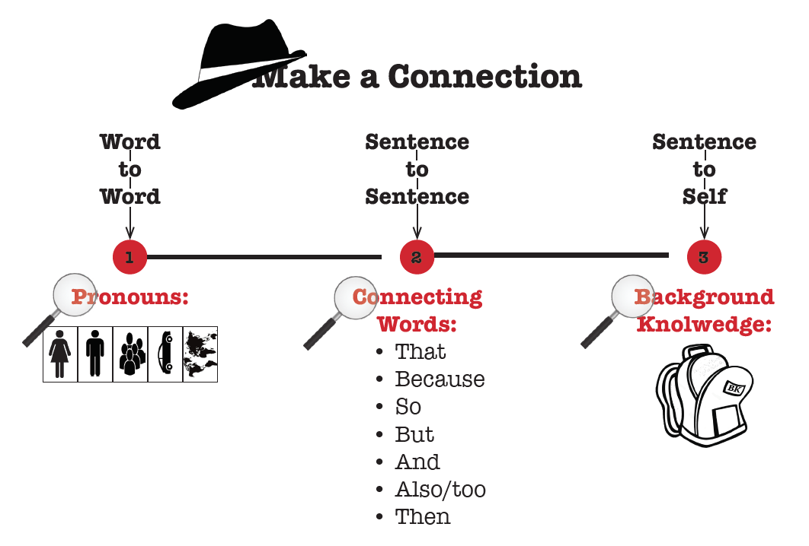
Example: Modeling Efficient Strategies
Source: Third-Grade Nonfiction Reading Comprehension Program (Walsh et al., 2019).
Notes:
This intervention includes several student strategies.
Each strategy has multiple steps, clear instructional procedures, and an accompanying poster.
The strategy shown here is the “Make a Connection” strategy. Students are taught to make three types of connections: word-to-word, sentence-to-sentence, and sentence-to-self.

Slide 73
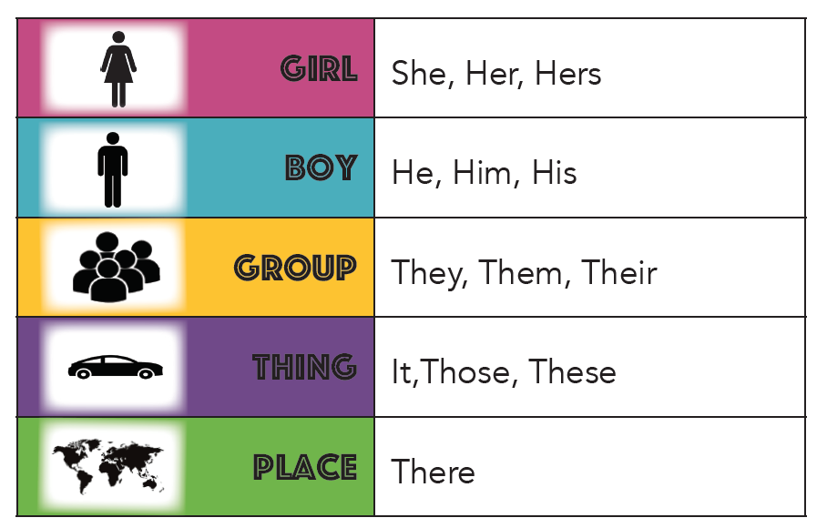
Example: Ensure Adequate Background Knowledge and Skills
Sources: Third-Grade Nonfiction Reading Comprehension Program (Walsh et al., 2019); https://pixabay.com/photos/apple-smartphone-desk-laptop-1282241/.
Notes:
Many struggling readers in third grade can’t identify pronouns. They have a harder time connecting the pronouns they find with their antecedent. The program provides a card with common pronouns for students to use. There also is a pronoun mini-lesson to help students learn about and identify pronouns.
Because students have different amounts of background knowledge, a media library is provided with each text. The videos help supplement inadequate background knowledge and promote connection making.
The script instructs teachers to focus on the lower level connections (word-to-word) before attempting more complex sentence-to-self connections. Similarly, the script also instructs teachers to abbreviate or skip the word-to-word connections for students who do this automatically.

Slide 74
Example: Gradually Fades Support
Source: Third-Grade Nonfiction Reading Comprehension Program (Walsh et al., 2019).
Notes:
In earlier lessons, feedback is even more carefully scripted. In this example, students are expected to make word-to-word connections. Nevertheless, correct answers and support procedures are defined.
A table provides specific procedures for supporting students’ sentence-to-self connections. Sample student answers are provided. The nature of the error is explained (paraphrase error versus elaboration error), and specific feedback is scripted.
In this program, the script specifically instructs teachers to provide feedback in early lessons. In the middle of the program, peers provide support. At the end of the program, teachers are instructed to provide as little support as possible.

Slide 75
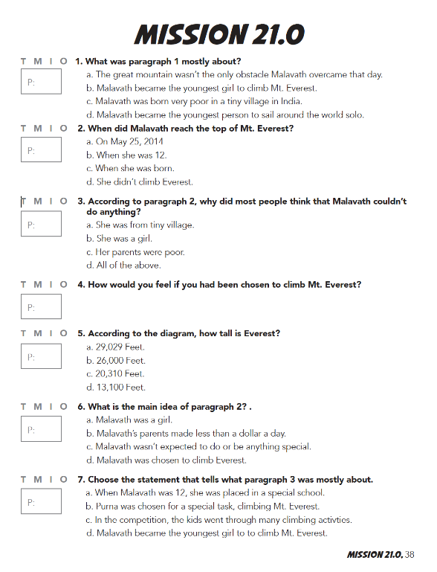
Example: Provides Adequate Practice
Students read texts daily (texts are between three and six paragraphs in length) for approximately 45 sessions.
Students practice prereading strategies (text features, vocabulary, activating background knowledge) for each text.
Students make a connection and identify a main idea for each paragraph.
Students identify the theme and answer a variety of questions for each text.
Source: Third-Grade Nonfiction Reading Comprehension Program (Walsh et al., 2019).
Notes:
Is this adequate practice? [Yes]

Slide 76
Example: Incorporates Review
Source: Third-Grade Nonfiction Reading Comprehension Program (Walsh et al., 2019).
Notes:
In this example curriculum, students are taught a series of seven strategies. Strategies are taught one at a time, and then each strategy is practiced for the remainder of the program on a daily basis. The connections between each strategy are reinforced throughout the program.

Slide 77
Rating the Example Curriculum
0 | 1 | 2 | 3
Fails to address standard | Addresses standard minimally | Addresses standard moderately | Addresses standard well
Does not incorporate any principles of explicit instruction. | Incorporates one or two principles of explicit instruction. | Incorporates three or four principles of explicit instruction. | Incorporates five or six principles of explicit instruction.
Principles of Explicit Instruction
Provides directions in clear direct language.
Models efficient solution strategies.
Ensures students have adequate background knowledge and skills.
Gradually fades support for correct execution of strategies.
Provides adequate practice opportunities.
Incorporates systematic cumulative review.
Notes:
This example curriculum incorporates all the principles of explicit instruction; it would receive a score of 3 for comprehensiveness.

Slide 78
Taxonomy Dimension 6: Behavioral Support
Notes:
The sixth dimension we will discuss is behavioral support.

Slide 79
Rating Behavioral Support
Behavioral support refers to the extent to which interventions incorporate
methods to promote self-regulation and executive function and
behavioral principles to minimize nonproductive behavior.
Notes:
The extent to which behavioral support is provided is the next dimension of the taxonomy. Behavioral support includes methods to promote self regulation and executive functioning:
Encourage students with a history of academic failure to persevere with challenging academic content.
Support students in developing a mindset that involves perseverance, hard work, and high standards.
The program also should incorporate behavioral principles that minimize noncompliant or disruptive behavior. Teachers should examine the intervention protocol and determine the extent to which the intervention includes these kinds of support.
Behavior and academics go hand in hand. The most intense academic interventions incorporate behavioral support. The most intense behavioral interventions incorporate academic support. Why? Because students experiencing academic challenges and failure often exhibit inappropriate or nonproductive behavior. Students experiencing behavior or emotional challenges often struggle academically. It is common to work with students who have comorbid learning and behavior disabilities. The most intensive programs address both academics and behavior!

Slide 80
Behavior Support Rating Scale
0 | 1 | 2 | 3
Fails to address standard | Addresses standard minimally | Addresses standard moderately | Addresses standard well
Does not incorporate behavioral supports. | Incorporates one of the following behavioral supports: Strategies to develop perseverance with challenging academic content Methods to promote attention, engagement, and other aspects of executive function Behavioral principles that minimize noncompliant or disruptive behavior | Incorporates two of the following behavioral supports: Strategies to develop perseverance with challenging academic content Methods to promote attention, engagement, and other aspects of executive function Behavioral principles that minimize noncompliant or disruptive behavior | Incorporates all of the following behavioral supports: Strategies to develop perseverance with challenging academic content Methods to promote attention, engagement, and other aspects of executive function Behavioral principles that minimize noncompliant or disruptive behavior
Notes:
Review scale.

Slide 81
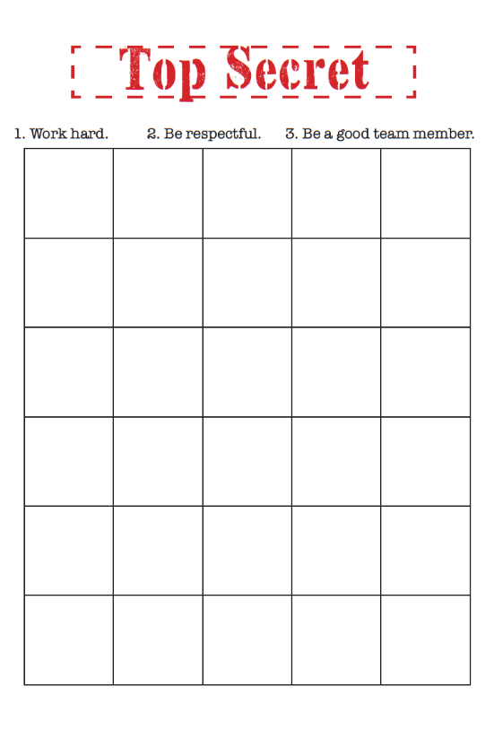
Strategies to Develop Perseverance
Appropriate level of challenge
Behavior contracts
Points/rewards based on effort
Use of a timer to develop stamina
Goal setting
Image Source: Reading PI: Nonfiction Comprehension Intervention, Grade 3. Fuchs ,Walsh, Patton, & Fuchs, 2019 ©The Fuchs Research Group.
Notes:
Students who are experiencing academic challenges must learn to persist despite difficulty and failure. For most students in need of intensive intervention, they have already experienced years of failure. Many of these students will have developed “learned helplessness” and task avoidance (for good reason).
An intensive intervention platform should build in some of these strategies. In addition to the scaffolded support provided in the intervention, students should be able to accomplish the instructional objectives. If the instructional objectives and tasks are the right amount of challenge, students are able to experience success and build both motivation and persistence.
You, or the teachers you work with, may already have these strategies in place in your classroom. If you already have strong strategies in place, the behavioral support provided in the intervention platform might be less important.

Slide 82
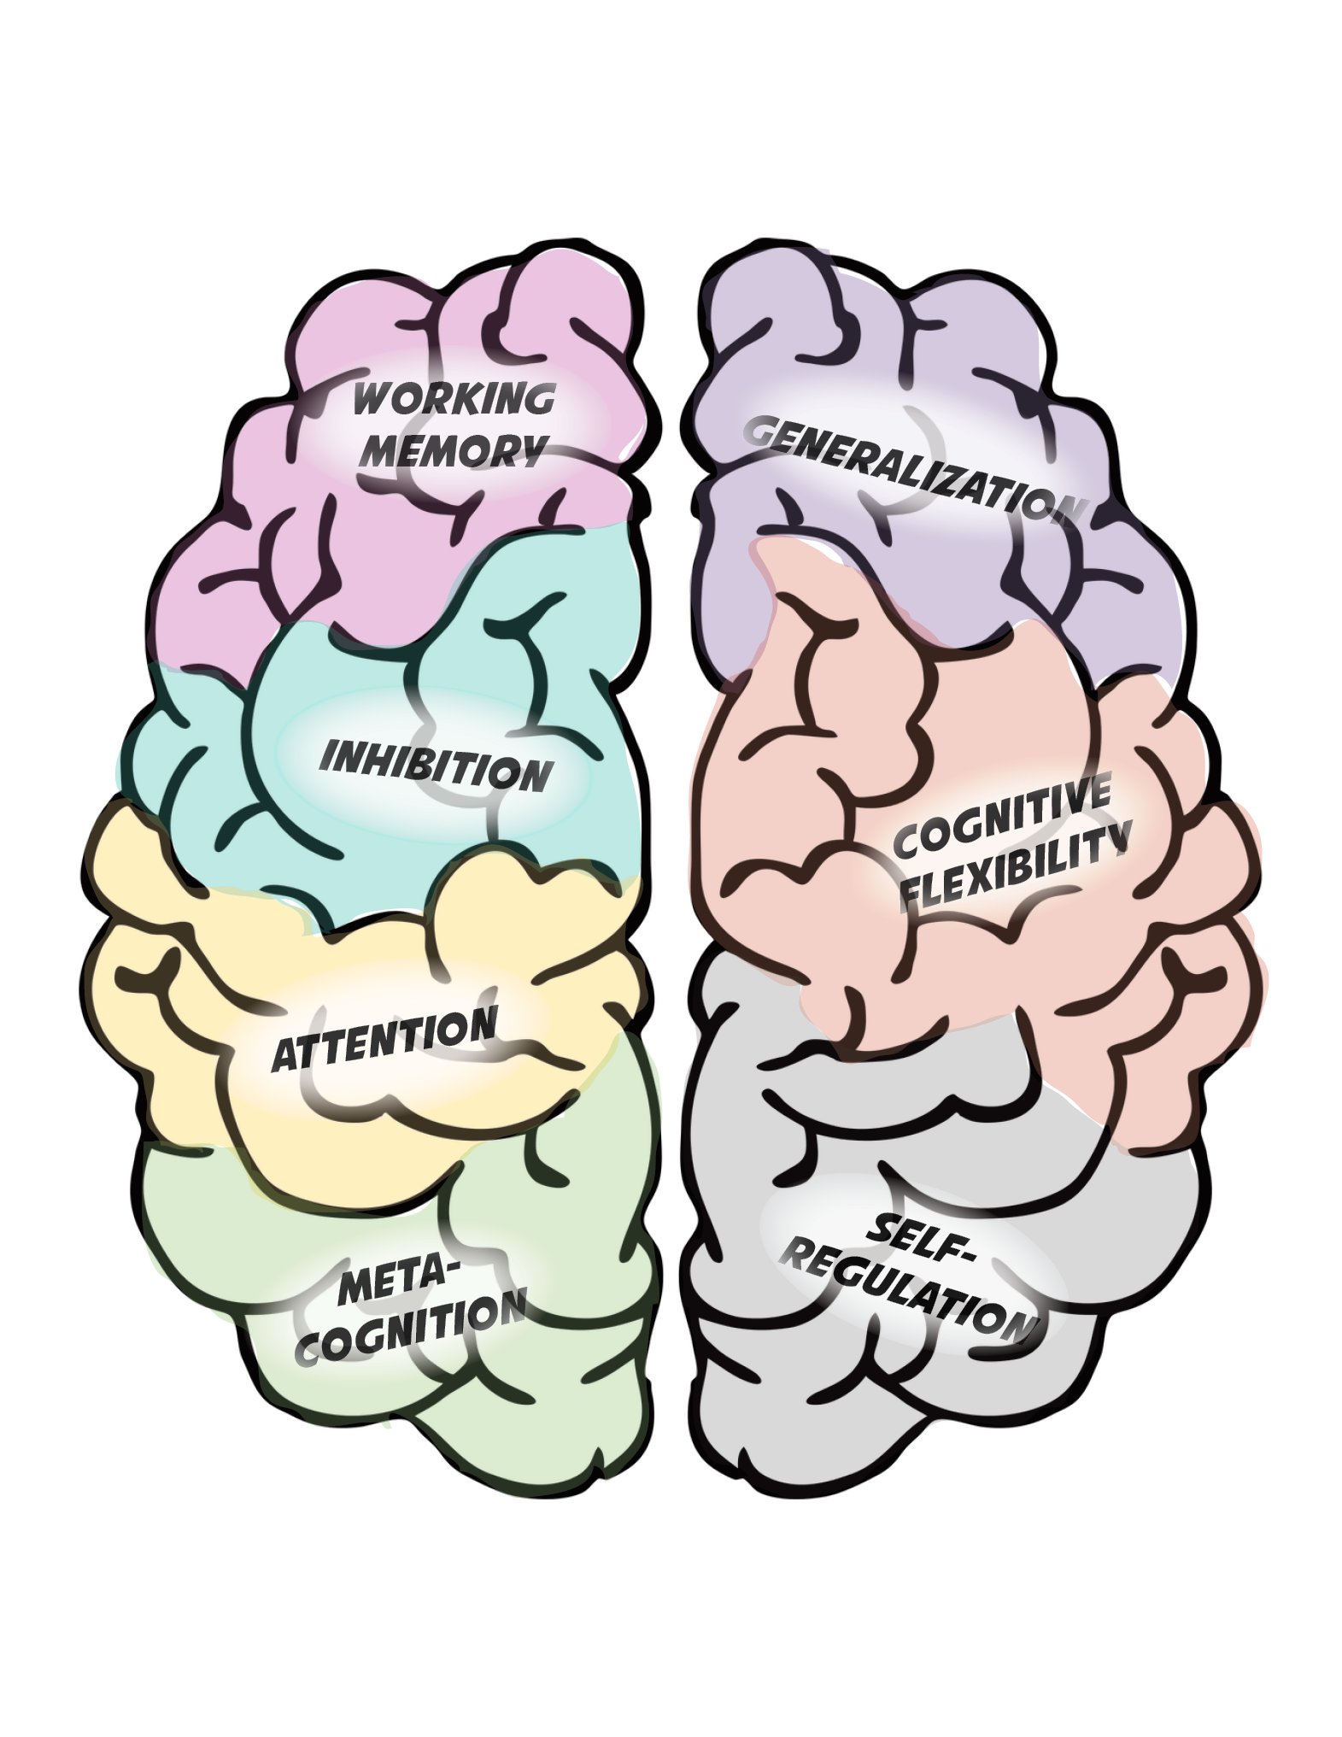
Executive Function
Executive function is a broad construct referring to the top-down mental processes required for concentration, reasoning, problem solving, and planning.¹
Executive function predicts academic performance above and beyond IQ and entry-level reading and mathematical ability.²
Students with or at risk for learning disabilities frequently demonstrate concomitant deficits in executive function.³
¹Definition based on Diamond (2012). ²See, for example, Blair and Razza (2007); Borella, Caretti, and Pelegrina (2010); Duncan et al. (2007); Gathercole, Pickering, Ambridge, and Wearing (2004). ³See, for example, Swanson and O’Connor (2009); and Swanson and Howell (2001).
Image created by Meagan Walsh for instructional purposes. No rights reserved. Free for use.
Notes:
In the last 20 years or so, the educational field has begun to recognize the extreme importance of executive function. When we talk about executive function, we mean the way that the brain directs or manages everything we do, including but not limited to the following main processes:
Working memory: The brain’s ability to store information while processing new information (e.g., decoding words while remembering all the previously read words when trying to comprehend a sentence, paragraph, or text.
Inhibition: The brain’s ability to block out irrelevant stimuli (the ability to block out things in the environment and irrelevant details when reading).
Attention: The ability to focus on and attend to a task.
Metacognition: The ability to identify one’s own mental processes (e.g., explaining your thinking and monitoring your strategy use).
Generalization: The ability to apply something you learn in one context to a novel context.
Cognitive flexibility, also known as creativity.
Self-regulation: The ability to plan and execute strategies and evaluate one’s performance on those strategies.
Executive function is closely linked to all areas of academic performance. Students with and at risk for learning disabilities may demonstrate deficits in one or many of the processes involved with executive function.

Slide 83
Methods to Promote Executive Function
Self-monitoring/self-evaluation instruction
“Think alouds” and strategy instruction to support metacognition
Checklists
Point systems
Transfer instruction
Games, media, and engaging materials
Image created by Meagan Walsh for instructional purposes. No rights reserved. Free for use.
Notes:
You might find a variety of strategies to promote executive function. The strategies listed on this slide are just a few in a rapidly developing research area.

Slide 84
Behavioral Principles That Minimize Nonproductive Behavior
Clear rules/expectations
Behavior contracts
Reinforcement systems
Checklists
Timers
Time management strategies
Notes:
Here are just a few of the strategies that can minimize nonproductive behavior.
Setting clear expectations for behavior is important. You might have such expectations or rules in place, but it’s important to review these procedures regularly within an intervention setting, especially when working with students with challenging behaviors.
These clear expectations can be supported by having students sign behavior contacts.
Reinforcement systems can help promote positive behavior, boost engagement, and minimize negative behaviors.
Checklists can help students know what to expect.
Timers and strong time management procedures can ensure that a few pauses in the execution of the lessons are okay so that students stay on task and focused throughout.
You may have strong behavior management systems in place, or you may be working with a student with a very specific behavior plan in place. You should continue to use the system that works for you or that student. An intervention that sufficiently supports behavior is one that provides the raw material for good behavior—even if it’s the canvas on which to place your existing system.
You can’t expect students to benefit from an academic intervention if their behavior prevents them from participating fully. It is essential to consider behavior when selecting and adjusting intervention platforms.
The NCII website has many resources for behavior management:
More information on finding behavior strategies to support intensifying interventions: https://intensiveintervention.org/intervention-resources/behavior-strategies-support-intensifying-interventions
Videos explaining why it is important to consider behavior and academics at the same time:
https://intensiveintervention.org/resource/why-it-important-consider-interaction-between-behavior-and-academics-when-providing
https://intensiveintervention.org/resource/bringing-it-together-why-it-important-integrate-academics-and-behavior-when-thinking-about
The Behavior Tools Chart: https://charts.intensiveintervention.org/chart/behavioral-intervention-chart

Slide 85
Demonstration: Third-Grade Comprehension Intervention: Behavioral Support
Developing perseverance
Behavior contract
Point system
Gradual increase in difficulty
Scaffolded support
Promoting executive function
Checklists to promote self-regulation
Transfer activities
Activities to promote engagement (e.g., games)
Main idea recall (to support working memory)
Minimizing nonproductive behavior
Clear rules/expectations
Reinforcement system
Time management strategies
Notes:
Let’s think about the behavioral support embedded in the third-grade intervention we’ve discussed a few times:
Look at the strategies used to develop perseverance. Do they seem adequate to you? Can you think of others?
Now think about the strategies used to promote executive function. Do these seem adequate to you?
Now look at the strategies to minimize nonproductive behavior. Do these seem adequate to you?
We could probably all think of additional strategies in each of these areas. However, for the purpose of rating this dimension, we are just looking to see whether strategies support each area. [Yes] So this intervention would receive a score of 3.

Slide 86
Learn More About Behavioral Supports
Source: https://intensiveintervention.org/intensive-intervention-behavior-course.
Notes:
NCII has released a set of course content focused on behavior support for intensive intervention. This resource includes an extensive amount of content to support educators in understanding how to support students in the classroom to maximize instruction. The course has eight modules that cover behavioral theory, strategies for supporting students’ behavioral needs, monitoring student progress and making decisions, and intensifying behavioral supports. The course content can be found on the NCII website at https://intensiveintervention.org/intensive-intervention-behavior-course.

Slide 87
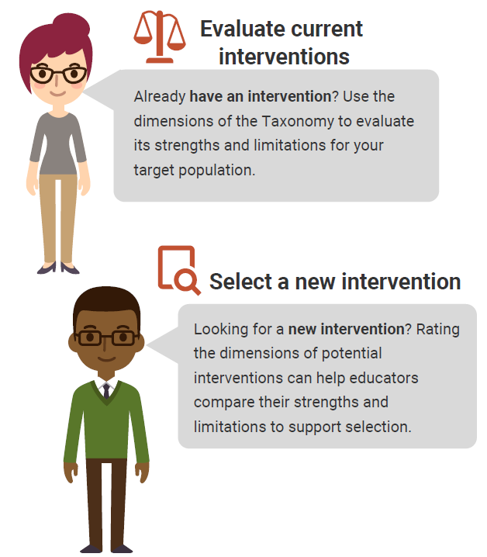
Using the Taxonomy to Find the Best Intervention
There are no perfect interventions.
BUT
Using the Taxonomy of Intervention Intensity can help you understand the strengths and weaknesses of your current intervention and support your selection of a new intervention.
Notes:
There is no perfect intervention that will work for every student. Educators can use the dimensions of the taxonomy to learn about the strengths and weaknesses of their current intervention and guide the selection process for new interventions.
Rating an intervention across the dimensions can help us quantify our assessments of the intervention’s strengths and weaknesses and document places where we may need to supplement the intervention. In addition, it can help us compare interventions that we might be using or selecting to identify one that might be a better fit for a student.

Slide 88
Rating the Validated Intervention Program
Ratings provide estimates for the strength and weaknesses of the intervention on a 0–3 scale.
Some dimensions will be easier to rate than others.
There is no hard and fast rule for ratings.
Ratings can help guide intensification.
0 | 1 | 2 | 3
Fails to address standard | Addresses standard minimally | Addresses standard moderately | Addresses standard well
Notes:
There is no perfect intervention that will work for every student. The six dimensions of the taxonomy that we just discussed provide a foundation for how we want to think about the features of our interventions. By rating each dimension using a simple 0–3 scale, we can document the strengths and weaknesses of those interventions. As we discussed, there is no exact science for this rating scale, and some dimensions are easier to rate than others. Getting a clear picture of the intervention can really help us see where we may need to intensify or adjust the intervention in the future if a student or a group of students does not respond.

Slide 89
Assessing the Quality of a Validated Intervention Platform
In groups of two or three, select one reading intervention from the list brainstormed earlier.
Review the handout definitions for each dimension and the rating rubric.
Rate the intervention as designed for each dimension (0–3).
Record your responses in the third column.
Handout
Notes:
In this activity, consider one of the academic interventions you brainstormed earlier and as a small group and do a brief rating of the intervention. If possible, use the NCII website to identify the strength (you also might visit the What Works Clearinghouse or the Best Evidence Encyclopedia) and your knowledge of the intervention to judge dosage, alignment, attention to transfer, comprehensiveness, and behavioral support. Because alignment is dependent on the skill needs of a specific student, instead consider the overarching areas that the intervention focuses on and the needs of students in your school or who you regularly work with.
Handout 8 in your workbook provides a place for you to note your rating and includes a brief review of what to consider for each dimension.
Provide groups 5–10 minutes to complete. If time permits, groups can review a second intervention.
Have teams share out any takeaways from the activity. Were some areas easier to rate than others?

Slide 90
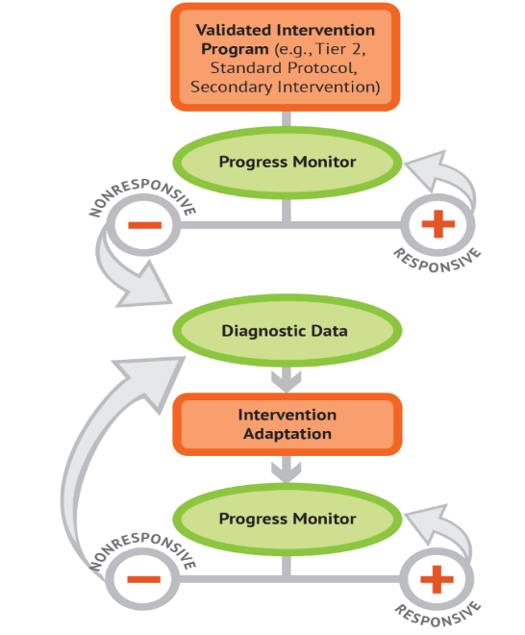
Individualization
A validated, data-based process for individualizing intervention, in which the special educator or interventionist systematically adjusts the intervention across time, in response to ongoing progress monitoring data, to address a student’s complex learning needs.
Notes:
This dimension is not assessed when selecting an intervention program.
Most interventions do not include a validated progress monitoring system.
Some may include a form of progress monitoring, but it might not be appropriate for making educational decisions because it has not been validated.
A validated progress monitoring tool is empirically sound and has been shown to be sufficiently sensitive to growth in the target area.
After an intervention has been selected, you will need to access the progress monitoring tools chart: https://charts.intensiveintervention.org/chart/progress-monitoring?field_apm_subject%5B%5D=359.

Slide 91
A Note About Fidelity
Selecting an intervention that gets high ratings on the dimensions of the taxonomy provides a good starting place, but it is only as intense as its implementation.
Fidelity is important because it
ensures that instruction has been implemented as intended,
allows us to link student outcomes to instruction, and
helps in the determination of effectiveness and instructional decision making.
Notes:
Review slide.
When a doctor prescribes an antibiotic, the doctor expects you to take it as directed (frequency and duration). Doctors know that if you don’t take the medicine as intended, the infection could return. Missed or skipped doses can lead to antibiotic resistance.
Poor fidelity—not giving students the dose you set out to give the student—will undermine the systematic nature of the DBI process. You will not be able to determine accurately if the intervention needs to be adapted because the student will not have received the intervention. Also, a lot of time is wasted.
The NCII website provides a fidelity tool for assessing student-level implementation of DBI: https://intensiveintervention.org/sites/default/files/DBI_Weekly_Log_508.pdf.

Slide 92
Turn and Talk
To what extent do these situations appear in your school or district?
Instructional disruptions (testing, special events, intervention session cut short)
Larger than designed group size
Fewer sessions than intended
Lack of engagement
Others
Notes:
Provide groups 3–5 minutes to discuss and then share out.

Slide 93
Five Elements of Fidelity
Student Engagement: How engaged and involved are the students in this intervention or activity?
Adherence: How well do we stick to the plan, curriculum, or assessment?
Program Specificity: How well is the intervention defined and different from other interventions?
Exposure/Duration: How often does a student receive an intervention? How long does an intervention last?
Quality of Delivery: How well is the intervention, assessment, or instruction delivered? Do you use good teaching practices?
Sources: Dane and Schneider (1998); Gresham, Gansle, Noell, Cohen, and Rosenblum (1993); O’Donnell (2008).
Notes:
This graphic provides one example of a way to think about fidelity and includes the elements of adherence, exposure, quality of delivery, program specificity, and student engagement.
Schools should have procedures in place to monitor the fidelity of their implementation of interventions. Although these procedures do not need to be formal, it is important to consider whether schools are implementing programs the way that they are intended to be delivered. In the midst of all the responsibilities of educators, small checks can make a big difference in keeping services for students on track.
Note: The notes on each element on fidelity are animated to pop up with each click. Click ahead each time you discuss a new element of fidelity and click again to close that element.
(Click) When we discuss adherence, we are focused on how well we stick to the plan/curriculum/assessment (i.e., implementing the plan/curriculum/assessment as it was intended to be implemented based on research). For a secondary intervention, adherence may mean how well teachers implement all pieces of an intervention, in the way they were intended to be implemented. This doesn’t necessarily mean that teachers should follow a script word for word, but covering certain content with appropriate pacing and relevant language and techniques are important. (Click)
2. (Click) Duration/exposure refers to how often a student receives an intervention and how long an intervention lasts. When thinking about fidelity, we are considering whether the exposure/duration being used with a student matches the recommendation by the author/publisher of the curriculum. In the case of secondary interventions, developers and researchers typically specify the required exposure/duration that is needed for the intervention to be effective for most students. If the intervention developer calls for 3 days per week for 45 minutes each day, is the student receiving this intervention dosage? (Click)
3. (Click) It is important to not only adhere to the plan/curriculum/assessment but also look at the quality of delivery—how well the intervention, assessment, or instruction is delivered. For example, do you use good teaching practices? Quality instructional delivery also means that teachers are engaged in what they are teaching and animated in their delivery, not simply reading from a script. Providing teachers with constructive feedback on their instructional delivery is one way to improve the quality of delivery for secondary interventions. (Click)
4. (Click) Another component is program specificity, or how well the intervention is defined and how different it is from other interventions. Clearly defined interventions and assessments allow teachers to more easily adhere to the program as defined. Is the intervention a good match for a student’s needs? Or does every low reader get the same intervention? (Click)
5. (Click) Just as quality of delivery is critical, it also is important to focus on student engagement, or how engaged and involved the students are in the intervention or activity. Following a prescribed program alone often is not enough. Consider whether competing behaviors make it difficult for students to take part in the intervention as designed. During the delivery of secondary interventions, teachers may need to use behavior management strategies to manage student behaviors, including providing choice, adding elements of competition, and offering frequent opportunities to respond. (Click)
Note: Throughout discussions of fidelity, it is important to ensure that teachers believe that they work in an open, nonthreatening environment that values their skills and expertise and where they can learn from their colleagues. With a system of open communication and productive feedback, fidelity checks of classroom techniques and the essential components of multitiered systems of support can be a useful and supportive way for teachers to collaborate and become a stronger teaching network. This may be a useful discussion point for some groups.

Slide 94
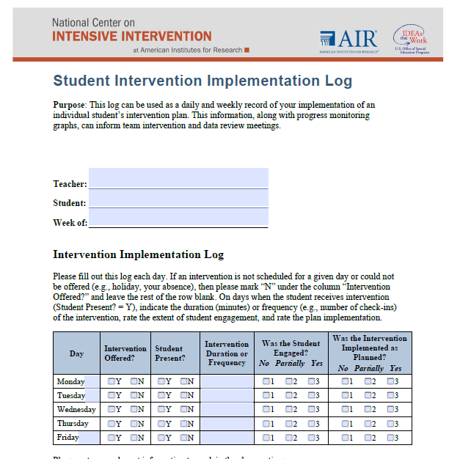
A Tool to Measure Fidelity
Source: https://intensiveintervention.org/sites/default/files/DBI_Weekly_Log_508.pdf.
Notes:
Although some interventions may provide a fidelity monitoring tool, if your intervention does not provide this resource, NCII has developed a quick log that can be used by individual teachers to monitor fidelity to the intervention. This log includes a place for teachers to mark whether the intervention was offered, if the student was present, the amount of time the intervention was provided for, whether the student was engaged, and whether it was implemented as planned.
Many factors may impact the ability to deliver an intervention with fidelity.
You may have a fire drill, a snow day, or other event that impacts the delivery of the session.
A behavioral issue from the student or a fellow student in the intervention may distract from instructional delivery time.
You may be absent and the substitute may not have the same knowledge level.
Although some factors are outside your control, it is important to document these when making decisions about a student’s response to the intervention.

Slide 95
What Does This Look Like in Practice? A Reading Example
Notes:
Now that we have considered and practiced how to rate a validated intervention program, let’s look at an example.

Slide 96
Using the Taxonomy to Intensify and Individualize an Intervention for Kelsey
Background: Kelsey presented serious reading problems at the beginning of second grade. Classroom assessments and diagnostic assessments identified three deficit areas: phonological awareness, word study, and reading fluency.
Intervention program: Kelsey’s teacher selected a research-validated program that addressed phonological awareness, word study, and fluency skills.
Notes:
Read slide.

Slide 97
Begin With a Validated Intervention!
Intervention Dimensions | Rating (0–3) | Evidence
Strength | 2 | ES = Between 0.35 and 0.49
Dosage | 2 | Group size: six students Session length: 20 minutes per session Frequency: five sessions per week
Alignment | 3 | Explicit instruction covering skills deficit areas, PA, word study, and fluency
Attention to transfer | 2 | Builds on previously learned skills; not clearly connected to Tier 1 content
Comprehensiveness | 2 | Includes three explicit instruction principles
Behavioral support | 1 | None found but doesn’t appear to be needed for student
Notes:
Kelsey’s teacher started by reviewing and rating her intervention. In the evidence column of the table, she noted what she used to make her decisions. (Click for animation). In the rating column, you can see the rating she provided for each dimension.
She gave a 2 for strength because the intervention showed moderate effects (between 0.35 and 0.49); a 2 for dosage because it was a daily intervention for 20 minutes with a moderate-sized group, allowing for multiple opportunities for peer practice and teacher feedback; a 3 for alignment as it clearly focused on three areas that Kelsey was struggling with; a 2 for attention to transfer as it builds on her previously learned skills but doesn’t clearly connect to her core instruction; a 2 for comprehensiveness as it includes three explicit instruction principles; and a 1 for behavior, although she isn’t concerned about this as Kelsey is currently not presenting with any major behavioral issues.

Slide 98
DBI requires ongoing progress monitoring to determine responsiveness.
Notes:
While implementing the intervention, the teacher collects progress monitoring data for Kelsey and the other students in the intervention.

Slide 99
Progress Monitoring Plan
Tool: Passage Reading Fluency (PRF)—second grade
Frequency: Weekly
Review Date: Four to six weeks
Baseline: 23 WRC
Target Goal (Spring Benchmark): 90 WRC
Notes:
Specifically, Kelsey’s teacher created the following plan for her progress monitoring. She is using the second-grade passage reading fluency measure, she collects data weekly, the team has determined that they will reconvene to review progress after 4–6 weeks.
Kelsey’s baseline was 23 words correct per minute and her target goal using the spring benchmark is 90 words correct per minute.

Slide 100
Progress Monitoring Graph
Spring Benchmark:
90 WRC
Notes:
This slide has animations.
On Kelsey’s graph, the teacher documents her baseline (23 words correct per minute) and her goal (click for animation) at 90 words correct per minute. She then (click for animation) draws a line between the two which will represent Kelsey’s progress.

Slide 101
Individual teacher or teams of teachers assess student’s responsiveness.
Notes:
After the 4–6 weeks of intervention implementation and data collection, Kelsey’s teacher meets with the team to determine how Kelsey is doing.

Slide 102
Progress Monitoring: Does Kelsey need DBI?
Intervention Phase Line
Notes:
Kelsey’s teacher has drawn a phase line to distinguish when the validated intervention (without adaptations) began. This allows the team to assess the impact of that “phase” of the intervention. Look at the data points following the intervention phase line. Did Kelsey respond to the intervention? Does she need DBI?
Using two common progress monitoring decision rules, we can confidently say that Kelsey is NOT responding to the validated platform. First, she has four consecutive data points below the goal line. In addition, the trend line, shown as dashed lines, indicates that she is not likely to meet her goal.

Slide 103
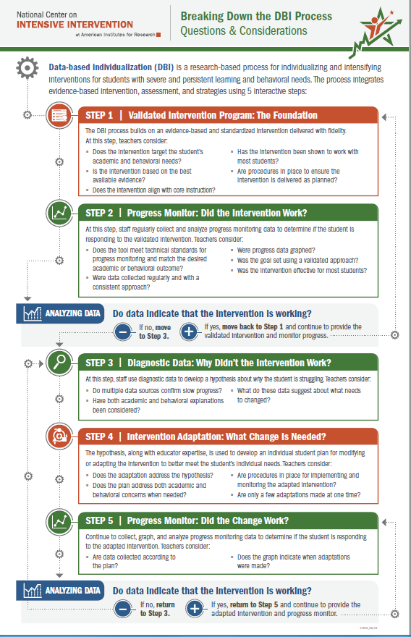
Decision-Making Considerations
To what extent was the intervention expected to impact student growth?
Is there sufficient evidence that the intervention was delivered with fidelity to Kelsey?
Are most students in the group responding?
What is the Kelsey’s level of engagement?
Others?
Notes:
In addition to just reviewing the data on Kelsey’s progress monitoring graph, the team also considered the following: (read slide)

Slide 104
Delivered with fidelity?
Strong ratings for engagement
Duration ~ 20 minutes per session
Notes:
Here are the fidelity data collected during the intervention. When determining fidelity, the team or teacher determines the extent to which the students participated in the intervention. Review the fidelity data. What trends do you see? (click for animation of duration box, click again for animation of strong ratings of engagement)
Provide participants about one minute to review the data and share what they see with their neighbor. Overall, the data suggest that the student is participating in the intervention and the teacher believes the intervention was delivered as designed. Note that the average duration is about 20 minutes.

Slide 105
Diagnostic Data: What changes are needed to support Kelsey?
Notes:
Having reviewed the fidelity data and considered the other questions, the team decides that Kelsey is not responding to the intervention, but most of her peers are and they didn’t see any major issues with fidelity. Before making an adaptation to the intervention, they collected informal diagnostic data to help them to understand why Kelsey might not be responding and to guide their hypothesis.

Slide 106
Using Diagnostic Data to Develop Hypothesis to Intensify
Teacher reviews Kelsey’s classroom assessment data and conducts observations of her learning behavior. Behavior observations suggest that Kelsey struggles to master skills as quickly as her same-age peers and needs more practice than her peers.
Hypothesis: If Kelsey is provided additional opportunities of direct instruction, feedback, and practice on target skills, she would move to mastery of these skills more quickly.
Notes:
Review slide.
When describing the hypothesis click for animation. You will notice that the darker box is around dosage as we are primarily focused on adding more opportunities to respond, but that there are also call outs for alignment and comprehensiveness as we will focus our practice opportunities on the student’s skill gaps and use explicit instruction principles.

Slide 107
Intervention Adaptation: Use diagnostic data to adapt the intervention.
Notes:
Once Kelsey’s teacher has identified Kelsey’s needs through diagnostic assessment, she will adapt the intervention based on the hypothesis.

Slide 108
Rating Table
Intervention Dimensions | Rate | Evidence | Adaptation 1
Strength | 2 | ES = Between 0.35 to 0.49
Dosage | 2 | Group size: six students Session length: 20 minutes per session Frequency: five sessions per week | Provide 40 minutes each session in smaller group (3)
Alignment | 3 | Explicit instruction covering skills deficit areas, PA, word study and fluency
Attention to transfer | 2 | Builds on previously learned skills; not clearly connected to Tier 1 content
Comprehensiveness | 2 | Includes three explicit instruction principles
Behavioral support | 1 | None found but doesn’t appear needed for student
Notes:
The team makes the following changes. (Click for animation) The team will increase the length of the session to 40 minutes per day and will move Kelsey into a smaller group of three students who have similar needs. They believe this will enable Kelsey to have more interactions with the teacher.
Although there may be other changes that could help Kelsey, the team knows that it is important to make very few changes to the intervention so that she can assess the impact of the change.

Slide 109
Was the intervention adaptation delivered with fidelity?
Duration ~ 40 minutes per session
Notes:
The teacher implements the intervention with the new adaption, 40 minutes per session. She uses the DBI Daily Log to monitor the extent to which she implemented the adaptation with fidelity. How did she do? Any other concerns regarding fidelity of implementation? (Click to focus on intervention duration and frequency and click again to bring up the box suggesting the average duration was 40 minute)

Slide 110
Progress monitor and assess the impact of the adaptation.
Notes:
While the teacher collects daily fidelity data, she also continues to collect weekly progress monitoring data through implementation of the progress monitoring plan. Remember, the teacher is administering Passage Reading Fluency (PRF) each week.

Slide 111
Progress Monitoring: Is Kelsey responding to the intervention?
Intervention
Adaption 1 Phase Line
Notes:
Because the teacher made a change to the original intervention, she draws another phase line. This allows her to assess the impact of the intervention with the new adaptation in comparison to the intervention without the adaptation. How is Kelsey responding to the intervention with greater dosage? Is this sufficient progress?
In this case, Kelsey is making progress as indicated by the upward trend line (red dashed). However, the progress is not sufficient to help her reach her goal of 90 words read correctly. The team must reconvene to review additional diagnostic data and identify intensification strategies that will help Kelsey reach her goal.

Slide 112
DBI is an ongoing process based on student responsiveness to the intervention.
Notes:
(Click for animation) Review slide.

Slide 113
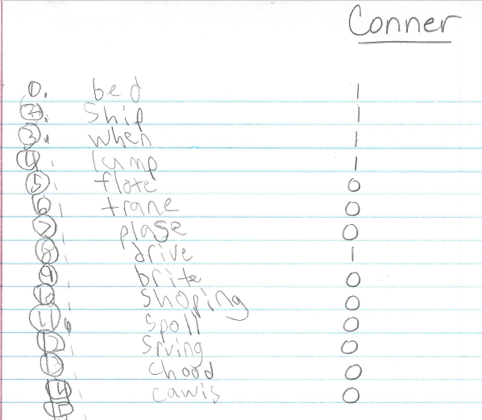
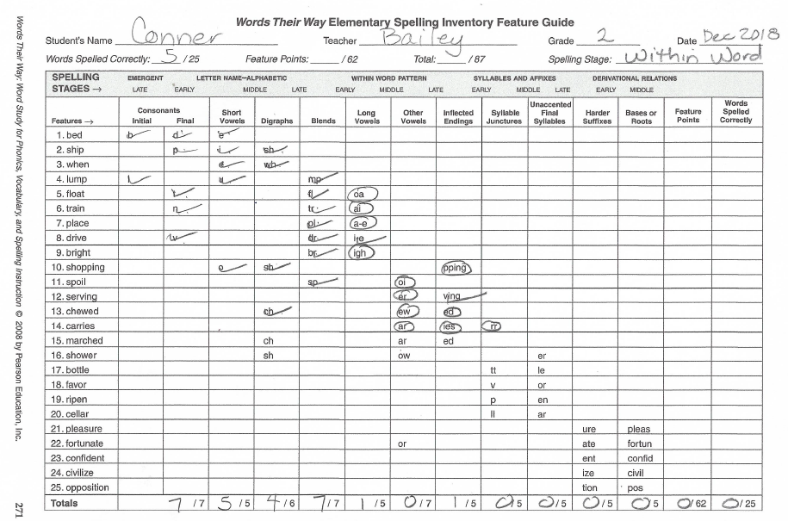
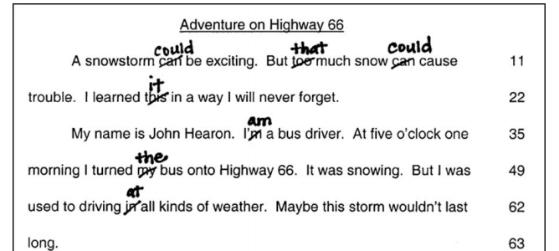
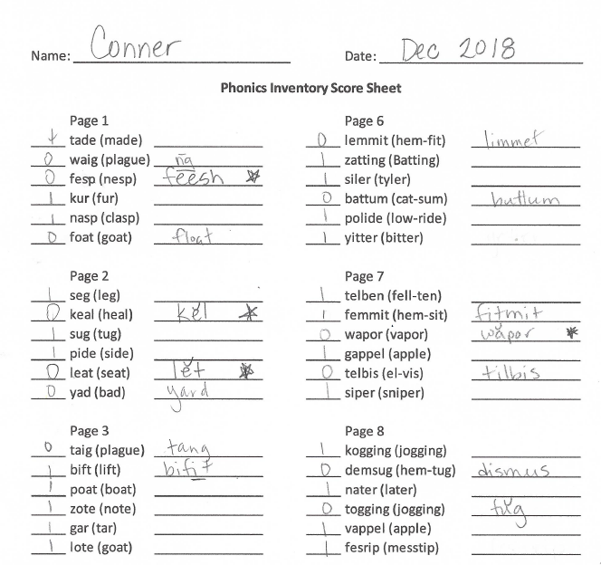
Informal Diagnostic Tools for Literacy
Consider a wide range of data sources to gather information about what literacy skill a student is struggling with.
Kelsey
Kelsey
Kelsey
Notes:
The teacher conducts some additional diagnostic assessments for Kelsey to understand the specific skill areas she is struggling with. (Click to bring up the different assessments)

Slide 114
What do you recommend?
Diagnostic data indicated Kelsey had difficulty applying decoding strategies to words with short and long vowels, especially “i” and “e.”
Observations also suggest that she needs the following instructional principles to benefit from decoding instruction:
Concrete, repeated opportunities to correctly practice the skill and receive feedback
Precise, simple language to introduce the lesson
Frequent checks for retention with reteaching as needed
Notes:
From the diagnostic data, the team finds that Kelsey is having success with phonological awareness but had difficulty applying decoding strategies to words with short and long vowels, especially “I” and “e,” and observations show that she needs concrete, repeated opportunities to correctly practice the skill and receive feedback; precise, simple language to introduce the lesson; and frequent checks for retention with reteaching as needed to benefit from decoding instruction:
They consider the intensification checklist and Taxonomy dimensions

Slide 115
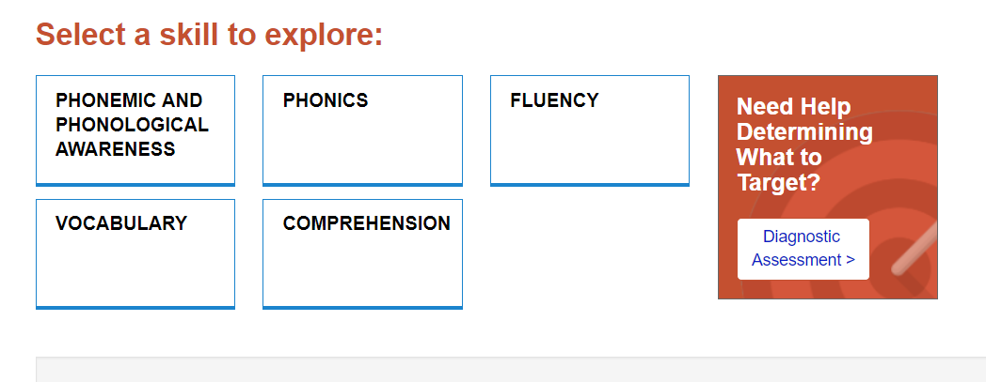
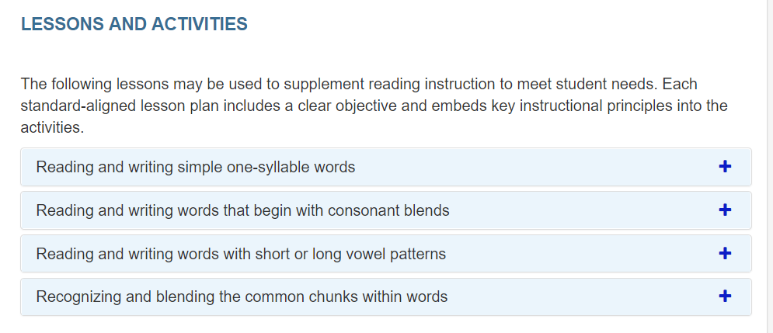
Lesson Plan Selection
Notes:
And review the sample lesson plans available from NCII and found that they have a series focused on phonics. She clicks on that button (click for animation) and sees that there are a variety of sample lessons and activities available (review lessons and activities)

Slide 116
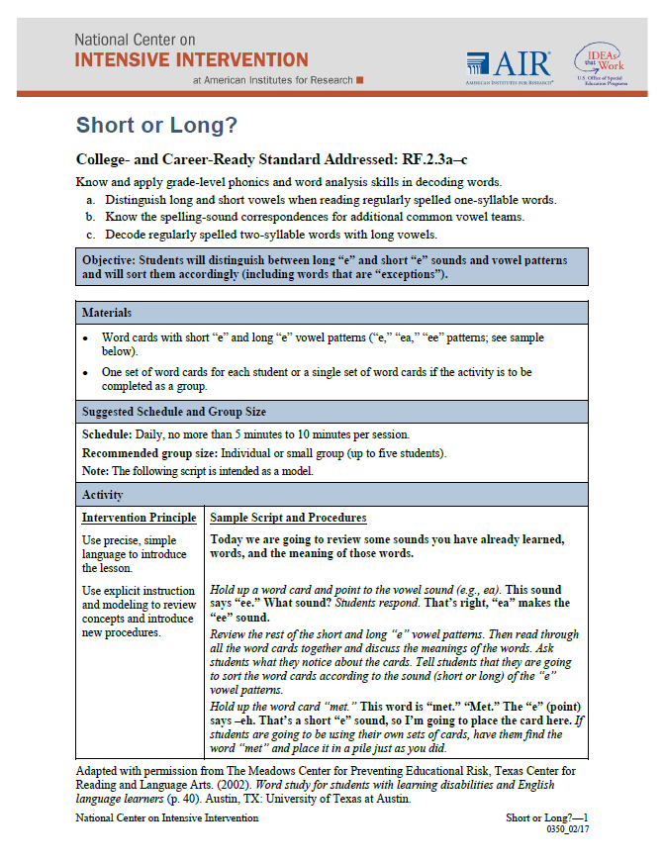
NCII Intensive Intervention Resources
Notes:
They find one, Short or Long, that is designed to help students distinguish between long “e” and short “e” sounds and vowel patterns and sort them accordingly (including words that are “exceptions”).

Slide 117
Rating Table 2
Intervention Dimensions | Rate | Evidence | Adaptation 1 | Adaptation 2
Strength | 2 | ES = Between 0.35 and 0.49
Dosage | 2 | Group size: six students Session length: 20 minutes per session Frequency: five sessions per week | Provide 40 minutes each session in smaller group
Alignment | 3 | Explicit instruction covering skills deficit areas, PA, word study, and fluency
Attention to transfer | 2 | Builds on previously learned skills; not clearly connected to Tier 1 content
Comprehensiveness | 2 | Includes three explicit instruction principles |  | Provide additional explicit instructional strategies
Behavioral support | 1 | None found but doesn’t appear needed for student
Notes:
The team decides to maintain the dosage and group size change and add additional explicit instruction around the specific skill area using the sample lesson.

Slide 118
Progress Monitoring: Is Kelsey responding to the adapted intervention?
Intervention
Adaptation 1
Adaptation 2 Phase Line
Notes:
The teacher indicates the new adaptation with another phase line. The team reviews the data for this phase and determines that Kelsey is making some progress, but not sufficient progress to close the gap and reach her goal. The team collects additional diagnostic data and identifies how best to intensify the intervention based on that data.

Slide 119
DBI is an ongoing process.

Slide 120
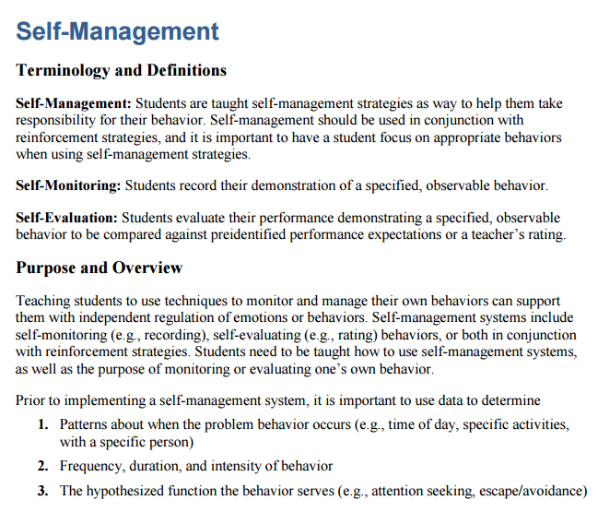
Using Data to Intensify the Intervention
Behavior Strategies to Support Intensifying Interventions
Fidelity and observation data indicate that Kelsey has become easily frustrated and less engaged in the intervention than her peers. Data indicate that she can learn the skill if she attends to the task.
Hypothesis: If Kelsey was more engaged and able to control her frustration, she would benefit more from the intervention.
Notes:
While behavior was not initially an area that the team was concerned with, additional diagnostic data collected by the teacher indicate that over time Kelsey is becoming more frustrated and less engaged in the intervention. They hypothesize that if she was more engaged, she would get more benefit from the intervention. (click for animation) They visit the behavior strategies on the NCII website and identify a resource on self-management.

Slide 121
Rating Table 3
Intervention Dimensions | Rate | Evidence | Adapt 1 | Adapt 2 | Adapt 3
Strength | 2 | ES = Between 0.35 and 0.49
Dosage | 2 | Group size: six students Session length: 20 minutes per session Frequency: three to four sessions per week | Provide 40 minutes each session in smaller group
Alignment | 3 | Explicit instruction covering skills deficit areas, PA, word study, and fluency
Attention to transfer | 2 | Builds on previously learned skills; not clearly connected to Tier 1 content
Comprehensiveness | 2 | Includes three explicit instruction principles |  | additional explicit instructional strategies
Behavioral support | 1 | None found but doesn’t appear needed for student |  |  | Implement engagement and self-regulation strategy
Notes:
They record the intervention change under behavioral support.

Slide 122
Is Kelsey responding to the adapted intervention? What would you do?
Notes:
The teacher draws another phase line to indicate the new adaptation. Take a minute to turn to your neighbor and share what you would do next.
Provide pairs or small groups 1–2 minutes to discuss what they would do next. Have several share out.

Slide 123
Evaluation of Kelsey’s Progress: What would you do?
Kelsey’s reading is improving but not fast enough to achieve her goal.
Kelsey’s teacher may collect additional diagnostic data if needed to make an informed instructional change.
Kelsey’s teacher will continue to collect progress monitoring data and meet with the intervention team to evaluate progress and modify the plan as needed.
Team may consider whether the student has a disability, if not currently eligible for special education.
If a referral was made, DBI would continue through eligibility determination and individualized education program (IEP) development and implementation until the student is making adequate progress.
Notes:
Read slide.

Slide 124
Activity, Part 2: Intensifying and Individualizing Validated Interventions
Get back into your same groups of 2–3.
Imagine that the group of students did not respond to the intervention. In the last column, brainstorm how 2–3 dimensions could be intensified for the group.
Review the Intensification Strategy Checklist for ideas.
Record your responses in the last column.
Handout
Notes:
In this activity, we are going to return to the handout and groups that we used earlier for rating our intervention. Based on your knowledge of the intervention and the ideas in the Intensification Strategy Checklist, consider some ways you could intensify the intervention across the different dimensions. You will have about 5–10 minutes for this activity.
Provide 5–10 minutes for this activity. Encourage participants to ue the Intensive Strategy Checklist to identify possible intensification strategies for each dimension.

Slide 125
Think-Pair-Share
What were some ways you considered intensifying?
Which dimensions do you think would be easier to intensify?
Which dimensions are more challenging?
Notes:
Get up from your current group and find a partner from another group. Briefly share some of the ways you considered intensifying your intervention. Together, discuss which dimensions you think would be easier to intensify and which might be more challenging.

Slide 126
Review and Wrap-Up

Slide 127
Learn More About the Taxonomy of Intervention Intensity
https://intensiveintervention.org/taxonomy-intervention-intensity
Notes:
If you are interested in learning more about the Taxonomy of Intervention Intensity, the NCII website includes a page focused on the taxonomy. On that page are four recorded webinars that go deeper into applying the taxonomy to different content areas. Additional resources will be added to that page in the future.

Slide 128
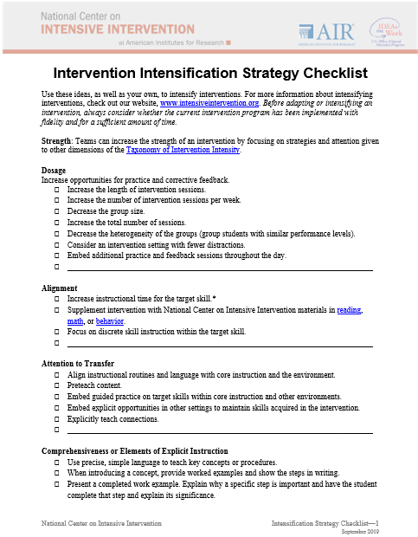
Resources to Support Individualization Decisions
Notes:
In addition to the webinars, you will be able to find many of the resources we referenced today, including the Intensification Strategy Checklist, the dimension overview handout, and the handout focused on questions to develop a hypothesis.
Some other resources we referenced throughout the presentation are included on the next slides as a reminder and resource.

Slide 129
Tool for Developing Your Hypothesis
Source: https://intensiveintervention.org/sites/default/files/Clarifying_Questions_Hypothesis_508.pdf.
Notes:
This NCII tool is designed to help teams develop a hypothesis of why a student is not responding to the intervention. It provides guiding questions that the team might consider.

Slide 130
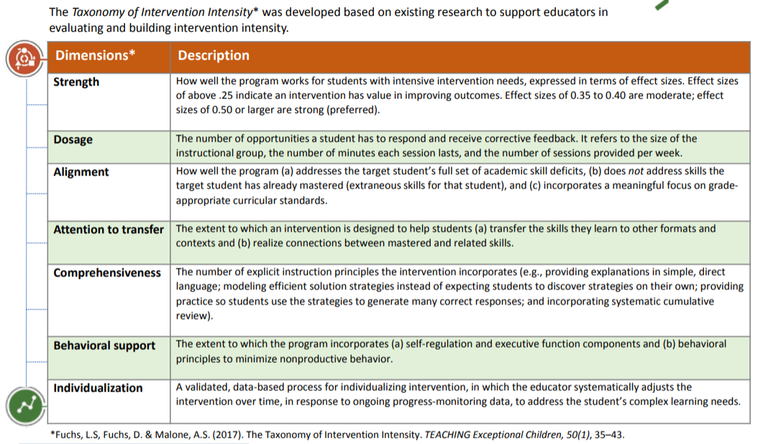
Adapting the Intervention: Tips for Successful Intensification
Select strategies that address the hypothesis.
Handout
Notes:
To guide decisions about the types of intensification they might want to make, the team can use the dimensions of the Taxonomy of Intervention Intensity and the ratings they provided when analyzing the validated intervention program. They also might explore the Intensification Strategy Checklist form NCII that provides some areas to consider for intensifying across the dimensions of the taxonomy.

Slide 131
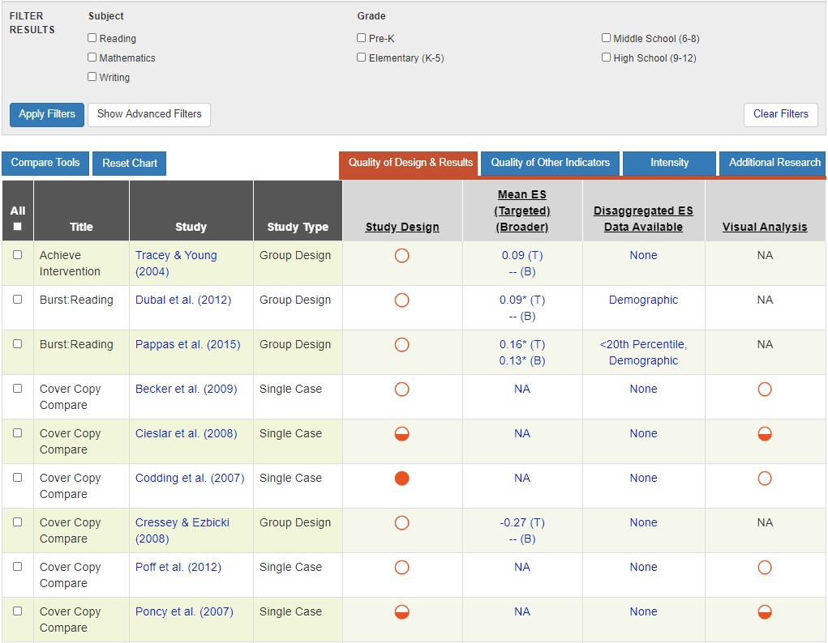
Resources to Evaluate Strength
Academic Intervention Tools Chart
https://charts.intensiveintervention.org/ chart/instructional-intervention-tools
Notes:
The Academic Intervention Tools Chart, seen here, was one of the tools we used to help us evaluate the strength dimension. This chart is one of six tools charts on the NCII website. In addition to the NCII Tools Chart, you might visit the What Works Clearinghouse and the Best Evidence Encyclopedia.

Slide 132
Resource to Support Intensification of Dosage
Source: https://intensiveintervention.org/resource/strategies-scheduling-how-find-time-intensify-and-individualize-intervention.
Notes:
This scheduling resource includes some strategies that might be helpful as you consider how to intensify your intervention within a busy school schedule, particularly as you think about the dosage dimension.

Slide 133
Resources to Learn More About Comprehensiveness
View module: https://intensiveintervention.org/instructional-delivery-math-course
View module: https://intensiveintervention.org/intensive-intervention-features-explicit-instruction
Notes:
If you are interested in learning more about comprehensiveness, the four-part module on Features of Explicit Instruction provides a wealth of content, examples, and resources. You also can find information and examples of explicit instruction in mathematics as part of Module 4 in the Intensive Intervention in Mathematics course.

Slide 134
Resources to Learn More about Behavior Intervention and Support
View module: https://intensiveintervention.org/intervention-resources/behavior-strategies-support-intensifying-interventions
Notes:
NCII also includes information to support your consideration of the behavior support dimension. The behavior strategies can help support teachers working with students with primary academic deficits and challenging behaviors. Each strategy incorporates key terminology, an overview of the purpose, and all associated materials. The strategies also integrate approaches for intensification for students with more challenging behaviors.
The Behavior Support for Intensive Intervention Course Content also provides a deep review of how educators can support student behavior in the classroom. This eight-part module series includes video lectures, activities, and more.

Slide 135
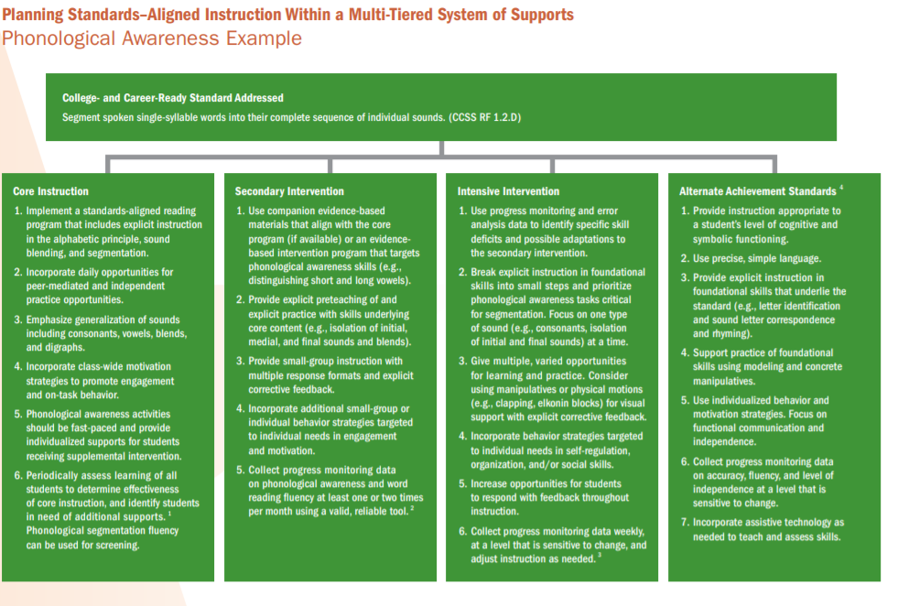
Resources for Individualization in Reading
Considerations for Alignment, Attention to Transfer, Comprehensiveness, and Dosage
https://intensiveintervention.org/intensive-intervention-reading-course
https://intensiveintervention.org/intervention-resources/literacy-strategies
Notes:
To support students who need more intensive support in reading, NCII has a series of sample lessons and activities aligned with the big five reading skill areas. These lessons may help add additional practice opportunities or targeted support related to a specific skill area that a student needs more support with. Examples of how to address standards across the levels of a tiered system of support also can help educators consider the attention to transfer domain.
In addition, the Intensive Intervention in Reading course content provides a robust amount of information. Content covers essential components of reading, intervention programs, progress monitoring, diagnostic assessment, and intervention adaptations.

Slide 136
Activity: Taxonomy K-W-L
What Does It Help Me KNOW? | What More Do I WANT to Know? | How Will I LEARN More?
Handout
Notes:
Return to the handouts we used at the start of this session. Consider what was discussed today. On your K-W-L handout, take about 5–10 minutes to note what the document helps you know and what you want to know more about.

Slide 137
Taxonomy of Intervention Intensity: Review
Notes:
The Taxonomy of Intervention Intensity is designed to support special educators and interventionists in understanding their validated intervention program. For those students who do not respond to the intervention as designed, the taxonomy can be used to help teams and educators make decisions about how the intervention can be individualized to better meet their needs. Future training modules will illustrate how the taxonomy can be applied to intensify an intervention.

Slide 138
Things to Remember
DBI is ongoing and intense. Relatively few students should need it (3% to 5% of the school population).
Academic and behavior supports do not exist in isolation.
There is no perfect intervention, but it is important to understand your intervention’s strengths and limitations and to start with a strong foundation.
Don’t make too many intervention adaptations at the same time.
Notes:
DBI is intense; relatively few students should need it.
If more than 3% to 5% of students in a school appear to require DBI, consider evaluating core instruction, schoolwide behavior supports, and Tier 2 intervention programs.
DBI often takes sustained and iterative cycles of adaptation across time.
Academic and behavior supports do not exist in isolation.
These supports often are most successful when combined to meet students’ individual needs.
There is no perfect intervention.
We have access to a growing repository of interventions that have shown evidence of effectiveness, but we need to consider the dimensions of the taxonomy to guide our decision-making process and understand the multiple dimensions that can help ensure we have a strong intervention.
Even when we can’t start with a standardized program, the taxonomy can guide our understanding of what we are providing.
Don’t make too many intervention adaptations at the same time.
It may be tempting to try everything at once because you want to help a student as soon as possible. However, if you make numerous changes at the same time, you won’t know which ones the student needs (any improvement in performance could be the result of one or more adaptations). Also, fewer changes may make implementation more sustainable.

Slide 139
Reflection
What am I most excited about? | What am I unsure or want to learn more about? | What changes will I make as a result of what I learned today?
Notes:
As we end the day, take a moment to reflect on what we covered. What are you most excited about? What questions do you still have? What changes will you make? Take 5 minutes to reflect and then share with a neighbor.

Slide 140
References
Blair, C., & Razza, R. P. (2007). Relating effortful control, executive function, and false belief understanding to emerging math and literacy ability in kindergarten. Child Development, 78, 647–663. https://doi.org/10.1111/j.1467-8624.2007.01019.x
Borella, E., Caretti, B., & Pelegrina, S. (2010). The specific role of inhibition in reading comprehension on good and poor comprehenders. Journal on Learning Disabilities, 43, 541–552.
Ciullo, S., Lo, Y-L. S., Wanzek, J., & Reed, D. K. (2016). A synthesis of research on informational text reading interventions for elementary students with learning disabilities. Journal of Learning Disabilities, 49(3), 257–271.
Dane, A. V., & Schneider, B. H. (1998). Program integrity in primary and early secondary prevention: Are implementation effects out of control. Clinical Psychology Review, 18, 23–45. https://doi.org/10.1016/S0272-7358(97)00043-3
Deno, S. L., & Mirkin, P. K. (1977). Data-based program modification: A manual. Reston VA: Council for Exceptional Children.

Slide 141
References
Diamond, A. (2012). Activities and programs that improve children’s executive functions. Current Directions ion Psychological Science, 21(5), 335–341. https://doi.org/10.1177/0963721412453722
Fuchs, D., Kearns, D., Patton, S., Elleman, A., Fuchs, L., Steacy, L., & Toste, J. (2016). Nashville Early Reading Project. Vanderbilt University, Nashville.
Fuchs, D., Walsh, M. E., Patton, S. A., & Fuchs, L. S. (2019). Reading PI: Nonfiction Comprehension Program, Grade 3. Unpublished reading curriculum. Vanderbilt University, Nashville, TN.
Gathercole, S. E., Pickering, S. J., Ambridge, B., & Wearing, H. (2004). The structure of working memory from 4 to 15 years of age. Developmental Psychology, 40(2), 177–190.

Slide 142
References
Gresham, F. M., Gansle, K. A., Noell, G. H., Cohen, S., & Rosenblum, S. (1993). Treatment integrity of school-based behavioral intervention studies: 1980–1990. School Psychology Review, 22(2), 254–272.
Hill, C. J., Bloom, H. S., Black, A. R., & Lipsey, M. W. (2008). Empirical benchmarks for interpreting effect sizes in research. Child Development Perspectives, 2(3), 172–177.
Kearns, D. M. (2018). Intensive intervention course content: Features of explicit instruction. Washington, DC: U.S. Department of Education, Office of Special Education Programs, National Center on Intensive Intervention. Available at https://intensiveintervention.org/intensive-intervention-features-explicit-instruction​

Slide 143
References
Moylan, L.A., Johnson, E.S., Crawford, A.R., Zheng, Y. (2017). Explicit Instruction Rubric. Recognizing Effective Special Education Teachers (RESET), Boise State University: Boise, ID. O’Donnell, C. L. (2008). Defining, conceptualizing, and measuring fidelity of implementation and its relationship to outcomes in K–12 curriculum intervention research. Review of Educational Research, 78(1), 33–84. https://doi.org/10.3102/0034654307313793
Scammacca, N. K., Roberts, G., Vaughn, S., & Stuebing, K. K. (2015). A meta-analysis of interventions for struggling readers in Grades 4–12: 1980–2011. Journal of Learning Disabilities, 48(4), 369–390. https://doi.org/10.1177/0022219413504995
Swanson, H. L., & Howell, M. (2001). Working memory, short-term memory, and speech rate as predictors of children's reading performance at different ages. Journal of Educational Psychology, 93(4), 720–734.

Slide 144
References
Swanson, H. L., & O’Connor, R. (2009). The role of working memory and fluency practice on the reading comprehension of students who are dysfluent readers. Journal of Learning Disabilities, 42(6), 548–575. https://doi.org/10.1177/0022219409338742
Vadasy, P. F., & Sanders, E. A. (2008). Benefits of repeated reading intervention for low-achieving fourth- and fifth-grade students. Remedial and Special Education, 29(4), 235–249.
Walsh, M. E., Fuchs, D., Patton, S. A., Lehman, P., & Fuchs, L. S. (2019). Improving outcomes for struggling third graders in nonfiction reading comprehension intervention: Small successes and enduring challenges. Poster presented at the annual conference of the Pacific Coast Research Conference, San Diego, CA.

Slide 145
Thank you
Thank you!

Slide 146
NCII Disclaimer
This presentation was produced under the U.S. Department of Education, Office of Special Education Programs, Award No. H326Q160001. Celia Rosenquist serves as the project officer. The views expressed herein do not necessarily represent the positions or policies of the U.S. Department of Education. No official endorsement by the U.S. Department of Education of any product, commodity, service, or enterprise mentioned in this webinar is intended or should be inferred.

