Slide 1
Module 8
DBI for Intensive Mathematics Intervention

Slide 2
Slide 2
Video Link: https://youtu.be/8ID17lWoZzo

Slide 3
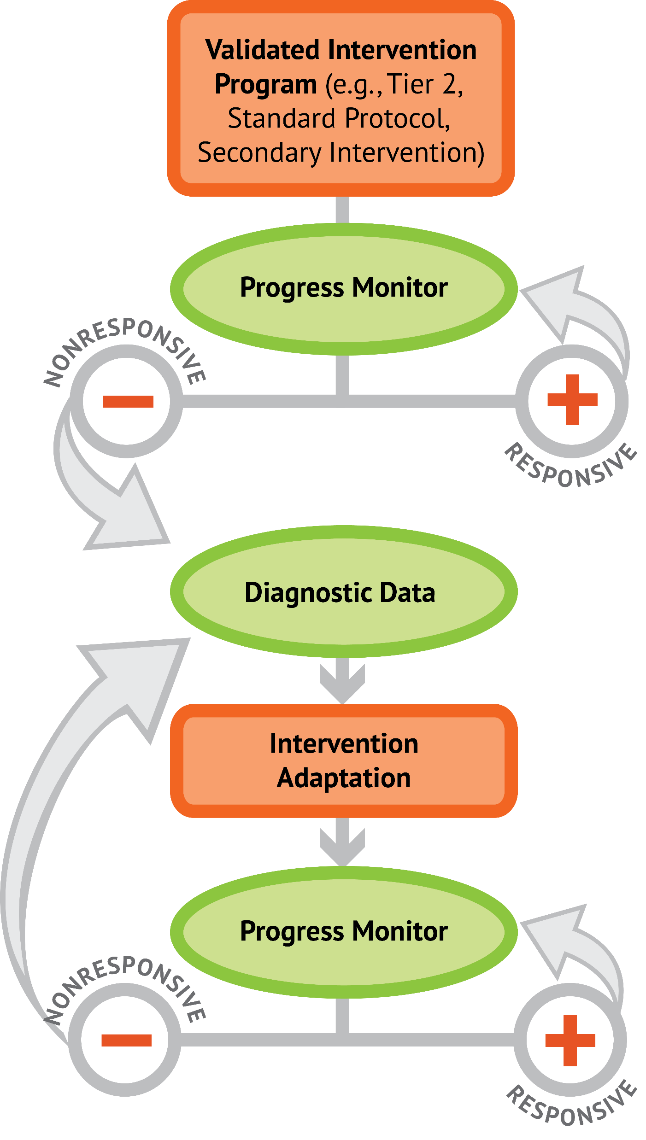
Slide 3
1: Developing a scope and sequence for intervention
2: Progress monitoring and determining response
3: Selecting evidence-based practices for the instructional platform
4: Instructional delivery: explicit instruction, multiple representations, language
5: Instructional strategies: fluency building, problem solving, motivation
6: Whole number content
7: Rational number content
8: DBI and mathematics: fidelity, adaptations

Slide 4
Objectives
PART 1: How do you implement intensive intervention with fidelity?
PART 2: How do you make adaptations within DBI?
PART 3: How does all of this come together within a DBI framework?

Slide 5
Activities
PART 1: How do you implement intensive intervention with fidelity?
Look at a lesson and its fidelity checklist
Create a qualitative fidelity checklist
Create quantitative and qualitative fidelity checklists
Share a fidelity checklist and discuss compared to a video

Slide 6
Activities
PART 2: How do you make adaptations within DBI?
List additional ways to adapt mathematics content
Revise a recently-taught lesson to include more explicit instruction
Describe decisions about adaptations

Slide 7
Activities
PART 3: How does all of this come together within a DBI framework?
Create your DBI implementation plan
Share your excitement and concerns about DBI

Slide 8
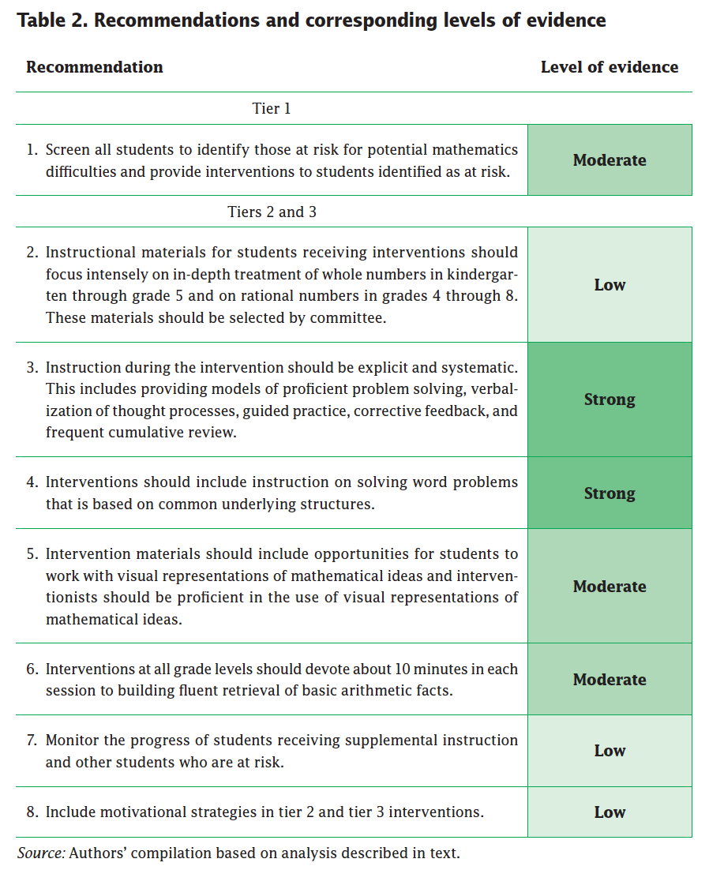
Slide 8
Explicit instruction
Multiple representations
Concise language
Fluency building
Problem solving instruction
Motivation component
Gersten et al. (2009)

Slide 9
Reading
Powell, S. R., & Fuchs, L. S. (2015). Intensive intervention in mathematics. Learning Disabilities Research and Practice, 30, 182–192. doi:10.1111/ldrp.12087

Slide 10
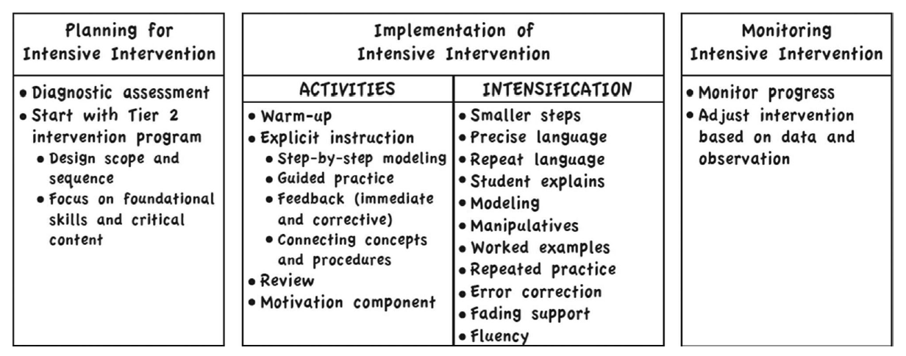
Slide 10

Slide 11
Classroom Application
Start implementing DBI!

Slide 12
Welcome!
Let’s get started on Module 8!

Slide 13
Slide 13
Part 1

Slide 14
How do you implement intensive intervention with fidelity?
Module 8, Part 1

Slide 15
Part 1 Objectives
In this part, you’ll learn—
About different methods for measuring fidelity
How to identify essential components that must be included within intensive intervention

Slide 16
Slide 16
Instructional Platform
Conduct a diagnostic assessment of the student’s strengths and weaknesses
Design a scope and sequence
Identify instructional platform
Implement with fidelity
1. evidence-based intervention
2. evidence-based strategy

Slide 17
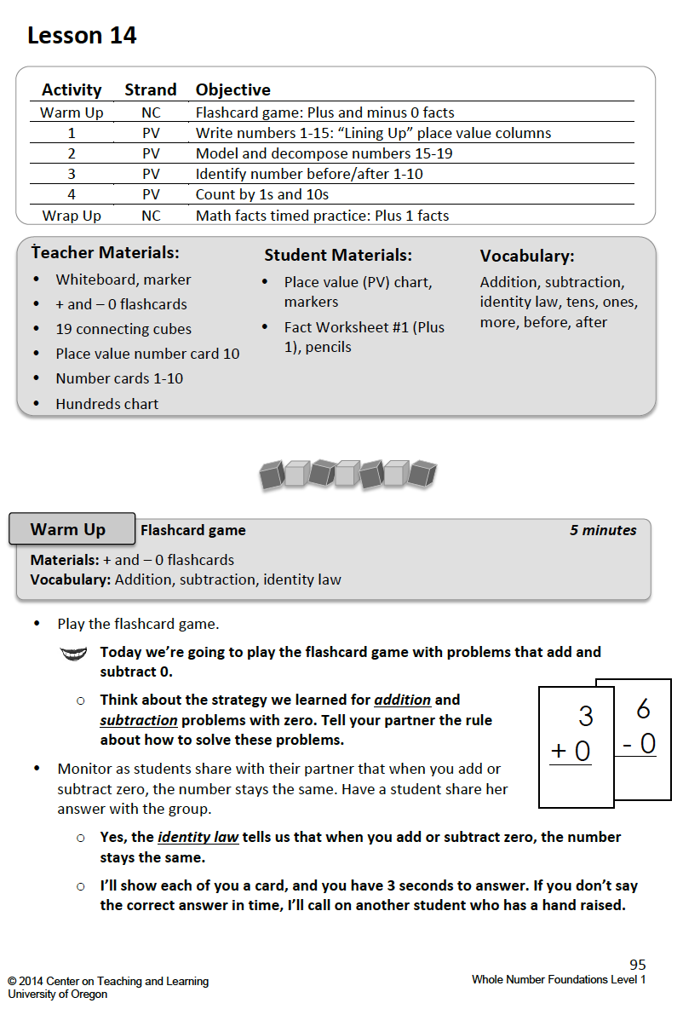
Slide 17
https://dibels.uoregon.edu/market/movingup/math

Slide 18
Slide 18
Implements all lessons and all components and adds in additional practice.
Implements some lessons and some of the components.
Implements some lessons and all of the components.
Implements some lessons and some components and includes technology games.
Implements all lessons and some of the components.
Implements a totally separate intervention.
Implements all lessons and all of the components.

Slide 19
Fidelity
Adherence to the intervention or strategy
Quantitative
Qualitative

Slide 20
Slide 20
Quantitative
Score of how many essential components were completed
”The teacher completed 96% of the intervention’s components.”
”The teacher addressed 8 of 10 essential components of explicit instruction.”

Slide 21
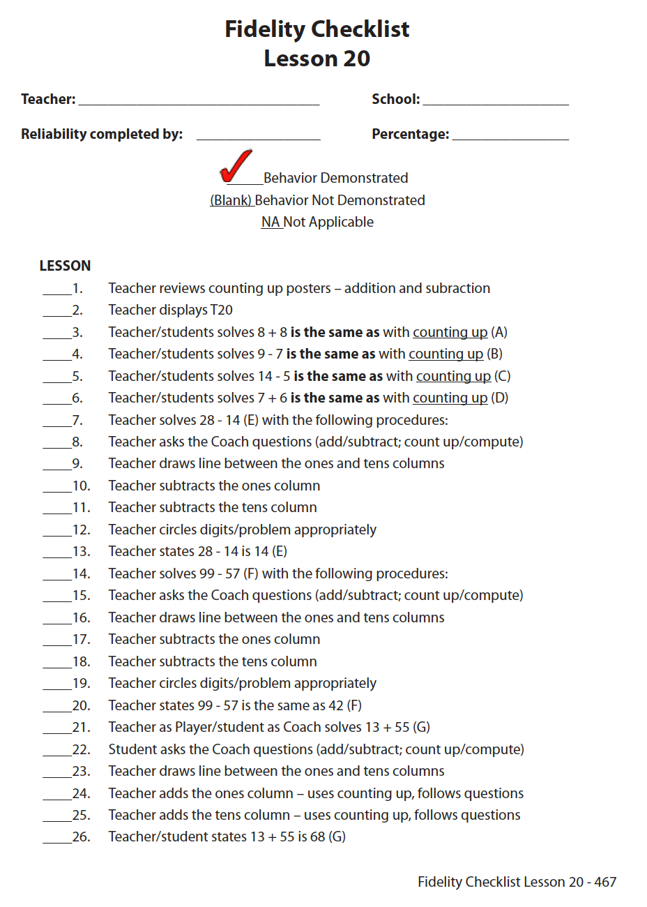
Slide 21
Quantitative
Fuchs, Powell, & Fuchs (2011)

Slide 22
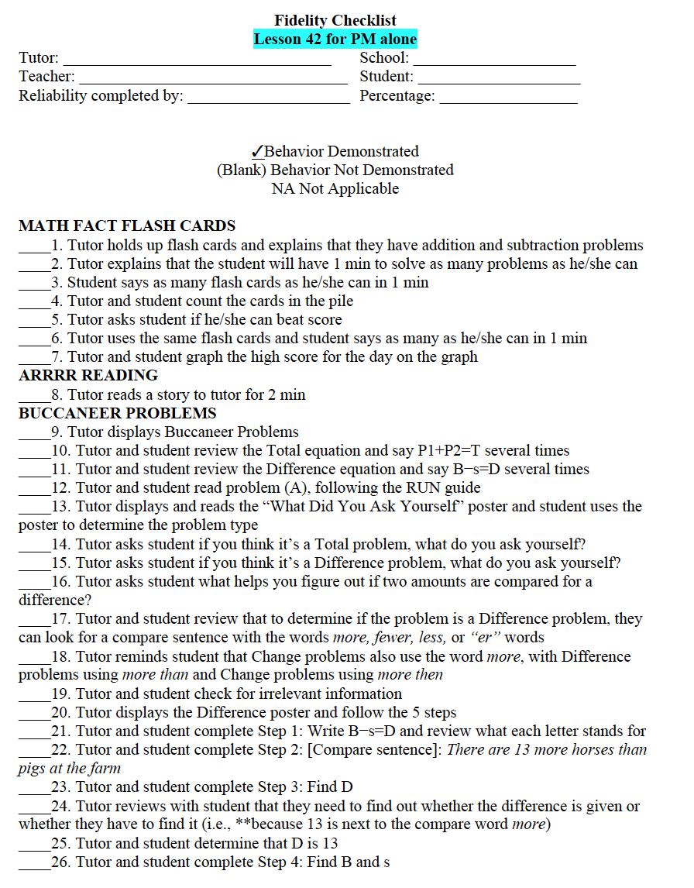
Slide 22
Quantitative
Powell & Berry (2016)

Slide 23
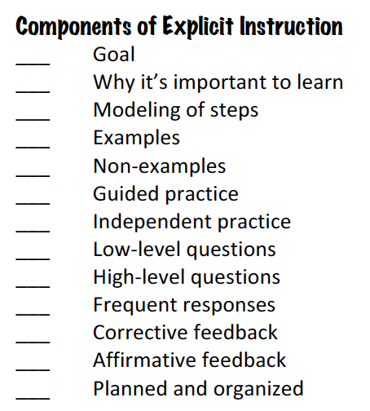
Slide 23
Quantitative

Slide 24
Slide 24
Implements some lessons and some of the components.
Implements all lessons and all components and adds in additional practice.
49%
94%
71%
Implements some lessons and all of the components.
Implements some lessons and some components and includes technology games.
64%
Implements all lessons and some of the components.
56%
Implements a totally separate intervention.
5%
Implements all lessons and all of the components.
97%

Slide 25
Workbook Activity #1
Look at the fidelity checklist and accompanying lesson. Compare to understand how much detail is provided within the fidelity checklist.

Slide 26
Slide 26
Implements all lessons and all components and adds in additional practice.
Implements some lessons and some of the components.
Implements some lessons and all of the components.
Implements some lessons and some components and includes technology games.
Implements all lessons and some of the components.
Implements a totally separate intervention.
Implements all lessons and all of the components.

Slide 27
Slide 27
Qualitative
Rating of how well the intervention or strategy was implemented
“On a score of 1 to 3…”
“Excellent, Good, Fair, Poor…”

Slide 28
Slide 28
Qualitative
Fuchs et al. (2014)

Slide 29
Slide 29
Implements some lessons and some of the components.
Implements all lessons and all components and adds in additional practice.
high
high
Implements some lessons and all of the components.
low
Implements some lessons and some components and includes technology games.
low
Implements all lessons and some of the components.
high
high
Implements a totally separate intervention.
Implements all lessons and all of the components.
medium

Slide 30
Workbook Activity #2
Go back and look at the lesson for Activity #1. What qualitative components would you include on a qualitative fidelity checklist?

Slide 31
Fidelity
Adherence to the intervention or strategy
Quantitative
Qualitative

Slide 32
Slide 32
Instructional Platform
Conduct a diagnostic assessment of the student’s strengths and weaknesses
Design a scope and sequence
Identify instructional platform
Implement with fidelity
1. evidence-based intervention
2. evidence-based strategy

Slide 33
Slide 33
Implements all lessons and all components and adds in additional practice.
Implements some lessons and some of the components.
Implements some lessons and all of the components.
Implements some lessons and some components and includes technology games.
Implements all lessons and some of the components.
Implements a totally separate intervention.
Implements all lessons and all of the components.

Slide 34
Workbook Activity #3
Video
First, look at the materials for a lesson on counting up. What quantitative and/or qualitative components would you include on a fidelity checklist?
Then, watch the video. Rate the tutor against your checklist.
Video Link: https://youtu.be/aUEm1rmCWxg

Slide 35
Why Is This Important?
All the evidence-based interventions and all the evidence-based strategies (in the world) can’t help a student unless the interventions and strategies are implemented with fidelity.

Slide 36
Part 1’s Checklist: How do you implement intensive intervention with fidelity?
Implement interventions and strategies with high fidelity
Check fidelity using quantitative indicators
Check fidelity using qualitative indicators

Slide 37
Discussion Board
Share your fidelity checklist from Activity #3, and describe how well the tutor adhered to your checklist.

Slide 38
Slide 38
Part 2

Slide 39
How do you make adaptations within DBI?
Module 8, Part 2

Slide 40
Part 2 Objectives
In this part, you’ll learn—
The taxonomy of intervention adaptations
Common adaptations to use within DBI when response is not adequate

Slide 41
Where Are We?

Slide 42
Slide 42
Taxonomy of intervention adaptations

Slide 43
Slide 43
Taxonomy of intervention adaptations
implement with fidelity
In research studies, how much does the program increase the achievement of students needing intensive intervention?
behavior supports provided
What are the possibilities?
Looking at all data, what is the cause of the student’s non-response?
taxonomy of adaptations
dosage (intervention time)
student-program alignment
What adaptation will address the cause and result in greater responsiveness?
explicit instruction principle use
attention to transfer within program

Slide 44
Slide 44
Instructional Platform
Conduct a diagnostic assessment of the student’s strengths and weaknesses
Design a scope and sequence
Identify instructional platform
1. evidence-based intervention
2. evidence-based strategy
Adaptation

Slide 45
Reading from Module 1
Powell, S. R., & Stecker, P. M. (2014). Using data-based individualization to intensify mathematics intervention for students with disabilities. Teaching Exceptional Children, 46(4), 31–37. doi:10.1177/0040059914523735

Slide 46
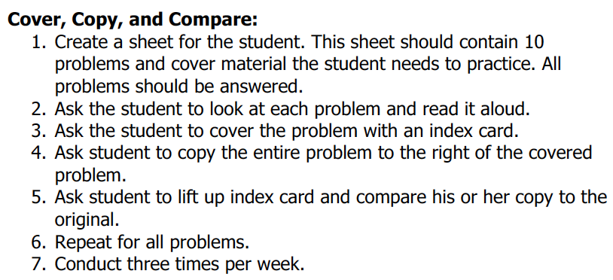
Slide 46
Implement with greater fidelity
Adaptation
Ensure that you are implementing the intervention or strategy with fidelity

Slide 47
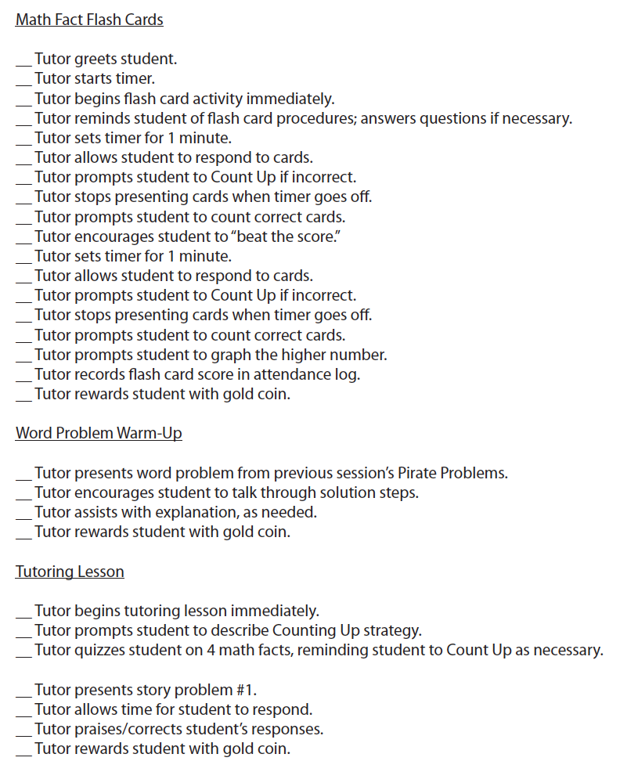
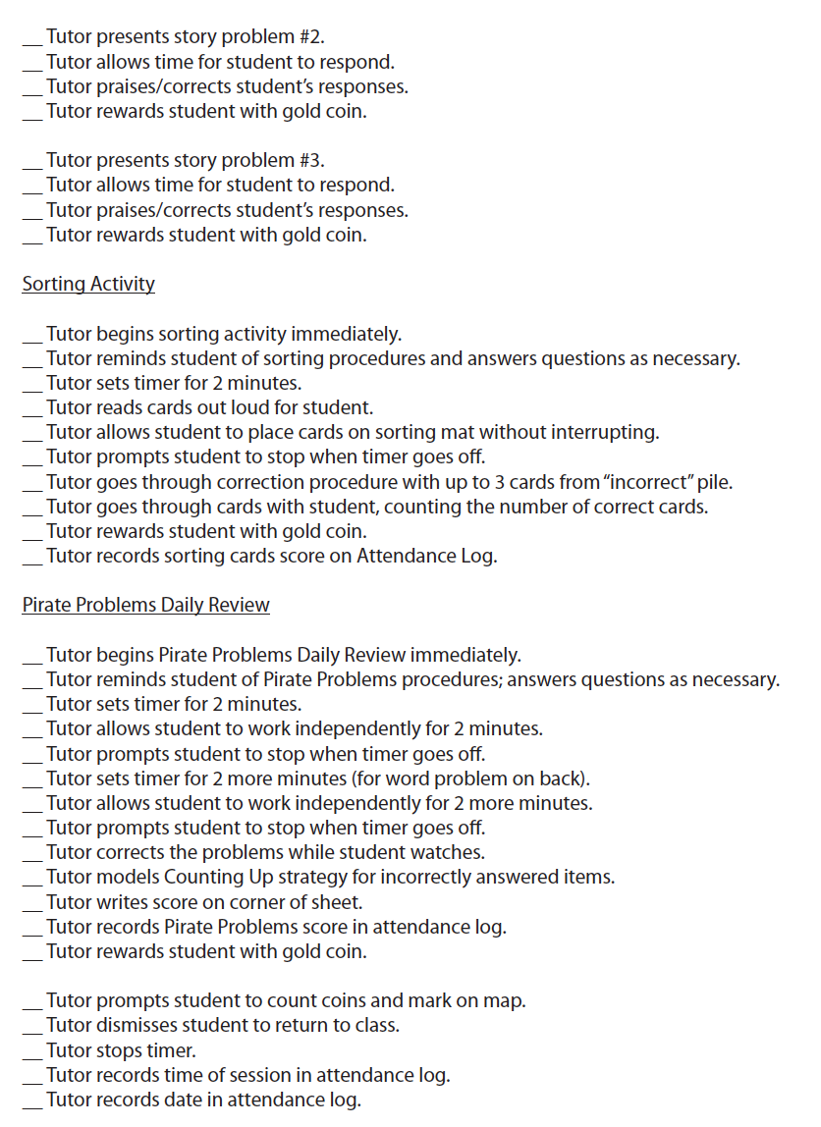
Slide 47
Implement with greater fidelity
Adaptation
Ensure that you are implementing the intervention or strategy with fidelity
Fuchs et al. (2008)

Slide 48
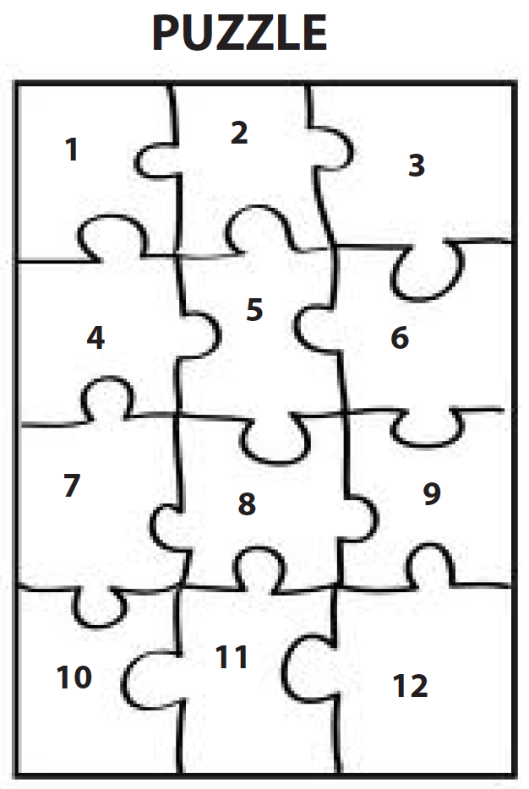
Slide 48
Implement with greater fidelity
Adaptation
Embed behavioral supports
May want to incorporate strategies to improve self-regulation and minimize nonproductive behavior
Powell, Driver, & Julian (2015)

Slide 49
Slide 49
Implement with greater fidelity
Adaptation
Embed behavioral supports
May want to incorporate strategies to improve self-regulation and minimize nonproductive behavior
UPSCheck
Understand
Plan
Solve
Check

Slide 50
Slide 50
Implement with greater fidelity
Adaptation
Embed behavioral supports
Increase dosage
Conduct longer sessions, more sessions per week, or more weeks within DBI

Slide 51
Slide 51
Implement with greater fidelity
Adaptation
Embed behavioral supports
Increase dosage
Conduct longer sessions, more sessions per week, or more weeks within DBI

Slide 52
Slide 52
Implement with greater fidelity
Adaptation
Embed behavioral supports
Increase dosage
Conduct longer sessions, more sessions per week, or more weeks within DBI
Number of weeks left in intervention

Slide 53
Slide 53
Implement with greater fidelity
Adaptation
Embed behavioral supports
Increase dosage
Adapt mathematics content

Slide 54
Slide 54
Implement with greater fidelity
Adaptation
Embed behavioral supports
Increase dosage
Adapt mathematics content
Where student IS
Where student NEEDS TO BE
Alter the scope and sequence
Explain why addition and subtraction strategies work, using place value and the properties of operations.
Use addition and subtraction within 100 to solve one- and two-step word problems…
Fluently add and subtract within 100 using strategies based on place value, properties of operations, and/or relationships.
Apply properties of operations as strategies to multiply and divide….
Fluently multiply and divide within 100, using strategies such as the relationship between multiplication and division…
Understand that the three digits of a three-digit number represent amounts of hundreds, tens, and ones.
Find whole number quotients and remainders with up to four-digit dividends and one-digit divisors, using strategies based on place value, …
Solve multi-step word problems posed with whole numbers and having whole-number answers using the four operations…
Understand that the two digits of a two-digit number represent amounts of tens and ones.
Use multiplication and division within 100 to solve word problems…
Fluently add and subtract multi-digit whole numbers using the standard algorithm.
Fluently multiply multi-digit whole numbers using the standard algorithm.
continuum of mathematics learning

Slide 55
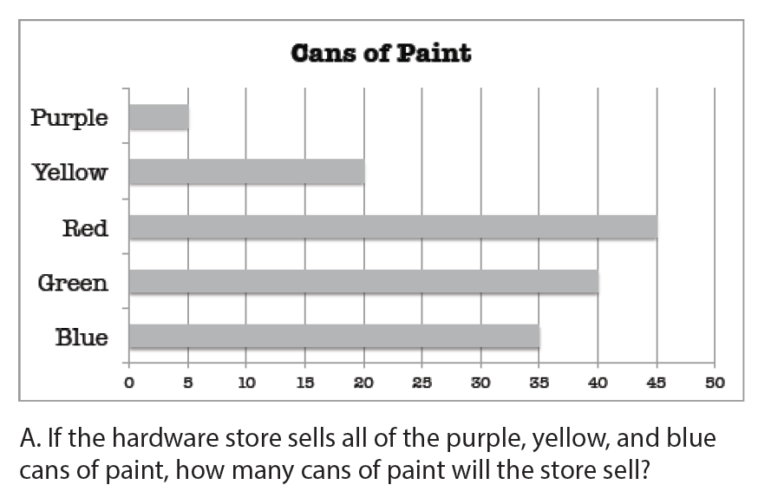
Slide 55
Implement with greater fidelity
Adaptation
Embed behavioral supports
Increase dosage
Solve
Adapt mathematics content
Write equation
Break down problems into smaller steps
Draw picture
Identify schema
Label graph
Underline labels
Read the problem

Slide 56
Slide 56
Implement with greater fidelity
Adaptation
Embed behavioral supports
Increase dosage
Adapt mathematics content
precise
Focus on the language of mathematics
concise

Slide 57
Slide 57
Implement with greater fidelity
Adaptation
Embed behavioral supports
Increase dosage
Adapt mathematics content
Focus on the language of mathematics
MATH JOURNAL

Slide 58
Slide 58
Implement with greater fidelity
Adaptation
Embed behavioral supports
Increase dosage
Adapt mathematics content
Define: | Characteristics:
Example: | Non-example:
Focus on the language of mathematics

Slide 59
Slide 59
Implement with greater fidelity
Adaptation
Embed behavioral supports
Increase dosage
“Tell me how you solved this problem.”
Adapt mathematics content
“What were you thinking about when you regrouped?”
Engage student in more discourse
“How would you teach this problem to another student?”
“Describe the word problem in 10 words or less.”

Slide 60
Slide 60
Implement with greater fidelity
Adaptation
Embed behavioral supports
Increase dosage
“Talk through this problem with me.”
Adapt mathematics content
Provide worked examples
405
+ 16
405
+ 16
411
521

Slide 61
Slide 61
Implement with greater fidelity
Adaptation
Embed behavioral supports
Increase dosage
Adapt mathematics content
Use more three-dimensional representations
Abstract
Representational
Concrete

Slide 62
Slide 62
Implement with greater fidelity
Adaptation
Embed behavioral supports
Increase dosage
Adapt mathematics content
Use more two-dimensional representations
Abstract
Representational
Concrete

Slide 63
Slide 63
Implement with greater fidelity
Adaptation
Embed behavioral supports
Increase dosage
Adapt mathematics content
Ensure students understand the abstract
Abstract
Representational
Concrete

Slide 64
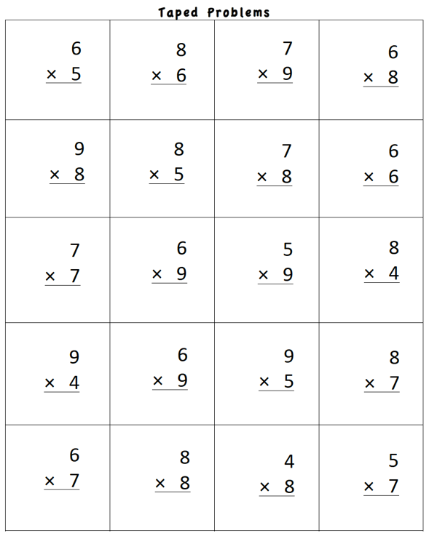
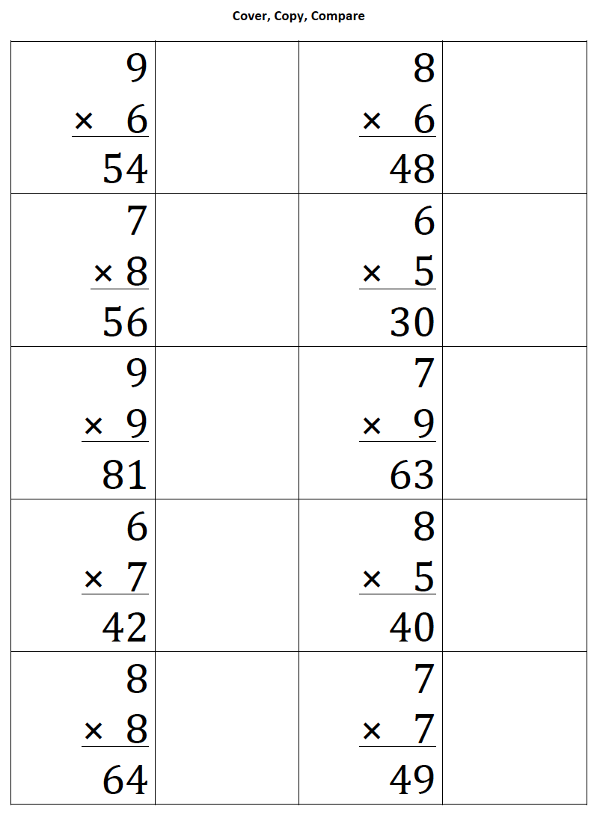
Slide 64
Implement with greater fidelity
Adaptation
Embed behavioral supports
Increase dosage
Adapt mathematics content
Focus on fact fluency

Slide 65
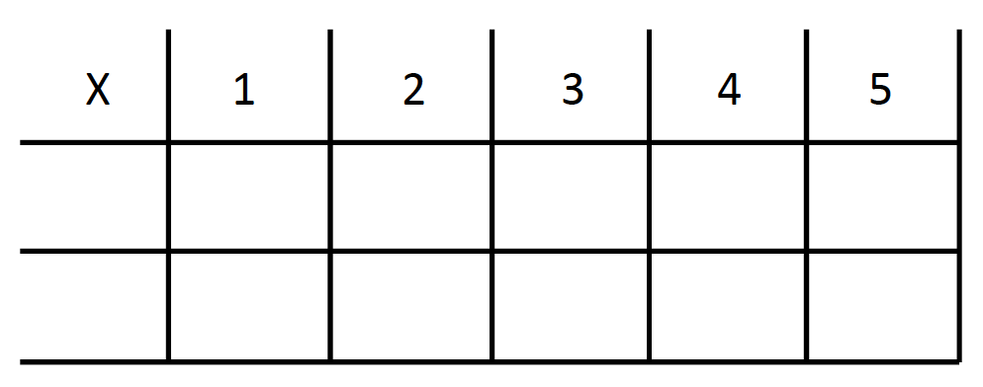
Slide 65
Implement with greater fidelity
Adaptation
Embed behavioral supports
Increase dosage
Adapt mathematics content
Focus on other types of fluency
-3 + (-4) = ___ 5 – (-6) = ___

Slide 66
Slide 66
Implement with greater fidelity
Adaptation
Embed behavioral supports
Increase dosage
Adapt mathematics content
Teach alternate algorithms

Slide 67
Slide 67
Implement with greater fidelity
Adaptation
Embed behavioral supports
Increase dosage
Adapt mathematics content
Explicitly teach problem solving
Additive
Multiplicative
Total
Equal Groups
Difference
Comparison
Change
Ratios/
Proportions

Slide 68
Slide 68
Implement with greater fidelity
Adaptation
Embed behavioral supports
Increase dosage
Adapt mathematics content
Encourage alternate methods and solutions
405
+ 16
405
+ 16
400
10
11
421
421
+

Slide 69
Slide 69
Workbook Activity #4
List three additional ways to adapt the mathematics content with DBI. Describe why each might be helpful.

Slide 70
Slide 70
Implement with greater fidelity
Adaptation
Embed behavioral supports
Increase dosage
I Do
Adapt mathematics content
Modeling
Practice
Utilize explicit instruction
Clear Explanation
Guided
Practice
We Do
Make sure you’re doing it! And do it well!
Planned
Examples
Independent Practice
You Do
Supporting Practices
Asking the right questions
Eliciting frequent responses
Providing immediate specific feedback
Maintaining a brisk pace

Slide 71
Slide 71
Workbook Activity #5
Select a lesson that you taught recently. Fill in the graphic organizer about how you used explicit instruction.
Then, go back and revise your lesson by including one additional component of modeling, guided practice, independent practice, and each of the support practices. In other words, how could you have done it better?

Slide 72
Slide 72
Implement with greater fidelity
Adaptation
Embed behavioral supports
Increase dosage
405
+ 16
4305
+ 216
Adapt mathematics content
Utilize explicit instruction
Explicitly teach transfer
Marney baked 89 cookies and sold 40 cookies at the bake sale. How many cookies does Marney have left?
Explicitly teach how current learning relates to other learning
Marney had $89 and spent $40 on shoes. How many much does Marney have left?
Marney had $89 and spent $40 on shoes. How much money will Marney have after buying the shoes?

Slide 73
Slide 73
Implement with greater fidelity
Adaptation
Embed behavioral supports
Increase dosage
Adapt mathematics content
Utilize explicit instruction
Explicitly teach transfer

Slide 74
Slide 74
Explicit instruction
Multiple representations
Concise language
Fluency building
Problem solving instruction
Motivation component
Gersten et al. (2009)

Slide 75
Slide 75
Instructional Platform
Conduct a diagnostic assessment of the student’s strengths and weaknesses
Design a scope and sequence
Identify instructional platform
1. evidence-based intervention
2. evidence-based strategy
Adaptation

Slide 76
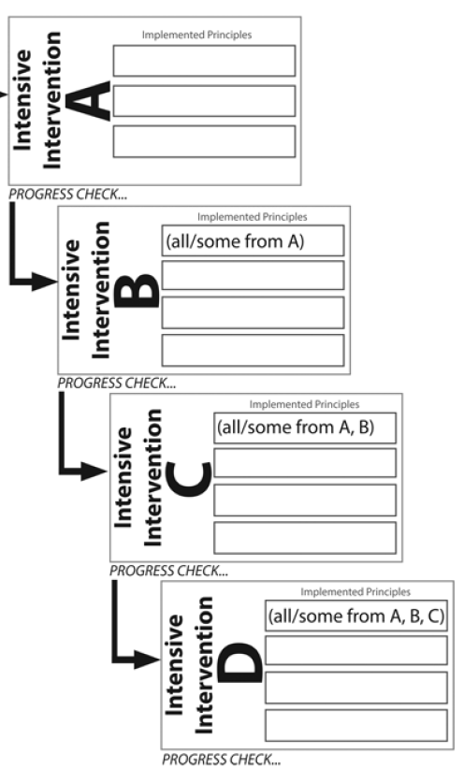
Slide 76
Powell & Stecker (2014)

Slide 77
Part 2’s Checklist: How do you make adaptations within DBI?
Implement with greater fidelity
Embed behavioral supports
Increase dosage
Adapt mathematics content
Utilize explicit instruction
Explicitly teach transfer

Slide 78
Discussion Board
Describe how you will make decisions about adaptations within DBI. Will you work on your own or with a team? What resources will you have available?

Slide 79
Slide 79
Part 3

Slide 80
How does all of this come together within a DBI framework?
Module 8, Part 3

Slide 81
Part 3 Objectives
In this part, you’ll learn—
How the entire DBI process works

Slide 82
Slide 82
Instructional Platform

Slide 83
Slide 83
Conduct a diagnostic assessment of the student’s strengths and weaknesses
Design a scope and sequence
Identify instructional platform (evidence-based intervention or strategy)
Instructional Platform

Slide 84
Slide 84
Conduct a diagnostic assessment of the student’s strengths and weaknesses
Design a scope and sequence
Identify instructional platform (evidence-based intervention or strategy)
Instructional Platform
Occurs frequently (3-4 times a week for 20-40 min/session)
Delivered with fidelity

Slide 85
Slide 85
Conduct a diagnostic assessment of the student’s strengths and weaknesses
Design a scope and sequence
Identify instructional platform (evidence-based intervention or strategy)
Instructional Platform
Occurs frequently (3-4 times a week for 20-40 min/session)
Delivered with fidelity
Occurs weekly
Using a reliable and valid assessment with alternate forms
Goals are set

Slide 86
Slide 86
Conduct a diagnostic assessment of the student’s strengths and weaknesses
Design a scope and sequence
Identify instructional platform (evidence-based intervention or strategy)
Instructional Platform
Occurs frequently (3-4 times a week for 20-40 min/session)
Delivered with fidelity
Occurs weekly
Using a reliable and valid assessment with alternate forms
Goals are set
After 6 to 10 weeks, data are interpreted using decision rules

Slide 87
Slide 87
Conduct a diagnostic assessment of the student’s strengths and weaknesses
Design a scope and sequence
Identify instructional platform (evidence-based intervention or strategy)
Instructional Platform
Occurs frequently (3-4 times a week for 20-40 min/session)
Delivered with fidelity
Occurs weekly
Using a reliable and valid assessment with alternate forms
Goals are set
After 6 to 10 weeks, data are interpreted using decision rules
Conducted to understand strengths and weaknesses
Determines adaptations

Slide 88
Slide 88
Conduct a diagnostic assessment of the student’s strengths and weaknesses
Design a scope and sequence
Identify instructional platform (evidence-based intervention or strategy)
Instructional Platform
Occurs frequently (3-4 times a week for 20-40 min/session)
Delivered with fidelity
Occurs weekly
Using a reliable and valid assessment with alternate forms
Goals are set
After 6 to 10 weeks, data are interpreted using decision rules
Conducted to understand strengths and weaknesses
Determines adaptations
Occurs frequently (3-4 times a week for 20-40 min/session)
Delivered with fidelity

Slide 89
Slide 89
Conduct a diagnostic assessment of the student’s strengths and weaknesses
Design a scope and sequence
Identify instructional platform (evidence-based intervention or strategy)
Instructional Platform
Occurs frequently (3-4 times a week for 20-40 min/session)
Delivered with fidelity
Occurs weekly
Using a reliable and valid assessment with alternate forms
Goals are set
After 6 to 10 weeks, data are interpreted using decision rules
Conducted to understand strengths and weaknesses
Determines adaptations
Occurs frequently (3-4 times a week for 20-40 min/session)
Delivered with fidelity
Occurs weekly
Using a reliable and valid assessment with alternate forms
Goals are set

Slide 90
Slide 90
Conduct a diagnostic assessment of the student’s strengths and weaknesses
Design a scope and sequence
Identify instructional platform (evidence-based intervention or strategy)
Instructional Platform
Occurs frequently (3-4 times a week for 20-40 min/session)
Delivered with fidelity
Occurs weekly
Using a reliable and valid assessment with alternate forms
Goals are set
After 6 to 10 weeks, data are interpreted using decision rules
Conducted to understand strengths and weaknesses
Determines adaptations
Occurs frequently (3-4 times a week for 20-40 min/session)
Delivered with fidelity
Occurs weekly
Using a reliable and valid assessment with alternate forms
Goals are set
After 6 to 10 weeks, data are interpreted using decision rules

Slide 91
Slide 91
1: Developing a scope and sequence for intervention
Instructional Platform
2: Progress monitoring and determining response
3: Selecting evidence-based practices for the instructional platform
4: Instructional delivery: explicit instruction, multiple representations, language
5: Instructional strategies: fluency building, problem solving, motivation
6: Whole number content
7: Rational number content
8: DBI and mathematics: fidelity, adaptations

Slide 92
Slide 92
Conduct a diagnostic of the student’s strengths and weaknesses
Design a scope and sequence
Identify instructional platform (evidence-based intervention or strategy)
1
3
Instructional Platform
3
Occurs frequently (3-4 times a week for 20-40 min/session)
Delivered with fidelity
4
5
6
7
8
Occurs weekly
Using a reliable and valid assessment with alternate forms
Goals are set
2
After 6 to 10 weeks, data are interpreted using decision rules
2
Conducted to understand strengths and weaknesses
Determines adaptations
2
Occurs frequently (3-4 times a week for 20-40 min/session)
Delivered with fidelity
8
3
4
5
6
7
Occurs weekly
Using a reliable and valid assessment with alternate forms
Goals are set
2
After 6 to 10 weeks, data are interpreted using decision rules
2

Slide 93
Part 3’s Checklist: How does all of this come together within a DBI framework?
Develop the instructional platform
Implement progress monitoring
Determine response to intervention
Conduct a diagnostic assessment (if necessary)
Make adaptations (if necessary)
Continue progress monitoring (if necessary)

Slide 94
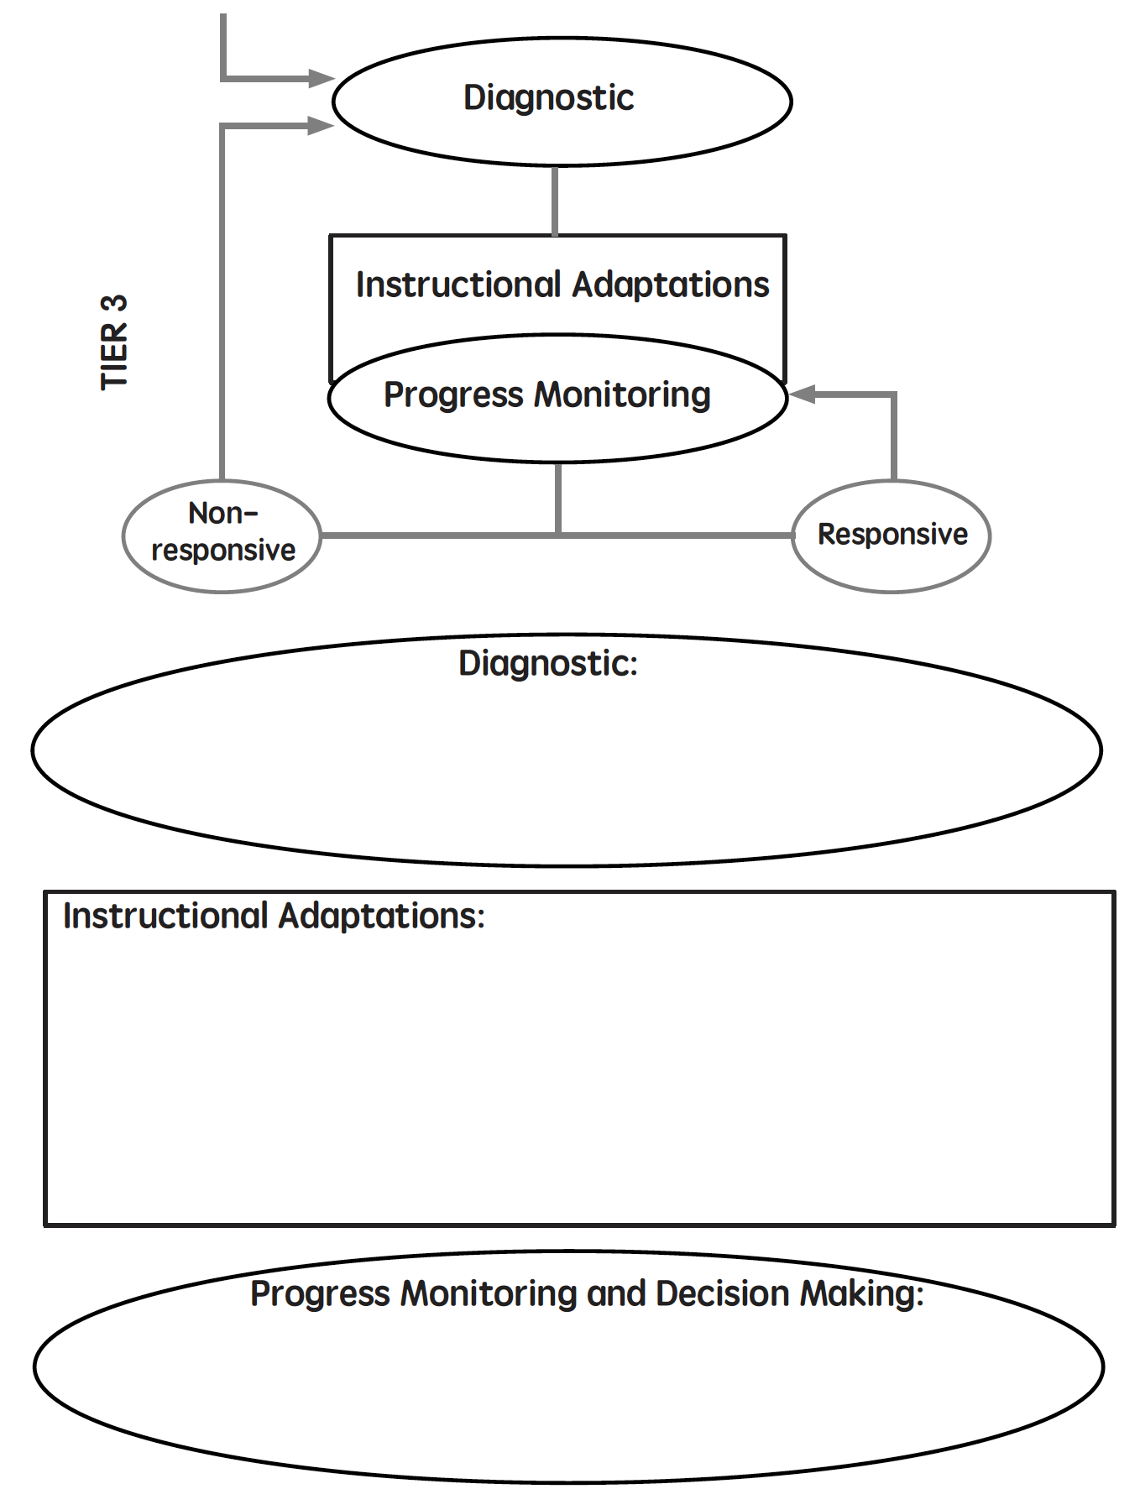
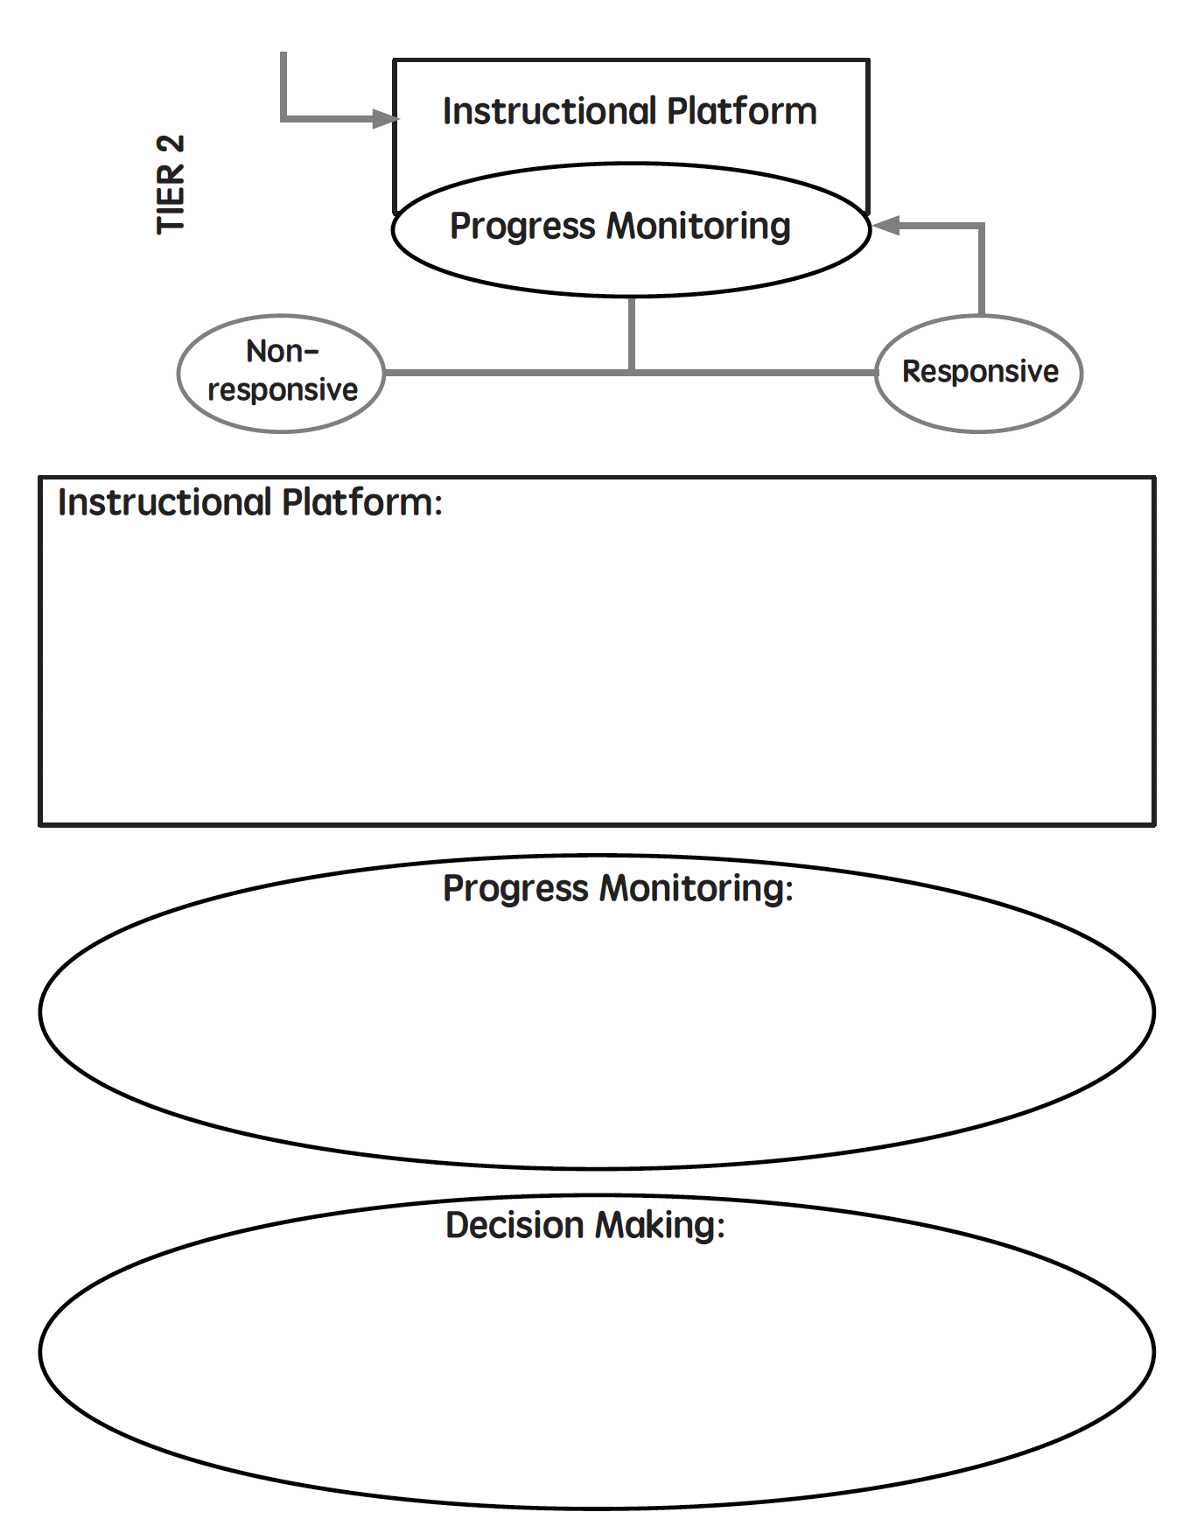
Workbook Activity #6
Create your plan for implementation of DBI. Fill in the DBI diagram.

Slide 95
Discussion Board
Share your excitement and concerns about starting (or continuing) DBI.

Slide 96
Slide 96
Closing

Slide 97
Thank You!
Suzanne Forsyth
Marney Pollack
Lela Spielberg
Devin Kearns
Lynn Fuchs
Diane Bryant
Ben Clarke
Our teachers
Our students

Slide 98
Objectives
PART 1: How do you implement intensive intervention with fidelity?
PART 2: How do you make adaptations within DBI?
PART 3: How does all of this come together within a DBI framework?

Slide 99
Part 1
Fidelity: Adherence to the intervention or strategy
Quantitative
Qualitative

Slide 100
Part 1’s Checklist: How do you implement intensive intervention with fidelity?
Implement interventions and strategies with high fidelity
Check fidelity using quantitative indicators
Check fidelity using qualitative indicators

Slide 101
Slide 101
Implement with greater fidelity
Adaptation
Embed behavioral supports
Increase dosage
Adapt mathematics content
Utilize explicit instruction
Explicitly teach transfer

Slide 102
Part 2’s Checklist: How do you make adaptations within DBI?
Implement with greater fidelity
Embed behavioral supports
Increase dosage
Adapt mathematics content
Utilize explicit instruction
Explicitly teach transfer

Slide 103
Slide 103
Conduct a diagnostic assessment of the student’s strengths and weaknesses
Design a scope and sequence
Identify instructional platform (evidence-based intervention or strategy)
1
3
Instructional Platform
3
Occurs frequently (3-4 times a week for 20-40 min/session
Delivered with fidelity
4
5
6
7
8
Occurs weekly
Using a reliable and valid assessment with alternate forms
Goals are set
2
After 6 to 10 weeks, data are interpreted using decisions rules
2
Conducted to understand strengths and weaknesses
Determines adaptations
2
Occurs frequently (3-4 times a week for 20-40 min/session
Delivered with fidelity
8
3
4
5
6
7
Occurs weekly
Using a reliable and valid assessment with alternate forms
Goals are set
2
After 6 to 10 weeks, data are interpreted using decisions rules
2

Slide 104
Part 3’s Checklist: How does all of this come together within a DBI framework?
Develop the instructional platform
Implement progress monitoring
Determine response to intervention
Conduct a diagnostic assessment (if necessary)
Make adaptations (if necessary)
Continue progress monitoring (if necessary)

Slide 105
Slide 105
Video Link: https://youtu.be/8ID17lWoZzo

Slide 106
Slide 106
1: Developing a scope and sequence for intervention
2: Progress monitoring and determining response
3: Selecting evidence-based practices for the instructional platform
4: Instructional delivery: explicit instruction, multiple representations, language
5: Instructional strategies: fluency building, problem solving, motivation
6: Whole number content
7: Rational number content
8: DBI and mathematics: fidelity, adaptations

Slide 107
Classroom Application
Start implementing DBI!

Slide 108
Thank you! Have fun! Good luck!

