Slide 1
Module 4
Intensive Mathematics Intervention: Instructional Delivery

Slide 2
Slide 2
Link to Video: https://youtu.be/HuSBQG8H2XI

Slide 3
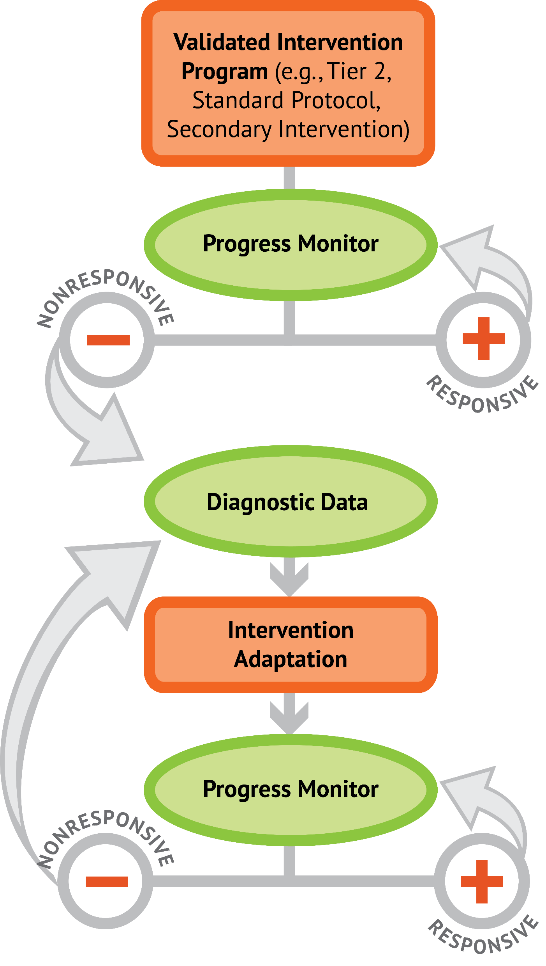
Slide 3
1: Developing a scope and sequence for intervention
2: Progress monitoring and determining response
3: Selecting evidence-based practices for the instructional platform
4: Instructional delivery: explicit instruction, multiple representations, language
5: Instructional strategies: fluency building, problem solving, motivation
6: Whole number content
7: Rational number content
8: DBI and mathematics: fidelity, adaptations

Slide 4
Objectives
PART 1: How do you use explicit instruction within intensive intervention?
PART 2: How should multiple representations be used within intensive intervention?
PART 3: How do you attend to language within intensive intervention?

Slide 5
Activities
PART 1: How do you use explicit instruction within intensive intervention?
Fill in components of modeling
Determine examples and non-examples
Fill in components of practice
Fill in supporting practices
Share a video of your explicit instruction

Slide 6
Activities
PART 2: How should multiple representations be used within intensive intervention?
Identify concrete materials you could use
Identify virtual representations you could use
Determine concrete, representational, and abstract activities to help a student
Share concrete or representational things you use

Slide 7
Activities
PART 3: How do you attend to language within intensive intervention?
Determine “instead of…say…” instances
Identify the precise and concise mathematical language within an intensive intervention protocol
Share examples of “instead of…say…”

Slide 8
Reading
Miller, S. P., & Hudson, P. J. (2007). Using evidence-based practices to build mathematics competence related to conceptual, procedural, and declarative knowledge. Learning Disabilities Research and Practice, 22, 47–57.

Slide 9
Classroom Application
Fill in the explicit instruction graphic organizer for an upcoming lesson.

Slide 10
Welcome!
Let’s get started on Module 4!

Slide 11
Slide 11
Part 1

Slide 12
How do you use explicit instruction within intensive intervention?
Module 4, Part 1

Slide 13
Part 1 Objectives
In this part, you’ll learn—
How to include modeling and practice within delivery of intensive intervention
Which supporting practices are necessary within explicit instruction

Slide 14
Where Are We?

Slide 15
Slide 15
Instructional Platform
Conduct a diagnostic assessment of the student’s strengths and weaknesses
Design a scope and sequence
Identify instructional platform
1. evidence-based intervention
2. evidence-based strategy

Slide 16
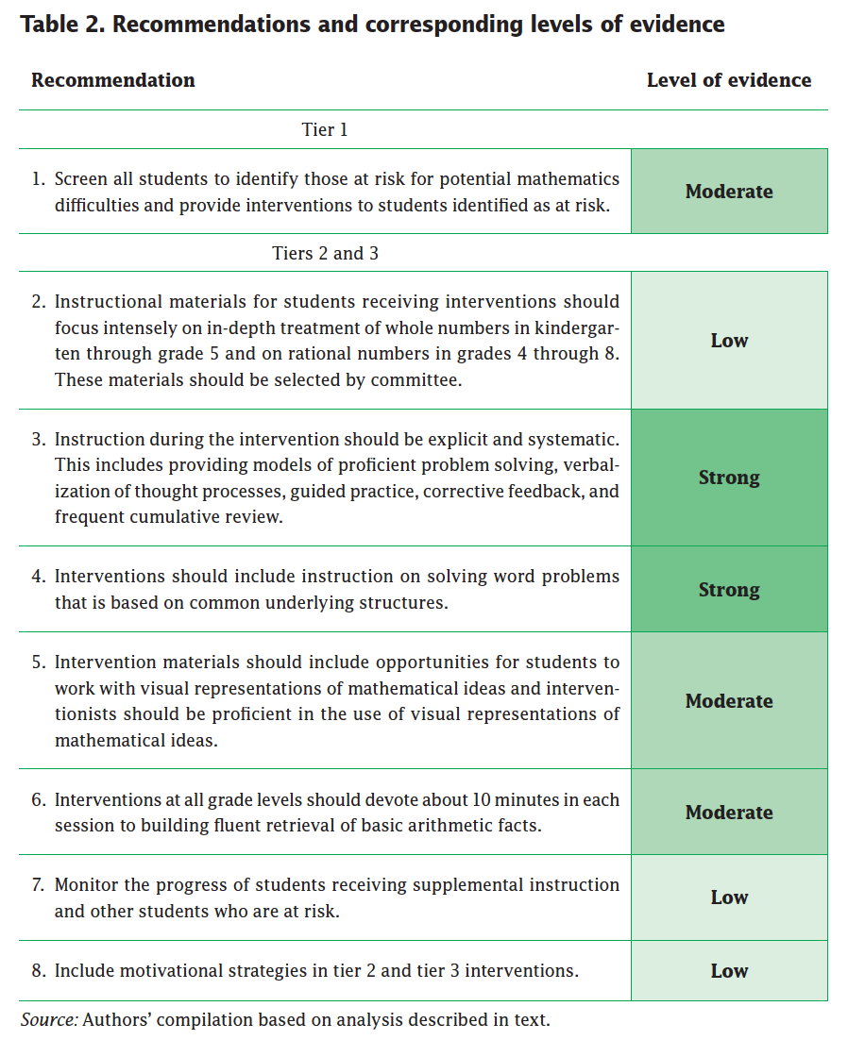
Slide 16
Explicit instruction
Multiple representations
Concise language
Fluency building
Problem solving instruction
Motivation component
Gersten et al. (2009)

Slide 17
Explicit Instruction
I Do
Modeling
Practice
Clear Explanation
Guided
Practice
We Do
Planned
Examples
Independent Practice
You Do
Supporting Practices
Asking the right questions
Eliciting frequent responses
Providing immediate specific feedback
Maintaining a brisk pace

Slide 18
Slide 18

Slide 19
Explicit Instruction
I Do
Modeling
Practice
Clear Explanation
Guided
Practice
We Do
Planned
Examples
Independent Practice
You Do
Supporting Practices
Asking the right questions
Eliciting frequent responses
Providing immediate specific feedback
Maintaining a brisk pace

Slide 20
Slide 20
Goal and importance
“Today, we are learning about division. This is important because sometimes you have to share objects or things with your friends.”
Modeling
Practice
Clear Explanation
Guided
Practice
We Do
Planned
Examples
Independent Practice
“Let’s continue working with our three-dimensional shapes and volume. Understanding volume and calculating volume helps with measuring capacity.”
You Do
Supporting Practices
Asking the right questions
Eliciting frequent responses
Providing immediate specific feedback
Maintaining a brisk pace

Slide 21
Slide 21
Goal and importance
Link to Video: https://youtu.be/ixWgcht9T5w
Practice
Guided
Practice
We Do
Independent Practice
You Do
Supporting Practices
Asking the right questions
Eliciting frequent responses
Providing immediate specific feedback
Maintaining a brisk pace

Slide 22
Slide 22
Goal and importance
Model steps
Modeling
Practice
Clear Explanation
Guided
Practice
“To solve 26 plus 79, I first decide about the operation. Do I add, subtract, multiply or divide?”
We Do
Planned
Examples
Independent Practice
“The plus sign tells me to add. So, I’ll add 26 plus 79. I’ll use the partial sums strategy. First, I add 20 plus 70. What’s 20 plus 70?”
You Do
Supporting Practices
“20 plus 70 is 90. I write 90 right here.”
Asking the right questions
Eliciting frequent responses
Providing immediate specific feedback
Maintaining a brisk pace
“Then I add 6 plus 9. What’s 6 plus 9?”
“6 plus 9 is 15. So, I write 15 here.”
“Finally, we add the partial sums: 90 and 15. 90 plus 15 is 105. So, 26 plus 79 equals 105.”

Slide 23
Slide 23
Model steps
Link to Video: https://youtu.be/2OshBVGFCI0
Practice
Guided
Practice
We Do
Independent Practice
You Do
Supporting Practices
Asking the right questions
Eliciting frequent responses
Providing immediate specific feedback
Maintaining a brisk pace

Slide 24
Slide 24
Model steps
Link to Video: https://youtu.be/IJMlrvSkPE8
Practice
Guided
Practice
We Do
Independent Practice
You Do
Supporting Practices
Asking the right questions
Eliciting frequent responses
Providing immediate specific feedback
Maintaining a brisk pace

Slide 25
Slide 25
Goal and importance
Model steps
Modeling
Practice
Clear Explanation
Concise language
Guided
Practice
We Do
Planned
Examples
Independent Practice
“To solve 26 plus 79, I first decide about the operation. Do I add, subtract, multiply or divide?”
You Do
“The plus sign tells me to add. So, I’ll add 26 plus 79. I’ll use the partial sums strategy. First, I add 20 plus 70. What’s 20 plus 70?”
Supporting Practices
Asking the right questions
Eliciting frequent responses
Providing immediate specific feedback
Maintaining a brisk pace
“20 plus 70 is 90. I write 90 right here.”
“Then I add 6 plus 9. What’s 6 plus 9?”
“6 plus 9 is 15. So, I write 15 here.”
“Finally, we add the partial sums: 90 and 15. 90 plus 15 is 105. So, 26 plus 79 equals 105.”

Slide 26
Slide 26
Concise language
Link to Video: https://youtu.be/IJMlrvSkPE8
Practice
Guided
Practice
We Do
Independent Practice
You Do
Supporting Practices
Asking the right questions
Eliciting frequent responses
Providing immediate specific feedback
Maintaining a brisk pace

Slide 27
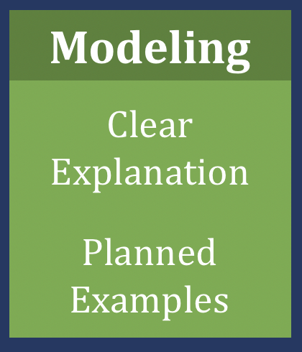
Slide 27
Workbook Activity #1
Watch this video of intensive intervention. Fill in the table with the different components of modeling.
Link to Video: https://youtu.be/LSwqLoQFnCU

Slide 28
Slide 28
Examples
“Today, we are learning about division. This is important because sometimes you have to share objects or things with your friends.”
Modeling
Practice
Clear Explanation
Guided
Practice
24 / 6
We Do
35 $)$ 5
28 $÷$ 7
Planned
Examples
Independent Practice
You Do
Supporting Practices
Asking the right questions
Eliciting frequent responses
Providing immediate specific feedback
Maintaining a brisk pace

Slide 29
Slide 29
Examples
“Today, we are learning about division. This is important because sometimes you have to share objects or things with your friends.”
Modeling
Practice
Clear Explanation
Guided
Practice
24 / 6
We Do
35 $)$ 5
28 $÷$ 7
Planned
Examples
Independent Practice
You Do
Non-examples
Supporting Practices
Asking the right questions
Eliciting frequent responses
Providing immediate specific feedback
Maintaining a brisk pace
32 $÷$ 8
42 $÷$ 7
25 $−$ 5

Slide 30
Slide 30
Workbook Activity #2
Look at each of the intensive intervention topics. What would be four examples and two non-examples to use in modeling or practice?

Slide 31
Explicit Instruction
Modeling
Practice
Clear Explanation
Guided
Practice
Planned
Examples
Independent Practice
Supporting Practices
Asking the right questions
Eliciting frequent responses
Providing immediate specific feedback
Maintaining a brisk pace

Slide 32
Slide 32
I Do
Modeling
Practice
Clear Explanation
Guided
Practice
Planned
Examples
Independent Practice
Supporting Practices
Asking the right questions
Eliciting frequent responses
Providing immediate specific feedback
Maintaining a brisk pace

Slide 33
Slide 33
Teacher and student practice together
Practice
Guided
Practice
Independent Practice

Slide 34
Slide 34
Teacher and student practice together
Link to Video: https://youtu.be/KHQgpa8DjYs

Slide 35
Slide 35
Teacher and student practice together
Student practices with teacher support
Practice
Guided
Practice
Independent Practice

Slide 36
Slide 36
Teacher and student practice together
Student practices with teacher support
Link to Video: https://youtu.be/noNlpc_qpIA

Slide 37
Slide 37
Workbook Activity #3
Continue watching this video of intensive intervention. Fill in the table with the different components of practice.
Link to Video: https://youtu.be/5ez7OgRusLY

Slide 38
Explicit Instruction
Modeling
Practice
Clear Explanation
Guided
Practice
Planned
Examples
Independent Practice
Supporting Practices
Asking the right questions
Eliciting frequent responses
Providing immediate specific feedback
Maintaining a brisk pace

Slide 39
Slide 39
I Do
Modeling
Practice
Clear Explanation
Guided
Practice
We Do
Planned
Examples
Independent Practice
You Do
Supporting Practices
Asking the right questions
Eliciting frequent responses
Providing immediate specific feedback
Maintaining a brisk pace

Slide 40
Slide 40
I Do
Low-level and high-level
“What is 7 times 9?”
“Which shape has 6 sides?”
Supporting Practices
“What do you do when you see a word problem?”
Asking the right questions
Eliciting frequent responses
Providing immediate specific feedback
Maintaining a brisk pace
“Why do you have to regroup?”
“How would you solve this problem?”
“Why do you have to use zero pairs?”

Slide 41
Slide 41
I Do
Low-level and high-level
Classwide, individual, partner, write on paper, write on whiteboard, thumbs up, etc.
Supporting Practices
Asking the right questions
Eliciting frequent responses
Providing immediate specific feedback
Maintaining a brisk pace
“Turn and discuss the formula for perimeter with your partner.”
“Write the multiplication problem on your whiteboard.”
“In your math journal, draw a picture to help you remember to term parallelogram.”

Slide 42
Slide 42
I Do
Low-level and high-level
Classwide, individual, partner, write on paper, write on whiteboard, thumbs up, etc.
Supporting Practices
Asking the right questions
Eliciting frequent responses
Providing immediate specific feedback
Maintaining a brisk pace
Affirmative and corrective
“Good work using your word-problem attack strategy.”
“Let’s look at that again. Tell me how you added in the hundreds column.”

Slide 43
Slide 43
Low-level and high-level
Classwide, individual, partner, write on paper, write on whiteboard, thumbs up, etc.
Supporting Practices
Asking the right questions
Eliciting frequent responses
Providing immediate specific feedback
Maintaining a brisk pace
Affirmative and corrective
Planned and organized

Slide 44
Slide 44
Workbook Activity #4
Rewatch the video of intensive intervention. Identify the supporting practices.
Link to Video: https://youtu.be/5ez7OgRusLY

Slide 45
Slide 45
Modeling
Practice
Supporting Practices
Introduction of material
Review of material
Modeling
Practice
Modeling
Practice
Supporting Practices
Supporting Practices

Slide 46
Slide 46
Instructional Platform
Modeling
Practice
Clear Explanation
Guided
Practice
Planned
Examples
Independent Practice
Supporting Practices
Asking the right questions
Eliciting frequent responses
Providing immediate specific feedback
Maintaining a brisk pace

Slide 47
Part 1’s Checklist: How do you use explicit instruction within intensive intervention?
Model steps using concise language
Provide guided practice opportunities
Provide independent practice opportunities
Use supporting practices during modeling and practice
Ask the right questions
Elicit frequent responses
Provide feedback
Be planned and organized

Slide 48
Slide 48
Part 2

Slide 49
How should multiple representations be used within intensive intervention?
Module 4, Part 2

Slide 50
Part 2 Objectives
In this part, you’ll learn:
What is meant by “concrete”
What is meant by “representational”
What is meant by “abstract”

Slide 51
Where Are We?

Slide 52
Slide 52
Instructional Platform
Conduct a diagnostic assessment of the student’s strengths and weaknesses
Design a scope and sequence
Identify instructional platform
1. evidence-based intervention
2. evidence-based strategy

Slide 53
Slide 53
Explicit instruction
Multiple representations
Concise language
Fluency building
Problem solving instruction
Motivation component
Gersten et al. (2009)

Slide 54
Multiple Representations
Abstract
Representational
Concrete

Slide 55
Slide 55
Abstract
Representational
Concrete
Three-dimensional objects

Slide 56
Slide 56
Abstract
Representational
Concrete
Link to Video: https://youtu.be/5zsEG0RJSXI

Slide 57
Slide 57
Workbook Activity #5
Identify 10 concrete materials that you might want to use within intensive intervention.

Slide 58
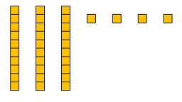
Slide 58
Abstract
Representational
Concrete
Two-dimensional images

Slide 59
Slide 59
Abstract
Representational
Concrete
Link to Video: https://youtu.be/v5z5eyuHCT4

Slide 60
Slide 60
Workbook Activity #6
Identify 10 virtual representations that you might want to use within intensive intervention.
You might want to check out the National Library for Virtual Manipulatives!

Slide 61
Slide 61
Abstract
Representational
Concrete
Numerals and symbols

Slide 62
Slide 62
Abstract
Representational
Concrete
Link to Video: https://youtu.be/a6_keAz1WzU

Slide 63
Multiple Representations
Abstract
Representational
Concrete

Slide 64
Slide 64
Workbook Activity #7
Watch Asher solve 6 + 8.
Describe two concrete activities you could use to help Asher solve the problem correctly.
Describe two representational activities you could use to help Asher solve the problem correctly. Draw them.
Describe one abstract activity for helping Asher solve the problem correctly.
Link to Video: https://youtu.be/AJQEKxb-B9U

Slide 65
Slide 65
Abstract
Representational
Concrete
I Do
Modeling
Practice
Clear Explanation
Guided
Practice
We Do
Planned
Examples
Independent Practice
You Do
Supporting Practices
Asking the right questions
Eliciting frequent responses
Providing immediate specific feedback
Maintaining a brisk pace

Slide 66
Why Is This Important?
Understanding how to use multiple representations fills your intensive intervention tool box.
Abstract
Representational
Concrete

Slide 67
Part 2’s Checklist: How should multiple representations be used within intensive intervention?
Use three-dimensional concrete materials to teach concepts and procedures
Use two-dimensional representations to teach concepts and procedures
Ensure students understand mathematics with numbers and symbols (i.e., the abstract)

Slide 68
Discussion Board
Describe three manipulatives or representations that you use on a regular basis. Describe the pros and cons of each.

Slide 69
Slide 69
Part 3

Slide 70
How do you attend to language within intensive intervention?
Module 4, Part 3

Slide 71
Part 3 Objectives
In this part, you’ll learn—
Why it’s important to be precise with mathematical language
Informal vocabulary terms that teachers often use and the formal vocabulary that could be used

Slide 72
Where Are We?

Slide 73
Slide 73
Instructional Platform
Conduct a diagnostic assessment of the student’s strengths and weaknesses
Design a scope and sequence
Identify instructional platform
1. evidence-based intervention
2. evidence-based strategy

Slide 74
Slide 74
Explicit instruction
Multiple representations
Concise language
Fluency building
Problem solving instruction
Motivation component
Gersten et al. (2009)

Slide 75
Additional Reading
Hughes, E. M., Powell, S. R., & Stevens, E. A. (2016). Supporting clear and concise mathematics language: Instead of that, say this. Teaching Exceptional Children, 49, 7–17. doi:10.1177/0040059916654901

Slide 76
Slide 76
PARCC (2016); Smarter Balanced (2016)

Slide 77
Confusion with Mathematical Language
Homonyms
Homophones
left
square
mean
base
round
ate
eight
some
sum
pie
pi
rows
rose

Slide 78
Language of Mathematics
Technical terms
Subtechnical terms
Symbolic terms
General terms
trapezoid
rhombus
numerator
addend
subtract
base
degrees
cube
plane
arc
plus
zero
twelve
dollars
and
above
measure
answer
longest
outside

Slide 79
Slide 79
Instead of…
Say…
“And the last one is 10.”
“8, 9, 10. We’ll stop counting there but we could count more.”
“What number is in the tens place?”
“What digit is in the tens place?”
“Six hundred and forty-eight”
“Six hundred forty-eight”
“Bigger number and smaller number”
“Number that is greater and the number that is less”
Hughes et al. (2016)

Slide 80
Slide 80
Instead of…
Say…
“Numbers in the fraction”
“This fraction is one number.”
“Top number and bottom number”
“Numerator and denominator”
“Reduce”
“Find an equivalent fraction”
“One point two nine”
“One and twenty-nine hundredths”
Hughes et al. (2016)

Slide 81
Slide 81
Instead of…
Say…
“Corner”
“Angle”
“Flips, slides, and turns”
“Reflections, translations, and rotations”
“Box or ball
“Cube or sphere”
“Long hand and short hand”
“Minute hand and hour hand”
Hughes et al. (2016)

Slide 82
Slide 82
Workbook Activity #8
Fill in the chart with your own “Instead of…say…” for each of the mathematics strands.

Slide 83
Slide 83
precise
“The denominator is the number of equal parts that make the whole.”
“A difference problem is two amounts compared for the difference.”
“To show the fraction, look at the denominator. A denominator of 5 means I need to break the whole into 5 equal parts.”
concise
“To use partial sums, add the hundreds, then add the tens, then add the ones. Finally, add all the partial sums.”

Slide 84
Slide 84
Link to Video:
https://youtu.be/HC9iKMEBk6s

Slide 85
Slide 85
Workbook Activity #9
Look at this intensive intervention lesson about word problems. Identify five instances where the mathematical language is precise. Identify five instances where the mathematical language is concise.

Slide 86
Part 3’s Checklist: How do you attend to language within intensive intervention?
Understand why formal mathematical language is important
Plan for mathematical language to be precise
Plan for mathematical language to be concise

Slide 87
Discussion Board
Share three examples of "instead of…, say…!" with your classmates.

Slide 88
Slide 88
Closing

Slide 89
Objectives
PART 1: How do you use explicit instruction within intensive intervention?
PART 2: How should multiple representations be used within intensive intervention?
PART 3: How do you attend to language within intensive intervention?

Slide 90
Slide 90
Link to Video: https://youtu.be/HuSBQG8H2XI

Slide 91
Slide 91
1: Developing a scope and sequence for intervention
2: Progress monitoring and determining response
3: Selecting evidence-based practices for the instructional platform
4: Instructional delivery: explicit instruction, multiple representations, language
5: Instructional strategies: fluency building, problem solving, motivation
6: Whole number content
7: Rational number content
8: DBI and mathematics: fidelity, adaptations

Slide 92
Part 1
I Do
Modeling
Practice
Clear Explanation
Guided
Practice
We Do
Planned
Examples
Independent Practice
You Do
Supporting Practices
Asking the right questions
Eliciting frequent responses
Providing immediate specific feedback
Maintaining a brisk pace

Slide 93
Part 1’s Checklist: How do you use explicit instruction within intensive intervention?
Model steps using concise language
Provide guided practice opportunities
Provide independent practice opportunities
Use supporting practices during modeling and practice
Ask the right questions
Elicit frequent responses
Provide feedback
Be planned and organized

Slide 94
Part 2
Abstract
Representational
Concrete

Slide 95
Part 2’s Checklist: How should multiple representations be used within intensive intervention?
Use three-dimensional concrete materials to teach concepts and procedures
Use two-dimensional representations to teach concepts and procedures
Ensure students understand mathematics with numbers and symbols (i.e., the abstract)

Slide 96
Part 3
precise
concise

Slide 97
Part 3’s Checklist: How do you attend to language within intensive intervention?
Understand why formal mathematical language is important
Plan for mathematical language to be precise
Plan for mathematical language to be concise

Slide 98
Slide 98
Instructional Platform
Abstract
Representational
Concrete
Modeling
Practice
Clear Explanation
Guided
Practice
Planned
Examples
Independent Practice
Supporting Practices
Asking the right questions
Eliciting frequent responses
Providing immediate specific feedback
Maintaining a brisk pace

Slide 99
Slide 99
Instructional Platform
INSTRUCTIONAL DELIVERY
Explicit instruction
Multiple representations
Concise language
INSTRUCTIONAL STRATEGIES

Slide 100
Classroom Application
Fill in the explicit instruction graphic organizer for an upcoming lesson.

Slide 101
Looking Ahead

Slide 102
Slide 102
1: Developing a scope and sequence for intervention
2: Progress monitoring and determining response
3: Selecting evidence-based practices for the instructional platform
4: Instructional delivery: explicit instruction, multiple representations, language
5: Instructional strategies: fluency building, problem solving, motivation
6: Whole number content
7: Rational number content
8: DBI and mathematics: fidelity, adaptations

Slide 103
Module 5
Woodward, J., Beckmann, S., Driscoll, M., Franke, M., Herzig, P., Jitendra, A.,..Ogbuehi, P. (2012). Improving mathematical problem solving in grades 4 through 8. Washington, DC: National Center for Education Evaluation and Regional Assistance, Institute of Education Sciences, U.S. Department of Education.

Slide 104
See You Soon!

