Slide 1
Module 3
Selecting and Evaluating Evidence-Based Practices in Mathematics

Slide 2
Slide 2
Link to Video: https://youtu.be/sh2dyx2BZf0

Slide 3
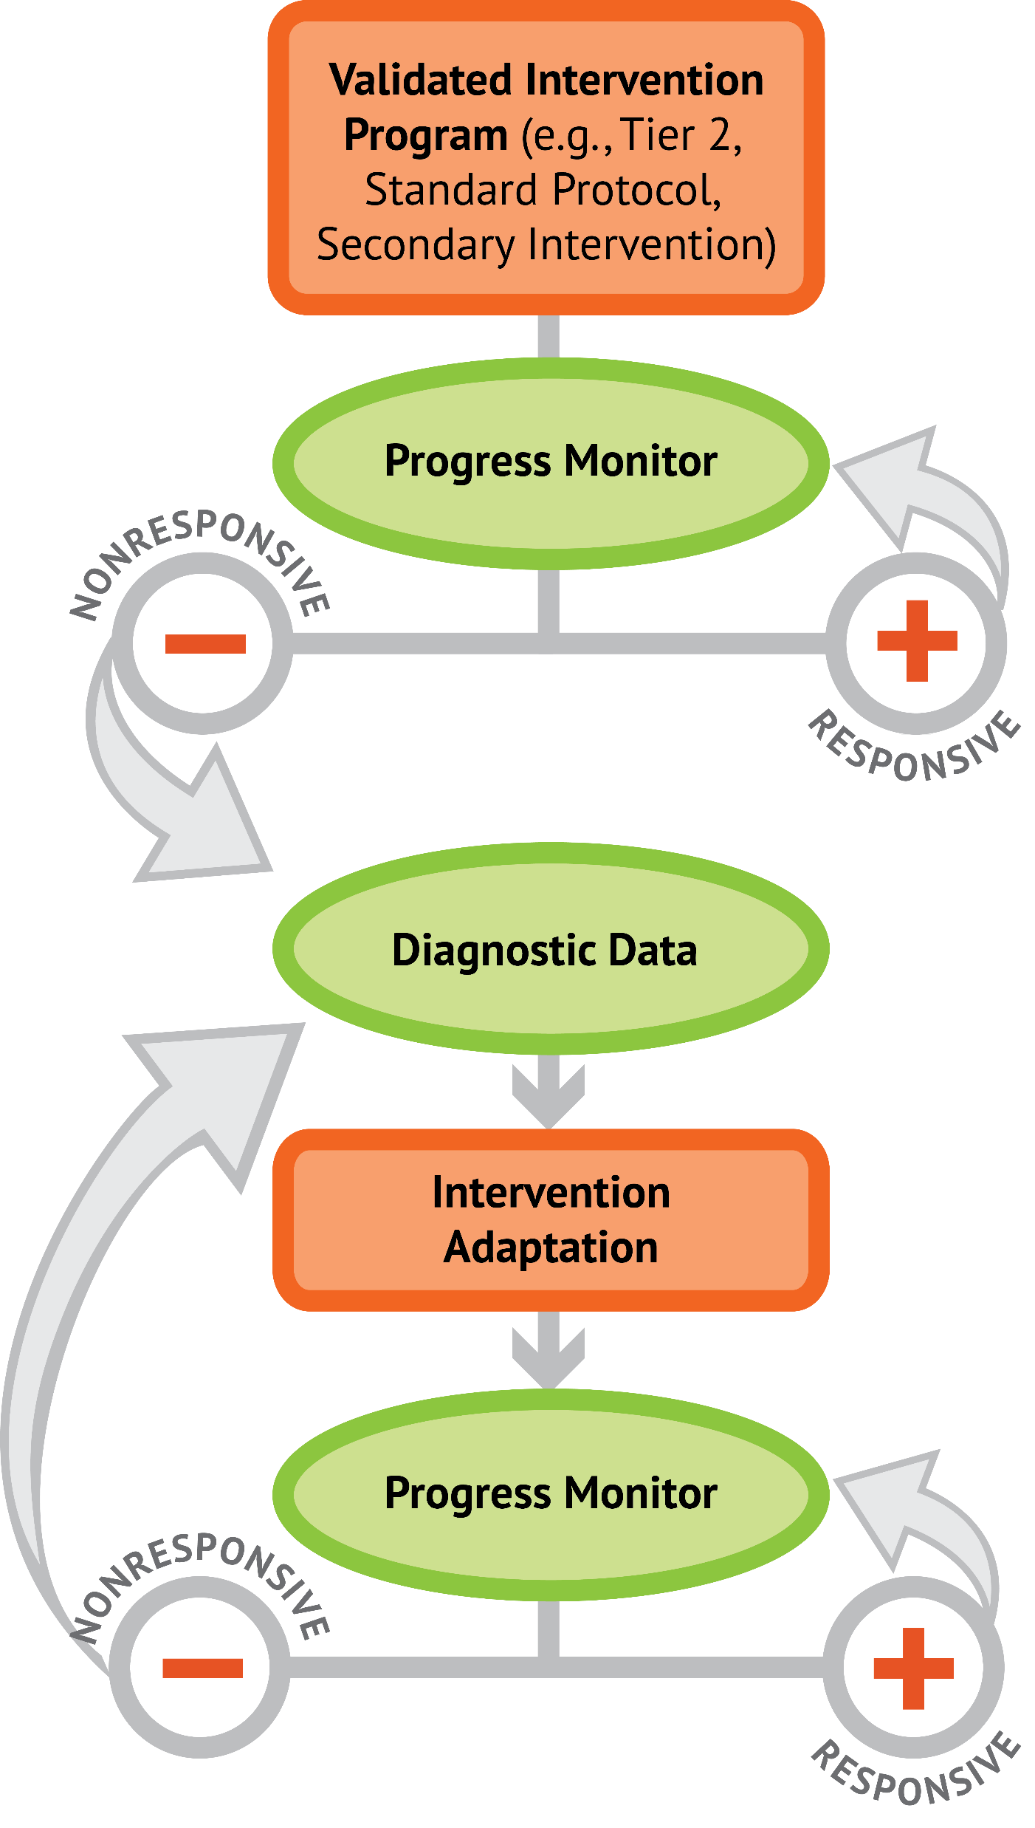
Slide 3
1: Developing a scope and sequence for intervention
2: Progress monitoring and determining response
3: Selecting evidence-based practices for the instructional platform
4: Instructional delivery: explicit instruction, multiple representations, language
5: Instructional strategies: fluency building, problem solving, motivation
6: Whole number content
7: Rational number content
8: DBI and mathematics: fidelity, adaptations

Slide 4
Objectives
PART 1: What are the forms of evidence-based practices in intensive intervention?
PART 2: Where do you locate evidence-based practices?
PART 3: How do you determine the instructional platform for intensive intervention?

Slide 5
Activities
PART 1: What are the forms of evidence-based practices in intensive intervention?
Determine differences between types of evidence
Rate evidence
Share an example of an evidence-based intervention or strategy that you find useful in the classroom

Slide 6
Activities
PART 2: Where do you locate evidence-based practices?
Look at websites for evidence-based practices
Locate mathematics interventions and rate the evidence

Slide 7
Activities
PART 3: How do you determine the instructional platform for intensive intervention?
Create a scope and sequence for a student and determine evidence-based practices
Make a table of the evidence-based interventions and strategies available at your grade level
Describe the evidence-based practices you need

Slide 8
Reading
Hughes, E. M., Powell, S. R., Lembke, E. S., & Riley-Tillman, T. C. (2016). Taking the guesswork out of locating evidence-based practices for diverse learners. Learning Disabilities Research and Practice, 31, 130–141. doi:10.1111/ldrp.12103

Slide 9
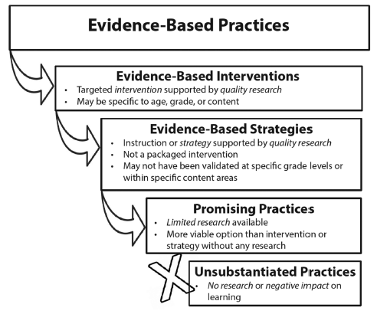
Slide 9

Slide 10
Classroom Application
Evaluate a current instructional intervention or strategy. What is the evidence?

Slide 11
Welcome!
Let’s get started on Module 3!

Slide 12
Slide 12
Part 1

Slide 13
What are the forms of evidence-based practices in intensive intervention?
Module 3, Part 1

Slide 14
Part 1 Objectives
In this part, you’ll learn—
The definition of the term “evidence-based practice”
The differences among evidence-based practices, evidence-based intervention, evidence-based strategies, and promising practices

Slide 15
Where Are We?

Slide 16
Reading
Hughes, E. M., Powell, S. R., Lembke, E. S., & Riley-Tillman, T. C. (2016). Taking the guesswork out of locating evidence-based practices for diverse learners. Learning Disabilities Research and Practice, 31, 130–141. doi:10.1111/ldrp.12103

Slide 17
Slide 17
A practice that has shown consistent and positive results
evidence-based practice

Slide 18
Slide 18
evidence-based practice
An intervention (i.e., packaged program) that has shown consistent and positive results
evidence-based intervention

Slide 19
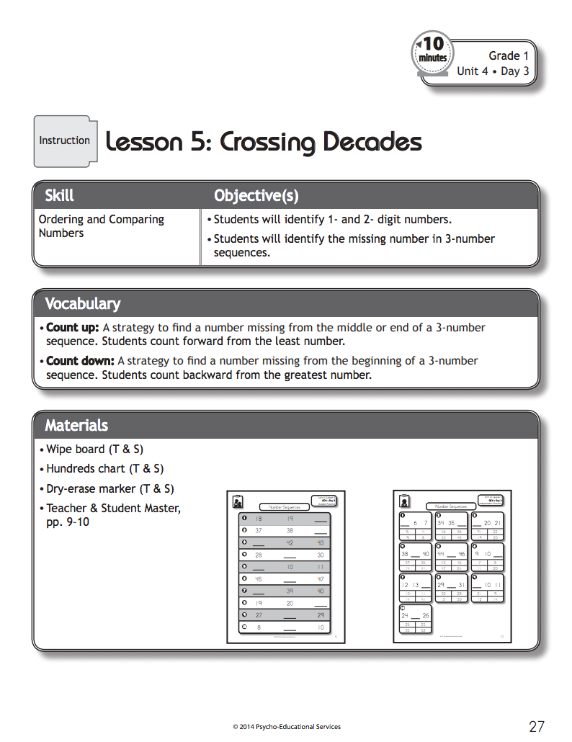
Slide 19
evidence-based practice
evidence-based intervention
Bryant, Bryant, Roberts, Vaughn, Hughes, Porterfield, & Gersten (2011)

Slide 20
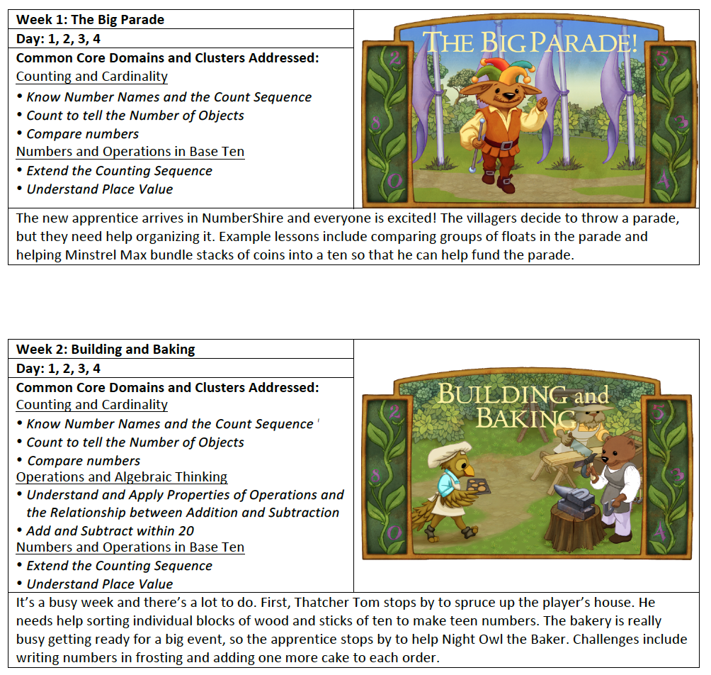
Slide 20
evidence-based practice
evidence-based intervention
https://dibels.uoregon.edu/market/numbershire

Slide 21
Slide 21
evidence-based practice
evidence-based intervention
Fuchs, Schumacher, & Fuchs (2014)

Slide 22
Slide 22
evidence-based practice
evidence-based intervention
evidence-based strategy
A method or strategy that has shown consistent and positive results

Slide 23
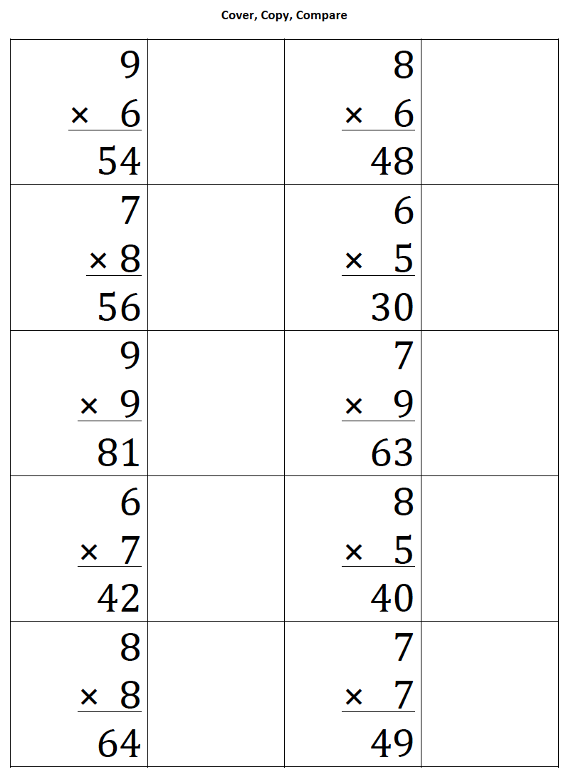
Slide 23
evidence-based practice
evidence-based strategy
ebi.missouri.edu/wp-content/uploads/2013/09/EBI-Brief-Template-Cover-Copy-and-Compare.pdf

Slide 24
Slide 24
evidence-based practice
evidence-based strategy
Strickland & Maccini (2012)

Slide 25
Slide 25
evidence-based practice
5
+ 6
2
+ 2
evidence-based strategy
Burns (2005)
7
+ 4
2
+ 6

Slide 26
Slide 26
evidence-based practice
evidence-based intervention
evidence-based strategy
A method or strategy that has shown a positive result
promising practice

Slide 27
Slide 27
evidence-based practice
evidence-based intervention
evidence-based strategy
promising practice
no or negative evidence

Slide 28
Slide 28
evidence-based practice
evidence-based intervention
evidence-based strategy
promising practice

Slide 29
s;lide 29
Workbook Activity #1
Look at the examples of different evidence-based practices. Is each an evidence-based intervention, an evidence-based strategy, or a promising practice?

Slide 30
Slide 30
Assessment data to show results
evidence-based practice
Improvement from before intervention
Improvement compared to no treatment students
Replication
evidence-based intervention
Multiple researchers
evidence-based strategy
Multiple students
Multiple times
promising practice
Setting and students similar to your own

Slide 31
Slide 31
Workbook Activity #2
Look at the same examples of the evidence-based practices. How would you rate the evidence?

Slide 32
Slide 32
Instructional Platform
1. evidence-based intervention
2. evidence-based strategy

Slide 33
Part 1’s Checklist: What are the forms of evidence-based practices in intensive intervention?
Define evidence-based practices
Identify the differences among evidence-based interventions, evidence-based strategies, and promising practices

Slide 34
Discussion Board
Share an example of an evidence-based intervention or strategy that you find useful in the classroom.

Slide 35
Slide 35
Part 2

Slide 36
Where do you locate evidence-based practices?
Module 3, Part 2

Slide 37
Part 2 Objectives
In this part, you’ll learn:
Several methods for locating evidence-based practices
How to understand what constitutes “evidence”

Slide 38
Where Are We?

Slide 39
Slide 39
evidence-based practice
evidence-based intervention
evidence-based strategy
promising practice

Slide 40
Journals or Books
Exceptional Children
Intervention in School and Clinic
Journal of Educational Psychology
Journal of Learning Disabilities
Learning and Individual Differences
Learning Disability Quarterly
Learning Disabilities Research and Practice
Teaching Exceptional Children

Slide 41
Websites
ies.ed.gov/ncee/wwc/

Slide 42
Websites
www.evidenceforessa.org

Slide 43
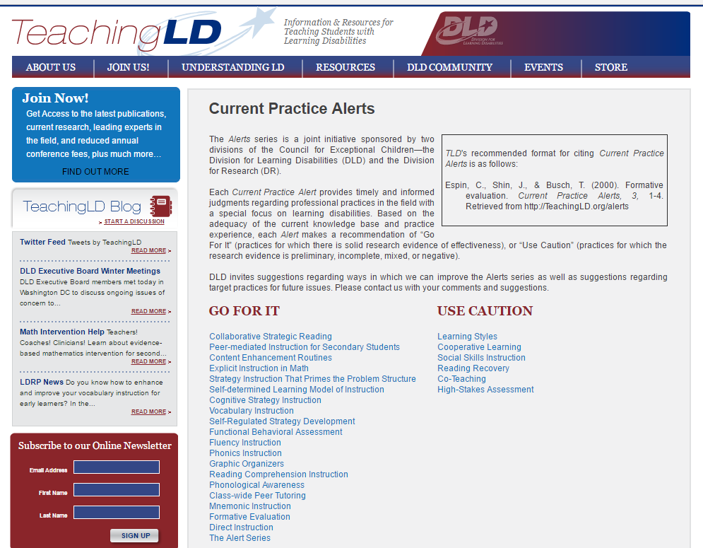
Websites
teachingld.org

Slide 44
Websites
ebi.missouri.edu

Slide 45
Websites
www.intensiveintervention.org

Slide 46
Slide 46
Workbook Activity #3
Locate a Tier 2 evidence-based practice in mathematics for a 4th-grade student.
Compare sites on:
Ease of locating information
Quality of information
Pros and cons of the site

Slide 47
Slide 47
Assessment data to show results
evidence-based practice
Improvement from before intervention
Improvement compared to no treatment students
Replication
evidence-based intervention
Multiple researchers
evidence-based strategy
Multiple students
Multiple times
promising practice
Setting and students similar to your own

Slide 48
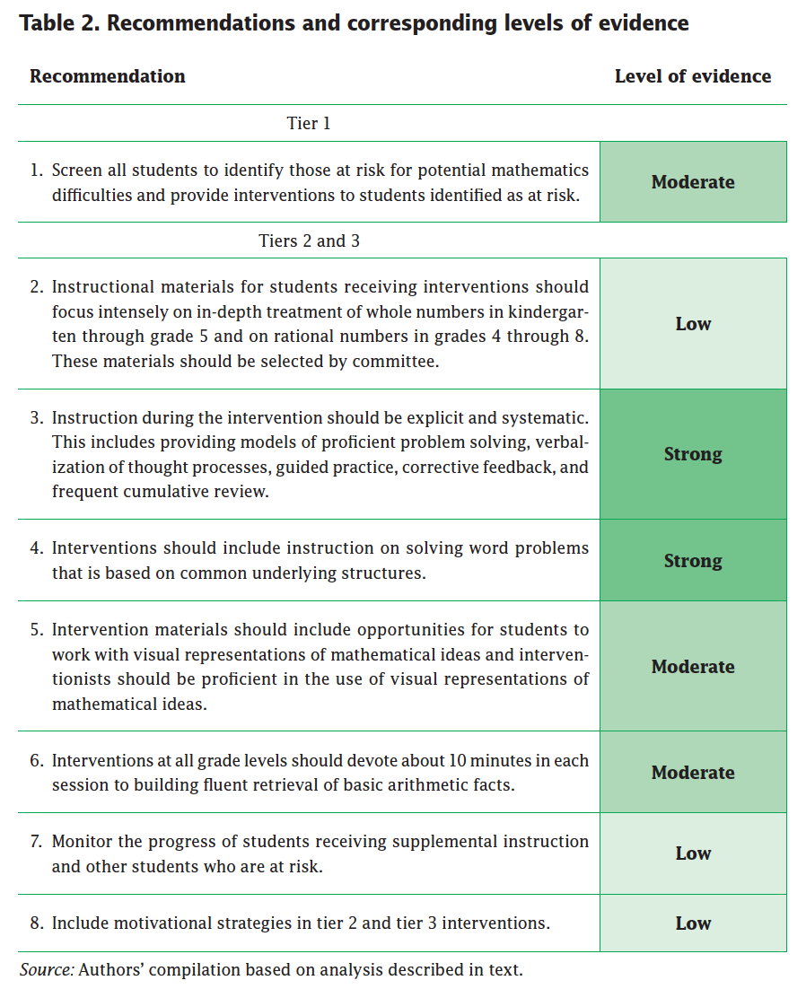
Slide 48
Assessment data to show results
Improvement from before intervention
Improvement compared to no treatment students
Replication
Multiple researchers
Multiple students
Multiple times
Gersten et al. (2009)
Setting and students similar to your own

Slide 49
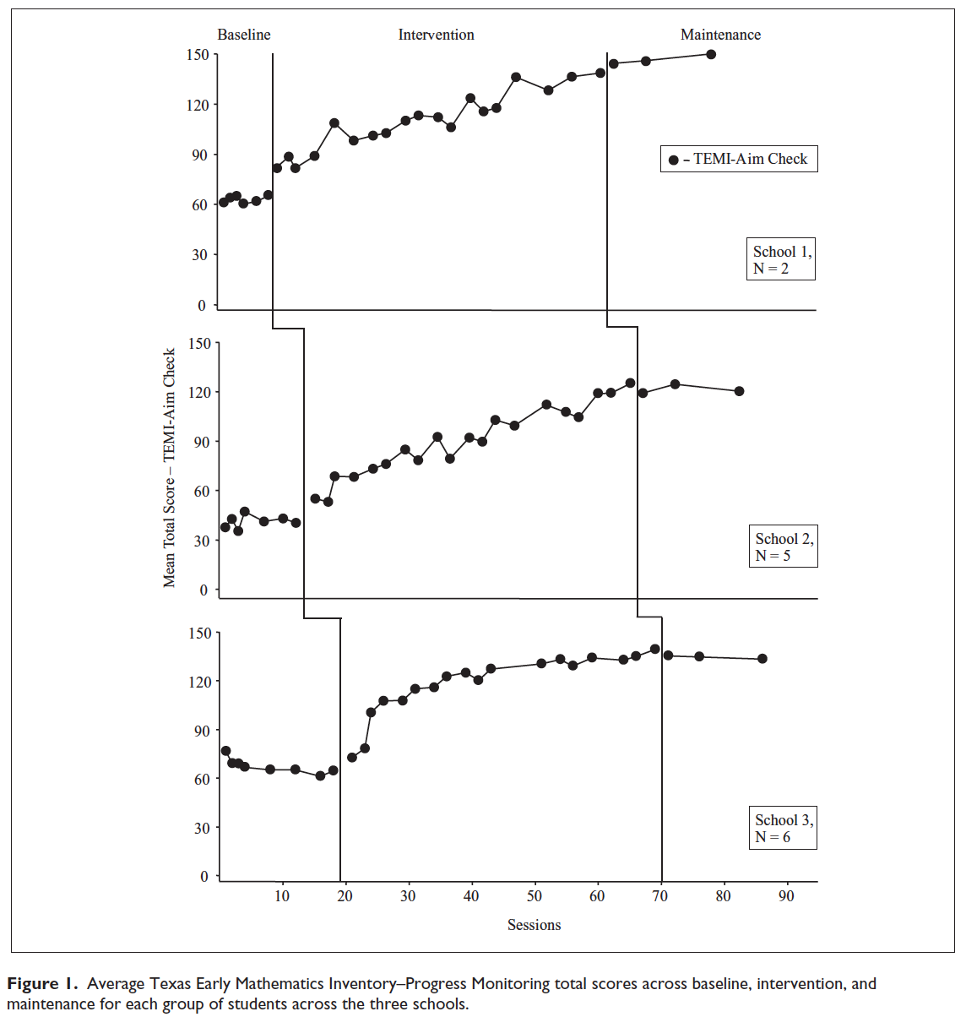
Slide 49
Assessment data to show results
Significant difference from baseline to posttest
Improvement from before intervention
Improvement compared to no treatment students
Replication
Multiple researchers
Multiple students
Multiple times
Bryant et al. (2016)
Setting and students similar to your own

Slide 50
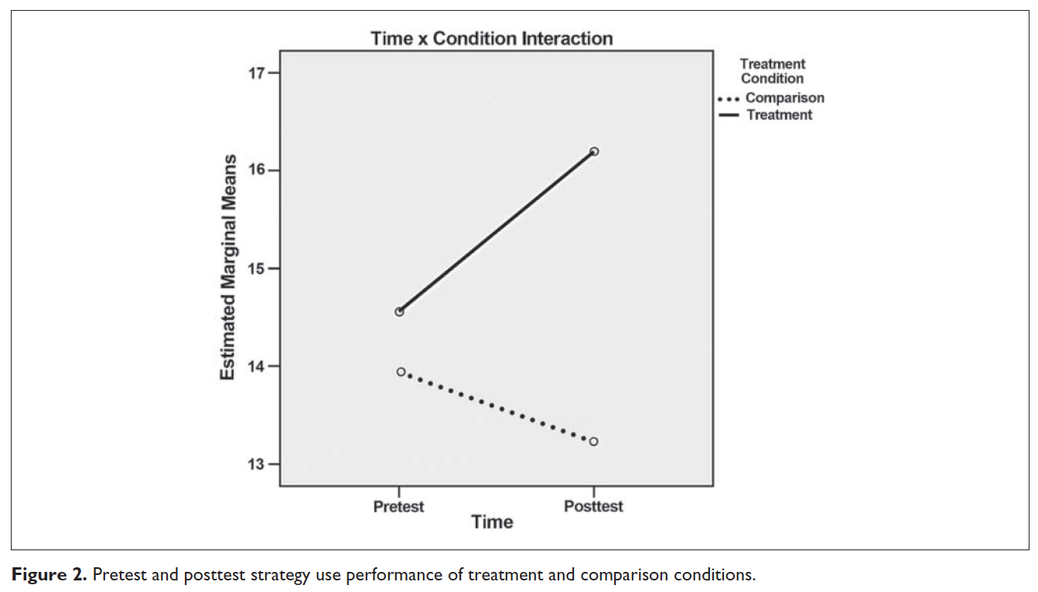
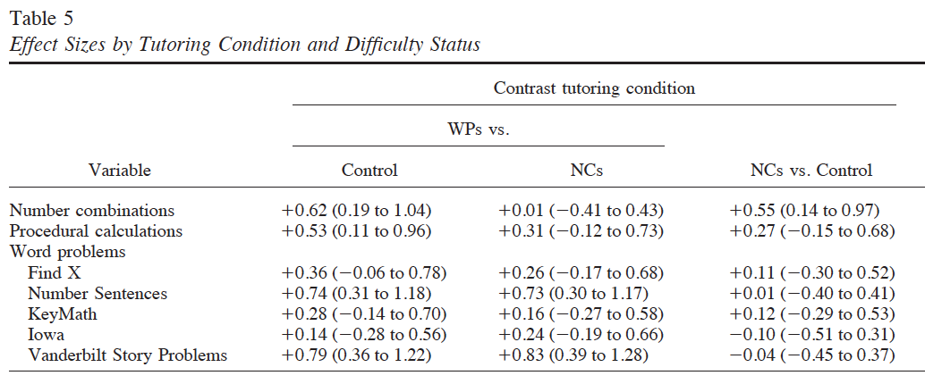
Slide 50
Significant difference between conditions
Assessment data to show results
Improvement from before intervention
Improvement compared to no treatment students
Replication
Fuchs et al. (2009); Krawec, Huang, Montague, Kressler, & de Alba (2012)
Multiple researchers
Multiple students
Multiple times
Setting and students similar to your own

Slide 51
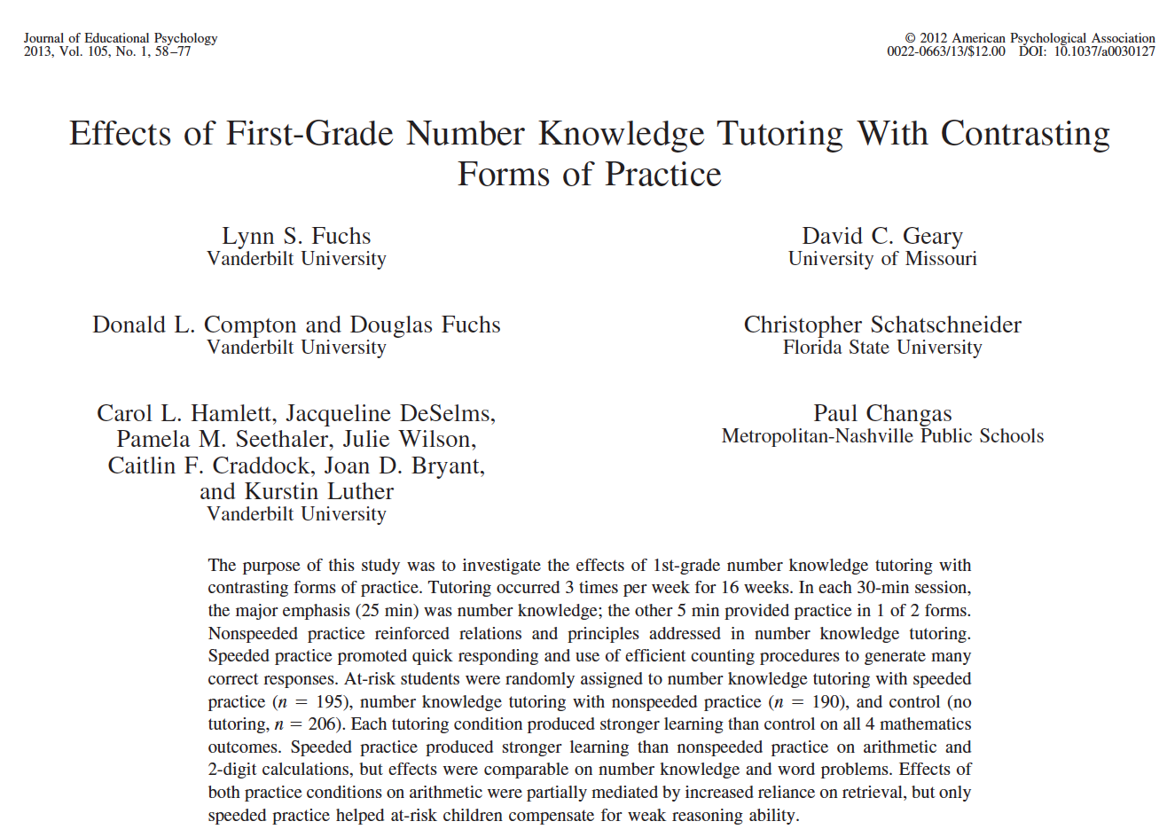
Slide 51
Assessment data to show results
Improvement from before intervention
Improvement compared to no treatment students
Replication
Multiple researchers
Multiple students
Multiple times
Setting and students similar to your own

Slide 52
Slide 52
Assessment data to show results
Improvement from before intervention
Improvement compared to no treatment students
Replication
Multiple researchers
Multiple students
Multiple times
Setting and students similar to your own

Slide 53
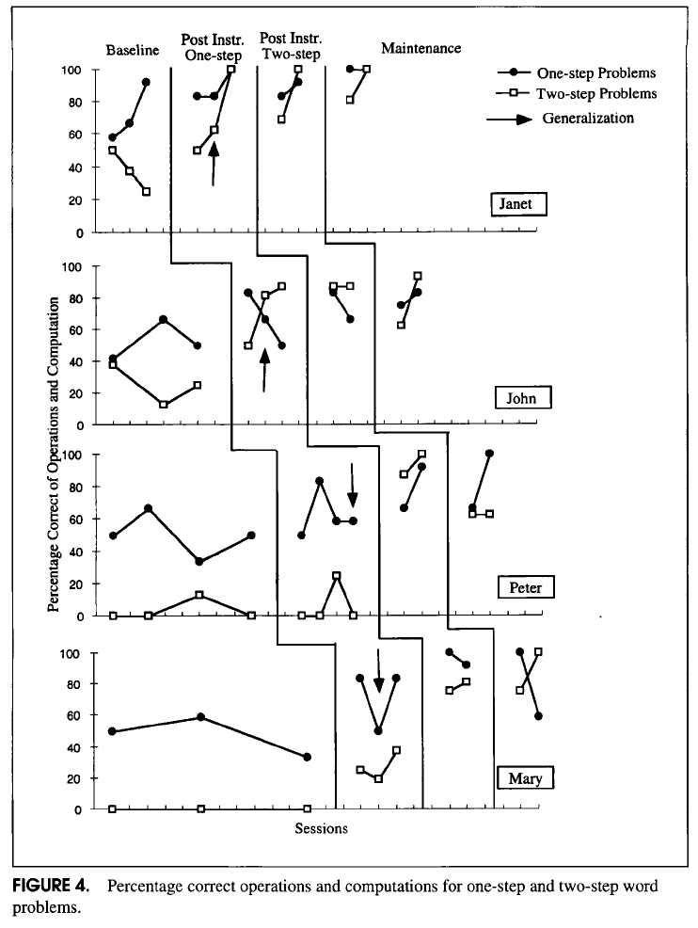
Slide 53
Assessment data to show results
Improvement from before intervention
Improvement compared to no treatment students
Replication
Burns, Kanive, & DeGrande (2012); Jitendra, Hoff, & Beck (1999)
Multiple researchers
Multiple students
Multiple times
Setting and students similar to your own

Slide 54
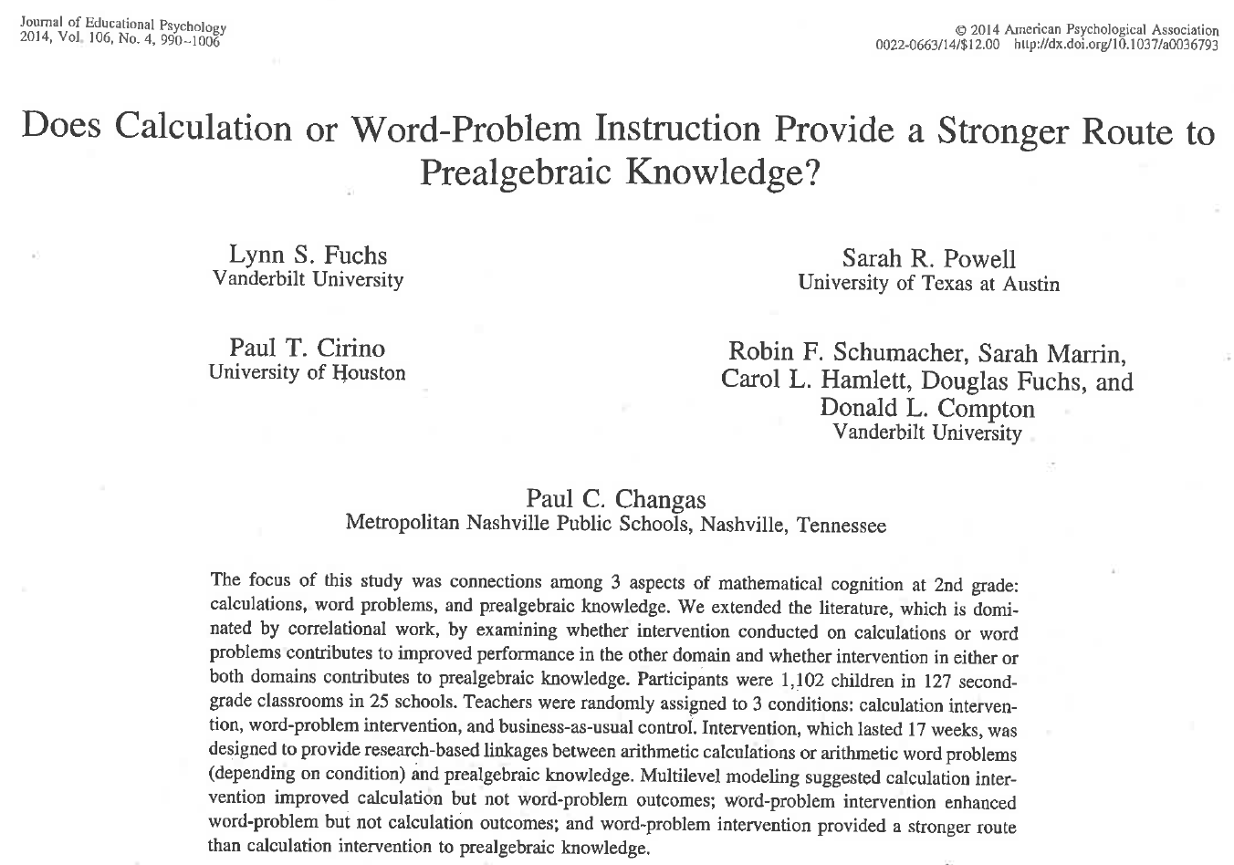
Slide 54
Assessment data to show results
Improvement from before intervention
Improvement compared to no treatment students
Replication
Multiple researchers
Multiple students
Multiple times
Setting and students similar to your own

Slide 55
Slide 55
Assessment data to show results
Improvement from before intervention
Improvement compared to no treatment students
Replication
Multiple researchers
Multiple students
Multiple times
Setting and students similar to your own

Slide 56
Slide 56
Workbook Activity #4
Locate the following mathematics interventions. How would you rate the evidence?

Slide 57
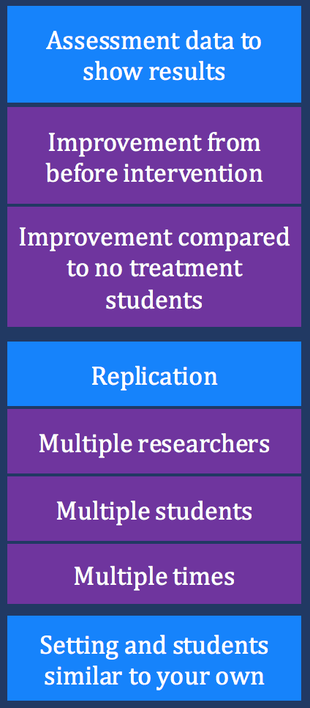
Slide 57
Instructional Platform
1. evidence-based intervention
2. evidence-based strategy

Slide 58
Part 2’s Checklist: Where do you locate evidence-based practices?
Identify sources for locating evidence-based practices
Determine the magnitude of the “evidence”

Slide 59
Journal Entry
Reflect upon your own teaching. What evidence-based practices are you using? How do you know of their evidence base?

Slide 60
Slide 60
Part 3

Slide 61
How do you determine the instructional platform for intensive intervention?
Module 3, Part 3

Slide 62
Part 3 Objectives
In this part, you’ll learn—
How to develop the instructional platform for intensive intervention

Slide 63
Where Are We?
Instructional Platform

Slide 64
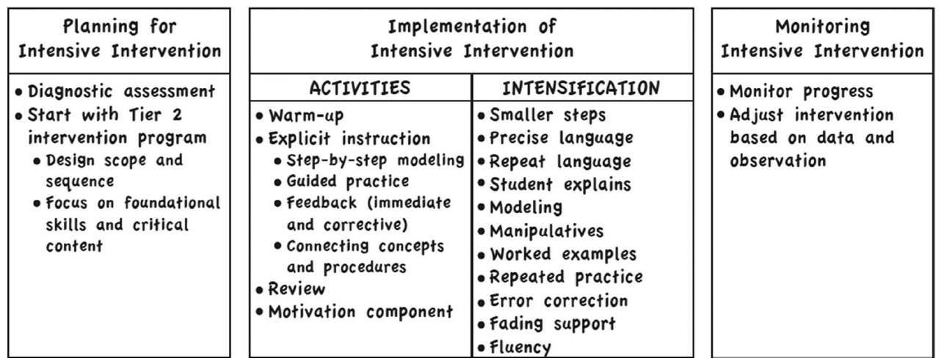
Additional Reading
Powell, S. R., & Fuchs, L. S., & Fuchs. D. (2015). Intensive intervention in mathematics. Learning Disabilities Research and Practice, 30, 182–192. doi:10.1111/ldrp.12087

Slide 65
Slide 65
Instructional Platform
Conduct a diagnostic assessment of the student’s strengths and weaknesses

Slide 66
Content for Intensive Intervention
Intervention: Occurs frequently and with intensity
Diagnostic assessment:
Data gathered before or during learning to understand strengths and weaknesses.
Measure multiple areas of mathematics
Provide detailed score profiles
Number and Operations
Geometry
Measurement
Algebra
Data Analysis

Slide 67
Content for Intensive Intervention
Intervention: Occurs frequently and with intensity
Formative assessment:
Data gathered during intervention to determine response.

Slide 68
Content for Intensive Intervention
Intervention: Occurs frequently and with intensity
Summative assessment:
Data gathered after intervention to determine performance compared to peers.

Slide 69
Content for Intensive Intervention
Intervention: Occurs frequently and with intensity
Error Analysis:
Types of errors and the possible causes of the errors.
5 4 7
+ 6 7 3

Slide 70
Content for Intensive Intervention
Intervention: Occurs frequently and with intensity
Standards:
continuum of mathematics learning

Slide 71
Slide 71
Instructional Platform
Conduct a diagnostic assessment of the student’s strengths and weaknesses
Design a scope and sequence

Slide 72
Slide 72
Where student IS
Where student NEEDS TO BE
Explain why addition and subtraction strategies work, using place value and the properties of operations.
Understand that the two digits of a two-digit number represent amounts of tens and ones.
Use addition and subtraction within 100 to solve one- and two-step word problems…
Fluently add and subtract within 100 using strategies based on place value, properties of operations, and/or relationships.
Apply properties of operations as strategies to multiply and divide….
Fluently multiply and divide within 100, using strategies such as the relationship between multiplication and division…
Use multiplication and division within 100 to solve word problems…
Fluently add and subtract multi-digit whole numbers using the standard algorithm.
Find whole number quotients and remainders with up to four-digit dividends and one-digit divisors, using strategies based on place value, the properties of operations, and/or the relationship between multiplication and division.
Solve multi-step word problems posed with whole numbers and having whole-number answers using the four operations…
Understand that the three digits of a three-digit number represent amounts of hundreds, tens, and ones.
Fluently multiply multi-digit whole numbers using the standard algorithm.
continuum of mathematics learning

Slide 73
Slide 73
Instructional Platform
Conduct a diagnostic assessment of the student’s strengths and weaknesses
Design a scope and sequence
Identify instructional platform
1. evidence-based intervention
2. evidence-based strategy

Slide 74
Slide 74
evidence-based practice
evidence-based intervention
evidence-based strategy
promising practice

Slide 75
Slide 75
Instructional Platform
Conduct a diagnostic assessment of the student’s strengths and weaknesses
Design a scope and sequence
Identify instructional platform
1. evidence-based intervention
2. evidence-based strategy

Slide 76
Slide 76
Instructional Platform
Conduct a diagnostic assessment of the student’s strengths and weaknesses
Ezri
4th-grade student
Strengths and Weaknesses:
Fact fluency GE = 2.4
Geometry GE = 3.8
Computation GE = 2.1
Measurement GE = 3.5
Problem solving GE = 3.1
Data Analysis GE = 3.1
Fractions GE = 2.6
Algebra GE = 2.8

Slide 77
Slide 77
Instructional Platform
Conduct a diagnostic assessment of the student’s strengths and weaknesses
Design a scope and sequence
continuum of mathematics learning

Slide 78
Slide 78
Explain why addition and subtraction strategies work, using place value and the properties of operations.
Fluently add and subtract within 100 using strategies based on place value, properties of operations, and/or the relationship between addition and subtraction.
Use addition and subtraction within 100 to solve one- and two-step word problems…
Apply properties of operations as strategies to multiply and divide….
Fluently multiply and divide within 100, using strategies such as the relationship between multiplication and division…
Use multiplication and division within 100 to solve word problems…
Understand a fraction 1/b as the quantity formed by 1 part when a whole is partitioned into b equal parts.
Explain why a fraction a/b is equivalent to a fraction (n x a)/(n x b) by using visual fraction models…
continuum of mathematics learning

Slide 79
Slide 79
Instructional Platform
Conduct a diagnostic assessment of the student’s strengths and weaknesses
Design a scope and sequence
Explain why addition and subtraction strategies work, using place value and the properties of operations.
Fluently add and subtract within 100 using strategies based on place value, properties of operations, and/or the relationship between addition and subtraction.
Use addition and subtraction within 100 to solve one- and two-step word problems…
Apply properties of operations as strategies to multiply and divide….
Fluently multiply and divide within 100, using strategies such as the relationship between multiplication and division…
Use multiplication and division within 100 to solve word problems…
Understand a fraction 1/b as the quantity formed by 1 part when a whole is partitioned into b equal parts.
Explain why a fraction a/b is equivalent to a fraction (n x a)/(n x b) by using visual fraction models…

Slide 80
Slide 89
Instructional Platform
Conduct a diagnostic assessment of the student’s strengths and weaknesses
Design a scope and sequence
Identify instructional platform
1. evidence-based intervention
2. evidence-based strategy

Slide 81
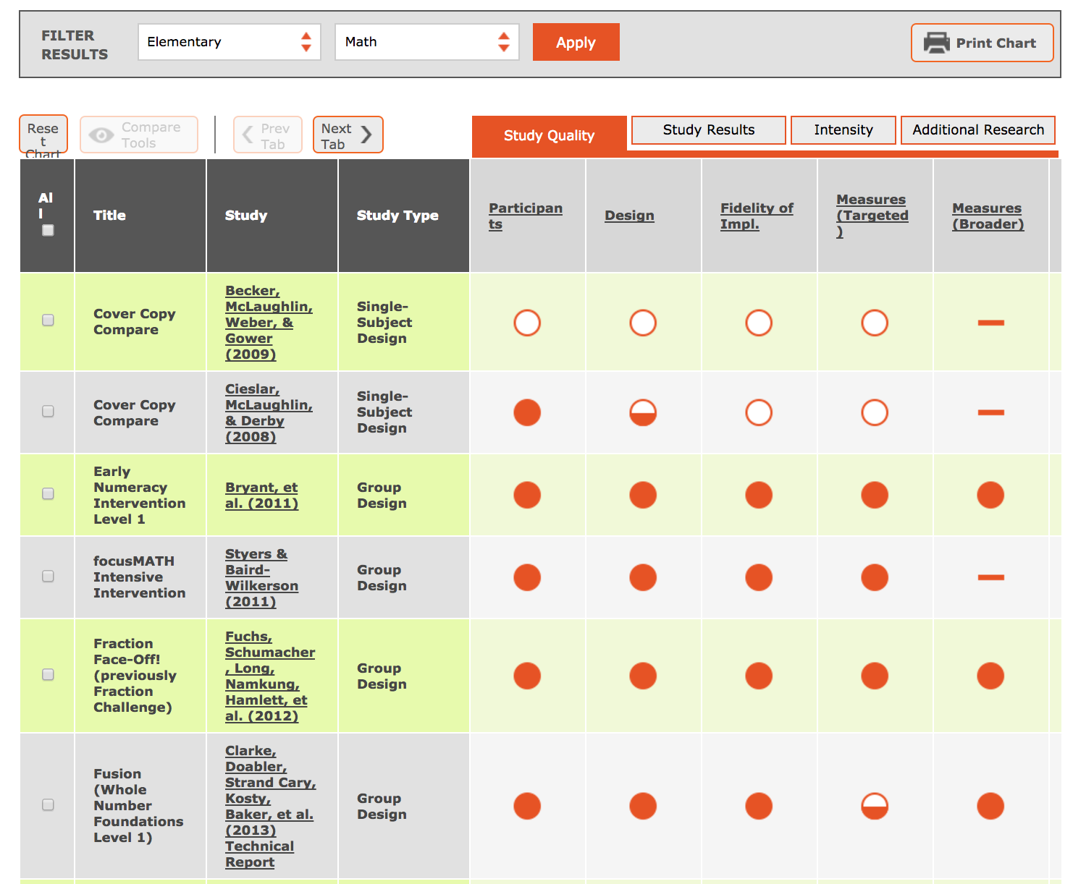
Slide 81
www.intensiveintervention.org

Slide 82
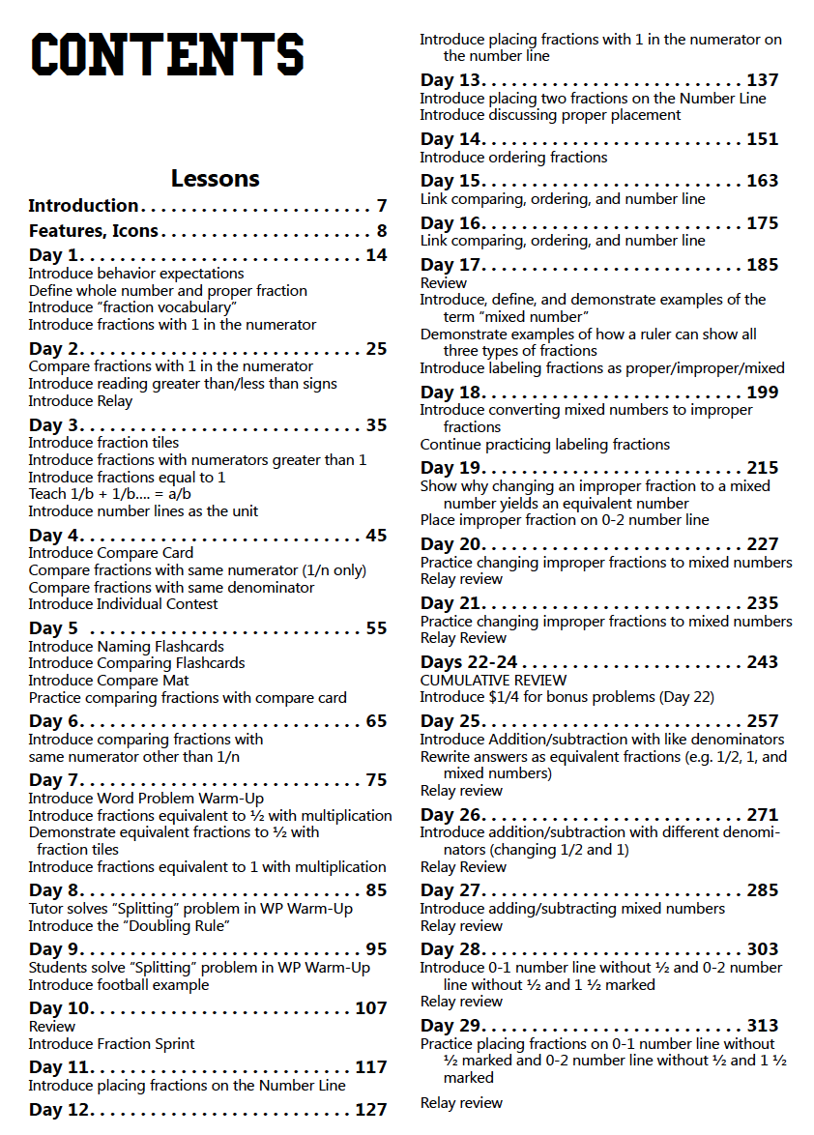
Slide 82
www.intensiveintervention.org
Fuchs, Schumacher, & Fuchs (2014)

Slide 83
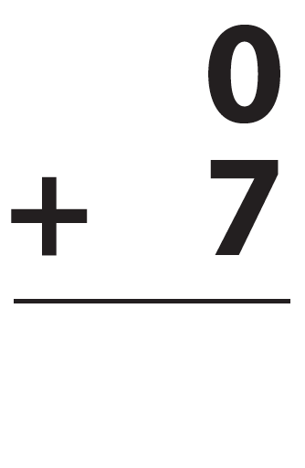
Slide 83
Instructional Platform
Conduct a diagnostic assessment of the student’s strengths and weaknesses
Design a scope and sequence
Identify instructional platform
1. evidence-based intervention
2. evidence-based strategy

Slide 84
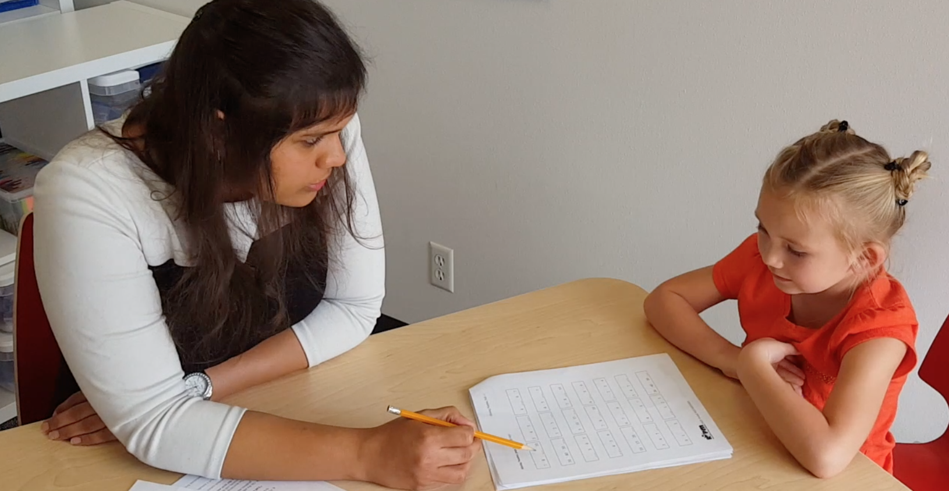
Slide 84
Workbook Activity #5
“You met Emma” is the module about assessment within DBI. Considering the mathematical strengths and weaknesses of Emma:
What would be a scope and sequence for Emma?
What evidence-based interventions or evidence-based strategies are available?
Link to Videos: https://youtu.be/c5cKCjAwjeY
https://youtu.be/LDe-AcB6T7w
https://youtu.be/tWLPtorzqGo

Slide 85
Slide 85
Instructional Platform
Conduct a diagnostic assessment of the student’s strengths and weaknesses
Design a scope and sequence
Identify instructional platform
1. evidence-based intervention
2. evidence-based strategy

Slide 86
Slide 86
Workbook Activity #6
Using the resources we’ve discussed (and additional resources), what evidence-based intervention and evidence-based strategies are available at the grade(s) you teach? What’s the quality of the evidence?

Slide 87
Part 3’s Checklist: How do you determine the instructional platform for intensive intervention?
Conduct a diagnostic assessment of the student
Identify the scope and sequence for instruction
Identify evidence-based practices

Slide 88
Discussion Board
What evidence-based practices do you need for intensive intervention? Share with your classmates.

Slide 89
Slide 89
Closing

Slide 90
Objectives
PART 1: What are the forms of evidence-based practices in intensive intervention?
PART 2: Where do you locate evidence-based practices?
PART 3: How do you determine the instructional platform for intensive intervention?

Slide 91
Slide 91
Link to Video: https://youtu.be/sh2dyx2BZf0

Slide 92
Part 1
evidence-based practice
evidence-based intervention
evidence-based strategy
promising practice
no or negative evidence

Slide 93
Slide 93
Instructional Platform
1. evidence-based intervention
2. evidence-based strategy

Slide 94
Part 1’s Checklist: What are the forms of evidence-based practices in intensive intervention?
Define evidence-based practices
Identify the differences among evidence-based interventions, evidence-based strategies, and promising practices

Slide 95
Slide 95
evidence-based practice
evidence-based intervention
evidence-based strategy
promising practice

Slide 96
Slide 96
Assessment data to show results
evidence-based practice
Improvement from before intervention
Improvement compared to no treatment students
Replication
evidence-based intervention
Multiple researchers
evidence-based strategy
Multiple students
Multiple times
promising practice
Setting and students similar to your own

Slide 97
Part 2’s Checklist: Where do you locate evidence-based practices?
Identify sources for locating evidence-based practices
Determine the magnitude of the “evidence”

Slide 98
Slide 98
Instructional Platform
Conduct a diagnostic assessment of the student’s strengths and weaknesses
Design a scope and sequence
Identify instructional platform
1. evidence-based intervention
2. evidence-based strategy

Slide 99
Part 3’s Checklist: How do you determine the instructional platform for intensive intervention?
Conduct a diagnostic assessment of the student
Identify the scope and sequence for instruction
Identify evidence-based practices

Slide 100
Classroom Application
Evaluate a current instructional intervention or strategy. What is the evidence?

Slide 101
Looking Ahead

Slide 102
Slide 102
1: Developing a scope and sequence for intervention
2: Progress monitoring and determining response
3: Selecting evidence-based practices for the instructional platform
4: Instructional delivery: explicit instruction, multiple representations, language
5: Instructional strategies: fluency building, problem solving, motivation
6: Whole number content
7: Rational number content
8: DBI and mathematics: fidelity, adaptations

Slide 103
Module 4
Miller, S. P., & Hudson, P. J. (2007). Using evidence-based practices to build mathematics competence related to conceptual, procedural, and declarative knowledge. Learning Disabilities Research and Practice, 22, 47–57.

Slide 104
See You Soon!

