Slide 1
Module 1
Developing a Scope and Sequence for Intensive Intervention

Slide 2
Slide 2
Link to Video: https://youtu.be/hp2JpOnPJiI

Slide 3
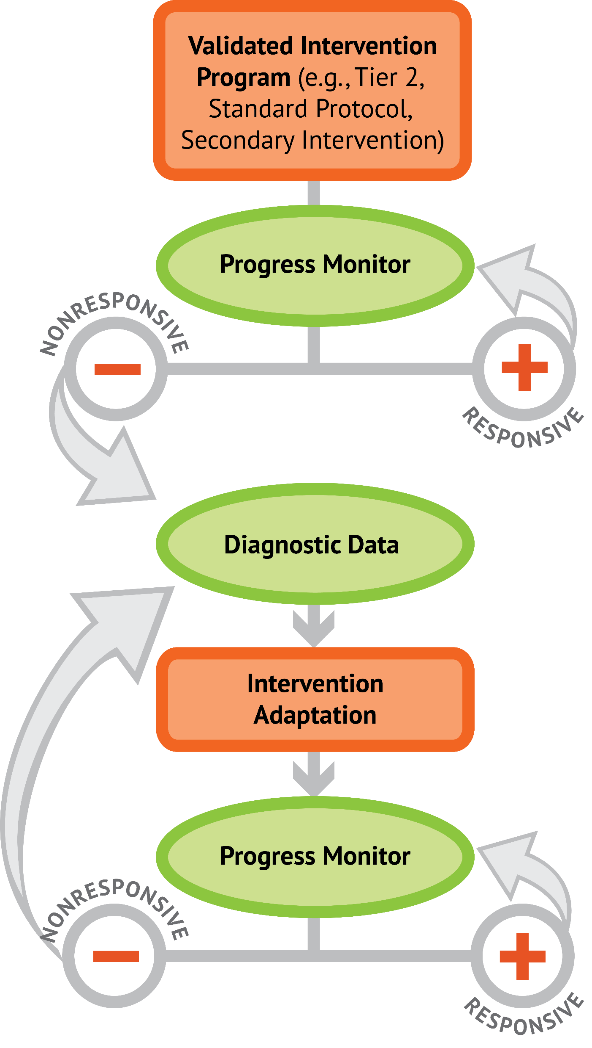
Slide 3

Slide 4
Slide 4
1: Developing a scope and sequence for intervention
2: Progress monitoring and determining response
3: Selecting evidence-based practices for the instructional platform
4: Instructional delivery: explicit instruction, multiple representations, language
5: Instructional strategies: fluency building, problem solving, motivation
6: Whole number content
7: Rational number content
8: DBI and mathematics: fidelity, adaptations

Slide 5
Objectives
PART 1: Why is mathematics intensive intervention important?
PART 2: What mathematical content do students need to master across kindergarten through eighth grade?
PART 3: How to identify mathematical content for intensive intervention and how to sequence intervention content

Slide 6
Activities
PART 1: Why is mathematics intensive intervention important?
Look at NAEP data for students with disabilities
Provide a rationale for the need for early intensive intervention

Slide 7
Activities
PART 2: What mathematical content do students need to master across kindergarten through eighth grade?
Place operations content in order
Place problem solving content in order
Determine foundational skills to include within intensive intervention for a student
Reflect upon something that you’re teaching soon and determine the foundational skills

Slide 8
Activities
PART 3: How to identify mathematical content for intensive intervention and how to sequence intervention content.
What foundational skills are necessary and what assessments would you use within intensive intervention?
Based on student strengths and weaknesses, what content would be included in intensive intervention?
Reflect upon a current student and the content for his or her intensive intervention.

Slide 9
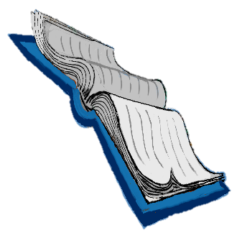
Reading
Powell, S. R., & Stecker, P. M. (2014). Using data-based individualization to intensify mathematics intervention for students with disabilities. Teaching Exceptional Children, 46(4), 31–37. doi:10.1177/0040059914523735

Slide 10
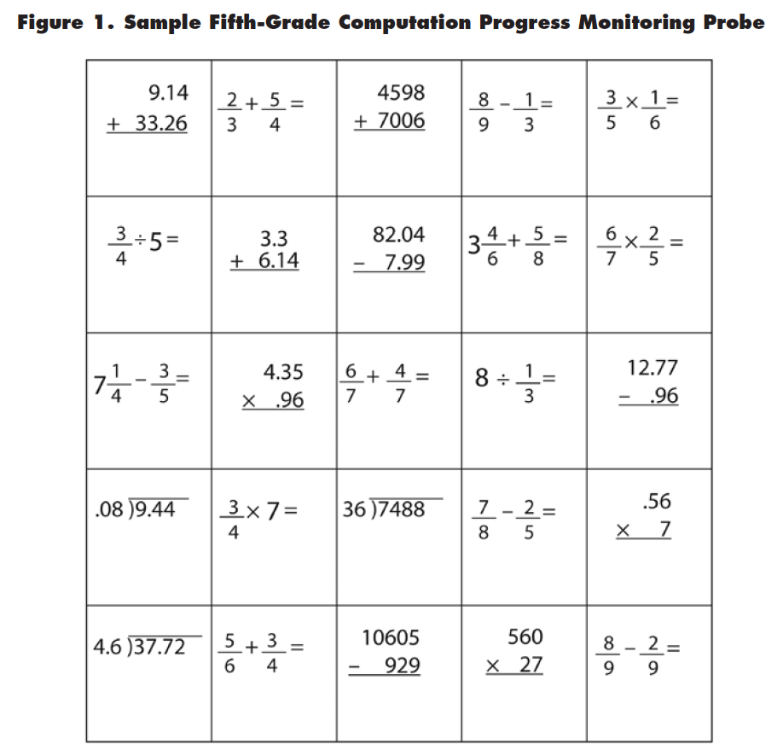
Slide 10

Slide 11
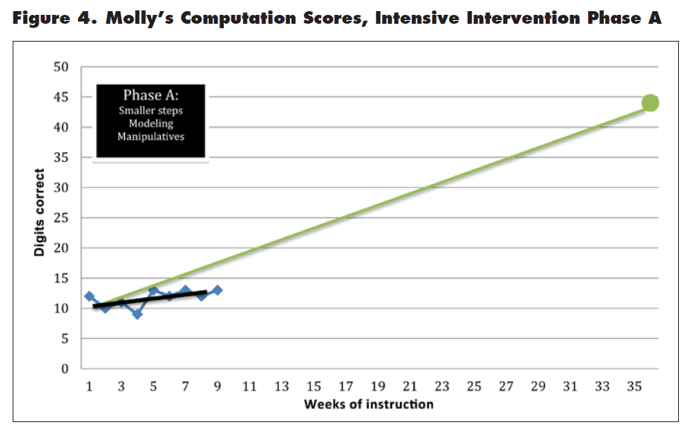
Slide 11

Slide 12
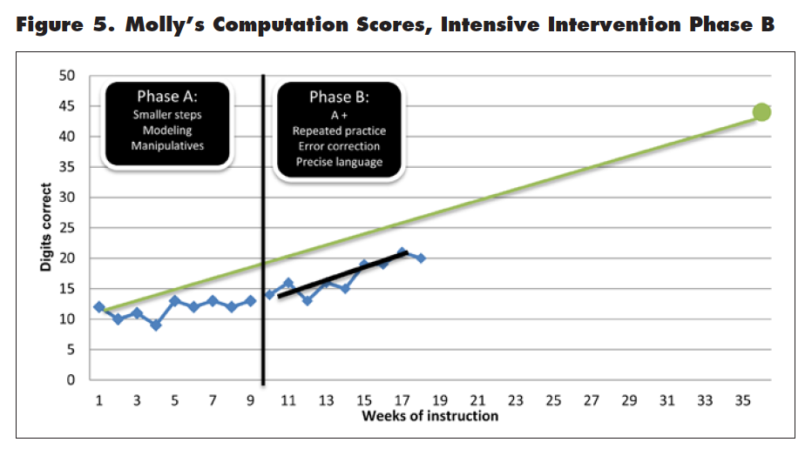
Slide 12

Slide 13
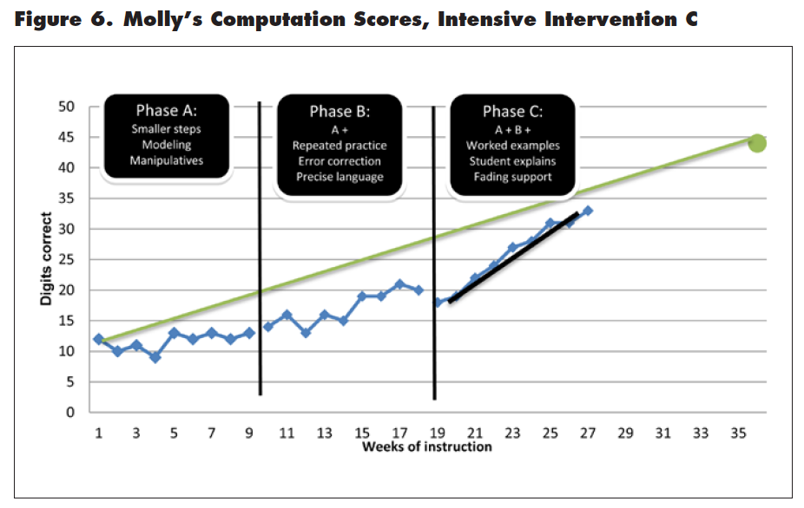
Slide 13

Slide 14
Classroom Application
Identify and map the foundational mathematics skills that you may include within intensive intervention

Slide 15
Welcome!
Let’s get started on Module 1!

Slide 16
Slide 16
Part 1

Slide 17
Why is mathematics intensive intervention important?
Module 1, Part 1

Slide 18
Part 1 Objectives
In this part, you’ll learn—
How earlier mathematics scores predict later mathematics scores
The school and adulthood outcomes for students with learning difficulties in mathematics
The importance of providing intensive intervention in mathematics

Slide 19
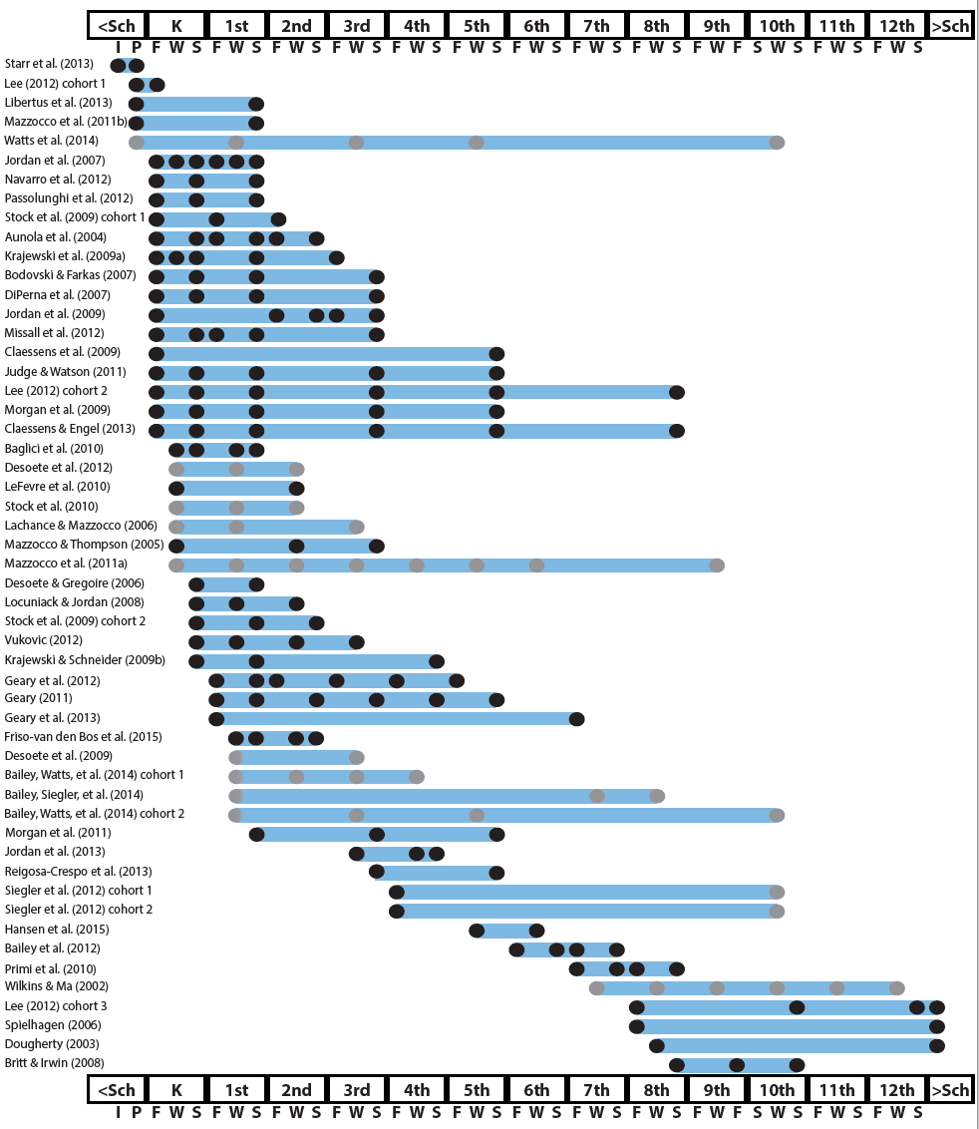
Slide 19
http://www.greatertexasfoundation.org/trajectories-of-mathematics-performance/

Slide 20
Slide 20
Broad math in preK predicted K broad math
Mathematics in preschool predicts later mathematics
http://www.greatertexasfoundation.org/trajectories-of-mathematics-performance/
Broad math in preK predicted grade 10 broad math

Slide 21
Slide 21
Counting in K predicted grade 1 broad math
Mathematics in kindergarten predicts later mathematics
http://www.greatertexasfoundation.org/trajectories-of-mathematics-performance/
Broad math in K predicted grade 8 broad math
K math accurately predicted math performance below 10th percentile in grades 2 and 3 with 84% correct classification

Slide 22
Slide 22
Mathematics in elementary school
predicts later mathematics
Addition influenced arithmetic with increasing importance from grades 1 to 5
http://www.greatertexasfoundation.org/trajectories-of-mathematics-performance/
Grade 1 arithmetic predicted arithmetic at grades 2, 3, and 4
Grade 1 broad math predicted broad math at grades 3, 5, and 10

Slide 23
Slide 23
Mathematics in middle school
predicts later mathematics
Counting and comparison in grades 2 or 4 predicted broad math 1 year later
http://www.greatertexasfoundation.org/trajectories-of-mathematics-performance/
Fractions at 10-12 years old predicted broad math 5 years later
Broad math in grade 7 predicted broad math in grade 8

Slide 24
Slide 24
Broad math in grade 8 predicted completion of 4-year college degree
Mathematics in
high school
predicts later outcomes
http://www.greatertexasfoundation.org/trajectories-of-mathematics-performance/
Students who took algebra in grade 8 took more advanced math courses and enrolled in 4-year colleges more often than students who took algebra in grade 9
Numeracy measured in adolescence impacted hourly earnings 7 to 15 years later

Slide 25
Slide 25
Mathematics in preschool predicts later mathematics
Mathematics in kindergarten predicts later mathematics
http://www.greatertexasfoundation.org/trajectories-of-mathematics-performance/
Mathematics in elementary school
predicts later mathematics
Mathematics in middle school
predicts later mathematics
Mathematics in
high school
predicts later outcomes

Slide 26
Why is this important?
Mathematics in preschool predicts later mathematics
Mathematics in kindergarten predicts later mathematics
Demonstrates the need for timely and effective intensive intervention
Mathematics in elementary school
predicts later mathematics
Mathematics in middle school
predicts later mathematics
Mathematics in
high school
predicts later outcomes

Slide 27
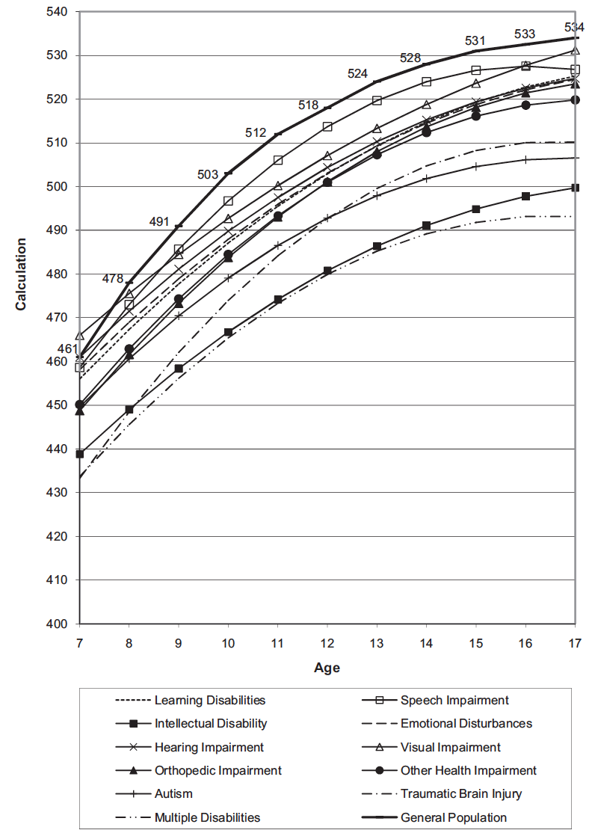
Slide 27
Wei, Lenz, & Blackorby (2013)

Slide 28
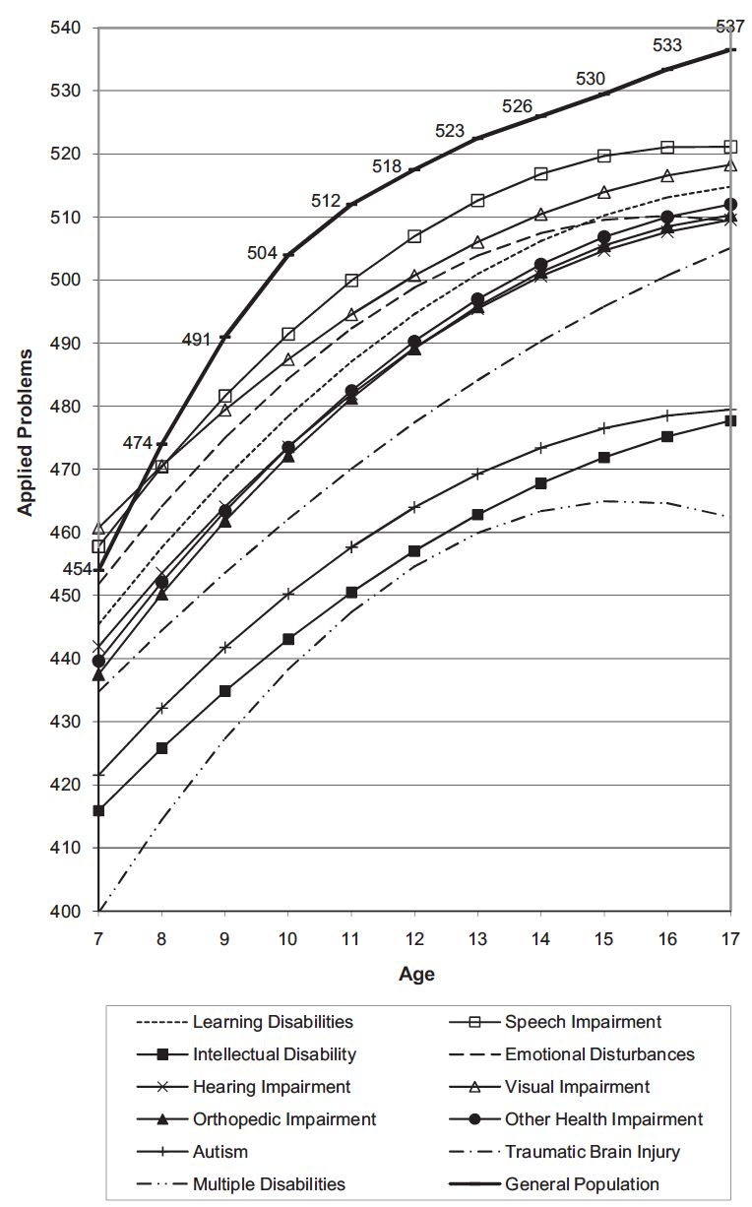
Slide 28
Wei, Lenz, & Blackorby (2013)

Slide 29
Why is this important?
Students with disabilities have difficulty with mathematics
These students require timely and effective intensive intervention

Slide 30
Slide 30
Workbook Activity #1
Look at NAEP data for students with disabilities. What is the level of performance compared to students without disabilities? What does this tell you about the necessity of intensive intervention?

Slide 31
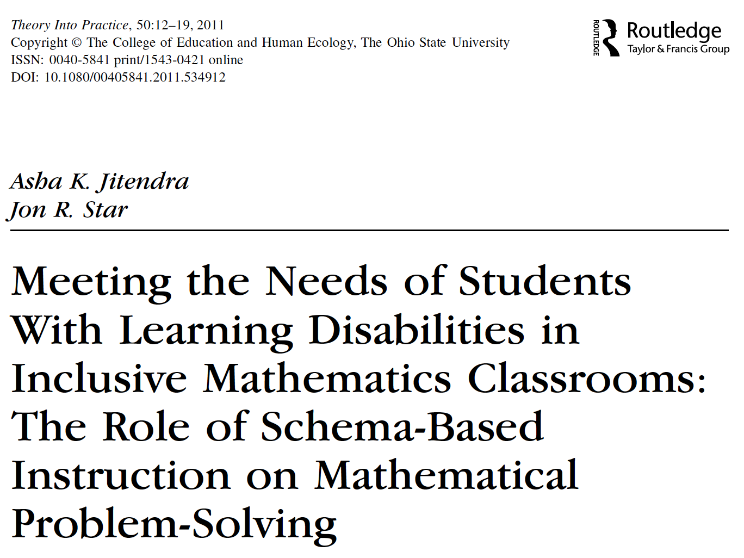
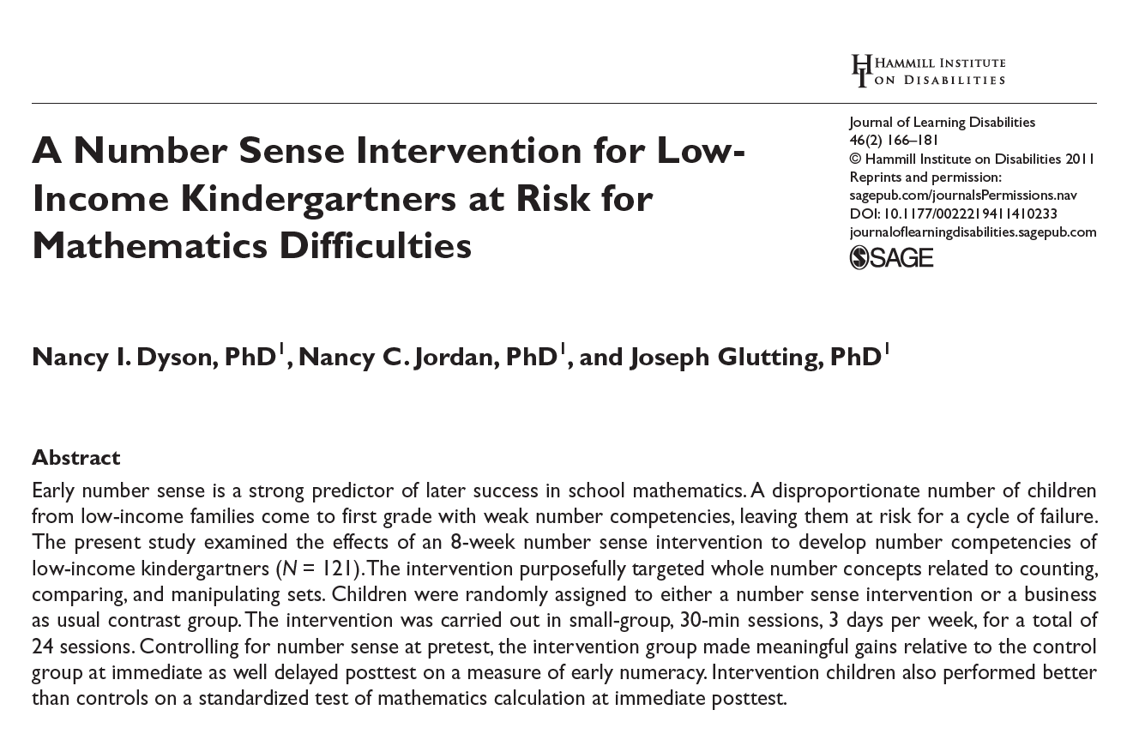
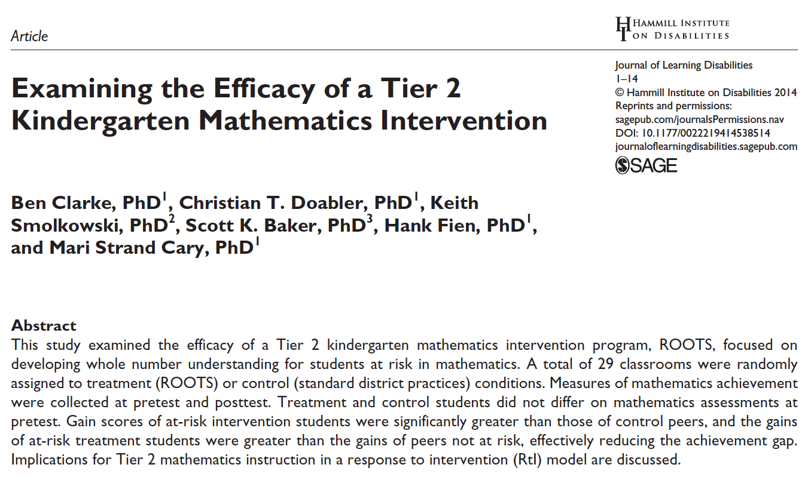
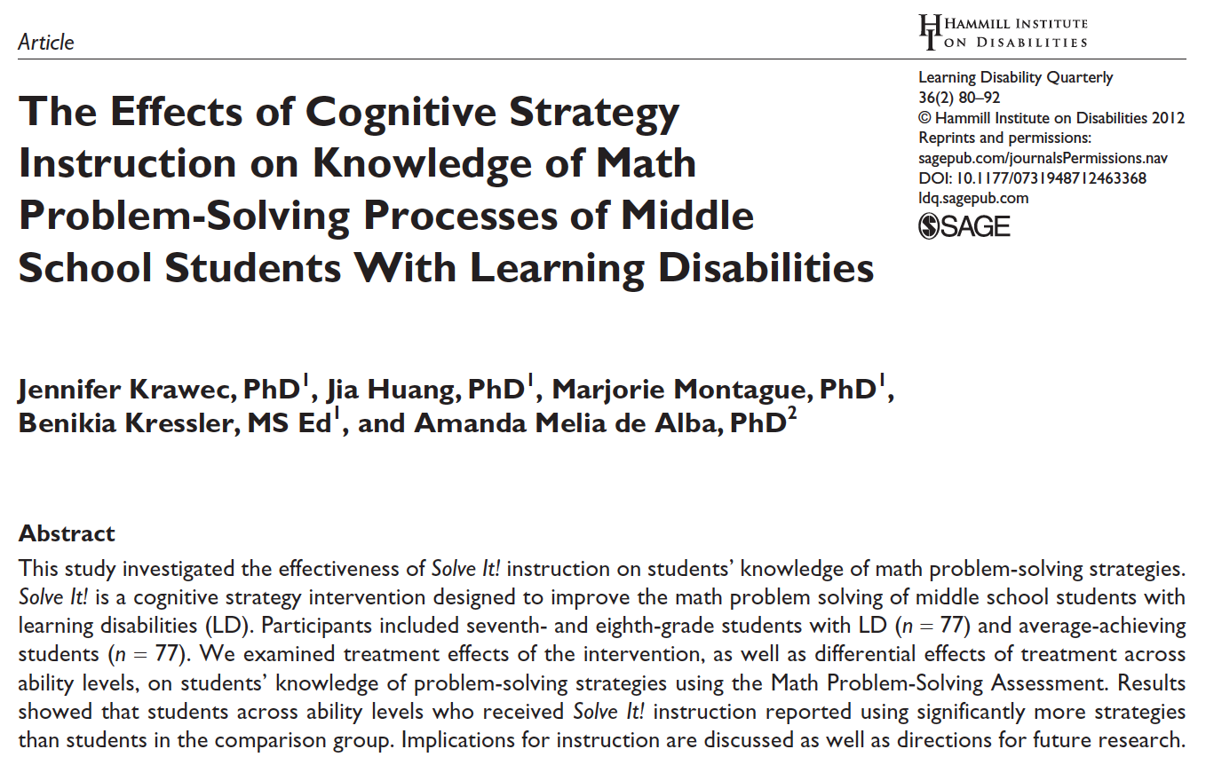
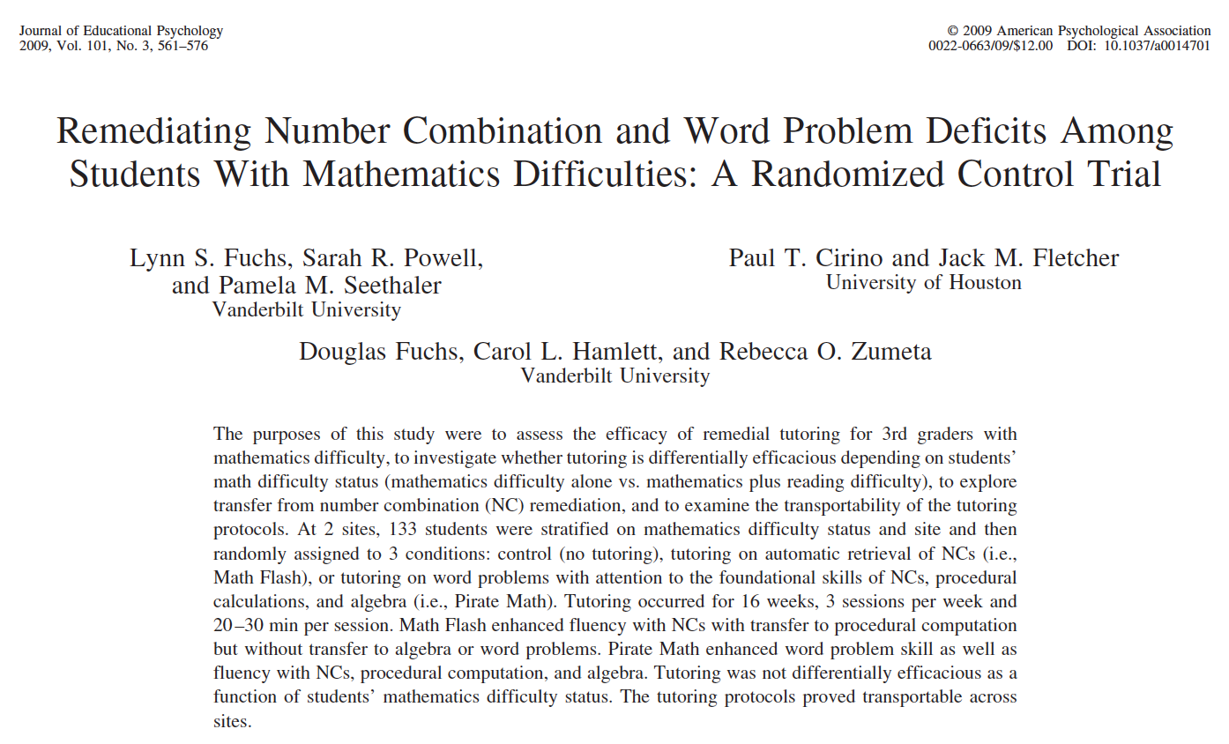
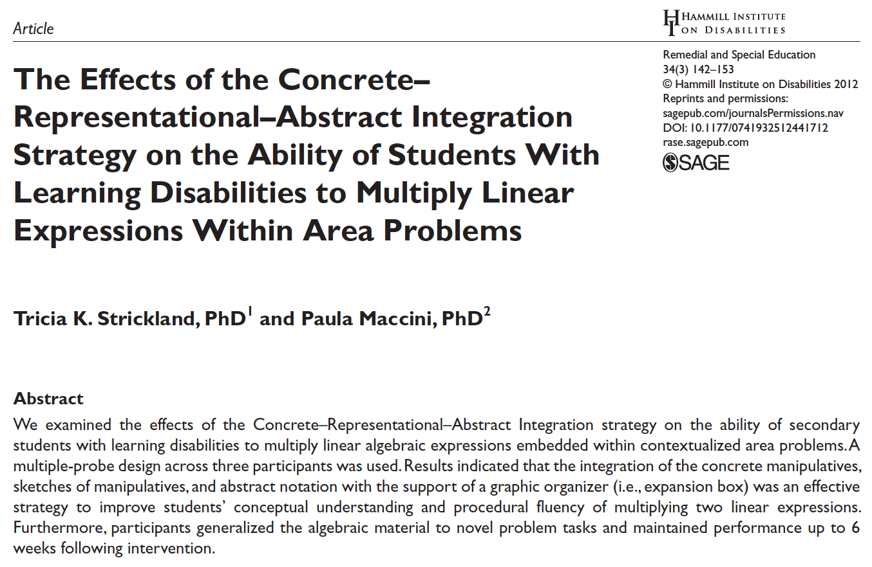
Intensive Intervention

Slide 32
Intensive Intervention
Intervention: Occurs frequently and with intensity
Assessment: Formative
Assessment: Diagnostic
Intervention adaptation: Content, dosage, explicit instruction, attention to transfer
Assessment: Formative

Slide 33
Part 1’s Checklist: Why is mathematics intensive intervention important?
Understand that earlier mathematics scores predict later mathematics scores
Understand the school and adulthood outcomes for students with learning difficulties in mathematics
Know how the data-based individualization (DBI) framework can be used to provide timely and effective intensive intervention

Slide 34
Journal Entry
Provide a rationale for the need for early intensive intervention by pretending you're trying to convince a district administrator of the need for the DBI process.

Slide 35
Slide 35
Part 2

Slide 36
What mathematical content do students need to master across kindergarten through eighth grade?
Module 1, Part 2

Slide 37
Part 2 Objectives
In this part, you’ll learn:
The foundational mathematical strands that students need to know across grade levels
How these strands should inform the mathematical content within intensive intervention

Slide 38
Intensive Intervention
Intervention: Occurs frequently and with intensity
Intervention adaptation: Content, dosage, explicit instruction, attention to transfer

Slide 39
Slide 39
Where student IS
Where student NEEDS TO BE
continuum of mathematics learning

Slide 40
Intensive Intervention
Intervention: Occurs frequently and with intensity
Needs to focus on foundational mathematics necessary across grade levels

Slide 41
Slide 41
Fluency
continuum of mathematics learning

Slide 42
Slide 42
Fluently add and subtract within 5.
continuum of mathematics learning

Slide 43
Slide 43
Fluently add and subtract within 5.
Add and subtract within 20, demonstrating fluency for addition and subtraction within 10.
continuum of mathematics learning

Slide 44
Slide 44
Fluently add and subtract within 5.
Add and subtract within 20, demonstrating fluency for addition and subtraction within 10.
Fluently add and subtract within 100 using strategies based on place value, properties of operations, and/or relationships.
continuum of mathematics learning

Slide 45
Slide 45
Fluently add and subtract within 5.
Add and subtract within 20, demonstrating fluency for addition and subtraction within 10.
Fluently add and subtract within 100 using strategies based on place value, properties of operations, and/or relationships.
Fluently multiply and divide within 100, using strategies such as the relationship between multiplication and division…
continuum of mathematics learning

Slide 46
Slide 46
Fluently add and subtract within 5.
Add and subtract within 20, demonstrating fluency for addition and subtraction within 10.
Fluently add and subtract within 100 using strategies based on place value, properties of operations, and/or relationships.
Fluently multiply and divide within 100, using strategies such as the relationship between multiplication and division.
Fluently add and subtract multi-digit whole numbers using the standard algorithm.
continuum of mathematics learning

Slide 47
Slide 47
Fluently add and subtract within 5.
Add and subtract within 20, demonstrating fluency for addition and subtraction within 10.
Fluently add and subtract within 100 using strategies based on place value, properties of operations, and/or relationships.
Fluently multiply and divide within 100, using strategies such as the relationship between multiplication and division…
Fluently add and subtract multi-digit whole numbers using the standard algorithm.
Fluently multiply multi-digit whole numbers using the standard algorithm.
continuum of mathematics learning

Slide 48
Slide 48
Fluently add and subtract within 5.
Add and subtract within 20, demonstrating fluency for addition and subtraction within 10.
Fluently add and subtract within 100 using strategies based on place value, properties of operations, and/or relationships.
Fluently multiply and divide within 100, using strategies such as the relationship between multiplication and division…
Fluently add and subtract multi-digit whole numbers using the standard algorithm.
Fluently multiply multi-digit whole numbers using the standard algorithm.
Fluently add, subtract, multiply, and divide multi-digit decimals using the standard algorithm.
continuum of mathematics learning

Slide 49
Slide 49
Where student NEEDS TO BE
Fluently add and subtract within 5.
Add and subtract within 20, demonstrating fluency for addition and subtraction within 10.
Fluently add and subtract within 100 using strategies based on place value, properties of operations, and/or relationships.
Fluently multiply and divide within 100, using strategies such as the relationship between multiplication and division…
Fluently add and subtract multi-digit whole numbers using the standard algorithm.
Fluently multiply multi-digit whole numbers using the standard algorithm.
Fluently add, subtract, multiply, and divide multi-digit decimals using the standard algorithm.
continuum of mathematics learning

Slide 50
Slide 50
Where student IS
Where student NEEDS TO BE
Fluently add and subtract within 5.
Add and subtract within 20, demonstrating fluency for addition and subtraction within 10.
Fluently add and subtract within 100 using strategies based on place value, properties of operations, and/or relationships.
Fluently multiply and divide within 100, using strategies such as the relationship between multiplication and division…
Fluently add and subtract multi-digit whole numbers using the standard algorithm.
Fluently multiply multi-digit whole numbers using the standard algorithm.
Fluently add, subtract, multiply, and divide multi-digit decimals using the standard algorithm.
continuum of mathematics learning

Slide 51
Slide 51
Where student IS
Where student NEEDS TO BE
Fluently add and subtract within 5.
Add and subtract within 20, demonstrating fluency for addition and subtraction within 10.
Fluently add and subtract within 100 using strategies based on place value, properties of operations, and/or relationships.
Fluently multiply and divide within 100, using strategies such as the relationship between multiplication and division…
Fluently add and subtract multi-digit whole numbers using the standard algorithm.
Fluently multiply multi-digit whole numbers using the standard algorithm.
Fluently add, subtract, multiply, and divide multi-digit decimals using the standard algorithm.
continuum of mathematics learning

Slide 52
Slide 52
Place Value
continuum of mathematics learning

Slide 53
Slide 53
Compose and decompose numbers from 11 to 19 into ten ones and some further ones…
continuum of mathematics learning

Slide 54
Slide 54
Compose and decompose numbers from 11 to 19 into ten ones and some further ones.
Understand that the two digits of a two-digit number represent amounts of tens and ones.
continuum of mathematics learning

Slide 55
Slide 55
Compose and decompose numbers from 11 to 19 into ten ones and some further ones…
Understand that the two digits of a two-digit number represent amounts of tens and ones.
Understand that the three digits of a three-digit number represent amounts of hundreds, tens, and ones.
continuum of mathematics learning

Slide 56
Slide 56
Compose and decompose numbers from 11 to 19 into ten ones and some further ones…
Understand that the two digits of a two-digit number represent amounts of tens and ones.
Understand that the three digits of a three-digit number represent amounts of hundreds, tens, and ones.
Use place value understanding to round whole numbers to the nearest 10 or 100.
continuum of mathematics learning

Slide 57
Slide 57
Compose and decompose numbers from 11 to 19 into ten ones and some further ones…
Understand that the two digits of a two-digit number represent amounts of tens and ones.
Understand that the three digits of a three-digit number represent amounts of hundreds, tens, and ones.
Use place value understanding to round whole numbers to the nearest 10 or 100.
Recognize that in a multi-digit number, a digit in one place represents ten times what it represents in the place to its right…
continuum of mathematics learning

Slide 58
Slide 58
Compose and decompose numbers from 11 to 19 into ten ones and some further ones…
Understand that the two digits of a two-digit number represent amounts of tens and ones.
Understand that the three digits of a three-digit number represent amounts of hundreds, tens, and ones.
Use place value understanding to round whole numbers to the nearest 10 or 100.
Recognize that in a multi-digit number, a digit in one place represents ten times what it represents in the place to its right…
Recognize that in a multi-digit number, a digit in one place represents 10 times as much as it represents in the place to its right and 1/10 of what it represents in the place to its left.
continuum of mathematics learning

Slide 59
Slide 59
Workbook Activity #2
Place the operations content in order from easier skills to more difficult skills.

Slide 60
Slide 60
Workbook Activity #2
Apply properties of operations as strategies to add and subtract.
Explain why addition and subtraction strategies work, using place value and the properties of operations.
Apply properties of operations as strategies to multiply and divide.
Find whole number quotients and remainders with up to four-digit dividends and one-digit divisors, using strategies based on place value, the properties of operations, and/or the relationship between multiplication and division.
Add, subtract, multiply, and divide decimals to hundredths, using concrete models or drawings and strategies based on place value, properties of operations, and/or the relationship between addition and subtraction.
Apply the properties of operations to generate equivalent expressions.
Apply properties of operations as strategies to add, subtract, factor, and expand linear expressions with rational coefficients.
Solve linear equations with rational number coefficients, including equations whose solutions require expanding expressions using the distributive property and collecting like terms.
continuum of mathematics learning

Slide 61
Slide 61
Workbook Activity #3
Place the problem solving content in order from easier skills to more difficulty skills.

Slide 62
Slide 62
Workbook Activity #3
Solve addition and subtraction word problems, and add and subtract within 10.
Solve word problems that call for addition of three whole numbers whose sum is less than or equal to 20.
Use addition and subtraction within 100 to solve one- and two-step word problems.
Use multiplication and division within 100 to solve word problems…
Solve multi-step word problems posed with whole numbers and having whole-number answers using the four operations.
Solve word problems involving addition and subtraction of fractions referring to the same whole, including cases of unlike denominators
Interpret and compute quotients of fractions, and solve word problems involving division of fractions by fractions.
Solve real-world and mathematical problems involving the four operations with rational numbers.
Solve real-world and mathematical problems leading to two linear equations in two variables.
continuum of mathematics learning

Slide 63
Slide 63
Where student IS
Where student NEEDS TO BE
Solve addition and subtraction word problems, and add and subtract within 10…
Solve word problems that call for addition of three whole numbers whose sum is less than or equal to 20…
Use addition and subtraction within 100 to solve one- and two-step word problems…
Use multiplication and division within 100 to solve word problems…
Solve multi-step word problems posed with whole numbers and having whole-number answers using the four operations…
Solve word problems involving addition and subtraction of fractions referring to the same whole, including cases of unlike denominators…
Interpret and compute quotients of fractions, and solve word problems involving division of fractions by fractions…
Solve real-world and mathematical problems involving the four operations with rational numbers.
Solve real-world and mathematical problems leading to two linear equations in two variables.
continuum of mathematics learning

Slide 64
Intensive Intervention
Intervention: Occurs frequently and with intensity
Needs to focus on foundational mathematics necessary across grade levels

Slide 65
Slide 65
Where student IS
Where student NEEDS TO BE
Use addition and subtraction within 100 to solve one- and two-step word problems…
Use multiplication and division within 100 to solve word problems…
Solve multi-step word problems posed with whole numbers and having whole-number answers using the four operations…
continuum of mathematics learning

Slide 66
Slide 66
Where student IS
Where student NEEDS TO BE
Explain why addition and subtraction strategies work, using place value and the properties of operations.
Understand that the two digits of a two-digit number represent amounts of tens and ones.
Use addition and subtraction within 100 to solve one- and two-step word problems…
Fluently add and subtract within 100 using strategies based on place value, properties of operations, and/or relationships.
Apply properties of operations as strategies to multiply and divide….
Fluently multiply and divide within 100, using strategies such as the relationship between multiplication and division…
Use multiplication and division within 100 to solve word problems…
Fluently add and subtract multi-digit whole numbers using the standard algorithm.
Find whole number quotients and remainders with up to four-digit dividends and one-digit divisors, using strategies based on place value, the properties of operations, and/or the relationship between multiplication and division.
Solve multi-step word problems posed with whole numbers and having whole-number answers using the four operations…
Understand that the three digits of a three-digit number represent amounts of hundreds, tens, and ones.
Fluently multiply multi-digit whole numbers using the standard algorithm.
continuum of mathematics learning

Slide 67
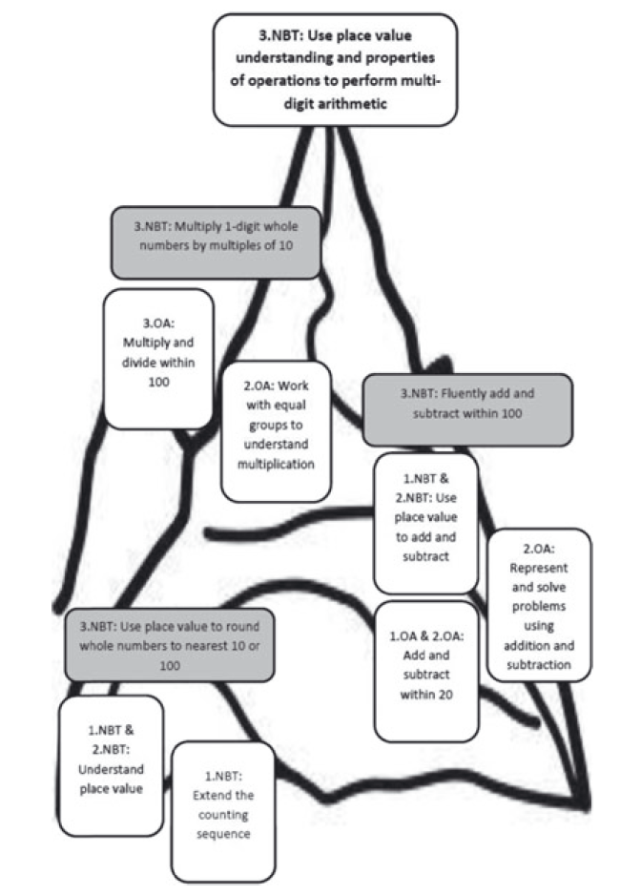
Additional Reading
Powell, S. R., Fuchs, L. S., & Fuchs. D. (2013). Reaching the mountaintop: Addressing the Common Core Standards in mathematics for students with mathematics difficulties. Learning Disabilities Research and Practice, 28, 38–48. doi:10.1111/ldrp.12001

Slide 68
Slide 68
Workbook Activity #4
Determine the foundational skills that may need to be included within your intensive intervention. You can use your state standards or your knowledge of mathematical pathways.

Slide 69
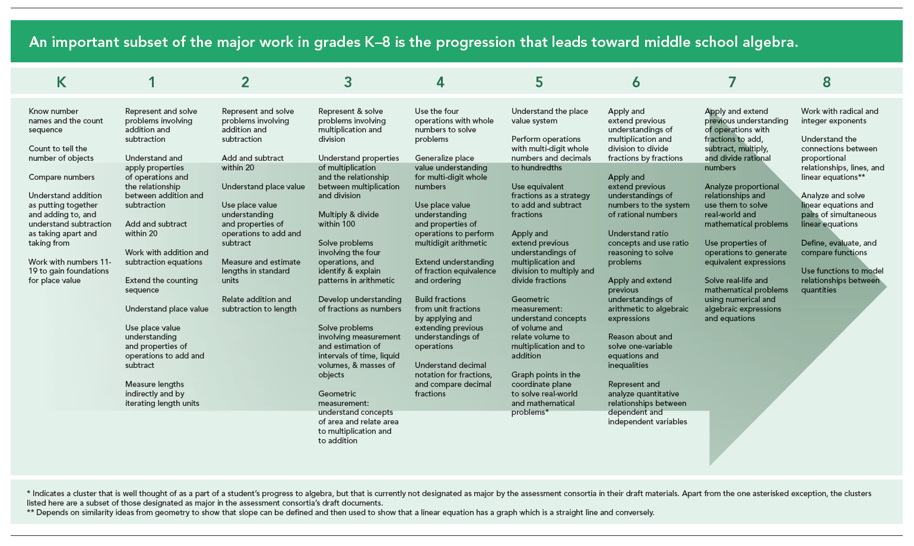
Slide 69
https://achievethecore.org/category/774/mathematics-focus-by-grade-level

Slide 70
Slide 70
Workbook Activity #4
Where student IS
Where student NEEDS TO BE
Add and subtract within 20
Represent and solve problems involving addition and subtraction
Solve problems involving the four operations
Develop understanding of fractions as numbers
Use the four operations with whole numbers to solve problems
Extend understanding of fraction equivalence and ordering
Build fractions from unit fractions
Use equivalent fractions as a strategy to add and subtract fractions
continuum of mathematics learning

Slide 71
Skills Across Grade Levels
We’ve focused on number and operations
Whole numbers
Rational numbers
Algebra
Intensive intervention may also include
Geometry
Measurement
Data analysis

Slide 72
Intensive Intervention

Slide 73
Part 2’s Checklist: What mathematical content do students need to master across kindergarten through eighth grade?
Identify foundational mathematical strands across grade levels
Place foundational mathematical strands in meaningful order for intensive intervention

Slide 74
Discussion Board
Reflect upon something that you're teaching soon.
What is the content that the student knows?
What comes before? What comes after?
How does this knowledge change your instruction?
What questions might you have for other teachers?

Slide 75
Slide 75
Part 3

Slide 76
How to identify mathematical content for intensive intervention and how to sequence intervention content.
Module 1, Part 3

Slide 77
Part 3 Objectives
In this part, you’ll learn—
How to identify mathematical content for intensive intervention
How to sequence instructional content based on foundational mathematical strands

Slide 78
Intensive Intervention
Intervention: Occurs frequently and with intensity

Slide 79
Content for Intensive Intervention
Intervention: Occurs frequently and with intensity
Diagnostic assessment:
Data gathered before or during learning to understand strengths and weaknesses.
Measure multiple areas of mathematics
Provide detailed score profiles
Number and Operations
Geometry
Measurement
Algebra
Data Analysis

Slide 80
Content for Intensive Intervention
Intervention: Occurs frequently and with intensity
Formative assessment:
Data gathered during intervention to determine response.

Slide 81
Content for Intensive Intervention
Intervention: Occurs frequently and with intensity
Summative assessment:
Data gathered after intervention to determine performance compared to peers.

Slide 82
Content for Intensive Intervention
Intervention: Occurs frequently and with intensity
Error Analysis:
Types of errors and the possible causes of the errors.
5 4 7
+ 6 7 3

Slide 83
Content for Intensive Intervention
Intervention: Occurs frequently and with intensity
Standards:
continuum of mathematics learning

Slide 84
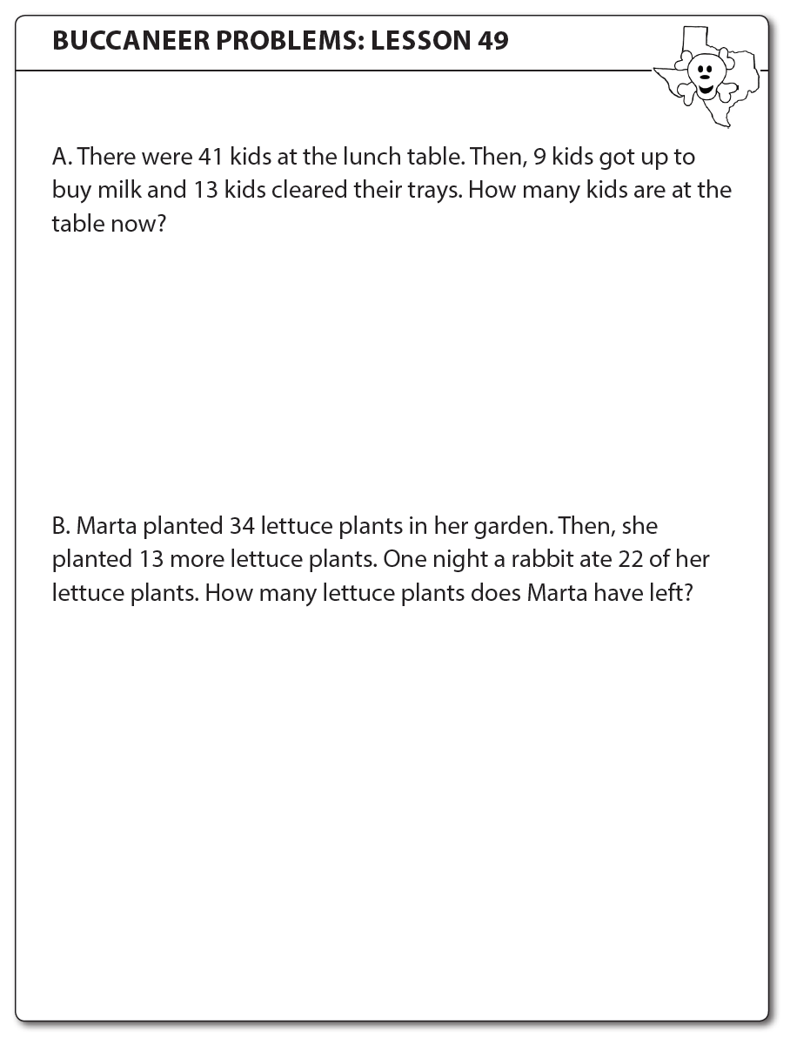
Slide 84
Workbook Activity #5
Look at this set of word problems used in a third-grade intervention.
What foundational skills do students need to know in order to successfully solve such problems?
What types of assessments would you use to design the mathematical content for intensive intervention?

Slide 85
Slide 85
Where student IS
Where student NEEDS TO BE
continuum of mathematics learning

Slide 86
Slide 86
Where student IS
Where student NEEDS TO BE
Use data and standards to appropriately sequence instructional content
continuum of mathematics learning

Slide 87
Slide 87
Link to Video: https://youtu.be/DZvy8m0C5HI

Slide 88
Slide 88
Addition of fractions with unlike denominators
Read
Follow directions
Understand language
Where student NEEDS TO BE
Add
Fraction concepts
Fraction models
Subtract
Numerator
Denominator
Multiples
continuum of mathematics learning

Slide 89
Slide 89
Workbook Activity #6
Here's a list of a student's strengths and weaknesses.
What mathematical content is important for this student in terms of intensive intervention?
What foundational skills might be a part of intensive intervention?
How might some of those things need to be retaught?

Slide 90
Intensive Intervention
Intervention: Occurs frequently and with intensity

Slide 91
Part 3’s Checklist: How to identify mathematical content for intensive intervention and how to sequence intervention content.
Use a variety of assessments and sources to identify mathematical content for intensive intervention
Use data and standards to appropriately sequence instructional content

Slide 92
Slide 92
Closing

Slide 93
Objectives
PART 1: Why is mathematics intensive intervention important?
PART 2: What mathematical content for students need to master across kindergarten through eighth grade?
PART 3: How to identify mathematical content for intensive intervention and how to sequence intervention content.

Slide 94
Slide 94
Link to Video: https://youtu.be/hp2JpOnPJiI

Slide 95
Part 1
Mathematics in preschool predicts later mathematics
Mathematics in kindergarten predicts later mathematics
http://www.greatertexasfoundation.org/trajectories-of-mathematics-performance/
Mathematics in elementary school
predicts later mathematics
Mathematics in middle school
predicts later mathematics
Mathematics in
high school
predicts later outcomes

Slide 96
Part 1
Intervention: Occurs frequently and with intensity
Assessment: Formative
Assessment: Diagnostic
Intervention adaptation: Content, dosage, explicit instruction, attention to transfer
Assessment: Formative

Slide 97
Part 1’s Checklist: Why is mathematics intensive intervention important?
Understand that earlier mathematics scores predict later mathematics scores
Understand the school and adulthood outcomes for students with learning difficulties in mathematics
Know how the data-based individualization (DBI) framework can be used to provide timely and effective intensive intervention

Slide 98
Parts 2 and 3
Where student IS
Where student NEEDS TO BE
continuum of mathematics learning

Slide 99
Part 2’s Checklist: What mathematical content do students need to master across kindergarten through eighth grade?
Identify foundational mathematical strands across grade levels
Place foundational mathematical strands in meaningful order for intensive intervention

Slide 100
Part 3’s Checklist: How to identify mathematical content for intensive intervention and how to sequence intervention content.
Use a variety of assessments and sources to identify mathematical content for intensive intervention
Use data and standards to appropriately sequence instructional content

Slide 101
Slide 101
1: Developing a scope and sequence for intervention
2: Progress monitoring and determining response
3: Selecting evidence-based practices for the instructional platform
4: Instructional delivery: explicit instruction, multiple representations, language
5: Instructional strategies: fluency building, problem solving, motivation
6: Whole number content
7: Rational number content
8: DBI and mathematics: fidelity, adaptations

Slide 102
Classroom Application
Identify and map the foundational mathematics skills that you may include within intensive intervention

Slide 103
Looking Ahead

Slide 104
Module 2
Lembke, E. S., Strickland, T. K., & Powell, S. R. (2016). Monitoring student progress to determine instructional effectiveness. In B. S. Witzel (Ed.), Bridging the gap between arithmetic and algebra (pp. 139–155). Arlington, VA: Council for Exceptional Children.

Slide 105
See You Soon!

