Slide 1
Making It Happen:
What Does it Take to Implement
Intensive Intervention?
  Dr. Lou Danielson, NCII Director
  Nicole Hitchener, Professional Development Coordinator, Coventry, Rhode Island
  Michele Walden-Doppke, NCII Coach for Rhode Island
      October 20, 2014

Slide 2
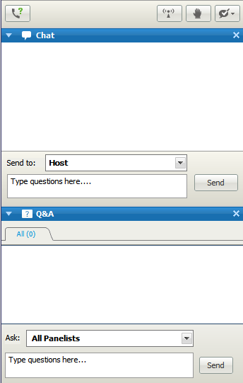
A Note About
Questions…
Please type questions related to technical issues in the Chat box.
Please type questions related to webinar content in the Q&A box.

Slide 3



Presenters
  Dr. Lou Danielson
  Director, National Center on Intensive Intervention (NCII)
  Nicole Hitchener
  Professional Development Coordinator for Coventry, Rhode Island
  Michele Walden-Doppke,
  NCII Coach for Rhode Island

Slide 4
NCII’s Mission
Our mission is to build district and school capacity to support implementation of data-based individualization in reading, mathematics, and behavior for students with severe and persistent learning and behavioral needs.

Slide 5

What Is Intensive Intervention?
Intensive intervention addresses severe and persistent learning or behavior difficulties. Intensive intervention should be:
Driven by data
Characterized by increased intensity (e.g., smaller group, expanded time) and individualization of academic instruction and/or behavioral supports

Slide 6
What Intensive Intervention…
Is:
Individualized based on student needs
More intense, often with substantively different content and pedagogy
Composed of more frequent and precise progress monitoring
Is Not:
A single approach
A manual
A preset program or curriculum
More of the same Tier 1 instruction
More of the same Tier 2 instruction

Slide 7



Why Do We Need
Intensive Intervention?
Low academic achievement: Few students with disabilities scored “Proficient” or above on 2013 NAEP (9% in reading and 8% in mathematics at Grade 8).
Dropout rates: Students with disabilities drop out of high school at a rate more than three times that of the general population (Aud et al., 2012; Planty et al., 2008).
Arrest rates: Young adults with disabilities are almost twice as likely to have been arrested (Sanford et al., 2011).

Slide 8


Why Do We Need
Intensive Intervention?
More Help
Validated programs are not universally effective programs; 3 to 5 percent of students need more help (Fuchs et al., 2008; NCII, 2013).
More Practice
Students with intensive needs often require 10–30 times more practice than peers to learn new information (Gersten et al., 2008).

Slide 9

Who Needs Intensive Intervention?
Students with disabilities who are not making adequate progress in their current instructional program
Students who present with very low academic achievement and/or high-intensity or high-frequency behavior problems (typically those with disabilities)
Students in a tiered intervention system
who have not responded to secondary
intervention programs delivered with fidelity

Slide 10
What Is NCII’s Approach to
Intensive Intervention?
Data-Based Individualization (DBI). A systematic method for using data to determine when and how to provide more intensive intervention:
Origins in data-based program modification/experimental teaching were first developed at the University of Minnesota (Deno & Mirkin, 1977).
DBI is a process, not a single intervention program or strategy.
DBI is not a one-time fix, but an ongoing process comprising intervention and assessment adjusted over time.
Research has demonstrated improved reading, math, and spelling outcomes, compared with business-as-usual special education practice (e.g., Fuchs, Fuchs, & Hamlett, 1989).

Slide 11
DBI Assumptions
Students with disabilities who require special education need specially designed instruction to progress toward standards.
A data-driven, systematized approach can help educators develop programs likely to yield success for students with intensive needs (including those with and without disabilities).

Slide 12
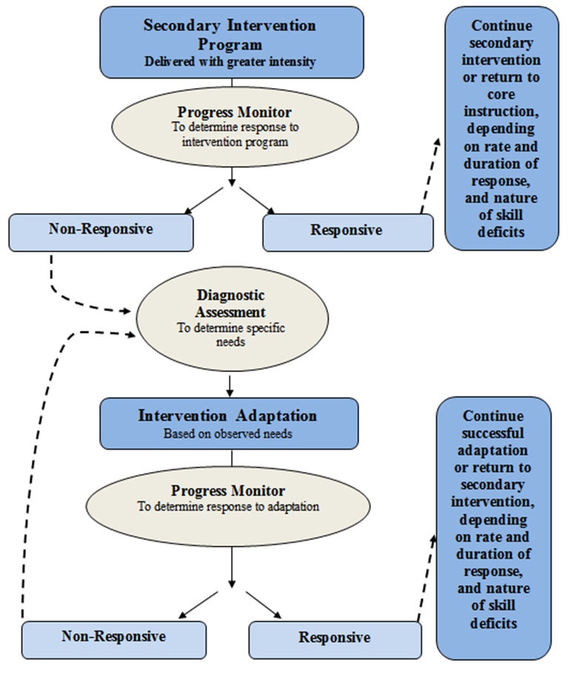

A Bird’s Eye View of DBI
11

Slide 13
What Do You Need to Implement DBI?

Slide 14
Considerations for Implementation: Staff Commitment
Key Element | Flexibility Within Implementation
Commitment of: Principal Intervention staff Special educators | Specific intervention staff involved including staff who work with students with intensive needs in the area(s) of concern. (e.g., reading specialists, social workers)
13

Slide 15
Considerations for Implementation: Student Plans
Key Element | Flexibility Within Implementation
Student plans are developed and reflect: Accurate and timely student data Goal(s) for the intervention based on valid, reliable assessment tools Timeline for executing and revisiting the intervention plan | Content area(s) Number of student plans Grade level(s)

Slide 16
Considerations for Implementation: Student Meetings
Key Element | Flexibility Within Implementation
Student meetings are data driven. There is a regularly scheduled time to meet. Meetings are structured to maximize efficiency and focused problem solving | Frequency Schedule Team members

Slide 17
Considerations for Implementation: Progress Monitoring
Key Element | Flexibility Within Implementation
Valid, reliable progress monitoring tools are used. Data are graphed. Data are collected at regular intervals. | Choice of tool Use of progress-monitoring data at other tiers

Slide 18
Considerations for Implementation: Students With Disabilities
Key Element | Flexibility Within Implementation
Students with disabilities must have access to intensive intervention. | Who delivers intervention for students with disabilities Inclusion of students with and without IEPs

Slide 19
Review of Key Elements
Staff commitment
Student plans
Student meetings
Valid, reliable data
Inclusion of students with disabilities
Supporting these elements requires aligned professional development and ongoing coaching support

Slide 20
An Example From Coventry, Rhode Island

Slide 21

Serves 35,000 people in a growing suburban and
rural area
Five elementary schools, one middle school, and one
high school
Leadership
  New superintendent hired in 2012
  Turnover in district administration
  Responsive to the needs of schools involved with NCII

Slide 22
Coventry Public Schools and NCII
School A
School B
Administrators and professional development coordinators indicate interest
Conducted initial self-assessment
Set goals and began training in 2012
School A
Streamlined NCII work with current initiatives
Relied on school-based team support
Determined an English language arts (ELA) focus for intensive intervention
School B
Initially willing, but lacked readiness
School-based team unable to support
After starting training, decision was made to discontinue involvement in the NCII initiative
21

Slide 23
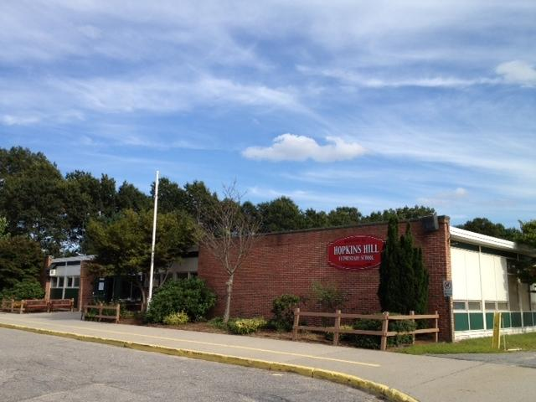
School A: Hopkins Hill Elementary
Demographics
  Serves 410 students in Grades PK–5
  Demographics: 97 percent white, 0 percent English language learners, 41 percent free or reduced-price lunch, and 8 percent special education
Staff and leadership
  New principal in 2009 and 2012
  Current principal is recipient of Rhode Island Association of School Principals’ Outstanding First Year Principal award
  Employs 26 staff and 20 support staff
  Support from external coaches
  School functioning at capacity
Academic milestones (2013–14)
  Nine percent schoolwide gain on NECAP reading
  Six percent schoolwide gain in STAR reading
  Moved out of State Warning Status in NECAP reading

Slide 24

Role of the Coach
Work with teams to apply knowledge learned from NCII trainings (“How can this work at my school?”)
Ask challenging questions
Provide an objective point of view
Support school-based teams in developing skills and increasing efficiency
Promote communication between district level and school
Assist with problem solving

Slide 25
What Has Contributed to the Success at Hopkins Hill?
Staff comfort level with data
Willingness to examine, refine, and reflect on Tier 3 intervention systems
Braiding of initiatives
General education involvement
Ongoing staff training plans (always training the “next person up”)

Slide 26
What Has Contributed to the Success at Hopkins Hill?
Determination of non-negotiables
  Leadership involvement
  Holding designated meetings
  Writing student-focused plans
  Progress monitoring with valid and reliable tools

Slide 27
What Has Contributed to the Success at Hopkins Hill?
Top Coventry NCII goals for 2014–15
  Aligning assessment to intervention
  Planning intervention when prior efforts do not work
  Scheduling and leveraging existing resources and alignment of intervention time
  Communication between intervention and classroom teachers
  Focus audience is on intensive students, including student learning objectives (SLOs)

Slide 28

Leadership
Establish purpose and focus
Build a shared vision
Shape culture and expectations
Communicate with and promote buy-in and involvement of staff in decision making
Provide supporting resources and structures
  Including assessments, interventions, professional development, staff time

Slide 29
Hopkins Hill Example
Leading by example—“Walk the talk”
  Superintendent has been involved throughout the process.
  Special education director is working to connect this work and special education processes.
  Principal is always present (at trainings, meetings, and coaching sessions).
All other staff members see this level of commitment from leadership and understand the importance of the work.
School/staff culture is one that actively engages in learning and is not afraid of change.

Slide 30
Hopkins Hill Example
Connected this work to change State Warning Status in New England Common Assessment Program (NECAP) reading.
Focused on ELA schoolwide.
Provided a voluntary summer retreat training on this area and had full attendance.
NCII team selected evidence-based intervention PALS-Reading and did schoolwide training and implementation.
NCII team members also were on response-to-intervention (RTI) team.
Implemented DBI process through weekly RTI meetings.
Used the same student data collected for SLOs.

Slide 31
Teams and Collaboration
Teams are needed to:
  Lead schoolwide DBI implementation
  Make student-level intervention decisions
Teams know their purpose, use data, and have consistently scheduled and structured meetings (e.g., communication protocols, agendas, roles, and responsibilities).

Slide 32
DBI Leadership Team Meetings
DBI team oversees and leads implementation efforts.
Team members have knowledge and understanding of DBI.
Team has decision-making authority.
  Includes principal or designee
Team allocates resources and supports policies aligned with DBI.
Rotating members may be involved in meetings for individual students based on their specific needs and which staff members work with the student.

Slide 33
Individual Student Meetings
Team meets on individual students with intensive needs (including those with disabilities).
Meetings focus on problem solving using student data.
Meetings provide time to plan and to assess effectiveness of intervention.

Slide 34

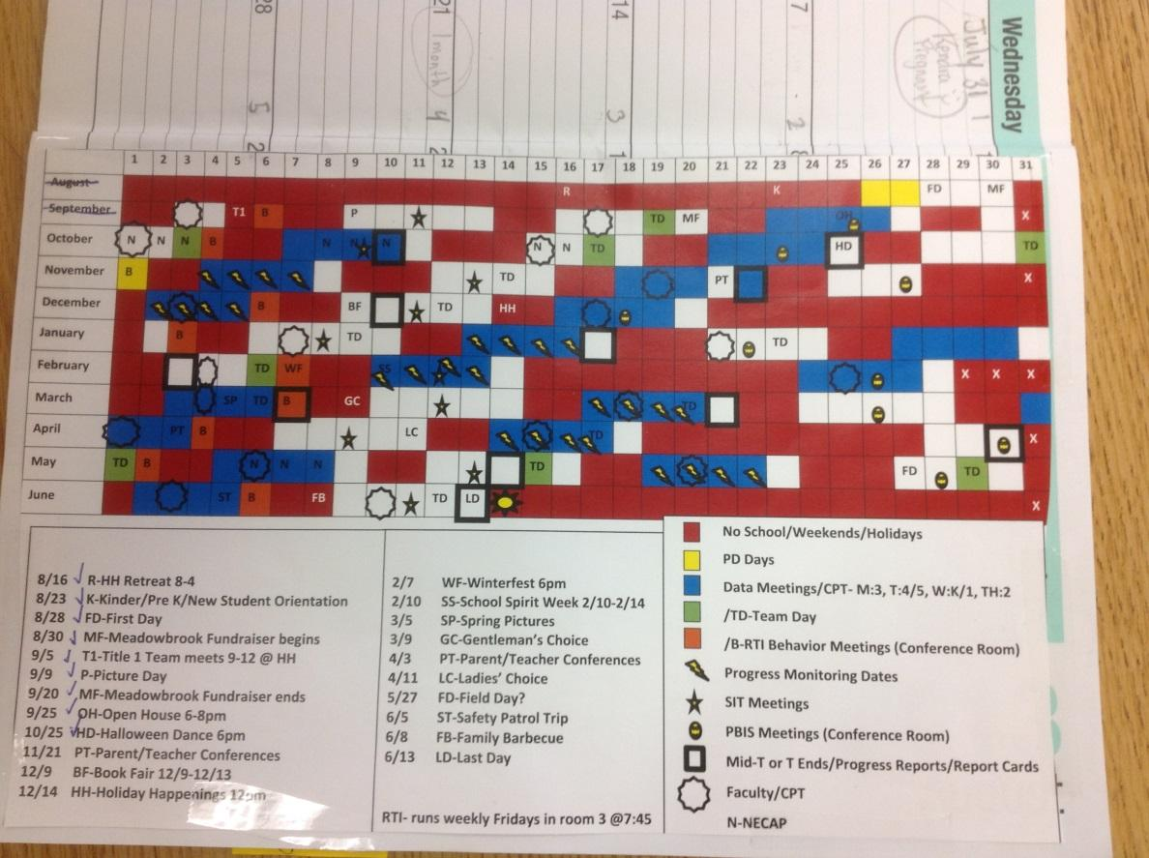
Hopkins Hill at Work

Slide 35
Individual Student Meetings: Potential Attendees
Referring teacher
Intervention provider
Content specialist
Administrator
Coach
School psychologist
Social worker
Special educator
General educator/classroom teacher
Parent (as available and appropriate)
Student (when appropriate)

Slide 36
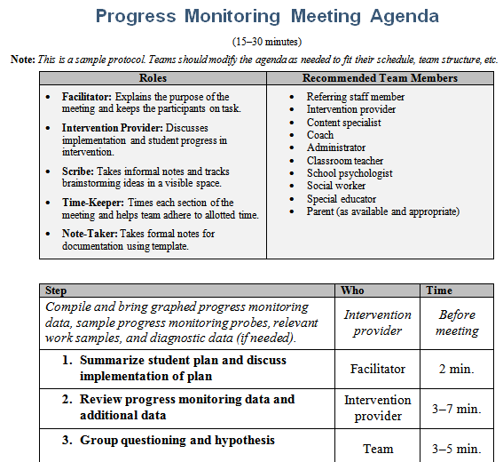
Example of Student
Meeting Tools
These example tools will be coming soon to the website (www.intensiveintervention.org).
35

Slide 37
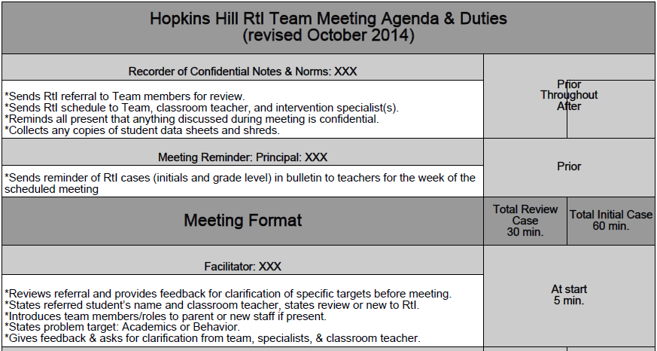
Hopkins Hill at Work
36

Slide 38
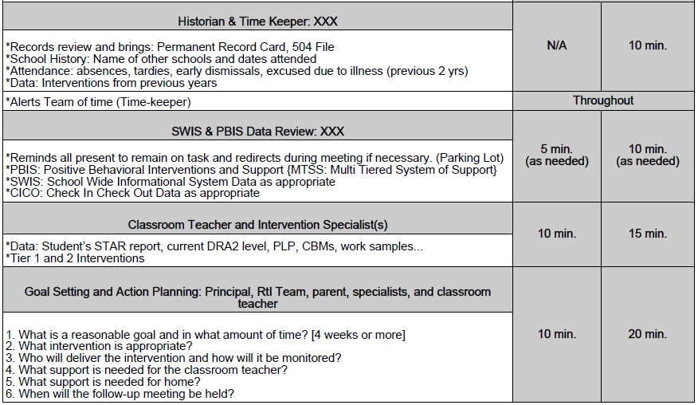
37

Slide 39
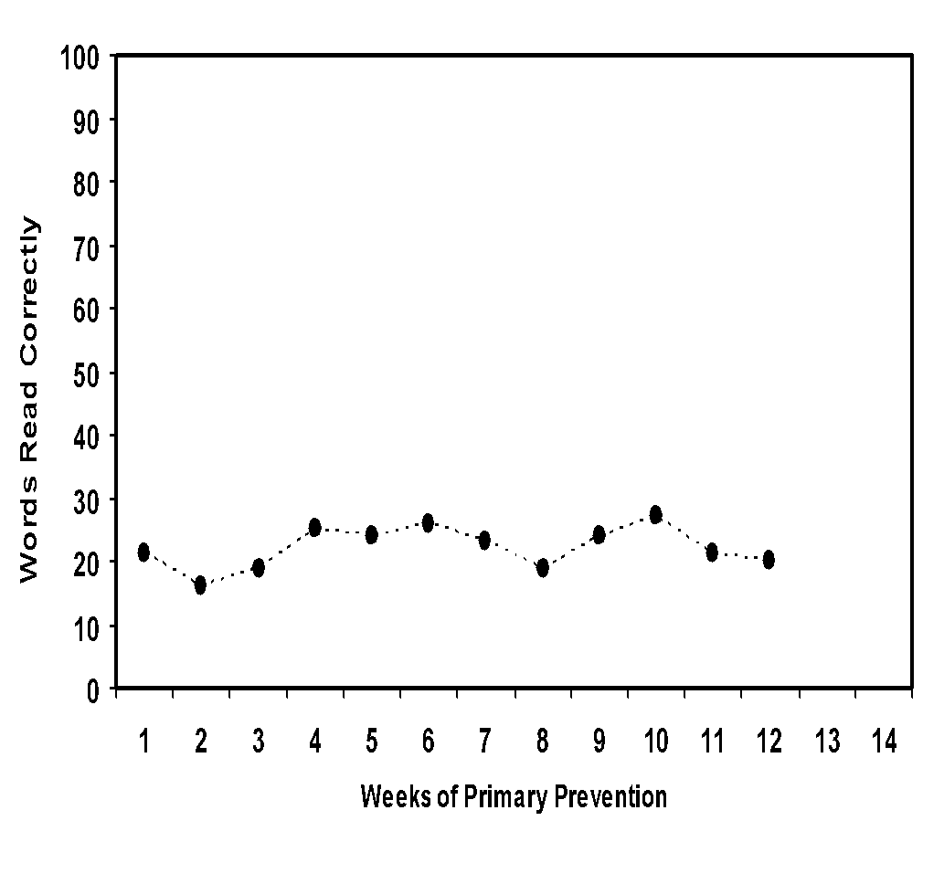
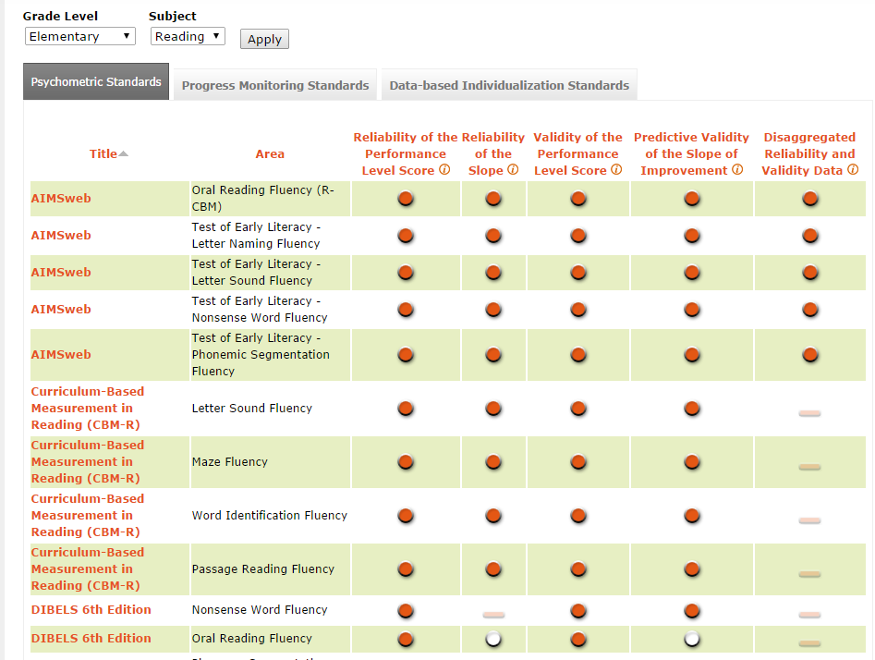
Valid Reliable Data
Progress-Monitoring Tools Chart
http://www.intensiveintervention.org/chart/progress-monitoring
38

Slide 40
Other Data Sources
Assessment data
  Universal screening
  Diagnostic assessment
  Progress-monitoring data at other levels (secondary intervention)
  Other formative data
39

Slide 41
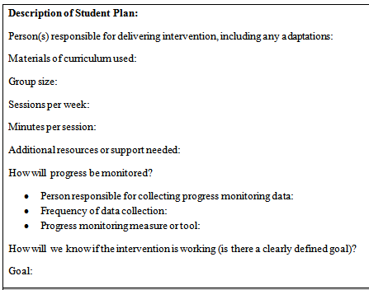
Student Plans
40

Slide 42
Scheduling Intervention Time to Execute Plan
Must supplement core instruction (not replace)
Considerations:
  Length of sessions?
  Days per week?
  Who will deliver interventions?
Structure
  Within classroom
  Within grade
  Across grades
41

Slide 43
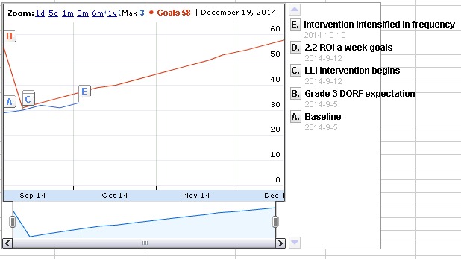
Hopkins Hill at Work
Progress- Monitoring Dates | DORF Words Correct | Comments | Goals | Comments
9/5/2014 | 29 | Baseline | 55 | Grade 3 DORF expectation
9/12/2014 | 30 | LLI intervention begins | 31 | 2.2 ROI a week goals
9/19/2014 | 32 |  | 33
9/26/2014 | 31 |  | 35
10/3/2014 | 33 |  | 37
10/10/2014 |  | Intervention intensified in frequency | 39
10/17/2014 |  |  | 40
10/24/2014 |  |  | 42
10/31/2014 |  |  | 44

Slide 44
Communicating Student Plans
Provide parents and staff with
Overview of DBI process
Updates on student’s progress
Involvement in decision making
43

Slide 45
Students With Disabilities
Students With Disabilities
Receive services at all levels, depending on need including intensive intervention
Intensive Level of Prevention
Targeted Level of Prevention
Universal Level of Prevention

Slide 46
Professional Development
All other aspects of DBI infrastructure hinge on professional development.
Professional development:
Builds staff knowledge
Provides continuous support for implementation
45

Slide 47
Refresher: Critical Features of
DBI Implementation
Staff commitment
Student meetings and plans
Progress-monitoring data for intensive intervention
All students with intensive needs have access to intensive intervention (including students with disabilities)
46

Slide 48
Questions

Slide 49

Connect to NCII
Sign up on our website to receive our newsletter and announcements.
Follow us on YouTube and Twitter:
  YouTube Channel: National Center on Intensive Intervention
  Twitter handle: @TheNCII

Slide 50
References
Aud, S., Hussar, W., Johnson, F., Kena, G., Roth, E., Manning, E., et al. (2012). The condition of education 2012 (NCES 2012-045). Washington, DC: U.S. Department of Education, Institute of Education Sciences, National Center for Education Statistics. Retrieved from http://nces.ed.gov/pubs2012/2012045.pdf
Deno, S. L., & Mirkin, P. K. (1977). Data-based program modification: A manual. Minneapolis, MN: Leadership Training Institute for Special Education.
Fuchs, L. S., Fuchs, D., & Hamlett, C. L. (1989). Effects of instrumental use of curriculum-based measurement to enhance instructional programs. Remedial and Special Education, 10, 43–52.
Fuchs, L. S., Fuchs, D., Powell, S. R., Seethaler, P. M., Cirino, P. T., & Fletcher, J. M. (2008). Intensive intervention for students with mathematics disabilities: Seven principles of effective practice. Learning Disability Quarterly, 31, 79–92.
49

Slide 51
References
Gersten, R., Compton, D., Connor, C. M., Dimino, J., Santoro, L., Linan-Thompson, S., & Tilly, W. D. (2008). Assisting students struggling with reading: Response to intervention and multi-tier intervention for reading in the primary grades. A practice guide (NCEE 2009-4045). Washington, DC: U.S. Department of Education, Institute of Education Sciences, National Center for Education Evaluation and Regional Assistance. Retrieved from http://ies.ed.gov/ncee/wwc/PracticeGuide.aspx?sid=3
National Center on Intensive Intervention. (2013). Data-based individualization: A framework for intensive intervention. Washington, DC: U.S. Department of Education, Office of Special Education.
50

Slide 52
References
Planty, M., Hussar, W., Snyder, T., Provasnik, S., Kena, G., Dinkes, R., et al. (2008). The condition of education 2008 (NCES 2008-031). Washington, DC: U.S. Department of Education, Institute of Education Sciences, National Center for Education Statistics. Retrieved from http://nces.ed.gov/pubs2008/2008031.pdf
Sanford, C., Newman, L., Wagner, M., Cameto, R., Knokey, A.-M., & Shaver, D. (2011). The post-high school outcomes of young adults with disabilities up to 6 years after high school. Key findings from the National Longitudinal Transition Study-2 (NLTS2) (NCSER 2011-3004). Menlo Park, CA: SRI International. Retrieved from http://www.ies.ed.gov/ncser/pubs/20113004/pdf/20113004.pdf
51

Slide 53
NCII Disclaimer
This presentation was produced under the U.S. Department of Education, Office of Special Education Programs, Award No. H326Q110005. Celia Rosenquist serves as the project officer. The views expressed herein do not necessarily represent the positions or polices of the U.S. Department of Education. No official endorsement by the U.S. Department of Education of any product, commodity, service, or enterprise mentioned in this website is intended or should
be inferred.

Slide 54
While permission to redistribute this webinar is not necessary, the citation should be:
National Center on Intensive Intervention. (2014). Making it Happen: What Does it Take to Implement Intensive Intervention? Washington, DC: U.S. Department of Education, Office of Special Education Programs, National Center on Intensive Intervention.

Slide 55
Lou Danielson
ldanielson@air.org
Nicole Hitchener
hitchenernicole@coventryschools.net
Michele Walden-Doppke
Mwalden-doppke@nric-ri.org
1000 Thomas Jefferson Street NW
Washington, DC 20007-3835
866-577-5787
www.intensiveintervention.org
ncii@air.org
Twitter: @TheNCII

