Slide 1
Hello! Welcome to "What Counts as Evidence? Making Decisions for Instruction and Intervention within a Multi-Tiered System of Support" The webinar will begin shortly. We appreciate your patience
March 10, 2016
Copyright © 2016 American Institutes for Research. All rights reserved.

Slide 2
What Counts as Evidence? Making Decisions for Instruction and Intervention within a Multi-Tiered System of Support
Allison Gruner Gandhi
Lynn Holdheide
Rebecca Zumeta Edmonds
March 10, 2016
Copyright © 2016 American Institutes for Research. All rights reserved.

Slide 3
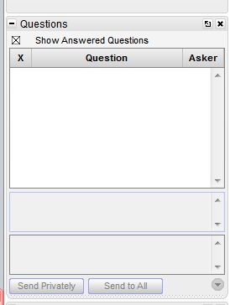
Question Box
Please direct questions to the question box. A webinar team member will try to assist you as soon as possible.

Slide 4
Participant Poll
What role do you serve in supporting student learning?
Technical assistance provider
Educators Preparation Program Faculty
State, district or school administrator
Teacher or other school staff
Other

Slide 5
Today’s Webinar: Goals
Lessen anxiety around EBPs!
Make the case for flexibility in evidence criteria across MTSS tiers
Share resources available through TA Centers
Core instructional practice
Evidence for intervention

Slide 6
Role of EBPs in Federal Policy
Every Student Succeeds Act
Requires use of “evidence-based interventions” in low performing schools
Four categories of evidence:
"strong evidence“: supported by at least one randomized study
"moderate evidence“: supported by at least one quasi-experimental study
"promising evidence“: at least one correlational study with pretests as covariates
programs with a rationale based on high-quality research or a positive evaluation that are likely to improve student or other relevant outcomes
School improvement interventions must be supported by categories 1-3

Slide 7
Role of EBPs in Federal Policy
OSEP’s Results-Driven Accountability (RDA) Initiative
States accountable for compliance AND results
State systemic improvement plans include strategies to achieve a “state-identified measurable result (SiMR)”
A child-level (or family-level, for Part C) outcome
Not a process or system result
May be a single result or a cluster of related results
Identified based on analysis of data

Slide 8
EBPs in the SSIP
“The focus of Phase II is on building State capacity to support local educational agencies (LEAs) with the implementation of evidence-based practices (EBPs) that will lead to measurable improvement in the State-identified Measurable Result(s) (SIMR) for children with disabilities”
Source: OSEP. (2015). Part B State Systemic Improvement Plan (SSIP) Phase II OSEP Guidance and Review Tool. Retrieved from: https://osep.grads360.org/#communities/pdc/documents/8823

Slide 9
EBPs in the SSIP
Improvement strategies must be “based on the best available research, aligned to data analysis and the infrastructure analysis, and support systemic change”
“The State should provide the evidence it used to make decisions on appropriate improvement strategies to improve the SIMR.”
Source: http://ncsi.wested.org/wpcontent/uploads/2015/02/CompilationofOSEPGuidanceonSSIP_January2015_Release.pdf

Slide 10
Challenge: They’re everywhere, but what are they?
Inconsistent Terminology: Authors and organizations refer to EBPs in a variety of ways
Evidence-based practice
Research-based practice
Scientifically-based practice
Promising practice
Best practice
Notes:
Possible poll/comment request: ask people to throw out other terms they have heard

Slide 11
Challenge: They’re everywhere, but what are they?
Inconsistent Criteria: Authors and organizations define criteria for EBPs in different ways
Quality of evidence (study design)
Direction and magnitude of results
Quantity of evidence
Source of evidence
Some combination of all these things

Slide 12
Participant Poll
What is the most important criteria for YOU when selecting an evidence-based practice?
The practice has been examined using the most rigorous research design
The practice has a very large body of research behind it showing mostly positive results
The practice has never been shown through research to have negative results
I have seen this practice work with my own kids or it has worked well for a colleague
The practice is aligned to my students’ needs

Slide 13
Are we taking EBPs a bit too seriously?
I can tell you’re struggling with fractions, Tony, but there aren’t any EBPs for kids in your grade. Maybe check back in a few years?

Slide 14
Common EBP Questions
What are EBPs and when can I benefit from them?
Can I adapt an EBP?
How do I know if it’s working?

Slide 15
ESSA and RDA
General educators:
We need EBPs to help our lowest performing schools! What practices were studied with an RCT?
Special educators:
We need EBPs to put in our SSIP for RDA!
What practices have some good research?
Common
aim: Implement practices to help lowest achieving students

Slide 16
Could MTSS help provide an organizational framework for communicating about the evidence base?
In MTSS, the “practice” in “evidence-based practice” is different in each tier!
Wouldn’t this mean that criteria for evidence should differ too?

Slide 17
Characteristics of Intervention Levels/Tiers
 | Primary (T1) | Secondary (T2) | Intensive (T3)
Instruction/ Intervention Approach | Comprehensive research-based curriculum | Standardized, targeted small-group instruction | Individualized, based on student data
Group Size | Class-wide (with some small group instruction) | 3–7 students | No more than 3 students (ideally)
Monitor Progress | 1x per term | At least 1x per month | Weekly
Population Served | All students | At-risk students | Students with significant & persistent needs

Slide 18
But what about evidence of effectiveness at each level?

Slide 19
Role of Evidence
 | Primary (T1) | Secondary (T2) | Intensive (T3)
Instruction/ Intervention Approach | Comprehensive research-based curriculum | Standardized, targeted small-group instruction | Individualized, based on student data
Evidence? | Comprehensive coverage of critical content Instructional practices and strategies with evidence of efficacy | Intervention aligned to target skill(s) Standardized program with demonstrated efficacy | Individualization of intervention, embedding instructional strategies and supports based on student data Frequent, ongoing progress monitoring to determine impact

Slide 20
Core instructional practice

Slide 21
Instructional Practice
Terminology
Evidence-based practice
Research-based practice
Scientifically-based practice
Promising practice
Best practice
High Leverage practices (HLPs)
Mixed Messages
Preparation
Certification and Licensure Standards
Educator Evaluation
Professional Learning and Support

Slide 22
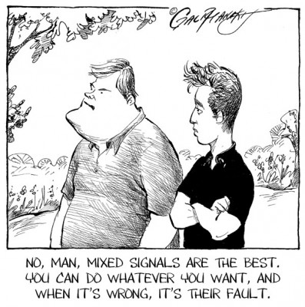
What Does it Feel Like for Teachers?

Slide 23
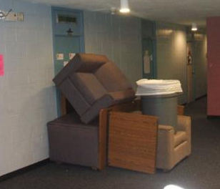
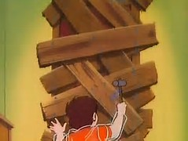
Result

Slide 24
Tier 1 Instruction: What is the goal?
Shared ownership and accountability for the progress of all students
Access to the curriculum (e.g., standards)
Instruction and practices that are effective at reaching the bulk of students
Screening and progress monitoring to
Determine effectiveness of instruction and practices
Identify students that are struggling
Adjust/differentiate instructional strategies and practices accordingly
Solicit consultation, support, and services
Recommendations for Tier 2 support

Slide 25
Defining Evidence-based Practices at Tier 1
Challenges
Variation in context
Implementation fidelity/quality
Student characteristics
End Result
Missed opportunity for shared ownership
Lack of alignment in expectations
Decreased confidence among general education teachers in supporting students with disabilities and struggling learners
More students referred to tier 2 and 3

Slide 26
Participant Poll
What do you perceive as the primary challenge in implementing evidence-based practices in core/tier 1 instruction (choose all that apply)?
EBPs place too much emphasis on lower order skills
EBPs don’t align with expectations about instruction at core/tier 1
EBPs are too cumbersome to use in general education classrooms
There is not enough time to teach EBPs in addition to the other content
EBPs are not always responsive to students’ cultural and language needs

Slide 27
Can/should there be a happy medium or consensus in the rigor of evidence at tier 1?
What evidence should we look for?
Gold Standard: Rigorous experiments, quasi-experiments, or RDDs of a well-defined practice, strategy, or program (if available)
Research-based: Meta-analyses or syntheses of research on instructional strategies
Promising practices: less rigorous, or correlational studies
Expert recommendations: Recommendations from reputable professional organizations (e.g., National Reading or Math Panel)
Alignment with grade level standards
Notes:
Difficulty in finding the gold standard in a program.
Meta analysis or synthesis – big studies that look at several strategies in instructional strateiges
Strategy – in tier 1 graphic organizers – hard to do a RCT in the graphic organizers – context etc changes….
Fidelity of implementation is different.
Never going to do just one strategy – confidence that each of the smaller ones and it will work
Monitoring appropriately and determining the effectiveness of it.
Educators taking ownership… using strategies – they need to take ownership to make sure they are implementing it correctly and checking to see it works
If they are in a position to choose

Slide 28
Tier 1: Dimensions of Fidelity
Element | Questions Addressed
Schedule | Did instruction occur as planned?
Content coverage | Was critical content covered in alignment with standards or recommendations from reputable professional organizations (e.g., National Reading Panel)?
Instructional practices and strategies | Were correct procedures followed for implementing practices/strategies?
Screening procedures | Were correct screening administration, and scoring procedures followed?

Slide 29
Resources to Support Identification of EBPs at Tier 1
What Works Clearinghouse
IES Practice Guides
Best Evidence Encyclopedia
IRIS Center: http://iris.peabody.vanderbilt.edu/ebp_summaries/
Teaching Works: High Leverage Practices (Ball): http://www.teachingworks.org/work-of-teaching/high-leverage-practices
CEEDAR Center: http://ceedar.education.ufl.edu/
Evidence-based Intervention Network: http://ebi.missouri.edu/

Slide 30
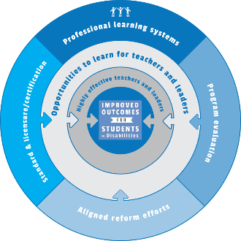
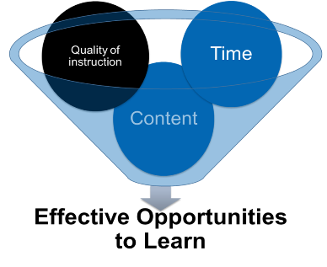
Barriers to Use of EBPs
Despite the strength of evidence in some areas, EBPs for students that struggle are not always well represented in preparation curriculum.
Content
Brownell et al, in press
Notes:
I think we should get the team to rank order the barriers. So that they can revisit them later when they are making plans to address them in their Blueprint or in their IHE work.

Slide 31
Evidence Base
CEEDAR Evidence Standards
4 levels of evidence
Strong
Moderate
Limited
Emerging
http://ceedar.education.ufl.edu/wp-content/uploads/2014/08/Evidence-Based-Practices-guide.pdf
(CEEDAR Center, 2014)
Notes:
You use the research that is available, and it is important to understand that research establishing causal relationships is privileged.
(CEEDAR Center, 2014)
Retrieved from: http://ceedar.education.ufl.edu/wp-content/uploads/2014/08/Evidence-Based-Practices-guide.pdf -- show them the guidance document
It was based on Cook and Cook (2011) and guidance provided by the Council for Exceptional Children.
Strong evidence is determined based on quantitative research. The other levels consider qualitative research as an indicator, but for Moderate you must have at least two meta-analyses conducted by independent researchers. I think this is a LOW bar.
See Handout on this

Slide 32
CEEDAR Innovation Configurations
Evidence-based content and instructional practices that increase student achievement and core competencies that general and special educators need for instruction SWDs.
http://ceedar.education.ufl.edu/tools/innovation-configurations/
Notes:
CEEDAR Innovations configurations.

Slide 33
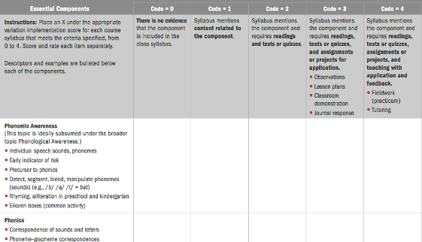
CEEDAR Tools and Resources
Knowledge Development Papers
Scientifically Based Reading
Classroom Organization
& Behavior Management
Evidence-Based Writing Instruction
Evidenced-based Math Instruction
Universal Design for Learning
Leadership
Technology
Inclusive Service
Significant Disabilities
Sensory Impairments
Culturally Responsive Instruction
Secondary Transition
Linking Assessment & Instruction
Innovation Configuration
Content Innovation Configuration
Course Enhancement Modules
Notes:
Recognizing that evidence-based practices (EBPs) account for at least part of the effects of teachers on achievement and the critical role of teacher preparation, the CEEDAR Center professionals, along with their partner Great Teachers and Leaders, offer innovation configurations (ICs) to promote the implementation of evidence-based instructional practices in teacher preparation activities. ICs are designed to evaluate current teacher preparation and professional development (PD) by determining the extent to which EBPs are taught, observed, and applied within teacher preparation and PD programs. However, more broadly ICs provide a synthesis of EBPs and could be modified for other state needs (i.e., observational rubrics, teacher self assessments, etc.)
Innovative Configurations -13 can be found on the CEEDAR website
http://ceedaar.education.ufl.edu/tools/innovation-configurations
Innovation configurations (ICs) promote the implementation of evidence-based instructional practices in teacher preparation activities. ICs are designed to evaluate current teacher preparation and professional development (PD) by determining the extent to which Evidence Based Practices (EBPs) are taught, observed, and applied within teacher preparation and PD programs.
ICs are designed to improve teacher education, which, in turn can lead to improved student achievement. The use of ICs to evaluate teacher education programs and PD activities provides an overview of the practices and competencies taught within general and special education teacher preparation programs.
IC results provide credible information about current practices and can be used as the basis or rationale for policy and program changes in teacher preparation and PD programs at the district, state and university levels.

Slide 34
CEEDAR Tools and Resources
Knowledge Development Papers
Innovation Configuration
Course Enhancement Modules
http://ceedar.education.ufl.edu/cems/
Notes:
(transition to CEM)

Slide 35
CEEDAR Tools and Resources
Knowledge Development Papers
Innovation Configuration
Course Enhancement Modules
Notes:
(transition to CEM)

Slide 36
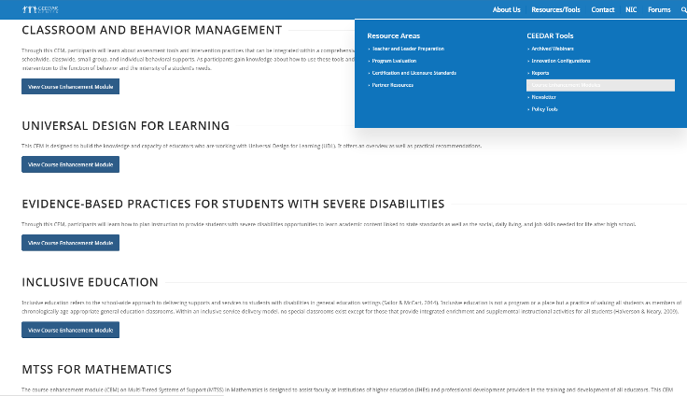
Course Enhancement Modules
Reading K-12
Secondary Transition
Writing
Leadership

Slide 37
Evidence for Intervention

Slide 38
Tier Two: Secondary Prevention
Intervention aligned to target skill(s)
Standardized program with demonstrated efficacy
Best aligned to current thinking about gold standard evidence

Slide 39
Resources to Support Identification of EBPs at Tier 2
http://www.intensiveintervention.org/chart/instructional-intervention-tools

Slide 40
Additional Resources
What Works Clearinghouse/IES Practice Guides: http://www.ies.ed.gov/ncee/wwc/Publications_Reviews.aspx?f=All%20Publication%20and%20Product%20Types,3;#pubsearch
Best Evidence Encyclopedia: http://www.bestevidence.org/index.cfm
IRIS Center: http://iris.peabody.vanderbilt.edu/ebp_summaries/
EBI Network: http://ebi.missouri.edu/
RTI Center: www.rti4success.org
Notes:
Multiple choice responses (click all that apply)
What Works Clearinghouse
NCII Tools Charts
Information from research journals
Recommendations from professional organizations
Other

Slide 41
Participant Poll
What resources do you use to identify evidence-based practices or curriculum materials for your setting? (check all that apply)
What Works Clearinghouse
NCII Tools Charts
Information from research journals
Recommendations from professional organizations
Other

Slide 42
Tier 2: Dimensions of Fidelity
Element | Questions Addressed
Schedule | Did instruction occur as planned?
Adherence to program | Did the interventionist deliver all components of the program consistent with the way it was designed?
Progress monitoring procedures | Were correct progress monitoring administration and scoring procedures followed?

Slide 43
Limitations of gold standard evidence…
Time and fiscal resources that delay movement from the research lab into schools may mean few options in certain areas.
Generalizability to other populations
Why isn’t this working?
Generally effective isn’t universally effective… Some kids need more.

Slide 44
Tier 3: Intensive Intervention
Individualization of intervention, embedding instructional strategies and supports based on student data (e.g., precision or experimental teaching procedures)
Targeted integration of academic and behavioral supports
Frequent, ongoing progress monitoring to determine impact

Slide 45
Data-Based Individualization

Slide 46
What’s the evidence?
Is the student making progress?
Student level responsiveness data from experimental or precision teaching approaches (e.g., Deno & Mirkin, 1977; Fuchs, Deno, & Mirkin, 1984; White, 1986)
Assessment tools with evidence of validity and reliability

Slide 47
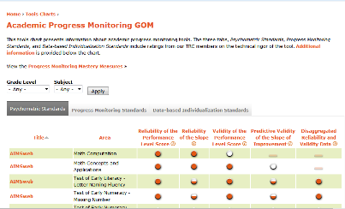
Resources to Support Identification of EBPs at Tier 3
Academic & Behavior Intervention
Progress Monitoring

Slide 48
Additional resources
National Center on Intensive Intention http://www.intensiveintervention.org/
Center on Instruction: http://www.centeroninstruction.org/intensive-interventions-for-students-struggling-in-reading-and-mathematics

Slide 49
Tier 3: Dimensions of Fidelity
Element | Questions Addressed
Schedule | Did instruction occur as planned?
Adherence to the student’s individualized plan | Was the student‘s program delivered as the intervention or IEP intended? Were correct procedures followed in implementing intensification strategies?
Progress monitoring procedures | Were correct progress monitoring administration and scoring procedures followed?

Slide 50
Resources for Monitoring Fidelity of the Intensive Intervention System
http://www.intensiveintervention.org/resource/dbi-implementation-rubric-and-interview

Slide 51
Resources for Monitoring Student-Level Fidelity

Slide 52
Challenges
Tier 2
Limited availability in many grades and subject areas
Validity across contexts
Transportability to different student populations
Lack alignment to Tiers 1 and 3, or to student need
Feasibility of implementation
Low-incidence populations
Tier 3
Lack of complex packaged interventions that target unique, multi-pronged problems
Practitioner expertise
Availability of appropriate progress monitoring tools
Perceptions of “off-level” instruction and assessment
Scale up

Slide 53
Questions

Slide 54
References
Brownell, M., Chard, D., Benedict, A., & Lignugaris/Kraft, B. (in press). Teacher preparation and Response to Intervention Frameworks. In M. Kennedy & P. Pullen (Eds)., Handbook of Response to Intervention
and Multi-tiered Instruction.
Deno, S. L., Mirkin, P. K., & Leadership Training Inst. for Special Education, M. n. (1977). Data-Based Program Modification: A Manual.
Fuchs, L.S., Deno, S.L.& Mirkin, P.K. (1984). The effects of curriculum-based measurement evaluation on pedagogy, student achievement, and student awareness of learning. American Educational Research Journal, 21(2), 449-460.
White, O. R. (1986). Precision teaching-precision learning. Exceptional Children, 52, 522-534.

Slide 55
Disclaimer
CEEDAR
This content was produced under U.S. Department of Education, Office of Special Education Programs, Award No. H325A120003. Bonnie Jones and David Guardino serve as the project officers. The views expressed herein do not necessarily represent the positions or polices of the U.S. Department of Education. No official endorsement by the U.S. Department of Education of any product, commodity, service, or enterprise mentioned in this website is intended or should be inferred.
NCSI
This presentation was produced under U.S. Department of Education, Office of Special Education Programs contract No. H326R140006. The views expressed herein do not necessarily represent the positions or policies of the U.S. Department of Education. No official endorsement by the U.S. Department of Education of any product, commodity, service, or enterprise mentioned is intended or should be inferred.
NCII
This presentation was produced under the U.S. Department of Education, Office of Special Education Programs, Award No. H326Q110005. Celia Rosenquist serves as the project officer.
The views expressed herein do not necessarily represent the positions or polices of the U.S. Department of Education. No official endorsement by the U.S. Department of Education of any product, commodity, service or enterprise mentioned in this website is intended or should be inferred.

Slide 56
American Institutes for Research
1000 Thomas Jefferson Street NW
Washington, DC 20007-3835
General Information: 202-403-5000
www.air.org

