Slide 1
Welcome to the National Center on Intensive Intervention webinar!
Our presentation will begin at 3:00pm Eastern Time.
To access the audio portion of this presentation on your phone, dial: 1-866-244-8528
When prompted, enter participant code: 117937
Your phone line will be muted. Please type questions into the chat box located on your screen.

Slide 2
Bringing Families to the Table: Family Engagement for Struggling Students
Kate Augustyn
Debra Jennings
Kelly Orginski
October, 2013
Notes:
Welcome

Slide 3

In today’s webinar…
Introduction to NCII and the Value of Family Engagement
Perspectives from our Panelists:
  Kate Augustyn- District Perspective: Parent Involvement in Grand Haven Public Schools
  Kelly Orginski- State and Parent Perspective: Michigan Alliance for Families
  Debra Jennings- National Perspective: $I^{5}$ Family Involvement
Questions and Discussion

Slide 4
Meet our Panelists
Kate Augustyn- Special Education Director of Grand Haven Public Schools in Michigan, a NCII TA site
Debra Jennings- Executive Co-Director of Statewide Parent Advocacy Network (SPAN) and Director of new OSEP-funded Center for Parent Information and Resources
Kelly Orginski- Statewide Trainer at Michigan Alliance for Families
Notes:
Our panelists bring a range of perspectives and experiences with regard to working with families.
Kate Augustyn began working with parents as the Executive Director of Tuesday's Child, a non-profit in Chicago, Illinois for 12 years. Moved to Michigan and worked with ECSE and then CI classes for 5 years. Became the Special Education Director 10 years ago for Grand Haven Area Public Schools. Kate continues to enjoy this job and working with parents everyday.
Debra Jennings is the executive co-director of the statewide parent advocacy network (SPAN) and the director of the new OSEP-funded Center for Parent Information and Resources.
Kelly Orginski is a statewide trainer at the Michigan Alliance for Families and has had 30 years of experience in Special Education and indirect programs and services to students with disabilities, parents, educators and state and local agencies.

Slide 5
Introduction to NCII and the Value of Family Engagement

Slide 6
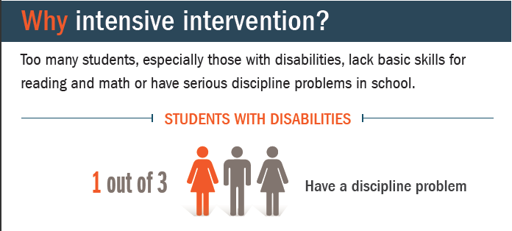
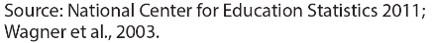
Notes:
The NCII arose from a critical and growing need to improve academic and behavioral outcomes for students with disabilities. While there have been many successful initiatives that have improved outcomes for students with disabilities in the past few years, data show us that a subset of these students are not responding to traditional supports and need something more individualized and intensive. Data from the NCES …

Slide 7
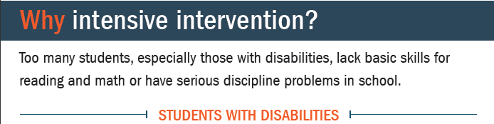
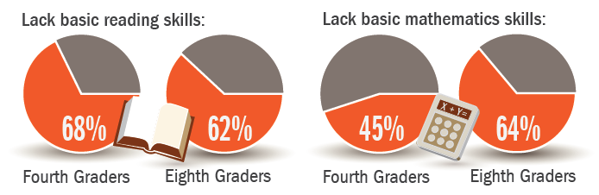
Source: National Center for Education Statistics, 2011.
Notes:
In academics…

Slide 8
Our Mission…
    to build district and school capacity to support implementation of data-based individualization in reading, mathematics, and behavior for students with severe and persistent learning and behavioral needs.
Notes:
Our mission at NCII is to…
We work toward this mission through a number of avenues. First, NCII provides universal technical assistance by sharing evidence-based tools, research, and experiences from the field in the form of webinars, reports, Tools Charts, and other resources on our website. We also provide intensive TA to 12 school districts in 4 different states across the country, including Grand Haven Public Schools where our panelist Kate Augustyn is the director of special education. Our intensive TA involves the delivery of training and ongoing coaching supports to help the districts build their capacity to deliver intensive interventions.

Slide 9
The Value of Family Engagement for Students with Intensive Needs
Notes:
Research and experience have illustrated the value and impact of family engagement for students. Families are an important partner when it comes to decision-making surrounding services and supports, but understanding multi-tiered systems of support such as RTI or MTSS presents its’ own challenges. Family engagement is particularly crucial for students with the most intensive needs, but comes with unique challenges.

Slide 10
Lessons Learned from our Knowledge Development Sites
Finding: Meaningful engagement and involvement of families in decisions about program planning was important for supporting implementation of intensive intervention.
  Regular and systematic communication with families
  Address home life challenges
Notes:
One example of the value of family engagement that has emerged through our work in the field is a finding from our knowledge development sites, which are districts from across the country that were selected based on their experienced success in educating their students with disabilities. NCII visited and conducted targeted interviews (including parents) at these 5 school districts to learn what factors facilitated their success in supporting students with disabilities and their delivery of intensive interventions.
The importance of family engagement for students with intensive needs was a common theme across sites. We found that meaningful engagement and involvement of families in decisions about program planning was important for supporting the implementation of intensive intervention. All sites reported efforts to increase family involvement related to intensive intervention, but noted varying degrees of success with their efforts. Interviewees spoke to the importance of establishing regular and systematic communication with families, addressing home life challenges, and establishing strong, trusting relationships with schools and specific staff members as part of their strategy.

Slide 11
Parent Involvement in Grand Haven Area Public Schools
Kate Augustyn

Slide 12
Parent Involvement in MTSS
Each of the elementary schools in Grand Haven has a different way to incorporate parents into their MTSS system.
These presentations and or meetings are often based on the character of the school and the mindset of the administrator and the building teams.

Slide 13
Parent Involvement in 5/6 Building
Based on the premise of Parent Connect and are interactive
Team members present curriculum overview and then work with parents to help them understand the curriculum and how to work with their students at home
The system is based on a positive model
Child care is provided
Treats and prizes are available
Notes:
Our 5/6 building has a unique way of presenting. Based on the premise of Parent Connect, White Pines runs several parent nights incorporating pieces of MTSS. Reading, math and behavior have been introduced so far this year. The meetings are 1 hour in length and are interactive. Team members present an over-view of the curriculum and then work with parents to help them understand the curriculum and how to work with their students at home.

Slide 14
Parent Involvement in 7/8 Building
Team presents MTSS model and intervention model at orientation
Team works individually with parents to explain how they incorporate students into groups for both academic and social interventions when needed
Parents are encouraged to visit and ask questions about groups
Notes:
Our 7/8 building presents their MTSS model and their intervention model at orientation in a written form as well as working individually with parents to explain how they incorporate students into groups for both academic and social interventions when needed. Parents are encouraged to visit and ask questions about what the groups entail.

Slide 15
Our District Commitment to Including Parents and Community
District has been involved with the MTSS model since 2008 when our seven elementary buildings joined the MiBLSi project
Established a MiBLSI Leadership Team made up of parents, community members, school staff and administrators
Team meets 3 times per year to review current trends in MTSS within the district
Notes:
We brainstorm and facilitate new ideas that will help the district to incorporate the ideas of MTSS and help the community better understand the ideas of interventions that schools use.

Slide 16
Taking MTSS to the Community
Work with MiBLSi Leadership Team has helped parents and students in the following ways:
  The Multi-agency Team
  Mentoring Programs that encourage individual work with students and incorporating parents when possible
  a. Central School
  b. 5/6 Kids Hope Project
Continue to work with district schools K-8 to sustain and ensure fidelity
Incorporate parents by increasing participation and awareness in our programs and interventions

Slide 17
Families with the Greatest Need
MAT team (monthly)
Backpack give away in the fall
Play and Learn for preschool (quarterly)
ECSE parent nights (child care provided)
a. Curriculum
b. Behavior
c. OT/PT
d. Speech needs
e. Summer ideas

Slide 18

Who We Are And What We Do
Kelly Orginski

Slide 19
An Evidence Based Model – Standards of Practice
Adult Learning Standards
Epstien – 6 Types of Parent Involvement
PTA National Standards of Parent Involvement
Mentoring Standards
Community Asset Mapping

Slide 20
Adult Learning Standards | Michigan Alliance for Families Activity
Content-Based
Topics in RFP & Grant Proposal Identified needs of learning communities Provides knowledge & skills to develop parent leaders | IFSP/IEP Training Issues (Learning Opportunities) Legal Issues (Learning Opportunities) Parent Leadership Mentoring (Leadership Mentoring) SICC/SEAC Support, PAC Survey, Regional Needs Assessments Parent Leadership Mentoring

Slide 21
Adult Learning Standards | Michigan Alliance for Families Activity
Practice-Based
Develop skills and obtain knowledge in a learning community over time. Provide opportunity to try out and apply skills Offer multiples methods for learning to accommodate various learning styles and strengths | Regionally-based Workshops provided over time Interactive workshops Opportunities to network with other parents Interactive workshops, Written materials provided, (Information Folders; Web support) Follow-up & Support from Regional Parent Mentors

Slide 22
Adult Learning Standards | Michigan Alliance for Families Activity
Research & Evidenced-Based
Based on nationally recognized curriculums Evaluation of measures tied to project goals and SPP indicators Addresses participants feelings and perceptions about their roles as parent leaders | Process for matching learning needs with existing nationally recognized curriculums/adapting training specifically for parents. Work with evaluators to ensure that measures can be evaluated Incorporated into workshops & follow-up

Slide 23
Epstein’s Six Types of Parent Involvement
TYPE 1: PARENTING
TYPE 2: COMMUNICATING
TYPE 3: VOLUNTEERING
TYPE 4: LEARNING AT HOME
TYPE 5: DECISION MAKING
TYPE 6: COLLABORATING WITH COMMUNTY

Slide 24
PTA Family Involvement Standards
PTA Family Involvement Standard | NCSEAM Measure | Michigan Alliance for Families Activity
Communication: between home and school is regular, two-way and meaningful. | School communicates regularly with parents regarding child’s progress on IEP goals. (B) Communication is offered to parents in a variety of ways. (B) Communicate more effectively with the people who work with the child and family. (C) Parents have access to training about special education issues. (B) | Information Dissemination; Learning Opportunities; Learning Opportunities: School & System Governance (All activities have goals of direct and indirect impact on school achievement and SPP Indicator). Learning Opportunities; Leadership Development & Mentoring
Parents play an integral role in supporting and assisting student learning. | Parents have the help they need to play an active role in their child’s education. (B) Parents understand how the Early Intervention System works and the roles of people who work with their families and children. (C) Parents understand their children’s special needs and feel that their efforts are helping their children. (C) | Information Dissemination; Learning Opportunities; Regional Parent Mentors

Slide 25
PTA Family Involvement Standards
PTA Family Involvement Standard | NCSEAM Measure | Michigan Alliance for Families Activity
Parents of diverse backgrounds are welcome to participate and volunteer in school. The school is inclusive in all ways. | Teachers and administrators seek out parent input. Parents feel that their families and children will be accepted and welcome in the community. (C) | Leadership Development and Mentoring; Regional Parent Mentors
Parents are full partners in decisions that affect children and families. | Parents understand options if they disagree with a student decision. (B) Parents have choices with regard to services that address their child’s needs. (B) Teachers treat parents as a team member. (B) Parents know about rights concerning Early Intervention Services. (C) | Information Dissemination Learning Opportunities; Leadership Development and Mentoring

Slide 26
PTA Family Involvement Standards
PTA Family Involvement Standard | NCSEAM Measure | Michigan Alliance for Families Activity
Community Resources are used to strengthen schools, families and student learning | Information on organizations that offer support for parents of students with disabilities. (B) A person is available to answer parents’ questions. (B) Parents know about services in the community and where to go for their services to meet the child’s needs. (C) | Regional Parent Mentors; Community Asset Mapping; Web site Provide information and support to the community resources so that resources are embedded and fluid.

Slide 27
Parent Mentoring
Mentoring:
Supports parent to move from the “I” voice to the “We” voice.
Is built on trust, respect and is reciprocal.
Is on-going, long-term and goal oriented.
Builds skills to help parents partner with schools for better outcomes for students.
Long-term outcomes for mentoring:
There are parents with skills to mentor other parents.
There is a strong parent network.
There is increased parent involvement in schools

Slide 28
Asset Mapping
The Michigan Alliance for Families core beliefs include the following:
Most communities have the resources to meet the needs of its members.
Frequently those resources need to be organized and be asked to join forces in a different way.

Slide 29
“Asset-based Community Development” – Stakeholder Meetings
Can be defined by three interrelated characteristics:
Asset-based
Internally focused
Relationship driven
Kretzmann, J. and McKnight, J., Building Communities The Inside Out, 1993, p. 9.
Notes:
Obviously enough, the first principle that defines this process is that it is “asset-based.” That is, this community development strategy starts with what is present in the community, the capacities of its residents and workers, the associational and institutional base of the area – not with what is absent, or with what is problematic or with what the community needs.
Because this community development process is asset-based, it is by necessity “internally focused.” That is, the development strategy concentrates first of all upon the agenda building and problem-solving capacities of local residents, local associations and local institutions.
If a community development process is to be asset-based and internally focused, then it will be in very important ways “relationship driven.” Thus, one of the central challenges for asset-based community developers is to constantly build and rebuild the relationships between and among local residents, local associations and local institutions.

Slide 30
Implementing a Statewide System to Serve Michigan Families
Statewide:
Information
Support
and
Resources
For
ALL Michigan
Families
  In Regions with
  Parent Mentors
  A Local Connection
  Information, support and resources
  Mentoring
  Learning Opportunities
  Supporting parent leaders and emerging parent leaders

Slide 31
Parent Mentors
Develop relationships – Family members and professionals
Understand the local systems that provide service to families
Offer learning opportunities designed to meet community needs:
    Large Group
    Small Group
    On-line
Support and mentor family members
Notes:
Describe some of the work you are starting to do.

Slide 32
Collaboration
Michigan Alliance Partners
The Arc Michigan
United Cerebral Palsy of Michigan
United Cerebral Palsy of Metro Detroit
Autism Society of Michigan
Association for Children’s Mental Health
Michigan Disability Rights Coalition
Learning Disabilities Association of Michigan
Michigan Protection & Advocacy Service, Inc.
Michigan Association of Intermediate School Administrators
Washtenaw Intermediate School District
Michigan Special Education Mediation Program
Wayne State University – Developmental Disabilities Institute
Epilepsy Foundation of Michigan

Slide 33
State Level Collaboration - Mandated Activities Projects (MAPs)
The Michigan Department of Education, Office of Special Education has developed a system to make sure evidence-based education practices are used to support students with disabilities. These Mandated Activities Projects (MAPs) are funded under the Individuals with Disabilities Education Act (IDEA) and address needs identified through federal and/or state mandates, systemic compliance findings, or stakeholder-based concerns. The MAPs system of support includes multiple initiatives designed to work collaboratively to serve Michigan’s diverse learners.
The State Education Agency
Mandated Activities Projects (MAPs)
  CEN (CENMI.ORG)
  CIMS
  MI-TOP
  MITS
  MSEMP
  MiBLSi
  Mi^2
  Michigan Alliance for Families
  Project Find Michigan
  RTSL
  START

Slide 34
Michigan Department of Education State Performance Plan
Part C
Indicator #4
Measures the percent of
families participating in Early
On® Michigan who report that:
Early intervention services
have helped the family:
A. Know their rights,
B. Effectively communicate
their children’s needs, and
C. Help their children
develop and learn
Part B
Indicator #8
Measures the percent of parents
with children receiving special
education services who report that:
Schools facilitate parent involvement as a means of improving services and results for children with disabilities
Notes:
Part C Indicator #4- Early On® Michigan families who have children from birth to 3 years old with disabilities or delays
Part B Indicator #8- Families who have children from 3 to 26 years old with disabilities receiving special education services

Slide 35



Climb To The Top
Working to increase the involvement of Michigan’s families in the growth and development of their infants and toddlers
www.michiganallianceforfamilies.org/eo

Slide 36
Keweenaw
Houghton
Ontonagon
Baraga
Gogebic
Marquette
Alger
Luce
Iron
Schoolcraft
Chippewa
Dickinson
Delta
Mackinac
Menominee
Emmet
Cheboygan
Charlevoix
Presque Isle
Leelanau
Antrim
Otsego
Montmorency
Alpena
Benzie
Grand
Kalkaska
Crawford
Oscoda
Alcona
Traverse
Wexford
Missaukee
Roscommon
Ogemaw
Iosco
Manistee
Missaukee
Mason
Lake
Osceola
Clare
Gladwin
Arenac
Huron
Oceana
Newaygo
Mecosta
Isabella
Midland
Bay
Montcalm
Gratiot
Saginaw
Tuscola
Sanilac
Muskegon
Lapeer
Ottawa
Kent
Ionia
Clinton
Shiawassee
Genesee
St. Clair
Allegan
Barry
Eaton
Ingham
Livingston
Oakland
Macomb
Van Buren
Kalamazoo
Calhoun
Jackson
Washtenaw
Wayne
Berrien
Cass
St. Joseph
Branch
Hillsdale
Lenawee
Monroe

Slide 37



Working Together to Help Families
800-552-4821
www.michiganallianceforfamilies.org

Slide 38
I⁵ Family Involvement
Implementing Intensive Interventions with the Intentional Involvement of Parents, Families & Communities
Debra A. Jennings, Director
Center for Parent Information & Resources @SPAN
debra.jennings@spannj.org
Website: Under Construction

Slide 39
Your takeaways:
A Construct for looking at the strengths and gaps of your family involvement initiatives.
A Tool for designing and implementing intentional family engagement strategies in the context of Tier III Intensive Interventions.
Resources for further information and ideas.
Connections to OSEP-funded Parent Centers (PTIs, CPRCs & PTACs) as partners in your efforts.

Slide 40
However, unless parent and community involvement in education is deliberately planned and connected to a school’s and district’s academic goals for students, such efforts may not produce the desired results.
- California Action Team Plan 2009

Slide 41
Involving the community and engaging parents in the education of their children is critical for the successful implementation of any intervention associated with closing the achievement gap and increasing graduation rates.

Slide 42
Six Types of Parent Involvement
Learning at Home
Parenting PLUS
Collaborating
Communicating
Volunteering
Decision-making
School, Family and Community Partnerships
Your Handbook for Action
Epstein et al. (2002)
Notes:
Defining the Framework (Epstein)
We are using this framework today to start our discussion –to really consider what we mean by involving parents in schools. Epstein defines six kinds of parent involvement – they are:
1. Parenting – Care-giving PLUS
Assist families with parenting skills, family support, understanding child and adolescent development, and setting home conditions to support learning at each age and grade level.
Assist schools in understanding families' backgrounds, cultures, and goals for children.
Volunteering.
Involve families as volunteers and as audiences at the school or in other locations.
Involve community partners as volunteers.
Improve recruitment, training, activities, and schedules to accommodate the needs and interests of diverse families.
Enable educators to work with volunteers who support students and the school.
4. Learning at Home and In the Community (e.g., Family Literacy Project)
Involve families with their children in academic learning at home, including homework, goal setting, and other curriculum-related activities
Encourage teachers to design homework that enables students to share and discuss interesting tasks.
5. Communicating.
Communicate with families and community partners about school programs.
Communicate with families about student progress.
Communicate with families and community partners about school’s progress.
Create various two-way communication channels between school and home.
6. Decision Making.
Include families as participants in school decisions, governance, and advocacy activities through school councils or improvement teams, committees, and parent organizations.
Give parents meaningful roles, training and information to fully participate in school change and improvement processes.
Enable educators and administrators to become consensus-builders and collaborators.
7. Collaborating with the School Community.
Coordinate resources and services for families, students, and the school with community groups, including businesses, agencies, cultural and civic organizations, and colleges or universities.
Enable all to contribute service to the school community.
FACILITATOR NOTE: Hand out a copy of this slide for their future reference.

Slide 43
Parent Involvement & Multi-Tiered Interventions
Parenting | Communication | Learning at Home | Volunteering | Decision-making

Slide 44
Examples of Effective Strategies

Slide 45
Type 1: Parenting
Help all families establish home environments to support children as students.
Information on:
  Home conditions that support learning at each grade level
  Parenting and child rearing at each age and grade level
Courses/training for parents (e.g., GED, college credit, family literacy.)
Family support programs - health, nutrition, and other services.
Neighborhood meetings to help families understand schools and to help schools understand families.
Notes:
Handout copies of slides for Types of Parent Involvement.
Break into six groups.
Each group will look at one type and answer the questions:
of the strategies listed, which ones would you say could be considered
Tier One: Students receive effective instruction in the general education setting, using validated practices. Student progress is monitored on a regular basis.
Translated to Parent involvement - School and classroom use validated practices to engage all parents as partners in supporting their child’s education. Parents are informed of their child’s progress on a regular basis.
Tier Two: Students whose progress is less than desired receive different or additional support from the classroom teacher or another educational professional. Student progress continues to be monitored.
Parents receive additional or different support and information in order to support their child’s education. Parents are informed of their child’s progress on a regular basis.
Tier Three: Students may receive even more intensive instruction, which can be provided in a variety of ways. Depending on local policy, students may qualify for special education services, or they may receive either an abbreviated or comprehensive evaluation for the identification of a learning disability.
Parents receive more intensive support or information in order to support their child’s education. Parents may be informed of the special education options and their rights to evaluation for special education services.

Slide 46
Type 2: Communicating
Effective forms of 2-way communications about school programs and children's progress.
Conferences with every parent to share assessment results, student progress data, RTI process, and any interventions/strategies used, including their effectiveness.
Regular Home-School communications – website, newsletters, e-mail blasts, social media, robo-calls, student folders, etc.
Address communication needs/strengths of culturally and linguistically diverse families.

Slide 47
Type 3: Parents as Resources
Recruit and organize parent help and support.
Annual survey to identify talents, times, and locations of volunteers.
School/classroom volunteers to help teachers, administrators, students, and other parents.
Parent/family center with resources and information staffed by volunteers.
Class parents or other structures to provide all families with needed information.

Slide 48
Type 4: Learning at Home
Provide information and ideas to families about how to help students at home with homework and other curriculum-related activities, decisions, and planning.

Slide 49
Learning at Home (cont’d.)
Information on:
  Skills required for students in all subjects at each grade
  Homework policies and how to monitor and discuss schoolwork at home
  How to assist students to improve skills on various class and school assessments

Slide 50
Learning at Home (cont’d.)
Homework that requires students to discuss and interact with families on what they are learning in class
Calendars with activities for parents and students at home
Family math, science, and reading activities at school

Slide 51
Learning at Home (cont’d.)
Summer learning packets or activities
Family participation in setting student goals each year and in planning for college or work
Involve families and their children in all-important curriculum-related decisions

Slide 52
Type 5: Decision-Making
Include parents in school decisions, developing parent leaders and representatives.
Engage as champions and critical friends:
Active PTA/PTO or other parent organizations, advisory councils, or committees.
Independent advocacy groups
To work for and support school reform and improvements.

Slide 53
Type 5: Decision-making
Networks to link all families with parent representatives.
Include parent leaders from all racial, ethnic, socioeconomic, and other groups in the school.
Offer training to enable leaders to serve as representatives of other families, with input from and return of information to all parents.
Include students (along with parents) in decision-making groups.

Slide 54
Type 6: Collaborating with Community
Identify and integrate resources and services from the community to strengthen school programs, family practices, and student learning and development.

Slide 55
Collaborating with the Community (cont’d.)
Information on:
  Community health, cultural, recreational, social support, and other programs or services
  Community activities that link to learning skills and talents, including summer programs for students
Service integration through partnerships involving school: civic, counseling, cultural, health, recreation, and other agencies and organizations; and businesses.
Notes:
Community by students, families, and schools
Participation of alumni in school programs for students.
Inform families of community programs for students, such as mentoring, tutoring, business partnerships.

Slide 56
RTI & Types of Parent Involvement

Slide 57
The I⁵ Planning Process
Identify needs
Generate activities to address needs
Apply criteria & select activities
Develop plan to implement activities

Slide 58
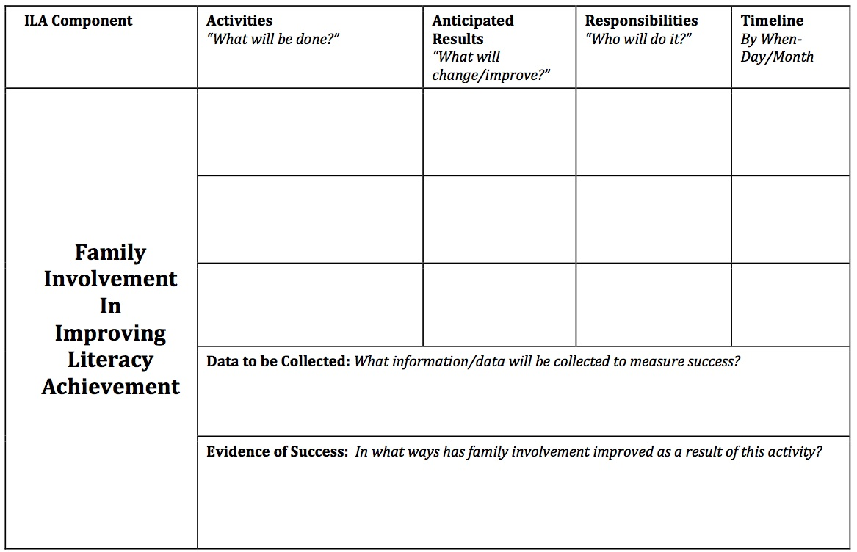

Slide 59
About Parent Centers
100+ Parent Centers serving families in every state, most of the U.S. territories, and including a specialized center for military families.
Helping families to understand special and general education laws and evidence-based practices and to actively participate in planning and decision-making about supports and services for early intervention, education, and transition to adult life.
Collecting Data to demonstrate the impact of there services and supports and for program improvement.
Partnering with professionals - their states, LEAs and EI providers to improve the systems serving children with disabilities.
Supported by a network of Parent Technical Assistance Centers & the new Center for Parent Information & Resources

Slide 60
Resources
Find the Parent Center serving families in your area:
  http://www.parentcenternetwork.org/parentcenterlisting.html
Parent Guide to Response to Intervention, National Center on Learning Disabilities: http://www.ncld.org
Center for School, Family & Community Partnerships: www.csos.jhu.edu/p2000
SEDL National Center for Family & Community Connections: www.sedl.org/connections
Harvard Family Research Project: www.hrfp.org
Henderson et al, Beyond the Bake Sale, 2007
Kovaleski et al. RTI Approach to Evaluating LD. Chapter 8, “Parent Involvement in an RTI System.” 2013.
Debra Jennings, Director, Center for Parent Information and Resources, debra.jennings@spannj.org

Slide 61
Questions and Discussion

Slide 62
Please complete our survey
We want to ensure that our webinar met your expectations, and we’d love to hear your feedback to inform our work with future webinars.

Slide 63
References
National Center for Education Statistics. (2011). The nation’s report card: Reading 2011 (NCES 2012–457). Washington, DC: National Center for Education Statistics, Institute of Education Sciences, U.S. Department of Education.
National Center for Education Statistics (2011). The nation’s report card: Mathematics 2011 (NCES 2012–458). Washington, DC: National Center for Education Statistics, Institute of Education Sciences, U.S. Department of Education.
National Center on Intensive Intervention (2013). Data-Based Individualization: A Framework for Intensive Intervention. Retrieved from http://www.intensiveintervention.org/sites/default/files/DBI%20a%20Framework%20for%20Intensive%20Intervention.pdf
Wagner, M., Marder, C., Blackorby, J., Cameto, R., Newman, L., & Levine, P., et al. (2003). The achievements of youth with disabilities during secondary school. A report from the National Longitudinal Transition Study-2 (NLTS2). Menlo Park, CA: SRI International. Retrieved from: www.nlts2.org/reports/2003_11/nlts2_report_2003_11_complete.pdf

Slide 64
National Center on Intensive Intervention
This webinar was produced under the U.S. Department of Education, Office of Special Education Programs, Award No. H326Q110005. Celia Rosenquist serves as the project officer.
The views expressed herein do not necessarily represent the positions or policies of the U.S. Department of Education. No official endorsement by the U.S. Department of Education of any product, commodity, service or enterprise mentioned in this presentation is intended or should be inferred.

Slide 65
National Center on Intensive Intervention (NCII)
E-Mail: NCII@air.org
1050 Thomas Jefferson Street, NW
Washington, DC 20007- 3835
Website: www.intensiveintervention.org

Slide 66
While permission to redistribute this webinar is not necessary, the citation should be: National Center on Intensive Intervention. (2013). Bringing Families to the Table: Family Engagement for Struggling Students. Washington, DC: U.S. Department of Education, Office of Special Education Programs, National Center on Intensive Intervention

